Slide 1


MEBT FC, WS, SC and EMU Status
Ángel Rodríguez Páramo
ESS-Bilbao
Beam Instrumentation Group
arparamo@essbilbao.org
November – 2018

Slide 2
Summary
Introduction
Faraday Cup
Wire Scanners
Scrapers
EMU
Conclusions

Slide 3
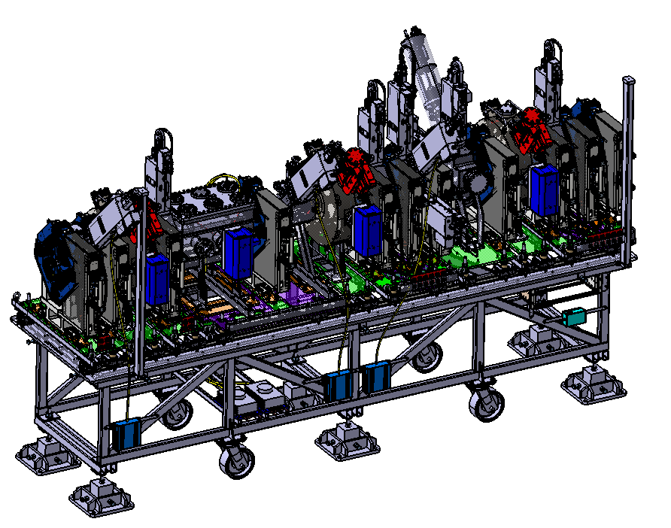
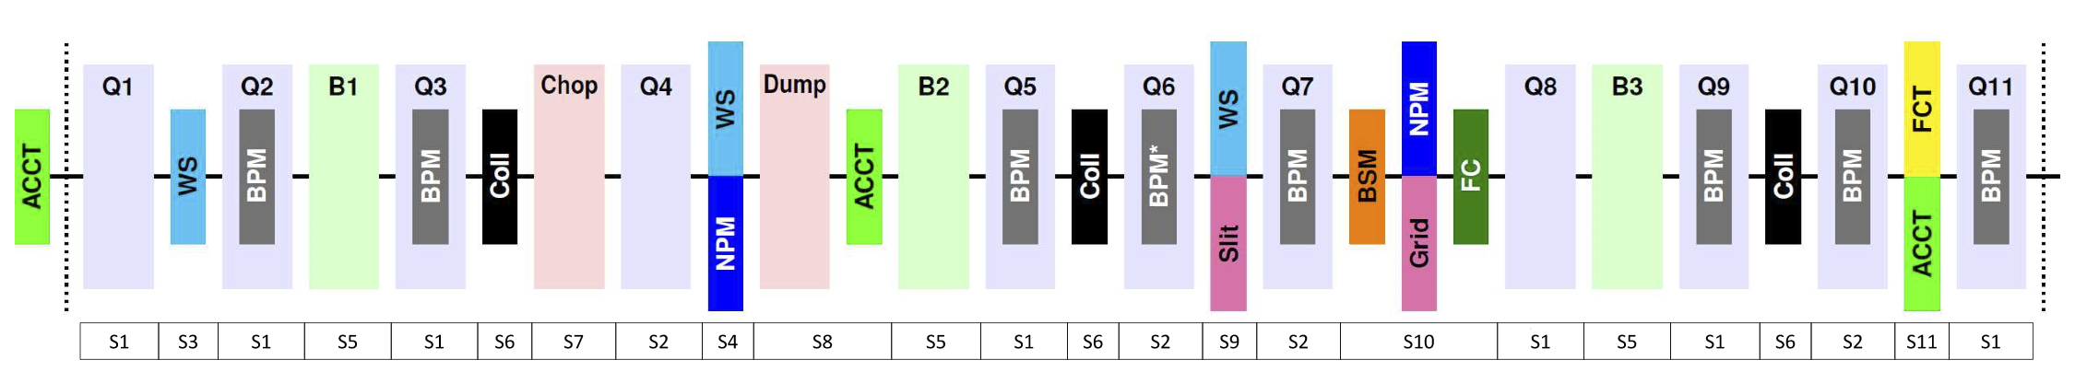
Introduction
ESS-Bilbao develops the MEBT as in-kind contribution to ESS
The MEBT PBI Includes
Interceptive: FC, WS, SC, EMU
Non-Interceptive: BPMs, ACCTs, FCT
  See Seadat Varnasseri talk
Control & Electronics
  See Idoia Mazkiaran talk
The MEBT PBI operates at:
3.63 MeV – 62.5 mA (230 kW)
Nominal Operation: 2.86 ms / 14 Hz
Commissioning Modes:
  Fast Tuning: 5 μs – 14 Hz
  Slow Tuning: 50 μs – 1 Hz

Slide 4
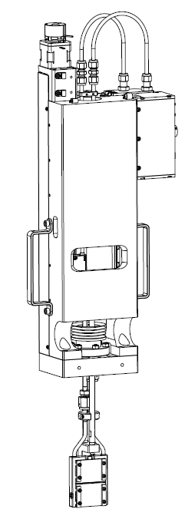
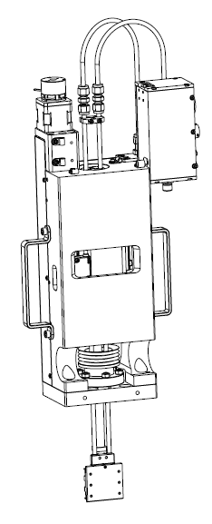
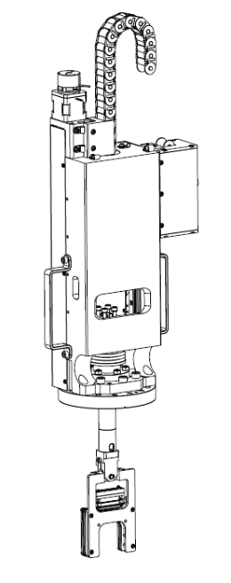

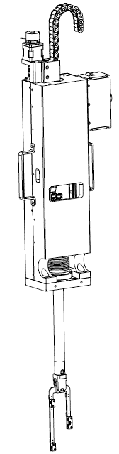
Introduction
EMU
FC
FC
WS
SC
EMU/Sl
EMU/Gr
WS
SC

Slide 5
Introduction
BI #1 Lund (Feb. 2016)
BI #2 Bilbao (Oct. 2016)
BI #3 Trieste (April 2017)
BI #4 Paris (Nov. 2017)
BI #5 Lund (Nov. 2018)

Slide 6
Summary
Introduction
Faraday Cup
Wire Scanners
Scrapers
EMU
Conclusions

Slide 7
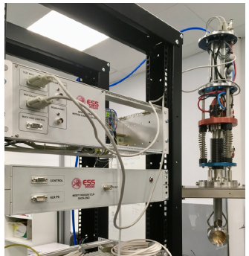
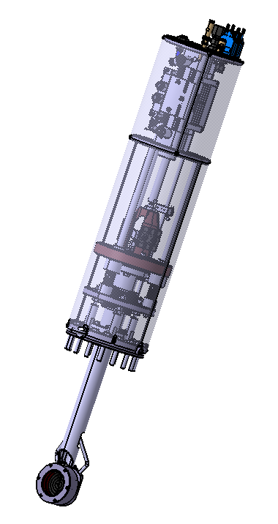
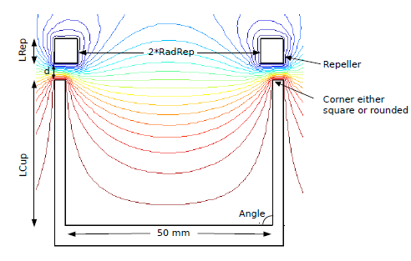
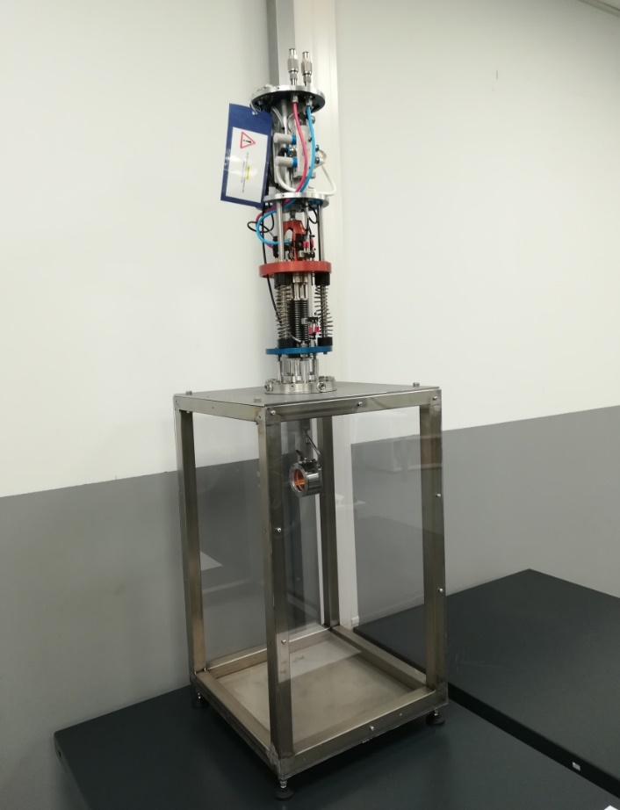
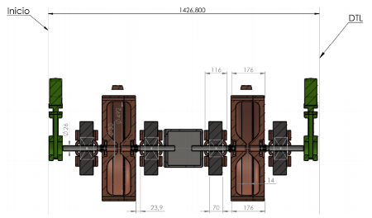
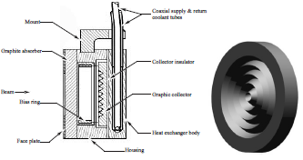
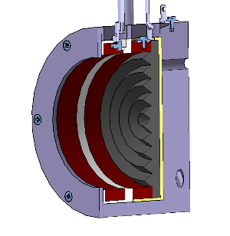
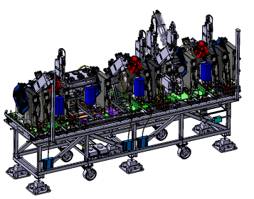
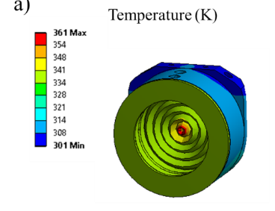
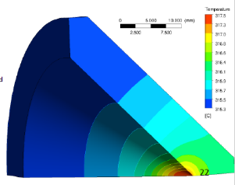
FC
The FC is designed for current measurement and as a beam stopper for MEBT commissioning modes.
The FC has been manufactured with a 1 kV repeller for SE suppression and with a graphite collector to withstand the high intensity beam.
Integration with Control & Electronics and in the ESS-Bilbao injector have been done.
ESS CD/TDR (2013)
DESIGN
PRODUCTION
“For the MEBT Faraday Cup, the challenge is to keep the thermal load below the mechanical limits, given the small beam sizes and the large stopping power of 3 MeV protons.”

Slide 8
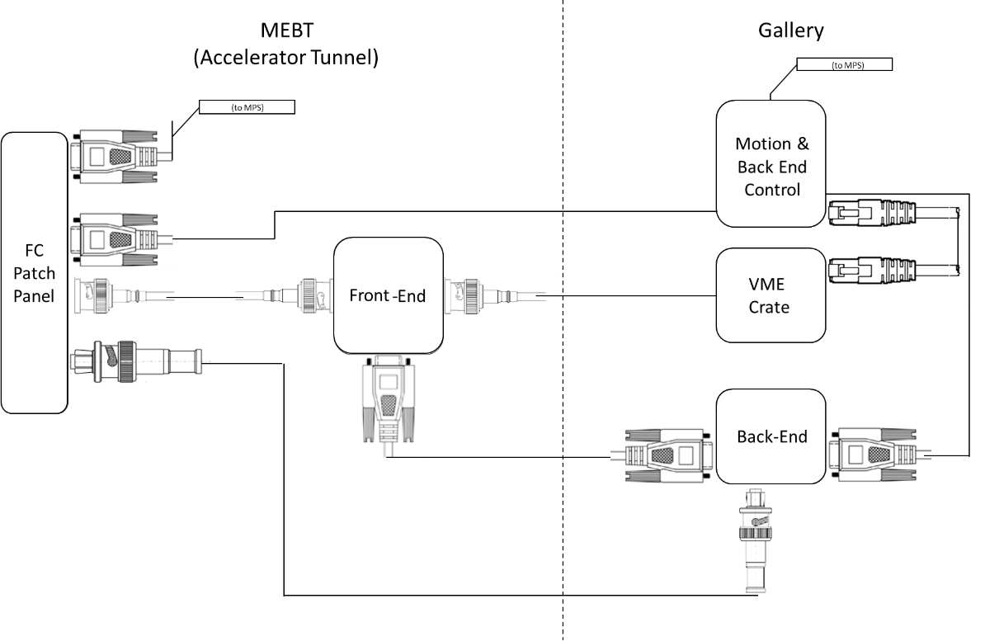
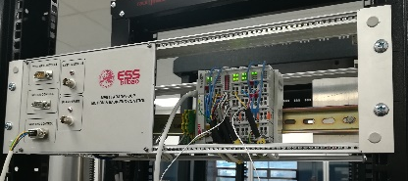

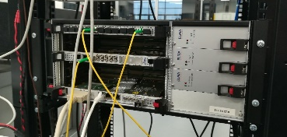
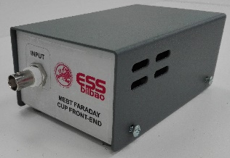
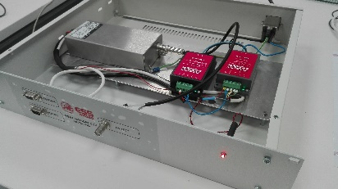
FC: Integration
μTCA Crate
 | Inst. | FE | BE | MC | μTCA/VME
FC | BIO | BIO | BIO | BIO | BIO
WS | BIO | ET | ET | ESS | ESS
SC | BIO | ESS | ESS | BIO | ESS
EMU | BIO | BIO | BIO | BIO | BIO
See also Idoia Mazkiaran talk

Slide 9
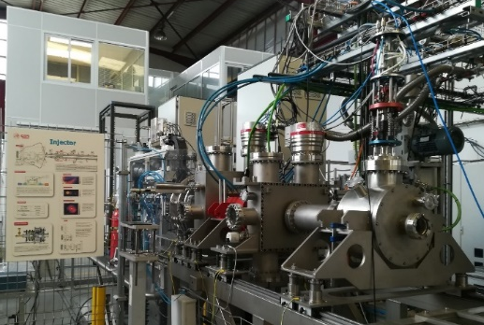
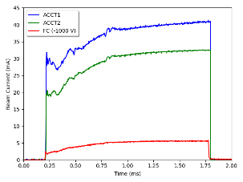
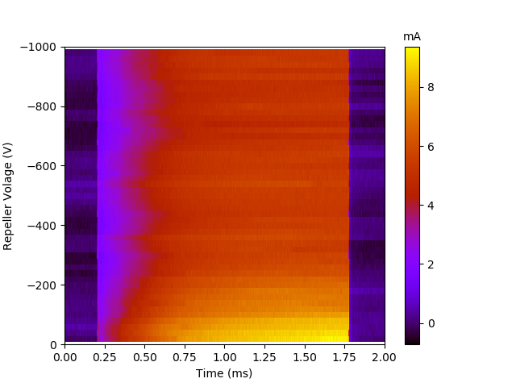
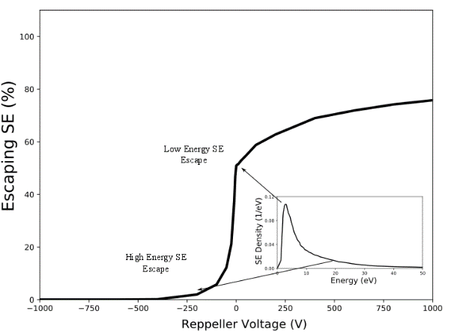
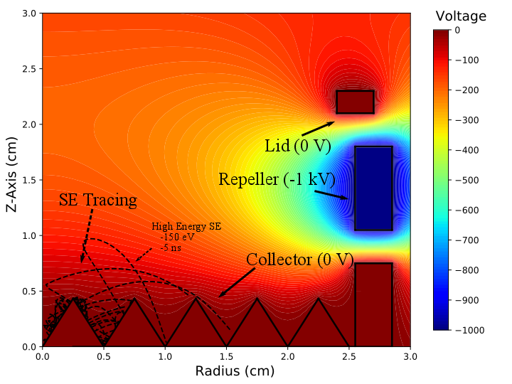
FC: Injector Test
ESS-Bilbao Injector (45 keV-40 mA)
Comparison to ACCTs
Test Results
-SE Suppression V_{rep}~400V
Electrostatic Field Simulation
- 200 V in the axis for V_{rep}-1 kV
- SE electrons with E up to ~100 eV*
GPT Simulation
-SE Suppression ~400V
* Drexler et al Physical Review A 53-3, 1996

Slide 10
Summary
Introduction
Faraday Cup
Wire Scanners
Scrapers
EMU
Conclusions

Slide 11
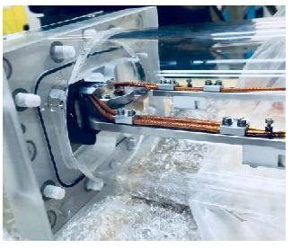
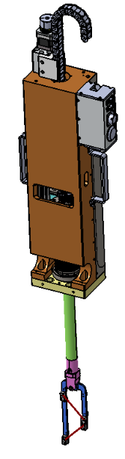
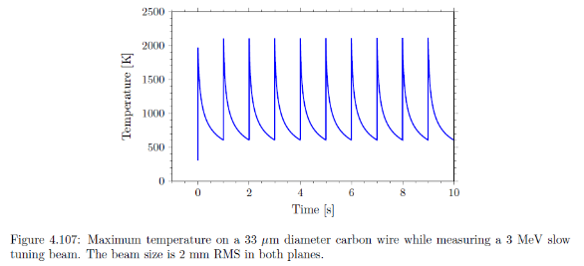
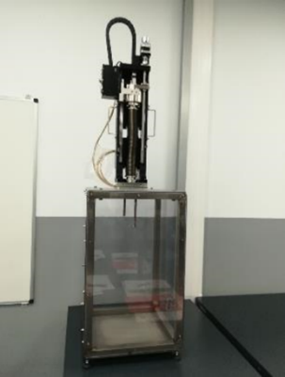
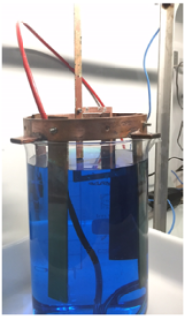
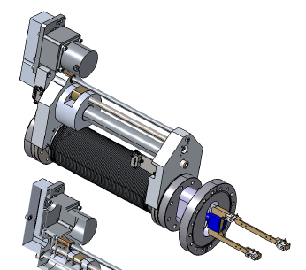
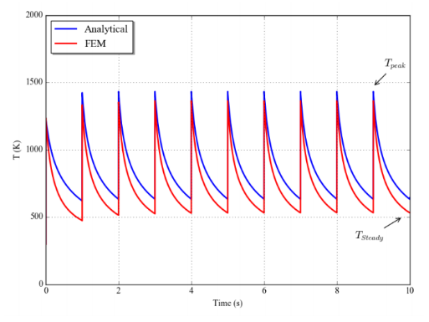
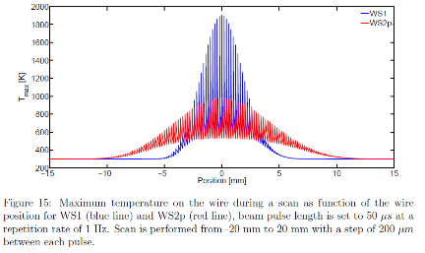
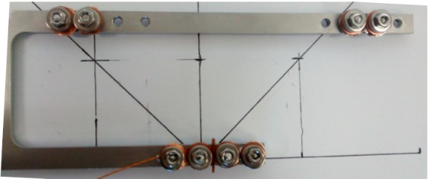
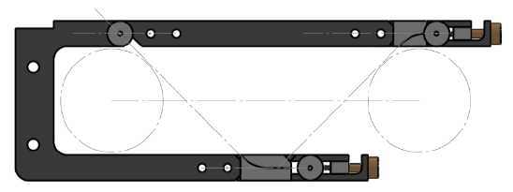
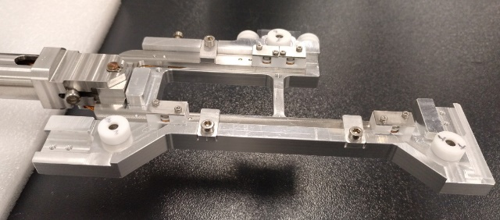
WS
The wire scanners are designed for measurement of beam profile at 3 MEBT locations in commissioning modes.
Equipped with 34 μm carbon wire and an alignment toolkit has been manufactured for wire placing.
Each carbon wire is connected to triaxial cabling with biased voltages of ± 100 V for minimisation of signal noises.
ESS TDR
DESIGN
PRODUCTION
ESS-0020237
Cheymol et al.

Slide 12
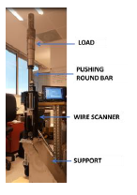
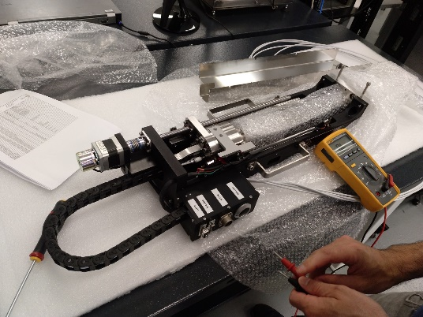
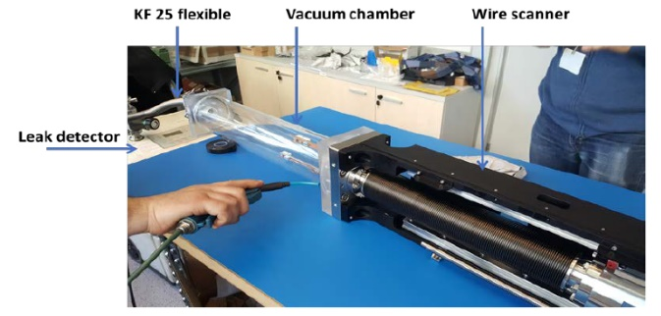
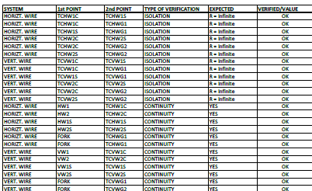
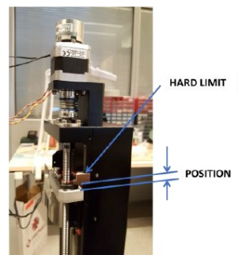
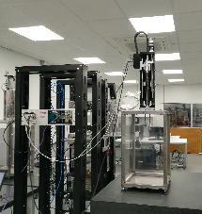
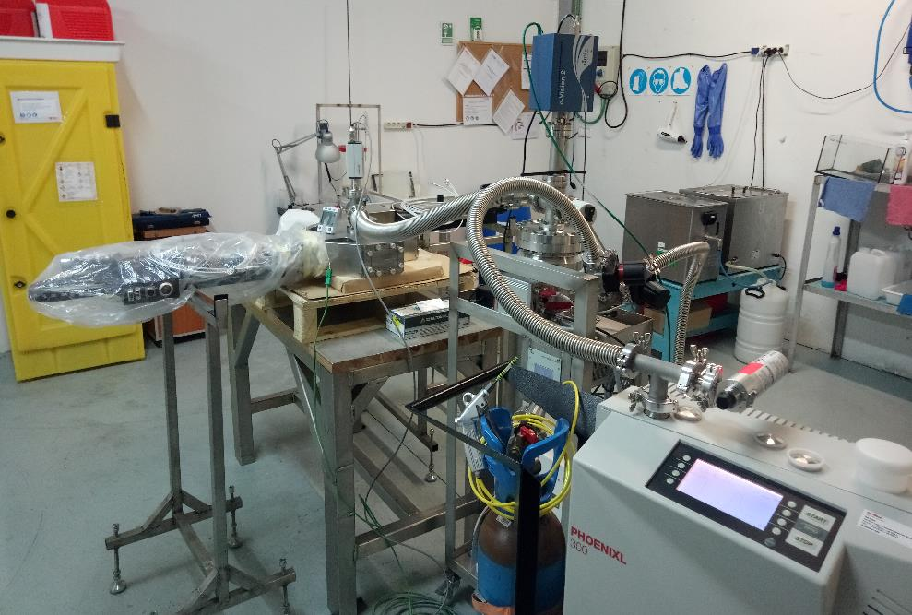
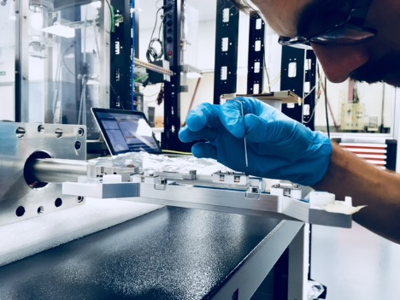
WS Acceptance
FAT
Continuity
Motion
Vacuum
Wire Integrity
*Acceptance Procedure similar for FC, SC & EMU

Slide 13
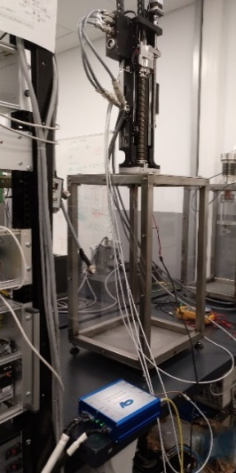
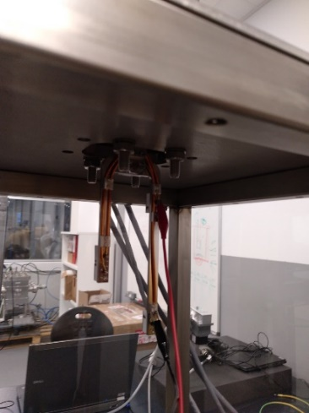
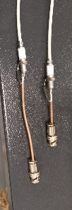
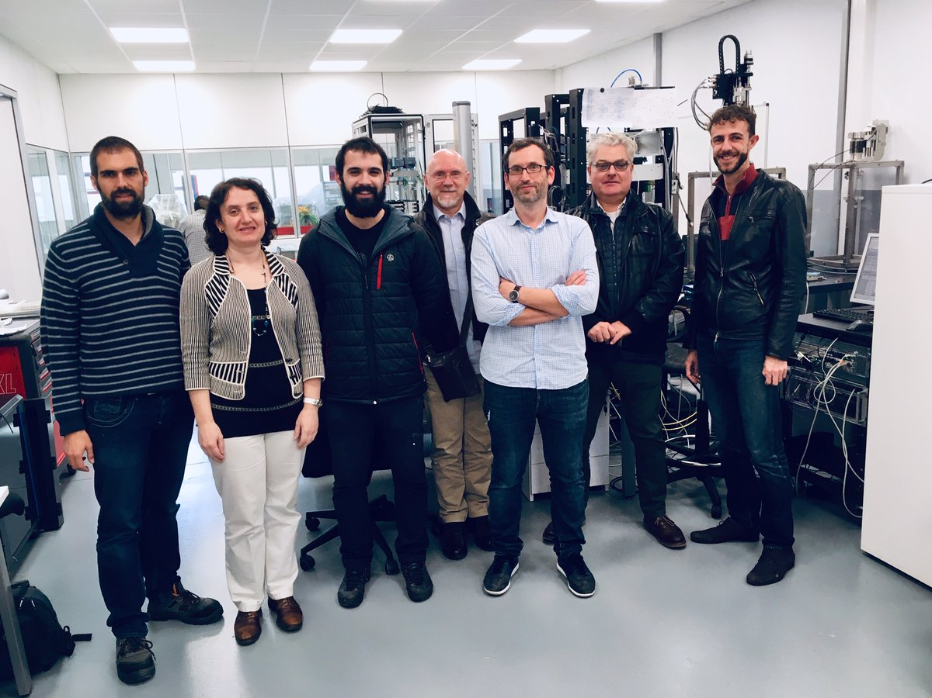
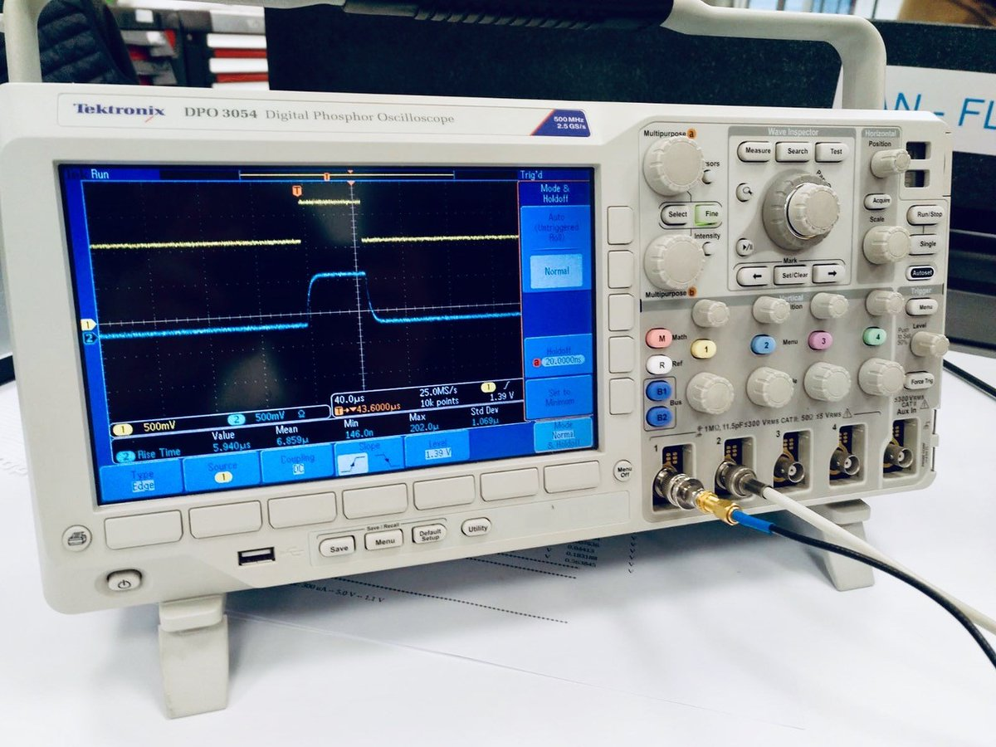
WS VIT
Vertical Integration Test (VIT):
ESS-Bilbao Instrument
Elettra AFE & BE
ESS MC, μTCA and EPICs control
Signal Integrity from Fork to AFE*
*Change from LEMO FFA to Triax BNC required

Slide 14
Summary
Introduction
Faraday Cup
Wire Scanners
Scrapers
EMU
Conclusions

Slide 15








SC
SC are designed to remove beam halo at 3 MEBT locations.
Each scraper blade will remove 0.25 % or 625 W of beam under nominal operation.
To withstand beam irradiation TZM plates over a refrigerated steel support are included.
The TZM plate is electrically insulated with a kapton foil and is connected to a triaxial cable for signal acquisition.
DESIGN
PRODUCTION
Bustinduy et al HB2014

Slide 16




SC
The 6 SC have arrived to Bilbao:
  SC1 accepted
  Acceptance SC2-6 expected end Nov. 2018
The MC module for SC1&SC2 has been assembled.

Slide 17
Summary
Introduction
Faraday Cup
Wire Scanners
Scrapers
EMU
Conclusions

Slide 18











EMU
The EMU is composed by two slit and grid subsystems separated ~400 mm for measurement of the phase space in the horizontal and vertical directions.
The slits are made of graphite in order to withstand beam irradiation and have an aperture of 100 μm for minimisation of emittance reconstruction error.
For the grid a prototype has already been manufactured and tested with 24 tungsten wires of 35 μm separated 500 μm.
ESS-0020535
(Cheymol et al)
DESIGN
PRODUCTION

Slide 19





EMU
The EMU is under manufacturing
  Arrival to Bilbao is expected for December
EMU Grid PCB Under Review
The BE has been assembled
The FE is being tested
The MC module for EMU/Slits has been assembled.
  For EMU/Grids in under manufacturing

Slide 20
Summary
Introduction
Faraday Cup
Wire Scanners
Scrapers
EMU
Conclusions

Slide 21



Conclusions
The FC has been produced, integrated and beam tested
The WS have been produced and the VIT performed
The SC have been produced and acceptance is ongoing
The EMU is under production, arrival expected in December

Slide 22
Conclusions
Thank You!

