Slide 1


MEBT Controls
ESS-Bilbao
Control & Beam Instrumentation Group
Idoia Mazkiaran Zelaia
imazkiaran@essbilbao.org
November – 2018

Slide 2
Summary
Introduction
Faraday Cup: FC
Emittance Meter Unit: EMU
Scrapers
Buncher
Fast Chopper
2

Slide 3
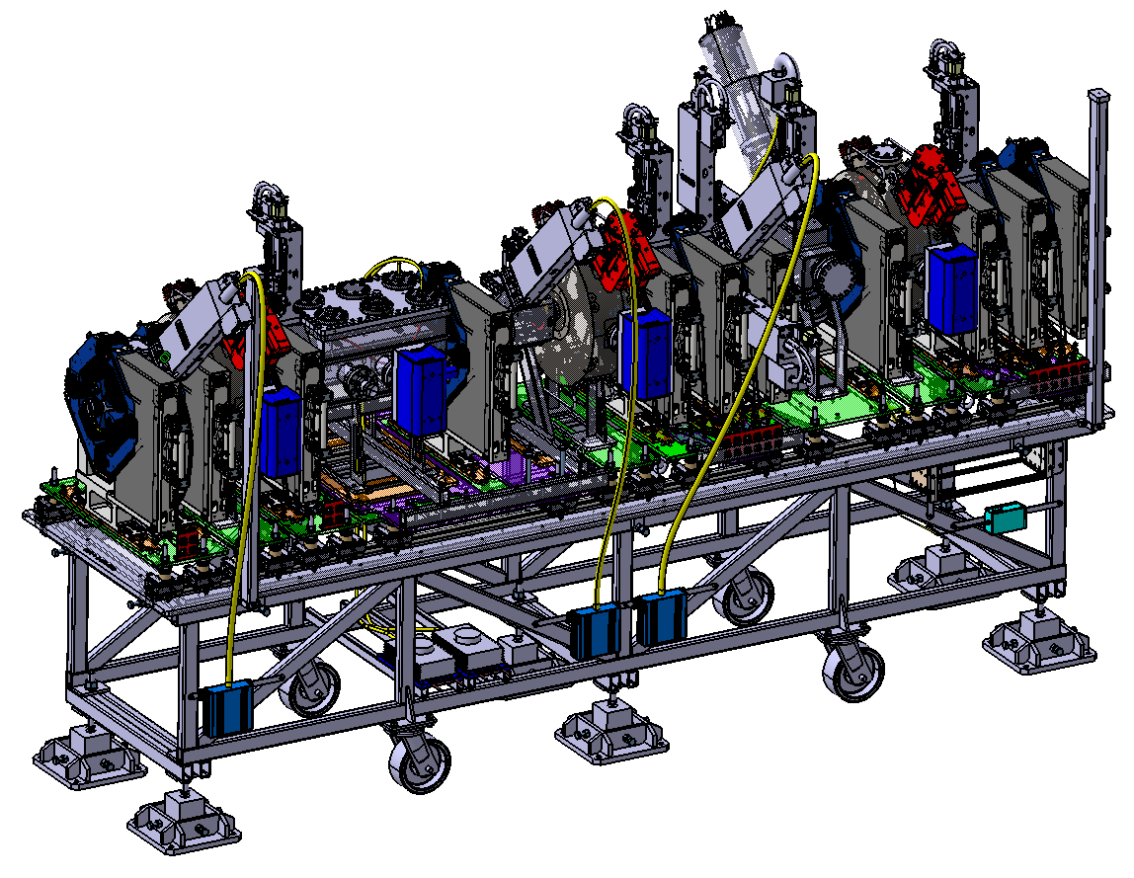
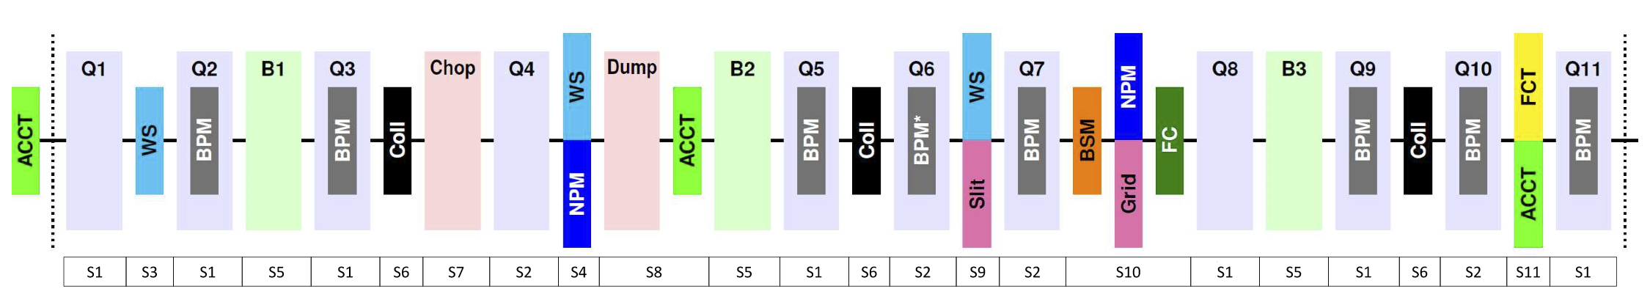
ESS MEBT
3

Slide 4
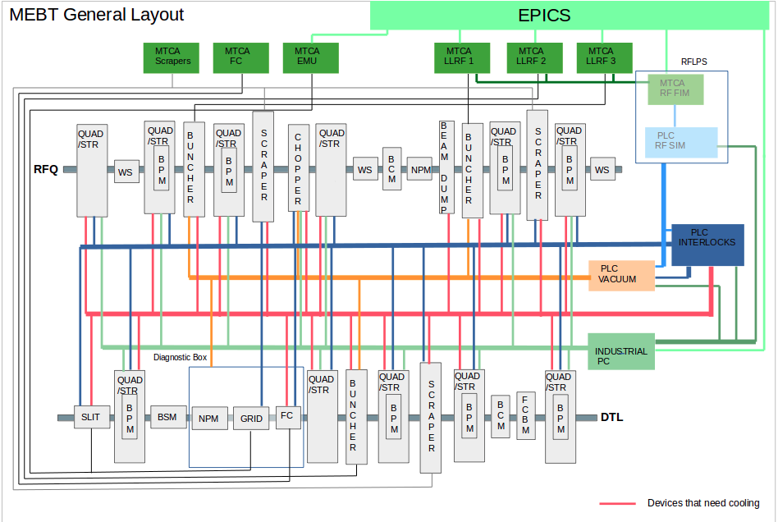
MEBT General Layout
4

Slide 5
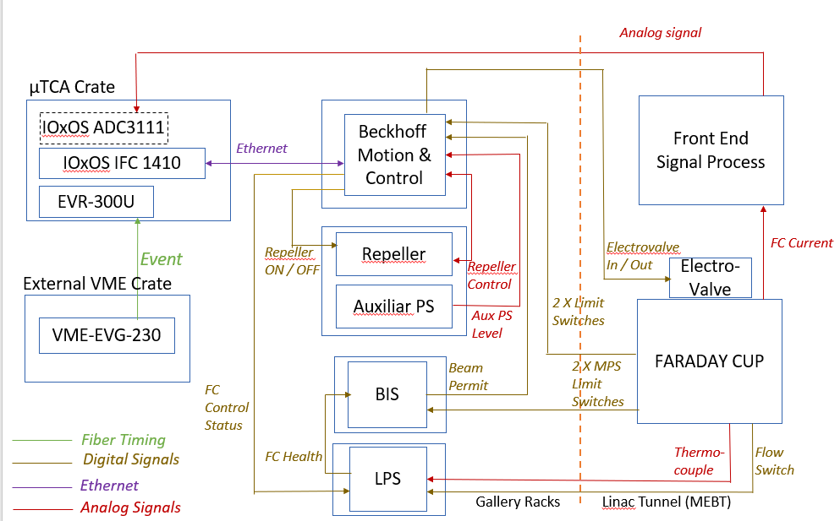
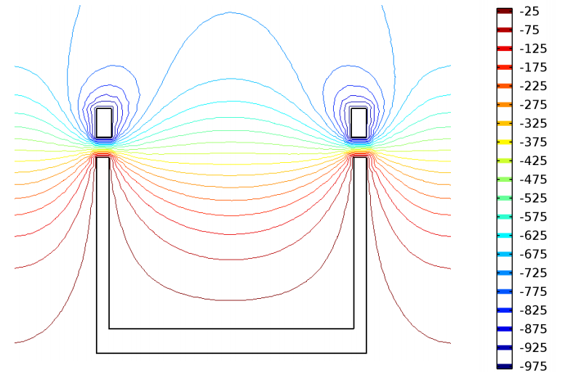
Faraday Cup HW: Control schematic

Slide 6
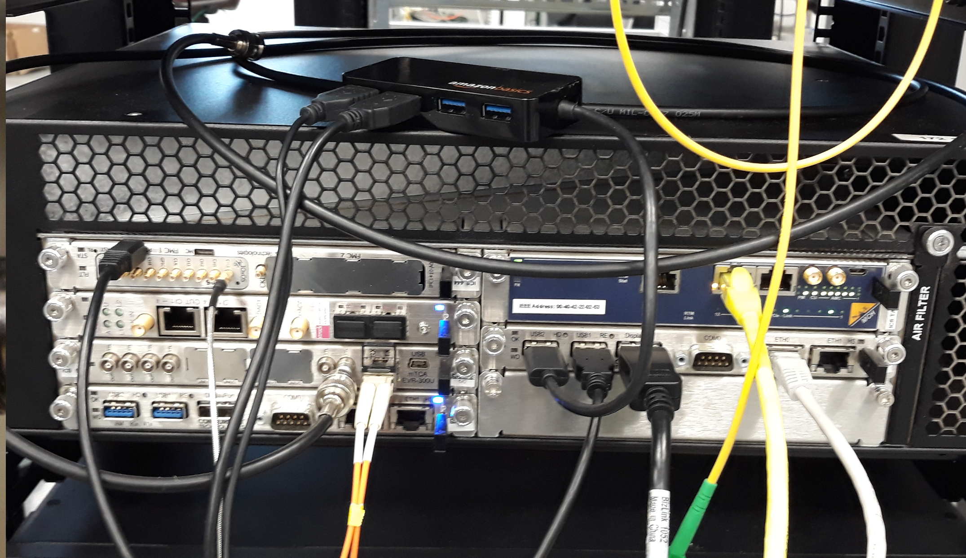
Faraday Cup HW: µTCA platform
Main control IOC and signal acquisition.
µTCA crate: Schroff custom 3U crate up to 6 AMC cards, 4 RTMS, redundant Power Supplies, 1 MCH slot.
MCH: NAT-MCH-PHYS-R1
CPUs:
  IOxOS IFC_1410 QorIQ T2081 & Kintex UltraScale AMC.
  Concurrent Technologies AM 900/412-99.
  Digitizer board:
    IOxOS FMC ADC 3111, 8 analog channels, 250 MSPS, 16 bits.
  Event Receiver board: MRF MTCA EVR-300U.
External integrated systems controlled from
the previous crate HW:
  FC insert/retraction: solenoid valve.
  Repeller control.
  Interlocks interface.
Siemens PLC for cooling and slow interlocks functions.

Slide 7
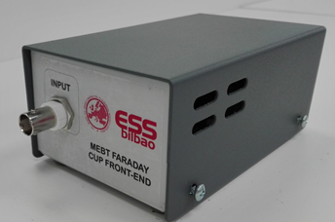
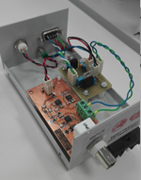
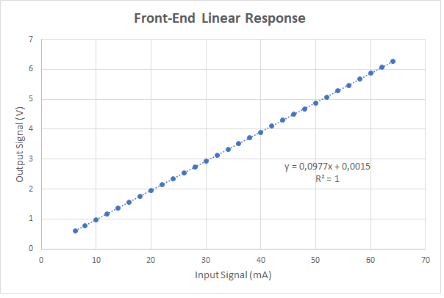

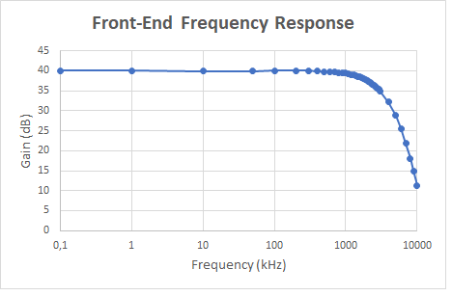
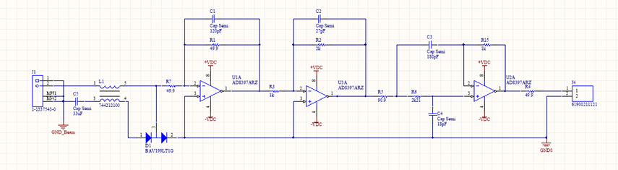
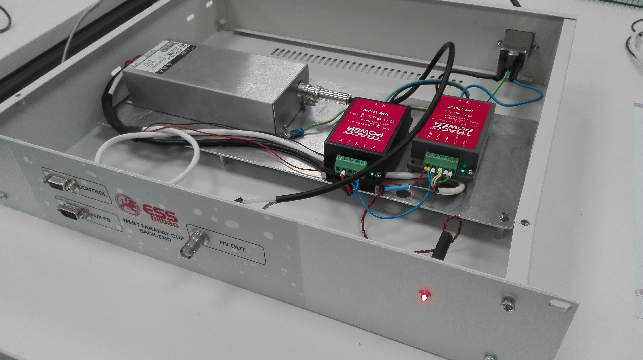
Faraday Cup: Front End / Back End
Front End SPECIFICATIONS
Number of channels 1
Nominal input current 62.5 mA
Maximum input current 100 mA
Minimum input current 6.25 mA
Bandwidth > 2MHz
Slow tuning mode 50us at 1 Hz
Fast tuning mode 5 us at 14 Hz
Output: Differential +/- 10 V, High Impedance
ADC Resolution 16 bits
Back End:
Auxiliar Power supplies for Front End.
FC Repeller.

Slide 8

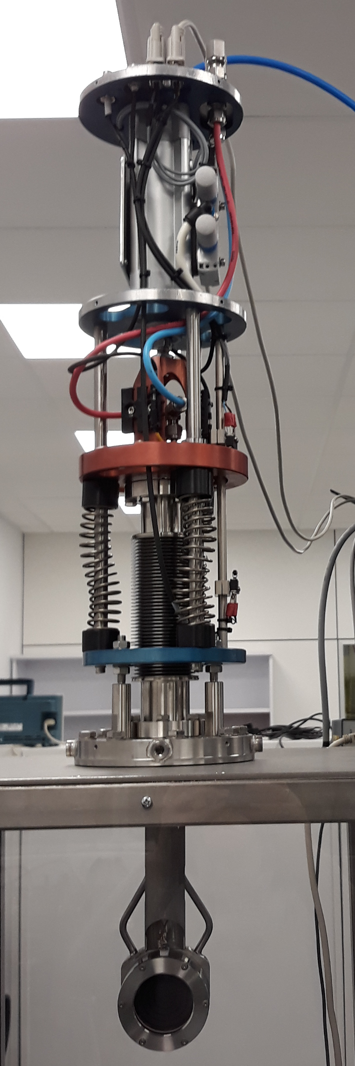
SW general control
FC SW based in EPICS: E3 Environment.
Four IOCs running.
Main FC IOC mebt_fc module:
General control and flow of the FC, Repeller control.
Modules:
  Ifc14edrv, ifc1410fc: Digitizer driver modules.
  Other modules:
  asyn, nds3, nds3epics.
2. Synchronization IOC: EVR received event generates µTCA back plane
acquisition trigger signal.
3. Ethercat IOC:
  ecat2 module: Beckhoff ethercat modules control.
4. Slow Interlocks IOC:
  sp7plc module: PLC interconnection module.
  MEBT_plc_FC: Interlocks specific developed module.
8
Notes:
8

Slide 9
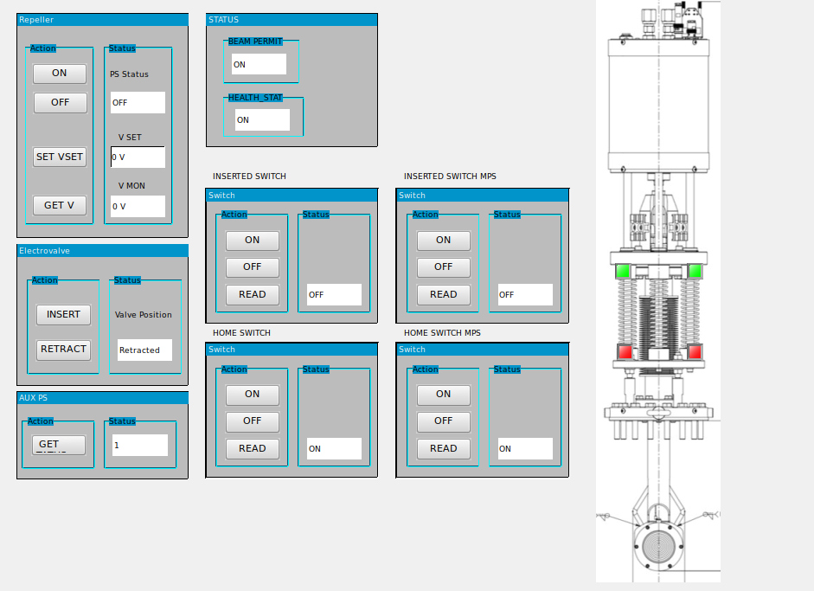
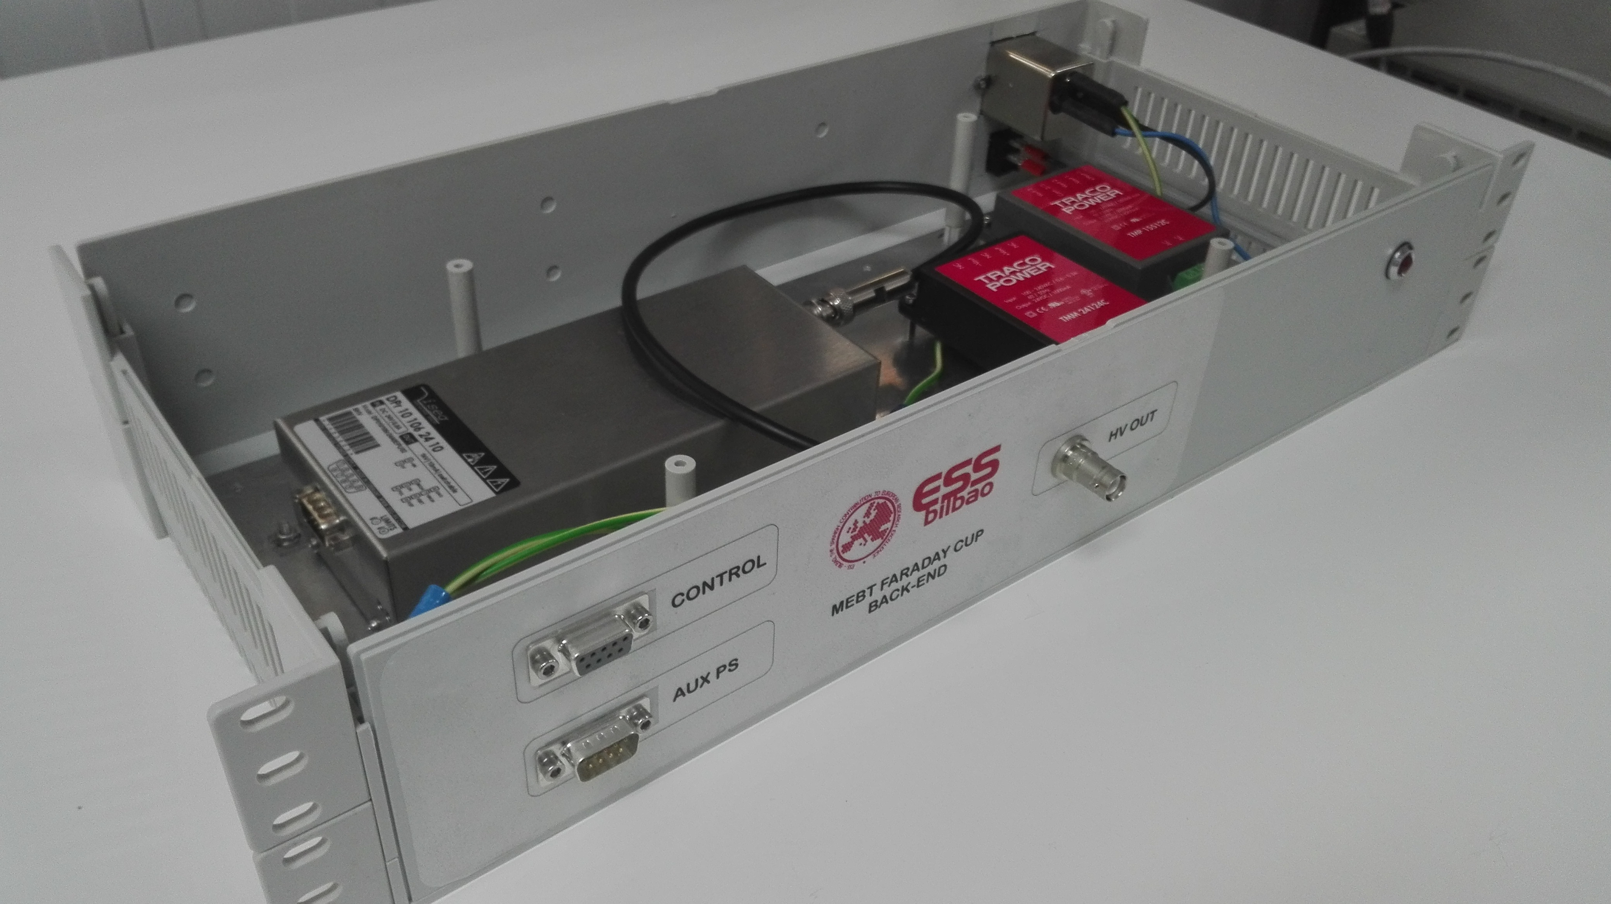
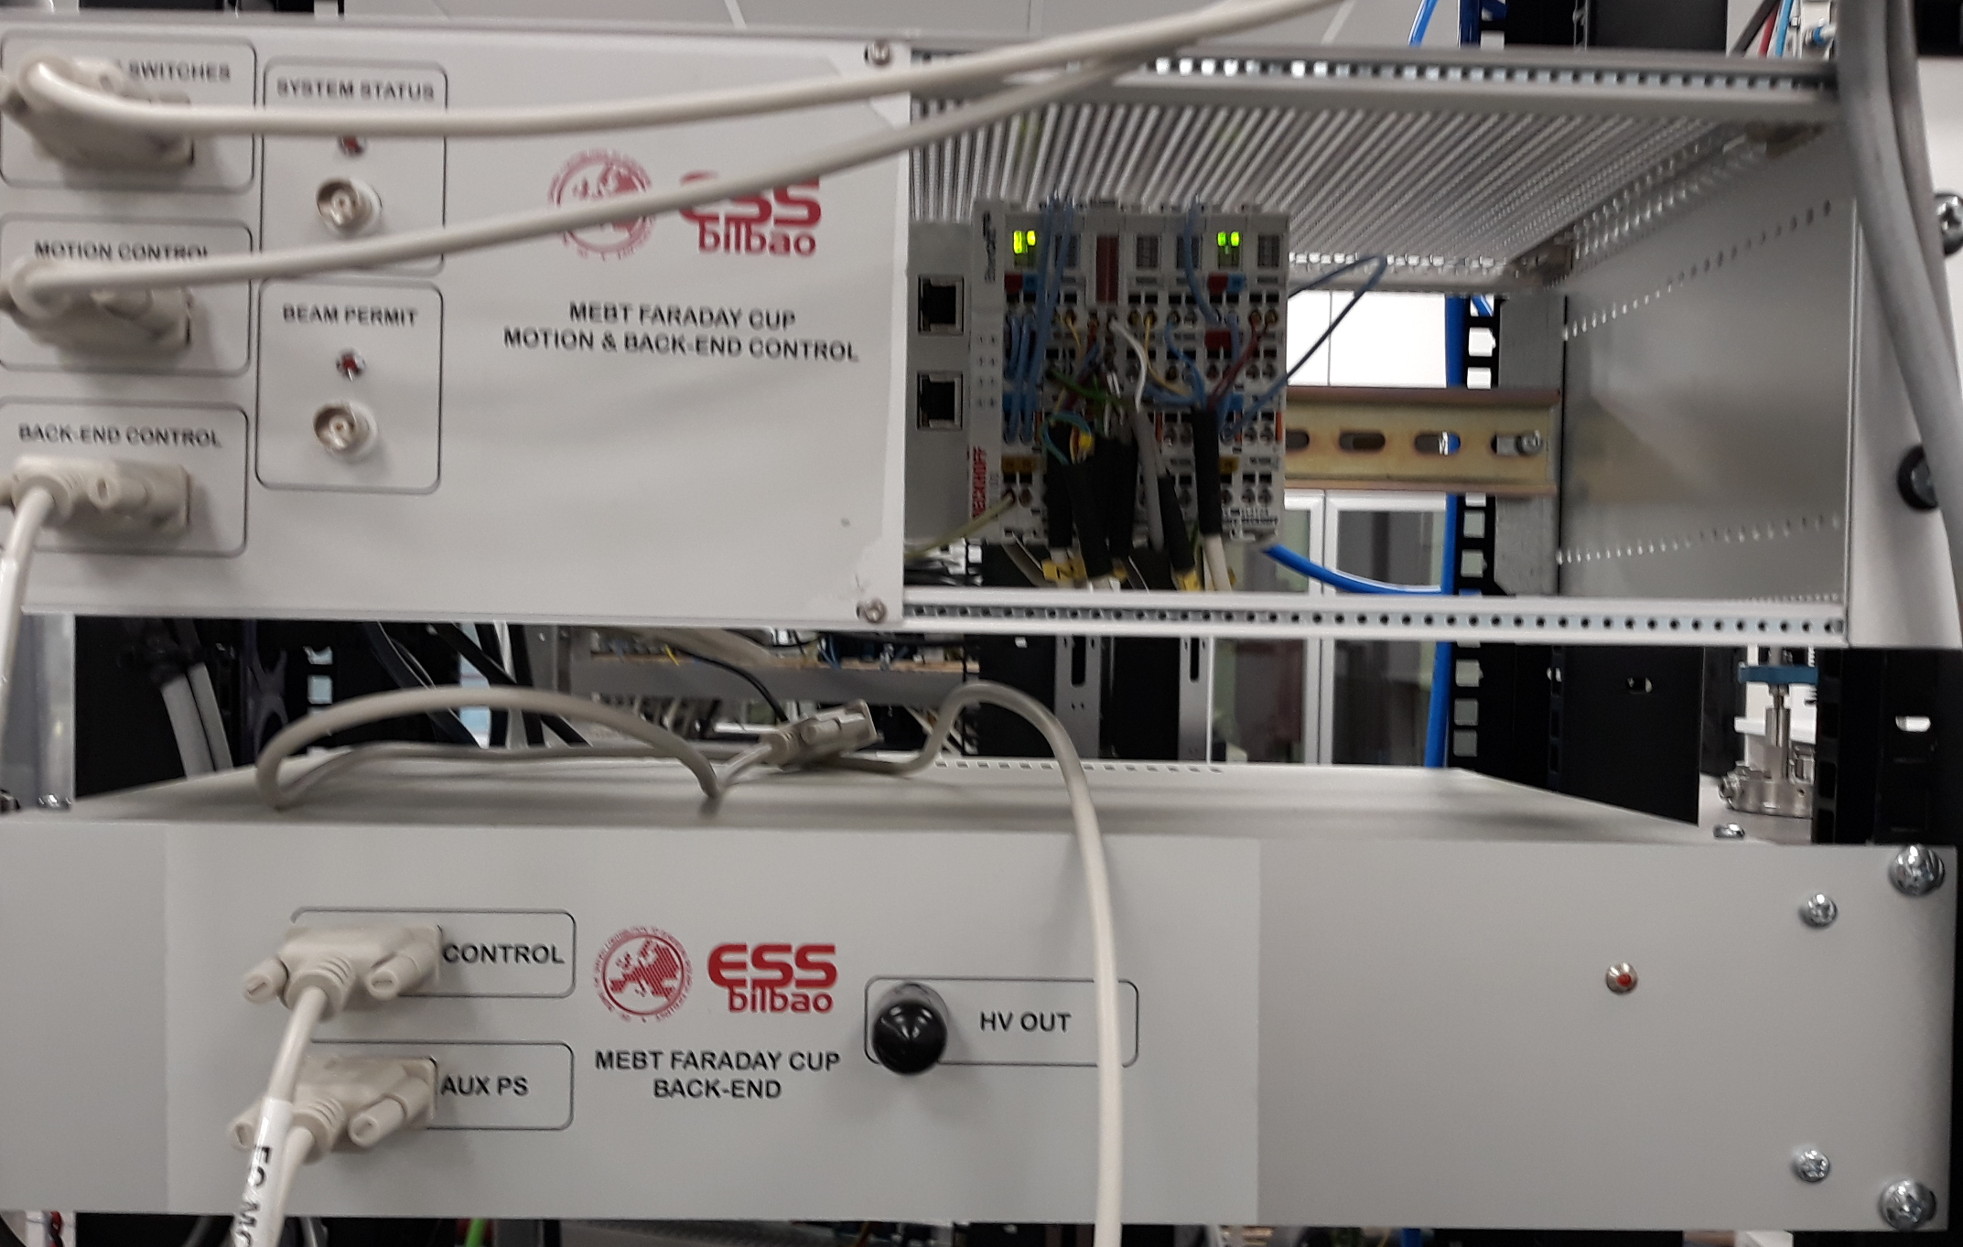
FC Intermediate Control
1. FC Repeller. (Back-end)
ISEG DPR 10 106 24 10 ESH
Vout: 0 to +/–1000 V
Imax: 10 mA
Vin/Iin: 24 V/0.8 A
Control Signal 0-10 V
2. FC insert/retraction: pneumatic valve.
Model: Solenoid valve 5/2 Monostable - FESTO – VUVG-L18-M52-MT-G14-U-1K7L
Home and end run switches: Local Switches: Proximity Sensor - Festo - SME-8-K-24-S6 (161756)
MPS switch: MPS Switches: Crouzet - 83 133 035
3. Auxiliar Powers Supplies. (Back-end) Front End Power Supplying.
4. Health Status, Beam Permit.
9
Notes:
9

Slide 10
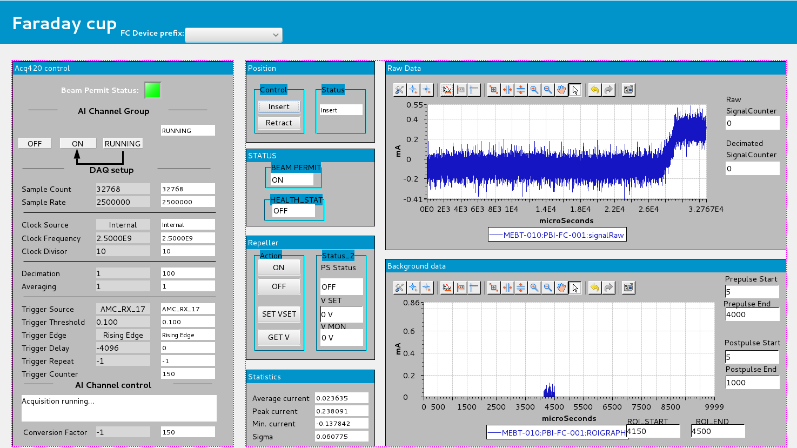
FC Engineering GUI
10
Notes:
10

Slide 11
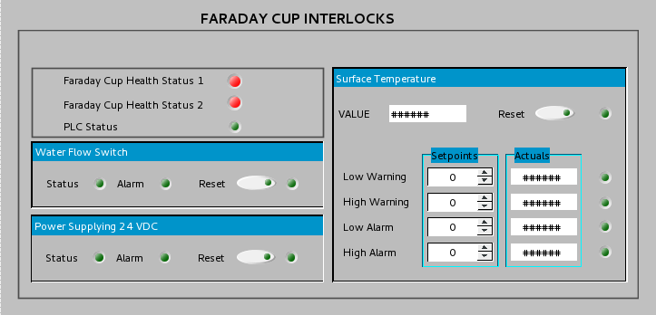
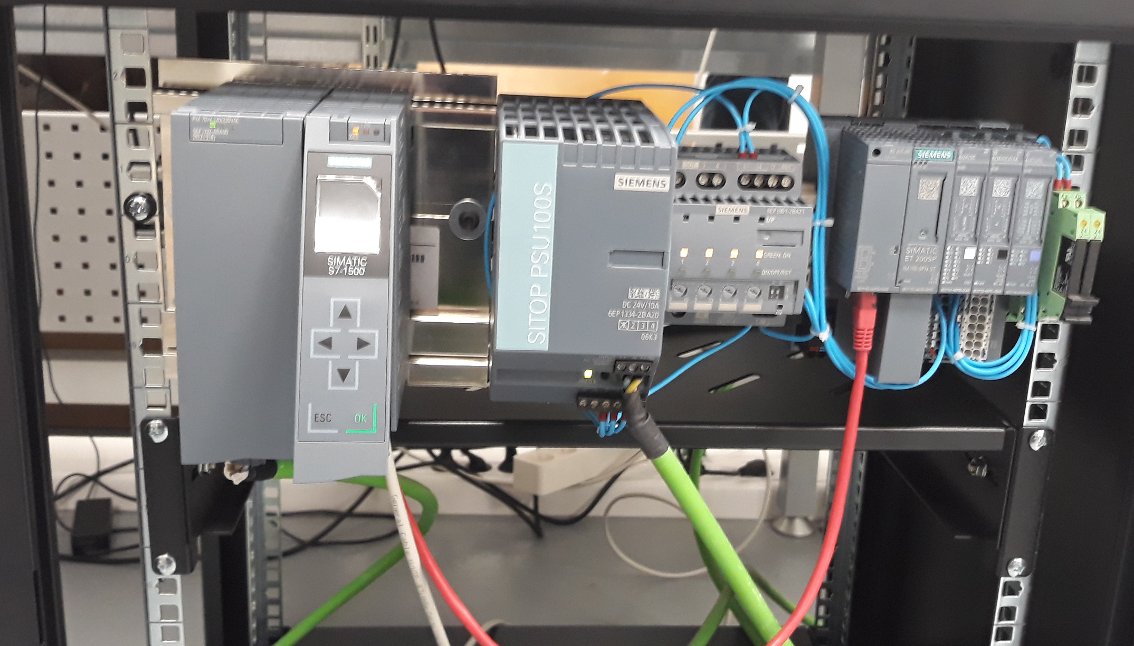
Faraday Cup LPS (Local Protection System)
  .
Siemens PLC for cooling and other slow interlocks functions.
Faraday Health: General
Repeller status.
Cooling: PT100.
Water flow sensor.
PLC 24 Vdc distribution.

Slide 12
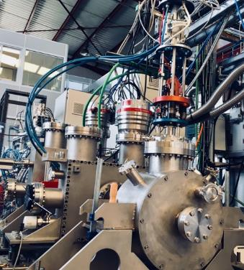
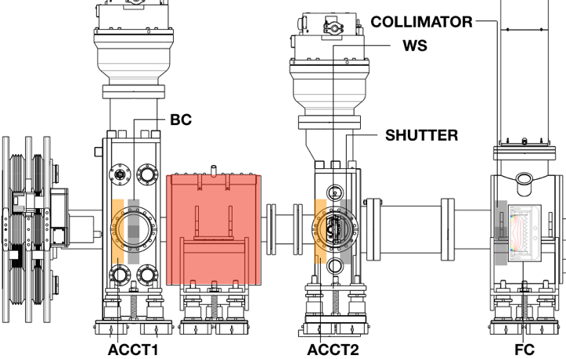
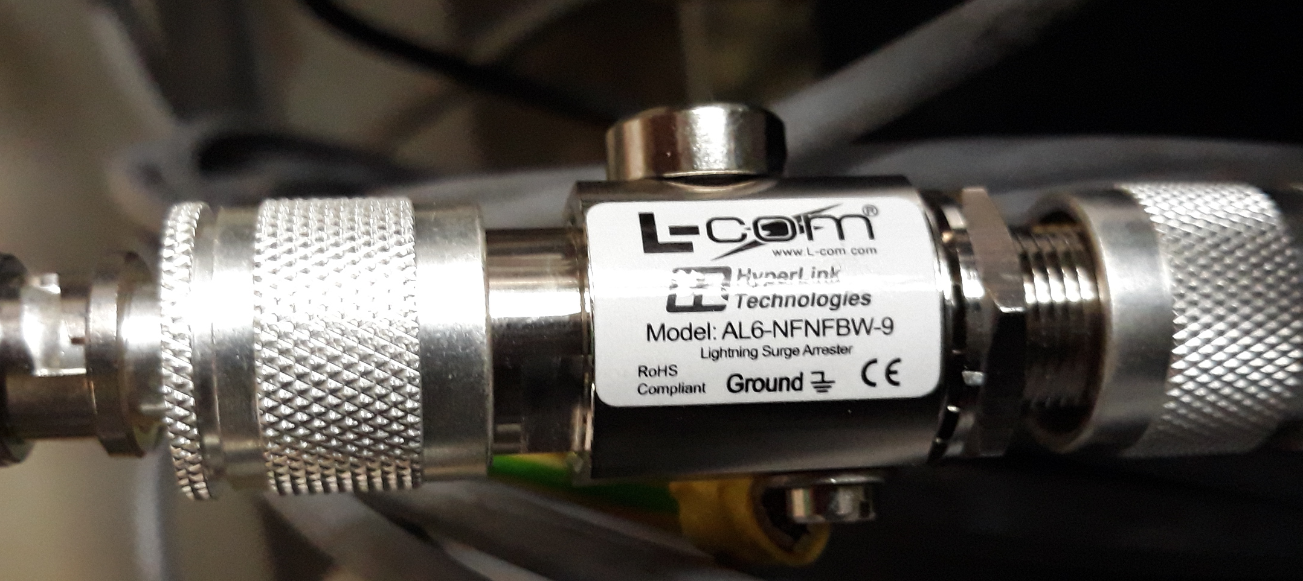
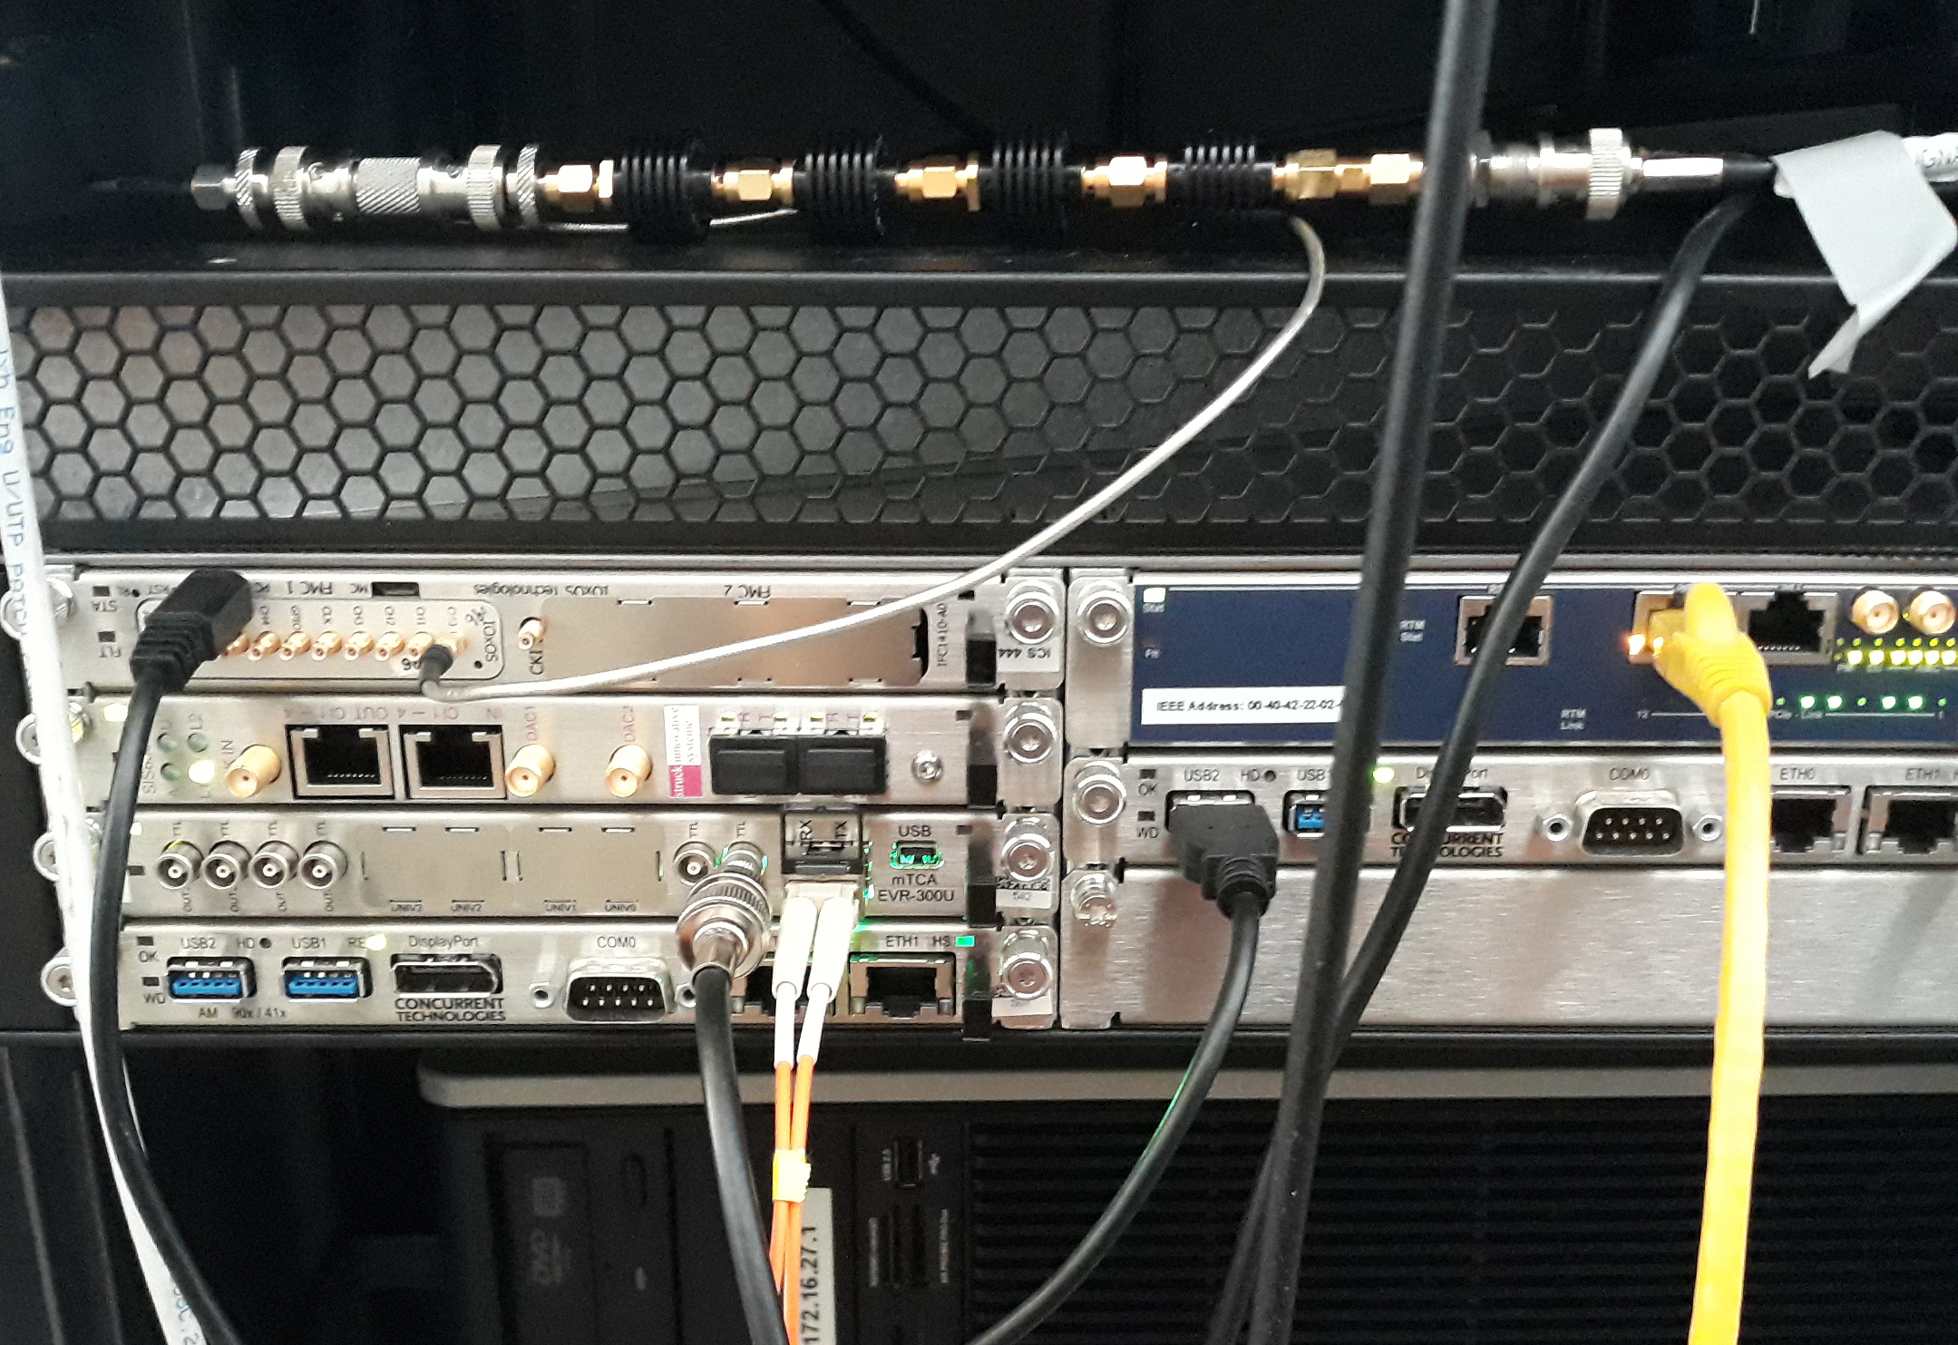
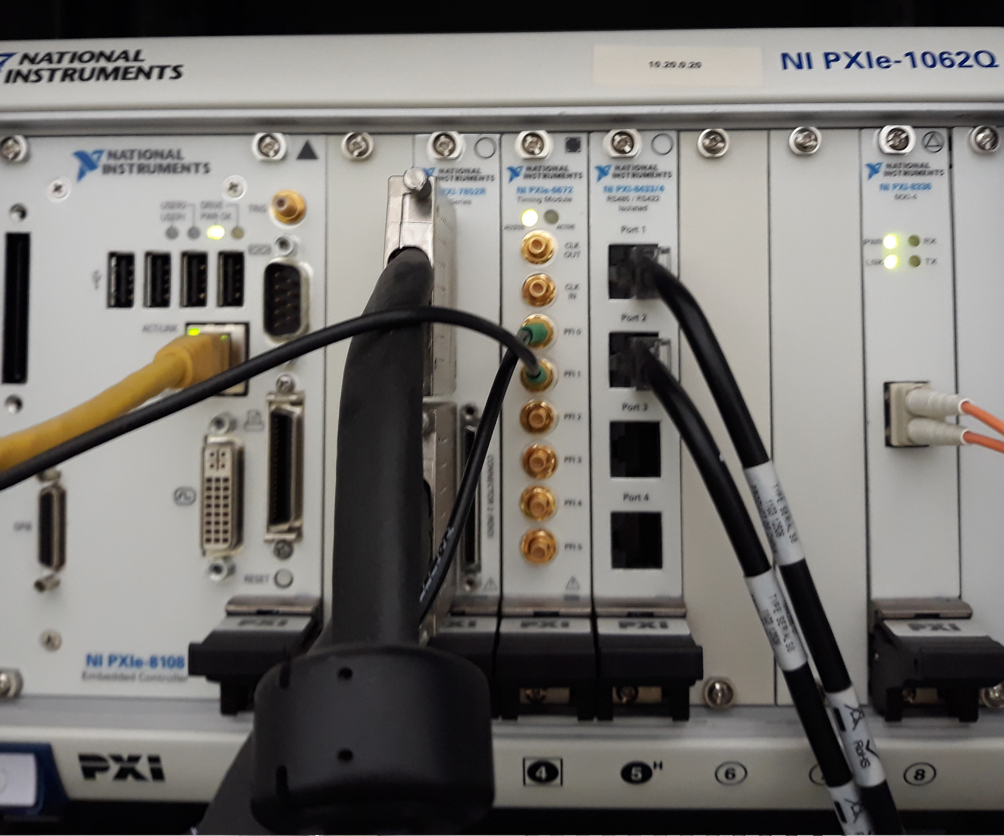
FC test stand at ESS Bilbao ISHP
Ion Source HP configuration
Configuration | (A) | (B)
Power (W) | 685 | 690
H2(%) | 45 | -
t (μs) | 1600 | -
Rep rate (Hz) | 1 | -
Plasma PS (A) | (2;5;10’2;3’5) | (2;5;10’2;3’5)
Stud | (575;632) | (519;636)
Absorbed power (%) | 98’67 | 99’1
Solenoid (A) | 150 | -
HV (kV) | 45 | -
Repeller (kV) | -1’5 | -
Publication in process
Collimator used to protect FC
Front End: 100 Ohm resistor.
NI Synchronization
Front End: FC active electronic FE.
12

Slide 13
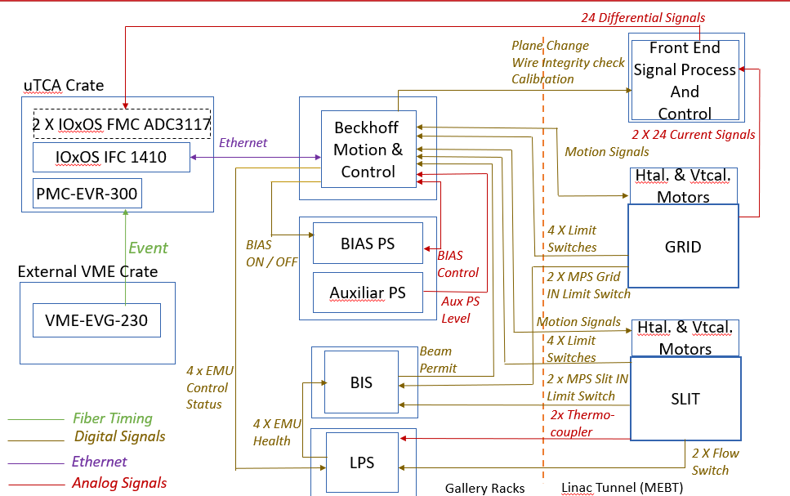
Slit & Grid system schematics
13

Slide 14
EMU HW: µTCA platform
µTCA platform for EMU prepared for E3 EPICS environment.
Main control IOC and signal acquisition.
µTCA crate: Schroff custom 3U crate up to 6 AMC cards, 4 RTMS, redundant Power Supplies, 1 MCH slot.
MCH: NAT-MCH-PHYS-R1
CPUs:
  IOxOS IFC_1410 QorIQ T2081 & Kintex UltraScale AMC.
  AM 900/412-99 by Concurrent Technologies.
  Digitizer boards:
    2 IOxOS FMC ADC 3117, 20 analog channels, 5 MSPS, 16 bits.
  Event Receiver board: MRF EVR-300U.
External integrated systems controlled from the previous HW crate :
  Motion Control: Bus ethercat, linear motion, Beckhoff modules.
  Power supply control for BIAS voltage supplying.
  Additional control functions: plane change, power supplying checking, wire checking, calibration.
  Analogue front-end interrelation for signal conditioning.
  Interlocks interface.
Slow Interlocks Siemens PLC for cooling and slow interlocks functions.
( Developed in EEE over VME, some needs to migrate to E3)
14

Slide 15
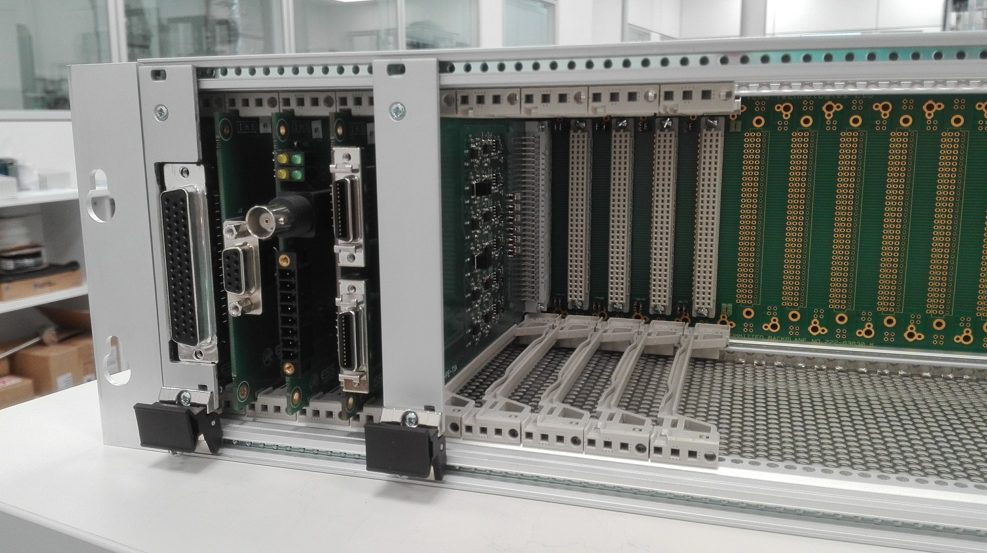
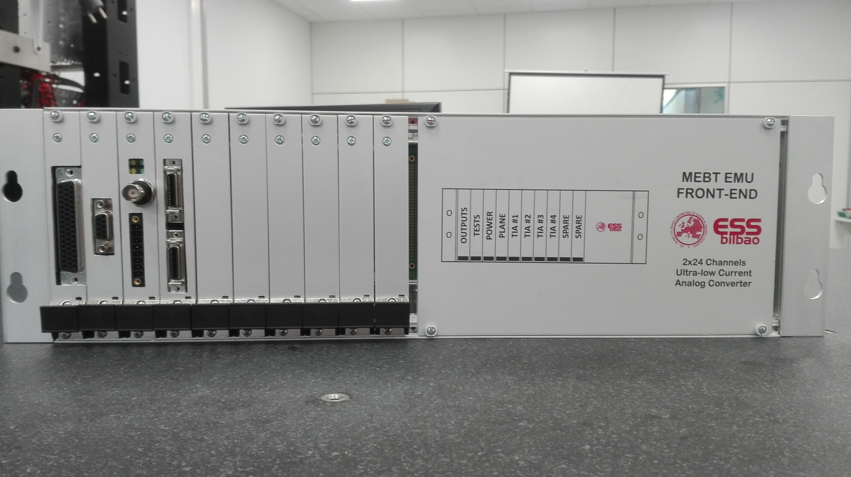
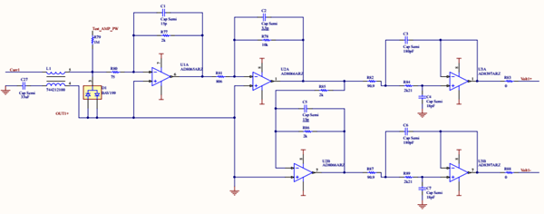
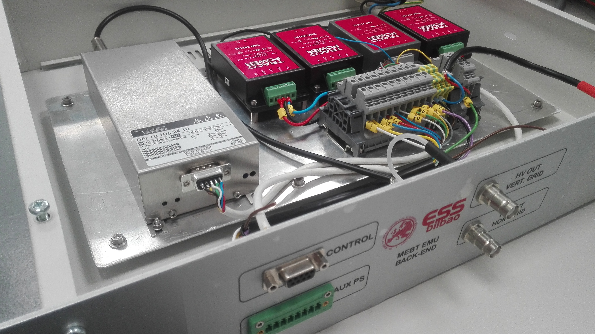
EMU: Front End / Back End
Front End:
Number of channels 24
Minimum input current 100 (200) nA
Maximum input current 100 (200) µA
Bandwidth ≥ 2MHz
Slow tuning mode 50us at 1 Hz
Fast tuning mode 5 us at 14 Hz
Output: Differential +/- 10 V, High Impedance
ADC Resolution 16 bits
Modular Sub-rack with backplane connections
  + Large modularity.
  + Robustness (no internal cabling)
  - Complex assembly design
Slot 1: Outputs.
Slot 2: Tests control.
Slot 3: Power.
Slot 4: Inputs: EMU Plane.
Slot 5 .. 8: Signal accommodation channels (4 boards x 6 channels).
Features:
1ST STAGE: Transimpedance
2nd STAGE: Voltage Amplification and single-ended to differential
3rd STAGE: Filter and Transmission line driver
Back End:
Auxiliar Power supplies for Front End.
BIAS Power Supply.

Slide 16
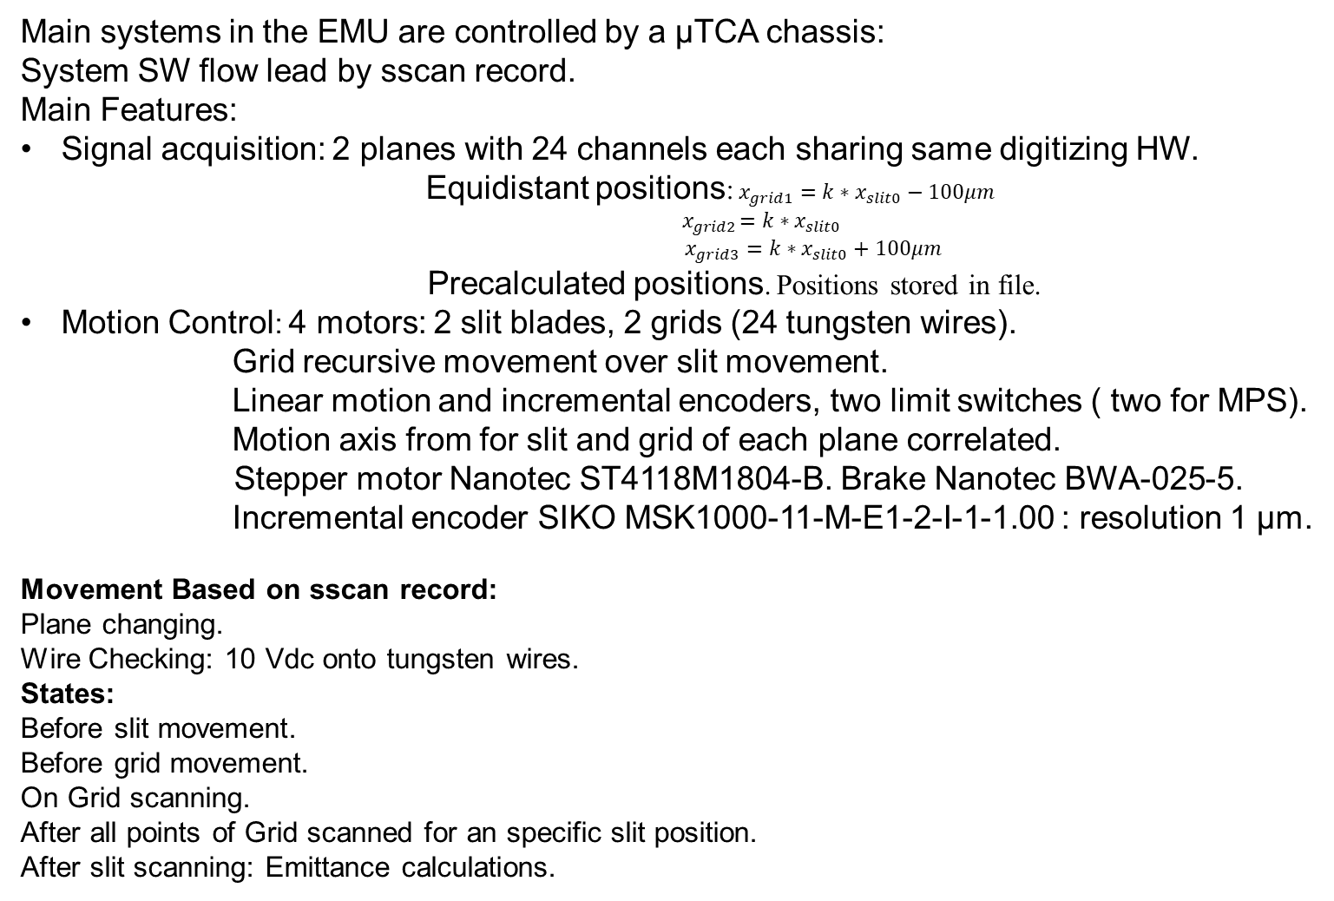
EMU SW development
Main systems in the EMU are controlled by a μTCA chassis:
System SW flow lead by sscan record.
Main Features:
Signal acquisition: 2 planes with 24 channels each sharing same digitizing HW.
Equidistant positions: $x_{grid1}={k∗x}_{slit0}−100μm$
$${ x}_{grid2 }={k∗x}_{slit0}$$
$x_{grid3}={k∗x}_{slit0}+100μm$
  Precalculated positions. Positions stored in file.
Motion Control: 4 motors: 2 slit blades, 2 grids (24 tungsten wires).
Grid recursive movement over slit movement.
Linear motion and incremental encoders, two limit switches ( two for MPS).
Motion axis from for slit and grid of each plane correlated.
      Stepper motor Nanotec ST4118M1804-B. Brake Nanotec BWA-025-5.
Incremental encoder SIKO MSK1000-11-M-E1-2-I-1-1.00 : resolution 1 µm.
Movement Based on sscan record:
Plane changing.
Wire Checking: 10 Vdc onto tungsten wires.
States:
Before slit movement.
Before grid movement.
On Grid scanning.
After all points of Grid scanned for an specific slit position.
After slit scanning: Emittance calculations.
16

Slide 17
EMU SW development (II)
Information arrays obtained:
  x, y: slit position array.
  x’, y’: angle of grid wires position respect slit position array.
  Avg: average in volts of the current induced by the beam in each wire.
  Emittance RMS.
  Twiss parameters: alpha, beta and gamma.
EMU SW developments based in EPICS: E3 Environment.
Four IOCs running.
Main FC IOC mebt_emu module: sscan control and functionalities.
Digitizer driver modules, other modules: asyn, nds3, nds3epics.
2. Synchronization IOC: EVR Event generates µTCA back plane acquisition trigger signal.
3. Ethercat IOC: Based on ecmc module: Analog and digital I/O, motors control.
4. Slow Interlocks IOC:
  sp7plc module: PLC interconnection module.
  MEBT_plc_EMU: Interlocks specific developed module.
17
Notes:
17

Slide 18
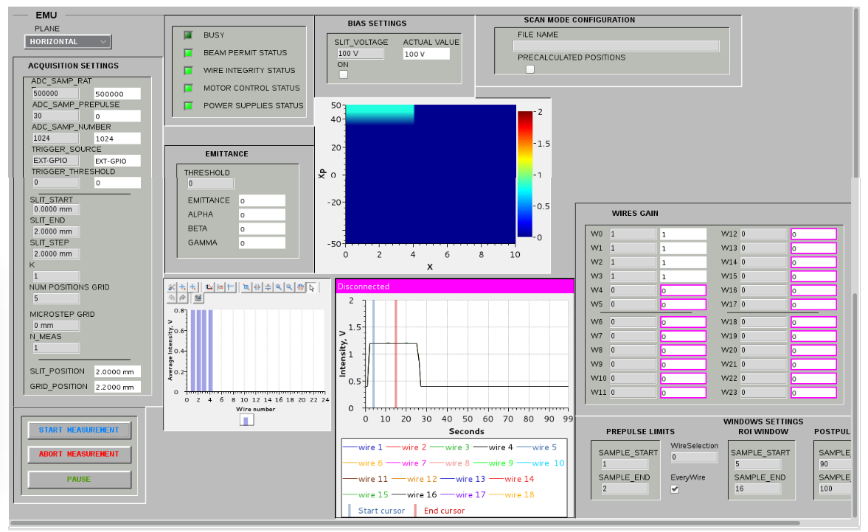
EMU Engineering GUI
18
Notes:
18

Slide 19
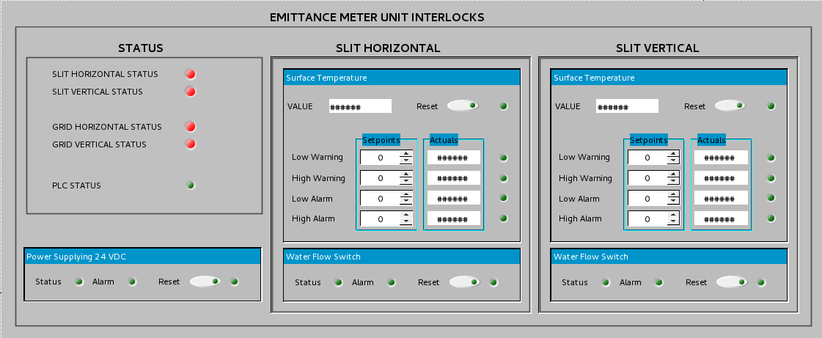
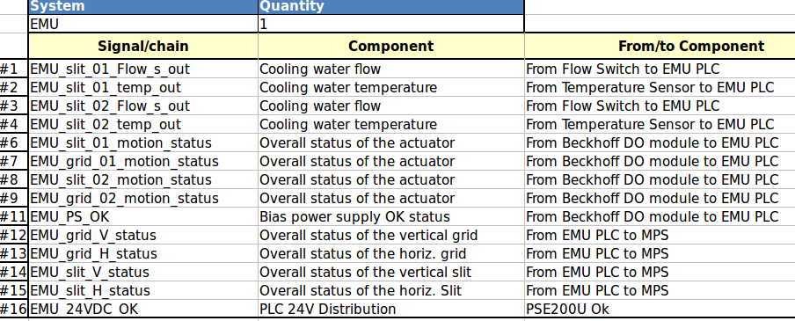
EMU LPS
19
Notes:
19

Slide 20
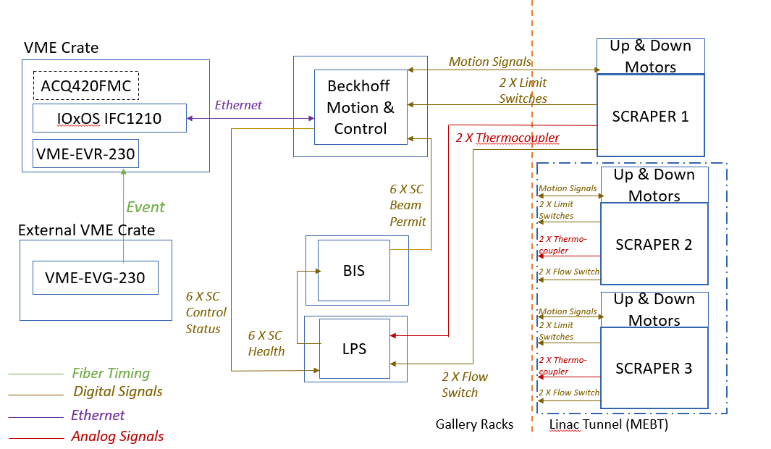
Scraper Control Schematic
20

Slide 21
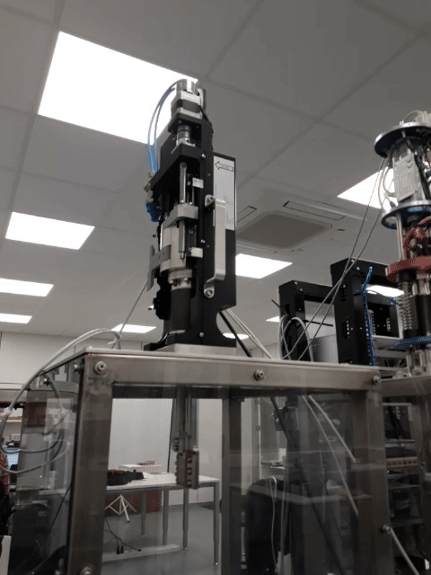
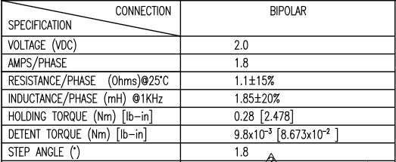
Scrapers motion features
6 Scraper axis to set in horizontal and vertical pairs.
Movement EPICS development either as independent axis or as correlated axis by pairs based on ecmc module.
Actuator: Stroke: 80 mm.
Pitch: 2 mm.
Total required torque in motor axis: 0,42193 Nm.
Stepper motor Nanotec ST4118M1804-B.
Brake Nanotec BWA-025-5.
Incremental encoder model SIKO MSK1000-11-M-E1-2-I-1-1.00 with magnetic band SIKO MSK1000-1-0.3-10-0.01-St-TM-AM-0: resolution: 1 µm, index signal 1 mm.
Bekchoff modules for motion control.
Motor features:
Motor features:
21

Slide 22
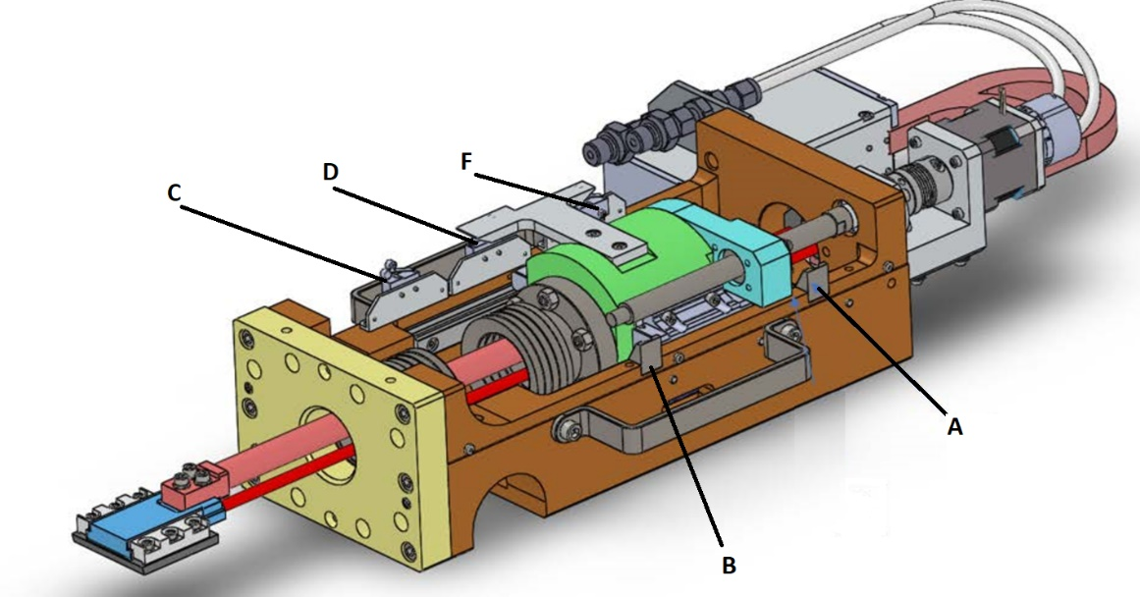
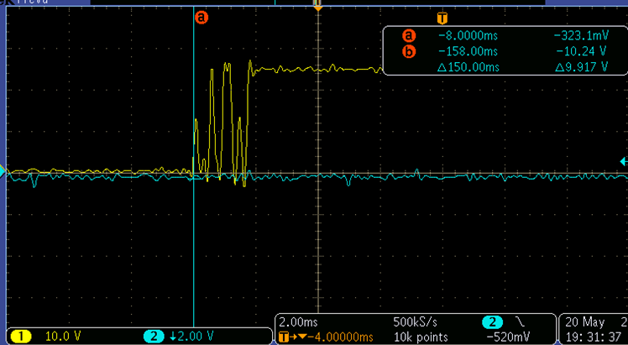
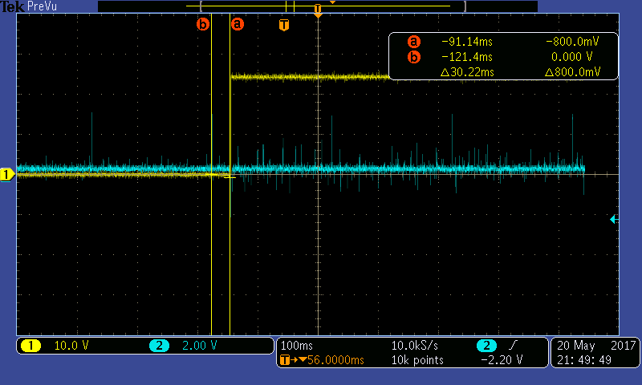
Scrapers limits and homing
Actuator limits
Mechanical limits: A, B.
Limit switches: F: Initial SC Travel Limit Switch.
D: MPS Limit Switch.
C: Final SC Travel Limit Switch.
SW limits.
Homing procedure: Home: home limit switch (or encoder reference signal).
Switch response at 1 mm/s
 | Zero to ONEs Statistics (µm)
 | 10 mm/s | 1 mm/s
Average | 239 | 160
Max. Error | 3 | 33
Std. Deviation | 3 | 18
Jitter | 6 | 53
Home position accuracy:
Based only in limit switch: > 50 µm.
Based on index pulse of encoder each 1 mm: 1 µm.

Slide 23
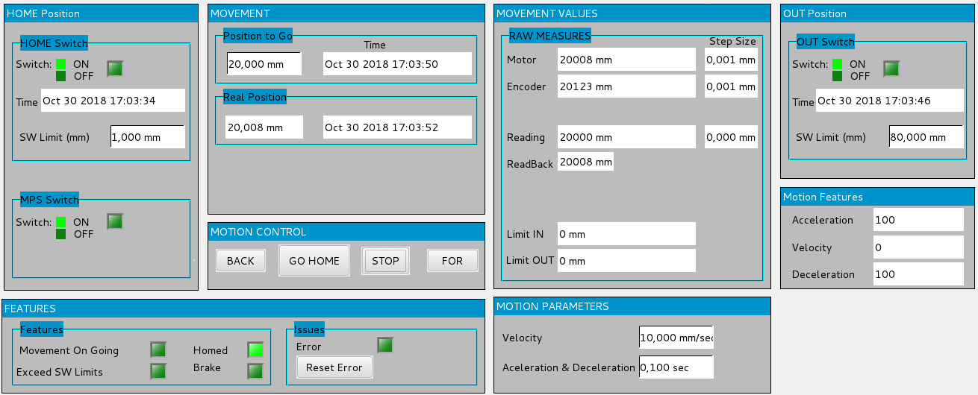
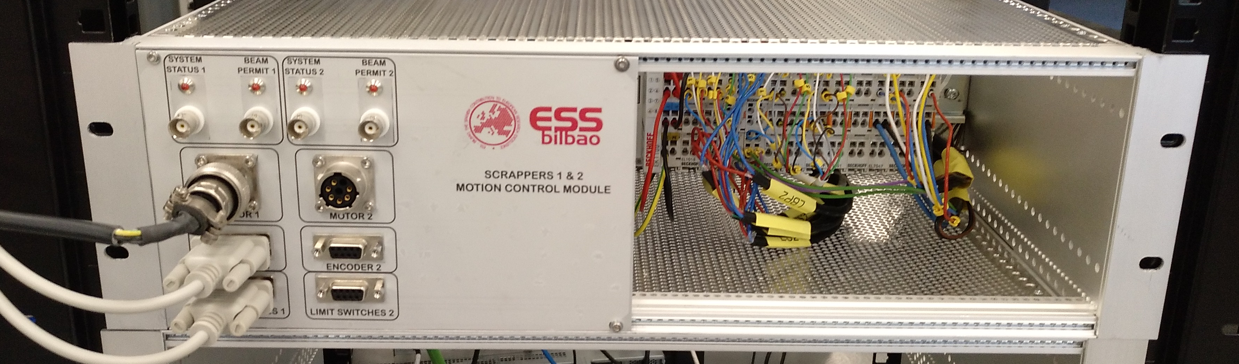
Scraper Motion Engineering GUI
Max speed: 20 mm/s.
Max required speed: 10 mm/s.
EPICS developments based on ecmc module.
Beckhoff modules:
EL1018: Digital Inputs: limit switches, MPS home switch and MPS Beam Permit signal.
EL2808: Digital Outputs for powering switches to 24V, motor brake and Health Status signal to MPS.
EL5101: Encoder driver.
EL7047: Motor driver: 2000 Hz.
23

Slide 24
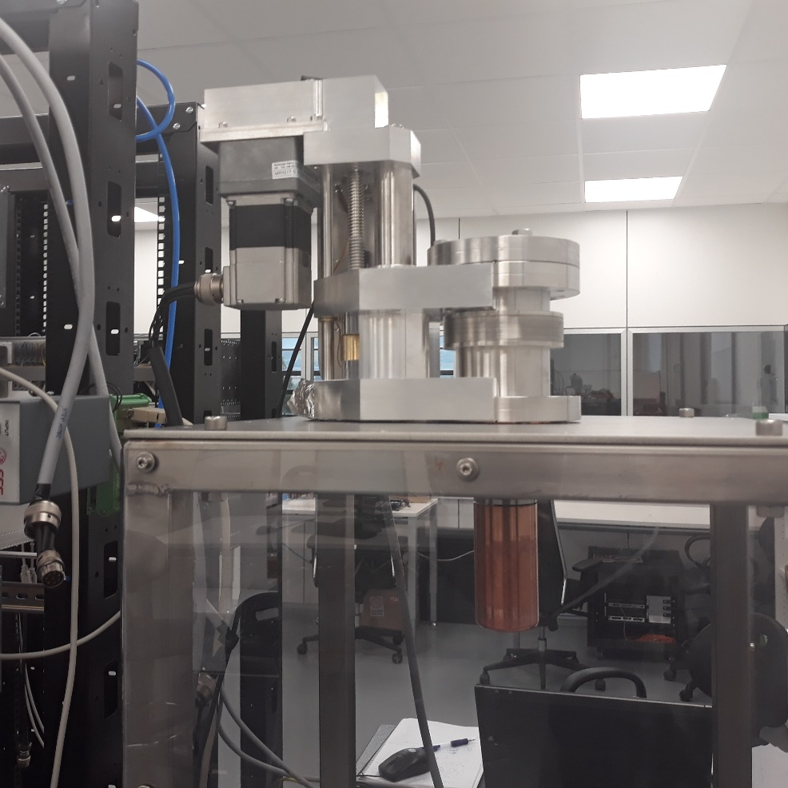
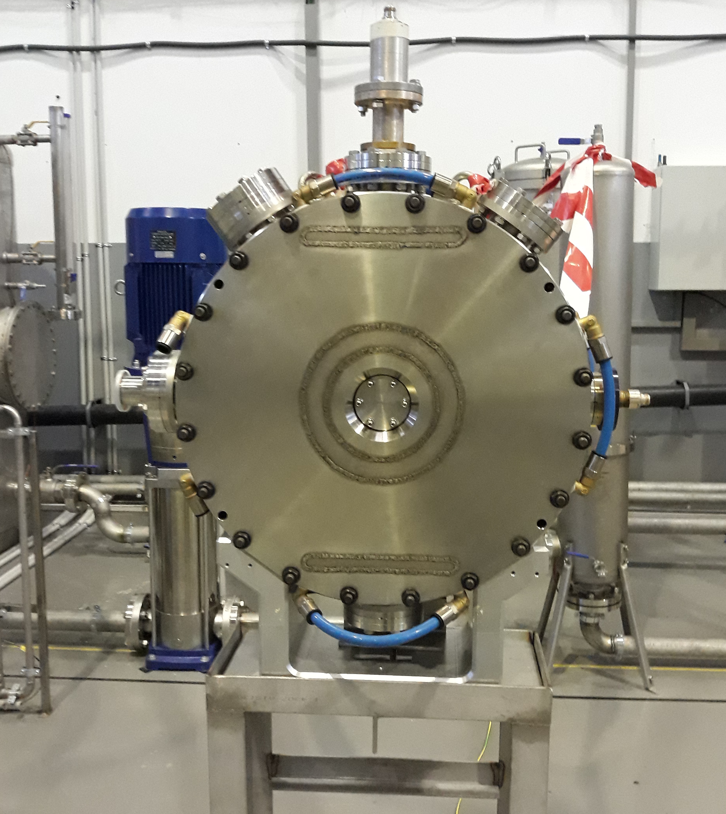
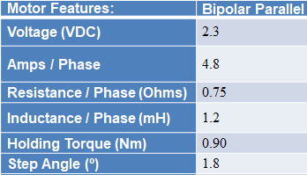
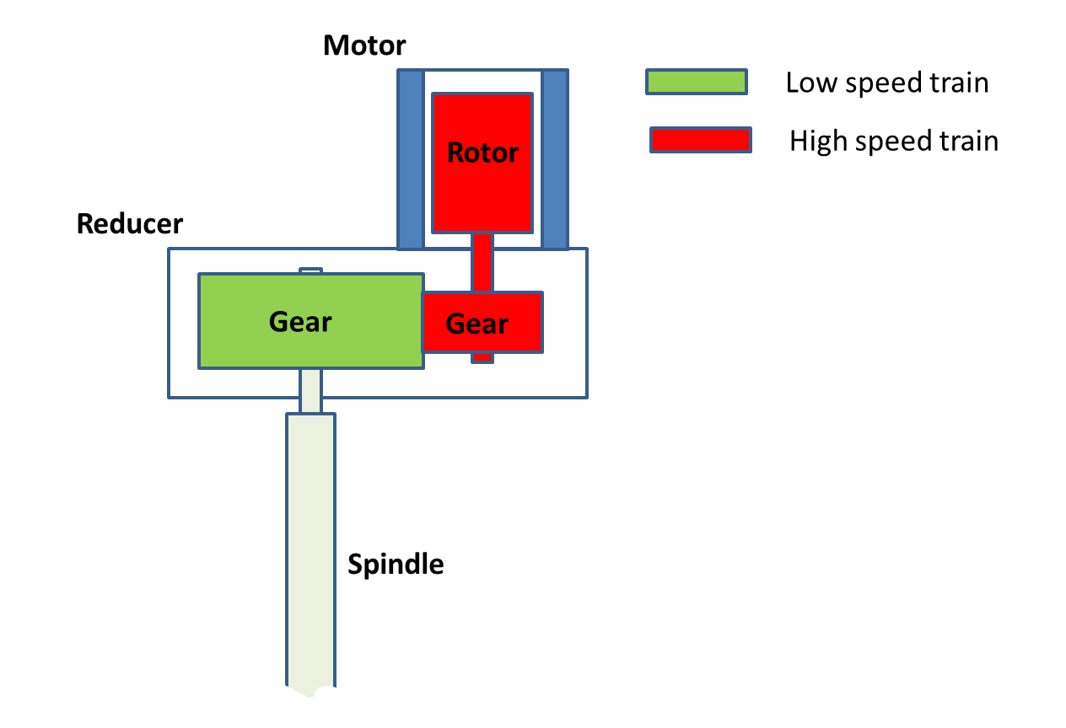
Buncher Tuner Mobile
3 Mobile tuners for each Buncher, used at cavity tunning.
Movement EPICS development either as independent axis or as correlated axis by pairs based on ecmc module.
Actuator: Linear shift mechanism: LSM64-21395-001 (UHV).
Stroke:75 mm.
Pitch: 2,54 mm.
Torque to move 245N load about 0.75Nm.
Stepper motor McLennan 23HT18C230.
12.5:1 spur gearbox.
Renishaw LM10IC010EA10A00 magnetic Encoder: 10µm resolution, index signal 2 mm.
Bekchoff modules for motion control.
Limit Switches Home Sensor.
24

Slide 25
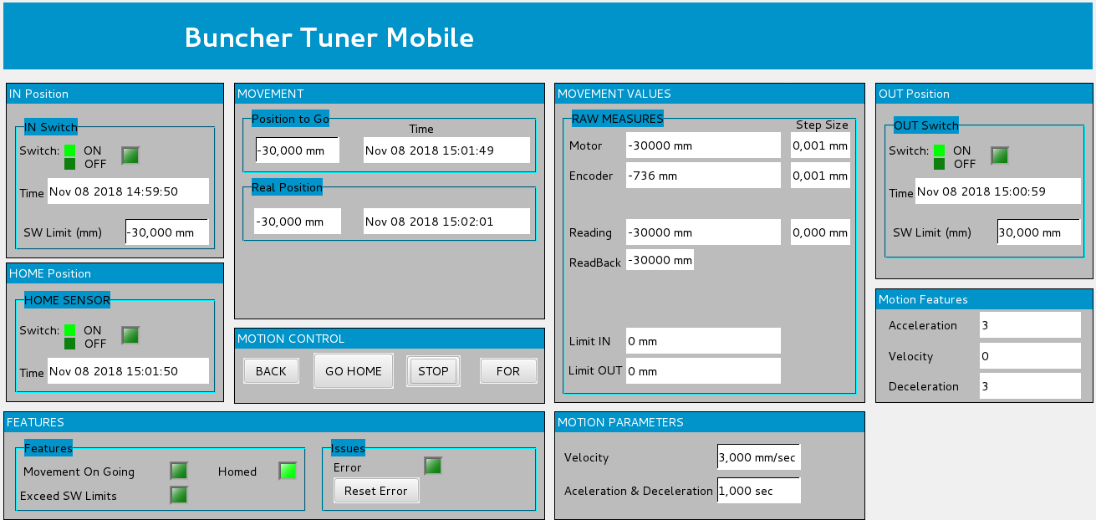
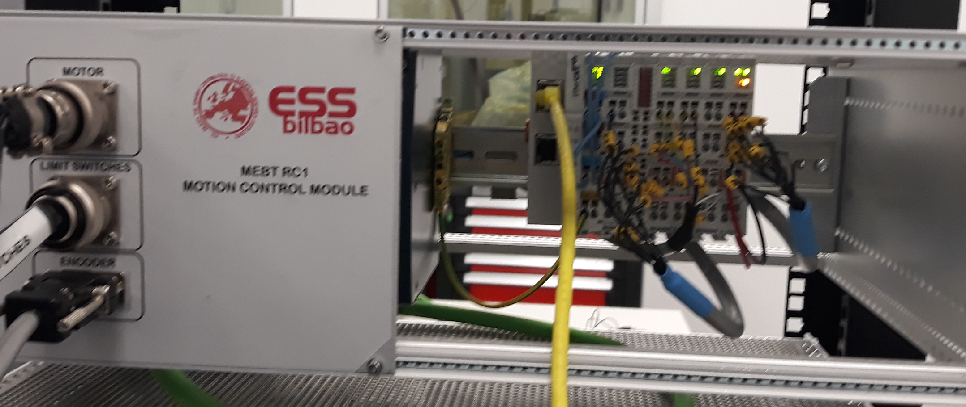
Buncher Tuner Mobile
Max speed: 5 mm/s.
Max required speed: 2,5 mm/s.
EPICS developments based on ecmc module. Additional BU_motion_interface module.
Beckhoff HW modules:
EL1018: Digital Inputs: limit switches, home sensor.
EL2808: Digital Outputs for powering switches to 24V.
EL5101: Encoder driver.
EL7047: Motor driver: 8000 Hz.
25

Slide 26
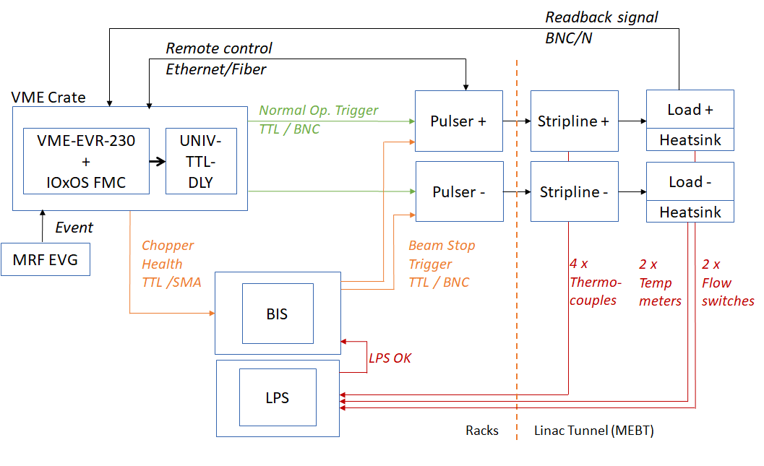
Fast Chopper schematics
26

Slide 27
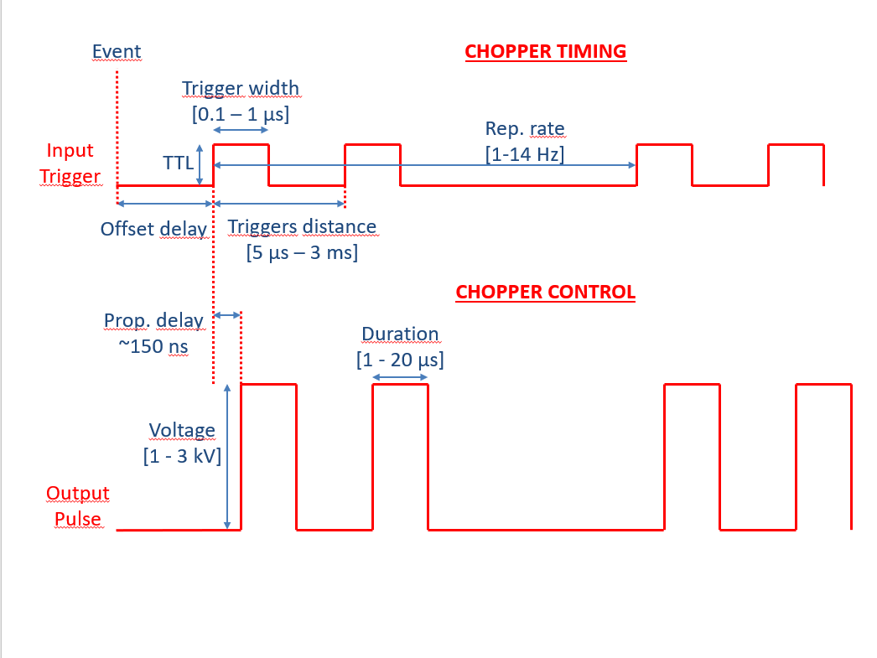
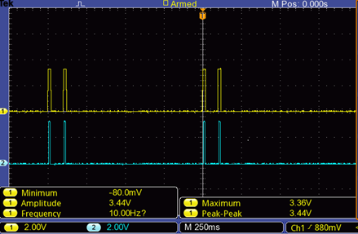



Fast Chopper Timing
Normal operation chopper signals
Triggers to introduce in the pulsers
Edge of trigger signals
Output pulses from the pulsers
Rising edge of the trigger signal that is a few ns.
Trigger Width: Recommended triggers from 0,1 to 1 s.
distance between triggers from 5 s to 3 ms.
Offset Delay: Synchronize chopper deflection with beam (µs).
Fine Delay: From 2,2 ns to 12,4 ns in steps of 10 ps.
Distance between paired triggers: From 5 s to 3 ms.
27

Slide 28
Fast Chopper SW
Control developments in EPICS based on the EEE’s recommendation.
Drivers needed for HW and VME :
IOxOS VME drivers
MRF (Timing) drivers.
Those are the EPICS modules used in the SW solution:
Timing control:
EVGChopper module: event generator configuration.
EVRChopper module, for configuring the event receiver of the chopper.
mrfioc2: MRF timing module special version for UNIV-TTL-DLY support.
System and device support related modules: pev, pevdrv, devlib2, regdev.
Pulser control:
PulserProtocol module, for configuring the features of the pulsers. (IOC for each pulser).
Serial communication and related modules: asyn, streamdevice, calc, seq, pcre.
Slow Interlocks:
Chopper_plc module, used s7plc module.
28

Slide 29




Fast Chopper Engineering GUIs
Chopper control of the pulsers (FID GmbH) through proprietary protocol.
29

Slide 30
Thank you for your attention.
Tack så mycket!
¡Muchas gracias!
Eskerrik asko!
30

