Slide 1
THE STATE OF BEAM DIAGNOSTICS
Tom Shea
for the ESS Beam Diagnostics Team

Slide 2
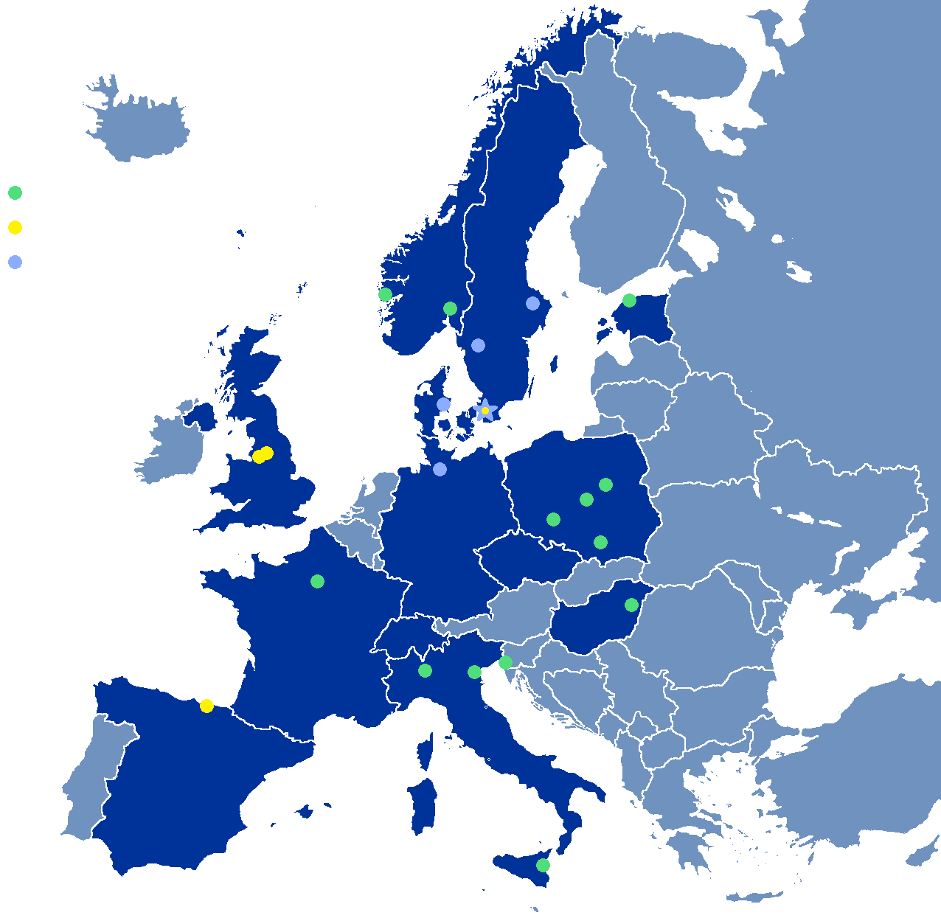
Accelerator Partner Institutions
In-kind (main contributions)
ATOMKI (RF-LPS)
CEA (RFQ, SRF, Diagn)
CNRS (SRF, Cryogenics)
Cockcroft Inst (Diagn)
Daresbury Lab (SRF, Vacuum)
Elettra (RF, Magnets, PS, Diagn)
ESS-Bilbao (MEBT, RF)
Huddersfield Univ (RF distrib)
IFJ PAN (Installations, test stand)
INFN Catania (Source, LEBT)
INFN Legnaro (DTL)
INFN Milan (SRF)
Lodz UT (LLRF)
NCBJ (LLRF, gamma blockers)
Tallinn UT (RF)
Univ Bergen (Seconded staff)
Univ Oslo (Diagn)
Warsaw UT (LLRF)
Wroclaw UT (Cryogenics)
IK signed
IK endorsed
Collaboration
agreement signed
Collaboration agreements
Aarhus Univ (Beam delivery, diagn)
DESY (Diagn)
Lund Univ (LLRF, RF)
Uppsala Univ (Test stand)
University West (Diagn)

Slide 3
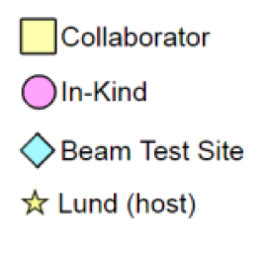
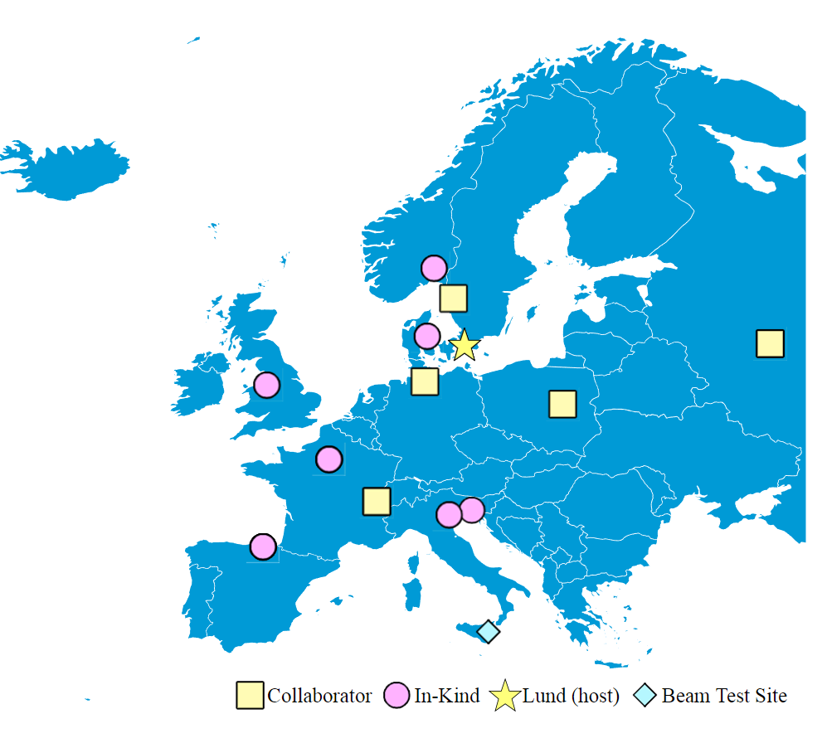
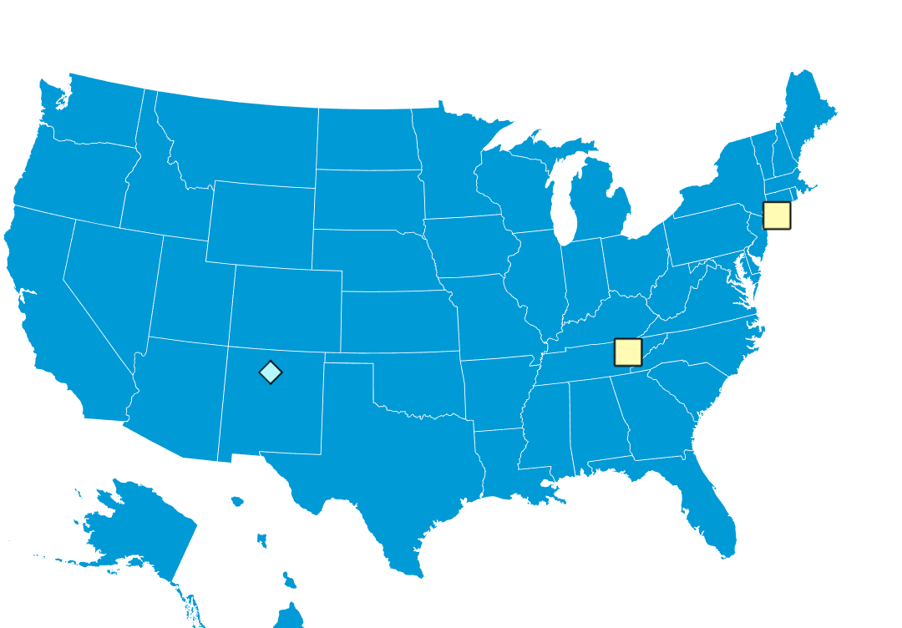
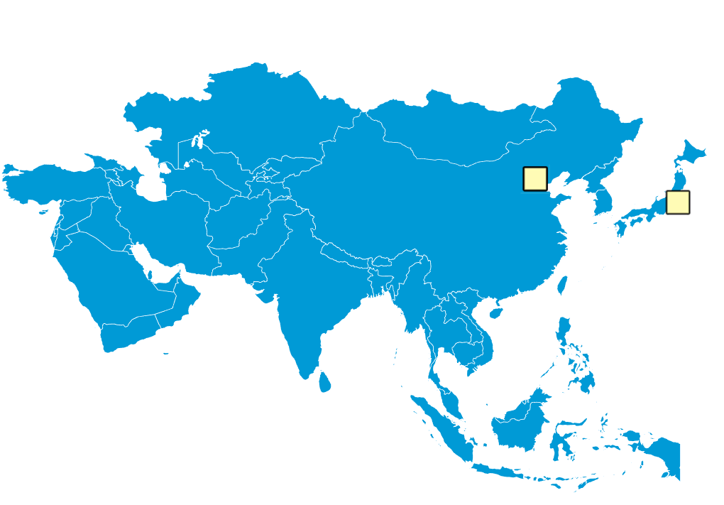
ESS Diagnostics: 22 Partners and Collaborators
Aarhus University
CEA Saclay, Paris
CERN, Geneva
Cockcroft Institute, Daresbury
DESY, Hamburg
Elettra – Sincrotrone Trieste
ESS Bilbao
INFN, Catania
INFN, Legnaro
Lund University
University of Oslo
Technical University of Denmark
Science and Technology Facilities Council, Daresbury
Warsaw University of Technology
IMP, China
J-PARC, Japan
Oak Ridge National Laboratory
Los Alamos National Laboratory
INR, Moscow
Högskola Väst, Trollhättan
Stony Brook U., New York
BNL, New York

Slide 4
In Lund – continuing to assemble the team
I’m second from the left… and a bit jet-lagged…

Slide 5
System Leads
System | System Lead
Aperture Monitor(fixed and moveable) | Cyrille Thomas
BCM (BCM, fast BCM, IS supply current) | Hooman Hassanzadegan
BLM (nBLM, ICBLM, X-Ray spectroscopy) | Irena Dolenc Kittelmann
BPM (BPM, fast BPM) | Hooman Hassanzadegan
Doppler | Cyrille Thomas
EMU (Alison, slit-grid) | Clement Derrez
FC | Elena Donegani
Imaging | Cyrille Thomas
Insertable Beam Stops | Elena Donegani
LBM (BSM) | Irena Dolenc Kittelmann
NPM (IPM, BIF) | Cyrille Thomas
Scraper(MEBT) | Cyrille Thomas
Target Grid | Cyrille Thomas
WS(scanning, fast) | Clement Derrez
https://confluence.esss.lu.se/display/BIG/Organization+of+Beam+Diagnostics

Slide 6
Technical Leads
Technical Area | Responsible
Cabling | Edvard Bergman
Commissioning (LEBT) | Cyrille Thomas
Data Management | Johan Norin
Electronics | Clement Derrez, Hooman Hassanzadegan
FPGA, digital architecture | Kaj Rosengren
Installation Manager | Viatcheslav Grishin
Laboratory Manager | Edvard Bergman
Mechanical | Thomas Grandsaert
Motion Control | Clement Derrez
Project Planning | Johan Norin
Protection | Irena Dolenc Kittelmann, Thomas Grandsaert
Radiation effects | Irena Dolenc Kittelmann ,Elena Donegani
Software, EPICS integration | Hinko Kocevar
Verification | Clement Derrez
https://confluence.esss.lu.se/display/BIG/Organization+of+Beam+Diagnostics

Slide 7
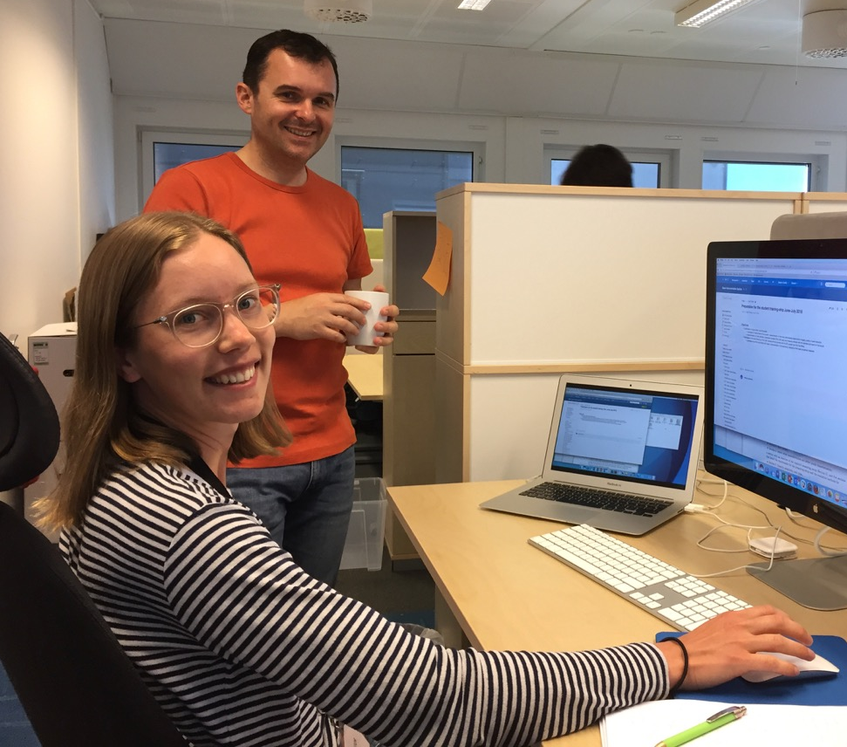
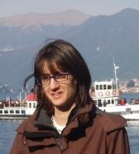
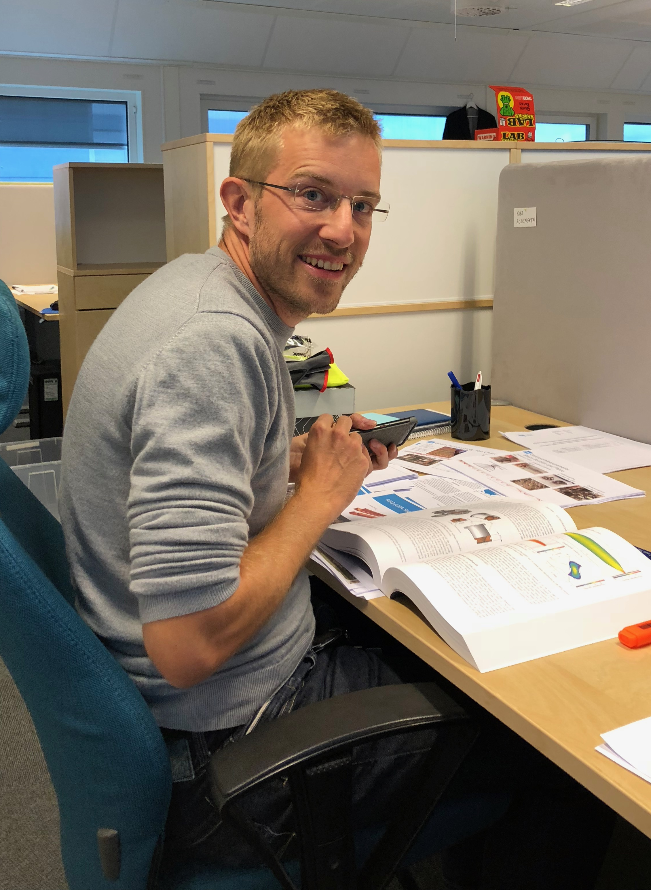
New arrivals in Lund
Maria Hoflund, student intern with Cyrille
NPM (BIF) camera studies over the summer
Elena Donegani, post-doc, is now System Lead for:
Faraday Cups: LEBT, MEBT (Bilbao IK), and DTL. Includes local shielding and activation analysis.
Insertable Beam Stops: Spoke and Medium Beta. Also includes local shielding and activation analysis.
Kaj Rosengren, engineer, responsible for digital architecture and FPGA design:
Assess state of digital platform for nBLM and icBLM
Launch Data-on-Demand project – representing diagnostics and LLRF, and working with ICS and other stakeholders.
Determine FPGA roadmap – Near and long-term strategies.
Roxana Tarkeshian has accepted the Diagnostics Scientist position
Starts in January
Initial focus areas: ion source diagnostics, EMU, IPM

Slide 8
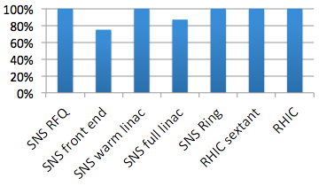
We are transitioning to the commissioning phase
In papers that report on accelerator commissioning – Percentage of figures that include data from diagnostics:
Spot check of papers from other facilities: approaching 100%. Most compare beam dynamics predictions to diagnostics’ measurements

Slide 9
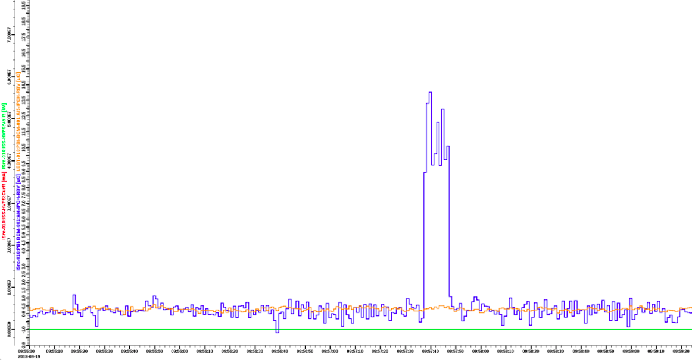
First proton beam on the ESS site
Charge per pulse vs. time of day measured by Beam Current Monitor

Slide 10
The Big Picture – paced by commissioning
Beam on Dump (BOD)
ISrc to DTL1
Accelerator Ready for Beam on Target (RBOT)
ISrc to LEBT
ISrc to DTL4
End of Construction
Beam on Target (BOT)
2018
2019
2020
2021
2022
2023
2024
2025
Deploy about half of the diagnostic system types
Start Of User Program (SOUP)
Design and deploy the other half of diagnostic system types
Update some systems based upon commissioning experience
Develop deferred systems (advanced detectors, non-invasive techniques, halo techniques, target…)
Developments, data analysis, machine studies, etc with goal of achieving full neutron source performance (collaboration with accelerator, target, neutron science)

Slide 11
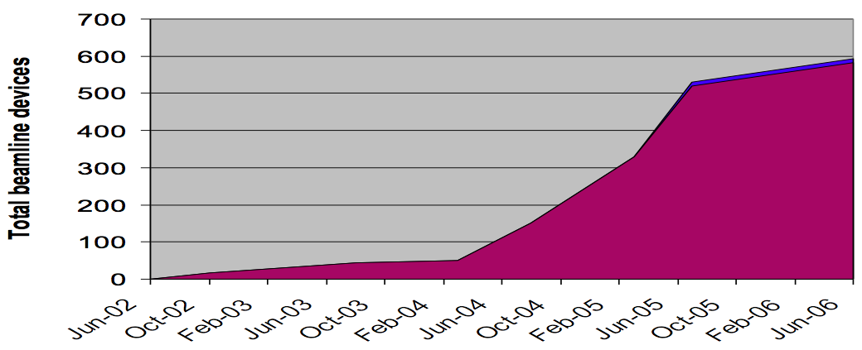
Comparison
DTL5
+ Spokes
+ Medium Beta
To target
Source/LEBT at Catania
RFQ/MEBT/DTL1
Source/
LEBT
DTL 2-4
ESS
2017
2018
2019
2020
2021
2022
SNS
2002
2003
2004
2005
2006
1
2
3
4
5
6
7
8
9
MEBT
improve
DTL 1
improve
Elliptical
Deployment at scale: superconducting linac devices
In the past, ESS appeared too compressed.
Now, I think that it looks achievable and similar to RHIC and SNS.

Slide 12
Focus Areas for 2019
Deploy normal-conducting linac diagnostic systems
Wrap up most prototype testing and remaining design reviews
Project management
Biggest issue: Projected budget gap of 2 to 5%
Soliciting ideas for cost savings/deferral
Technical
V 1.0 firmware and software architecture
Data on demand
Timing integration
MPS integration
Low latency link

Slide 13
thanks

