Slide 1
J-PARC test of Aperture and Grid prototype
Dr Cyrille Thomas
Beam Diagnostics Physicist
European Spallation Source ERIC
22-11-2018

Slide 2
Outline
Beam on Target Diagnostics as a suite of diagnostics supporting beam tuning and neutron production
GRID and APerTure Monitor (APTM) prototype:
  From design to installation at J-PARC
  Preliminary results and lessons learned
Concluding remarks

Slide 3
Beam on Target Diagnostics
Suite of instruments to measure beam properties on target:
    Size, position (IMG)
    Current density distribution (IMG, GRID)
    Beam outside defined aperture (APTM)
  Scale time: Intra-pulse, pulse, cumulative pulses
Objectives:
  Support tuning beam on Target/Dump:
    establish nominal operation: from non-destructive probe pulses to full 125MW (peak) pulse
    protection
  Support beam on target operation (production):
    monitor
    protection

Slide 4
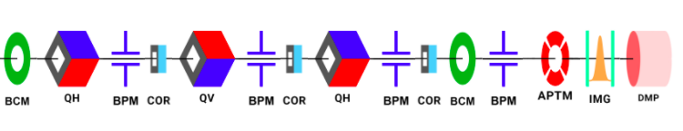
Beam on Dump
σ = 3mm
σ = 16mm
440 MW/cm²
15 MW/cm²
BPM: phase, position, trajectory
  degraded performance with long bunch
BCM: peak current along pulse
APTM: charge loss into the defined aperture
  Measure all charges from MHz sample to minutes
  Can be biased by secondary electrons
IMG: beam transverse 2D profile, peak current density distribution
  Detects small beam size
  Limitation in dynamic range: too large beam size may not be seen

Slide 5
Beam on Dump
Tuning
for every pulse:
Verify beam size predicted by the model
MPS on: check beam size larger than σ_{th} (mode dependant)
Check beam current on aperture (protection)
Check trajectory and divergence (protection)
1µA
314K
APTM (active collaboration)
IMG
Current / sectors (MS/s)
Temperature / Thermocouples (sub Hz)
X₁, Y₁, σ_{x1}, σ_{y1}
4µA
3µA
Screen 2
X₂, Y₂, σ_{x2}, σ_{y2}
360K
350K
Screen 4
ΔX, ΔY, Δσ_{x}, Δσ_{y}
0.8µA
310K
Screen 1
Image 1
Dump
Screen 3
Image 2
APTM
Screen 3
* future collaboration

Slide 6
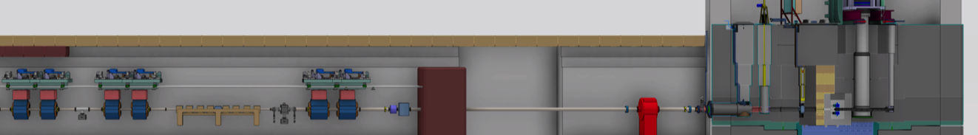
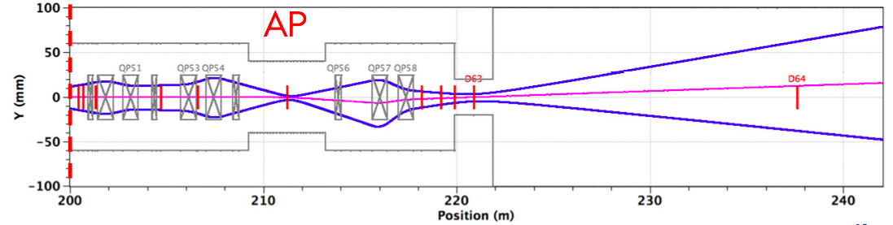
Beam on Target
Accelerator region
Target region
440 MW/cm²
1.5MW/cm²
TW
Heine Thomsen (ISA, Aarhus University)
A2T and Raster Magnets
CO
PBW
PBIP
BEW
BPM: phase, position
BCM: peak current
NPM: beam profile, size, positon
WS: (low power) beam profile, size
BPM
BCM
NPM
APTM: beam aperture (protection)
APTM
GRID
APTM
IMG (x2): current density

Slide 7
Beam on Target
Beam parameters:
Power: 5MW
Peak Current: 62.5mA
Avg Current: 2.5mA
Pulse: 2.86 ms
APTM
1µA
314K
1µA
314K
H. GRID
FFT peaks
V: 29kHz
H: 39kHz
4µA
3µA
4µA
2µA
360K
350k
360K
350K
0.8µA
310K
0.9µA
310K
PBW
PBIP
IMG
Max peak density: 50%
Max peak density: 30%
V. GRID
PBW
BEW

Slide 8
APTM and Grid Prototype
Build and install a prototype for the APTM and GRID in an environment similar to ESS target.
Collaboration with J-PARC:
  3NBT Dump:
    downstream Al window, in rough vacuum, (not so) close to the Dump
  Benefit from local experience, which has similar GRID and APTM
Collaboration with IMP:
  Experience mechanical engineers
  Synergy with IMP Diagnostics Group

Slide 9
Time line of the project
09/2017
11/2017
01/2018
03/2018
06/2018
09/2018
10/2018
Starts Control system integration
Initial discussion with J-PARC
Discussion with IMP
Purchase Electronics
Proposal Submission
Proposal Approval
Start Control system verification test
ESS sketch design sent to IMP / J-PARC
Final Design Mechanical Assembly
Sub-contract Keye Industry for manufacturing
FAT at Keye
Construction starts
Delivery
Installation
Tests with beam

Slide 10
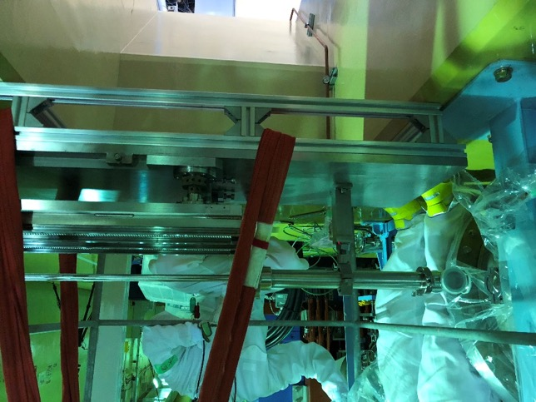
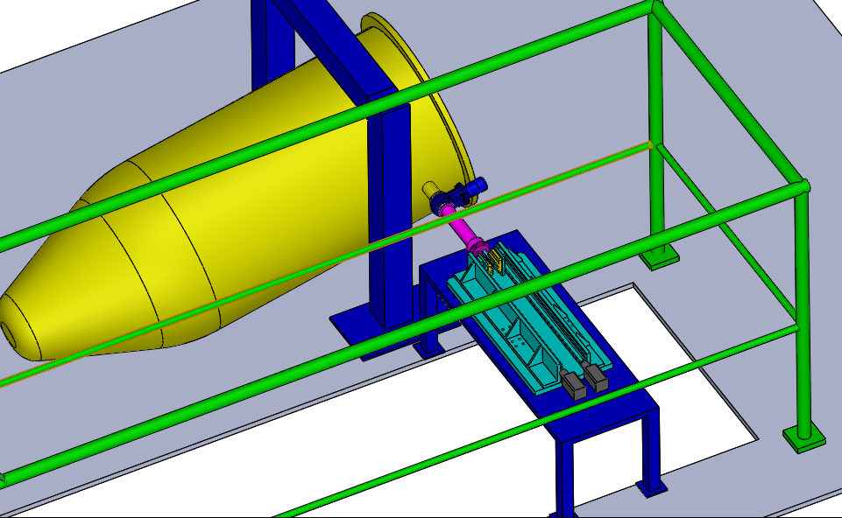
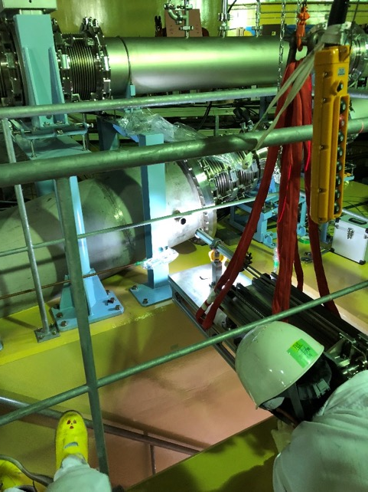
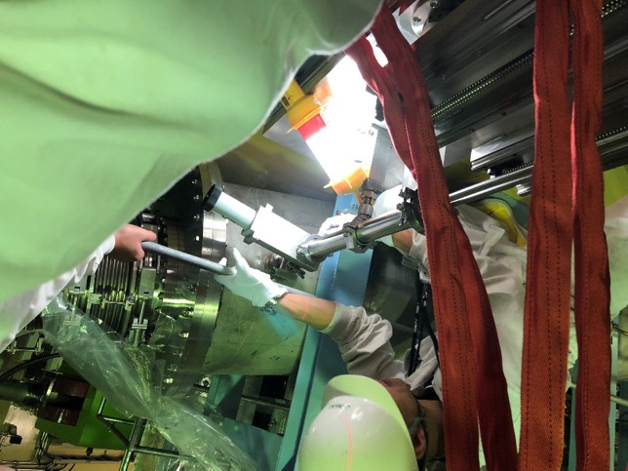
From design to installation

Slide 11
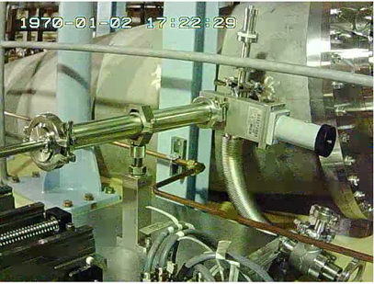
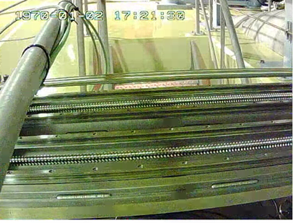
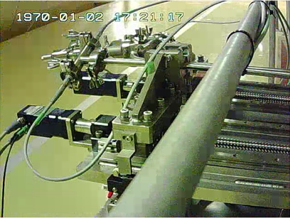
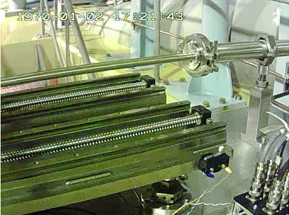
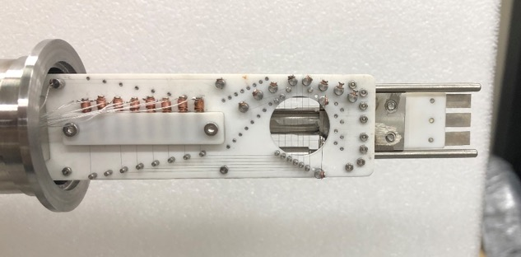
Mechanical Assembly installed on 3NBT Dump
630mm
Mechanical constraints:
  fit APTM and GRID through DN40 port
    miniature design
  Long range travel >500mm
    High rigidity
34mm

Slide 12
Data Acquisition/Control System
MTCA hardware: high performance and robustness;
AMC-Pico-8 digitizer: 8 current input channels per board, 1MSPS @ 20-bit; ±1 mA and ±1 µA range;
EPICS controls with ESS in-house developments;
Full scale integration and deployment;
MRF EPICS integrated timing system
Beckhoff EtherCAT hardware for Motion Control; Temperature controller
ESS open-source framework: ECMC;
Gain experience with control system in real environment
High level control applications
EPICS IOC for motion control
EPICS IOC
for data acquisition
ECMC
areaDetector dev. support
EtherCAT driver
Vendor driver
MTCA Hardware
3x AMC-Pico-8
MRF Event Receiver
Motion Control Hardware

Slide 13
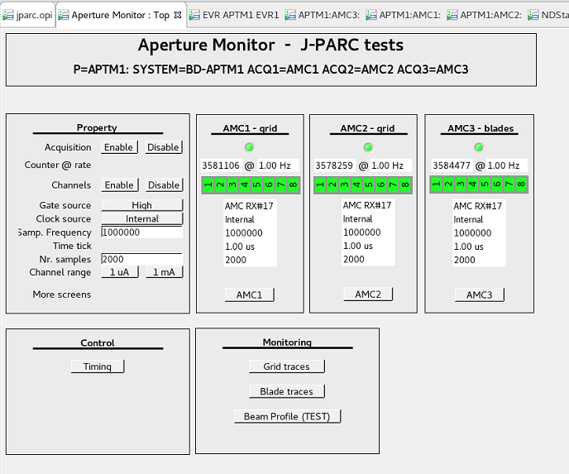
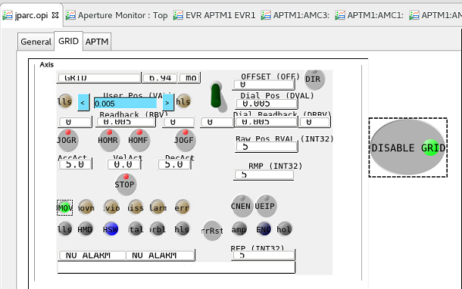
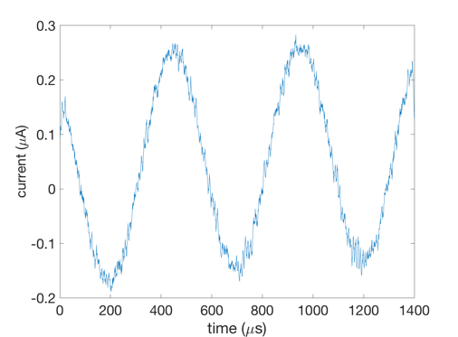
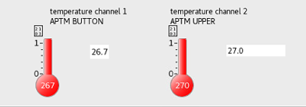
Pico8 AMC integrated in µTCA crate
ECAT: Motion Controller
AreaDetector: EPICS integration
ECAT: Temperature Controller
Open-Hardware EPICS integration
Full system verification prior installation at J-PARC

Slide 14
Prototype experience return
Tests:
W and SiC wire signal
Signal from Ni Blades
Signal from Thermocouples
Parasitic signal and noise: electrons, EMC
Cross-talk between GRID and APTM
Motion control in radiation environment
signal intensity
comparison with actual model
Real environment perturbation
Direct comparison with ESS
Tests of fully EPICS integrated system

Slide 15
Scan APTM
300mm
570mm
APTM from in to out
Grid out then in
Scan APTM
Scan beam

Slide 16
V Grid: signal
H Grid: signal wire 1 (SiC)
V grid: proton signal + 26kHz
H Grid: only wire 1 showing signal
  Only electrons signal
Blades: strong 26kHz
APTM Blade Signal

Slide 17
Grid in Position
Grid on
APTM 24mm out
Bias on APTM: -30V
Retrieval of profile
Beam: 50mA, 500µs, width = ~2mm

Slide 18
MC simulation

Slide 19
MC simulation
ANSYS thermo-mechanical:
with full beam power
Melt!
Energy deposition

Slide 20
MC simulation
Total electrons >2keV on wire:
10⁻⁴ /proton (Air, other wires, plate, etc.)
Total electrons 25eV out of wire:
SEY = 10⁻¹ /proton
-> peak current in W wire,
at 2mm beam size: 160µA
-> measured: 400µA
Protons
Electrons
…and many more particles

Slide 21
Concluding Remarks
Successful design and manufacturing of APTM and GRID prototype, delivered in time for the installation
Successful Acquisition Electronics system design, built, and integrated into EPICS ESS control system
Successful deployment of full instrument at J-PARC
Successful test in real environment similar to ESS

Slide 22
Acknowledgment
Thanks to all the people involved in this challenging project:
  ESS ICS group, Julen Etxeberria Malkorra, Joao Paulo, Simone Farina, Han Lee, Peter van Velze, et al., who help and support the integration of the Electronics and the implementation of the control system
  IMP collaborators, HaiHua, Zhangbin, He, who design the assembly and have it manufactured and tested, and their colleagues from diagnostics group who supported us in the design and factory acceptance tests
  ESS BI group, Hinko Kocevar, Edvard Bergman, Viatcheslav Grishin, Clement Derez, Thomas Shea, who help all along the project in all aspects, and Elena Donegani who performed all MC simulations and Thomas Grandsaert for mechanical engineering support (3D model, ANSYS)
  LTH collaborators: Markus Tormanen, Anders J. Johansson

Slide 23
Last shot quiz: can you explain what you see?

