Slide 1
FPGA roadmap
Kaj Rosengren
FPGA Designer – Beam Diagnostics
www.europeanspallationsource.se
20 November, 2018

Slide 2
Agenda
FPGA roadmap
  Overview (aka the roadmap)
  Highlights of topics
Data-on-demand
  What is it?
  Use-cases
  Things to solve

Slide 3
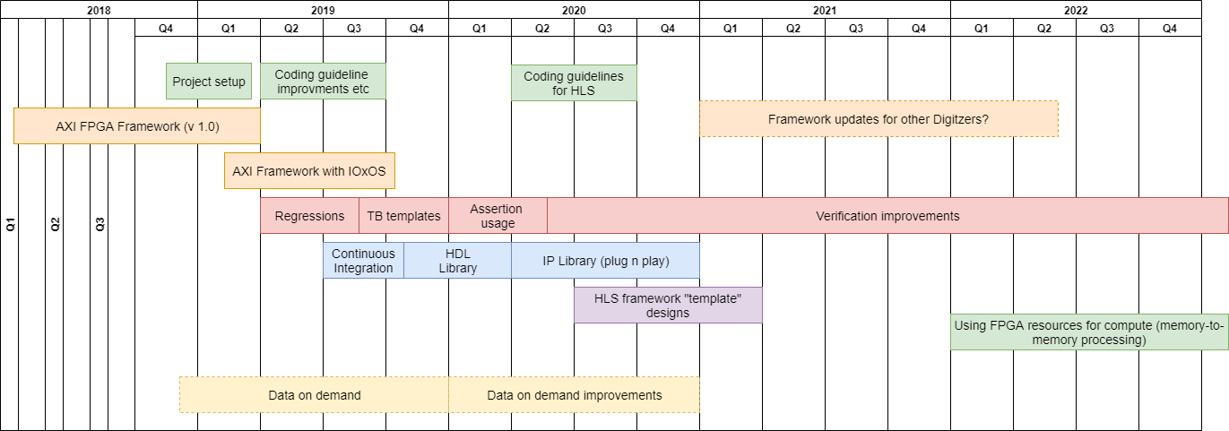
Overview
Note that this is not aligned with prototype/commissioning milestones.

Slide 4
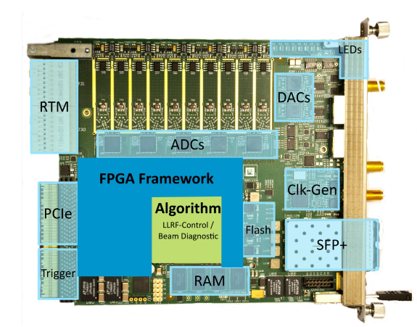
AXI FPGA framework v1
AXI FPGA framework developed to separate user-code from board specifics.
  Improved flexibility -> different board/different applications
  Long term support -> Reduction of dependency
  Re-use of existing IP
  Using industry standard AXI interfaces
Work already progressed a long way.
  Missing one major detail, the PCIe/DMA IP still using the Struck example implementation.

Slide 5
Overview

Slide 6
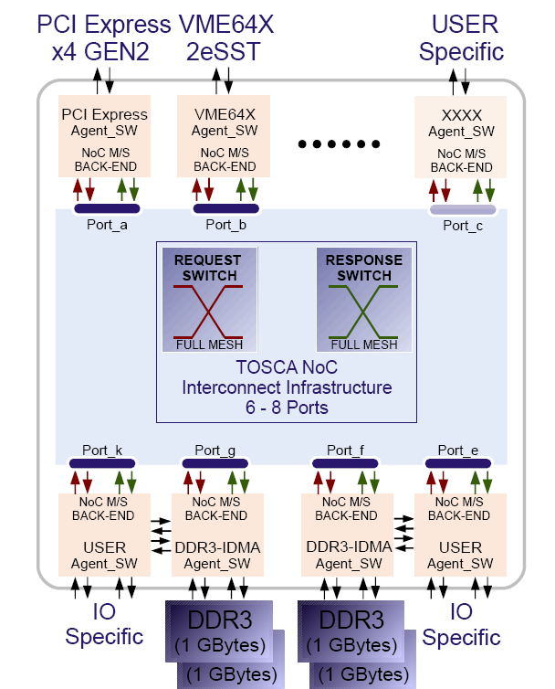
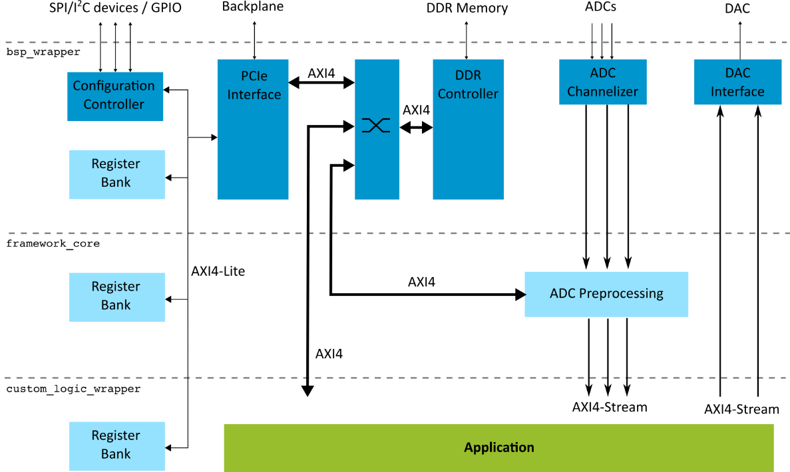
AXI FPGA framework with IOxOS
How-to deal with IOxOS boards. Using a proprietary framework. Very dependent on IOxOS support.
  First analysis by Simone indicates that we cannot use Xilinx DDR controller for memory.
  The TOSCA NoC could provide us with 32-bit AXI lite for register bank access and 64/128-bit AXI for memory/PCIe access.
  Trials needed, we don’t know what the performance for AXI -> DDR would be for this configuration.
Notes:
Note: Currently the FMC setup interfaces doesn’t seem to be a part of the AXI bridge parts.

Slide 7
Overview

Slide 8
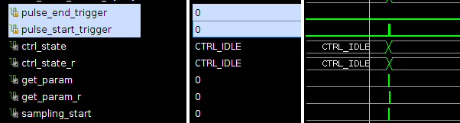
Verification topics
Simulation
Evaluate the simulator situation.
Ability to run regressions.
TB templates – howto deal with System models and golden references
Assertions (PSL or SystemVerilog) – could at least be used for simulation of standard interfaces.
  Assert property (Valid & !ready |-> valid)
”top-level” test benches – would be nice to have
  Auto generate register tests etc.
  Would also be nice if this could be re-used on linux driver level
  IOxOS provides something with their framework (requires modelsim).
Constrained random verification – No
Formal verification – No
FPGA
Debug interfaces – best practices for debugging design on board.
  Default ILA instantiations
  Debug interface in register maps
Replay testbenches – maybe (many clock domain crosses creates uncertainty)

Slide 9
Overview

Slide 10
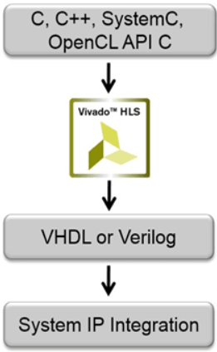
Longer term topics
Continuous integration
  Using Jenkins or similar automation tool to run tool flows (synthesis etc).
  Mainly useful when multiple people are working on the same codebase.
HDL Catalogue & HLS Templates
  Collect commonly used IP:s into the Xilinx IP container formats for plug-n-play.
  HLS Template framework design. Basically scope apps but with HLS customizable processing chains.
  More for non-FPGA users to play around with FPGA.

Slide 11
Overview

Slide 12
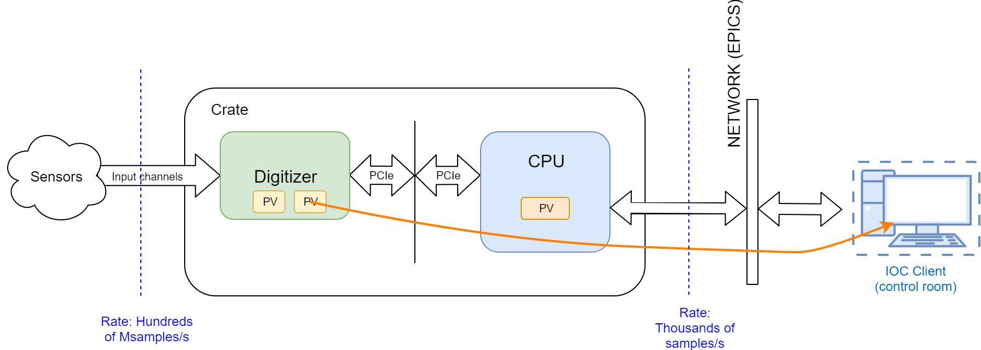
Data-on-demand – What is it?
The ”Normal” case is that the IOC clients are updating small PV:s with heavily processed items or shorter waveforms
But we do acquire a lot more data than this and it would be very useful to have it available for analysis.

Slide 13
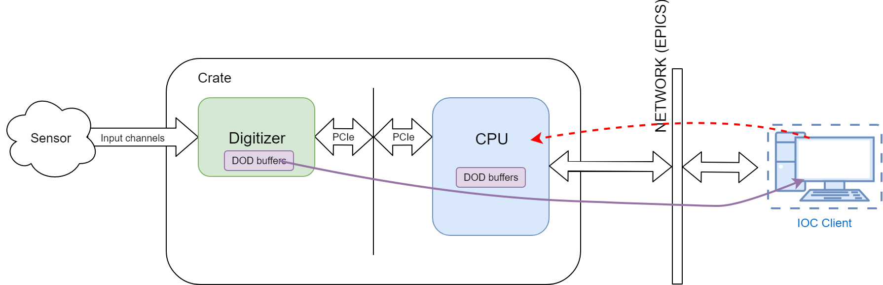
Data-on-demand
The digitizer we use have quite a bit of DDR.
  Store incoming data (from RAW input channel or processed data) into circular buffer.
  On a “trigger” read the data from the digitizer and move it into CPU memory. Where it could be published as a PV or stored to local storage.

Slide 14
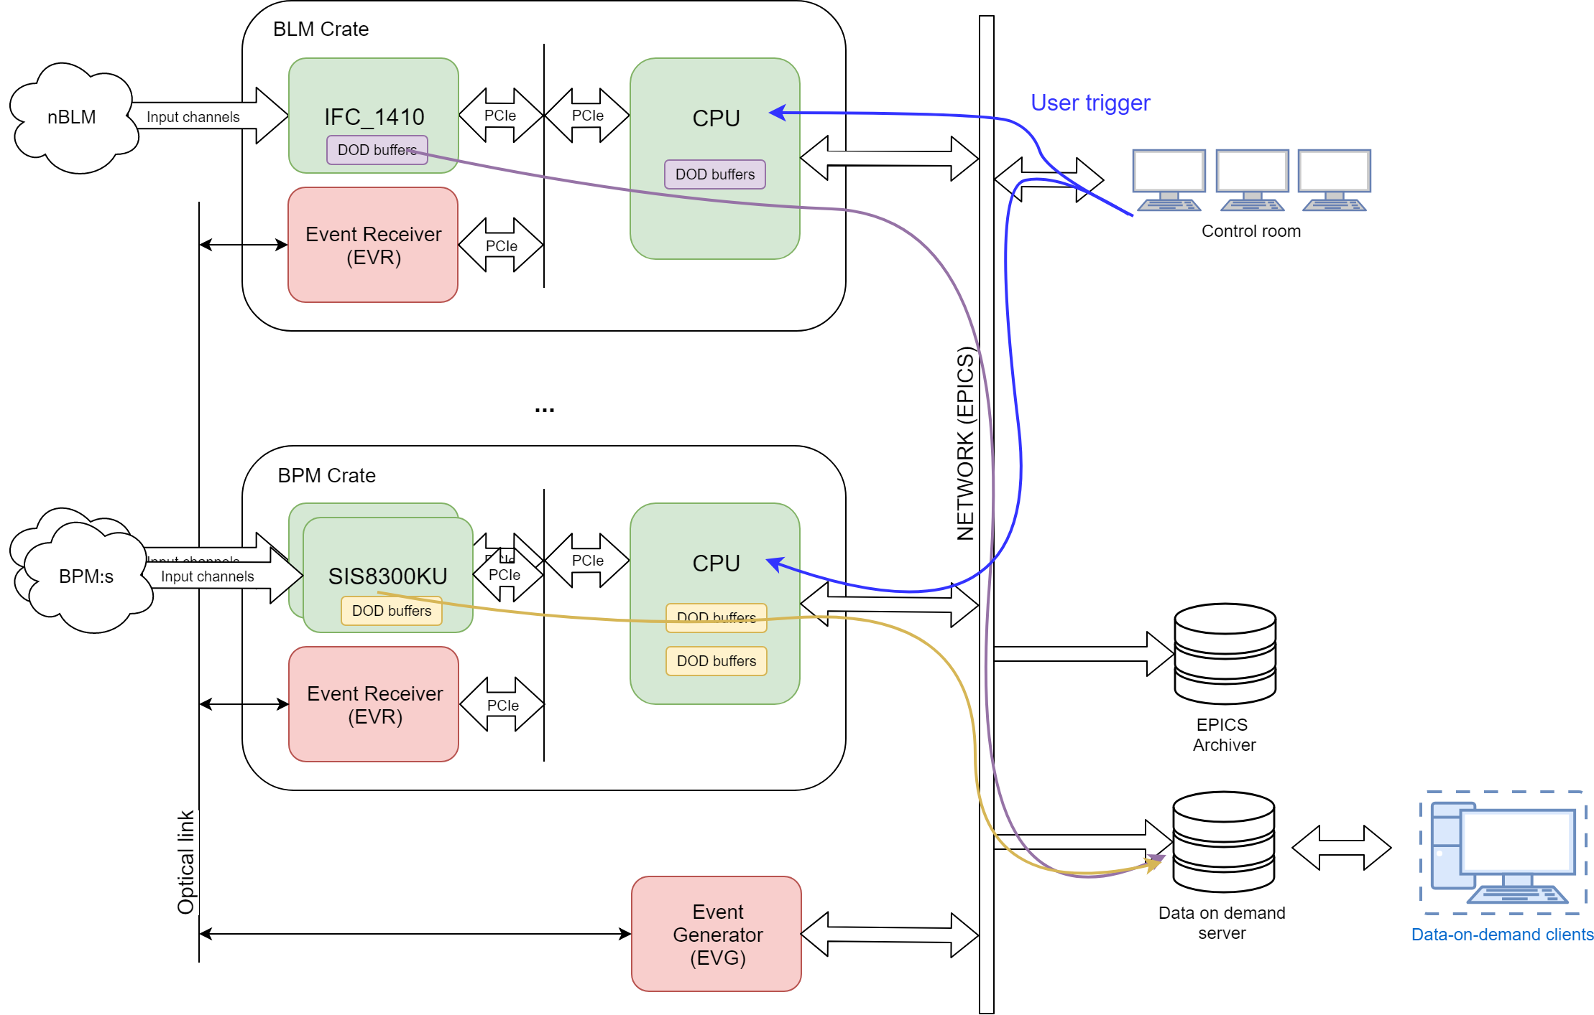
Use-case – User trigger
Notes:
Notes: Skipped the Machine protect system component

Slide 15
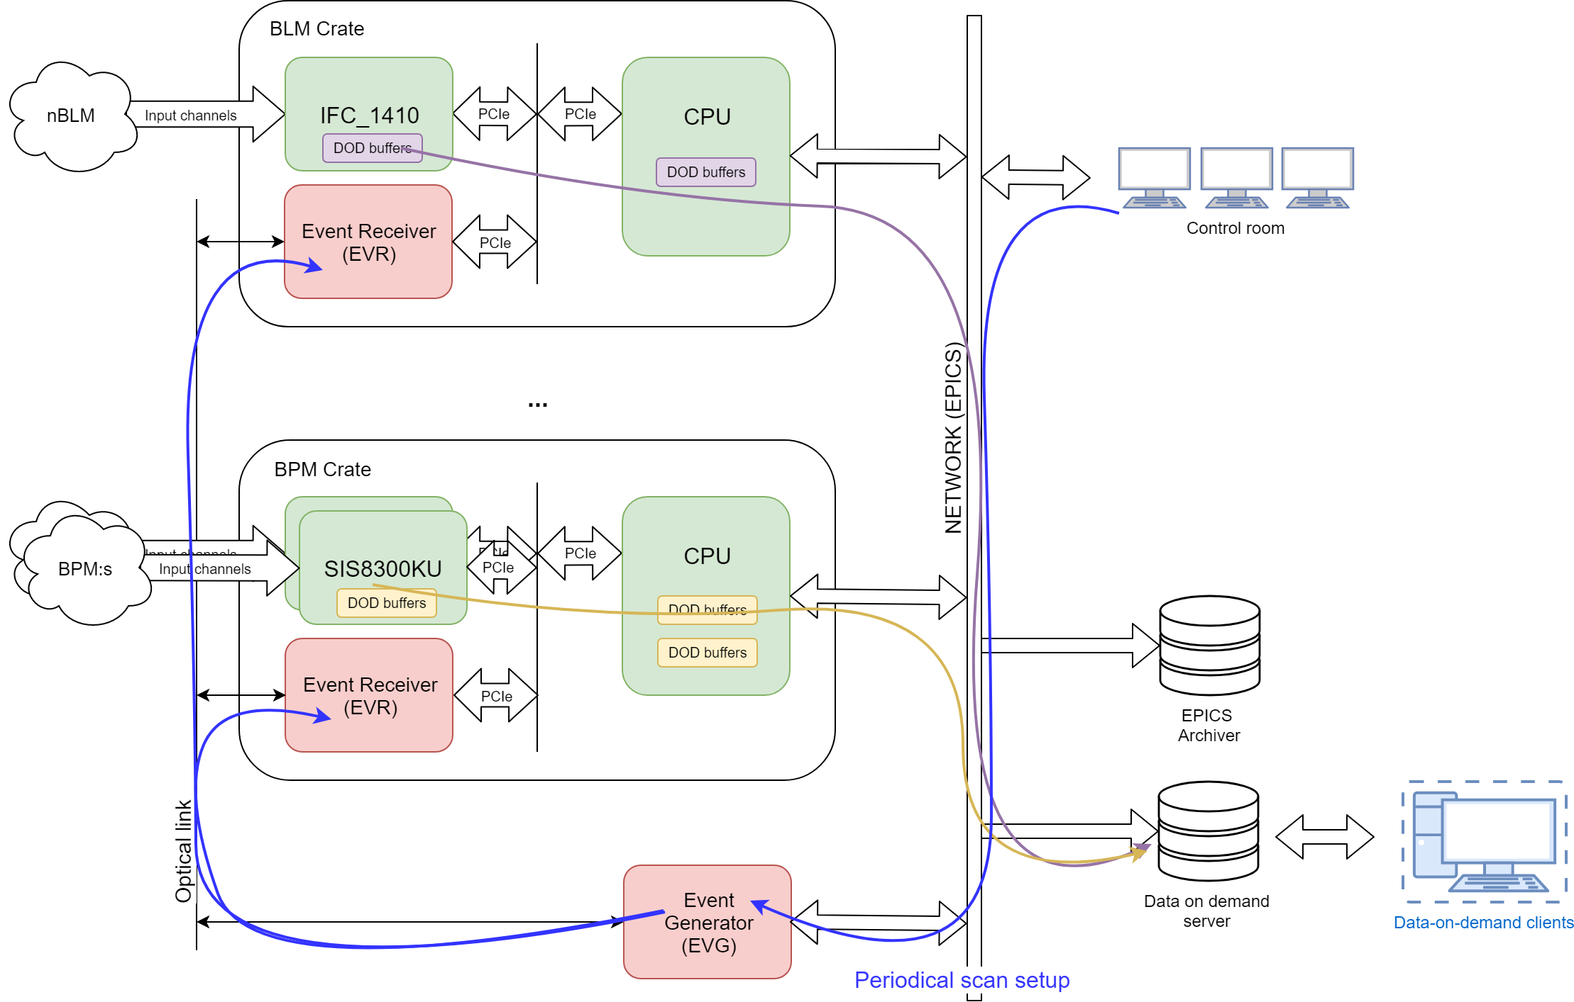
Use-case – Periodical scan

Slide 16
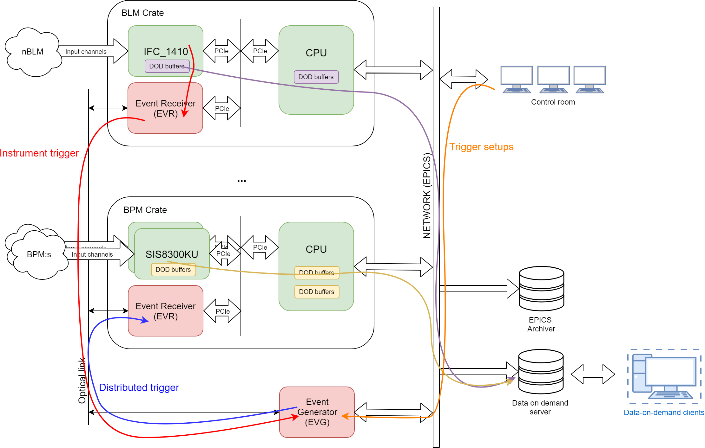
Use-case –Instrument trigger

Slide 17
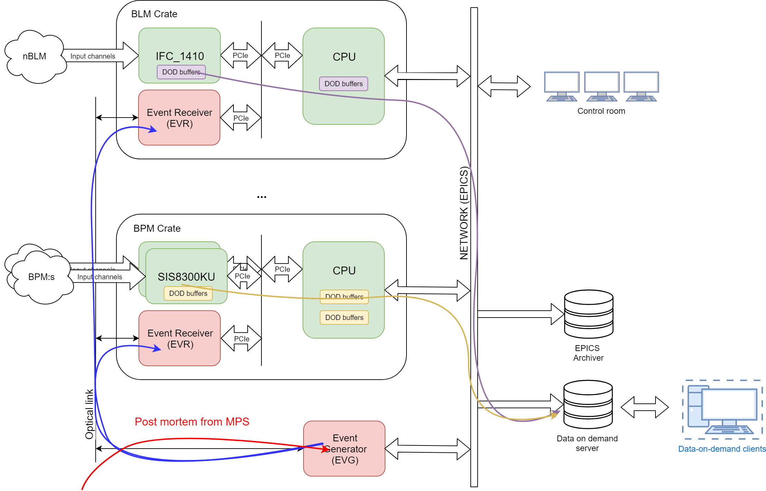
Use-case – Post-mortem trigger

Slide 18
Bigger picture of items to solve
Digitizer performance
  Avoiding data loss
Timing system requirements
  Define new types of trigger ”packets”
  Define the behavior when we have multiple triggers.
Data being sent
  Formatting
  Timestamping and other ”meta” data within the steam
  Where to store it all (and not overload the network…), local is always an option.

Slide 19
Thank you!
Questions?

Slide 20
Backup slides

Slide 21
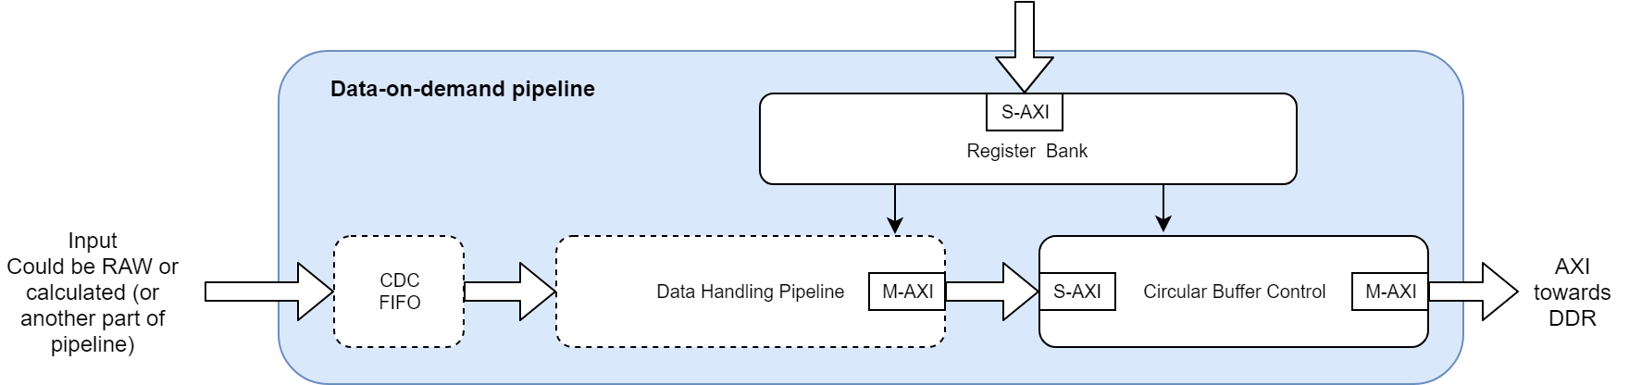
Digitizer FPGA – General DoD pipeline
D
Goal is to have a DoD pipeline with similar SW interfaces that fits into the AXI framework.
  Options to have data-handling pipeline for format conversion, downsampling etc.
  A system may instantiate multiple pipelines, the reading being handled by the same DMA reading routines.
  The circular buffer based on the prototype made for BLM.
First version a trigger will basically initiate an interrupt for the DMA routines to start reading.
Notes:
Note: The amount of data rea

