Slide 1
BLM update & overview
Irena Dolenc Kittelmann
(BLM System Lead)
BI Forum, ESS, Lund, Sweden, 20-22/11/2018

Slide 2
Outline
ESS BLM:
  Reminder
  MC beam loss simulations
nBLM
  HW overview
  FPGA functionality & neutron detection algo
Other updates – not covered
  Detector layout
  Electronics layout
  icBLM FPGA functionality

Slide 3
ESS BLM
Two BLM systems
icBLM
  Primary monitor in the high energy parts
  Detector: ionization chambers (ICs)
nBLM
  Primary monitor in the low energy parts
  Detector: neutron sensitive micromegas detectors
icBLM
nBLM

Slide 4
ESS BLM: beam loss simulations
MC simulations for tracking of lost protons needed to determine
  Detector locations, system response time and dynamic range
  Expected particle fields, signals
  Initial MPS threshold settings at the startup and later adjustments
  Anticipated response of the system during fault studies - to verify and calibrate the system response
Required inputs
  Ideally
    Expected loss maps during normal operation
    A list of accidental beam loss scenarios with loss maps
    Elements to be protected, damage levels
  Large number of possible accidental scenarios: simplifications/assumptions needed
Simulation tool
  Geant4 simulation framework developed by the ESS neutron detector group
  Geant4 based ESS linac geometry created (current version: DTL - HEBT)

Slide 5
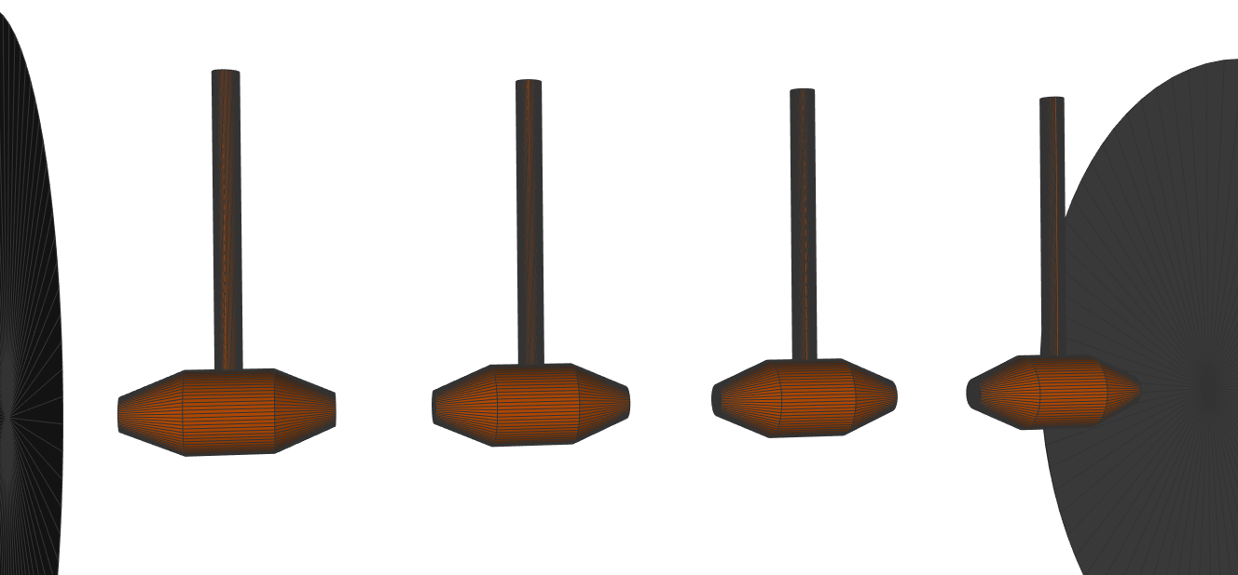
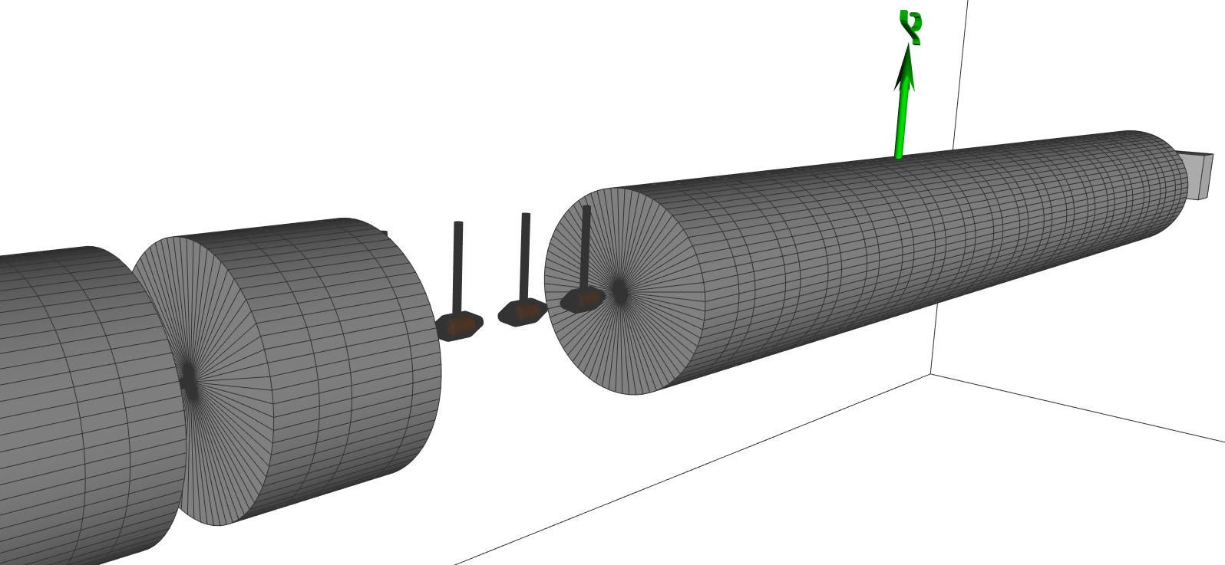
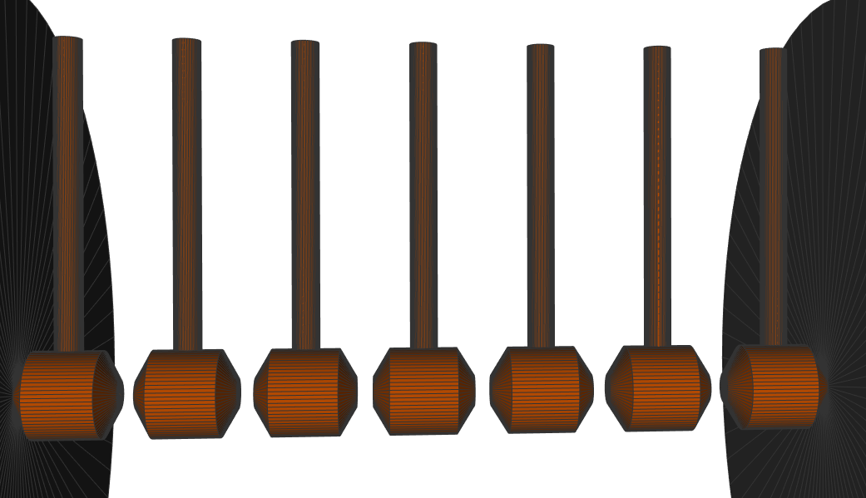
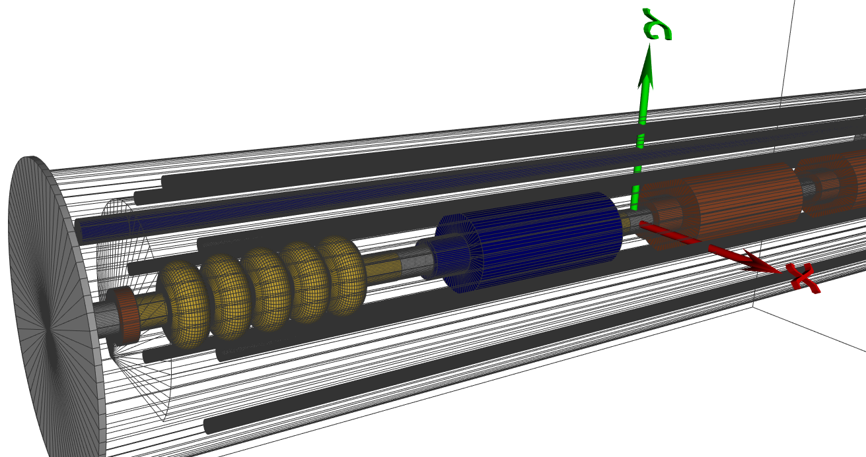
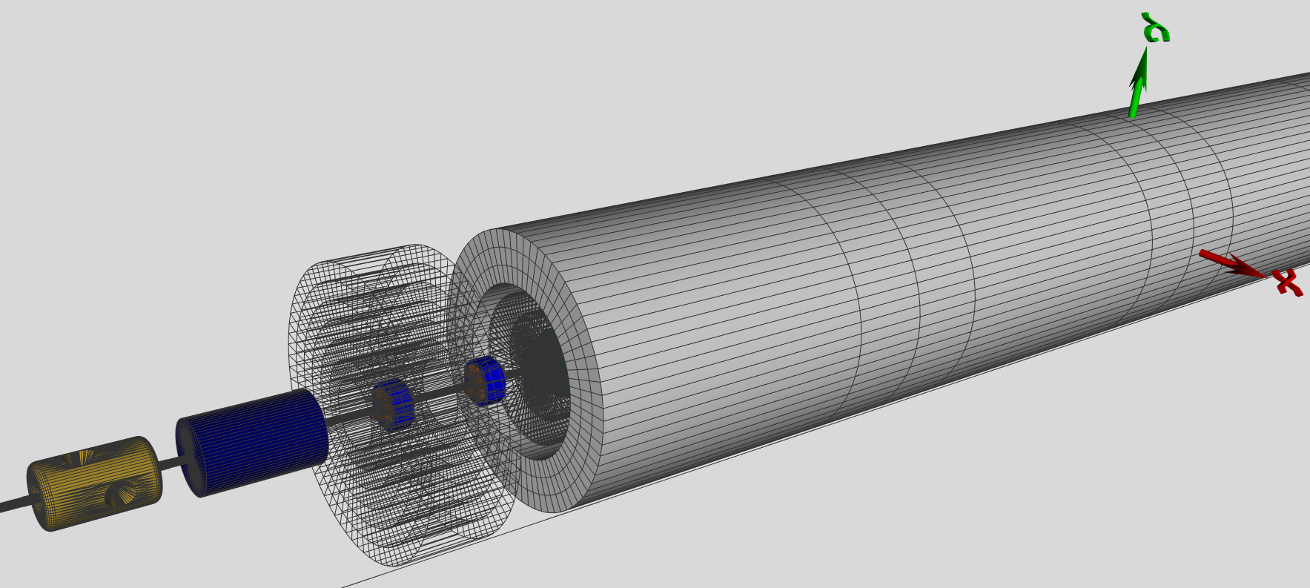
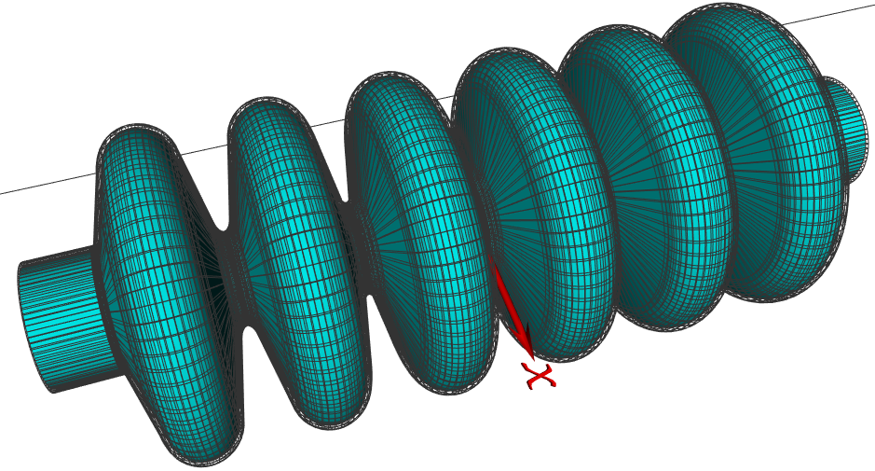
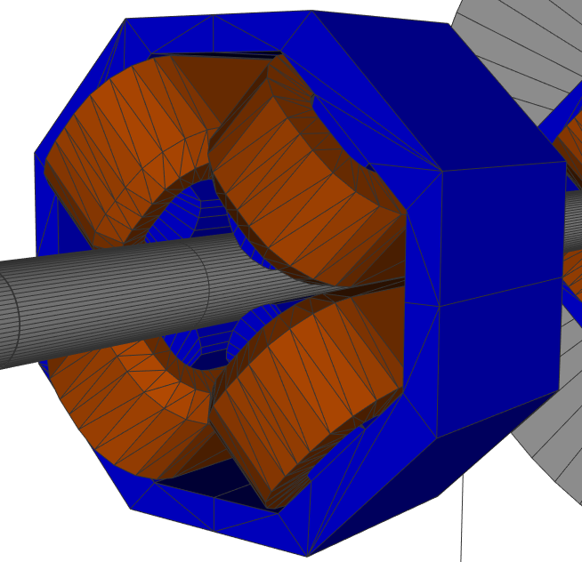
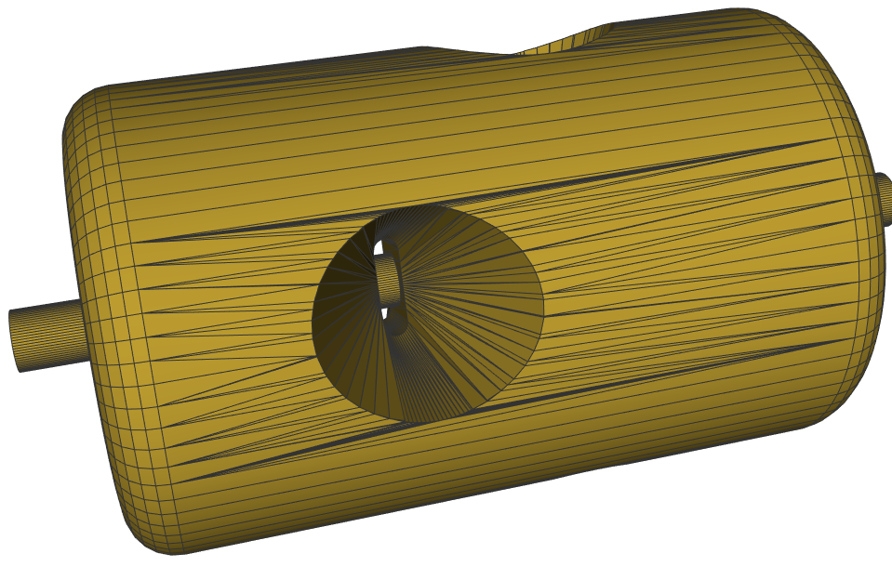
ESS BLM: MC simulations - linac geo
DTL1
DTL5
DTL4 - DTL5
HB cryo
Spoke & phantom detectors
Spoke quad magnet
(Q5)
Spoke cavity
MB cavity
MB cavity

Slide 6
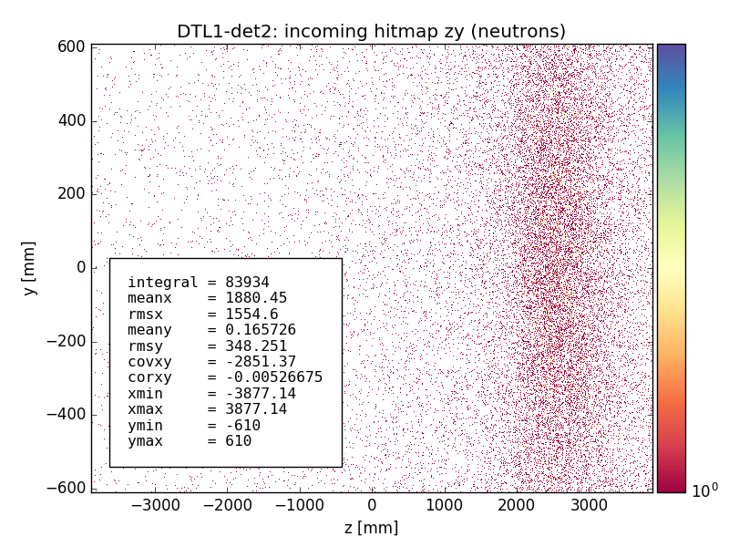
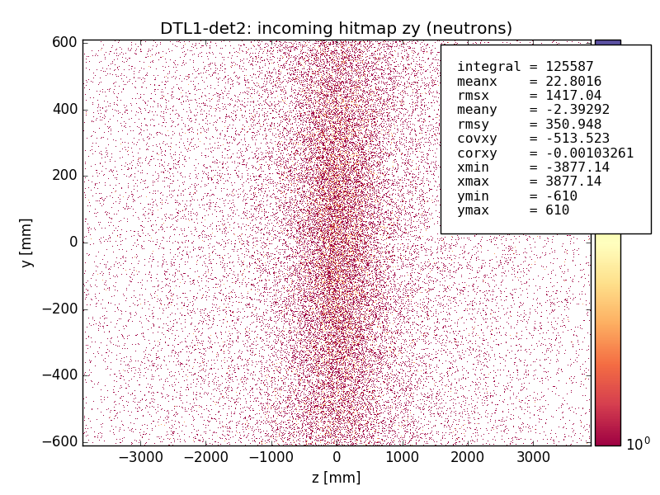
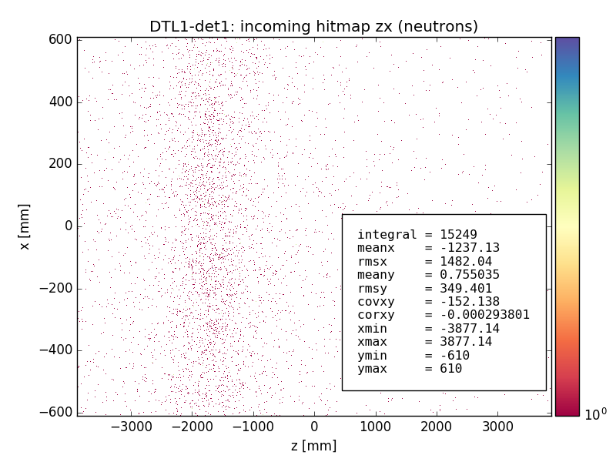
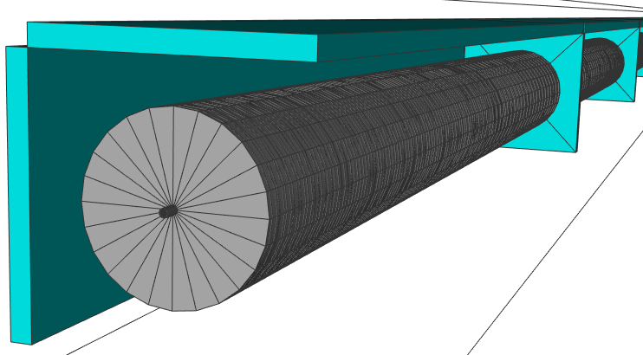
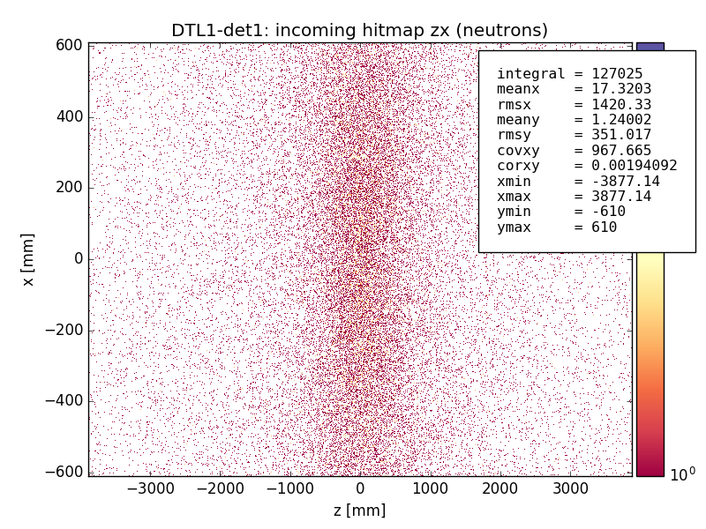
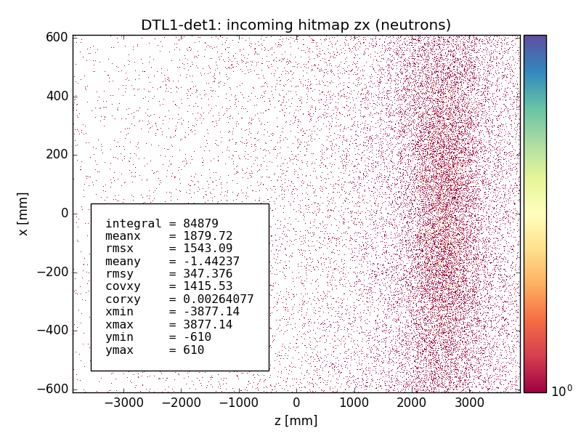
ESS BLM: MC simulations
Past studies
Focused on DTL
Tanks surrounded with “phantom detectors”
Loss scenarios:
  Accidental losses: scanned over various configurations of energy, beam size, hit angles and position along the DTL
  Uniform loss, 1W/m loss
  Nominal operation
Studied:
  Expected particle fields (type, energy, fluxes along the beam line)
  Correlation between the loss location (center) and peak position in neutron hitmaps
  Spread (RMS) of neutron hitmaps
  Threshold energy to discriminate fast/slow neutrons
Tasks:
  Support nBLM detector design, results used
    As inputs to MC simulations to optimize detector design
    For signal estimations
  nBLM detector layout
Sim2-9: loc. loss at the beginning of the DTL5 (histogram normalized per number of primaries):
hitmap mean=-2.76m
Gauss fit mean = -3.56m
Peak visible ~3.5m
Neutron hitmaps with E_{k}>0.5 MeV cut: difference between the hitmap mean and the loss position
Hitmaps for det2 “detector” volume
y
z
Hitmaps for det1 “detector” volume
x

Slide 7
ESS BLM: MC simulations
Current focus
Cold linac
Loss scenarios:
  Scanned over various for various configurations of energy, beam size, hit angles and position along the cryo modules or quads
  Uniform loss, 1W/m loss
  Nominal operation
Tasks:
  Expected particle fields (type, energy, fluxes along the beam line)
  Estimate signals/rates
  Correlation between loss location and peak in distributions (hitmaps, Edep) & spread
  Starting point for further studies
    Determination of loss location (loss pattern) from the measurements (ANNs?)
    MPS Thresholds

Slide 8
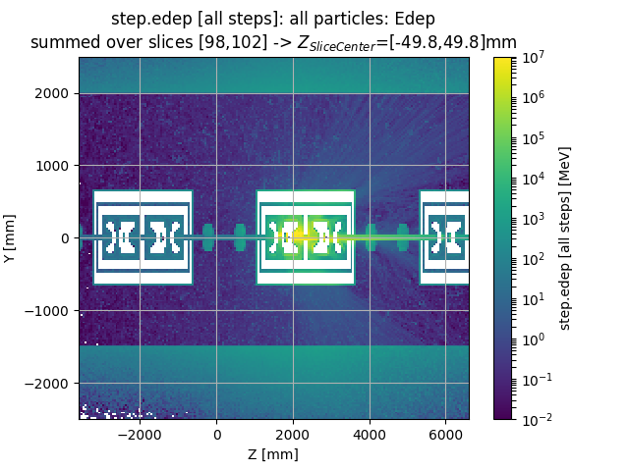
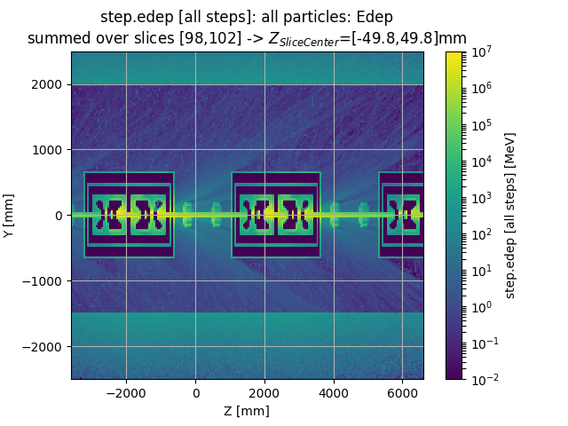
ESS BLM: MC simulations
Example: energy deposition summed over 4 center slices along x
220MeV protons,
Beam center hits inside a Spk cryo: on 1st insertion in 1st Spoke cavity
Theta=1mrad
Pencil beam
3x3mm² (gaussian) beam

Slide 9
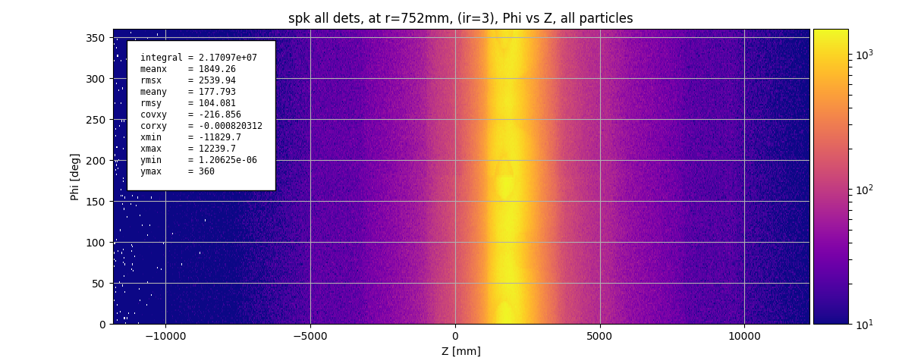
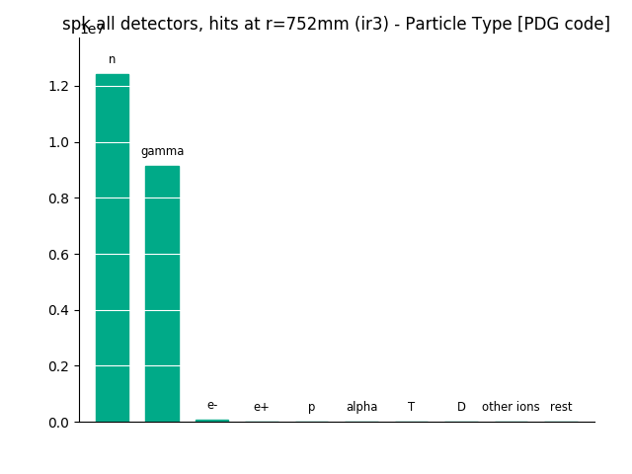
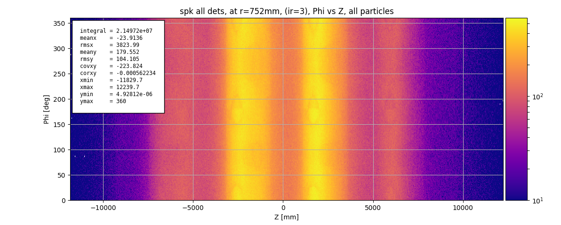
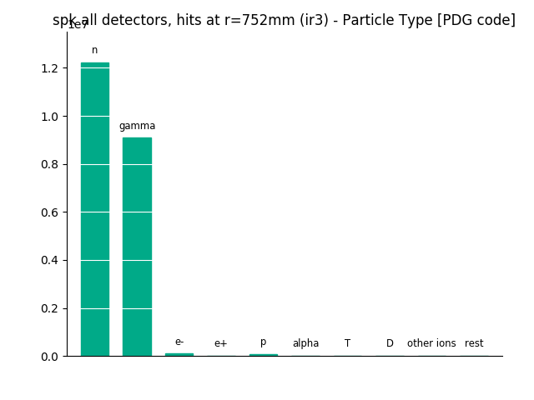
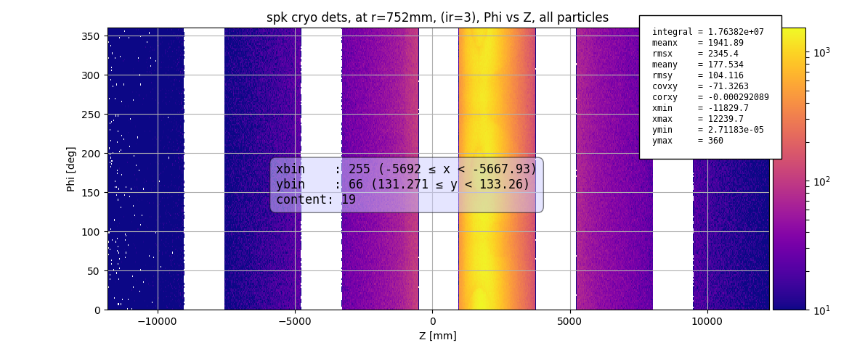
ESS BLM: MC simulations
Example:
220MeV protons
Hit center inside Spk cryo at 1st insertion in 1st Spk cavity (z=1650mm)
Theta=1mrad
Plots:
Phi vs Z for particles at r=752mm from the beam axis
Particle types (n, gamma, e-,…)
Pencil beam
3x3mm² beam
Cryo module positions

Slide 10
nBLM

Slide 11


nBLM: collaboration
CEA DEDIP (BD IK)
Detector and FEE design & production
Gas system and mechanical support design & fabrication/procurement
Procurement of part of DAQ HW (digitizers, HV, LV, short cables)
CEA DIS (ICS IK)
Monitoring and control SW
LUT DMCS (ICS IK)
FPGA FW design and implementation
ESS BD
System architecture, for example
  Detector and electronics layout
  Mechanical support integration
  Gas lines 3d model
  Development of specifications and requirements
    Spec. relevant for detector design
    Def. of FW and SW functionality
      Def. of data processing (FPGA algos)
      Definition of monitoring variables and algos
      Beam loss simulations: MC simulation of lost protons
    Installation
    System commissioning
    Coordination & project management
ESS ICS
FW and SW support and integration

Slide 12
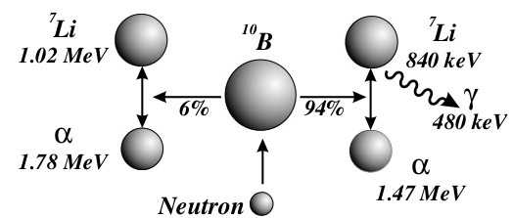
nBLM: overview
Detectors
Micromegas detectors (CEA), designed to be:
  Sensitive to fast neutrons – suppression of thermal neutrons (no correlation with beam loss)
  Insensitive to low energy photons (X- and γ-rays) – to suppress the RF induced photon background
2 types
  “Fast” – nBLM-F: to detect fast losses
  “Slow” – nBLM-S: aimed to monitor slow losses
See talk by P. Legou for update on detector tests
nBLM-S
nBLM-F

Slide 13
nBLM: overview
FEE:
  Custom made mezzanine card with FAMMAS preamps (CEA)
  Housed in a detector module together with the detector chamber and HV mezzanine card
BEE
  IOxOS IFC1410
  ADC3111 FMC digitizer (250MS/s, DC coupled).

Slide 14
nBLM FW functionality
nBLM block diagram: FPGA based data processing, connection to SW
See talk by G. Jablonski regarding implementation

Slide 15
nBLM FW functionality
Raw data:
250MS/s sampling rate
Pre-processing
Pedestal subtraction
Neutron detection
Event detection
Neutron counter

Slide 16
nBLM FW functionality
Buffering of Data-On-Demand (DOD)
DOD data:
  available on demand (DOD trigger assert)
  DOD trigger request types
    Post mortem
    Conditional
    Periodic
nBLM DOD CBs:
  Raw data – every 4ns
  1st stage of processed data – every event
    EventInfo
  2nd stage of processed data – every MTW (monitoring time window =1μs):
    Neutron counts
    Background counts
    Number of +/- ADC saturations
Pulse processing
3rd stage of data processing
Outputs: 1st stage of periodic data available to SW
Periodic data: monitoring data available periodically (max 14Hz)

Slide 17
nBLM FW functionality
Low Latency Link block
To combine information coming from different systems of parts of a system
Upgrade
Smart trigger
Part of DOD functionality
Inputs:
  Waveforms of raw data and processed data
  Trigger settings
Output:
  Asserts DOD trigger request (“conditional trigger”) in case conditions set by the user were met
Protection functionality
Asses beam loss conditions
In case of unacceptably high losses
  Drop BEAM_PERMIT
  Asserts DOD trigger request (“post mortem trigger”)

Slide 18
nBLM: signal
nBLM mode of operation:
The system is operating in two modes, transition is automatic on the FW level.
Counting mode: individual neutron signals are counted
Current mode: the rate of incoming neutrons is too high to able to distinguish between 2 individual neutron signals
  Events pile up
  Number of neutrons estimated through charge.
Typical neutron signal
The characteristics depend on detector properties/settings (drift length, applied voltage/gain) - settings not finalized.
Typical numbers:
  30-50ns rise time
  100-200ns signal length
  Amplitude:
    nBLM-S: ~ constant (~100mV)
    nBLM-F: continuous (maximum value 500mV - ADC saturation)
Note: the nBLM signals are negative.

Slide 19
nBLM: neutron detection algo
What do the neutron detection related blocks provide?
Number of neutrons reported after every MTW - N_{MTW}
  Is calculated as a sum of a pair of numbers, representing the counts inside MTW calculated by the two different methods.
  At the end of each MTW:
    N_{MTW} is stored in the CB2 and
    N_{MTW} is reset at the end of every MTW.
  Additional data stored in CB2:
    Number of pos. ADC saturations
    Number of neg. ADC saturations
    Background counts
EventInfo for each “interesting event”
  The structure contains information about the event (Q, TOT, rise time, time stamp,…)
  The structure is stored in the circular buffer CB1 and
  Reset at the end of each “interesting event”.
MTW (Monitoring Time Window):
Time window in which the neutron counts are measured/reported
Currently set to 1us (250 samples).

Slide 20
nBLM: neutron detection algo
EventInfo structure
TOT – event Time Over Threshold
Q_TOT – charge inside the TOT window
peakValue – amplitude (min signal inside TOT window)
TOTstartTime
peakTime
peakValid – true if condition on amplitude for single neutron is met
TOTvalid – true if condition on TOT for single neutron is met
pileUp – true if pile up conditions are met
MTWindx – index of the MTW where event started
isTruncated – true if event 1. part of a split signal
isPart2 - true if event 2. part of a split signal

Slide 21
nBLM: neutron detection algo
Basic idea (by T. Papaevangelou):
Detect “interesting events”
  Identify single neutrons
    TOT within a certain range
    Amplitude below a certain limit
  Identify pile-up events
    Amplitude below the same limit as for single neutron
    TOT above the upper limit for single neutron
Use either of 2 methods for neutron counting for each neutron event:
  Single neutron counting method
    for single neutron events: count events
  Charge method:
    for pile-up events: calculate counts from charge
nBLM data processing (by ESS):
Basic idea applied to real time processing and MTW framing of counts/events.
Requirement: algo must provide information (neutron counts) without unnecessary delays.
Both nBLM-F and –S have the same neutron algo running (different settings)

Slide 22
Back up material

Slide 23
ESS Beam Loss diagnostic tools
(from T. Shea)
  Total beam loss, microsecond measurement latency required for protection
  BCM, icBLM (saturation, nBLM (current mode) ➔ Interlock; Threshold/derivative term for fast protection
> 1.6 milliamp lost for up to 200 µs
  BCM, icBLM, nBLM -> Interlock; Damage model for protection
~ μC lost over 200 µs to many seconds (diffusion time)
  icBLM, nBLM -> Interlock; Damage model for protection
~ “1 Watt/meter” radiation dose management
  icBLM, nBLM -> alarm based on dose/activation plan
Sparse coverage by Current Monitors
coverage by Ion Chambers
Neutron
Detectors

Slide 24
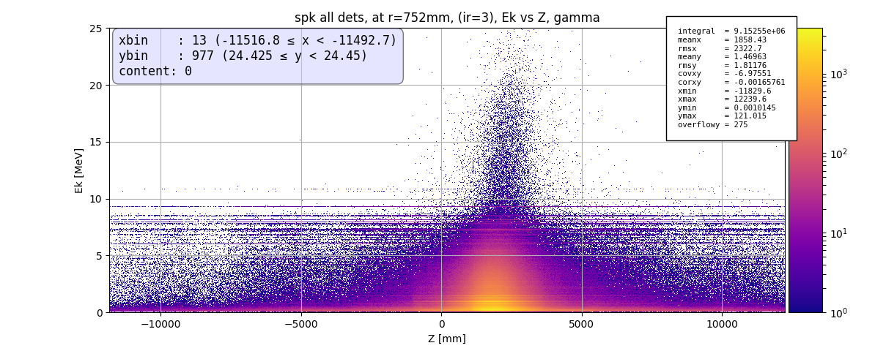
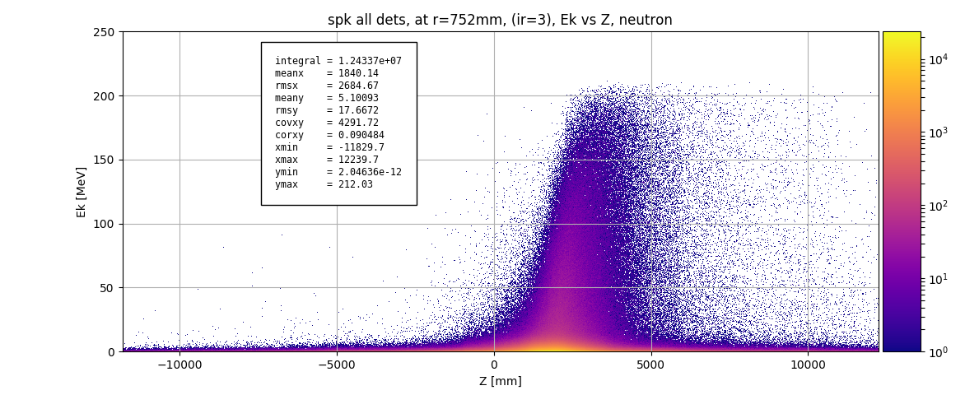
ESS BLM: MC simulations
Example:
220MeV protons
Hit at: 1st insertion in 1st Spk cavity
Theta=1mrad
Pencil beam
Plots: hits at r=752mm from beam axis
Neutron and photon energy along the beam line

Slide 25
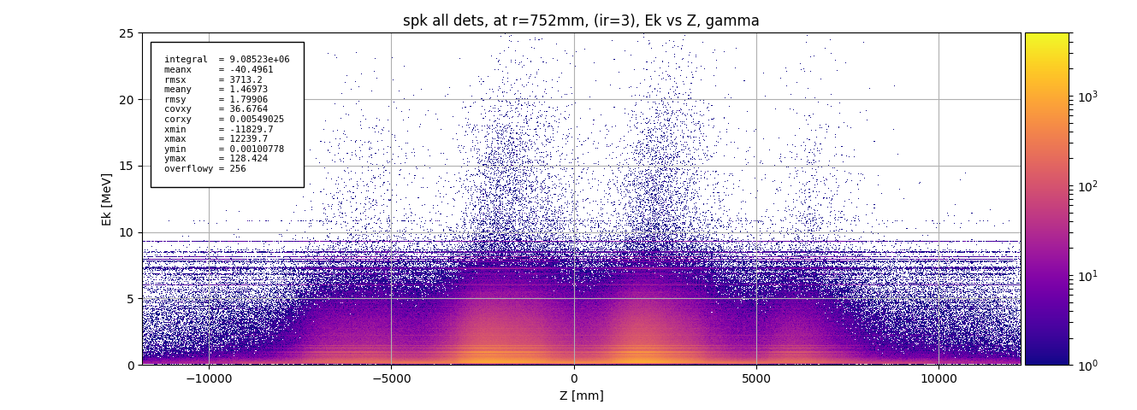
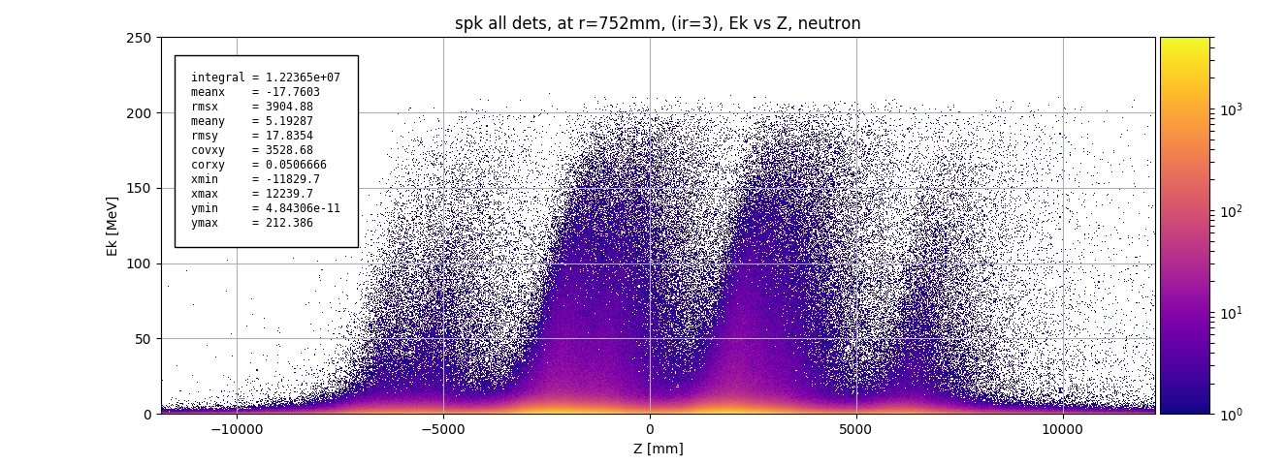
ESS BLM: MC simulations
Example:
220MeV protons
Hit at: 1st insertion in 1st Spk cavity
Theta=1mrad
3x3mm² beam
Plots: hits at r=752mm from beam axis
Neutron and photon energy along the beam line

Slide 26
ESS BLM: detector layout (MEBT-MB)
nBLM-F vs. nBLM-S
Majority of the linac: F and S placed separately in an alternating fashion
At certain locations: a pair of F & S device
Normal conducting linac (NCL):
nBLM:
  MEBT: 4 devices (nBLM)
  DTL: ~ 1 device / 1m
icBLM:
  DTL: 1device/tank
Superconducting linac (SCL):
nBLM
  Spoke: 1 device / 2m
  Sparsely located in other parts of SCL
icBLM:
  3/quad pairs
  1/cryo

Slide 27
ESS BLM: detector layout (HB – end)
nBLM-F vs. nBLM-S
Majority of the linac: F and S placed separately in an alternating fashion
At certain locations: a pair of F & S device
Normal conducting linac (NCL):
nBLM:
  MEBT: 4 devices (nBLM)
  DTL: ~ 1 device / 1m
icBLM:
  DTL: 1device/tank
Superconducting linac (SCL):
nBLM
  Spoke: 1 device / 2m
  Sparsely located in other parts of SCL
icBLM:
  3/quad pairs
  1/cryo

Slide 28
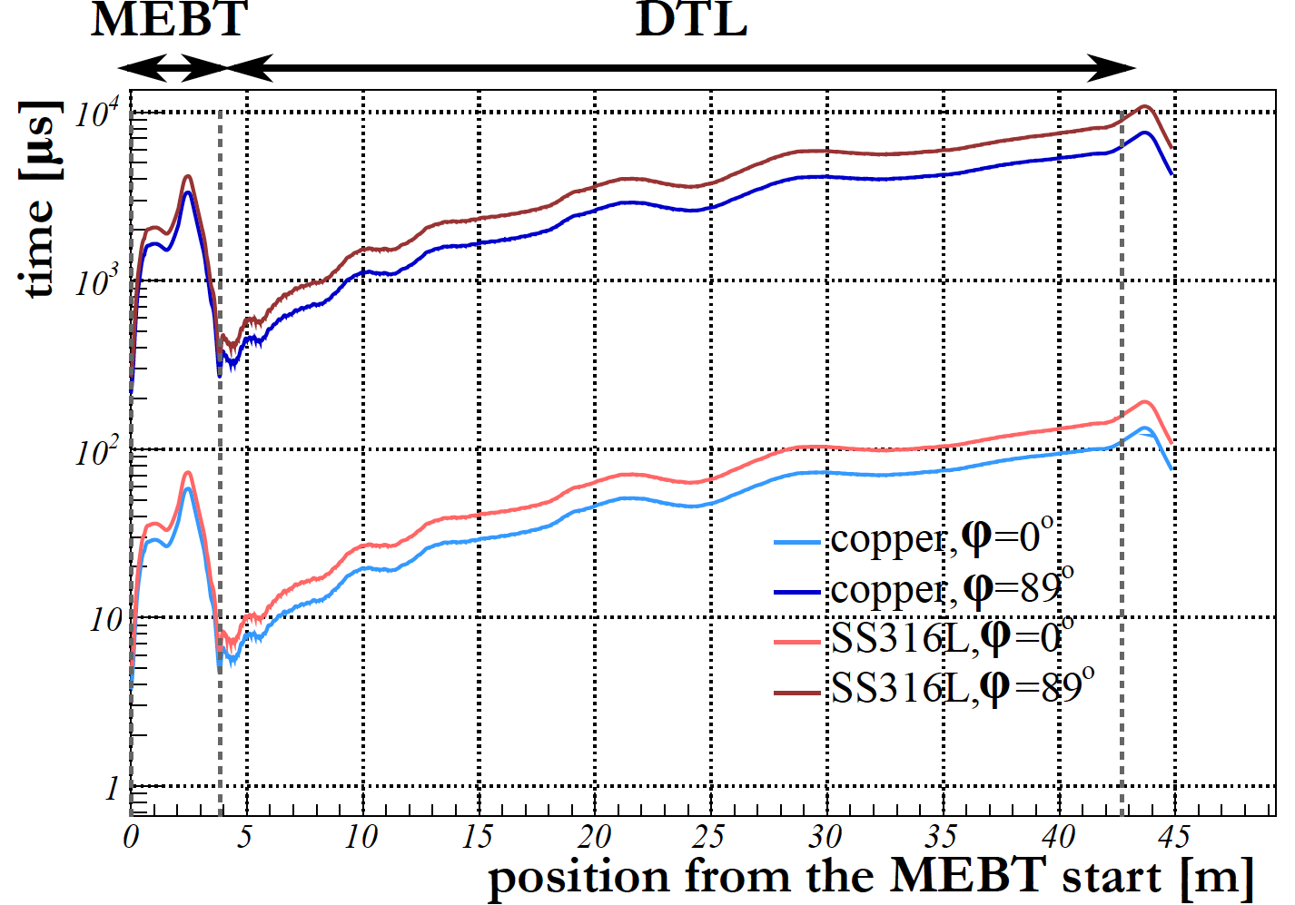
ESS BLM: Response time
Required response time set in the past:
  NC linac (MEBT-DTL): ~5 μs.
  SC linac: ~10 μs.
  Numbers based on a simplified melting time calculations, where a block of material (copper or stainless steel) is hit by a beam of protons with a uniform profile under perpendicular incidence angle, no cooling considered [9].
Numbers re-checked with a Gaussian beam and update beam parameters:
  NC linac: calculated melting time values
  of 3-4μs imply even stronger demands
  on the response time (confirmed with a
  MC simulation as well).
  SC linac: the 10μs requirement for
  response time fits well with the results
  of this calculations.
  However: other damage mechanisms may
  mandate even shorter response time
  SCL (discussed further).

Slide 29
icBLM

Slide 30
icBLM: collaboration
LUT DMCS (ICS IK)
FPGA FW design and implementation
SW design and implementation
ESS BD
System architecture, for example
  Detectors & electronics
  Detector and electronics layout
  Mechanical support
  Development of specifications and requirements
    Spec. relevant for detector design
    Def. of FW and SW functionality
      Def. of data processing (FPGA algos)
      Definition of monitoring variables and algos
      Beam loss simulations: MC simulation of lost protons
    Installation
    System commissioning
    Coordination & project management
ESS ICS
FW and SW support and integration

Slide 31
icBLM: collaboration
LUT DMCS (ICS IK)
W. Cichalewski (proj. management)
G. Jablonski (FW, SW)
R. Kielbik (FW)
W. Jalmuzna (FW)
ESS BD
    T. Shea (section leader, interim BLM system lead)
    I. Dolenc Kittelmann (BLM system lead)
    K. Rosengren (FW, DOD)
    H. Kocevar (SW)
    J. Norin (bookkeeping: det. & el. Layout, naming)
    S. Grishin (installation, gas system)
    C. Derrez (verification plan, QA, electronics)
    E. Bergman (cables, connectors, PPs)
    T. Grandsaert (mech. integration, mech. support)
ESS ICS
S. Farina
F. dos Santos Alves
(W. Fabianowski)

Slide 32
icBLM: overview
Detectors
Parallel plate gas Ionisation Chambers (ICs) developed for the LHC BLM.
Beam loss information based on ionisation current measurement of secondaries
BEE
IOxOS IFC1410
Pico 4 FMC digitizer (CAENels)
  Modified COTS
  1MS/s, 20-bit ADC, 300kHz bandwidth
  Dynamic range:
    0 – 500μA,
    0 – 10mA
HV PS
Provides:
  Power the ICs (1.5kV) – several ICs are daisy changed and connected to one HV ch
  Modulation voltage for system HEALTH check.
HV module (1ch):
  ISEG DPr 40 305 24 5_CAB High Precision HV-PS
Ethercat crate with
  ethercat coupler,
  DIO (for PS config.) and
  Analogue module (to modulate)
  with real time kernel on the CPU.

Slide 33
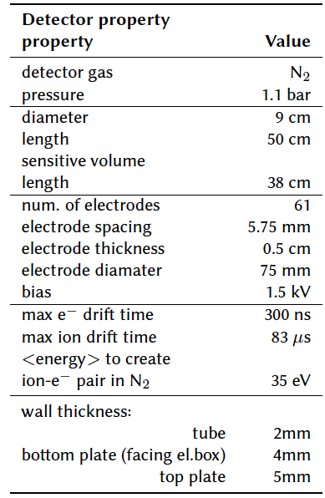
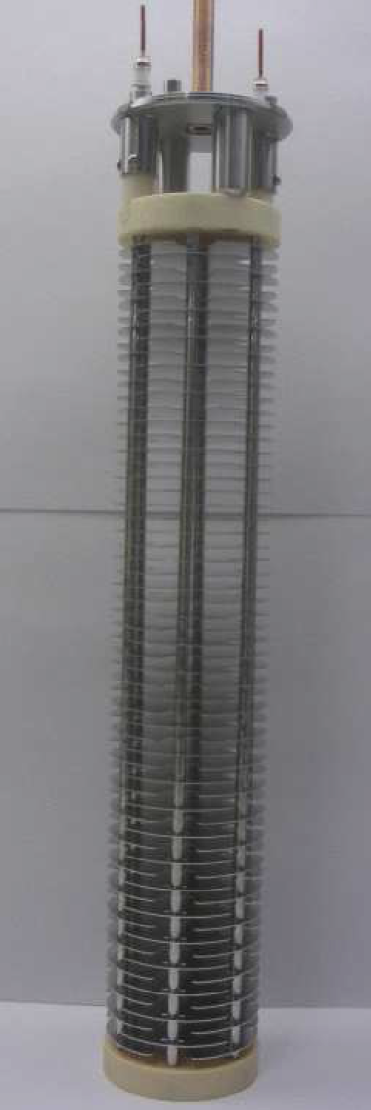
icBLM: detectors (1)
icBLM
Parallel plate gas Ionisation Chambers (Ics) developed for the LHC BLM system will be used
Primary BLMs in SCL
Beam loss information based on ionisation current measurement of secondaries.
Inner structure of the LCH BLM

Slide 34
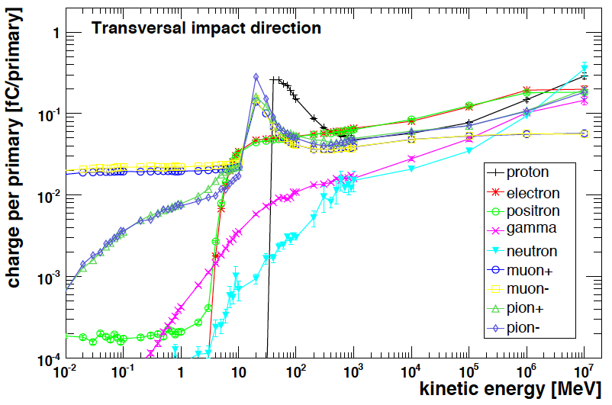
icBLM: detectors (2)
icBLM
“cut off” at transversal photon and electron incidence ~2MeV (~30MeV for p and n) [1].
Photon background due to the RF cavities
  Bckg. mainly due to el. field
  Emission from cavity walls,
  resulting in bremsstrahlung
  photons created on cavity/beam
  pipe material [3].
  Levels are difficult to predict
  numerically – depend on the quality
  of cavities, operation conditions and
  time.
  Energy spectra estimation [4]: photons with
  energies up to tens of MeV in the high energy parts expected.
LHC BLM IC response functions

Slide 35
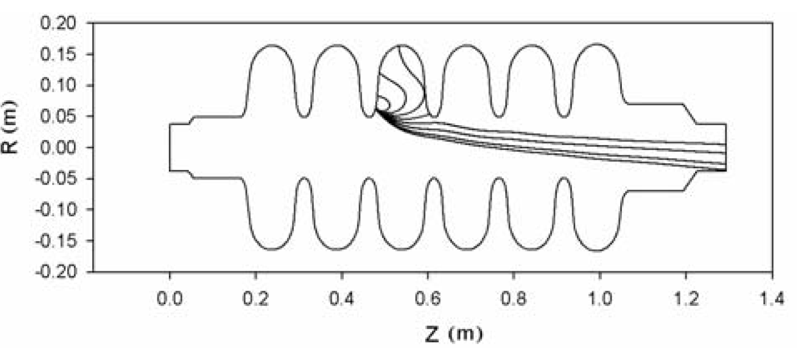
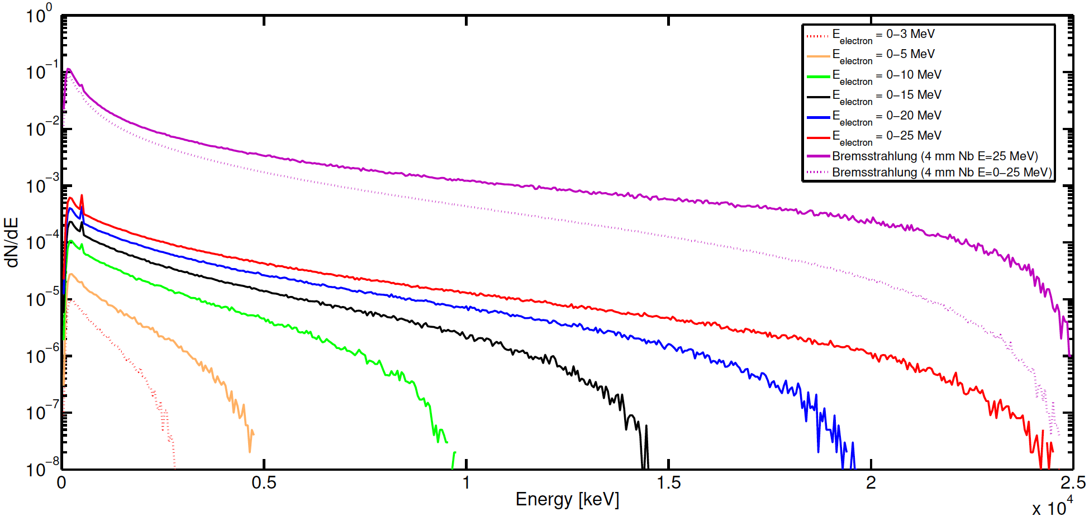
Background photons due to RF
Photon background due to the RF cavities mainly
due to field emission from electrons from cavity
walls, resulting in bremsstrahlung photons
created in the field of nuclei of cavity/beam pipe
materials [3].
Energy spectra estimations show that photons up to few tens of MeV can be expected [4]:
  A MC code (FLUKA) was used for these estimations
  where a pencil electron beam is impacting a 4mm
  niobium foil.
  Purple curves on the plot on the left show expected energy
  spectra for the photons produced at the exit of the foil:
    Solid line – for the monochromatic beam of electrons with energy of 25MeV
    Dotted line – for the beam of electrons with uniform energy distribution
    from 0 to 25MeV.
    Spectra are normalized per number of primaries.
  Note: maximum acc. Gradient expected at ESS ~25MeV/m, cavity size ~1m.
e⁻
γ

Slide 36
icBLM: electronics layout
2 groups of detectors
To limit the situations with larger parts of the system un-operational
Signal electronics for each group placed in separate racks
  Group1: Odd detectors
  Group2: Even detectors

Slide 37
icBLM electronics layout
Estimated signal cable length
Most detectors: 40 - 70m
< 110m

Slide 38
icBLM electronics layout
HV connections
Same separation scheme as for signal connections
A set of odd/even detectors (5-7)
  Connected a given AMC in Group1/Group2 rack X
  Powered by a HV PS (HV ch) located in rack X

Slide 39
icBLM electronics layout
HV connections
Same separation scheme as for signal connections
A set of odd/even detectors (5-7)
  Connected a given AMC in Group1/Group2 rack X
  Powered by a HV PS (HV ch) located in rack X

Slide 40
icBLM: FW functionality

Slide 41
icBLM: FW functionality
Modulation detection
Check the presence of small HV modulation
For system health checks
Baseline calculation
Average waveform inside the RF_ON part of the pulse
Only empty pulses
Raw data:
1MS/s sampling rate
(pre-)processing:
Baseline subtraction (to suppress RF induced γ background)
(modulation correction –upgrade)

Slide 42
icBLM: FW functionality
Pulse processing
2rd stage of data processing
Outputs available to SW – periodic data
Periodic data: monitoring data available periodically (max 14Hz)
Buffering of Data-On-Demand (DOD)
DOD data:
  available on demand (DOD trigger assert)
  DOD trigger request types
    Post mortem
    Conditional
    Periodic
3 CBs for icBLM:
  Raw data – every μs
  (pre-)processed data: baseline corrected data – every μs
  Baseline waveform - every pulse without beam

Slide 43
icBLM: FW functionality
Smart trigger
Part of DOD functionality
Inputs:
  Waveforms of raw data and processed data
  Trigger settings
Output:
  Asserts DOD trigger request (“conditional trigger”) in case conditions set by the user were met
Protection functionality
Asses beam loss conditions
In case of unacceptably high losses
  Drop BEAM_PERMIT
  Asserts DOD trigger request (“post mortem trigger”)
Low Latency Link block
To combine information coming from different systems of parts of a system
Upgrade

Slide 44
nBLM

Slide 45
nBLM: collaboration
CEA DEDIP (BD IK)
T. Papaevangelou (local coordinator)
L. Segui (detector)
P. Legou (FEE)
S. Aune (gas system)
D. Desforge (mechanical support)
CEA DIS (ICS IK)
F. Gougnaud (local coordinator)
Y. Mariette (EPICS)
V. Nadot (EPICS)
Q. Bertand (PLC)
LUT DMCS (ICS IK)
W. Cichalewski (proj. management)
G. Jablonski (FW, SW)
R. Kielbik (FW)
W. Jalmuzna (FW)
ESS BD
    T. Shea (BD section leader, interim system BLM lead)
    I. Dolenc Kittelmann (BLM system lead)
    K. Rosengren (FW, DOD)
    H. Kocevar (SW)
    J. Norin (bookkeeping: det. & el. Layout, naming
    S. Grishin (installation, gas system)
    C. Derrez (verification plan, QA)
    E. Bergman (cables, connectors, PPs)
    T. Grandsaert (mechanical integration)
ESS ICS
S. Farina
F. dos Santos Alves
(W. Fabianowski)

Slide 46
nBLM project: time line
Jul. 2017:
PDR1.2
Start of prototype tests
April 2018:
Start of the FW development
Nov. 2018:
Start of the SW development
Mid 2019: installation - start
Jul. 2016: Kick-off
Dec. 2016: PDR1.1
Dec. 2017: CDR1.1
Planned focus: electronics design
Progress on electronics delayed due to availability of BEE HW (ICS standard platform)
Review on BEE postponed to the final CDR
Jul. 2018: CDR1.2 (extra)
Final detector module design (detector+FEE)
Gas system control: rack architecture and components
Additional review to start procurement
Review on electronics postponed until Nov. 2018
Aug. 2018:
Gas system design finalized
Autumn 2019: system commission - start
? 2019: CDR1.3 - final
Prototype with basic FW and SW expected
Postponed again due to maturity of the BEE

Slide 47
nBLM: Detectors (1)
nBLM detectors:
2 types,
depending on location placed separately or back-to-back (detector unit)
1st module (slow losses): nBLM-S
  Capable of monitoring low fluxes
  (~few n cm⁻²s⁻¹).
  Response time: ~200μs (~10% events detected in 4μs).
  Polyethylene (~4cm): moderator to thermalize the incoming fast n.
  B₄C layer (deposited on the Al surrounding the gas chamber) to capture thermalized n – (n,α) ¹⁰B reaction (α with fixed energy of 1.4MeV).
  Borated rubber to eliminate background thermal n.
  Efficiency: few 10⁻² (1eV < E_{n}< few 10MeV)
  Solid angle: 4π

Slide 48
nBLM: Detectors (2)
nBLM detectors:
2nd module (fast losses): nBLM-F
  appropriate for high fluxes of fast n, coming from the front (~few 0.01 n cm⁻²s-¹).
  Polypropylene (deposited on Al foil at the entrance window) for n conversion to p recoils (~ few mm) through n elastic scattering on H atoms (continuous distribution of recoiled p energies).
  Cross-section threshold: E_{n}~0.5MeV.
  Efficiency: 10-100 times lower than for nBLM-S (10⁻⁵–10⁻³ for En= ~0.5MeV – 10MeV)
  Solid angle: 2π
  Response time: ~10ns

Slide 49
nBLM: Signals
Typical neutron signal:
  30-50ns rise time
  100-200ns signal length
  Amplitude
    ~Constant for S
    Continuous distribution for F
nBLM originally planned to operate
in counting mode
MC simulations: up to GHz rates expected
in case of complete loss.
Minimum response time for the system to drop the BEAM_PRMIT: ~5μs
If counts are monitored in 1μs time window: pile-up when ≳6 counts (“neutron events”) ⟹ transition to current mode.
The FPGA neutron detection algo. is foreseen to automatically transition to current mode (monitoring both TOT and Q).

Slide 50
nBLM electronics layout: signal
3 groups of detectors
To limit the situations with larger parts of the system un-operational
MEBT - Spoke: signal electronics for each group placed in separate racks
  Group1: Odd pairs of S & F detectors
  Group1: Even pairs of S & F detectors
MB - A2T: Group3

Slide 51
nBLM electronics layout: signal
Estimated signal cable lengths 40 – 90m

Slide 52
nBLM electronics layout: HV, LV
Same crate for LV and HV PS
2 HV lines per detector
Each LV channel used to power several detector modules
2 crates along the linac
  Separation in HV and LV connections between group 1 and 2 not possible down to the rack level
  A set of detector modules
    connected to an AMC/FMC has FEE powered by the same LV channel
    with signal connected to the same rack has all HV cables connected to the same HV module

Slide 53
nBLM electronics layout

Slide 54
nBLM: neutron detection algo
“Interesting Event”
Basic rule:
  Starts when signal falls below start event threshold.
  Ends when signal exceeds the end event threshold.
Exceptions when signal extends over MTW edge
  Split signal in 2 events if:
    At the MTW edge the signal already qualifies as a single neutron.
    Event too long (longer max TOT for a single neutron)
  Otherwise end the event when signal exceeds end event threshold in the following MTW.

Slide 55
nBLM: neutron detection algo
”Interesting Event” types
Single neutron
Neutron pile up
Background (gamma or other)
Spike/noise, spark
“Simulated” sample data

Slide 56
nBLM: neutron detection algo
Neutron identification
Single neutron
  TOT: within limits
  Amplitude: below the threshold
Pile up neutrons
  TOT larger than for single neutron
  Amplitude: below the threshold
Background identification
Valuable for
  Comparison with icBLM data and/or
  Corsscheck that algo or detector settings are ok
Initial version:
  TOT above the limit for single neutron
  Amplitude above single neutron limit

Slide 57
nBLM: neutron detection algo
Neutron Counts per MTW:
Number of single neutron
events with i-th MTW
(Single neutron counting method)
Number of neutrons within i-th MTW calculated through charge method
For pile up (or split) events:
Else:

Slide 58
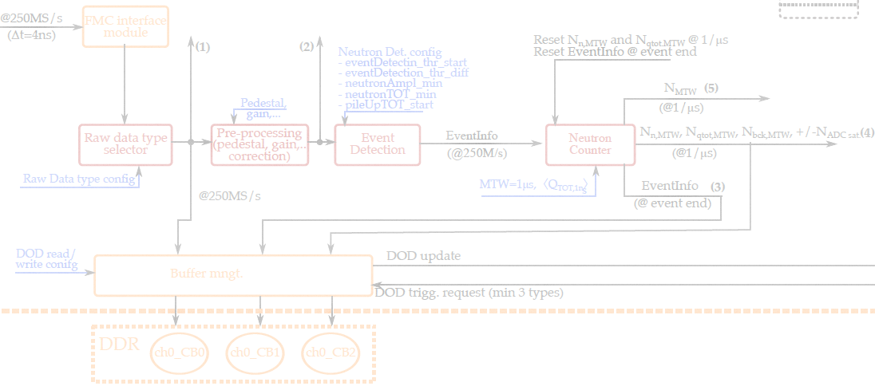
nBLM: neutron detection algo
Neutron detection related blocks
“Event Detection”
  Detects start of an “interesting event”
  Updates EvenInfo every 4ns
“Neutron counter”
  Ends event and resets EventInfo
  Sums and resets neutron counts at the end of each MTW

Slide 59
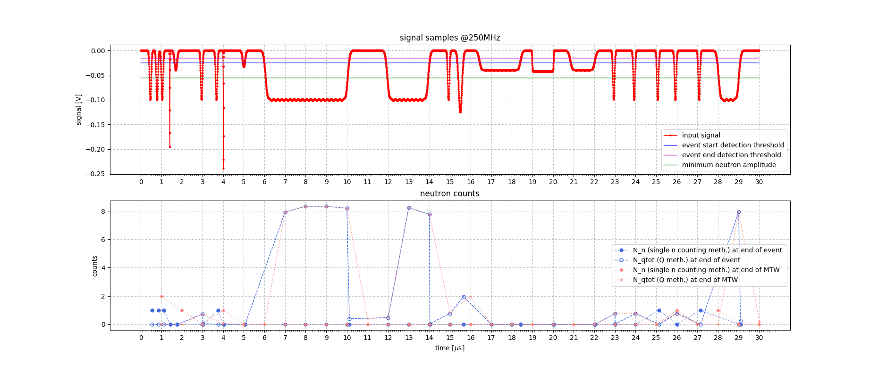
nBLM: neutron detection algo

