Slide 1
Testing and deployment
Clement Derrez
European Spallation Source ERIC
November 22nd 2018

Slide 2
Introduction
Beam Diagnostics systems: deployment of
  623 sensors,
  48 separate front end units,
  78 mTCA crates
  Thousands of cables
  etc.

Slide 3
Reminders: Naming convention, data management tools
Naming convention: Every Field Replaceable Unit (FRU) is named. A FRU can be a simple part or an assembly
Data management system: going from Insight to EAM
  Data export / import with other software tools
  Ensures traceability between tests and production data,
  system components and laboratory devices.
  Systems and subsystems tests results coming from
  different locations (ESS, IK Partner, commercial partners…)
  SciCat is a good candidate to complete EAM
Data files format: HDF5
  Files, groups and datasets minimum mandatory
  attributes are defined
Insight -> EAM
Component requirements
System FRUs list
Tests report
Test plan
Laboratory devices
Test Design document
JIRA: timeline

Slide 4
Reminders: acceptance workflow
System requirements
System Verification plan
Validation of verification plan
System requirements are analyzed for each system and its components
Verification document is validated by system lead: we make sure test requirements are correctly translated
Test coverage is reviewed.
Describes subsystems' test setup and characterization procedures
Tests IDs defined for each measurements
When not COTS: test plan is prepared/discussed and agreed with IK partner
Run tests
Acceptance tests performed in BI lab, possibly compared with IK results.
System verification performed after installation, without beam and with beam from the LCR
System hand over

Slide 5
Reminders: After-installation tests sequence
After-installation tests sequence:
  cold check-out
  commissioning with beam
  quick self-check
Sequential testing is important (tests timestamps are checked automatically). Otherwise the statement: “the instrument is installed and working properly” has less confidence.
During debugging:
  Relevant tests in each architectural layer are repeated until satisfactory results are obtained.
  If the problem is identified and can be isolated within its layer, there is normally no need to repeat all of the tests which are sequentially following. Depending on the situation, some test might become mandatory nevertheless (for instance a software recompilation might entail a standard interface check, and a repaired connector might entail a signal transmission check).
Notes:
Cold check out: Testing of the whole instrument on all architectural layers:
monitor, front-end electronics, cables, mTCA-electronics, timing, data treatment, publishing, network transmission and machine protection interface.
Commissioning with beam: Aims at verifying the correctness of the integration for machine operations.
Includes initial comparisons and cross-calibrations in order to gain confidence in the instrument. Performance limiting factors are identified.
Quick self test: The self-test procedure includes testing of calibration, machine protection and data transmission.

Slide 6
LEBT systems tests & deployment
Faraday Cup
  Verified, handed over to operations. Repeller HV scan to do.
LEBT & ISrc BCM
  Verified, handed over to operations
  First beam measured on both systems in September
Ongoing activities:
Noise issues on the BCM system (source of the problem is on the ISrc)
IOC and OPI upgrades for both systems → Provide unified view of both systems, and ease system operation from LCR.
  This upgrade means systems will be handed over to BI, and verified before going back to operation.

Slide 7
LEBT systems tests & deployment
LEBT Doppler
  System verification is 90% complete, ongoing from LCR depending on
  manpower
LEBT NPMs
  System verification is 90% complete, ongoing from LCR depending on
  Manpower
  Second NPM needs to be fiducialized
LEBT EMU
  Second head came back repaired from CEA, now installed on the LEBT
  Entire system ready for cold check-out thanks to Thomas Fay
Ongoing activities:
Systems cold check out from control room
Verification with beam will resume possibly in December
Notes:
NPM:
• Names of the motion PV that should be consistent with naming. There’s a fix for that, and it needs to be checked
• OPI is in the LCR and needs to be verified
• Second NPM needs to be fiducialised: we need to get the IOC / OPI running in the optics lab, and we also need to get a motion driver in addition to the two ones already in the optics lab. The 3 axis have to drive the camera lens motion, and the 2 linear stages
DPL:
• Motion should be seen in the LCR, so there should be a launcher which points to a standard OPI for motion, and which shows the temperature of the system
• Encoder: it is not in use at the moment (we know that) but this is important that it can be integrated in the system and that we can drive the system knowing where we are. There is a collision risk with the FC, and with the beam. So we can carefully start commissioning with beam, but sooner rather than later we need to get it fixed.

Slide 8
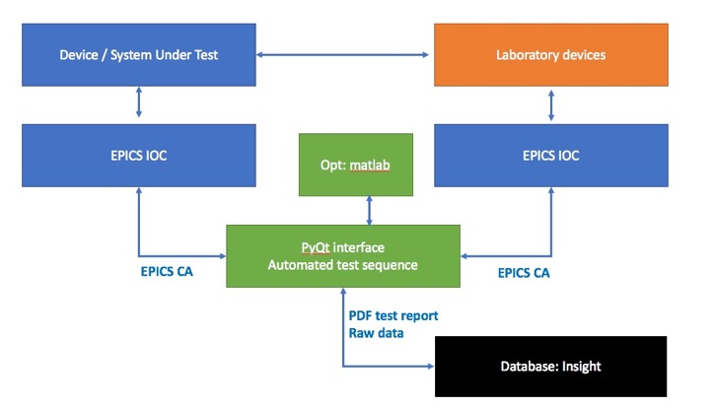
LEBT systems tests & deployment: lessons learnt
90% of verification activities not automatized for the first LEBT systems
  Time consuming
  Focus on automation needed for the next installation steps
The operator OPI LCR deployment step has been overlooked
when planning verification, adding delays
Controls support very much appreciated (Saeed)
Notes:
VIT allow us to gain confidence with the instrument, spot obviously possible installation & deployment “hard points”

Slide 9
LEBT systems tests & deployment: lessons learnt
Setting up the beam diagnostics lab according to our defined “systems-specific benches” layout is a urgent item
Vertical Integration Tests prior to installation are crucial
Detailed and accurate planning is necessary to have the right resources available at the right time, this was not the case this summer
”Test boxes” and fixtures should be produced to reduce testing time
Installation preparation, FRU acceptance support from partners is extremely important and very appreciated
  → Elettra provided hardware and software tools for acceptance tests of the AFE, OFE & BE.

Slide 10
Coming soon
LEBT FC verification when FC moves to permanent tank
Further MEBT systems tests
Series wire scanner acquisition system reception tests (AFE & BE)
WS scintillator prototype vertical test
BCM interface units
pico FMCs reception tests
Struck digitizers reception tests
icBLM detectors reception tests (IK ?)
BLM beam tests
More cables tests
Other systems tests I can’t think about now , and migration to EAM

Slide 11
Thank you!
Questions ?

Slide 12
LEBT FC verification
More details:
  HV tests
  Motion tests
  Signal tests
Same for the BCM

