Slide 1
Way of working with ICS HWI
Hardware and Integration
www.europeanspallationsource.se
2018-11-19

Slide 2
Background
My impression coming in in April 2018
Little interaction on developer level
Communication characterized by coffee machine small talk
Unclear priorities
Unclear decisions
Unclear responsibilities
Meetings and discussions characterized by frustration on both sides
Lack of trust
What has happened
A series of meetings on different levels to discuss way of working
Introduction of dedicated work package manager for IFC platforms
Addition of development resources from ICS (2 new developers and one returning from parental leave)
Where we are today
Much improved interactions on developer level
Communication has moved from coffee machine to Jira
We have a commonly established priority for the IFC platform
We still have room for improvement regarding clarity of decision
We still have room for improvement regarding clarity of responsibility
At least we have a platform for starting to re-build mutual trust

Slide 3
Purpose
The purpose of the talk is to:
Give a systematic view of the different type of control system activities within ICS HWI
Show the system engineering life cycles for the different types of activities
Map these activities towards the concrete beam instrumentation systems
Map these activities towards the ICS HWI work packages
Give concrete instruction for how to make engineering work requests toward the different work packages in Jira

Slide 4
ICS
Life cycles
Control System
of interest
standard
component or software
generic
control system technology
ESS facility
control system
section 5.
Standard control
components
and software
drivers, PCB boards,
hardware modules, APIs
section 4.
System life cycle for
generic control systems
and technology
developments
generic chopper control system
generic cryomodule control system
generic RF control system
section 3.
System life cycle for
ESS facility
control system
ESS process control system
ESS device integration system
ESS standardised
generic control systems
ESS facility
control systems
ESS standardised
control components
used several times in

Slide 5
Generic control system life cycle
Requirements
Design
Development
Integration
and Test
SRR
System
Requirements
Review
CDR
Critical
Design
Review
SAR
System
Acceptance
Review
Use this for
Standard MTCA crate configurations (e.g. generic BLM crate)
Standard EPICS modules and environment
Other reusable standard systems
system life cycle phase
system review

Slide 6
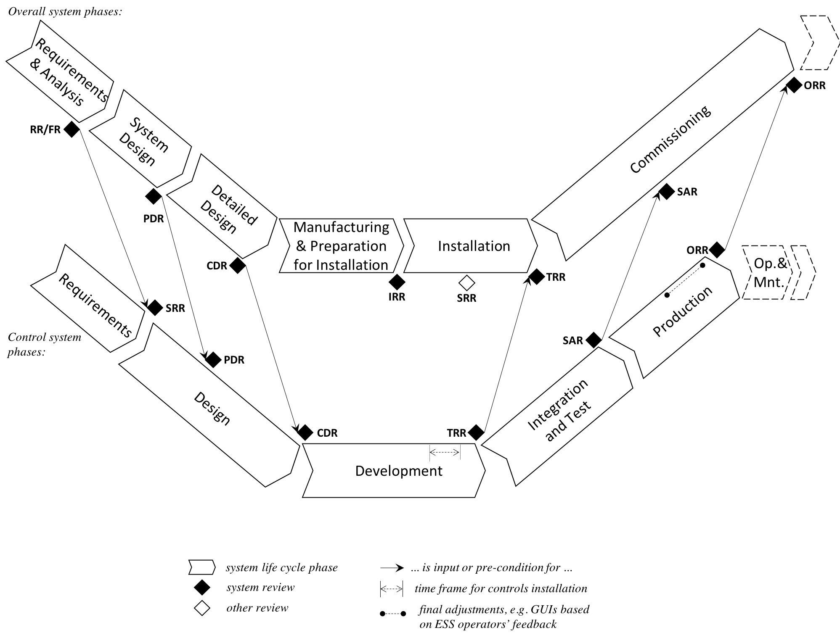
ESS facility control system life cycle
Use this for
Beam loss monitoring system
Beam position monitoring system
Other ESS wides systems built on the standard systems

Slide 7
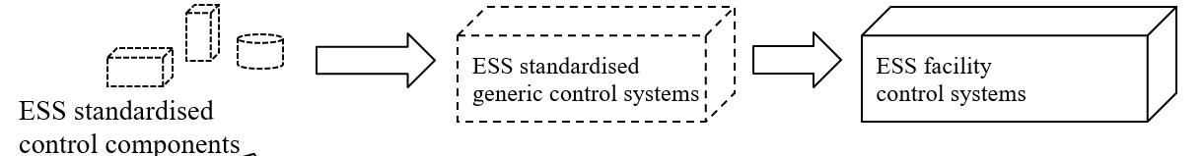
Work packages and line management in ICS HWI
Hardware and Integration Group
Karl Vestin
WP04: Hardware Core
Simone Farina
WP10: Accelerator integration
Philippe Rabis
WP11: Target integration
WP11: Target integration
WP11: Target integration

Slide 8
System ownership for beam instruments
Proton Beam
Instrumentation
Systems
ICS delivers integration to the facility control system (WP10)
BCMs
BLMs
BPMs
FCs
<other local BI group/system>
BI (possibly with ICS) support develops instrument application (WP10)
ICS delivers standard generic control systems (WP04)
BPM-01
BPM-...
BPM-14
FBPM-01
ICS provides standard control system components (WP04)
BPM-01
.B01
BPM-01
.B ...
BPM-01
.B17
BPM-01
control system

Slide 9
Jira for team communication
From the ICS HWI Jira User Manual (ESS-0289012):
Stakeholder responsibility
Create an issue of the type “Task”
Provide accurate and complete specifications for the service requested.
Assign the issue to responsible work package manager
Respond accurately and in a timely fashion to requests for further information posted as comments in the Jira ticket
ICS HWI responsibility
Responsible work package manager to provide initial response within 3 working days
Follow up and track request to completion
Update the ticket accurately and in a timely fashion with each step of the process (e.g. update the ticket when goods are ordered, received etc).

Slide 10
Jira for team communication
For requests concerning components or generic control systems (e.g. a IFC board or standard MTCA crate configuration):
Raise a Jira ticket for WP04.
For requests concerning ESS facility control systems (e.g. integration of a BLM):
Raise a Jira ticket for WP10.
A request is confirmed only after the responsible work package manager has acknowledged it in Jira.
It is likely that there will be questions regarding requests. Once we have stabilized on a format we can promote this to a task template in Jira to ensure all relevant information is included and reduce the amount of questions that needs clarification.

Slide 11
Thank you for your attanetion
Questions are welcome

