Slide 1
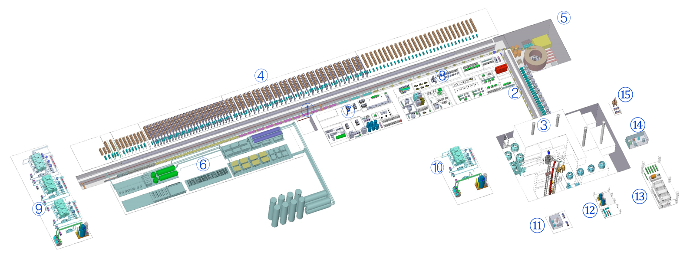
Status of CiADS
Yuan He
On behalf of China ADS Groups
Institute of Modern Physics, CAS
Supported by
“Strategic Priority Research Program” of the Chinese Academy of Sciences, Future Advance Fission Energy-ADS
Mega scientific project: China Initiative Accelerator Driven System

Slide 2
Outlines
Background of Accelerator Driven System
Design Status of CiADS
Progress of Prototypes
Accelerator, Target and Reactor
Material SIMP
New Approach of Fuel Recycle
Sammary

Slide 3
Strategy and Status of NP in China
Current status of China (including Taiwan, China) nuclear power (by the end of 2018)
46 nuclear power reactors in operation, 42.858 GWe (3th , total 452 and 399.354 TWe in the world)
Produced electricity: 286.5 TW.h, 4.22%
11 reactors under construction, 10.982 GWe, (1st , total 54 in the world)
The development plan of NP in China (2014-2020)
By 2020, the installed nuclear capacity will be 58 GWe, and 30 GWe are under construction
Nuclear energy is an inevitable strategic option to meet China energy demand in the future
China is the largest energy consumer and Greenhouse Gas source.
She has claimed that the CO₂ emissions will reach the peak before 2030 on Paris Climate Agreement.
Data from IAEA/PRIS, update on 2019-05-18
Notes:
almost same scale of the total capacity in the world todays!

Slide 4
One of Solution of Sustainable Development
Nuclear waste is not only the issue of sustainable, but also the long-term supply.
“The ADS has the advantage that it can burn pure minor actinides while avoiding a deterioration of the core safety characteristics.”
⎯ ADS and FR in Advanced Nuclear Fuel Cycles – A Comparative Study, NEA/OECD, 2002

Slide 5
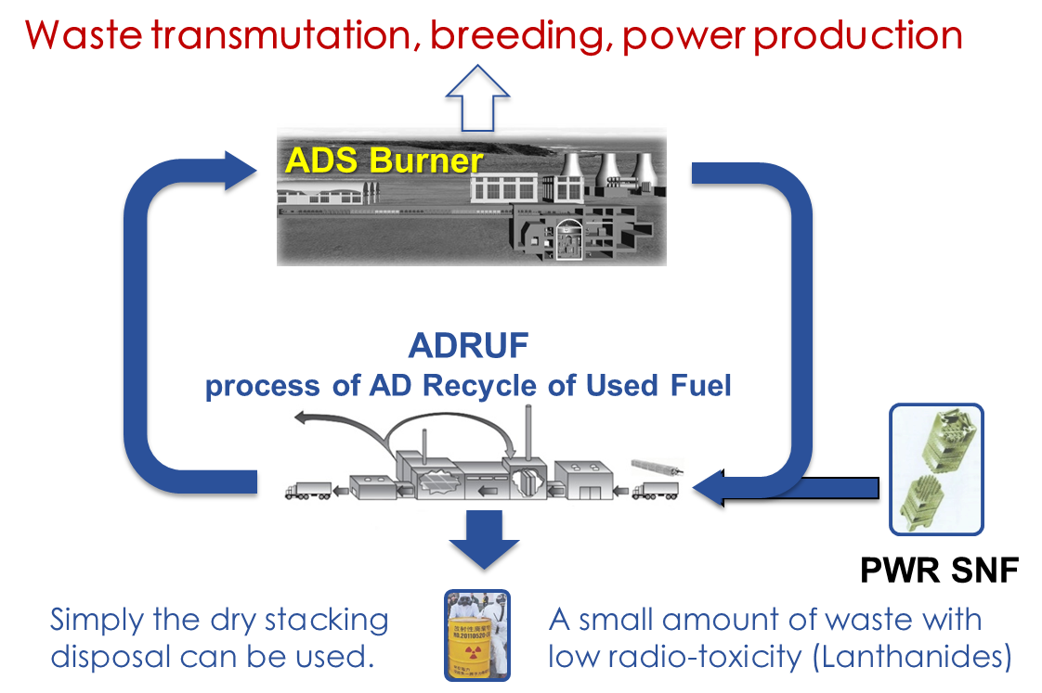
Sustainable Perspective of NP
**Fuel ~10000 y; Waste Radiotoxicity<500 y
ADANES Concept
High Resource Utilization → Breeding
**Fuel < 100 y (Supply 1000GWe);
Waste Radiotoxicity>100000 y
Other than P&T, high radioactive elements, like Minor Actinide, will not be Partitioned but burned in ADS Buner.
Radiotoxicity Reduction → Transmutation

Slide 6
ADS/ADANES Roadmap in China
￥1.78 B
Phase I
2011--2016
Phase II
2018--2024
Phase IV
Phase III
Inject I
Inject II
10 MeV
10 MW_{t}
>500 MW_{t}
≥1 GW_{t}
2014
~2.5 MeV
&10mA
2016
~25 MeV
&~10mA
2024
~500 MeV
&5~10mA
<2030
~1.0 GeV
&<15mA
~203x
~1.0 GeV
&>15mA
Key Tech. R&D : Acc., Target, Blanket… Prototypes
Initial Facility
Demo. Facility
Indust. Facility
“strategic Priority Research Program” of the Chinese Academy of Sciences
CiADS

Slide 7
Outlines
Background of Accelerator Driven System
Design Status of CiADS
Progress of Prototypes
Accelerator, Target and Reactor
Material SIMP
New Approach of Fuel Recycle
Sammary

Slide 8
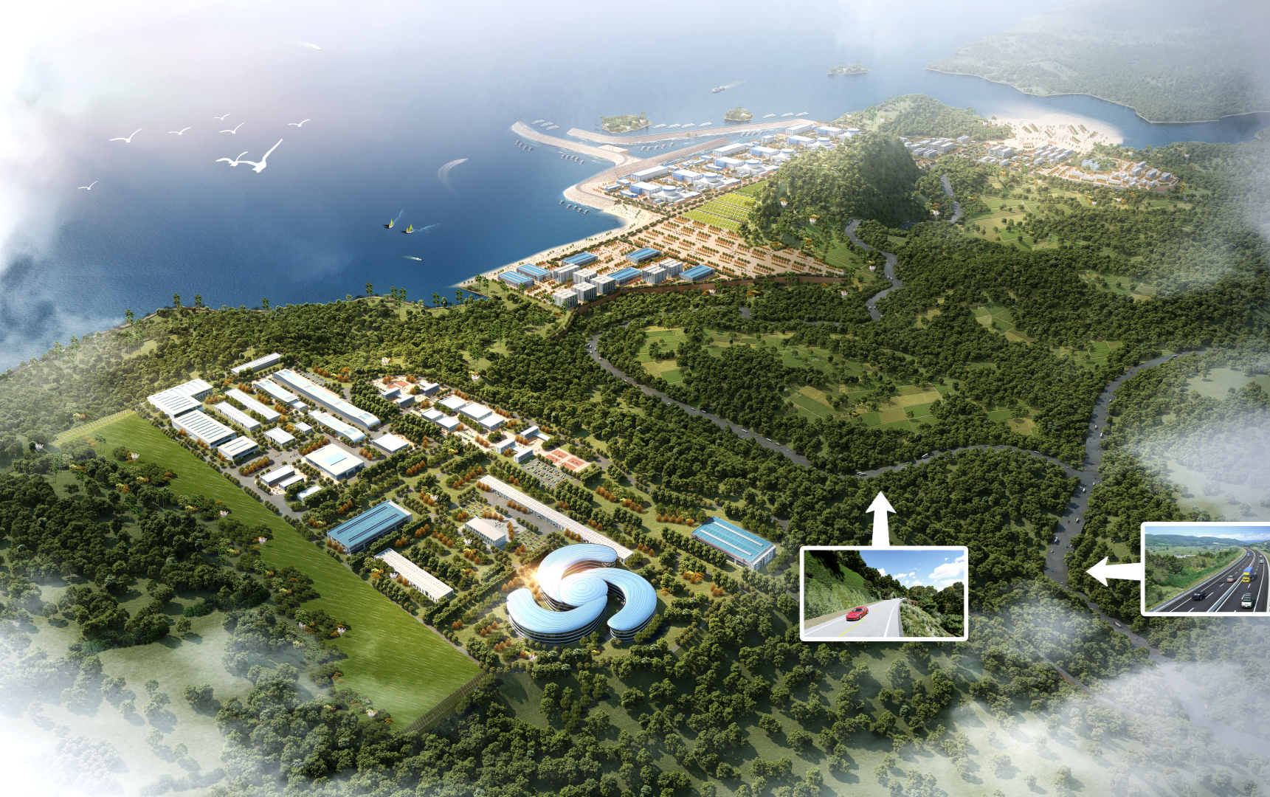
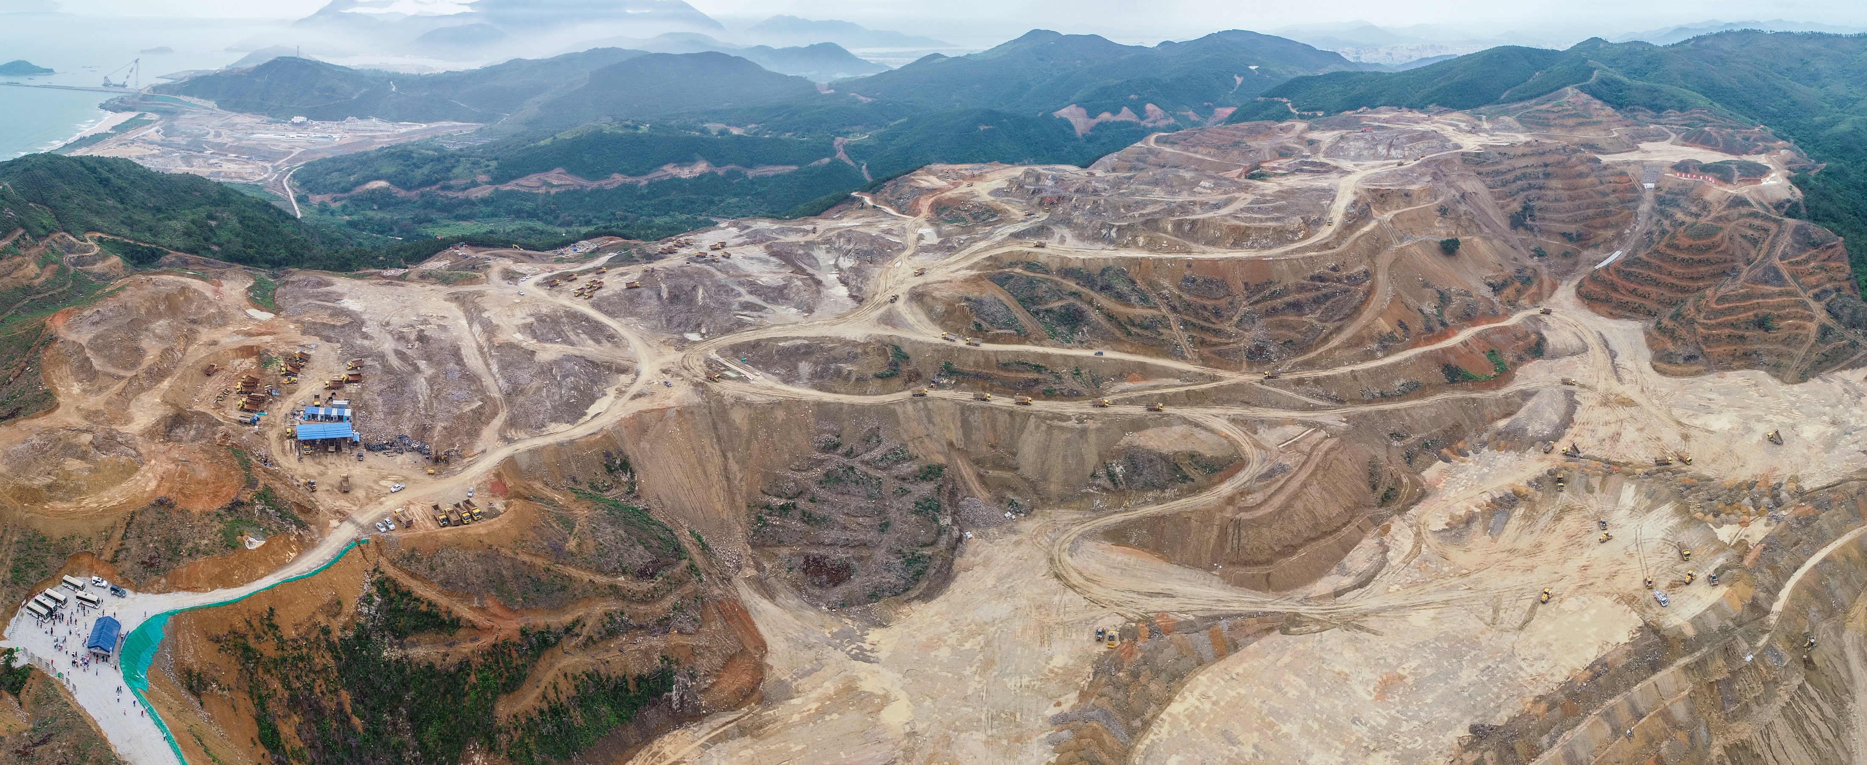
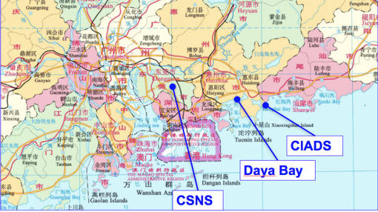
CiADS Project (2018-2025)
Approved in Dec. 2015
Leading institute: IMP
Budget: ~4 B CNY (Gov. + Corp.)
Location: Huizhou, Guangdong Prov.
Partners: CIAE, CGN, IHEP, etc.
Ground broke in August 2018
CiADS & HIAF
Earthwork will be finished by the end of the year

Slide 9
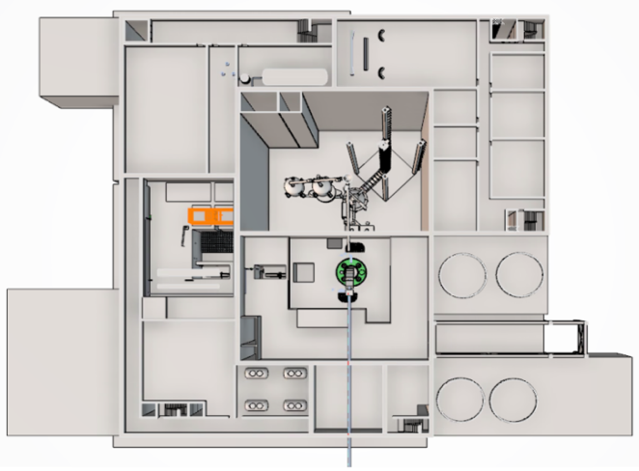
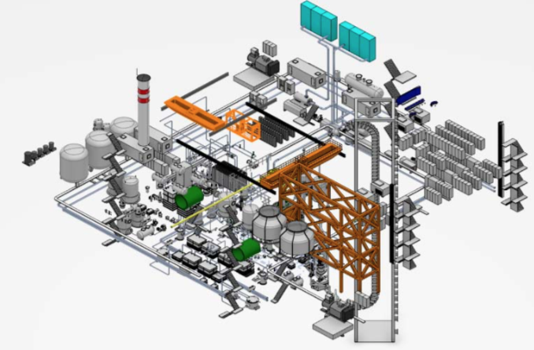
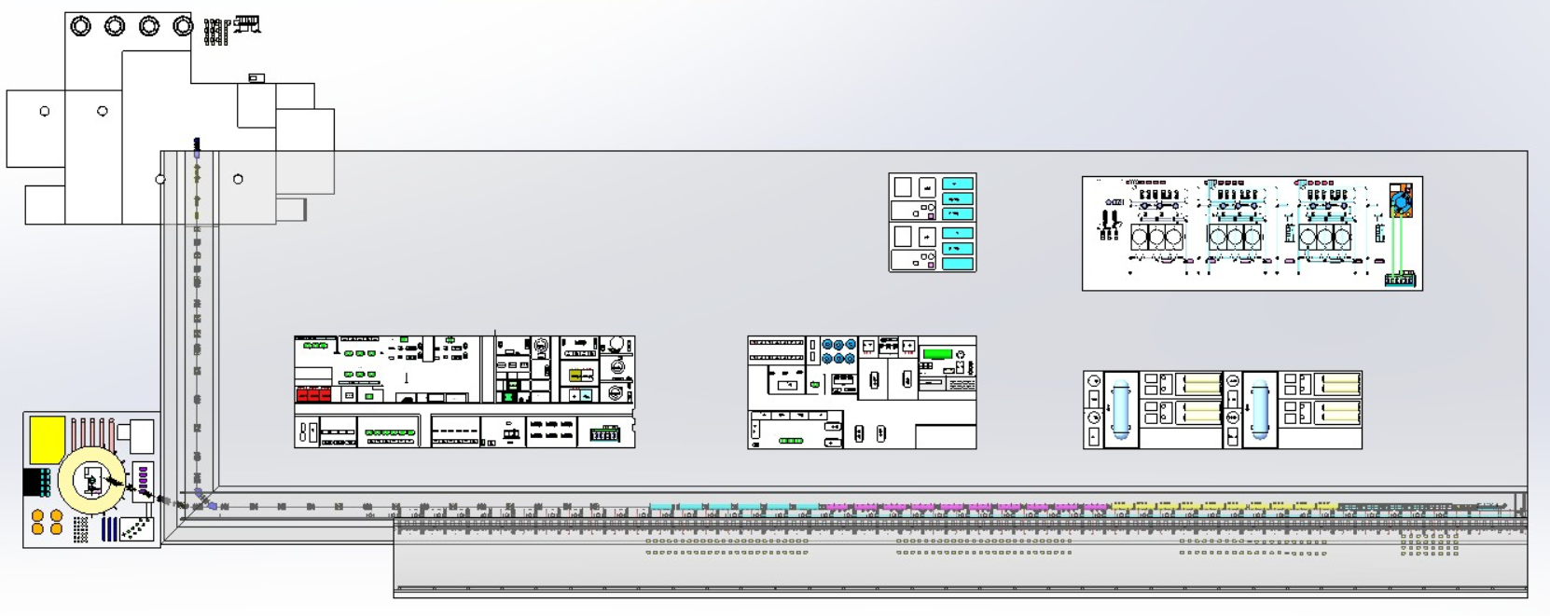
Layout of CiADS
Design Particle | proton
Energy | 500 MeV
Beam current | 5 mA
Beam power | 2.5 MW
Operation mode | CW&Pulse
Reactor power | 10 MWt (incl. beam)
Cryogenic | 2 K
③
⑦
④

Slide 10
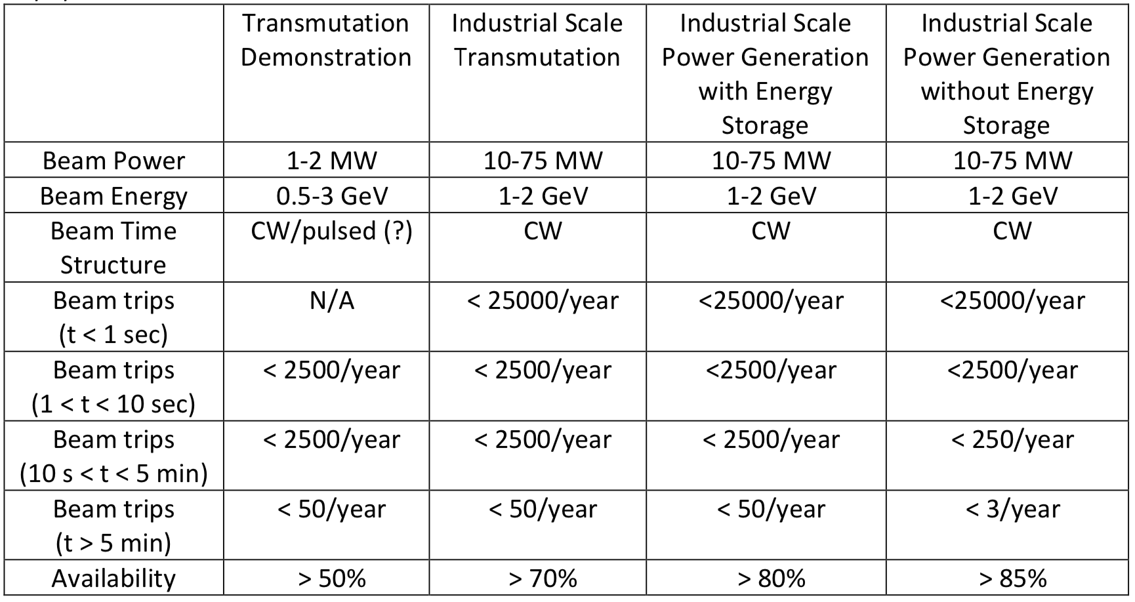
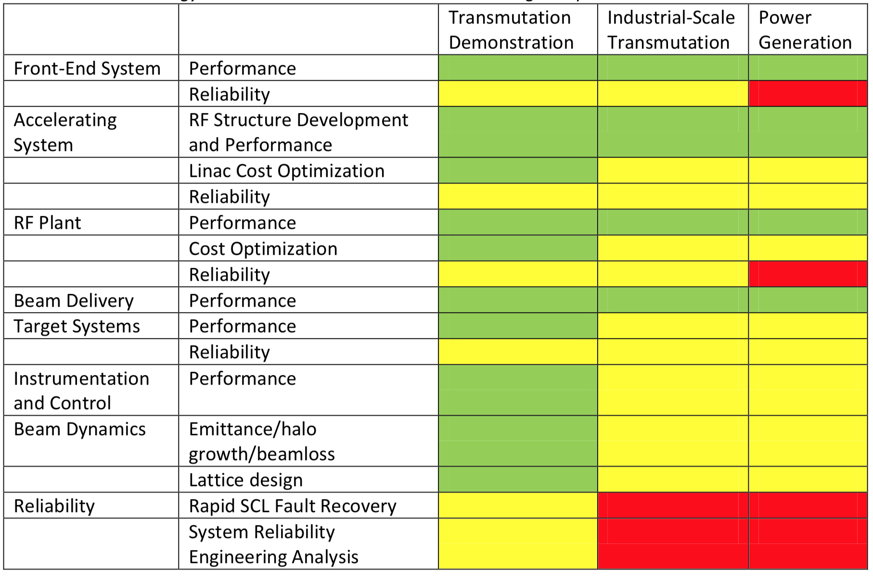
Reliability Requirements of ADS
green “ready”
yellow “may be ready, but demonstration or further analysis is required”
Red “more development is required”
MYRRHA:
Beam-trip-duration tolerance is 3 s.
< 3 s, rapid recovery
> 3 s, <10/3months
MTBF 250 hours
CiADS:
Beam-trip-duration tolerance is 10 s.
< 10 s, rapid recovery
10 s ~ 5 min, <2500 /year
> 5 min, < 50 /year
Whitepaper:“Accelerator and Target Technology for Accelerator Driven Transmutation and Energy Production ”2010
© Springer International Publishing Switzerland 2016 J.-P. Revol et al. (eds.), Thorium Energy for the World, DOI 10.1007/978-3-319-26542-1_13

Slide 11
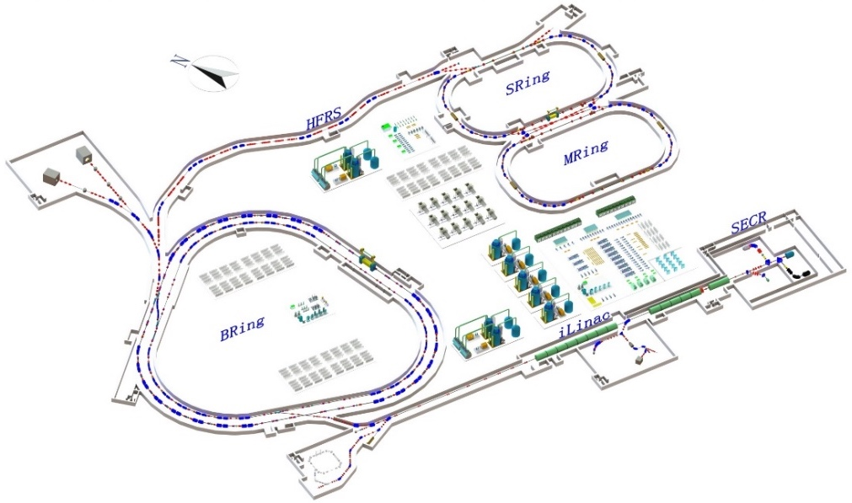
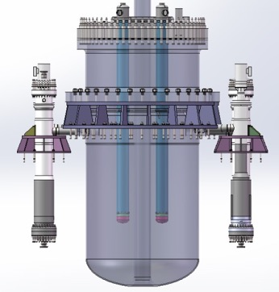
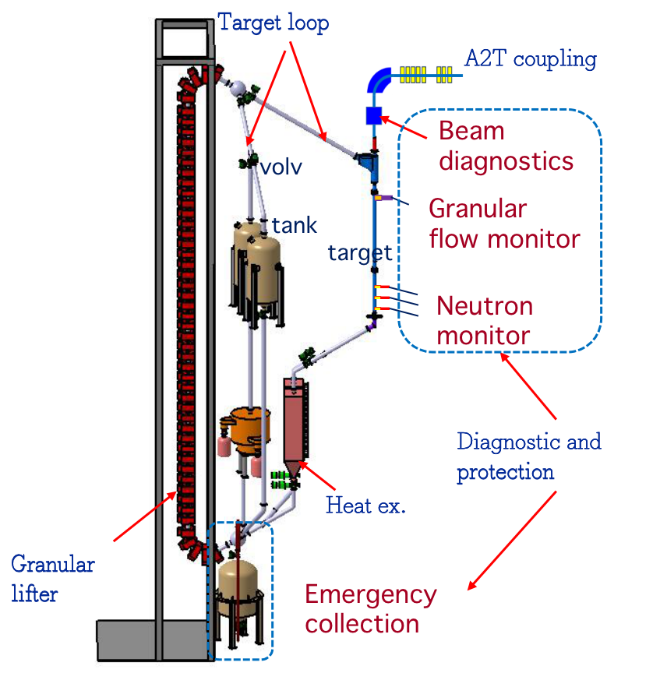
Terminals planned of CiADS
T1: low power dump 50 kW; accelerator study; nuclear physics
T2: liquid metal target 250 kW ~ MW; material irradiation,
T3: granular target 100 kW ~ MW; target study
T4: 10 MW fast reactor, LBE target, Keff 0.75~0.97; demo of ADS
T5: upgrade ISOL target: iLinac of HIAF is post-acc, to 100 MeV/u
T5:ISOL target
T1：dump, low-power exp. , ……
T2：liquid metal target, high-power neutron source
Energy: 500 MeV (upgrading to 1.5GeV)
design current：10 mA
beam loss：1W/m
modes：pulse&CW（Hus gap for reactor）
energy stability：±1%@100ms
current stability：±2%@100ms
position stability：±1mm
profile stability：±1mm
T4：LBE sub-critical reactor
~10 MW
T3：granular target exp. 2.5 MW licenses

Slide 12
Commissioning Plan of CiADS
Characteristic: The first nuclear experimental facility for ADS principle verification of the world researches on the integration, coupling operation, transmutation and design verification with the accelerator, target and reactor system.
Requirement： Feasibility + Flexibility
Coupling characteristics study→ Gradually achieve low power to high power coupling
Operation plan study→ Reliability and stability operation
Key technology study→ CiADS system integration
Transmutation and material research：
Metamorphic neutrons and principle experiments of secondary lanthanides ；
Material irradiation, etc. ；
Experimental study on ADS fuel performance and transmutation samples ；
Design and verification:
Future ADS system design software development and verification
Database and verification

Slide 13
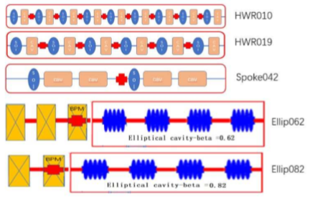
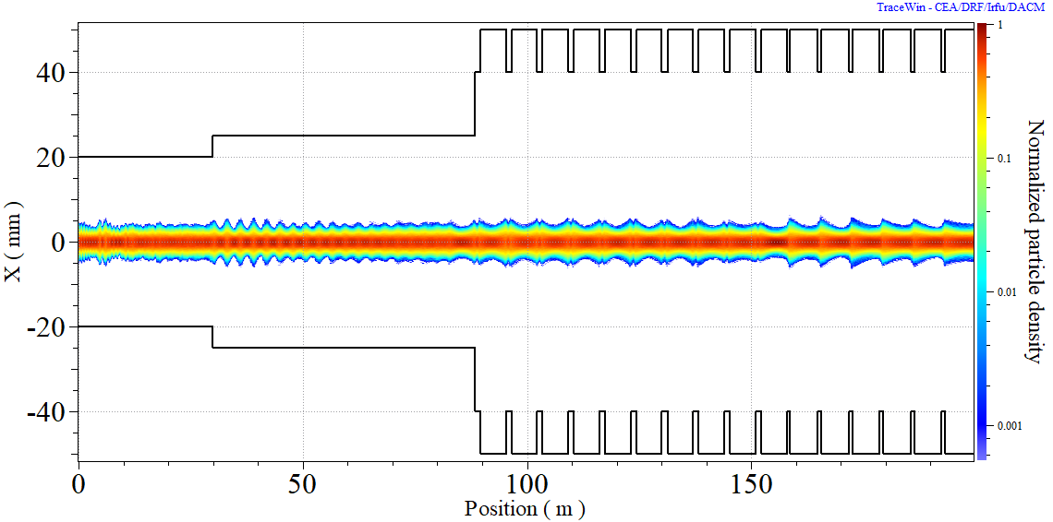
Design of SC section
Physics ：phase advance <90; smoothness of focusing strength
Engineering ：minimization and uniformity of the hardware, such as CM, SC cavities
Operation：the margin of operation VS design value
Baseline:
Beam
dump
Optimization of “smoothness” from 2 to 10 degs !!
 | HWR010 | HWR019 | Spoke042 | Ellip062 | Ellip082
f（MHz） | 162.5 | 162.5 | 325 | 650 | 650
βopt | 0.10 | 0.19 | 0.42 | 0.62 | 0.82
Number of cells | 2cell | 2cell | 3cell | 6cell | 5cell
Epeak(MV/m) | 26/30 | 28/33 | 28/33 | 28/33 | 28/33
Num of cavities | 9 | 24 | 40 | 40 | 24
Focusing elements | SC sol | SC sol | SC sol | triplet | doublet
Num of magnets | 9 | 24 | 20 | 10 | 6
Magnet field(T) | 7.5 | 7.5 | 7.5 | 0.9 | 0.9
Length of CM(m) | 6 | 6 | 6 | 6 | 6
Num of CMs | 1 | 4 | 10 | 10 | 6

Slide 14
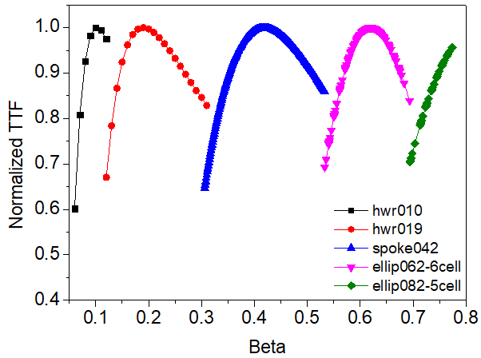
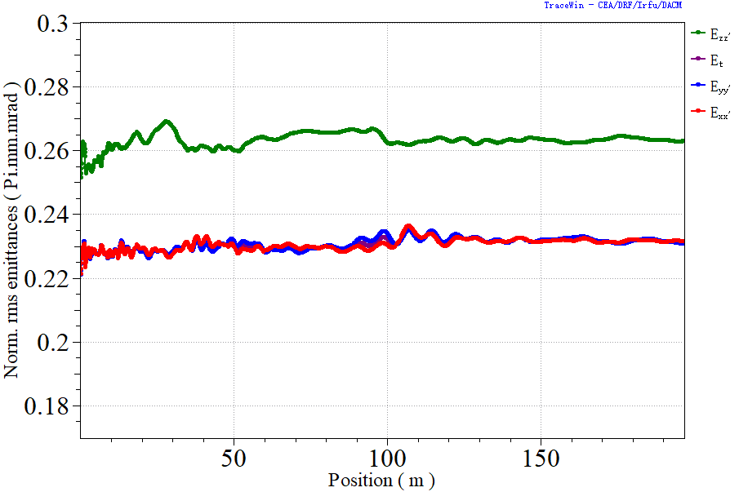
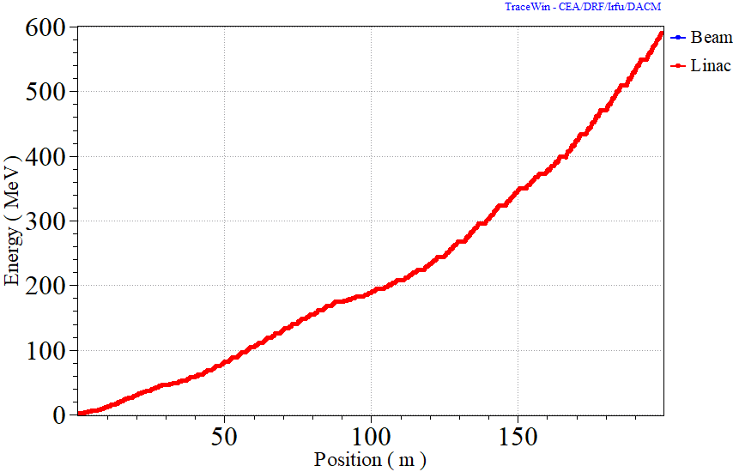
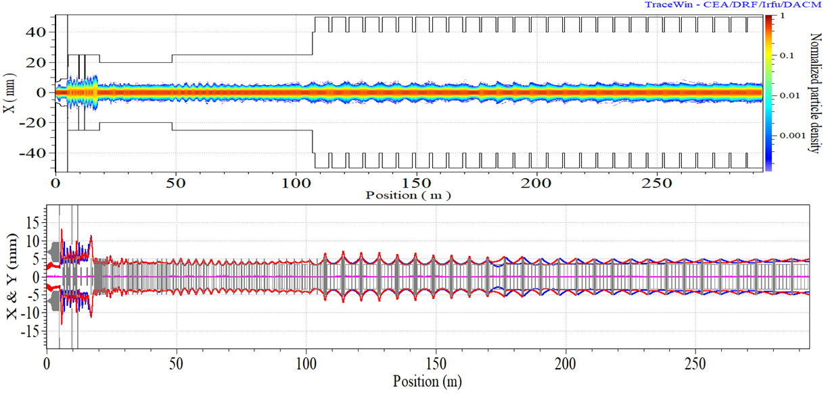
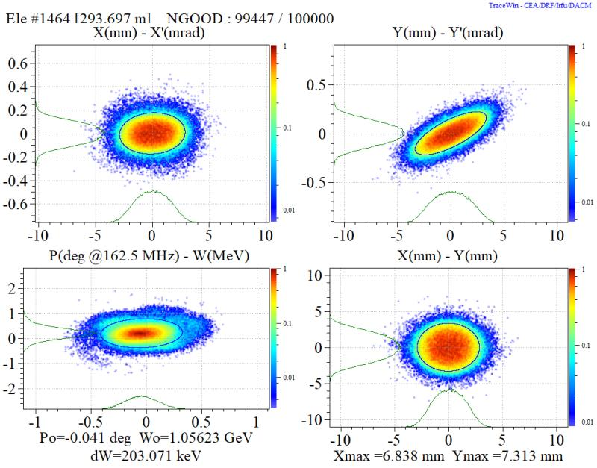
End to end simulation
Emittance growth：
X/Y/Z: 4.5%/4.5%/4.4%
Acceleration efficiency >50%

Slide 15
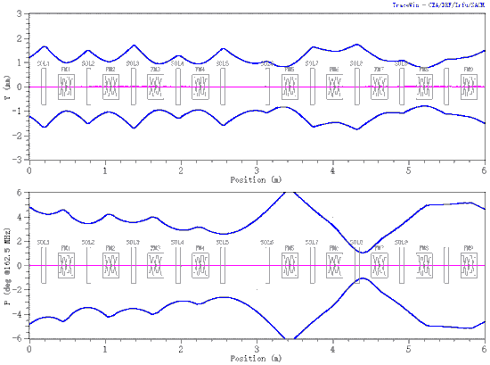
Rapid Recovery Stratrgy
Adaptive compensations scheme + AI
Find the output energy threshold of each cavity type based on the velocity acceptance and matching requirements
Matching at low energy
Compensate energy at high energy
Iterative optimization to get the minimum cavity voltage redundancy
DQN error function
Network change
quantity
Envelope data
Beam envelope
Neural Network (Selector)
Neural Network (learner)
Network data
Memory data
Lattice change quantity
Memory Area
Type | 010 | 019 | 042 | 062 | 082
Redundancy | 20% | 15% | 10.7% | 6% | 10%
Beam envelope data
Lattice change quantity
Beam function value
DQN reinforcement algorithm flow chart
design
Cavity failure
Adaptive Compensation

Slide 16
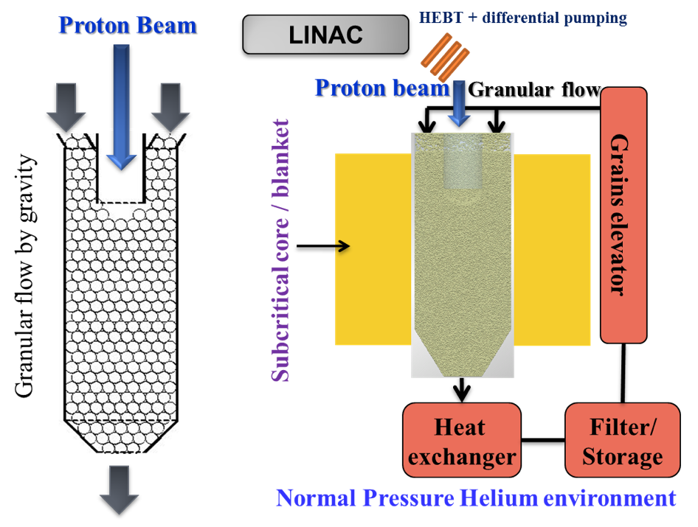
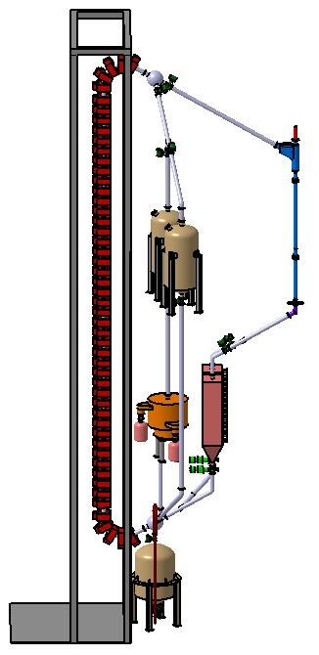
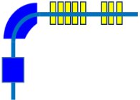
High Power Target
Target loop
A2T coupling
Beam
diagnostics
volv
Granular
flow monitor
tank
target
Spallation
neutron
Neutron
monitor
Diagnostic and
protection
Heat ex.
Merits:
Heat exchange outside
No Stress due to beam trip
No thermal shock due to beam pulse
Drawbacks：
Dusty due to abrasion
Volume of target materials
Granular
liftor
Emergency
collection
Notes:
改模式，框图保留，加入CiADS系统之间的关系
加入流程图

Slide 17
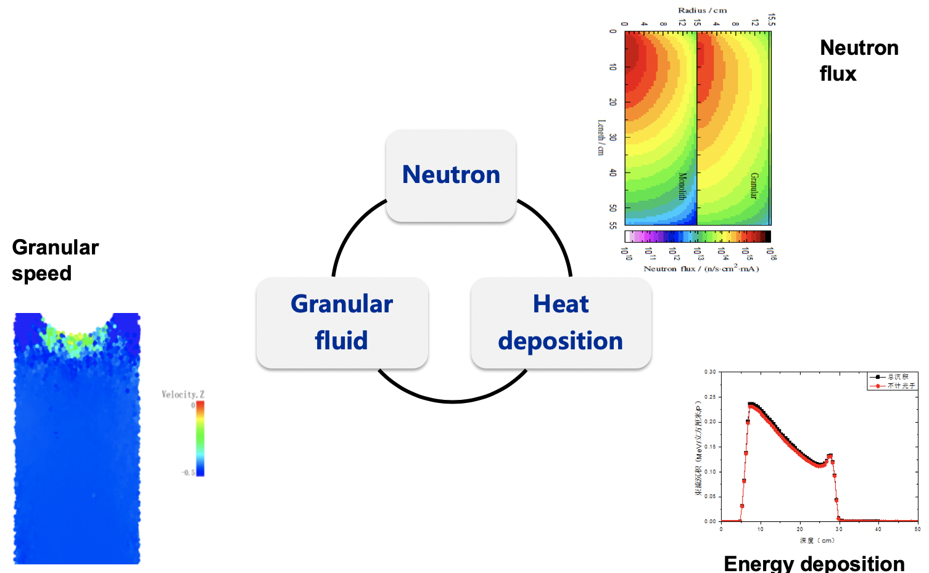
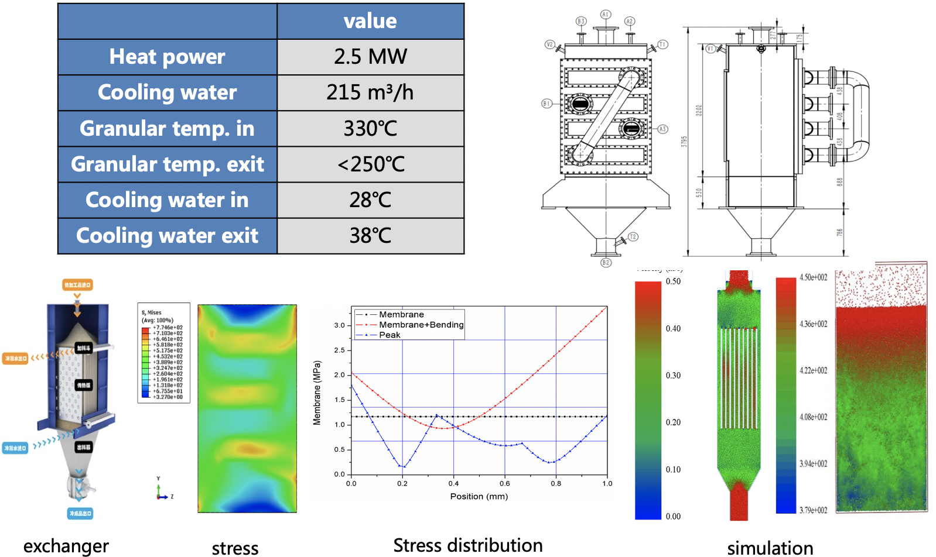
Design of Granular Target

Slide 18
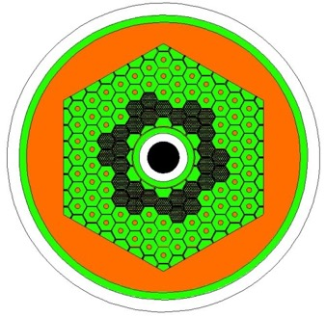
Subcritical Fast Reactor
 | Top level spec.
type | LBE sub- FR
Power | 10MWt (incl. beam)
fuel | UO₂ (19.75%)
Keff | ~0.75
Main coolant Configuration | Pool-loop
Main coolant driven mode | Forced circulation
Coolant | LBE
Main coolant pressure | Normal
Main coolant temp | 280-380℃
main coolant exchanger | Main exchanger×2 Auxiliary exchanger×4
Main pump | Mechanical pump×2
Secondary Loop coolant | Pressure water
Secondary Loop pressure | 1.4MPa
Secondary Loop Temp | 225-260℃
Notes:
改模式，框图保留，加入CiADS系统之间的关系
加入流程图

Slide 19
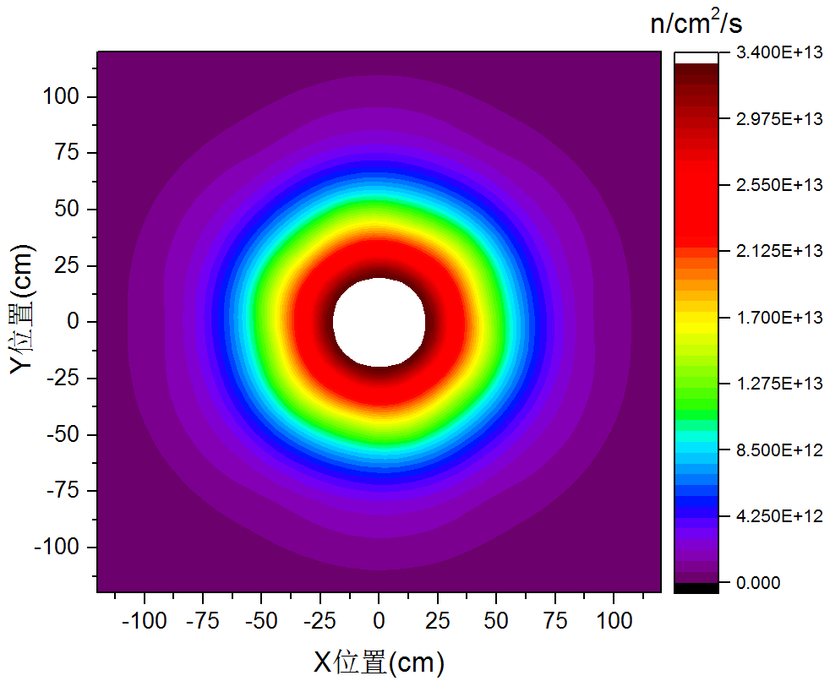
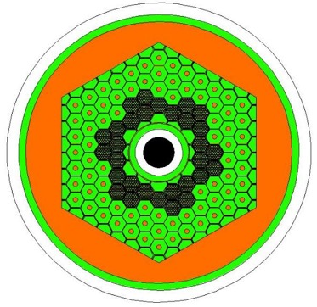
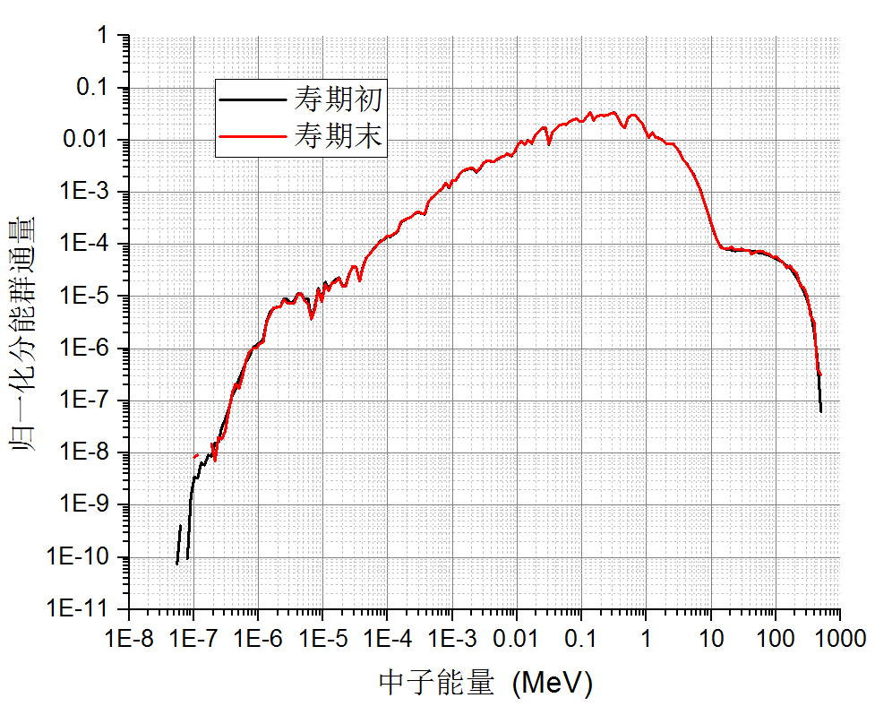
Nuclear design of reactor
Parameters | Unit | Value
 |  | BOL | EOL
Reactor Power | MW | 7.74 | 7.66
Target Power | MW | 2.26 | 2.34
Proton Energy | MeV | 500
Beam Intensity | mA | 4.51 | 4.67
Neutron Yeild | n/p | 8.81
Uranium Load | t | 1.7217
EOL Burnup | MWd/tU | 4902
Keff | - | 0.73457 | 0.72687
Ks | - | 0.76922 | 0.76450
19.75% UO₂, 30 boxes
Neutron spectrum
(full energy range)
3.40E+14 n/cm²/s（at core）
Neutron spectrum at the hot point
Notes:
堆芯的核设计经过优化后，采用30组19.75%的燃料组件，提供7.74MW的堆芯热功率，采用低线功率密度燃料设计，平均线功率密度为34w/cm，堆芯最高线功率密度为42w/cm，极大的提高了运行的可靠性

Slide 20
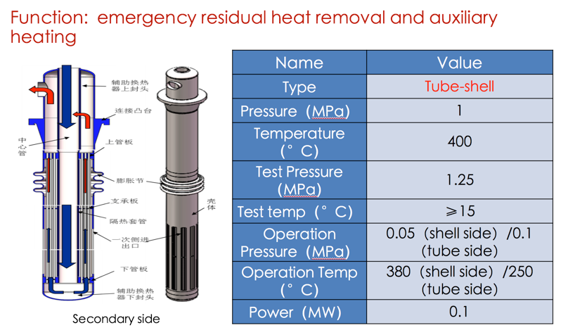
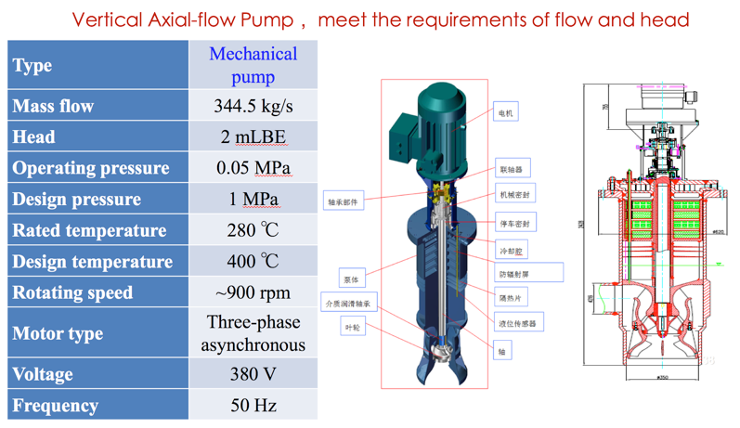
Coolant System Design

Slide 21
Outlines
Background of Accelerator Driven System
Design Status of CiADS
Progress of Prototypes
Accelerator, Target and Reactor
Material SIMP
New Approach of Fuel Recycle
Sammary

Slide 22
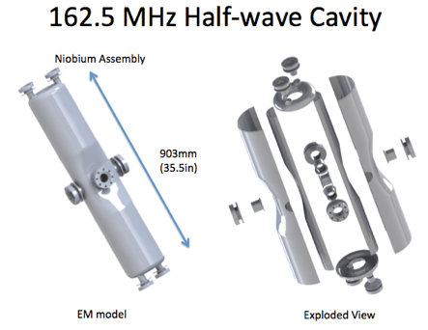
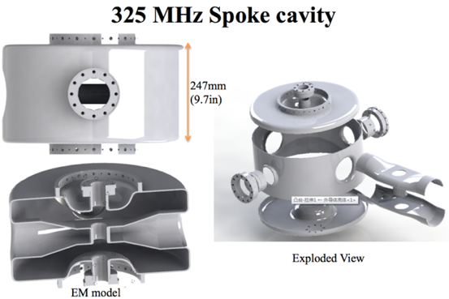
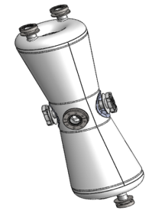
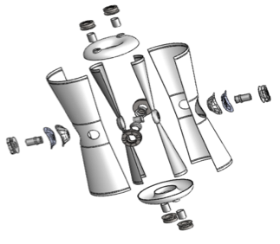
Chinese ADS Front-end Demo linac (CAFe)
IMP collaboration with IHEP 2011 ~ 2017
ions | P，H₂⁺，α
frequency | 162.5 MHz
current | 10 mA
E in RFQ | 40 keV
E out RFQ | 3.1 MeV
Energy | 25/30/40MeV
Temp. | 4.5 K
DUMP
Beta=0.1
IMP
HEBT
Beta=0.15
IMP
ADS RFQ：2014-2017
(cooperation with LBL)
CMIF RFQ：2018-
162.5 MHz Taper HWR
Beta=0.21
IHEP
Goal: to demonstrate 10 mA CW beam of superconducting front-end Linac for CiADS.
Supported by “Strategic Priority Research Program” of the Chinese Academy of Sciences.

Slide 23
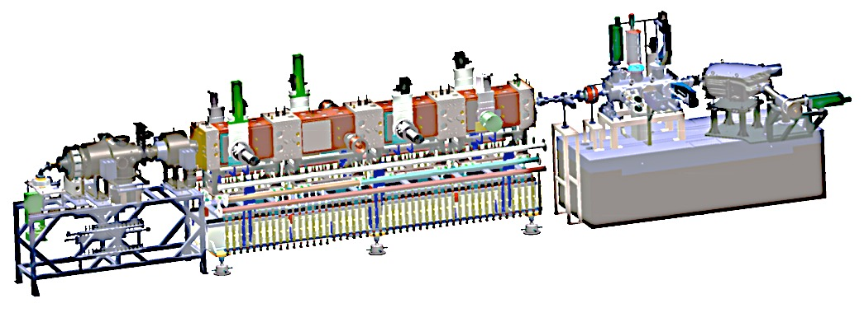
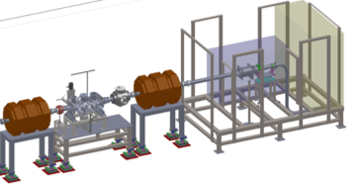
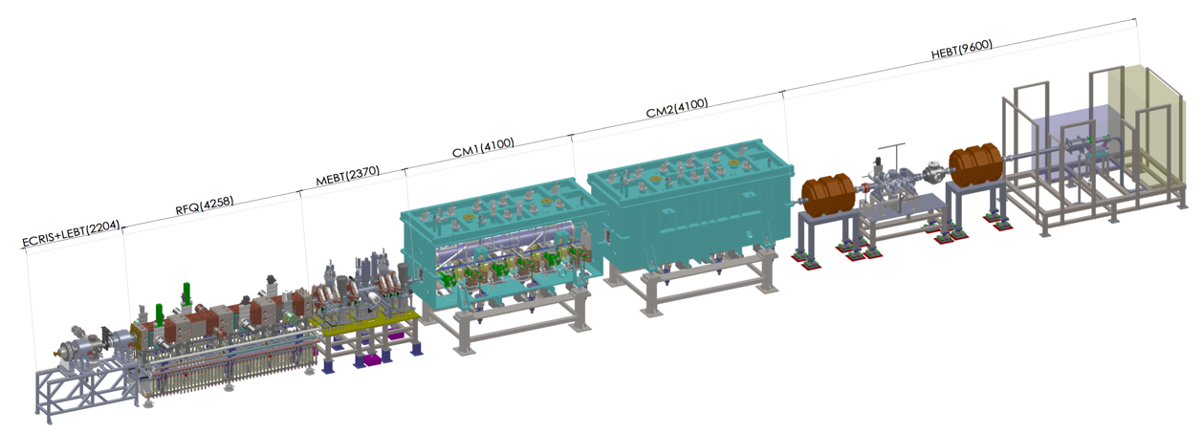
Commissioning of Superconducting Linac
1
Commission stage | First CW beam | Max Energy (MeV) | Beam time (hours) | CW beam time Total (hours) | CW Current Max(A) | CW Power Max(kW)
RFQ1/2 | Jun. 21, 2014 | 2.15/3 | 2036/~200 | 90/~120 | 11 | 23
TCM1 | Nov. 24, 2014 | 2.55 | 208 | 22.5 | 11 | 28
TCM6 | Jun. 24, 2015 | 5.3 | 400 | 20 | 4 | 21
Inject II | Sep. 24, 2016 | 10.2 | 327 | 11 | 2.7 | 26
CAfE | Jun. 7, 2017 | 26.1 | ~500 | ~140 | 2.55 | 45
162.5 MHz RFQ
2
162.5 MHz HWR010
3
2014.06.06——2014.07.24, RFQ
2014.09.14——2015.02.13, TCM1
2015.03.26——2015.06.29, TCM6, beam accident, RFQ AMP and coupler broken 2015.10.28——2016.01.21, TCM6 commissioning
2016.05.01——2016.06.20, injector II, coupler broken 2016.09.01——2016.12.17, injector II high power
2017.04.28——2017.06.18, CAFe, current leads broken 2017.10.03——2018.01.23, CAFe, operation stability 2019.01.04 ——2 mA CW beam, operation stability
162.5 MHz HWR010
4
5
162.5 MHz HWR010
Commissioning Goal: Higher power, Higher stability

Slide 24
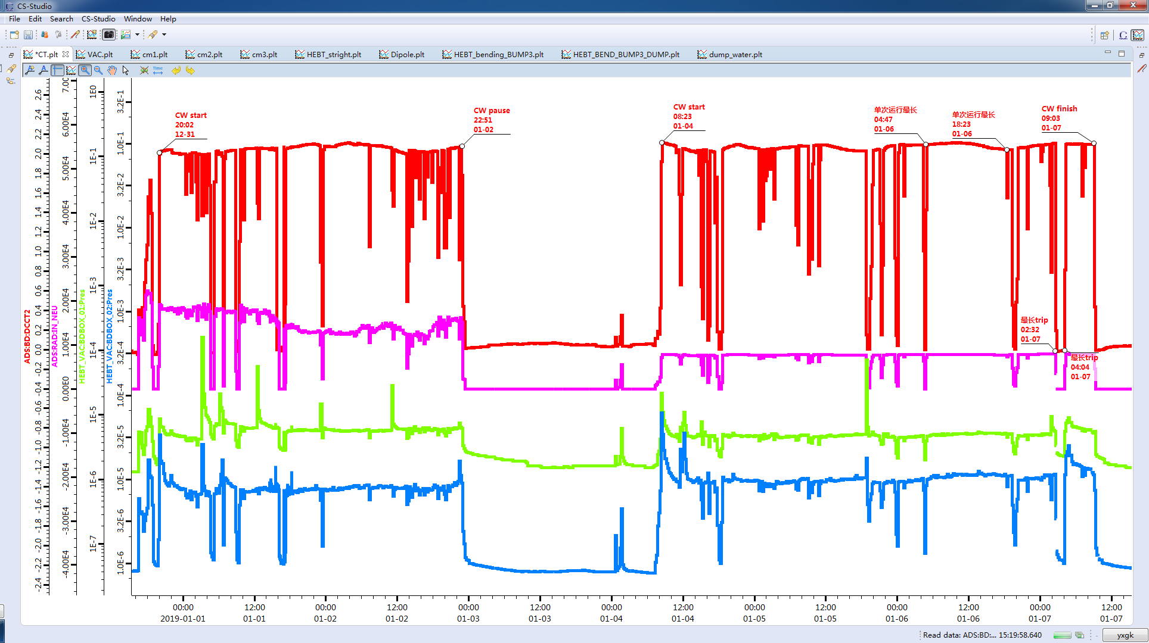
Operation Reliability Test with high power in 2019
Fist stage（15.8MeV@2.0mA）
Second stage（16.4MeV@2.1mA）
Stop to Change
current
and energy

Slide 25
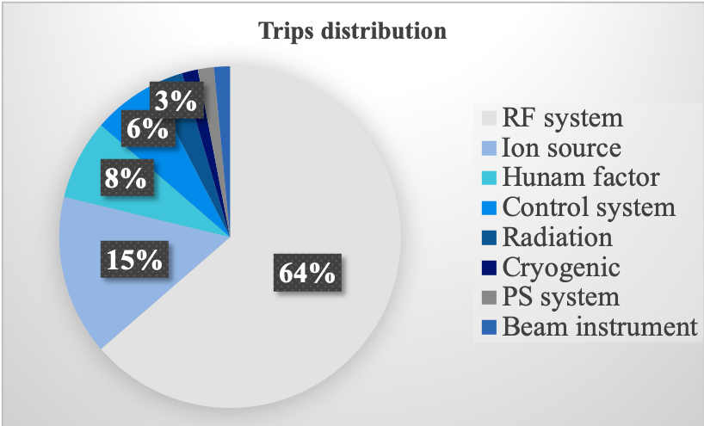
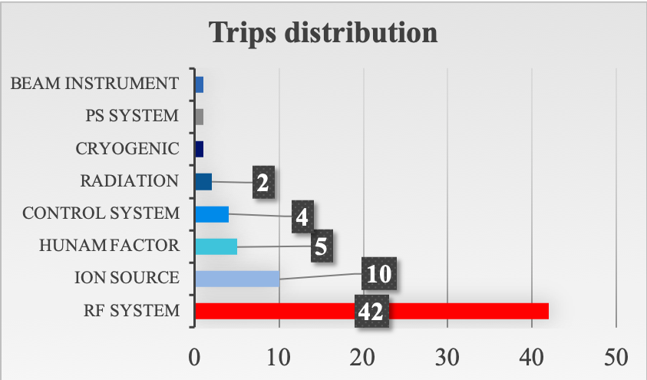
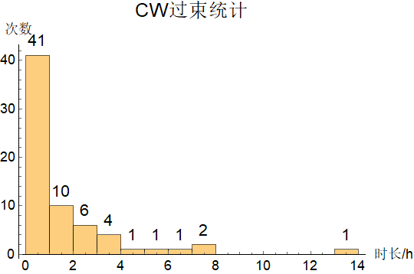
RAMI of CW beam with active MPS
Operation time 7553 min, downtime 737 min, availability 89%
Max power is 45 kW with 2.55 mA @17.5 MeV
No trip gap, 13.5 hours
1st stage: 2018/12/31 18:44 - 2019/01/02 23:42
2nd stage: 2019/01/04 08:08 - 01/07 09:03
Availability | MTBF | MTTR
0.89 | 90.7 min | 11.1 min
Availability | MTBF | MTTR
0.89 | 113.7 min | 14.6 min

Slide 26
Operation for Users
Operation for users, Dec. 7th – 30th , 2018, May 14th ~June 30th 2019
Beam: H⁺ and ⁴He²⁺, energy 2.1-32MeV, average current 100nA~125uA
Available beam time 58.0 hours for 62 experiments
Downtime: 5.9 hours
Availability: ~ 0.90
source | trips
RF (incl. RFQ, LLRF) | 9
IS | 1
human | 4
control | 3
PS | 1
Diagnostic | 1
coupler | 2
total | 9

Slide 27
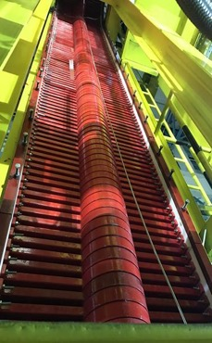
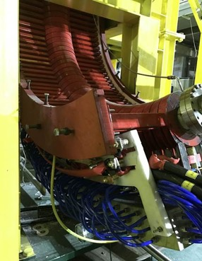
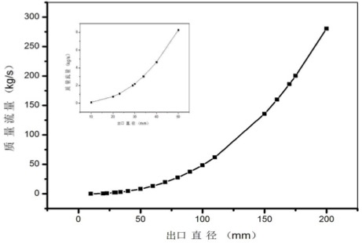
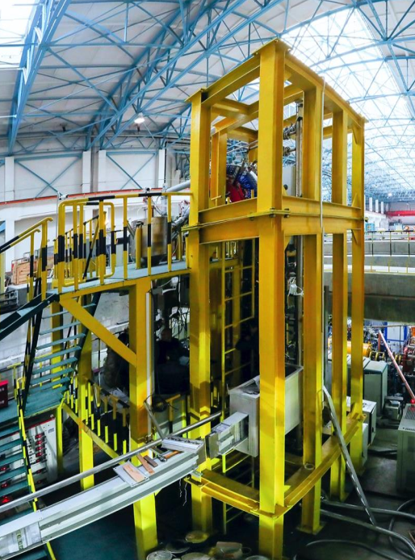
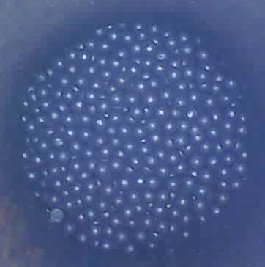
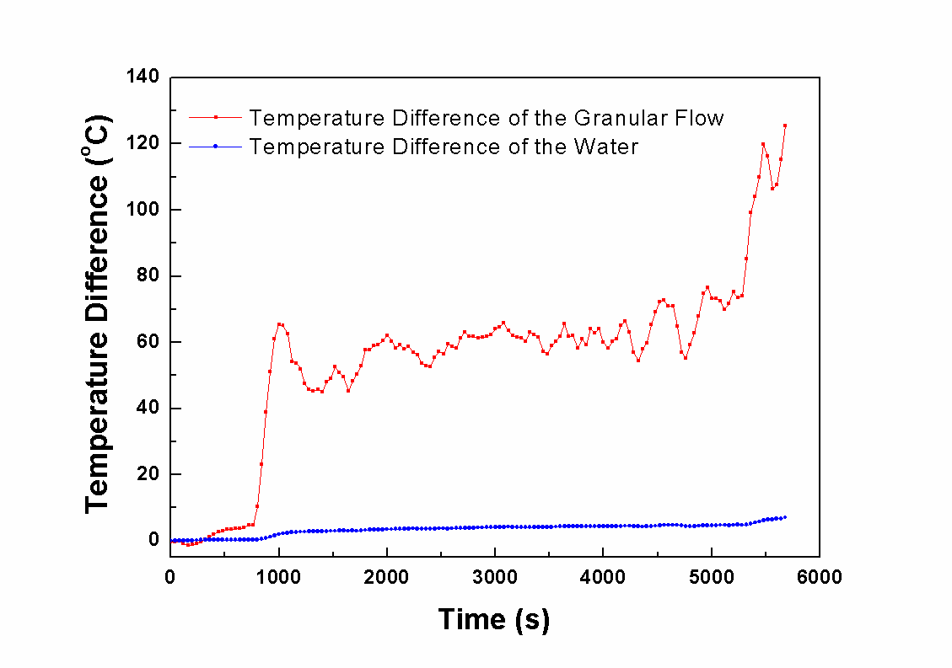
Prototype of granular target
Flux with aperture
Electro-magnetic lifter
Granular temp.
Water temp.
Heat exchange exp.
Granular flow
Integral target setup, verify granular flow, heat exchanger, electro-magnetic lifter, purifier, and so on

Slide 28
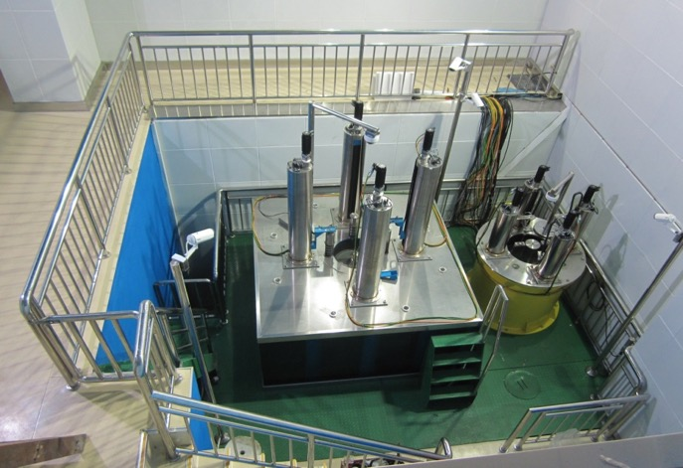
Zero-Power Lead Reactor
I supercritical
II critical
III
IV
Neutron count
time
operation monitoring system
Target material | Period method/mk | Simulation /mk | Relative error/mk
Tungsten particles | -0.932 | -0.99 | -0.058
Tungsten | -1.144 | -1.162 | -0.018
Lead | 1.322 | 1.562 | 0.24
Experiments verified The accuracy of target-reactor coupling calculation and core design

Slide 29
LBE Loop & Oxygen Control System
Oxygen control setups
LBE Loop

Slide 30
Outlines
Background of Accelerator Driven System
Design Status of CiADS
Progress of Prototypes
Accelerator, Target and Reactor
Material SIMP
New Approach of Fuel Recycle
Sammary

Slide 31
Smelting and Casting of SIMP
5 ton
Industrial grade !
2 tons
5 tons
1ton
5ton SIMP ingot
2016
2015
2014
Tensile properties
stable mechanical properties
2013
impact toughness
Upper-part texture
lower-part texture
2012
2011
Control: purity, homogeneity

Slide 32
Evaluation experiments to SIMP

Slide 33
General Evaluation
Tests | Result
TS/YS/elongation rate at RT-600℃ | SIMP > ( EP823, T91, RAFM )
Oxidation resistance at RT-800℃ | SIMP > ( EP823, T91)
LBE corrosion resistance (600℃, static saturation oxygen） | SIMP > EP823 > T91
LBE corrosion resistance (450℃, static saturation oxygen） | SIMP > T91
Short durability at 600℃ (150 MPa) | SIMP > ( EP823, T91)
Durability at 650℃ (100 MPa) | SIMP > T91 > EP823
Ion irradiation resistance at RT- 450℃ | SIMP > (T91, RAFM )
Ion irradiation resistance at 550℃ | SIMP > T91 > RAFM
SC water corrosion resistance (600℃, 25Mpa, 1000h) | SIMP > TP347, 304 SIMP > T/P91, T/P91
SIMP steels irradiated at SINQ-PSI, (n/p, ∼ 20dpa, 2012-2014)
Post Irradiation Examination (PIE) is under way, more results is coming.

Slide 34
LBE Bump Prototype using SIMP
Panel / plate
Tubes/pipes
15mm
Liquid LBE centrifugal pump
Φ60mm×10mm
Φ60mm×5mm
30kW
2950r/min
The pump is currently being manufactured
Φ60mm×1mm
Φ5mm×1mm

Slide 35
Outlines
Background of Accelerator Driven System
Design Status of CiADS
Progress of Prototypes
Accelerator, Target and Reactor
Material SIMP
New Approach of Fuel Recycle
Sammary

Slide 36
Technical Route of Reprocessing & Fabrication
Technical route
Pulverization of UO₂ pellets
Removal of the FPs from spent nuclear fuels
Preparation of ceramic nuclear fuel microspheres
Notes:
The picture is Technical route of the Production and Reprocessing of Nuclear Fuels.

Slide 37
Pulverization of Pellets & Removal of Volatile FPs
Removal of the volatile fission products from spent fuel by the Voloxidation Process
Pulverization & Ox/Re of real UO₂ pellets
Oxidation：air, 450 ℃, 4 h
Reduction：4% H₂-Ar, 700 ℃, 4 h
Element | Mo | Cs | Ru | Te | Rh | Se
Removal% (1200 ℃) | 95 | 90 | ~50 | 82 | ＜5 | 100
Notes:
Pulverization of UO2 pellets are accomplished by oxidation - reduction Process . This is a nonmechanical method for the pulverization of sintered uranium dioxide fuels suitable for use as an economical procedure for the low decontamination reprocessing of such nuclear fuels.
Removal of the volatile FPs by the Voloxidation Process. Iodine, and the volatile fission gases are released from the spent fuel at high temperatures. The separations processes rely on the ability of some actinides and fission products to form volatile or semi-volatile oxides.

Slide 38
New Approach to Spent Nuclear Fuel Recycle
Highly Efficient and Selective Dissolution Separation of Fission Products from Spent Nuclear Fuels by an Ionic Liquid, [Hbet][Tf2N]
Fang-Li Fan et al., Inorg. Chem. 2019 58(1) 603-609
Notes:
This innovative method allows the selective dissolution of neutron poisons, lanthanides oxide, as well as some fission products with high yield, leaving most of the UO2 matrix and minor actinides behind in the spent nuclear fuel and accomplishing the actinides recovery as a group. This approach features a little waste and efficient selectivity, mild conditions, which opens up a new avenue for simple, convenient, sustainable, and green for the spent nuclear fuel reprocessing.

Slide 39
Preparation of ceramic nuclear fuel microspheres
In-situ mixing internal gelation-microwave heating device
Optical image of
UC ceramic microspheres
Preparation of UC ceramic microspheres by an improved microwave-assisted rapid internal gelation process combined with carbothermic reduction
UC ceramic microspheres
size: Ø 675 µm
density : 12.53 g/cm³ (92% TD)
Wei Tian et al., Ceramics International 44 (2018) 17945–17952
Notes:
Uranium monocarbide (UC) ceramic fuel has been considered as a potential nuclear fuel because of its high thermal conductivity, high melting point, good mechanical property and high uranium atom density.
In our work, uniform sized ceramic UC microspheres were prepared by an improved microwave-assisted internal gelation combining with carbothermic reduction process. The UC ceramic microspheres have an average diameter of 675µm and a density of 12.53 g/cm3, which is 92% of the theoretical density. So, this method can provide an important guidance for the preparation of Pu and MAs carbides microspheres for nuclear reactors in the future.

Slide 40
Outlines
Background of Accelerator Driven System
Design Status of CiADS
Progress of Prototypes
Accelerator, Target and Reactor
Material SIMP
New Approach of Fuel Recycle
Sammary

Slide 41
Sammary
The ADANES was proposed as a new closed fuel cycle system, aiming sustainable nuclear energy.
The CiADS (prototype of ADB) started earthwork in last August. It is planned to be the first commission in 2024.
The front-end demo CAFe (25 MeV superconducting linac) started commissioning in 2017. It has achieved max beam power of 45 kW with 2.55 mA @ 17.5 MeV. It operated at 2 mA more than 100 hours. 100 kW beam power, rapid recovery and long-term operation is the next goal.
The granular flow spallation target was proposed to be a candidate for 10 MWs application. A prototype was built and tested.
The SIMP steel was developed for the use to LBE related nuclear energy systems. The experimental results show that its property could be better than other candidates.
The new recycle procedures of Spent Nuclear Fuel for ADB was proposed, and it is proved with SIMFUEL in IMP laboratory.

Slide 42
Thank you! Welcome collaboration!
Thanks our team and worldwide collaboration in the past!

