Slide 1
Overview of the JAEA-ADS accelerator
Yasuhiro Kondo, Jun Tamura, Bruce Yee-Rendon,
Fujio Maekawa, Shin’ichiro Meigo, and Hayanori Takei
Japan Atomic Energy Agency (JAEA)

Slide 2
Contents
Overview of JAEA ADS
Development of linac for ADS at JAEA
Summary

Slide 3
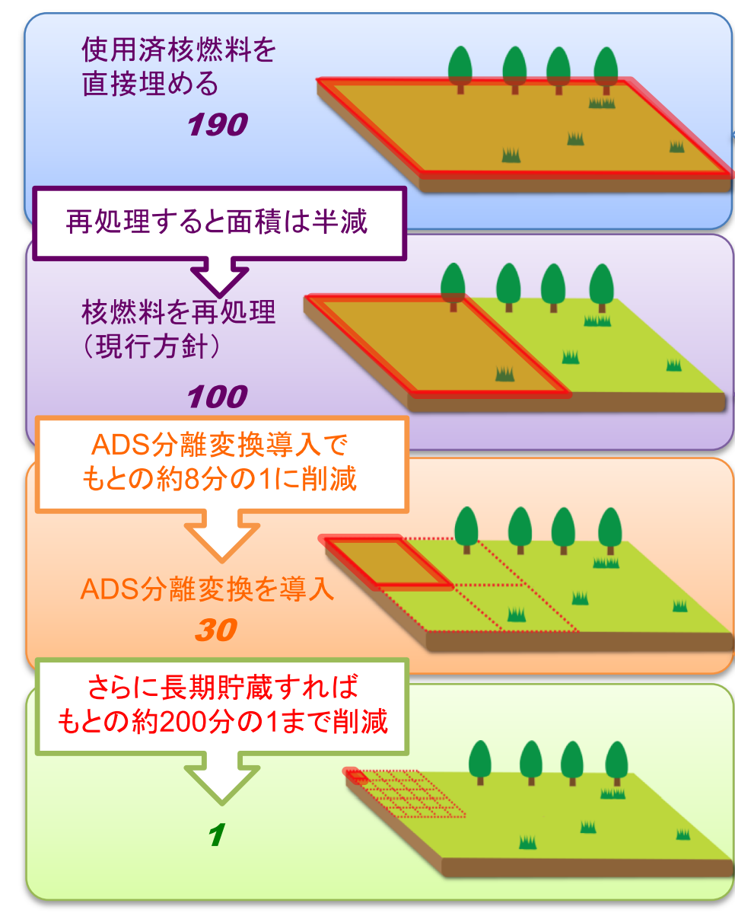
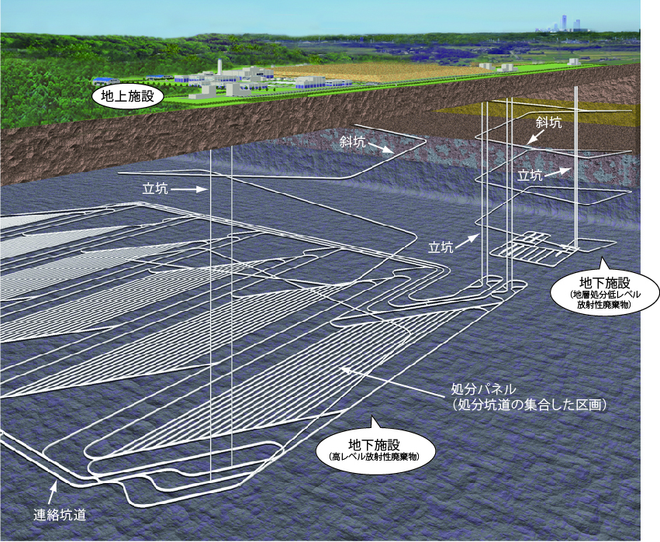
Nuclear waste problem
How to dispose nuclear waste is the common issue for all humanity.
Japan’s case
  Already exiting 18,000 tons
  If nuclear plant can restart,
  1000 tons newly generated (/year/40 plants)
If Partitioning and Transmutation effectively work...,
Direct disposal
Recycle
Current policy
Raw waste
HLW
After P&T
Natural U
ADS P&T
Potential toxicity (Sv)
Disposal space 1/3
Wait ⁹⁰Sr & ¹³⁷Cs
decay
300 y
100,000 y
Current plan of geological disposal
https://www.numo.or.jp/
10 km² required
Year
Toxic period 1/300

Slide 4
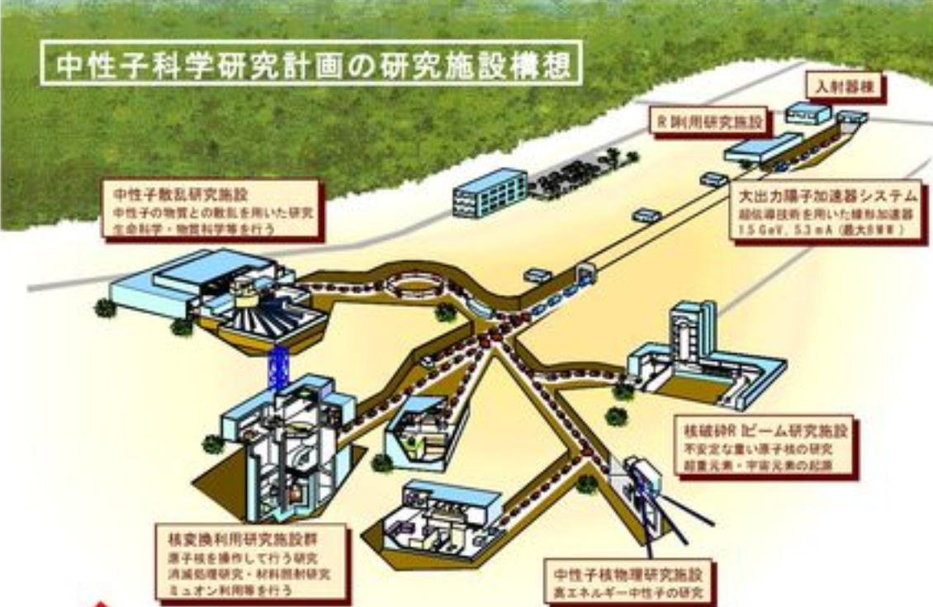
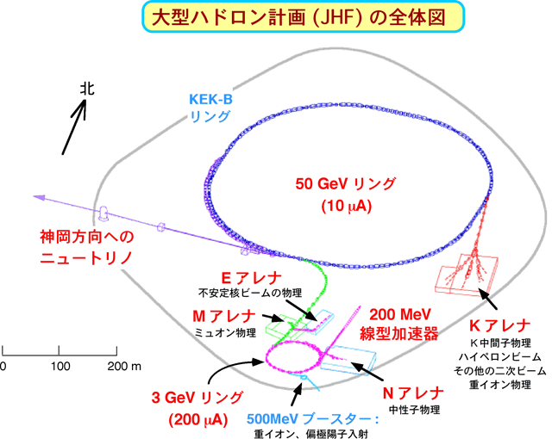
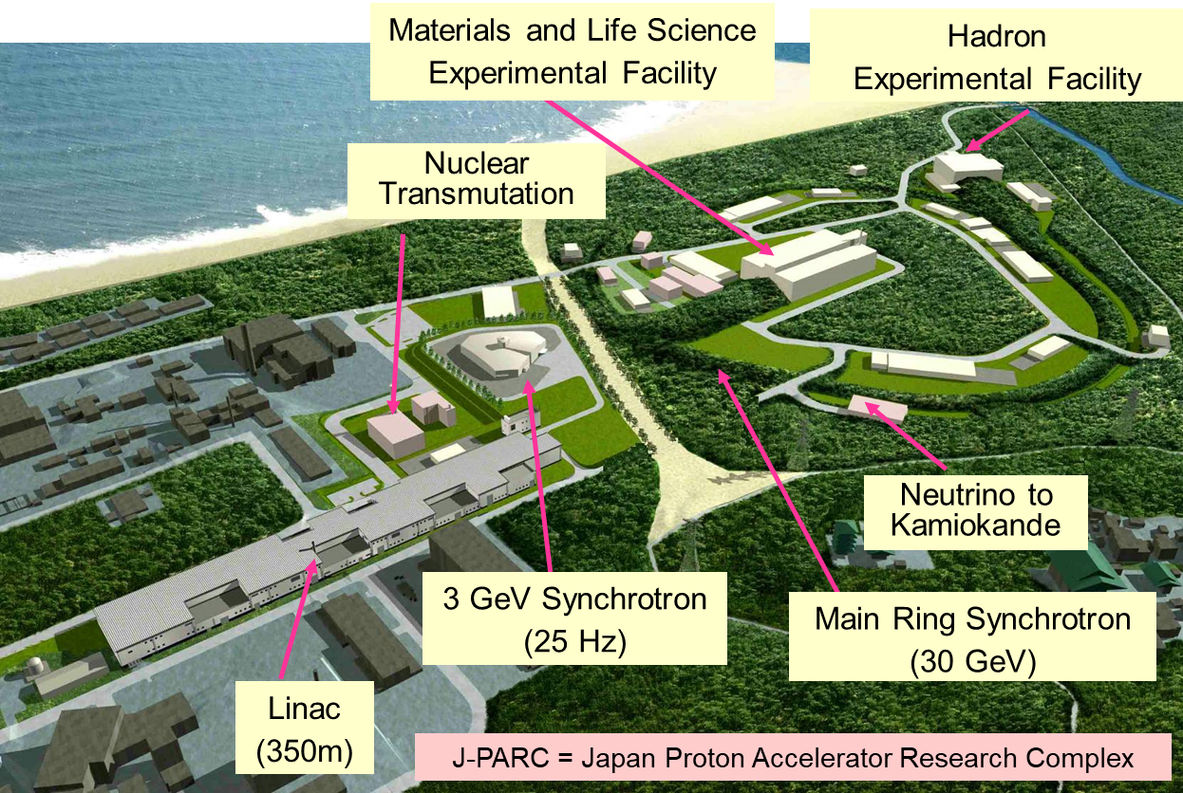
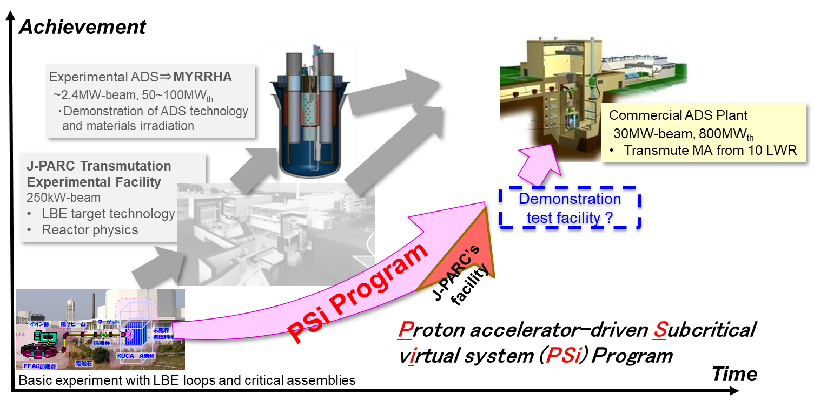
History of JAEA ADS
JAERI (JAEA)
project
KEK project
1988
Omega project start
JHP start
1990
ADS Conceptual
design
NSP
JHF start
included
jointed
2001
J-PARC start
Concentrated on
J-PARC construction
2009
User operation start
2011
Great e. Japan
earthquake
(severe accident of F1 plant)
Funding for TEF
got smaller and
smaller
2019
Reconsidering
strategy
10th anniversary

Slide 5
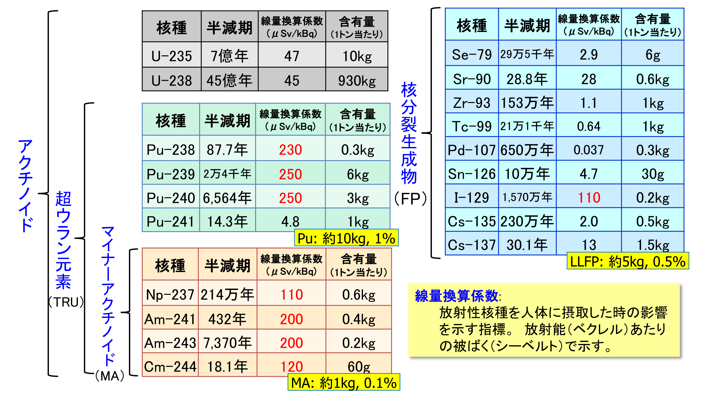
Aim of the JAEA ADS
nuclide
τ_{1/2} (y)
Dose rate
mass
/ton
nuclide
τ_{1/2} (y)
Dose rate
mass
/ton
Reduce
  long-term toxicity of
  disposal space for
nuclear waste.
Focus on
MA transmutation.
700M
0.295M
4500M
28.8
1.53M
Fission Products
nuclide
τ_{1/2} (y)
Dose rate
mass
/ton
0.211M
87.7
6.5M
24000
0.1M
Actinoid
6564
15.7M
Transuranium
14.3
2.3M
~
30.1
nuclide
τ_{1/2} (y)
Dose rate
mass
/ton
~
Minor Actinoid
2.14M
Major long lived nuclide
in 1 ton nuclear waste
432
7370
18.1
~

Slide 6
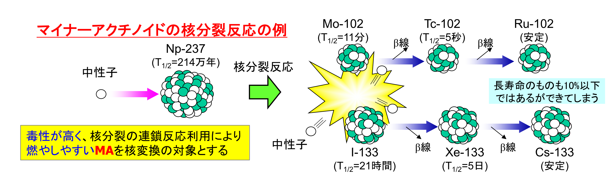
Transmutation of Minor Actinoids
Example of fission reactions of Minor Actinoids
11m
β
5s
β
(stable)
Fast neutron
2.14My
fission
LLFP (~10%)
MA: High toxicity, burnable by chain reaction
n
β
β
21 h
5d
(stable)
Need ultimate neutron source (~10¹⁹ /s J-PARC: 10¹⁷ /s)

Slide 7
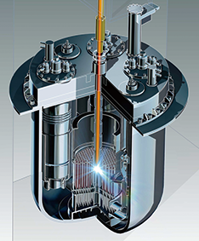
High intensity proton accelerator + subcritical reactor = ADS
Accelerator power 1MW→30MW
Chain reaction
x 30
Total 100 gain from existing neutron source
Super-conducting LINAC
Proton beam
Max. 30 MW
100 MW
To accelerator
800 MW
170 MW
Fission energy
To grid
270 MW
Power generation
Features of ADS:
Chain reactions stop when the accelerator is turned off.
LBE is chemically stable.
➔ High safety is expected.
High MA-bearing fuel can be used.
➔ MA from 10 LWRs can be transmuted.
Spallation target
(LBE)
MA-fueled LBE-cooled subcritical core

Slide 8

Conceptual design : Reference ADS
Liq. He
RF
RF
RF
RF
RF
RF
Injector
Proton beam
RFQ
DTL
Superconducting linac
Steam generator
Primary pump
Beam energy : 1.5 GeV
Max. beam current : 20 mA
Spallation target : Pb-Bi eutectic (LBE)
Coolant : LBE
Max. k_{eff} = 0.97
Thermal output : 800 MWt
MA initial inventory : 2.5t (1000 mol)
Transmutation rate : 10%MA / Year
(MA from 10 LWRs/year equivalent)
600EFPD (Effective Full Power Days)
/ 1 batch
Inner barrel
Beam duct
Beam window
Reactor vessel
Core barrel
13.5m
Guard vessel
Core support structure
11.8m
Notes:
Next, the conceptual design of JAEA’s reference ADS
JAEA's reference design of ADS is a tank-type subcritical reactor.
The accelerated energy is 1.5 GeV. In order to keep the thermal power at 800 MW, the maximum beam current of the linac is set at 20 mA.
The linac consists of a series of 151 klystrons, which were designed for a 972 MHz RF wave. Maximum rated output power of the klystron is 750 kW.

Slide 9
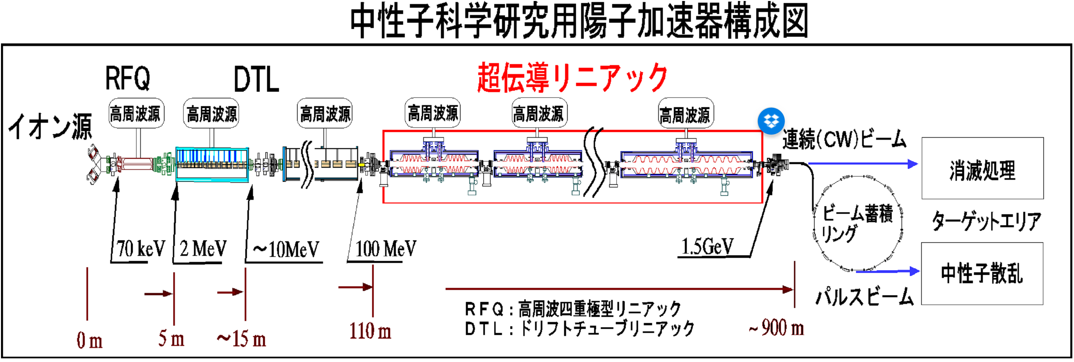
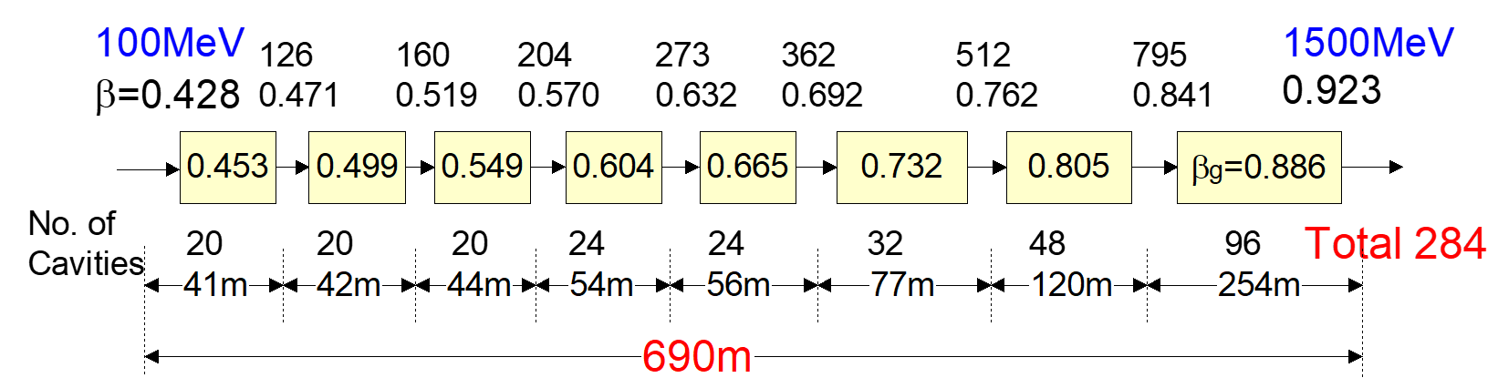
Neutron Science Project (NSP) at JAERI
SC Linac
IS
CW beam
Transmutation
ring
Neutron
Scattering
Pulse beam
100 MeV -> SC linac
N. Ouchi et al., SRF97, A02
M. Mizumoto et al, LINAC98, TU1004
N. Akaoka et al., SRF99, WEP020

Slide 10
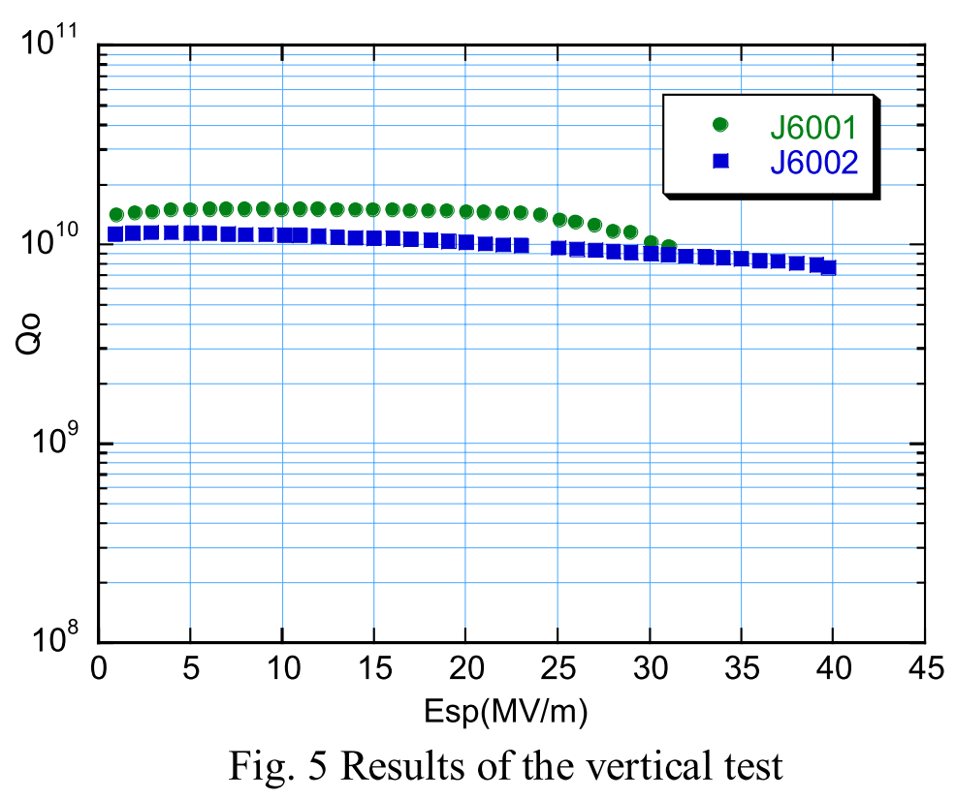
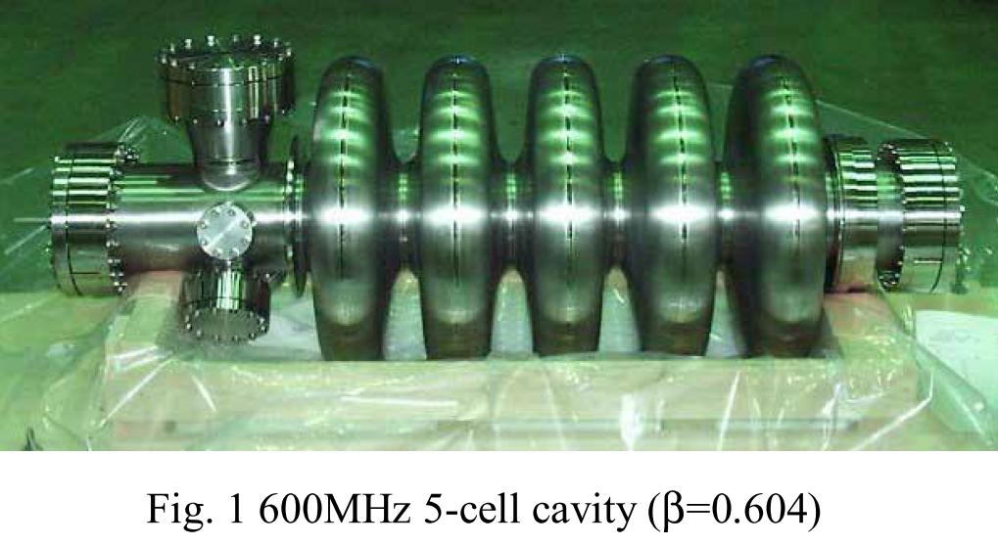
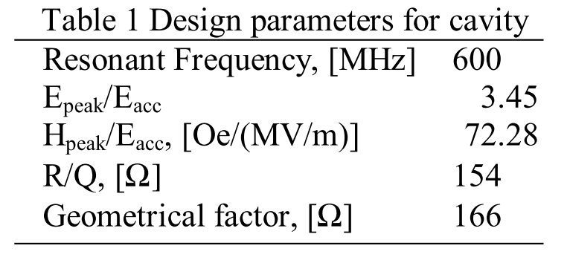
SFR development for NSC
Design 16 MV/m
O. Takeda et al, SRF01 PR013

Slide 11
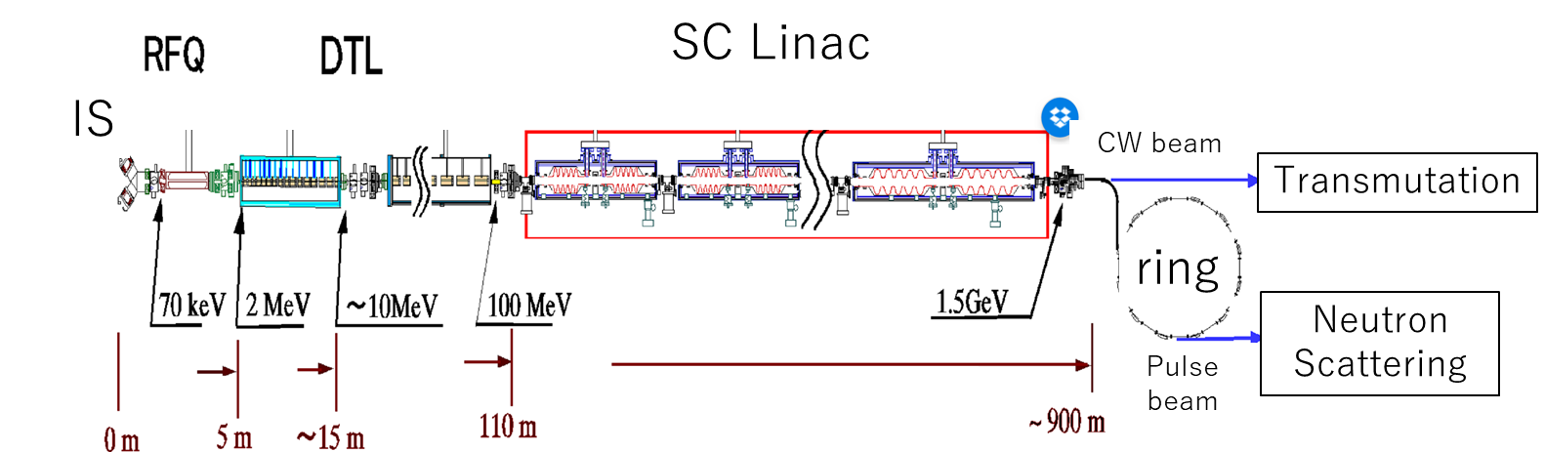
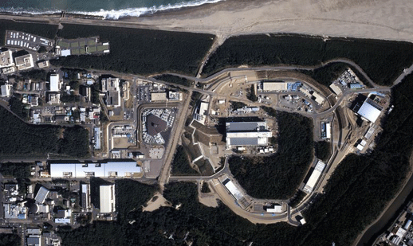
JAERI-KEK joint (JKJ) project → J-PARC (2001)
a
Neutron Science Project (NSP) @ JAERI
Jointed
Japan Proton Accelerator Research Complex
(J-PARC) @ JAEA
Japan Hadron Project (JHP) @ JAERI

Slide 12
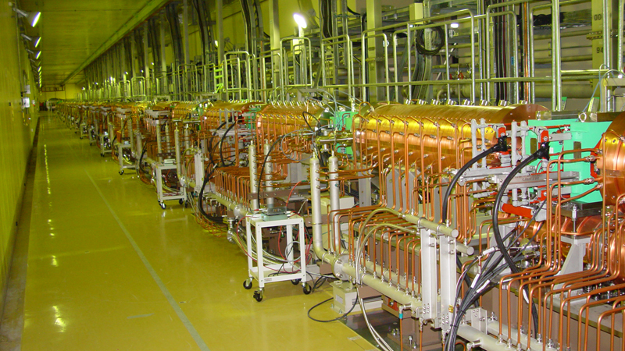
J-PARC linac
– The last high-power warm proton linac?

Slide 13
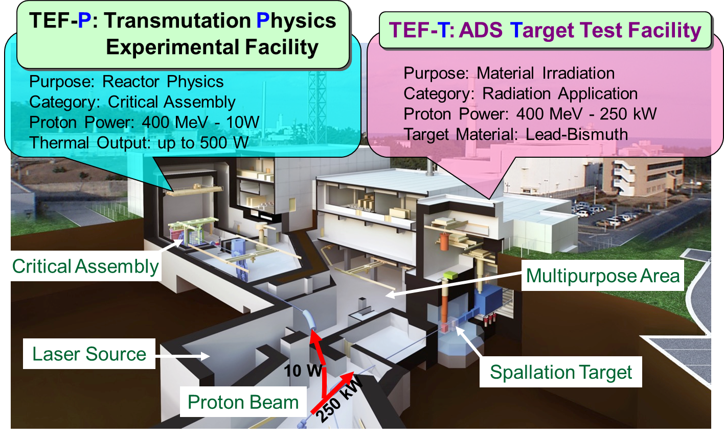
Transmutation Experimental Facility (TEF)
was one of the main facilities of J-PARC (MLF, HD, NU, and TEF)

Slide 14
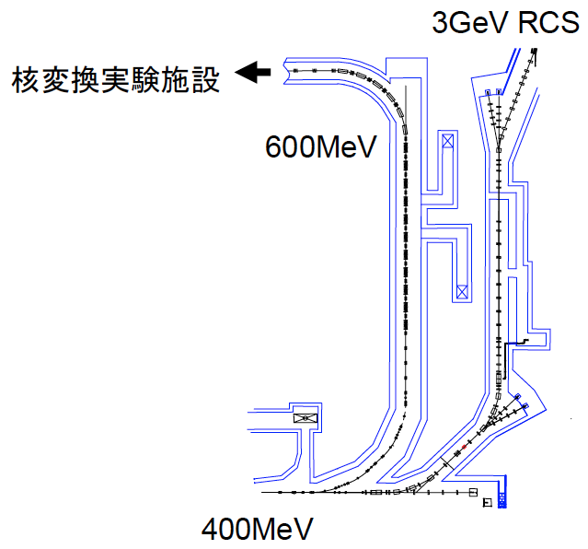
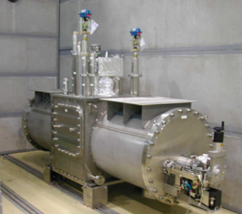
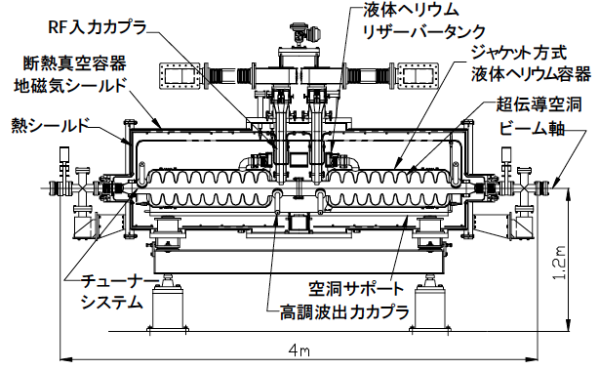
Elliptical cavity
developed for transmutation experiment at J-PARC
Transmutation
experimental
facility
RF coupler
Heat insulation
vacuum vessel
11 cryomodules
Tuner
System
HOM coupler
This upgrade project for transmutation experiment was suspended
-> The elliptical cavity development in JAEA
has been stopped more than ten years.
IS
2MeV-RFQ
50MeV-DTL
190MeV-SDTL
400MeV-ACS

Slide 15
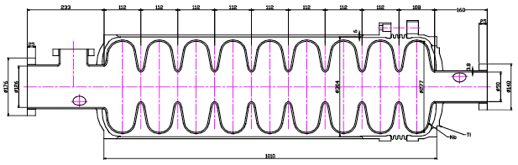
Elliptical cavity
developed for transmutation experiment at J-PARC
Beam energy | 400 – 600 MeV
Frequency | 972 MHz
β | 0.71 – 0.79
Num. of cell per cavity | 9
Num. of cavity per cryomodule | 2
Num. of cryomodule | 11
Total length | 57.7 m
Surface peak electric field (Esp) | 30 MV/m
Accelerating electric field (Eacc) | 9.7 – 11.1 MV/m
Synchronous phase | -30 deg
Number of klystrons | 11
Total RF power | 10 MW
Loaded Q value | 〜5E5
Parameters of J-PARC SCC
Esp/Eacc | 3.07
Bsp/Eacc | 5.54 mT/(MV/m)
R/Q | 478 Ω
Geometrical factor | 208 Ω
Coupling constant | 2.80 %
N. Ouchi, SRF09 FROBAU05

Slide 16
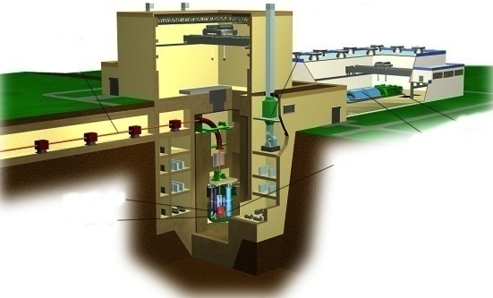
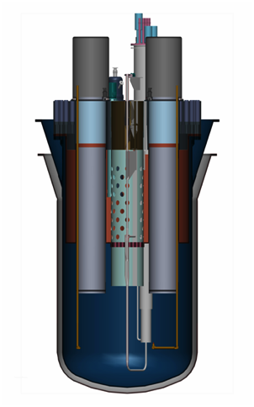
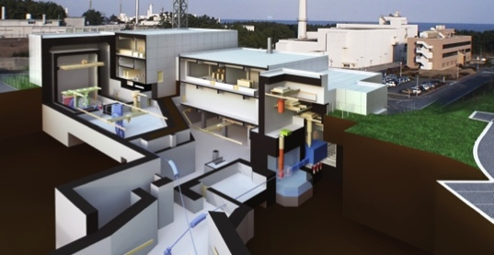
Roadmap for Establishment of ADS (old)
ADS technology without MA fuel
(Pb-Bi core, Accelerator, Operation Experience)
Power
ADS Demo⇒MYRRHA
~2.4MW-beam, 50~100MW_{th}
・Demonstration of ADS
ADS Plant
30MW-beam, 800MW_{th}
・MA transmutation
Physics of MA-fueled sub-critical core driven by a proton beam
Radiation damage of beam window material and LBE target
Lead the worldwide R&D for transmutation technology in cooperation with J-PARC, MYRRHA, etc.
Obtain knowledge & experiences to realize ADS in 2030th
J-PARC Transmutation Experimental Facility
250kW-beam
・Pb-Bi target ・ADS core
Basic tests (Pb-Bi loop, KUCA, etc.)
2010
2020
2030
2050
Year

Slide 17
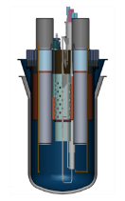
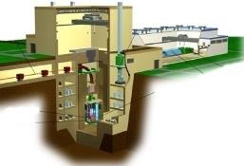
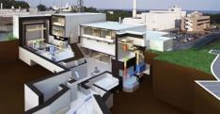
New approach by enhancing computer science
Enhancement on the development of advanced modeling and simulation, and high ­performance computing methods to improve designs of future ADS, reduce uncertainty in facilities development and construction costs.
Achievement
Experimental ADS⇒MYRRHA
~2.4MW-beam, 50~100MW_{th}
・Demonstration of ADS technology
and materials irradiation
Commercial ADS Plant
30MW-beam, 800MW_{th}
Transmute MA from 10 LWR
J-PARC Transmutation Experimental Facility
250kW-beam
LBE target technology
Reactor physics
Demonstration test facility ?
PSi Program
J-PARC’s
facility
Proton accelerator-driven Subcritical virtual system (PSi) Program
Basic experiment with LBE loops and critical assemblies
Time

Slide 18
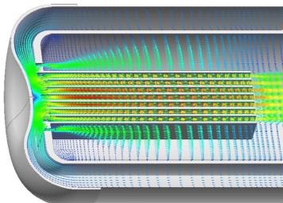
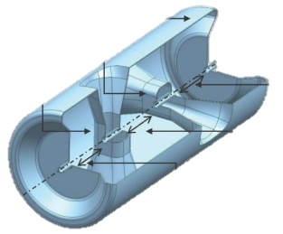
Concept of the new proton irradiation facility
Irradiation samples (fusion & fission)
PBW
Pb-Bi
400 MeV, 250 kW
Proton beam
LBE target
TEF-T is the baseline design.
Sample specimens （SUS･T91）
Irradiation samples
(accelerators)
H- beam from Linac
400 MeV, 250 kW
Water or He cooling
Hold the concept of TEF-T’s multi-purpose use
Heavy neutron irradiation
High-energy neutron beam port
Use of a small fraction of the proton beam (ex. ISOL)
Eliminate BT-line to TEF-P
Space for accelerator development for ADS
low β part, 10 MeV,
20 mA, 200 kW
PIE specimens
Hot-labo.
PIE specimens
to JAEA’s Hot-labo.
TEF-P
PIE specimens
MLF
HD
NU
･･･

Slide 19
Requirement for JAEA ADS accelerator
- Beam energy : 1.5 GeV
high efficiency of neutron generation per beam power
- Beam power : 30 MW
- Beam duty : CW
decrease thermal shock @ beam window
- Beam current : 20 mA
(cf. J-PARC linac: peak current : 50mA duty : 1.25% (25Hz, 500us)
J-PARC complex: 1 MW @ exit of 3 GeV synchrotron -> pulsed beam)
- Extreme reliability
avoid thermal shock of reactor
300 days for operation + 65 days for maintenance (beam window)
- Pulse mode operation
Transient of start up and shut down operation
⇒ Flexible controlability of beam power is required

Slide 20
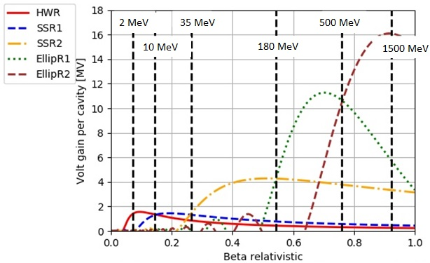
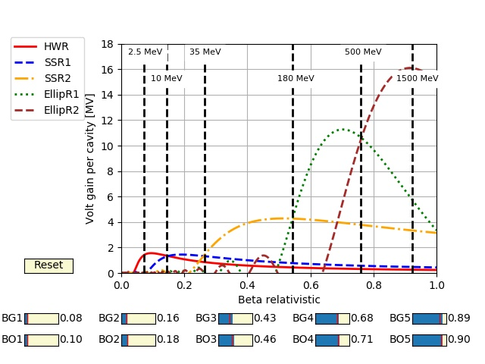
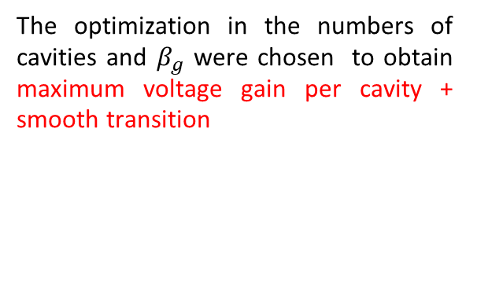
SRFC baseline → Bruce’s presentation
SRF cavity start point model
Cavity type | Freq [MHz] | # of Cell
HWR | 162 | 2
SS | 324 | 2
Elliptical | 648 | 5
2.5 MeV
35 MeV
500 MeV
10 MeV
180 MeV
1500 MeV
Voltage gain was computed
assuming:
Sinusoidal E fields
Synchronous phase of -30⁰
Vmax of 2.0,2.05,4.987,11.9
and 19.9 MV (values of PIP-II)
The optimization in the numbers of cavities and $β_{g}$ were chosen to obtain maximum voltage gain per cavity + smooth transition
Low beta’s are replaced by SRF
Family of ellips are reduced → Fault tolerance
Higher current than other ADS linacs
JAEA-ADS superconducting linac layout
162 MHz
324 MHz
648 MHz
HWR
βg=0.08
SSR1
βg=0.16
SSR2
βg=0.43
EllipR1
βg=0.68
EllipR2
βg=0.89
2.5 MeV
10 MeV
35 MeV
180 MeV
500 MeV
1500 MeV
Notes:
Based in the J-PARC linac experience and in similar projects(PIP-II,C-ADS, etc..).

Slide 21
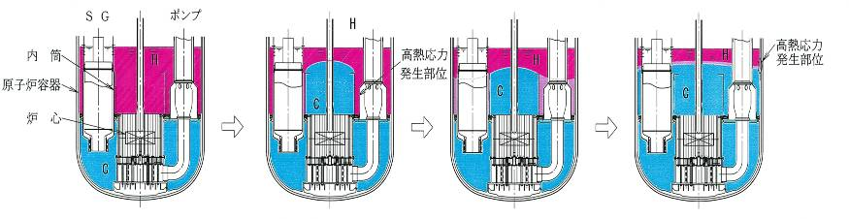
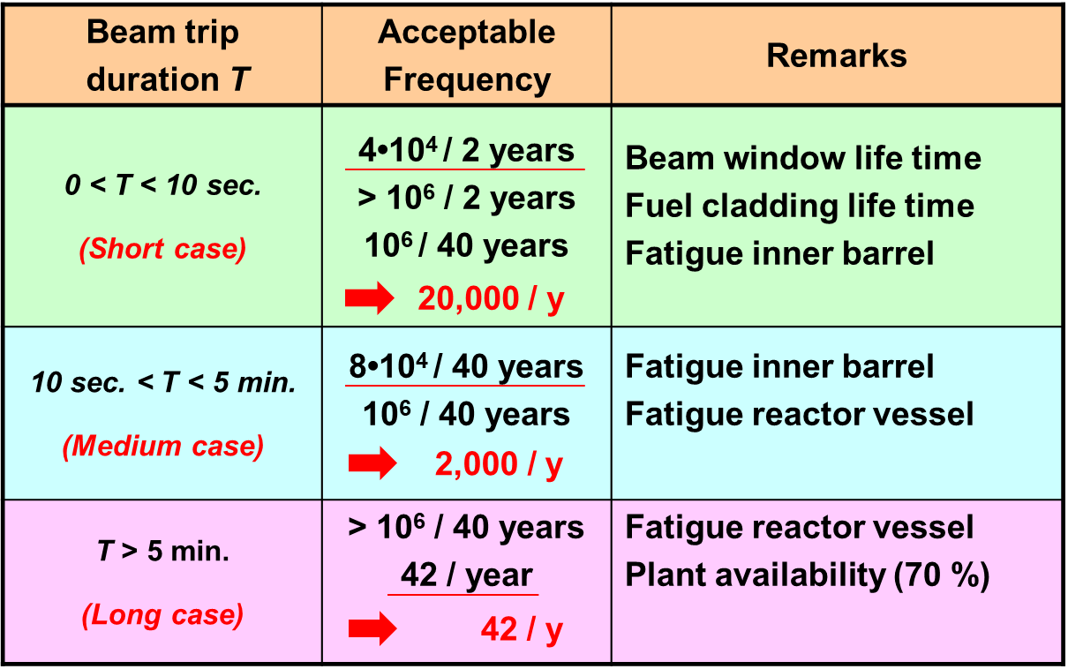
Transient due to beam trip
SG
Pump
Reactor
vessel
Inner barrel
H
H
Inner
barrel
H
H
Reactor vessel
C
C
C
Core
C
Beam
window
Fuel
cladding
H
:High temperature
A
Before beam trip
B
Several seconds
After beam trip
C
Transient
D
Several minutes
after beam trip
C
:Low temperature
Transient analyses were made on the thermal responses of following four parts of the reactor components.
  Beam window
  Fuel cladding
  Inner barrel
  Reactor vessel
Notes:
Next, acceptable frequency of beam trips.
These figures show the cross-section of the subcritical core. During normal operation, the cold LBE flows upward through the subcritical core and is heated. Finally, the hot LBE exits into an upper plenum.
In the case of the beam trip, the cold LBE exits from the core into the upper plenum. On the several minutes after the beam trip, the most of the LBE temperature becomes low.
To get the acceptable frequency of beam trips, transient analyses were made on the thermal responses of following four parts of the reactor components. That is, the beam window, the fuel cladding, the inner barrel and the reactor vessel, are picked up.

Slide 22
Trip rate analysis using J-PARC data
T. Sugawara et al., Annals of Nuclear Energy 125 (2019), p242
10⁵
Acceptable beam-trip frequency
Beam trip frequency of the JAEA's SC-linac was estimated using the operational data of J-PARC Linac.
10⁴
1/5
10³
Beam trip frequency (times/year)
The beam trip frequency (T < 10 sec.) is within the acceptable value at the present level of accelerator technology.
1/24
10²
While that exceeding five min. should be reduced by about 1/24 to satisfy the acceptable level.
10
Estimation based on the operational data of J-PARC Linac
1
0 - 10 s
10 s -
5 min
> 5 min
Caution: used data is old. Now updating.
Beam trip duration
Notes:
Next, comparison of beam trip frequencies.
This is the acceptable beam trip frequencies as a function of the beam trip duration. This axis represents the beam trip duration. And this axis represents the beam trip frequency.
The acceptable frequency of beam trips is shown as this red straight line.
On the other hand, the beam trip frequency of the JAEA SC-linac was roughly estimated as: Nads ~ Ninj + NRFQ + Nacc, where the Ninj, NRFQ and Nacc are the beam trip frequency caused by the injector, RFQ, and accelerator, respectively.
Three values were obtained from the operational data of J-PARC Linac.
Using the operation data, the down time distribution of the JAEA linac is shown as yellow histogram.
A comparison of the straight line and histogram shows that the beam trip frequency for durations of 10 seconds or less is within the acceptable value at the present level of the accelerator technology, while that exceeding five minutes should be reduced by about 1/35 to satisfy the acceptable level.

Slide 23
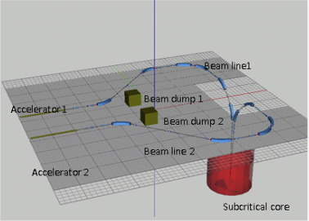
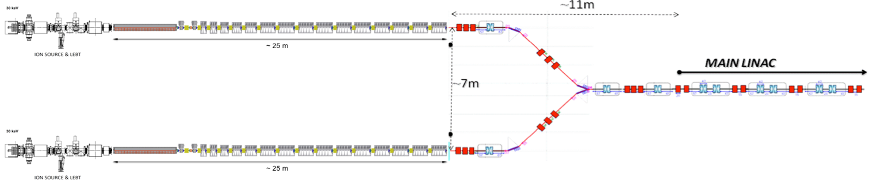
Fault tolerance
Low-β duplication + recover by adjacent cavities
(CADS, MYRRHA)
Full duplication (JAEA proposal)

Slide 24
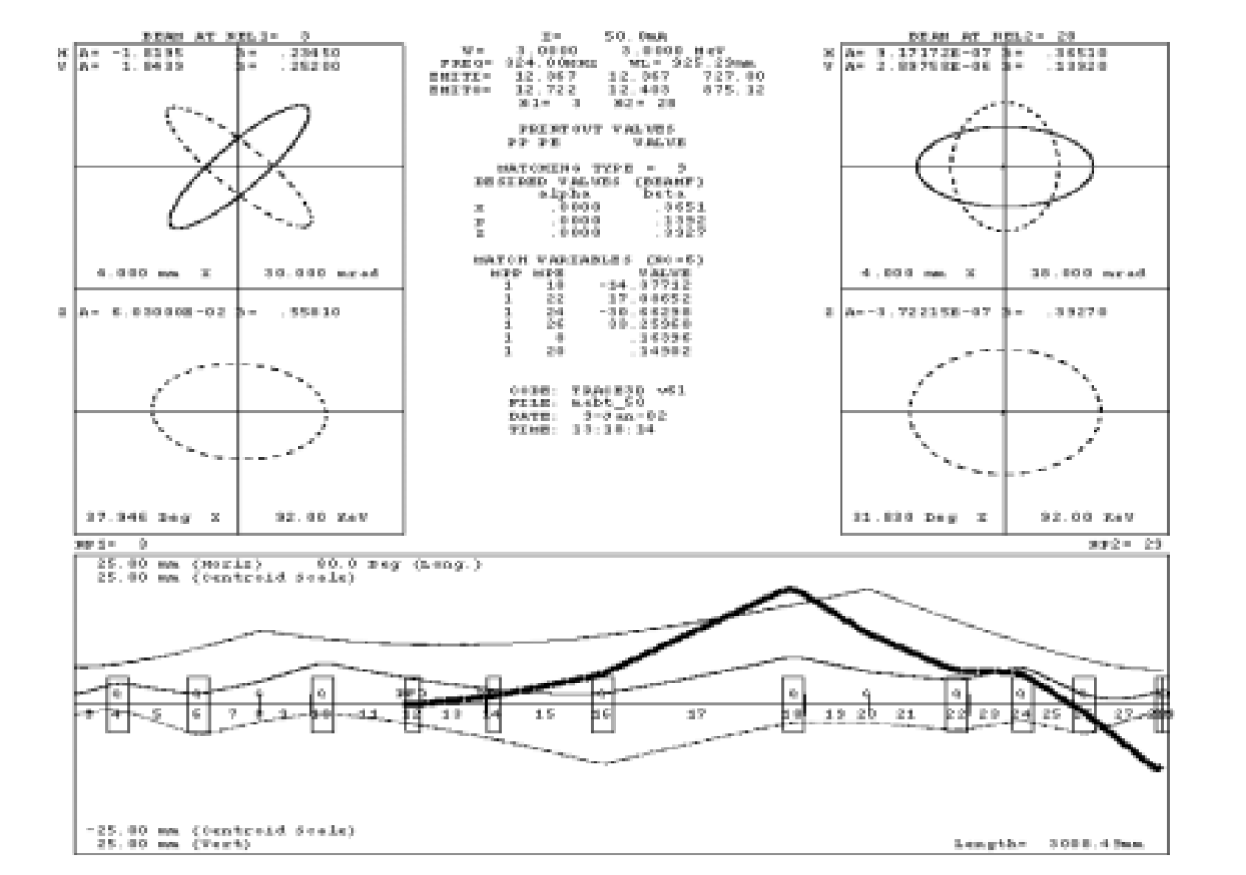
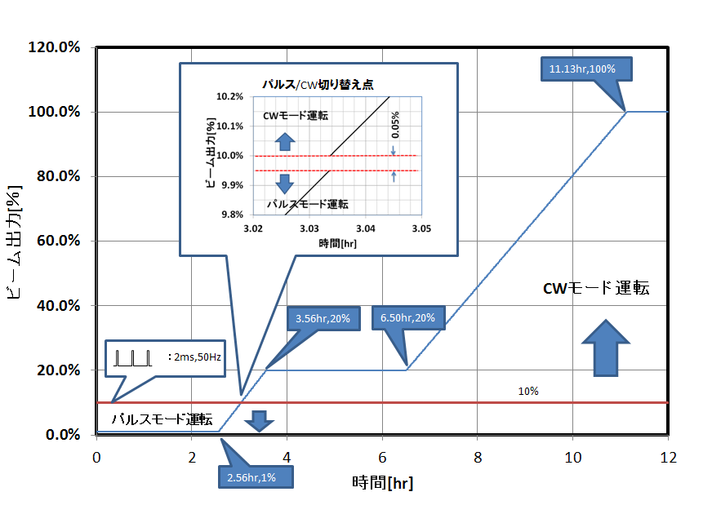
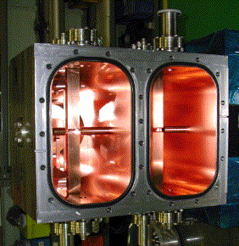
Reactor start up scheme
J-PARC MEBT Chopper
Beam power (%)
CW mode
pulse mode
time (h)

Slide 25
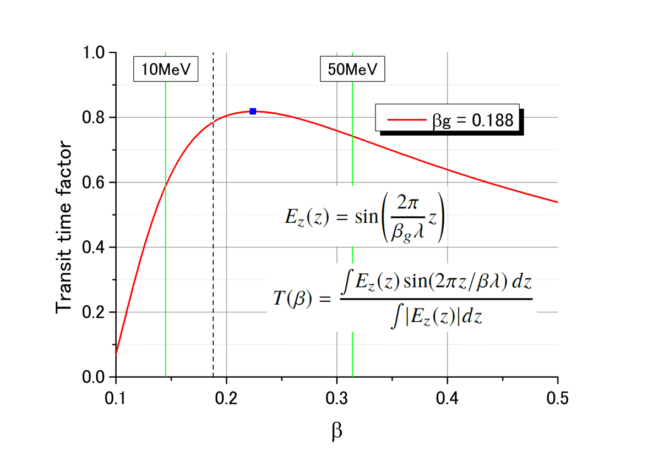
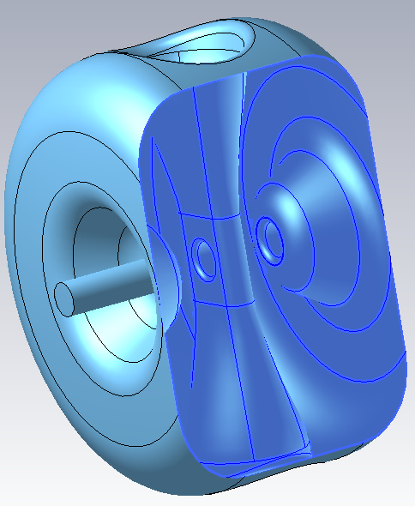
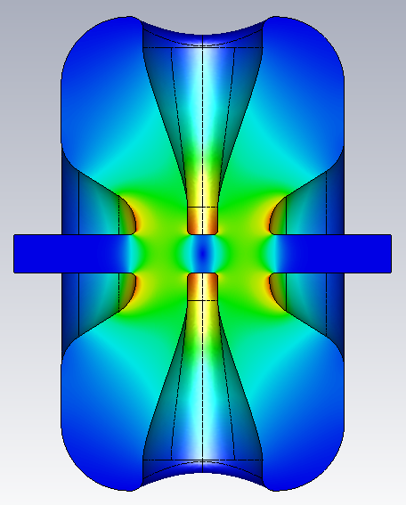
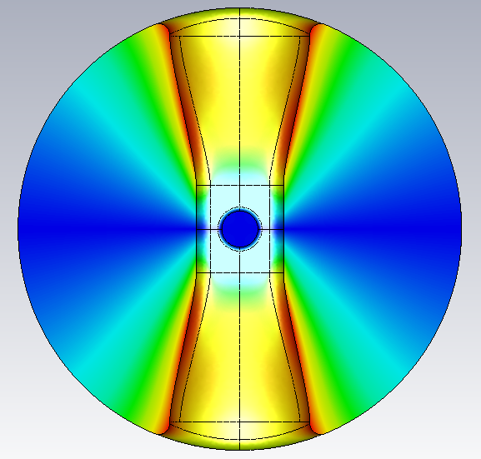
Cavity prototyping
Prototype Spoke Cavity for JAEA-ADS Linac
- Frequency : 324 MHz
- Shape : Single Spoke
- βg : 0.188
- βopt : 0.224
- Beam aperture : 40 mm
- Cavity length : 300 mm
- Cavity diameter : approx. Φ500 mm
E-field
H-field
Optimized Cavity Performance
- G : 90 Ohm
- R/Q : 240 Ohm
- Esp/Eacc : 3.8
- Bsp/Eacc : 6.1 mT/(MV/m)

Slide 26
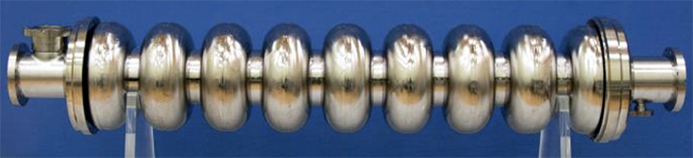
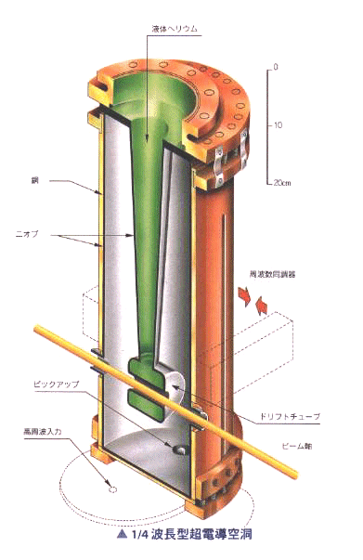
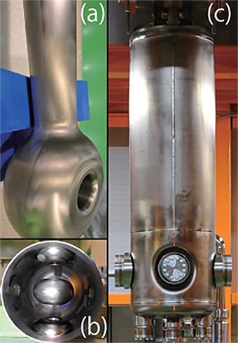
Japan’s SRF development
KEK 1.3GHz for ILC
JAERI 600MHz for ADS
No completed Spoke cavity in Japan
JAERI
QWR (‘93)
RIKEN
QWR (‘16)
H. Padamsee, Lectures given at the CAS course, 2013

Slide 27
Summary
JAEA has been developed ADS in these tree decades.
This program including superconducting proton linac development.
We are now redesigning the superconducting proton linac to meet modern trend.
  Beam dynamics for low beta SRF
  Fault tolerance
  Cavity prototyping

