Slide 1
Status of CSNS Project Sheng Wang, Shinian Fu, Huachang Liu China Spallation Neutron Source Institute of High Energy Physics, CAS

Slide 2
Outline
Project Overview
Accelerator Commissioning
User Operation
Upgrade Plan
Summary
2

Slide 3
1. Project Overview
3

Slide 4
Site Area
Location of CSNS
Located in Dongguan, Guangdong Province
First spallation neutron source in China and the fourth in worldwide
First large scientific facility in southern China
★
IMP
•
CSNS
•

Slide 5
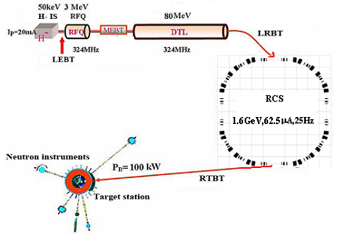
Project Design
The phase-I CSNS facility consists of an 80-MeV H⁻ linac, a 1.6-GeV rapid cycling synchrotron(RCS), beam transport lines, a target station, and 3 instruments.
Project Phase | I | II
Beam Power on target [kW] | 100 | 500
Proton energy [GeV] | 1.6 | 1.6
Average beam current [μA] | 62.5 | 312.5
Pulse repetition rate [Hz] | 25 | 25
Linac energy [MeV] | 80 | 300
Linac type | DTL | +SC
Linac RF frequency [MHz] | 324 | 324/648
Macropulse. ave current [mA] | 15 | 50
Macropulse duty factor | 1.05 | 1.5
RCS circumference [m] | 228 | 228
RCS harmonic number | 2 | 2
RCS Acceptance [πmm-mrad] | 540 | 540
Target | 1 | 1
Spectrometers | 3 | 20
Linac
The first high-energy high-intensity proton accelerator in China

Slide 6
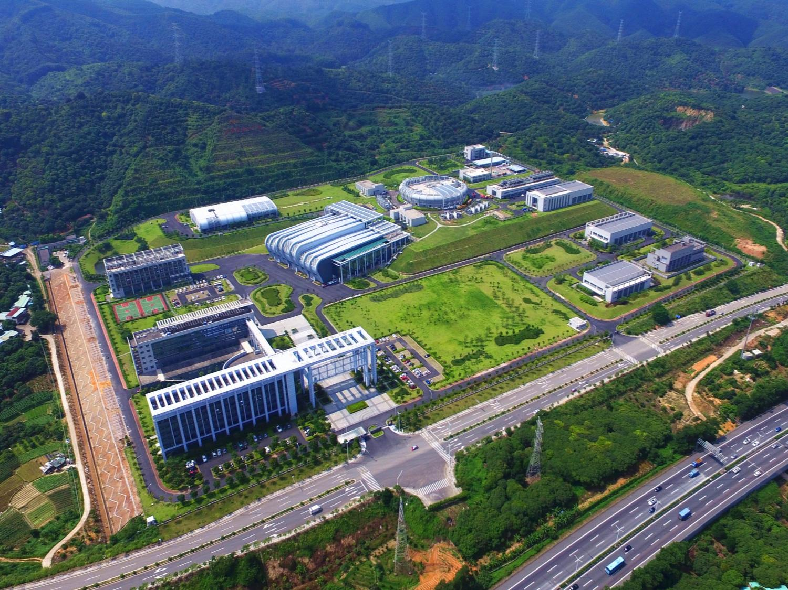
Before ground breaking(May.2009)
CSNS Campus, Aug. 2017
RCS building
Linac building
Target station and scattering hall

Slide 7
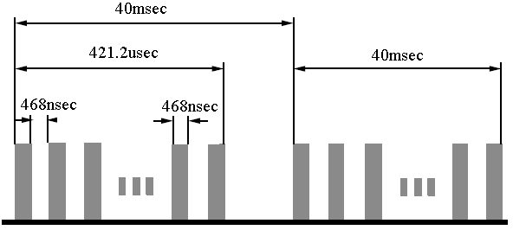
H⁻ Linac Design
EMQ option in FFDD lattice for DTL
Electrostatic chopper in LEBT
 | Ion Source | RFQ | DTL
Input Energy（MeV) |  | 0.05 | 3.0
Output Energy(MeV) | 0.05 | 3.0 | 80
Pulse Current (mA) | 20 | 15 | 15
RF frequency (MHz) |  | 324 | 324
Chop rate (%) |  | 50 | 50
Duty factor (%) | 1.3 | 1.05 | 1.05
Repetition rate (Hz) | 25 | 25 | 25

Slide 8
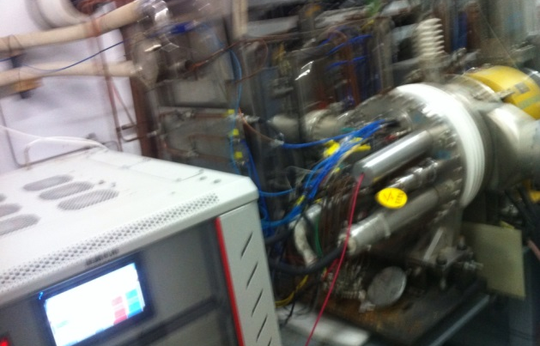
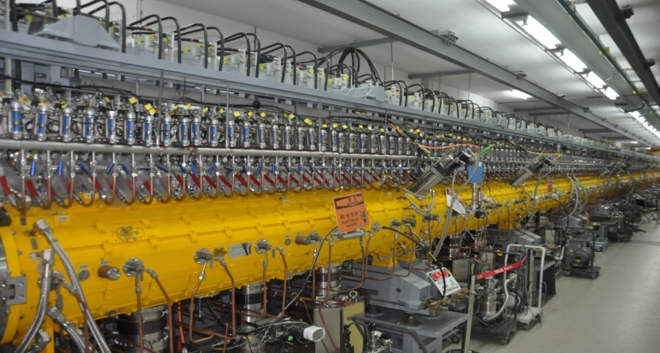
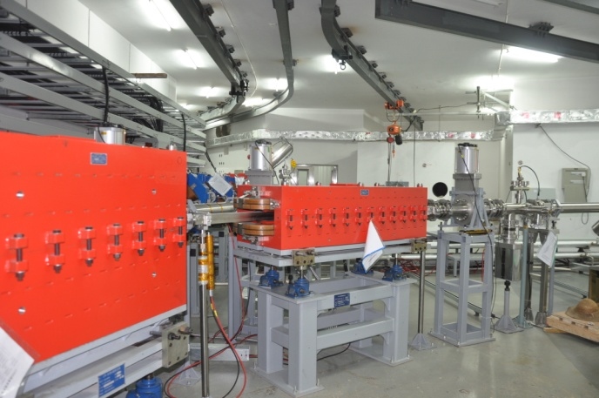
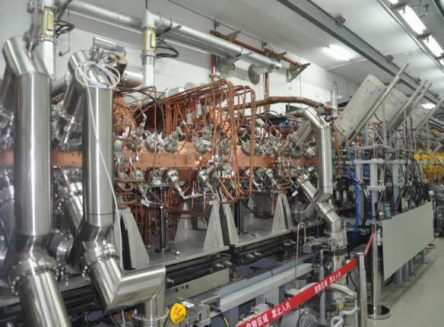
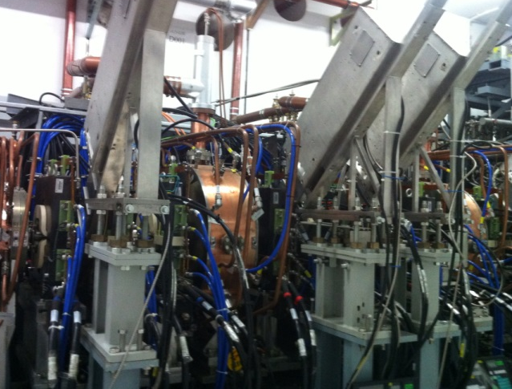
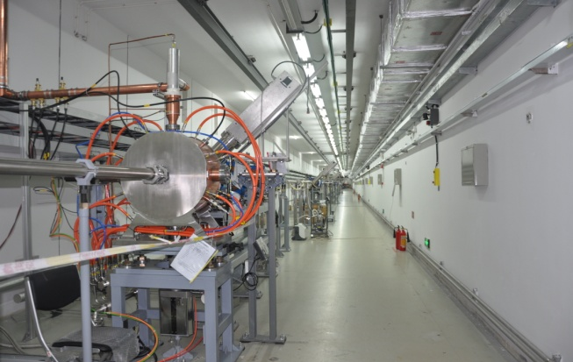
Linac installed in the tunnel
IS
DTL
LRBT
RFQ
MEBT
LRBT

Slide 9
RCS Design
Lattice of 4-fold symmetry, triplet.
227.92m circumference.
Four long straight sections for injection, acceleration, collimation and extraction.
24 main dipoles with one power supply.
48 main quadrupoles with 5 power supplies.
Ceramic vacuum chambers for the AC&pulsed magnets.
8 RF ferrite loaded cavities to provide 165 kV.

Slide 10
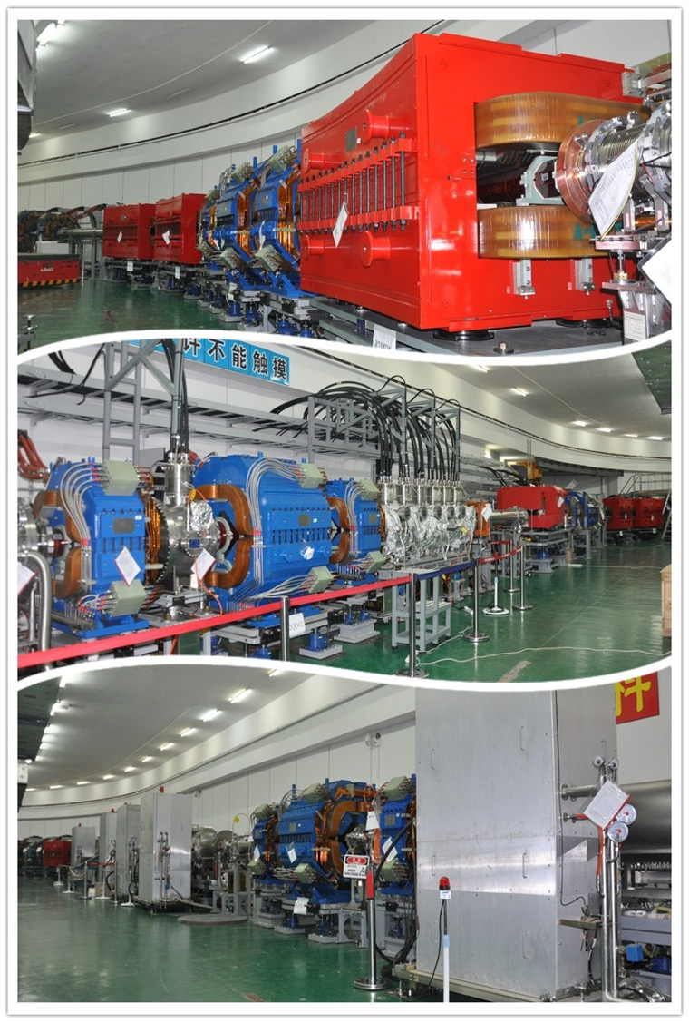
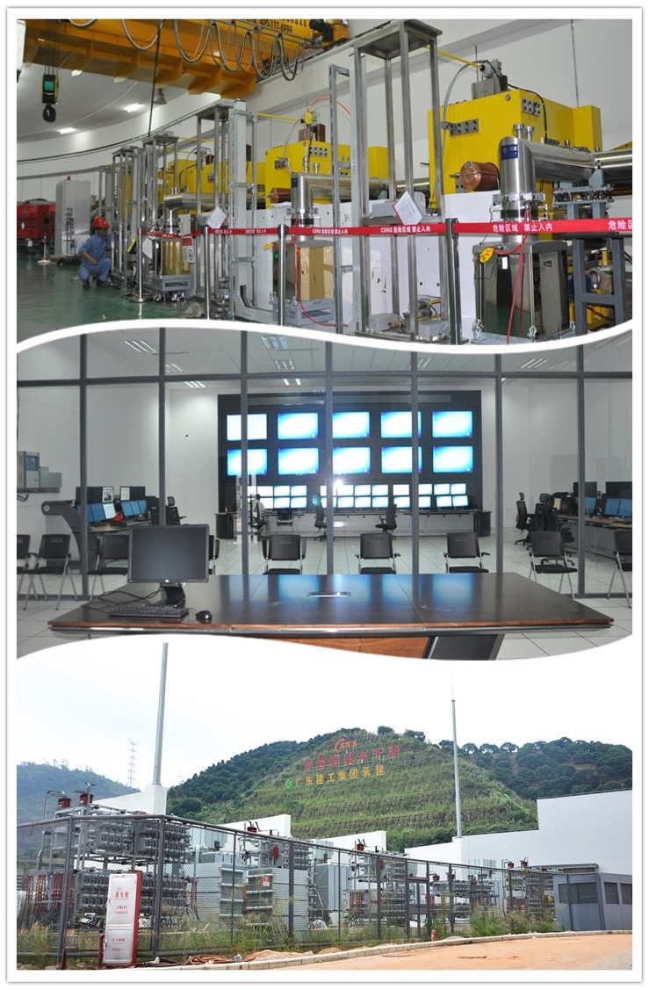
RCS Installation
Dipole magnet
Collimator
Quadrupole and Extraction magnet
Central control
Ring RF
Power supply for magnet

Slide 11
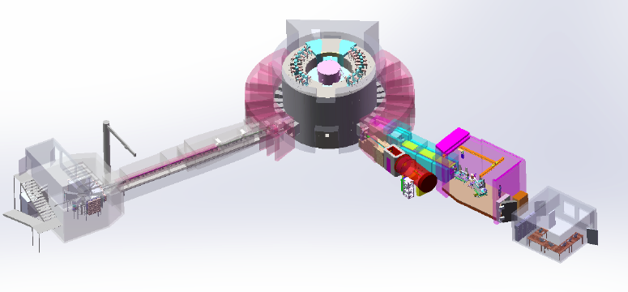
Instruments Suite
Blue: constructed 3
Red: Near future instruments 7
Green: CSNS upgrade project 10
High Resolution Diffractometer
Back scattering
Atmospheric neutron irradiation
Engineering Diffractometer
VSANS
Energy selected Neutron imaging
D-G Polarized Inelastic
Neutron Physics
Spin Echo
Reverse Geometry Chemical
High energy DG inelastic
Total Scattering
Elastic Diffuse Scattering
Low energy DG inelastic
General Purpose Powder Diffractometer
Liquid Relectometer
Single Crystal Diffractometer
Multi-purpose Relectometer
SANS
High Pressure diffractometer
Proton Beam
Decoupled & Poisoned Hydrogen Moderator (20K）
Coupled Hydrogen Moderator (20K)
Decoupled water moderator(300K), plan change to Decoupled Hydrogen (20K)
Notes:
CSNS has signed cooperation agreements with local Universities and Institutes to build 7 user instruments, including of High-pressure Powder Diffractometer for the structure studies of materials under extreme conditions （high pressure and high temperature）, Atmosphere Neutron Irradiation Spectrometer for the studies of single particle effect on electric systems and functional materials, Multi-physics Diffractometer for the micro-structure studies of complex materials, High-resolution Diffractometer for the fine structure studies of crystalline materials, High Energy Direct Geometry Spectrometer for the dynamic process studies of Strongly Correlated Electron Systems, and Engineering Materials Diffractometer for the studies of internal residual stress. CSNS is also planning for the development of the other 10 instruments.

Slide 12
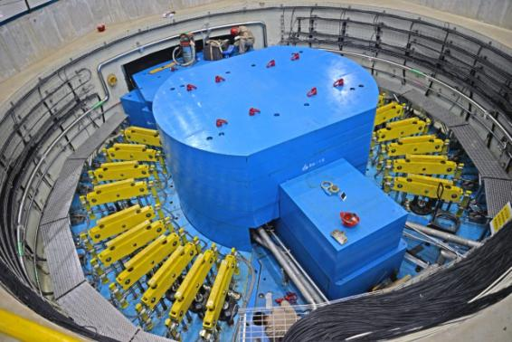
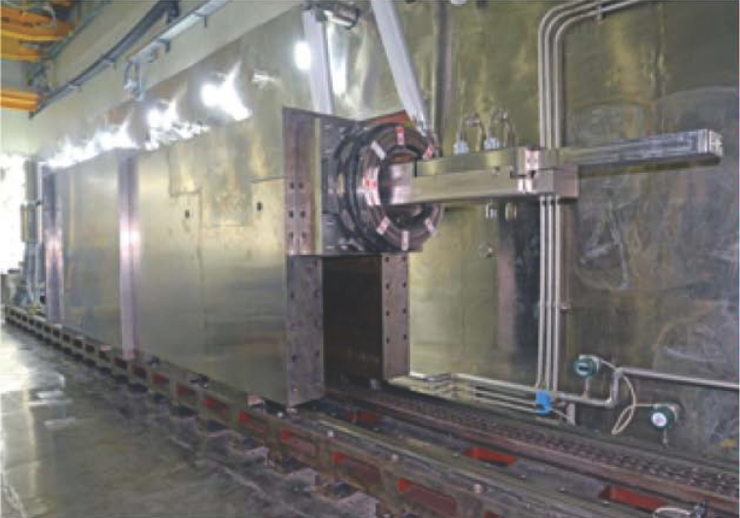
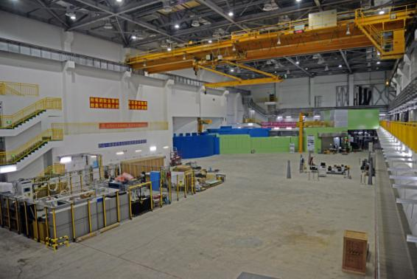
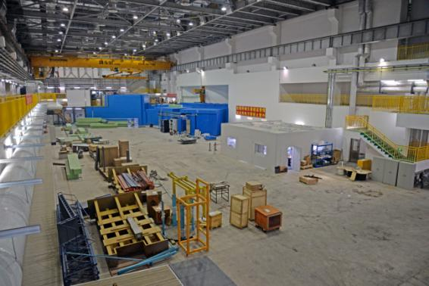
Target Station
Scattering Halls

Slide 13
Key Milestones (on schedule)
Proposal for the CSNS Project
proposal approved
civil construction started
Feb. 2001
Jan. 2006
Sep. 2008
Sep. 2011
May 2012
Oct. 2014
prototyping R&D started
construction started
installation started
DTL-1 Beam commissioning
RCS commissioning start
project complete/operation start
(6.5 years from start)
Jan. 2016
Apr. 2017
May. 2017
Aug. 2017
Mar. 2018
Mar. 2021
Linac beam commissioning
first beam on target, first neutron beam
100kW beam power

Slide 14
Budget and Expenditure (within budget)
The total budget approved is 1.86632 B RMB (268M US$)， actual investment is 1.8740665 B RMB (268.7M US$)
The expenditure of the equipment's is within the budget
The deficit of the civil construction is paid by the local governments
NO. | Systems | Approved Budget (Million RMB) | Actual Investment (Million RMB)
1 | Accelerator | 62,664.66 | 62,362.90
2 | Target and Instrument | 39,763.04 | 41,161.86
3 | Utilities | 21,853.81 | 24,914.20
4 | Others | 62,350.49 | 58,967.69
Total |  | 186,632 | 187,406.65

Slide 15
2. Accelerator Commissioning

Slide 16
Beam commissioning in 2017
1 of 4 DTL klystrons was not available in 2017.
RCS was commissioned with 60MeV linac beam from 3 DTL tanks.
It took 67 days to reach the beam power of 10kW.
RCS/AC (13 days)
RCS/DC (8 days)
Linac
(10 days)
RCS/DC
(10 days)
2017.04.15~04.24
2017.05.26~06.07
2017.06.30~07.12
2017.07.13~07.20
First beam on target, first neutron beam
Increase beam power to 10 kW
RCS/AC (8 days)
RCS/AC (18 days)
2017.07.21~07.28
2017.08.11~08.28
2017.08.28
2017.11.01~11.09
16

Slide 17
Beam commissioning in 2018
In the beginning of 2018, 4 DTL tanks were available and the beam commissioning were resumed.
It took 18 days to recover the beam power to 10kW with 80MeV linac beam.
From the Jan. 22, the beam was delivered to target for neutron spectrometers commissioning and user operation
By mid-March, the beam power is increased to about 25kW.
Time table of commissioning in 2018:
Jan. 4~ 13 Linac to 80MeV
Jan. 14~ 17 RCS/DC
Jan. 18~ 21 RCS/AC
Jan. 22~ Commissioning of instruments and user operation
March Beam power increased to ~25kW
17

Slide 18
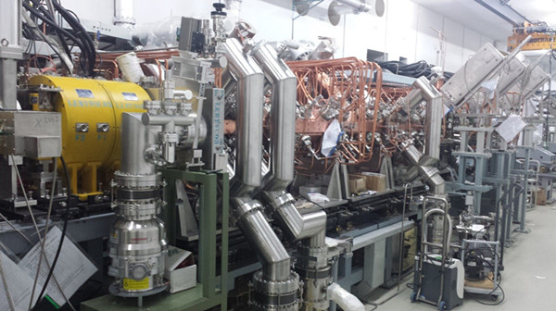
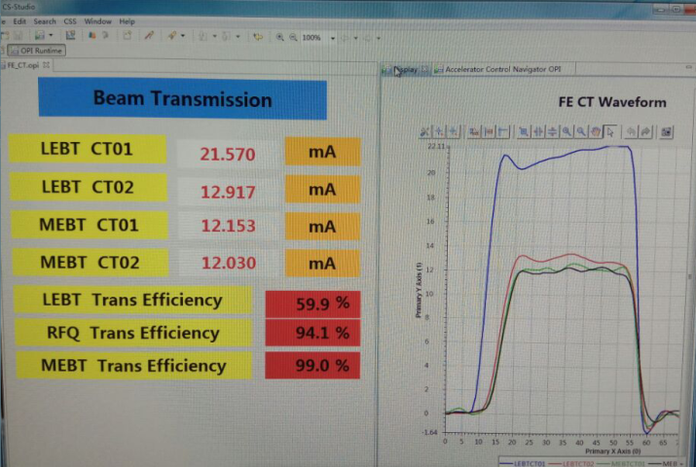
Frontend beam commissioning
From low duty to high duty: 50 → 500 μs, 1 → 25 Hz
(chop rate: 0 → 50 %) 。
Then, 90 hours continuous operation @25Hz, 500 μs , 50% chop rate。
Best transmission rate for RFQ: 94% 。
 | Design | Measured
Ion source current [mA] | 20 | 31
MEBT Peak current [mA] | 15 | 17
MEBT Beam energy[MeV] | 3.0258 | 3.02±0.015
Chopping rate [%] | 50 | 50
Pulse width [μs] | 420 | 500
Pulse repetition rate [Hz] | 25 | 25
Emittance (π mm mrad ) | 0.22 | 0.27

Slide 19
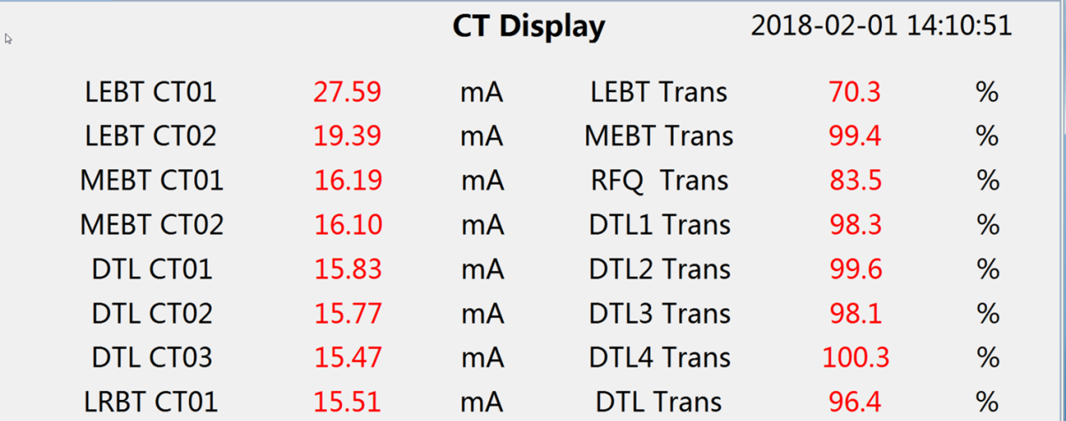
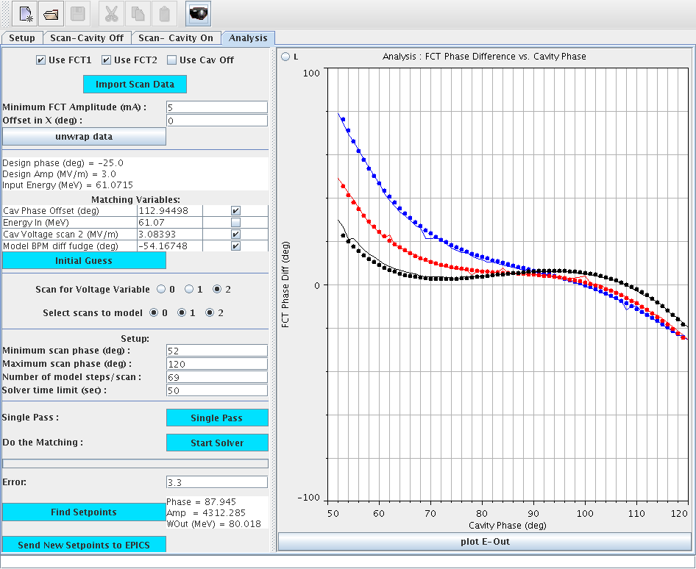
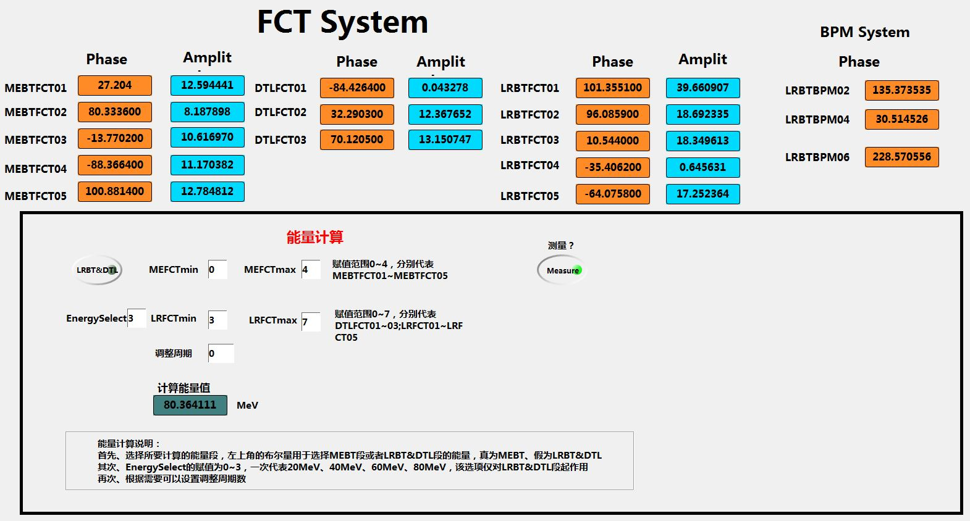
DTL tanks
DTL 1-3 ：Apr. 2017, Tank-3 output 15mA beam @60MeV.
DTL 4：Jan. 2018, 80MeV beam.
 | Measured（MeV） | Designed（MeV）
DTL1 | 21.81 | 21.67
DTL2 | 41.67 | 41.41
DTL3 | 60.80 | 61.10
DTL4 | 80.57 | 80.09

Slide 20
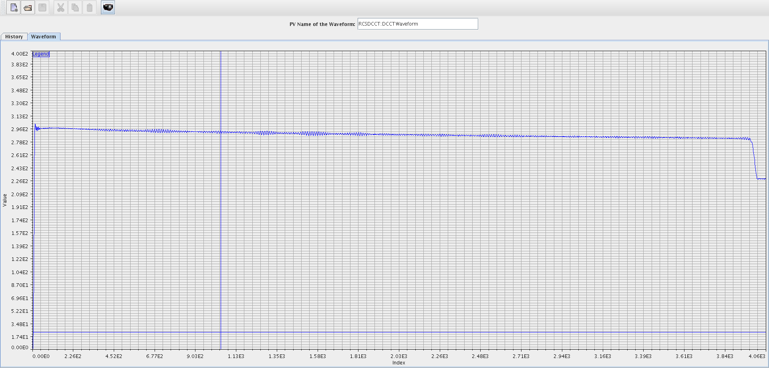
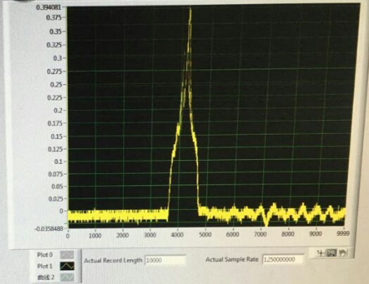
PPT模板：www.1ppt.com/moban/ PPT素材：www.1ppt.com/sucai/
PPT背景：www.1ppt.com/beijing/ PPT图表：www.1ppt.com/tubiao/
PPT下载：www.1ppt.com/xiazai/ PPT教程： www.1ppt.com/powerpoint/
资料下载：www.1ppt.com/ziliao/ 范文下载：www.1ppt.com/fanwen/
试卷下载：www.1ppt.com/shiti/ 教案下载：www.1ppt.com/jiaoan/
PPT论坛：www.1ppt.cn PPT课件：www.1ppt.com/kejian/
语文课件：www.1ppt.com/kejian/yuwen/ 数学课件：www.1ppt.com/kejian/shuxue/
英语课件：www.1ppt.com/kejian/yingyu/ 美术课件：www.1ppt.com/kejian/meishu/
科学课件：www.1ppt.com/kejian/kexue/ 物理课件：www.1ppt.com/kejian/wuli/
化学课件：www.1ppt.com/kejian/huaxue/ 生物课件：www.1ppt.com/kejian/shengwu/
地理课件：www.1ppt.com/kejian/dili/ 历史课件：www.1ppt.com/kejian/lishi/
RCS——storage mode（DC）
For controlling beam loss, we started RCS operation with storage mode at single shot.
June 2017, the storage beam was firstly extracted from the ring.
Beam transmission rate higher than 98% through the ring
Measured signal of the extracted beam

Slide 21
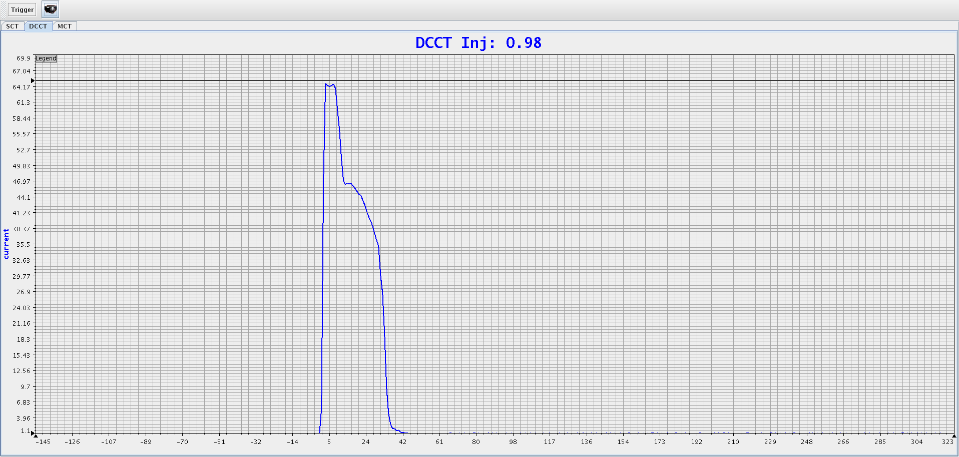
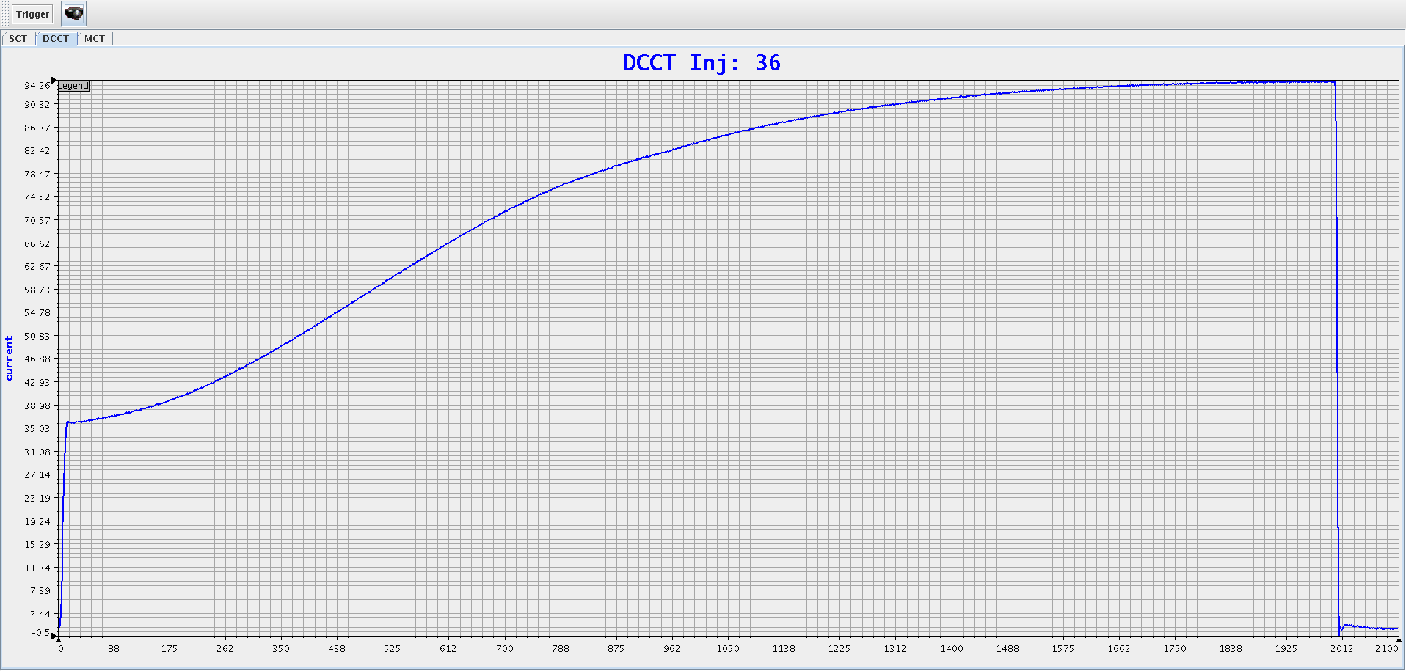
PPT模板：www.1ppt.com/moban/ PPT素材：www.1ppt.com/sucai/
PPT背景：www.1ppt.com/beijing/ PPT图表：www.1ppt.com/tubiao/
PPT下载：www.1ppt.com/xiazai/ PPT教程： www.1ppt.com/powerpoint/
资料下载：www.1ppt.com/ziliao/ 范文下载：www.1ppt.com/fanwen/
试卷下载：www.1ppt.com/shiti/ 教案下载：www.1ppt.com/jiaoan/
PPT论坛：www.1ppt.cn PPT课件：www.1ppt.com/kejian/
语文课件：www.1ppt.com/kejian/yuwen/ 数学课件：www.1ppt.com/kejian/shuxue/
英语课件：www.1ppt.com/kejian/yingyu/ 美术课件：www.1ppt.com/kejian/meishu/
科学课件：www.1ppt.com/kejian/kexue/ 物理课件：www.1ppt.com/kejian/wuli/
化学课件：www.1ppt.com/kejian/huaxue/ 生物课件：www.1ppt.com/kejian/shengwu/
地理课件：www.1ppt.com/kejian/dili/ 历史课件：www.1ppt.com/kejian/lishi/
RCS accelerating mode (AC)
July 2017 RCS started AC mode: the first shot of beam survive only for 4ms，not reaching the final energy.
On the same day, beam was accelerated to 1.6GeV design energy. And soon transmission rate reached almost 100%

Slide 22
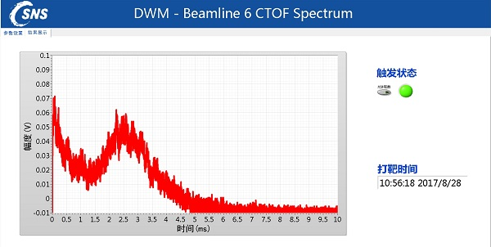
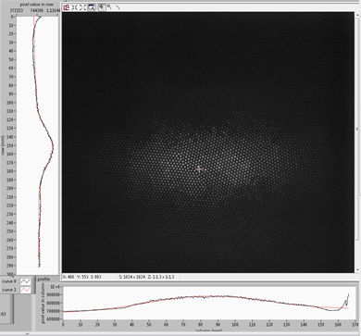
First beam on target on schedule
August 2017 the first proton beam hit on the target and produced spallation neutrons. This a important milestone for CSNS project.
Beam commissioning confirms a good performance in design, manufacture and commissioning.

Slide 23
Design Goal (Sept. 2011)
Beam power | Rep. rate | Ave. Curr. | Beam Energy | Neutron Effi. | Neutron Flux
100 kW | 25 Hz | 63 μA | 1.6 GeV | 0.1 (n/p/sr) | 2*10⁷
Keep the potential of upgrading beam power to 500kW.
1/10 beam power is required for acceptance, and the design goal will be met in 3 more years.
All achieved
or exceeded
Achieved in Acceptance (Aug. 2018)
Beam power | Rep. rate | Ave. Curr. | Beam Energy | Neutron Eff. | Neutron Flux
10 kW | 25Hz | 6.3μA | 1.6GeV | 0.005(n/p/sr) | 10⁵
23 kW | 25Hz | 14.5μA | 1.6GeV | 0.125 | 2.5*10⁶
23

Slide 24
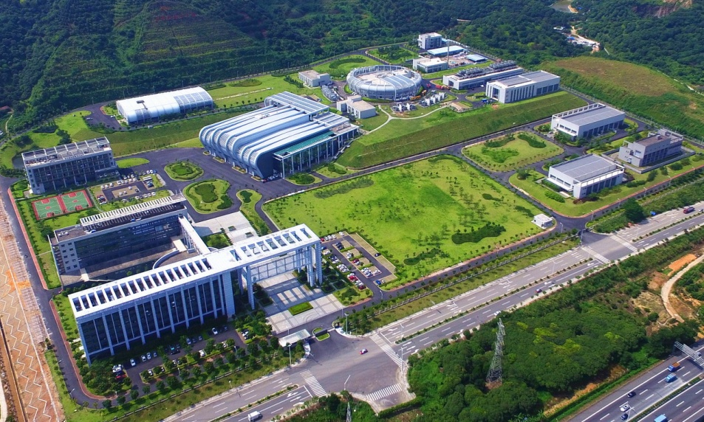
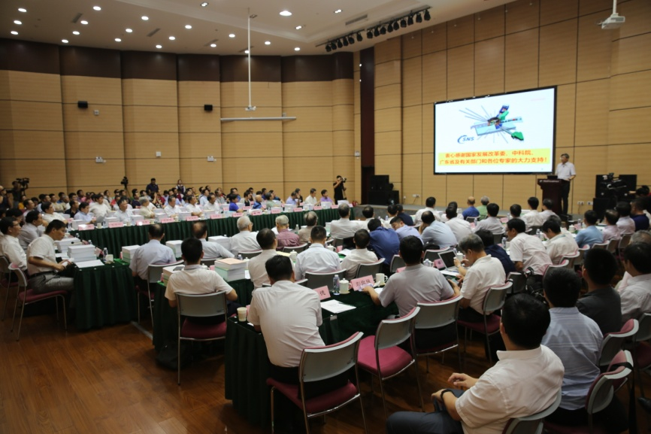
CSNS Passed State Acceptance on Aug. 23 2018
The review committee agreed that the performance of the CSNS has reached or is even better than the planned acceptance goal. The highest neutron efficiency of the target station and the three initial instruments reached the international level.
The review committee concluded that some significant innovative technologies in accelerators, target station and instruments were achieved at CSNS.
24

Slide 25
3. User Operation

Slide 26
CSNS commissioning and operation overview
10kW
20kW
Open to users
30kW
40kW
50kW
Spark of RFQ
Summer shutdown
50kW machine study
Spring Festival
80kW machine study

Slide 27
Operation statistics (until now)
Availability is 80%

Slide 28
Downtime statistics (up to now)
Notes:
the linac contributed most of the shut-off time, Especially for the RFQ cavity, the frequent RF breakdown is the highest cause of beam trips

Slide 29
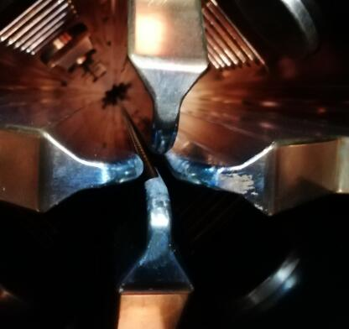
Problem of RFQ spark
The chopped beam lost in the vane of RFQ, is confirmed to be the reason of RFQ spark
By rotating the chopper 45 degrees, most of the chopped beam passed through the slit between to adjacent vanes.
RFQ cavity spark counts per day
RFQ vane at entrance

Slide 30
Downtime statistics (from last summ. Maint. to now)

Slide 31
Upgrade the RF source of RFQ
The stability of the RFQ 4616 tetrode is one of the main cause of fault.
The short lifetime and price of 4616 tetrode.
The retired klystron from DTL, can be used for RFQ, zero cost.
Circulator
Arch waveguide
LLRF
Magic T
RFQ
CPI klystron
Dummy Load

Slide 32
High availability after summer maintenance
With accumulation of the operation experience, the availability of accelerator was quickly increased. After the summer maintenance, the availability is above 90%.

Slide 33
Operation statistics (from last summ. maint. to now)
Availability is 91%

Slide 34
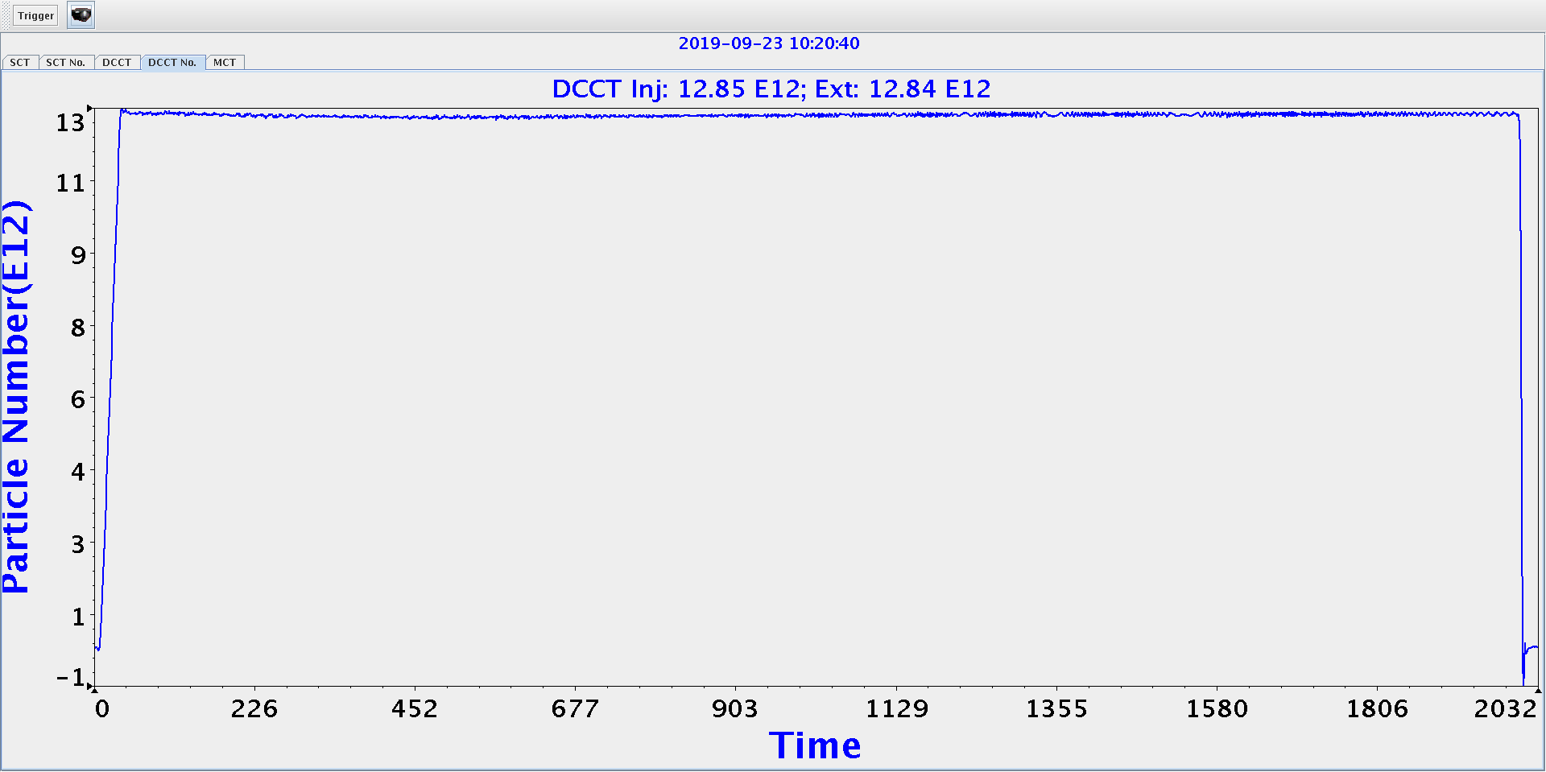
Achievement 80-kW in CSNS/RCS
The equivalent beam power achieved 80kW with the single-shot mode with low beam loss.
Transmission reach ~100% without collimation system

Slide 35
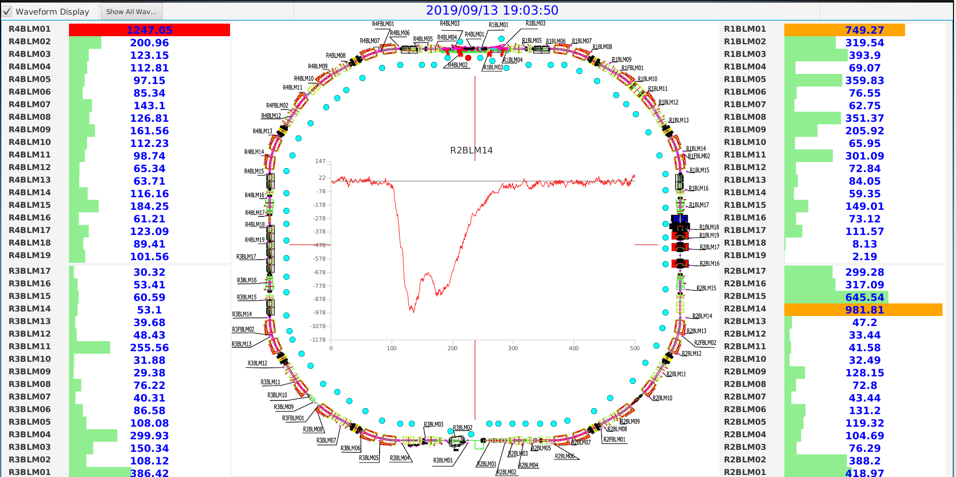
Achievement 80-kW in CSNS/RCS
Low beam loss by using collimation system, with the beam transmission ~98.5%

Slide 36
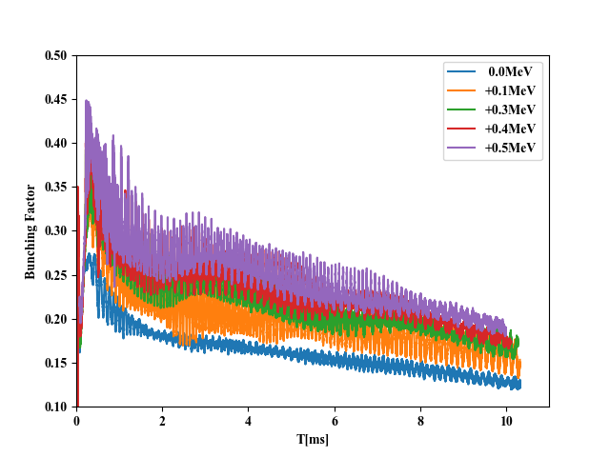
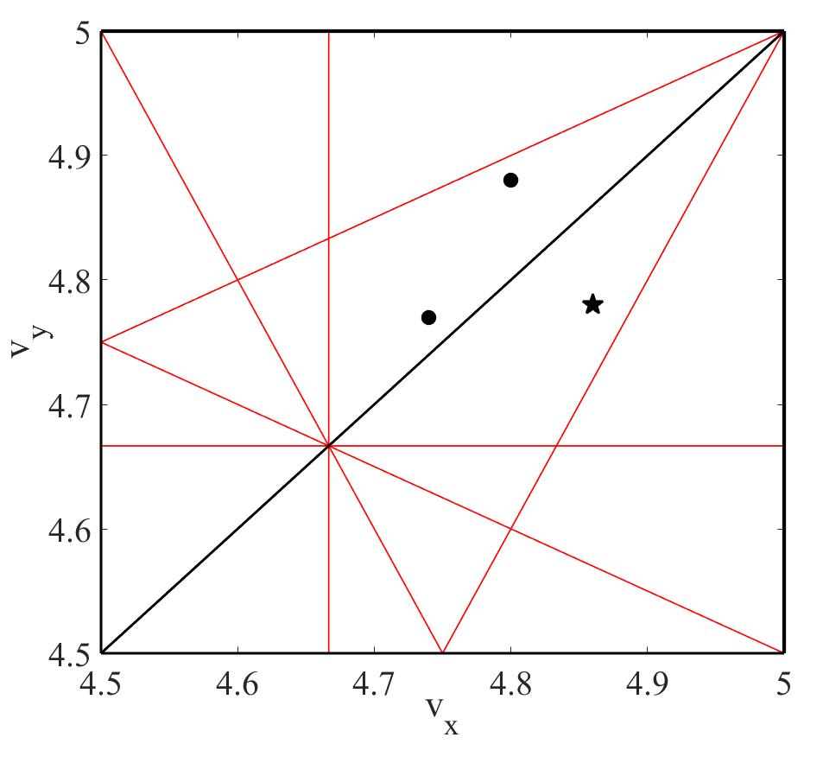
Path to Beam Loss Reduction in CSNS/RCS
Increase the bunching-factor
Correlated-Painting was adopted
Tune was optimized
By using chromatic sextupoles to increase the Chromaticity in horizontal direction and decrease the Chromaticity in vertical direction
……
Injection
Extraction
Designed

Slide 37
4. Upgrade Plan

Slide 38
Necessity of CSNS Upgrade
Facility | Beam power | Upgrade plan | Number of spectrometer | Number of target
SNS | 1.4MW | 2.8MW | 18+5 | 1+1（CD0）
J-PARC | 1MW | 1.5MW | 18 | 1+1?
ISIS | 200kW |  | 20+18 | 1+1
ESS | 5MW |  | 15+7 | 1+?
CSNS | 100kW | 500kW | 3+17 | 1+1？
Notes:
Higher neutron intensity can shorten the experimental time, reduce the demand of the sample quantity and improve the signal to noise ratio. In the world, developing new neutron scattering technologies and megawatt spallation neutron sources have become a trend

Slide 39
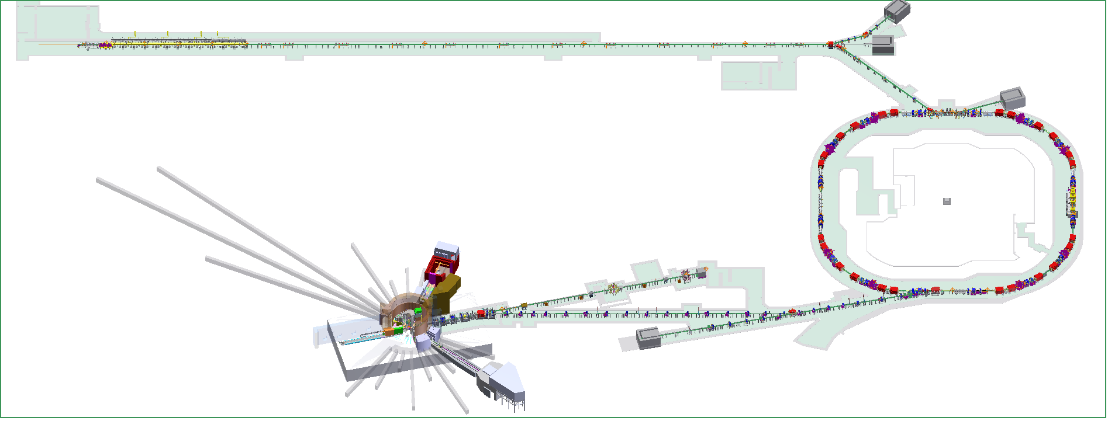
80MeV H- linac
SC cavities
New injection
2nd Harmonic MA cavities
1.6GeV
25Hz
100kW
More spectrometers
Target Station
Phase-I status and phase-II upgrade
39

Slide 40
Beam dynamics requirements for Linac upgrade
 | CSNS Phase I | Linac Upgrade
Output energy | 80.1MeV | >300MeV
Particles | H⁻ | H⁻
Beam current (peak) | 15mA | 50mA
Pulse width | 0.5ms | 0.6ms
Repetition rate | 25 | 25
RF frequency | 324MHz | 324MHz (648MHz)
length | RFQ(3.6m)+DTL(35m) | RFQ+DTL+95m
Linac length <95m
Peak current 50mA
Pulse width 0.6 ms
Repetition rate 25Hz
Beam energy at exit of linac >300MeV

Slide 41
SCL option is preferred mainly due to :
Higher gradient( shorter beam line/ higher beam energy)
Upgrading potential
Cheaper operating cost since SCL requires less electricity
Individually powered SRF cavity provides high operational flexibility which leads to high availability
The extremely low vacuum and larger beam acceptance in SCL results in lower beam loss
Make use of the current development results from ADS and heavy ion projects in China
Notes:
but the SC linac option can make use of the current development results from ADS and heavy ion
projects in China.• If the SC option is chosen, this machine will be the first machine in the world
to use an SC linac for injection into an RCS.

Slide 42
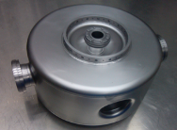
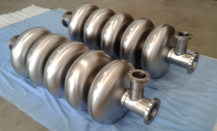
Similar SC Cavities Developed at IHEP for ADS
 | Cavity type | Freq. (MHz) | βg | Energy (MeV) | Max. Vacc. (MV)
Injector I | Spoke012 | 325 | 0.12 | 3.2-10 | 0.82
Main Linac | Spoke021 | 325 | 0.21 | 10-34 | 1.32
 | Spoke040 | 325 | 0.40 | 34-178 | 2.79
 | Elliptical063 | 650 | 0.63 | 178-367 | 7.68
 | Elliptical082 | 650 | 0.82 | 367-1500 | 15.47
Notes:
More than 40 SRF cavities and their CMs have been developed. The fabrication, testing and assembly technics are matuer. The problems that limit the cavity gradient have been solved.

Slide 43
Layout of the CSNS Linac in Phase-II
Option1:
50keV
3MeV
3MeV
80MeV
154MeV
303MeV
H-
RFQ
MEBT
DTL
DSR,β=0.5
Elliptical ,β=0.65
324MHz
31.5m
9cryomodules
648MHz
30m
6cryomodules
Option2:
50keV
3MeV
3MeV
80MeV
174MeV
300MeV
H-
RFQ
MEBT
DTL
Elliptical,β=0.47
Elliptical ,β=0.60
648MHz
39m
11cryomodules
648MHz
31m
5cryomodules
Notes:
The . RF-performance, fabrication, surface treatment/cleaning, mechanical properties, choice of frequency, choice of operation temperature, beam cavity
interaction and cost. SRF community agrees that the lower limit is around a beta of 0.4 - 0.5. which of the two technologies is more advantageous than the other in the transition region around β = 0.5

Slide 44
Summary
CSNS construction finished successfully within budget and on time.
Accelerator beam commissioning has been completed with a good results.
We reached 50kW beam power on target for user operation with availability higher than 90%.
CSNS started user operation and meanwhile will gradually raise beam power to 100kW.
500kW upgrade is under planning, and the upgrade project is foreseen to be launched as long as we realize 100kW.

Slide 45
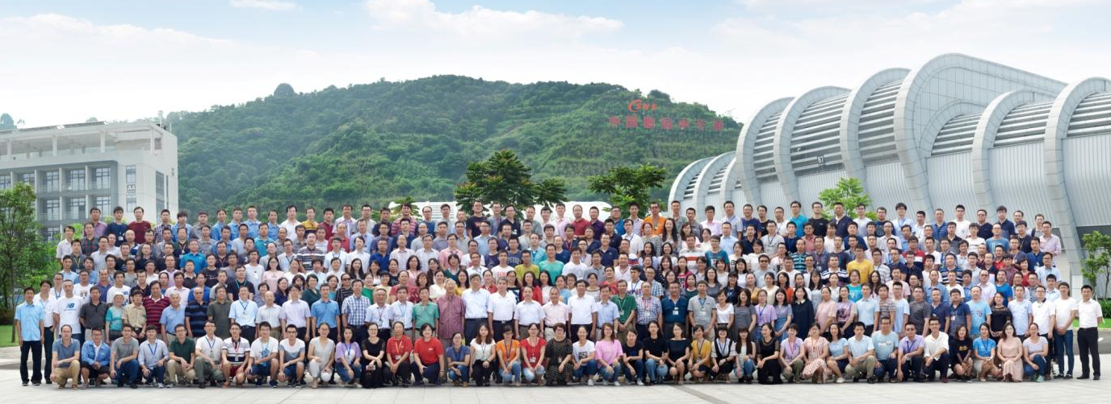
Thank you!

