Slide 1
Challenges, Progress and Prospects of High beam Power in J-PARC
Y. Liu, KEK/J-PARC
On behalf of J-PARC Accelerator Division
SHLiPP-9, Lanzhou, China, 25-27 September 2019

Slide 2
Outlines
Introduction of J-PARC
Operation Status and Upgrade Plan
Linac
RCS
MR(Slow extraction ≡SX & Fast extraction ≡FX)
Challenges: request of more current, longer pulse, faster cycle, lower beam loss/residue radiation, stable long-term operation, etc.
Summary

Slide 3
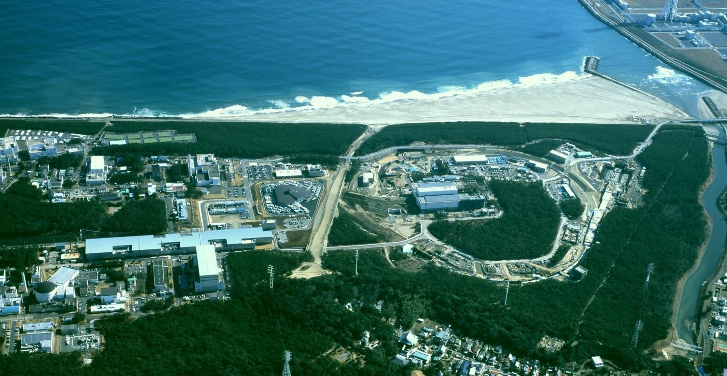
J-PARC Facility Layout at Tokai, JAEA Site
Materials and Life Science Experimental Facility (MLF)
Hadron Experimental Facility
3-GeV Rapid-Cycling Synchrotron, RCS
(Circumference 350m）
ADS: Accelerator Driven Nuclear Waste Transmutation System (in the 2nd phase)
Linac (181 -> 400MeV)
(330m)
Main Ring Synchrotron, MR (30-50 GeV)
（Circumference 1600m)
Neutrino Experimental Facility
Multi-Purpose Facility
Joint Project between KEK and JAEA

Slide 4
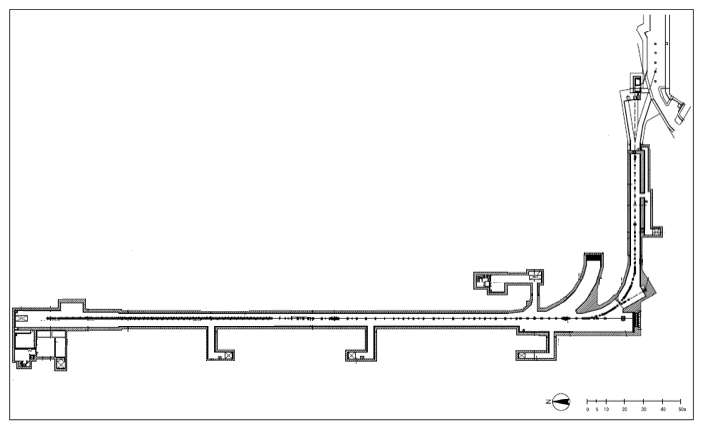
J-PARC Linac Layout
J-PARC linac consists of
50-keV negative hydrogen ion source (RF ion source)
3-MeV RFQ, 324MHz (RFQ3)
50-MeV DTL (Drift Tube Linac) , 324MHz
SDTL (Separate-type DTL) 190-MeV , 324MHz
ACS (Annular Coupled Structure Linac) 400 MeV , 972MHz
90-deg dump
100-deg dump
RCS injection
Injection section
2nd Arc
Collimator section
Org. Proposed
S.C. section
Suspended
Front-end
(7 m)
MEBT2
ADS
30-deg dump
DTL
SDTL
ACS section
(27 m)
(84 m)
(109 m)
400MeV
3 MeV
50mA
50 MeV
190 MeV
0-deg dump
50m
Front-end = IS + LEBT+ RFQ + MEBT

Slide 5
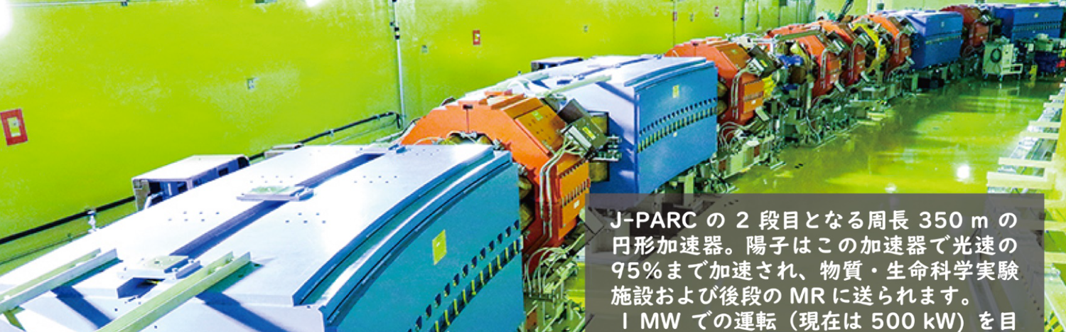
Rapid Cycling Synchrotron: Parameters
Circumference: 348.333 m
Super-periodicity: 3
Harmonic number: 2
Injection Energy: 400 MeV
Extraction Energy: 3 GeV
Original Design Beam Power: 1 MW
  Large Aperture: 486π mmmrad
              Painting injection during 0.5 ms (307 turns)
  Beam Loss Localization with Collimators
  Lattice for high transition 𝛾: 9.14
Repetition Rate: 25 Hz
Ramping Pattern: Sinusoidal
ACS
Dipole Magnets: 24
Quadrupole Magnets: 60 (7 families)
Sextupole Magnets: 18 (3 families)
Steering Magnets: 52
RF Cavities: 12 (Fundamental 440 kV, 2nd 180 kV)

Slide 6
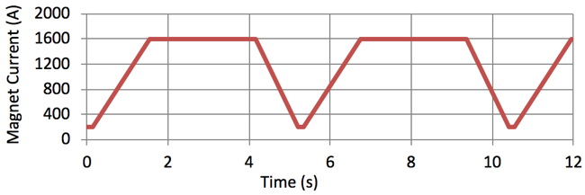
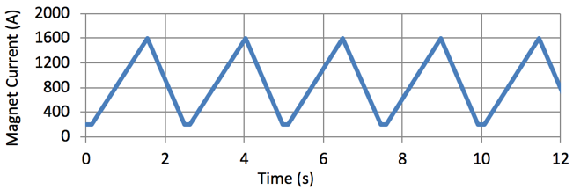
MR Design and Operation Modes
Circumference: 1567.5 m
Three-fold symmetry
Harmonic number: 9
Original Design Beam Power: 750 kW
  Large Aperture
  Beam Loss Localization
  Imaginary Transition 𝛾 Lattice
Slow extraction mode (SX) for the hadron hall: 2s-spill extraction.
Fast extraction mode (FX) for the neutrino Facility: 1 turn extraction.
SX (5.2 s)
FX (2.48 s)

Slide 7

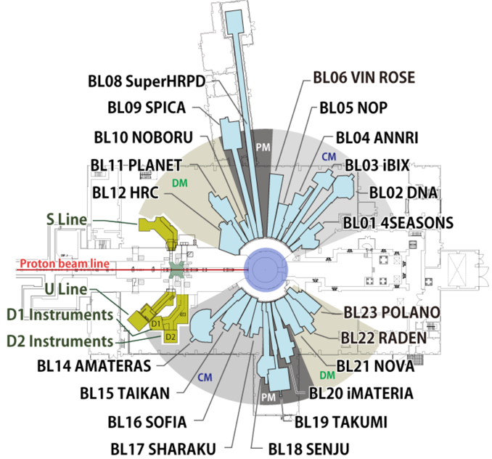
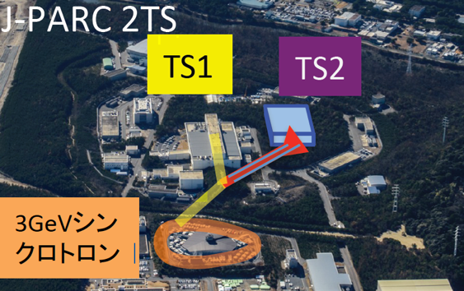
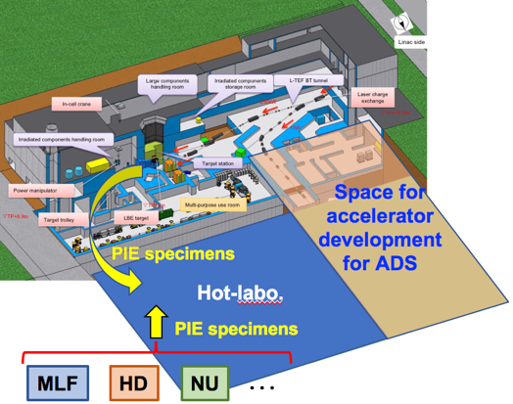
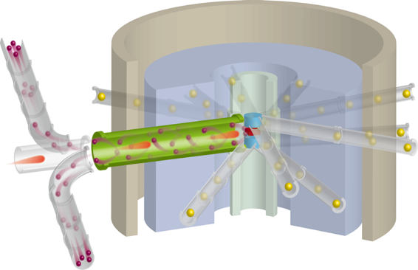
High Power Beams to Users
Materials and Life Science Experimental Facility (MLF) (2008−)
21 Neutron beam lines
3 Muon beam lines
RCS Design Beam Power : 1 MW
Future Plan of the MLF Second Target Station
New design of target, moderators, reflectors
Neutron Brightness : > 20 times
Muon Intensity : > 50 times
RCS Beam Power : 1.5 MW
Future Program with the Linac Beam :
Proton Irradiation Facility
with laboratories of
Post irradiation examination
Accelerator development for ADS
400 MeV, 250 kW
RCS

Slide 8
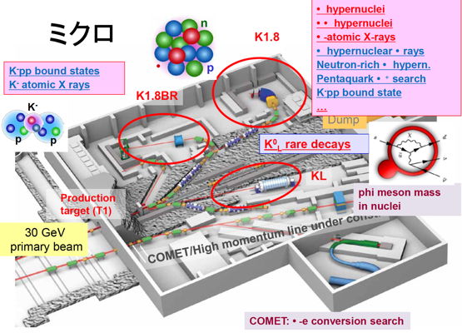
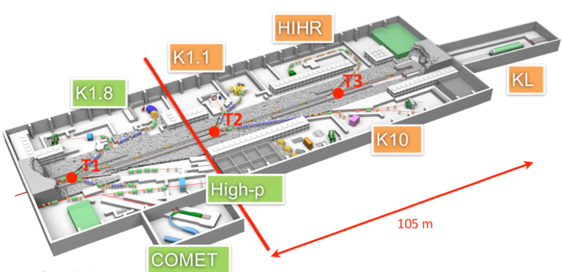
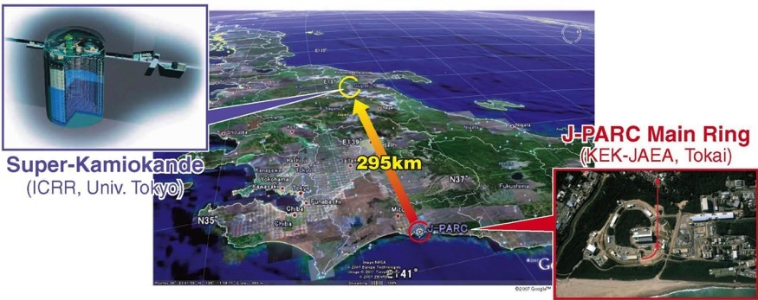
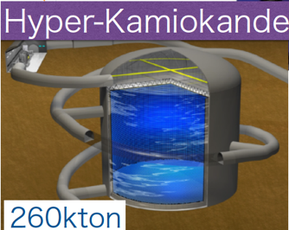
High Power Beams to Users
Hadron Experimental Hall (2009−)
Nuclear and particle physics
Future Plan for the extension of the Hadron hall
More intensity of secondary particles
Purity
Δp/p
Neutrino Facility (2009−)
Long baseline neutrino oscillation experiment (T2K)
Upgrade Plan for the Neutrino Experiment
Far Detector
  50 kton → 260 kton Water Cerenkov detector
MR Beam Power
  750 kW → 1.3 MW
50kton
+
J-PARC Main Ring
Beam Power Upgrade

Slide 9
J-PARC Operation Status

Slide 10
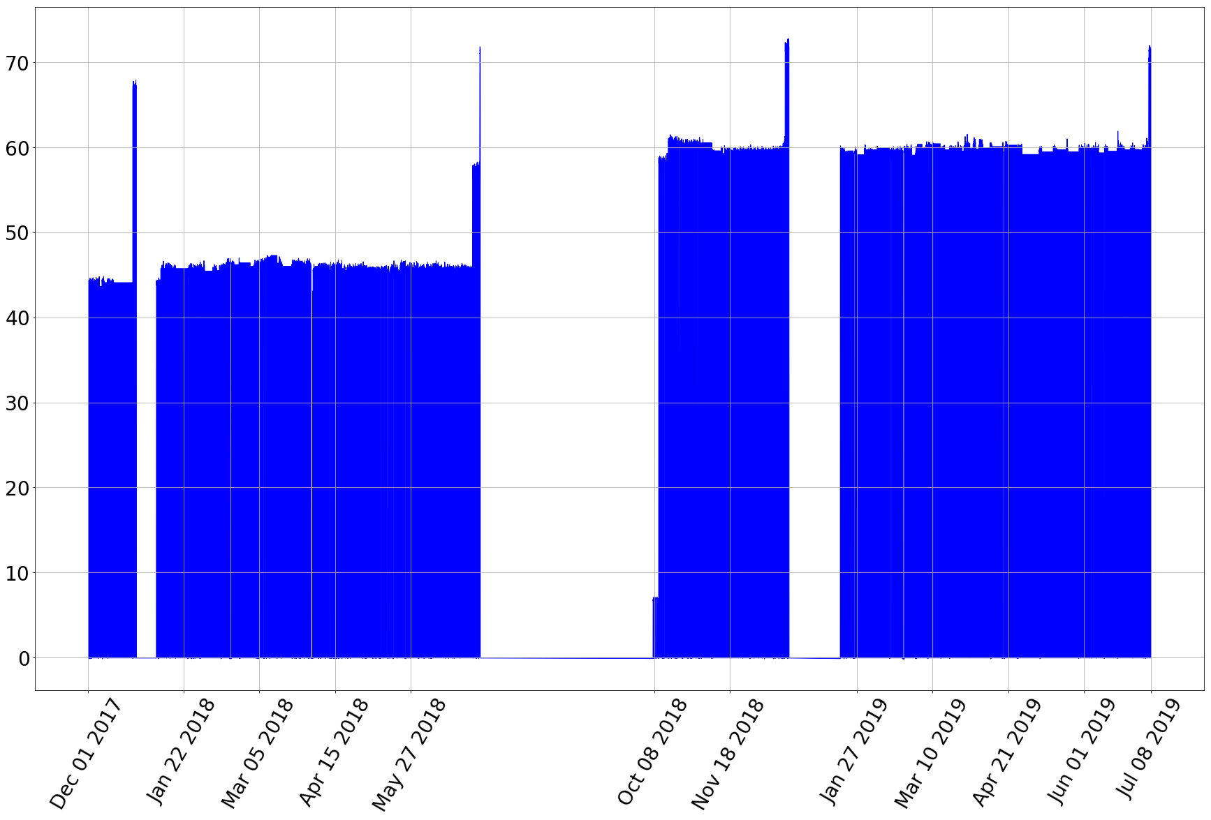
Recent Linac Status (Current at LEBT)
mA
60mA study #2,3,4,5
50mA
operation
started

Slide 11
2019.Jul.4
1 MW, 12hr
Trial
1.5 MW eq.
Trial

Slide 12
Beam Power History at MLF
Beam Power(kW)
Accident at
Hadron Facility
↓
Beam Power Accumulated (MWh)
Earthquake
↓

Slide 13
MR: Beam Power History
Max. delivered power:
Fast extraction ~ 500 kW (2.6x10¹⁴ppp)
Slow extraction ~ 50 kW (5.5 x10¹³ppp)
FX
SX

Slide 14
Overview of J-PARC Power Upgrade

Slide 15
Power Upgrade of Li and RCS
I. Exceed 1MW beam at RCS
1. 1.2MW stable operation
Net 1MW beam deliver to MLF after MR repetition upgrade
→ Potential request from the MLF users
2. 1.5MW stable operation
MLF 2nd target station
→ One of the future plans currently under consideration in J-PARC
3. >1.5MW operation
→ Future beam power upgrade
II. Linac 50Hz operation
To deliver beam both to the RCS and to the Experimental Facility for Nuclear Transmutation Experiments
→ One of the future plans currently under consideration in J-PARC

Slide 16
Roadmap of J-PARC LINAC+RCS Intensity Upgrade
16
181/190MeV → 400MeV: Jan., 2014
Operation/Study 15/30mA → 30/50mA: Oct. 2014
400MeV, 50mA: ready for 1MW from RCS (Demo:Dec.2014)
--------------------- Design accomplished ---------------------
40mA in Operation: Jan. 2016
Next step: 50→60mA or/and 500→600us: aim at 1.2/1.5MW@RCS
1st Trial of 60mA: Jul.5 2017: 68mA(IS) 62mA(MEBT1)
2nd Trial of 60mA: Dec.25,26 2017 60mA(DTL no accel. ), 57mA(Li)
3rd Trial of 60mA: Jul.3, 2018 62mA(Li)
50mA in Operation: Oct. 2018
50mA, 600us injection to RCS : Oct. 19, 2018 (~1.2MW@RCS)
60mA (4th Trial ), 500us injection to RCS : Dec. 26, 2018 (~1.2MW@RCS)
Jul. 2019 60mA (5th Trial ), 600us injection to RCS (for ~1.5MW@RCS)

Slide 17
Residue Radiation/Beam Loss Mitigation/Control for J-PARC Linac
J-PARC Linac Residue Radiation
Sections with higher Residue Radiation：200MeV~400MeV ACS
Several hotspots(surface)3~3.5mSv/h@500kW(40mA) before 2018.7
@ entry of ACS A-cavities
Main source：Intra-beam stripping of H⁻ (IBSt)
Beam loss “localization” (ACS aperture re-arrangement、2018.9 accomplished)
Hottest: ACS A-entry 3~3.5mSv/h@500kW(~2018.7) →
Hottest: ACS bw. QM-doublet ~2.4mSv/h@500kW(~2019.3)
Beam loss mitigation
IBSt-mitigation lattice (2019.4~ T_{ACS}=0.7)
→ Hottest: ACS bw. QM-doublet ~1.5mSv/h@500kW

Slide 18
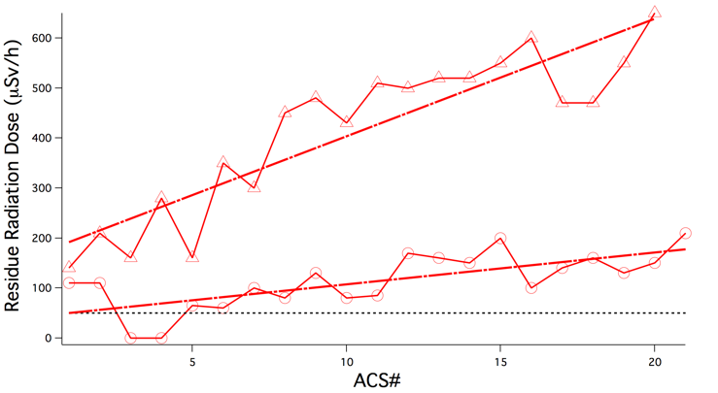
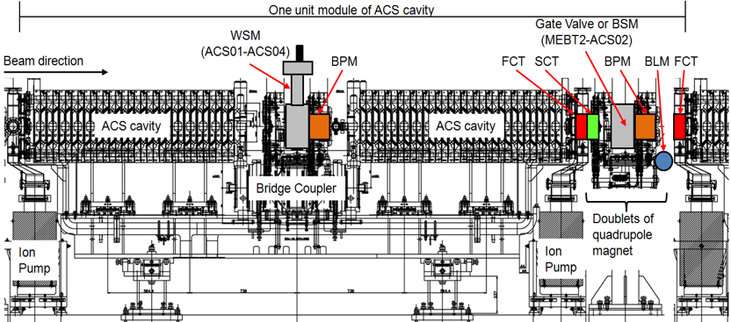
Abnormal Residue Radiation and Aperture Re-arrangement
18
Abnormal regularity of residue radiation at ACS since very beginning
Reason 1: CT aperture is 3mm less than else
Reason 2: CT materials is vulnerable to radioactivation
Shown in ATAC2016
①
②
③ ④
Shown in ATAC2014
Empty duct
FCT+SCT, FCT
Aperture re-arrangement 2015:
Latter half: aperture increase, FCT ② removed
aperture increase in #4,7,8, etc.
Aperture re-arrangement 2018:
All the rest: aperture increase, FCT ② removed
All aperture → Φ40
A
③ ④
B
① ②

Slide 19
H0 Loss-pattern Simulation(1)
19
W/m
With uniform aperture 𝚽40mm
Loss-pattern of H0
By IBSt@ACS06
ACS06

Slide 20
H0 Loss-pattern Simulation(2)
20
MEBT2 ACS →
zoom

Slide 21
Residue Radiation at 500kW, Mar.~Jun., 2018
21
A
B
A
B

Slide 22
ACS Residue Radiation at 500kW, Nov. 2018~Mar. 2019
After Aperture Re-arrangement at ACS first Half
22

Slide 23
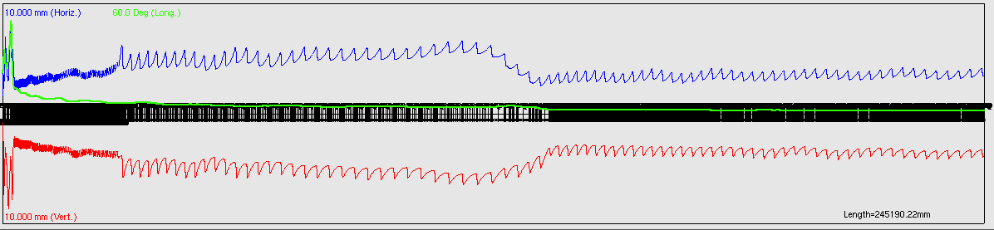
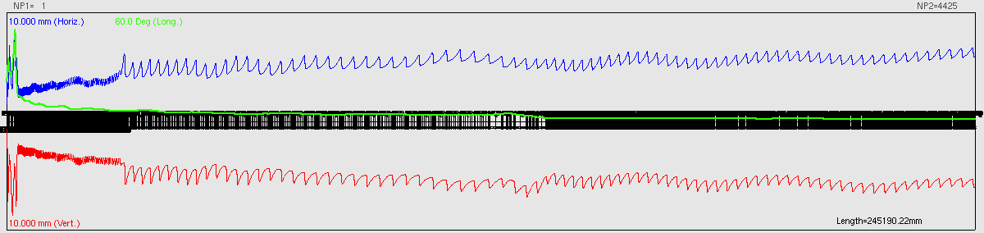
J-PARC LINAC Lattice and IBSt
23
IBSt@ACS was verified as the dominant source of beam loss since 2016 by lattice exercises both in simulation and experiment
IBSt=intra-beam striping (of H⁻): depends almost only on lattice
50 191 → 400
MeV MeV MeV
T=1
T=0.3
DTL SDTL ACS
324MHz → 972MHz

Slide 24
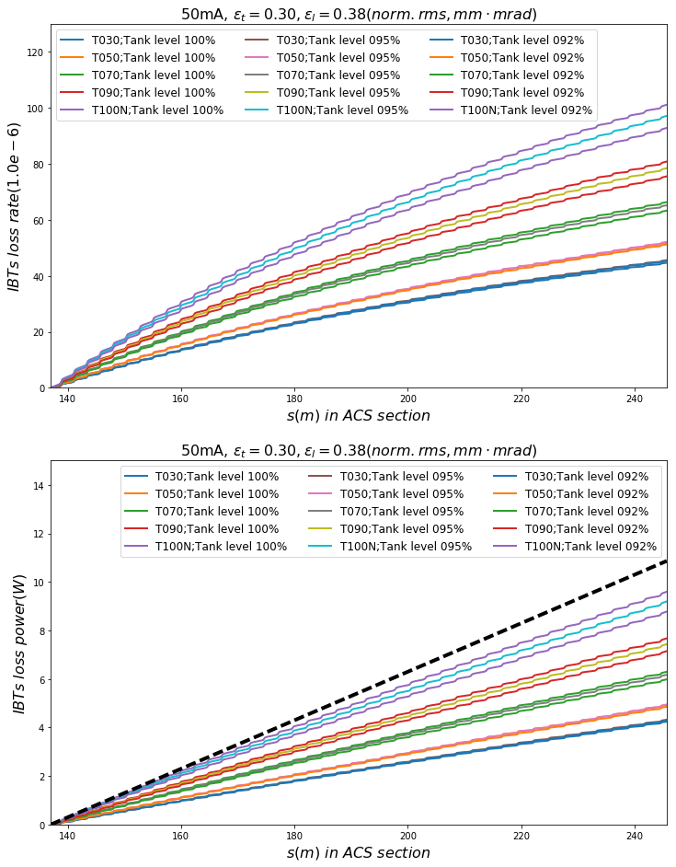
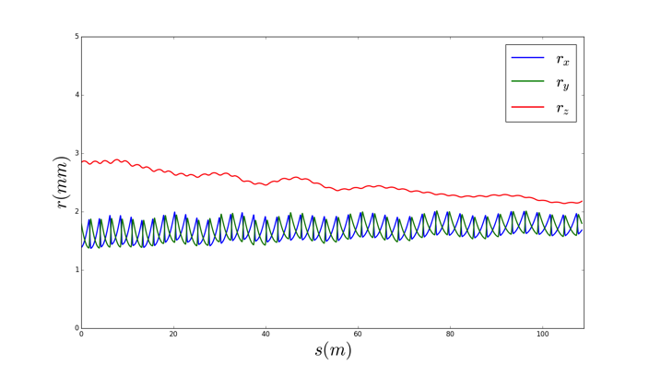
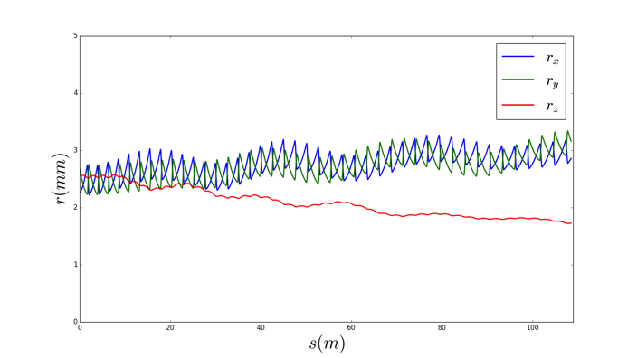
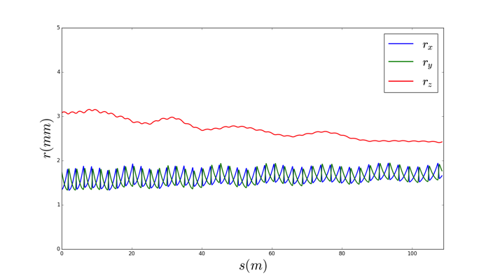
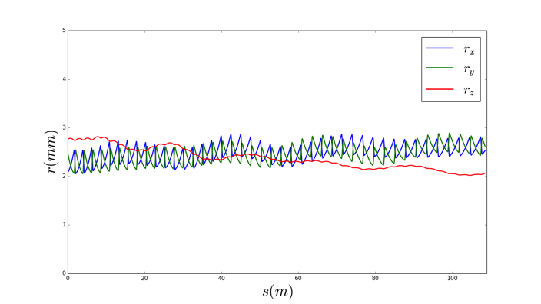
Comparison of IBSt for ACS Lattices
24
Simulated envelope
T=1.0, E₀ 100%
T=0.3, E₀ 100%
Accumulated loss rate
T=1.0, E₀ 96%
T=0.3, E₀ 96%
For 50mA operation with optimized emittance
IBSt loss power is close to 0.1W/m at ACS
T=0.3 helps to reduced more than 50%
Stability?
Accumulated loss power
0.675% duty
0.1W/m

Slide 25
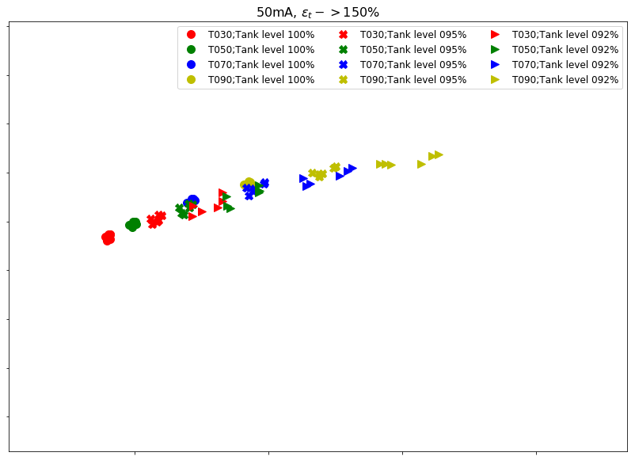
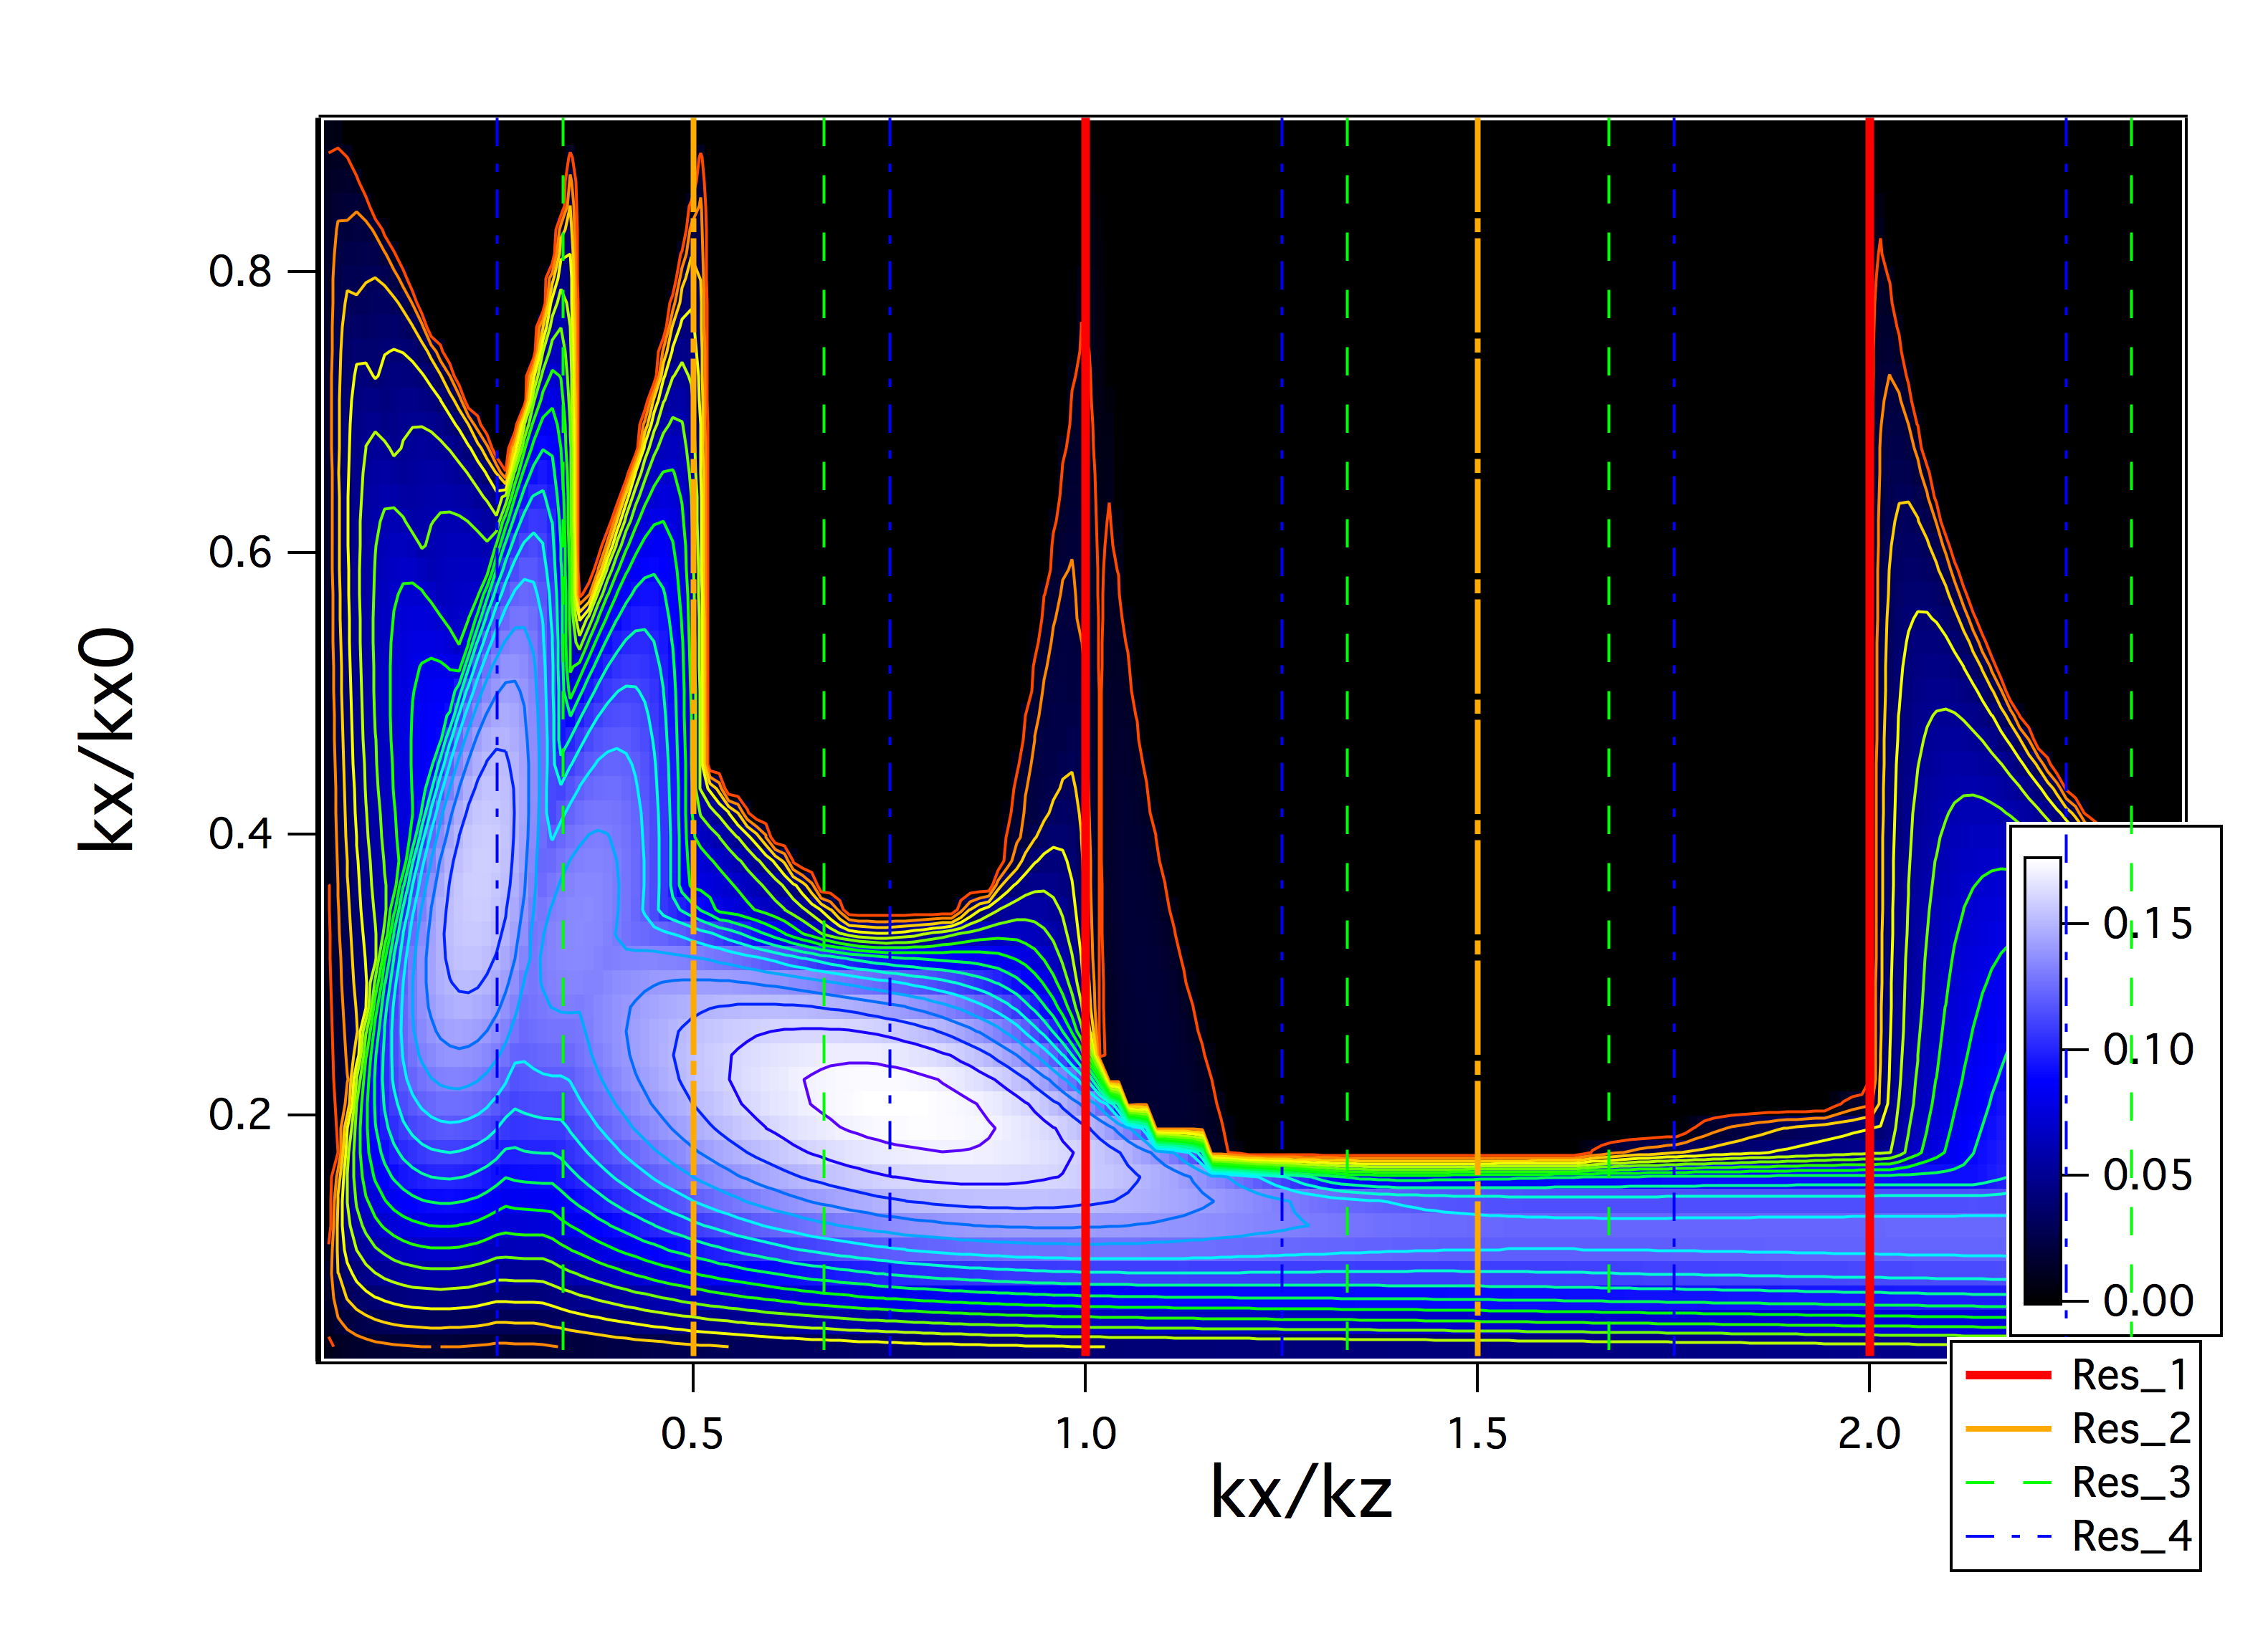
Tune Diagram for J-PARC LINAC ACS (191~400MeV)
25
Transverse redesign
T=1
Baseline
design
Longitudinal redesign
“Temperature ratio”
Stronger quad setting or weaker longitudinal focusing

Slide 26
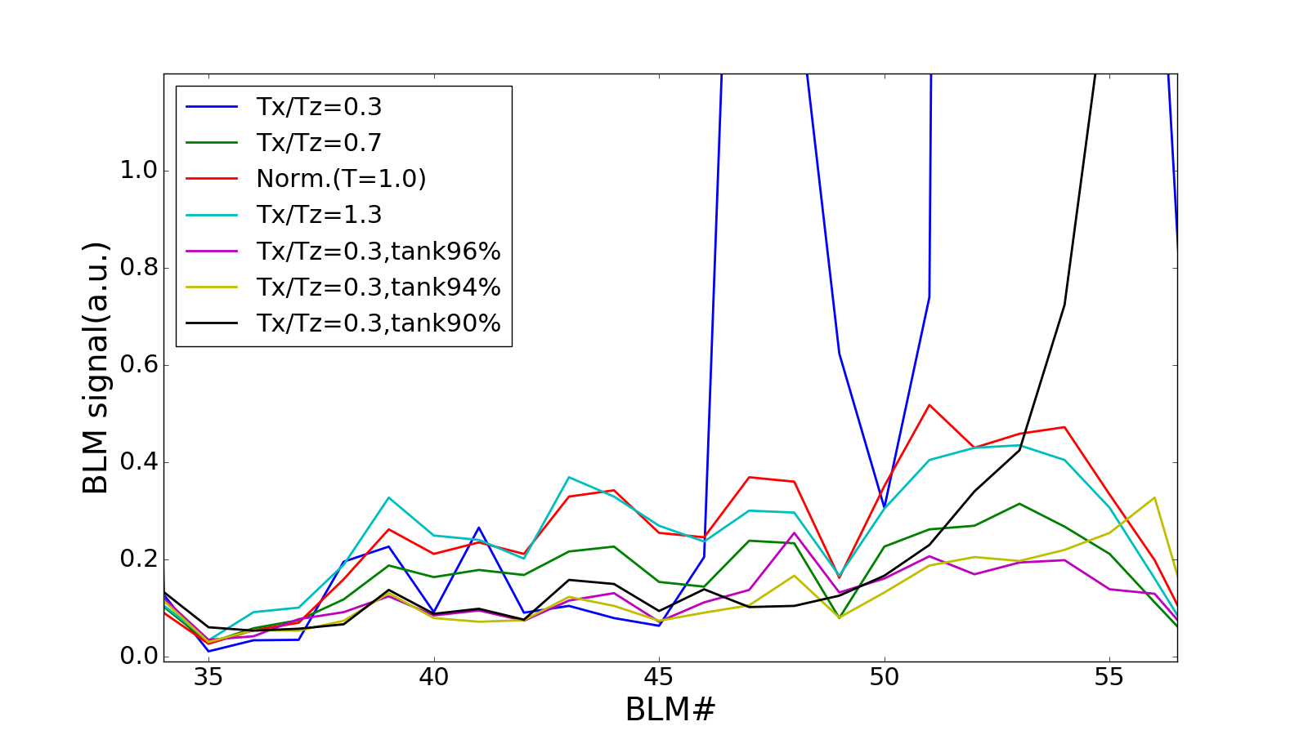
Experiment Results for Resonance・IBSt Mitigation at ACS
26
Beam Study on Oct.10, 2016. 40mA, ε_{x,y|nrms} =0.3mm*mrad, ε_{z|nrms} ~ 0.38mm*mrad(?)
After longitudinal “redesign” Tx/Tz=0.3 was stabilized near Tank level ~95%;
Fine tuning is needed
For Tank level ~90%, loss happened at later 1/3
Unstable
Previous best
Comparison
Stabilized
Stabilized
Near z-accept.
ACS01
ACS21

Slide 27
Trend of Residue Radiation @ACS
50mA
T=1.0
50mA
T=0.7
~ -40%
Zigzag?
~ -40%

Slide 28
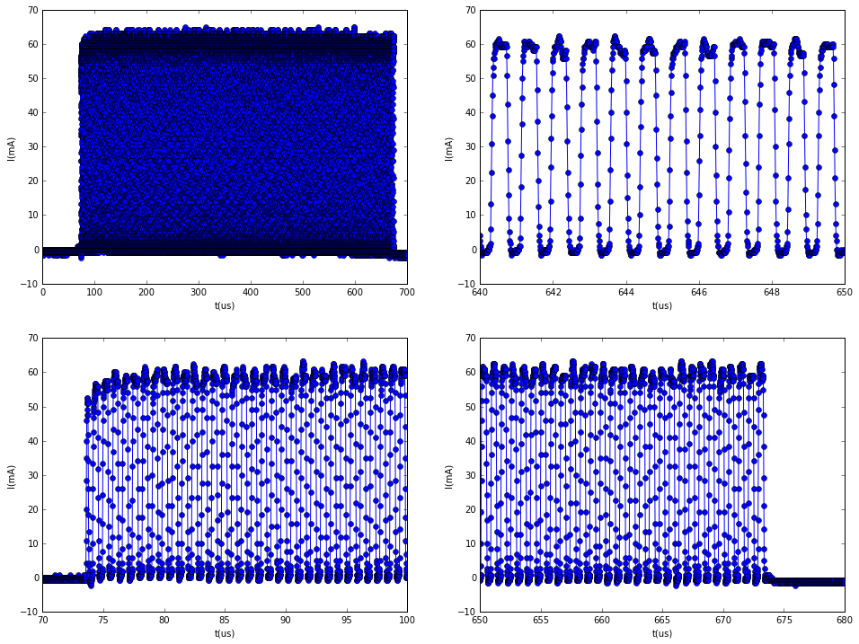
Accomplishment of 60mA*600us from J-PARC Linac on Jul. 8, 2019
L3BT SCT waveform ~0.2kC → 1.5MW eq. (if) at 3GeV
600us

Slide 29
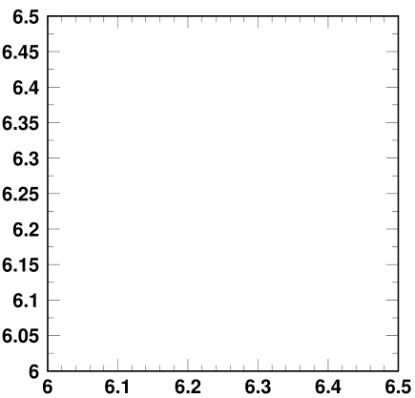
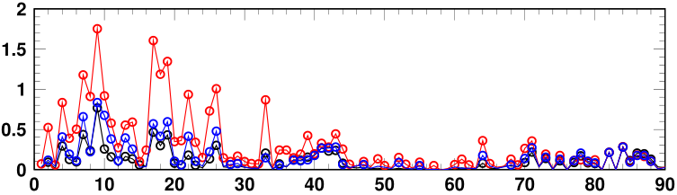
RCS: 1-MW Operation and the Beam Loss Reduction
Random resonances
2018.7 1-hour to MLF
- (6.43, 6.32)
- 200π correlated painting
- Δp/p=-0.1%
- Sextupoles used for ν_{x}-2ν_{y}=-6 corr.
(6.43, 6.32)
(6.46, 6.32)
Vertical tune ν_{y}
2019.7 10.5-hour to MLF
- (6.46, 6.32)
- 200π anti-correlated painting
- Δp/p=0.1%
- Sextupoles used for ν_{x}-2ν_{y}=-6 corr.
Horizontal tune ν_{x}
1 MW@25 Hz, 10.5 hrs
ー Run#79 (2018.7)
ー Run#80 (2018.10)
1 MW-eq.
ー Run#82 (2019.7)
BLM signals (a. u.)
BLM IDs

Slide 30
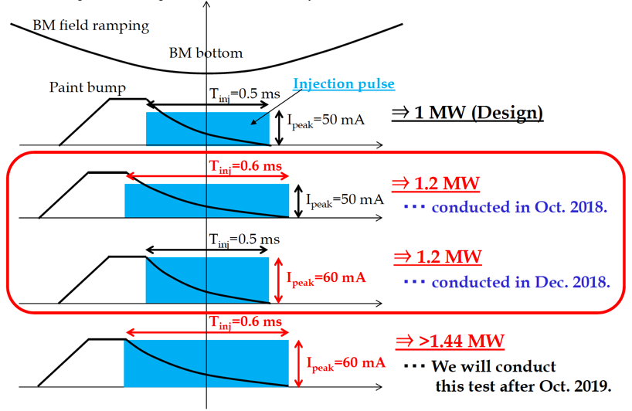
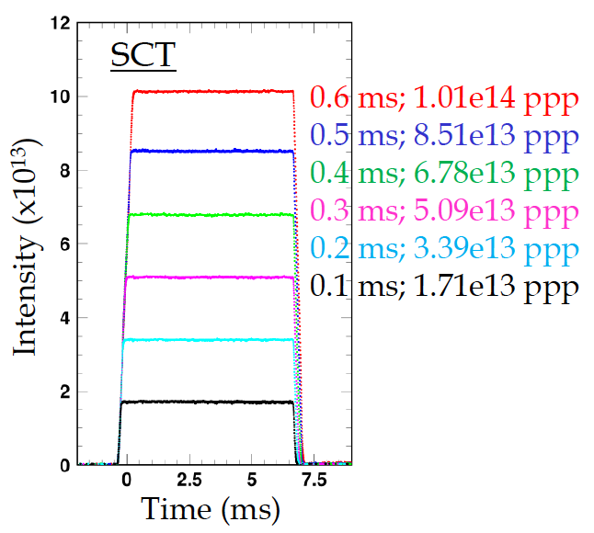
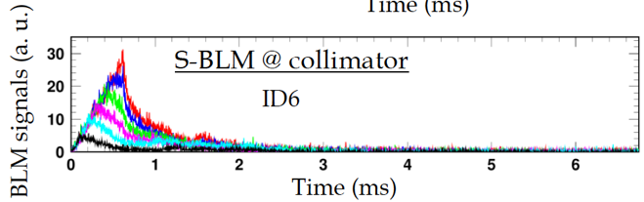
RCS: High Power Operation beyond 1 MW
The upgrade is planned for 1.5 MW with the 2nd target station of MLF.
The operation of 1.2 MW equiv. was demonstrated for the acceleration of up to 1 GeV.
RF system will be upgraded this summer for the beam loading compensation for the beam power beyond 1 MW.
Beam Intensity
1.2 MW equiv.

Slide 31
Mid-term Plan of MR Power Upgrade
FX: Faster cycling: 2.48 s ➝ 1.32 s for 750 kW ➝ 1.16 s for 1.3 MW
SX: Mitigation of the residual radiation for 100 kW
JFY | 2017 | 2018 | 2019 | 2020 | 2021 | 2022 | 2023 | 2024
Event |  |  | HD target |  | Long shutdown
FX power [kW] SX power [kW] | 475 50 | 500 50 | 500 50 | 500 70 |  | >700 > 80 | 800 > 80 | 900 > 80
Cycle time of main magnet PS New magnet PS | 2.48 s | 2.48 s | 2.48s | 2.48s |  | 1.32 s | <1.32s | <1.32s
High gradient rf system 2nd harmonic rf system
Ring collimators | Capacity 2 kW |  |  |  | Capacity 3.5kW
Injection system FX system
SX collimator / Local shields
Ti ducts and SX devices with Ti chamber | Ti-ESS-1
New buildings
Mass production/installation/test
Manufacture, installation/test
Kicker PS improvement, Septa manufacture /test
Kicker PS improvement, FX septa manufacture /test
Local shields

Slide 32
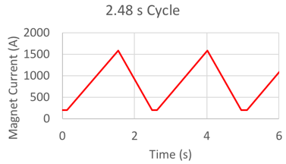
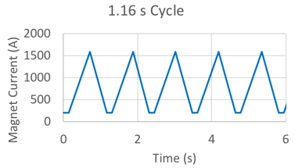
MR FX Beam Power Upgrade Concept
 | Beam Power | Cycle Time | Number of accelerated protons | Equivalent beam power in RCS
Present | 500 kW | 2.48 s | 2.6×10¹⁴ ppp | 780 kW
Original Design | 750 kW | 1.32 s | 2.1×10¹⁴ ppp | 610 kW
New Plan | 1.3 MW | 1.16 s | 3.3×10¹⁴ ppp | 1 MW
For the Beam power upgrade of 500 kW ➝ 1.3 MW
  Factor of 2 by faster cycling
  ~30% gain by intensity increase

Slide 33
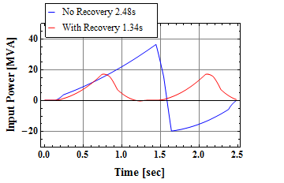
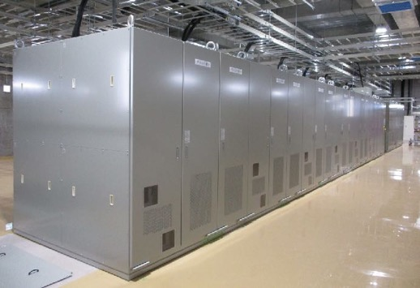
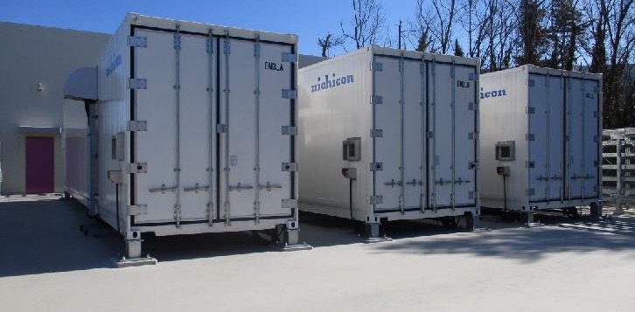
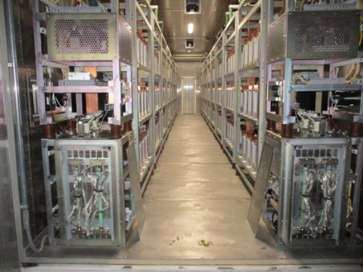
New Magnet Power Supply for Faster Cycling
A new power supply was designed with capacitor banks for the cycle of 1.3 s.
The power supplies for the BM families are being constructed and tested.
Requirement : Higher Repetition Rate (2.48 s ➝ 1.3 s )
Issue：Large power variation @ AC main grid $P=VI=\left(L\frac{dI}{dt}+RI\right)I$
1.3 sec cycle
ΔP_{in} > 100MVA
ΔP_{in}~ 60MVA
Not allowed by Electric Power Supplier
Energy Recovery with Capacitor Banks
New PS for BM3
Capacitor Banks for BM3
Interior of Container

Slide 34
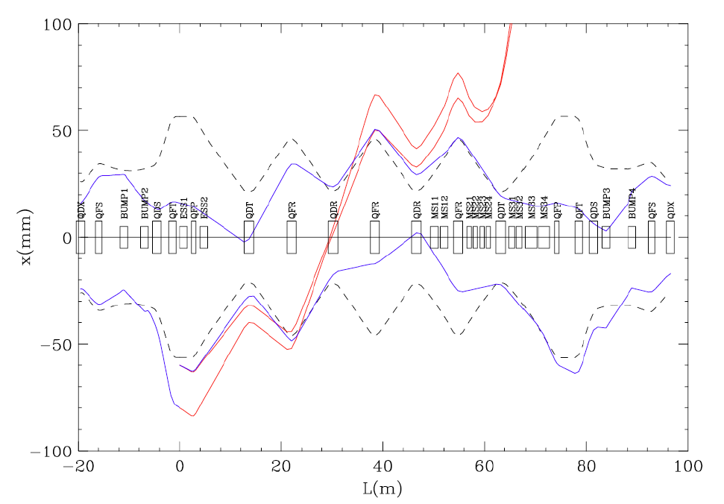
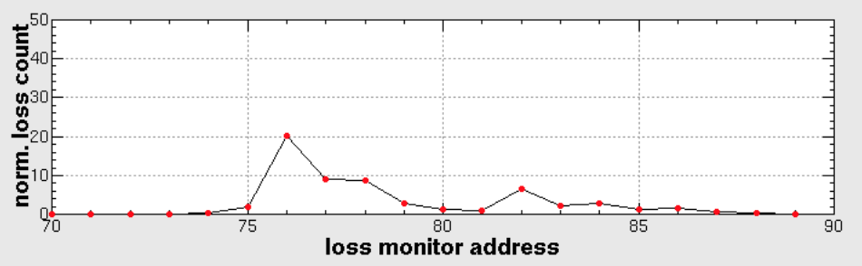
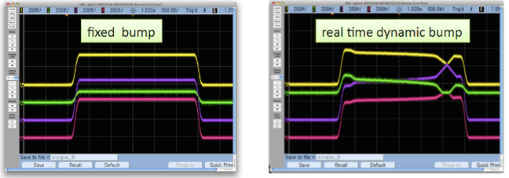
MR Slow Extraction Tunings and the Beam Loss Reduction
Extraction scheme with a third order resonance of νx = 22.33
The extraction efficiency of 99.5% was achieved with fine tunings of
  Main Quadrupole Magnets
  Resonant Sextupole Magnets
  Bump Magnets
  Electro-Static Septum (ESS) 30 μm W ribbons at high β=40 m
  Septum Magnets (SMS)
Beam Envelope
during Injection
Extraction Beam
Beam @ flattop
with Bump Orbit
Fixed Bump
Dynamic Bump
x – x’
phase space
Step size 20 mm
Beam Loss Distribution
Bump 1 – 4
current
vs. time
ESS1 2
SMS1 2 3

Slide 35
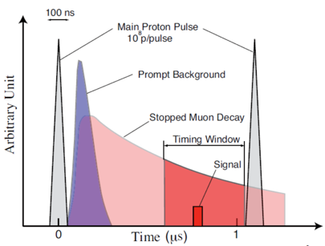
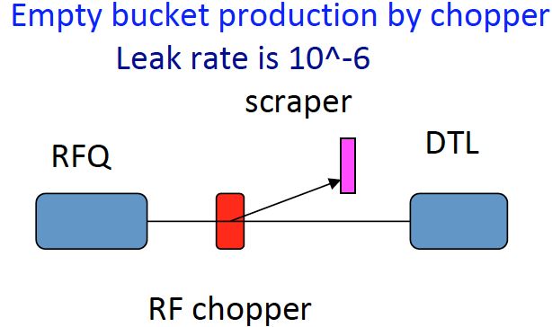
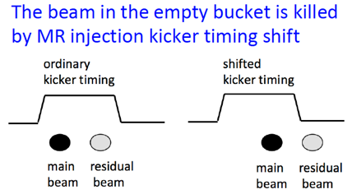
MR SX for the μ to e conversion search experiment
The COherent Muon to Electron Transition (COMET) experiment to search for the process of lepton flavor violation requires
  slow extraction of 8 GeV beam for suppression of the anti-proton production and
  sparse bunched beam for the signal detection with the extinction ratio of 10⁻¹⁰ for the empty bucket.
    Empty bucket production with RF chopper
    1 bunch acceleration in RCS
    Injection kicker timing shift in MR
The proton beam required for the phase 1 was delivered to Hadron hall to measure extinction factor of secondary beam.
8GeV 1MHz pulsed beam
1.6×10¹² ppb
6.2×10¹² ppb
Empty bucket
We found the solution for the extinction for K4_rear.
< 6×10⁻¹¹

Slide 36
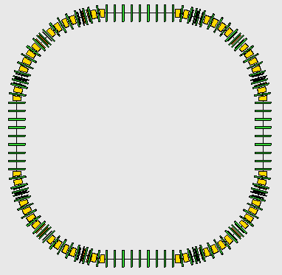
Multi-MW Scenarios for the Neutrino Experiment with a New Booster
3.2 MW with a new 8-GeV Booster in J-PARC
9 MW with a 9-GeV proton driver in the KEKB Tunnel after the B-factory project.
J-PARC Tokai site
KEK Tsukuba site
6.2 GeV
9 GeV
To Kamioka
3.3 GeV
1.2 GeV
Conceptional Design of 8 GeV Ring
Circumference 696.666 m
Super-periodicity 4
Transition gamma ~15 GeV
For the acceleration in the 2nd to 4th straight section, the ILC cavity is adopted.
- Peak current : 100 mA (pulse)
- Beam duty : 1 %
- Beam power : 9 GeV x 0.1 A x 1 % = 9 MW
R&Ds : High duty horn, higher gradient SC cavity, high power target...

Slide 37
Summary
J-PARC accelerators have been providing high power beams for 10 or more years to users at
  Materials and Life Science Experimental Facility
  Hadron Experimental Hall
  Neutrino Facility.
The Linac original design current of 50 mA was achieved with efforts of beam loss reduction.
  The operation of 60 mA was demonstrated in the beam study.
With RCS, the 10.5-hour stable operation of 1 MW was achieved with the loss of 10⁻³ level.
  The beam power of 1.2 MW equivalent was demonstrated in the beam study.
  The beam power of 1.44 MW has been tested for the upgrade plan.
MR delivers the SX beam to the hadron hall with the beam power of 51 kW and the extraction efficiency of 99.5%.
  Hadron target will be upgraded this summer for the capacity of 57 kW → 95 kW.
  The proton beam of 8 GeV required for the phase 1 of the muon to electron conversion search experiment (COMET) was delivered to hadron hall to measure extinction factor of secondary beam.
The beam power of 500 kW was achieved for the MR FX operation.
  The beam power upgrade of 1.3 MW is planned with
    faster cycling : 2.48 s ➝ 1.16 s, and accelerated protons : 2.6×10¹⁴ ppp ➝ 3.3×10¹⁴ ppp.
  Possibilities are being explored for the beam power of multi-MW for the neutrino experiment.

