Slide 1
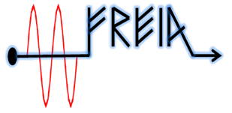
Preliminary Test Results
from the
Spoke Prototype cryomodule
Han Li
In behafe of FREIA team
Sep. 2019
SLHiPP 2019

Slide 2
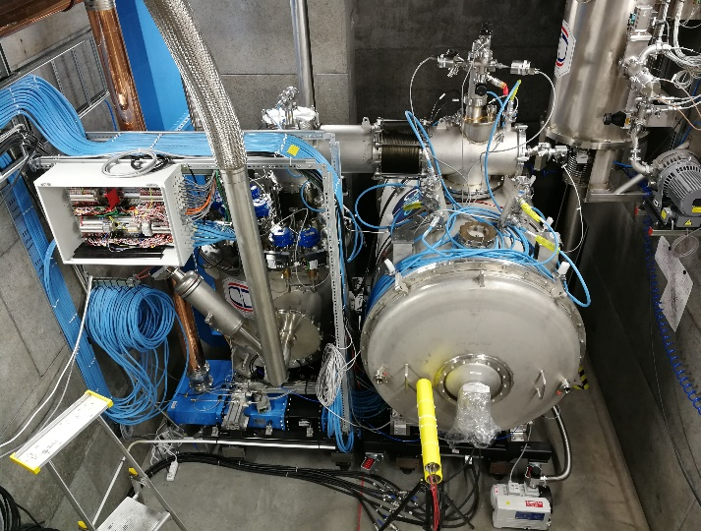
RF Test Goals
The test of spoke prototype CM has the following goals:
verify cooling procedures,
verify power coupler (FPC) conditioning procedure, coupler ability and performance,
verify cavity intrinsic ability, accelerating performance,
verify LLRF ability and performance,
verify the high power RF amplifier ability and performance in combination with the cavity and LLRF,
verify cold tuning system (CTS) performance,

Slide 3
FPC conditioning
FPC conditioning program
FPCs’ conditioning are done by FREIA auto conditioning program
Only e- pickup interlock for FPC is activated
Frequency for off resonance conditioning : 353 MHz
Test with RF station and coupler (off resonance) up to 400kW @ 3.2ms
Parameter | value
Loop control time (s) | 1
Pulse repeat rate (Hz) | 14
Vacuum upper limit (mbar) | 5e-6
Vacuum lower limit (mbar) | 5e-7
Initial pulse length (µs) | 20
pulse length step | 20µs, 50µs, 100µs, 250µs,500 µs, 1ms, 2 ms,3.5ms
Vacuum hardware interlock (mbar) | 1e-5
e- pickup interlock (mA) | 2
Main Parameters of Spoke FPC Conditioning
3

Slide 4
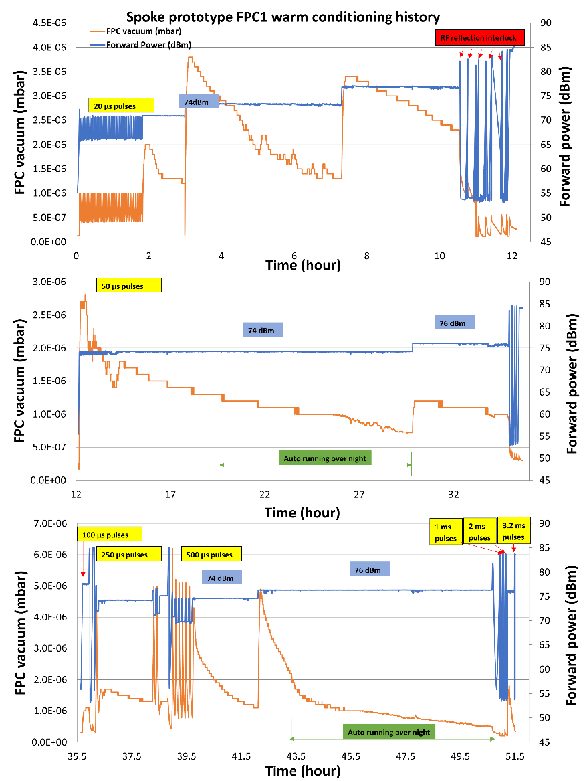
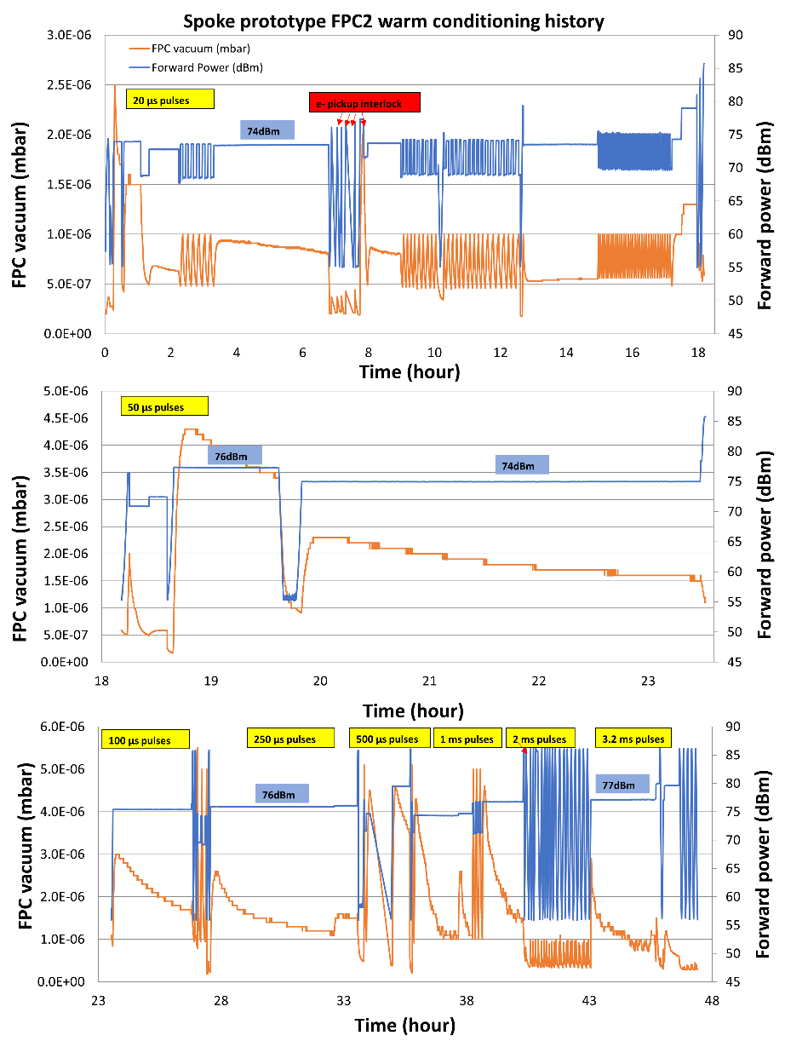
FPC warm conditioning
4
Two major multipacting (MP) bands: 1) ~20kW (74 dBm) and 2) 40kW (76 dBm)

Slide 5
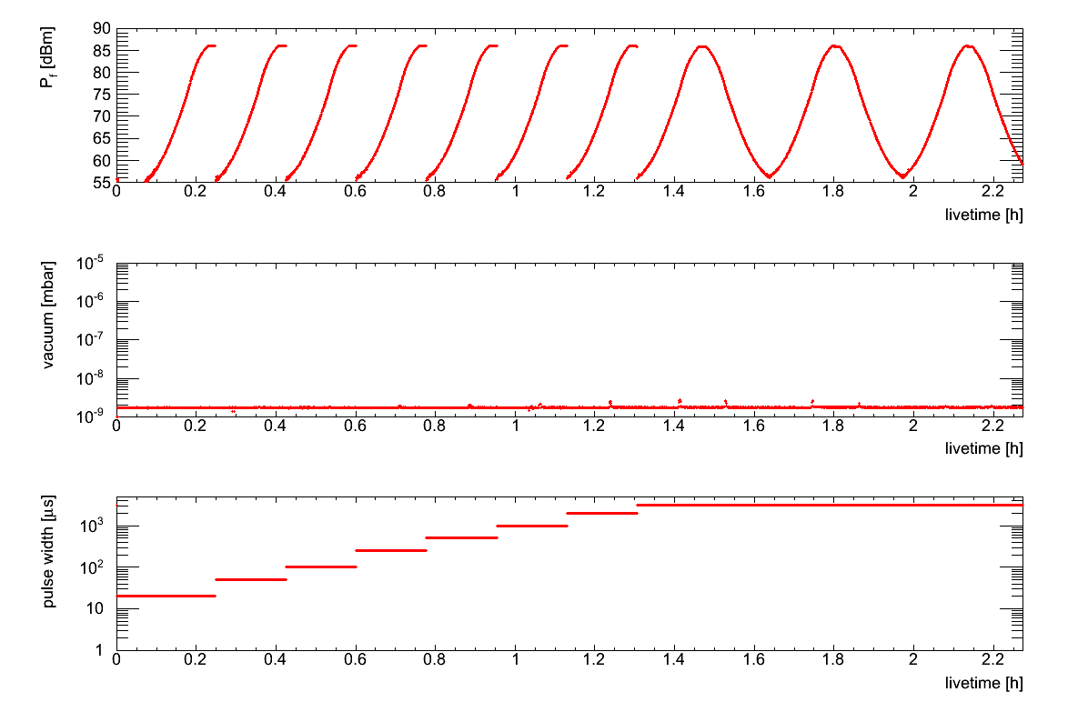
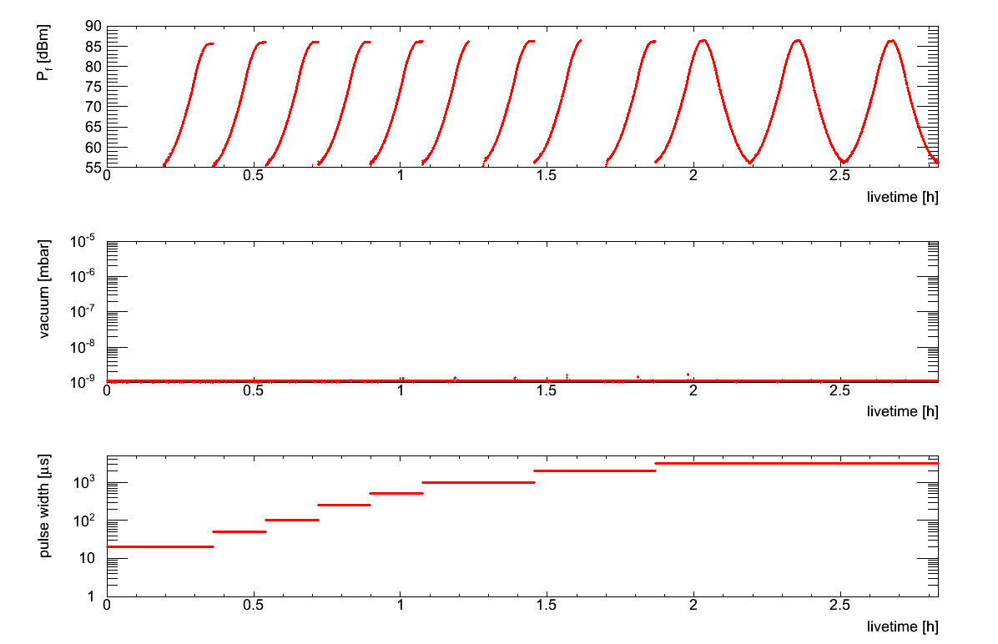
FPC cold conditioning
FPC1
FPC2
Forward power (dBm)
Forward power (dBm)
vacuum
vacuum
Pulse length
Pulse length
Common MP bands at warm:
1) ~20kW (74dBm) dominating at short pulses (< 500 us)
2) 40kW (76dBm) dominating at long pulses (> 500 us)
No significant outgassing was found at cold FPC conditioning
Cold FPC only took less than half day

Slide 6
FPC conditioning conclusion
FPC1 | Warm | Cold
Real time [h] | 304 | 4.1
Intervention # | 17 | 2
Up time [h] | 76 | 2.3
Down time [h] | 228 | 1.8
FPC2 | Warm | Cold
Real time [h] | 297 | 2.9
Intervention # | 23 | 1
Up time [h] | 78 | 2.8
Down time [h] | 219 | 0.1
Re-conditioning is required due to cross contamination
Total conditioning timing is about 4 weeks (real time), can be improved to 7 days (based on Up time) or even 3 days if conditioning two couplers simultaneously
Major bottleneck:
Pumping capacity -> two pumping carts will be tested on the first series CM
Stable operation of two RF stations

Slide 7
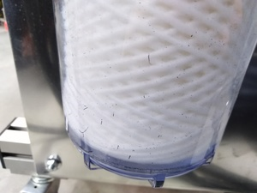
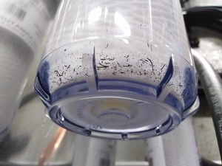
Investigation of downtimes
Only RF on during working hour→ improved by automatic code (24/7 running)
Interventions to the bunker → can be minimized by better coordination
System trouble → most issues have been solved before series testing
Filter installed before the water flow meter

Slide 8
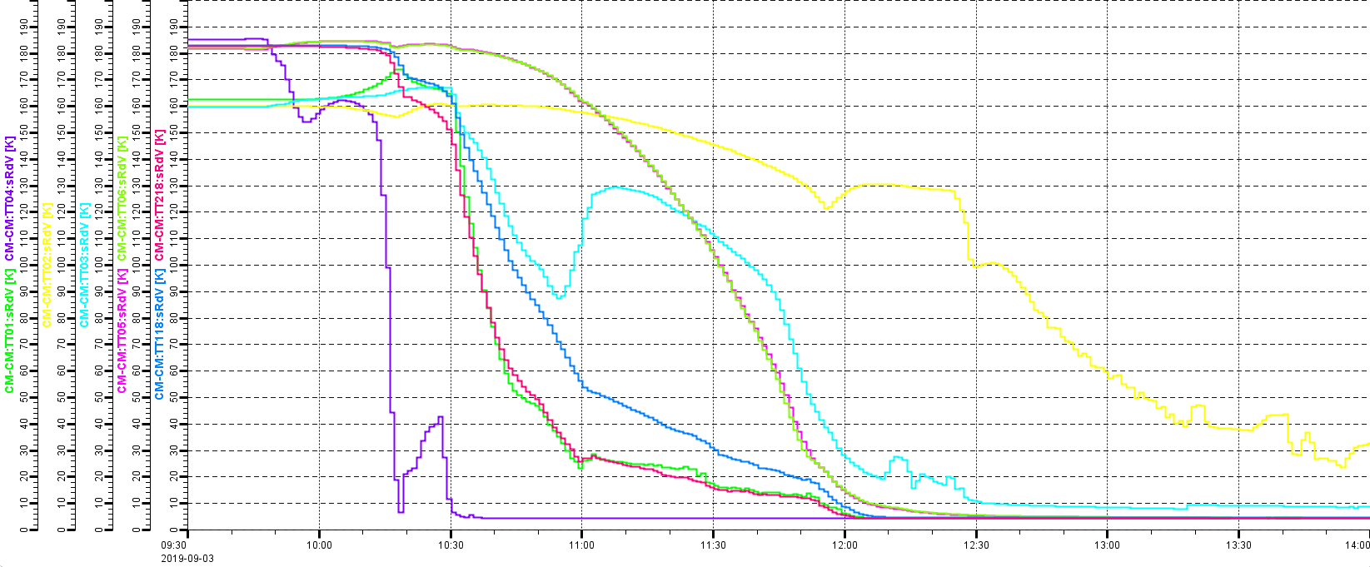
Cooldown
Cooldown rate :
for cavity 1 (TT118):
from 150 K to 50 K-> 3.7 K/min
for cavity 2 (TT218) :
from 150 K to 50 K -> 5.3 K/min
Parameter | Frequency (MHz)
 | 300K | 4K | 2K | Frequency shift
Cavity 1 (Romea) | 351,88 | 352,402 | 352,373 | 0,493
Cavity 2 (Giulietta) | 351,91 | 352,2 | 352,171 | 0,261
Cooldown rate bigger than 1 K/min was applied
The typical cooldown time: 4 hours (from room temperature to 4 K) and 2.5 hours (from 4 K to 2 K)
Cavity resonance frequency is monitored during cooldown with VNA S parameter
Discrepancy of frequency shift is observed

Slide 9
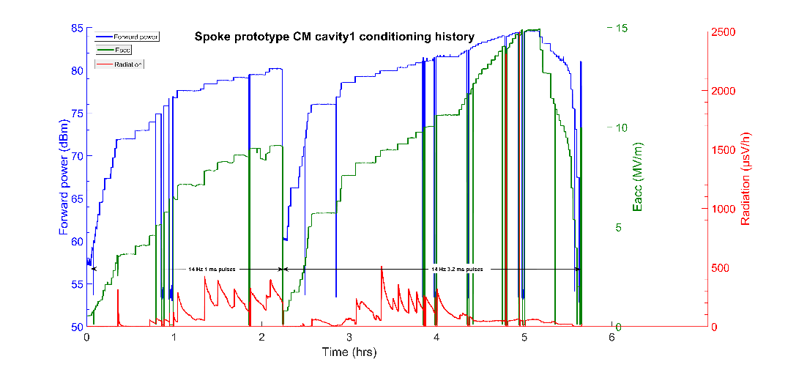
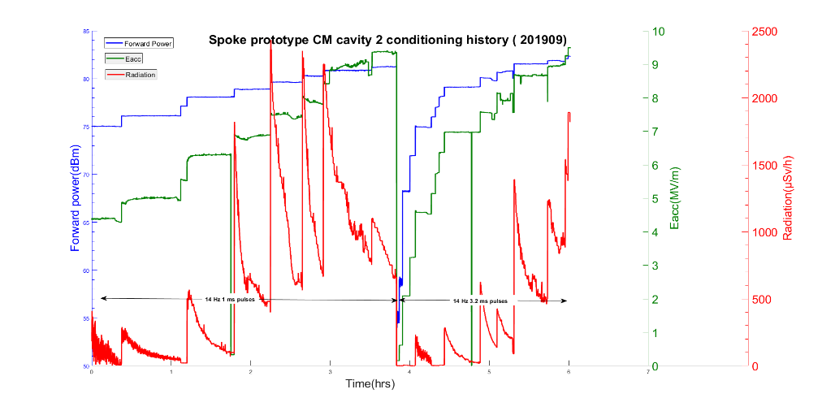
Cavity conditioning history
Cavity 1 conditioning
Cavity 2 conditioning
Common MP barriers:
1)around 4.5-5.5 MV/m
2)around 6-8 MV/m
MP barriers and radiation were reproducible after thermal cycle
Higher heat load was observed in both cavities during conditioning
Cavity performance recovers after conditioning
9

Slide 10
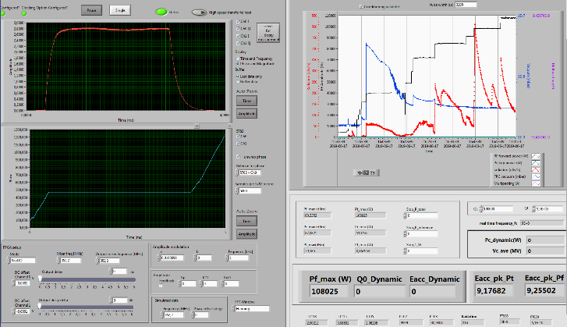
Cavity conditioning conclusion
 | Cav1 1st run | Cav2 1st run | Cav2 2nd run | Cav2 3rd run | Cav2 4th run | Cav1 2nd run
live time [h] | 6 | 6.7 | 7.3 | 7.4 | 6 | 6
Loop | Open loop | SEL | SEL | SEL | Open loop | Open loop
Conditioning strategy | 1ms@ 14Hz 3.2ms@14Hz | 1ms@ 14Hz 3.2ms@14Hz | 3.2ms@ 1Hz 3.2ms@14Hz | 1ms@ 14Hz 3.2ms@14Hz | 1ms@ 14Hz 3.2ms@14Hz | 1ms@ 14Hz 3.2ms@14Hz
Different loop setting and conditioning strategies were studied and no significant difference was found in the time variation of cavity conditioning
Open loop with a fixed repetition rate of 14 Hz would be an optimal option
Total cavity conditioning timing is about 2 days
10

Slide 11
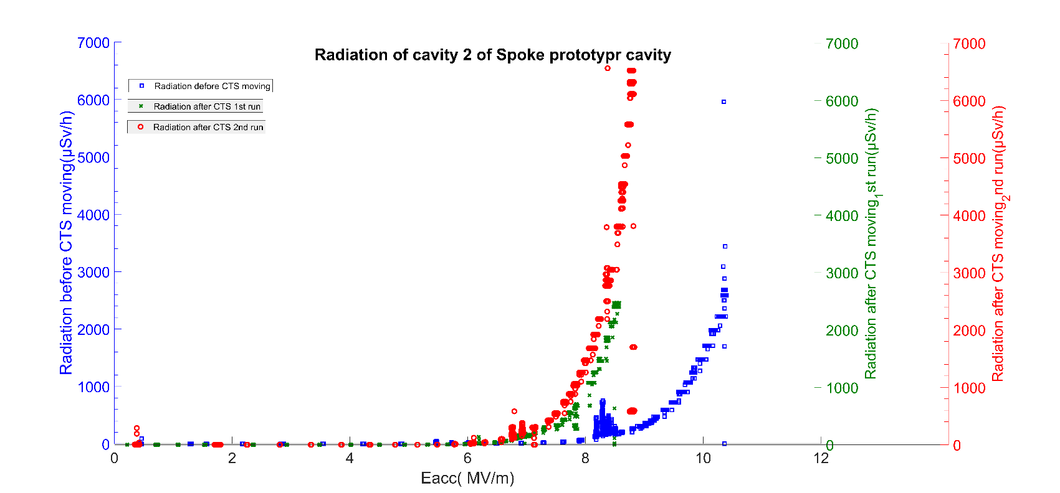
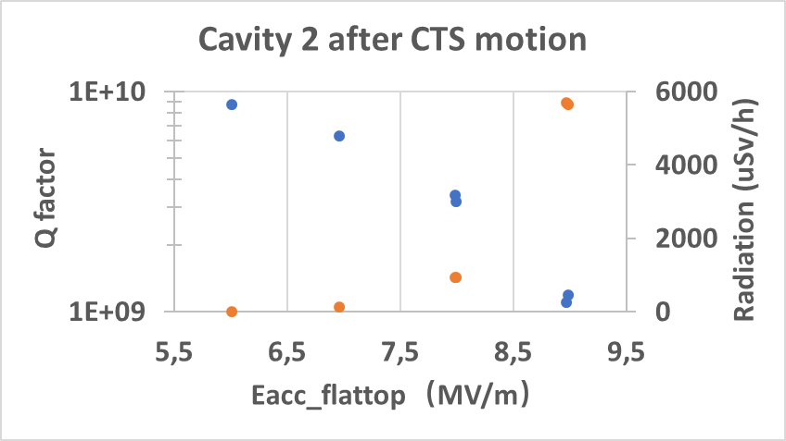
Field emission of cavity 2
A strong field emission associated with CTS activities was found in cavity 2
The field emission onset was decrease to Eacc of 7 MV/m after moving the CTS to the target frequency (the green curve)
Released the CTS and returned to the target position, the field emission showed almost the same onset point but higher radiation, and the maximum Eacc was decrease from 10.5 MV/m to about 9 MV/m
The dynamic heat load was also increasing along with the radiation
Lower Q0 performance of cavity2 was observed after CTS activities

Slide 12
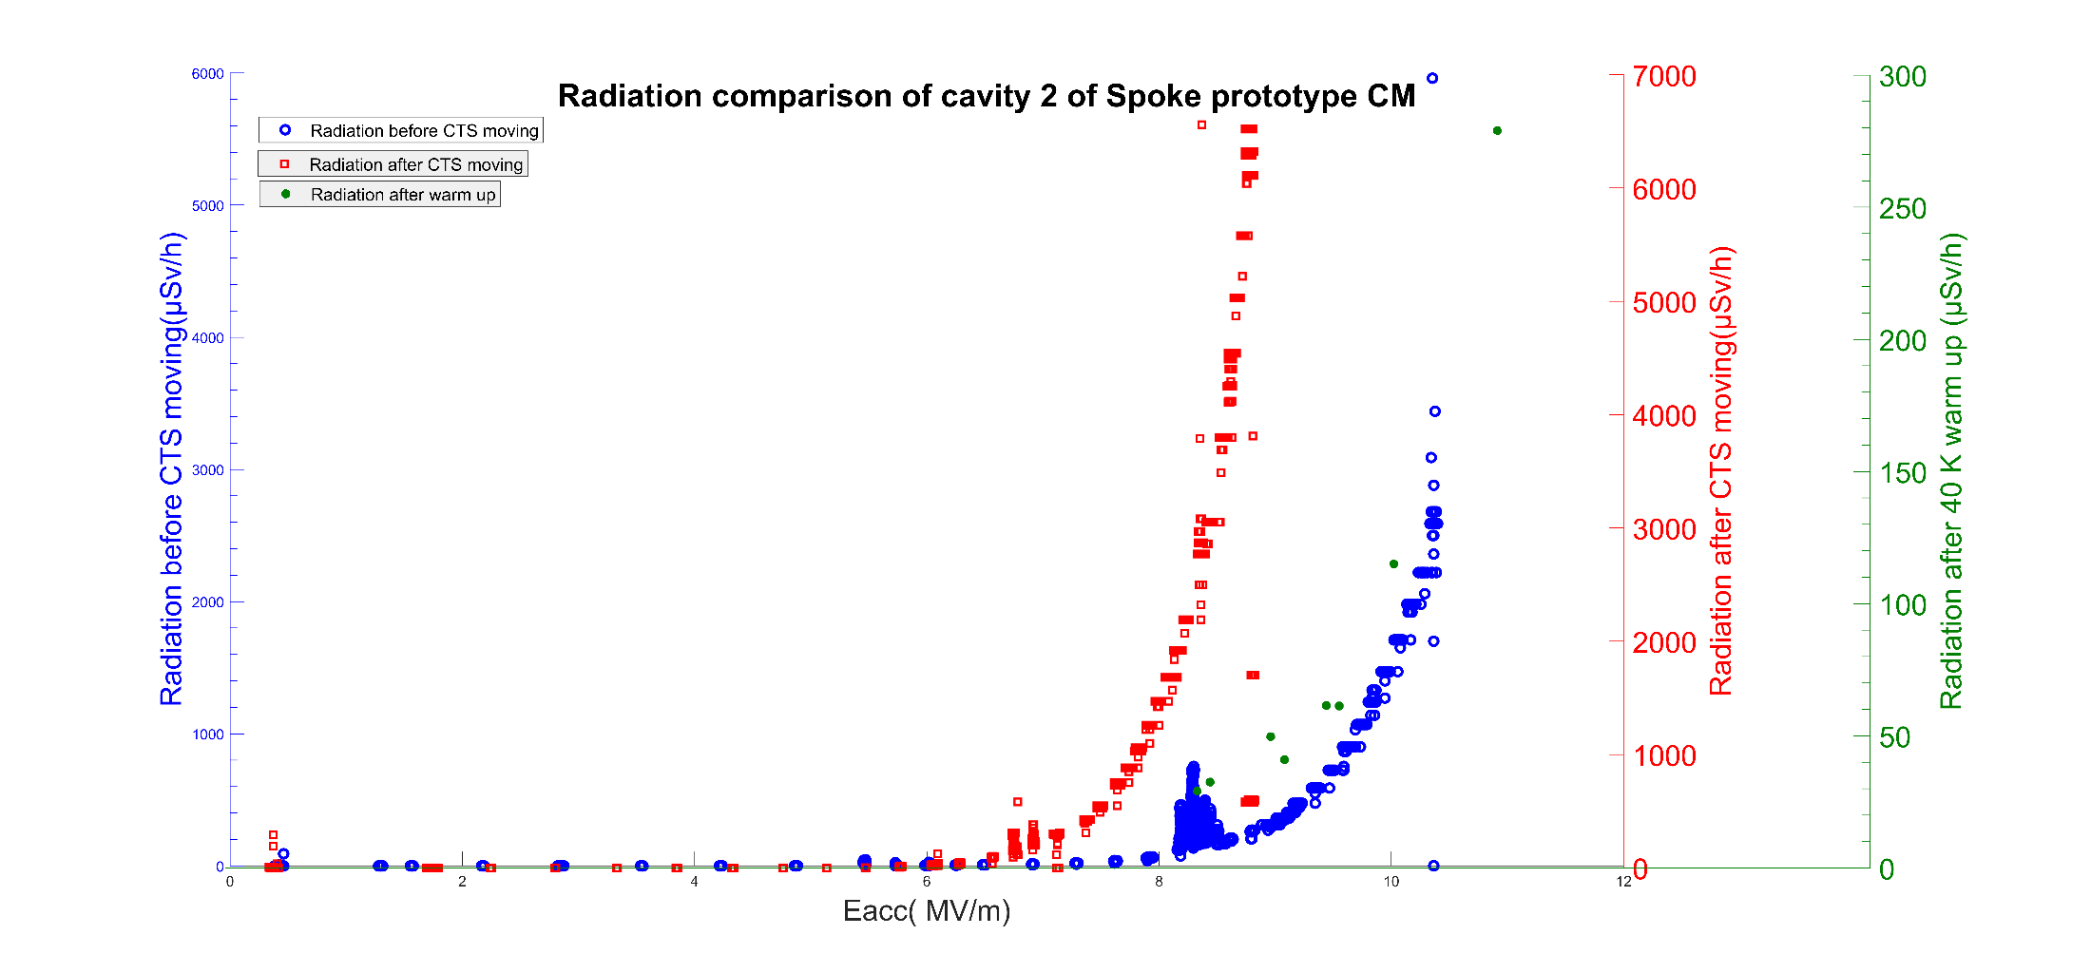
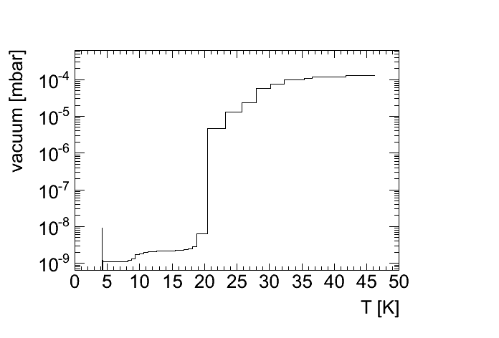
40 K thermal cycle
A thermal cycle up to 40 K was performed for the CM
Outgassing up to 10⁻⁴ mbar was observed around 20 K, implying that hydrogen is vaporized from the cavity surface.
Field emission was almost back to the situation before the CTS activities
Maximum Eacc was improved from 9 MV/m to 10.5 MV/m after thermal cycle.
Q0 performance of cavity2 was recovered as before the CTS activities.

Slide 13
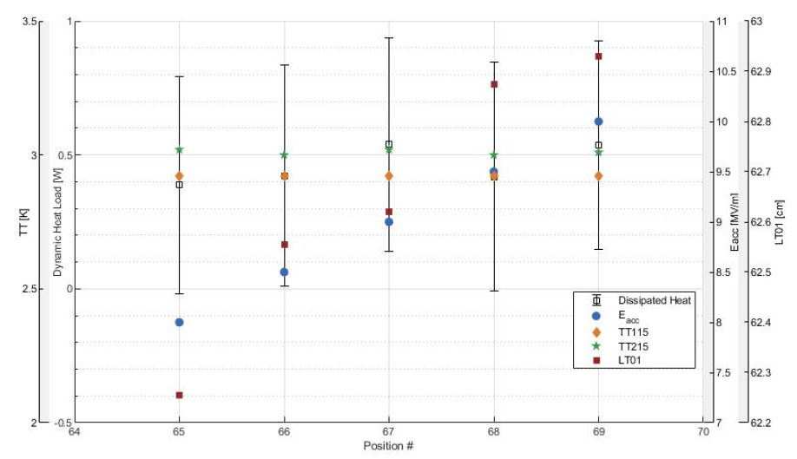
Q measurement (I)
Q factor is done by the calorimetrical method
Both SEL and PID operation method are implemented
Heat load is measured via the flowmeter placed at room temperature and atmospheric pressure
Low dynamic heat load of spoke cavity (around 0.5 W) is within the measure uncertainty
Cavity 2 dynamic heat load

Slide 14
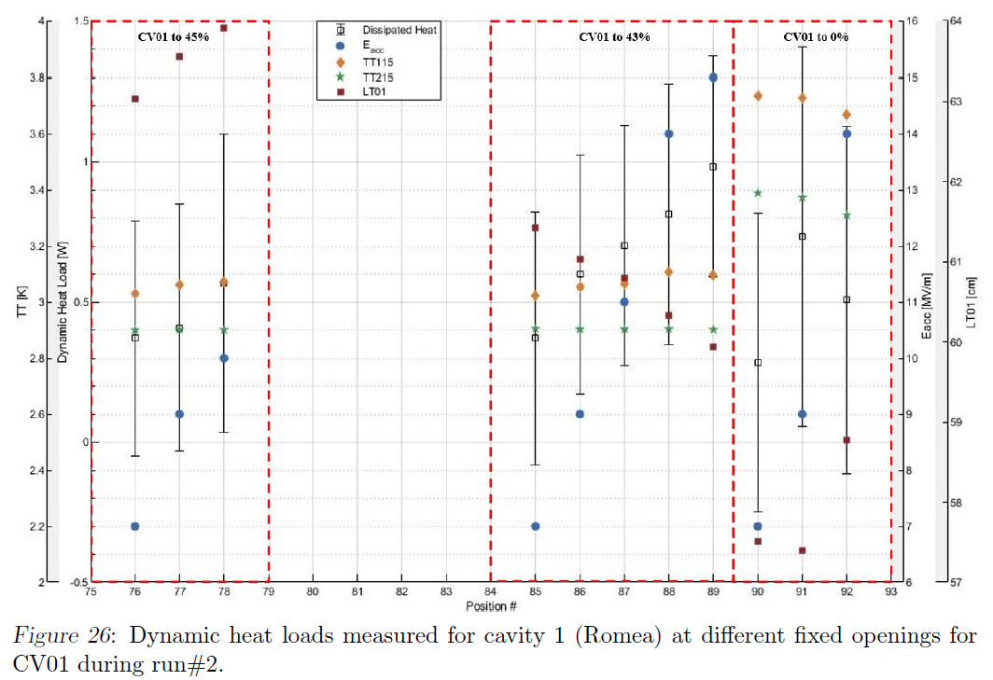
Q measurement (II)
Different methods have been tested in order to improve the measurement accuracy
Measurement uncertainty of heat load is ± 0.5 W
Cavity 1 dynamic heat load at different cavity filling valve opening

Slide 15
Q measurement (III)
 | Cav1 | Cav2
Loop setting | Open loop/ PID | SEL/ PID
Max Eacc | 15 MV/m | 10.5 MV/m
Dynamic heat load at 9MV/m | < 1 W | < 1 W
Q at 9MV/m | higher than specification
The maximun gradient higher than 9 MV/m was achieved.
Performance of spoke cavity in the cryomodule is way higher than the specification and is close to that in the vertical test.
Only several measurements points around the nominal accelerating gradient will be carried out in the series test for the trade off of test time.
High accuracy of Q factor is not necessary for series CM test.

Slide 16
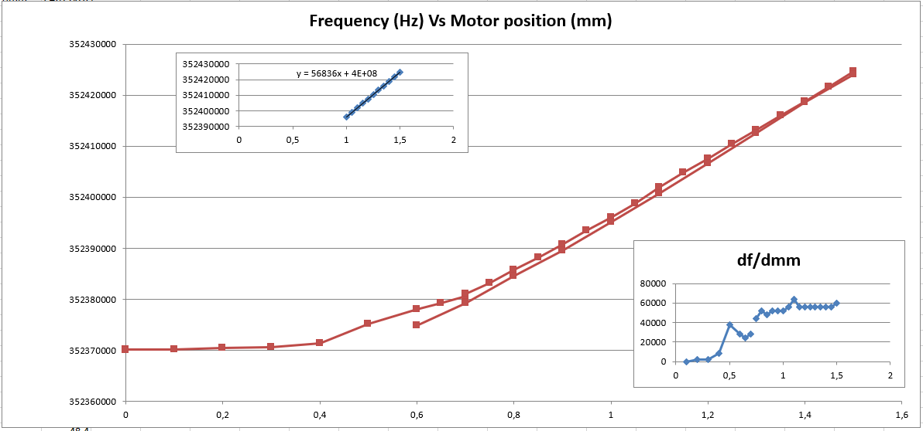
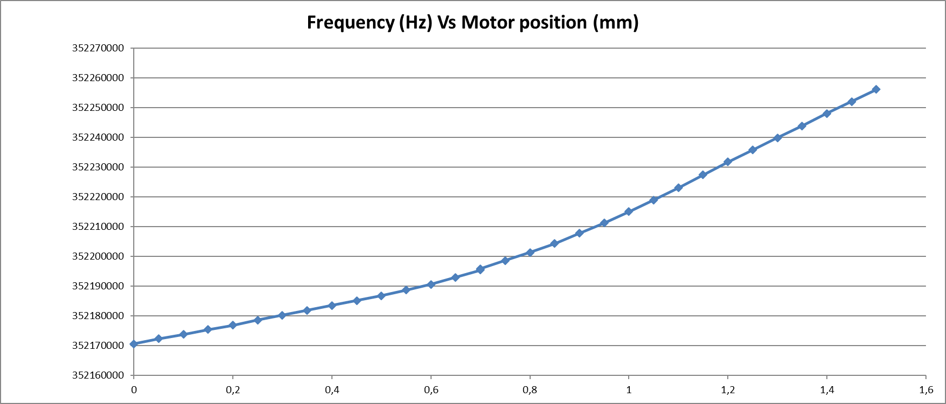
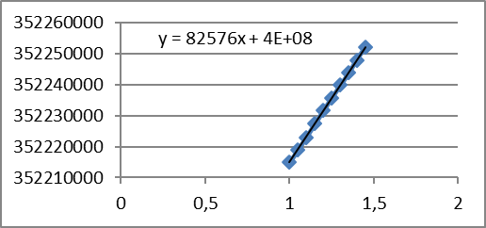
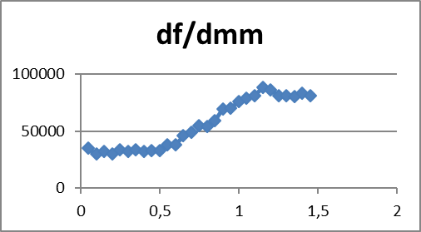
CTS study (I)
Cavity frequency (Hz)
Cavity1 tuning sensitivity
Tuning sensitivity of both CTS at 2 K has been carried out with SEL
No missing step has been observed
The reproducibility of stepper tuner linearity is validated
Different tuning sensitivity for different cavities has been studied
Motor position (mm)
Item | CTS1 | CTS2
Stepper motor Tuning Range (kHz) | 54.4 | 85.5
Tuning Sensitivity (kHz/mm) | 56.836 | 82.576
Cavity2 tuning sensitivity
Cavity frequency (Hz)
Motor position (mm)

Slide 17
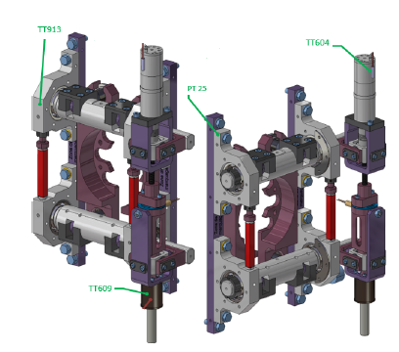
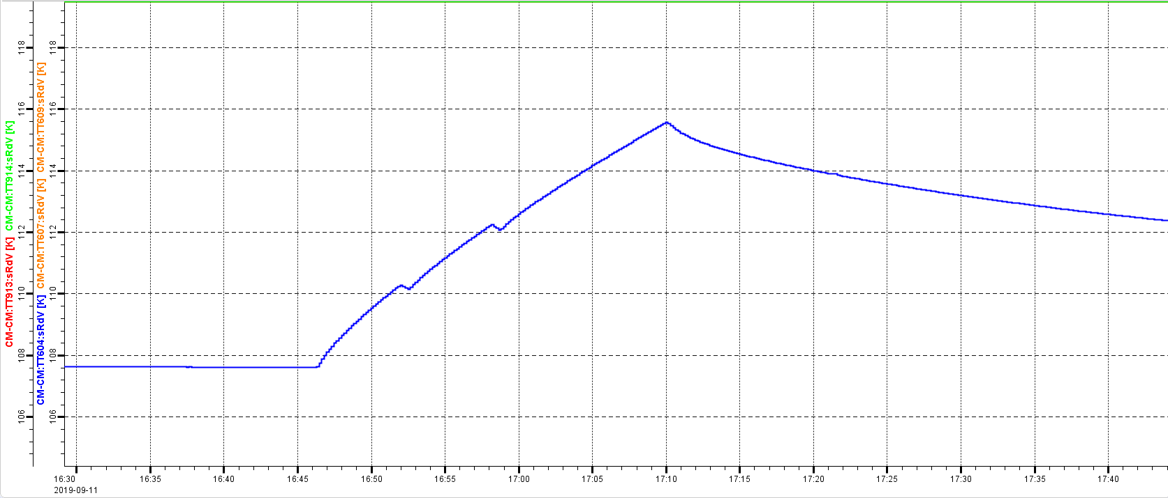
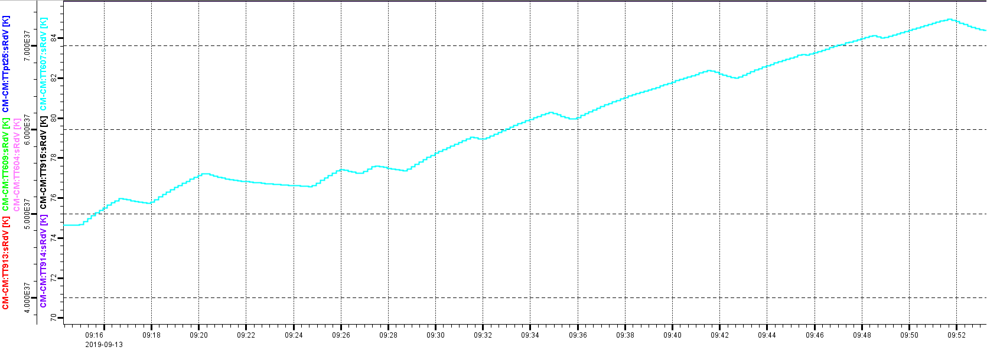
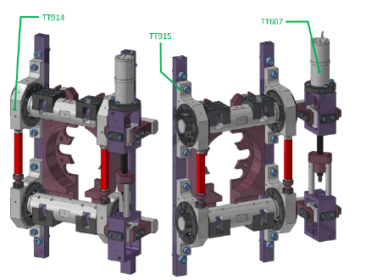
CTS study (II)
Temperature increasement of tuner motion is within 10 K
CTS1: from 107K-> 116K
CTS2: from 75K-> 85K
Safe disengaging system (installed on CTS 1) will be tested with only the prototype CM.
Stepper motor is back to the home position during night for safety consideration
CTS 1
116 K
107 K
85 K
CTS 2
75 K

Slide 18
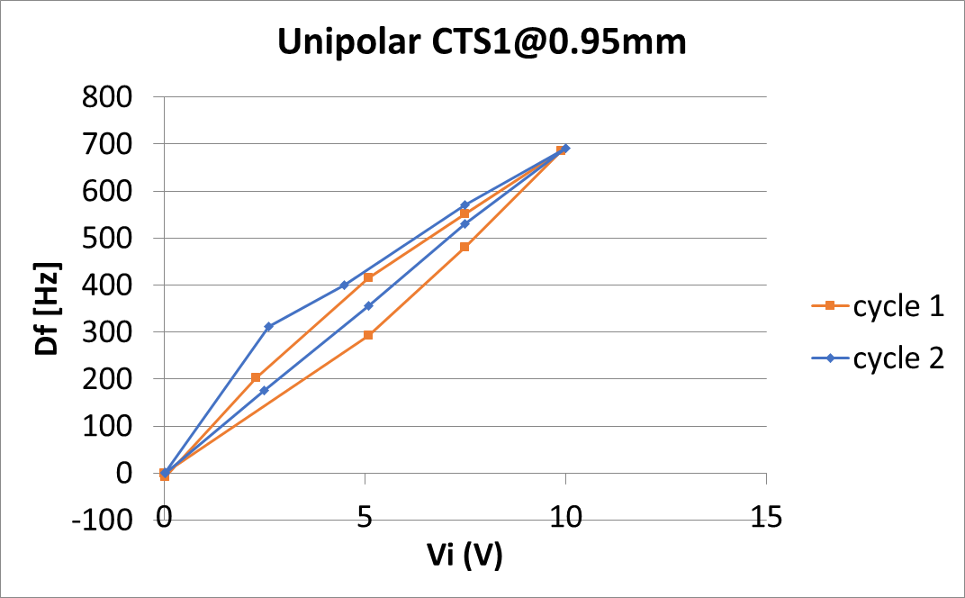
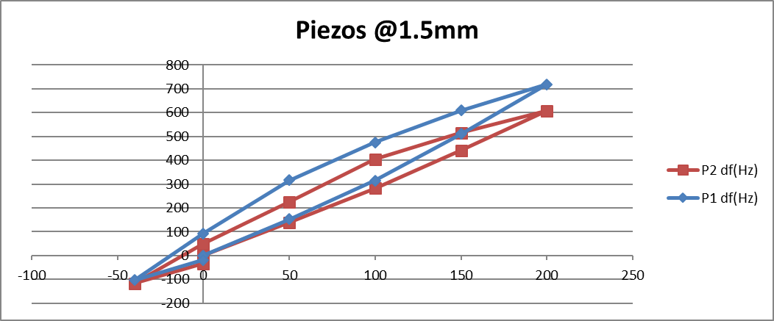
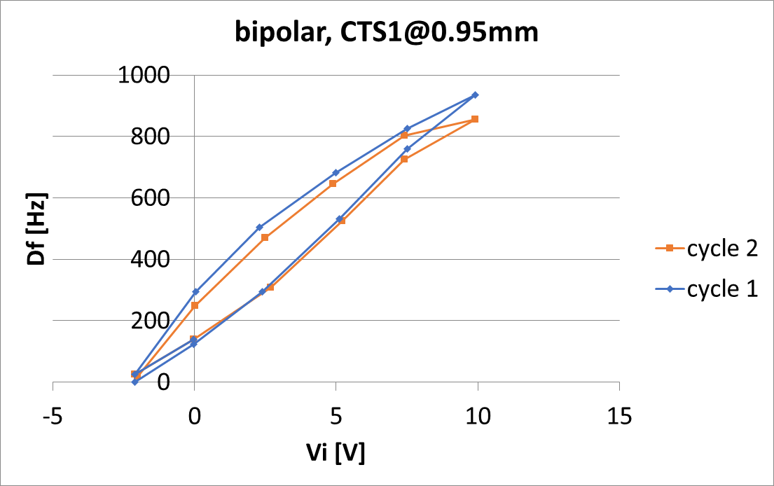
Piezo test
Characteristic of piezo at 2 K has been carried out at FREIA
Different high voltage range applications have been studied
Different type of piezo has been studied and compared
NAC2022-H72
Piezo Tuning Range | Piezo 1 (ZA02 @0.95mm) | Piezo 2 (ZA02 @0.7mm) | Piezo 2 (ZA02 @1.5mm)
Unipolar (0V->200V) | 694Hz | 465Hz | 626Hz
Bipolar (-40V->200V) | 936Hz | 692Hz | 821Hz

Slide 19
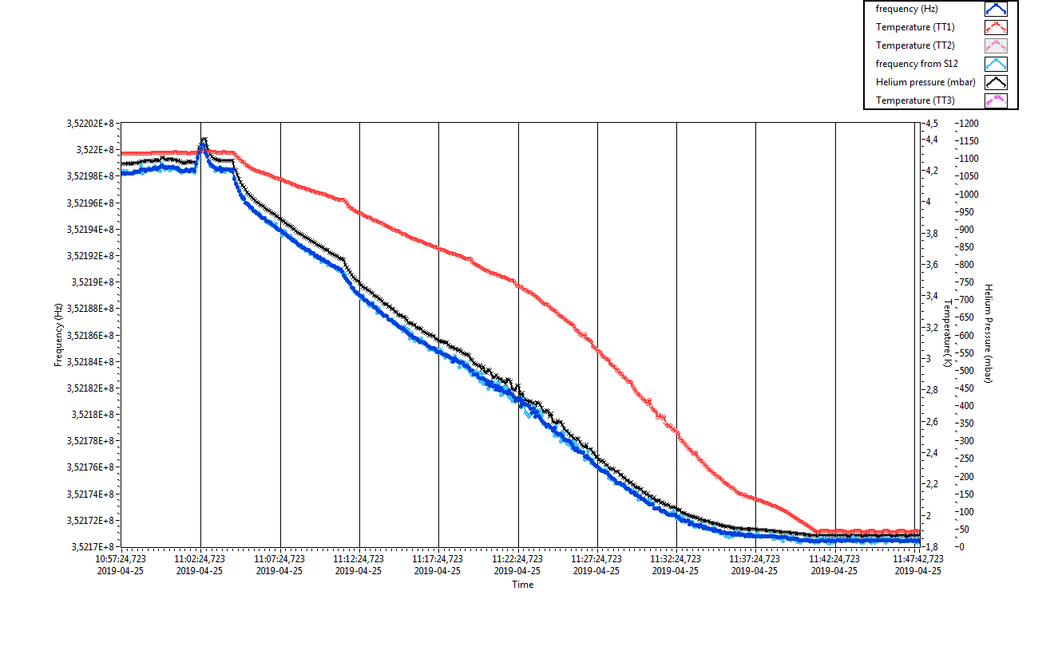
Frequency vs. Pressure
Checking the cavity frequency shift as a function of helium pressure during cool down from 4.2 K (~1080mbar) to 2 K (~31mbar)
Similar pressure sensitivity has been observed
Cavity 2 frequency shift as a function of pressure
Frequency sensitivity to Pressure:
27.6 Hz/mbar (cavity 1: Romea)
28.57 Hz/mbar (cavity 2: Giulietta)

Slide 20
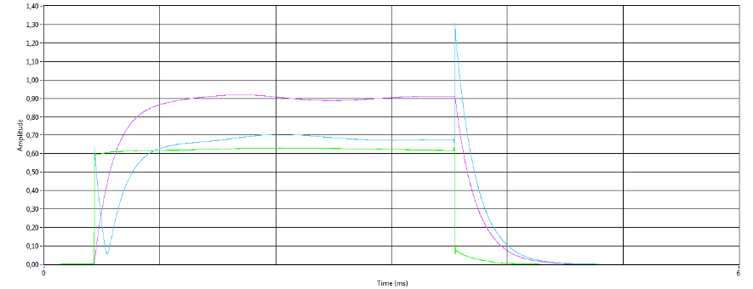
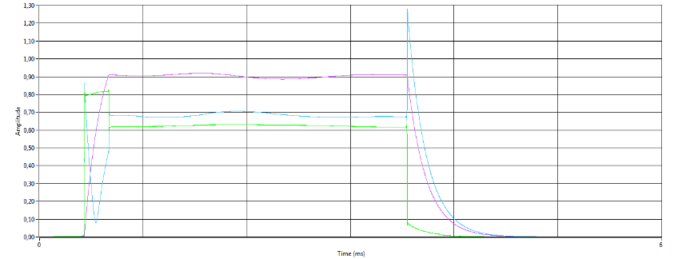
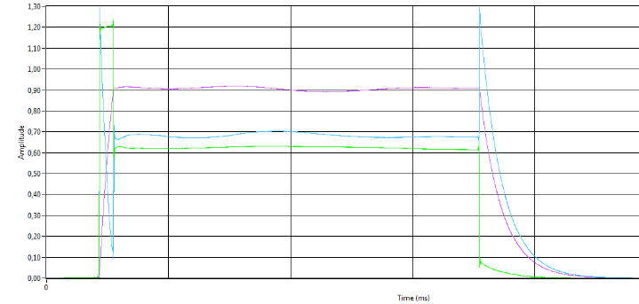
Filling time vs. Forward power
Forward power required by different filling time has been studied with open loop
The whole chain including LLRF system, RF station, RF distribution is involved
About 110 kW peak power is required to maintain 9 MV/m
With about 250 kW peak power, filling time of 300 us is achieved
Test results are consistent with those from PID test
Nature filling of cavity of 800 us
filling of cavity of 300 us @ 250 kW
filling of cavity of 130 us @ 400 kW
 | Cav1 | Cav2
Forward power required by filling time | 110 kW is needed for 800 us 200 kW is needed for 300 us 250 kW is needed for 200 us 400 kW is needed for 130 us | 105 kW is needed for 800 us 170 kW is needed for 300 us 200 kW is needed for 200 us 400 kW is needed for 120 us

Slide 21
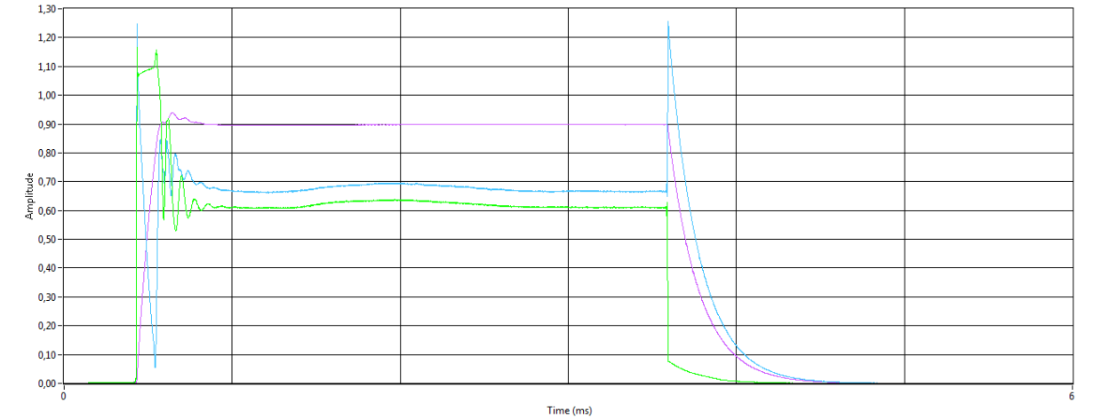
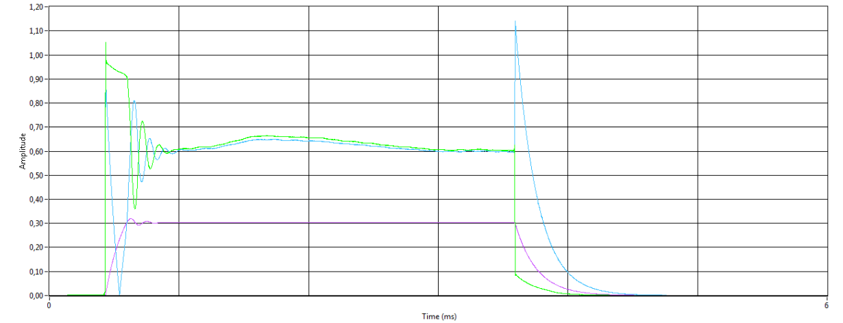
PID Operation
ESS LLRF PID control has been tested on spoke prototype CM with single RF station (DB),
Field flatness managed by only PID control is within 1%
Flattop of pulse profile is around 2.8 ms
Peak power for achieving flattop gradient is about 380 kW
Optimal parameter of PID control is under studied
Q factor of spoke cavity was carried out by PID operation
380 kW
2.8 ms
Cavity 1
About 350 kW
Forward power
Reflectted power
Transmited power
Cavity 2

Slide 22
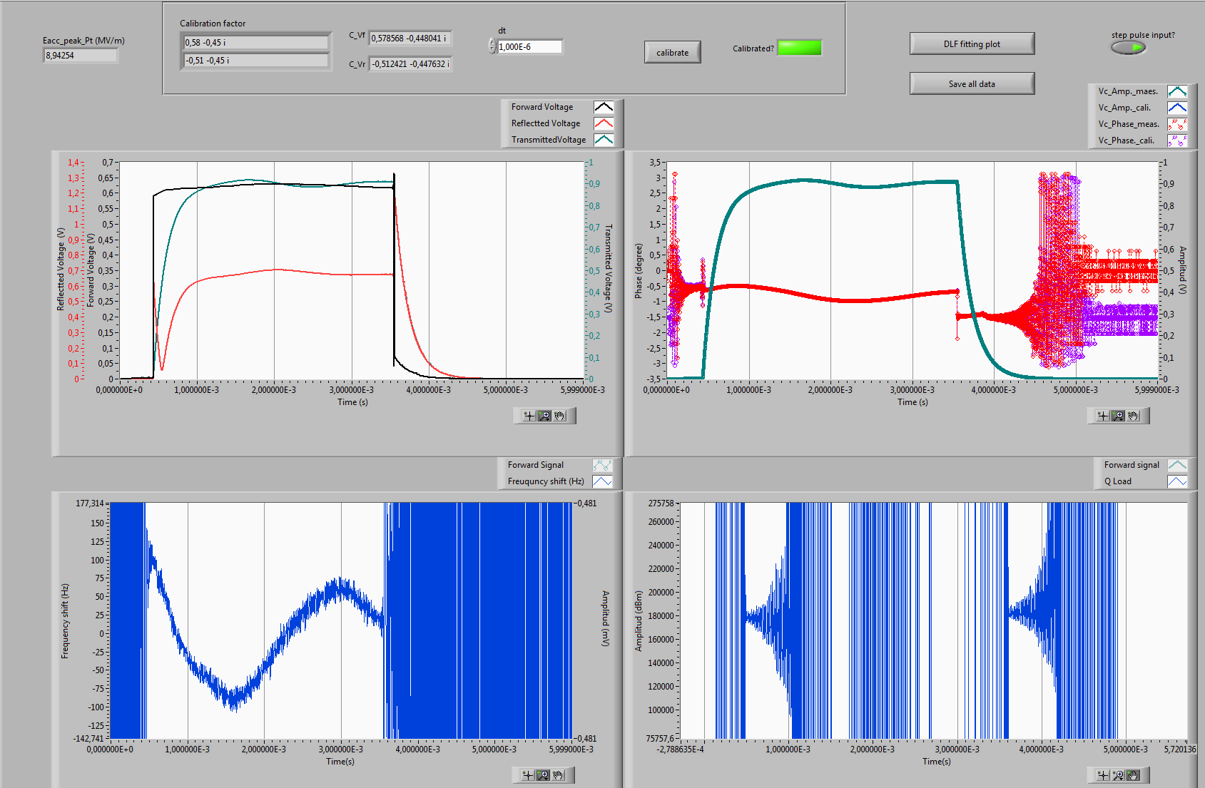
Lorentz Force Detuning
Developed a FPGA-based LabView program for dynamic Lorentz force detuning
Frequency shift at accelerating gradient 9MV/m@ 3.2 ms pulse length is about 250Hz (open loop) and 320 Hz (PID)
A Loaded Q value of $1.8×105$ from state space equation caculation is consistent with the VNA measurement
$$∆f=250Hz$$
$$∆f=320Hz$$
$$QL=1.8×105$$

Slide 23
Conclusion
The ESS spoke prototype cryomodule has been successfully tested at FREIA.
The whole chain of LLRF, RF station, RF distribution, FPC, CM has been verified.
Excellent performance of the prototype cryomodule ( about 0.5 W@9 MV/m per cavity) is observed.
Experience gain from prototype CM
Long time conditioning of FPC is required due to cross contamination,
Low pumping capacity and technical problem of RF station are the bottleneck of speeding up test ,
Strange field emission after CTS motion is observed but recovered after the thermal cycle,
Open loop and ESS LLRF PID control will be the major method for CM tests,
Dynamic heat load of 0.5 W of each cavity is hard to measured.
The system is ready for spoke series CM test.

Slide 24
Thank you for your attention!

Slide 25
Appendix: Spoke CM RF Test List
Warm test | Cool down | Cold test | Warm up
Central cavity frequency Qe | Frequency shift due to cool down Pressure sensitivity | Coupler cold conditioning
 |  | Central frequency Loaded Q and Qe
 |  | Tuning range of the slow step tuner
 |  | Cavity conditioning
Coupler warm conditioning
 |  | Steady heat load of CM
 |  | Q0 Dynamic heat load Reach 9 MV/m
 |  | Stabilization of the cavity field
CRYO
VNA
Open loop
SEL ( back up)
PID
with/without piezo

