Slide 1
Development of Elliptical Cavities in IMPCAS
Yulu Huang
On behalf of the CiADS SRF group

Slide 2
OUTLINE
1
Background Introduction and Basic Parameters
2
Main concerns in Our Elliptical Cavity Design
3
Worldwide Performances and Limitations
4
RF Design
5
Mechanical Design
6
Prototype, Post-processing and Test System Status
7
Summary

Slide 3
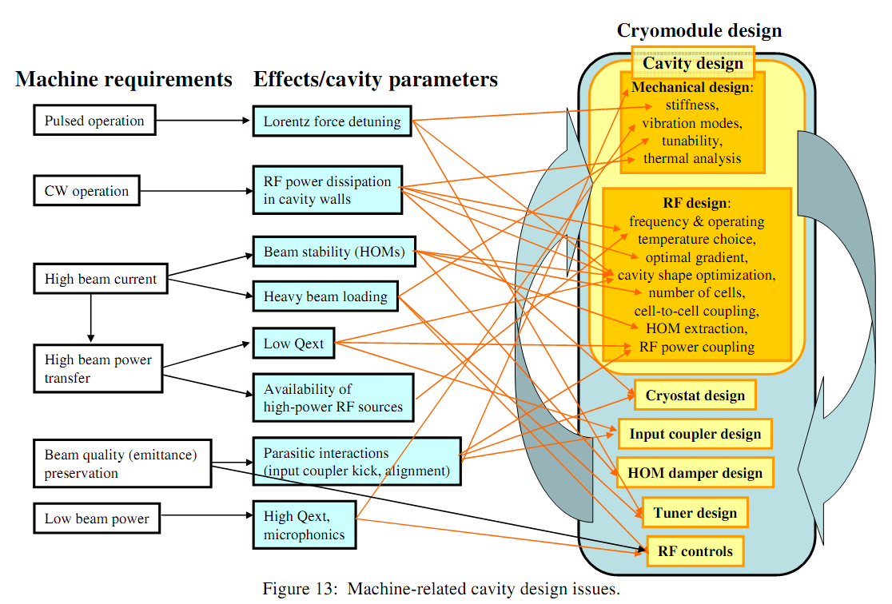
Background-CiADS 500 MeV Demo Facility
175 MeV
Particle | proton
Energy | 500 | MeV
Beam current | 5 | mA
Upgradeability | 10 | mA
Operation mode | CW& Pulse
Beam loss | ＜1 | W/m

Slide 4
Specification From Related Systems
Accelerator Physics
 | Cavity | unit | Ellip.062 | Ellip.082
Accelerator Physics | β_{opt} |  | 0.62 | 0.82
 | Frequency | MHz | 650 | 650
 | Aperture | mm | 100 | 100
 | Cell Number |  | 6 | 5
Cryogenic | Temperature | K | 2 | 2
 | Helium Pressure Fluctuation | Pa | ±10 | ±10
 | Max stress in helium vessel（RT） | bar | 2 | 2
 | Max stress in helium vessel（2K） | bar | 4 | 4
LLRF | Bandwidth | Hz | 220 | 220
 | LFD coefficient | Hz/(MV/m)² | <1 | <1
LLRF
Beam Dynamics
Cryogenic
Power Supply
SRF
vacuum
alignment
vibration
solenoid
…
…
2018-9 international review
2019-4 internal review
2019-9 international review

Slide 5
Main concerns in Our Design
High Eacc, High Q0
E_{pk} and B_{pk} limitation（operation Epk）
R_{res}（Q₀ and Cryogenic losses）
Balance between V_{acc} and P_{losses}
Main coupler design，
Coupler kick，
Increase the beam pipe…
Low Qext（2.95E6）
Cryogenic losses;
Emittance growth，energy spread, BBU …
HOM coupler or not?
High Order Modes
Helium vessel and stiffening ribs design
Tuner Design
LFD coefficient less than 1 Hz/(MV/m)²
Lorentz Force Detuning
Helium pressure, 2bar(RT), 4bar(2K)
Cool down to 2K
Tuning
Stress Analysis

Slide 6
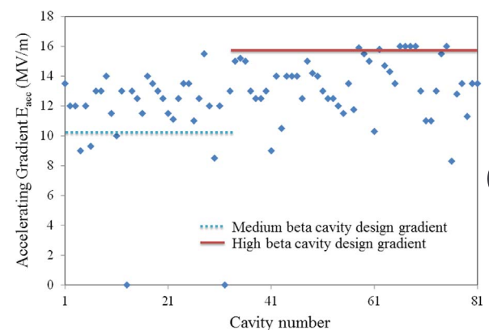
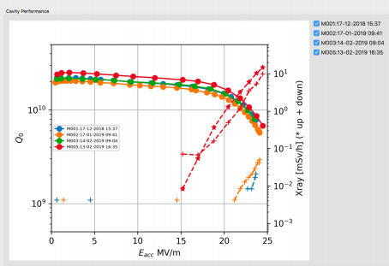
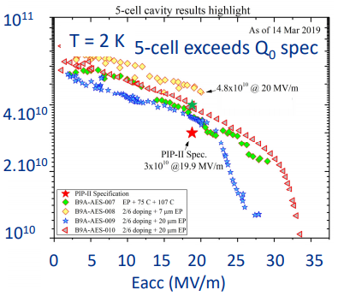
Epk Limitation
SNS 805MHz Cavities
ESS 704 MHz Cavities_VT
PIP II 650 MHz Cavities_VT
Epk/Eacc=2.19
Epk/Eacc=2.36
Epk/Eacc=2.71
Epk in operation with 60pps bunch:
LB804 :24-43 MV/m
HB804:20-36 MV/m
Epk >40 MV/m
Epk >40 MV/m
CiADS Elliptical Cavities Operation Epk=29 MV/m
Consider:
Performance degradation from VT to operation
Cryogenic and RF power supply budget
Long time stable operation

Slide 7
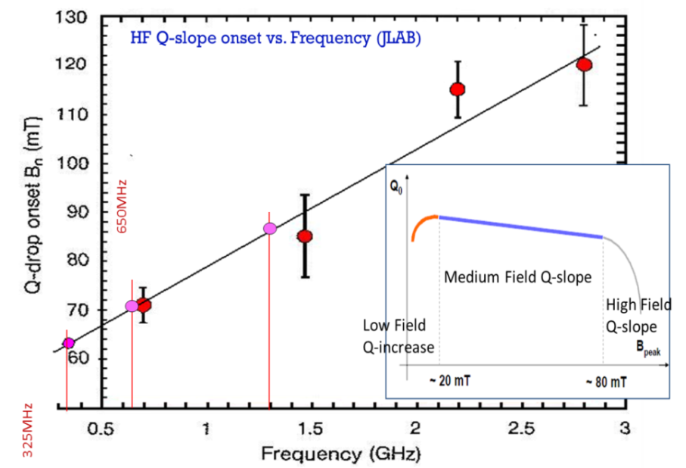
Bpk Limitation
325 MHz: B_{pk} < 60mT
650 MHz: B_{pk} < 70mT
1300 MHz: B_{pk} < 80mT

Slide 8
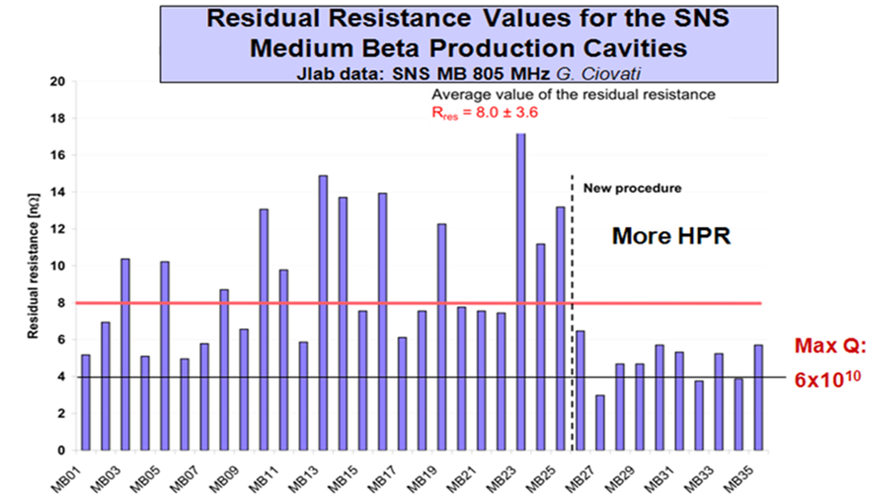
Residual Resistance
 | SNS(MB) | SNS(HB) | ProjectX
β_{G} | 0.6 | 0.8 | 0.9
Frequency, MHz | 805 | 805 | 650
B_{max}/E_{acc} | 5.72 | 4.72 | 3.75
B_{max}, mT | 72 | 72 | 72
E_{acc}, MeV/m | 12.6 | 15.2 | 19.2
G, Ω | 179 | 260 | 255
Q₀ meas.(at Bmax=72mT) | 2∙10¹⁰ | 1.8∙10¹⁰ | 3∙10¹⁰
Measur: Rs=G/Q₀ , nΩ | 9 | 14 | 5
SNS Cavities(805MHz)
CiADS Cavities(650MHz)
R_{BCS} = 4.2 nΩ
R_{BCS} = 2.73 nΩ
R_{res} = 5-10 nΩ
R_{trap} = 4.84 nΩ
R_{res} = 10 nΩ
R_{surf} = 17.57 nΩ

Slide 9
Operation Target
20W (more or less) Cryogenic losses@:
Epk=29 MV/m (Operation)
Rsurf=10+2.73+4.84(20mG)=17.57nΩ
Relatively Conservative!

Slide 10
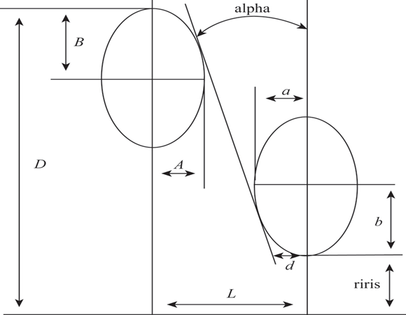
RF Design-Geometry
3 independent parameters!
Fixing wall angle alpha=2 degree for both the middle cell and the end cell
For tuning in each optimization step
Fixing riris=50mm for both 062 and 082 cavities due to beam dynamics requirements.
The midcell half cell length are determined by their optimum betas

Slide 11
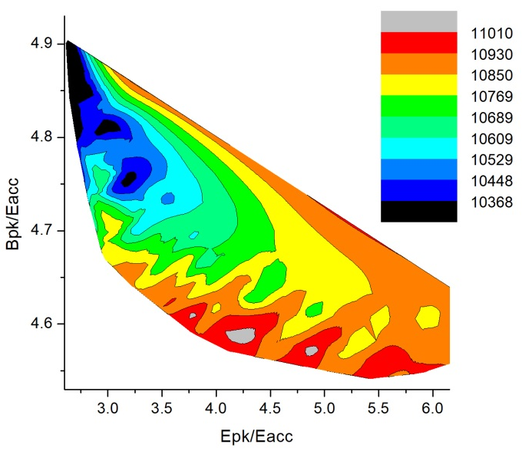
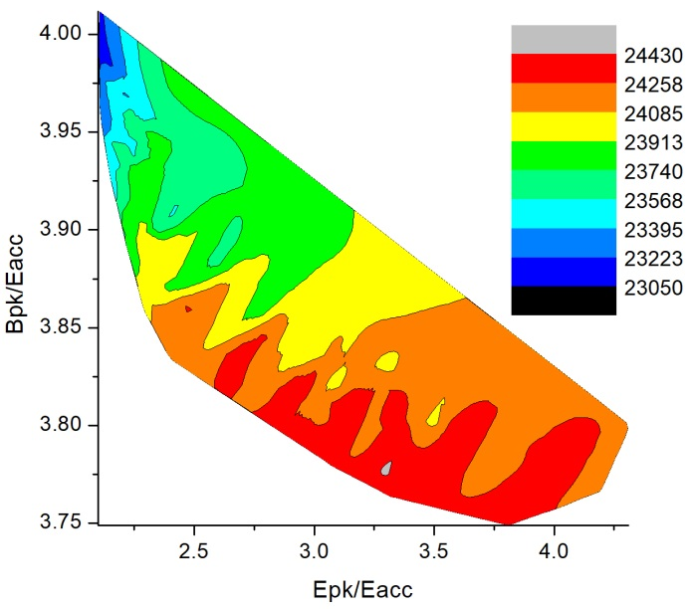
Parameter Sweeping Results
Coutour Plot of G*R/Q VS Epk/Eacc and Bpk/Eacc
062_G*R/Q
082_G*R/Q
082_G*R/Q

Slide 12
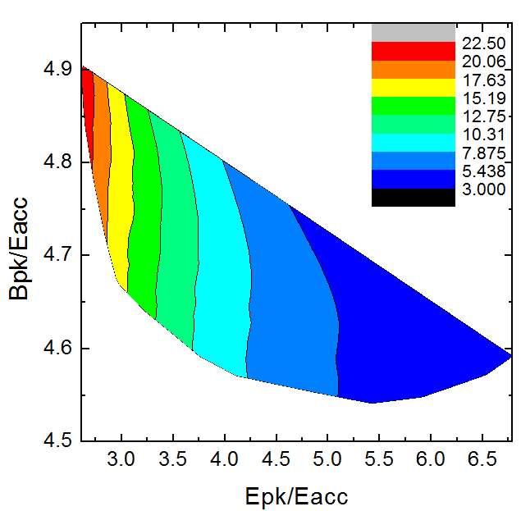
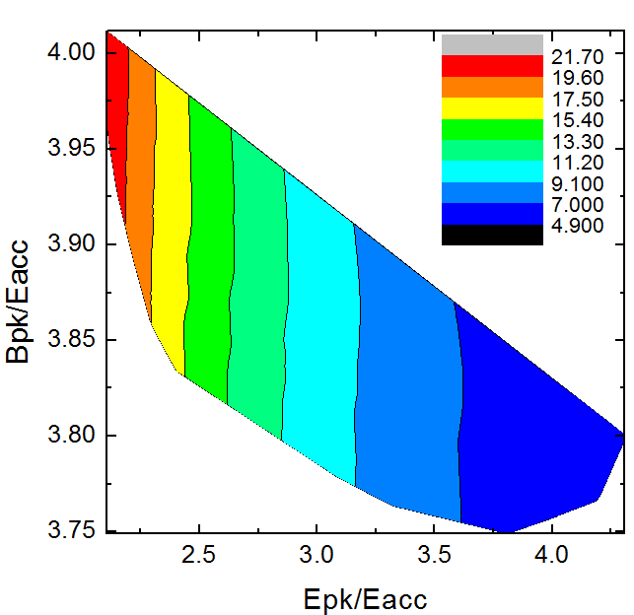
Parameter Sweeping Results
Cryogenic Losses Estimated @Epk=29MV/m,Rs=17.57nΩ
062
082

Slide 13
Final Geometry
Cavity | 6 Cell 062 |  | 5 Cell 082
Cell | Middle | End | Middle | End
Equator Dia. 2D (mm) | 395.346 | 395.346 | 393.003 | 393.003
Iris Dia. 2r (mm) | 100 | 110 | 100 | 110
Half-cell length L (mm) | 68 | 72 | 89.6 | 89.2
Iris b (mm) | 22 | 22 | 30 | 30
Iris a (mm) | 13.61 | 17.79 | 17.86 | 17.63
Equator B (mm) | 59 | 59 | 70 | 70
Equator A (mm) | 52 | 52 | 70 | 70
Wall Angle (degree) | 2 | 2 | 2 | 2
End-Cell Sl (mm) | 0 | 0 | 0 | 0
Beam pipe length Ltube (mm) |  | 198 |  | 162
Beam pipe diameter Dtube (mm) |  | 110 |  | 110

Slide 14
EM Parameter
Parameter | LB650 | HB650
Cell number | 6 | 5
βopt | 0.62 | 0.82
TTF_opt | 0.72 | 0.74
E_{pk}/E_{acc} | 2.80 | 2.10
B_{pk}/E_{acc}（mT/(MV/m)） | 4.86 | 3.98
R/Q(Ω)_β_{opt} | 334 | 501
G | 187 | 229
Field Flatness | 98.76% | 99.48%
Coupling Factor k | 1.54% | 0.96%
L_{eff} | 0.824 | 0.895
L_{total} | 1.22 | 1.22
E_{pk}_Operation | 29 | 29
E_{acc} | 10.36 | 13.81
V_{acc} | 8.54 | 12.36
B_{pk} | 50.37 | 54.96
R_{bcs}（2K） | 2.73 | 2.73
R0 | 10 | 10
R_{trap}（20mG） | 4.84 | 4.84
Q0 | 1.1e10 | 1.3e10
Ploss(2K) | 20.52 | 23.41

Slide 15
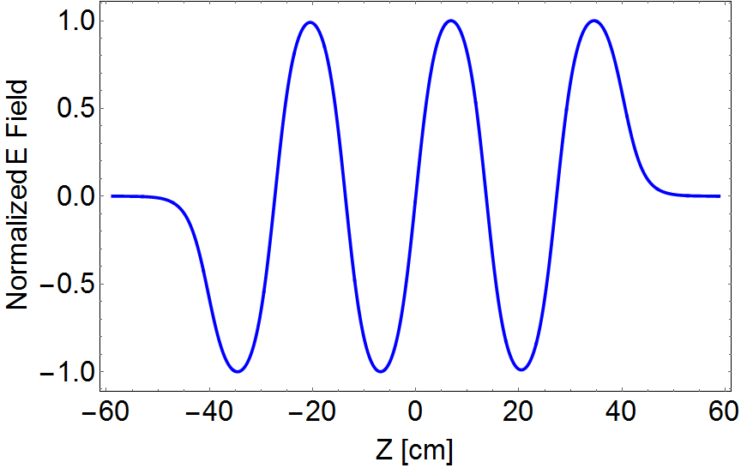
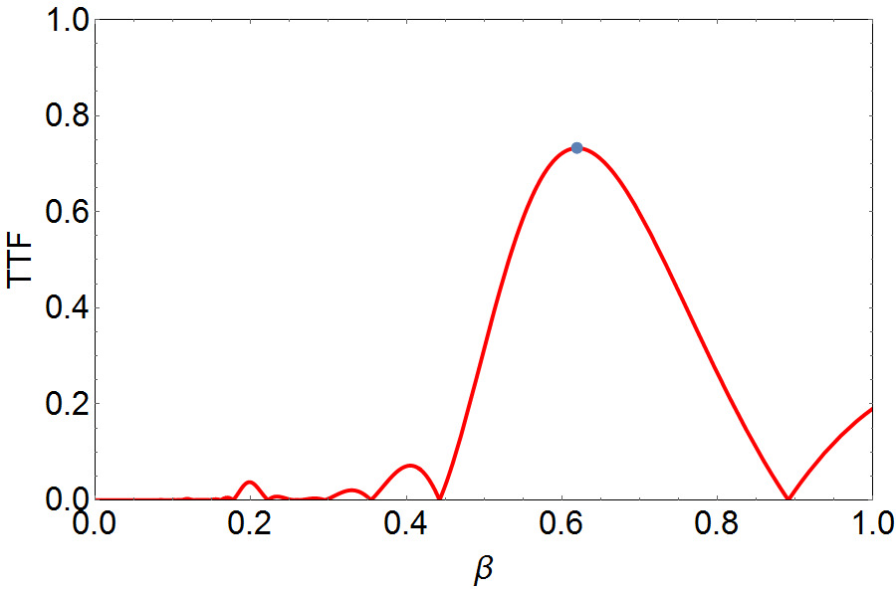
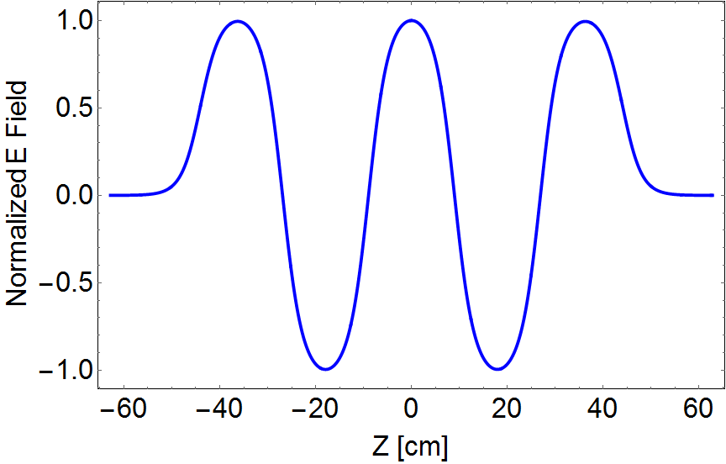
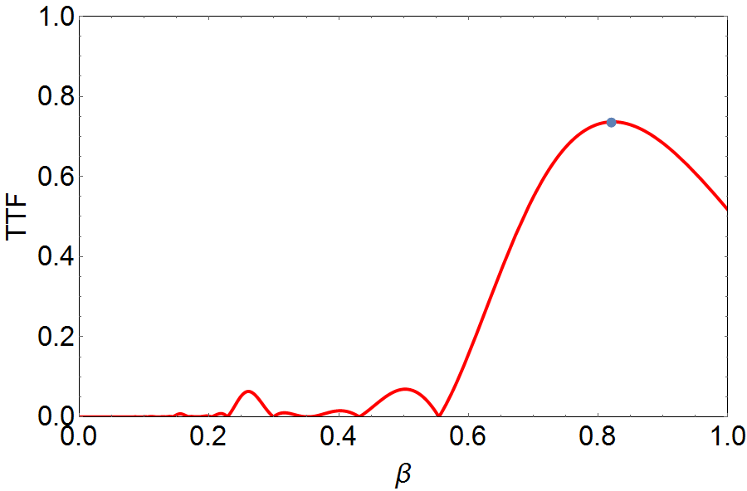
Normalized Electric Field and TTF
(0.62,0.723)
175-377MeV
0.542-0.7
>0.55
(0.82,0.74)
377-1000MeV
0.7-0.875
>0.56

Slide 16
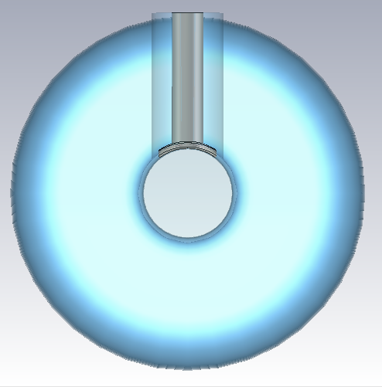
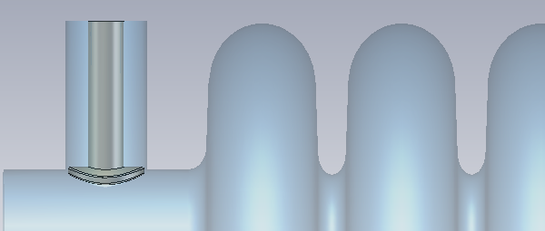
RF Power Coupling
Bandwidth 220Hz for both LB650 and HB650
Different values of L and D are shown for QL=2.95E6
L
D

Slide 17
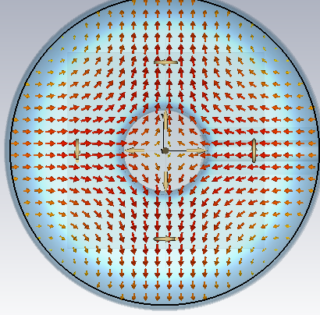
High Order Modes (HOMs)
TM Modes
TE Modes(No couple to the beam)
Monopole_TM_{0np}
Dipole_TM_{1np}
Quadpole_TM_{1np}
And higher…
Dipole_TE
Quadpole_TE
And higher…

Slide 18
HOM Issues
Emittance degradation
Energy spread
Beam-Break-Up (BBU)
Cryogenic loading (Incoherent and Resonating)
$$δf≥f \frac{I(R/Q)σ_{z}}{4\sqrt{2}cε_{z}}$$
$δf≥\frac{I\left(\frac{R}{Q}\right)x_{0}c}{8\sqrt{2}πβγU_{0}}$ $\sqrt{\frac{β_{f}}{ε_{t}}}$
$\frac{{δE}_{b}}{E_{b}}$=$\frac{2qk_{ll}}{E_{acc}}$
$$I_{th}=\frac{π^{3}E_{b}k}{{(\frac{R}{Q})}_{nt}Q_{L}L^{2}}$$
$$k_{nl}=\frac{ω_{n} }{4}{(\frac{R}{Q})}_{nl}exp⁡(−\frac{{ω_{n}}^{2}{σ_{z}}^{2}}{2{(βc)}^{2}})$$

Slide 19
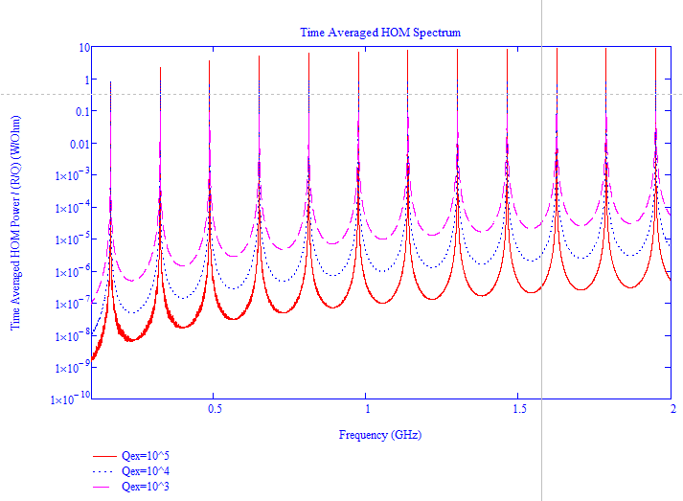
HOM Power Spectrum
162.5MHz CW single time structure；
Gaussian bunch，rms length is 1mm；
Beam current 10 mA；
Time Averaged HOM Power Spectrum Normalized to R/Q_062
Phom-total=0.57mW
Phom-res-5M=172mW

Slide 20
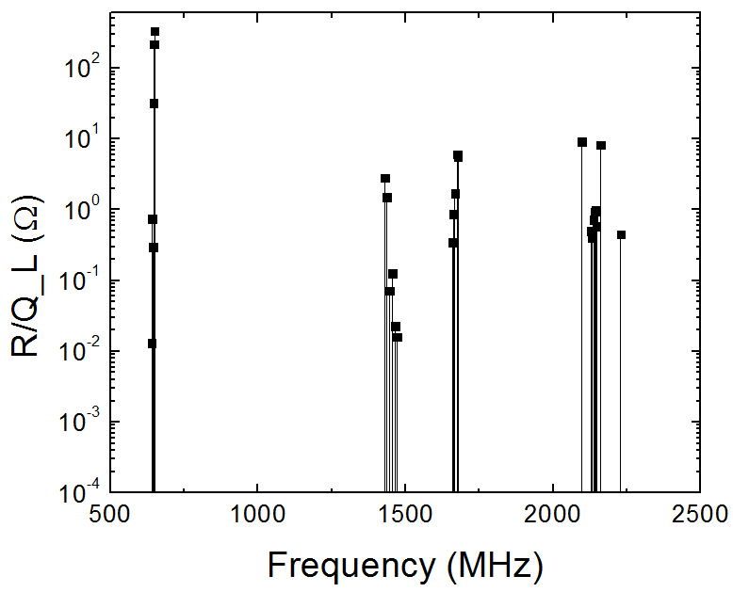
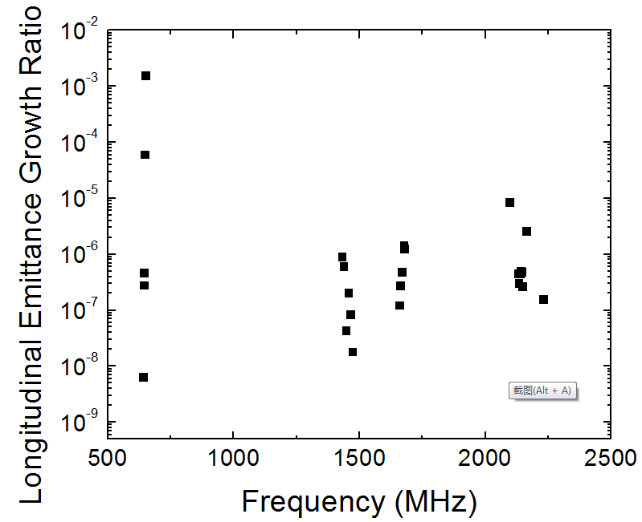
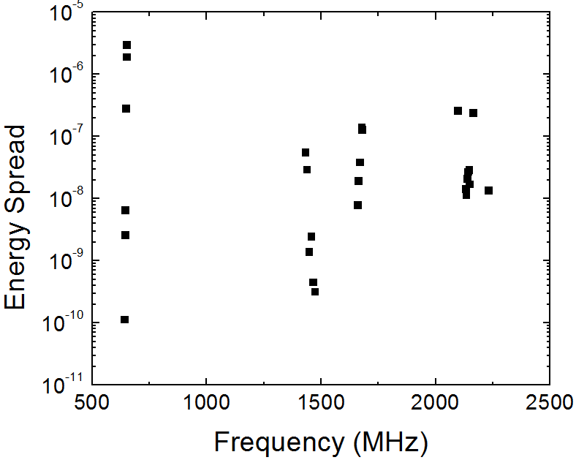
Monopole Impedance Spectrum

Slide 21
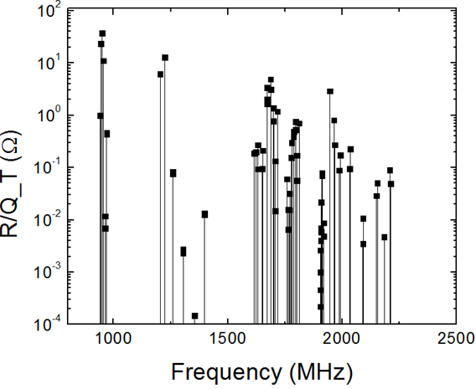
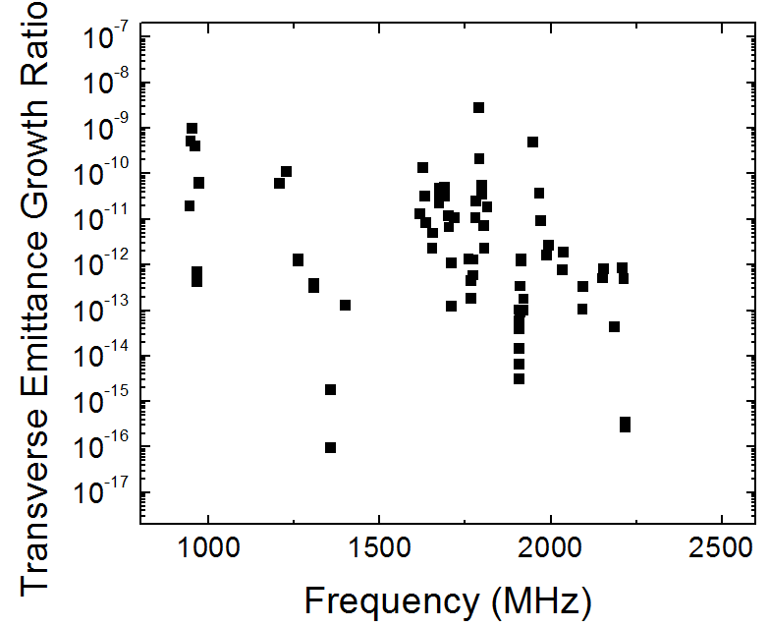
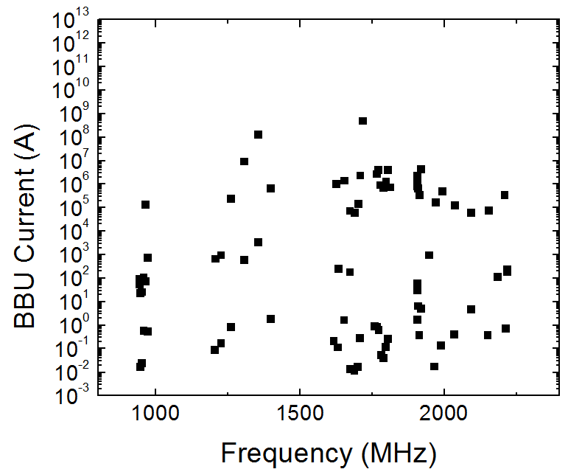
Dipole Impedance Spectrum

Slide 22
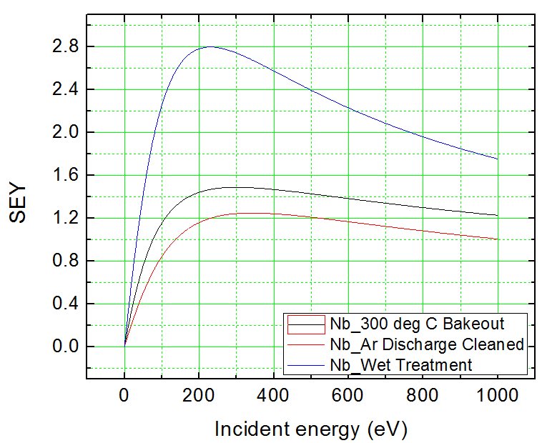
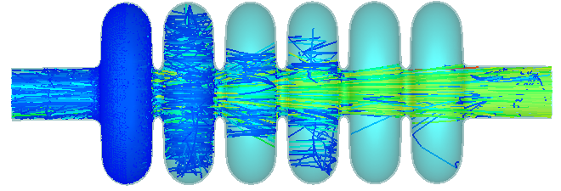
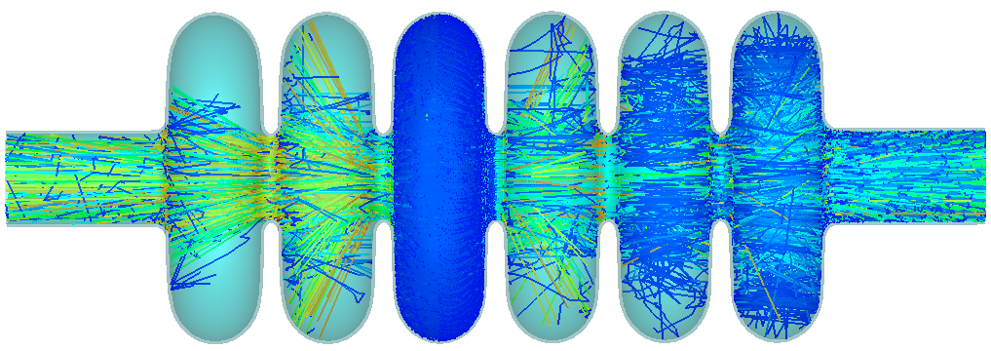
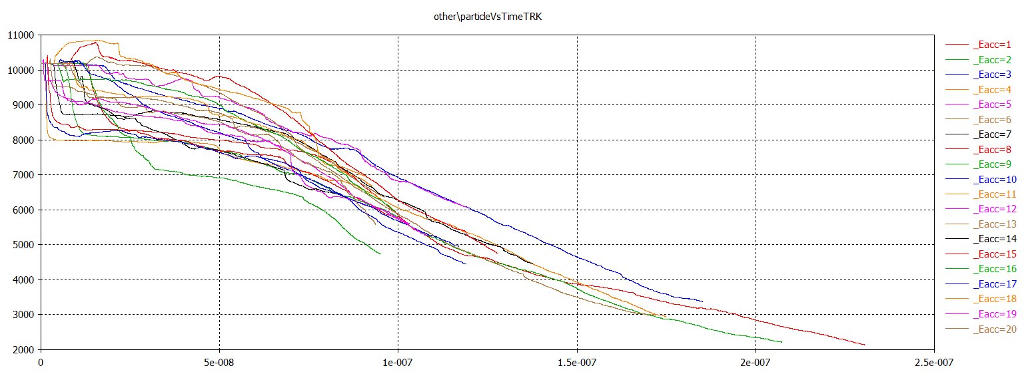
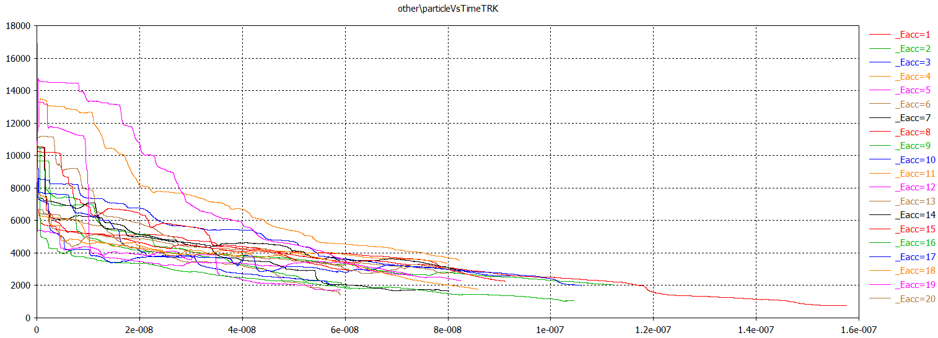
MP Analysis
MultiPac 2.1
CST-Particle Tracking
CST-PIC
300 degree bakeout Nb
Initial electron energy 4eV with 200% spread，initial angle +/-45 degree
End cell and middle cell，Eacc=1-20MV/m sweeping, no MP

Slide 23
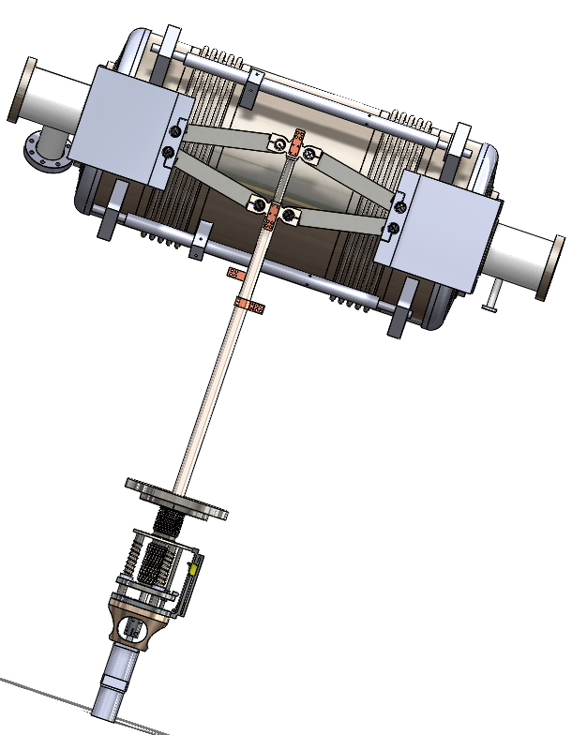
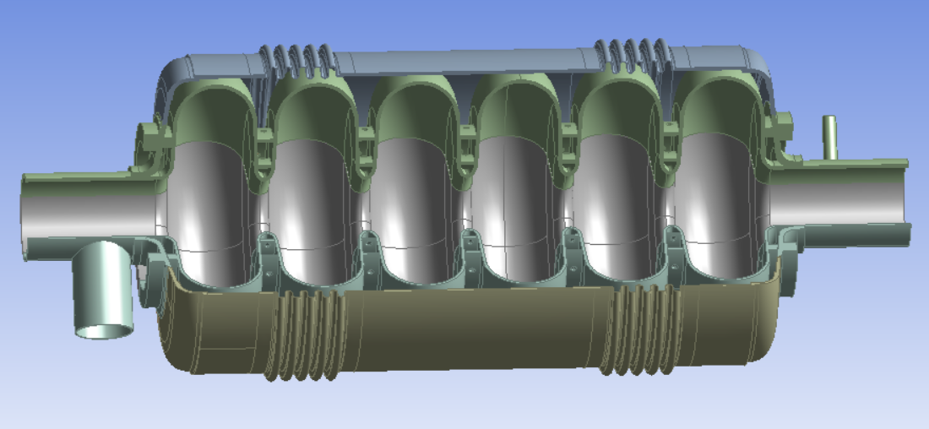
Mechanical Design
Scissor tuner
bellows（RT tuner）
SS flange and helium vessel（sealing，cost，fabrication）
4 mm Nb sheet, post-processing to 3.8 mm
Double stiffen rings（LFD）
Similar mechanical design for both 062 and 082 cavities.

Slide 24
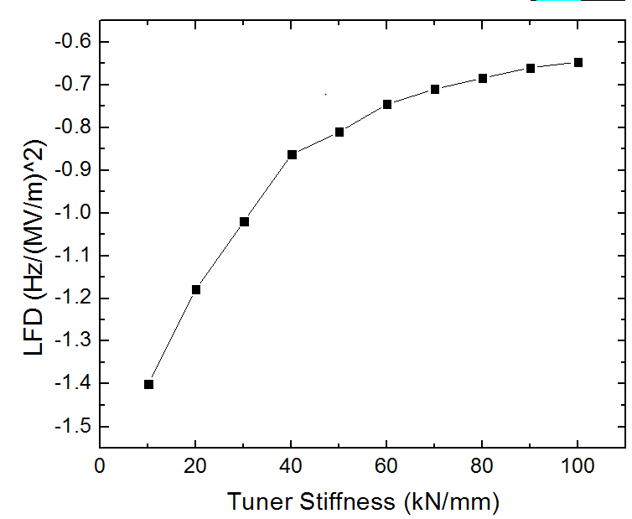
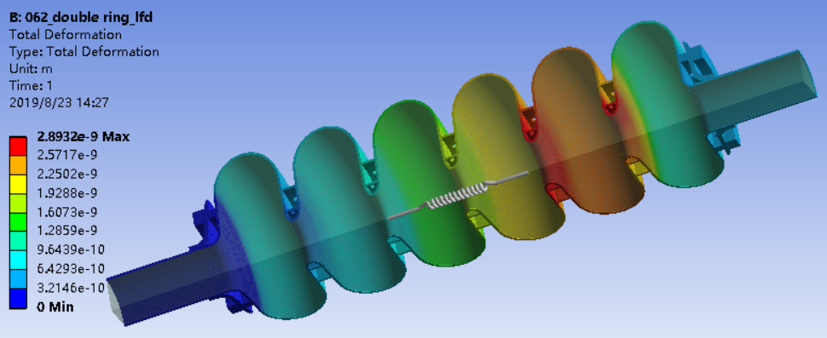
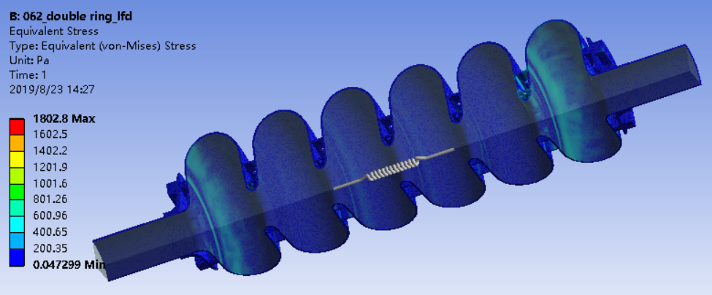
Lorentz Force Detuning Analysis
Boundary Conditions：
Uz=0
Tuner is simplified to a spring with unknown stiffness
Calculating the LFD coefficient with different tuner stiffness
When tuner stiffness is larger than 30kN/mm，LFD coefficient less than 1 Hz/(MV/m)²

Slide 25
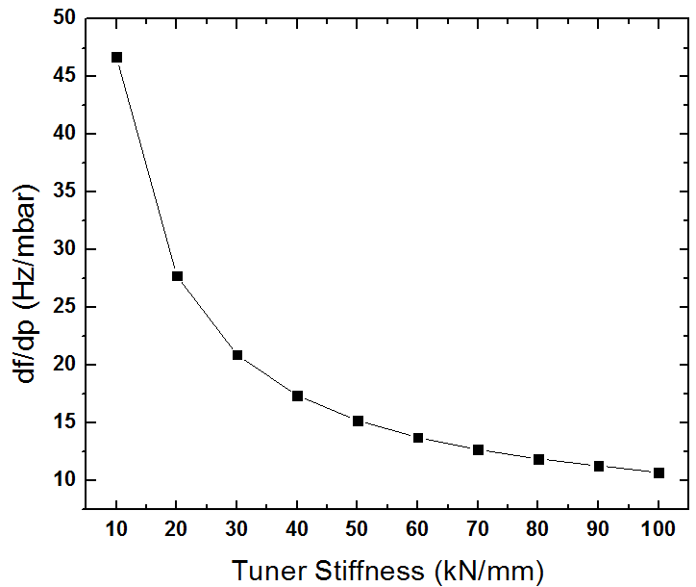
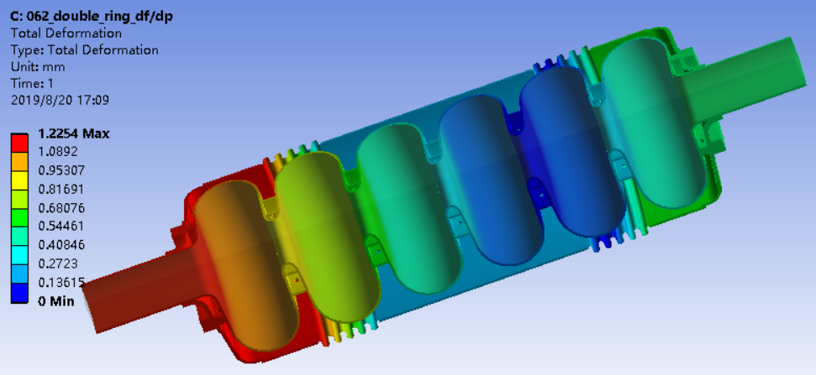
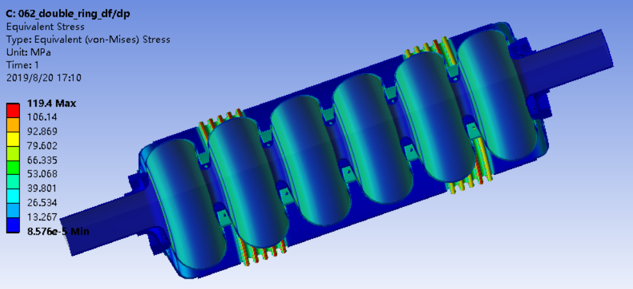
Df/dp analysis
Boundary Conditions：
Uz=0
Tuner is simplified to a spring with unknown stiffness
Calculating the df/dp with different tuner stiffness
Helium pressure fluctuation is within +/-10 Pa in 2K system
Df/dp requirement for PIP II is less than 25Hz/mbar, tuner stiffness need to be larger than 25kN/mm.

Slide 26
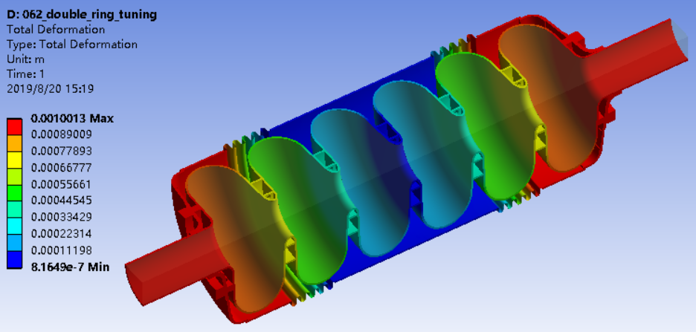
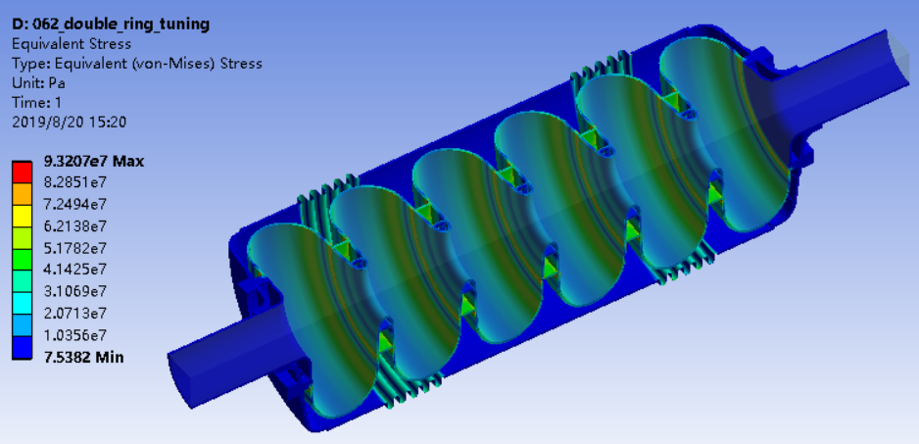
Tuning Sensitivity Analysis
Tuning sensitivity =209kHz/mm
Cavity longitudinal stiffness=2.6kN/mm

Slide 27
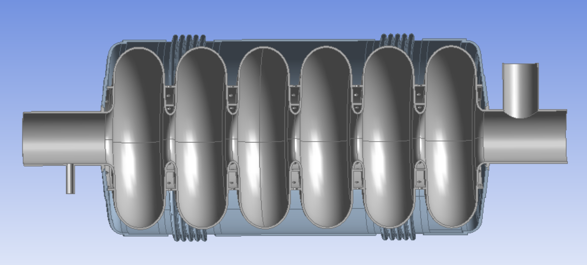
Stress Analysis
Consider：Gravity，cool down，tuning，pressure…
Make sure equivalent stress on the cavity and helium vessel less than their yield strength
RRR300 Nb Yield strength：RT 50MPa，2K 450MPa
316L SS Yield strength ：RT 250MPa，2K 550MPa
P1-Pressure in Lhe volume
Boundary conditions：
Uz=0
P3-Beam Vacuum
P2-Insulating Vacuum

Slide 28
Stress Analysis
Load case 1：
（1）Gravity
（2）P1=0.205MPa
（3）P2=P3=0
RT，Nb<50MPa, SS<223MPa
Load case 2：
（1）Gravity
（2）P1=0.4MPa
（3）P2=P3=0
（4）Liquid Helium
2K，Nb<98MPa, SS<445MPa
Load case 3：
（1）Cool down to 2K
（2）Tuner Extension of 2 mm
2K，Nb<52MPa, SS<52MPa

Slide 29
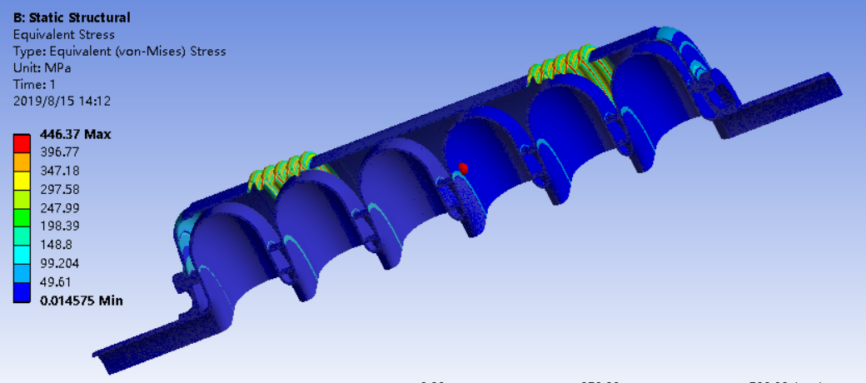
Stress Analysis
Load case 4：
（1）Gravity
（2）P1=0.4MPa
（3）P2=P3=0
（4）Liquid Helium
（5）Cool down to 2K
（6）Tuner Extension of 2 mm
2K，Nb<148MPa, SS<447MPa
Load case 5：
（1）Gravity
（2）P1=0
（3）P2=P3=0.1MPa
RT，Nb<45MPa, SS<138MPa

Slide 30
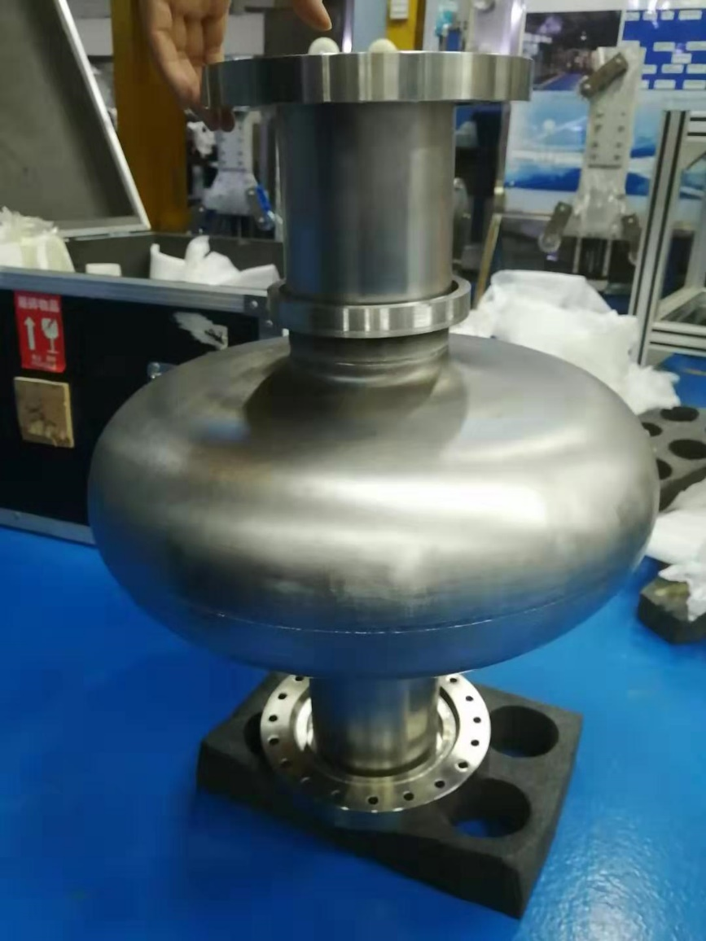
650 MHz Single Cell Prototype Cavities
3 single cell 650 MHz elliptical prototype cavities
Made from 3.5 mm niobium sheet (less than our designed 4 mm)
Expected be ready for VT test at the end of this year

Slide 31
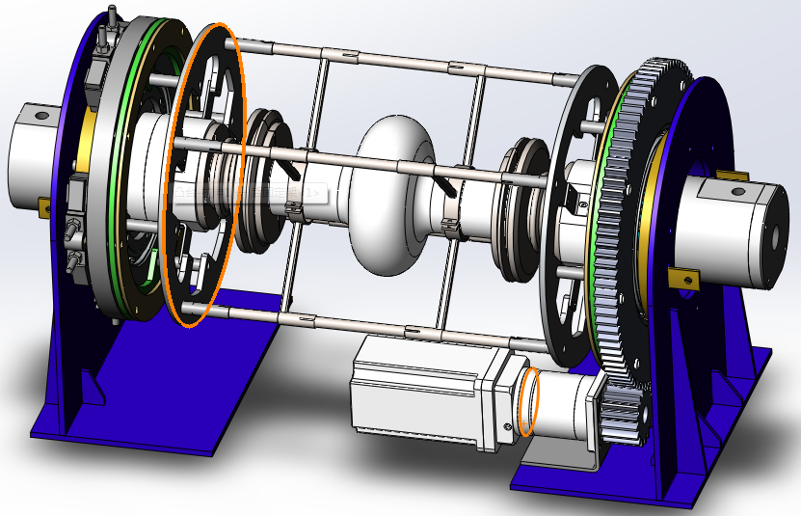
650 MHz Elliptical Cavity EP System
Based on the 1.3GHz elliptical cavity EP system
Electrode optimization to fit the small wall angle (2 degree)
Expected to be available at the end of this year (2019)

Slide 32
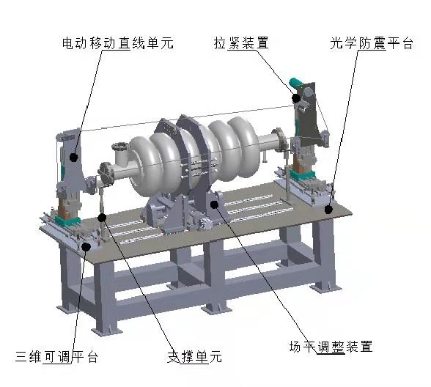
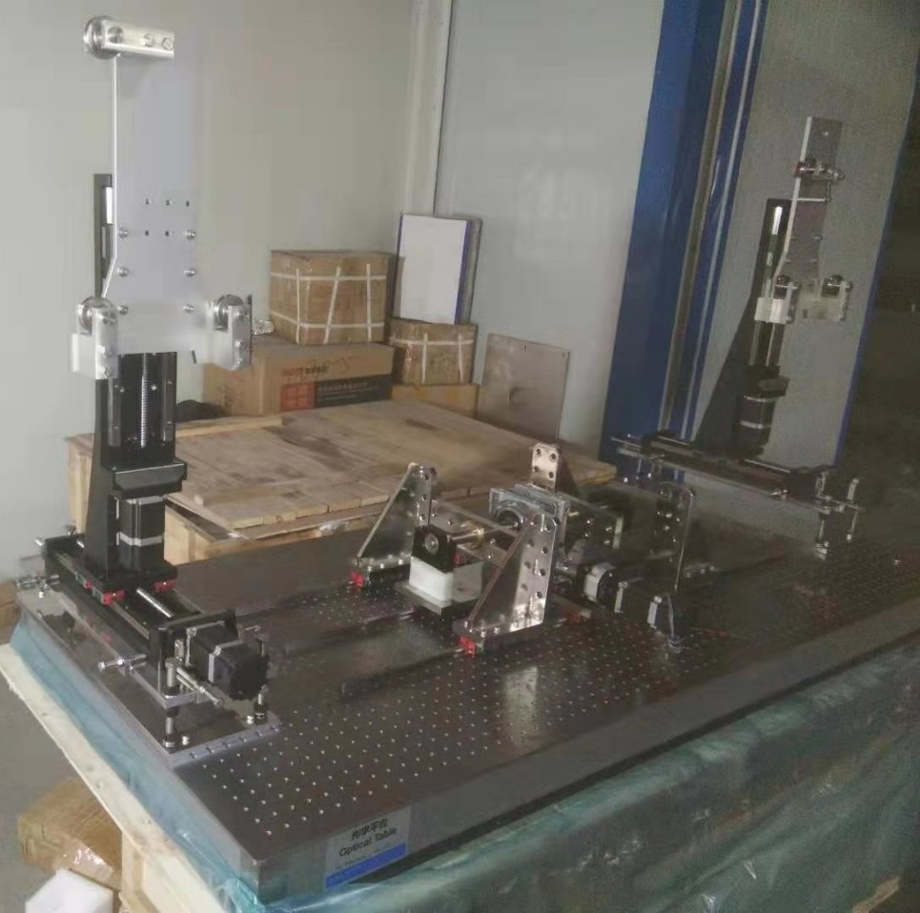
Multi-cell Cavity Pre-Tuning System

Slide 33
Summary
RF Design and Mechanical Design of the CiADS 650 MHz elliptical cavities (062 and 082) were finished.
3 single cell prototype cavities were fabricated and will be test at the end of this year
Multi-cell prototypes with helium vessels are on the way…

Slide 34
Thanks for your attention!

