Slide 1
Overview of development and testing of spoke cavities
Feisi He
Key Laboratory of Particle Acceleration Physics and Technology,
Institute of High Energy Physics (IHEP)

Slide 2
Outline
Background
History of spoke cavity development
Projects that use or propose spoke cavities
Design
Fabrication
Post processing
Test and commissioning in projects

Slide 3
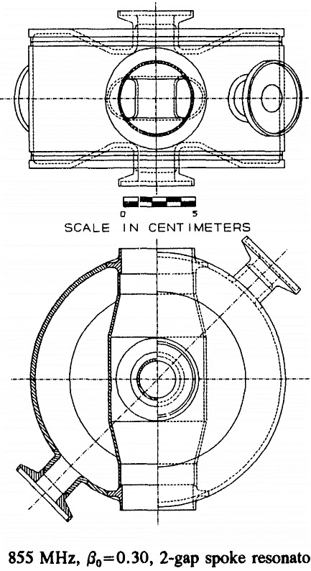
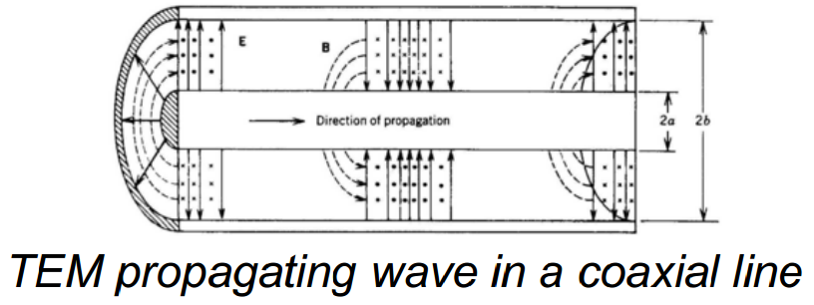
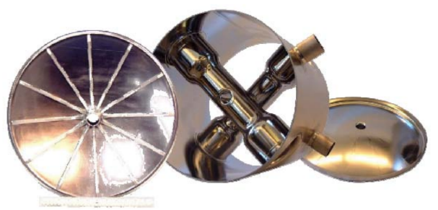
History of spoke cavity development
Spoke cavity is a TEM-like resonator, where the length of the spoke is
approximately half of
the RF wavelength.
The first single-spoke resonator (SSR) was proposed by J. Delayen at ANL in SRF1989, with f₀=855MHz and β₀=0.3.
The first VT test results was published in Linac1992, with Ea ~ 4.3MV/m (with L_{eff} defined as Ngap*β₀*λ/2), Ep ~ 25MV/m, and Bp ~ 56mT.
The first multi-spoke cavity (345MHz, β₀=0.4) was developed at ANL in 2003, which adopted EP to pieces before final EBW
Reference [1-3]

Slide 4
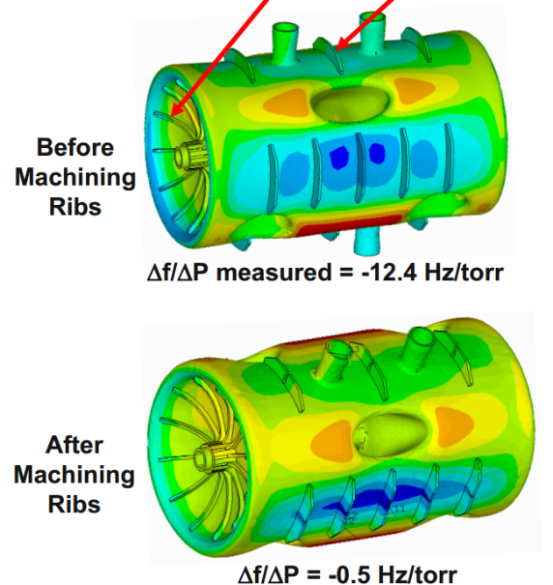
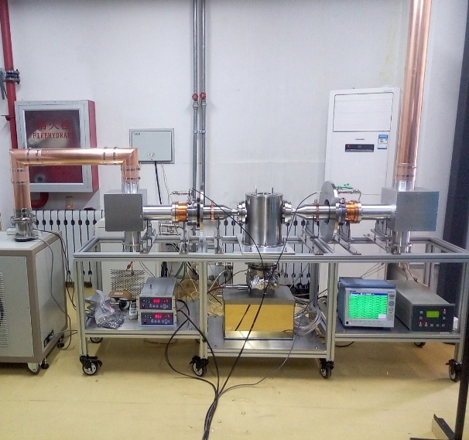
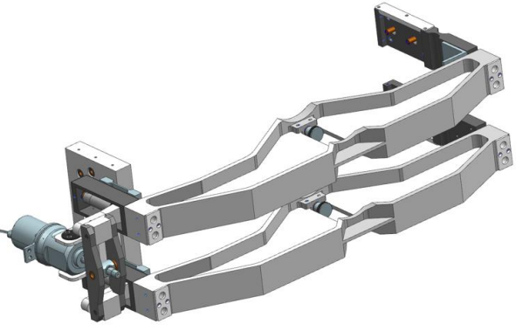
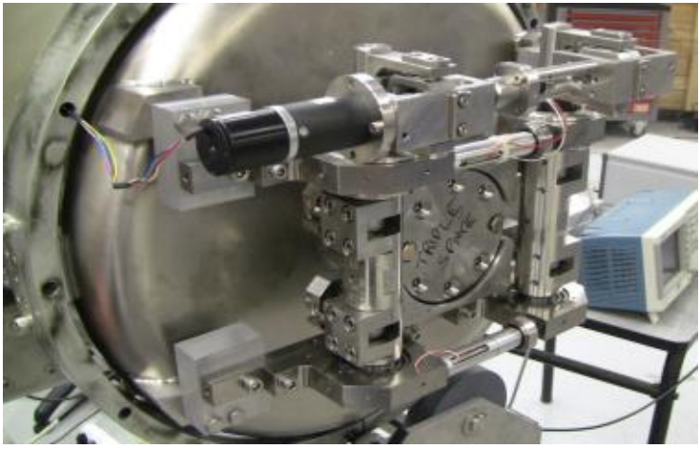
History of spoke cavity development (2)
“Self-compensating” design was first applied to spoke cavities to reduce df/dp at ANL in 2005.
β₀~0.14 SSR was developed at IHEP in 2012
β₀~1 spoke was developed at ODU/JLab in 2013
Ancillaries for spoke cavities have been well developed nowadays
SSR have been commissioned with CW proton beam of 2mA at IHEP in 2017
Reference [4-11]

Slide 5
Projects that choose spoke cavities
20 cavities in tunnel; 350 approved; more planned.
Project | Duty factor | Frequency [MHz] | β₀ | # of spoke cavities | Status
PIP-II | CW | 325 | 0.22/0.47 | 16/35 (12) | Construction
ESS | Pulsed | 352 | 0.5 | 26 | Construction
Raon | CW | 325 | 0.3/0.53 | 69/150 | Construction
LCS-JAEA | CW | 324 | 0.224/0.3-0.4 | dependent | Proposed
CADS | CW | 325 | 0.14/0.24 | 14/6 | Operation
CIADS | CW | 325 | 0.42 | 54 | Approved
CSNS-upgrade | Pulsed | 325 | 0.5 | 18 | Proposed
Reference [8,10,12-14]
Notes:
PIP-II: 800MeV
Raon: heavy ion upto to 200-600MeV/u
ESS: 2GeV pulsed machine

Slide 6
Outline
Background
Design
Design target
RF optimization
Multipacting analysis
Mechanical analysis
Fabrication
Post processing
Test and commissioning in projects

Slide 7
Design target
beam long. size&f
velocity acceptance
beam optics
beam transv. size
Resonance frequency f
Number of gaps N
Transient time factor
Optimized beta β₀
Bore radius
E_{peak} / E_{acc}, B_{peak} / E_{acc}
Ra/Q
Geometry factor G
Lorentz force detuning coefficient: ${∆f}/{E_{acc}^{2}}$
He pressure sensitivity: df/dp
Beam
specifications
$$G×{R_{a}}/Q=\frac{{\left(T(β)×\int_{−∞}^{+∞}{\left|E(z)\right|dz}\right)}^{2}}{1/2\iint{{\left|H\right|}^{2}dA}}$$
Technological
choices

Slide 8
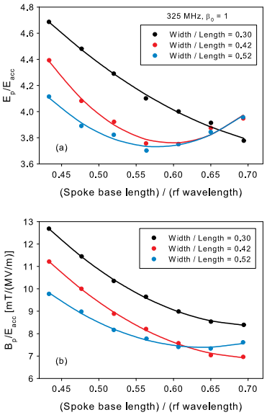
RF optimization
Surface field is minimized by distributing field to larger area:
Base of spoke and end-cover: magnetic field
Central part of spoke: electric field
Typical Bp/Ep is 2~2.3 ${mT}/{({MV}/m)}$, and
E_{p}/E_{a}~3.3 or B_{p}/E_{a} ~ 7 is achievable
for β>0.2
B
E
Reference [15]
Notes:
to distribute field to larger surface area.
The B-field; base of the spoke, end-cone instead of flat end ; base expanded
E-field ; center of the spoke,
parameters are swept one by one to get local minimum, iterations

Slide 9
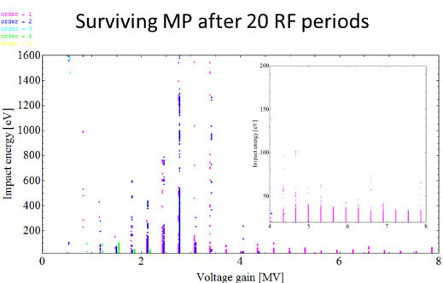
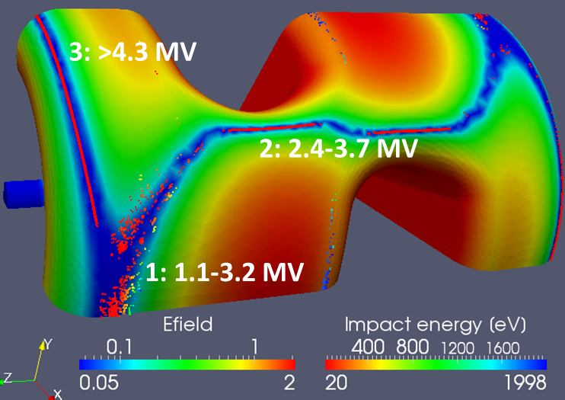
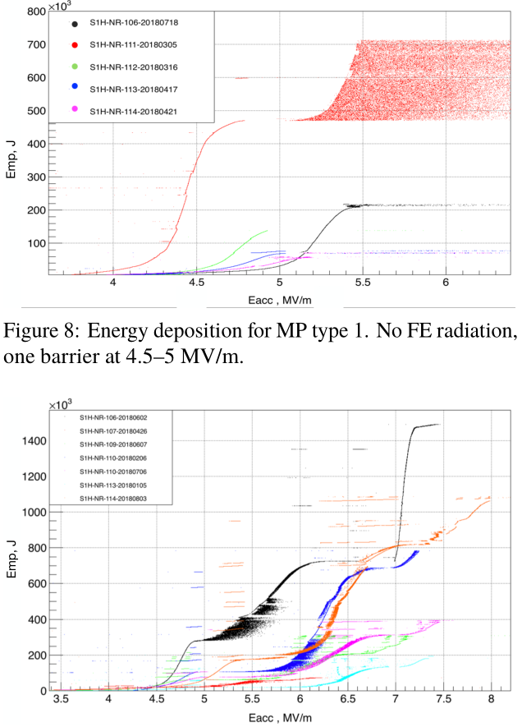
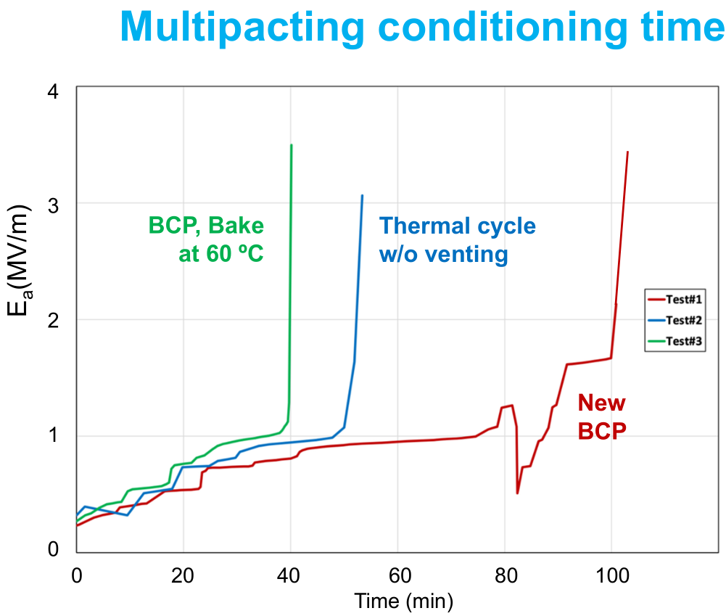
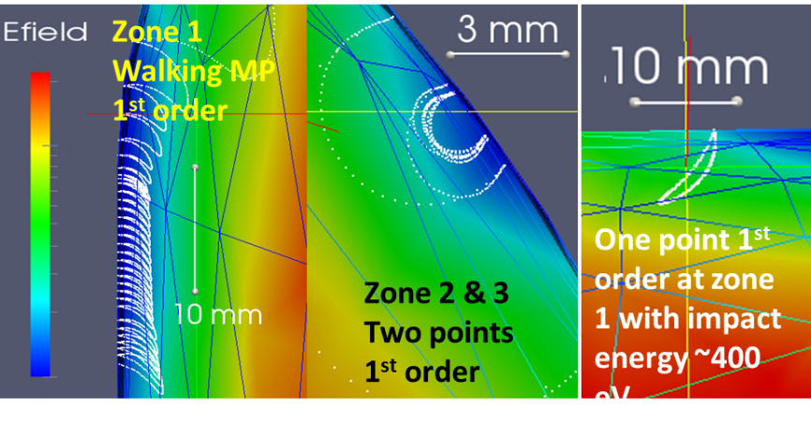
Multipacting analysis
Stable MP could be eliminated by larger blending radius
MP has never been a show-stopper in the testing of spoke cavities
Reference [16,21,25]
Notes:
MP usually occurs at areas where surface E field has minimum value and change sign, Impact energy of the electron is positively correlated to the surface E field strength
Walking MP usually move towards the direction where E field is lower; then some electrons are “trapped” (more or less), while the other electrons continue moving to stronger E field area and become un-stable (impact energy too high so SEY<1)
Discovery at FNAL: FNAL have done 34 horizontal tests circles to 10 of their 12 SSR1 cavities, with both critical coupling and strong coupling couplers. They found that with FE onset, more MP barriers may occur with additional initial electron. Another claim made by FNAL is that 120C*48h low baking is effective to surpress MP.
A second claim from TRIUMF: on the balloon SSR1 for Korean project, they found that: 1. traditional 120Cx48h reduces MP conditioning time by 50%; 2. baking at 50-60C for several hours only makes the same benefit of reducing MP time, while not increasing the residual resistance.

Slide 10
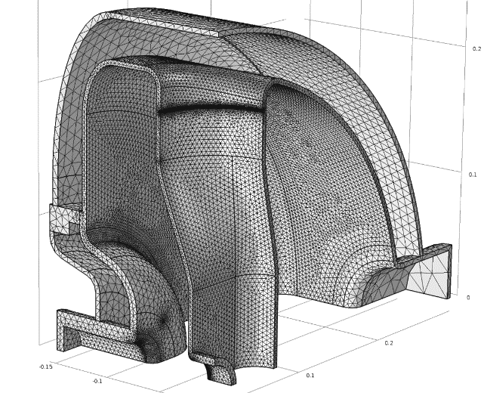
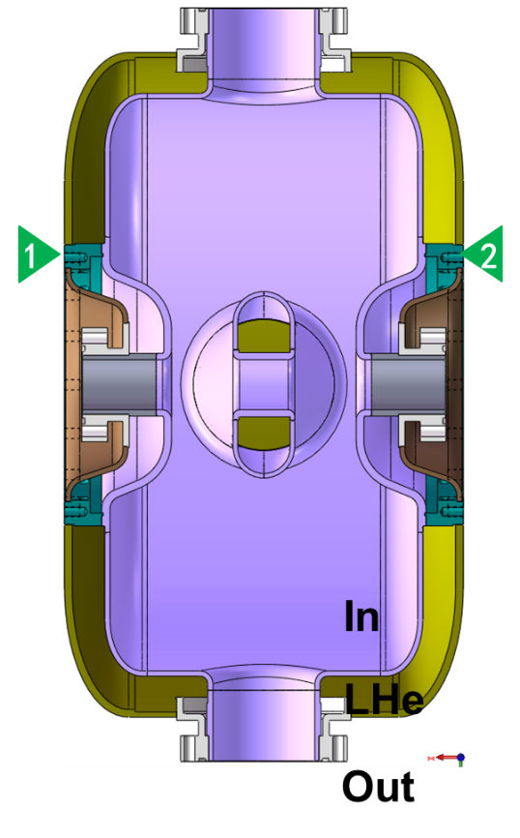
Mechanical analysis
Stress and buckling analysis:
Pressure vessel code, e.g. ASME-BVPC-VIII.Div2.Part5
Typical allowable stress for Nb is ~50MPa at RT
 | Boundary | In | LHe | Out | T
Tuning | Pull/Push | 1 bar | 1 bar | 1 bar | RT
Cavity-string leak check | Free | Vacuum | 1 bar | 1 bar | RT
Cool down/ Operation | Free+pull | Vacuum | 0.03-2 bar | Vacuum | 4K/2K

Slide 11
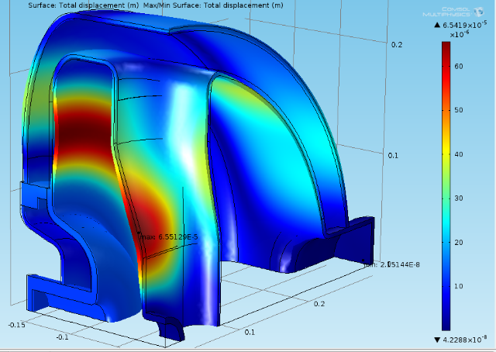
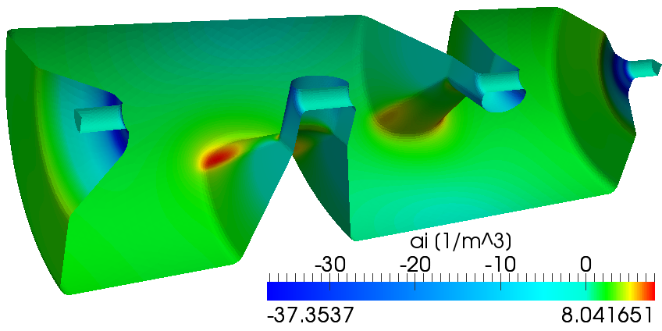
Mechanical analysis (2)
Reducing LFD
Vibration of the spoke
Reducing df/dp
Makes cavity body stronger
Stiffening ribs to control distortion as needed
Connect cavity to He vessel (or not) to cancel unwanted distortion
Notes:
Reduce unwanted frequency fluctuation, common idea is to make the structure stronger;

Slide 12
Outline
Background
Design
Fabrication
Fabrication sequence
Surface quality control
Shape control
Frequency control
Post processing
Test and commissioning in projects

Slide 13
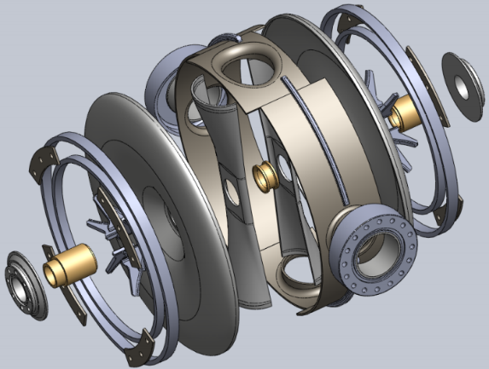
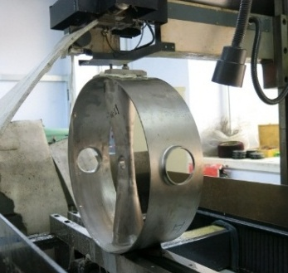
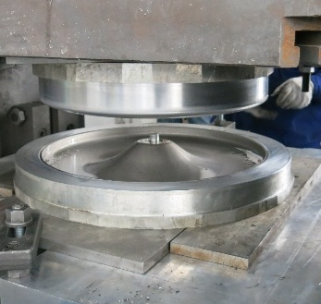
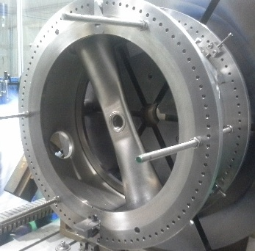
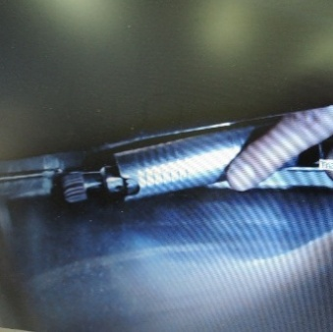
Fabrication of the spoke cavity
Design
Vertical test
String assembly
Fabrication
Post processing
LHe vessel
Material
Technology
Quality control
Certification from vendor
Eye inspection
Deep drawing
Annealing
Machining
EDM
Frequency tuning
Grinding
EBW
Defect inspect and grinding before final EBW
Shape control
Frequency control

Slide 14
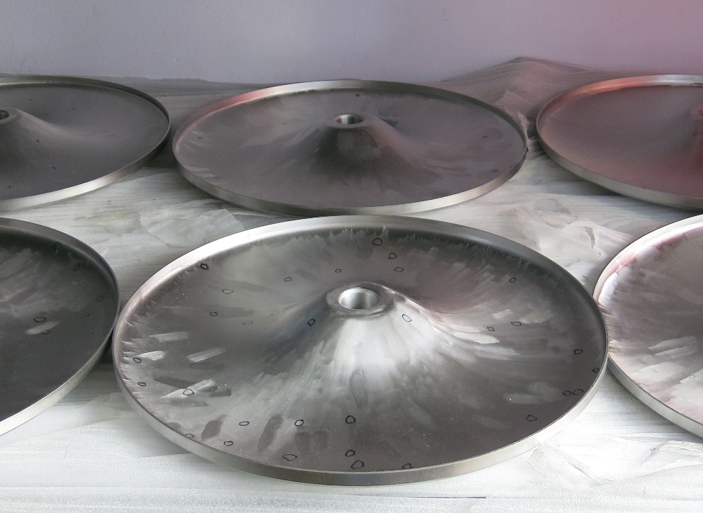
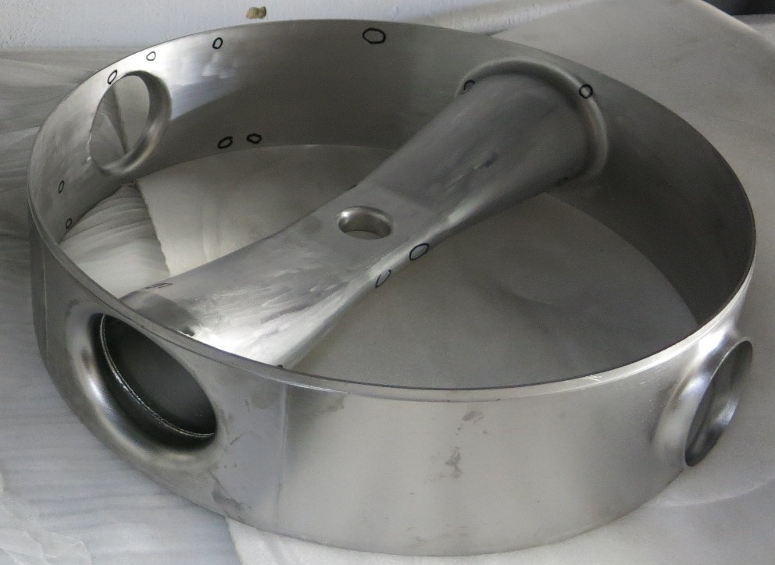
Surface quality control
Before final EBW it is the last chance to get easy access to the cavity inner surface
Defect, e.g. pits in diameter 0.1mm, could be addressed by eye inspection. Sometimes magnifier or very light BCP helps to find defects.
Notes:
Normal aluminum oxide wheels (e.g. 3M-02684) works well on Nb cavity grinding

Slide 15
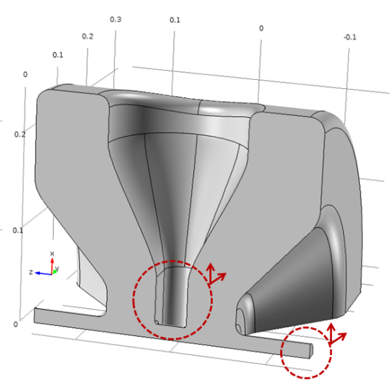
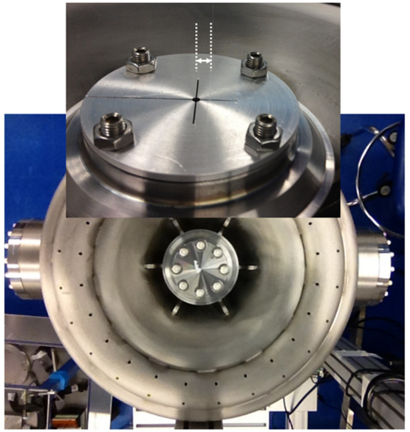
Shape control
Transverse displacement of beam pipe or spoke may introduce transverse kick.
FNAL measured the trans. kick by bead-pull, and confirmed 0.7mm of displacement introduce ~1.1mrad beam deviation, which is within the ability of the 10mrad corrector
Longitudinal error had no significant effect on either field flatness or transverse kick, due to the very strong coupling between gaps
Reference [17]

Slide 16
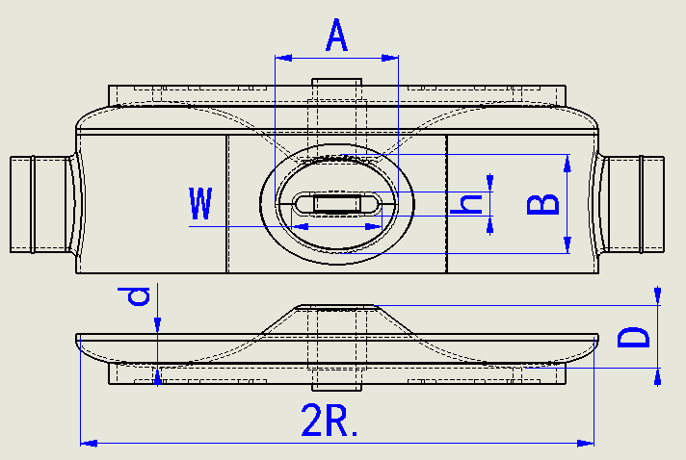
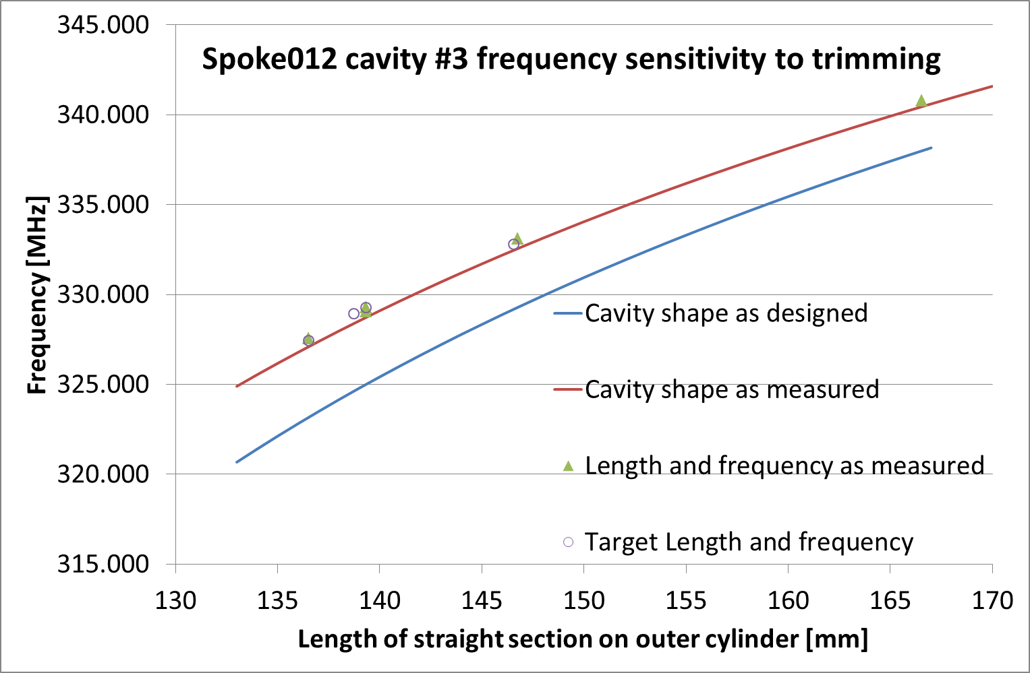
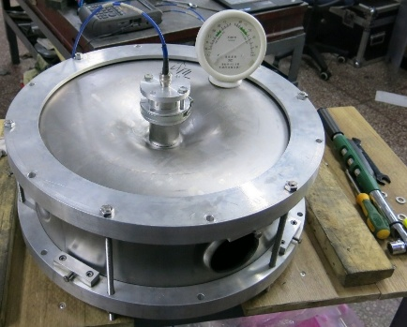
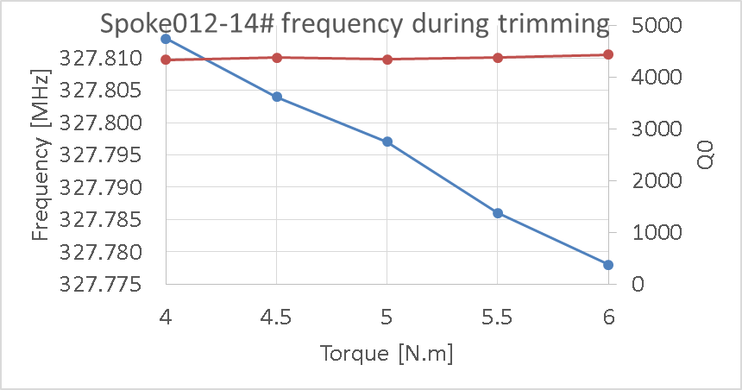
Frequency control
Frequency tuning is typically done by stacking parts together before EBW, and trim the cylindrical part after frequency measurement.
Reference [18]
Notes:
1. Gap between parts
2. Torqued wrench, fit the linear curve to extrapolate the frequency at no pressure
3. Temperature and humidity

Slide 17
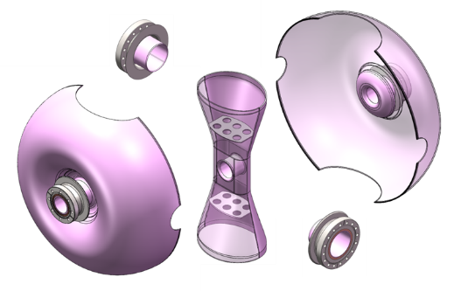
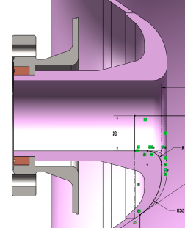
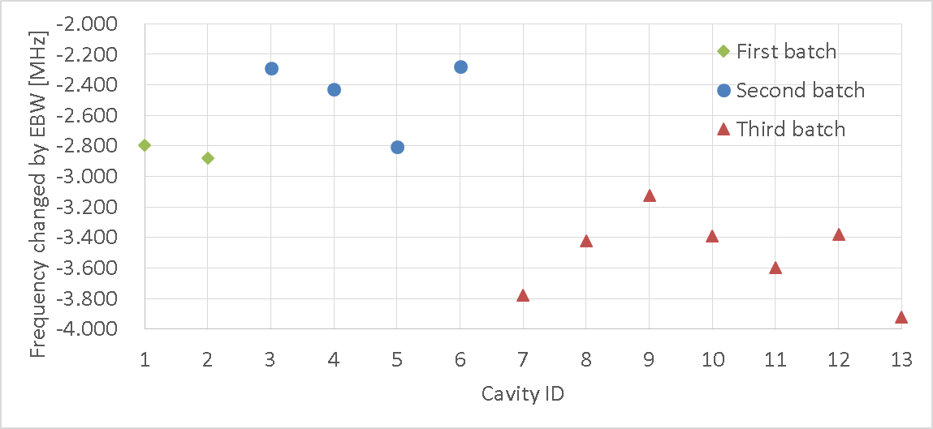
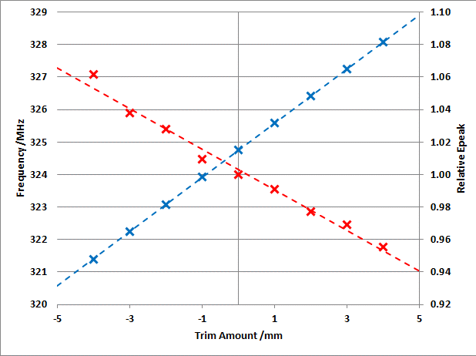
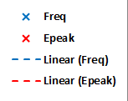
Frequency control (2)
Other idea on frequency trimming (RISP SSR1):
End-cone is made of ingot Nb
The end-cove is trimmed after
stacked frequency measurement
Frequency change other than EBW shrinkage: distortion of end-cover induced by EBW has to be well understood and controlled
Reference [19]
Notes:
EBW distortion: 1.6 MHz scattering without stiffening ring; 0.2MHz with stiffening ring weld to end-cover first.

Slide 18
Outline
Background
Design
Fabrication
Post processing
BCP, part EP
HPR
Clean assembly
Test and commissioning in projects

Slide 19
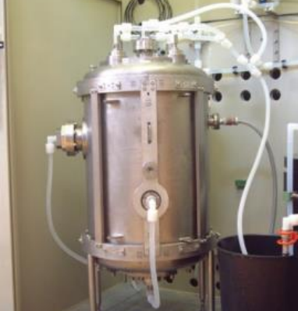
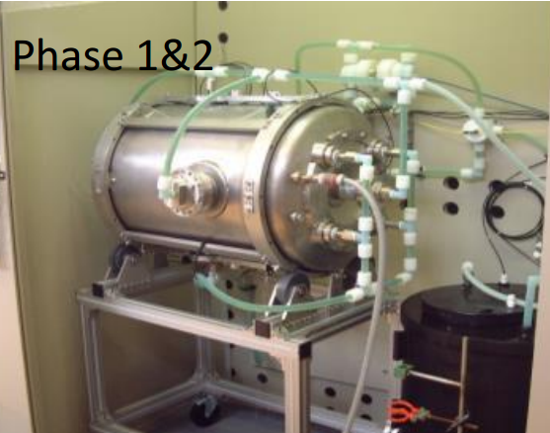
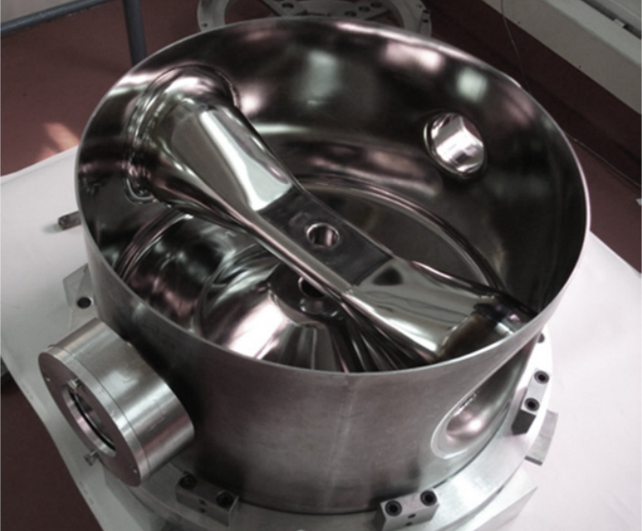
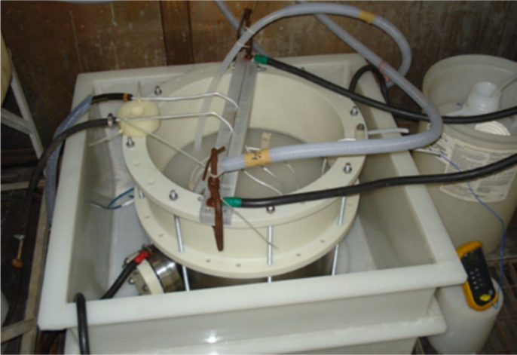
Post processing (etching)
Standard treatment as elliptical cavities
Ultrasonic
BCP120-200 um
600-800C for hrs
Flash BCP
HPR
120C 48hr
Vessel weld
(high baking)
(light BCP)
HPR
String assembly
Vertical test
Reference [8,20]

Slide 20
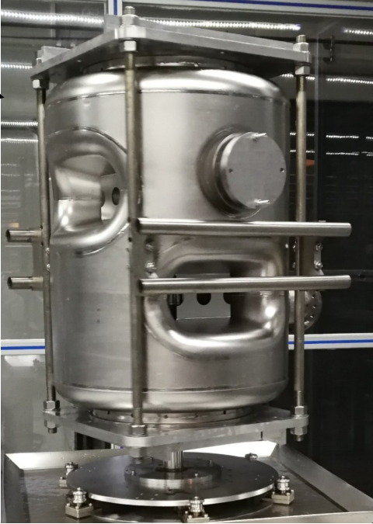
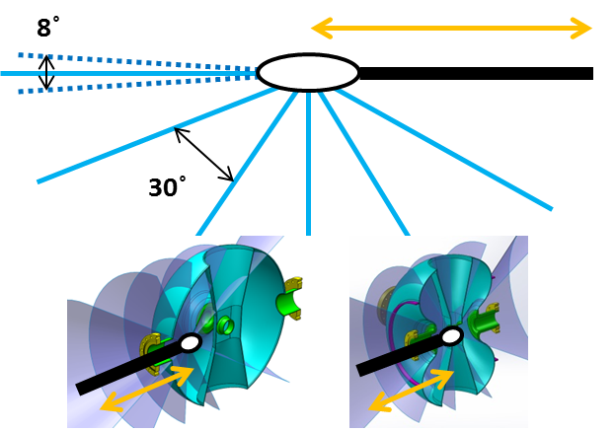
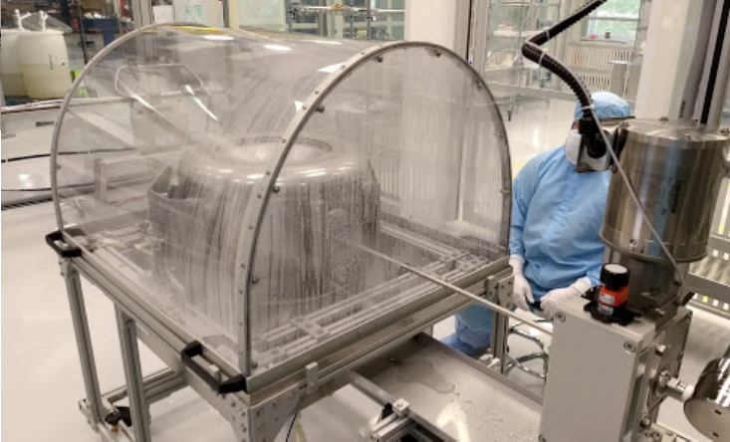
HPR
HPR is typically through all available ports.
Coverage to inner surface could be checked with CAD software.
Reference [19]

Slide 21
Clean assembly
Cavity or string assembly is performed in ISO4 cleanroom.
Edge-welded
bellows are
used for PIP-II
to save space
in between
spoke cavities
Reference [9]

Slide 22
Outline
Background
Design
Fabrication
Post processing
Test and commissioning in projects
ESS
PIP-II
CADS

Slide 23
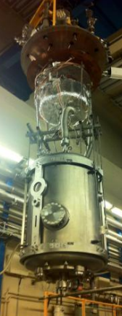
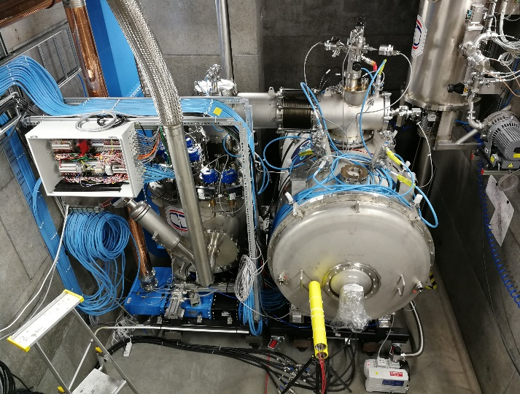
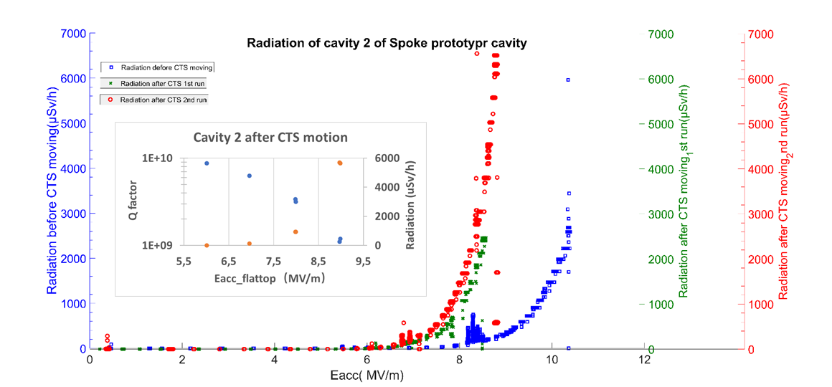
ESS prototype cavity tests
Reference [8,24]
Notes:
Several double spoke cavities has been qualified in vertical test, and two of them have been horizontal tested for 6 times with prototype cryomodule

Slide 24
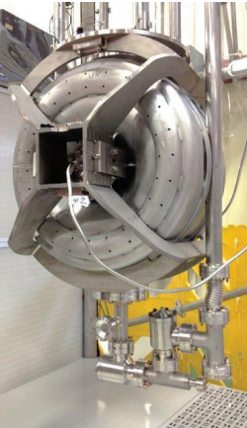
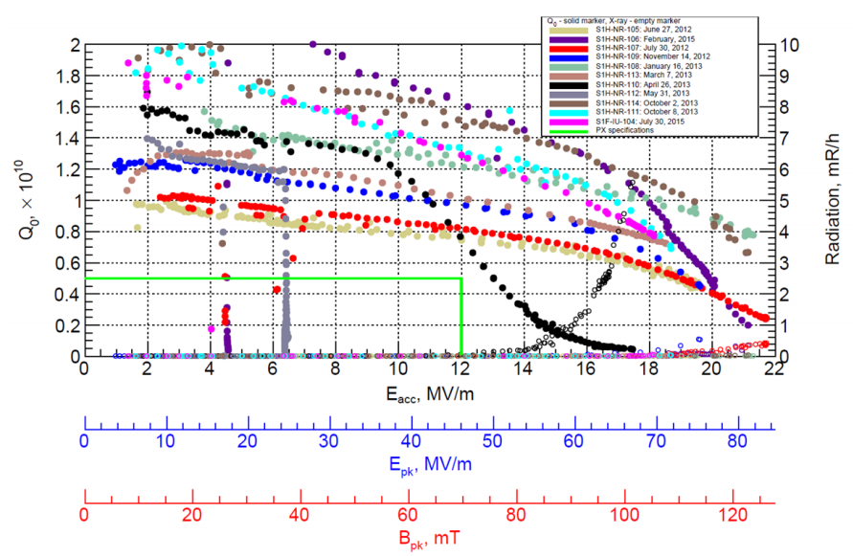
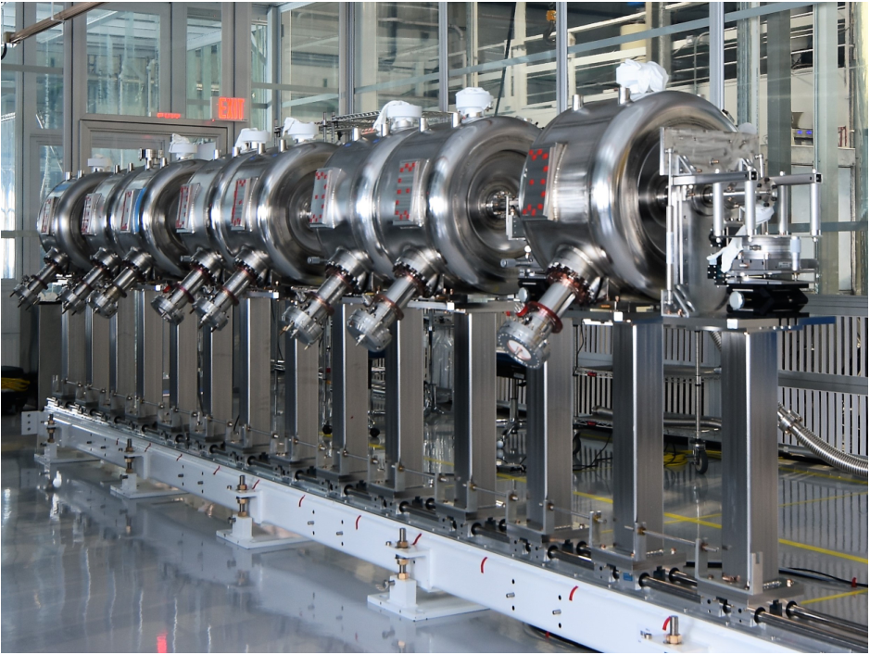
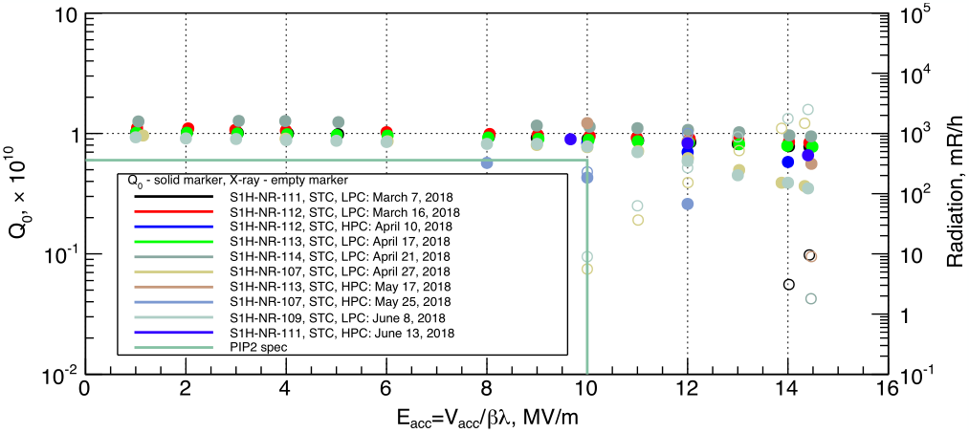
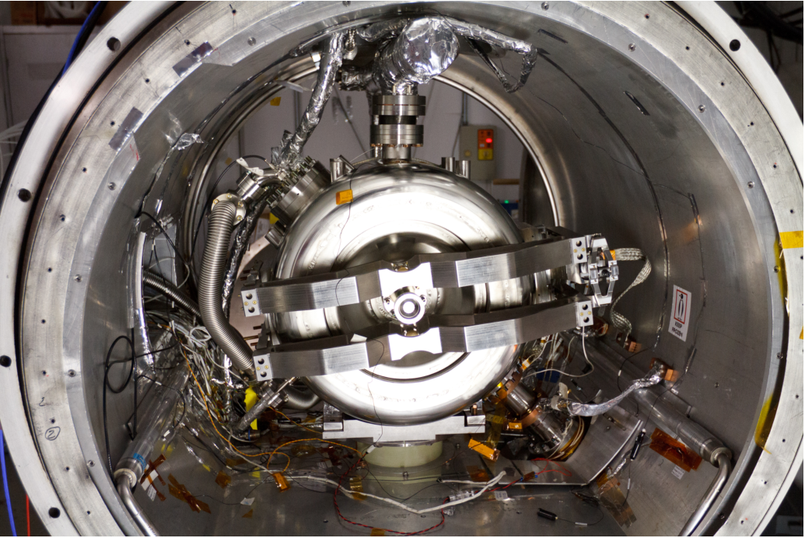
PIP-II prototype cavity tests
Reference [12, 22-23]
Notes:
12 SSR1 cavities built in US (10) and India (2) were vertical tested and qualified. 10 of the cavities are horizontal tested integrated with tuner and coupler. 8 of qualified cavities have been assembled to a cavity-string

Slide 25
CADS-injector I spoke012 VT results
MP conditioned in 1 hour with variable coupler
Eacc increased by 2 MV/m with better cooling
120C baking increases Q₀ by about 50-100%
At 2K, Q0 is 6 times higher, Bp~125mT achieved.

Slide 26
CADS-main linca Spoke021 VT results
MP conditioned in 1 hour
Design target consistently exceeded
Bp of 120mT and Rres of 7nΩ achieved at 2K

Slide 27
State of art performance
Bp>80mT & Ep>60MV/m is routinely achievable at VT

Slide 28
What Rs to expect for spoke cav?
Rres < 10nΩ should be safe enough

Slide 29
Thanks for your attention!

Slide 30
Backup slides

Slide 31
References
A. Facco, “Non-elliptical resonators_Tutorial,” in SRF2015.
J. Delayen, et. al, “Prototype niobium resonators for high-current ion beams,” in SRF1989.
J. R. Delayen, et. al, “Design and test of a superconducting structure for high-velocity ions,” in Linac92.
K. Shepard, et. al, “Superconducting Intermediate-Velocity Drift-Tube Cavities for the RIA Driver Linac,” in PAC2001.
M. Kelly, et. al, “Cold Tests of the RIA Two-Cell Spoke Cavity,” in SRF2003.
M. Kelly, “Status of Superconducting Spoke Cavity Development,” presentation in SRF2007.
K. Shepard, et. al, “Superconducting Triple-Spoke Cavity for Beta = 0.5 Ions,” in PAC05.
C. Darve, “Prototype Experience SRF Cavities for ESS,” TTC2017.
L. Ristori, “PIP-II SSR1 Cryomodule Technical Issues,” 2016.
F. Yan, et. al., “Commissioning of te China-ADS injector-I testing facility”, https://arxiv.org/abs/1705.05068
C.Hopper, “High velocity spoke cavities,” presentation in SRF2015
V.Yakovlev, “SRF development for PIP-II: status and challenges,” in SRF2015
H.Jang, “Start-to-end simulation for RAON superconducting linac,” in IPAC2015.
J. Tamura, et.al., “Electromagnetic Design of the Prototype Spoke Cavity for the JAEA-ADS Linac,” in SRF2019.
Notes:
端盖+中间环（内导体两半、相邻两片、圆环）；

Slide 32
References (2)
J.R. Delayen, et al, “Design of Superconducting Spoke Cavities for High-velocity Applications,” in PAC2011.
F. He, et.al, “RF design for ESS double spoke cavity at Jlab”, JLab-TN-12-005, 2012
M. Awida, et.al, “Transverse kick analysis of SSR1 due to possible geometrical variations in fabracation,” in IPAC2012
F. He, et al, “Status of the superconducting cavity development at IHEP for the CADS linac,” in IPAC2015.
Z. Yao, et al, “RISP SSR1 Design - `Balloon’”, in TTC2016, June 2016.
L.Ristori, et. al, “Cold tests of SSR1 resonators manufactured by IUAC for the Fermilab PIP-II project,” in SRF2015.
A. Sukhanov, et.al., “Characterization of SSR1 Cavities for PIP-II Linac”, in SRF2019
D. Passarelli, et.al., “Lessons Learned Assembling the SSR1 Cavities String for PIP-II”, in SRF2019
A. Sukhanov, “Testing 325 MHz SSR1 cavities for PIP-II”, in TTC2018
H. Li, “Preliminary Test Results from the Spoke Prototype cryomodule”, in this meeting
Z. Yao, “Balloon single spoke resonator-a new SSR variant for reduced multipacting”, in SRF2019
Notes:
端盖+中间环（内导体两半、相邻两片、圆环）；

Slide 33
Backup: spoke for high beta?
Below β<0.5, trans.size of is ~40% smaller than elliptical cavity
For high β~1, this advantage gets weaker

Slide 34
Backup: β range for spoke cavity?

