Slide 1
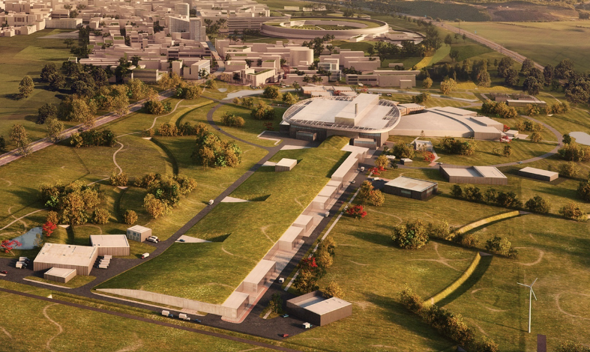
STFC SRF Linac Contributions for ESS
Peter McIntosh STFC Daresbury Laboratory
9th Superconducting Linacs for High Power Proton Beams (SLHiPP-9)
25th – 27th September 2019
IMPCAS Campus

Slide 2
Outline
UK SRF Linac In-Kind Contributions:
  RF Distribution (RFD) Systems
  Beam Transport Modules (BTM)
  High Beta Cavities (HBC)
Summary

Slide 3
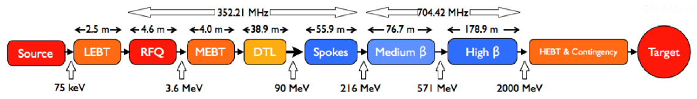
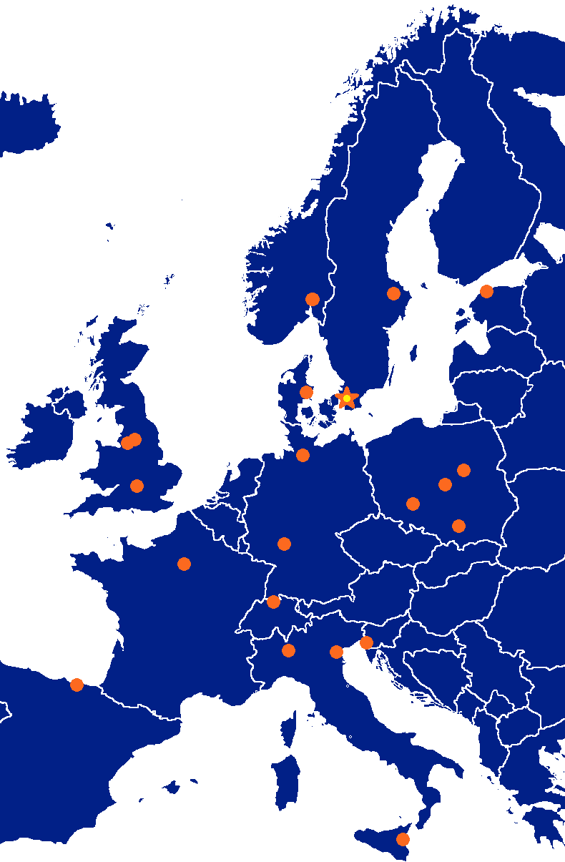
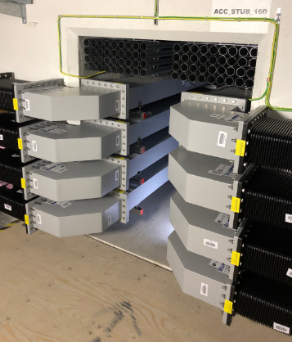
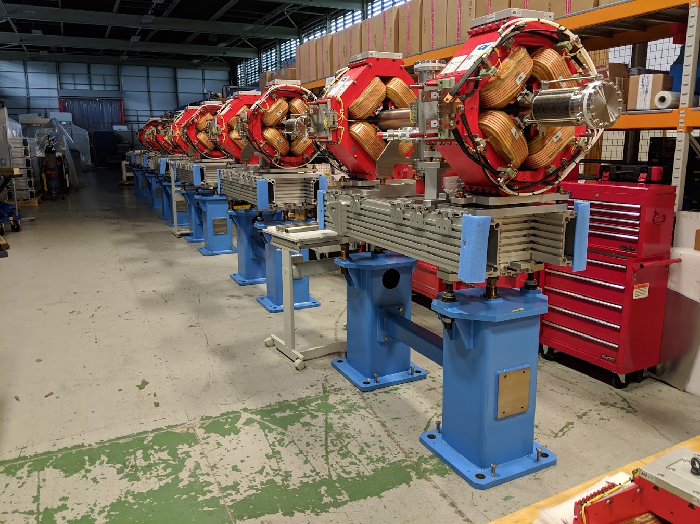
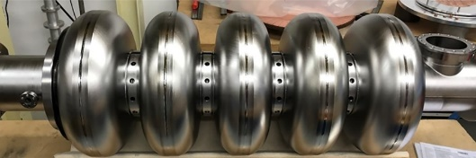
ESS Superconducting Linac
RF Distribution (RFD)
Beam Transport Modules (BTM)
Huddersfield University
STFC Daresbury Laboratory
High Beta Cavities (HBC)

Slide 4
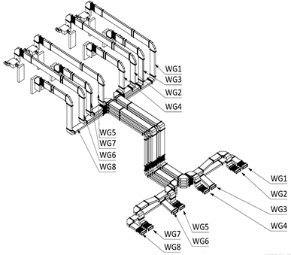
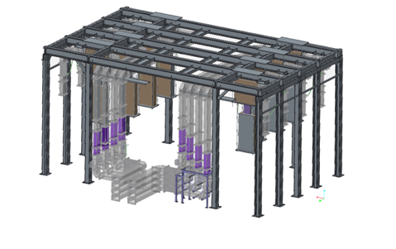
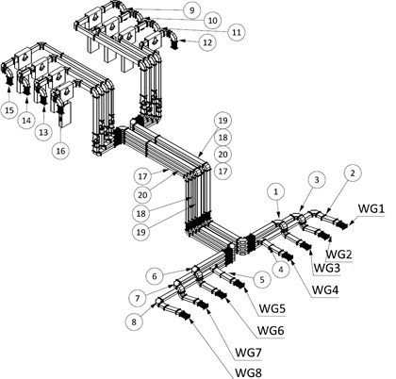
RF Distribution (RFD) System
STFC in collaboration with Huddersfield University
Supply of >4km worth of waveguide system
398 Arc Detectors
132 RF windows
132 RF Loads
132 RF Circulators
Design and delivery of all support structures
Installation planning, test and commissioning involvement
Total Contribution £16m ($21m)
Medium and High Beta Systems
Spoke systems

Slide 5
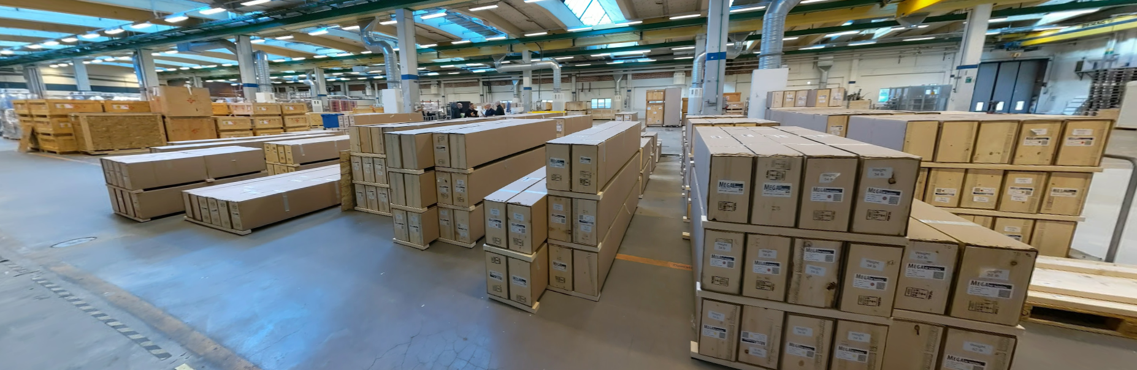
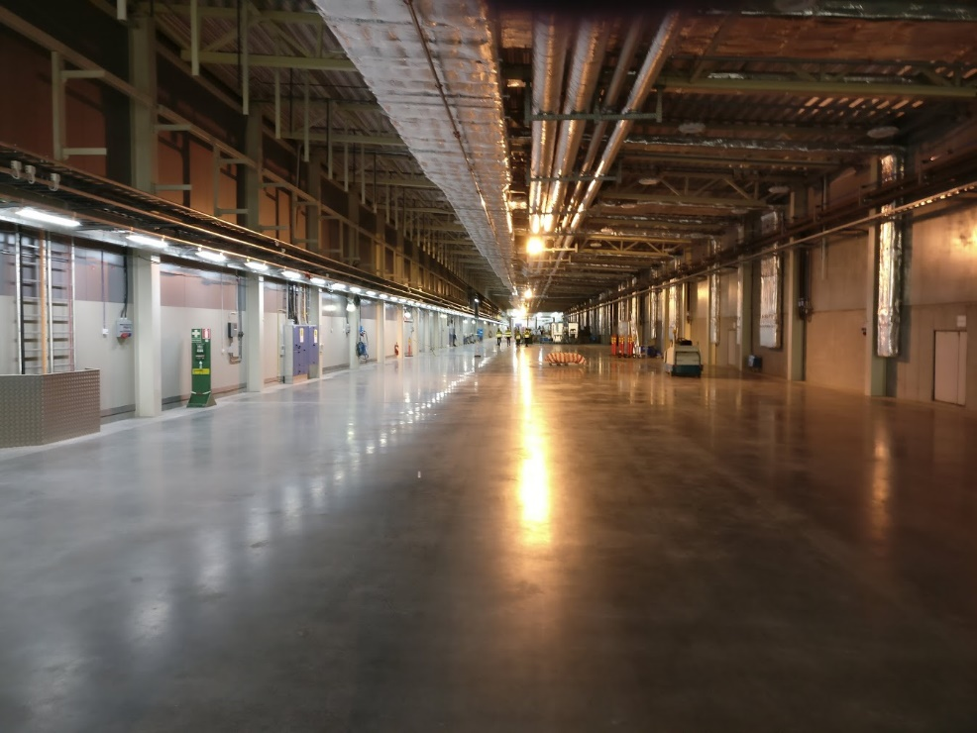
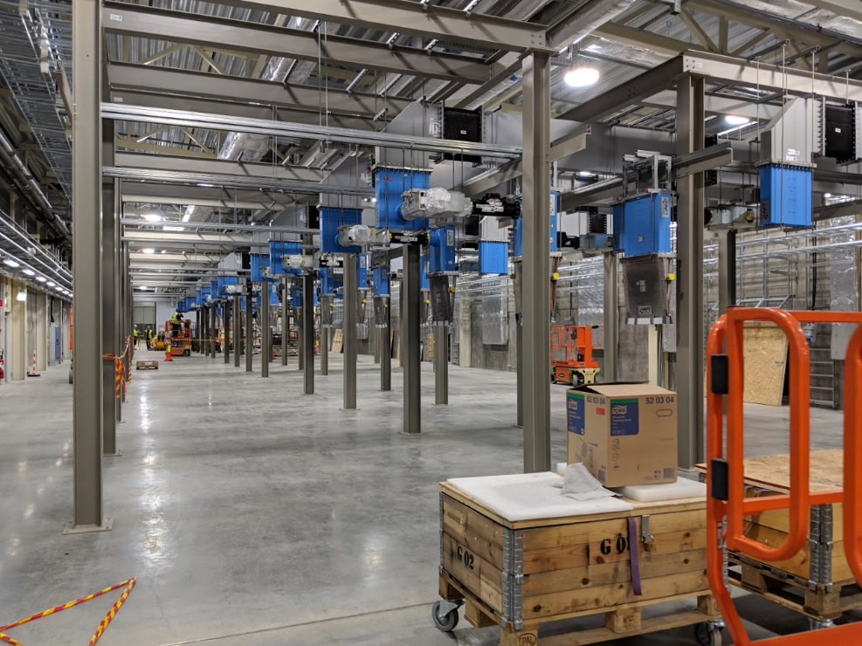
>5000 Pieces of Waveguide Delivered!
and >3000 sections have been installed
Installation undertaken by IFJPAN (Poland IKC)

Slide 6
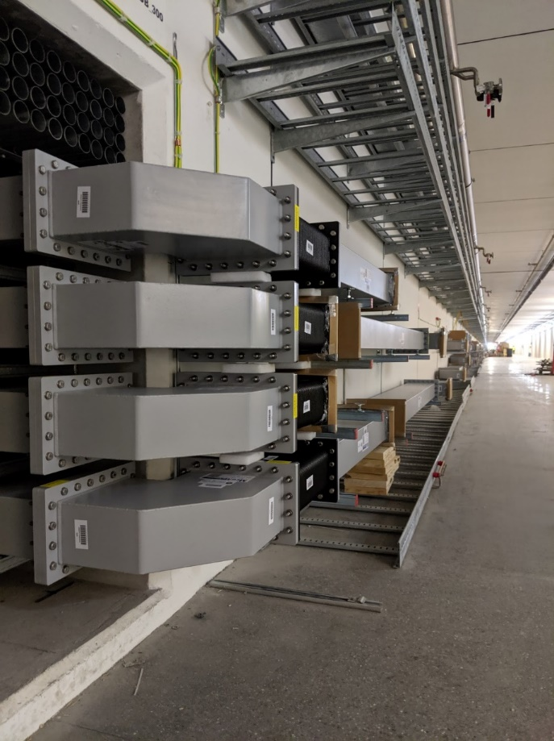
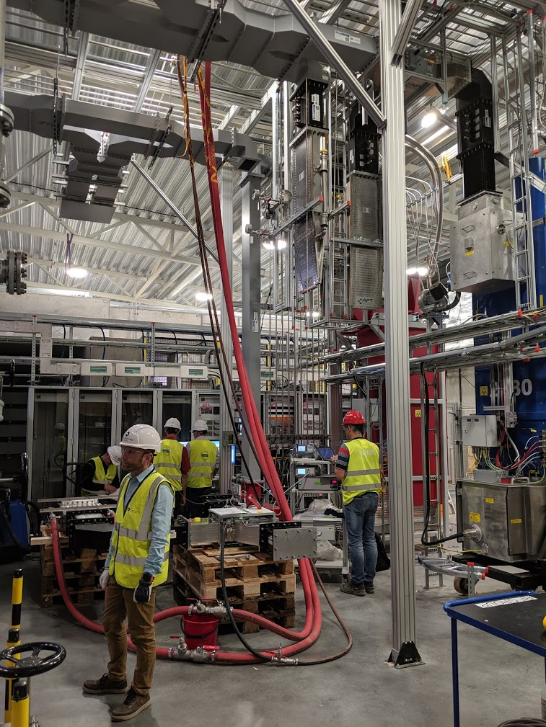
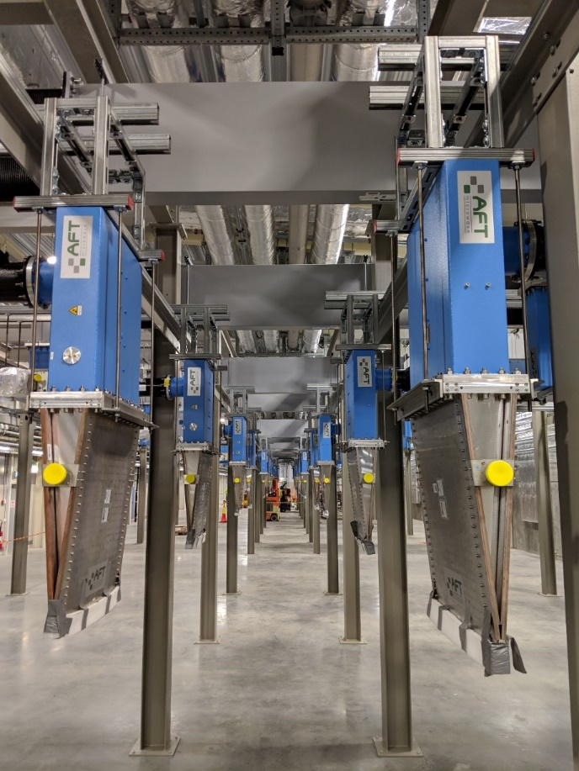
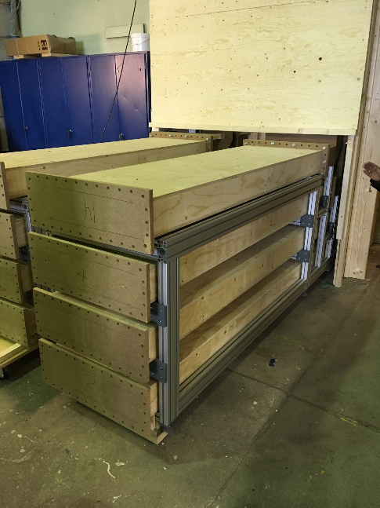
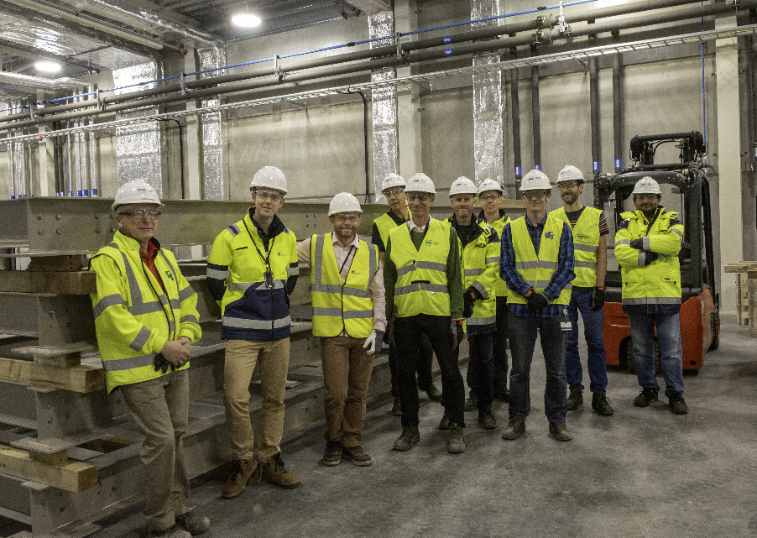

RF System Tests Now Underway at ESS
2017 Prototypes
STFC with ESS Installation Team
Completed Stub

Slide 7
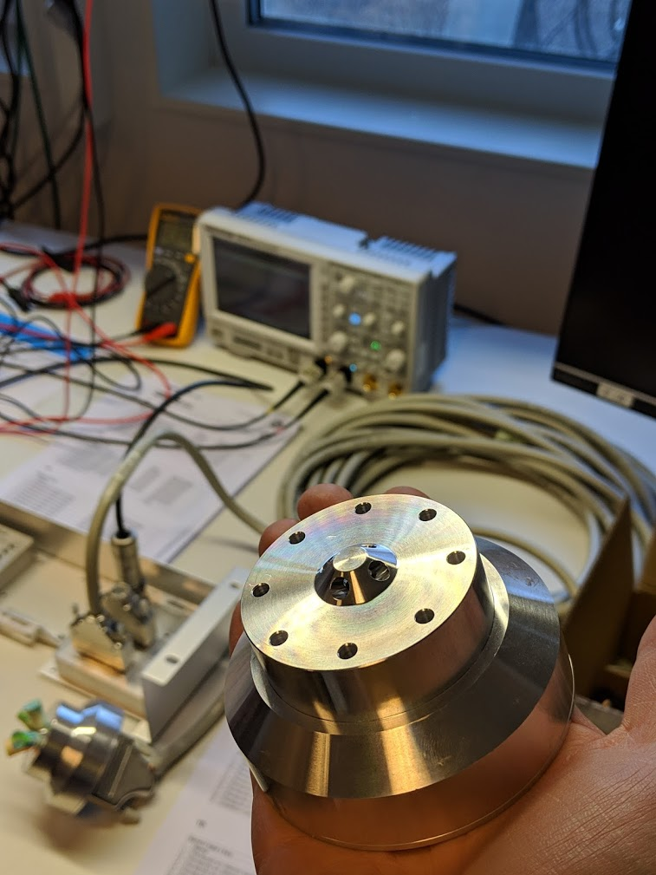
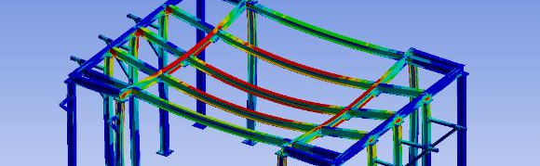
RFD Technical Challenges
Arc detector location studies.
Arc detector logic systems for high power operation.
Structural analysis and design of support fixtures.
Development of RFD factory acceptance tests.
Improved QA/QC control of waveguide surface interfaces.
Involvement in commissioning, test and tuning of all RFD systems.
Structural Analysis
Arc Detector Tests

Slide 8
RFD Current Status
STFC Deliveries have maintained schedule ahead of ESS installation plan.
RFD project work done is now at ~85%, remaining value is £1.9m ($2.5m).
All deliveries expected to be finished by April 2020.
Project moving into final phase, commissioning and test.

Slide 9
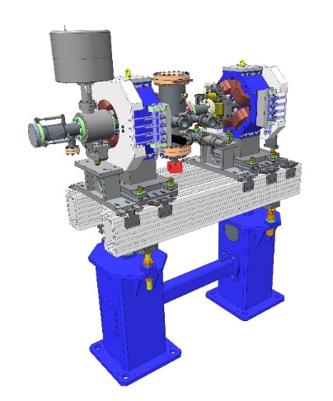
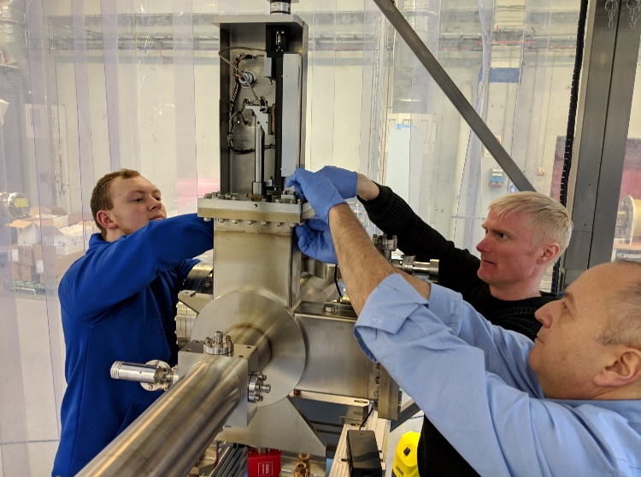
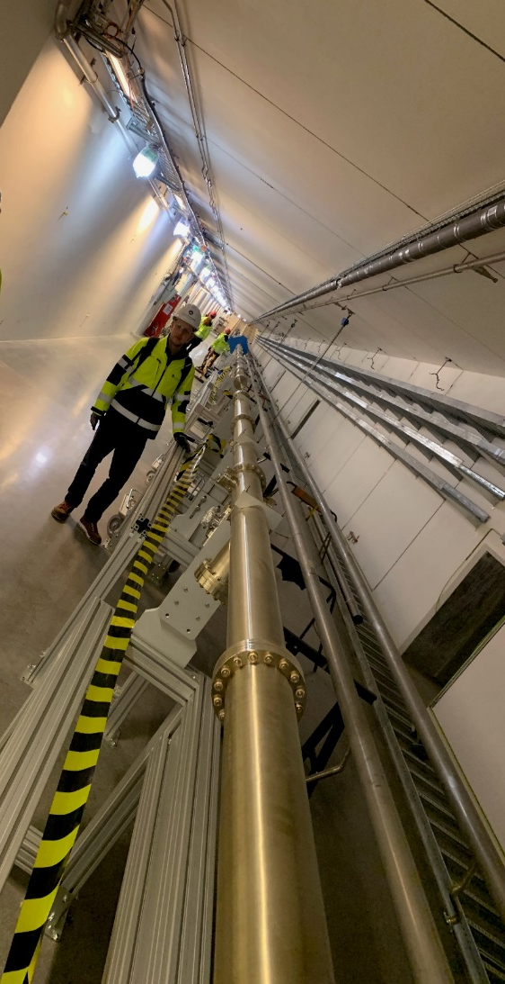
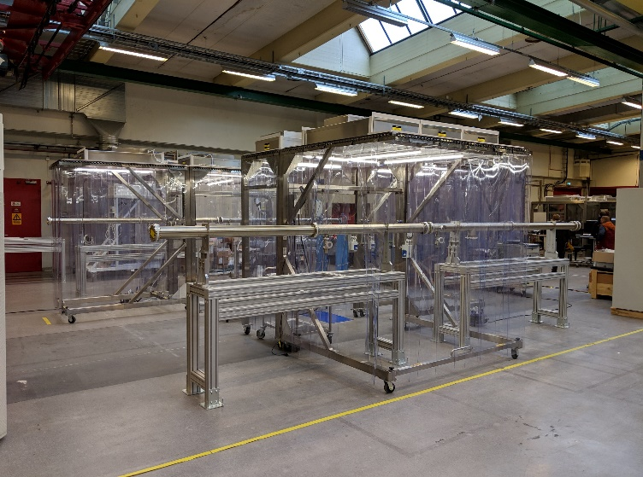
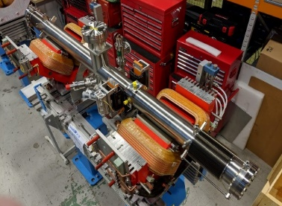
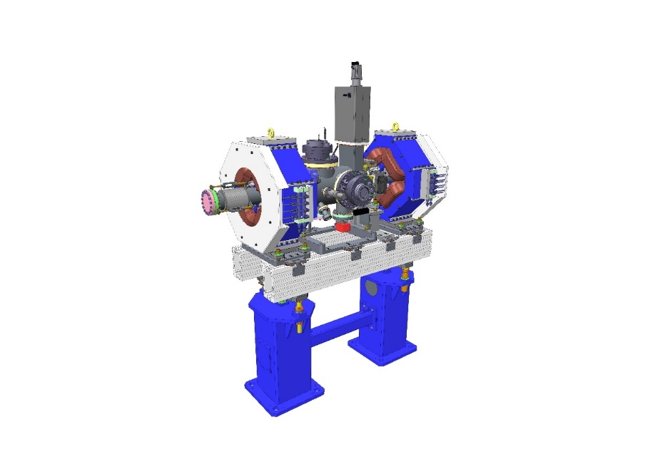
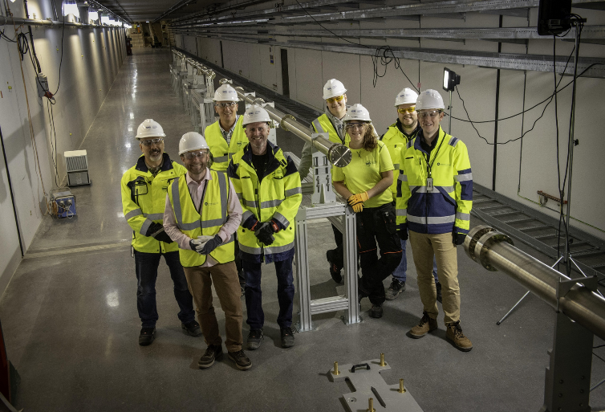
Beam Transport Modules (BTM)
STFC design, procure & assembly:
2 Prototype Linac Warm Units (LWU)
3 Test Drift-tube Chambers
75 LWU Modules with magnets:
  15 different configurations
52 Magnet-less modules (BP & DCMs)
2 Dipole Vessels
2 Differential pumping systems
4 mobile installation cleanrooms
134 Modules in Total
Knowledge transfer
mobile cleanrooms
LWU in Build
STFC & ESS team
Beam pipes installed in the tunnel

Slide 10
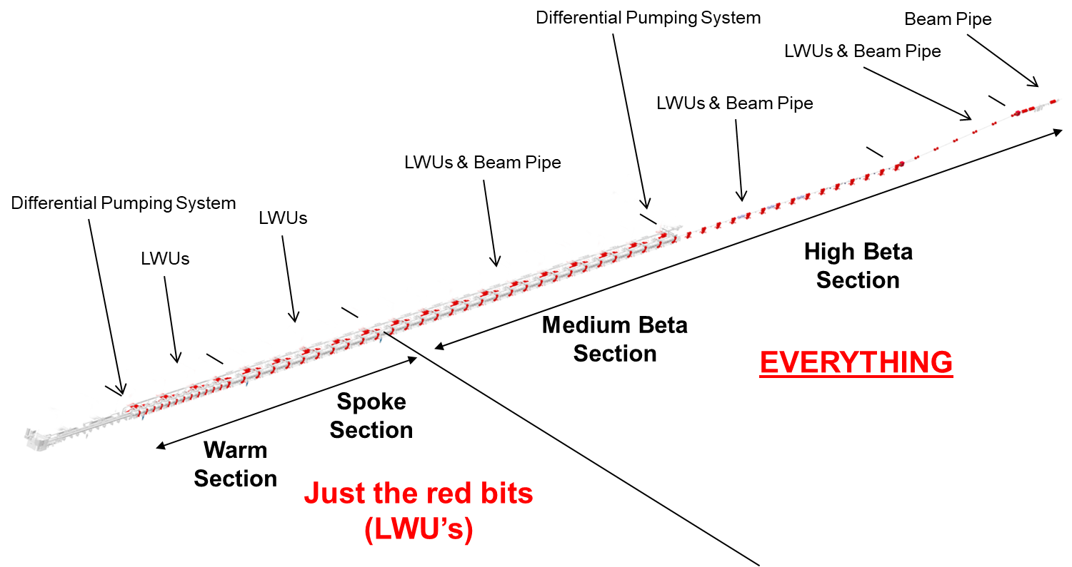
Extent of STFC BTM Delivery
Total length to process 480m
Total Shipped 285m (59%)

Slide 11
LWUs in build at Daresbury
480m of the Linac
Will form over 85% of the total length of ESS!

Slide 12
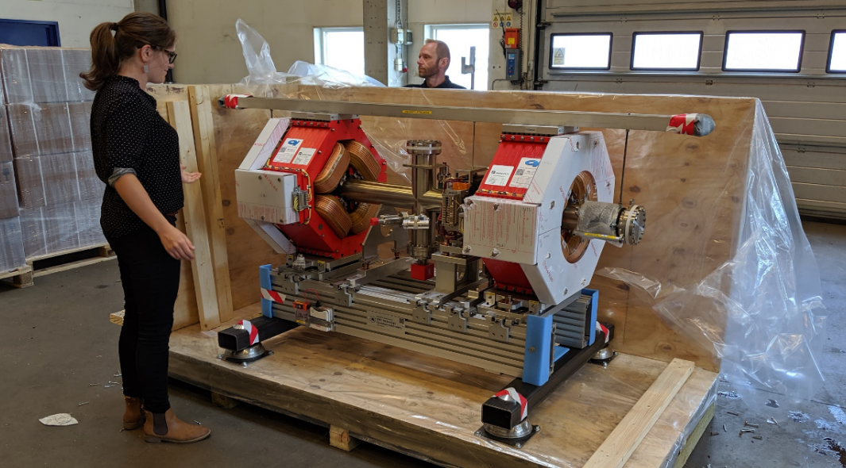
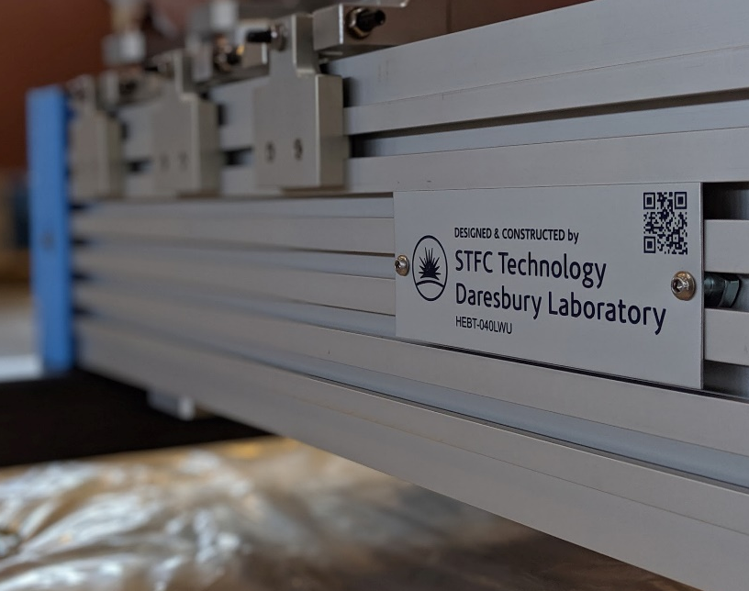
July 2019 saw the First LWU Delivered!
Date | LWUs | DCMs
2018 | 0 | 52
15/07/2019 | 7
06/09/2019 | 8
11/10/2019 | 8 | 1
15/11/2019 | 8
13/12/2019 | 4
01/02/2020 | 8 | 6
13/03/2020 | 4 | 7
13/04/2020 | 8
18/05/2020 | 8
20/07/2020 | 7
01/09/2020 | 7
Total Delivered | 15/77 | 52/66
LWU at ESS Inspection Facility
Since then 14 more LWUs have now shipped to ESS
Notes:
TD@DL have recently delivered the first Linac Warm Unit (LWU) to ESS as part of the Beam Transport Module (BTM) project, this is a major milestone (despite having already delivered 280m of the accelerators total length) as this marks the next phase of the project where design, production and qualification of the modules becomes much difficult. Each one of the 74 modules will contain diagnostics, vacuum equipment as well as quadrupole and corrector magnets – all surveyed into with +/-100um. Of the 74, 54 will be processed through the cleanroom to remove particles down to the ISO5 level, this will ensure that no particles can travel from the LWUs into the accelerating cavities. Delivery of the units will now start to ramp up peaking towards the end of the year with the aim to be completed by March 2020.

Slide 13
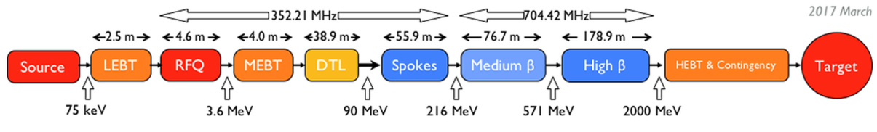
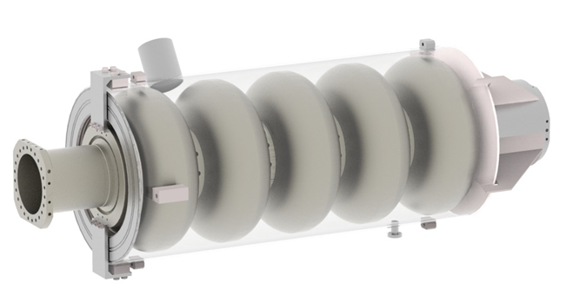
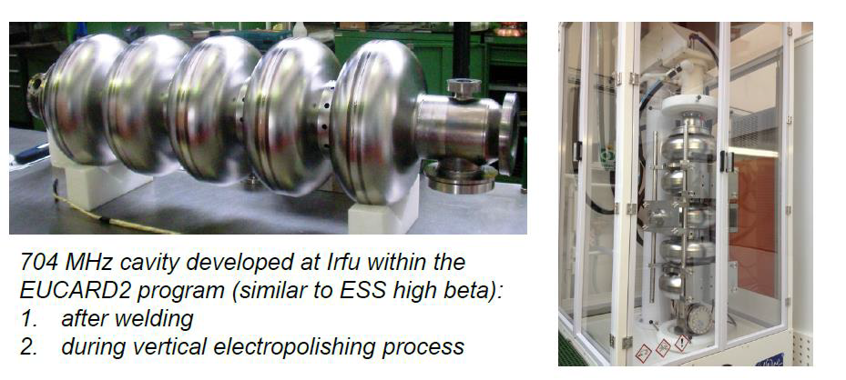
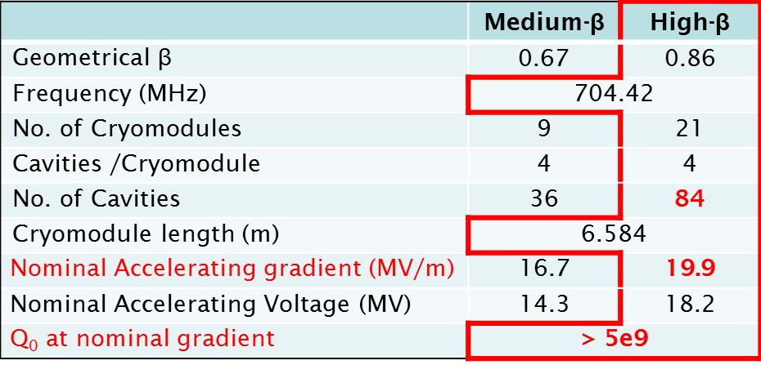
High Beta Cavities (HBC)
STFC Daresbury Laboratory responsible for delivery of all ESS high beta cavities.
Procurement of high purity Niobium and NbTi material:
  Sheets, tubes, flanges etc.
  Eddy current scan sheets at DESY under contract.
Manage cavity manufacturing with a well recognised vendor.
Implement necessary preparation and testing facilities at STFC Daresbury Laboratory.
Qualify all manufactured cavities to ESS specifications.
Deliver all cavities safely to CEA Saclay:
  CEA responsible for HB cryomodule integration.

Slide 14
HBC Testing Provisions
Ability to qualify a total of 84 (+4) x 704 MHz elliptical cavities.
Cavities will be received ‘dressed’ and BCP processed.
4 x “Pre-series” cavities used to qualify industrial BCP procedures.
Cavity testing throughput to be consistent with CEA delivery constraints:
  Delivery of 4 cavities/month to CEA.
  CEA performing CM integration of tested cavities.
Need integrated ability to HPR any FE-limited cavities:
  Assume 30% retreatment (~ 27 testing cycles).
  ISO4 cleanroom required to process cavities through HPR cycle.
Multi-cavity VT facility provisioned, with a cryogenic system to qualify cavities to ESS specifications at throughput required.
Cavities which fail as result of additional HPR, to be returned to industry for remedial action:
  Assume <3%, based upon XFEL experience (~3 cavities).

Slide 15
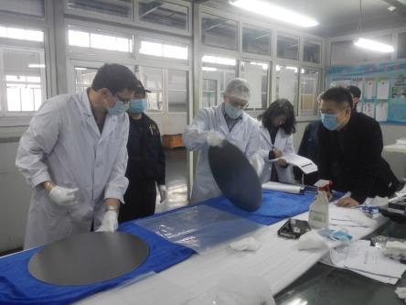
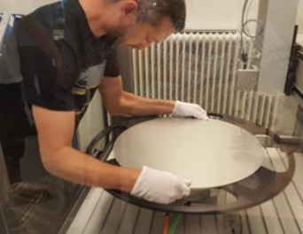
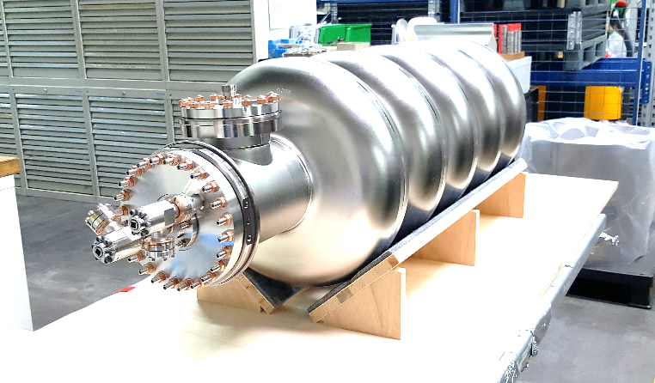
Cavity Manufacturing Status
Niobium deliveries complete (Ningxia OTIC):
  924 sheets delivered; Eddy current scanned at DESY
  Only 2% rejected, replaced by vendor
Cavity manufacturing strategy (Research Instruments):
  4 pre-series cavities used to qualify vendor processes:
    Pre-series cavities undergo cold tests ‘undressed’ at DESY and ‘dressed’ at Daresbury
  Series manufacturing:
    During pre-series fabrication/testing, continue preparing component series parts
    Release to full batch production after pre-series tests successful
Cavity | Status | Undressed cold test at DESY | Dressed cold test at DL
H001 | Integrating into helium tank | Completed successfully | Sep/Oct 2019
H002 | Shipping for test | Sep/Oct 2019 | Oct/Nov 2019
H003 | BCP complete Tuning and assembly for test | Oct 2019 | Nov 2019
H004 | Dumbbell manufacture | Nov 2019 | Dec 2019
H001 READY FOR HELIUM JACKET ASSEMBLY
Notes:
98% passed in total
84% passed 1st scan
9% passed after 2nd scan
5% passed after 2nd scan and further analysis
2% rejected

Slide 16
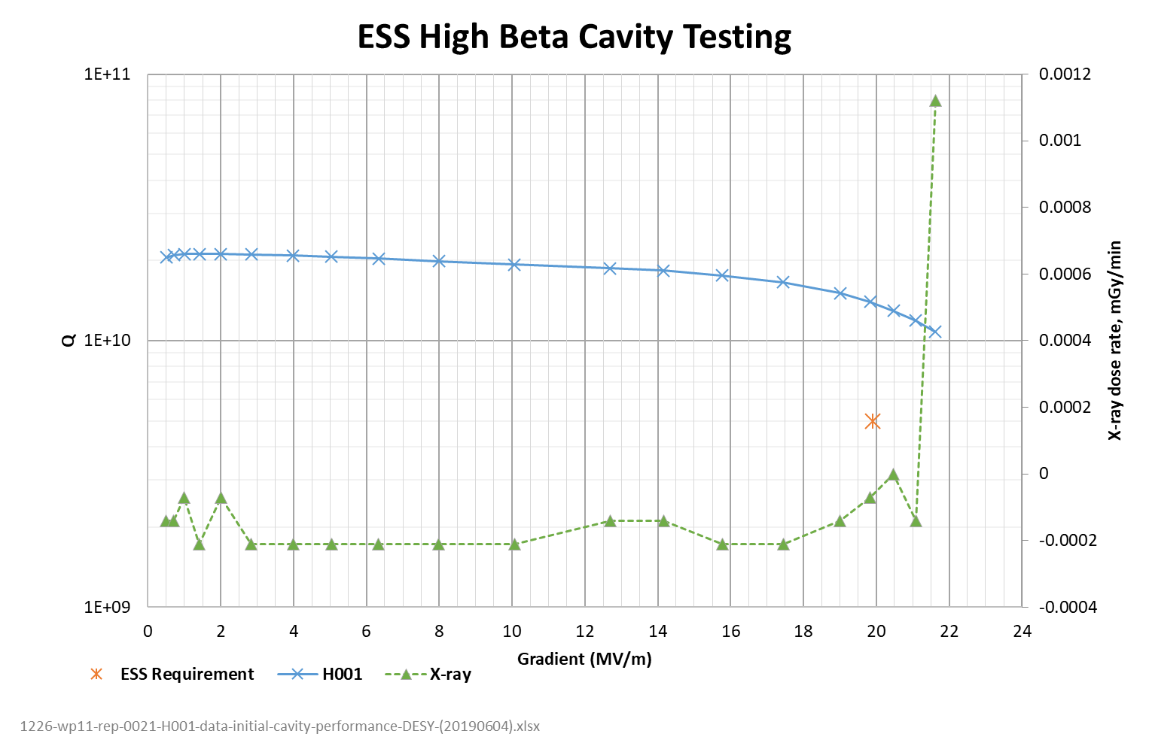
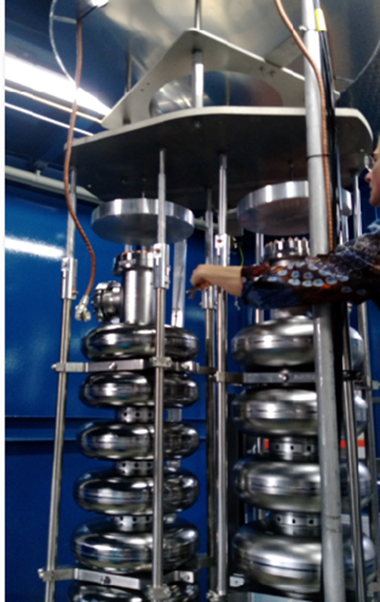

H001 ‘Pre-series’ Cavity Test at DESY
4/6/19
INFN MB
STFC H001
Eacc vs Qo
  OK
X-ray
  OK
F(pi):
  NOK -> vendor to retune cavity
  target between [704.030, 704.264] MHz
Test stopped at 21.6MV:
  after achieving specification
Highest Power Measurements
Eacc (MV/m) | 21.62
Qo | 1.08 x 10¹⁰
Frequency (MHz) | 704.424
X-ray – Top (mGy/min) | 0.00112
X-ray – Bottom (mGy/min) | 0.00182

Slide 17
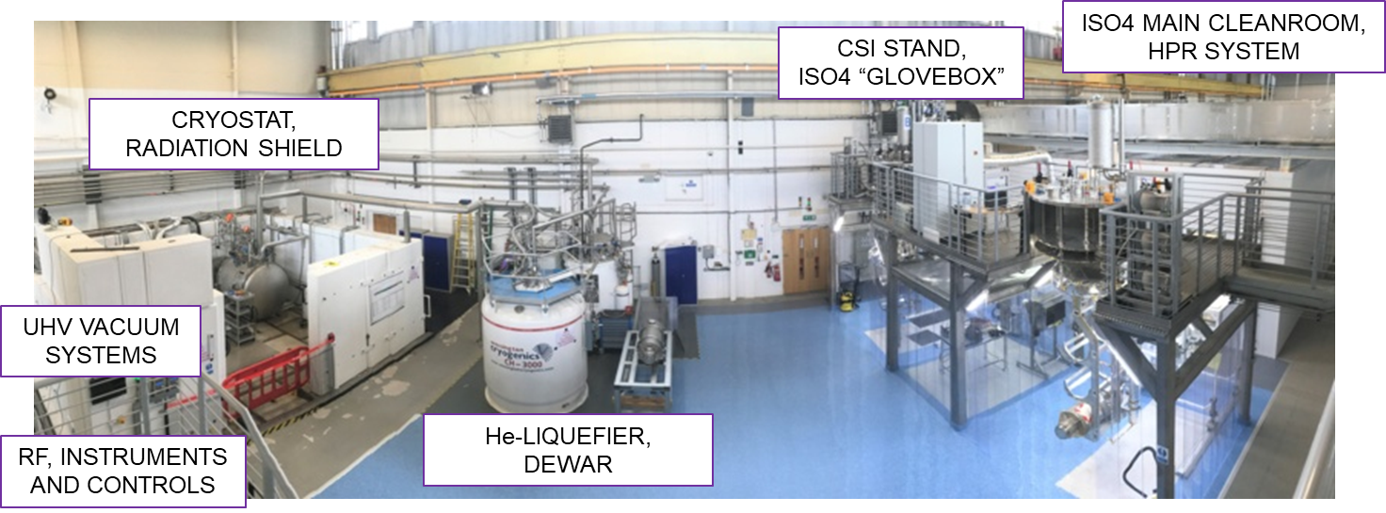
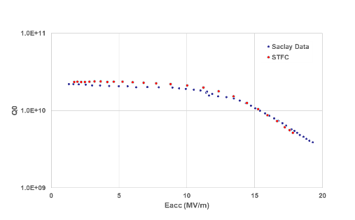
Vertical Test Facility Status at Daresbury
Currently commissioning with ESS prototypes:
  Good performance agreed with tests from CEA
RF performance:
  LLRF tracking validated & HPRF successfully tested up to P_{INCIDENT} ~ 200W
Cryogenics:
  Excellent static T, P stability (±1mK, ±0.1mBar); dynamic stability assessment planned for next run
Cleanroom and HPR facility:
  Completed installation in June/July; started commissioning in July/August
Target ‘series’ testing readiness Q1/Q2 2020.
CEA prototype cavity P02 test at Daresbury
Specification
17/6/19

Slide 18
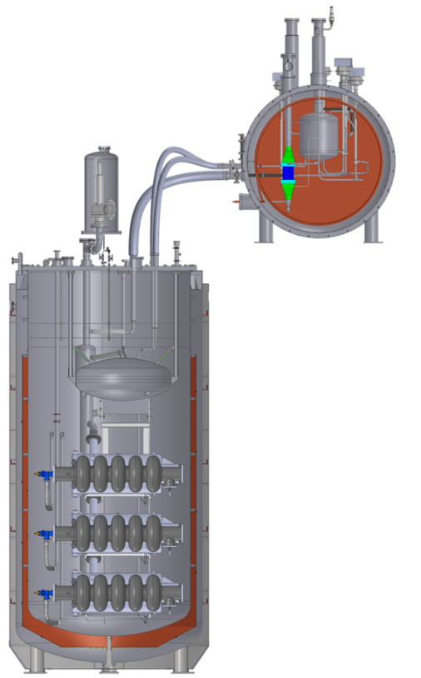
Future HBC Delivery Plans
Q4/2019:
  Complete “Pre-series” manufacture and testing:
    Good test results required to release ‘Series’ manufacturing
  Complete commissioning of Vertical Test Facility:
    Additional Vertical Test(s) to optimise equipment & processes
    High-Pressure Rinsing system and cleanroom
    Commissioning with CEA prototype cavities
Q1/2020:
  First test of STFC/RI ‘Series’ cavity
  ‘Benchmarking’ facility and final commissioning:
    3 STFC/RI ‘Series’ cavities, with reference test data from DESY
Q2/2020:
  Start of “full” testing operations
  Delivery of first qualified ‘Series’ cavities to ESS/CEA for integration into HB01 Cryomodule
Q3/20 – Q1/22:
  Full through-put testing operations
  Delivery of 4 cavities/month to ESS for integration into cryomodules

Slide 19

Summary
STFC (UK) at Daresbury Laboratory is providing a significant amount of ESS beamline components (~85%), plus all of the RF power distribution hardware.
RF Distribution:
  >4km waveguide systems, with almost 800 arc detectors, loads, windows and circulators, plus the design and fabrication of all installation support systems.
  Delivery 85% complete, with remainder expected before April 2020.
Beam Transport Modules:
  134 modules to be provided, plus prototypes, cleanrooms and pumping stations.
  Delivery ~45% complete, with remainder expected before end 2020.
High Beta Cavities:
  84 x 704MHz SRF ‘Series’ cavities to be procured, tested & issued to CEA Saclay for CM integration.
  First successful ‘pre-series’ cavity test at DESY and first ‘prototype’ cavity test at the new vertical test facility at Daresbury Laboratory achieved.
  Qualified ‘Series’ cavity delivery to CEA expected from Q2 2020 to Q1 2022.
STFC’s SRF linac system delivery for ESS is well underway!

