Slide 1

Neutron Source for BNCT
(Boron Neutron Capture Therapy)
Dongguan HEC High-energy Medical Devices Co., LTD
RONG LIU 2019-09-27
www.dbnct.com.cn
Notes:
Popular Science Article on BNCT

Slide 2
Outline
BNCT Intro.
Features of BNCT
Neutron Source for BNCT
Reactor based BNCT
Accelerator based BNCT
Future prospective

Slide 3
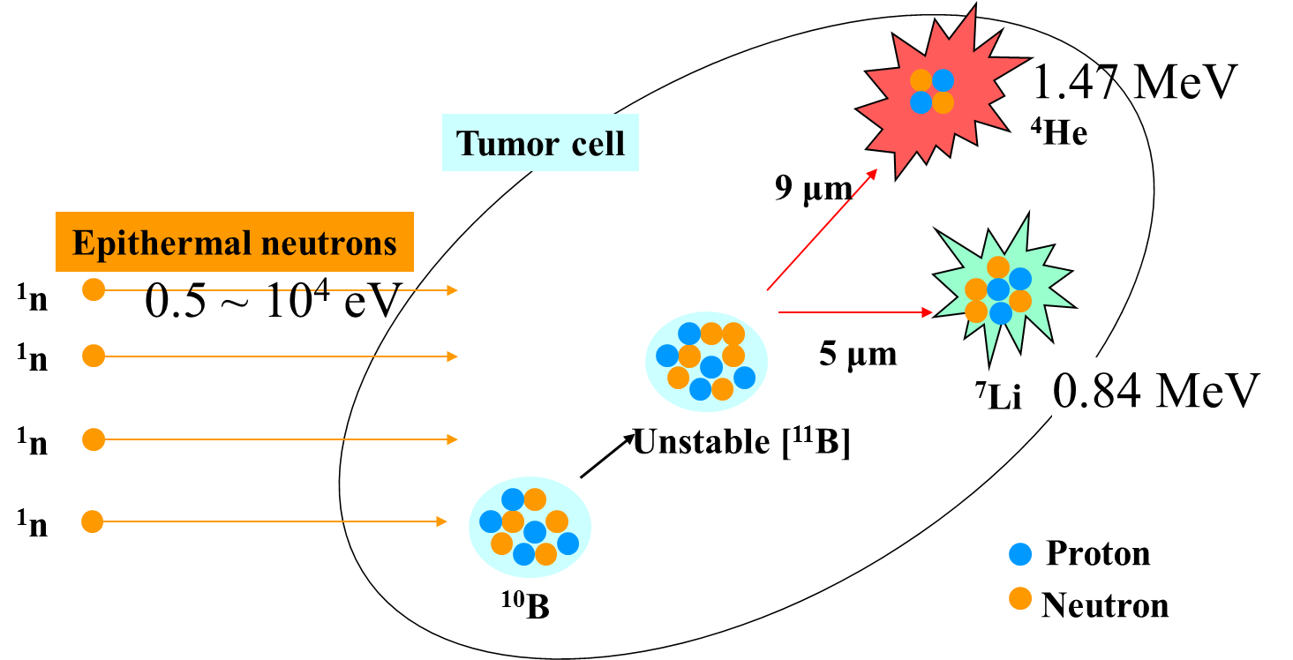
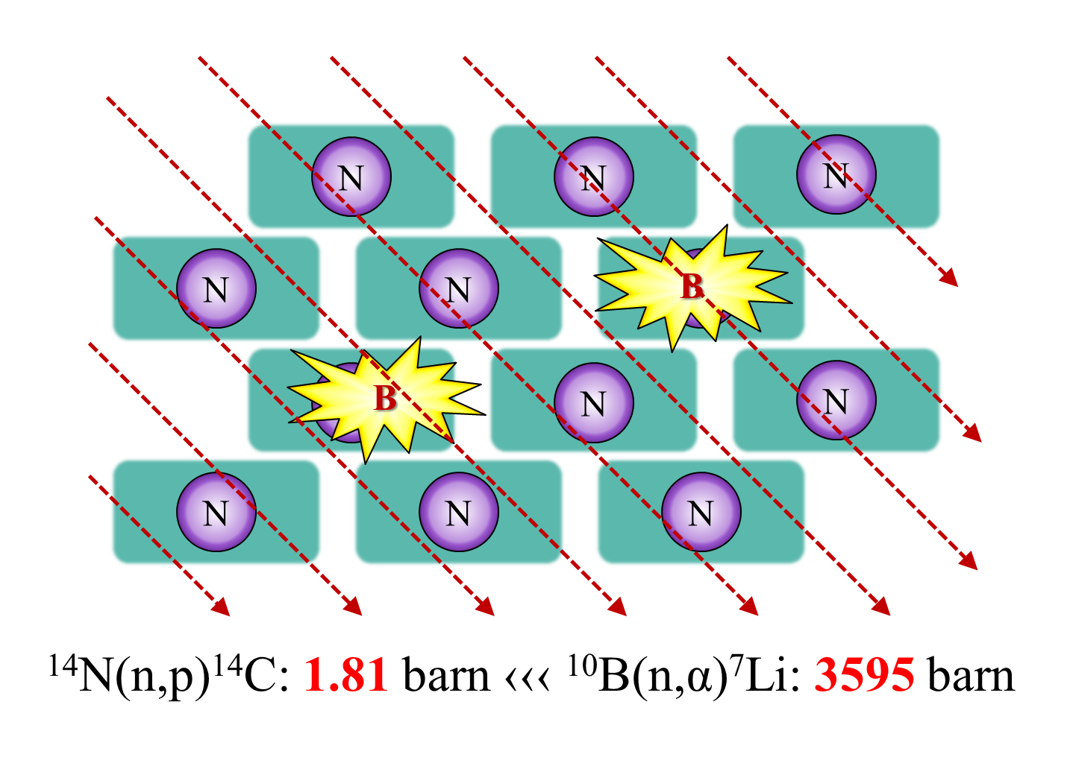
BNCT Intro.
¹⁰B + n_{th} → [¹¹B] *→ α + ⁷Li + 2.31 MeV
BNCT is based on the nuclear reaction between epithermal neutrons (0.025 eV) and ¹⁰B atoms, which produces unstable ¹¹B isotopes that undergo fission to generate ⁴He(α) and ⁷Li particles with path lengths of < 10 μm (approximately one cell diameter).

Slide 4
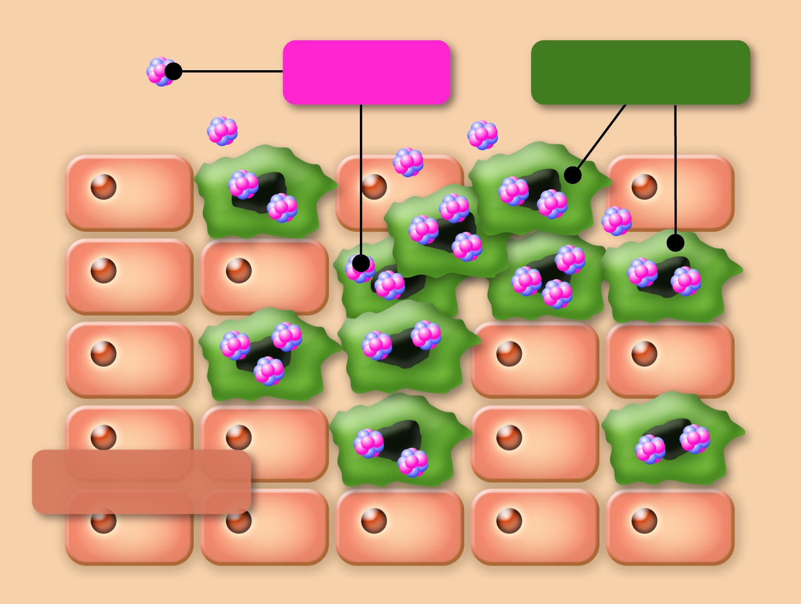
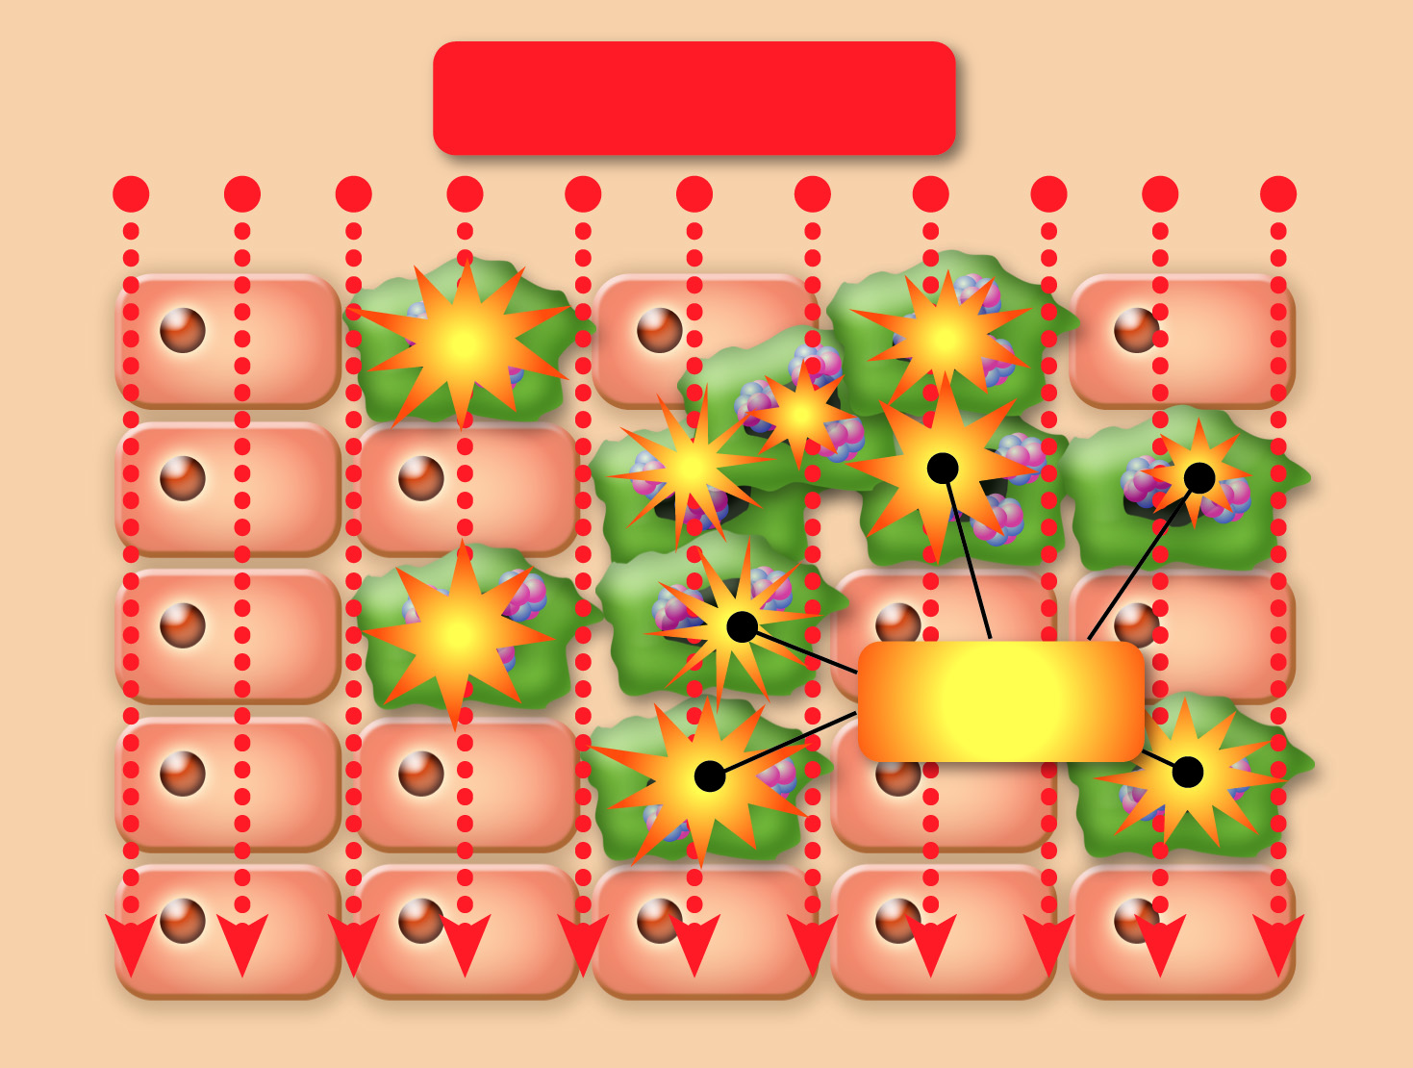
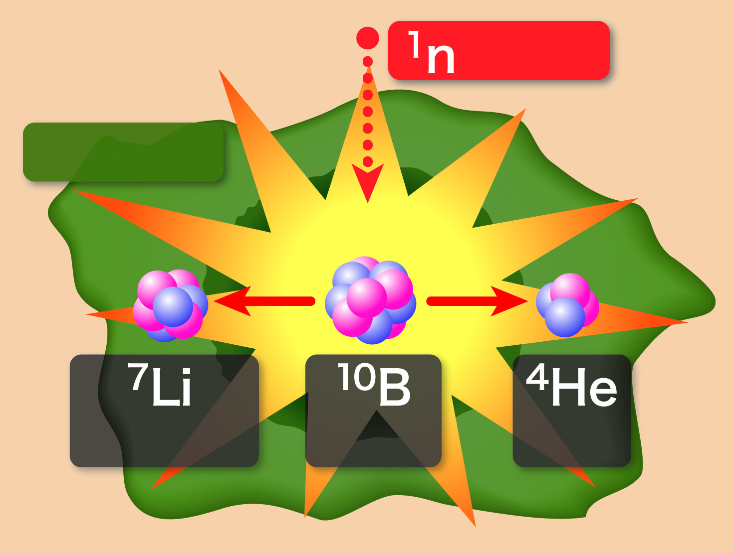
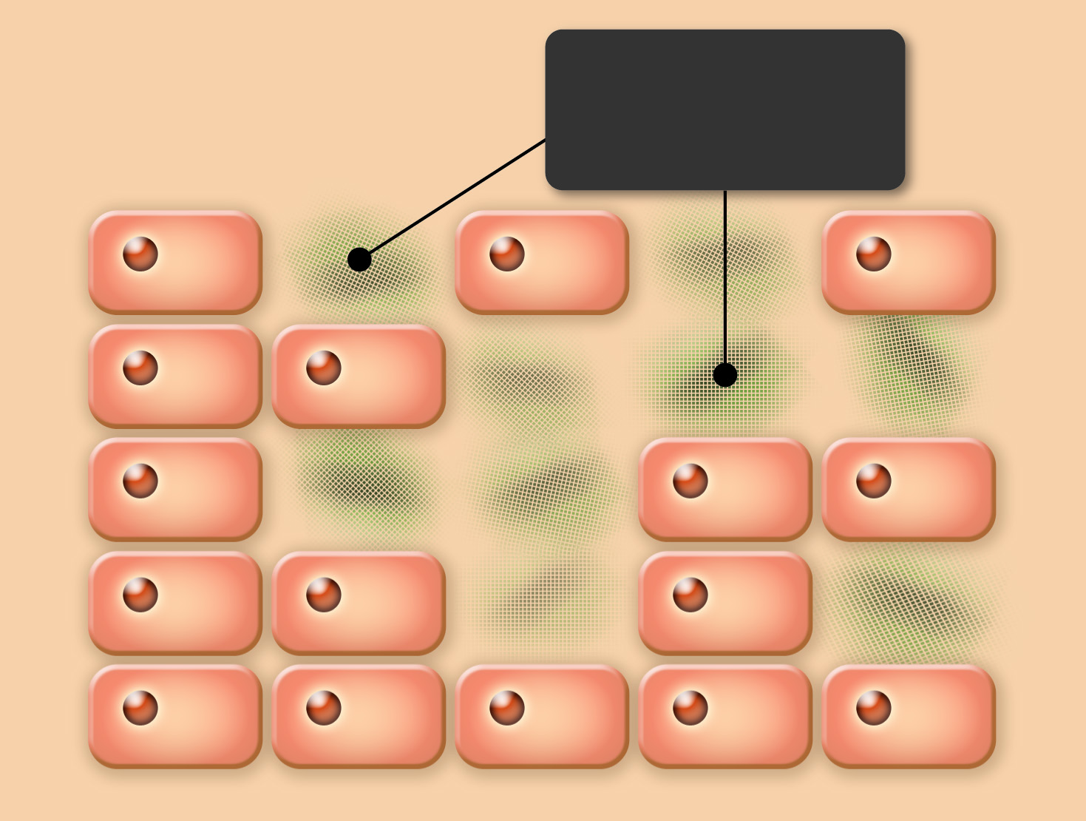
Mechanism of the treatment
Administer boron
-containing drug:
Neutron irradiation:
Neutron react with boron:
Cancer cells are destroyed:
Boron
Cancer Cells
Neutron Beam
Neutron
Destroyed
cancer cells
Nuclear
reaction
Normal Cells
Lithium
Boron
Alpha
Particle
A boron-containing drug that selectively accumulates in cancer cells is used.
The affected site is irradiated with an energy-adjusted neutron beam.
Emitted alpha particles and lithium particles destroy cancer cells
These particles only travel a distance of one cell width (about 10μm), allowing for cell-level treatment.
Features of BNCT
Pinpoint treatment at cell level
Alpha particles and lithium particles, with energy three times higher than regular radiation,
selectively destroy the DNA helixes of cancer cells.
New treatment of refractory cancer
Including invasive cancer, multiple cancer, recurrent cancer, radiation-resistant cancer,
cancer patents not indicated for surgery or radiation therapy, etc.
Causes minimal stress and provides high quality of life to patients
Treatment is completed in only one session of 30 minute irradiation without incision.
Indication for medication can be determined in advance.
Notes:
First, this slide shows principle of BNCT and its advantages.
As you know, BNCT can destroys cancer cells selectively using alpha particle and lithium nucleus as heavy particles.
So, BNCT is called “Cancer cell selective heavy-ion therapy”.
BNCT can be applied to refractory cancers as invasive cancer, multiple cancer and radiation resistant cancers and so on. And recurrent cancer after conventional radiotherapy are also applied.
Further advantage is that the treatment completes in only one session of 30 minute irradiation because neutron dose for healthy tissue is limited.
So, it provides highly quality of life to patient.

Slide 5
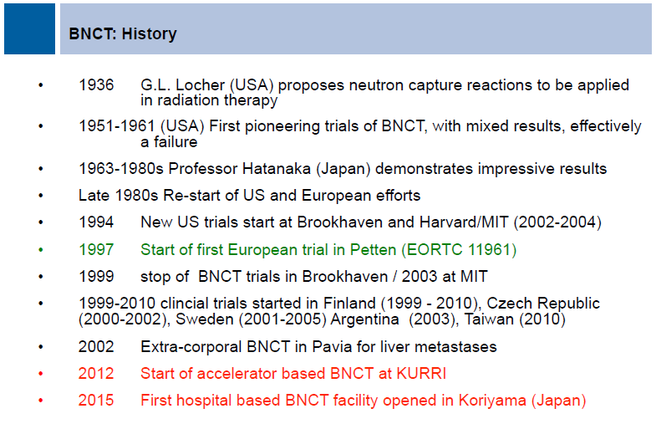
BNCT History
Eighty years of history. Reliable neutron source; visualized targeted drugs;
dosing system and treatment planning system; clinical integration of hospitals

Slide 6
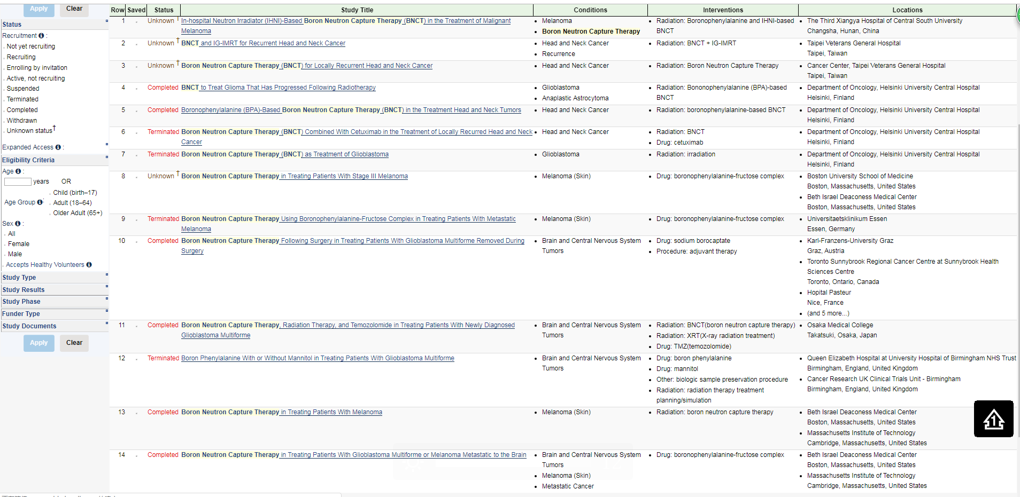
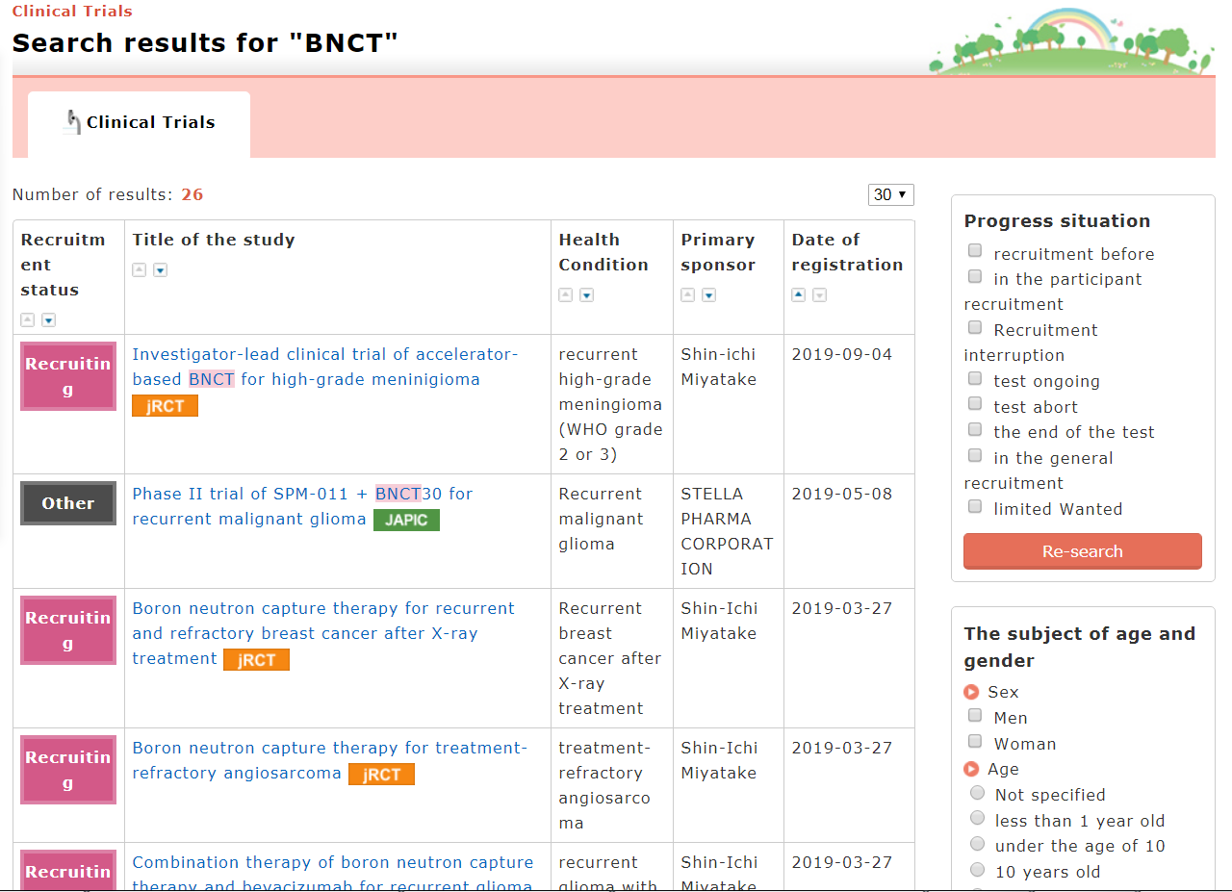
Clinical trials https://www.clinicaltrials.gov/; https://rctportal.niph.go.jp

Slide 7
Beam quality or require
Recommended beam characteristics in IAEA TEC-DOC-1223

Slide 8
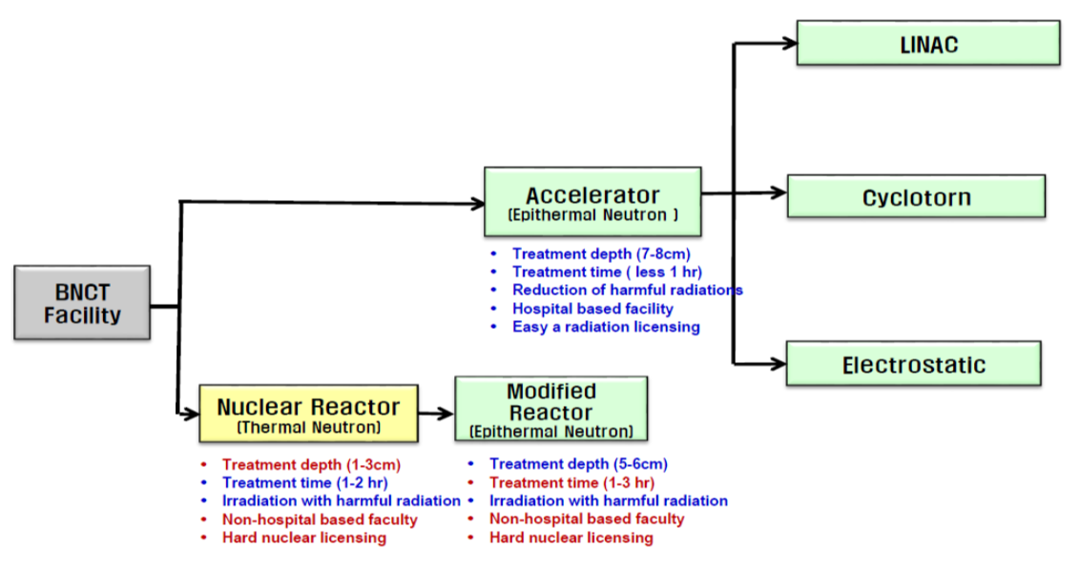
Evolution of BNCT Facilities – Neutron Source

Slide 9
Reactor-based Boron Neutron-Capture Therapy Facilities
http://www-naweb.iaea.org/napc/physics/research_reactors/database/RR%20Data%20Base/datasets/utilization/b_neutroncap_ther.html
No. | Country | Name | Reactor Type | Thermal Power, kW | Thermal Flux, n/cm²/s | Fast Flux, n/cm²/s | Criticality Date
1 | Argentina | RA-1 ENRICO FERMI REACTOR | TANK | 40 | 1.50E+12 | 1.00E+12 | 1958-1-20
2 | Argentina | RA-6 | POOL | 500 | 1.10E+13 | 1.80E+12 | 1982-9-23
3 | Argentina | RA-3 | POOL | 5000 | 4.80E+13 | 1.40E+14 | 1968-8-1
4 | Brazil | IEA-R1 | POOL | 5000 | 4.60E+13 | 1.30E+14 | 1957-9-16
5 | Czech Republic | LVR-15 REZ | TANK WWR | 10000 | 1.50E+14 | 3.00E+14 | 1957-9-24
6 | Finland | FIR-1 | TRIGA MARK II | 250 | 1.00E+13 | 1.20E+13 | 1962-3-27
7 | Germany | BER-II | POOL | 10000 | 2.00E+14 | 1.40E+13 | 1973-12-9
8 | Germany | FRM II | POOL | 20000 | 8.00E+14 | 5.00E+14 | 2004-3-2
9 | Hungary | NUCL. TRAINING REACTOR | POOL | 100 | 4.00E+12 | 2.00E+12 | 1971-5-22
10 | Italy | LENA, TRIGA II PAVIA | TRIGA MARK II | 250 | 1.00E+13 | 1.20E+13 | 1965-11-10
11 | Italy | RSV TAPIRO | FAST SOURCE | 5 |  | 4.00E+12 | 1971-4-4
12 | Japan | JRR-4 | POOL | 3500 | 7.00E+13 | 8.70E+13 | 1965-1-28
13 | Japan | KUR | TANK | 5000 | 6.00E+13 | 6.50E+13 | 1964-6-25
 |  |  |  |  |  |  | Temp.Shut.
14 | Kazakhstan | WWR-K ALMA ATA | POOL | 6000 | 1.40E+14 | 1.60E+13 | 1967-10-22
15 | Netherlands | HFR | TANK IN POOL | 45000 | 2.70E+14 | 5.10E+14 | 1961-11-9
16 | Russian Federation | IRT | POOL, IRT | 2500 | 4.80E+13 | 4.30E+13 | 1967-5-26
17 | Russian Federation | IRT-T | POOL, IRT | 6000 | 2.50E+14 | 1.20E+13 | 1967-7-22
18 | Russian Federation | RBT-10/2 | POOL | 7000 | 7.40E+13 | 5.70E+13 | 1984-12-1
19 | Taiwan, China | THOR | TRIGA CONV | 1000 | 1.60E+13 | 3.00E+12 | 1961-4-13
20 | United States of America | MITR-II MASS. INST. TECH. | TANK | 4900 | 7.00E+13 | 1.70E+14 | 1958-7-21

Slide 10
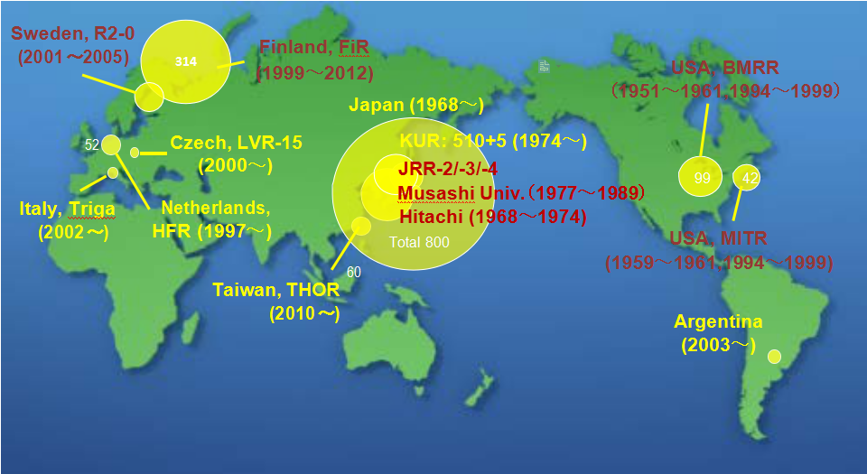
RB-BNCT
Source for Prof. Yoshiaki Kiyanagi

Slide 11
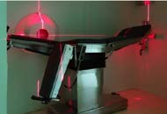
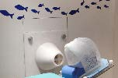
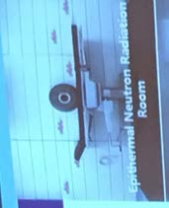
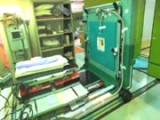
Reactor based BNCT center in operation, 4 centers
Argentina
Taiwan
China
Japan
KURRI 5MW Reactor

Slide 12
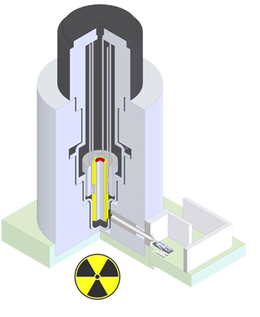
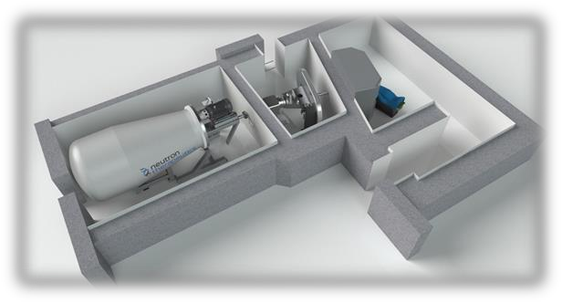
Reactor based BNCT
Accelerator based neutron
Source for BNCT
It is need to alternate Neutron source for BNCT
In-hospital, accelerator-based neutron source:
Enables broad adoption of neutron capture therapy
Nuclear research reactor:
Used for research but not
suitable In-Hospital

Slide 13
AB-BNCT
Reference:ICNCT-15, “Accelerator-Based BNCT”, A. J. Kreiner
Location | Machine (Status) | Target & reaction | Beam Energy (MeV) | Beam current (mA)
Budker Institute (Russia) | Vacuum insulated Tandem (Ready) | Solid ⁷Li(p, n) | 2 | 2
iPPE-Obninsk (Russia) | Cascade generator KG- 2.5 (Ready) | Solid ⁷Li(p, n) | 2.3 | 3
Birmingham Univ. (UK) | Dynamitron (Ready) | Solid ⁷Li(p, n) | 2.8 | 1
Soreq (Istael) | RFQ-DTL (Ready) | Liquid ⁷Li(p, n) | 4 | 1
Legnaro INFN (Italy) | RFQ (Under construction) | Be(p, n) | 4-5 | 30
CNEA Buenos Aires (Argentina) | Single ended Tandem Electrostatic Quadrupole (TESQ) (Under construction) | Be(d, n) | 1.4 | 30
 |  | Solid ⁷Li(p, n) | 2.5 | 30
KURRI (Japan) | Cyclotron (Clinical Trial) | Be(p, n) | 30 | 1
Tsukuba (Japan) | RFQ-DTL (Under construction) | Be(p, n) | 8 | 10
NCCenter, CICS (Japan) | RFQ (Under construction) | Solid ⁷Li(p, n) | 2.5 | 20
Fukushima South Tohoku Hospital (Japan) | Cyclotron (Under construction) | Be(p, n) | 30 | 1
Tokyo Institute of Technology (Japan) | Neutron target system only (Under construction) | Liquid ⁷Li(p, n) | ~2.5 | -
Osaka University (Japan) | Neutron target system only (Under construction) | Liquid ⁷Li(p, n) | ~2.5 | -

Slide 14
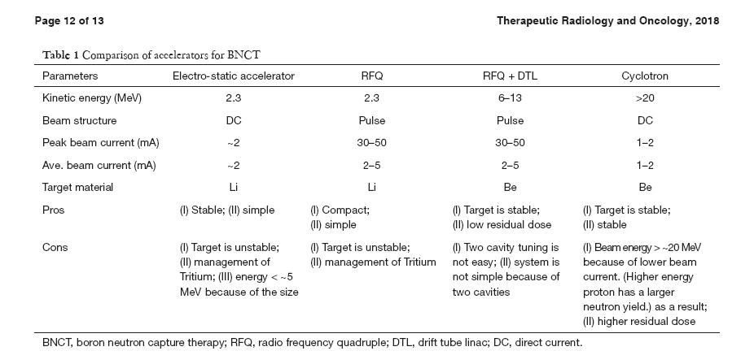
Comparison the accelerator for BNCT
Neutron yields of various reactions as a function of
projectile energy.

Slide 15
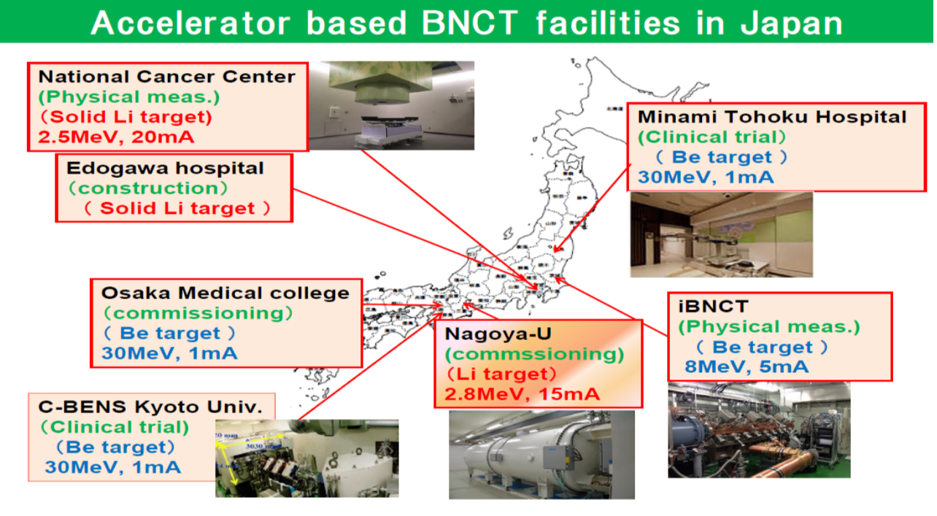
Japan
Source for Prof. Yoshiaki Kiyanagi

Slide 16
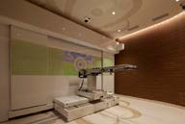
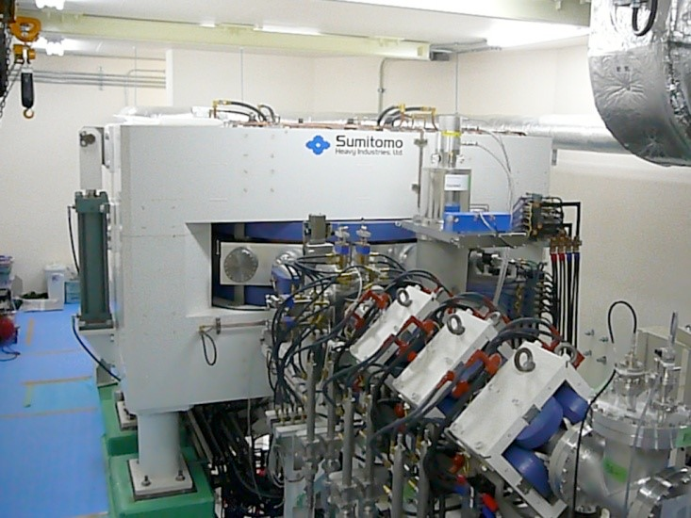
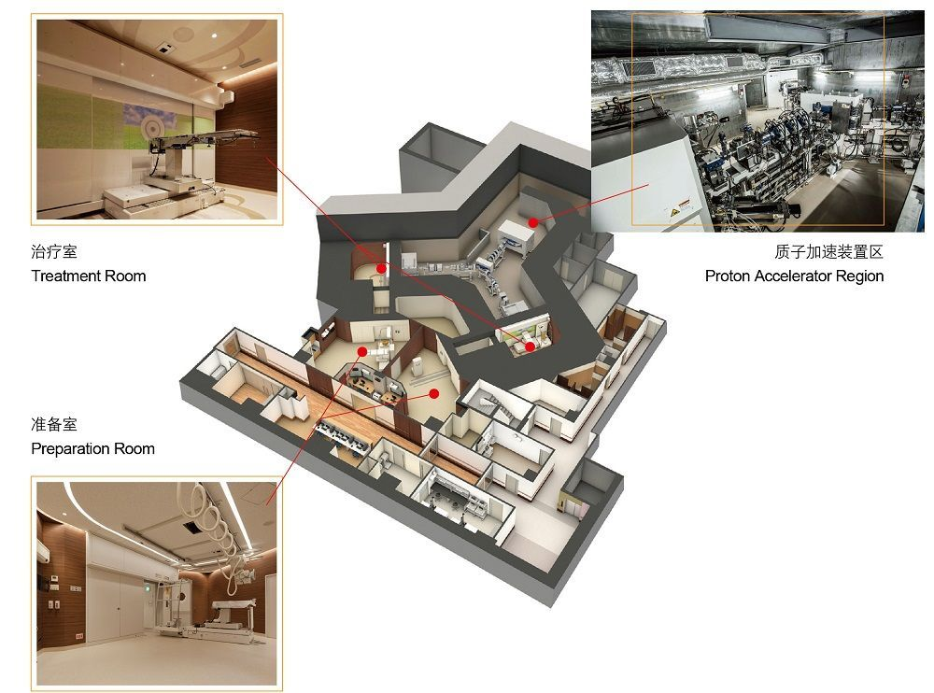
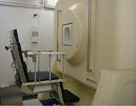
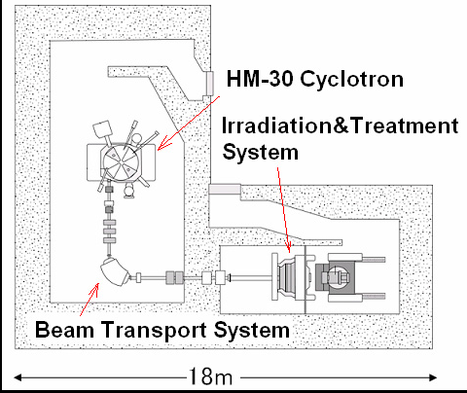
Accelerator based BNCT in operation
Southern Tohoku BNCT research center
Kyoto University, KURRI C-BENS

Slide 17
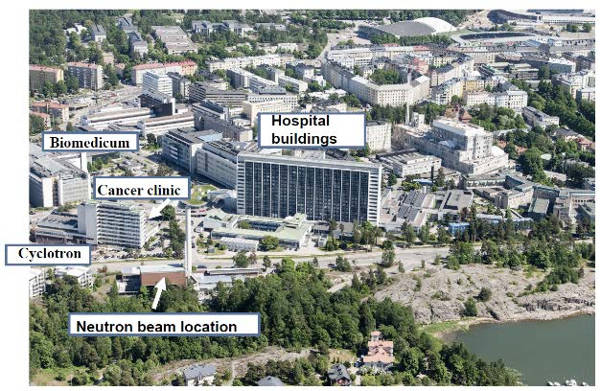
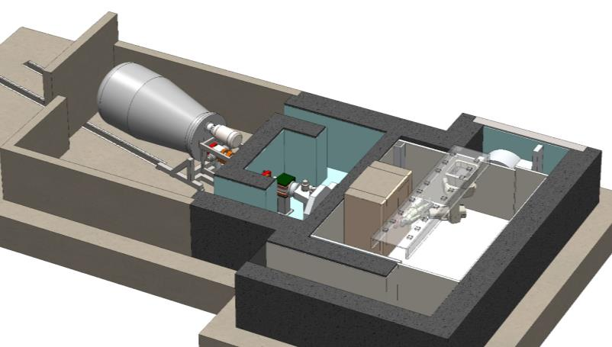
Accelerator based BNCT will start clinical trial.
Helsinki University Hospital announced an in-hospital accelerator-based
BNCT project on September 15, 2016

Slide 18
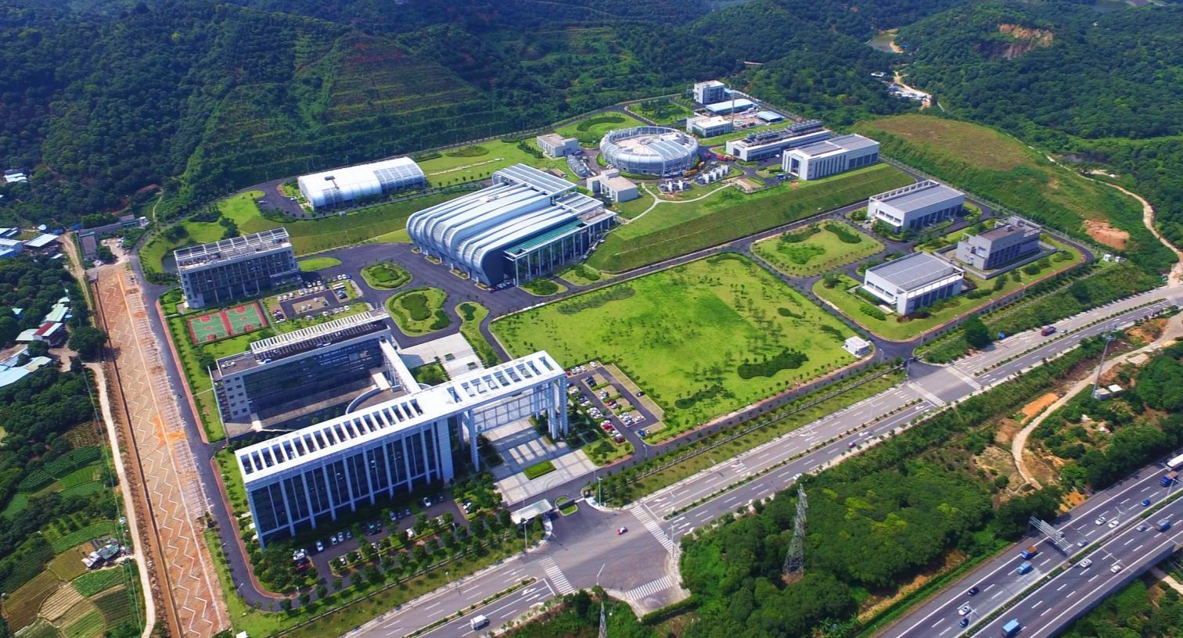
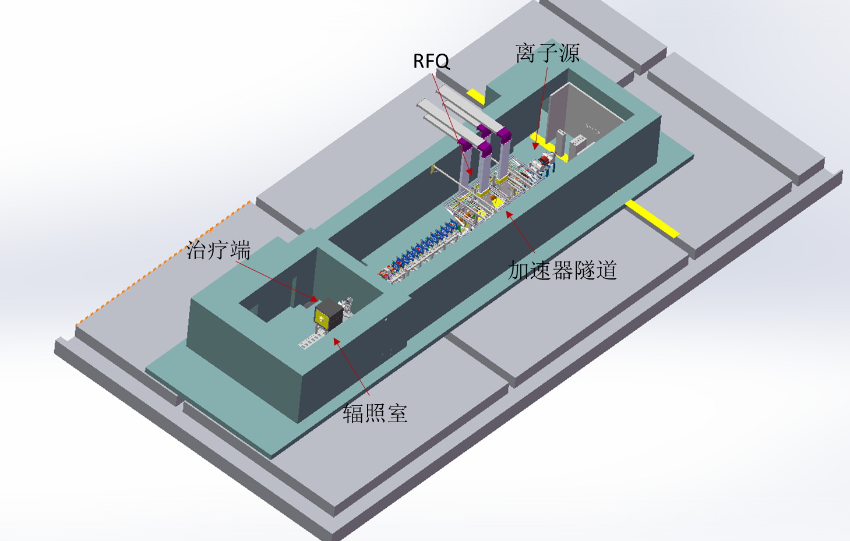
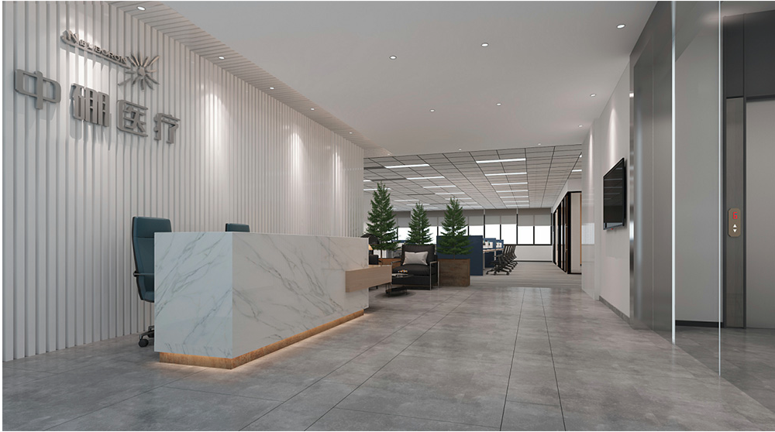
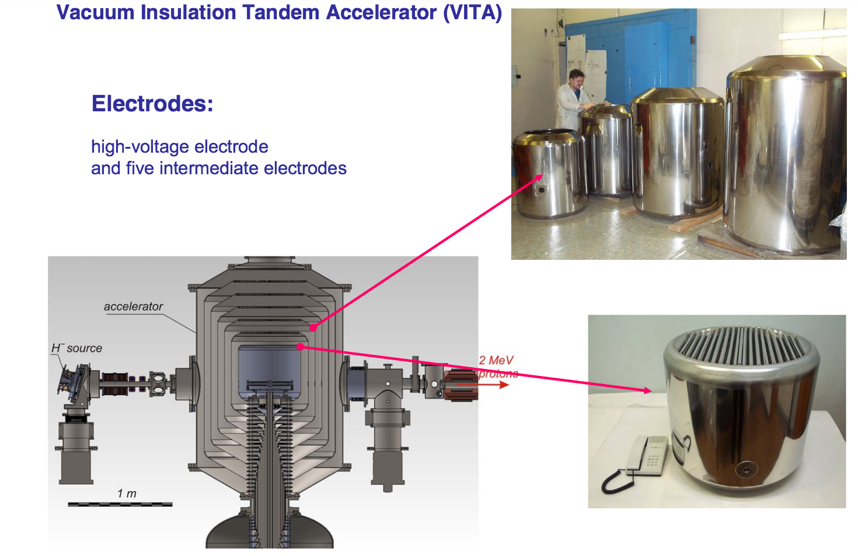
China (CSNS, Xiamen Humanity Hospital, CIEA,……)

Slide 19
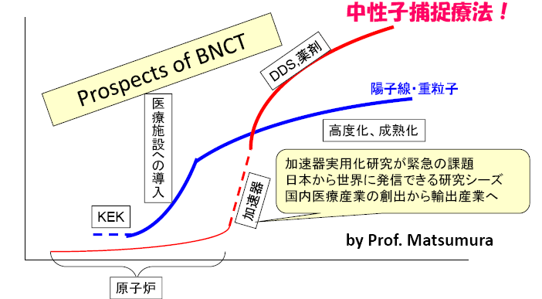
AB-BNCT Prospective

Slide 20
Thanks!

