Slide 1
RF source system design for CiADS
Liepeng SUN
On behalf of Department of RF power and LLRF
Notes:
Good afternoon, everyone, its my pleasure to stand here give a talk about rf source system, and my name is liepeng sun , on behalf of department of

Slide 2
Outline
Introduction of CiADS Project
SSA design for the project
The solution to some problems
Summary
Notes:
This is outline,

Slide 3
CiADS Project Design
162.5MHz
325MHz
650MHz
ECR IS
LEBT
RFQ
MEBT
HWR010&019
Spoke042
Ellipse062&082
HEBT/Ellipse082
Beam dump
~100m
~220m
Target& Reactor
0.035MeV
2.1MeV
500MeV
Energy: 500 MeV (can be upgraded to 1.0GeV)
Intensity：5mA（or 10mA）
Beam loss：1W/m
Operating mode：pulse&CW（Hus gap for reactor）
Energy stability：±1%@100ms
Intensity stability：±2%@100ms
Beam positon stability：±1mm
Beam envelope stability：±1mm
Notes:
This is the layout of ciads project, and its design and specifications has already been introduced from my colleges, so I skip it

Slide 4
Power distribution
2.5 mA
5mA
10 mA

Slide 5
SSA design for the project
RF strucure
Transmission line
The estimation of RF power
Specification of whole set

Slide 6
RF structure design in one rack
CiADS has a large difference in power demand comparing other projects.
Power waste is very serious if no a good design for multi-level power.
3. Low energy conversion efficiency during operation.
4. Flexible design—6 or 8 modules in one layer.
Fixed design —four layers in every rack.
Multi-level output power can be achieved. The greater match of power sources and beam loads in cavities.
For some low power cavities on low energy section, the number of output ports were optimized on combiners for two or four cavities.
Notes:
From the design above, three phases should be careful. Shown in 1
So we put forward a new design, see 4

Slide 7
Example of HWR010 section
Mode | 1 | 2 | 3 | 4 | 5 | 6 | 7 | 8 | 9 | 10
RF output | 6 | 8 | 6+6 | 6+8 | 8+8 | 6+6+6+6 | 6+6+8+8 | 6+6+6+8 | 6+8+8+8 | 8+8+8+8
Power（kW） | 4.9 | 6.5 | 9.6 | 11.8 | 12.9 | 19.1 | 21.2 | 22.2 | 24.4 | 25.5
 | Output Power of SSA
NO. | 2.5 |  | 5 |  | 10
 | Pb（kW） | mode | Pb（kW） | mode | Pb（kW） | mode
1 | 1.4 | 1 | 1.9 | 1 | 3.0 | 1
2 | 1.8 | 1 | 2.4 | 1 | 3.9 | 1
3 | 2.3 | 1 | 3.1 | 1 | 5.0 | 2
4 | 3.0 | 1 | 3.9 | 1 | 6.1 | 2
5 | 3.4 | 1 | 4.4 | 1 | 6.8 | 3
6 | 3.3 | 1 | 4.4 | 1 | 6.9 | 3
7 | 3.3 | 1 | 4.4 | 1 | 7.0 | 3
8 | 0.9 | 1 | 1.6 | 1 | 3.3 | 1
9 | 3.9 | 1 | 4.6 | 1 | 6.2 | 2

Slide 8
Beam power for every cavity

Slide 9
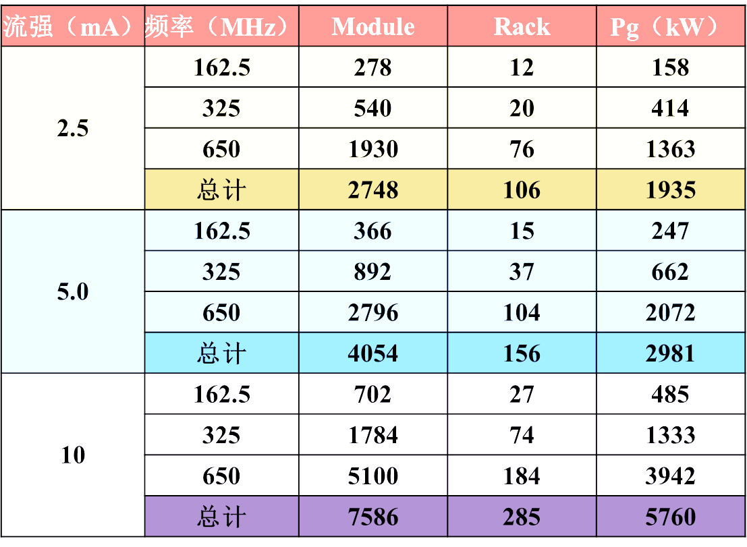
Requirements of SSA from beam dynamics
Notes:
According to the design of beam dynamics, whole project was divided into this phases based on the intensity,2.5, 5 and 10mA.

Slide 10
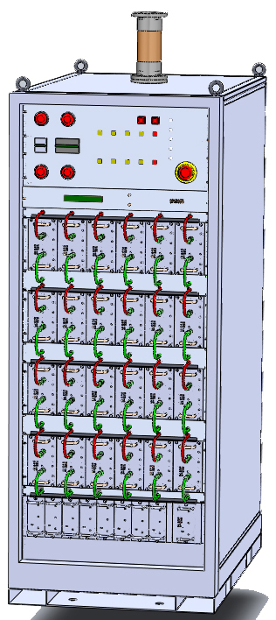
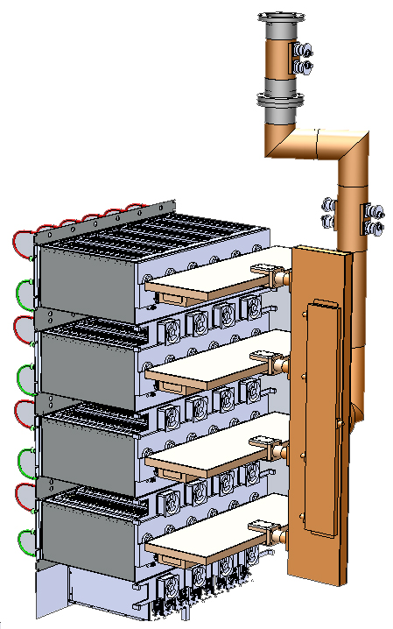
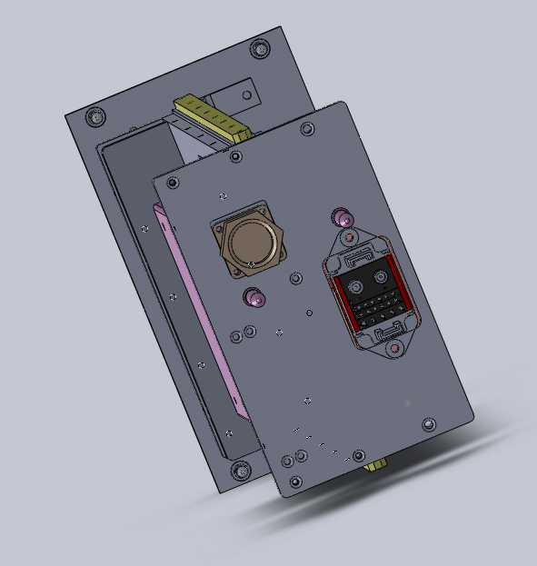
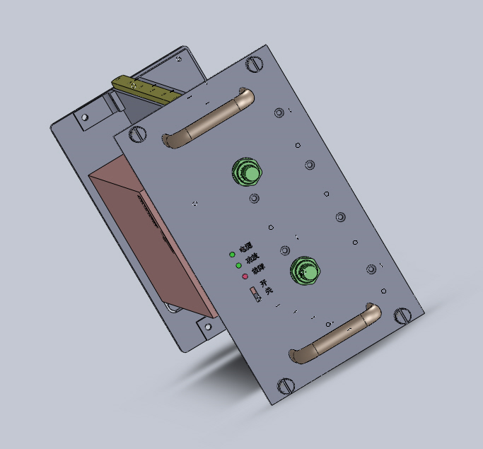
RF Modules and structure
6-way or 8-way combiner was designed in microstrip line.
Only two water fittings were put in front of module.
Four layers may be designed to operate independently.
P₋₁ power was defined for good linearity.
Current-sharing method.
Every module is 930W output.

Slide 11
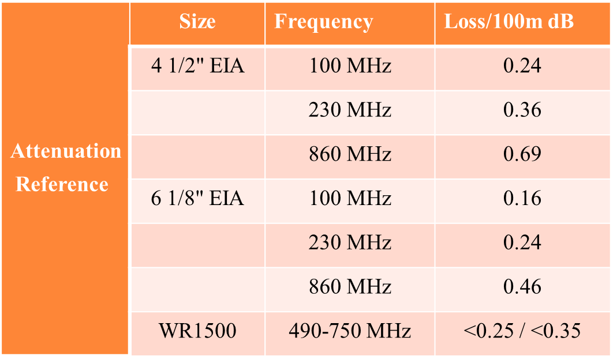
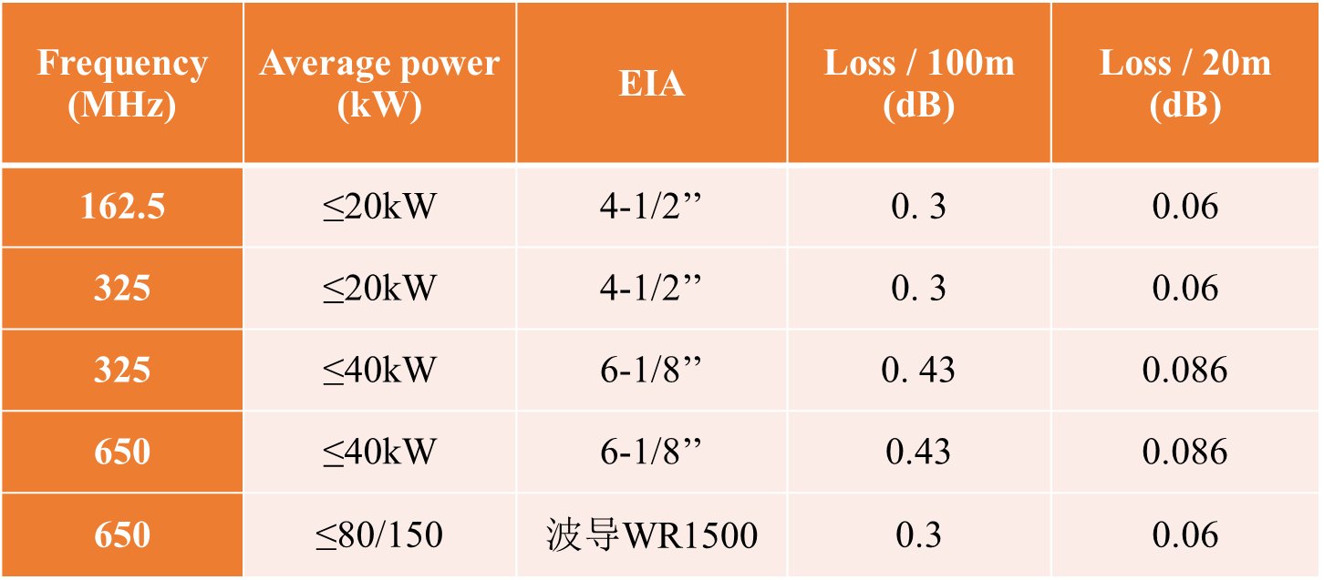
Characteristic of transmission line
The capacity of power and loss were estimated, the real power in cavities was confirmed according to the attenuation of trans. line and frequency fluctuation.

Slide 12
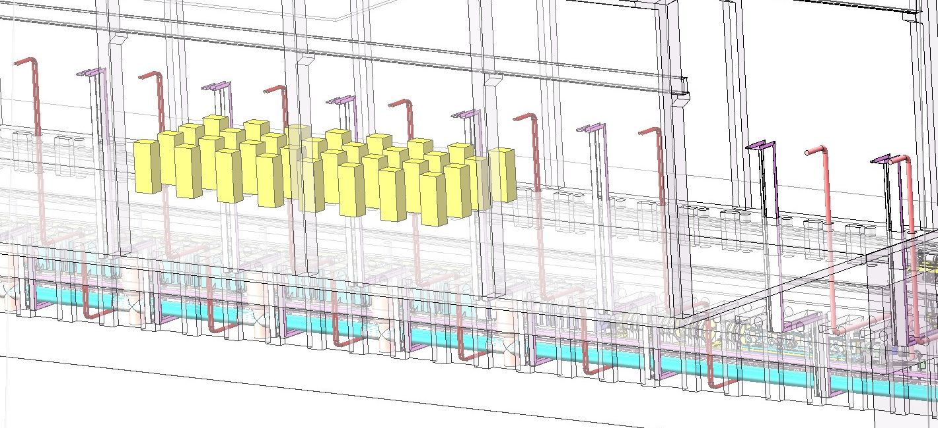
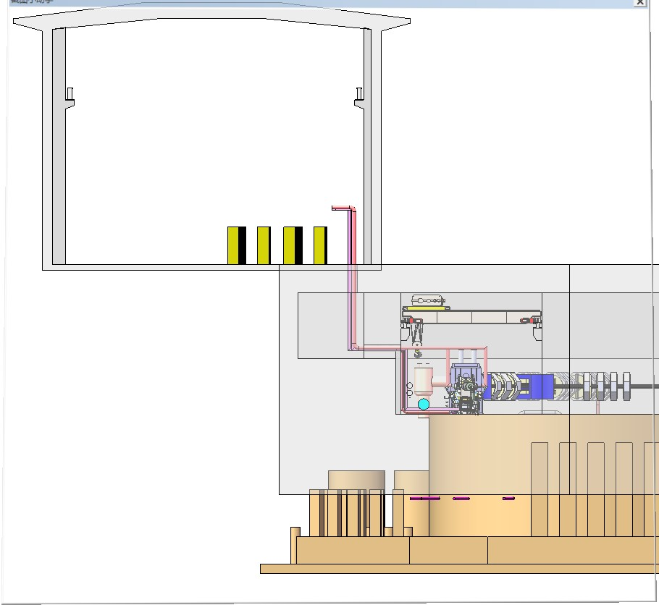
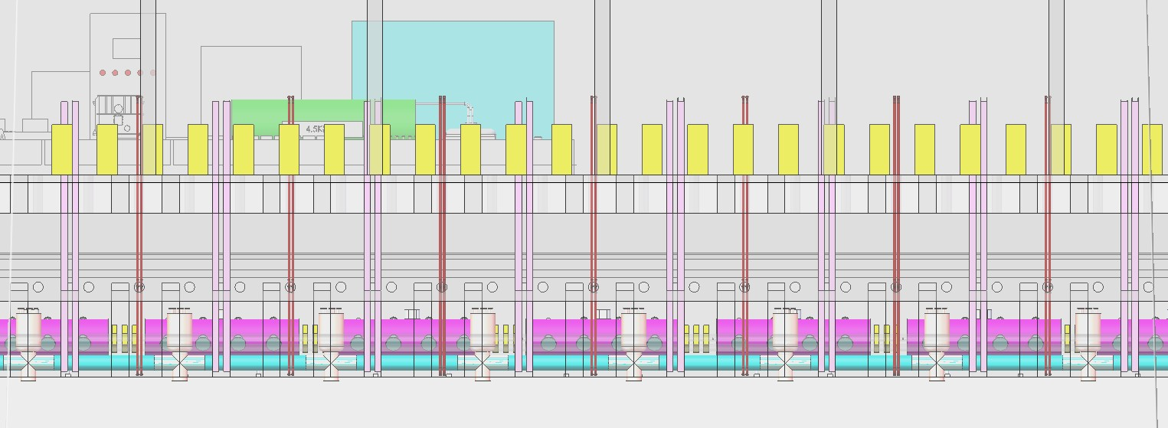
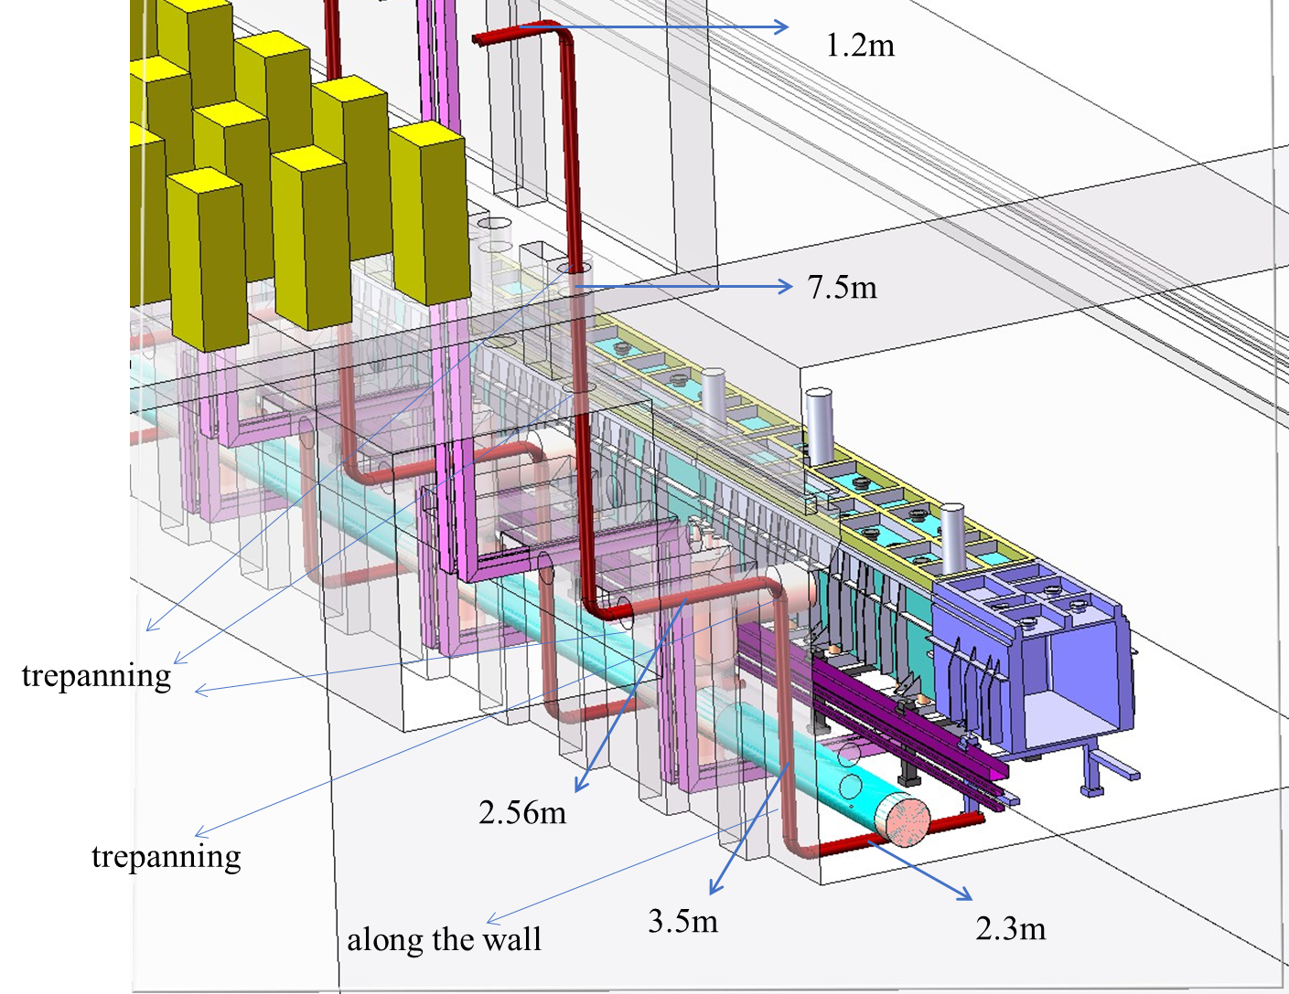
The layout of transmission line
All SSA racks are above sub-tunnel.
The length of every SSA should be controlled within 20 meters.
SSAs
Sub-tunnel
Transmission line
Main tunnel
Accelerator

Slide 13
Multi-levels of power with two kind of losses
Stage NO. of synthesizer | one | two | three
Synthesis loss | 5.6% | 2.3% | 2.3%
Loss of trans. Line and LLRF | 2.3%+5.0% | 2.3%+5.0% | 2.3%+5.0%
Number of modules | 6; 8 | 12; 14; 16 | 24; 26; 28; 30; 32
Output power （kW） | 4.7; 6.3 | 9.2; 10.7; 12.3 | 18.0; 19.5; 20.9; 22.5; 24.1
8-way combiner | 0.25dB
2-way combiner | 0.1dB
Stage NO. of synthesizer | one | two | three | four
Synthesis loss | 6.7% | 2.3% | 2.3% | 2.3%
Loss of trans. Line and LLRF | 2.3%+5.0% | 2.3%+5.0% | 2.3%+5.0% | 2.3%+5.0%
Number of modules | 6; 8 | 12; 14; 16 | 24; 26; 28; 30; 32 | 48; 52; 56; 60; 64
Output power （kW） | 5.2; 6.9 | 10.2; 11.8; 13.5 | 19.8; 21.4; 23.0; 24.7; 26.4 | 38.8; 41.8; 45.0; 48.3; 51.7
Stage Number of synthesizer | one | two | three | four | five
Synthesis loss | 7.7% | 2.3% | 2.3% | 2.3% | 2.3%
Loss of trans. Line and LLRF | 2.3%+5.0% | 2.3%+5.0% | 2.3%+5.0% | 2.3%+5.0% | 2.3%+5.0%
Number of modules | 6; 8 | 12; 14; 16 | 24; 26; 28; 30; 32 | 48; 52; 56; 60; 64 | 96; 104; 112; 120; 128
Output power （kW） | 5.1; 6.9 | 10.0; 11.7; 13.4 | 19.6; 21.2; 22.8; 24.4; 26.2 | 38.3; 41.4; 44.5; 47.8; 51.1 | 83.8; 90.2; 96.8; 103.6
Notes:
For LLRF, we must leave a margin to control and adjust the signal. And the attenuation of tran. Line can be estimated from the length and layout.

Slide 14
Requirements of Solid State Amplifier
 | Specification
Output power（P₋₁） | 6/8/14/16/24/…/32（162.5/325MHz）≤150kW（650MHz）
Operation mode | CW、Pulse
Reflection | Full power reflection on arbitrary phase
-1dB bandwidth（MHz） | ±5
Amplitude stability（open loop） | 1%
phase stability（open loop） | ±5°
Noise suppression | -70 dBc，BW=1kHz
Harmonic suppression | -40 dBc
VSWR | ≤ 1.2
Efficiency（%） | 55（162.5）、50（325）、45（650）
RF leakage | ≤0.2mW/cm² @30cm
Warm-up time | ≤5min
Stable operation | ＞20000h

Slide 15
The solution to some problems
SSA for high power cavity
High-precision power detection
Maintainability and yield stress

Slide 16
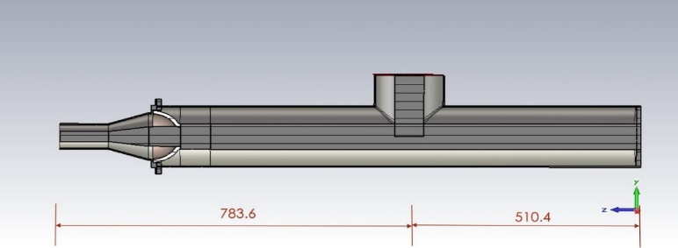
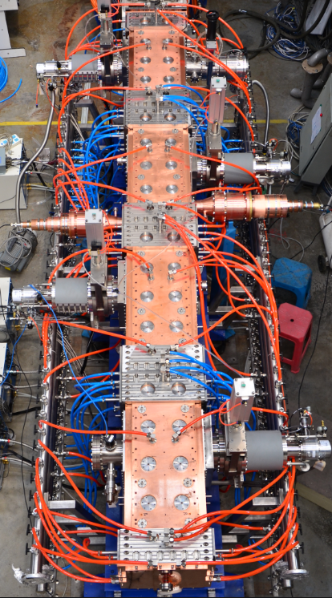
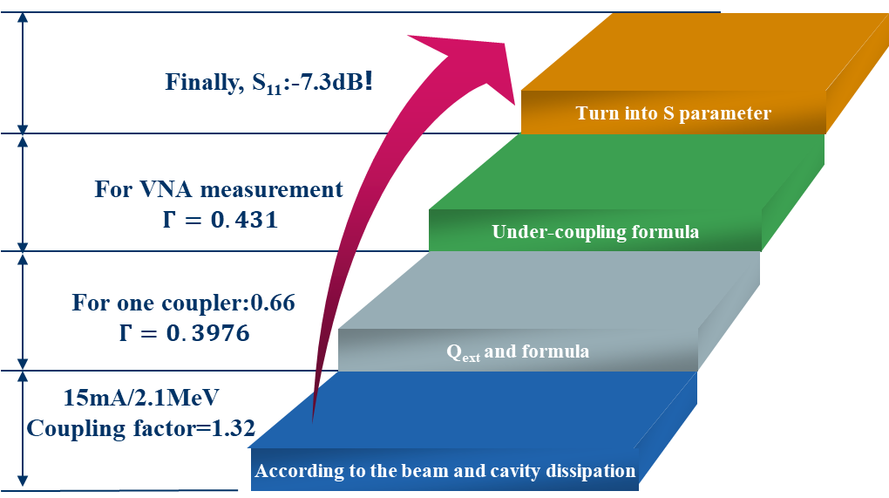
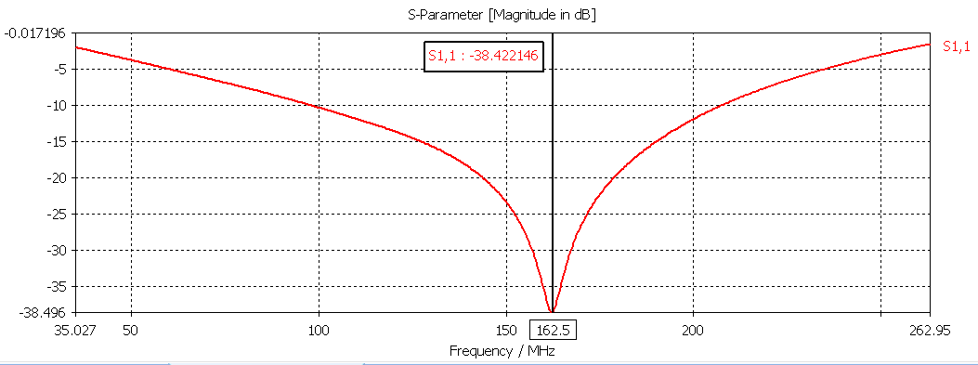
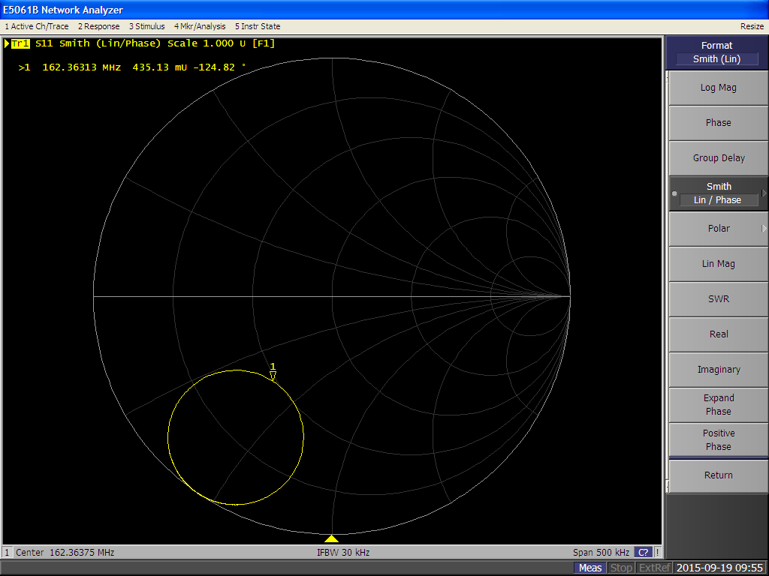
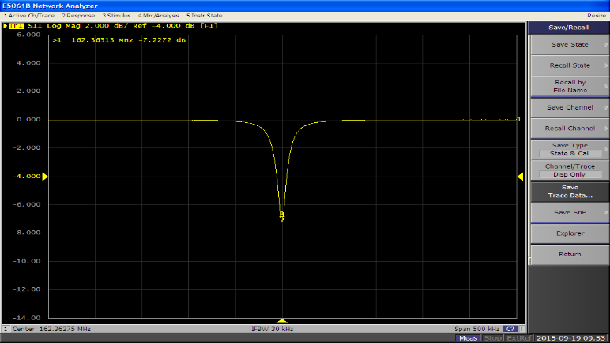
For RFQ: multi-port coupling configuration
RFQ cavity
Coupler design
Two-port
configuration
Coupler measurement
Smith chart

Slide 17
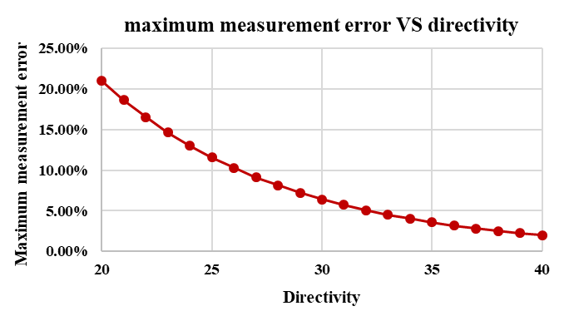
Directional coupler
Power (full reflection)（kW） | 10/20/40/60
Frequence + bandwidth（MHz） | 162.5/325 ± 10
Size | 3 1/8” or 4 1/2”
Coupling(dB) | 50 - 60
Directiveity(dB) | ≥ 35
Power (full reflection)（kW） | 180
Frequence + bandwidth（MHz） | 650 ± 10
Size | WR1500
Coupling(dB) | 50 - 60
Directiveity(dB) | ≥ 35

Slide 18
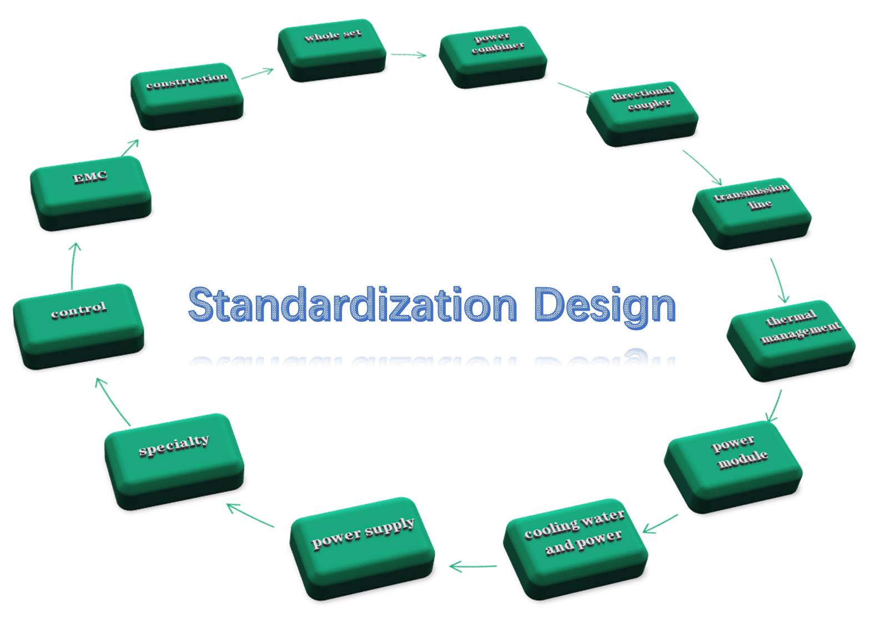
New design——SSA standardization
Frequency （MHz） | Power of module (P-1) | circulator | efficiency
162.5 | 900W | single | 70%
325 | 1000W | double | 65%
650 | 1000W | double | 60%
More work to do according to the previous experiences. The first step to interchange the power modules on site, especially they come from different manufacturers.
Output VSWR | ≤ 1.2
Gain（p-1） | 36±0.3dB
Insertion phase | 180°±5°
Anti-reflection | 1.5 times（CW）and 4 times（1mS pulse width）
Notes:
We plan to design deeply for whole ssa system, incluing ….. We called this standardization of ssa.
We can continue this work according to many experiences from previous ads project
The first step is to interchange the power module on site, especially they come from different manufacturers.

Slide 19
Summary
  The specific requirements of SSAs were designed;
  A flexible design based on too many power level;
  RF structure based on the flexible design;
  Every module was restricted with its gain and phase result;
  For high power demand on SSA, multi-port coupling method is a good option;
  High-precision power detection during the full power reflection;
  The solution to maintainability and yield stress.

Slide 20
Thank you!

Slide 21
