Slide 1
ESS TEST STAND 2, work PLAN
Nuno ELIAS
Lead Engineer
European Spallation Source ERIC
27-September-2019, SLHIPP9 - LANZHOU

Slide 2
The ESS Accelerator
 | Length (m) | W_in (MeV) | F (MHz) | β Geometric | No. Sections | T (K)
LEBT | 2.38 | 0.075 | -- | -- | 1 | ~300
RFQ | 4.6 | 0.075 | 352.21 | -- | 1 | ~300
MEBT | 3.81 | 3.62 | 352.21 | -- | 1 | ~300
DTL | 38.9 | 3.62 | 352.21 | -- | 5 | ~300
LEDP + Spoke | 55.9 | 89.8 | 352.21 | 0.50 (Optimum) | 13 | ~2
Medium Beta | 76.7 | 216.3 | 704.42 | 0.67 | 9 | ~2
High Beta | 178.9 | 571.5 | 704.42 | 0.86 | 21 | ~2
Contingency | 119.3 | 2000 | 704.42 | (0.86) | 14 | ~300 / ~2
Key parameters
Protons (H+)
5 MW
2.86 ms pulses
14 Hz
2 GeV
62.5 mA peak
Low losses
Minimize energy use
Flexible design for future upgrades

Slide 3
Cryomodule InKind model
 | Spokes | Elliptical
# | 13 | 9 (medium beta) + 21 (high beta)
Assembled | IPNO (France) | CEA (France)
testing* | - | CEA (France)
Acceptance testing | FREIA TS (Sweden) | ESS TS2 (Sweden)
Final commissioning and Operation | ESS LINAC (Sweden) | ESS LINAC (Sweden)

Slide 4
ESS Test Stand 2
The Test Stand 2 allows for testing of elliptical cryomodules of both families (MB and HB)
It is used for the site acceptance testing (SAT) of all Elliptical cryomodules and preparation for tunnel installation
Once ESS enters nominal operation the test stand will remain for testing of cryomodules that have to undergo repair or maintenance outside the tunnel.
It mainly consists of a RP bunker, a test stand cryoplant and RF power sources and distribution.
Testing can be performed with full cryogenic load, at final operating temperature and full RF load in all 4 cavities in parallel.
The test stand is located in G02 building (end of klystron gallery)

Slide 5
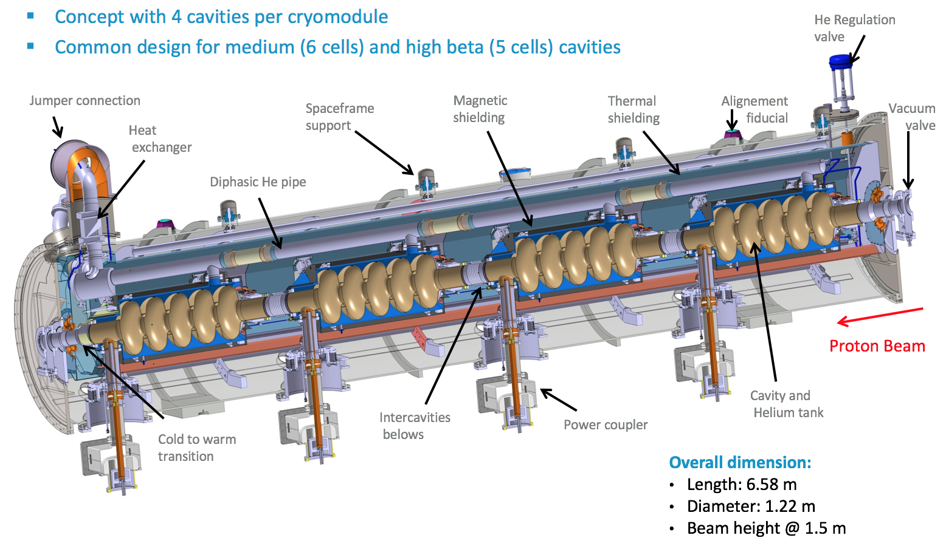
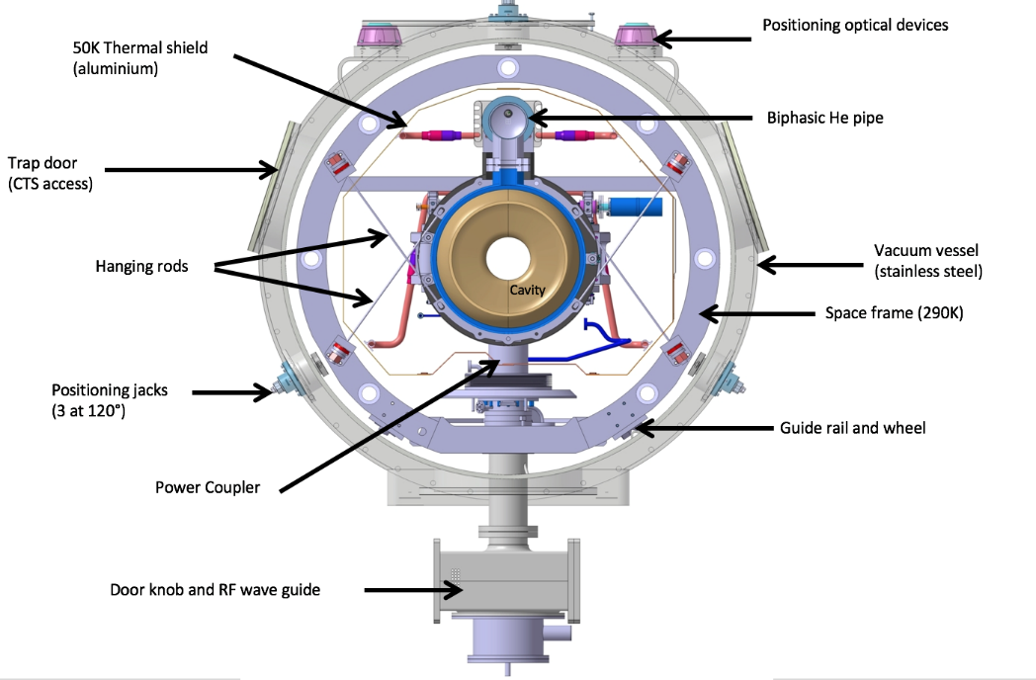
Elliptical Cryomodule

Slide 6
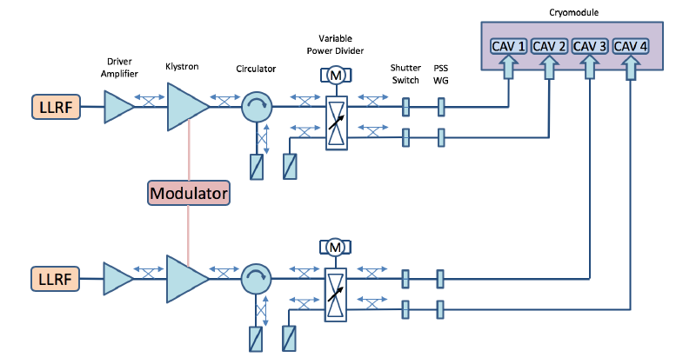
RF system
The system operates at 704.42 MHz and it is pulsed at 14 Hz with maximum pulse length of 3.5ms. The RF drive is supplied by LLRF system and amplified by solid state driver amplifier up to 100 W peak. The klystron output peak power is 1.5 MW. After going through circulator, that power is divided by the variable power divider to feed two SC cavities from each klystron.

Slide 7
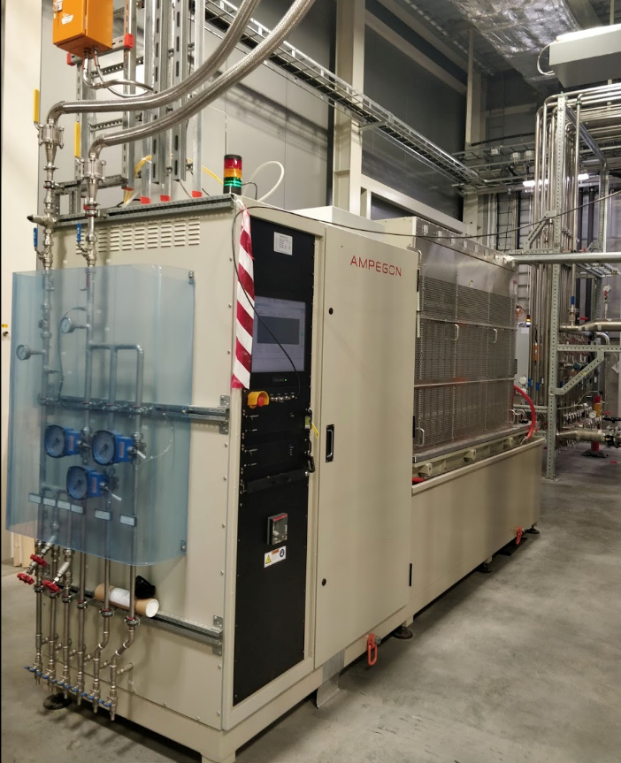
RF System ; Modulator
Modulator:
AMPEGON: High Voltage Power Supply SHV-115kV-50A
The High-Voltage Power Supply System delivers pulsed power in continuous or single-shot mode to one or two klystrons.
Technical Data | Value
Nominal Pulse voltage amplitude | -115 kV
Nominal Pulse current amplitude | 50 A
Nominal Pulse power amplitude | 5.75 MW
Nominal Pulse repetition rate | 14 Hz
Nominal Pulse width | 3.5 ms
Pulse rise time (0…99%) | 77us
Pulse fall time (100…10%) | 35 us
Flat top duration | > 3.3 ms
Energy in case of arc | < 6 J
Efficiency at nominal conditions | >89 %
Input voltage | 400 V ± 10%

Slide 8
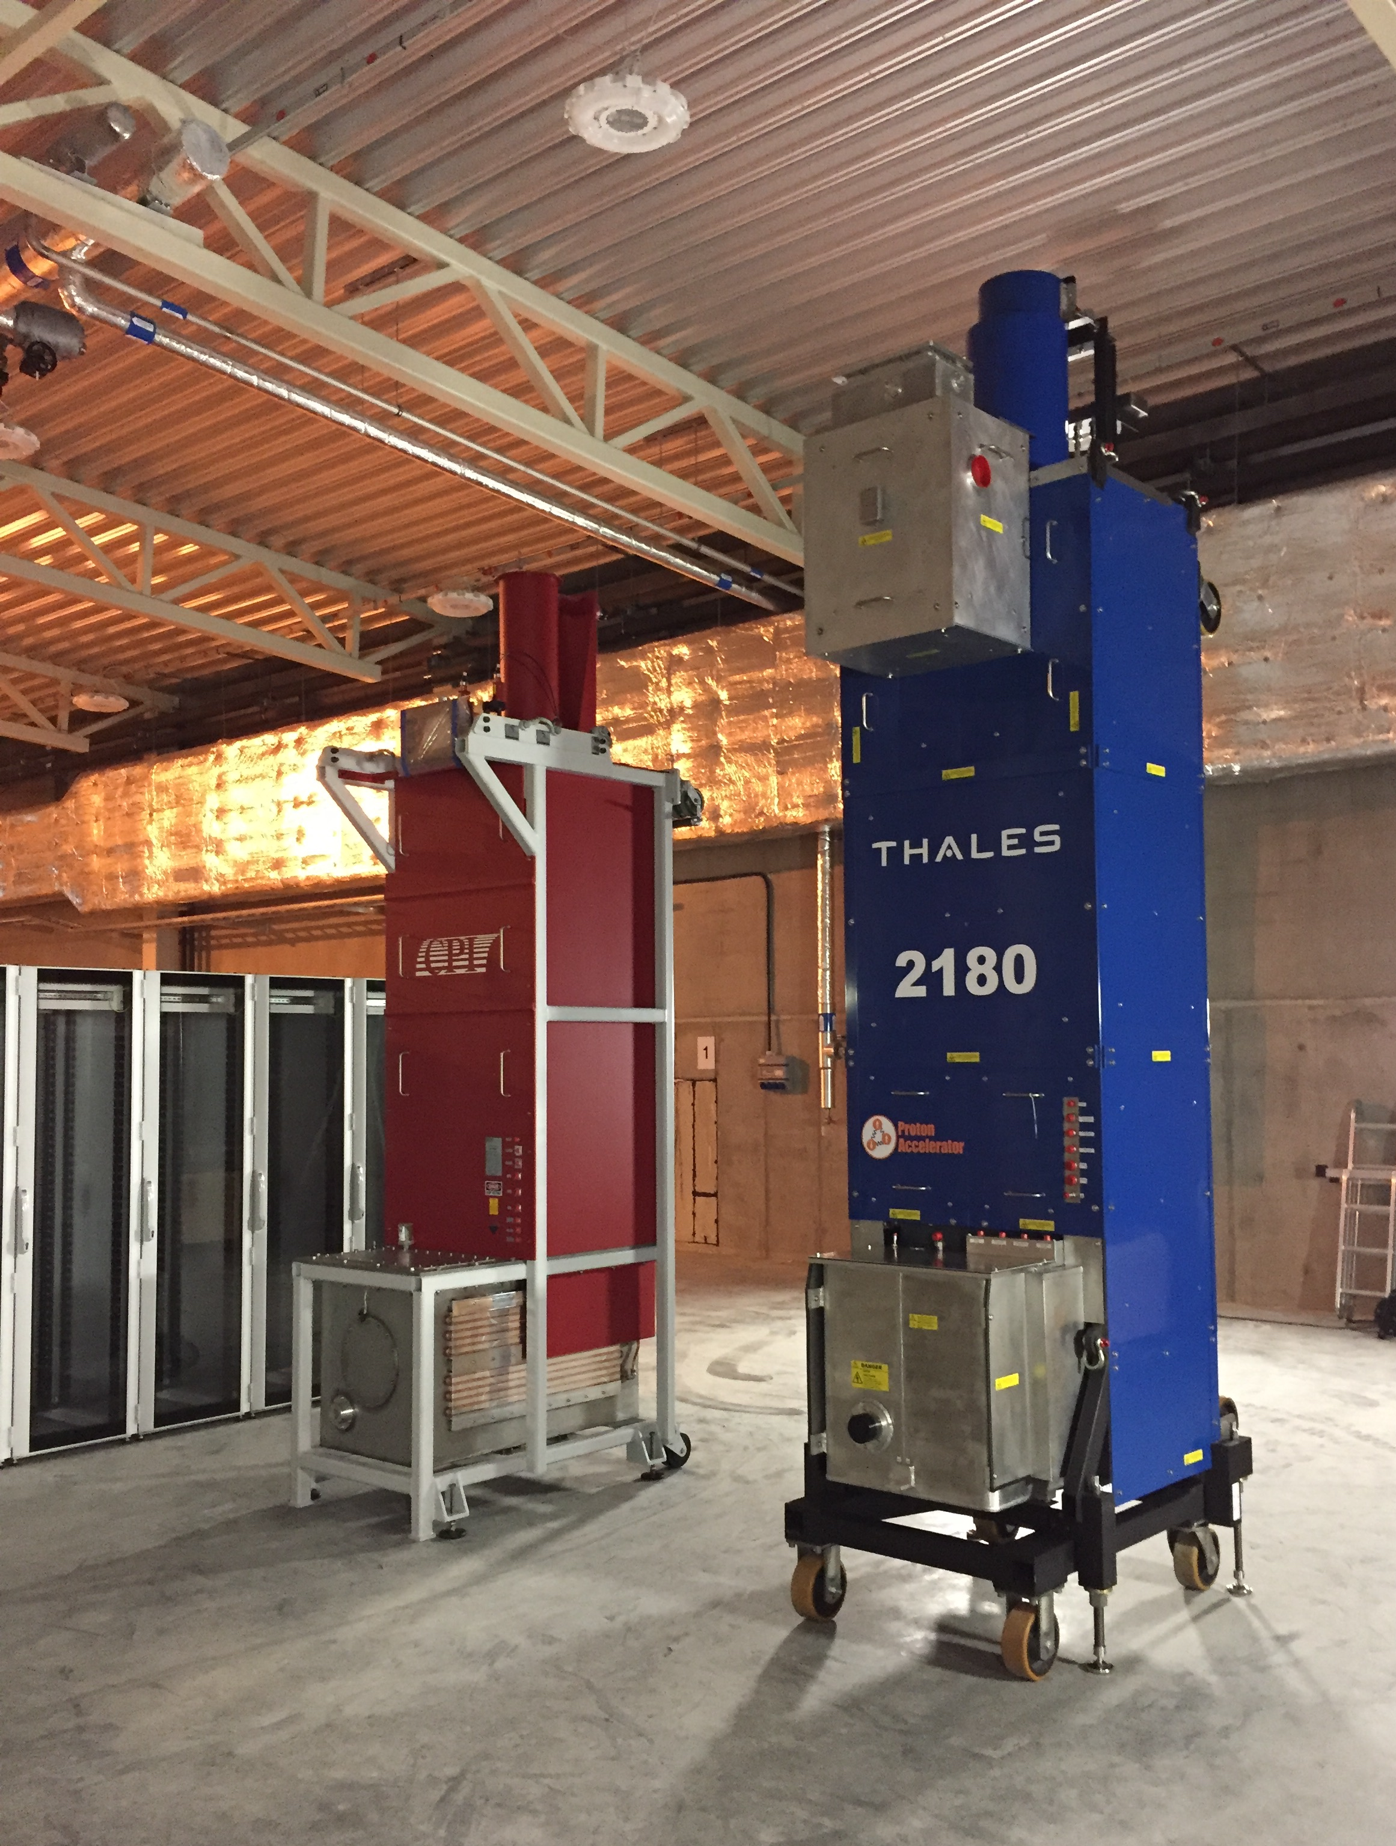
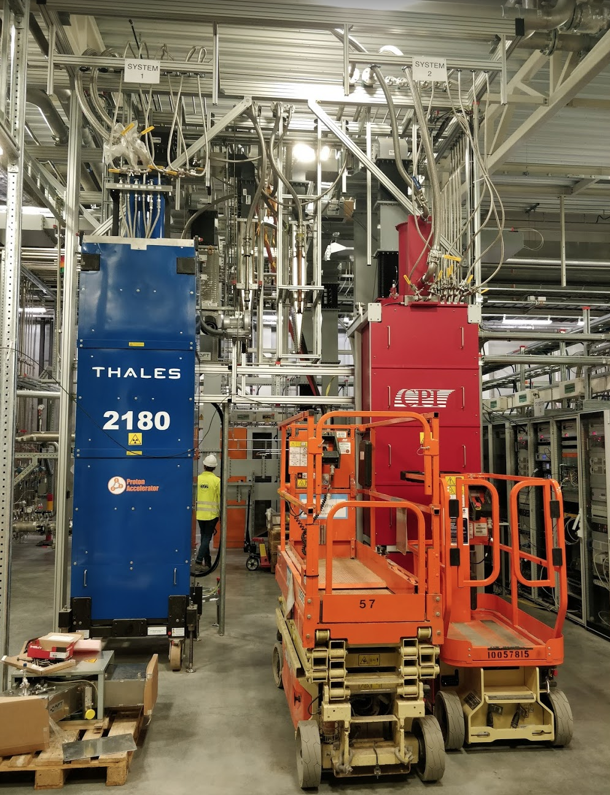
RF System: Klystrons
Klystron 1:
1.5 MW 704MHz PULSED KLYSTRON FOR ESS: THALES TH2180
Klystron 2:
1.5 MW 704MHz PULSED KLYSTRON FOR ESS: CPI VKP-8292A

Slide 9
Test Stand 2: views

Slide 10
Test Stand 2: views

Slide 11
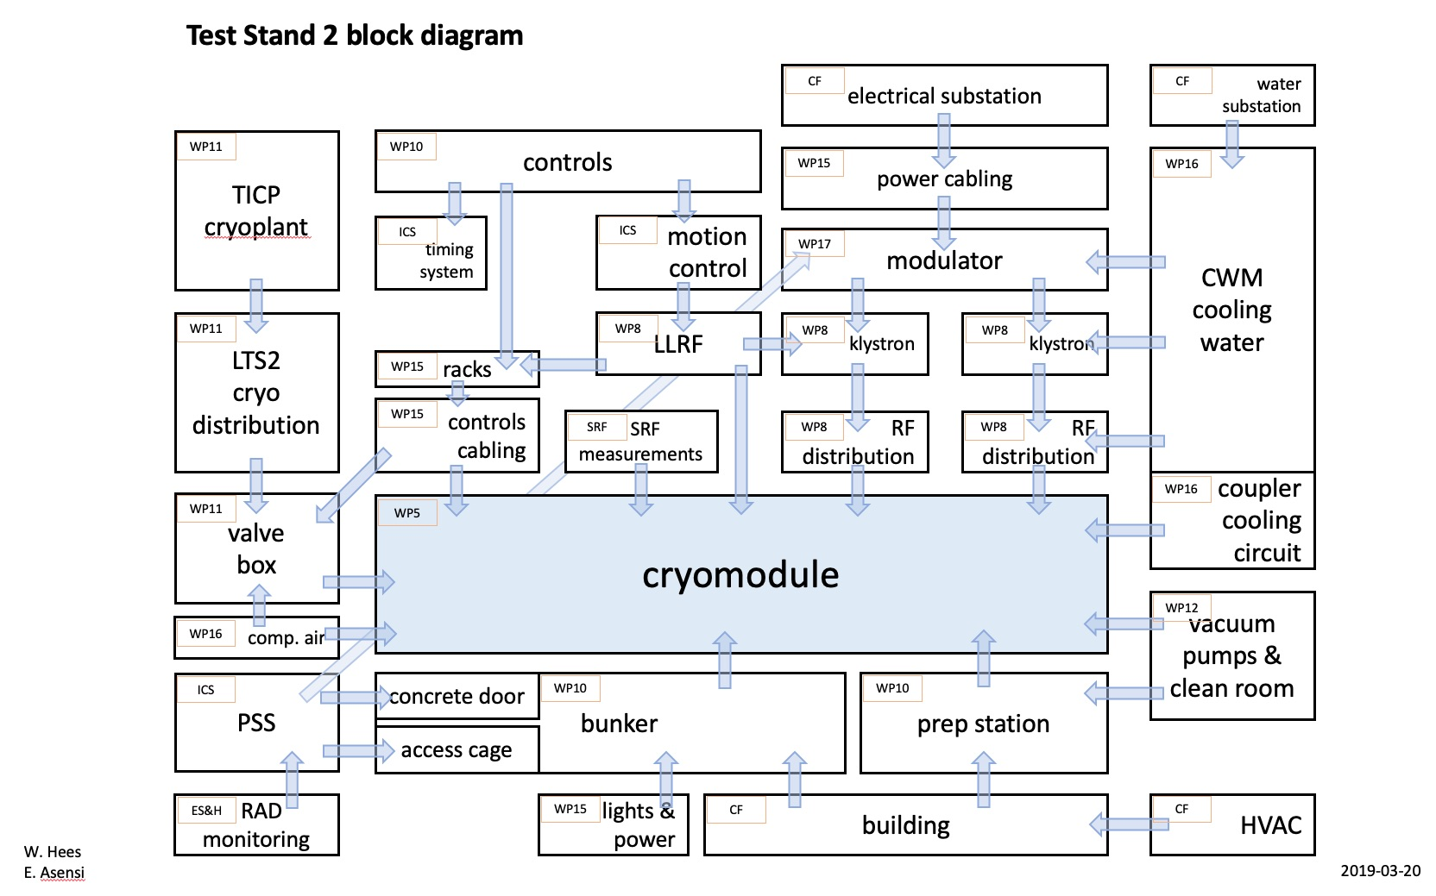
Test Stand 2: bloc diagram

Slide 12
ESS TS2 floorplan and CM flow
Reception Area
10 meter
Control Room
RF Stations
Preparation
Area
Test Area

Slide 13
Cryomodule Workflow: 9 steps
1)
Reception
2)
Preparations
3)
Installation
4)
Warm tests
5)
Cold tests
6)
Warm-up
7)
Disconnection
8)
Preparations
9)
Dispatch
1
days
3 to 4
days
2 to 3
days
3 to 5
days
8 to 10
days
2 to 3
days
1 to 2
days
4
days
1
day
Reception
Area
Preparation
Area
Bunker Test
Area
Preparation
Area
Reception
Area
Aimed Cryomodule Throughput = 1 per month

Slide 14
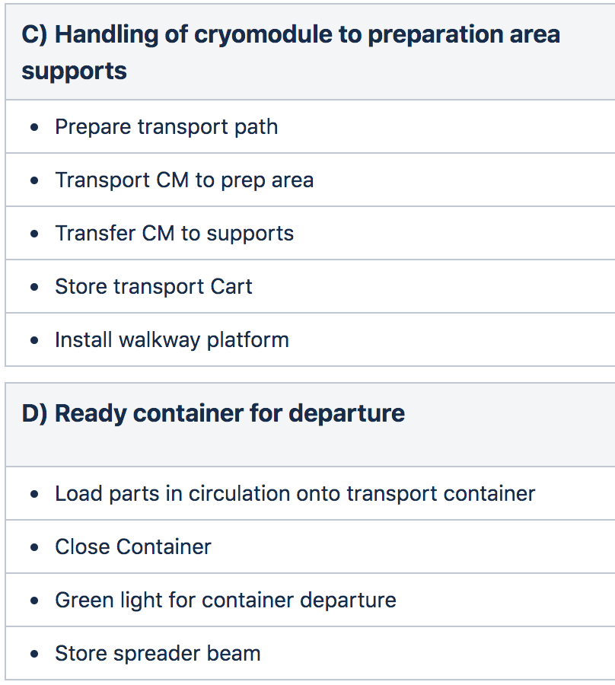
Cryomodule reception
1)
Reception
2)
Preparations
3)
Installation
4)
Warm tests
5)
Cold tests
6)
Warm-up
7)
Disconnection
8)
Preparations
9)
Dispatch

Slide 15
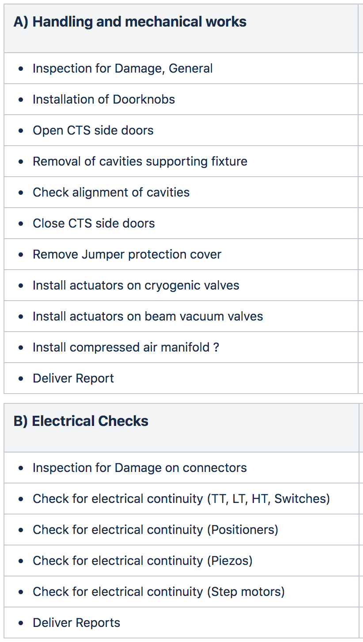
Cryomodule preparations for bunker
1)
Reception
2)
Preparations
3)
Installation
4)
Warm tests
5)
Cold tests
6)
Warm-up
7)
Disconnection
8)
Preparations
9)
Dispatch

Slide 16
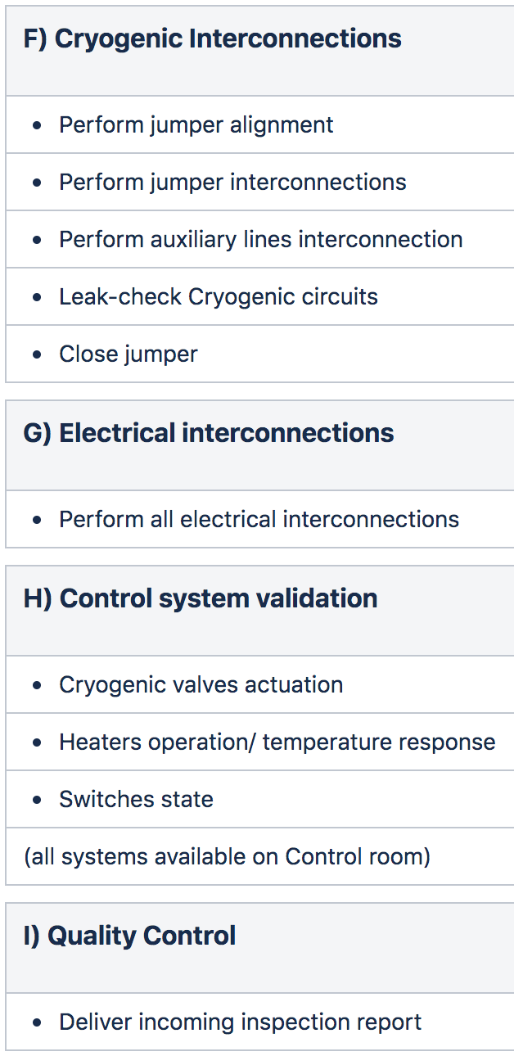
Cryomodule installation in bunker
1)
Reception
2)
Preparations
3)
Installation
4)
Warm tests
5)
Cold tests
6)
Warm-up
7)
Disconnection
8)
Preparations
9)
Dispatch

Slide 17
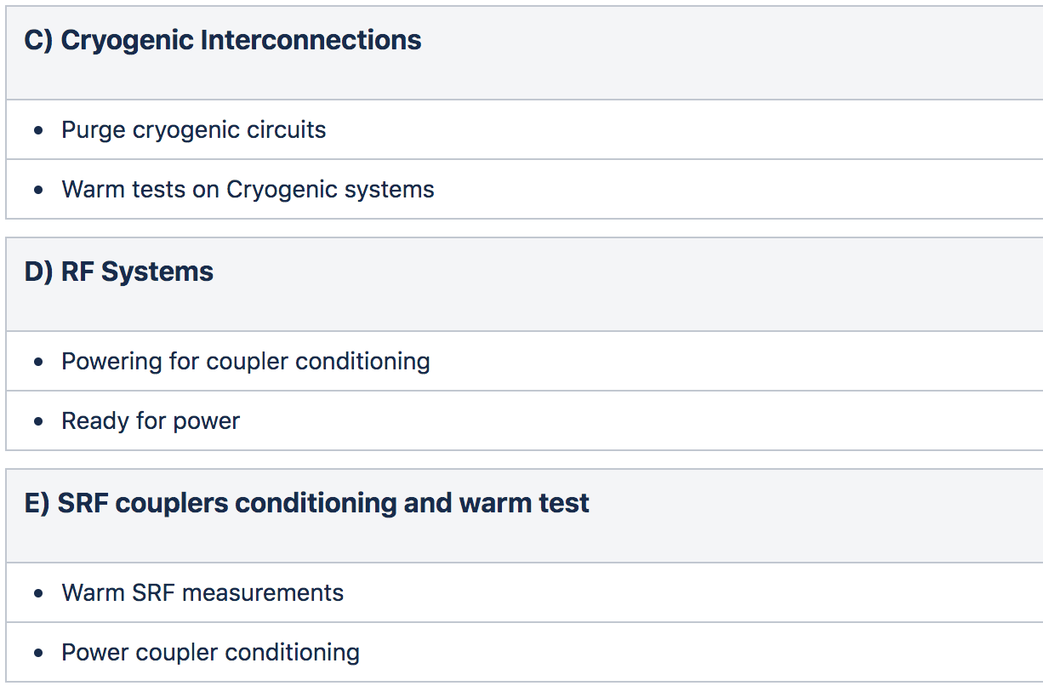
Warm tests in bunker
1)
Reception
2)
Preparations
3)
Installation
4)
Warm tests
5)
Cold tests
6)
Warm-up
7)
Disconnection
8)
Preparations
9)
Dispatch

Slide 18
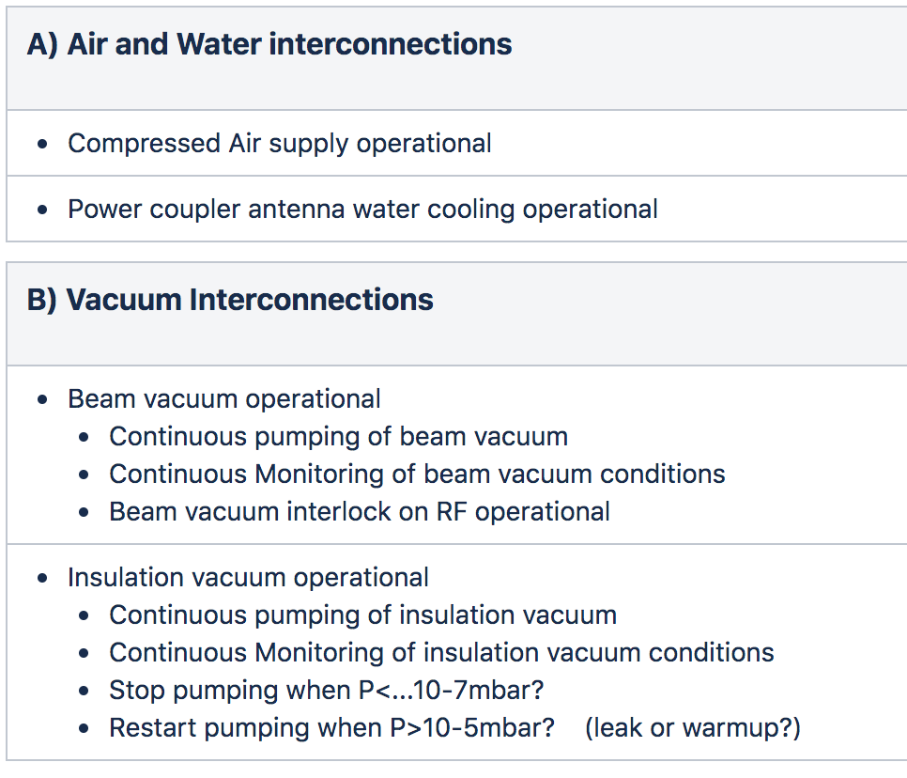
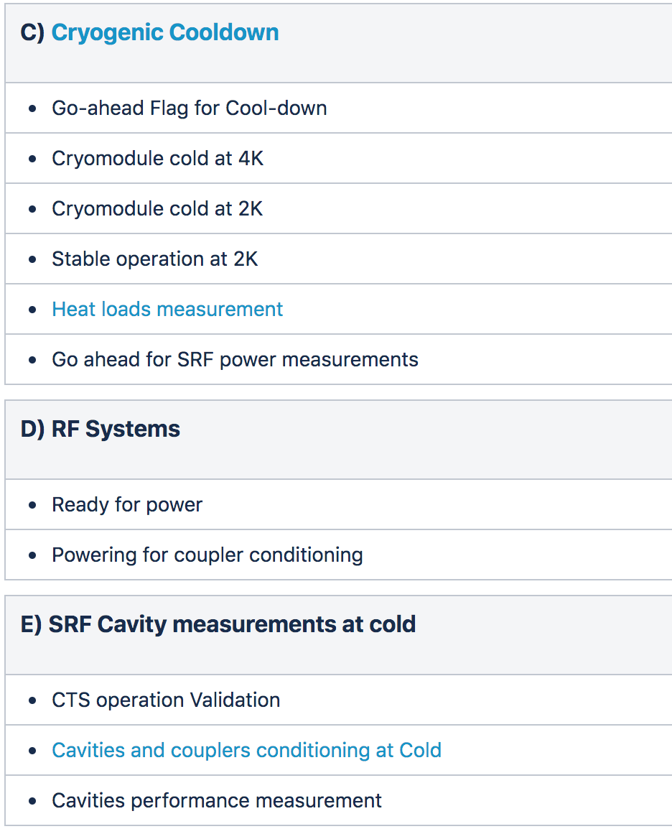
Cold tests in bunker
1)
Reception
2)
Preparations
3)
Installation
4)
Warm tests
5)
Cold tests
6)
Warm-up
7)
Disconnection
8)
Preparations
9)
Dispatch

Slide 19
Cryomodule Warm-up
1)
Reception
2)
Preparations
3)
Installation
4)
Warm tests
5)
Cold tests
6)
Warm-up
7)
Disconnection
8)
Preparations
9)
Dispatch

Slide 20
Cryomodule disconnection from bunker
1)
Reception
2)
Preparations
3)
Installation
4)
Warm tests
5)
Cold tests
6)
Warm-up
7)
Disconnection
7)
Disconnection
8)
Preparations
9)
Dispatch

Slide 21
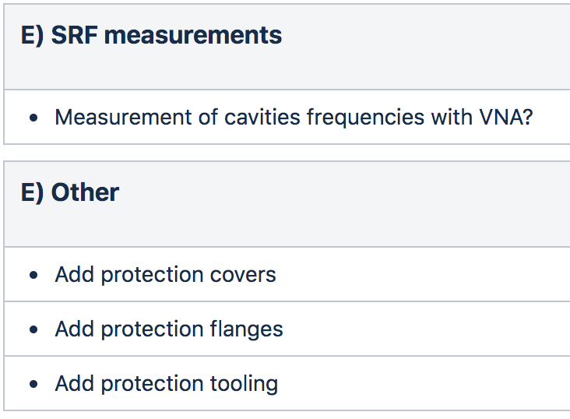
Preparations for dispatch and tunnel
1)
Reception
2)
Preparations
3)
Installation
4)
Warm tests
5)
Cold tests
6)
Warm-up
7)
Disconnection
8)
Preparations
8)
Preparations
9)
Dispatch

Slide 22
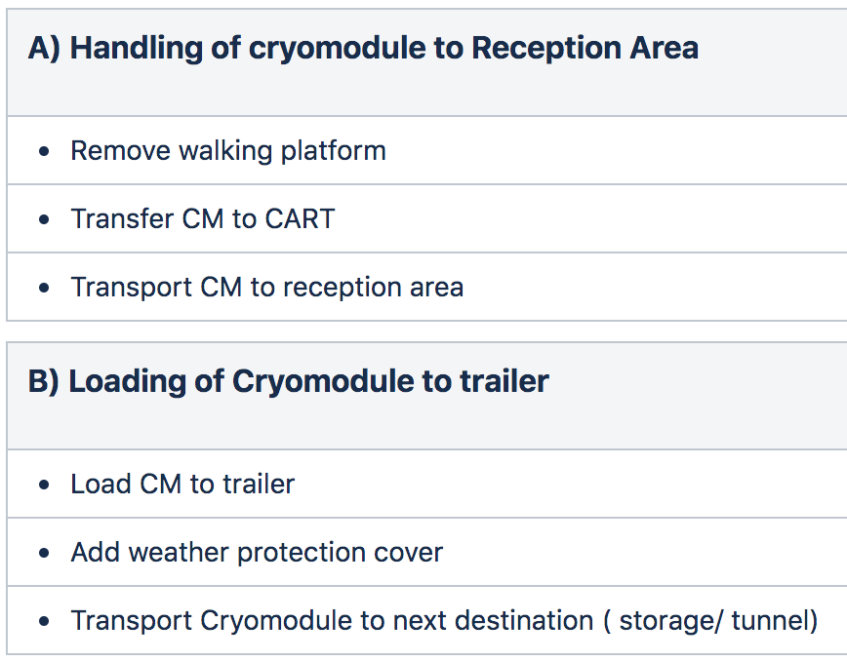
Dispatch of cryomodule to tunnel
1)
Reception
2)
Preparations
3)
Installation
4)
Warm tests
5)
Cold tests
6)
Warm-up
7)
Disconnection
8)
Preparations
9)
Dispatch
9)
Dispatch

Slide 23
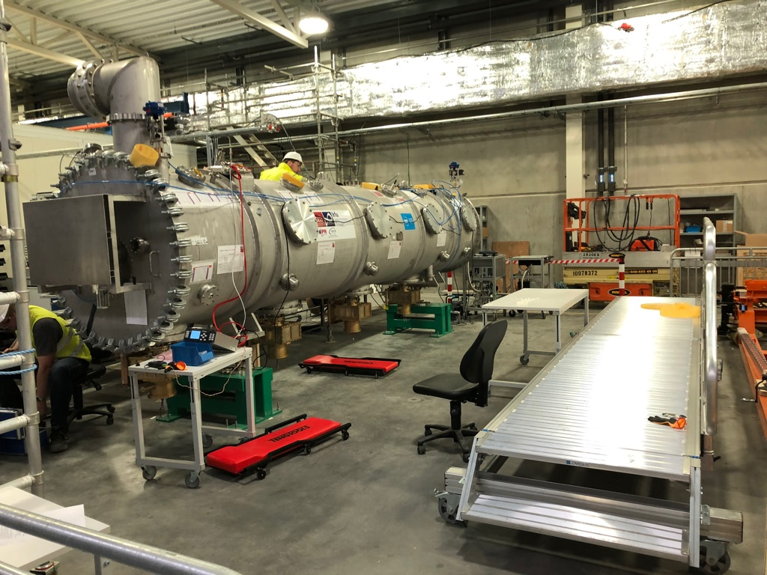
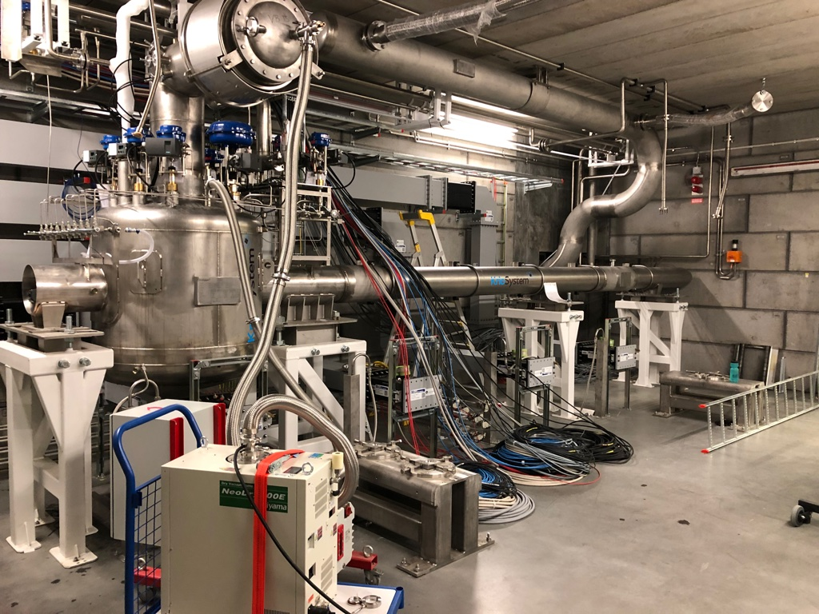
CM views: Preparation, Valve box and CDS

Slide 24
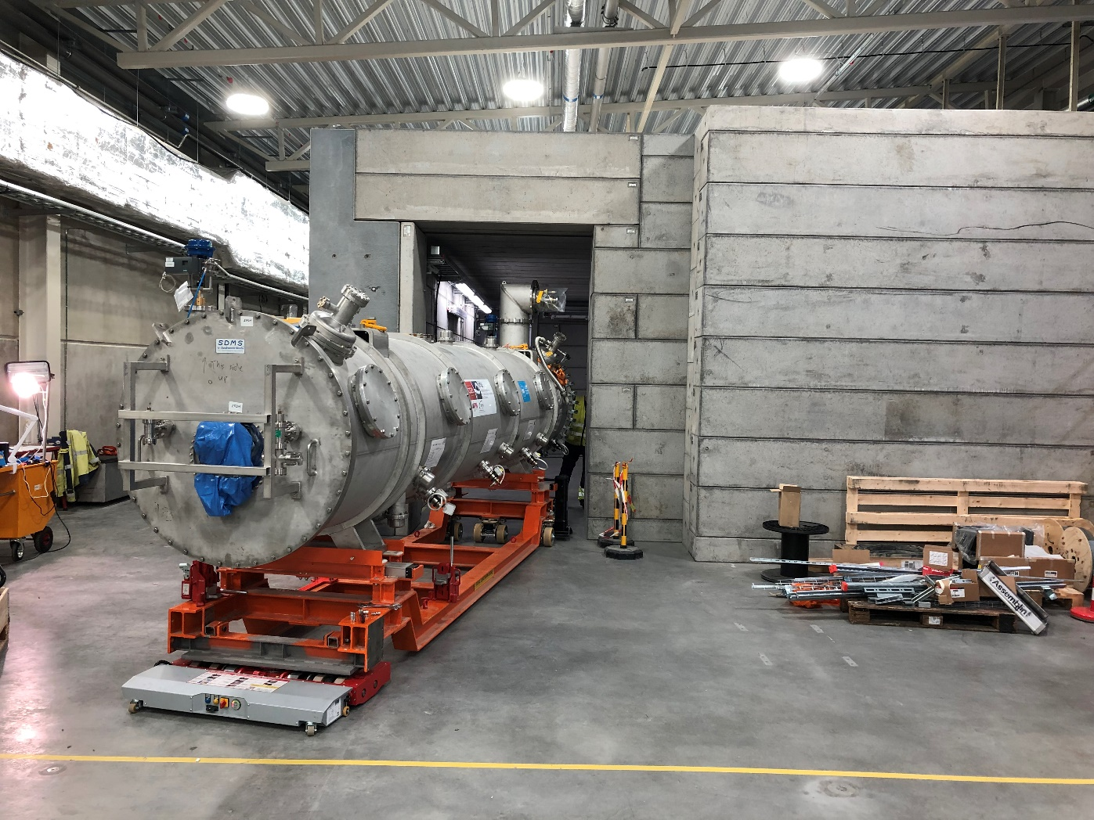
Cryomodule installation in bunker

Slide 25
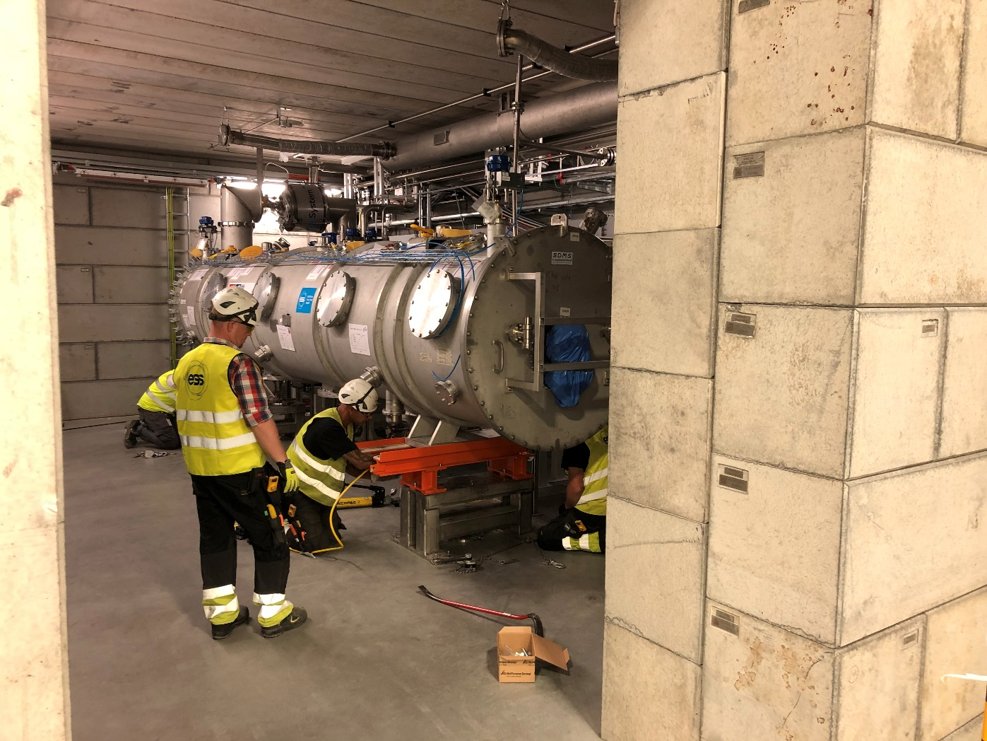
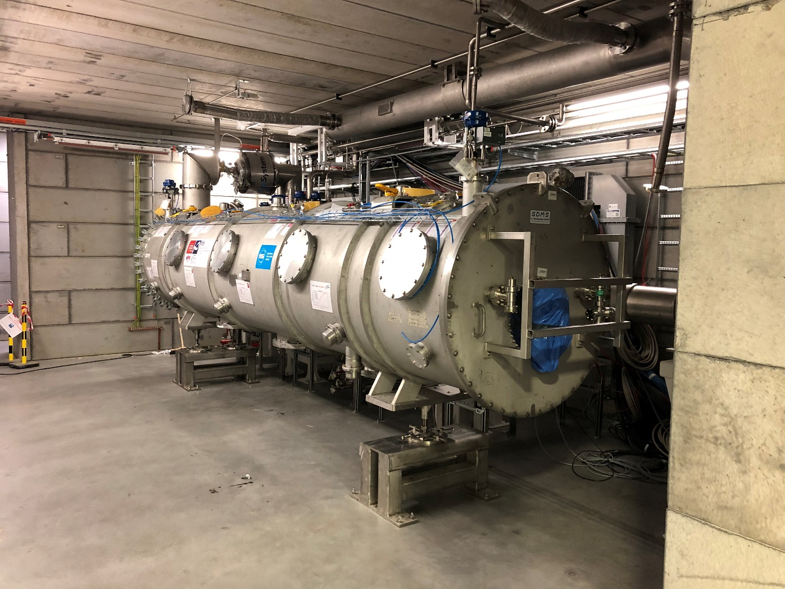
Cryomodule installation in bunker

Slide 26
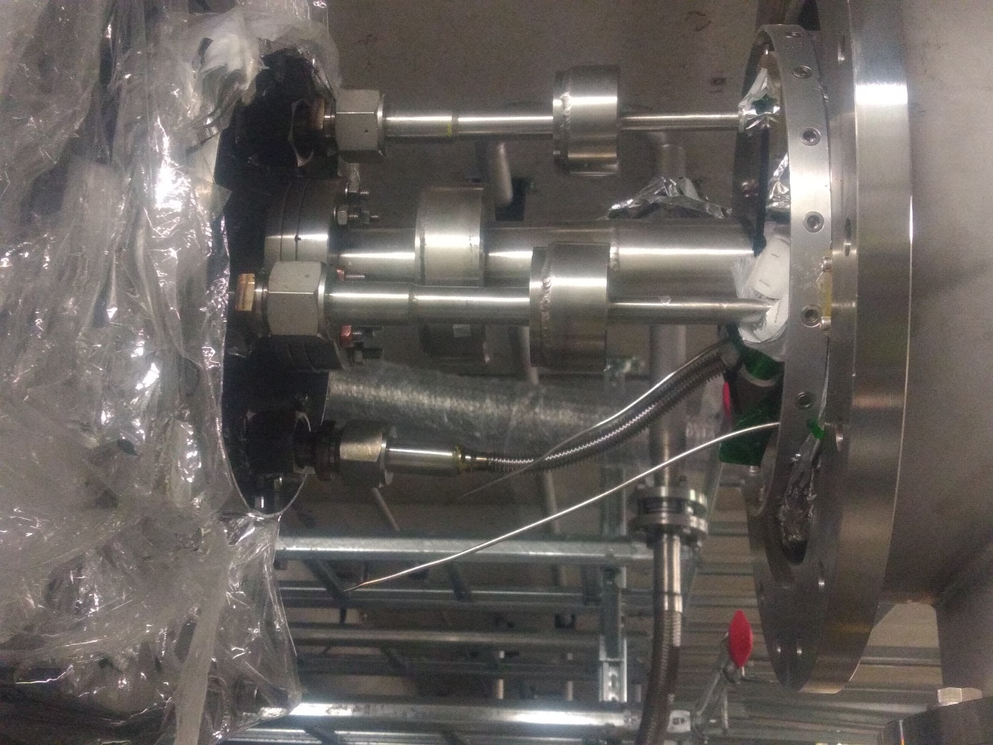
Cryomodule installation in bunker, Interconnections

Slide 27
Current status
M0, Elliptical CM technical demonstrator (prototype) is in the TS2 bunker, preparations for cooldown are underway.
M0 is ‘almost’ a replica of the series CM, at least in functionality.
M0 has extra diagnostics
M0 arrived in CEA post test configuration
Series CMs have design improvements
Some of the Series CMs mechanical interfaces are different (connectors, flanges, valves)
M1 is scheduled to arrive at the end of the year
TS2 is gearing up for 2 ‘different’ CM and allow a relatively ‘easy’ transition

Slide 28
Conclusion
ESS TS2 workflow and plan was presented
We are now facing an extremely intense period of activities where,
ESS teams are getting ‘hands-on’ training with the prototype cryomodule while
Getting TS2 in shape for the very intense testing phase of the next 9+21 cryomodules
Thank you for your attention
Thanks also to all the TS2 team, SRF section and supporting groups.

