Slide 1
A Design of kW Solid State Power Amplifier to be used for Optimal Charging of Superconducting Cavities
L. Hoang Duc, A. Bhattacharyya, A. Rydberg, R. Ruber, J. Olsson, D. Dancila
FREIA Laboratory, Uppsala University, Sweden

Slide 2
Outline
Step Charging and Optimal Charging Schemes of RFSuperconducting (SC) Cavities
Motivation
Implementation of Envelope Tracking (ET) Amplifiers Using Optimal Charging Scheme
Conclusion

Slide 3
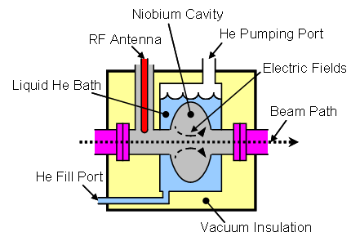
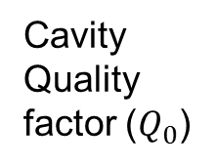


RF SUPERCONDUCTING CAVITIES
$$E^{−}$$
$$E^{+}$$
Reflection
Cavity Quality factor ($Q_{0}$)

Slide 4
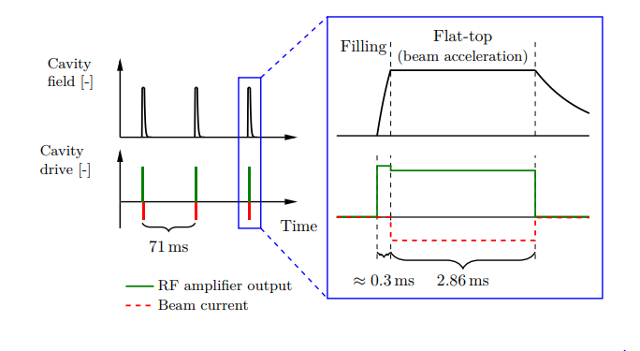
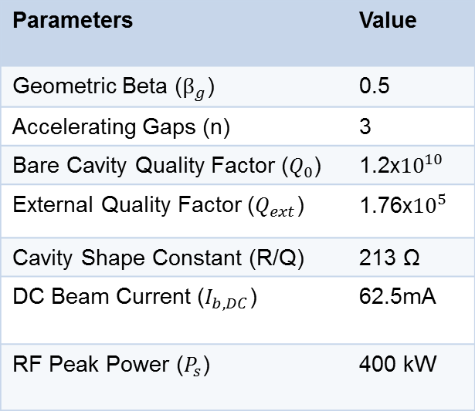
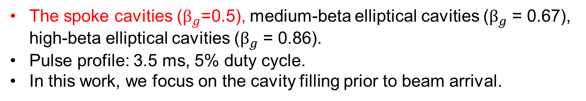
ESS SUPERCONDUCTING CAVITIES
Parameters | Value
Geometric Beta ($β_{g}$) | 0.5
Accelerating Gaps (n) | 3
Bare Cavity Quality Factor ($Q_{0}$) | 1.2x${10}^{10}$
External Quality Factor ($Q_{ext}$) | 1.76x${10}^{5}$
Cavity Shape Constant (R/Q) | 213 Ω
DC Beam Current ($I_{b,DC}$) | 62.5mA
RF Peak Power ($P_{s}$) | 400 kW
3.5 ms
Step Charging Scheme
Pulse Structure of ESS SC Cavities
(Courtesy of Olof Troeng)
The spoke cavities ($β_{g}$=0.5), medium-beta elliptical cavities ($β_{g}$ = 0.67), high-beta elliptical cavities ($β_{g}$ = 0.86).
Pulse profile: 3.5 ms, 5% duty cycle.
In this work, we focus on the cavity filling prior to beam arrival.
(*) ESS = European Spallation Sources

Slide 5
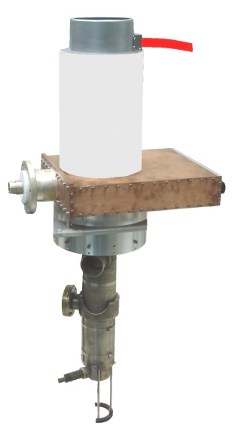
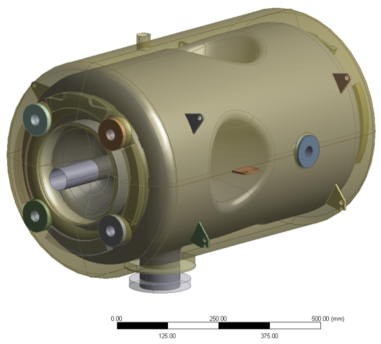
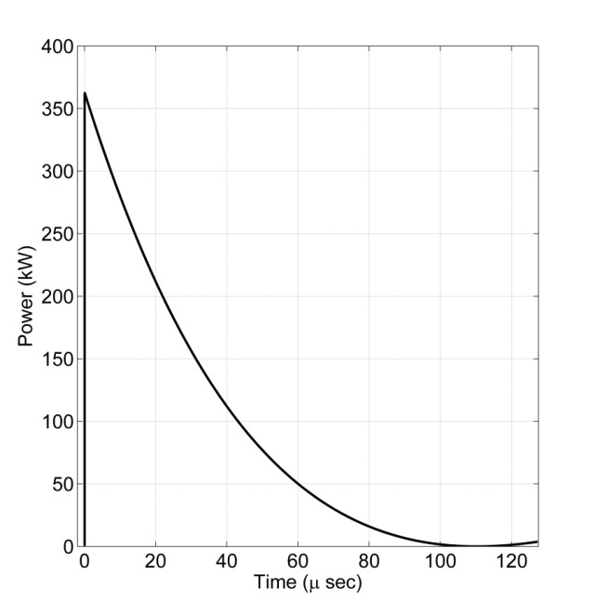
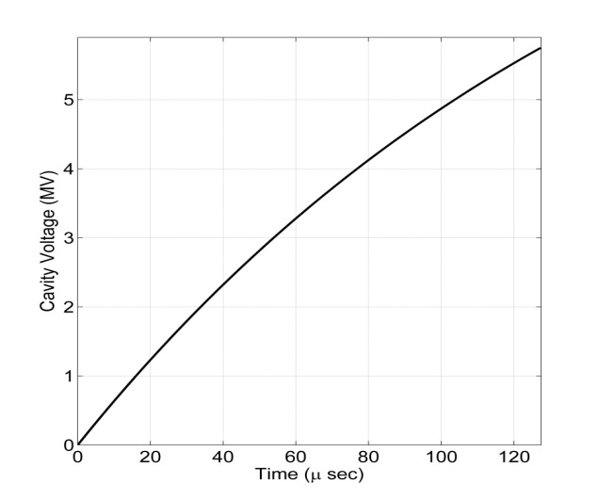
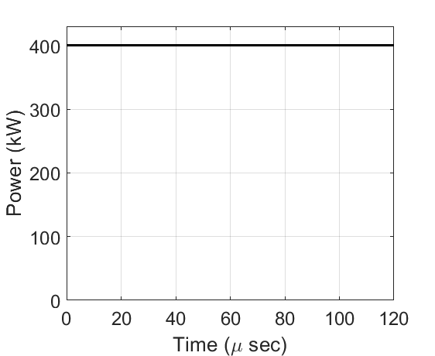
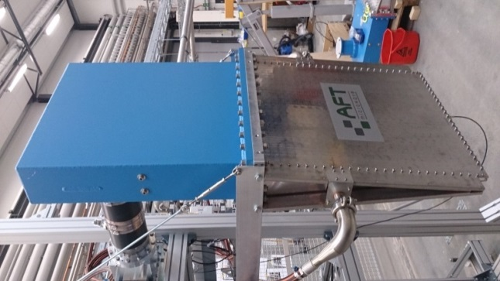
STEP CHARGING SCHEME
RF Source
Circulator
Cavity
Courtesy of P. Duthil
Spoke Cavity
(super - conducting)
RF Power
Minimizing Reflection
Load
Charging time

Slide 6
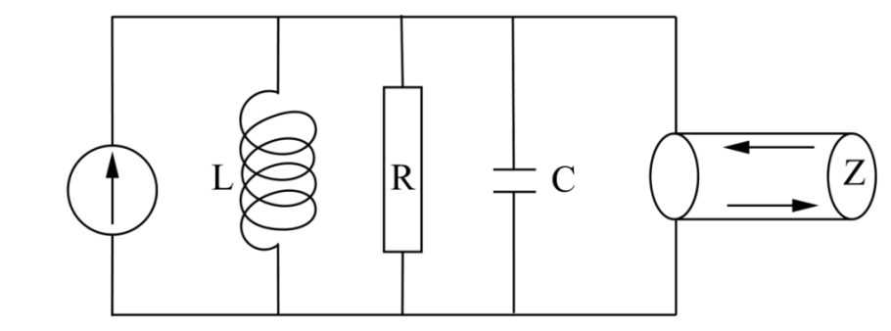


OPTIMAL CHARGING SCHEME
I_{g}
I_{b}
Loaded cavity impedance
I_{r}
Generator current
Instantaneous cavity voltage
Filling time (Natural time scale)
Loaded Quality factor
(Nominal cavity voltage)
Reflected current
External Quality factor
Bare cavity Quality factor
(*) A. Bhattacharya, et al, “Minimization of power consumption during charging of superconducting accelerating cavities,” Nuclear Instruments and Methods in Physics Research A, 801, 78–85

Slide 7
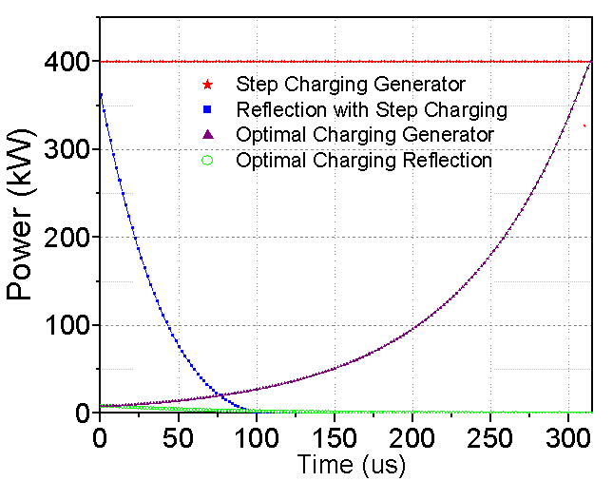
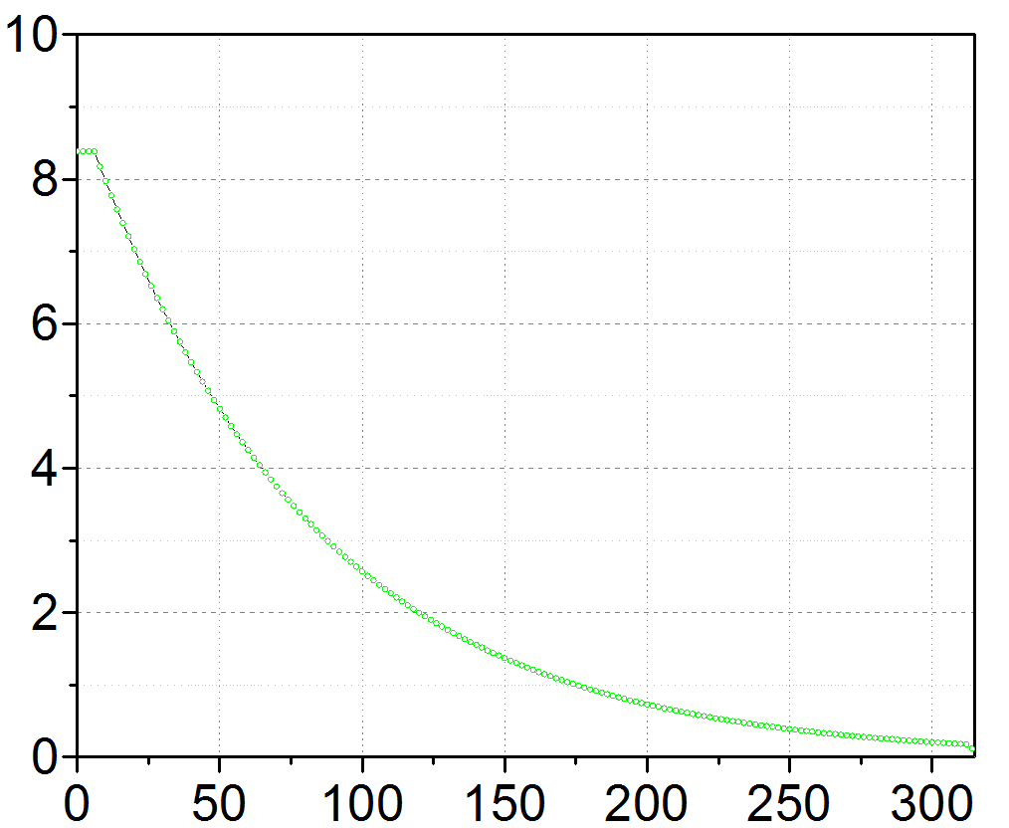
A COMPARISON OF TWO SCHEMES

Slide 8
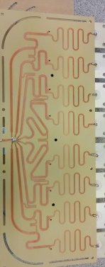
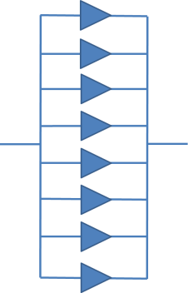
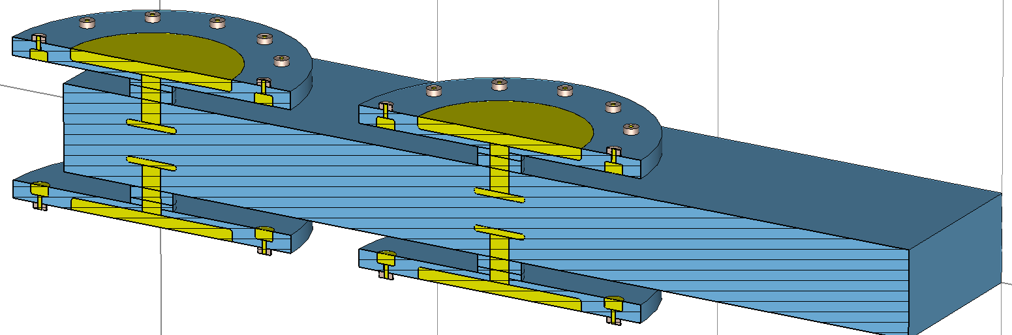
MOTIVATION
10 kW output power
8 SSPA modules
Gysel combiner
& splitter 8:1
400 kW station
with major components developed at FREIA
4 x 12
Input RF pulsed signal with optimal shaping function
300 W pre-amplifier
1 SSA module
1 SSA 25 W amplifier
Output RF pulsed of 400 kW with optimal shaping function
400 kW
1.2 meter
(*) D. D. et al, “A compact 10 kw solid-state RF power amplifier at 352 MHz,” Journal of Physics: Conference Series, vol. 874, no. 1, p. 012093, 2017. [Online]. Available: http://stacks.iop.org/1742-6596/874/i=1/a=012093
(**) L. Haapala, A. Eriksson, L. H. Duc, and D. Dancila, “Kilowatt-level power amplifier in a single-ended architecture at 352 MHz,” Electronics Letters, vol. 52, no. 18, pp. 1552–1554, 2016.

Slide 9
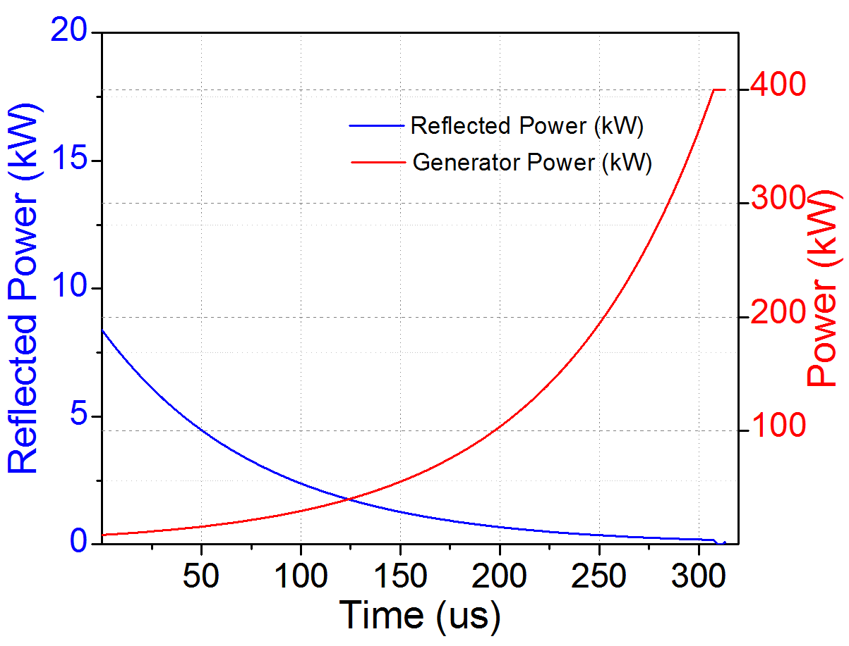
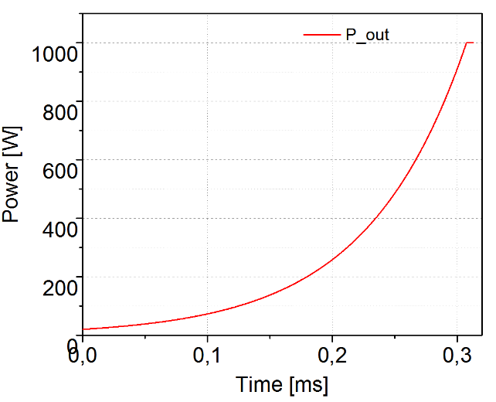
SSPA DESIGN FOR OPTIMAL SCHEME
400 kW SSPA
1kW SSPA
Low Efficiency
The efficiency of solid state amplifiers is low at low-power range.
To apply optimal charging scheme on SSPAs, the efficiency at low power must be taken consideration.
Envelope tracking technique is chosen to improve the overall efficiency during the charging time of 300 us.
A proof of concept design is implemented to be used for optimal charging

Slide 10
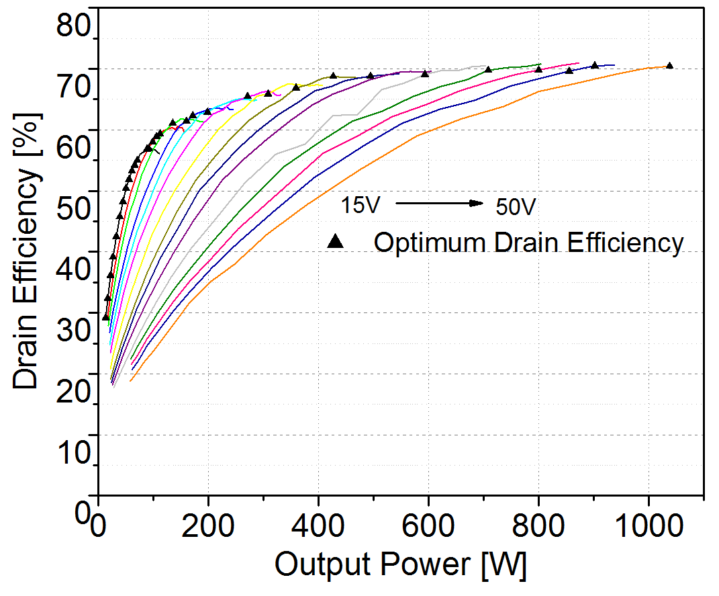
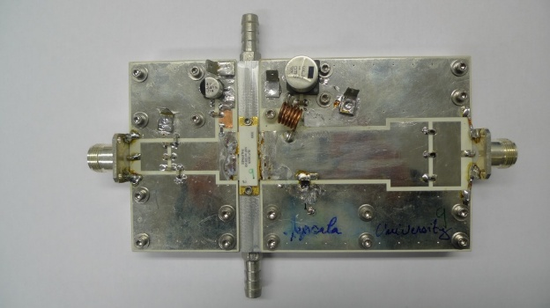
CHARACTERIZING SSPA MODULE
(**) L. Haapala, A. Eriksson, L. H. Duc, and D. Dancila, “Kilowatt-level power amplifier in a single-ended architecture at 352 MHz,” Electronics Letters, vol. 52, no. 18, pp. 1552–1554, 2016.

Slide 11
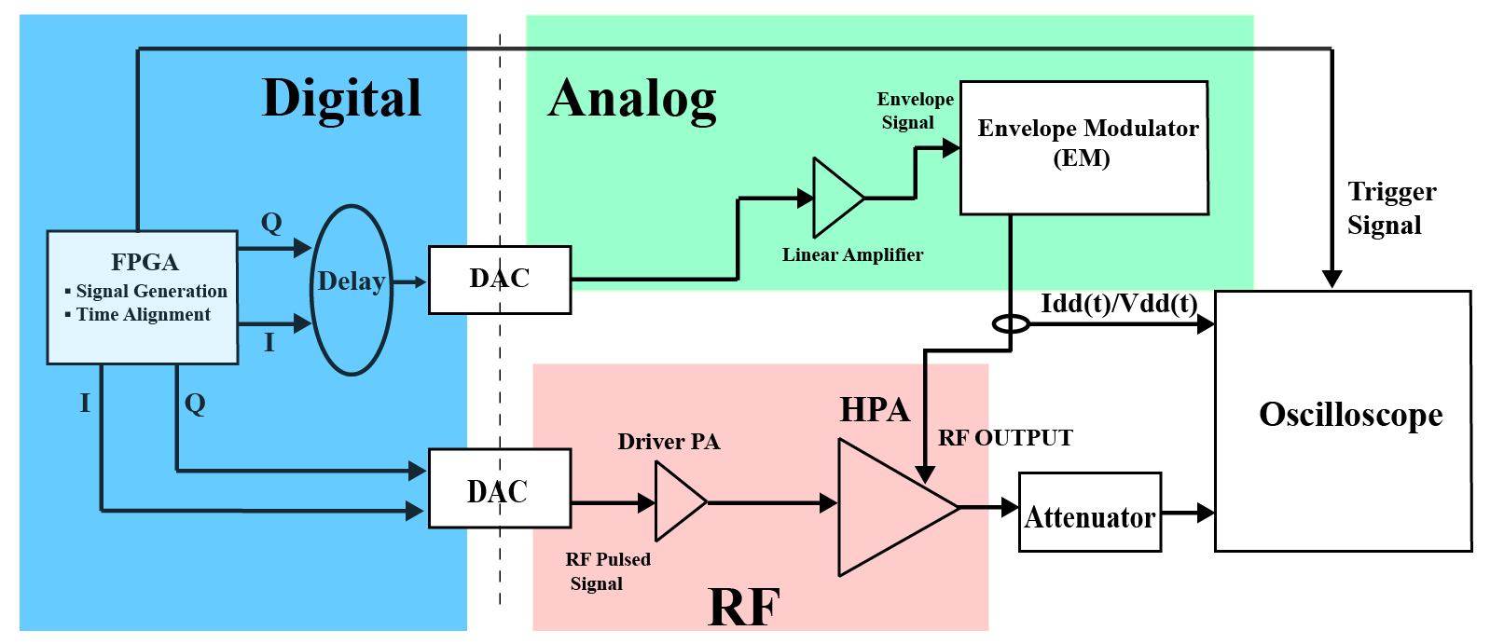
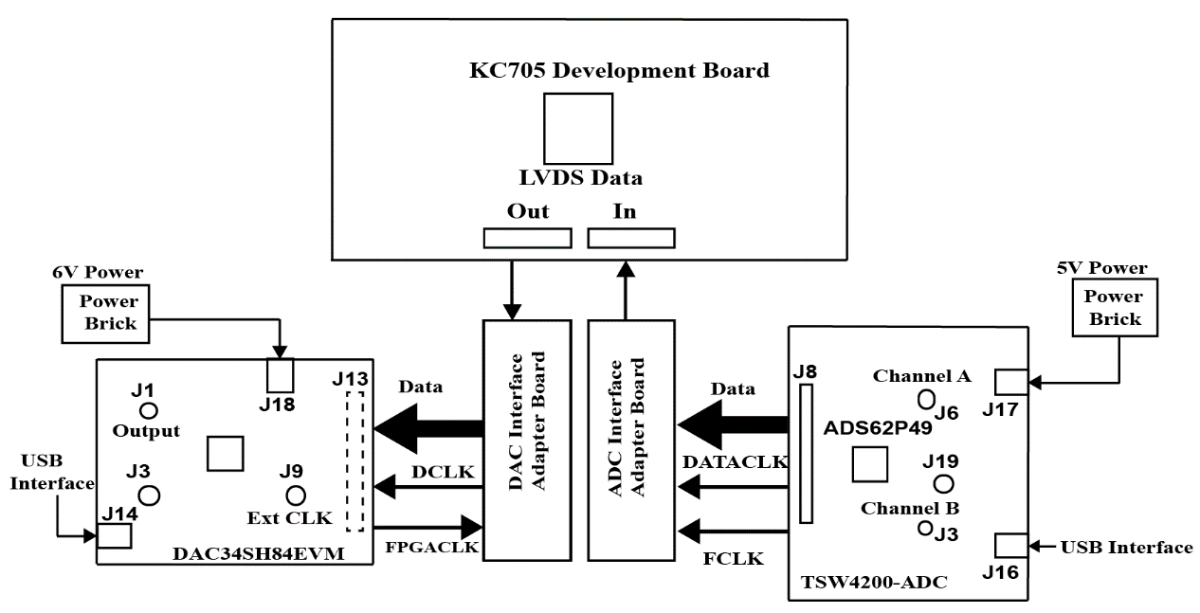
BLOCK DIAGRAM OF THE SYSTEM
Feedback

Slide 12
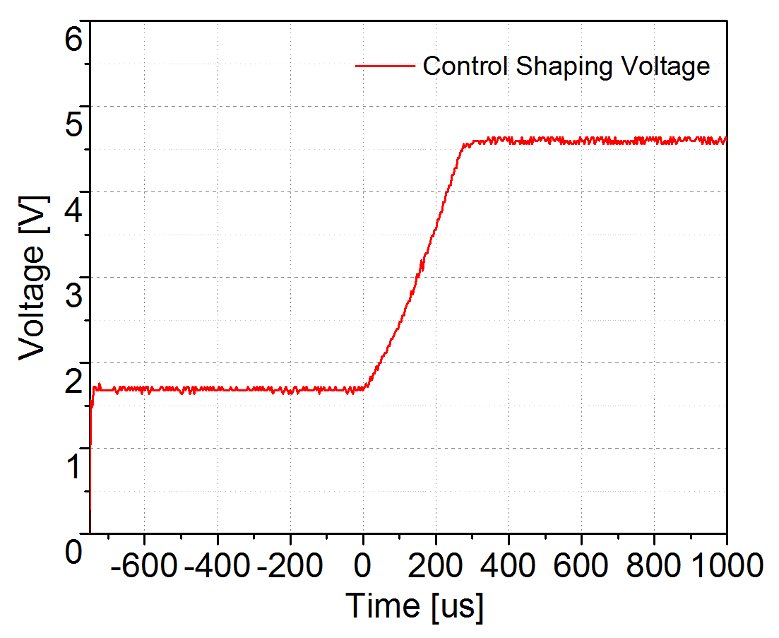
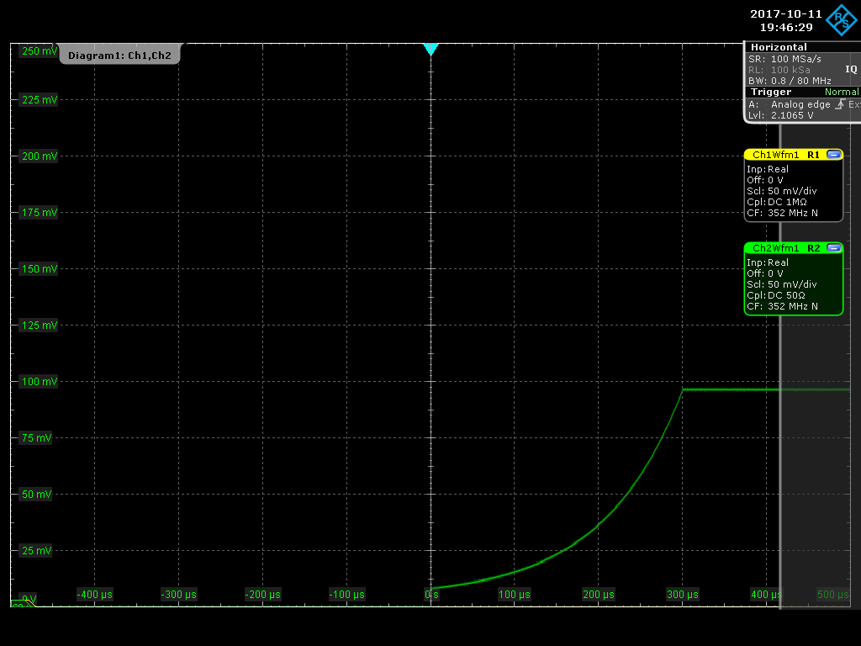
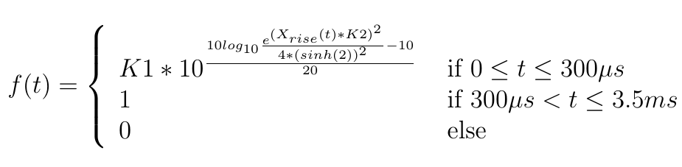
OPTIMAL FILLING FUNCTIONS
K1,K2 are chosen optimally for highest efficiency

Slide 13
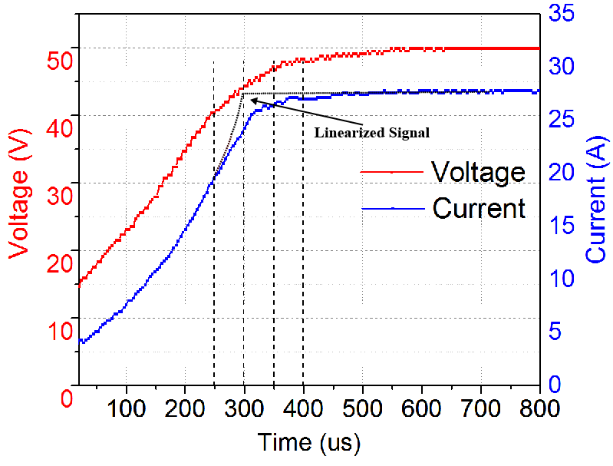
VOLTAGE AND CURRENT VS TIME

Slide 14
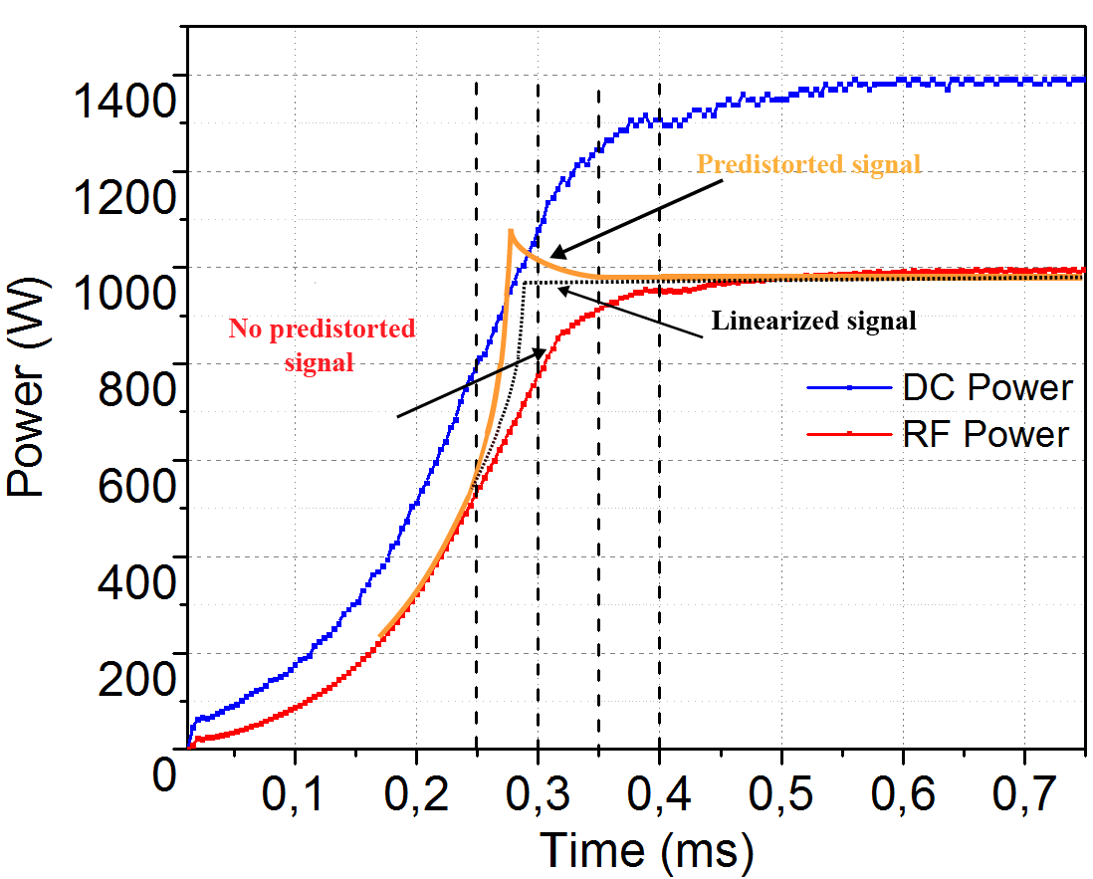
DC AND RF OUTPUT POWER VS TIME

Slide 15
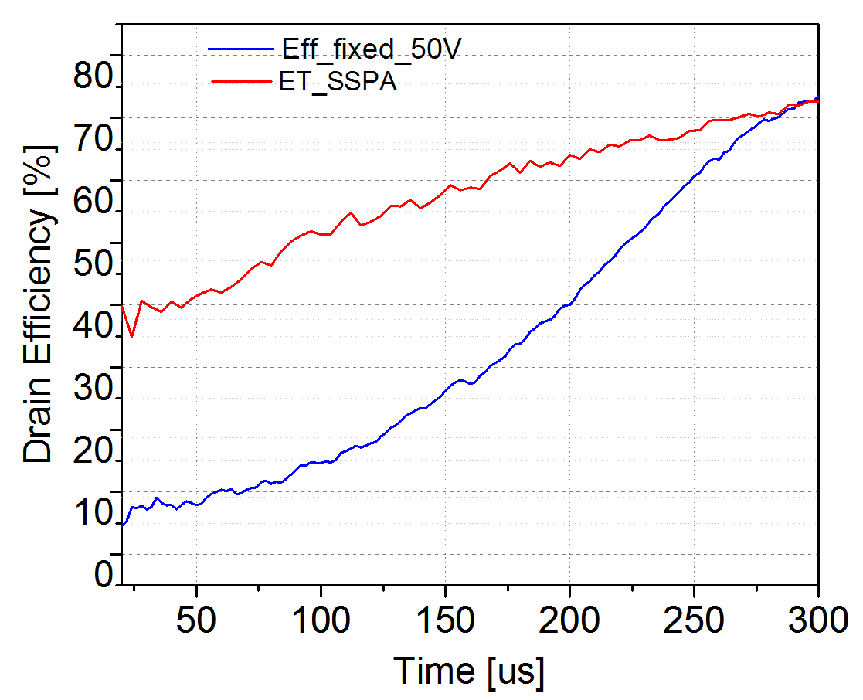
EFFICIENCY USING ET TECHNIQUE

Slide 16
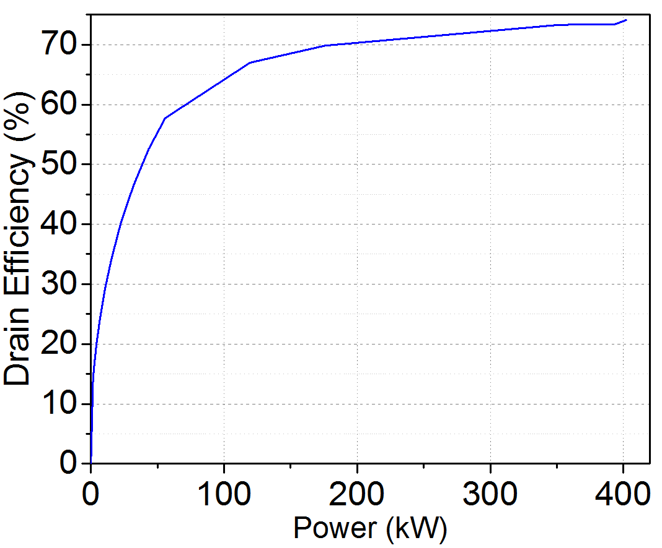
TRACKING EFFICIENCY VS POWER

Slide 17
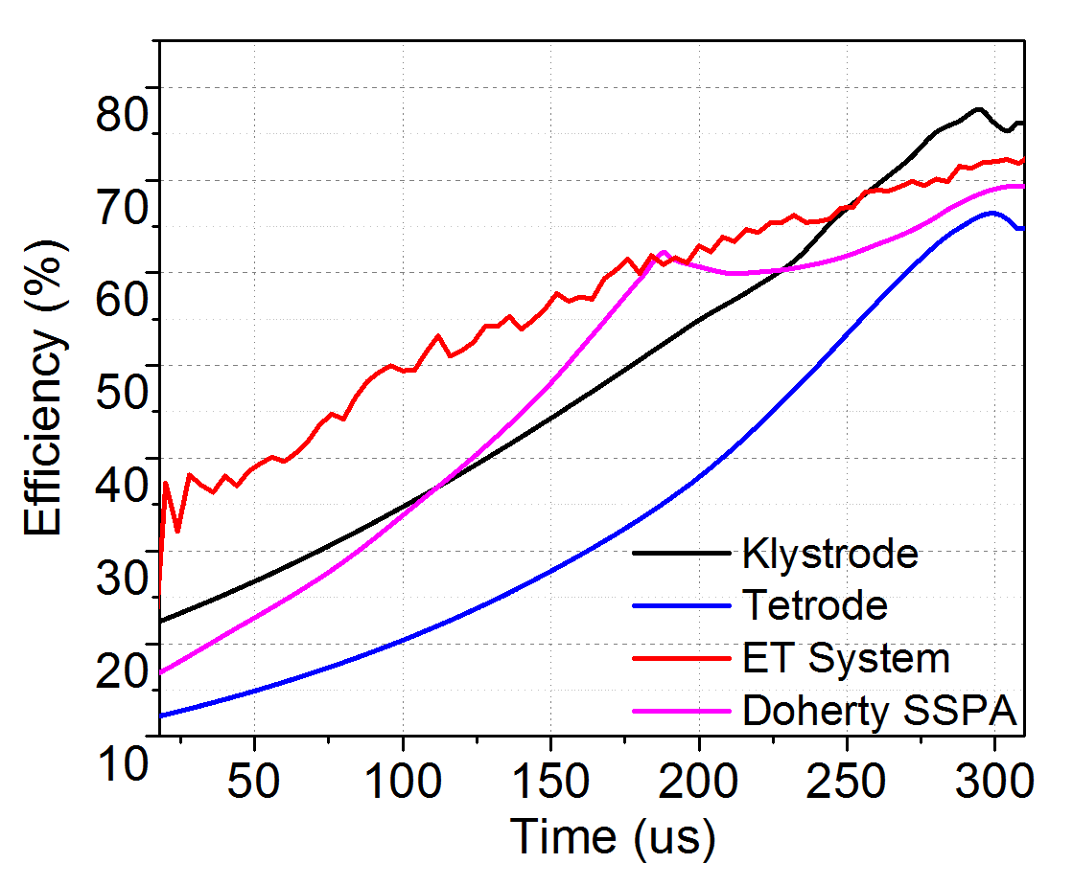
ET SSPA VS OTHER TECHNOLOGIES
W. Doherty, A new high efficiency power amplifier for modulated waves,
Radio Engineers, Proceedings of the Institute of 24 (9) (1936) 1163–1182.
doi:10.1109/JRPROC.1936.228468.
B. Kim, J. Kim, I. Kim, J. Cha, The doherty power amplifier, Microwave
Magazine, IEEE 7 (5) (2006) 42–50. doi:10.1109/MW-M.2006.247914.
R. Pengelly, N-way rf power amplifier with increased backoff power and
power added efficiency, wO Patent App. PCT/US2003/002,365 (Aug. 7
2003).
URL http://www.google.com/patents/WO2003065573A1?cl=en
P. Colantonio, F. Giannini, R. Giofr, L. Piazzon, The doherty power ampli
fier, INTERNATIONAL JOURNAL OF MICROWAVE AND OPTICAL
TECHNOLOGY 5 (6) (2010) 419–430.
G. Ahn, M. su Kim, H. chul Park, S. chan Jung, J. ho Van, H. Cho,
S. wook Kwon, J.-H. Jeong, K. hoon Lim, J. Y. Kim, S. C. Song, C.-S.
Park, Y. Yang, Design of a high-efficiency and high-power inverted doherty
amplifier, Microwave Theory and Techniques, IEEE Transactions on 55 (6)
(2007) 1105–1111. doi:10.1109/TMTT.2007.896807.
NXP Semiconductors, AN10967 BLF578 demo for 352 MHz 1kW CW
power, 2nd Edition, application note (November 2012).
D. Rees, D. Keffeler, W. Roybal, P. Tallerico, Characterization of a
Klystrode as a RF Source for High-Average-Power Accelerators, Conf.Proc.
C950501 (1995) 1521.
E. Montesinos, Tetrode power amplifiers, in: TIARA Workshop on RF
Power Generation for Accelerators, Uppsala University, Angstrom Laboratory,
2013.

Slide 18
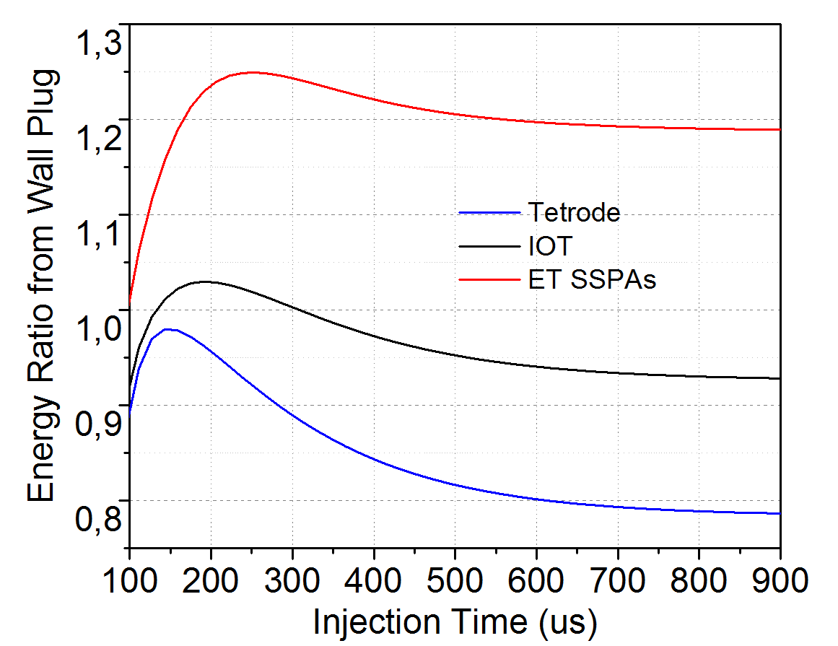
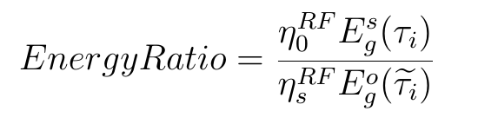
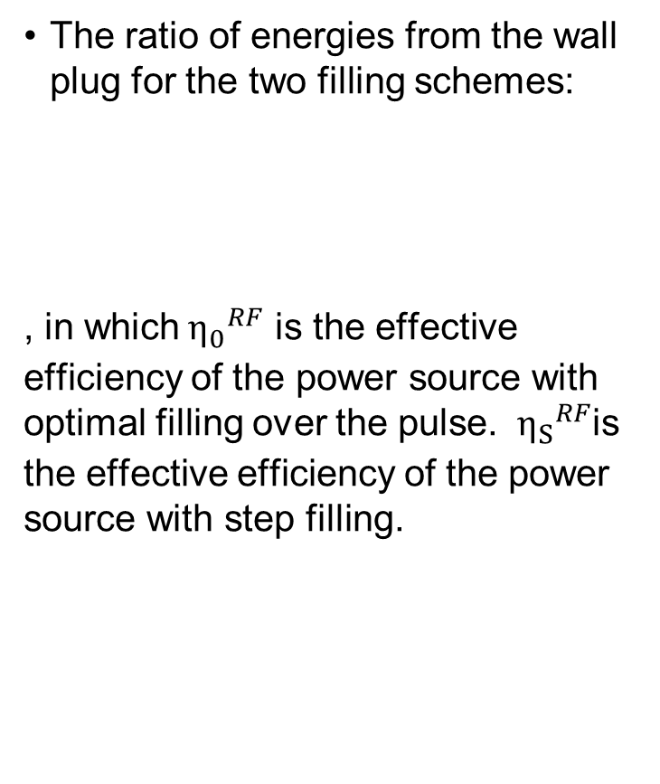
ENERGY SAVINGS VS CHARGING TIME
The ratio of energies from the wall plug for the two filling schemes:
, in which${ η_{0}}_{}^{RF}$ is the effective efficiency of the power source with optimal filling over the pulse. ${ η_{S}}_{}^{RF}$is the effective efficiency of the power source with step filling.
Optimal Beam Injection

Slide 19
Conclusions
Reflected energy can be reduced by the proposed filling profile.
R&D on high power sources for high efficiency at low output powers by using voltage envelope tracking technique.
We successfully improve about 24% in energy efficiency .

Slide 20
Thank You

Slide 21


