Slide 1
Spoke Cavity Design and Development in IHEP
Jianping Dai, Feisi He, Quan Zhou and Zhongquan Li
SLHiPP, Lanzhou
9. 26~27, 2019

Slide 2
Layout of ADS Project
10 MeV
INJECTOR I
ECR
0.15MeV
LEBT
RFQ
325MHz
0.15~3.2MeV
MEBT1
SSR012
325MHz
(7+7)
3.2~10MeV
Main Linac
MEBT2
HWR015
166.5MHz
(5)
10~18
SSR021
325MHz
(6+6)
18~36
SSR040
325MHz
(72)
36~160
HEBT
MB063
650MHz
5-cell
(32)
160~350
HMB082
650MHz
5-cell
(85)
350~150
INJECTOR II
ECR
0.15MeV
LEBT
RFQ
162.5MHz
0.15~2.5MeV
MEBT1
HWR009
162.5MHz
(6+6)
2.5~10MeV
2011-2016, Pulse 25MeV@3-10mA

Slide 3
IHEP Contribution to ADS
 | SSR012 | SSR021 | SSR040 | 5CELL Ellip082 | SSR024 | HWR014 | DSR050
No. of cavity | 2*7+3spare +5demo | 1*6+4spare +3demo | 4 demo | 2 demo | 1 demo | 1 demo | 1 demo
Freq. [MHz] | 325 | 325 | 325 | 650 | 325 | 325 | 325
β₀（Opt. Beta） | 0.14 | 0.24 | 0.46 | 0.86 | 0.24 | 0.14 | 0.5
Aperture [mm] | 35 | 40 | 50 | 100 | 40 | 35 | 50
E_{p}/E_{acc} | 5.0 | 4.4 | 3.8 | 2.1 | 4.0 | 4.6 | 3.39
B_{p}/E_{acc} [mT/(MV/m)] | 6.9 | 9.4 | 9.2 | 4.1 | 6.4 | 4.8 | 8.57
G [Ω] | 60 | 71 | 104 | 235 | 81 | 73 | 125
R/Q [Ω] | 150 | 191 | 265 | 514 | 206 | 197 | 415
Note: Eacc normalized with β₀λ

Slide 4
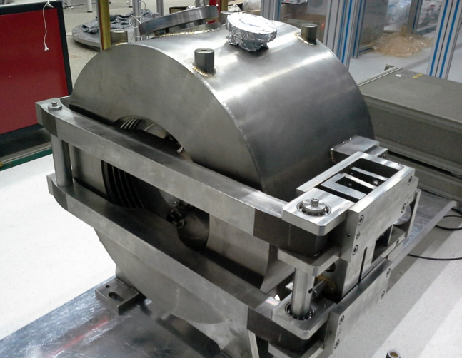
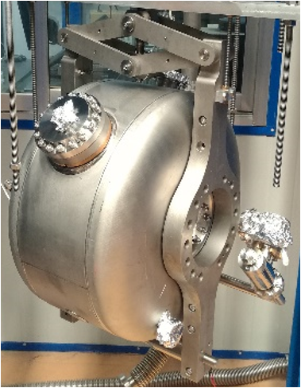
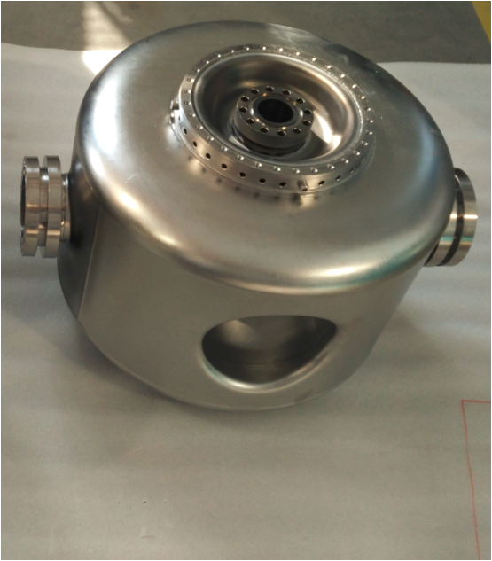
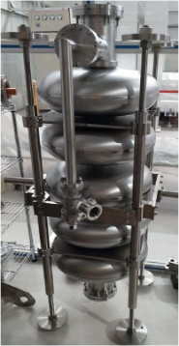
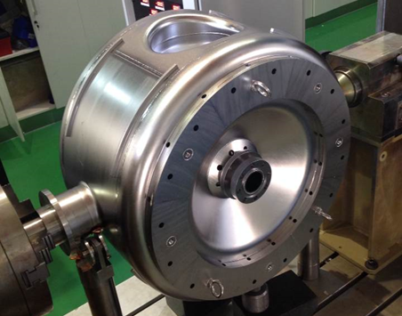
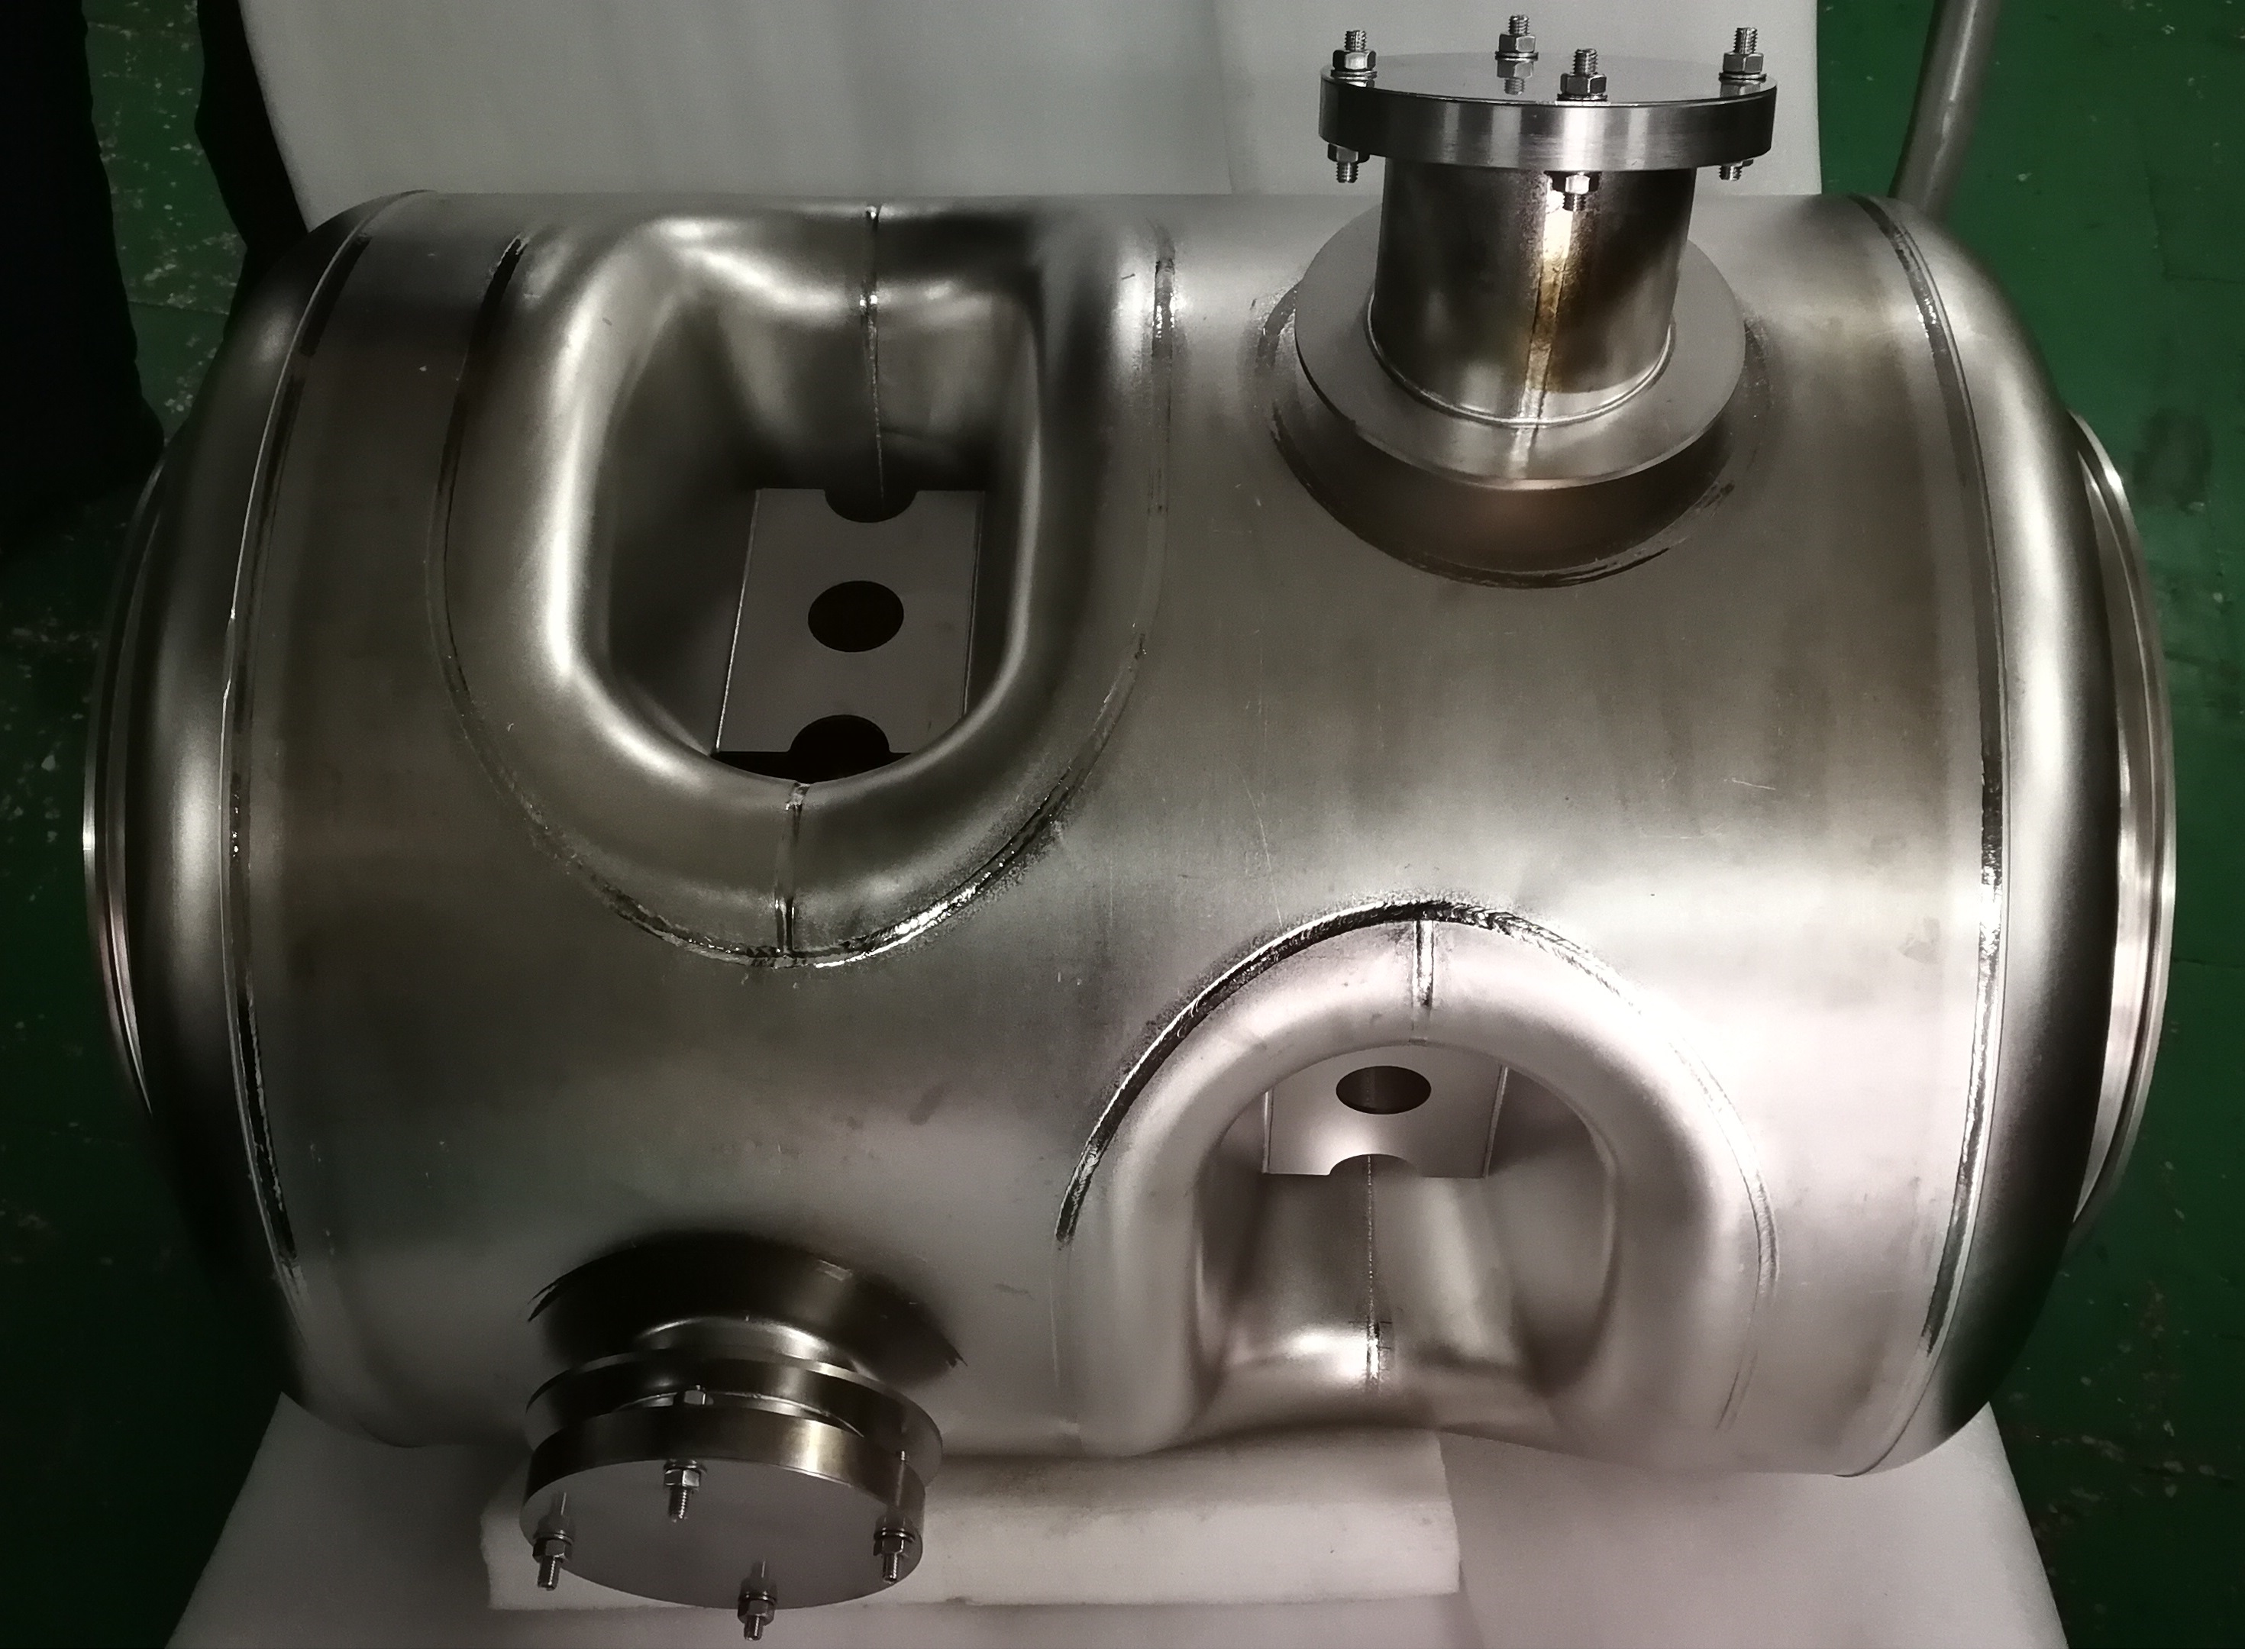
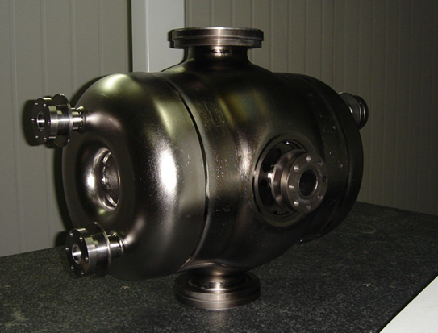
Series of SC Cavities for ADS
 | SSR012 | SSR021 | SSR040 | Ellip 082 | SSR024 | HWR014 | DSR050
No. of cavity | 22 | 13 | 4 | 2 | 1 | 1 | 1
Freq. [MHz] | 325 | 325 | 325 | 650 | 325 | 325 | 325
β_{opt} | 0.14 | 0.24 | 0.40 | 0.86 | 0.24 | 0.14 | 0.5

Slide 5
R&D and Activities of SRF cavities at IHEP
Design
Single cavity Test
Assembly
Fabri.
Post Process
LHe Vessel Dressing
RF Performance
Structure
(Stress, Deformation)
Material
Machining and Welding
Quality Control
Heavy BCP, Annealing
Pretuning
/Field Flatness
Light BCP
HPR
Clean Assembly
Cavity String Assembly
Cryostat Assembly
Onsite Installation
Module Hori. Test
Vert. Test
Prototype Hori. Test
Physics requires
Freq, gradient, Iris

Slide 6
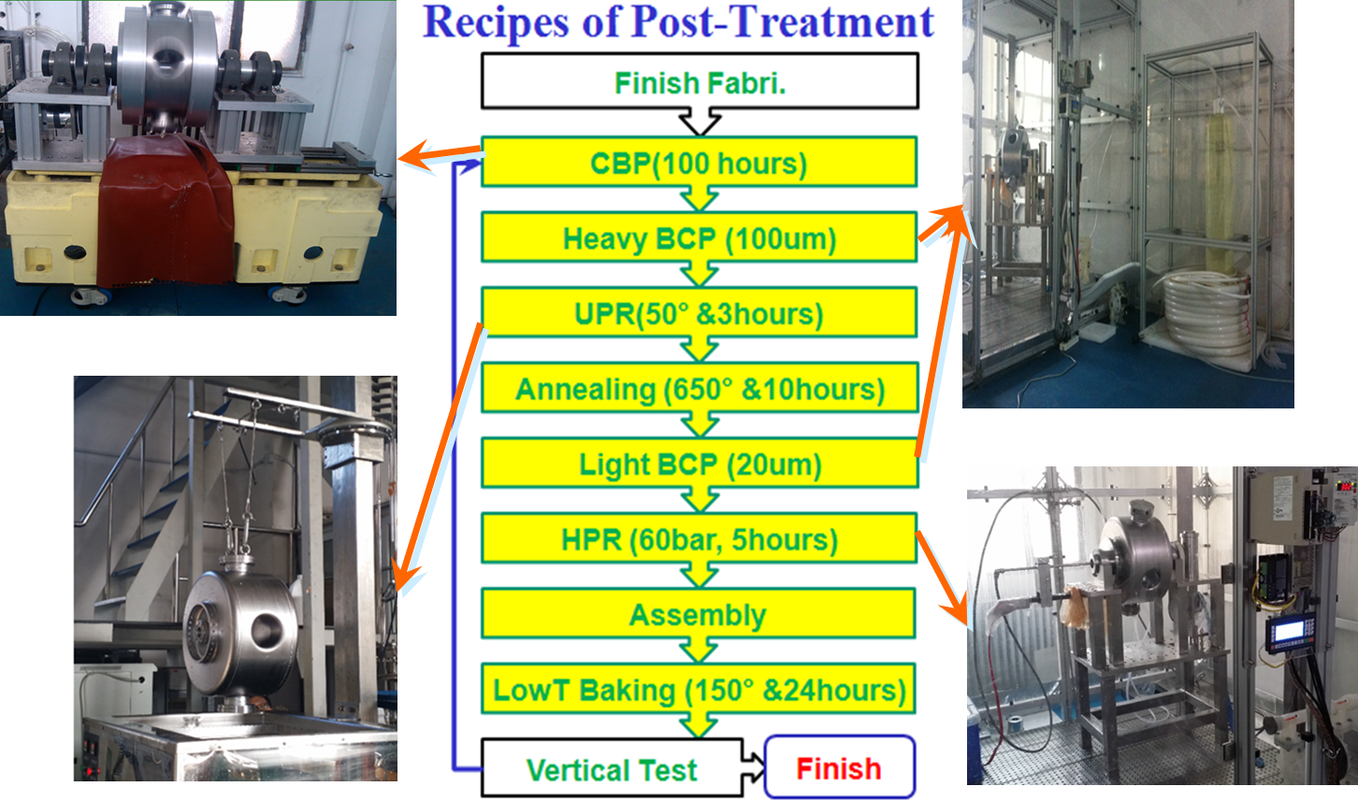
Procedures of Post Treatment
Centri-Barrel Polishing
Buff. Chemical Polishing
Ultrasonic Washing
High Pressure Rinsing

Slide 7
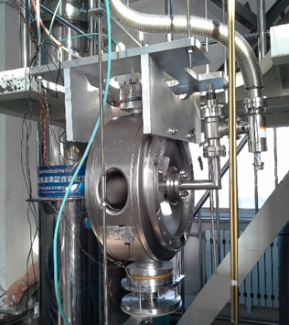
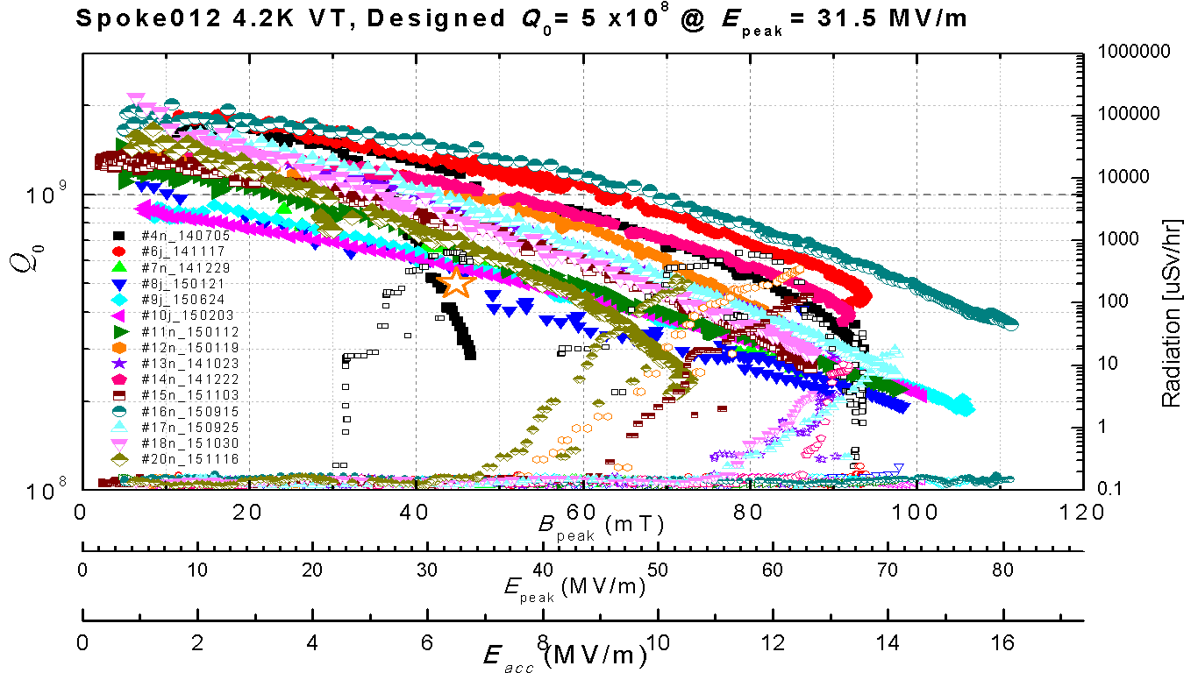
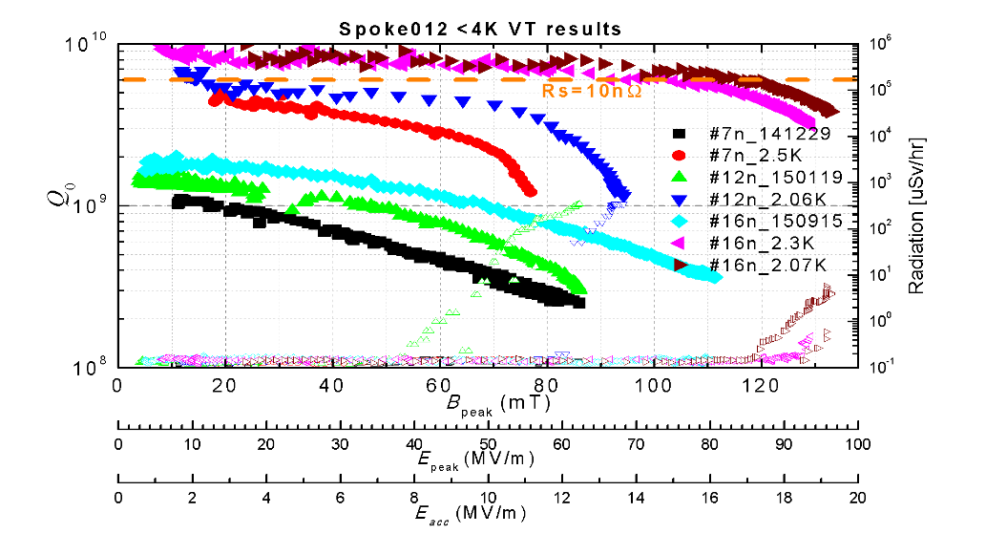
V.T Results of SSR012
Total 22 pieces of SSR012 fabri., and 14 pieces of SSR012 are used to combine 2 CM.
At 2K, typically Q₀ valve increasing 5-6 times for SSR012
Notes:
端盖+中间环（内导体两半、相邻两片、圆环）；

Slide 8
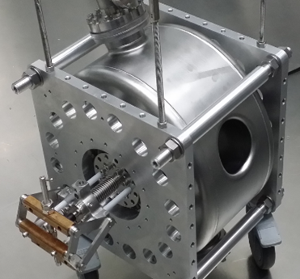
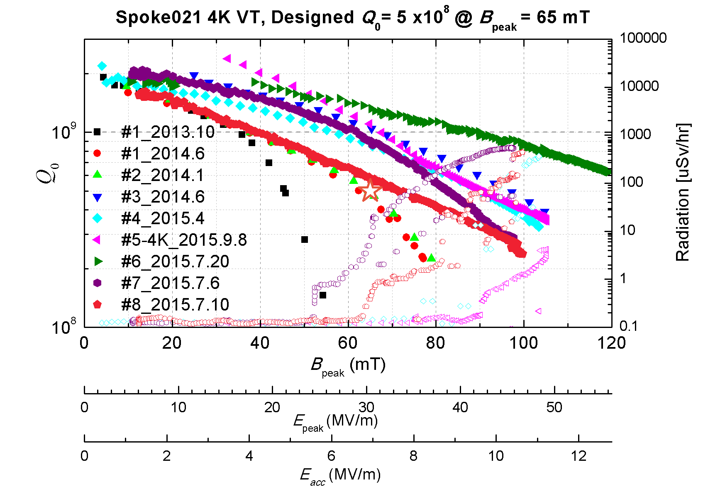
V.T Results of SSR021
With a adjustable input antenna, Typically 1and half hour is needed to aging the cavity pass through MP zone
Total 13 pieces of SSR021 Fabr., and 8 of them had been test, 6 of SSR021 are used to combine one CM
 | SSR021
Freq. [MHz] | 325
β_{opt} | 0.24
Aperture [mm] | 40
E_{p}/E_{acc} | 4.4
B_{p}/E_{acc} [mT/(MV/m)] | 9.4
Notes:
端盖+中间环（内导体两半、相邻两片、圆环）；

Slide 9
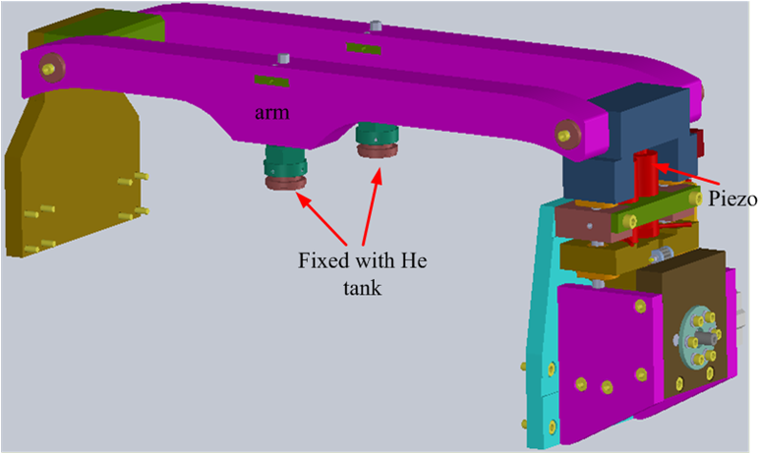
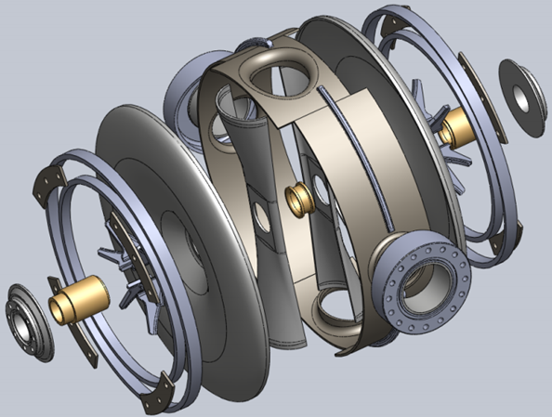
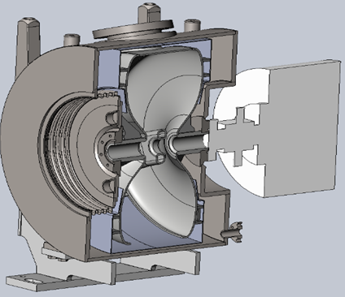
Structure of SSR012 and Upgraded
2 crymodule including 14 SSR021 had been fabricated
Upgraded ：
Coupler assembled in clean room
Enhanced the Helium Vessel to reduce the LFD
Tuner Change push to pull cavity，to reduce df/dp and LFD, and decrease tuner backlash

Slide 10
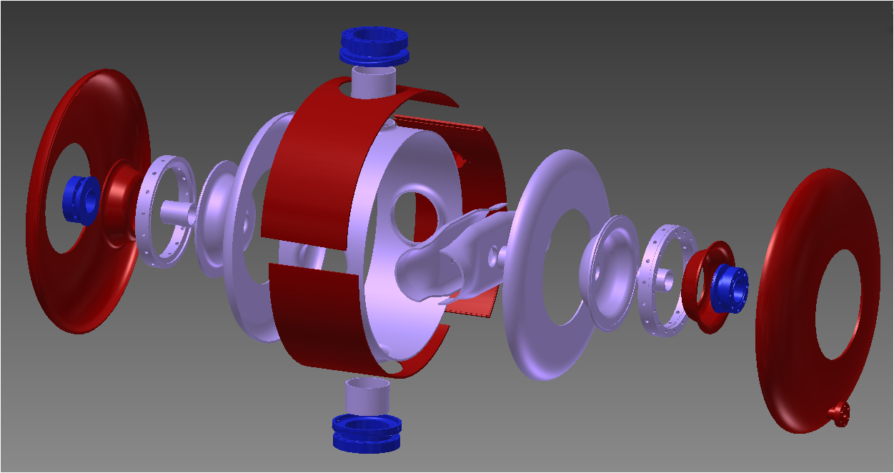
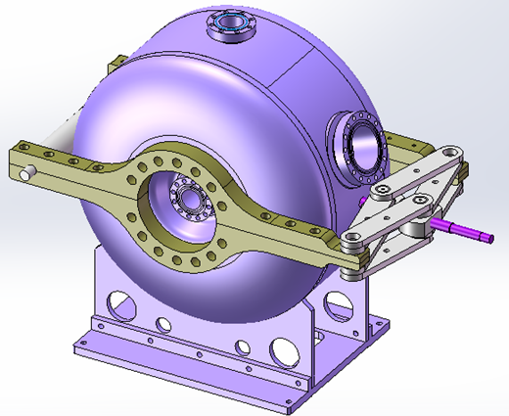
Compact Struct. of SSR021 and SSR040
Total 21 welding seam for niobium cavity, and 14 welding seam for helium vessel
Each seam can be polished by hand for niobium cavity itself
Simpler stiffen ring structure
All of seam is EBW
Tuner connect with stiffen ring directly, not beam flange
Helium vessel composed by 9 parts only
Ti helium vessel welded with the NbTi flange of cavity directly, no bellow adopted here

Slide 11
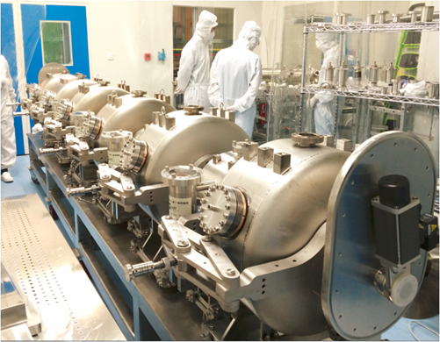
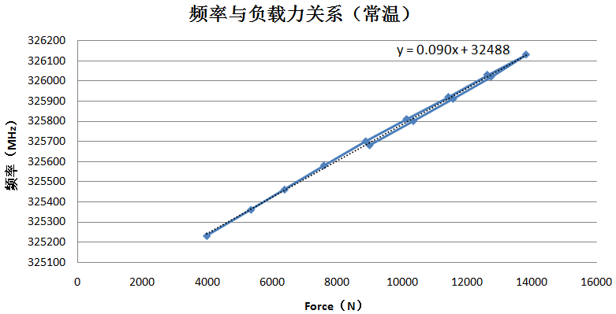
R&D of Tuner and Helium Vessel
To balance the force from niobium cavity and helium vessel，the position of the stiffen ring is optimized, design valve：with free flange, fixed flange and tuner, df/dp = -15/+15/+0.6 Hz/mbar separately.
The backlash is neagilable at cold test
Tuning Range:±400kHz,
No. of SSR021 | Tuner free df/dp [Hz/mbar]
021-5# | 0
021-6# | -13
021-7# | -12
021-8# | -9
021-9# | Not measured
021-10# | -4

Slide 12
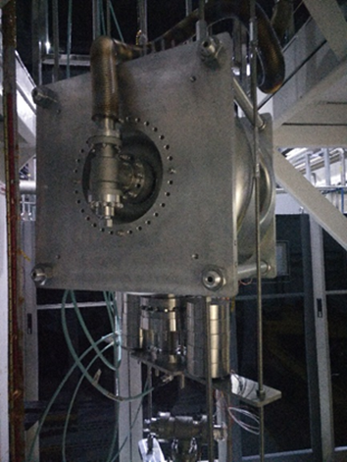
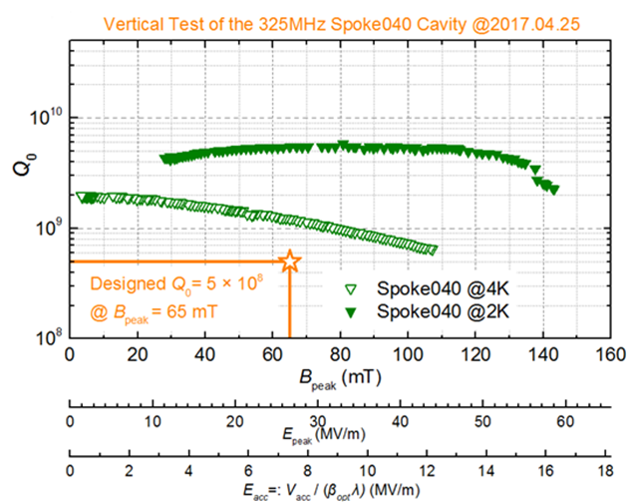
V.T Results of SSR040
Spoke040 reached 16.5MV/m@Q0=2.17e9 at 2K
 | SSR 040
Freq. [MHz] | 325
β_{opt} | 0.46
Aperture [mm] | 50
E_{p}/E_{acc} | 3.8
B_{p}/E_{acc} [mT/(MV/m)] | 9.2
B_{p}（V.T）[mT] | 143

Slide 13
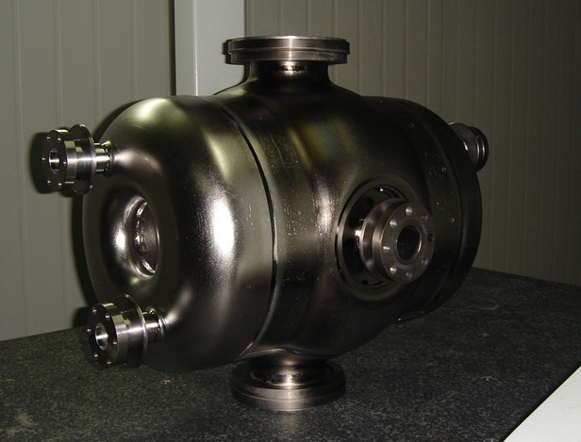
HWR014 vs SSR012
As a candidate scheme of SSR021, a HWR of beta=0.14 designed and fabricated
It is possible for Ep
Similar Eacc achieved at 4K as SSR012
 | SSR 012 | HWR014
Freq. [MHz] | 325 | 325
β_{opt} | 0.14 | 0.14
Aperture [mm] | 35 | 35
E_{p}/E_{acc} | 5.0 | 4.6
B_{p}/E_{acc} [mT/(MV/m)] | 6.9 | 4.8

Slide 14
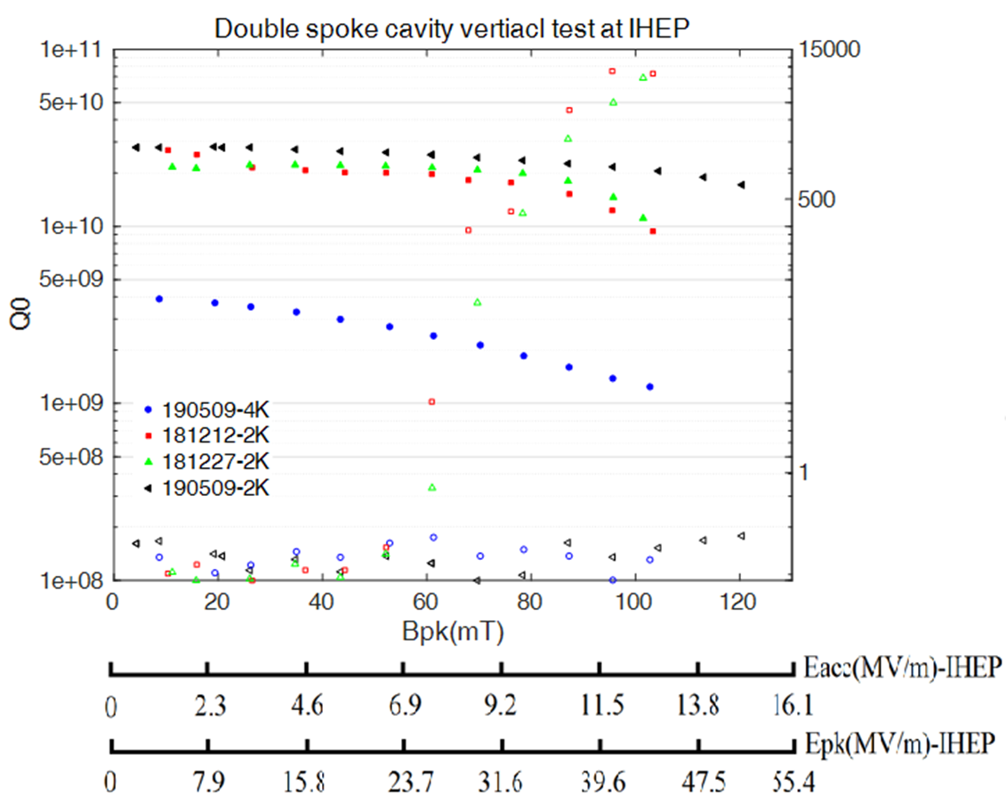
DSR050
As a R/D project, A DSR050 cavity had been fabr. and tested
DSR050 reached 14.0MV/m@Q0=1.8e10 at 2K
 | DSR050
Freq. [MHz] | 325
β_{opt} | 0.50
Aperture [mm] | 50
E_{p}/E_{acc} | 3.39
B_{p}/E_{acc} [mT/(MV/m)] | 8.57
B_{p}（V.T）[mT] | 123

Slide 15
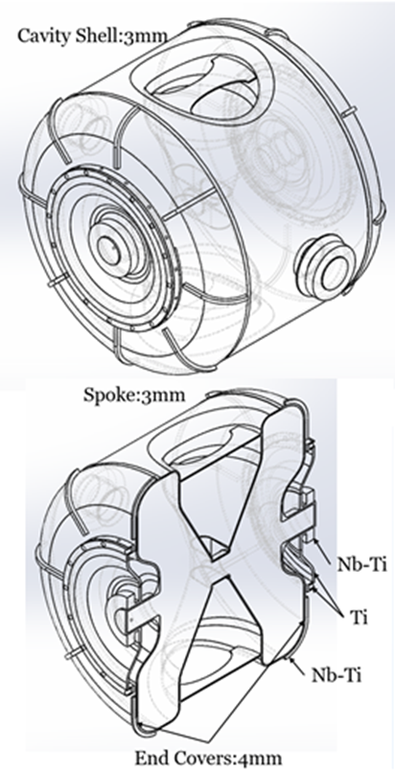
SSR051 for RISP of IBS Korea
Refer to experience of above, a SSR051 cavity had been designed for RISP of IBS Korea
Design target as 8.7MV/m@Q0=0.5e10 at 2K
 | SSR051
Freq. [MHz] | 325
β_{opt} | 0.51
Aperture [mm] | 50
E_{acc} [MV/m] | >8.7
df/dP [Hz/mbar] | <10
Operation Temp. [K] | 2.05

Slide 16
Experiences
Simplify and optimize the structure of cavity, helium vessel and tuner to reduce the total cost
Mechanical stiffening should give enough consideration to limit Lorentz detuning and microphonic issues
Coupler should be pre-assembled with cavity to avoid performance degradation; direct field emission current towards ceramic window should be avoided; it is better to mount the coupler in horizontal direction or from bottom side
Pulling cavity is suggested to enhance the structure stiffness; fast piezo freq. tuning compensation can be used to cure microphonic induced instability during beam operation
Helium vessel without bellow to reduce cost and leak risk

Slide 17
THANKS for Your Attention！

