Slide 1
北广科技 创造非凡
Application and Development of Solid State Power Source in High Energy Accelerator
北京北广科技股份有限公司
Beijing BBEF Science & Technology Co., LTD
Notes:
Hello everyone! I am Dongsheng Zhang , I am a engineer come from Beijing BBEF Science&Technology Co., LTD. I will introduced the Application and Development of Solid State Power Source in High Energy Accelerator

Slide 2
History of high energy accelerator power source
Characteristics of solid state power source system
Key technology & Application prospect
Notes:
My introduction divided to 3 parts,
1, History of high energy accelerator power source 2 Characteristics of solid state power source system
3 Solid state power source key technology & Application prospect

Slide 3
History of high energy accelerator power source
Notes:
Now it ‘s the 1st one

Slide 4
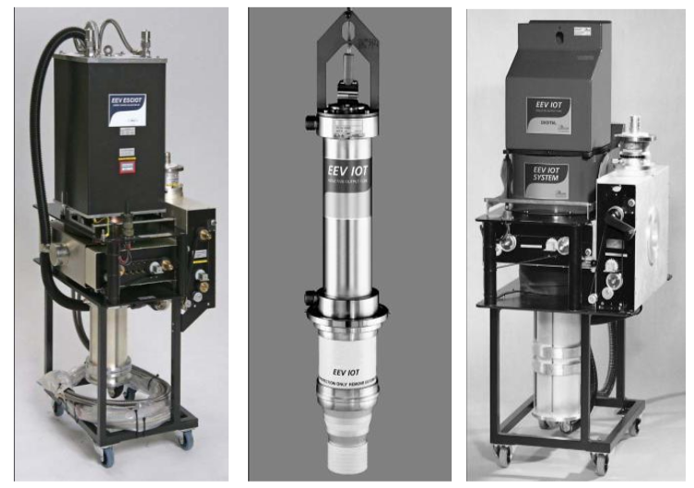
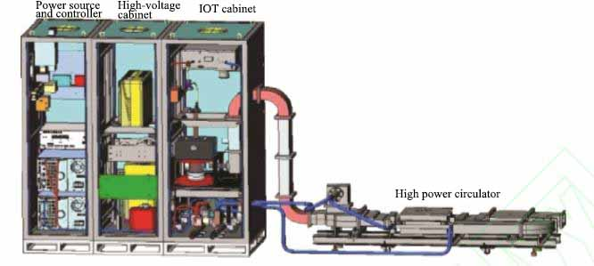
Beijing BBEF Science & Technology Co., Ltd.
北京北广科技股份有限公司
Power source system - IOT tube
IOT developed and produced by UK E2V
Power source system of IOT tube
Notes:
Power source for high-energy accelerator varies according to the beam energy of the accelerator. The high-frequency power required also ranges from kilowatt level to megawatt level and the operating frequency ranges from several megahertz to several gigahertz. Due to the harsh working environment and large output power, traditionally, high-power RF power source is provided mainly with electronic vacuum amplifier as amplification element to meet the demand of the system. There are electronic triodes, electronic tetrode, Klystron, induction output tube, traveling wave tube and other different devices with different characteristics respectively for each wave band. The output power ranges from tens of kilowatts to thousands of kilowatts. It is occupying the power source market of super-large power output. The main large power and high frequency amplifier is klystron tube for amplification at present and some synchrotron radiation source also uses IOT tube for amplification.

Slide 5
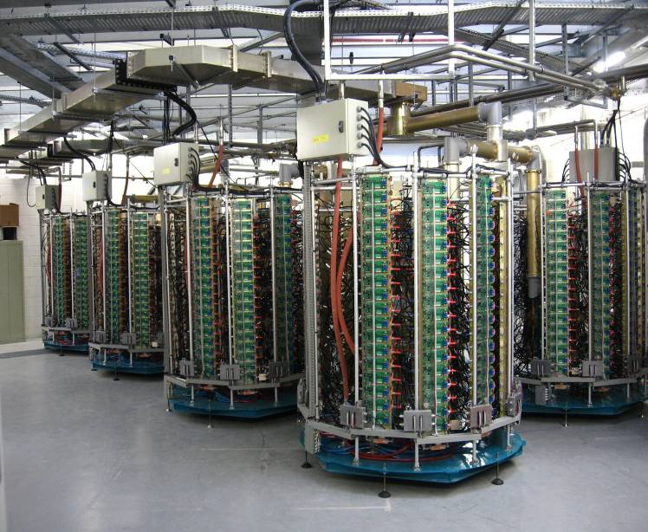
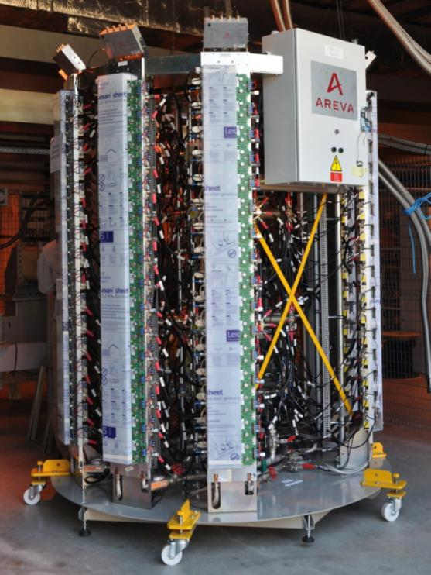
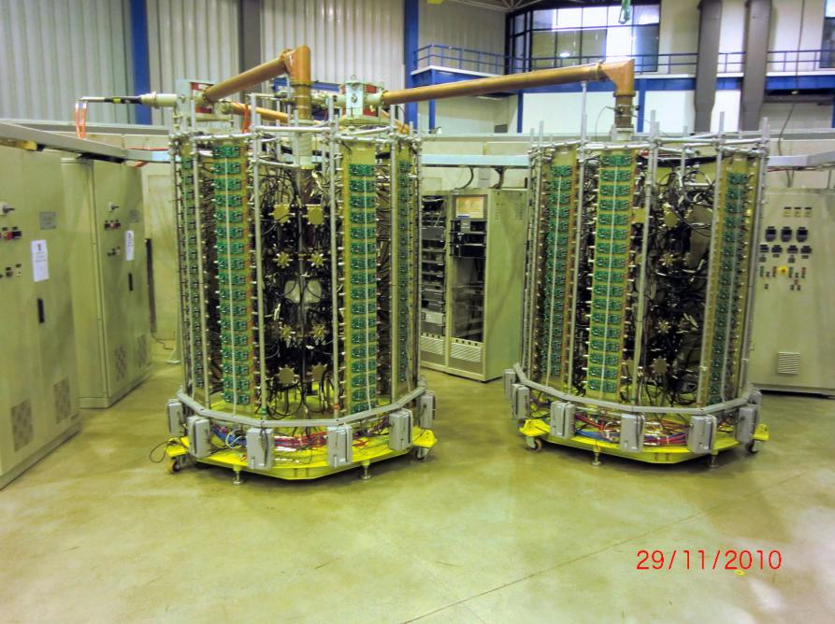
Beijing BBEF Science & Technology Co., Ltd.
北京北广科技股份有限公司
Global Power source system - solid-state power amplifier
SOLEIL 180kW/352MHz RF Power Source Installed in France
352MHz/150kW solid state power source of the European Synchrotron Radiation Facility (ESRF)
LNLS Laboratory in Brazil
Notes:
Higher frequency and higher power tubular design means more difficulty in geometric design and more complex system design.
Advantages of solid-state power amplifier are gradually exhibited along with the progress of integrated circuit technology and continuously improving level of solid-state power amplifier. It has been widely used in accelerator 。
BBEF company has designed & developed solid-state power amplifier for more than 40 years, and provide high power equipment for Science facility all over the world . The pictures of solid-state (except IOT) power source equipment in this presence comes totally from BBEF.
IN CHINA EXCETP OUR BBEF, KAITENGSIFANG IS ANOTHER IMPORTANT MANUFACTURE ,IS ALSO DISTRUIBUTE TO THE SOLIDE POWER SOURCE .
the successful application of ultra-high power (180kW) solid-state power source in SOLEIL Laboratory of French Light Source, proved that the all-solid-state power source in this frequency band can meet the requirements of load mismatch application environment and ultra-high power output of high-energy accelerator.
European Synchrotron Radiation Facility (ESRF) also began its solid-state transformation subsequently.
LNLS Laboratory in Brazil is similar to SOLEIL in France.. A device with an output power of 50kW was constructed for the pre-injector in a mode similar to SOLIEIL.

Slide 6
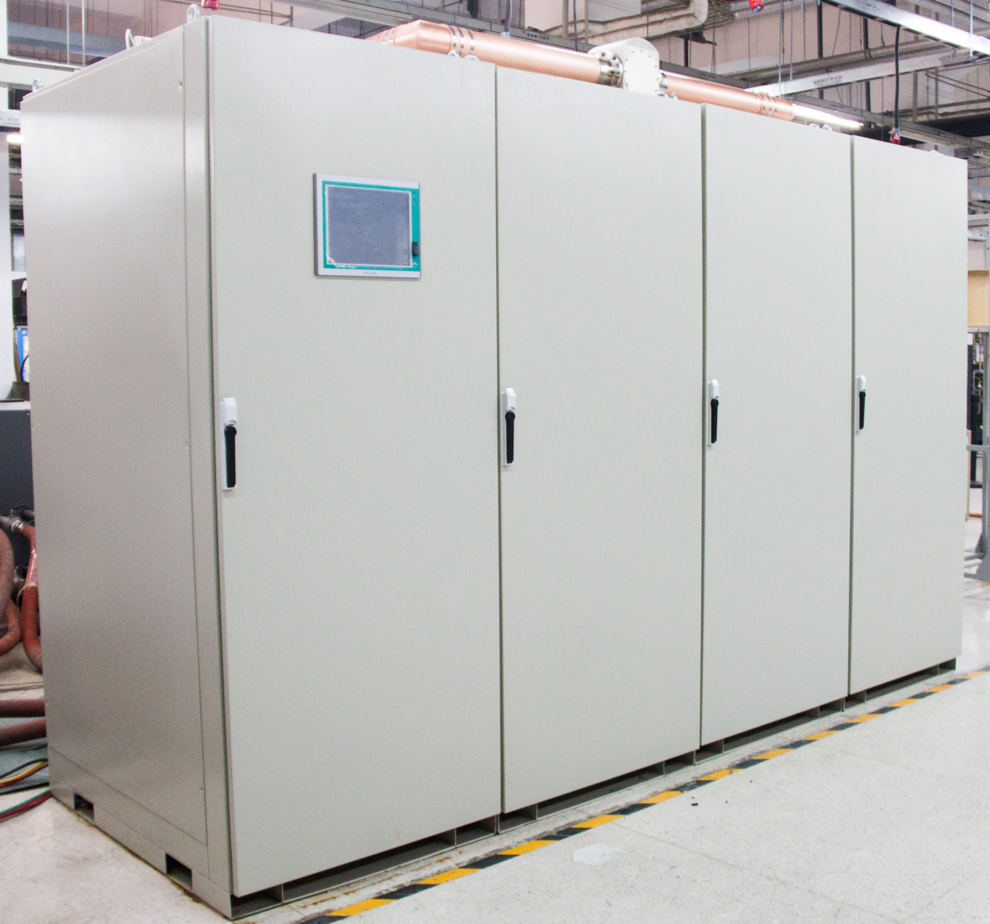
Beijing BBEF Science & Technology Co., Ltd.
北京北广科技股份有限公司
China Power source system - solid-state power amplifier
The application of China's all-solid-state RF power source in accelerator field has reached the international advanced level.
325MHz/80kW solid state power source of Institute of Modern Physics, Chinese Academy of Sciences (Lanzhou)
Notes:
Solid-state power source for accelerator has operated at different power levels and different frequency bands in China, that has been verified by experiments, such as 162.5MHz/80kW solid-state power source of Institute of Modern Physics of the Chinese Academy of Sciences, 650MHz/150kW solid state power source of Institute of High Energy Power (IHEP), and 1300MHz/20kW solid-state power source of Peking University. All of them have successfully operated with beam. A large quantity of experimental data has proved that the application of China's all-solid-state RF power source in accelerator field has reached the international advanced level.

Slide 7
Characteristics of solid state power source system

Slide 8
Beijing BBEF Science & Technology Co., Ltd.
北京北广科技股份有限公司
2、Characteristics of solid state power source system
Multistage Combiner to increase system output power;
Isolator is used for abrupt load characteristics;
Modular structure and layout:;
Notes:
Multistage Combiner to increase system output power; Due to the limitation of semiconductor technology, the output power of single solid tube is much lower. In order to get a larger system output power, multistage Combiner can realize this purpose. therefore, the stage of Combiner should be minimized in the design, so as to reduce the complexity of the system and improve system reliability. The total Combiner loss of the system is controlled less than 1.5 dB.
Isolator is used for abrupt load characteristics:, the solid-state power source is provided with an isolator to the output of the power amplifier to enhance the total reflection resistance of the power amplifier at present. the accelerator solid-state power source system mostly adopts distributed isolators in layout at present. so as to reduce the structure processing difficulty of isolator and absorption load.
modular structure and layout: The power amplifier single board has high structural consistency, convenient to make a standardized module structure, and convenient for the whole accelerator system to organize flexibly the system structure into a complete accelerator system with different power levels to meet different power requirements of accelerator system at all levels.

Slide 9
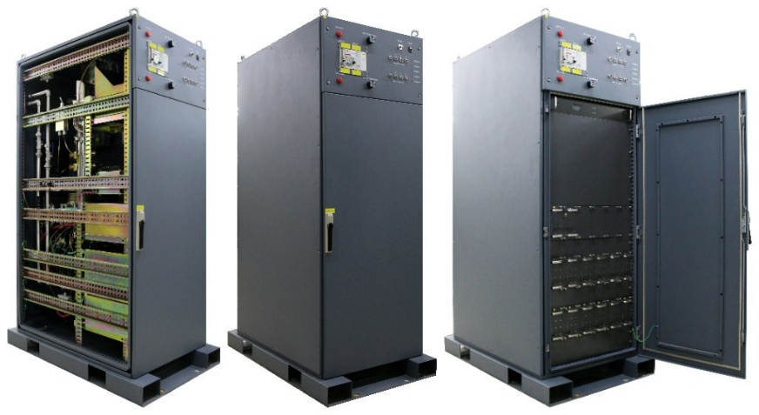
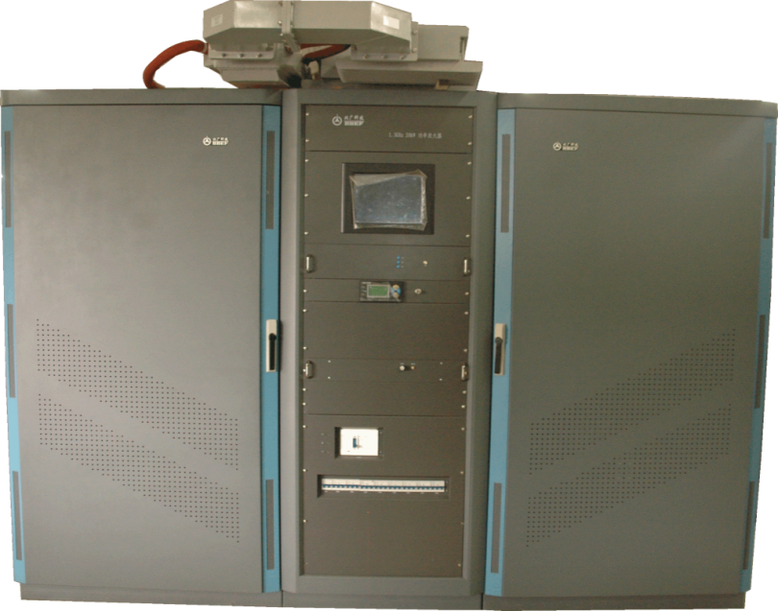
Beijing BBEF Science & Technology Co., Ltd.
北京北广科技股份有限公司
Application of solid state power source in other accelerator systems
SLAC1.3GHz/3.8kW solid-state power source
1.3GHz/20kW solid state power source of Peking University
Notes:
SLAC 1.3GHz/3.8kW solid-state power source
LCLS II project of U.S. SLAC adopts 1.3GHz/3.8kW solid-state power source. The efficiency of the whole machine reaches 42%, saving a lot of cost for long-term operation.
1.3GHz/20kW solid state power source of Peking University
The Institute of Physics of Peking University developed a 1.3GHz/20kW solid-state power amplifier for the superconducting accelerator in 2010..

Slide 10
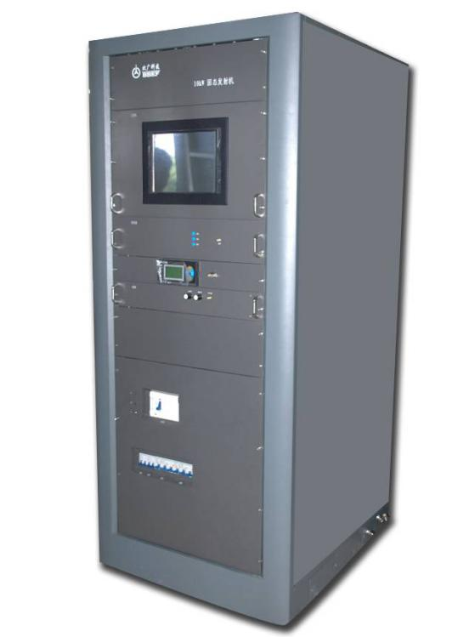
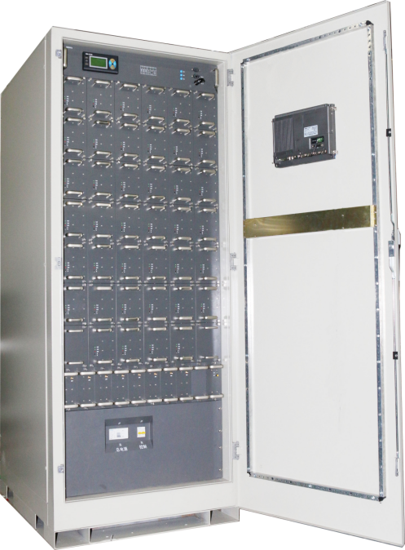
Beijing BBEF Science & Technology Co., Ltd.
北京北广科技股份有限公司
325MHz/10kW solid state power source for ADS by Institute of High Energy Physics, Chinese Academy of Sciences
162.5MHz/25kW solid state power source of ADS by Institute of Modern Physics of Chinese Academy of Sciences
Notes:
325MHz/10kW solid state power source project of Institute of High Energy Physics, Chinese Academy of Sciences.
162.5MHz solid state power source project of Institute of Modern Physics, Chinese Academy of Sciences in 2011 belongs to ADS pilot project.
The blind insertion structure has been developed successfully and the technical performance of the product had also been greatly improved after standardized and modular design. The efficiency of 24kW products could reach 60%. Compared with previous products, the efficiency had increased by 10%, so the operation cost could be greatly reduced.

Slide 11
Beijing BBEF Science & Technology Co., Ltd.
北京北广科技股份有限公司
4、Advantages and disadvantages of solid state power source compared with vacuum power source
From an economic point of view：In the case of ultra-high power amplification (megawatt level), the electronic vacuum amplifier has the advantages of large single-transistor power and lower initial investment. In the case of medium and small power amplification (100 kilowatts and below), the cost advantage of all-solid power source is more obvious；
technically speaking： the mismatch resistance of the electronic vacuum amplifier is better than that of the all-solid-state amplifier. All-solid-state amplifier is superior to electronic vacuum amplifier in performance index, reliability and maintainability.

Slide 12
Beijing BBEF Science & Technology Co., Ltd.
北京北广科技股份有限公司
Power amplifier of common frequencies and power levels in accelerator field
Different power advices in common use for accelerator
Device type | Frequency | Working mode | Single tube power
Vacuum tube Tetrode | 30~300MHz | CW & pulse | ~3MW
Inductive output tube IOT | 500-1500MHz | CW & pulse | ~100kW
Klystron | 220-18GHz | CW & pulse | ~1MW
MOSFET | 30~500MHz | CW & pulse | Single tube 1800W
 | 500-1000MHz | CW & pulse | Single tube 900W
 | 1000-1500MHz | CW & pulse | Single tube 750W
Notes:
As can be seen from the table, no power amplifier can cover full bands in the field of high-energy accelerators. In the electronic vacuum amplifier, the price of tetrode is relatively low, work is stable, but the working frequency is lower. IOT has higher efficiency, but when applied to accelerator field, it has low reliability; Klystron is the most widely used electronic vacuum amplifier in accelerator field. The klystron cannot cover completely the frequency range of 300 MHz to 10Ghz, there are frequency gaps, therefore, it is sometimes necessary to customize production according to the frequency and power of accelerator application. As the quantity is less and the cost is getting higher, the price is becoming more expensive.

Slide 13
Beijing BBEF Science & Technology Co., Ltd.
北京北广科技股份有限公司
Comparison between electronic vacuum amplifier and all-solid-state amplifier
Comparison between electric vacuum amplifier and solid-state amplifier
Device type | Advantages | Disadvantages | Application
Electronic vacuum amplifier | Single tube power is large; good reflection resistance; The initial cost is low. | Poor reliability; Narrow bandwidth; complex maintenance; the maintenance cost later is high; high voltage, X-ray. | MW level continuous wave amplification; when the high-power pulse is amplified, it has cost advantage.
All solid state amplifier | Small power of single tube, multi-module Combiner, high reliability; no high voltage, no x-rays; long device service life; simple service and maintenance; high amplitude and phase stability; Wide operating bandwidth. | High initial cost; Small power of single tube; the device itself has poor mismatch resistance. | Continuous wave amplification below 100kW has good cost advantage. The output is less affected by the power supply and it is easier to ensure technical indexes.
Notes:
The comparison is listed in the table. In general, all-solid-state amplifier is powered by low voltage power and formed by multi-module parallel Combiner, therefore, the damage of individual module has less influence on the overall performance and the reliability is higher than that of electronic vacuum amplifier. The price of single module of the all-solid-state amplifier is lower, the repair cost is low when damaged, and the module has no high voltage and can be replaced online. In addition, the single tube has long service life, All-solid-state amplifiers generally adopt single tube or single module plus circulator to solve the problem of adaptability.

Slide 14
key technology & Application prospect

Slide 15
Beijing BBEF Science & Technology Co., Ltd.
北京北广科技股份有限公司
Key technologies of solid state power source
High efficiency power amplification technology
Power Combiner technology
Total reflection resistance technology
Water cooling power supply technology
Blind insertion of functional units
Low level control technology
Notes:
5.1 High efficiency power amplification technology
All-solid-state power source has high-power output obtained by several basic amplification units through power Combiner, therefore, the power amplification module is the most basic unit. The efficiency, power and basic electrical parameters of the module determine the performance of the whole device. Various power amplifier units with series of frequencies have been developed as solid-state power source at present, so we have mastered the high-efficiency amplification technology. Meanwhile, work stability of the power amplification module is greatly improved also by designing the input-output matching circuits, so that high efficiency output can be realized at both high power and low power levels.
5.2 Power Combiner technology
In order to improve Combiner efficiency, Combiner loss shall be reduced as much as possible. The most effective method is to reduce Combine levels. Major technologies include: High-efficiency and high-power Combiner is realized by adopting microstrip lines, coaxial lines, waveguide cavity Combiner and other forms. The microstrip line ensures the manufacturing process to be reliable. Suspended strip line method solves the problem of power resistance; The coaxial Combiner method achieves balance with minimal loss; As the number of branches is changed and adjusted, more paths Combiner can be realized conveniently. The solid-state power source has gradually improved the high-power Combiner technology in various wave bands at present. The maximum power output also exceeds 200kW.
5.3 Total reflection resistance technology
The load of the accelerator power source is cavity, especially in superconducting cavity applications, total reflection often occurs. Therefore, total reflection resistance is the most important requirement of solid-state power source. By adopting the internal isolation technology of the power amplifier module, the reflected power is guided to the internal absorption load, so the power amplifier circuit will not be damaged. In addition, the transmission inconsistency is reduced due to the reliability of the microstrip power divider and the coaxial power combiner of the power divider and combiner, ensuring that the consistency of total gain and total phase of each power amplification unit reaches the best, balanced distribution of reflected power. The output cable of each power amplifier module, the output port and transmission of each synthesizer are specially designed and can resist total reflection at any phase.
5.4 Water cooling power supply technology
One power supply module provides power to one power amplifier module. Both modules share same water cooling plate and are formed together as a power amplifier unit. The power supply has its own MCU, which collects state parameters required such as voltage, current, temperature and the like. The startup and protection are controlled by hardware, which has fast protection functions such as over temperature, over current, over voltage, etc. The power module output voltage can be adjusted by software and panel. When the output power of the solid-state power source shall be reduced, the working point of the power amplifier can be adjusted by adjusting DC voltage, so that the whole machine still works in a high-efficiency working condition.
5.5 Blind insertion of functional units
The maintenance of solid-state power source requires each functional unit to have a blind insertion structure. The power high frequency connector is developed by selecting and combining water connector and electric connector. The blind insertion technology of the power amplifier unit is realized through positioning, guide rail and support frame. The functional modules can be replaced conveniently and quickly.
5.6 Low level control technology
Operation mode switching of all solid-state power source, amplitude and phase control, modulation of pulse waveform, and the temperature drift during operation, dynamic compensation of phase drift require fast and accurate adjustment and control by low-level control system. Therefore, the sampling accuracy of the low-level control system, fast response time, control accuracy of amplitude and phase, accuracy of temperature compensation all play a vital role in the overall performance of solid-state power source system. The low-level control system adopts fast sampling device, high-speed processor at present, combined with the distributed control platform to form the system, they can meet the requirements of solid-state power source system on signal system control.

Slide 16
Beijing BBEF Science & Technology Co., Ltd.
北京北广科技股份有限公司
Application prospect of solid state power source in accelerator
Series of solid-state power source products at present
1. Working frequency
1.5MHz/81.25MHz/204MHz/325MHz/352MHz/650MHz/1.3GHz
2,Output power:
10kW/20kW/25kW/45kW/80kW,/150kW/180kW/200kW/260kW,

Slide 17
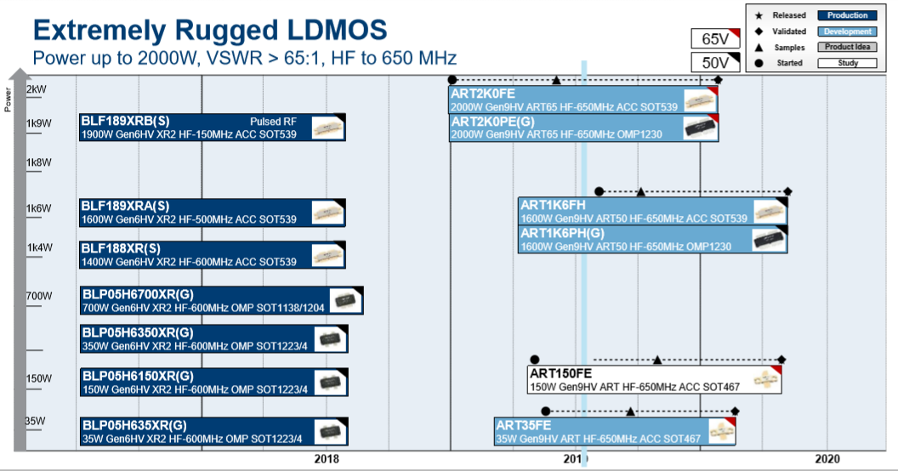
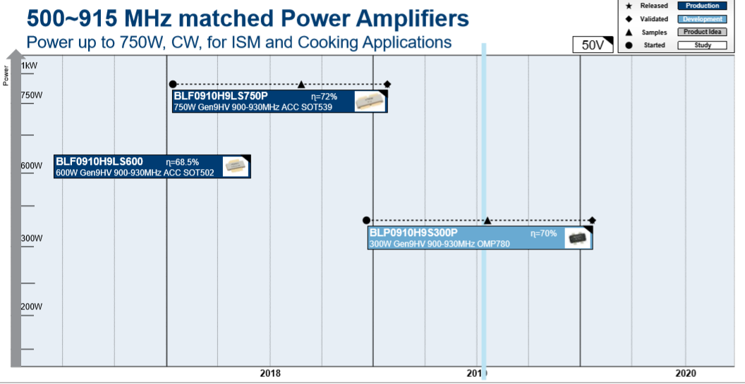
Beijing BBEF Science & Technology Co., Ltd.
北京北广科技股份有限公司
Notes:
The figure shows the development roadmap of solid-state power source for 30-650MHz and 500-915MHz high-power solid-state power amplifiers. The maximum output power of single amplifier in 30-650MHz frequency band is 1800W at present and expected to reach 2kW in this frequency band by 2020. The maximum output power of single amplifier in the frequency band of 500-915MHz is 600W at present and reaches 750W in this band in 2019. The maximum output power of single amplifier in this frequency band is expected to reach 900W by 2020. The maximum output power of single amplifier in 900-1500MHz frequency band is 750W at present and is expected to reach 900W in this frequency band by 2020.

Slide 18
Beijing BBEF Science & Technology Co., Ltd.
北京北广科技股份有限公司
Conclusion
The solid-state RF power develop direction of accelerator power source to replace vacuum power source by solid-state RF power source for large accelerators.
The long-term operation with beam prove that solid-state power source technology has gradually matured and pointed out the direction with higher frequency and larger power for the next generation of accelerator.
Notes:
WU

Slide 19
Beijing BBEF Science & Technology Co., Ltd.
北京北广科技股份有限公司
Thank you.

