Slide 1

SLHiPP-9
Status and new developments of HIAF
High-Intensity Heavy Ion Accelerator
Jiancheng Yang
Institute of modern physics, CAS
26 September, 2019, Lanzhou

Slide 2
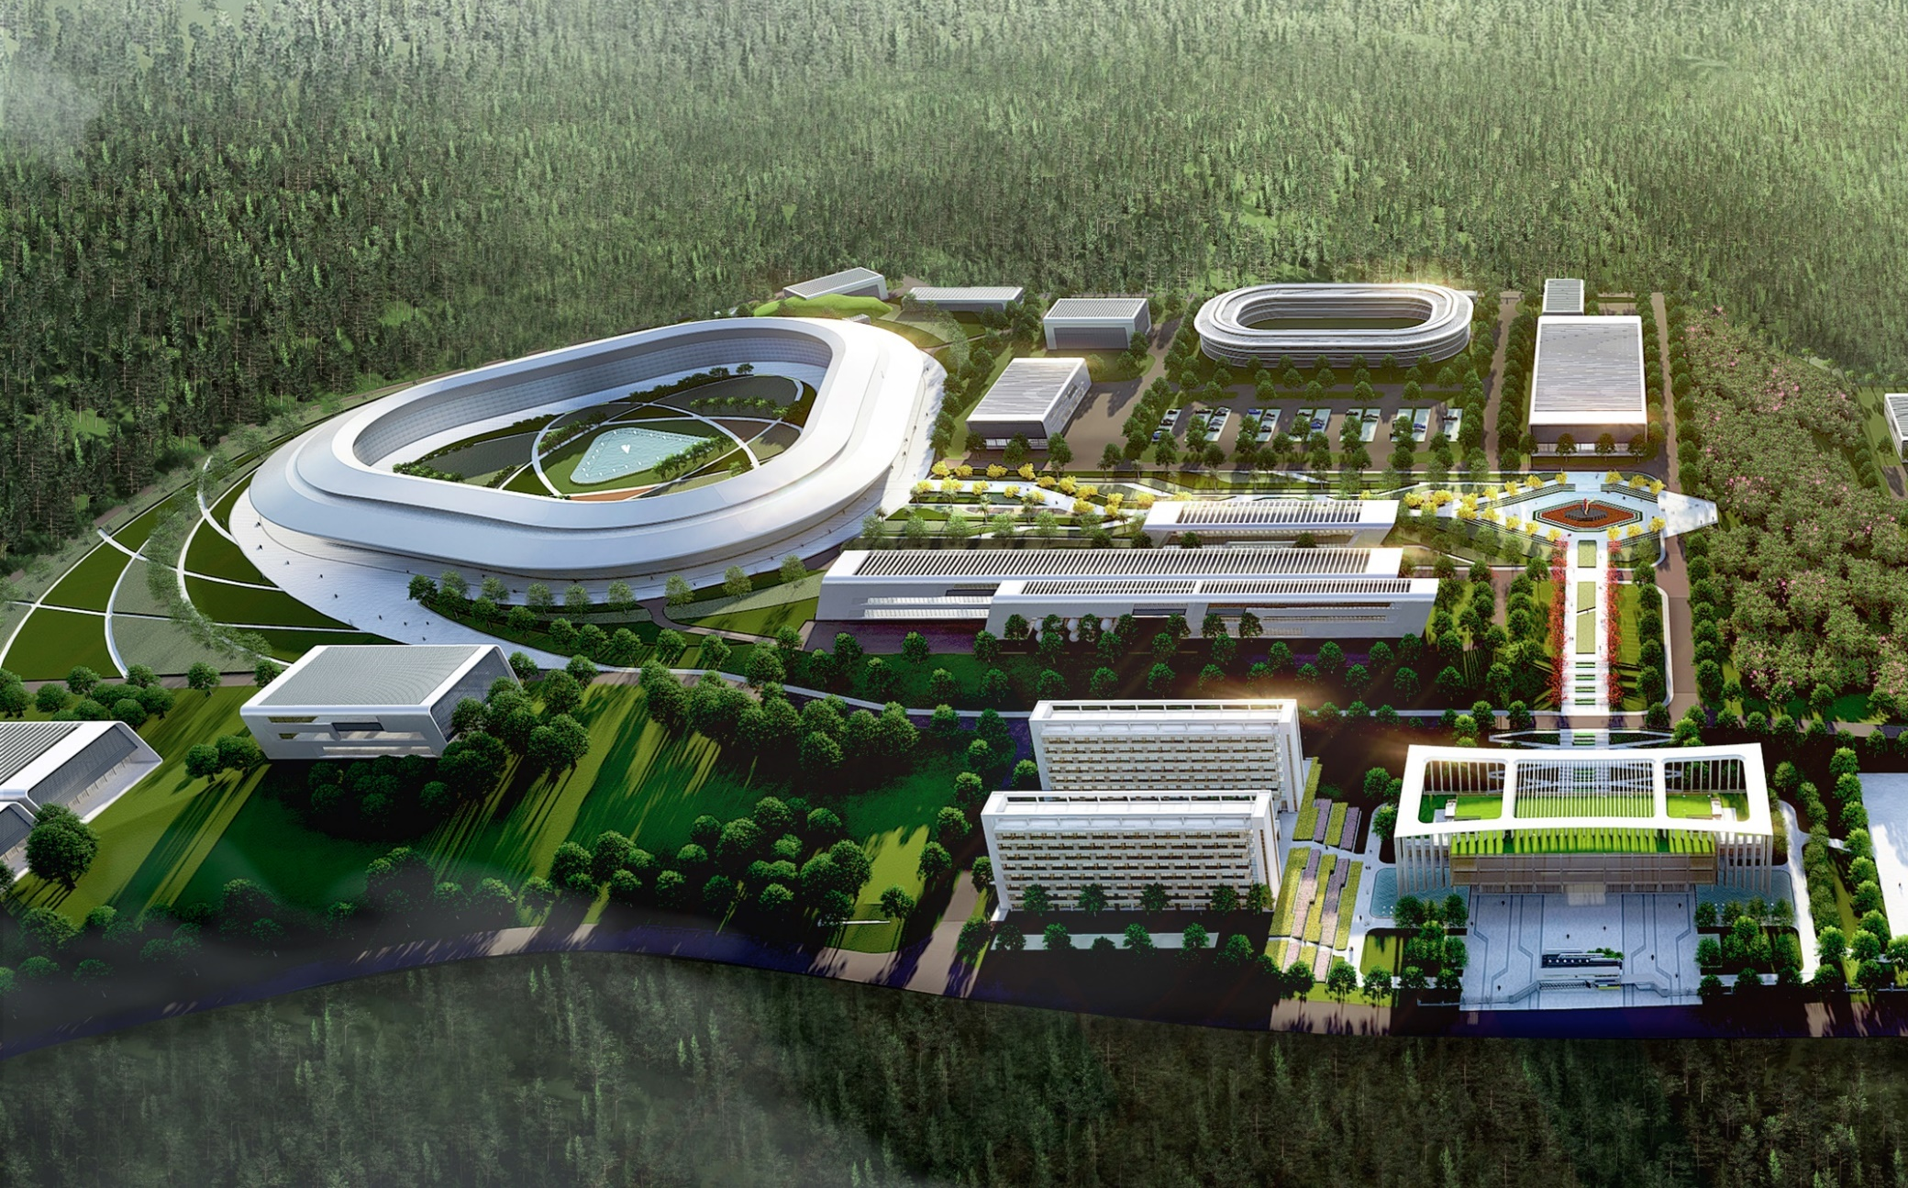
HIAF introduction and status
High-Intensity Heavy Ion Accelerator Facility-HIAF

Slide 3
Outline
Background and science motivations
General description of project
Design concept and unique features
Innovative technologies and developments
Present status and summary
Notes:
In my talk, I will give a brief introduction of HIAF status, because the proposed EicC will be constructed in the same campus of HIAF, and some of main accelerator components will be used for EicC. So the construction progress is very important for EicC.

Slide 4
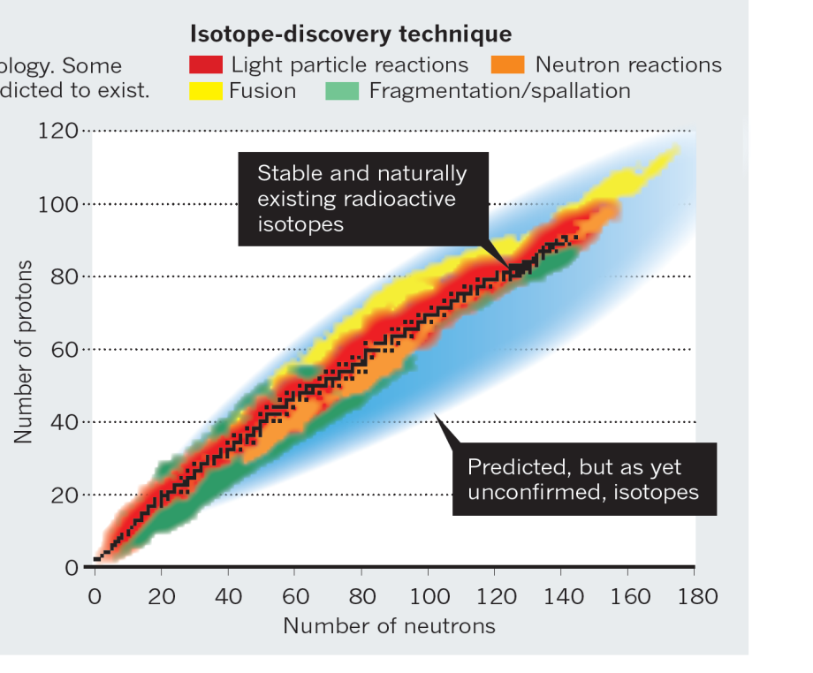
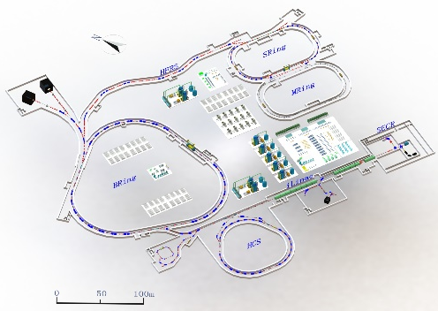
HIAF introduction and status
Next-generation high intensity facilities are required for advances in
nuclear physics and related research fields:
Fascinating and crucial questions
To explore the limit of nuclear existence
To study exotic nuclear structure
Understand the origin of the elements
To study the properties of High Energy
and Density Matter
……
Available today
Next-generation facilities are being constructed or proposed worldwide:
SPIRAL2 at GANIL in Caen, France
FAIR at GSI in Darmstadt, Germany
FRIB at MSU in the U.S.
NICA at JINR, Dubna, Russia
EURISOL in Europe
High Intensity Heavy-ion
Accelerator Facility
HIAF in China

Slide 5
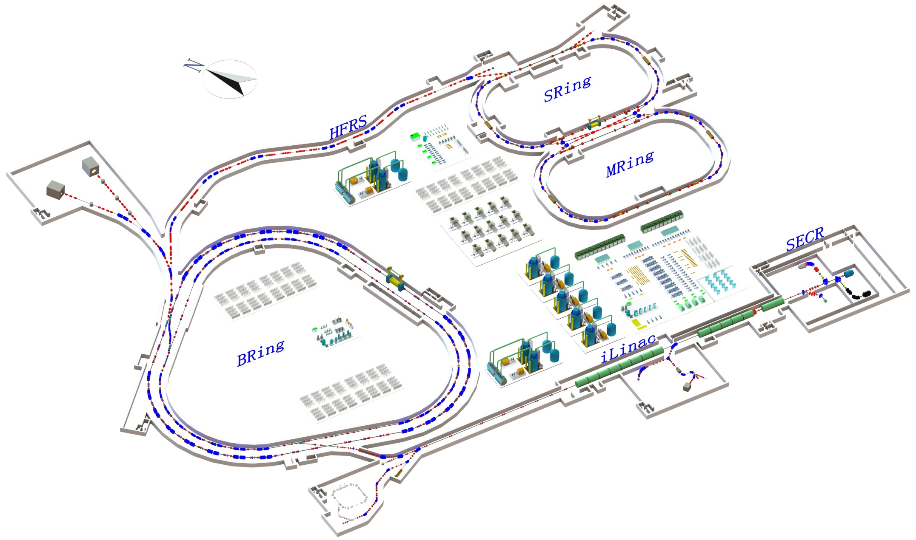
HIAF introduction and status
Main accelerator components
SRing: Spectrometer ring
Circumference: 273m
Rigidity: 13-15 Tm
Electron/Stochastic cooling
Two TOF detectors
Four operation modes
BRing-S: Booster ring
Circumference: 650 m
Rigidity: 86 Tm
Beam stacking
Beam acceleration
L: 180m, Bρ: 25 Tm
MRing: Figure “8” ring
Circumference: 273m
Rigidity: 15 Tm
Ion-ion merging
BRing-N: Fast cycle ring
Circumference: 570 m
Rigidity: 34 Tm
Large acceptance (250/120)
Two planes painting injection
Fast ramping rate（5-10Hz, 20Hz）
iLinac: Superconducting linac
Length:100 m
Energy: 17-22 MeV/u(U³⁵⁺⁻⁴⁵⁺)
These tunnels will be built in a cut and cover method and will be filled with 5 m overlay of soil. This conforms to the requirements of radiation safety.
Notes:
The design concept and layout of HIAF facility has evolved from the scientific requirements. This is the whole layout of the HIAF accelerator, it consists of superconducting ECR source, superconducting linac as injector, synchrotron booster, radioactive beam separator, and storage rings for in-ring experiments. ECR source is the next generation ECR source with high operation frequency, the superconducting linac can provide the highest intensity heavy ion beam for low energy research and synchrotron injection. The output energy is the about 17-25MeV, we keep the free space for update to 100MeV/u in the future. The central part of the HIAF facility is a synchrotron complex consisting of two rings. Both rings have nearly the same circumference and will be installed in the same tunnel.

Slide 6

HIAF introduction and status
Unprecedented parameters and unique features:
Highest beam Intensity （Comparison with HIRFL）:
Primary beam intensity increases by x 1000 - x 10000
Secondary beam intensity increases by up to x 10000
Highest heavy ion beam intensity in the world
Precisely-tailored beams - Precision frontiers
Beam cooling (Electron, Stochastic, laser; high quality, very small spot )
Beam compression (Ultra-short bunch length: 50-100ns)
Super long period slow extraction (Super long, high energy, quasi-continuous beam )
Versatile operation modes:
Parallel operation, beam splitting ( increase of target time, high integrated luminosity)
Parallel mode
Chopper
Switch
iLinac
Switch
BRing-N
SECR
Notes:
With this design concept and layout, HIAF can provide unprecedented parameters and unique features for research program. Such as beam intensity, if compare with our exiting facility HIRFL, the

Slide 7
HIAF introduction and status
Heavy ion beam intensity
 | Ions | Energy | Intensity
SECR | ²³⁸U³⁵⁺ | 14 keV/u | 0.05-0.1 pmA
iLinac | ²³⁸U³⁵⁺ | 17 MeV/u | 0.028-0.05 pmA
BRing-N | ²³⁸U³⁵⁺ | 0.8 GeV/u | ~2.0×10¹¹ ppp
BRing-S | ²³⁸U³⁵⁺ | 2.3 GeV/u | ~1.0×10¹² ppp
 | ²³⁸U⁷⁶⁺ | 5.8 GeV/u | ~5.0×10¹¹ ppp
 | ²³⁸U⁹²⁺ | 7.3 GeV/u | ~5.0×10¹¹ ppp
SRing | RIBs: neutron-rich, proton-rich | 0.84 GeV/u(A/q=3) | ~10⁹⁻¹⁰ ppp
 | Fully stripped heavy ions H-like, He-like heavy ions | 0.8 GeV/u(²³⁸U⁹²⁺) | ~10¹¹⁻¹² ppp

Slide 8
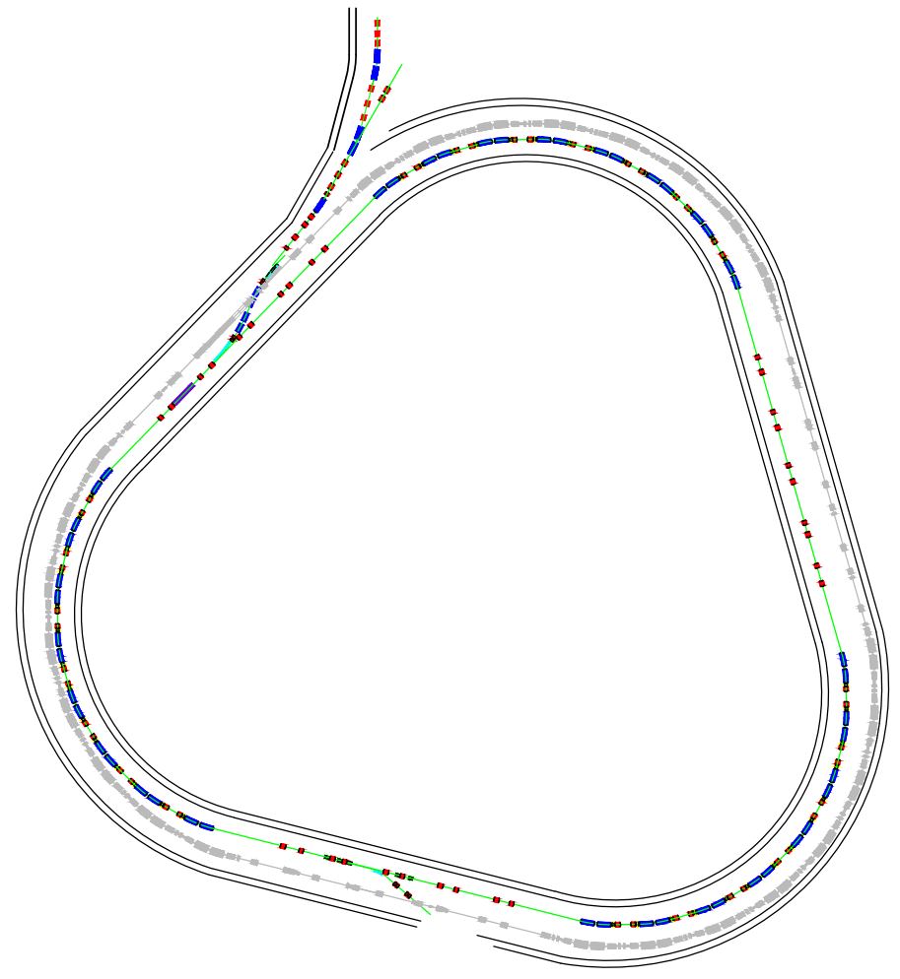
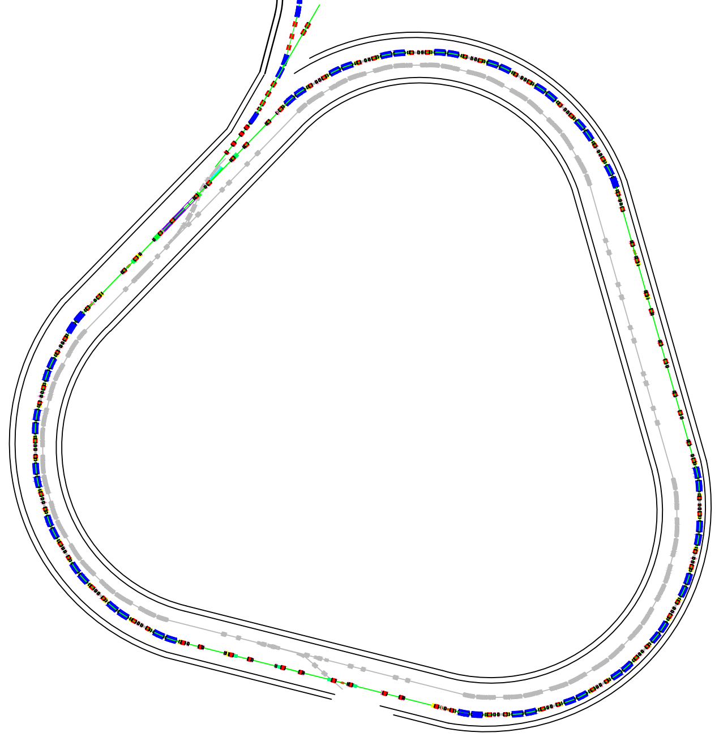
High intensity beam
Concepts for approaching the highest heavy ion intensity
BRing-N
Novel two planes painting injection scheme - 2.0×10¹¹ ppp
Fast ramping rate operation mode- 3-5 Hz
BRing-N
Barrier bucket stacking longitudinal
BRing-S
Innovative timing system of RF synchronization
5 times increase of intensity
1.0×10¹² ppp
BRing-S

Slide 9
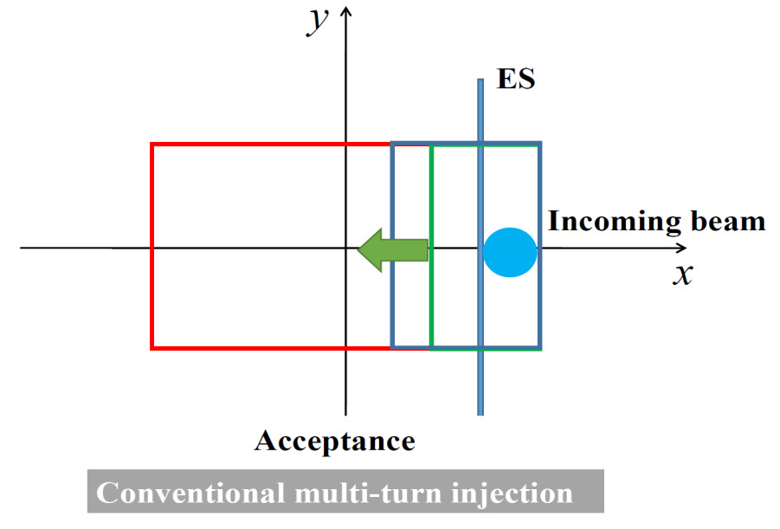
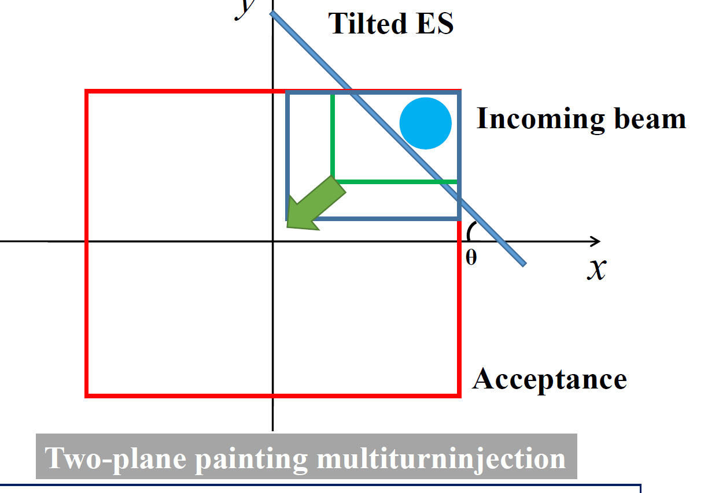
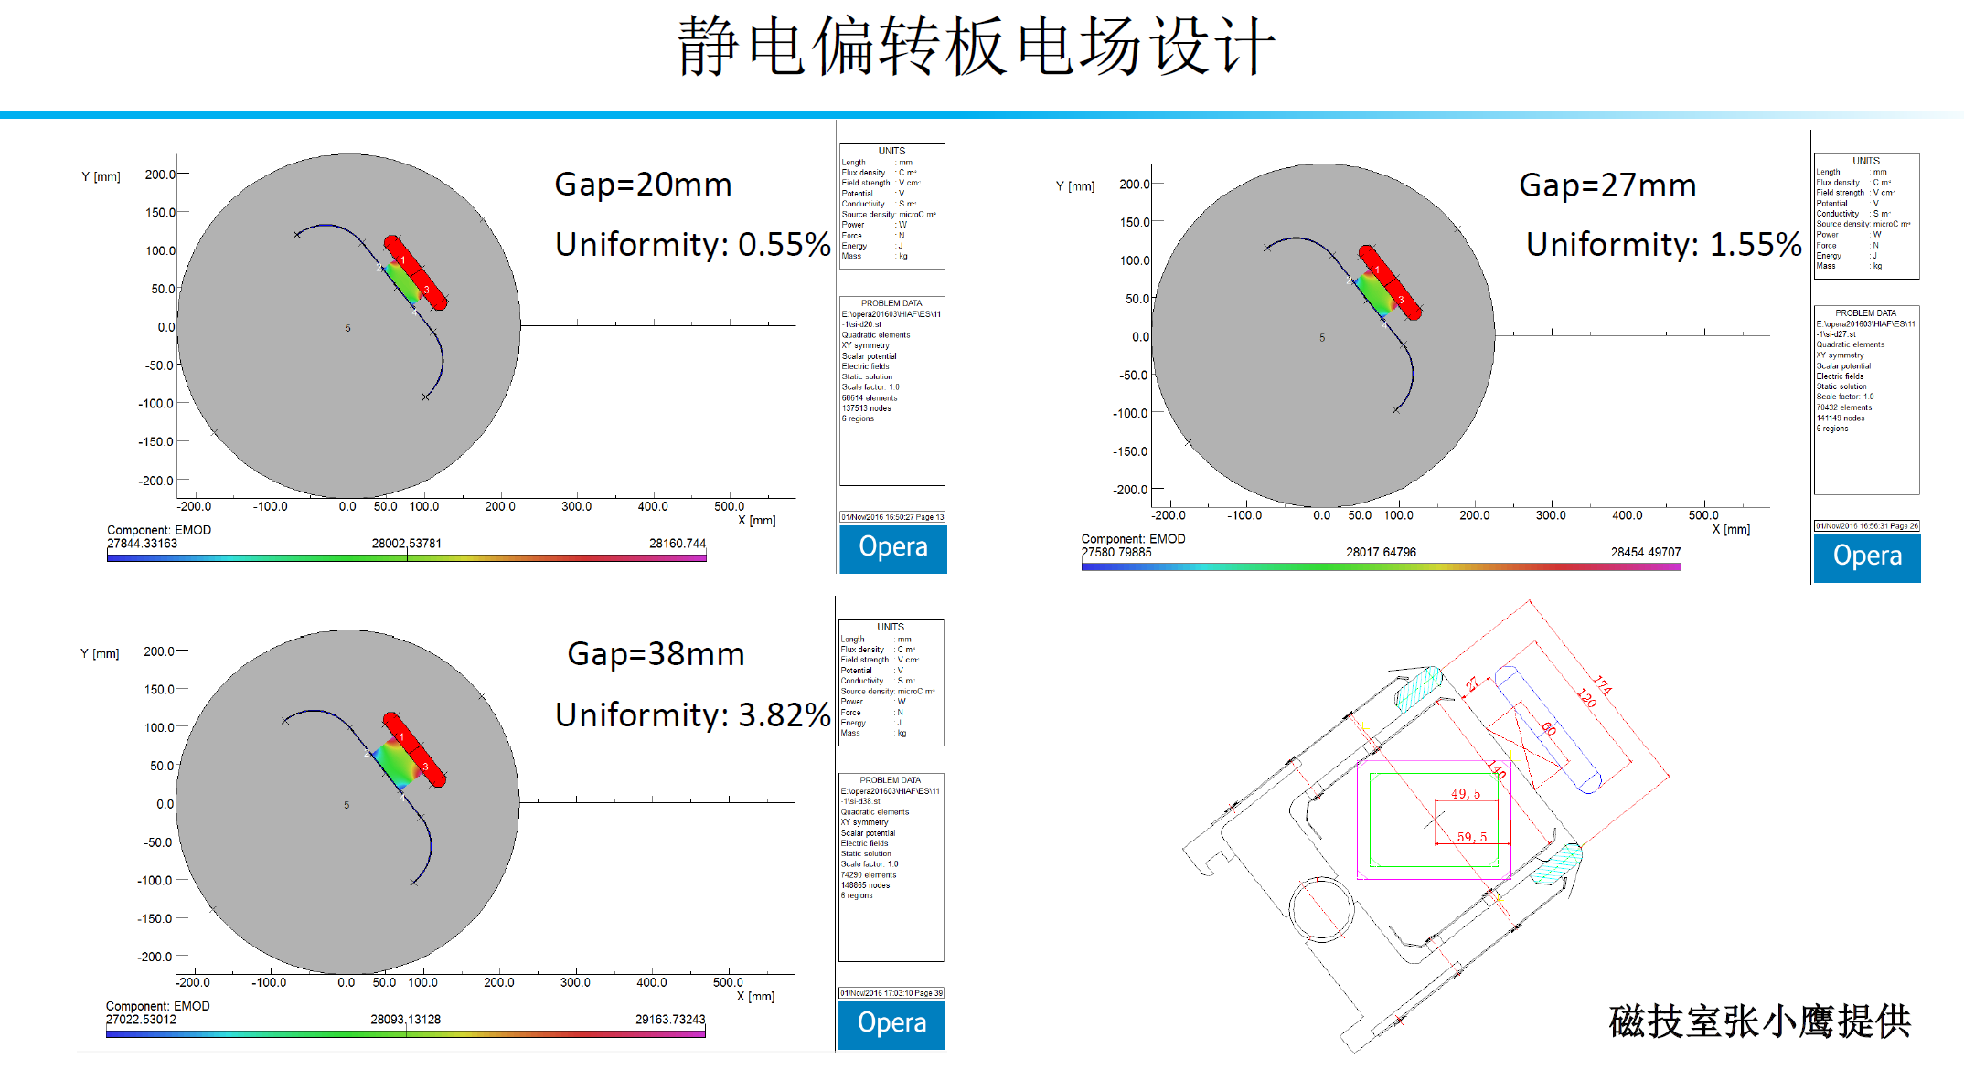
High intensity beam
Two planes painting injection
Simultaneous injection in H and V planes using tilted septum

Slide 10
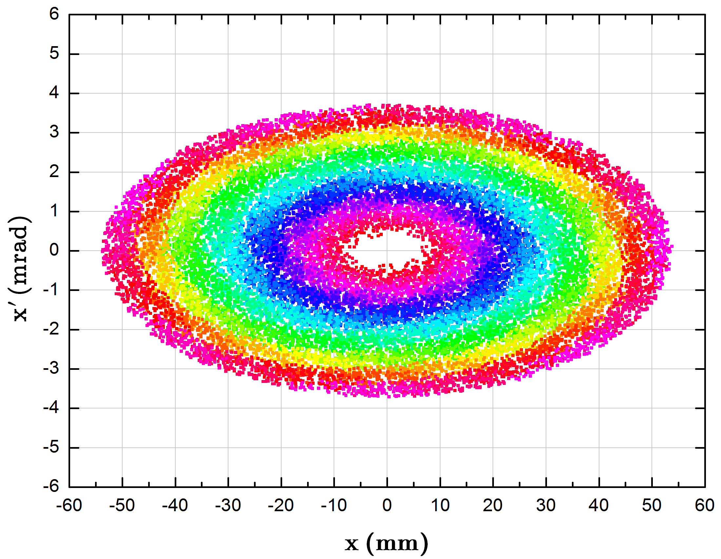
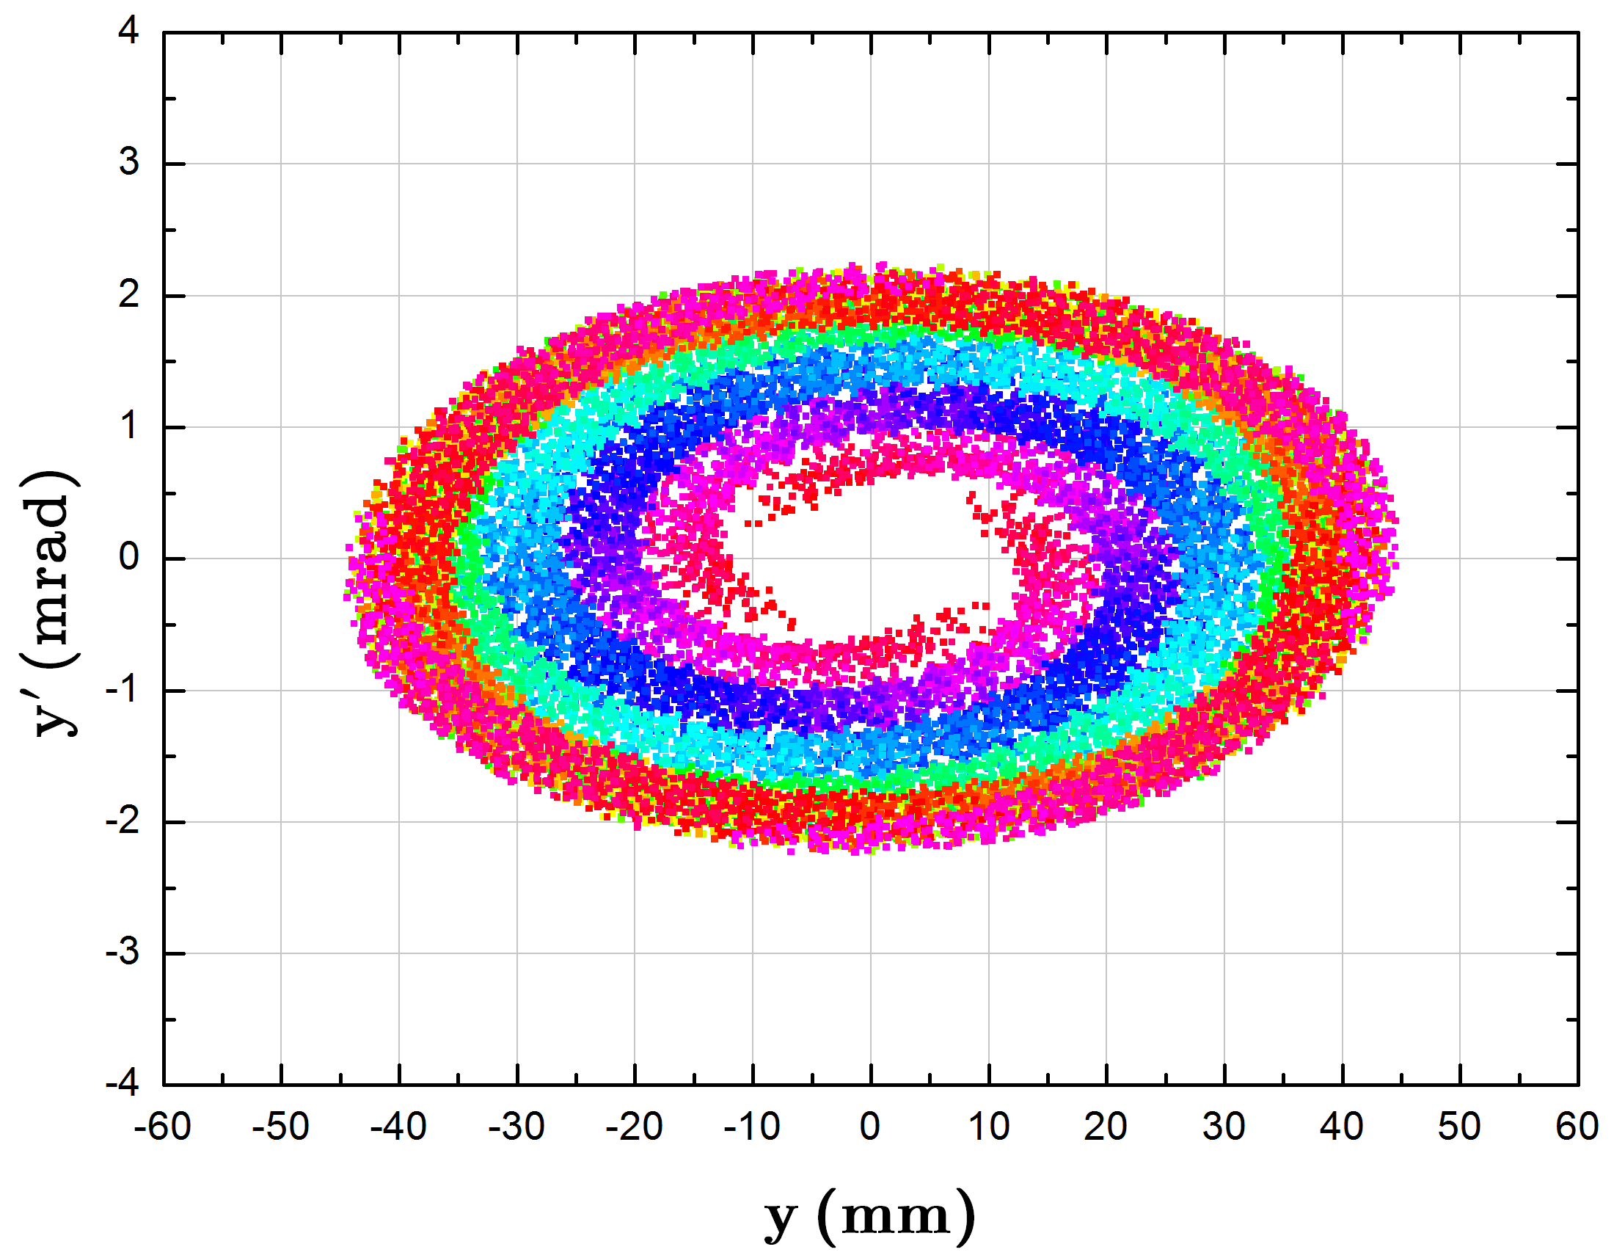
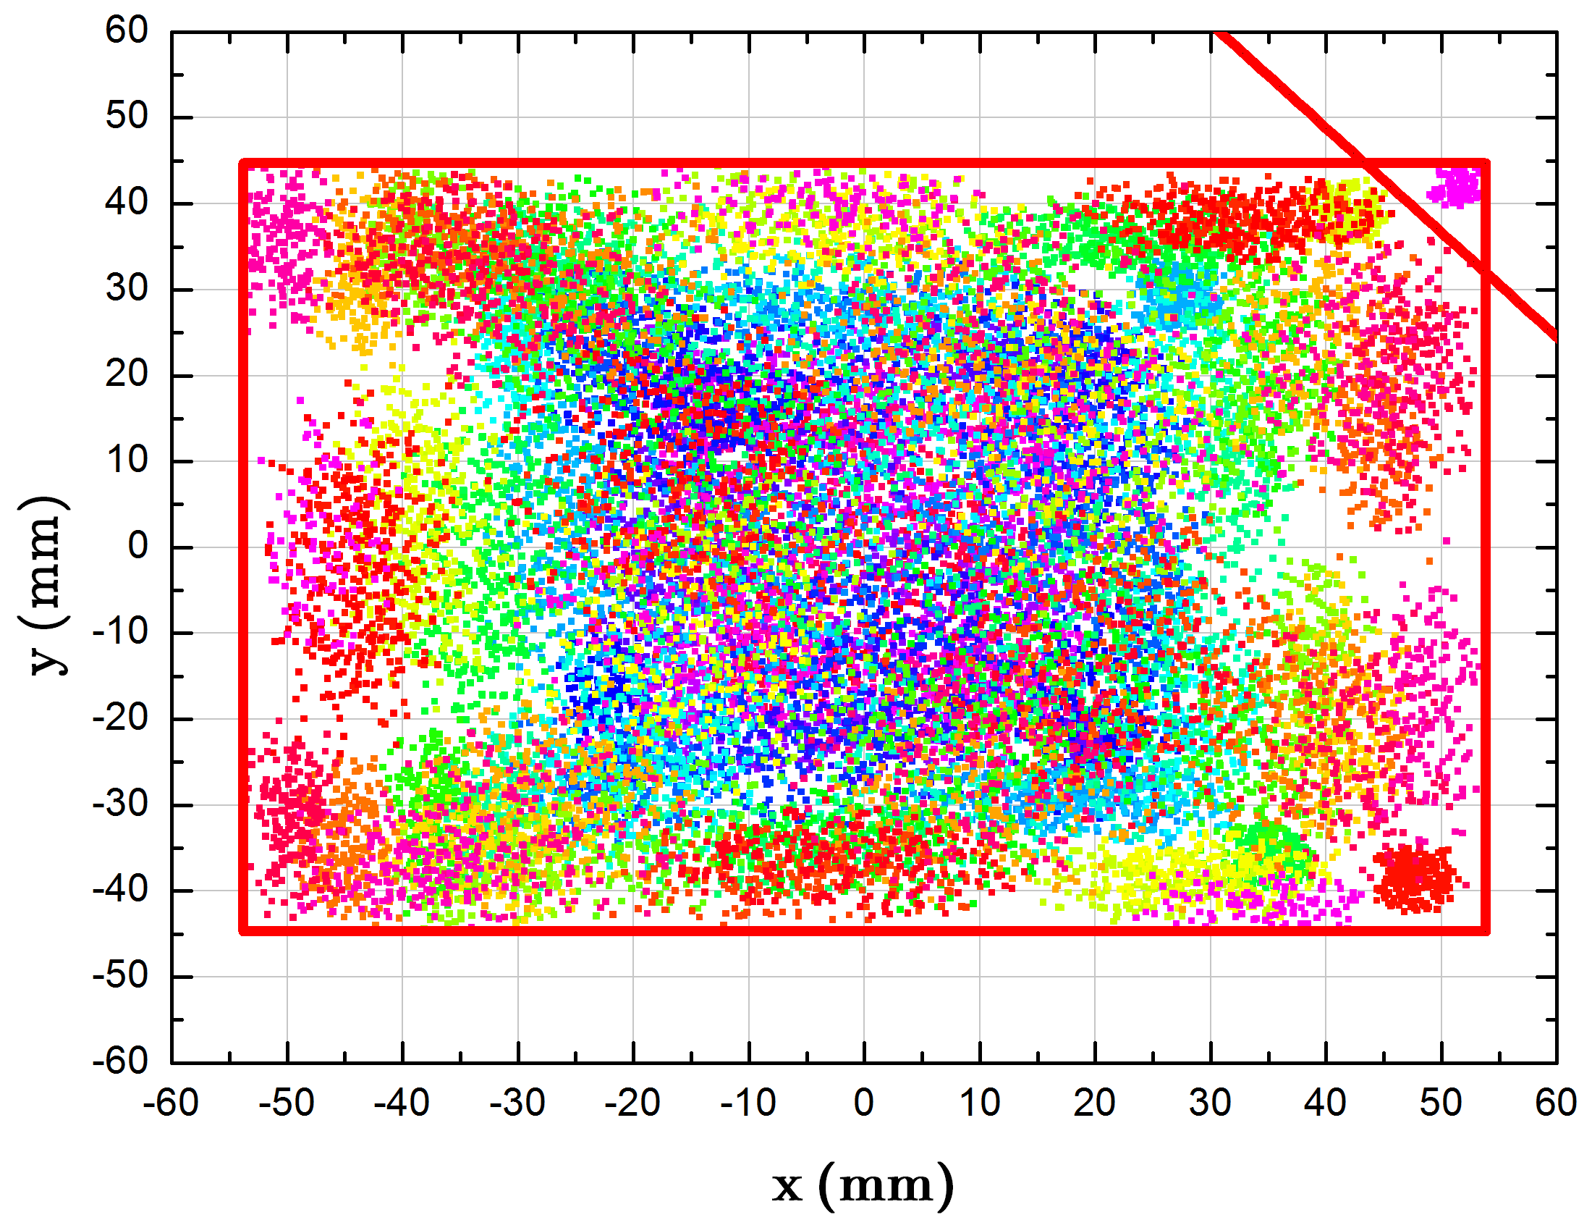
High intensity beam
Simulation results
Ions | Plane | Injection Turns | Single injection
²³⁸U³⁵⁺ | H | 33 | 3.3×10¹⁰
 | V | 16 | 1.6×10¹⁰
 | H+V | 150 | 2.0×10¹¹
The beam intensity could reach 2.0 ×10¹¹ with two planes painting, nearly 10 times over the conventional single-plane injection.

Slide 11
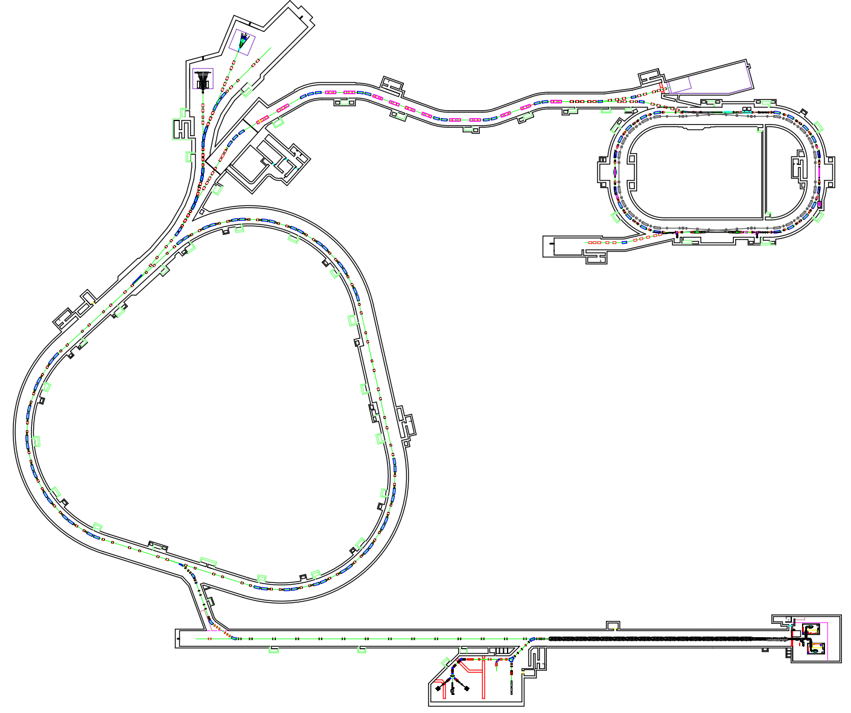
HIAF: First phase
HFRS
HFRS: Radioactive beam line
SRing
L: 180m, Bρ: 25 Tm
BRing
SRing: Spectrometer ring
Circumference: 273m
Rigidity: 13-15 Tm
Electron/Stochastic cooling
Two TOF detectors
Four operation modes
BRing: Fast cycle ring
Circumference: 590 m
Rigidity: 34 Tm
Large acceptance (250/120)
Two planes painting injection
Fast ramping rate（5-10Hz）
iLinac
SECR
iLinac: Superconducting linac
Length:100 m
Energy: 17-22 MeV/u(U³⁵⁺⁻⁴⁵⁺)
SECR:
Superconducting ECR source

Slide 12
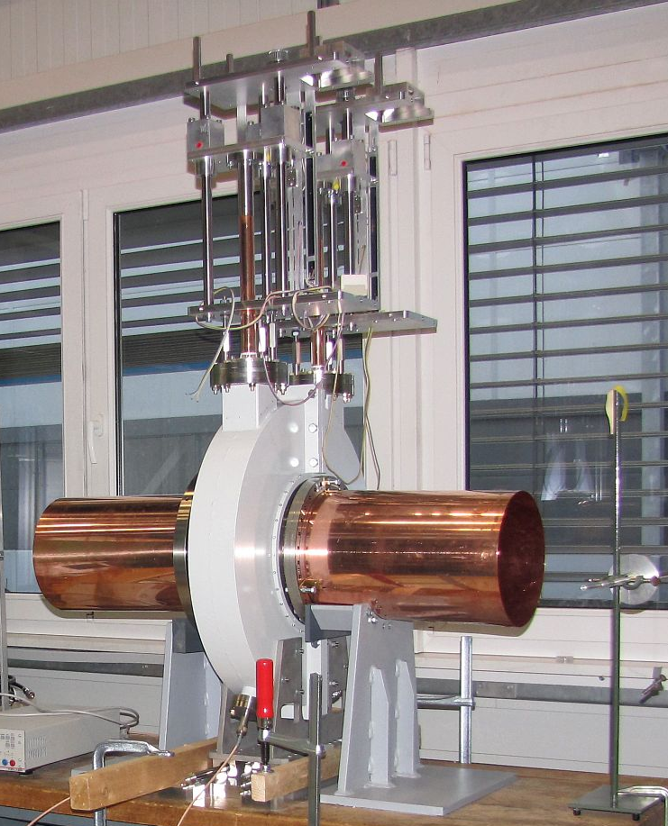
HIAF: Experiment terminals
External target station
Nuclear Matter study-CEE
Hypernuclear
High energy irradiation
RIBs physics station
HFRS
SRing
e-ion recombination
spectroscopy
High Energy
Density Physics
Terminal
High precision
spectrometer ring
BRing
iLinac
SECR
Low energy irradiation
Low energy nuclear
structure terminal
Around the whole facility, there are a series of experiments terminals

Slide 13
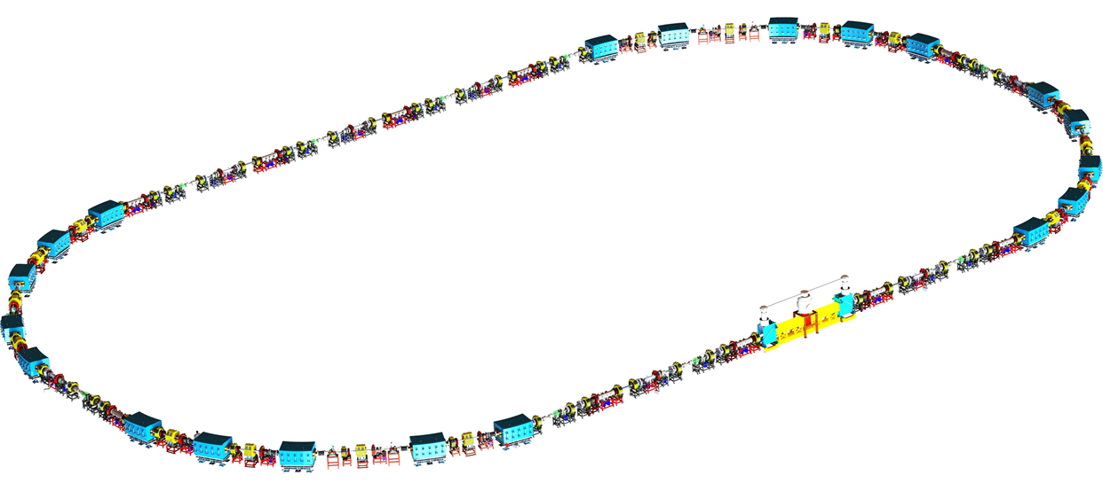
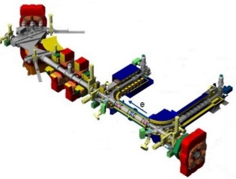
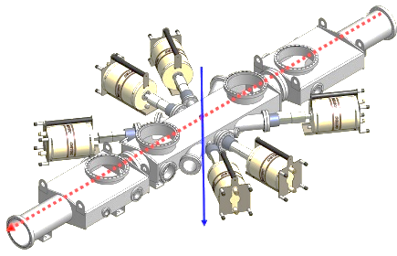
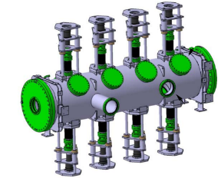
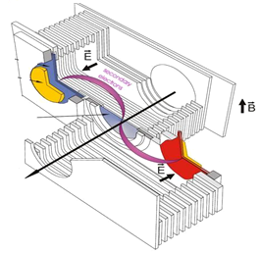
HIAF introduction and status
Unique feature-1
Multi-function storage ring
Key devices
  Electron cooling
  Stochastic cooling
  Two TOF detectors
  Electron target
Operation modes
  Isochronous mode
  Normal Mode
  Internal-target Mode
  Ion-ion merging Mode
Experiment programs
  Gas-jet target experiments
  DR experiments
  IMS & SMS
  Ion-ion merging experiments
Electron target
SRing
Gas-target
TOFdetector
Stochastic cooling pick-up
Precision frontiers machine for in-ring experiments
Notes:
Storage ring is unique in their capability to store, cool, bunch and stretch beams and thus fulfill the stringent requirements from experiments. For SRing, advanced cooling technologies, including the electron cooling, stochastic cooling and laser cooling will be used, we designed different operation modes for different research programs, such as …..

Slide 14
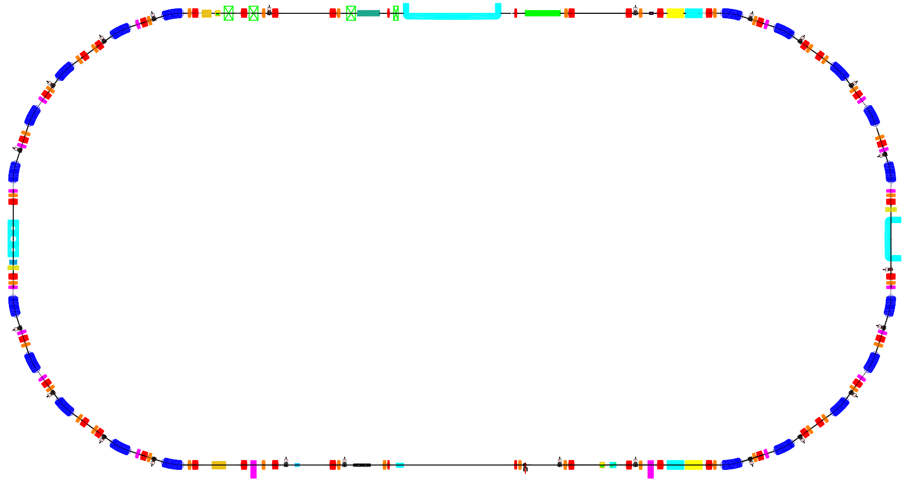
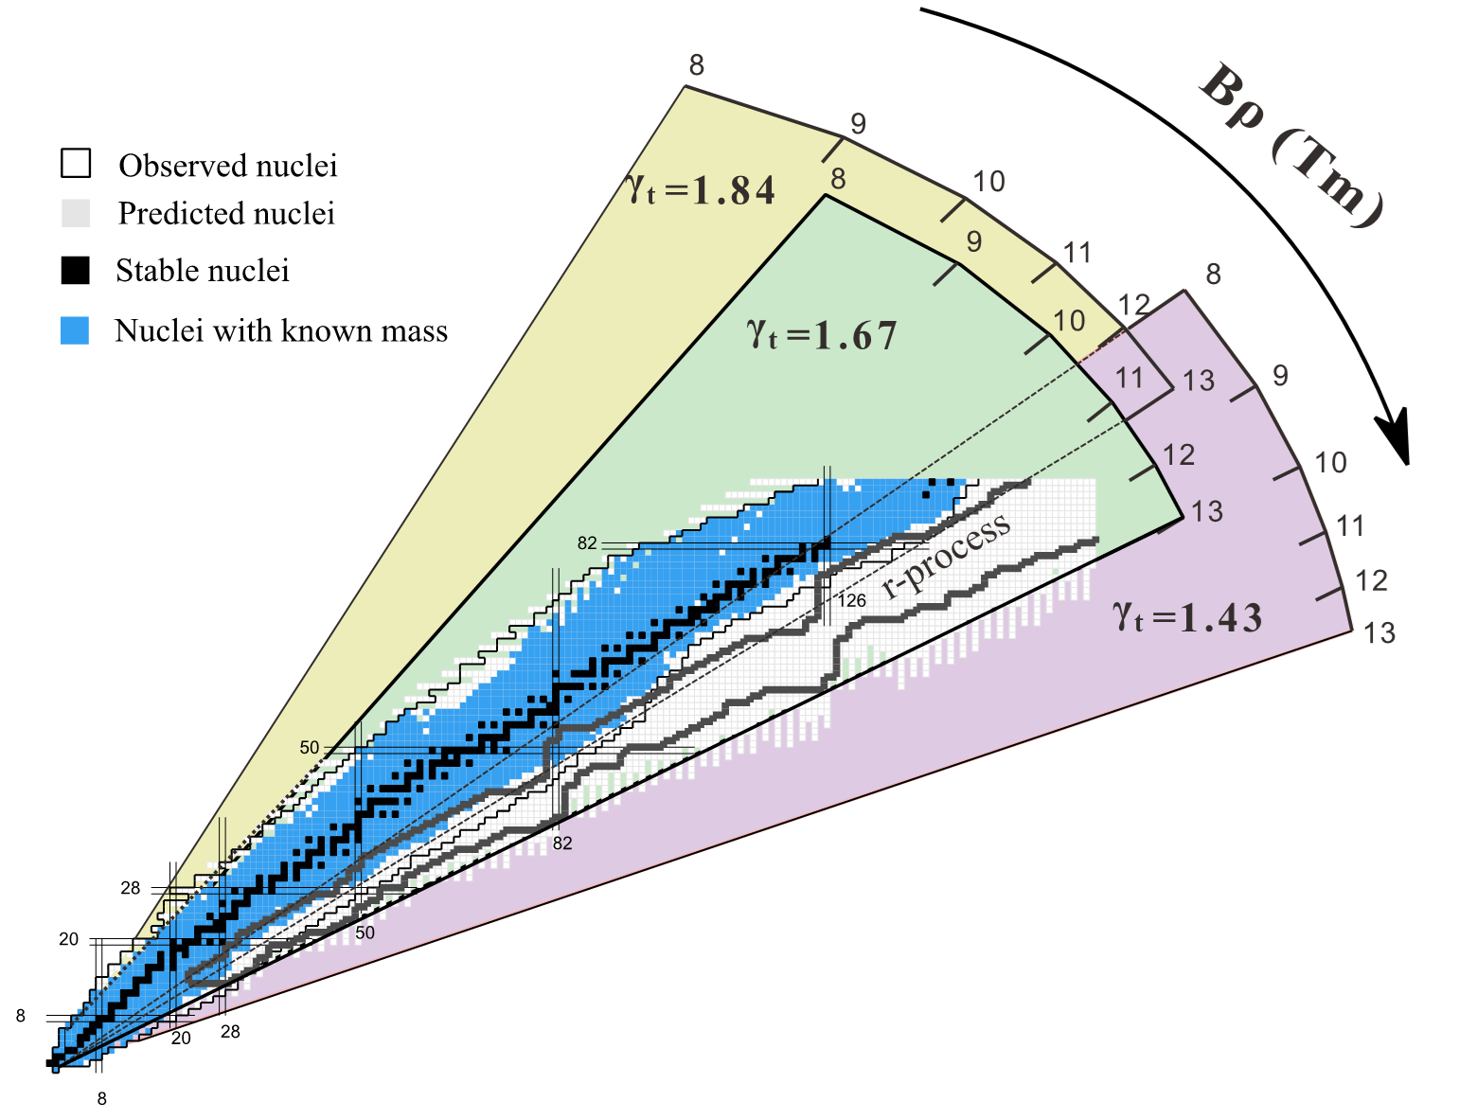
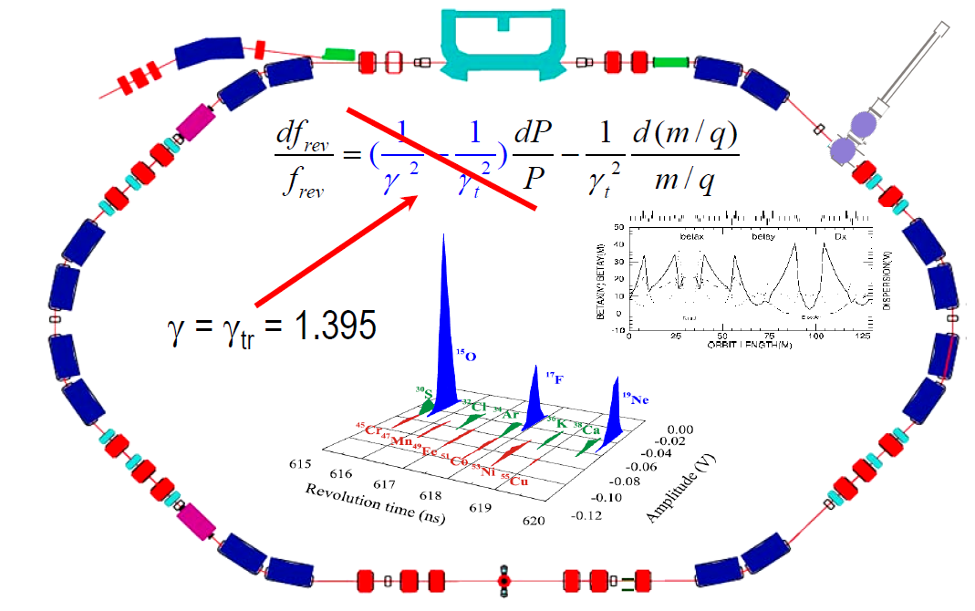
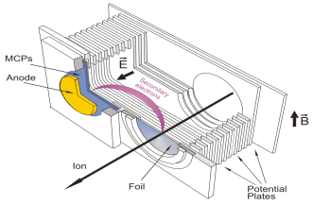
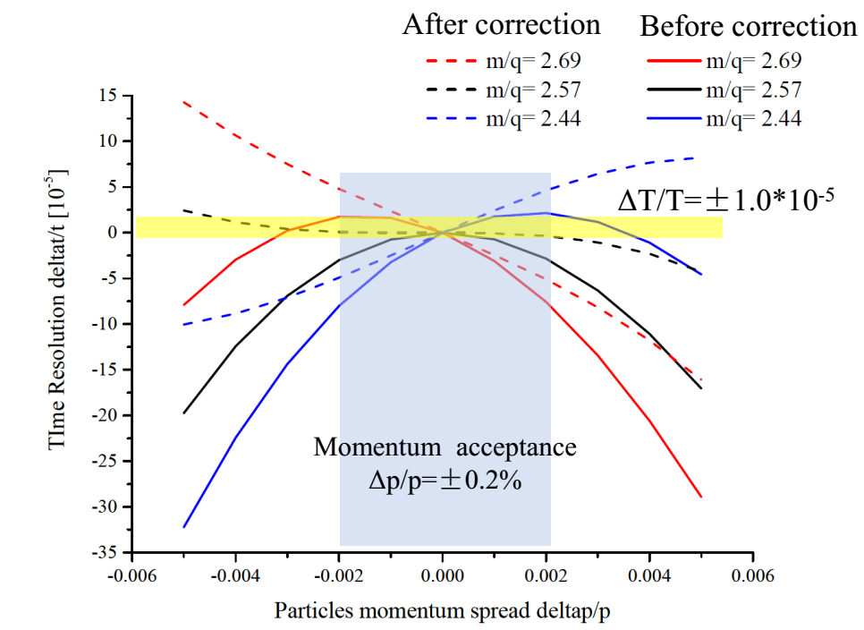
HIAF introduction and status
Isochronous mode with two TOF
HIRFL-CSRe
HIAF-SRing
Beams：⁵⁸Ni, ⁷⁸Kr, ⁸⁶Kr and ¹¹²Sn
43 masses are measured
Measured for the first time: 16
Precision improved: 27
Precision achieved: ∆M/M~10⁻⁷
Demonstrated the TOF mode first time in the world
∆M/M~10⁻⁷-10⁻⁸
Notes:
Especially the Isochronous mode with two TOF detectors, we have demonstrated the two TOF mode in our exiting machine HIRFL-CSRe and improved the precision of mass measurement. Two TOF system of SRing has been optimized based on the CSRe and the precision will reach 10^-8, that will be the highest precision of isochronous mass measurement.

Slide 15
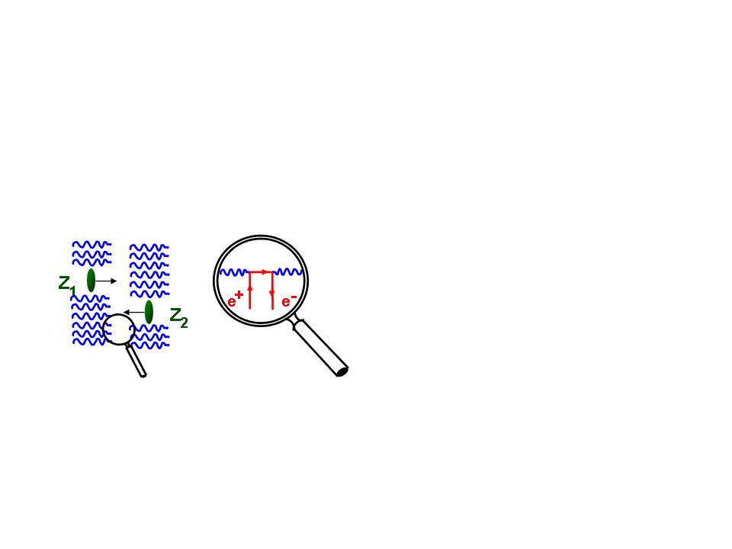
HIAF introduction and status
Unique feature-2
First figure-8 shape ring for ion-ion merging
Spontaneous electron–positron pair production
QED
Bound pair production
A fundamental question of QED-spontaneous electron-positron pair creation in supercritical Coulomb fields
Theory prediction: occur in the collisions of two very heavy ions with the total atomic number Z1 + Z2 ≥ 173.
Failed to observe in fixed target experiments due to the interference of extranuclear electrons.
Notes:
The second unique feature of HIAF is the ion-ion merging scheme based on figure“8”storage ring. The science motivation is

Slide 16
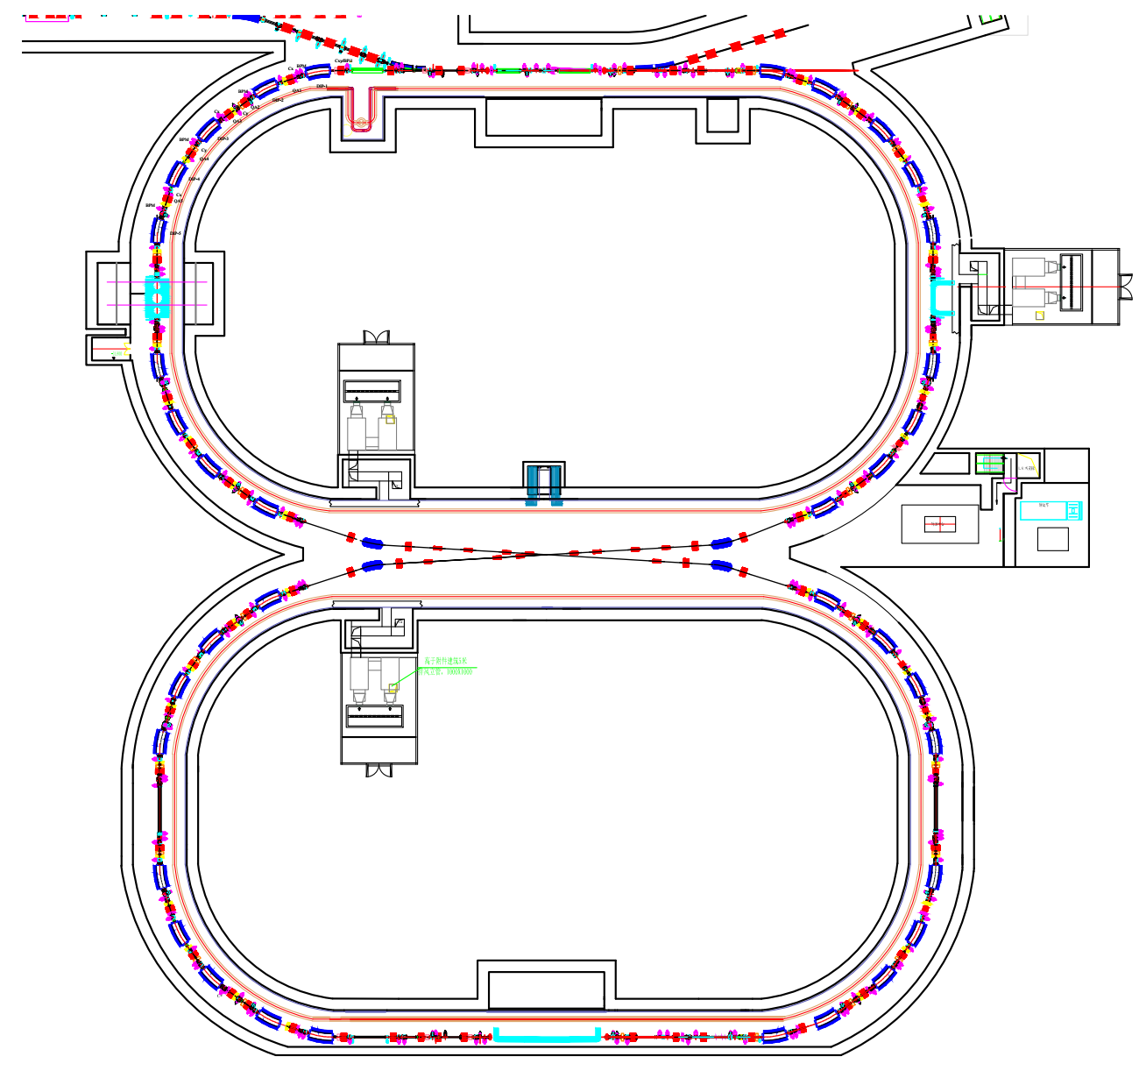
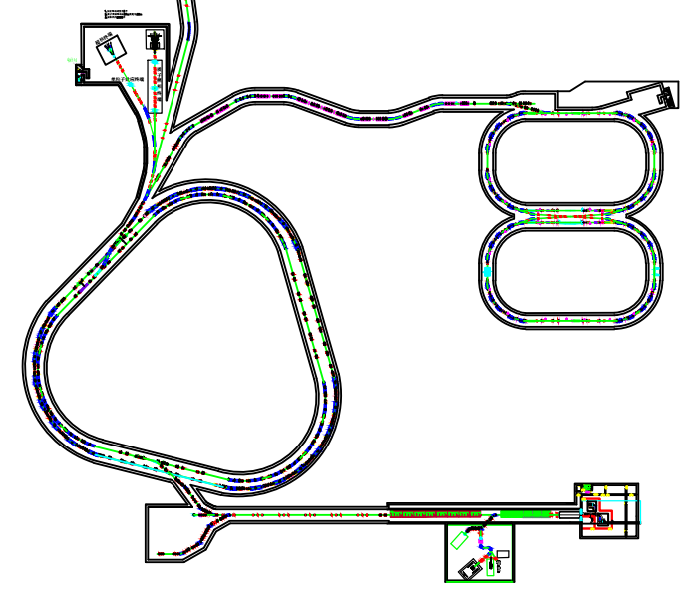
HIAF introduction and status
First figure-8 shape ring for ion-ion merging: pair production
Unique features:
“8” shape ring
Coasting beam merging with itself scheme
Based on SRing
Sharing the injection and cooling system
No powerful RF system
SRing
Advantages:
No electron-electron correlation
Ultra-low background signals
Small angle collision provides the energy (6~8MeV/u) to cross column barrier
MRing
Bare heavy nuclei, e.g. ²³⁸U⁹²⁺,
Z1 + Z2 =184 ≥ 173
Notes:
This is the first ion-ion merging machine in the world. The features are: Figure 8 shape and coasting beam can support the ion merging with itself. This design is based on SRing, Sharing the injection and cooling system with SRing, the coasting beam confirm the merging without the powerful RF system for beam bunching, so this is a cost-effective scheme

Slide 17
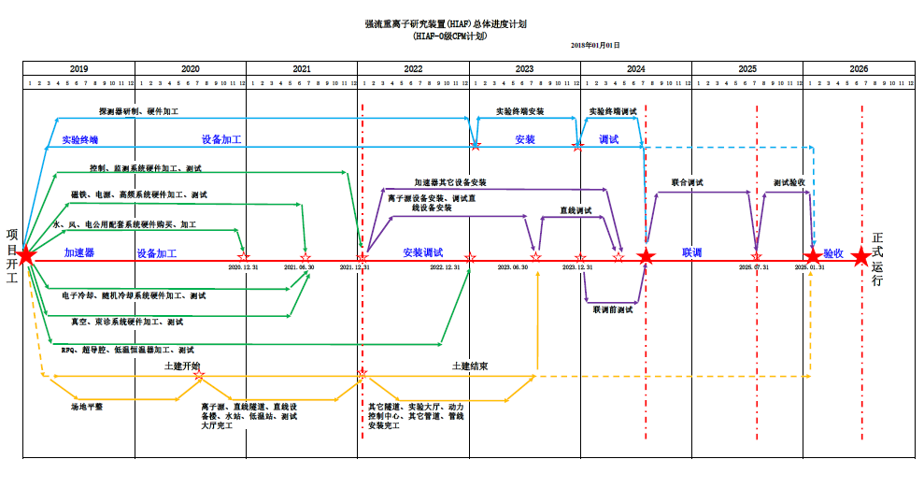
HIAF introduction and status
Schedule
Notes:
The planed construction period is about 7 years, and we hope we can finished the projector in end of 2025.

Slide 18
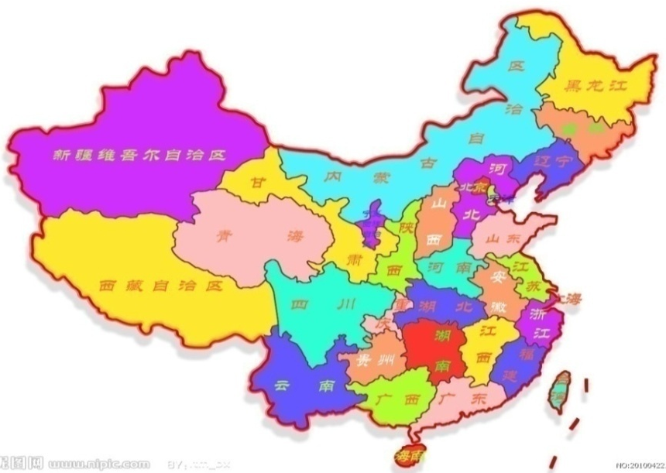
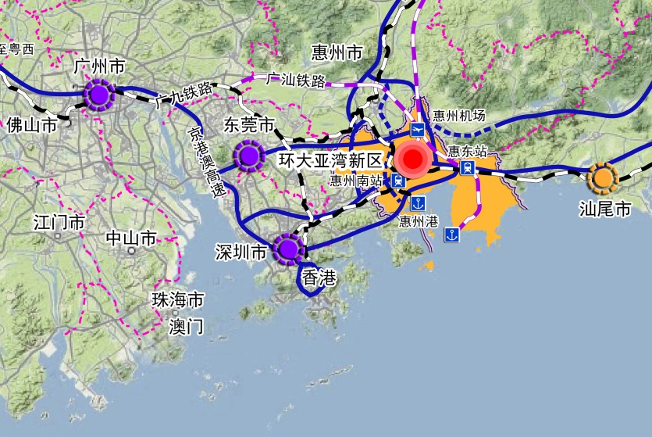

HIAF introduction and status
New campus
HIAF site
HIAF site
HIAF

Slide 19
Innovative technologies and developments
Notes:
These unprecedented parameters and unique features can only be met with new technical solutions. So a series of new and innovative technologies have been proposed for HIAF accelerator. Now let me introduce the new technology developments.

Slide 20
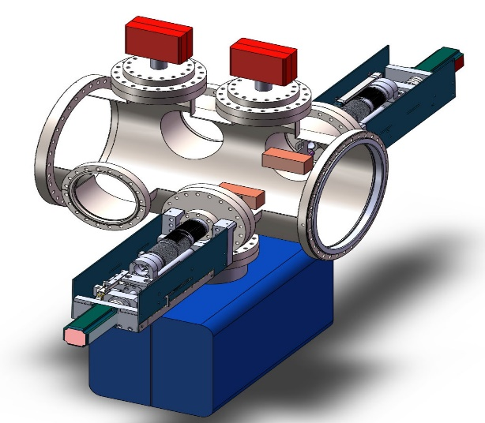
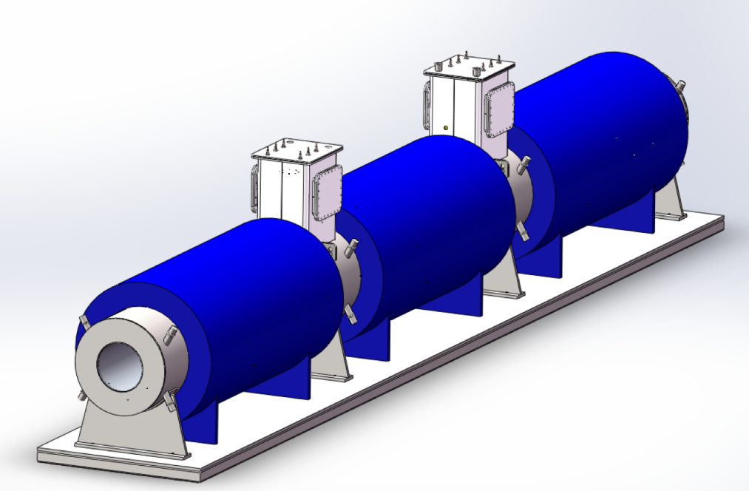
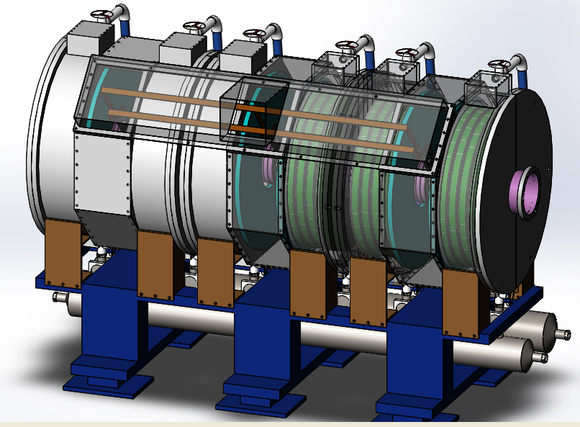
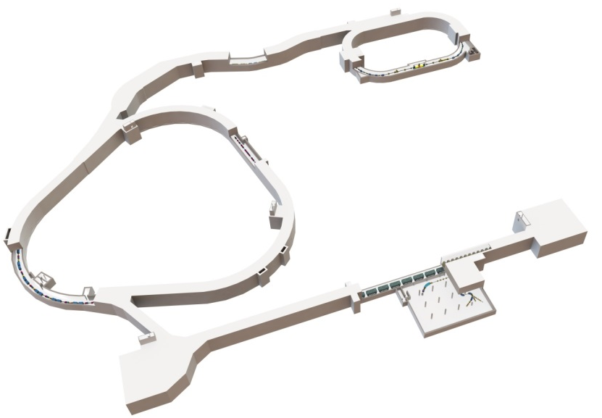
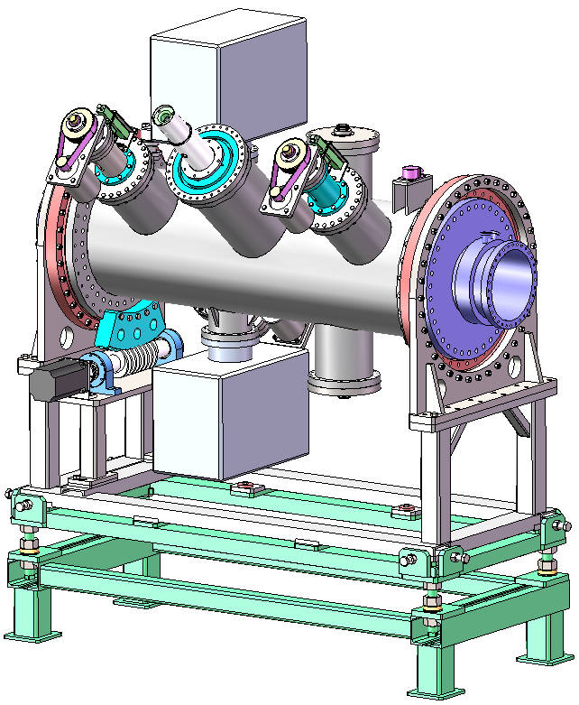
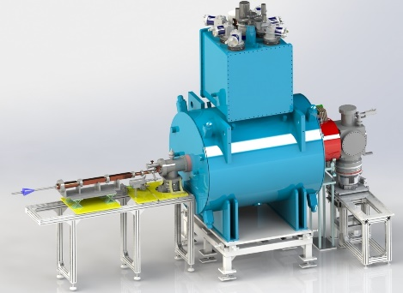
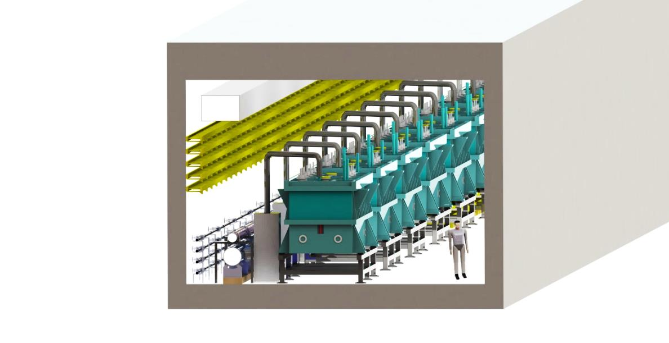
Innovative technology development
Dynamic vacuum collimator
HFRS-CCT（Canted Cosine Theta）coils
Magnetic alloy core loaded cavity
HIAF
Inclined electro-static septum
Superconducting ECR ion source-45GHz
高真空
旋转密封
High intensity super conducting linac
旋转
驱动系统
Notes:
A series of new and innovative technologies have adopted for HIAF, such as …….Here is just a selection of these technologies. The prototypes have been developed for these system for the varication of the feasibility, reliability and performance.

Slide 21
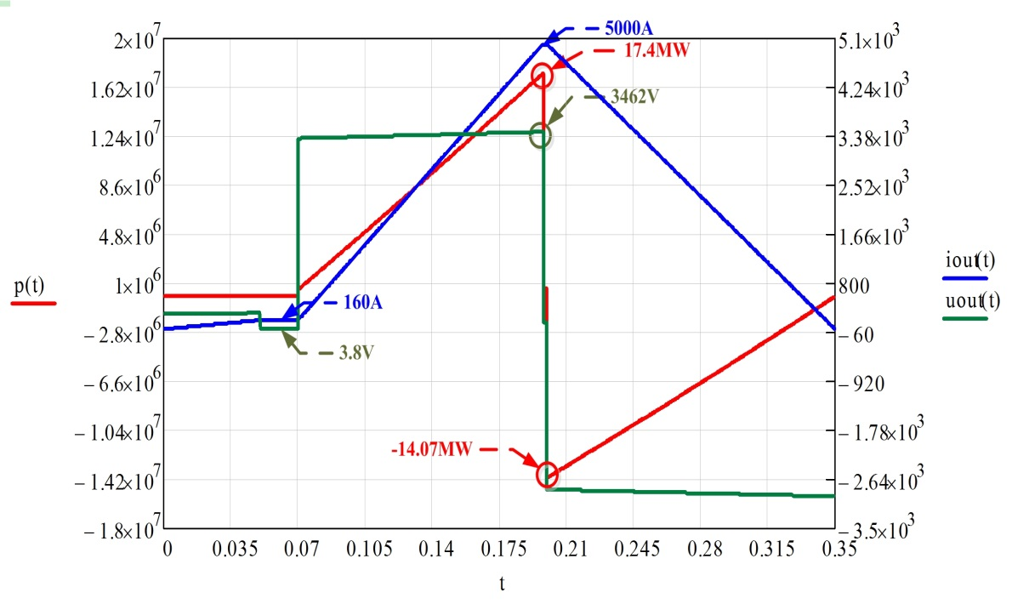
Fast cycling power supply
The main magnets for BRing consist of 48 dipoles in twelve groups of four magnets, load specification and performance requirement featured by fast ramping rate
Parameters | Values
Resistance of load | 24mΩ
Inductance of load | 88mH
Current | 5000A
Voltage | 3462V
Rising time | 130ms
Max. ramping/falling rate | ±38000A/s
Tracking error | ≤±1×10⁻⁴
Platform error | ≤±5×10⁻⁵
Operation Waveform
Challenges:
A broad dynamic current range
A high precision and reproducibility
Very low tracking errors relative to current reference
The strong shock of large return power to the power grid

Slide 22
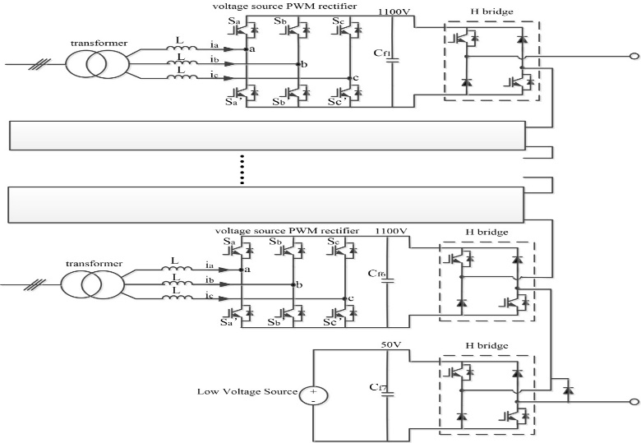
Fast cycling power supply
Innovative concept based on full-energy store principle
Voltage-changed stimulation asymmetrical multi-level cascaded PWM
Low voltage source for injection & extraction platform, high voltage source for fast ramping stage
Energy capacitor will be used to store energy.
The energy can be controlled by PWM rectification technology, only active power will be taken from the grid!
Asymmetrical PWM cascade Structure: keep high accuracy and fast output dynamic response
Modular designed circuit schematic diagram

Slide 23
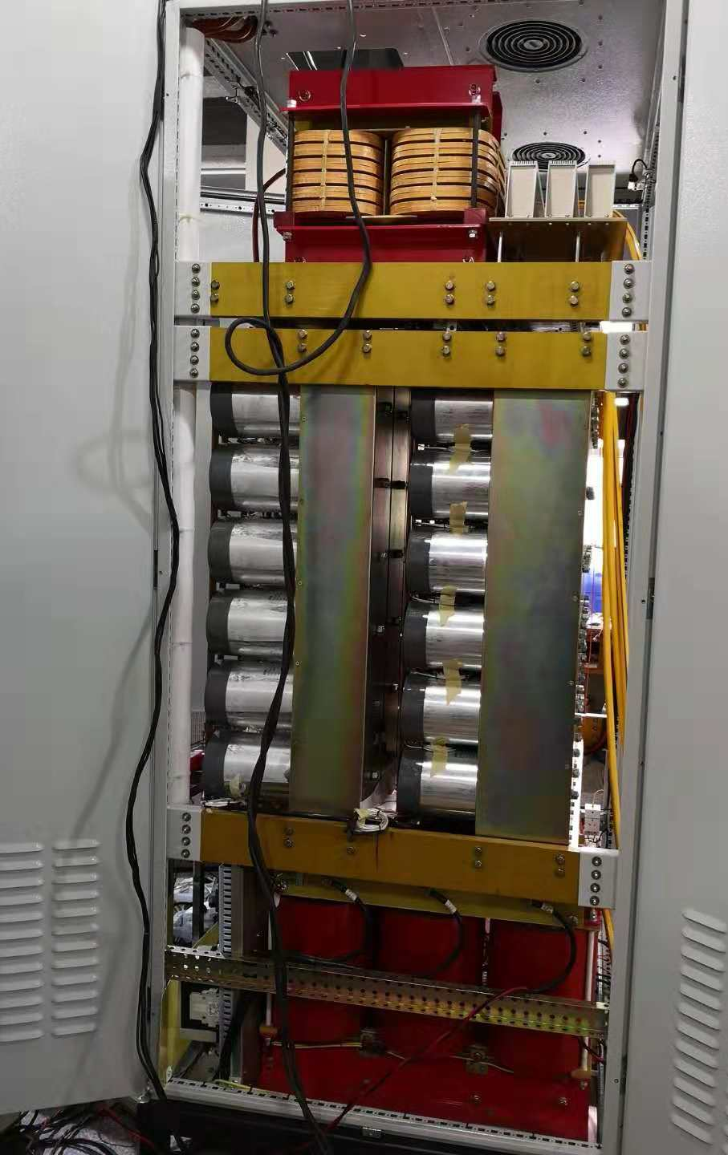
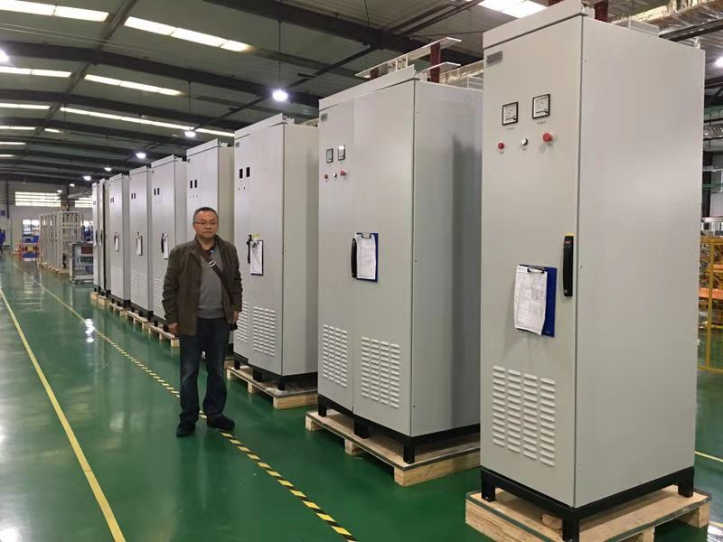
Fast cycling power supply
Power unit of 2000A/1100v

Slide 24
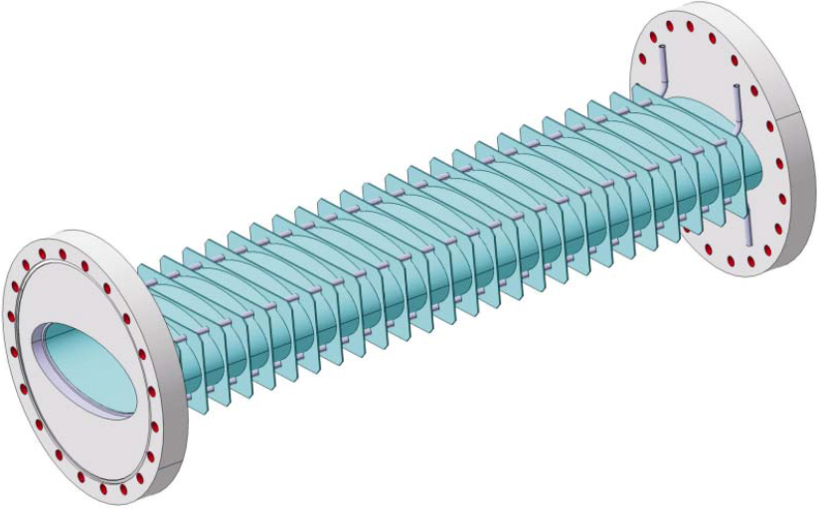
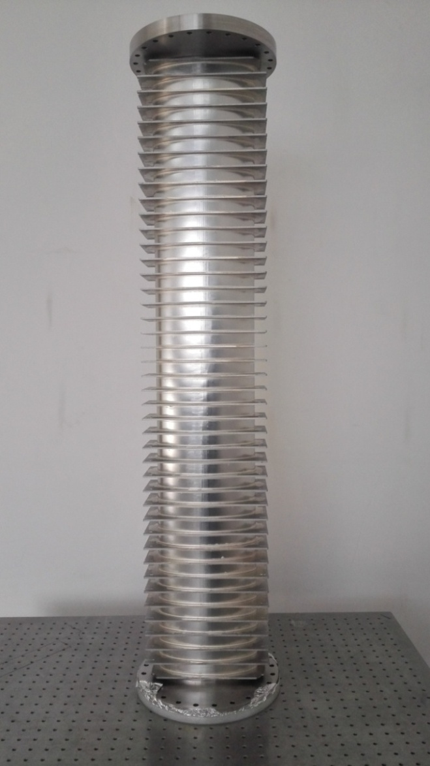
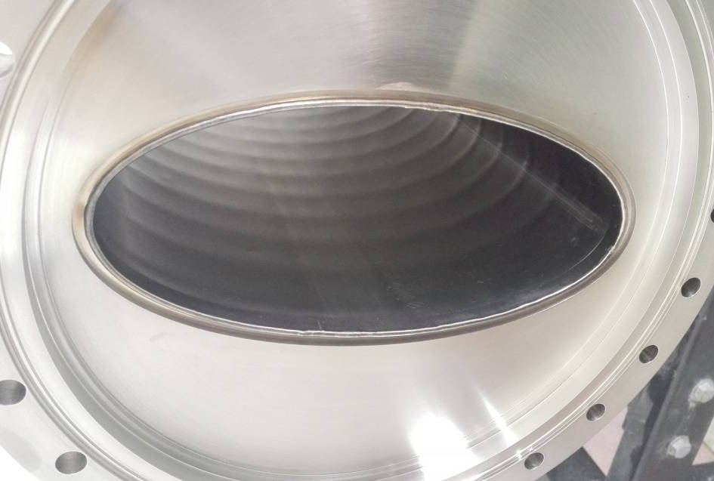
Thin wall vacuum chamber
Due to high ramping rates, thin wall vacuum chambers are needed for all magnets to keep eddy currents at a tolerable level.
The traditional technology is ribs supporter thin wall chamber, ribs supporter parallel to the magnetic field lines
Stainless steel-0.3mm
L=1.2m, 2.0m long, curved thin wall chamber prototype have been developed

Slide 25
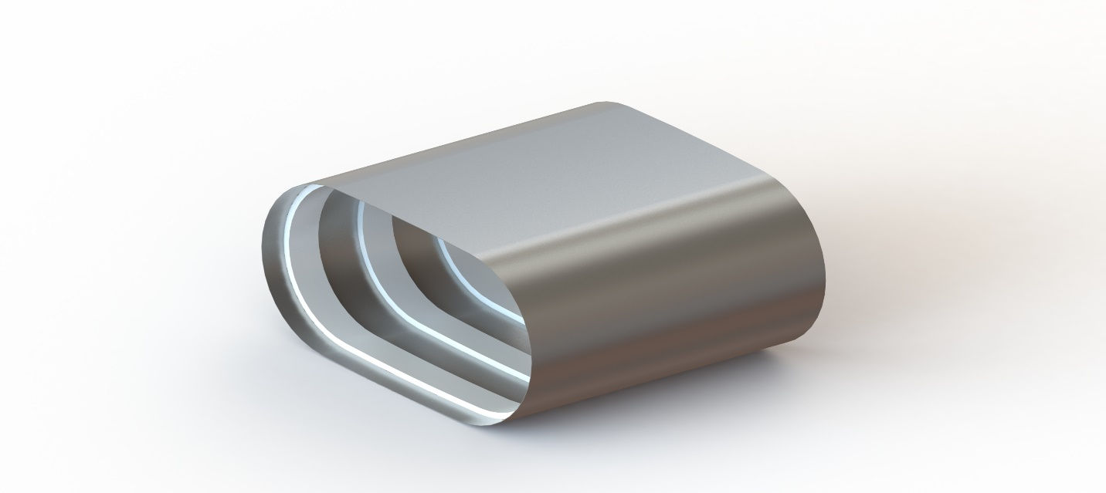
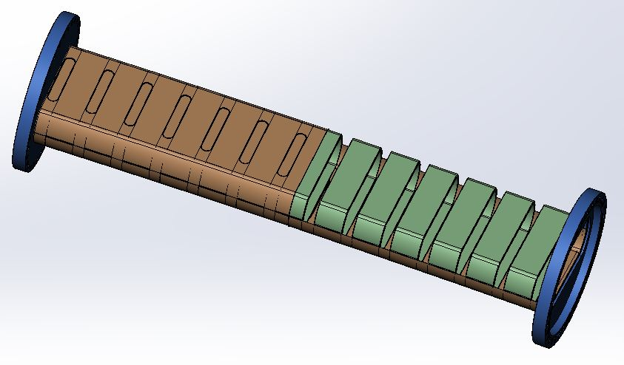
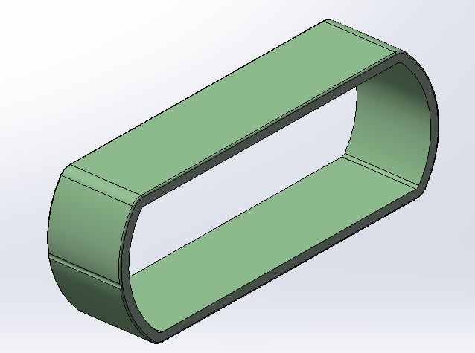
Thin wall vacuum chamber
A novel thin wall vacuum chamber are designed for HIAF
(chamber supported by ceramic rings )
Chamber with ceramic supporter
Static structural equivalent stress

Slide 26
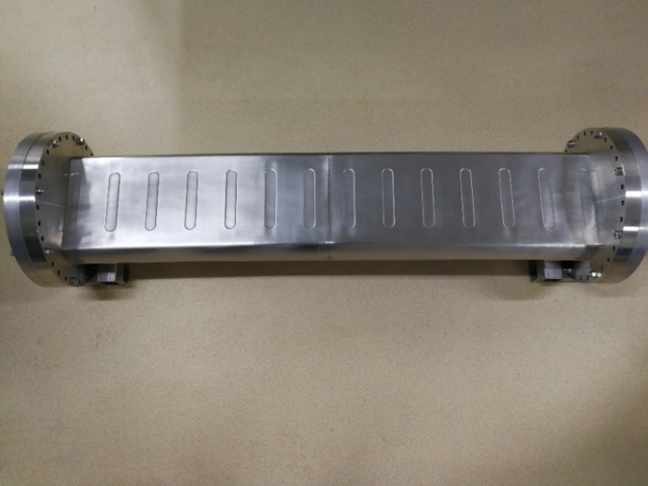
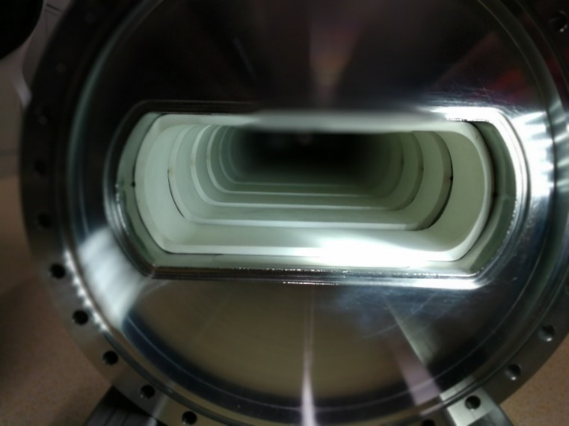
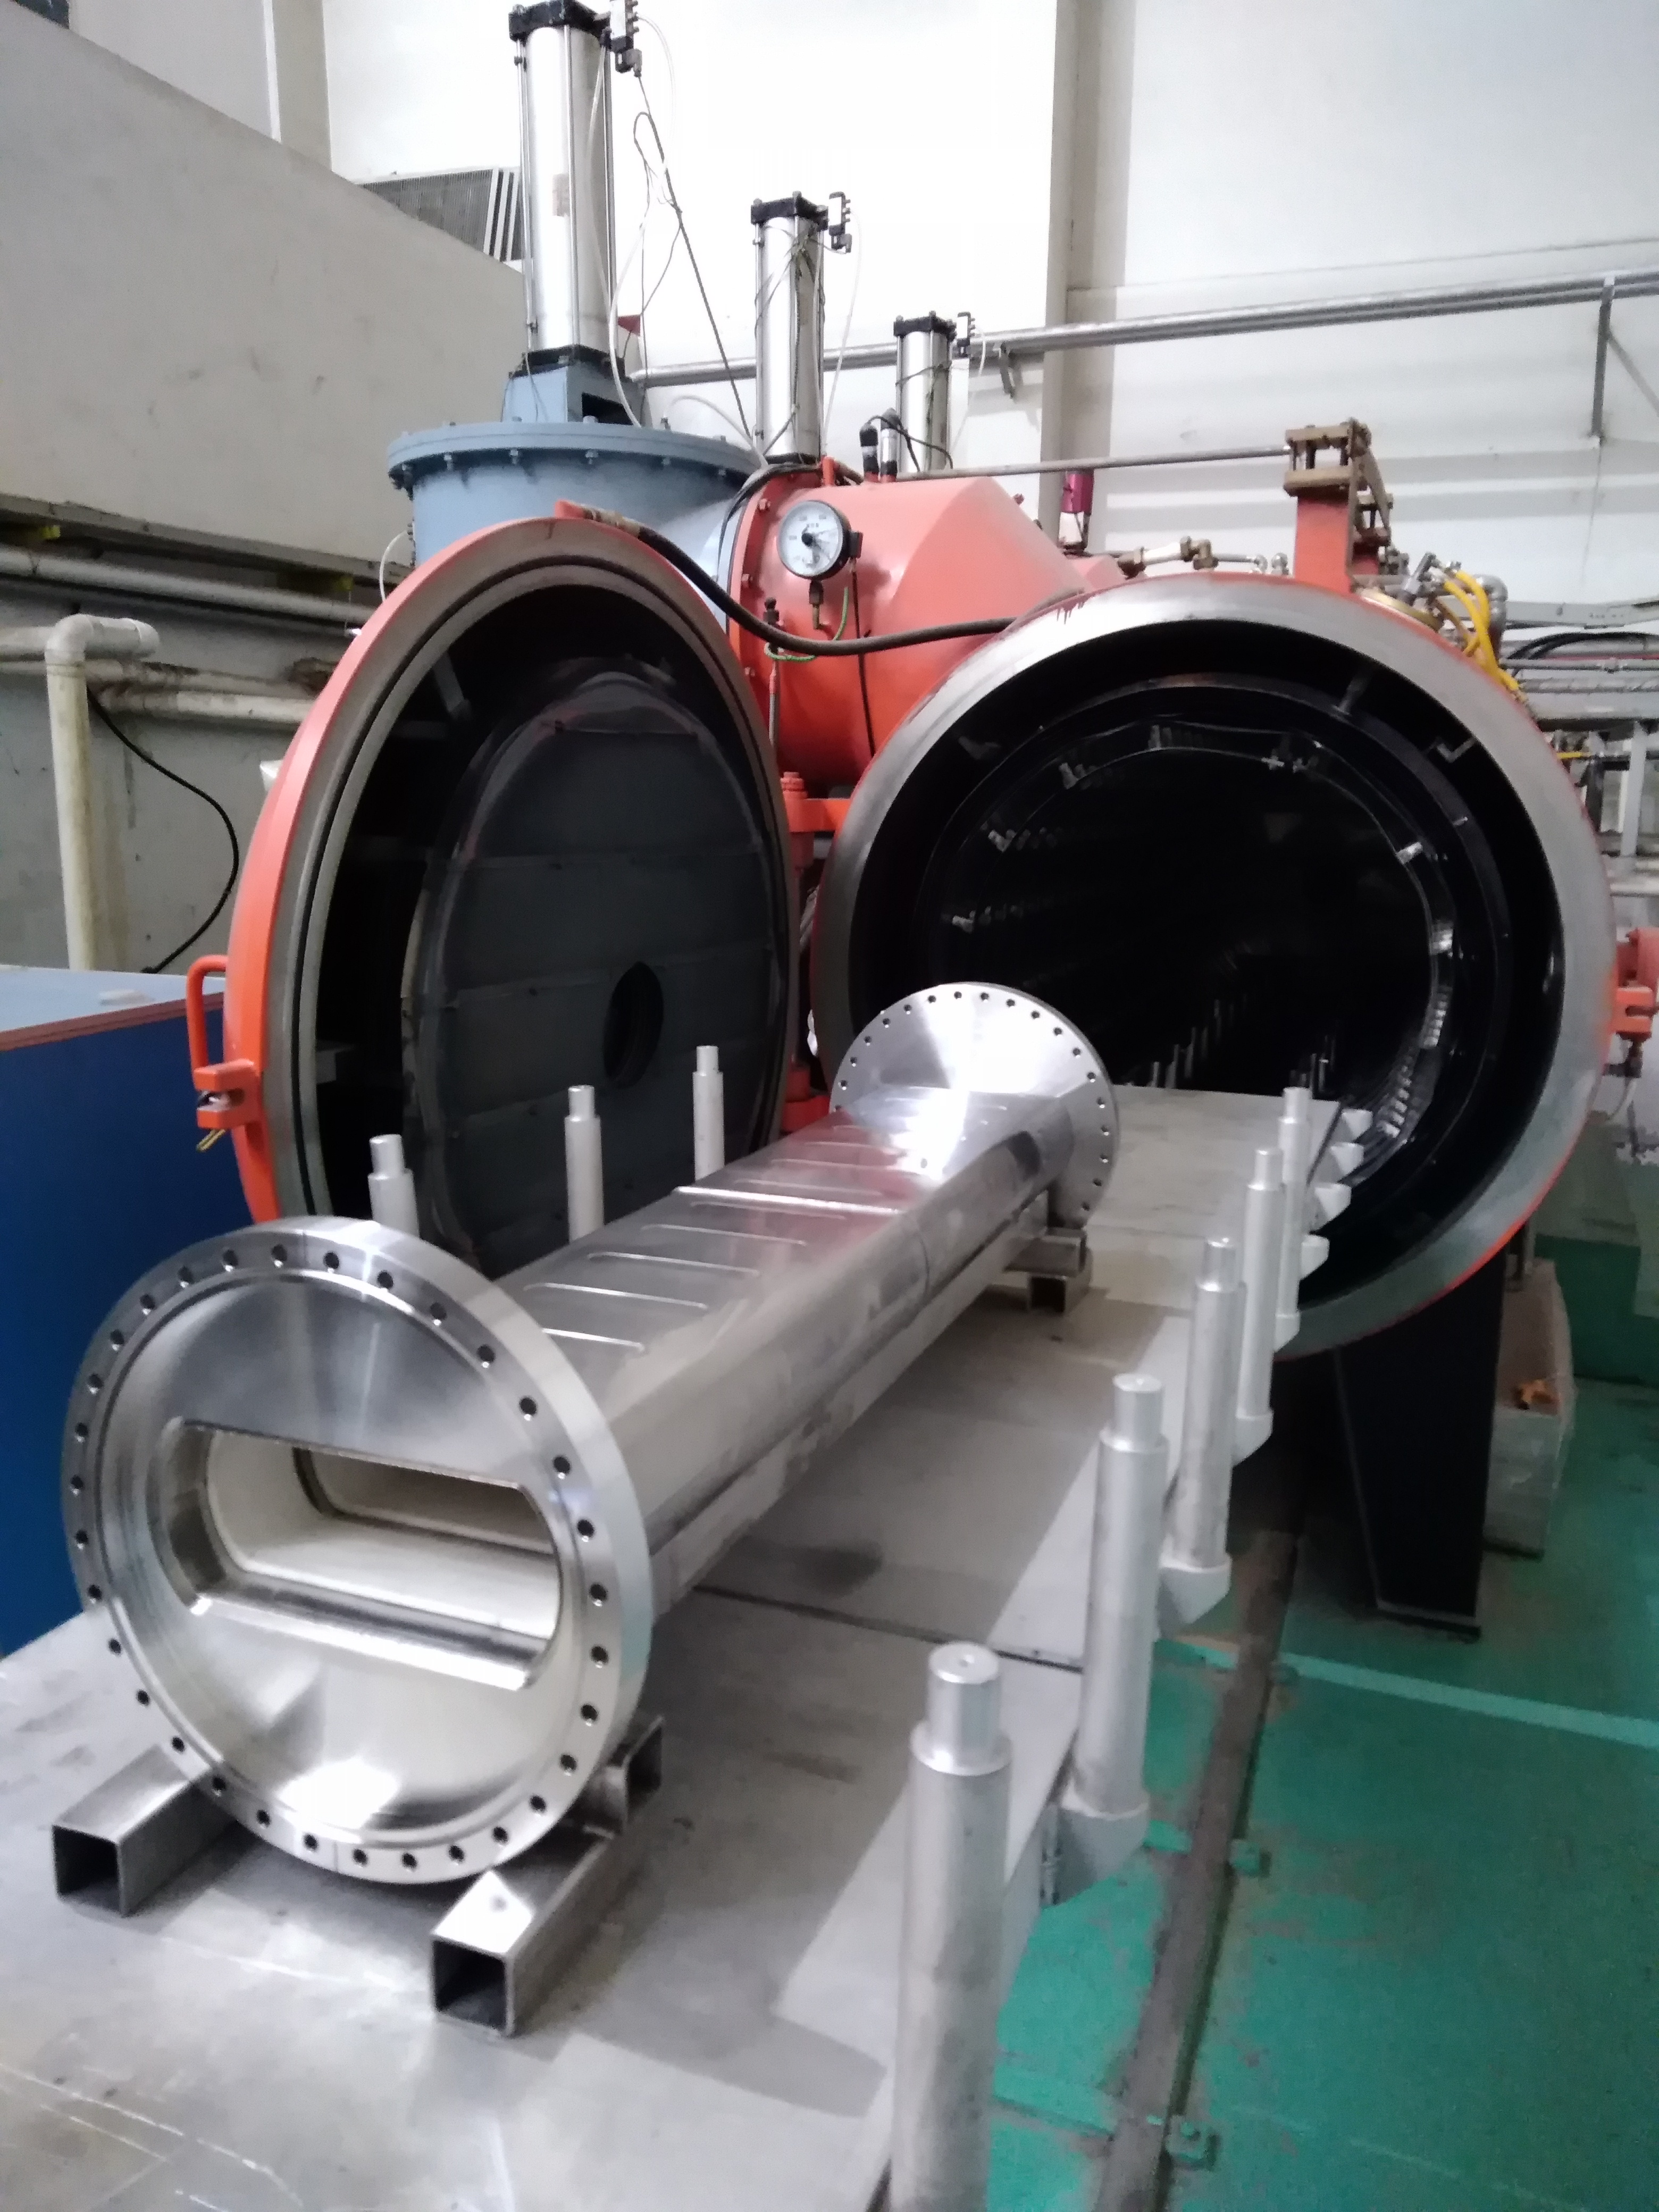


Thin wall vacuum chamber
Chamber supported by ceramic rings
Inside view of chamber
4.0×10⁻¹² mbar
Outgassing
Bake system

Slide 27
Present status and summary
Notes:
In the past several years, a series of prototypes have been developed for technical challenges and critical issues. The machine design was optimized based on these prototypes developments, details of technical design has been finished and some hardware systems already go into production. The civil construction and common system are also going smoothly,

Slide 28







Present status and summary
Details of technical design has been finished and most of hardware systems are under production.
SRing
HFRS
BRing
iLinac
SECR

Slide 29





Present status and summary
Tunnel utilities and mechanical installation
iLinac section
BRing arc section
BRing straight section
Beam transfer line
SRing arc section
Tunnel mechanical installation
Notes:
The civil construction and common system are also going smoothly

Slide 30

Present status and summary
Layout of tunnel and cross sectional view of the tunnels
Notes:
Also engineering design of the tunnel

Slide 31



Present status and summary
Present status
Notes:
The campus civil construction started serval months ago, this is the view before groundbreaking, and this is the latest view
Five years later a more beautiful campus will come into being.

Slide 32

Present status and summary
Present status

Slide 33

Present status and summary
High-Intensity Heavy Ion Accelerator Facility-HIAF
2025-Huizhou, HIAF welcome all of you !!!

Slide 34
Thanks for your attention!

Slide 35

Present status and summary
2025-Huizhou, HIAF welcome all of you !!!

Slide 36

The Front-End and iLinac
SECR
45GHz
SECR
Pulsed 50 pμA U³⁵⁺, U^{4x+}
CW 20 pμA U³⁵⁺
QWR005
2.4MeV/u
RFQ
0.5MeV/u
HWR015
17.0MeV/u
HWR010
5.8MeV/u
iLinac
Pulsed 28 pμA U³⁵⁺, U^{4x+}
CW 15 pμA U³⁵⁺
Notes:
The first is Front-End and iLinac, the front-end includes superconducting ECR and RFQ and the iLinac includes three different cavities. These numbers are very challenging.

Slide 37

The Front-End and i-Linac
LEAF Platform
Prototype for HIAF Front End
  45 GHz FECR
  81.25 MHz 4-vane RFQ
FECR
MEBT
L-RFQ
LEBT
Notes:
So for challenges of the front-end, a LEAF Platform is under development in our institute to demonstrate the ECR and RFQ, this is the layout of the LEAF. …… The most important ones are ECR and RFQ.

Slide 38

4th G. ECRIS Development
Nb₃Sn magnet
Cryogenic system
Microwave system
Beam extraction and transmission
All technical challenges and critical issues have been verified and full size prototype is under development
Notes:
The challenges of ECR are

Slide 39


RFQ Development
L-RFQ RF training log
RFQ fully commissioned to its designed RF power of 66.8 kW (70 kV vane voltage)
CW beam operation with He+ and N²⁺ have been done, total operation time >700 hours
Notes:
For RFQ prototype, fabrication has been finished and now is under on beam test. The results show the performance of RFQ can meet the requirement of HIAF.

Slide 40

SRF Cavity Development
ADS Front-end Demo Linac (2011-2017)
Proton, 25 MeV, 10 mA, CW, ~ 35 m, 4.5 K operation
To demonstrate the technology of superconducting linac:
CW RFQ, Superconducting cavities, Cryomodule
Supported by “Strategic Priority Research Program” of the Chinese Academy of Sciences
 | RFQ/IMP | CM1/IMP | CM2/IMP | CM3/IMP | CM4/IHEP
frequency | 162.5 MHz | 162.5 MHz | 162.5 MHz | 162.5 MHz | 325 MHz
output energy | 2.1 MeV | 5 MeV | 10 MeV | 18.5 MeV | 25 MeV
cavity type | 4-vane | HWR010 | HWR010 | HWR015 | Spoke021
cavity number | 1 | 6 | 6 | 5 | 6
Notes:
and also the SFR technologies for iLinac has been verified with the ADS Demo Linac, in order to demonstrate the technology of superconducting linac, a 25MeV SC linac has been built and run with proton beam successfully, several types of SC cavities have been developed for this demo facility.

Slide 41







SRF Cavity Development
High performance SRF cavities
162.5 MHz Taper HWR015
βopt | 0.10
Vmax (MV) | 1.06
Epeak (MV/m) | 28
βopt | 0.15
Vmax (MV) | 1.8
Epeak (MV/m) | 32
βopt | 0.246
Vmax (MV) | 1.75
Epeak (MV/m) | 32.5
Notes:
Such as HWR 010 cavity and HWR 015 cavity and Spoke cavity with good performance.

Slide 42






SRF Cavity Development
ECRIS + RFQ
Energy is ~2.1 MeV
First beam Jun. 6th, 2014;
achievement 10 mA, 2.1 MeV, 4.5 hours
1
162.5 MHz RFQ
ECRIS + RFQ + MEBT + TCM1 (single HWR)
Energy is ~2.5 MeV
First beam October 1st, 2014;
achievement 11 mA, 2.55 MeV
2
162.5 MHz HWR010
ECRIS + RFQ + TCM6
Energy is ~5 MeV
First beam June 6th, 2015;
achievement 2.7 mA, 5.3 MeV; ~7.5 hours 2 mA 4 MeV operation
3
162.5 MHz HWR010
ECRIS + RFQ + CM1 + CM2
Energy is ~10 MeV
First beam September 15th, 2016
Achievement ~ 2.7 mA, 9.55 MeV
4
ECRIS + RFQ + CM1 + CM2 + CM3 + CM4
Energy is ~25 MeV
First beam May 28th, 2017
Achievement 0.2 mA 25 MeV
162.5 MHz HWR010
5
Notes:
All these cavities have been tested by beam. Here are the beam commissioning records and we realized 11mA pulse beam and 0.2mA CW beam with these cavities.
The 25MeV SC demo facility has been built and run with proton beam successfully, including CW RFQ, high performance SC cavities, CMs . Tens of kilowatt CW beam achieved in the SC front-end of Chinese ADS.
The dumper and radiation shielding is a limit for tuning higher power beam.
Beam loss，higher power and operation stability will be the key issues to be demonstrated in the future.

Slide 43
Fast cycling power supply
The main magnets for BRing consist of 48 dipoles in twelve groups of four magnets, load specification and performance requirement featured by fast ramping rate
Parameters | Values
Resistance of load | 24mΩ
Inductance of load | 88mH
Current | 5000A
Voltage | 3462V
Rising time | 130ms
Max. ramping/falling rate | ±38000A/s
Tracking error | ≤±1×10⁻⁴
Platform error | ≤±5×10⁻⁵
Operation Waveform
Challenges:
A broad dynamic current range
A high precision and reproducibility
Very low tracking errors relative to current reference
The strong shock of large return power to the power grid
Notes:
A plenty of experience have been got from LEAF and ADS demo linac for HIAF injector. There are also challenges for fast ramping rate high intensity synchrotron, first is

Slide 44
Fast cycling power supply
Innovative concept based on full-energy store principle
Voltage-changed stimulation asymmetrical multi-level cascaded PWM
Low voltage source for injection & extraction platform, high voltage source for fast ramping stage
Energy capacitor will be used to store energy.
High voltage source
The energy can be controlled by PWM rectification technology, only active power will be taken from the grid!
Asymmetrical PWM cascade Structure: keep high accuracy and fast output dynamic response
Low voltage source
Modular designed circuit schematic diagram
Notes:
So innovative concept based on full-energy store principle was designed for HIAF, this new technology based on

Slide 45




Fast cycling power supply
PWM rectification and full energy storage technology have been tested on the low power prototype, for the verification of this new design concept.
Power supply based on PWM rectification technology
Results of the PWM rectifier prototype
Full energy storage testing prototype
450A full energy storage technology test

Slide 46


Fast cycling power supply
A full prototype (4000A/2770V) is being manufactured in the factory. The distribution and process structure design have been established already.
Distribution of the prototype
Structure of one power unit

Slide 47
Fast cycling power supply
Power unit of 2000A/1100v

Slide 48





Fast cycling power supply
The test results show the feasibility and reliability of full-energy store principle, will go into production

Slide 49
Thin wall vacuum chamber
Due to high ramping rates, thin wall vacuum chambers are needed for all magnets to keep eddy currents at a tolerable level.
The traditional technology is ribs supporter thin wall chamber, ribs supporter parallel to the magnetic field lines
Stainless steel-0.3mm
L=1.2m, 2.0m long, curved thin wall chamber prototype have been developed

Slide 50
Thin wall vacuum chamber
A novel thin wall vacuum chamber are designed for HIAF
(chamber supported by ceramic rings )
Chamber with ceramic supporter
Static structural equivalent stress
Notes:
So a novel technique has been successfully developed for HIAF in our institute, the chamber

Slide 51



Thin wall vacuum chamber
Chamber supported by ceramic rings
Fabrication process

Slide 52
Thin wall vacuum chamber
Chamber supported by ceramic rings
Inside view of chamber
4.0×10⁻¹² mbar
Outgassing
Bake system

Slide 53


Thin wall vacuum chamber
Chamber supported by ceramic rings
This new technology greatly reduce the cost of manufacture process, the difficulty, shorten the production cycle, and improve the quality.

Slide 54
Budget
Items | 1st phase (MRMB)
iLinac | 360
BRing | 350
Beam transfer line | 50
Experiment setups | 240
Cryogenics | 80
Civil engineering | 190
Tunnel construction | 160
Contingency cost | 100
Total of facility | 1530 (central government)
Infrastructure & common systems | 1000 (local government)
Total | 2530

Slide 55

Key technical-1
Inclined E-Septum
Inclined E-Septum
Electromagnetism design
Notes:
The septum foil is tilted by 30°to cope with the combined longitudinal and transverse injection scheme. A new septum has been constructed to cope with the extremely tight vacuum requirements of LEIR. By optimising the internal surface under vacuum and increasing the pumping speed and beam scrubbing, a dynamic vacuum in the low 10-12 mbar range is expected. The technical specification is shown in Table 3 and a
cross section in Fig. 3.

Slide 56

Key technical-1
Inclined E-Septum
Inclined E-Septum
Big challenge – Vacuum seal in the extreme high vacuum -10⁻¹² mbar
Multi-Differential Vacuum System was designed, a small prototype has been developed
for the verification of this system
Notes:
The rotation system is one of the most challenging aspects, mainly because of the vacuum seal in the extreme high vacuum. A full size prototype is under fabrication and will be accomplished in this year.
2.Finally, we present a new type of XHV electrostatic saddle field ionization gauge which features very small electrode sizes and low outgassing/ sorption rates and high sensitivity.
3. A novel technique has been successfully developed to calibrate the ultra high vacuum ( UHV) and extra high vacuum ( XHV), whichconsists of XHV/ UHV chambers, a flow separation and a gas supply.
4.On the studies of this subject, design and implement a small prototype and the control system. Also research of the nonlinear motion system algorithm for the control system, verification of control system is reasonable.

Slide 57




Key technical-3
MA core loaded cavity
Two functions: acceleration & compression
High voltage: 240kV
Short rise time: ≤10μs
MA core loaded cavity
Gap voltage and phase waveform of BRing RF system
Notes:
Beside the fast cycling power supply, another challenge of fast ramping is RF system, the challenges for RF are high voltage and short rise time, the rise time less than 10 microsecond.

Slide 58




Key technical-3
MA core loaded cavity
MA ring core test
Established test bench and completed measurement under power and cold state
Measurement result
Measured under power
Power test result
Notes:
But there will be some challenges for hardware system. Such as RF system and power supply system. The first challenge for RF is high voltage.

