Slide 1
SRF Planning at ESS,
Overview and Status
Nuno Elias on behalf of
Paolo Pierini
Superconducting RF Section, Linac Group, Accelerator Division
European Spallation Source ERIC
September 26st 2019 – SLHIPP9, LANZHOU

Slide 2
Outline
ESS Intro
  From construction to operation in a (former) ”green-field” organization
High Level Accelerator Milestones
SRF Activities at ESS
  Elliptical test stand preparation
  Incoming cryomodule reception
  (Preparation of) testing
Status of SRF infrastructure
  Tunnel installations
  Power RF installation activities in the service gallery
  Cryoplants status
Summary

Slide 3
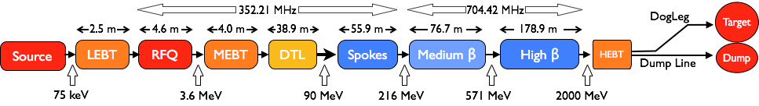
The ESS Accelerator
Scope, Parameters, Technical Performances
Key parameters & Design criteria:
    Pulse length: 2.86 ms pulses
    Max Energy: 2 GeV
    Pulse peak current: 62.5 mA
    Pulse Repetition rate: 14 Hz
    Particles: Protons (H+)
    Low losses
    Minimize energy use
    Flexible design for risk mitigation and future upgrades
Design Drivers:
High Average Beam Power
5 MW (Initially 2 MW)
High Peak Beam Power
125 MW
High Availability (User Facility)
95%
β=0.5
β=0.67
β=0.86
Staged: 1.3 GeV capacity with 2 MW on target for 2025
remaining RF sources (40) installed after 2026

Slide 4



ESS, large in kind scope
Technical SRF work so far at IK, shift to ESS for test/install/commissioning
Almost all components of the linac are designed and provided as in kind contributions
After handover scope transferred to ESS
For the SRF linac, the partners are organized in the ESS SRF Collaboration with the workshare:
  Spoke cavities and cryomodules (including prototype) by IPNO, F
  Testing of spokes modules by FREIA laboratory of Uppsala University, S
  Medium beta cavity production, by INFN, I
  High beta cavity production, by STFC, UK
  Cryomodule assembly and prototyping, CEA, F
  Testing of elliptical module at TS2@ESS
Construction project:
  External WP4 (IPNO) WP5 (CEA) for preparation and delivery of components
  Internal WP19 for testing, installation, commissioning and initial operation
ESS Organization: Accelerator Division/Linac Group/SRF Section

Slide 5
From Construction to installation and operation
(from IK to ESS)
In Construction Phase (Past)
  Most of the SRF activities during the Construction Phase so far has been performed by the
  In-Kind partners at the home institutions (CEA, IPNO, INFN and STFC)
  Design, construction and prototyping of cavities and modules
  ESS in charge of the CM “interface” agreements towards neighboring WPs
Installation & Testing is getting very close (Now)
  Delivery of prototypes at test stand happened and first series components in Fall 2019
  Start of the Test Stand 2 operation for the Elliptical CM testing (summer)
  Start of the FREIA Test Stand operation at UU for Spoke CM testing (UU running!)
Getting ready for testing and commissioning (Now & Future)
  Transfer know-how from IK, capture design intent, get ownership of SRF components
  Ramp up of local “hands-on” SRF activities at ESS
Construction to Test and Operation

Slide 6
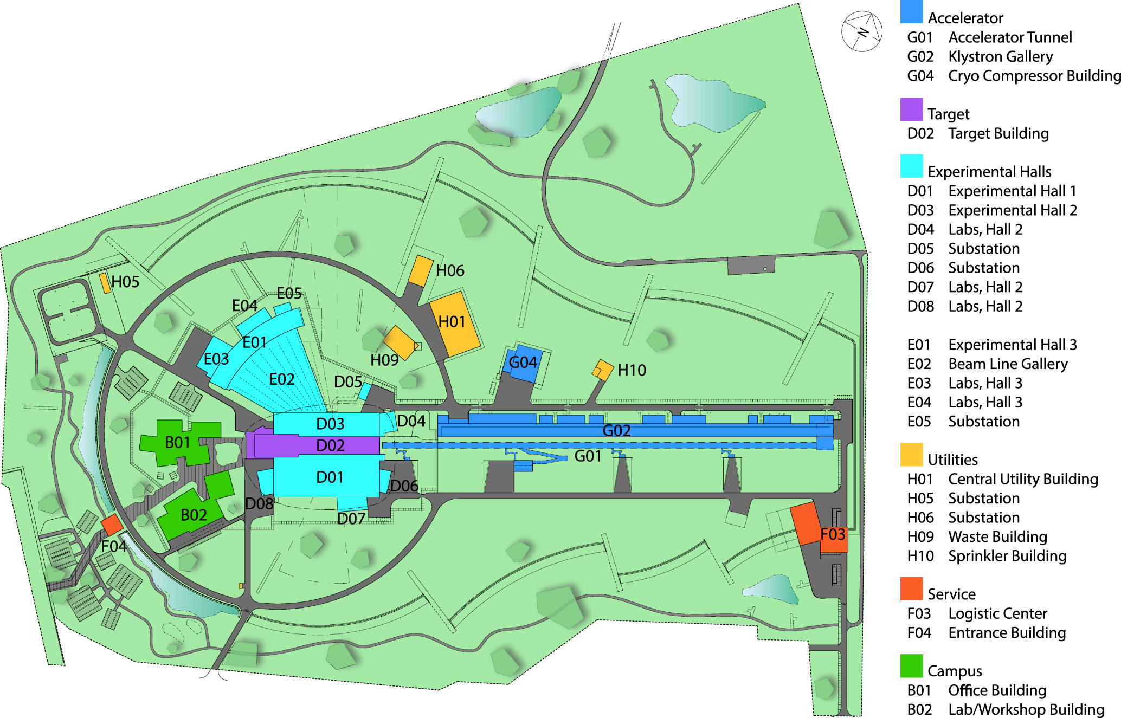
ESS Site Layout

Slide 7
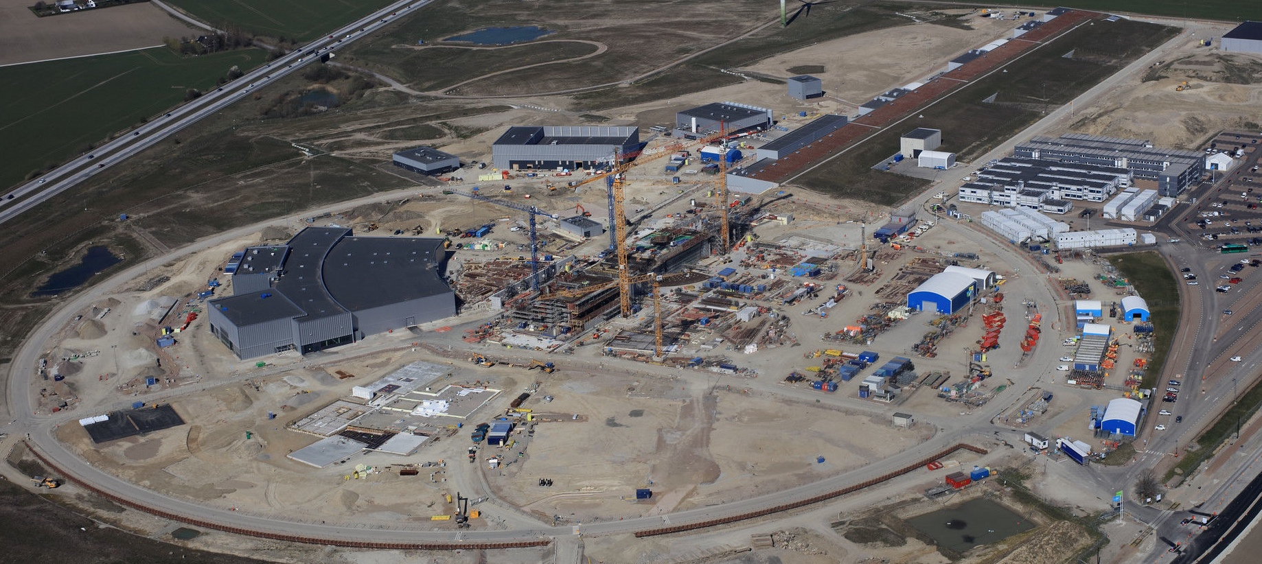
The ESS site
Target area more advanced now, Tunnel and Gallery transferred to ESS
Cryo Compressor Building
Cold Boxes
LINAC
Target
Experimental Hall
(Far)
Exp. Halls
(Near)
Temporary Offices/Labs
(all staff on site)
Loading Bay
Future Campus Area
ESS Office Complex
(Laboratories)
Klystron Gallery and Technical Areas

Slide 8
Major Accelerator milestones
Source installed and commissioned, MEBT under installation
RFQ and DTL sections delivered in 2019
Staged NC Linac beam commissioning in 2020
  First to DTL1, then to DTL4
  Shielding wall in tunnel will allow concurrent installation of SPK and MB CM
Beam on Dump (BOD) commissioning with Linac up to MB Linac
  Floats in schedule managed centrally
First Science end 2023
Beam on Dump (BOD)
Accelerator Ready for Beam on Target (RBOT)
ISrc to DTL1
ISrc to LEBT
ISrc to DTL4
Beam on Target (BOT)
End of Construction
2018
2019
2020
2021
2022
2023
2024
2025
Today
Start Of User Program (SOUP)

Slide 9
Installation and Commissioning activities
BOD with Linac up to MBL
HB CM installation until Target is ready for Beam, Not all HB modules RF powered for BOT
ISrc to Beam Dump (BOD)
Today
ISrc to DTL1
ISrc to DTL4
RBOT
2019
2020
2021
2022
ISrc to DTL1 Beam Commissioning
ISrc to DTL4 Beam Commissioning
ISrc to DMPL Beam Commissioning
NCL Installation (RFQ/MEBT/DTL1)
NCL Installation (DTLs)
NCL RF System Installation
SPK CDS Installation
SPK CM Installation
SPK LWU Installation
SPK RF System Installation
SRF
Elliptical CDS Installation
MBL CM Installation
MBL LWU Installation
MBL RF System Installation
HBL CM Installation
HBL RF System Installation
HEBT/A2T LWU Installation
Infrastructure

Slide 10
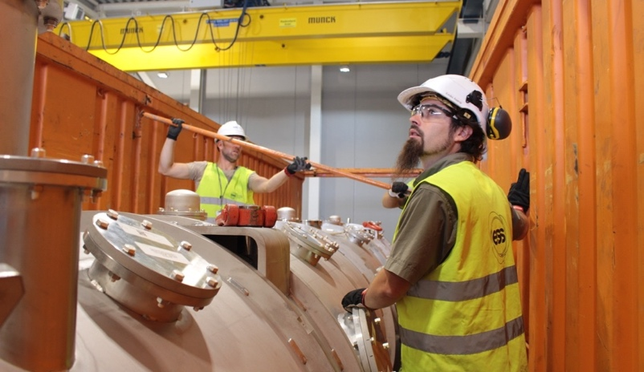
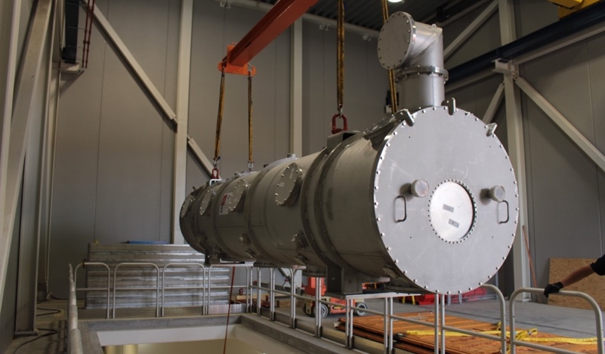
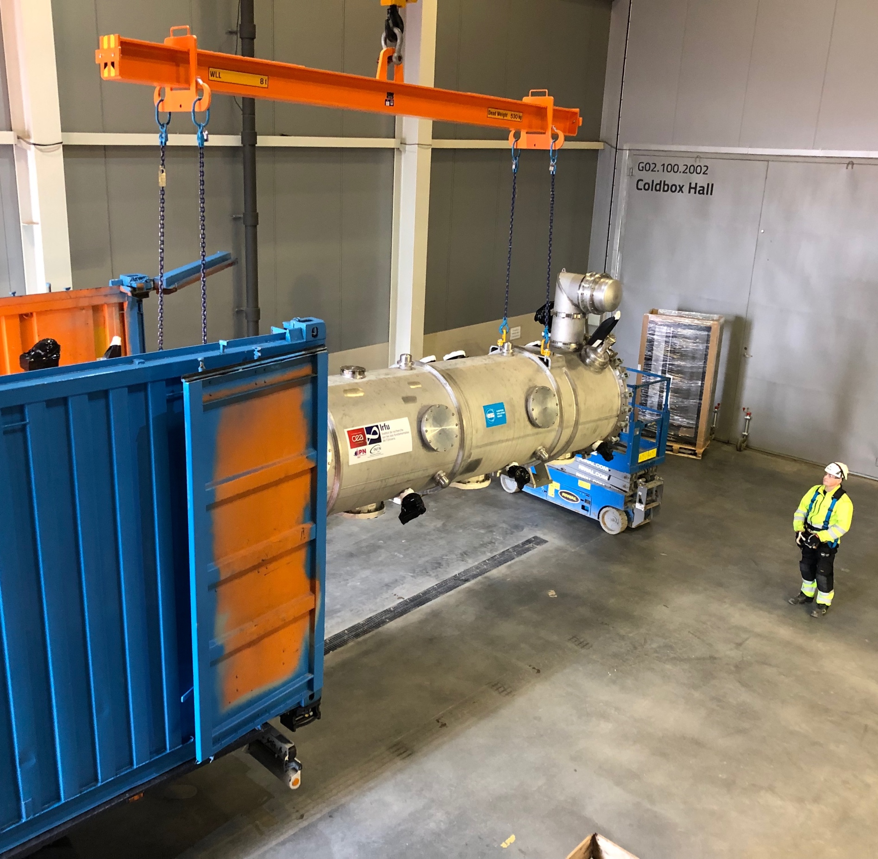
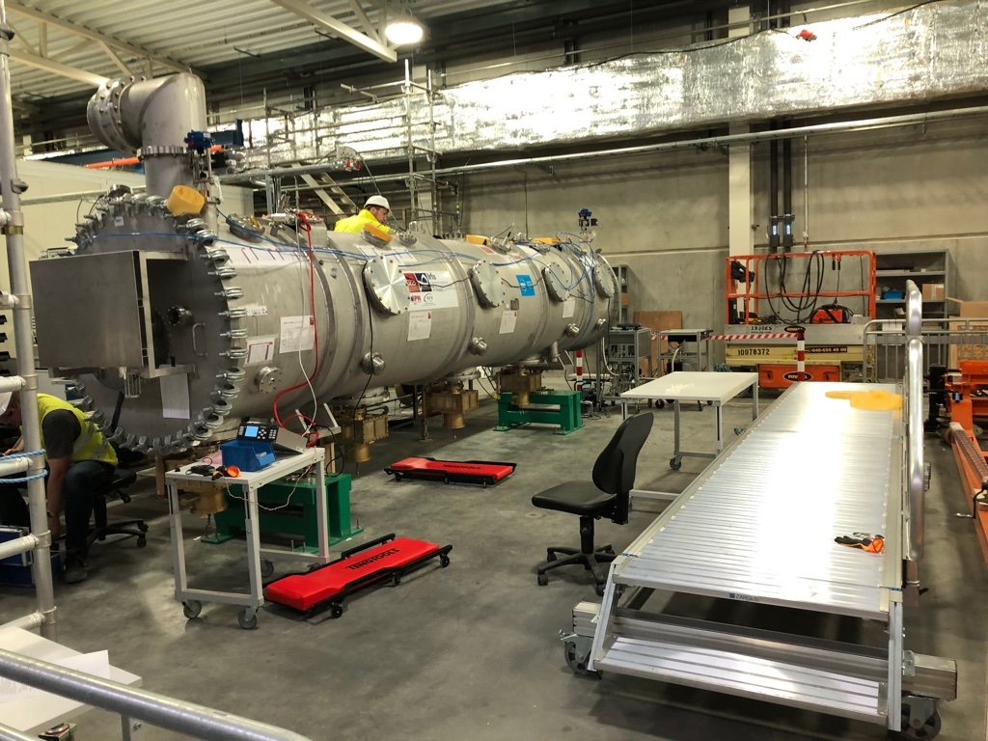
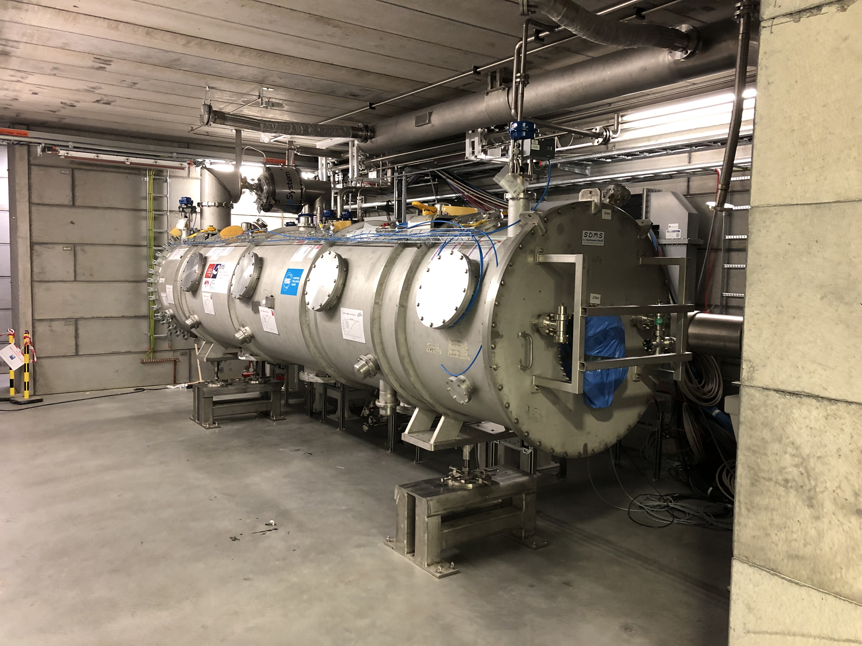
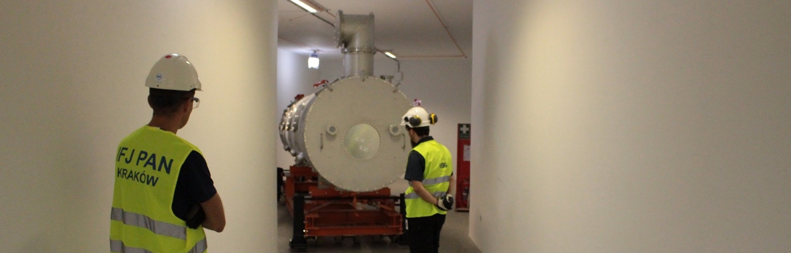
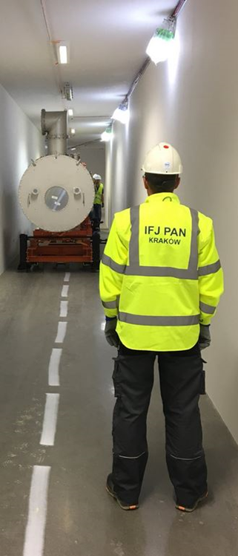
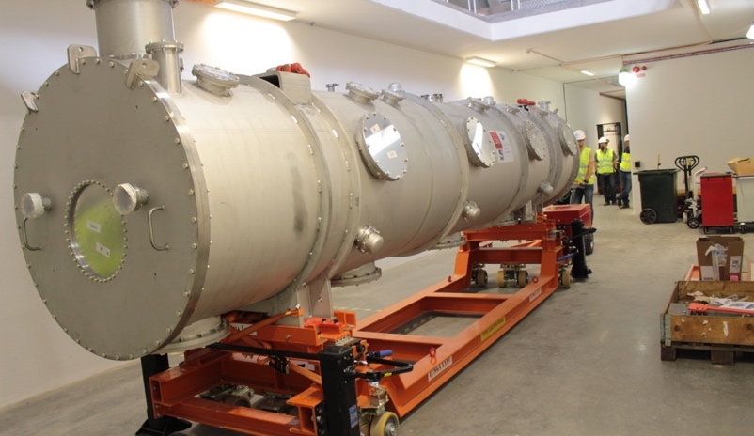
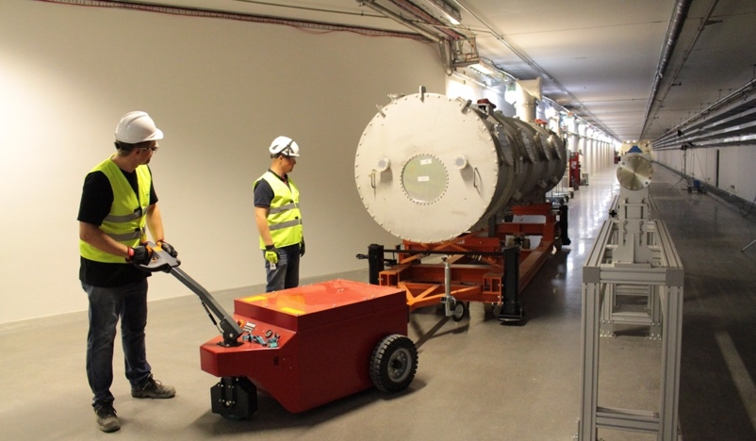
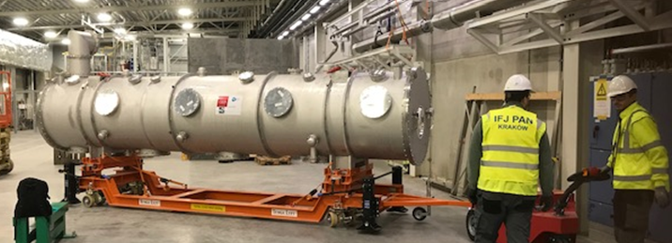
Preparation for elliptical module installation and test
Transport tests and prototype receival
ESS in charge of development and procurement of
  Transport container (with vibration dampers) at ESS
  Installation tools and tunnel supports
Transportation tests performed in 2018 with a bare
vessel, to validate design and procedures
Prototype cryomodule transported to ESS
in February 2019
  Beam vacuum preserved
  Few loose screws on isovac flanges and tuner
  components
Preparation for cold testing is now taking place
  Cryomodule is installed in Bunker and interconnected to the valve box.
M-ECCTD February 15th 2019

Slide 11
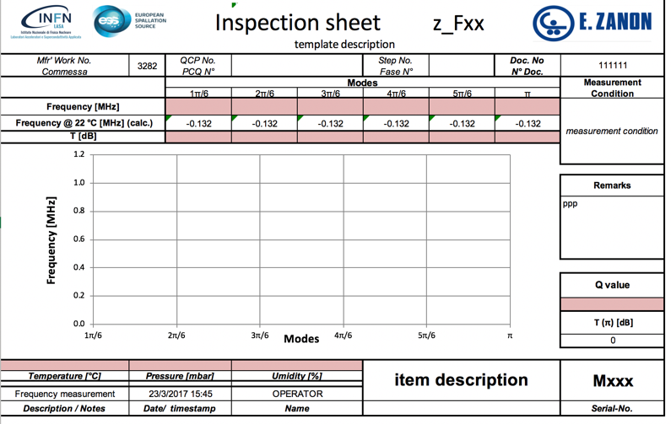
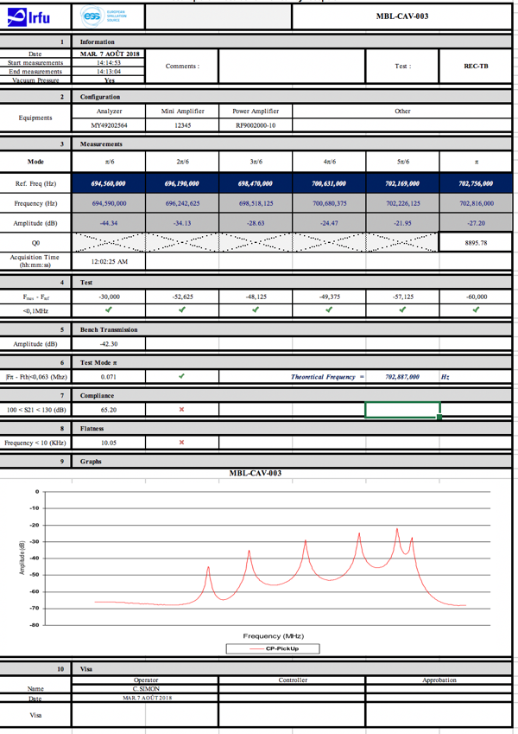
Preparation for tests
Know what to expect… Estabilished ESS Cavity Database
MEASUREMENTS @ IKC
After fabrication
Intermediate handover
Outgoing
ESS Scope
Measurement&Calibration DB
(ownCloud service)
ESS Asset Management
ID Installation Structure
https://meas01.esss.lu.se/owncloud/index.php/login
Transfer
Live Staging Area
(typ. text files)
Tagging (in metadata)
Script
In QA/QC
https://gitlab.esss.lu.se/SRF_Section
Normalized Data
(HDF files, metadata)
Save
APPLICATIONS
Browse
Compare
Assess
MEASUREMENTS @ ESS
Incoming
Preparation TS2/Linac
Script

Slide 12
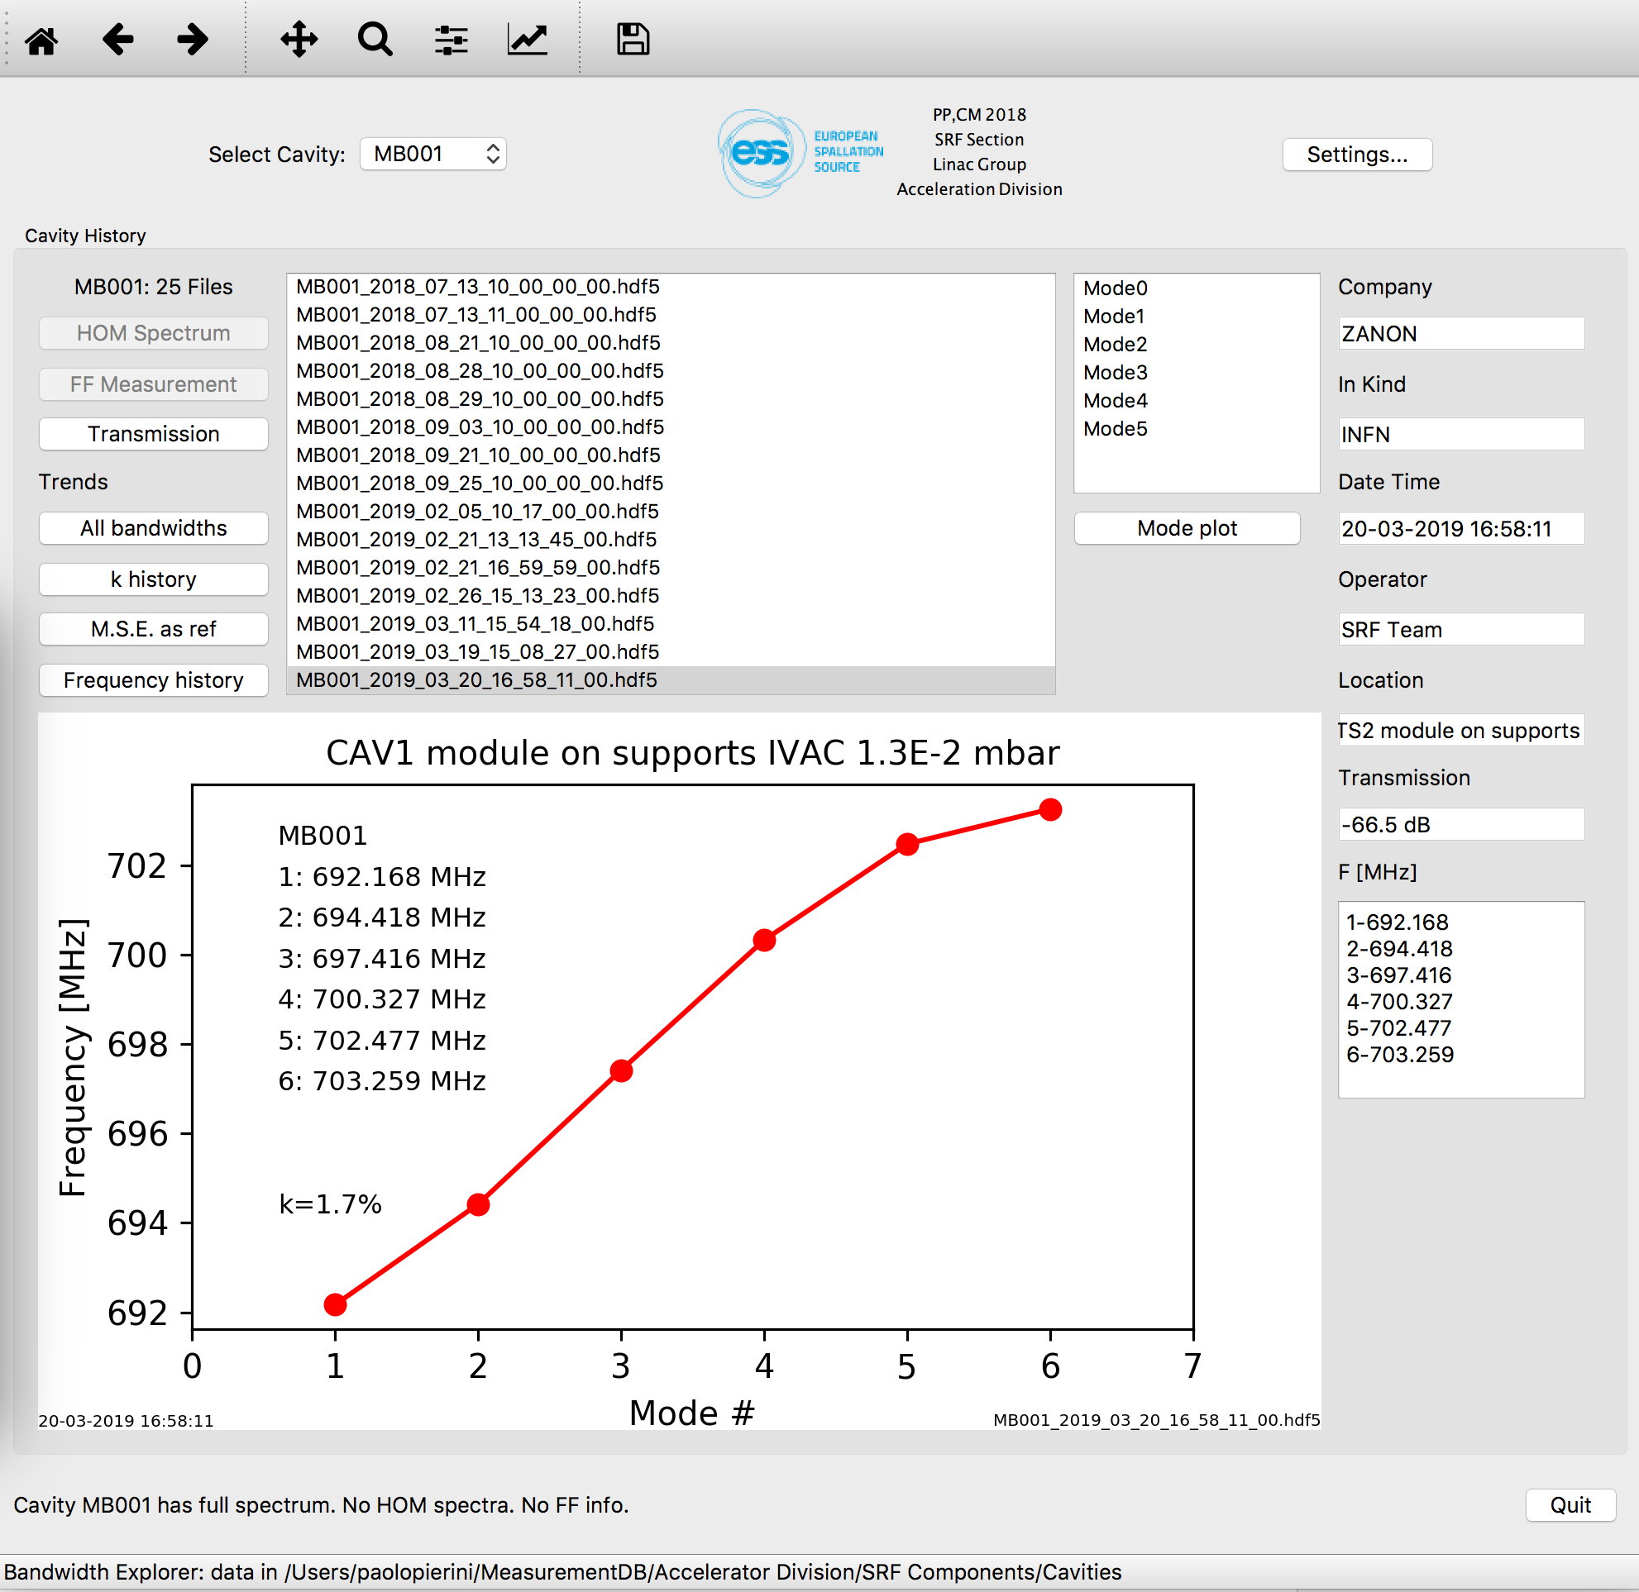
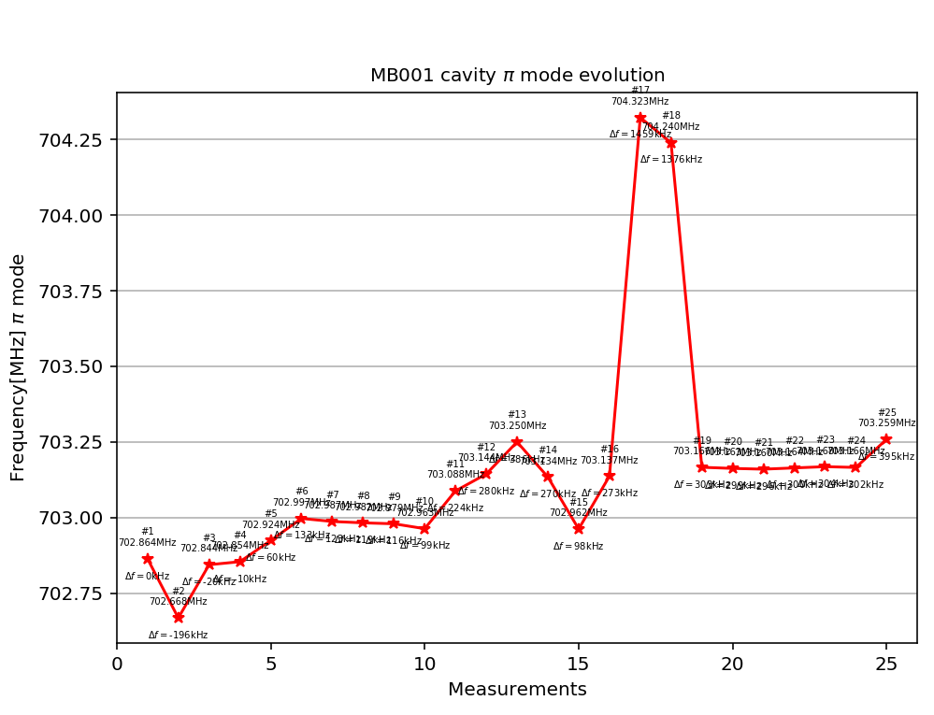
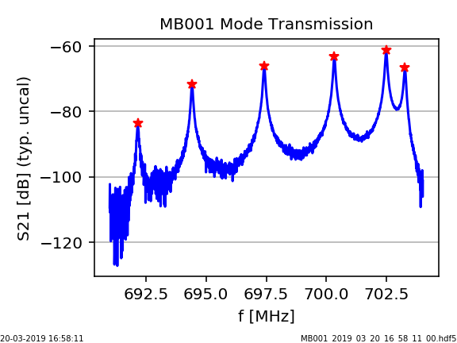
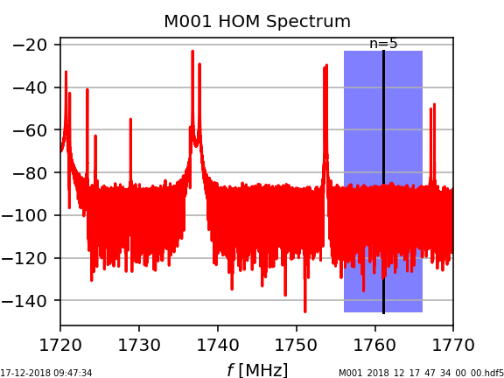
Preparation activities: We need to know our cavities!
ESS Cavity DB
Measurement at IK are transferred into DB, to allow reception and evaluation
  Part of handover process IK-CEA-ESS
Data at ESS then adds to DB
Historical trends and visualization, for assessments
ESS Reception
String ASSY@CEA
Handover INFN/CEA
Cooldown @ CEA
Fabrication

Slide 13
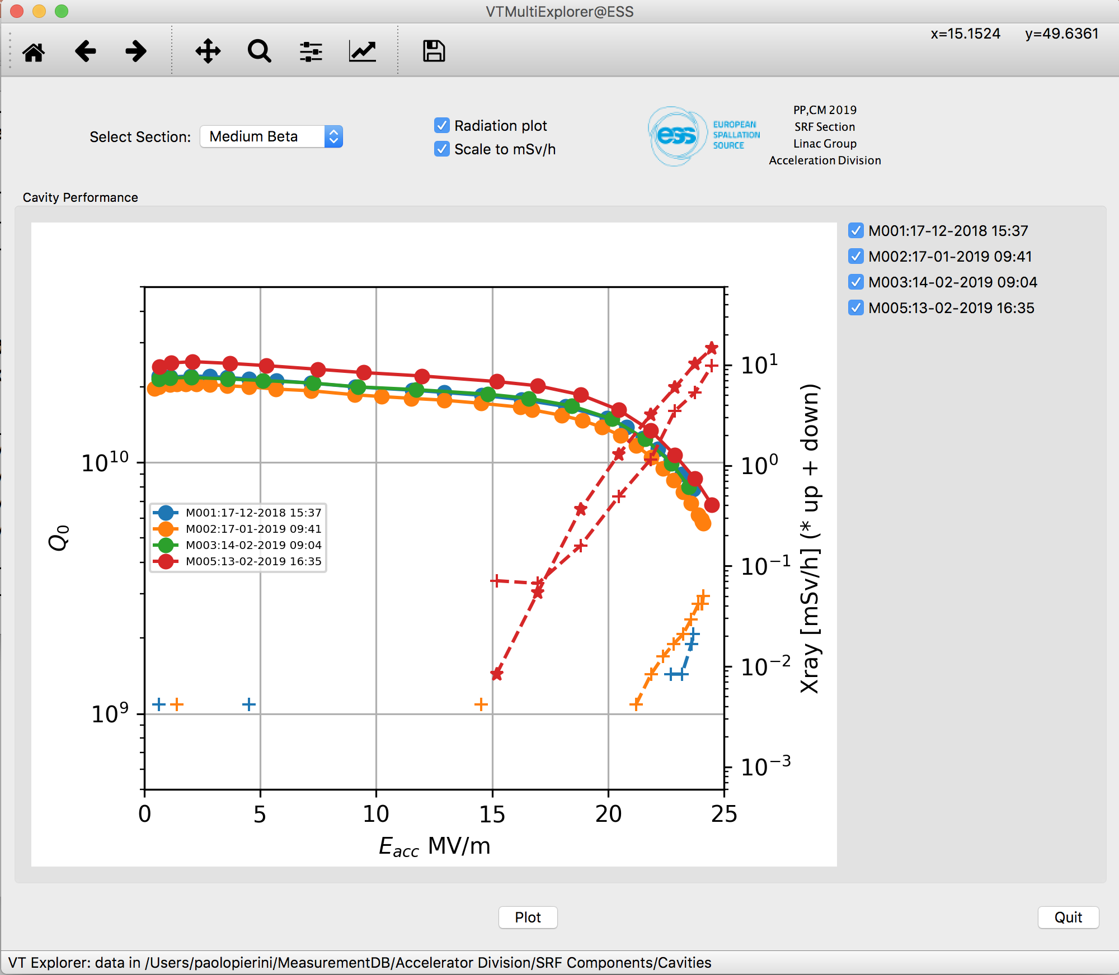
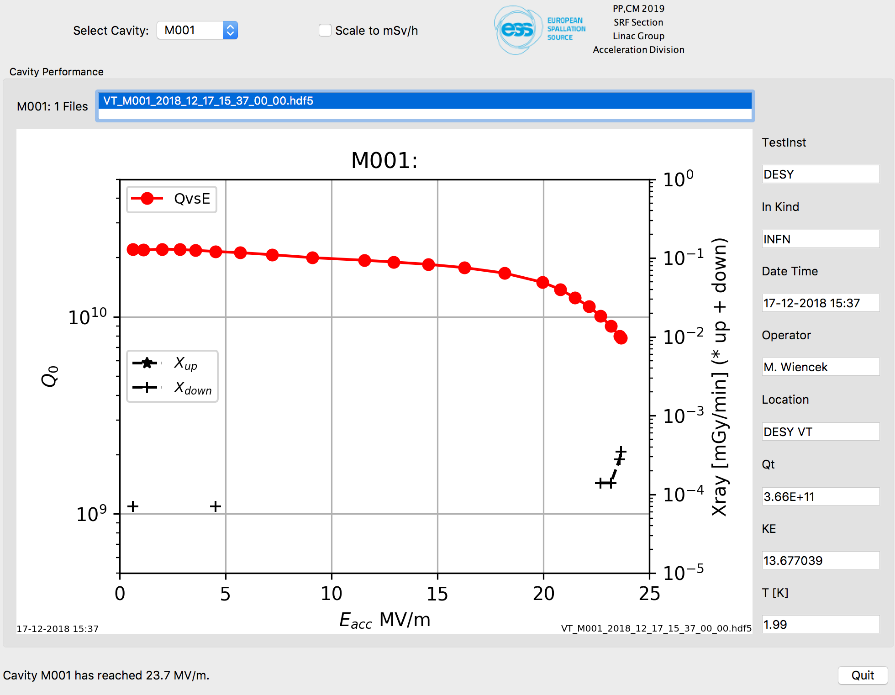
Preparation activities: Cavity performance data
First four cavities of M1 string, real time transfer
In the handover we also receive from the IK the summary data of the vertical tests
  Performance data (Eacc, radiation levels)
  Calibration data for TS2
e.g. PU calibration data from DESY VT

Slide 14
Sensitivity analysis
From demonstrator retrieved data of expected behavior of series in TS2
Parameter, all data kHz | CAV1 M001 | CAV2 MP04 | CAV3 MP01 | CAV4 MP02 | <AVE> SPREAD
From string in vacuum, RT, VV&tank PA, to 4.2 K | 1186 | 1181 | 1169 | 1150 | 1172±18
From string in vacuum, RF, VV&tank PA, to 2K | 1103 | 1107 | 1091 | 1080 | 1095±14
4.2K to 2K, cold, (Pressure sensitivity 1 bar to 30 mbar ) | -83 | -74 | -78 | -70 | -76±7
String from air to vacuum (tuner, tank & VV air, RT) | 174 | 177 | 190 | 195 | 184±11
Vessel from air to vacuum (tuner, string vacuum, tank air, RT) | 111 | 105 | 107 | 75 | 99±18
Data to be used during TS2/Tunnel preparation phases and incoming checks
  Account for change in environmental conditions

Slide 15
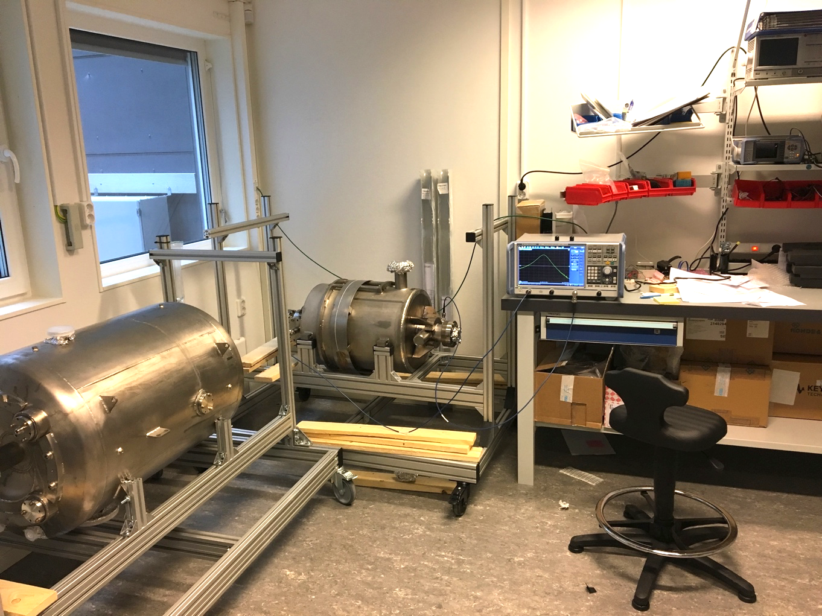
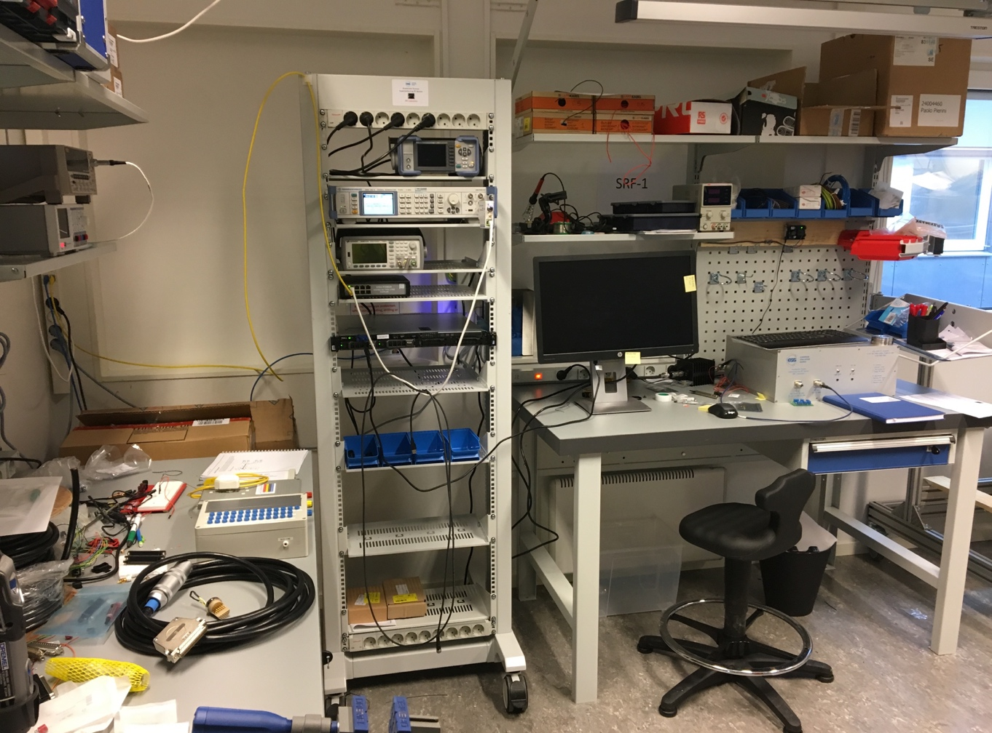
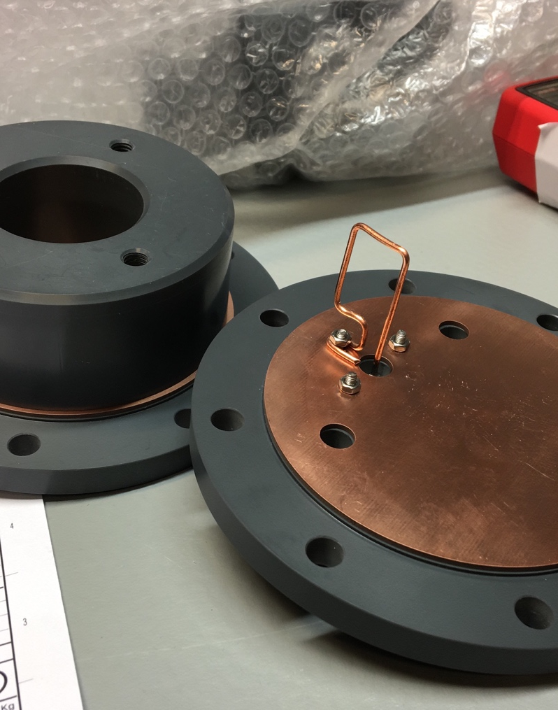
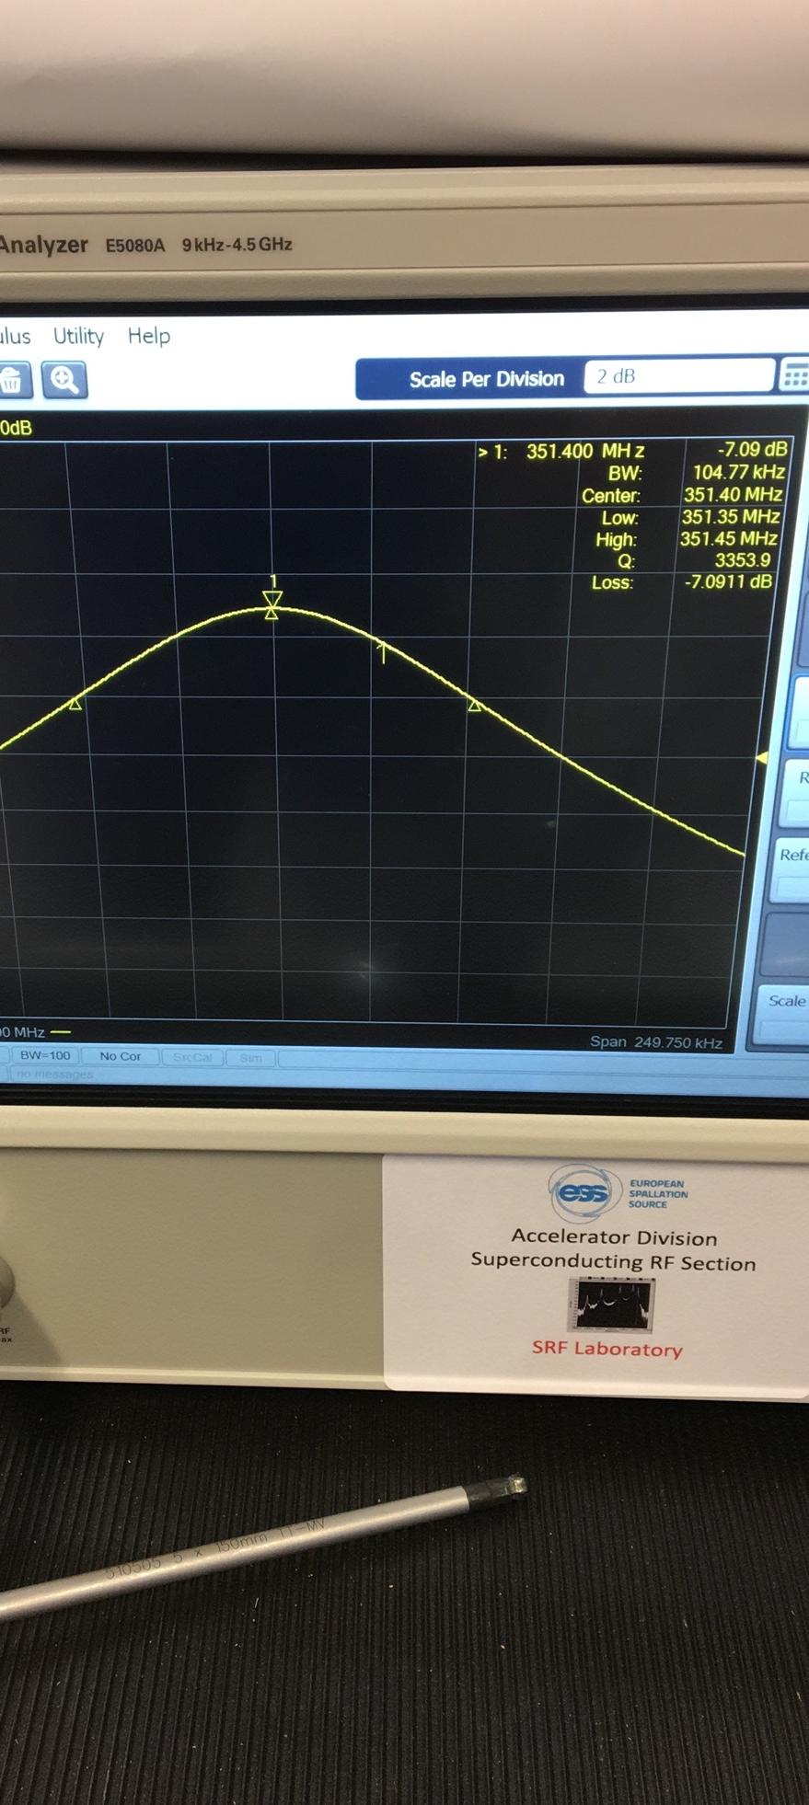
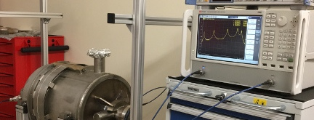
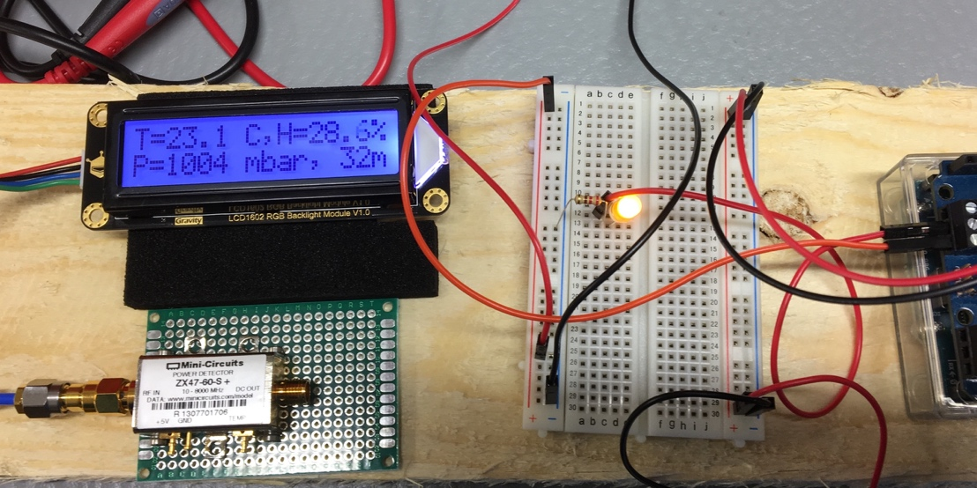
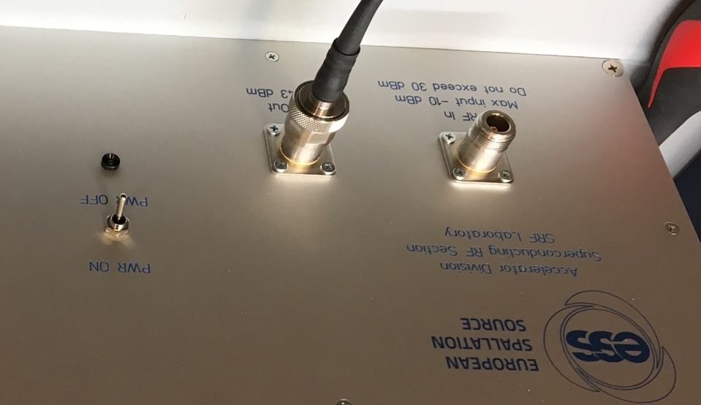
Preparation activities: SRF
Established local laboratories
All the prior development phase at IK, “hands-on” capabilities at ESS
  Setup of SRF Laboratory for the preparation of all incoming reception measurements
  Permanent laboratories in B02 building when available
INFN β=0.5
5-cell
elliptical
IPNO ESS
Double Spoke

Slide 16
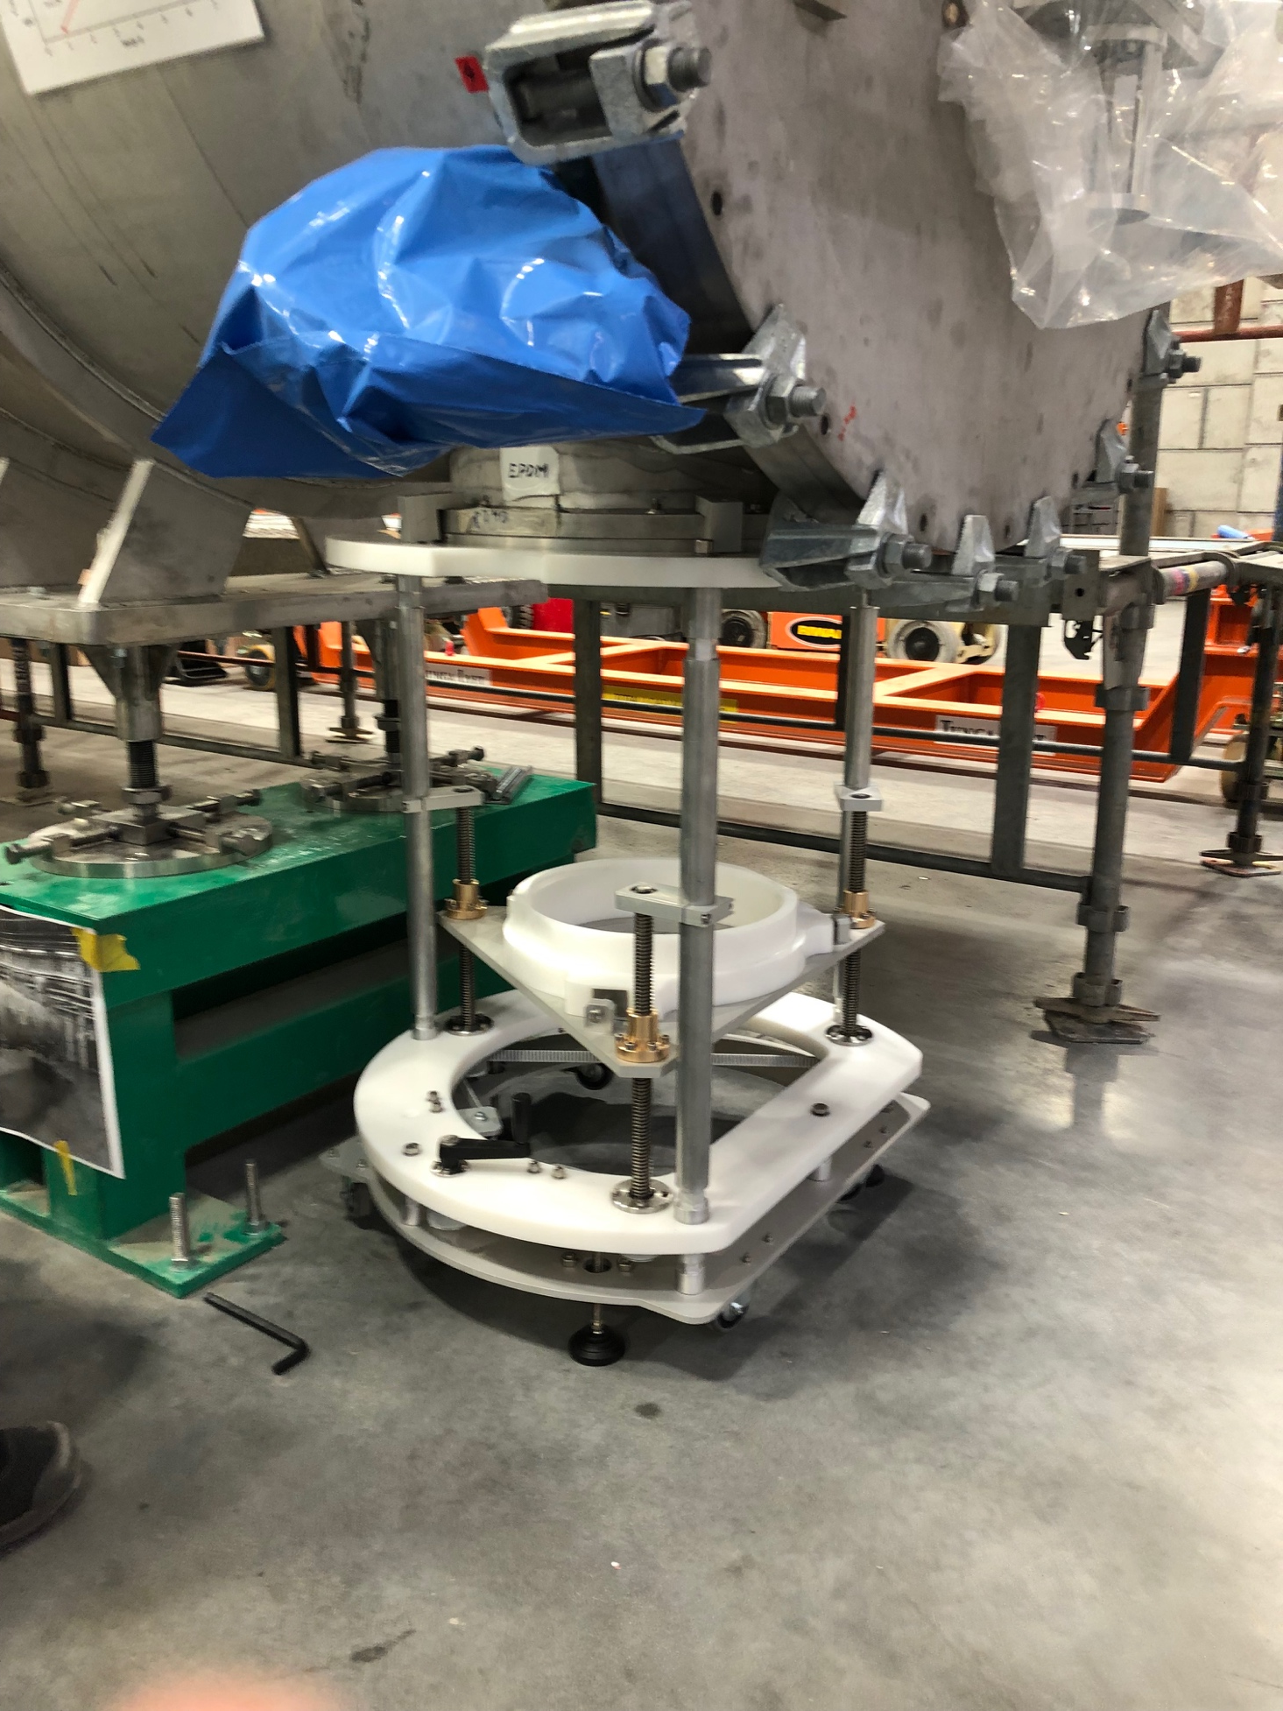
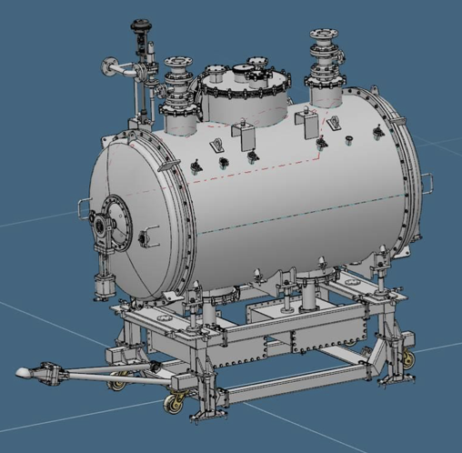
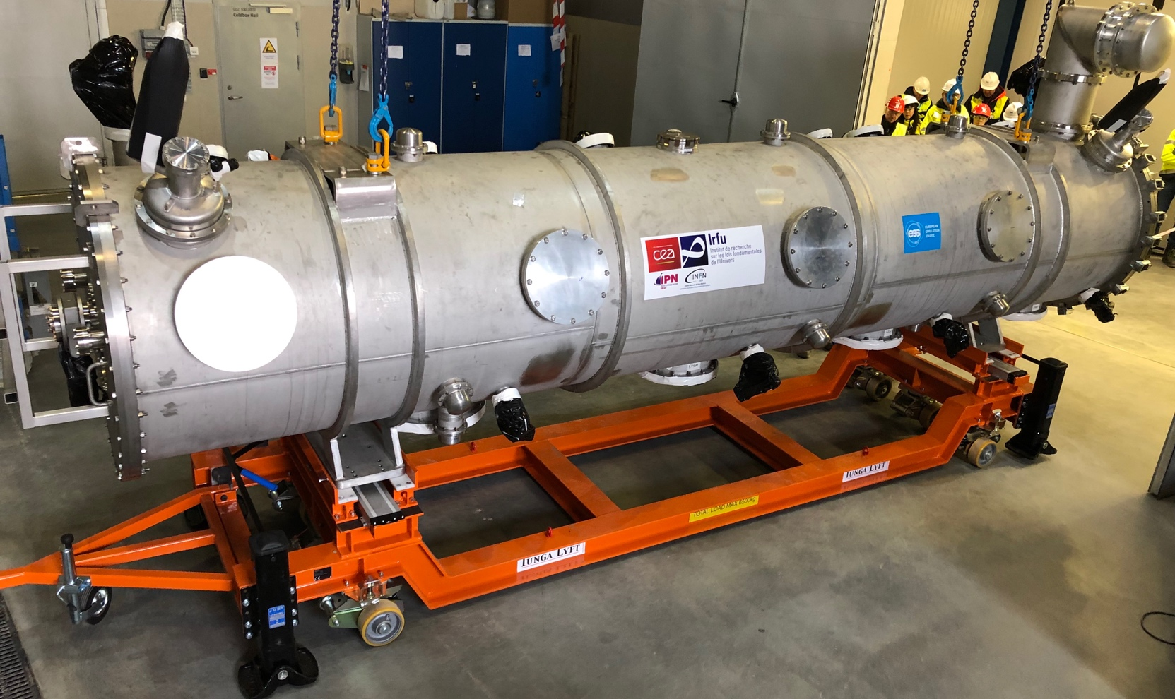
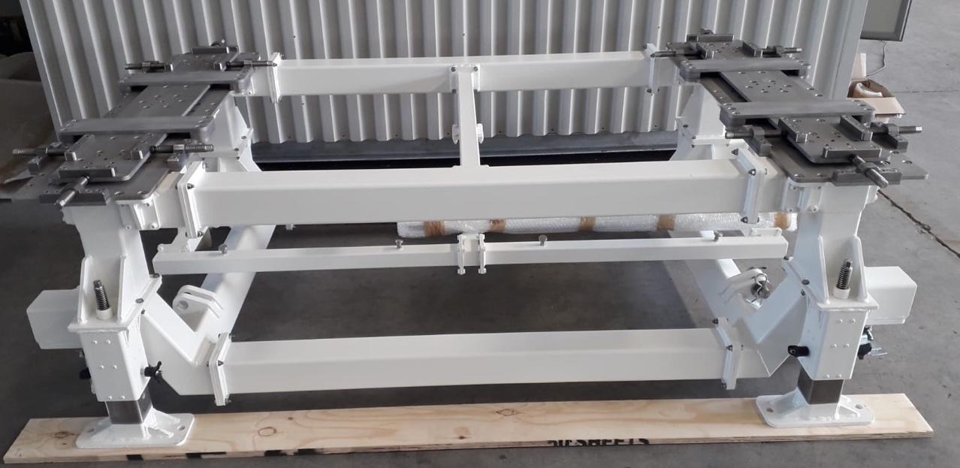
Preparation activities: Mechanical
Development of installation tools
ESS responsibility for transport tools (IK, internal) and supports
  In close contact with ESS Engineering Division (Rigging, Design, Manuf.)
Customization of CEA assembly tools to adapt to the TS2/Tunnel
  e.g. Doorknob Installation Tool
Design at ESS discussed with IK
  Part of know-how transfer process,
  support from EIS
On site transport cart
Spoke cart/support
DK installation tool (ESS)

Slide 17
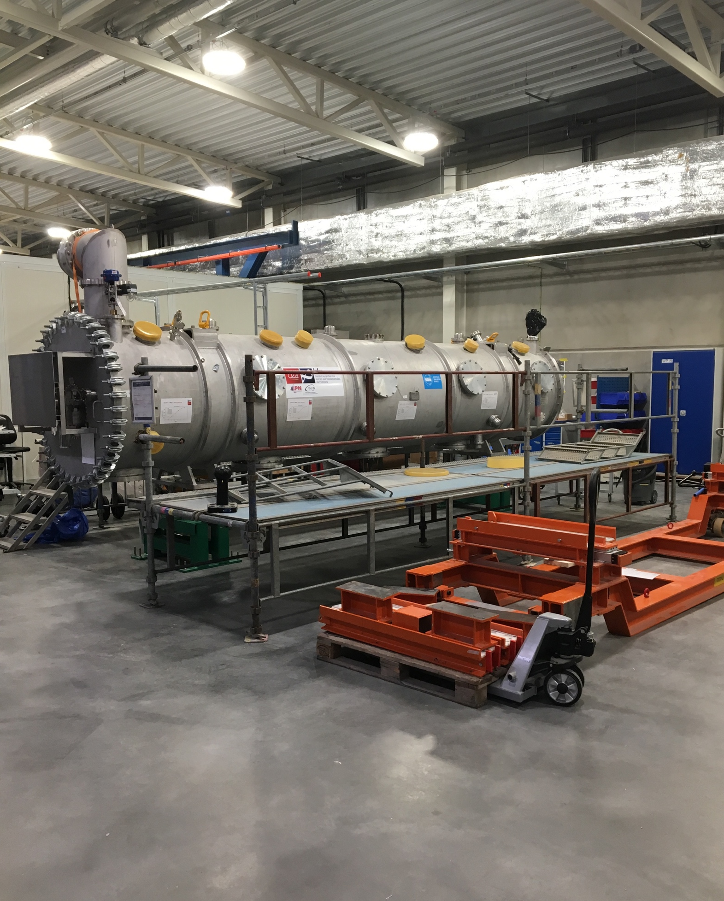
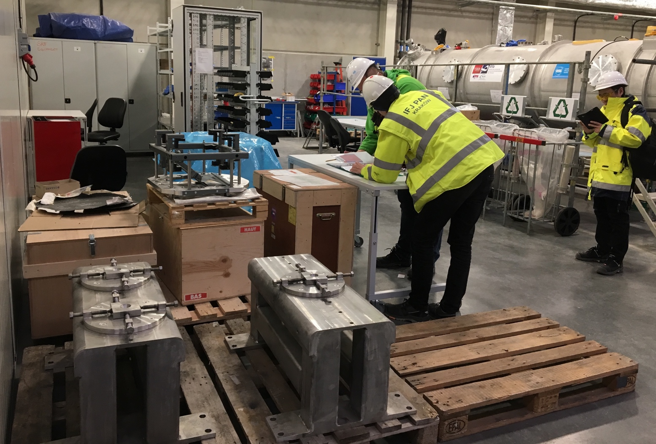
Preparation activities: Incoming inspections at TS2
Setup of Module reception area with M-ECCTD
Preparation of areas for
  Storage of components/instrumentations/tools
  Workstations for mechanical, electrical and RF incoming inspections
  Workstations for activities needed for the TS2 test/tunnel
    E.g. dismount/remount of transport fixations on thermal shields and string
  Local instrumentation racks
  Training teams!
    Main
    mechanical reception
    operations on M-ECCTD
    iso-vacuum
    procedures
    RF incoming
    measurements
    Electrical measurements
    on inner instruments
    Assembly of Doorknobs
DK Fixation
Doorknobs
TS2 Bunker Supports
Incoming reception area

Slide 18
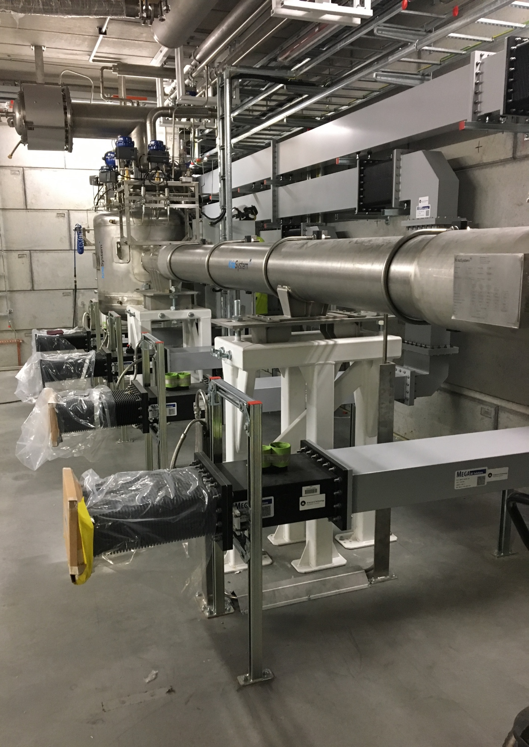
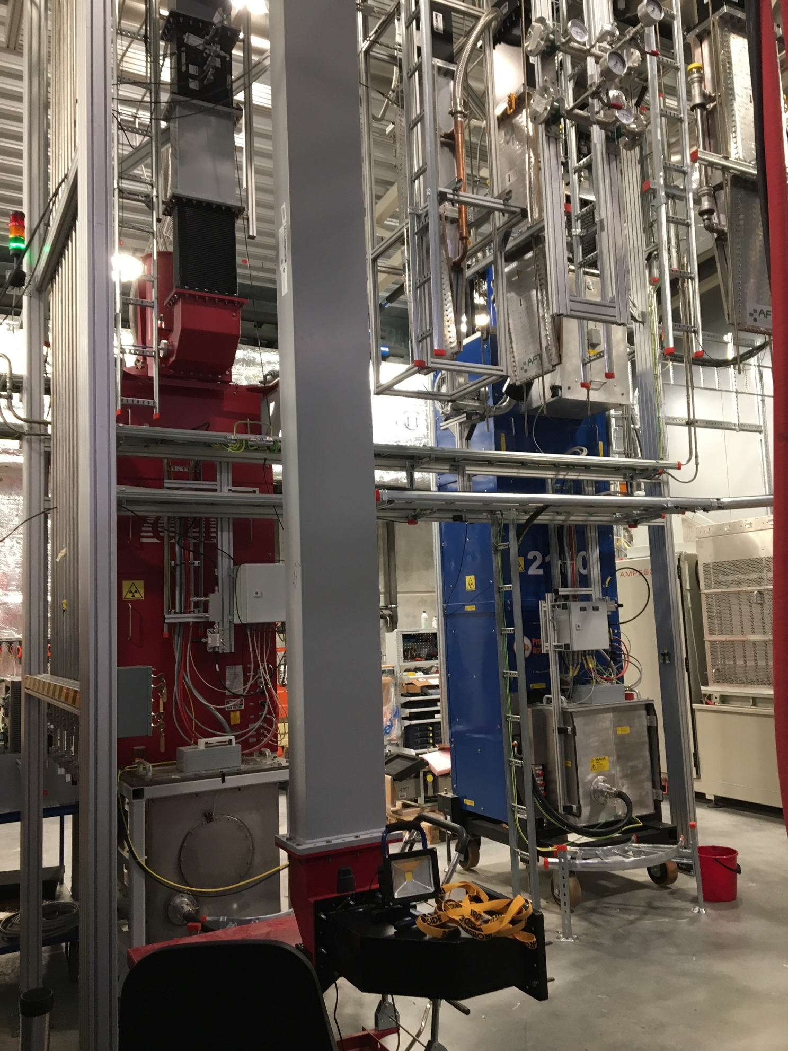
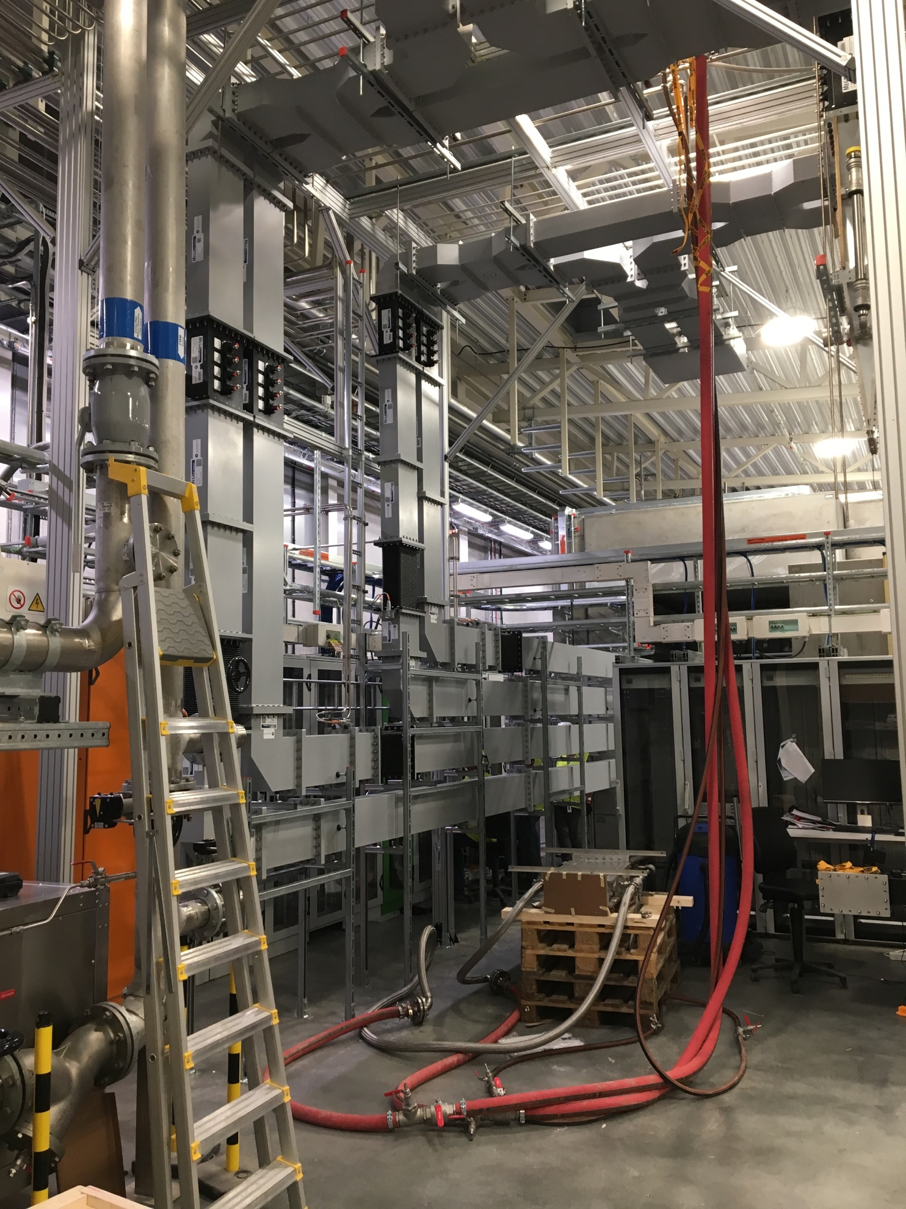
Test Stand 2 Readiness
Radiation authority permit and internal Safety Readiness Review Done
Variable Power Dividers
CM cabling ongoing…
VB
Cryoline
Control System Racks
RFDS
RFDS
Cooling circuits
Klystron commissioning on loads

Slide 19
Testing at TS2
Steady state test cycle: one CM/month
Before Cooldown
  Warm Cable & Component Calibration
  Warm Input RF Couplers Conditioning
After cooldown no HP RF
  Cold cable Calibration
  4K/2K passband measurements, before tuning
  Cavities slow Tuners Test and Cavities Tuning
  2K passband measurements, after tuning
Stable conditions @2K starting HP RF
  Cold coupler Conditioning (off-resonance)
  Open loop operation at low forward power
  Fine tuning with Pt
  Calibration
  E_{acc} ramp up (cavities on resonance)
  Field emission measurements (dose & energy spectrum)
Test goals
  Performance assessment (specs fulfilled?)
  Limiting mechanisms (quench, FE, Power limitations)
  Comparison/correlation wrt VT results (and cryomodule results, where possible)
  Store data for future Linac operations (degradation, perf. recovery)

Slide 20
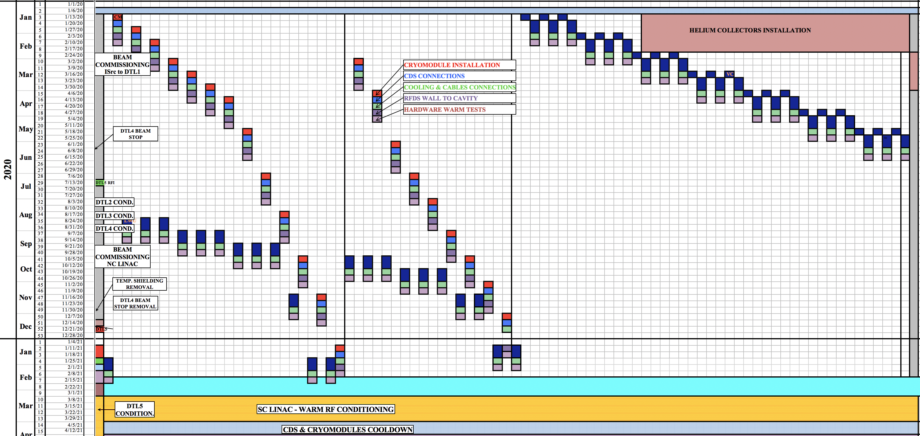
2020, concurrent SPK/MB ELL Component installation
13 Spokes
9 MB ELL

Slide 21
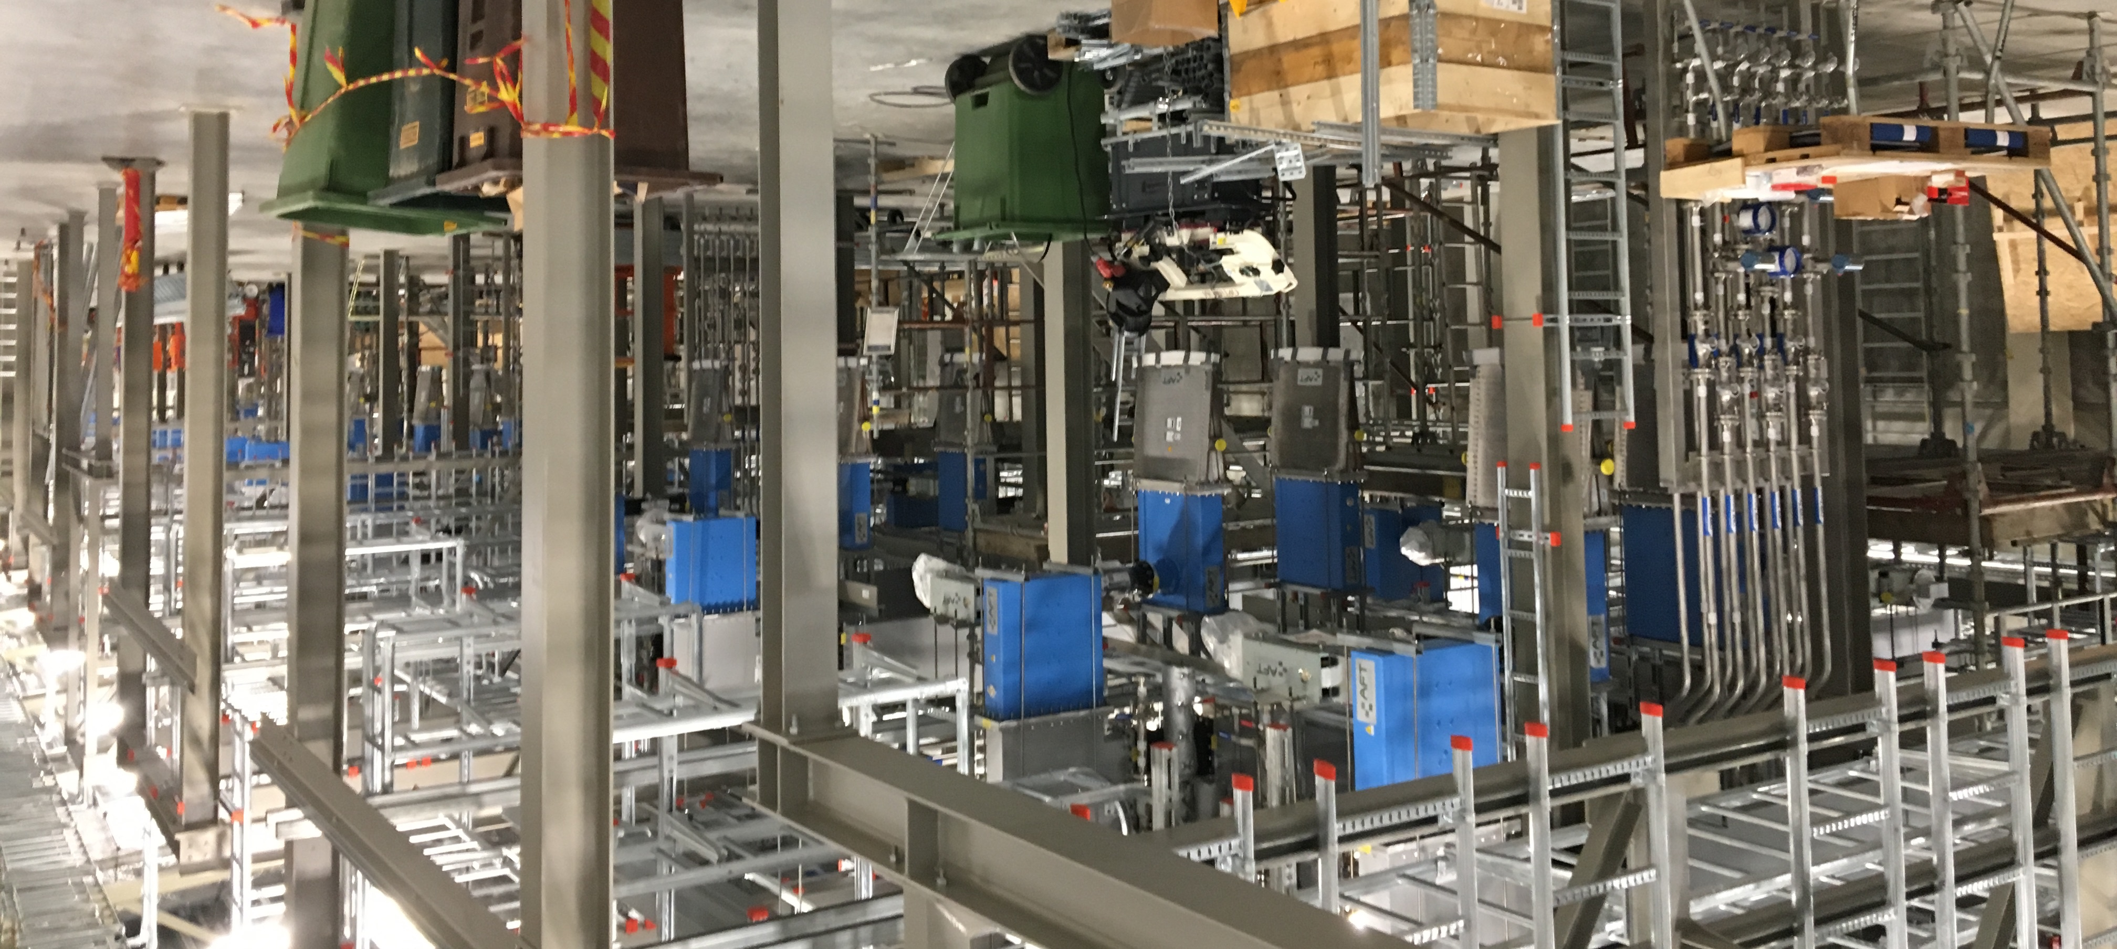
Spoke section gallery preparation
support structures
Cable trays for racks
Waveguides
Circulators
Loads
Manifolds

Slide 22
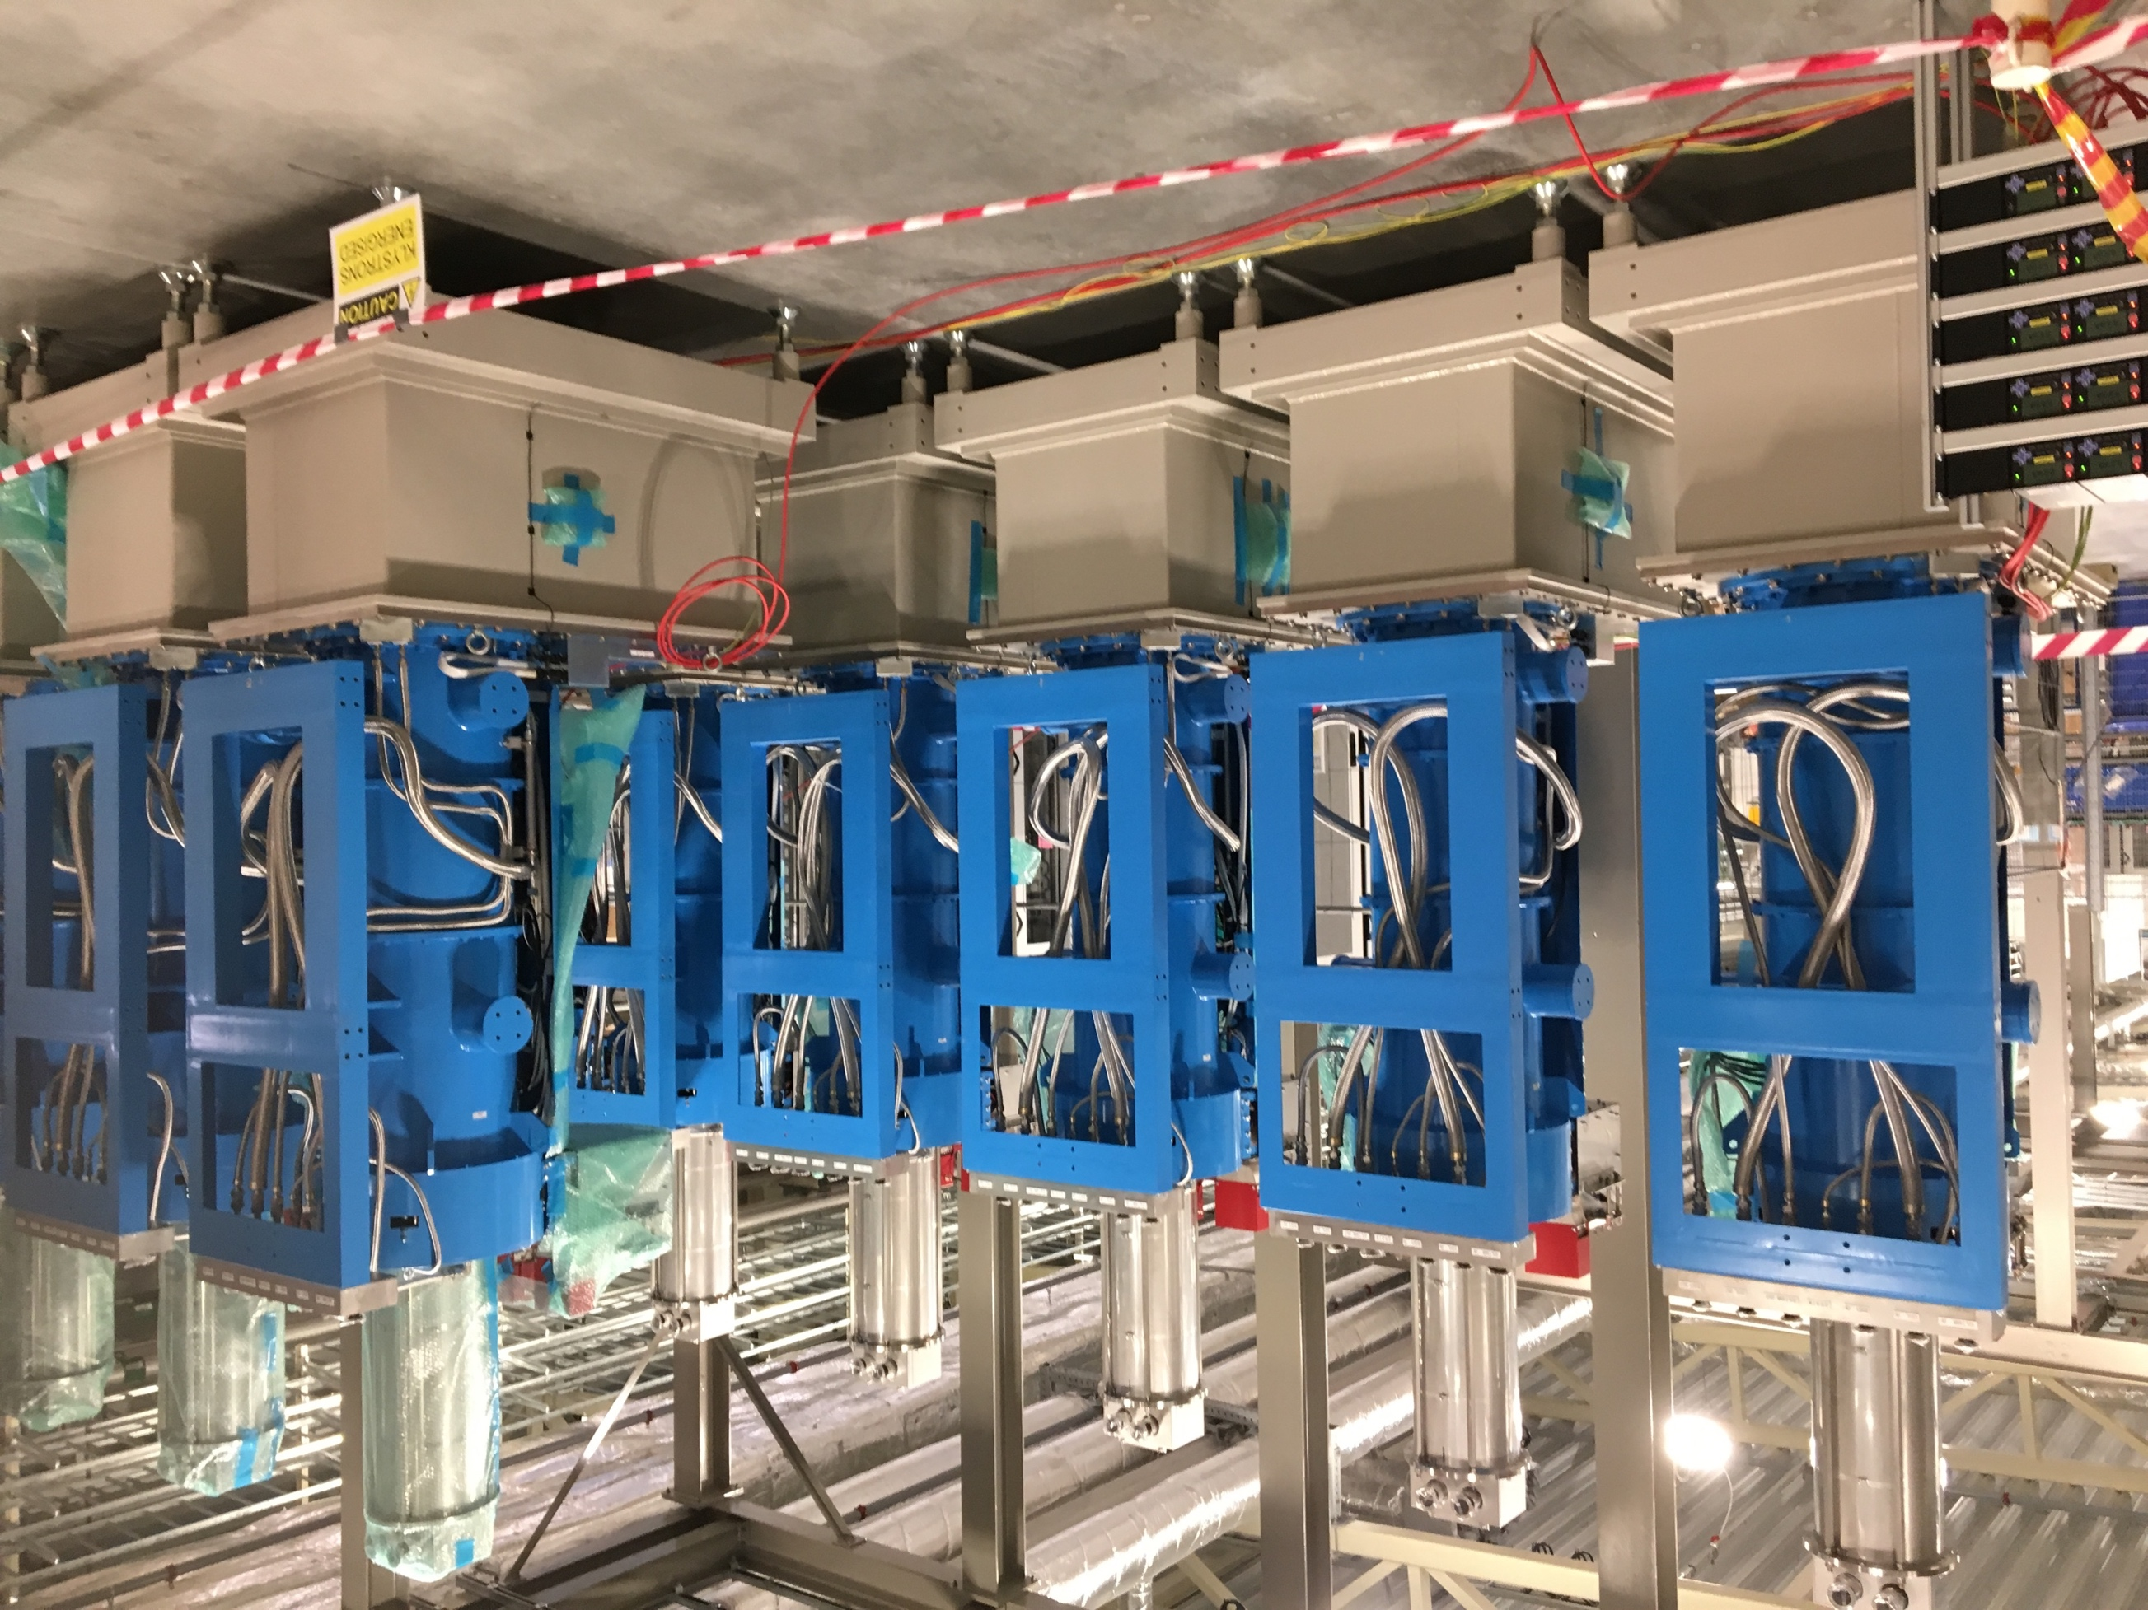
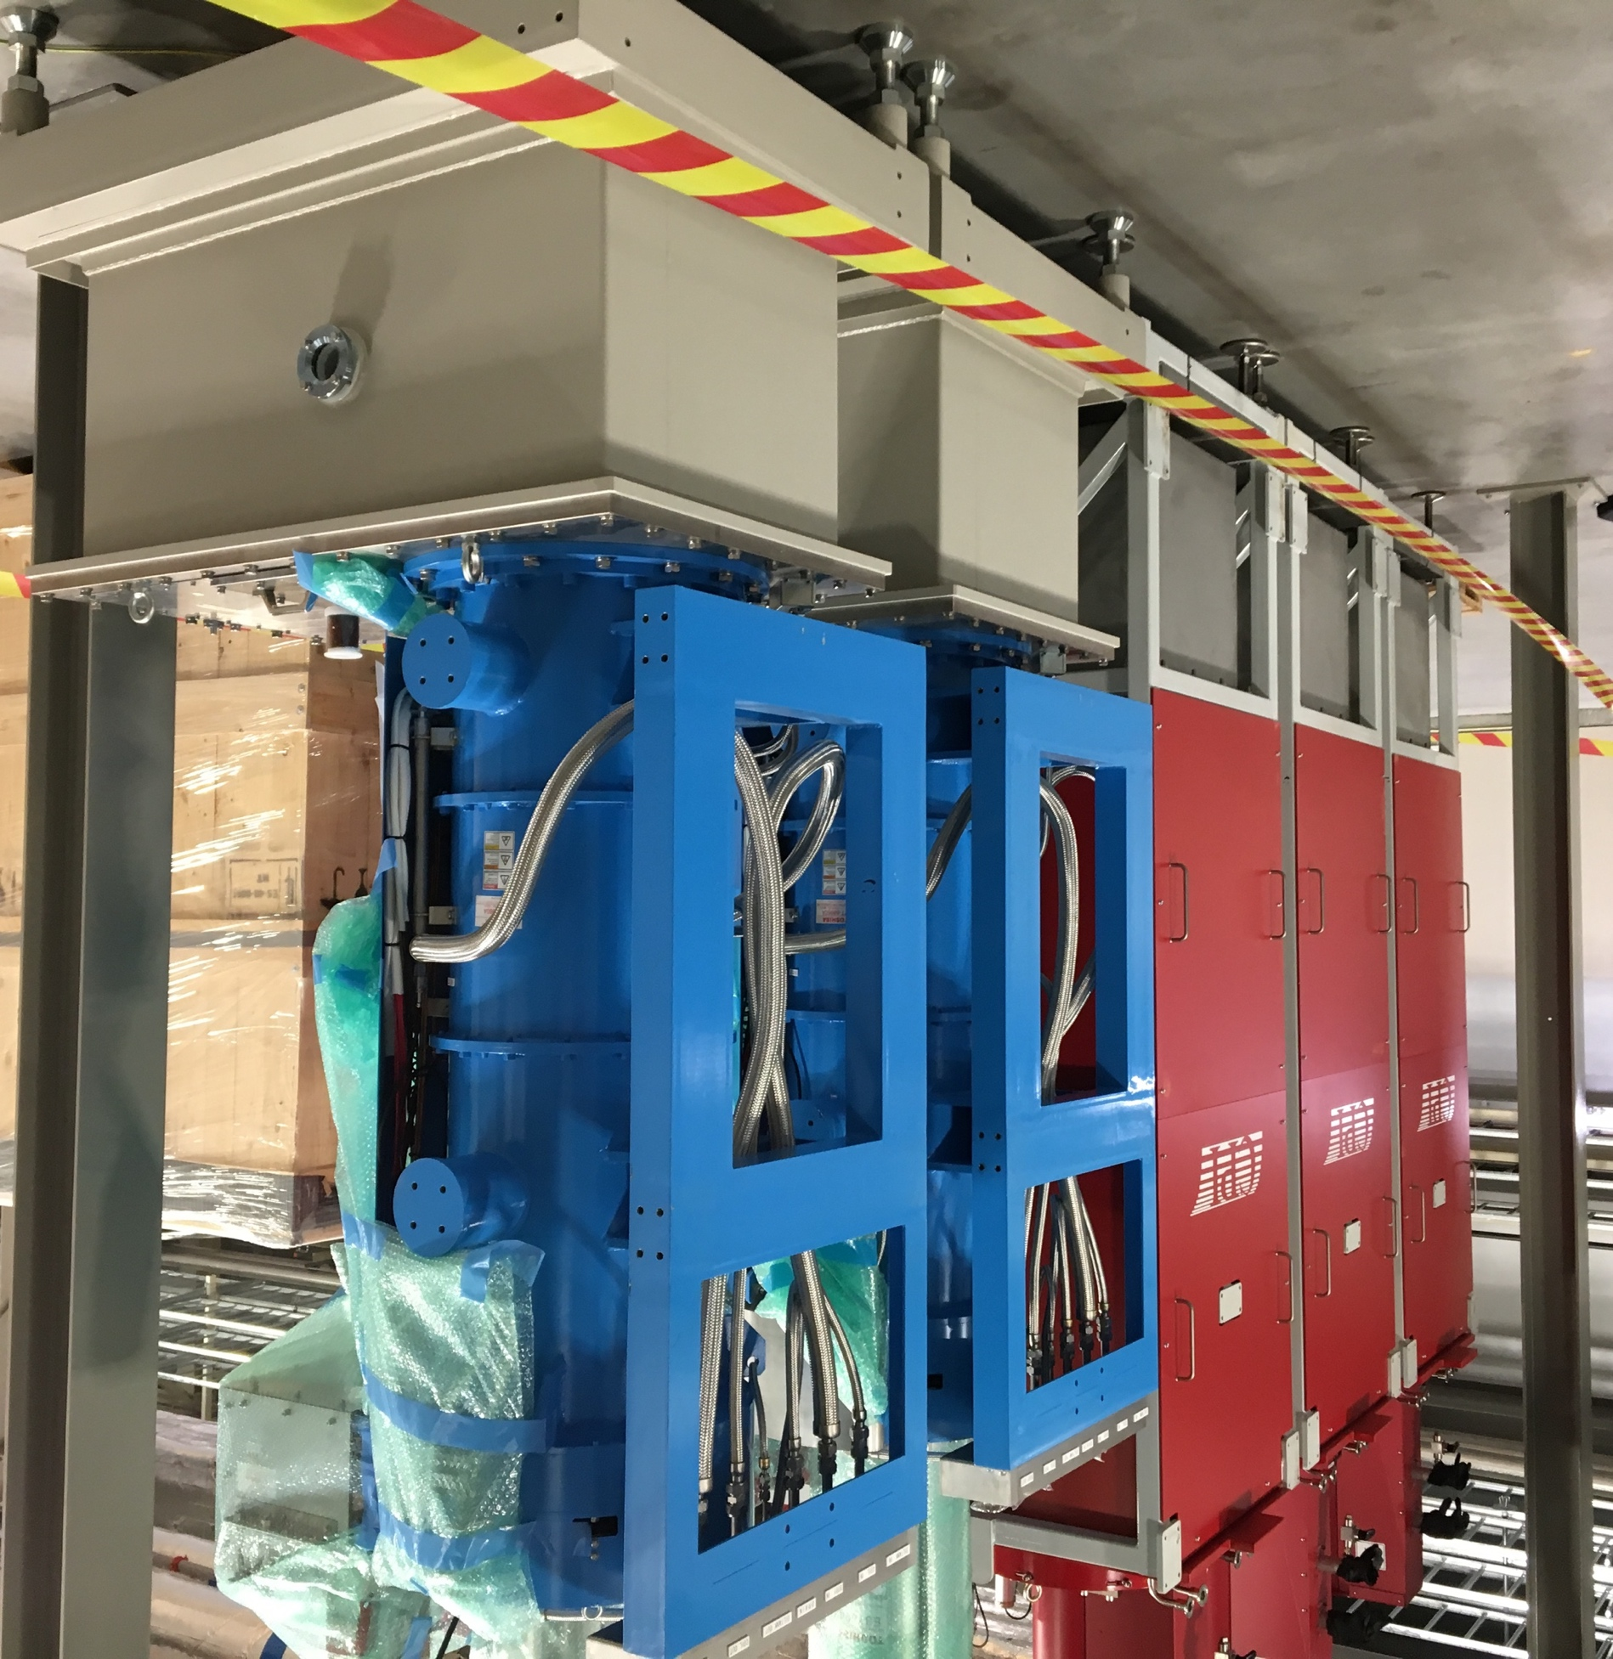
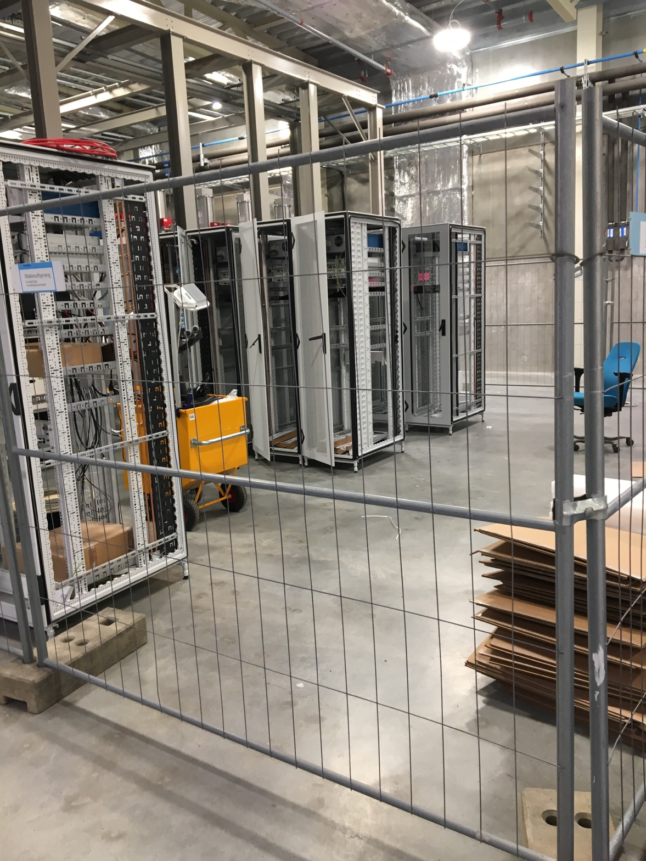
Delivery of MB Klystrons
Half of production stored in gallery
a
A. Sunesson/M.Jensen, ESS

Slide 23
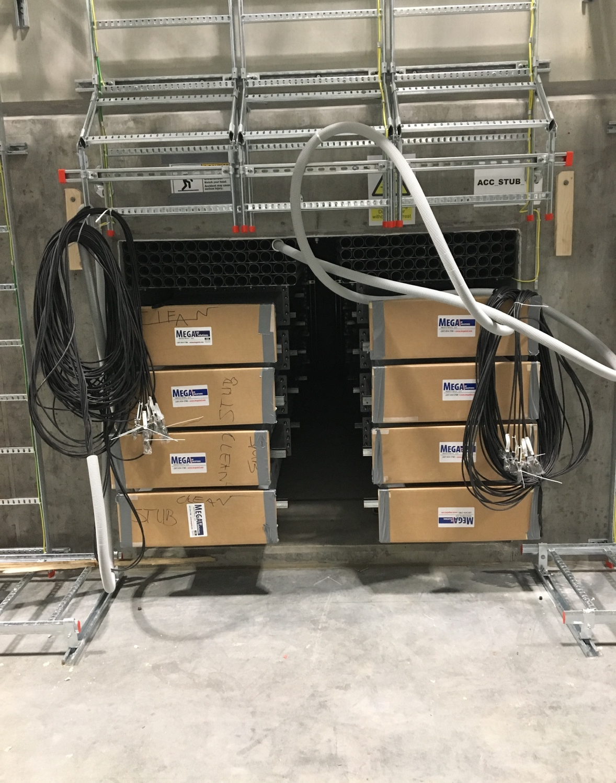
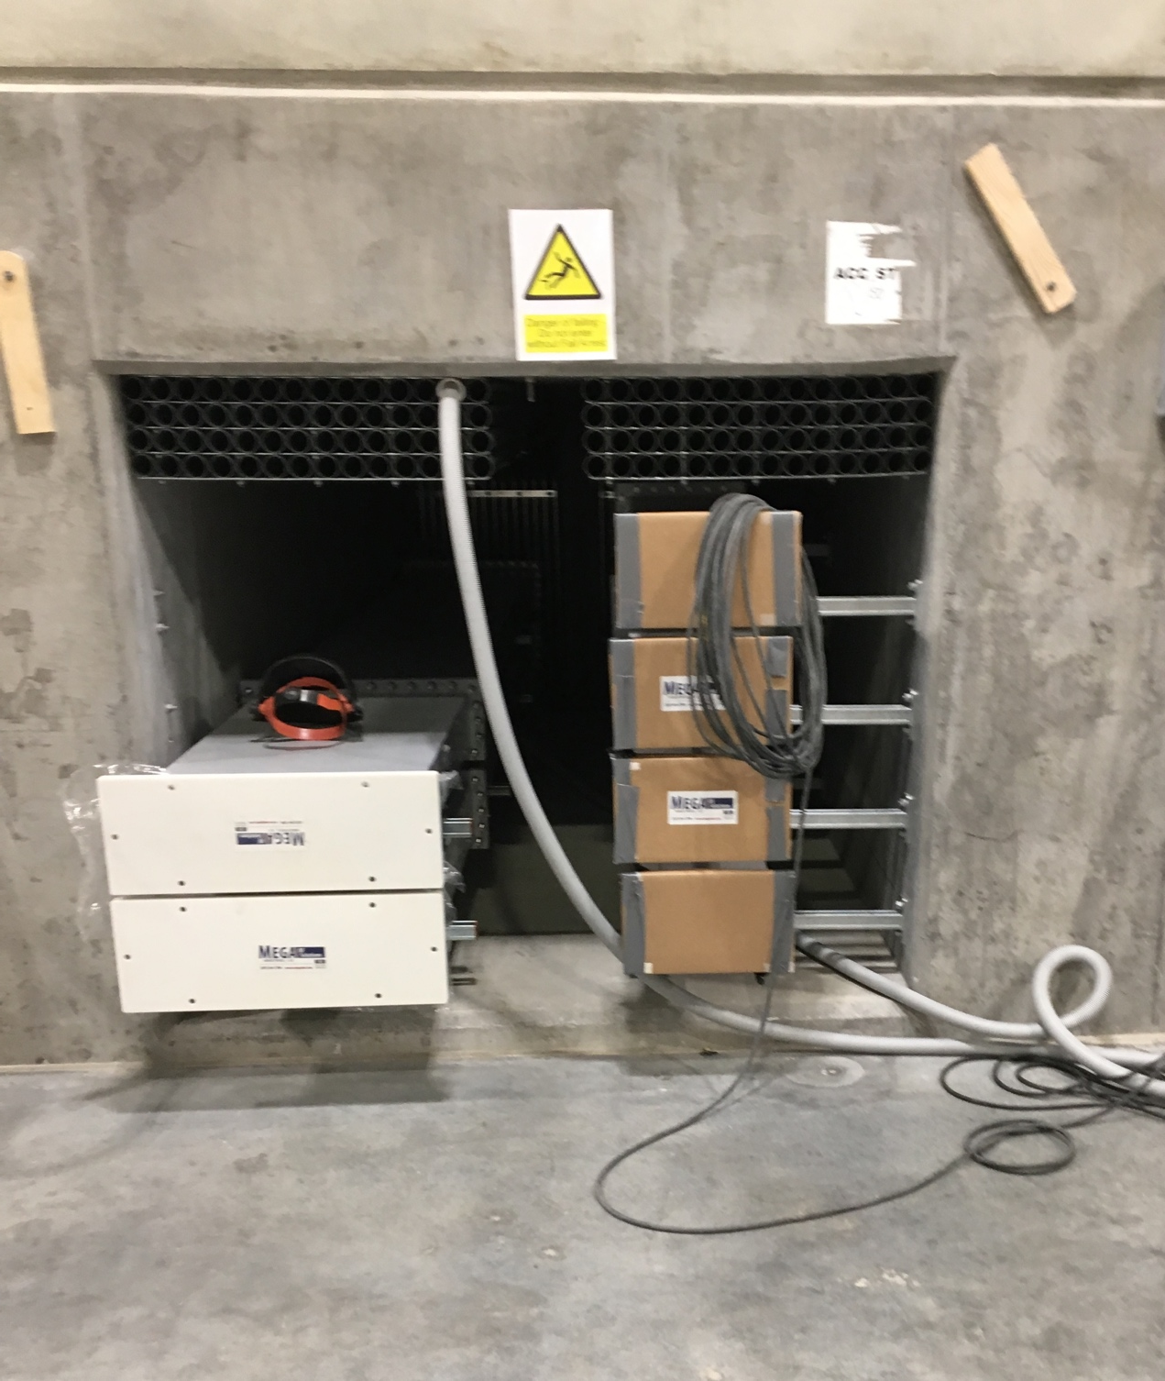
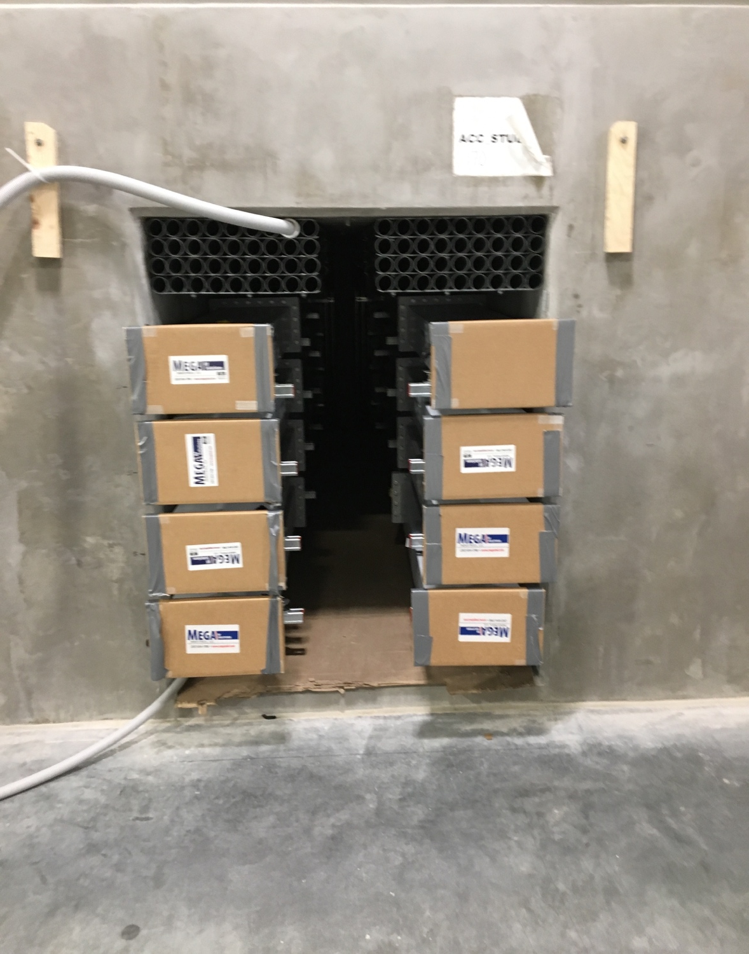
Stubs, gallery side
Close to completion, for the start of the cable pulling operations
A. Sunesson/M.Jensen, ESS
Cable conduits
WR2300HH
WR1150
Spokes
Transition
Elliptical

Slide 24
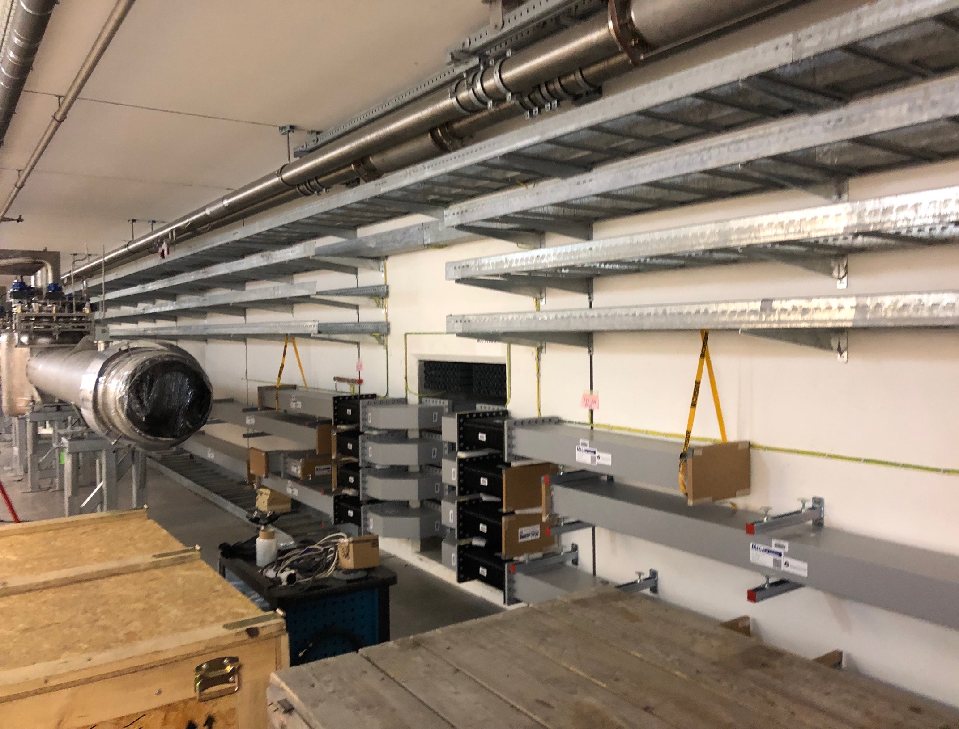
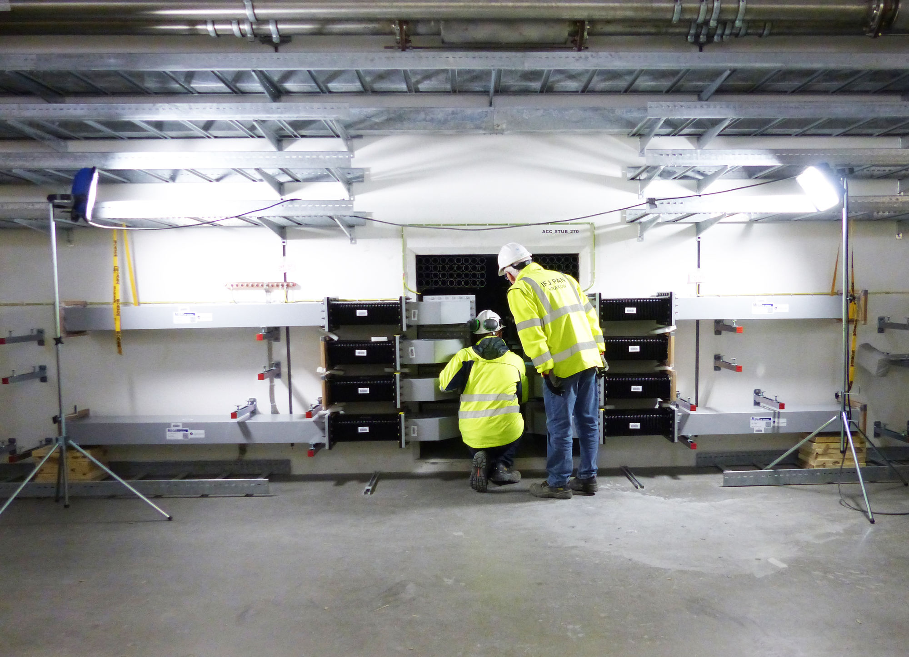
Stubs, tunnel side
Installation of tunnel components of RFDS before VB components
Cryoline
RFDS
for 2
modules
A. Sunesson/M.Jensen, ESS

Slide 25
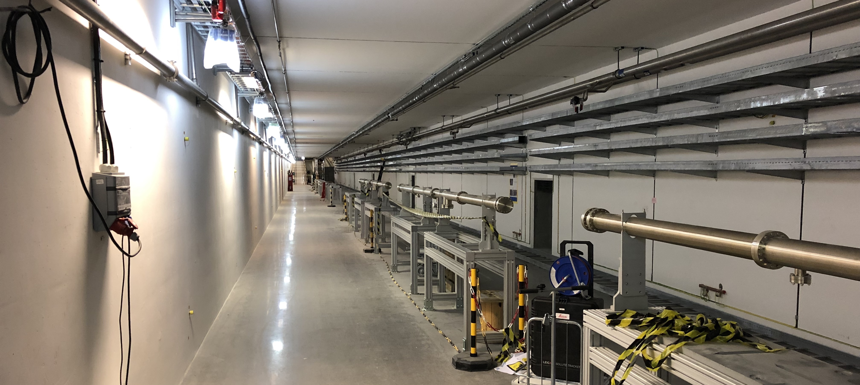
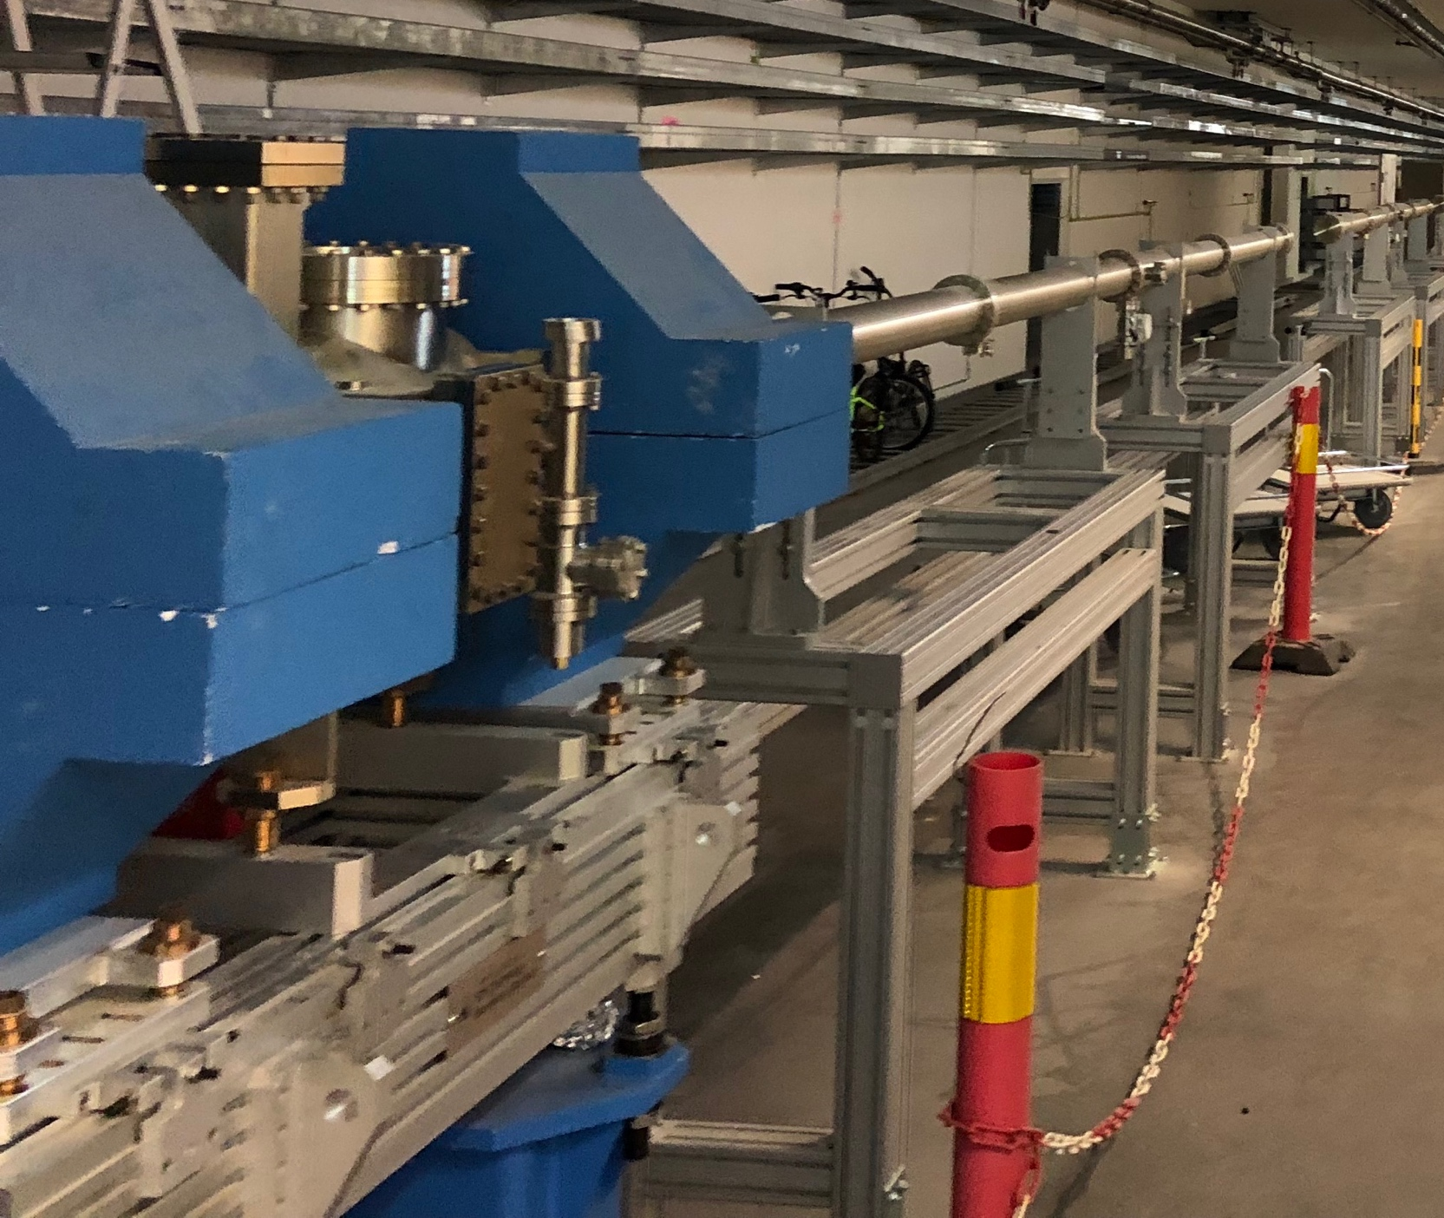
Tunnel: Cryomodule Dummies (and Soon Warm Units)
In the accelerator “contingency” space (reserved for upgrades)
To the
Dump
Linac Warm Units here
Same flange to flange length of CM
M. Juni Ferreira/ESS

Slide 26
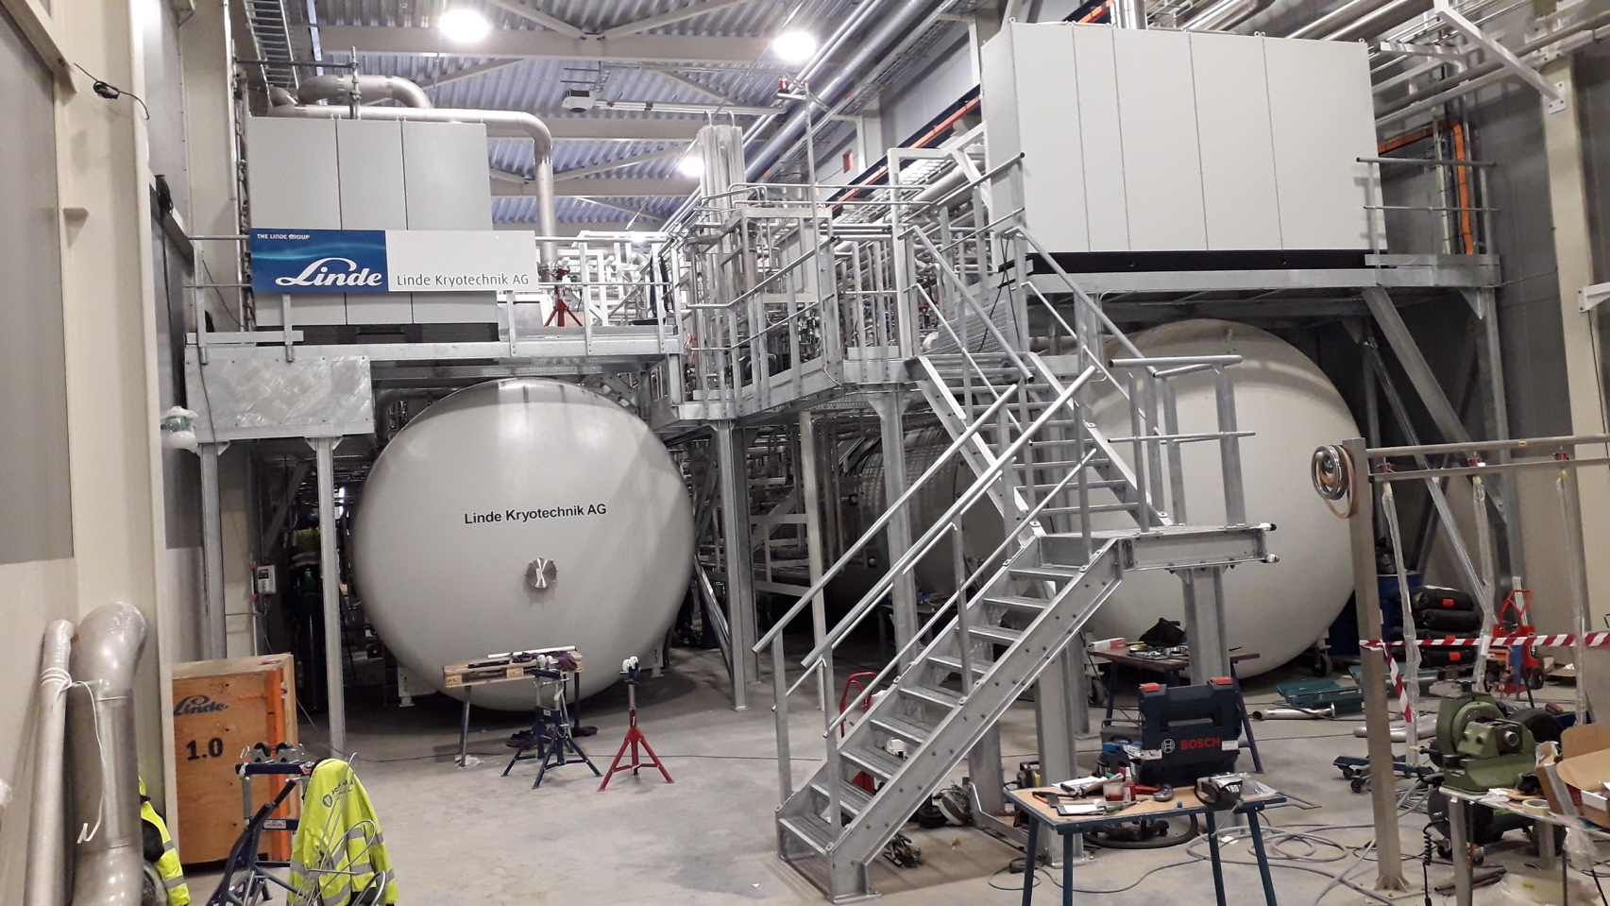
Cryogenics for the Linac
Three cryoplants procured and being commissioned by ESS Cryo Team
ACCP (ACcelerator CryoPlant)
  Main plant for the entire accelerator (96% of energy gain by SRF)
  3 kW @ 2K, 11.4 kW @ 40-50K, 9 g/s liquefaction
  Designed to cope with upgrade scenario in the contingency space
  Producing LHe: ready for CDS commissioning in Q1 2020.
  Commissioning (including 2 K operation with cold compressors)
  completed by 2019
Linac
Cryoplant
Cryogenic Transfer Line (75 m)
X.Wang/P. Arnold, ESS
Cryogenic
Distribution Line
(120 m)
Cryogenic Distribution Line
(310 m)
Endbox
Splitting box
Endbox
14 High Beta Cryomodules
(Contingency, 116 m)
21 High Beta
Cryomodules
(174 m)
9 Medium Beta
Cryomodules
(75 m)
13 Spoke
Cryomodules
(54 m)

Slide 27

Cryogenics for the Linac
Installation of linac Cryogenic Distribution line
J. Fredrick, ESS
CDS (Cryogenic Distribution System)
  Delivers cryogenics to the Accelerator
  from ACCP, provided as IK
  contribution by
    WUST/PL (CDS-ELL)
    IPNO/FR (CDS-SPK)
  9 CDS-ELL Valve boxes installed
  and connected with Cryolines in tunnel,
  and other 3 positioned
  Next: CDS-SPK (VB delays)
Goal is CDS cooldown by
end 2019-beginning 2020

Slide 28

Cryogenics for the Test Stand and Moderator
Installation of linac Cryogenic Distribution line
TICP (Test and Instruments CryoPlant)
  Cooling for CM Test Stand 2: 76W @ 2K, 420W @ 40K, 6 l/h Liquefaction
  Liquefaction for Neutron Instruments / Sample Environments: 7500 l/month
  Commissioned to specs and currently providing liquid helium to Lund University and MAX IV
  Warm Pumps for subatmospheric operation
  Commissioning of transfer line to TS2 currently undergoing,
  then cryogenic operation of the TS2 with modules could
  start in summer
TMCP (Target Moderator CryoPlant)
  Non-accelerator related
  For the LH₂ cooling of the Target Moderator: 30 kW @ 15-20 K
  Entering commissioning stage
Courtesy P. Arnold, ESS

Slide 29
Summary
Intense workload across all SRF machine section
Installation/Testing goals for 2019
  Completion of CDS-EL and CDS-SPK
  He recovery line in tunnel (venting events)
  HEBT LWUs and beam lines
  Completion of Stubs and waveguides along tunnel walls
  Installation of Cryomodule support stands
  Preparation of the infrastructure: cabling, piping and support systems
  Start TS2 operation with prototypes
  Start testing of series spokes and elliptical modules
Module installation in tunnel will follow in early 2020, after the testing of the initial series components now under assembly)

Slide 30

Thank you for the attention!

