Slide 1
Hands on Session
www.europeanspallationsource.se
18-11-27

Slide 2
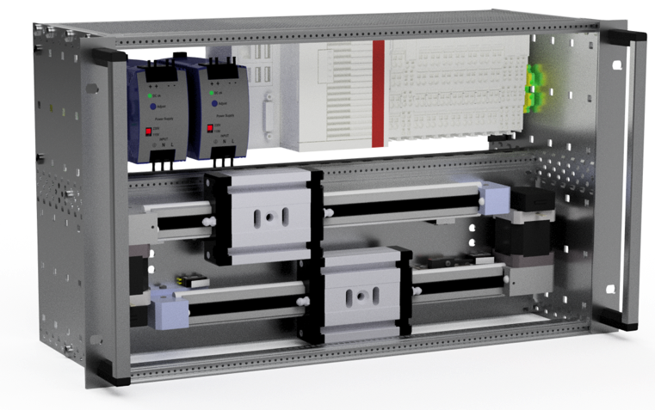
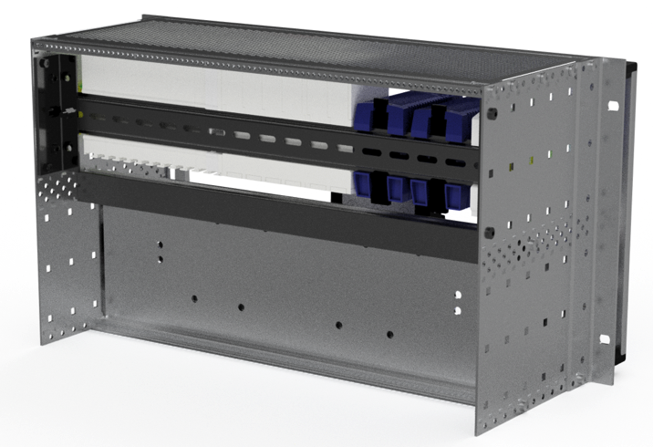
Hardware: Test Crates
19’’- 6HU – subcrate, depth 175mm
Different configurations for 1 or 2 axes
Standardized set of IOs per axis
Mechanics included
For both OS versions (W7/TwinCAT and Linux/Open Source/ECMC )
Notes:
We will use 19” test crates
Some with one and some with two axes

Slide 3
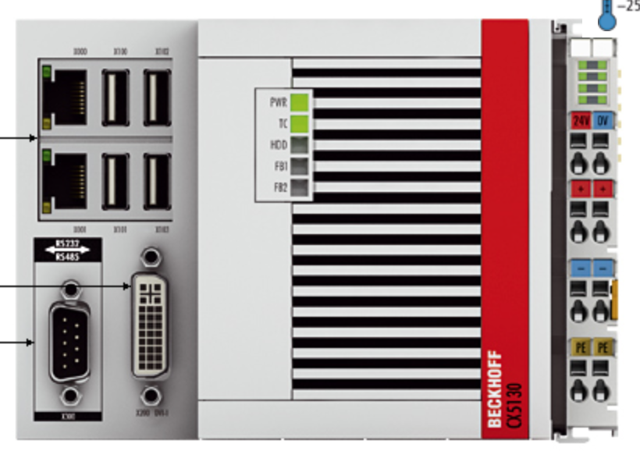
Hardware: CX5130 CPU
Embedded PC with Intel® Atom™ processor, 1.75 GHz, 2 cores (TC3: 40)
Flash memory slot for CFast card
Integrated 1-second UPS (1 MB persistent memory on CFast card)
3 network ports (2 RJ45 and 1 dedicated EtherCAT)
4 USB ports
DVI connection
Diagnostic LEDs (for TwinCAT only)
Notes:
CPU

Slide 4
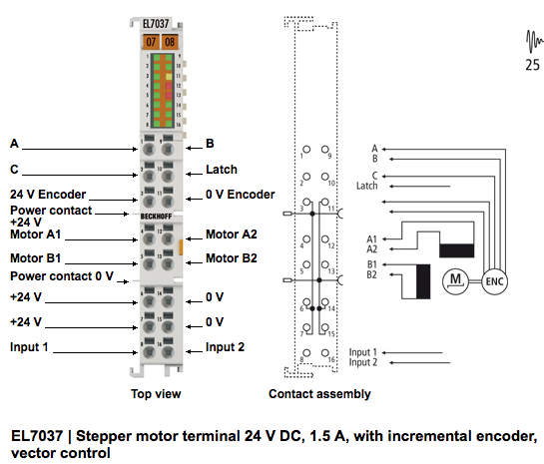
Hardware: EL7037 Drive Card
2 phase stepper drive
24V, 1.5A
Incremental Encoder (TTL)
2 Inputs
Distributed clock
Modes:
Open Loop (step counter)
Closed Loop with encoder
Vector Control (closed loop with current control)
Supported Control Modes:
Cyclic Synchronous Position
Cyclic Synchronous Velocity
Positioning Interface

Slide 5
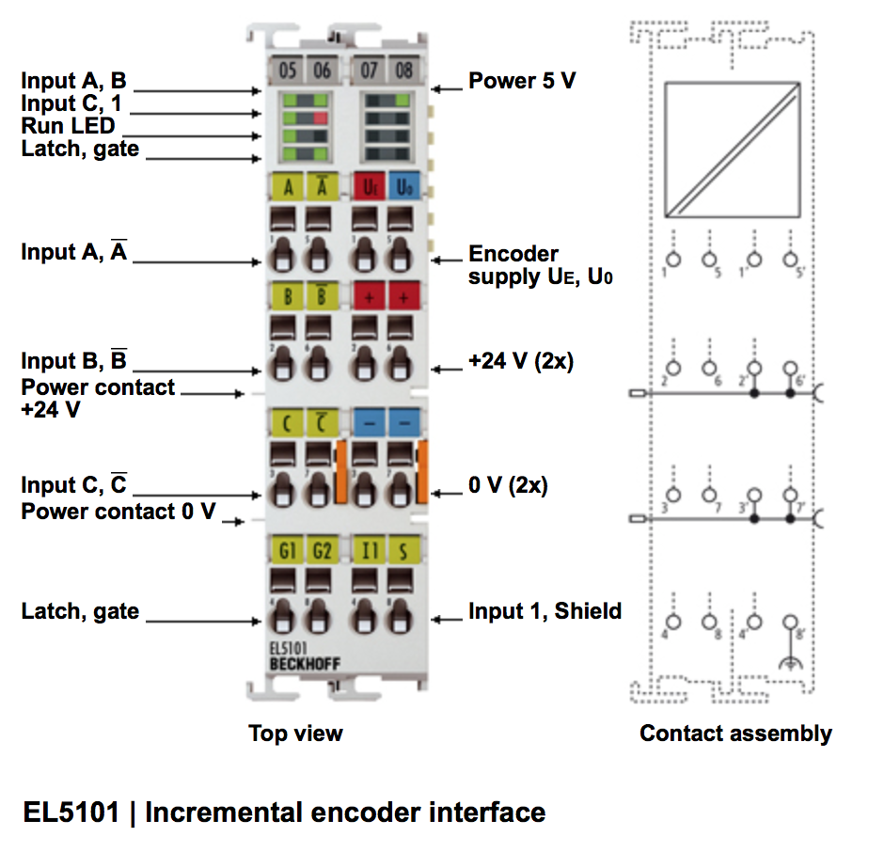
Hardware: EL5101 Incremental Encoder
Differential Incremental Encoder Interface (A, A/, B, B/, C, C/)
1 Input
Distributed clock
Encoder supply
Latch, Gate functionalities (can be used as inputs)

Slide 6
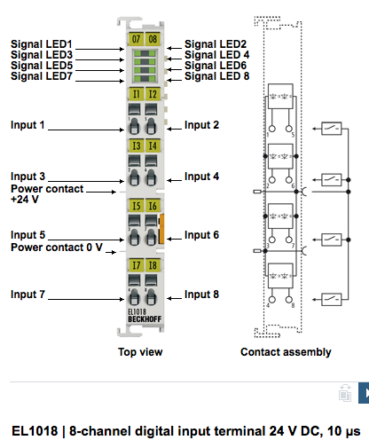
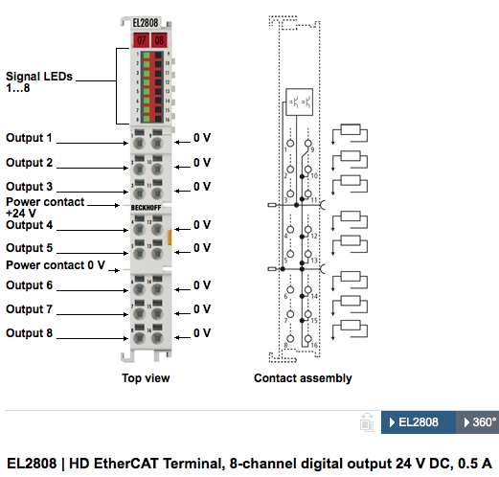
Hardware: EL1018, EL2808 Digital Inputs
EL1018:
8 inputs
24V
10 micro seconds filter
EL2808:
8 outputs
24V, 0.5A

Slide 7
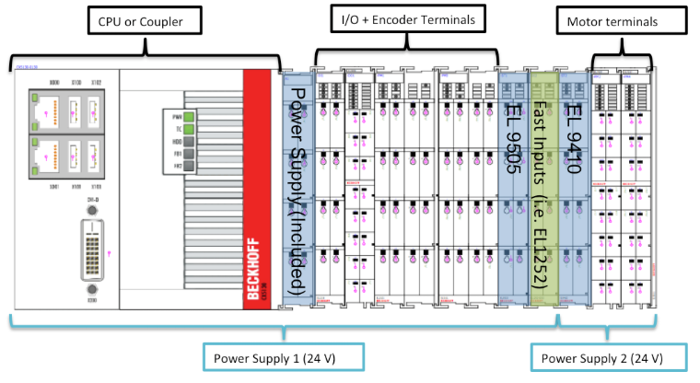
Power Concept
Note: We have a standard document describing standard hardware setups (with instructions)
Notes:
Power concept.
Divide so that drive cards get power from one supply and control logic from other supply.
This to minimize EMC issues.
smb://fileserver01.esss.lu.se/Share/Science Directorate/Neutron Technologies division/MCAG/Motion/MCA HW Standards/MC Controller/Terminals/Standard_Terminals_Selection_Levels_v1-1.docx

Slide 8
Tasks
Get familiar with hardware
Clone ecmctraining repository
Follow instructions in ecmctraining/doc/hands_on_session_1
Commission one axis in closed loop
Commission one axis in open loop
…
More detailed information in hands_on_session_1!
GOOD LUCK!
Notes:
The instructions are not covering 100% of everything that needs to be done so therefore one person from MCAG will “supervise/support” each group”
And finally. Don’t expect miracles.
GOOD LUCK

Slide 9
Acknowledgments
Igh open source EtherCAT master (www.etherlab.org)
EPICS community (base, motor, asyn, stream device)
ExprTK C++ Mathematical Expression Library
(www.partow.net/programming/exprtk)
Questions?
9
Notes:
Thanks

