Slide 1
Open Source Motion Control
Part 1 Basics
Based on the Etherlab open source EtherCAT master (www.etherlab.org)
Anders Sandström
ESS Motion Control and Automation Group
www.europeanspallationsource.se

Slide 2
Outline
Motion Control:
  Overview
  Control Loops
  Feed Forward
EtherCAT:
  Fieldbus overview
  Control Loops in motion systems
  Feed Forward and Trajectories
ECMC (EtherCAT Motion Control):
  Architecture
  Hardware Configuration Tree
  Axis, Trajectory, Monitor, Controller, Drive, Encoder
  Data links
  Documentation
  Configurations
Acknowledgments
2
Notes:
This is the outline of my talk. Beginning with a brief introduction of EtherCAT and explaining an overview of the architecture and then more detailed..

Slide 3
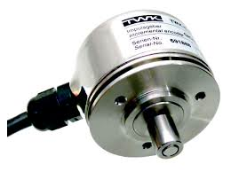
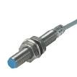
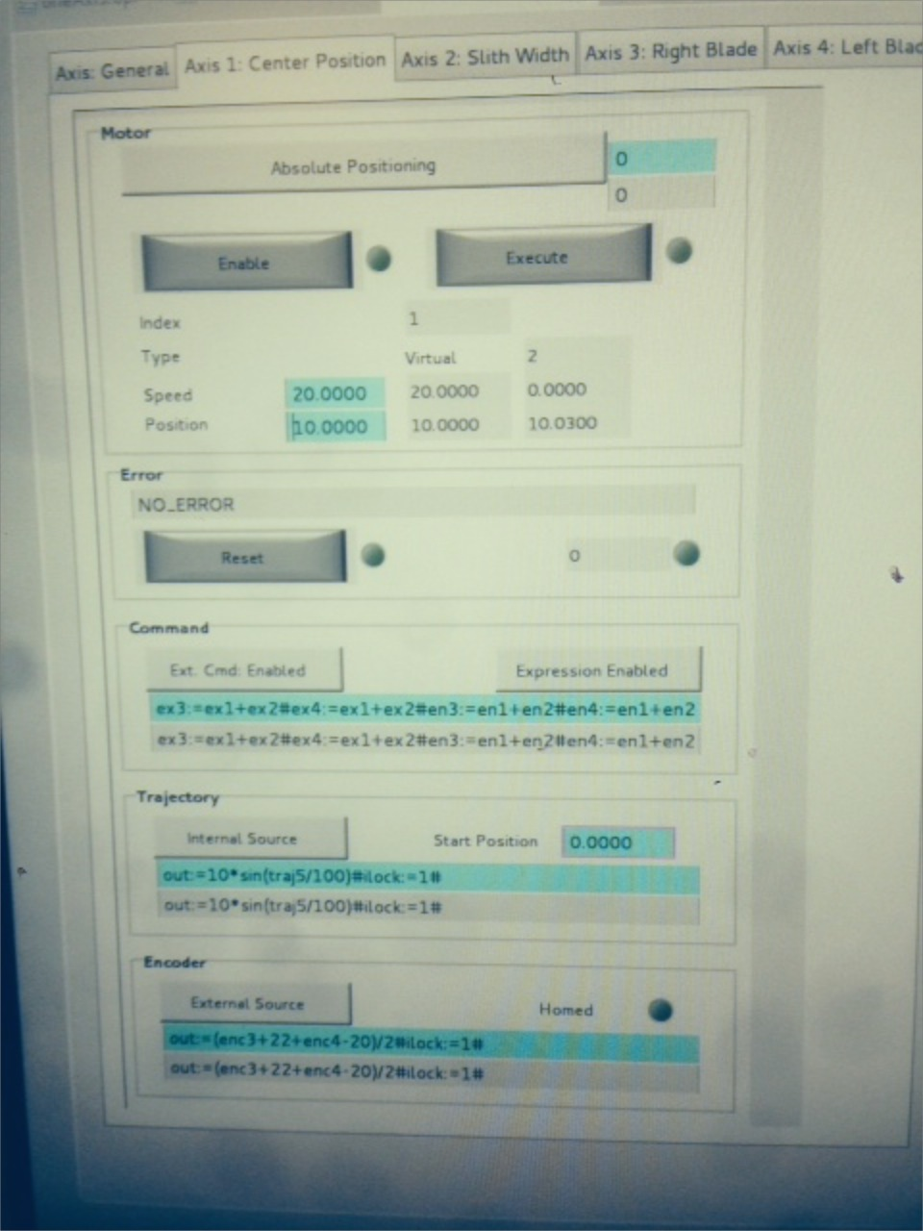
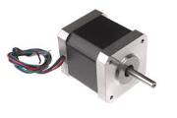
Motion: Overview
Electronics
Mechanics

Slide 4
Motion: Control Loops
Current Control Loop:
  Needed for both open and closed loop setups (however depends on actuator)
  Functionality depends on motor type (phase shift output for commutation)
  Current is related to torque via the motor K_{T} constant for rotary motors or to a force for linear motors.
  Common sample rate range: 10-50kHz
  Type: PI controller (maybe filters, observer)
Velocity Control Loop:
  Needed for closed loop, sometimes used for open loop (frequency control)
  Common sample rate range: 1-10kHz
  Type: PI controller
Position Control Loop:
  Needed for closed loop, sometimes used for open loop (for consistency)
  Common sample rate range100-5kHz
  Type: P or PI controller (if P the stationary error will be handled by velocity PI)
Notes:
Normally in a motion system you have these control loops.

Slide 5
Motion: Control Loops cont.
Position Control
Speed Control
Current Control
O_{Position}
SP_{Speed} =FF_{Speed}
FF_{I}
+
+
+
+
+
+
SP_{Position}
P(ID)_{Position}
PI(D)_{Speed}
PI(D)_{I}
Process
-
-
PV_{Speed}
PV_{Position}
SP_{Position} Position setpoint
O_{Position} Position offset
PV_{Position} Actual position
SP_{Speed} Speed Setpoint
FF_{speed} Speed feed forward
PV_{Speed} Actual speed
Mech., motor, feedback
Notes:
Cascaded loops

Slide 6
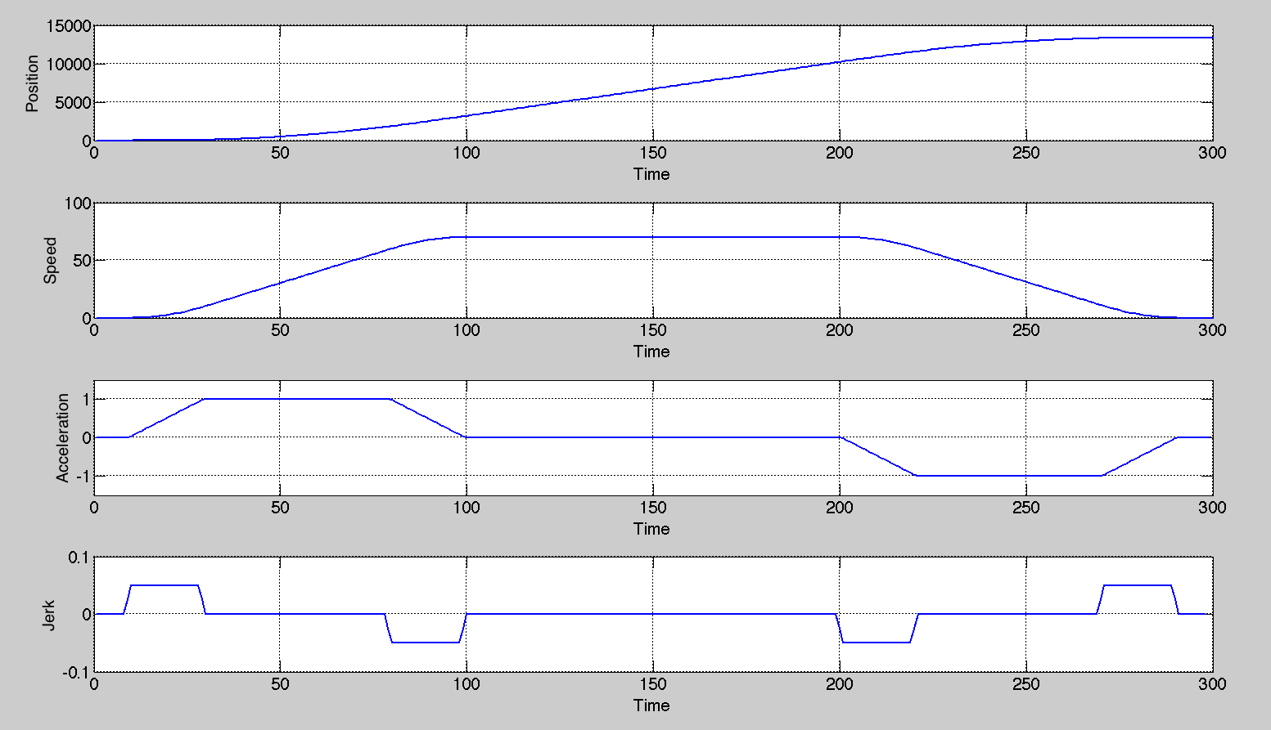
Motion: Feed Forward and Trajectory
Already known changes can be fed forward. The error for the controller to handle will be less. Scaling of velocity feed forward is made by setting the drive scale parameters.
P(ID)_{Position}
+
PI(D)_{Speed}
+
PI(D)_{I (torque)}
Process
Notes:
Important for good tracking (small following error)
Picture show trajectory in position, veloccity, acc, jerk
Since this is the setoiunts ofcource this information is valuable and should be fed forward. Different for different drives. However the top one is most imortant and can be used for most drives.

Slide 7
Motion: Feed Forward
Target position
Already known changes can be fed forward to increase performance.
➔The error for the controller to handle will be smaller.
Actual position
Trajectory generator set-point
Position Controller output
Feed Forward output (to speed PID)
No Feed Forward
Feed Forward
Feed Forward handles
main part of the control
Position / Output
Position / Output
Position controller
only handles small
deviations
Time
7
Time
Notes:
Trajectory in order to guide motion.
Since we know the trajectiry we can also feedforward the velocity (differentiation of position)
Main part will be handles by ff but the world is not ideal so the position controller is needed to handle small error.

Slide 8
EtherCAT: Overview
EtherCAT = Ethernet for Control Automation Technology
Open fieldbus standard originally developed by Beckhoff GmbH
Maintained by EtherCAT Technology Group (www.EtherCAT.org).
Hardware requirements:
  Master: standard computer hardware (NIC)
  Slaves: dedicated hardware, EtherCAT Slave Controller (ESC)
Masters: Several commercial and open source masters available
Slaves: Several 100 manufacturers of slaves (drives, I/O, sensors, robots)
Topologies: Line, Star, Ring
Media: Cat 5 cable, plastic fiber, glass fiber
Supports Distributed Clock (DC) in slaves
Bandwidth utilization: 80%-97% (100 Mbit/s , Ethernet, Full-Duplex)
Applications: Motion, large or long distance systems, synchronized systems
Cycle times > 50μs
Notes:
Abbrevation
General
Released 2004 (stable standard from the beginning=> hardware from 2004 is still compliant)
Opened up and maintained by EtherCat Technology Group (www.ethercat.org)
10 year old standard
Commercial and open source masters:
Commercial: Beckhoff, ABB, Aerotech, Vipa, Omron (at least 100 suppliers)
Open Source: EtherLab, SOEM (Simple Open EtherCat Master)
Topoligies:
Line
Star (hot swap fuctionality of slaves)
Ring (for redundancy).
Typical Applications:
Motion (real-time, synchronization, robotics)
Large systems (theoretical max 65535 slaves)
Systems with high demands of speeds and reaction times (compared to other PLC systems).
Cycle times > 50micro sec (default in most masters is 1ms )
Comment time to transfer at 100mbit one frame 1500b rougly 100micro sec
NIC= Network interface cards
Time-Sensitive Networking
AVB
8

Slide 9


EtherCAT: Control Loop Execution Options
CSP-Mode
Cyclic Sync. Position
CSV-Mode
Cyclic Sync. Velocity
CST-Mode
Cyclic Sync. Torque
- Trajectory gen.
- No control
-Trajectory gen.
-Position cont.
-Trajectory gen.
-Position cont.
-Velocity cont.
Act. position
Position setp.
Act. position
Velocity setp.
Act. position
Torque setp.
Amplifier
Level
Control:
Pos.
Velo.
Torque
Control:
Velo.
Torque
Control:
Torque
Controller: No loops needed
Drive: All control loops
Controller: Position loop
Drive: Velocity and current loop
Controller: Position, velocity loop
Drive: Current loop
Notes:
With EtherCAT hardware it looks like this..
VELOCITY MODE is what we use right now. This can change..
Why velocity? Very generic. Feedback from different terminals.
Also position interface.. Where traj is made in card! Good for open loop..

Slide 10
ECMC: EtherCAT Motion Control
ECMC is an open source motion control framework for EPICS environment [10].
Functionalities:
Motion (with EPICS Motor Record support):
  Positioning (absolute, relative)
  Constant speed
  Referencing sequences
Motion (extension to Motor Record)
  Motion interlocks
  Triggering, latching positions
  Synchronization axis to axis
  Synchronisation to external source (timing system)
General
  Data acquisition (analogue <100kHz, digital <1Mhz)
  General I/O + low level control
  SDO , Oversampling terminals
10
Notes:
Will focus on the talk on motion functionalities
10

Slide 11
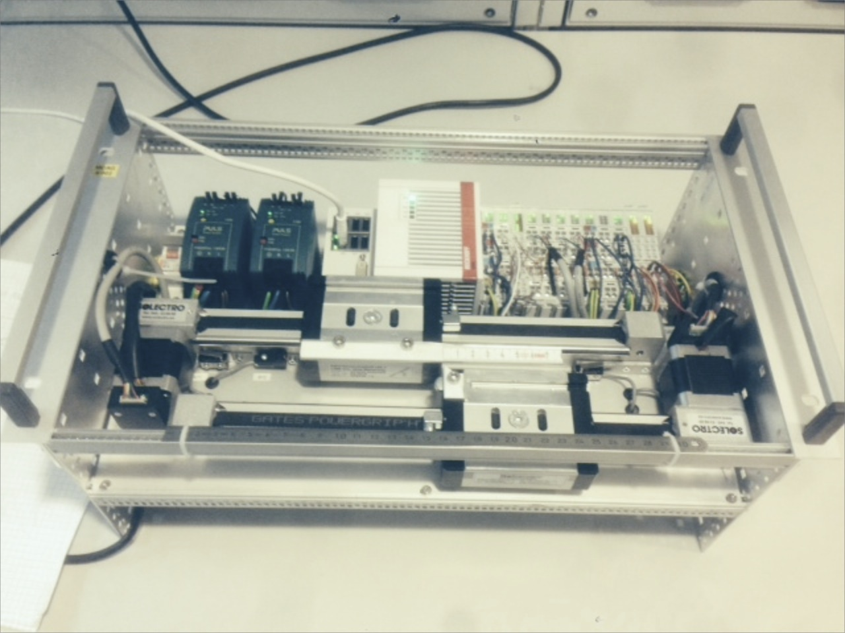



ECMC: Overview
HMI (CSS, BOY)
Channel Access
Linux Controller (Centos)
EPICS IOC
Model 3 driver, Asyn
Motion Control
(ECMC)
Igh open source EtherCAT master
(www.etherlab.org)
EtherCAT
EtherCAT Terminals
EtherCAT Terminals
EtherCAT Drive
Analog
Analog
Drive
Digital
XXXX
Drive
Digital
XXXX
11
Notes:
This slide shows an overview of our current system architecture.
The Motion Control algorithms then links to the open source EtherCAT master from Etherlab.
The EtherCAT master is used for configuring the ethercat bus and sending/reciving data from EtherCAT slaves. Typical slaves could be drives (stepper BLCD, pulse direction, analog or digital data)
All softwares in the controller is open source EPCIS, drivers, ECMC and etherlab.

Slide 12
ECMC: Architecture
Controller (Linux)
Epics IOC (softIoc)
Asyn model 3 driver
Asyn
Motion Controller (ECMC)
Communication Thread
Direct access
(I/O Intr)
Command parser
Motion Thread (1kHz)
Axis 1
Axis 2
Axis 3
Axis 4
Axis N
EtherCAT process image
ecrt.h
EtherCAT master
EtherCAT
Master n
12
Notes:
This slide shows some details about the threads running in controller used for executing Motion Control algorithms.
First, on top, you can se the communication thread running a command parser, handling the communication with EPICS (over TCP/IP).
Then the Motion thread, the real time thread executing motion control algorithms receives commands from the command parser.
The Motion thread also receives data from the EtherCAT terminals by reading and writing to the process image of the EtherCAT master.
CentOS7, linux kernel 3.1

Slide 13
ECMC: Motion Thread
Motion Thread (1kHz)
Axis 1
Encoder
Trajectory
PID-Control
Monitor
Drive
Axis 2
Encoder
Trajectory
PID-Control
Monitor
Drive
Axis 3
Encoder
Trajectory
PID-Control
Monitor
Drive
Axis N
Encoder
Trajectory
PID-Control
Monitor
Drive
Notes:
The Motion thread, which is the realtime thread executing the motion control algorithms can be configured to control a number of axis. Each axis in turn contains certain objects!

Slide 14
ECMC: Axis object
Axis
Types: Normal, Virtual
“Cfg.CreateAxis(…)”
Encoder
Trajectory
PID-Control
Monitor
Drive
ECPdoEntry
Transform / Expression
Transform /Expression
ECPdoEntry
ECPdoEntry
ECPdoEntry
ECPdoEntry
ECPdoEntry
ECPdoEntry
ECPdoEntry
ECPdoEntry
Encoder Y
Trajectory Z
EC master
Optional link:
Sync. External
Optional link:
Sync. Trajectory
EC master
EC master
Executes and links objects:
  Encoder
  Trajectory Generation
  PID-Controller
  Monitor
  Drive
Sequences
  Homing (different types)
14
Notes:
Like I said, the axis object links and executes certain other objects like Encoder, trajectory, PID-control, monitor and Drive.
The encoder typically links to an analog input value from a slave. Could be an encoder, analog input or any input.
The Trajectory object generates trajectory setpoints for the motion.
The PID- controller controls based on the error between the trajectory generated setpoint and the actual value from the encoder object.
The monitor object monitors the motion and the drive links to an output value of a slave. Could be a stepper module or analogoutput, pulse direction.
Different versions of axis object have been implemented: Normal, Virtual, Encoder, Trajectory.

Slide 15
ECMC: Trajectory object
Trapezoidal trajectories
Feed Forward (position and velocity set-point)
Motor Record Support
  Constant velocity
  Relative positioning
  Absolute positioning
  Homing
  Hard and soft limits
Synchronization / Kinematics
  Absolute/Relative
  Gear
  Expressions
    Other axis encoder
    Other axis trajectory set-point
Axis x
Trajectory x
Transform /Expression
Transform /Expression
Encoder Y
Trajectory Z
Optional link:
Sync. External
Optional link:
Sync. Trajectory
Notes:
Like I said the trajectory object main functionality is to generate setpoint trajectories guiding the motion.
Both position setpoint and velocity setpoints are calculated. The velocity setpoint is used for FF in order to improve performance.
Basically the object implements the different functionalities for Epics motor record support like …..
Additionally the trajectory object can handle synchronization functionalities to other axis actual values (encoders or setpoints).
The synchronization can be made in an absolute or relative way and with gear ratios.
Synchronization can also be made via expressions. Will talk about that later..

Slide 16
ECMC: Monitor object
Position lag monitoring
“At Target” Monitoring
Limit switches
Over Speed Monitoring
Axis
Monitor
ECPdoEntry
ECPdoEntry
ECPdoEntry
Notes:
The monitoring object is responsible for supervision of the motion.
For instance the position lag can be monitored ensureing that the difference between the trajectory setpoint and actual value is not getting to high due to for instance mechanical blocikng.
The object also can supervice that the motion reaches the target position.
Supervising limit switches. Non normal situations like both limit switches activated simultaneously will interlock motion.
Then the object also supervises that the speed of the motion is not to high.

Slide 17
ECMC: Encoder object
Actual position value links to any input process value in EtherCAT process image.
Scaling
1-64bit
Handles over/under flow (1-63bit)
Calculates velocity
Filter
Axis
Encoder
ECPdoEntry
ECPdoEntry
ECPdoEntry
EC master

Slide 18
ECMC: Controller object
PID controller
Feed forward functionality
Setpoint from trajectory object
Actual value from encoder object
Axis
Controller

Slide 19
ECMC: Drive object
Link Velocity Setpoint to EtherCAT process image
Link Enable to EtherCAT process image
Link Enabled to EtherCAT process image
Scaling
1-64bit
Axis
Drive
ECPdoEntry
ECPdoEntry
ECPdoEntry

Slide 20
ECMC: Data links needed
EtherCAT entries need to be linked to the following objects:
Drive Object (“Cfg.LinkEcEntryToAxisDrive(…)”):
  Velocity setpoint
  Enable command / control word (DS402)
  Enabled / status word (DS402)
  Break
Encoder Object (“Cfg.LinkEcEntryToAxisEncoder(…)”):
  Actual position (could be encoder or step counter or..)
Monitor Object(“Cfg.LinkEcEntryToAxisMonitor(…)”):
  Limit switch Fwd
  Limit switch Bwd
  Reference switch
  (Interlock)
20

Slide 21
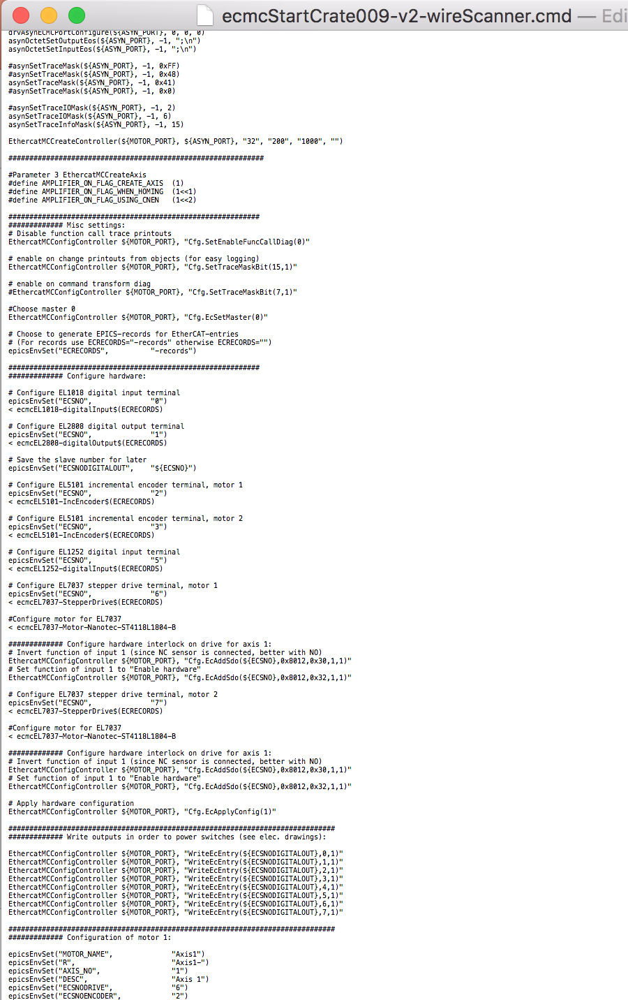
ECMC: Configuration
All configuration in EPICS startup file:
ECMC configurations
(speed, acceleration…..)
Terminal configurations
(Service Data Object access:
max current, mode…)

Slide 22
ECMC: Configuration cont.
The motion system is precompiled as an EEE-module (ESS Epics Environment module) and only needs configuration (“require ecmc”).
Configuration command:
EthercatMCConfigController ”asynport” “command”
Return values for commands: 0 for success or otherwise error code.
Example 1: Create Axis 1 object:
EthercatMCConfigController “MCU1” ”Cfg.CreateDefaultAxis(1)”
Example 2: Set position controller gain for axis 1 to 0.1
EthercatMCConfigController ”MCU1” ”Cfg.SetAxisCntrlKp(1,0.1)”
22
Notes:
Later also CCDB

Slide 23
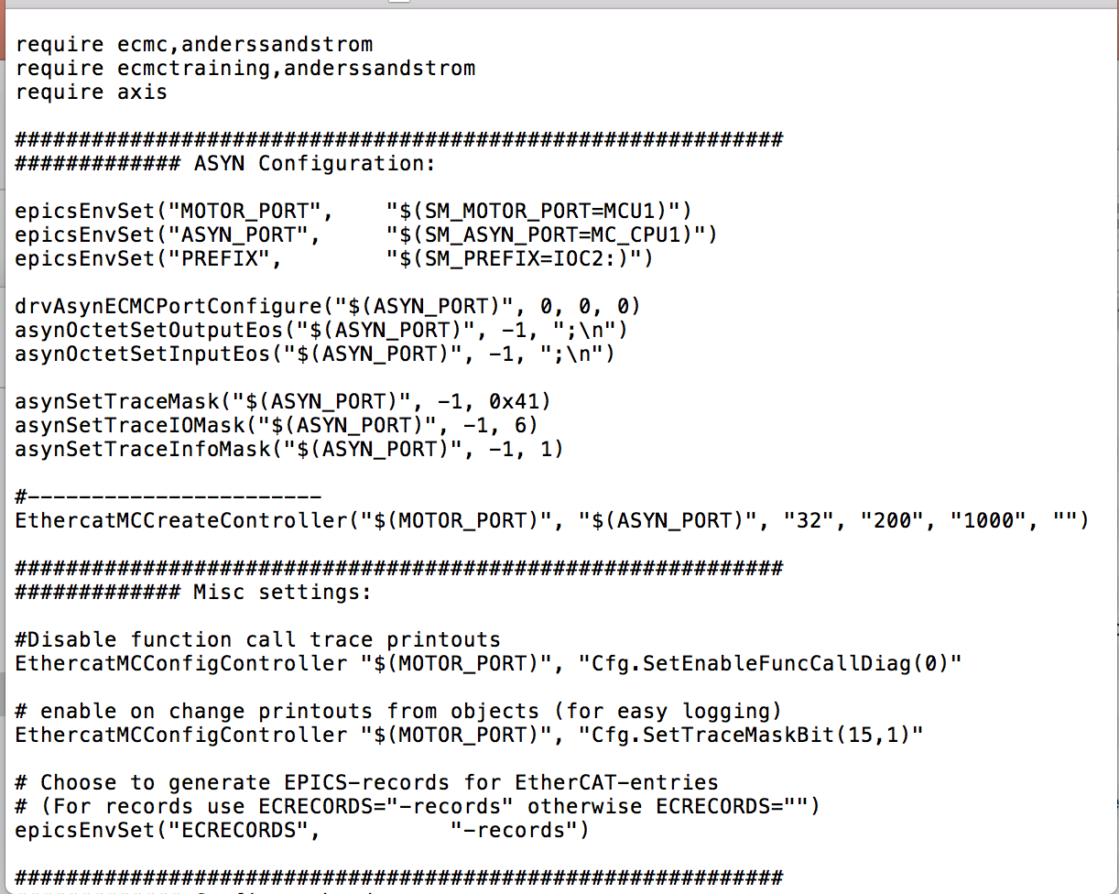
ECMC: Startup file structure part 1
Require
Asyn config
Misc settings
23
Notes:
Later also CCDB

Slide 24
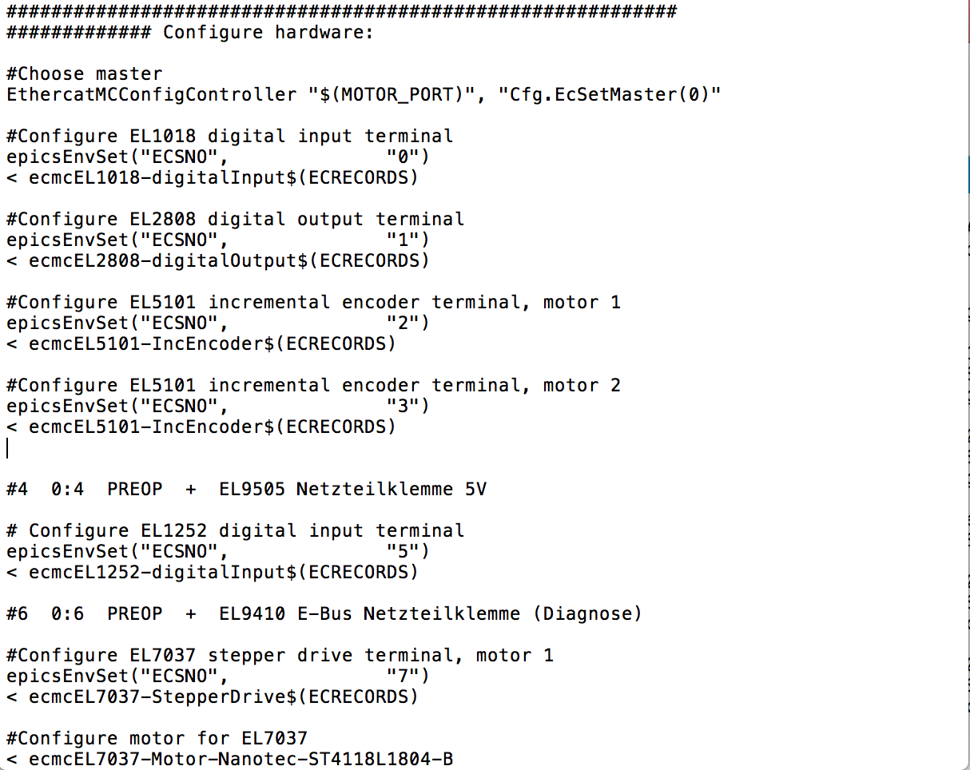
ECMC: Startup file structure part 2
Hardware configuration
Choose master
Configure I/O slaves:
  Set slave bus position
  “include” “snippet”
Configure motion hardware:
  Set slave bus position
  Drive “snippet”
  Motor “snippet”
24

Slide 25
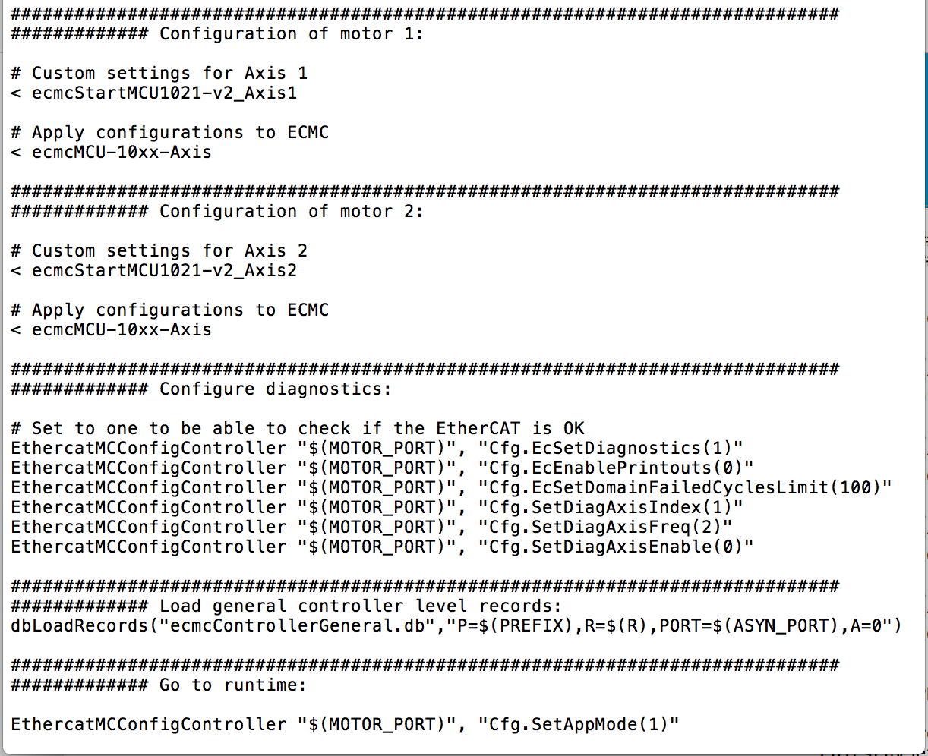
ECMC: Startup file structure part 3
Configuration of axes
  Axis configuration snippet (custom settings for axis)
  Apply settings with the snippet ”ecmcMCU-10xx-Axis”
Diagnostics
Load controller records
Start real time thread
25

Slide 26
ECMC: Command Types
Normal ECMC commands (most commands):
  Cfg.CreateDefaultAxis (1)
  Cfg.SetAxisCntrlKp(1,0.1)
TwinCAT compatible variable access commands (most run-time commands):
  Main.M1.fVelocity=12;
  Main.M1.fActVelocity?;
TwinCAT ADS syntax (backward soft limit):
  ADSPORT=501/.ADR.16#5001,16#D,8,5=-100;
Commands of type 2 and 3 are supported because, eventually, the intention is to use the same model 3 motor record driver for ECMC as TwinCAT.
26

Slide 27
ECMC: Hardware Configuration
EC Master
“Cfg.EcAddSlave(…)”
EC Slave 0
EC Slave N
EC Slave …
EC SM 0
EC SM 1
EC SM X
EC PDO 0
EC PDO 1
EC PDO 0
EC PDO 1
EC PDO Y
EC PDO Z
Cfg.EcAddEntryComplete()
ECPdoEntry
ECPdoEntry
ECPdoEntry
ECPdoEntry
ECPdoEntry
ECPdoEntry
ECPdoEntry
ECPdoEntry
ECPdoEntry
ECPdoEntry
ECPdoEntry
ECPdoEntry
EC PdoEntry
EC PdoEntry
EC PdoEntry
EC PdoEntry
EC PdoEntry
EC PdoEntry
Notes:
Only one domain used..
Not all pdos and sdos exposed in sii memory.

Slide 28
ECMC: Hardware Configuration
Choose EtherCAT master with index n:
“Cfg.EcSetMaster(n)” // Choose EtherCAT master
Configure a PDO entry (data entry):
“Cfg.EcAddEntryComplete(slavePosition, // Slave position on EtherCAT bus
vendorId, // Id of vendor (see documentation)
productCode, // Id of product
direction, // data direction 1=output, 2=input
syncManagerIndex, // index of sync manager
pdoIndex, // index of process data object (pdo)
entryIndex, // index of entry inside pdo
entrySubIndex, // sub index of entry
bits, // bit size
alias)” // String for later linking
Example: Beckhoff EL1018
slavePos=0, vendorId=0x2, productCode=0x03fa3052, direction=2, syncManagerIndex=0, pdoIndex=0x1a00, entryIndex=0x6000, entrySubIndex=0x1, bits=1,Alias=INPUT_0
“Cfg.EcAddEntryComplete(0,0x2,0x03fa3052,2,0,0x1a00,0x6000,0x1,1,INPUT_1)”
Apply hardware configuration for master 0
Cfg.EcApplyConfig(0) // Apply hardware config (EtherCAT bus must be accessible)
Note: All EtherCAT entries ,including arrays/waveforms, can be pushed to EPICS records as “I/O Intr” over asyn (max update rate is the same as the motion thread, default 1kHz).
28
Notes:
Safety: needed in motion systems.
Need to have correct product code.. And relevant pdo addreses.. Otherwise will not run.
Absolute addressing..

Slide 29
ECMC: Hardware Configuration
Safety:
ECMC is a control framework (not only data acq.). Controlling wrong hardware could result in serious situations damaging equipment or even hurting people. Therefore, ECMC will only go to run-time if hardware configuration matches what is found on the EtherCAT bus (same as TwinCAT):
  EtherCAT product ID and vendor ID needs to be correct
  PDO addresses needs to be correct (absolute addressing)
Hardware Support:
Many complex slaves needs manual configuration:
  Many servo drives (Example Technosoft IPOSXXXX, Kuhnke FIODrive..)
  Oversampling terminals (Example EL3632, EL3702)
Note: ECMC has a few auto configuration features implemented but should NOT be used for motion applications.
29
Notes:
Safety: needed in motion systems.
Need to have correct product code.. And relevant pdo addreses.. Otherwise will not run.
Absolute addressing..

Slide 30
ECMC: Supported Hardware
EK1100-EtherCatCoupler
EK1101-EtherCatCouplerID
EK1110-EtherCatExtension
EK1122-EtherCatJunction
EL1018-digitalInput
EL1252-digitalInput
EL2808-digitalOutput
EL2819-digitalOutput
EL3002-analogInput
EL3162-analogInput
EL3204-analogInput
EL3214-analogInput (PT100(0), TC)
EL3255-potentiometerInput
EL3602-analogInput
EL3632-analogInput-50 (oversampling)
EL3702-analogInput-100 (oversampling)
EL3702-analogInput-10 (oversampling)
EL4032-analogOutput
EL4134-analogOutput
EL5002-ssiEncoder
EL5021-SinCosEncoder
EL5101-IncEncoder
EL6080-memory
EL7031-StepperDrive
EL7037-StepperDrive
EL7037-StepperDrive-PosIF
EL7041-StepperDrive
EL7047-StepperDrive
EL7201-ServoDrive
EL9410-powerSupplyEBus
EL9505-powerSupply5V
EL9576-BrakeChopper
FIODrive-StepperDrive
IPOS4808-driveCSV
IPOS8020-driveCSV
Note: New hardware support is continuously added!

Slide 31
ECMC: Axis Configuration
Create an axis object at index n:
“Cfg.CreateDefaultAxis(n)” // Create axis object of type 1 (Normal axis)
Configure dynamics for axis object at index n:
"Main.Mn.fAcceleration=acc” // Set acceleration
"Main.Mn.fDeceleration=dec” // Set deceleration
"Cfg.SetAxisEmergDeceleration(n,emergdec)” // Set emergency deceleration
"Main.Mn.fVelocity=vel” // Set target velocity
"Cfg.SetAxisHomeVelTwordsCam(n,vel)” // Homing velocity twords cam
"Cfg.SetAxisHomeVelOffCam(n,vel)” // Homing velocity off cam
Define motion command (see documentation for FB_DriveVirtual):
"Main.Mn.nCommand=cmd”
cmd=0: Jog
cmd=1: Constant Velocity
cmd=2: Relative Positioning
cmd=3: Absolute Positioning
cmd=10: Homing/referencing
31

Slide 32
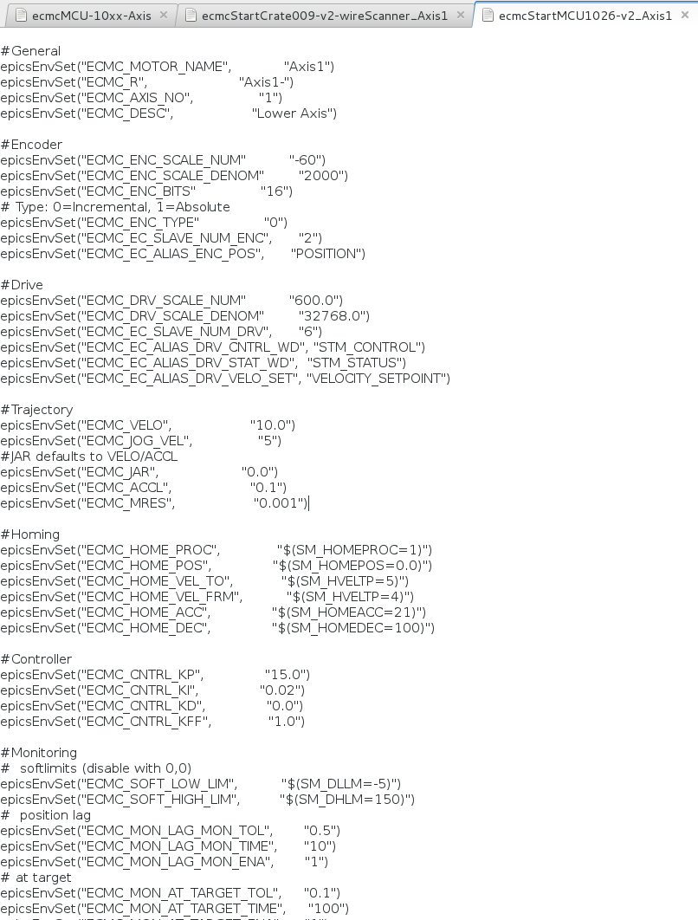
ECMC: Axis configuration snippet
Custom config. for each axis:
  General
  Encoder
  Drive
  Trajectory
  Homing
  Controller
  Monitoring
32

Slide 33
ECMC: PID Controller Configuration
Configure control parameters (position loop) for axis n:
"Cfg.SetAxisCntrlKp(n,kp)” // Gain
"Cfg.SetAxisCntrlKi(n,ki)” // Integration gain
"Cfg.SetAxisCntrlKd(n,kd)” // Differentiator gain
"Cfg.SetAxisCntrlKff(n,kff)” // Velocity feed forward gain
"Cfg.SetAxisCntrlOutHL(n,outhl)” // Maximum controller output
"Cfg.SetAxisCntrlOutLL(n,outll)” // Minimum controller output
Example: Set controller gain to 5.0 for axis 2 (on asynport MCU1):
EthercatMCConfigController ”MCU1” “Cfg.SetAxisCntrlKp(1,5.0)”
33

Slide 34
ECMC: Encoder Configuration
Configure encoder parameters for axis n:
"Cfg.SetAxisEncScaleDenom(n,scaleDenom)” // Set encoder scale denominator
"Cfg.SetAxisEncScaleNum(n,scaleNum)” // Set encoder scale numerator
"Cfg.SetAxisEncType(n,type)” // type=0: incremental encoder
// type=1: absolute encoder
"Cfg.SetAxisEncBits(n,bitCount)” // set bit count
"Cfg.LinkEcEntryToAxisEncoder(slavePosition, // Slave position on EtherCAT bus
alias, // alias defined Cfg.EcAddEntryComplete(..)
n, // axis index
encoderEntryIndex, // encoderEntryIndex=0: Actual position
bit)” // bit to use (-1= all bits)
Example: Link EtherCAT entry with alias “POSITION” on slave 2 as encoder actiual value on axis 5:
EthercatMCConfigController ”MCU1” “Cfg.LinkEcEntryToAxisEncoder(2,POSITION,5,0,-1)”
34

Slide 35
ECMC: Drive Configuration
Configure drive parameters for axis n:
"Cfg.SetAxisDrvScaleDenom(n,32768.0)” // Velocity scale denominator
"Cfg.SetAxisDrvScaleNum(n,600.0)” // Velocity scale numerator
"Cfg.LinkEcEntryToAxisDrive (slavePosition, // Slave position on EtherCAT bus
alias, // alias defined Cfg.EcAddEntryComplete(..)
n, // axis index
driveEntryIndex, // See below
bit)” // bit to use (-1= all bits)
driveEntryIndex=0: Enable Cmd/Control Word (output)
driveEntryIndex=1: Velocity setpoint (output)
driveEntryIndex=2: Enabled/Status Word
Example: Link EtherCAT entries to drive object of axis 2 for a simple stepper drive on slave position 6:
EthercatMCConfigController ”MCU1” “Cfg.LinkEcEntryToAxisDrive(6,STM_CONTROL, 2,0,0)”
EthercatMCConfigController ”MCU1” "Cfg.LinkEcEntryToAxisDrive(6,VELOCITY_SETPOINT, 2,1,-1)”
EthercatMCConfigController ”MCU1” "Cfg.LinkEcEntryToAxisDrive(6,STM_STATUS, 2,2,1)”
35

Slide 36
ECMC: Monitor Configuration
Configure monitor parameters for axis n:
"Cfg.SetAxisMonAtTargetTol(n,0.1)” // “At target” tolerance band
"Cfg.SetAxisMonAtTargetTime(n,100)” // “At target” time “filter”
"Cfg.SetAxisMonEnableAtTargetMon(n,1)” // Enable/Disable at target mon.
"Cfg.SetAxisMonPosLagTol(n,0.5)” // Position lag tolerance band
"Cfg.SetAxisMonPosLagTime(n,10)” // Position lag time “filter”
"Cfg.SetAxisMonEnableLagMon(n,0)” // Enable/Disable Position lag mon.
"Cfg.SetAxisMonMaxVel(n,100)” // Set maximum velocity
"Cfg.SetAxisMonEnableMaxVel(n,1)” // Enable/Disable velocity mon.
"Cfg.SetAxisMonMaxVelDriveILDelay(n,500)” // Vel. mon. drive time delay
"Cfg.SetAxisMonMaxVelTrajILDelay(n,200)” // Vel. mon. traj time delay
36

Slide 37
ECMC: Monitor Configuration cont.:
"Cfg.LinkEcEntryToAxisMonitor (slavePosition, // Slave position on EtherCAT bus
alias, // alias defined Cfg.EcAddEntryComplete(..)
n, // axis index
monitorEntryIndex, // See below
bit)” // bit to use (-1= all bits)
monitorEntryIndex=0: Limit switch backward direction
monitorEntryIndex=1: Limit switch forward direction
monitorEntryIndex=2: Home/Reference Switch
monitorEntryIndex=3: External Interlock (optional)
Example: Link EtherCAT entries to drive object of axis 2 for a simple stepper drive on slave position 6:
EthercatMCConfigController "MCU1", "Cfg.LinkEcEntryToAxisMonitor(0,INPUT_1,1,0,0)"
EthercatMCConfigController "MCU1", "Cfg.LinkEcEntryToAxisMonitor(0,INPUT_3,1,1,0)"
EthercatMCConfigController "MCU1", "Cfg.LinkEcEntryToAxisMonitor(0,INPUT_2,1,2,0)”
Example: Override limit switches with simulation entries (use slave position -1 and alias “ONE”):
EthercatMCConfigController "MCU1", "Cfg.LinkEcEntryToAxisMonitor(-1,ONE,1,0,0)"
EthercatMCConfigController "MCU1", "Cfg.LinkEcEntryToAxisMonitor(-1,ONE,1,1,0)"
37

Slide 38
ECMC: Diagnostics / Error handling
Diagnostics:
“Cfg.EcSetDiagnostics (enable)” // Enable/disable EC diagnostics IMPORTANT
“Cfg.EcEnablePrintouts (enable)“
“Cfg.SetDiagAxisIndex (axisIndex)”
“Cfg.SetDiagAxisFreq (freq)”
“Cfg.SetDiagAxisEnable (enable)” // Enable/disable printouts from axis objects
“Cfg.SetEnableTimeDiag (enable)”
“Cfg.SetEnableFunctionCallDiag (enable)“
"Cfg.SetTraceMaskBit(15,enable)” // Enable/disable on change axis diagnostics
Error commands:
“Cfg.EcResetError ()”
getControllerError ()
controllerErrorReset ()
getErrorString (errorNumber)
Axis specific error commands for axis n:
“Main.Mn.nErrorId?” // getAxisErrorID (n)
“Main.Mn.sErrorMessage?”
“Main.Mn.bError?” // getAxisError (n)
38
Notes:
Stress that not all normal safety settings are included in the example programs. For a more complete startup files look at slit demo..

Slide 39
Terminal Configurations (SDO)
Access to terminal specific settings is over SDO access:
EcAddSdo() write and verify SDO
EcWriteSdo() write SDO
EcReadSdo() read SDO
“Cfg.EcAddSdo(slaveBusPosition, // Slave position on EtherCAT bus
sdoIndex, // Sdo index address (see manual for terminal)
sdoSubIndex, // Sdo sub index address (see manual for terminal)
value, // value to write
byteSize // number of bytes to write
)”
Example 1: Set maximum current to 1000mA on EL7037 (slave 6):
EthercatMCConfigController ”MCU1” "Cfg.EcAddSdo(6,0x8010,0x1,1000,2)”
39
Notes:
Later also CCDB

Slide 40
ECMC: TwinCAT Syntax
Main.Mn.bEnable: Amplifier On/Off
Main.Mn.nCommand: Defines commands
  0 = Jog
  1 = Constant Velocity
  2 = Relative Positioning
  3 = Absolute Positioning
  10 = Homing/Referencing procedures
Main.Mn.nCmdData: Parameter to nCommand
  Example: For nCommand = 10, the nCmdData specifies which homing procedure to use.
Main.Mn.fPosition: Target position
Main.Mn.fVelocity: Target velocity
Main.Mn.bExecute (Execute new command on rising edge)

Slide 41
ECMC: TwinCAT Syntax
Absolute positioning to a target position of 100 with a target velocity of 200.
bEnable = 1 (Amplifier On)
Wait for bEnabled: bEnabled?
nCommand = 3 (Absolute Positioning)
nCmdData = 0 (not used for nCommand =3)
fPosition = 100
fVelocity =200
bExecute = 0
bExecute = 1 (Positive Edge)
Or use “MoveAbsolutePosition(….)” command
Notes:
This is also how the motor record driver runs motion

Slide 42
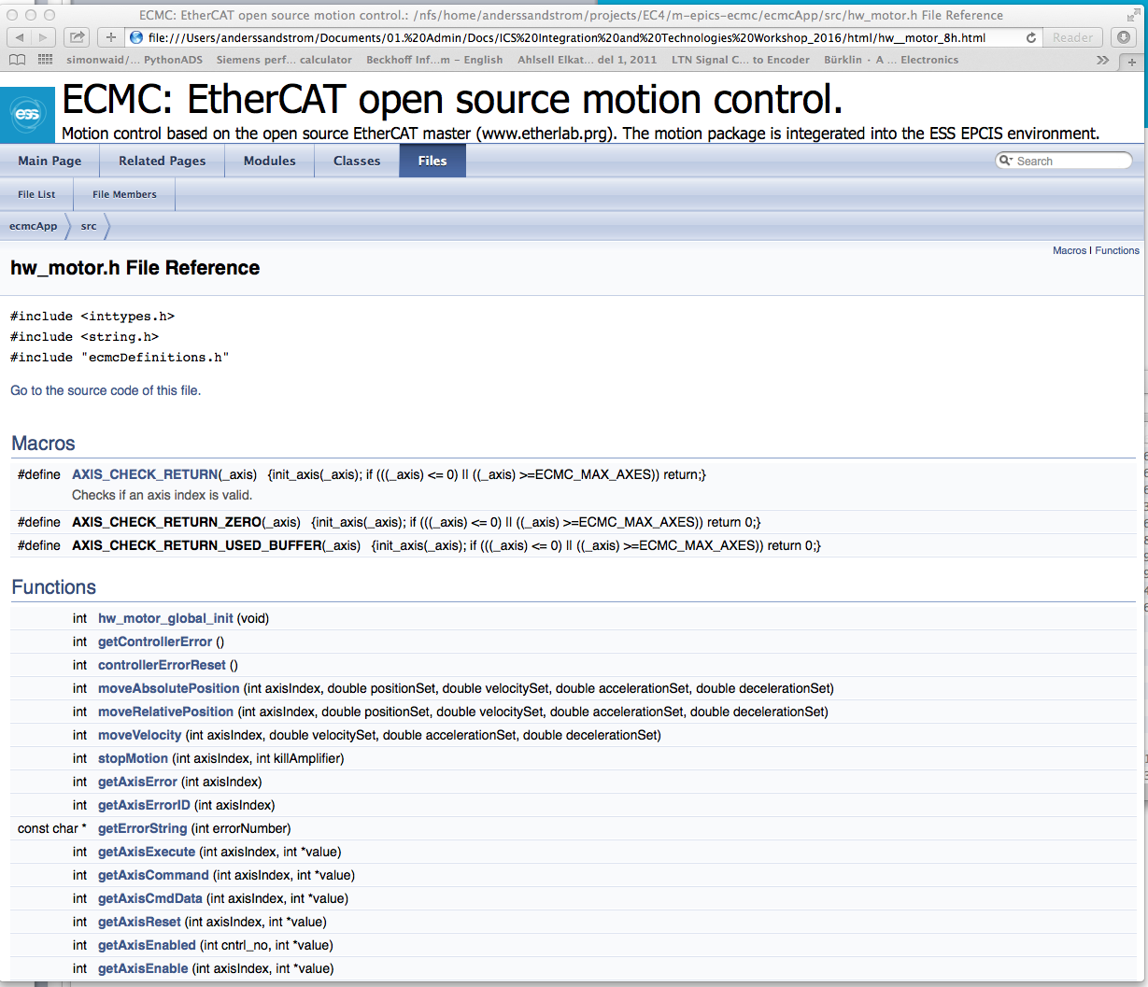
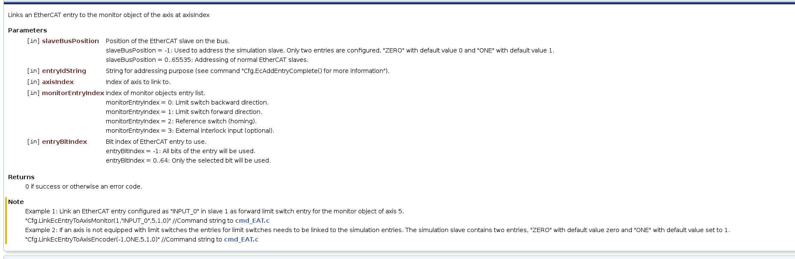
ECMC: Documentation
ECMC:
Doxygen documentation for all commands can be found in hw_motor.h (and ecmctraining/doc/html/index.html)
Wiki: https://ess-ics.atlassian.net/wiki/display/MCAG/Open+Source+Motion+Control
Etherlab (EtherCAT master):
www.etherlab.org
Hardware:
www.beckhoff.com
…
42
Notes:
Go and show docs

Slide 43
Etherlab EtherCAT tool:
EtherCAT tool from www.etherlab.org
Display master status:
ethercat master
Display slaves and status:
ethercat slaves
Display available PDOs for slave 3:
ethercat –p3 pdos
Display available SDOs for slave 3:
ethercat –p3 sdos
Display help:
ethercat –h
43

Slide 44
Acknowledgments
Igh open source EtherCAT master (www.etherlab.org)
EPICS community (base, motor, asyn, stream device)
ExprTK C++ Mathematical Expression Library
(www.partow.net/programming/exprtk)
Questions?
44
Notes:
Thanks

