Slide 1
Open Source Motion Control
Part 2 Advanced
Based on the Etherlab open source EtherCAT master (www.etherlab.org)
Anders Sandström
ESS Motion Control and Automation Group
www.europeanspallationsource.se

Slide 2
Outline
Synchronization
ECMC and EtherCAT data access
Commands from EPICS records
Motion Interlocks
Event, Recorder, Storage, Command List
PLC:s
Distributed Clocks
2

Slide 3
Synchronization: Axes types
Normal axis:
Controller
Drive
Trajectory
Encoders
Monitor
Virtual axis (used for kinematics / synchronization):
Trajectory
Encoder
Monitor
3
Notes:
Encoder axis could be a timing system
Future ideas:
Axis group..

Slide 4
ECMC: Synchronization
Synchronization of axes by expressions (exprTk) [14].
setPosx = Trajectory generated setpoint for axis x
actPosx = Actual position of axis x
enx = Enable amplifier of axis x
ilx = Motion interlock of axis x (allowed to move if true)
Update of expression at runtime possible (evaluated in 1kHz).
Examples:
Slaving: setPos2:=actPos1;
Synchronization: setPos2:=setPos1;
Gearing: setPos2:=0.5*setPos1;
Phasing: setPos3:=setPos1+setPos2;
Advanced: setPos1:=10*sin(setPos2+actPos3);
Interlocks: il1:=il2 and il5 and actPos4>actPos3;
Enable: en2:=en1;
4

Slide 5
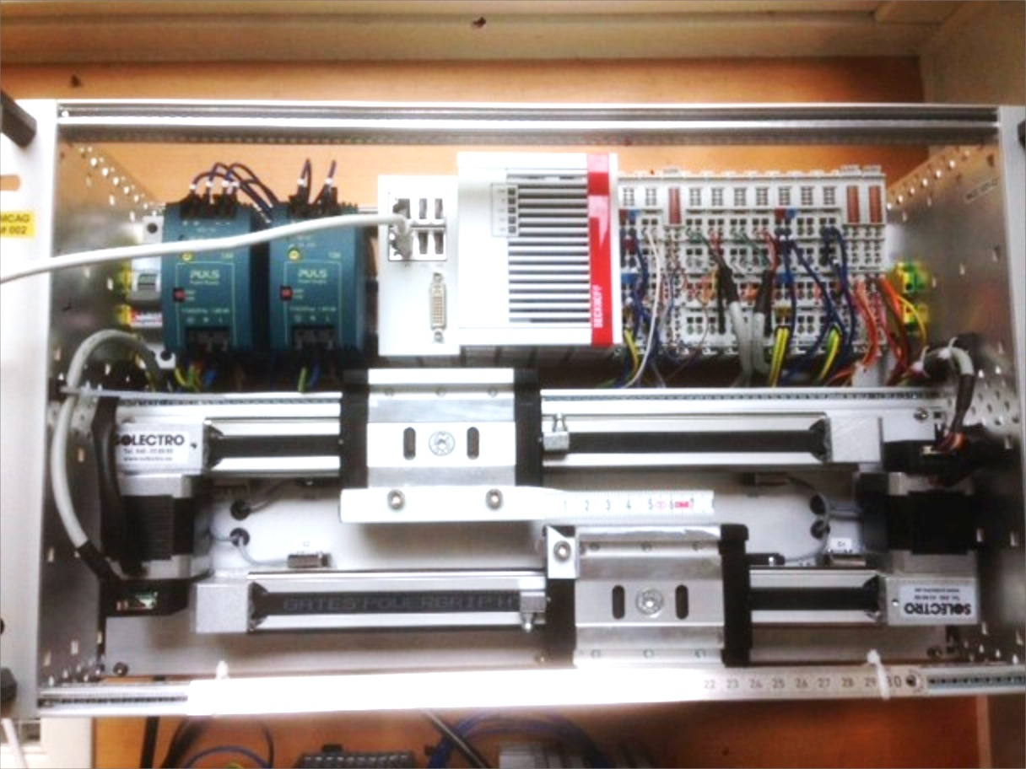
Kinematics Example: 2 axes slit set
2 virtual axes
Slit center position
Slit gap
2 normal axes (blade positions)
Forward Kinematics:
setPos3:=setPos1-setPos2/2;
setPos4:=setPos1+setPos2/2;
Inverse Kinematics:
actPos1:=(actPos3+actPos4)/2;
actPos2:=(actPos4-actPos3);
Amplifier enable:
En3:=En1 or En2;
En4:=En1 or En2;
Axis 1 (Virt: Center position)
Axis 2 (Virt: Gap)
Axis 3 (Normal: Blade position)
Axis 4 (Normal: Blade position)
Blade
Axis 3
Blade
Axis 4
Notes:
For example a slit set with two virtual axes defining the slit center position as one axis and the slit gap as one axis.
As you see in the picture then. Axis 1 and 2 is virtual and axes 3 and 4 is Normal kinked to hardware.
‘To these axis 4 motor records can be connected.
Forward kinematics:
If we move axis 1 or 2 we need to move both axes 3 and 4.
The relation could easily be calculated..
The setpoint for the normal axis 3 is the centerposiiton minus half the gap.
The setpoint for the normal axis 4 is the centerposiiton plus half the gap.
The inevrse kinematics then can be calculated:
Actual position of axis 1 is the act 3 + act 4 diveded by2
And for axis 2 the actual value will be the differnce of the normal axes 3 and 4.
Since the expressions are evaluated in the realtime loop the movements can be done on both the virtual axis simultaneously if needed and still ensuring a proper synchronization during the movement.
Which then could result in sweeps with a different gap at different center positions for instance.
An additional feature is that the enable of the amplifiers also can be linked between the axis by expressions. In this way when any axis is moved the amplifier for the normal axis will be enabled.

Slide 6
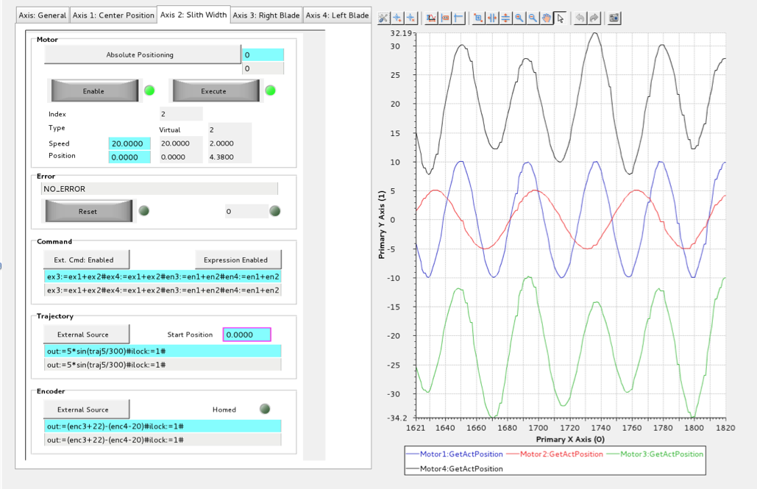
Kinematics Example: 2 Axes slit set
Axis 4
Axis 1 (Centre)
Axis 2 (Gap)
Axis 3

Slide 7
Synchronization Commands
Commands:
"Cfg.SetAxisEncTransExpr(n)=out:=(enc3+22+enc4-20)/2ilock:=1”
"Cfg.SetAxisEncSourceType(n,1)” // 0 = EtherCAT entry, 1=Expression
"Cfg.SetAxisTrajTransExpr(n)=out:=traj1+traj2/2-22ilock:=1”
"Cfg.SetAxisTrajSourceType(n,0)” // 0 = Internal, 1=Expression
"Cfg.SetAxisEnableCommandsFromOtherAxis(n,1)”
"Cfg.SetAxisEnableCommandsTransform(n,1)”
"Cfg.SetAxisTransformCommandExpr(n)=ex3:=ex1+ex2”
"Cfg.SetAxisEnableCommandsTransform(n,1)”
7
Notes:
Explain why

Slide 8
ECMC data access over Asyn:
Data in ECMC can be exposed in EPICS records over Asyn framework (“I/O Intr”):
EtherCAT:
EtherCAT entries (also waveforms from oversampling cards)
EtherCAT slave diagnostics
EtherCAT master diagnostics
Diagnostics:
Motion thread time jitter
Motion Axis:
Trajectory generated setpoint
Actual position
Diagnostic string (containing most info of axis)
Maximum update rate of the data is the frequency of the real time loop (default 1kHz).
Asyn parameters can be added with the iocsh command: ecmcAsynPortDriverAddParameter("<asyn port name>", ”<parameter name/path>", "<asyn type>",<skip cycles>)
<asyn port name> = Name of ECMC Asyn port
<skip cycles> = Update rate of parameter (0= update in every realtime loop, default 1kHz).
”<parameter name/path>"= String defining data to link to Asyn parameter (“drvInfo” string):
8

Slide 9
ECMC data access over Asyn: EtherCAT
ecmcAsynPortDriverAddParameter("<asyn port name>", ”<parameter name/path>", "<asyn type>",<skip cycles>)
EtherCAT related parameters (”<parameter name/path>”):
Entries: “ec<master index>.s<slave index>.<data alias>”
Memory area: “ec<master index>.mm<memory map alias>”
Slave diagnostics: “ec<master index>.s<slave index>.default”
Master diagnostics: “ec<master index>.default”
Example of analog input EL3002:
master=0, slave=2, data alias = “CH1_VALUE”, skip cycles=0 (default 1kHz):
ecmcAsynPortDriverAddParameter(”TEST”,"ec0.s2.CH1_VALUE","asynInt32",0)
Record definition:
record(ai,”IOC:ec0-s2-EL3002-AI1")
{
field(INP, "@asyn(TEST,0,1)ec0.s2.CH1_VALUE")
field(DTYP, "asynInt32")
field(SCAN, "I/O Intr")
………
…..
}
Generation of PVs for EtherCAT entries are simplified when using ecmctraining repo.
9

Slide 10
ECMC data access over Asyn: Motion
ecmcAsynPortDriverAddParameter("<asyn port name>", ”<parameter name/path>", "<asyn type>",<skip cycles>)
Motion parameters (”<parameter name/path>”):
Motion thread time jitter: “thread.default”
Motion Axis:
Trajectory setpoint, actual position: “ax<axis index>.default”
Diagnostic string (most relevant axis data): “ax<axis index>.diagnostic”
10

Slide 11
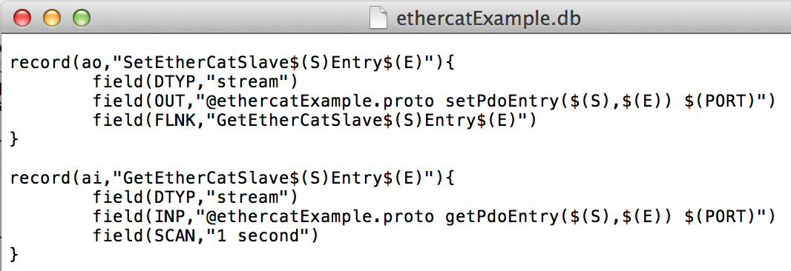
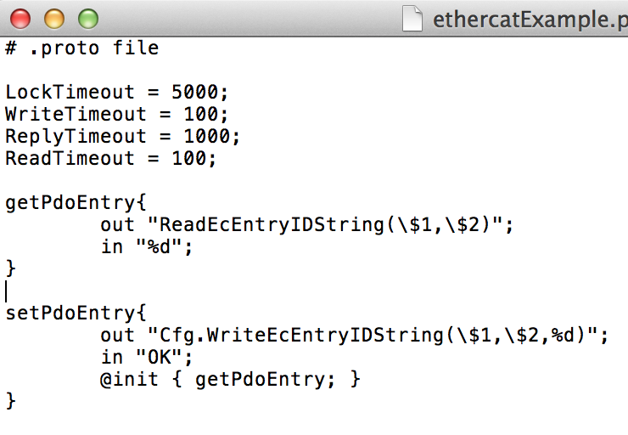
Commands from EPICS records:
All commands can be executed from EPICS records using stream device.
Typically settings and communication that are not handled by motor record or model 3 driver can be applied through stream device or ASYN record.
Example:
Motor
record
Stream
Device
11

Slide 12
Motion Interlocks
1. Interlock by I/O:
Any digital EtherCAT entry can be linked to interlock motion
Example: Link I/O to interlock axis n
EthercatMCConfigController "MCU1", "Cfg.LinkEcEntryToAxisMonitor(0,INPUT_7,n,3,0)"
EthercatMCConfigController "MCU1", "Cfg.SetAxisMonEnableExtHWInterlock(n,1)”
2. Interlock by I/O in motion terminal:
Inputs of some motion terminals, like Beckhoff Stepper terminals, can be configured to disable power of amplifier.
Example: Hardware enable on input 1 of EL7037 (slave bus position m)
EthercatMCConfigController "MCU1", "Cfg.EcAddSdo(m,0x8012,0x32,1,1)"
3. Interlocks by Expressions:
Interlocks can be described through mathematical expressions.
Example: Interlock expression for axis n
EthercatMCConfigController "MCU1", "Cfg.SetAxisTrajTransExpr(n)=xxxxilock:=enc3>1*enc2>enc1”
4. Interlocks from PLC:
Example: Interlock axis 1 from plc
ax1.mon.ilock:=0;
12

Slide 13
Events
Events can be generated at a fixed sample rate or by an signal transitions of an EtherCAT entry.
Commands:
"Cfg.CreateEvent(…)”
”Cfg.LinkEcEntryToEvent(…) ”
“Cfg.SetEventType(….)” // Sampled or transition (rising/falling edge)
“Cfg.SetEventSampleTime(….)”
“Cfg.SetEventTriggerEdge(….)” // Rising or falling
“Cfg.SetEventEnableArmSequence(….)” // Arm state machine (latch hardware)
“Cfg.SetEventExecute (….)”
“Cfg.SetEventEnableArmSequence (….)”
“Cfg.SetEventEnablePrintouts (int indexEvent, int enable)”
“Cfg.TriggerEvent (int indexEvent)”
“Cfg.ArmEvent (int indexEvent)”
Two types of object can be linked to an event as consumers:
Data recorder: “Cfg.LinkRecorderToEvent(…)”
Command list: “Cfg.LinkCommandListToEvent(…)”
NOTE : Events are more or less obsolete since functionality can be coverered by PLCs
13

Slide 14
Data recorder / data storage
Data Recorder Commands:
“Cfg.createRecorder (….)”
“Cfg.linkStorageToRecorder (….)”
“Cfg.linkEcEntryToRecorder (….)”
“Cfg.SetRecorderExecute (….)”
“Cfg.SetRecorderEnablePrintouts (….)”
“Cfg.LinkRecorderToEvent (….)”
“Cfg.TriggerRecorder (….)”
Data Storage Commands:
“Cfg.CreateDataStorage (….)”
“Cfg.ClearStorage (….)”
“ReadStorageBuffer(….)”
“Cfg.SetStorageEnablePrintouts (….)”
“Cfg.PrintStorageBuffer (….)”
“Cfg.LinkStorageToRecorder (….)“
Future: data storage will be used for trajectories from epics/motor record model 3…
NOTE: For most data, this functionality can also be accomplished by feeding the data directly to EPICS records over Asyn. However using a data recorder can be more efficient.
14
Notes:
Data storage used for sampling of data and in future also to store trajectory arrays

Slide 15
Command list
Commands can be added to command lists.
“Cfg.CreateCommandList (….)”
“Cfg.LinkCommandListToEvent (…..)”
“Cfg.SetCommandListExecute (….)”
“Cfg.SetCommandListEnablePrintouts (….)”
“Cfg.AddCommandListCommand(….)”
“Cfg.TriggerCommandList (….)”
Example: Command List to start a homing sequence for axis 4:
EthercatMCConfigController "MCU1", "Cfg.CreateCommandList(0)”
EthercatMCConfigController "MCU1", "Cfg.AddCommandToCommandList(0)=Main.M4.bExecute=0”
EthercatMCConfigController "MCU1", "Cfg.AddCommandToCommandList(0)=Main.M4.nCommand=10”
EthercatMCConfigController "MCU1", "Cfg.AddCommandToCommandList(0)=Main.M4.nCmdData=3”
EthercatMCConfigController "MCU1", "Cfg.AddCommandToCommandList(0)=Main.M4.fVelocity=5”
EthercatMCConfigController "MCU1", "Cfg.AddCommandToCommandList(0)=Main.M4.bExecute=1"
Note: Command lists are executed in real time thread (not in command parser thread like normal). Special care needs to be taken in order to not disturb the real time thread. Commands which are allocating memory or have a long execution time like “Cfg.CreateXxxxxx()” should be avoided.
15

Slide 16
Command list
Commands can be added to command lists.
“Cfg.CreateCommandList (….)”
“Cfg.LinkCommandListToEvent (…..)”
“Cfg.SetCommandListExecute (….)”
“Cfg.SetCommandListEnablePrintouts (….)”
“Cfg.AddCommandListCommand(….)”
“Cfg.TriggerCommandList (….)”
Example: Command List to start a homing sequence for axis 4:
EthercatMCConfigController "MCU1", "Cfg.CreateCommandList(0)”
EthercatMCConfigController "MCU1", "Cfg.AddCommandToCommandList(0)=Main.M4.bExecute=0”
EthercatMCConfigController "MCU1", "Cfg.AddCommandToCommandList(0)=Main.M4.nCommand=10”
EthercatMCConfigController "MCU1", "Cfg.AddCommandToCommandList(0)=Main.M4.nCmdData=3”
EthercatMCConfigController "MCU1", "Cfg.AddCommandToCommandList(0)=Main.M4.fVelocity=5”
EthercatMCConfigController "MCU1", "Cfg.AddCommandToCommandList(0)=Main.M4.bExecute=1"
Note: Command lists are executed in real time thread (not in command parser thread like normal). Special care needs to be taken in order to not disturb the real time thread. Commands which are allocating memory or have a long execution time like “Cfg.CreateXxxxxx()” should be avoided.
16

Slide 17
PLCs
PLC functionality can be added by PLC objects
PLC source files can be transferred and executed in the PLC object. Syntax based on exprtk parser (however extended with a few more features)
Accessible Variables:
EtherCAT pdo entries: ec<id>.s<id>.alias (ec0.s1.POSITION)
Motion data: ax<id>.<obj>.<data> (ax1.enc.actpos)
PLC variables: plc<id>.<data> (plc0.error)
Local variables: var <any name> (var errorCode)
Static variables: static.<any name> (static.cycleCounter)
Global variables: global.<any name> (global.scaleFactor)
4. Accessible functions:
1. Expr tk functions: math, println,…., see exprtk readme
2. MC Lib: Motion functions
3. DS Lib: Access do data storages
4. EC Lib: Bit functions
17

Slide 18
PLCs: Simple Example Code:
if(plc0.firstscan){ # Initiations
plc3.enable:=0; # Block other motion plc
ax1.blockcom:=1; # Block Epics Communication
println('Startup sequence PLC0 starting!’); # Print Diagnostics
};
var blink_cycles:=1/plc0.scantime; # Local variable (losses value between cycles)
var warning_light:=ec0.s2.OUPIN_4.0;
ec0.s2.OUPIN_8.0:=ec0.s1.INPIN_1.0 and ax1.enc.actpos>0; # Set output
static.counter+=1; # Static variable (keeps value between cycles)
if(static.counter>=blink_cycles)
{
warning_light:=not(warning_light);
static.counter:=0;
plc0.error:=123; # PLC error code
};
global.test:=warning_light; # global.test is accessible in all PLC objects
ec0.s2.OUPIN_4.0:= warning_light; # Output will flash in 1Hz
# This is a comment
return [] # Returns
println(‘Never here!!!’); # Will never execute
18

Slide 19
PLCs: Motion Example Code:
if(static.seqStep==1) # State 1. Put power on axis (run mc_power())
{
if(not(ax1.error))
{
errorCode=mc_power(1,1); # Put power on axis 1
if(errorCode)
{
println('Function mc_power() returned error: ', errorCode); # Printout in iocsh window
plc3.error:=errorCode; # Error code
};
}
else
{
mc_reset(1); # Reset error on axis 1
};
if(ax1.drv.enabled){
static.seqStep:=2; # Start homing if enabled
println('2. Function mc_home() triggered!');
};
};
if(static.seqStep==2) # State 2. Do homing sequence (run mc_home())
{
var homingSeq:=3;
var velTwoardsCam:=5;
var velOffCam:=4;
errorCode=mc_home(1,1,homingSeq,velTwoardsCam,velOffCam); # Home axis 1
if(errorCode){
println('Function mc_home() returned error: ', errorCode);
plc3.error:=errorCode;
};
if(mc_get_homed(1) and not(mc_get_busy(1))) # Homing ready?..
{
static.seqStep:=3;
println('3. Function mc_move_abs() triggered!');
};
};
…
19

Slide 20
PLCs: Variables
1. static.<varname> Static variable. Initiated to 0. (rw)
Access only in the PLC where defined.
Will keep value between execution loops.
Example: static.cycleCounter+=1; # Add one each execution
2. global.<varname> Global variable. Initiated to 0. (rw)
Access from all PLCs.
Will keep value between execution loops.
Example: global.enableAll:=1; # Global var set to 1
3. var <varname> Local variable (exprtk syntax) (rw)
Will NOT keep value between execution loops.
Example: var errorCode:=100; # Local var set to 100
20

Slide 21
PLCs: PLC and EtherCAT
PLC variables:
1. plc<id>.enable plc enable (rw)
(end exe with "plc<id>.enable:=0"
Could be usefull for startup sequences)
2. plc<id>.error plc error (rw)
Will be forwarded to user as controller error.
3. plc<id>.scantime plc sample time in seconds (ro)
4. plc<id>.firstscan true during first plc scan only (ro)
usefull for initiations of variables
Example: plc1.enable:=0; Disable PLC 1 (stop execution)
EtherCAT data:
1. ec<ecid>.s<sid>.<alias>.<bitid> ethetcat data (rw)
ecid: ethercat master index
sid: ethercat slave bus position
alias: entry name as defined in "Cfg.EcAddEntryComplete()
bitid: bit index (optional)
Example: ec0.s1.POSITION:=100; Set ethercat value to 100;
Function Lib: EC
1. retvalue = ec_set_bit(<value>, <bitindex>); Sets bit at bitindex position of value. Returns the new value.
2. retvalue = ec_clr_bit(<value>, <bitindex>); Clears bit at bitindex position of value. Returns the new value.
3. retvalue = ec_flp_bit(<value>, <bitindex>); Flips bit at bitindex position of value. Returns the new value.
4. retvalue = ec_chk_bit(<value>, <bitindex>); Checks bit at bitindex position of value. Returns the value of bit.
5. retvalue = ec_get_err(): Returns error code from last lib call.
21

Slide 22
PLCs: Motion Variables
1. ax<id>.id axis id (ro)
2. ax<id>.reset reset axis error (rw)
3. ax<id>.counter execution counter (ro)
4. ax<id>.error error (ro)
5. ax<id>.enc.actpos actual position (ro)
6. ax<id>.enc.actvel actual velocity (ro)
7. ax<id>.enc.rawpos actual raw position (ro)
8. ax<id>.enc.source internal source or expressions (ro)
source = 0: internal encoder
source > 0: actual pos from expr
9. ax<id>.enc.homed encoder homed (rw)
10. ax<id>.enc.homepos homing position (rw)
11. ax<id>.traj.setpos current trajectory setpoint (ro)
12. ax<id>.traj.targetpos target position (rw)
13. ax<id>.traj.targetvel target velocity setpoint (rw)
14. ax<id>.traj.targetacc target acceleration setpoint (rw)
15. ax<id>.traj.targetdec target deceleration setpoint (rw)
16. ax<id>.traj.setvel current velocity setpoint (ro)
17. ax<id>.traj.setvelffraw feed forward raw velocity (ro)
18. ax<id>.traj.command command (rw)
command=1: move velocity
command=2: move rel. pos
command=3: move abs. pos
command=10: homing
19. ax<id>.traj.cmddata cmddat. Homing procedure (rw)
only valid if ax<id>.traj.command=10
cmddata=1 : ref low limit
cmddata=2 : ref high limit
cmddata=3 : ref home sensor (via low limit)
cmddata=4 : ref home sensor (via high limit)
cmddata=5 : ref center of home sensor (via low limit)
cmddata=6 : ref center of home sensor (via high limit)
cmddata=15 : direct homing
cmddata=21 : ref partly abs. Encoder (via low limit). ref at abs bits over/under-flow..
cmddata=22 : ref partly abs. Encoder (via high limit). ref at abs bits over/under-flow..
22

Slide 23
PLCs: Motion Functions
20. ax<id>.traj.source internal source or expressions (ro)
source = 0: internal traj
source > 0: setpoints from expr
21. ax<id>.traj.execute execute motion command (rw)
22. ax<id>.traj.busy axis busy (ro)
23. ax<id>.traj.dir axis setpoint direction (ro)
ax<id>.traj.dir>0: forward
ax<id>.traj.dir<0: backward
ax<id>.traj.dir=0: standstill
24. ax<id>.cntrl.error actual controller error (ro)
25. ax<id>.cntrl.poserror actual position error (ro)
26. ax<id>.cntrl.output actual controller output (ro)
27. ax<id>.drv.setvelraw actual raw velocity setpoint (ro)
28. ax<id>.drv.enable enable drive command (rw)
29. ax<id>.drv.enabled drive enabled (ro)
30. ax<id>.seq.state sequence state (homing) (ro)
31. ax<id>.mon.ilock motion interlock (rw)
ax<id>.mon.ilock=1: motion allowed
ax<id>.mon.ilock=0: motion not allowed
32. ax<id>.mon.attarget axis at taget (ro)
33. ax<id>.mon.lowlim low limit switch (ro)
34. ax<id>.mon.highlim high limit switch (ro)
35. ax<id>.mon.homesensor home sensor (ro)
36. ax<id>.mon.lowsoftlim low soft limit (rw)
37. ax<id>.mon.highsoftlim high soft limit (rw)
38. ax<id>.mon.lowsoftlimenable low soft limit enable (rw)
39. ax<id>.mon.highsoftlimenable high soft limit enable (rw)
40. ax<id>.blockcom enables/disables "set" commands (rw)
via command parser (ascii commands)
Statuses can still be read.
Exceptions ("set"-commands) that will work:
- "StopMotion(axid)"
- "Cfg.SetAxisBlockCom(axid,block)"
23

Slide 24
PLCs: Motion Functions
Function Lib: MC
1. retvalue = mc_move_abs(<axIndex>, <execute>, <pos>, <vel>, <acc>, <dec>); Absolute motion of axis.
Motion is triggerd with a positive edge on <execute> input.
returns 0 if success or error code.
2. retvalue = mc_move_rel(<axIndex>, <execute>, <pos>, <vel>, <acc>, <dec>); Relative motion of axis <axIndex>.
Motion is triggerd with a positive edge on <execute> input.
returns 0 if success or error code.
3. retvalue = mc_move_vel(<axIndex>, <execute>, <vel>, <acc>, <dec>); Constant velocity motion of axis <axIndex>.
Motion is triggerd with a positive edge on <execute> input.
returns 0 if success or error code.
4. retvalue = mc_home(<axIndex>, <execute>, <seqId>, <velTwoardsCam>, <velOffCam>); Perform a homing sequence of axis <axIndex>.
Motion is triggerd with a positive edge on <execute> input.
returns 0 if success or error code.
5. retvalue = mc_halt(<axIndex>, <execute>); Stop motion of axis <axIndex>.
Motion is triggerd with a positive edge on <execute> input.
returns 0 if success or error code.
6. retvalue = mc_power(<axIndex>, <enable>); Enable power of axis <axIndex>.
Motion is triggerd with a positive edge on <execute> input.
returns 0 if success or error code.
7. retvalue = mc_get_err(); Returns error code for last lib call.
24

Slide 25
PLCs: Data Storage
Variables:
1. ds<id>.size Set/get size of data storage (rw)
Set will clear the data storage
2. ds<id>.append Add new data at end (rw)
Current position index will be increased
3. ds<id>.data Set/get data ar current position (rw)
4. ds<id>.index Set/get current position index (rw)
5. ds<id>.error Data storage class error (ro)
6. ds<id>.clear Data buffer clear (set to zero) (ro)
7. ds<id>.full True if data storage is full (ro)
Function Lib: DS
1. retvalue = ds_append_data(<dsIndex>,<data>); Append data to data storage
2. retvalue = ds_clear_data(<dsIndex>); Clear data to data storage.
3. retvalue = ds_get_data(<dsIndex>, <bufferIndex>); Returns data from buffer.
4. retvalue = ds_set_data(<dsIndex>, <bufferIndex>); Sets data in data storage buffer.
5. retvalue = ds_get_buff_id(<dsIndex>); Returns current buffer index.
6. retvalue = ds_set_buff_id(<dsIndex>, <bufferIndex>); Sets current buffer index in data storage buffer.
7. retvalue = ds_is_full(<dsIndex>); Returns true if buffer is full.
8. retvalue = ds_get_size(<dsIndex>); Returns buffer size of data storage.
9. retvalue = ds_get_err(); Returns error code for last lib call.
25

Slide 26
Distributed Clocks
Commands:
“Cfg.EcSlaveConfigDC(….)”
“Cfg.EcSelectReferenceDC (….)”
Note: Etherlab master seems to have some bugs in the support of distributed slave clocks.
Several patches, at least 4, exists however none of them have been accepted / included in the master branch. Not to worry to much, the code works but all benefits of DC might not be available! We must investigate if we need any of these patches.
26

Slide 27
Future work
Expand supported hardware catalog
Improve hardware config
27

Slide 28
Demo session:
Demo of synchronization on two axes slit system.
Demo of wire-scanner application:
Interlocks
Position capture
28

Slide 29
Acknowledgments
Igh open source EtherCAT master (www.etherlab.org)
EPICS community (base, motor, asyn, stream device)
ExprTK C++ Mathematical Expression Library
(www.partow.net/programming/exprtk)
Questions?
29
Notes:
Thanks

