Slide 1
PLCs at CERN for machine protection and access interlocks
Session: Machine Protection and interlock systems at different labs
I. Romera Ramírez (CERN / TE-MPE)
PLC Workshop - Lund – 29th-30th August 2013

Slide 2
Outline
General overview of use of PLCs at CERN
Requirements for Machine Protection Systems
A case study: Powering Interlock System
  Design choices
  Hardwired current loops
  Software and configuration aspects
  Operational experience

Slide 3
LHC safety
LHC and accelerators in general follow some general principles with respect to safety:
Protect the equipment => Machine Protection Systems
Protect the personnel (e.g: LHC Access Safety System, Evacuation alarms, ODH…)
Protect the environment (e.g: Ventilation systems follow legal requirements)

Slide 4
LHC Machine Protection Systems
LHC Machine Protection relies on by highly dependable interlock systems
Due to the complexity and the high energy stored in the magnet system, magnet protection systems are decoupled from beam protection

Slide 5
LHC Machine Protection Systems
Cryogenics
Biggest PLC installation in the LHC accelerator complex
About 80 redundant-failsafe PLCs deployed for cryogenics control system. Several 1000s of I/O channels to monitor and control temperature, pressure, helium levels, …

Slide 6
LHC Machine Protection Systems
Access Safety System
In charge of personnel protection
10 failsafe-redundant PLCs in charge of monitoring the access conditions and beam important safety elements and taking the necessary safety actions

Slide 7
LHC Machine Protection Systems
Magnet Interlock Systems:
In charge of the protection of the superconducting and normal conducting magnets and discharging the magnet energy in the LHC.
It accounts with more than 40 PLCs…

Slide 8
LHC Machine Protection Systems
Collimation Systems:
More than 100 collimators to absorb beam losses in the LHC.
PLCs used to monitor collimator temperature and cooling water temperature, acting as a backup interlock if needed

Slide 9
LHC Machine Protection Systems
Vacuum system:
28 PLCs to control vacuum gauges and valves
Detector safety system:
Detects abnormal situations in the experimental facilities
Redundant PLCs take the safety actions

Slide 10
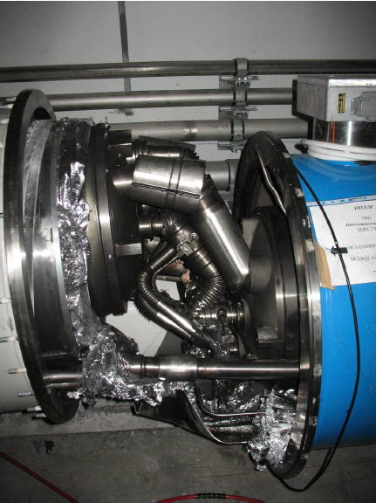

Why are protection systems needed?
LHC needs 8.3T dipole fields with circumference of 27 km
Superconducting magnets at 1.9°K with operational current of 13kA
Stored energy in the magnet circuits is about 9GJ
Stored beam energy of 360MJ per beam
If beam or magnet energy is released in an uncontrolled way => massive damage !!
Kinetic energy of Aircraft Carrier
at 50km/h ≈ 9GJ
Result of a chain of events triggered by a quench in a LHC bus-bar

Slide 11
Requirements for a Protection System
Failsafe: System has to be safe by design and react under any failure mode
Redundancy: All critical paths have to be duplicated (and if possible using diversity in components, algorithms, etc…) to increase safety integrity.
Critical actions by hardware: No software involved on the critical path
Dependable system: Safe/Available/Reliable
Masking: Only possible if safety is not compromised (highly desirable for commissioning)
Integration in the control system: Configuration data, logging, SCADA
Technology choice normally driven from technical requirements and environment: reaction times, EMC, radiation,…

Slide 12
A case study
Powering Interlock System

Slide 13
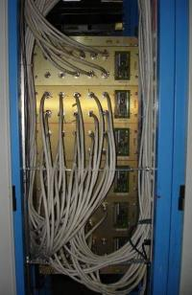
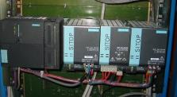
Powering Interlock System
  PLC-based system in charge of ensuring correct powering conditions (>10.000 sc magnets powered in 1700 circuits)
  Interfaces with Power Converters and Quench Protection Systems (several 1000s of channels) and technical infrastructure (Cryogenics, UPS, AUG and Controls)
  Distributed system (36 controllers SIEMENS PLCs grouped by powering subsectors) and close to main clients (EMC and radiation tolerant design)
  Handling very high stored energies (GJ), system must be fast and reliable
  Hybrid technology using PLC-based + custom electronics
  It represents 25% of the inputs to the Beam Interlock System

Slide 14
Interlock signals and criticality (1/3)
3 levels of interlock signals exchanged depending on the criticality of the protection function
1) Circuit level interlocks: High critical signals are implemented via hardwired current loops and no PLC dependent. Up to 2500 current loops in the LHC!
Cryostat
DFB
Magnet
Magnet
Magnet
…
QPS
PIC
PC_PERMIT
PC
CIRCUIT_QUENCH
PC_FAST_ABORT
POWERING_FAILURE
DISCHARGE_REQUEST
PC_DISCHARGE_REQUEST

Slide 15
Interlock signals and criticality (2/3)
2) Global level interlocks: In addition to the circuit level protection, global interlocks will provoke runtime aborts in all circuits in a subsector
Signals exchange via hardware (UPS, Emergency stop buttons) or via PLC-PLC communication (Cryogenics)
Cryostat
DFB
Magnet
Magnet
Magnet
…
QPS
PC
QPS
PC_PERMIT
PC
QPS
1 PIC
PC
CIRCUIT_QUENCH
PC_FAST_ABORT
x M
POWERING_FAILURE
x N
DISCHARGE_REQUEST
PC_DISCHARGE_REQUEST

Slide 16
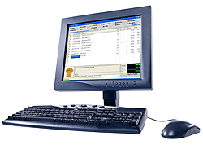
Interlock signals and criticality (3/3)
3) Start-up interlocks: In addition to hardwired interlocks, several software interlocks exist
Exchange via the controls middleware between SCADA systems
Verified only at start-up and never provoke aborts during powering
QPS_OK
CRYO_START
QPS SCADA
PIC SCADA
CRYO SCADA
Surface – ‘Software’ signal exchange
Tunnel – Hardwired signal exchange
QPS
PIC
PC_PERMIT
PC
CIRCUIT_QUENCH
PC_FAST_ABORT
POWERING_FAILURE
DISCHARGE_REQUEST
PC_DISCHARGE_REQUEST

Slide 17
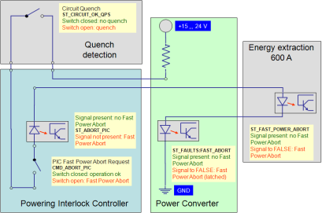
Safety critical hardwired current loops
Safety critical signals exchanged via hardware loops between clients (reliable, simple low cost solution, EMC…)
System requesting signal provides current source to the loop
Loops driven by 15-24V and 10-20mA
Optocouplers used to read signal status (galvanic isolation)
Fail-safe by design and do not rely on a PLC program

Slide 18

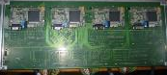
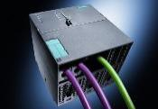
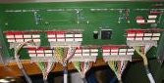

Redundancy and diversity
Beam dump requests following powering failures must be transmitted in a fast and reliable way to the Beam Interlock System
For speed and redundancy a hybrid technology based on PLC + CPLD (MATRIX)
Common mode and systematic failures such as those caused by design flaws are reduced to the minimum
Max 16 Inputs / Patch Panel
Max 96 Inputs / Total
PROFIBUS
QPS / PC
SIEMENS 319 CPU
MATRIX
to BEAM INTERLOCK SYSTEM…

Slide 19

Remote IOs
The Powering Interlock System combines the use of standard SIEMENS PLCs with custom electronics
Remote IOs are installed close to main clients (dedicated EMC and radiation tests campaigns performed to all sensitive components: optocouplers, AC-DC, CPLDs, …)
SIEMENS ET200 modules not adequate to radiation environments, thus ANYBUS 32 I/O modules for Profibus-DP communication (size, cost, radiation tolerant…)
Interlock cabling connections directly routed through patch panels (better for MTBF)

Slide 20
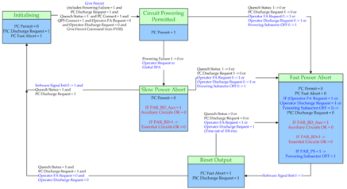
Software aspects
Each of the 36 PLC instances runs a generic program configurable from database
Clear separation between safety and monitoring functions (higher priority to critical actions)
  OB1 Free running block: in charge of SCADA dialogue, cryogenics, history extraction…
  OB35 Cyclic interrupt (1ms cycle): reads system configuration, executes interlock function calls, local history…
  OB100 System restart block: counts number of PLC restarts
Interlock functionality implemented on sate machines defining the different interlock states
Configuration data containing information about circuits and operational data is available from FC10 and FC11

Slide 21
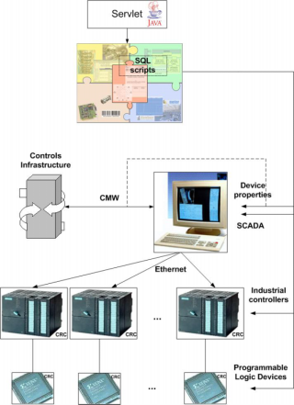
Mechanisms for secure configuration (1/2)
LHC Functional Layout DB as unique source of information
Configuration data required for PLCs, MATRIX and SCADA
Consistency guaranteed with strict versioning scheme and approval process before migration to new data version
Dedicated script for the generation of configuration data
Files signed with Cyclical Redundancy Check (CRC)
SCADA configuration file will contain all checksums for validation
Flexibility for Commissioning
No changes during operation without repeating all commissioning procedures!!

Slide 22
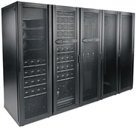

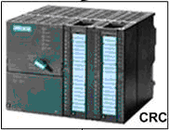

Mechanisms for secure configuration (2/2)
PVSS
DB
Version
PLC HW CRC
PLC SW CRC
Version
Matrix CRC
Ethernet
PLC
PLC
PLC
Version
PLC HW CRC
PLC SW CRC
PUBLISH
PROFIBUS
PROFIBUS
…
PROFIBUS
matrix
matrix
matrix
Version
Matrix CRC

Slide 23
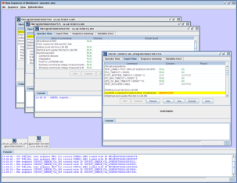
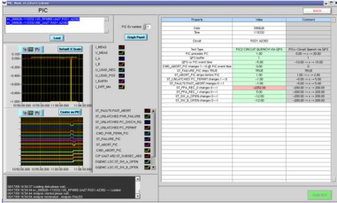
Commissioning and operation
100% automated functional test in the lab before installation in the LHC tunnel (PLC-based test bench simulating clients behaviour)
Interface tests after installation to detect major cabling problems
System is 100% commissioned during a dedicated Hardware Commissioning campaign (PC, QPS, CRYO, UPS, …)
High level software tools to automate the execution and validation of interlock tests (more than 3000 tests executed!)
Sequencer to automate test execution
Analysis tools to automate test validation

Slide 24
Operational experience
Good experience so far with standard industrial controllers and custom electronics, exceeding reliability predictions
Minimized downtime from Powering Interlock System due to component failures
  1x Faulty optocoupler (related to a circuit intervention)
  3x Power supplies faults (not affecting operation)
  4x Spurious triggers on current loops (connectivity issues not excluded)
  4x PLC memory corruption due to Single Event Upsets (radiation)
Current loops demonstrated to be a reliable solution for safety critical protection (simple, reliable, low cost solution…)
No hardware changes required to the system, only few software improvements to fulfil operational requirements
Good performance of the system is based on full commissioning

Slide 25
Thank you for your attention

Slide 26
Spare slides

Slide 27
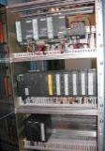
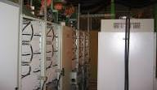

Warm Magnet Interlock System
148 nc magnets powered in 45 circuits in the LHC
Classical protection of nc magnets based on thermo-switches, flow-meters, emergency buttons…
Use of fail-safe PLCs and remote IO modules
Power Converter
Warm magnet
Interlock
Controller
Status info
Power Permit
Several thermo-switches @ 60°C
Thermoswitches
Water Flow
Red button…
Magnet 1
Magnet 2

