Slide 1
Detector Bulk Interface and Slow Control Workshop
Bulk Data Interface Requirements

Slide 2
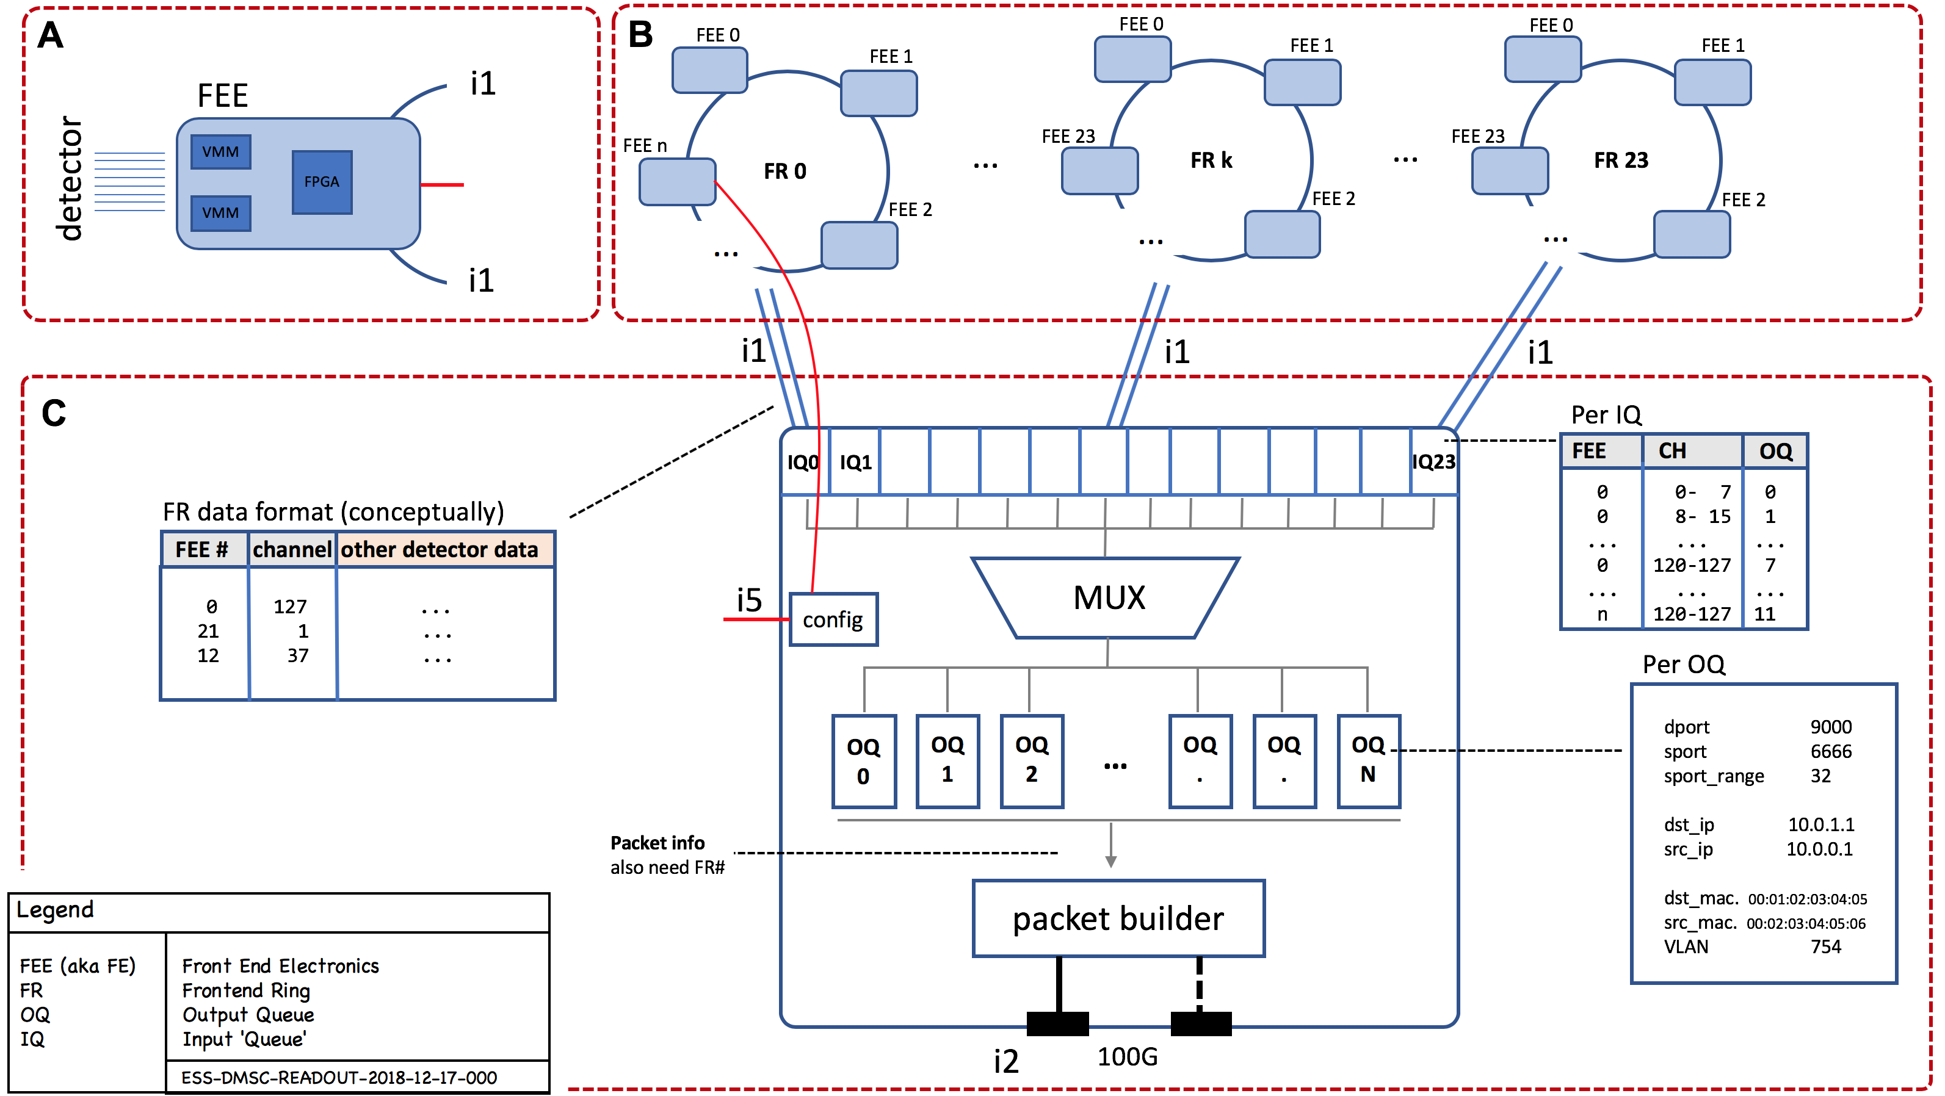
FPGA Master

Slide 3
FPGA Master

Slide 4
Single Detector Panel
NMX panel, VMM3 readout
NMX panel, VMM3 readout
readout
Intel x86_64CPU
CPU00
CPU01
CPU02
CPU03
CPU04
CPU05
CPU06
CPU07
CPU08
CPU09
CPU10
CPU11
Reused Slide
February 2018 mtg.

Slide 5
Single Detector Panel
NMX panel, VMM3 readout
NMX panel, VMM3 readout
readout
Intel x86_64CPU
CPU00
CPU01
CPU02
CPU03
CPU04
CPU05
CPU06
CPU07
CPU08
CPU09
CPU10
CPU11
Reused Slide
February 2018 mtg.

Slide 6
Consideration: Speed up
- by parallelisation
General solution
  distribute readouts across multiple EFU’s
  distribute readouts to a EFU across multiple queues
  can have implications for design of readout backend
Reused Slide
February 2018 mtg.

Slide 7
Speed up by parallelisation
Some detectors are easy
  Multiblade - blades are independent
  Multigrid – grid stacks are independent
  SoNDe – comes as detector pixels (more or less)
  DREAM – comes as detector pixels (more or less)
At least one is complicated
  Gd-GEM – panels are independent, but cannot easily be segmented
Reused Slide
February 2018 mtg.

Slide 8
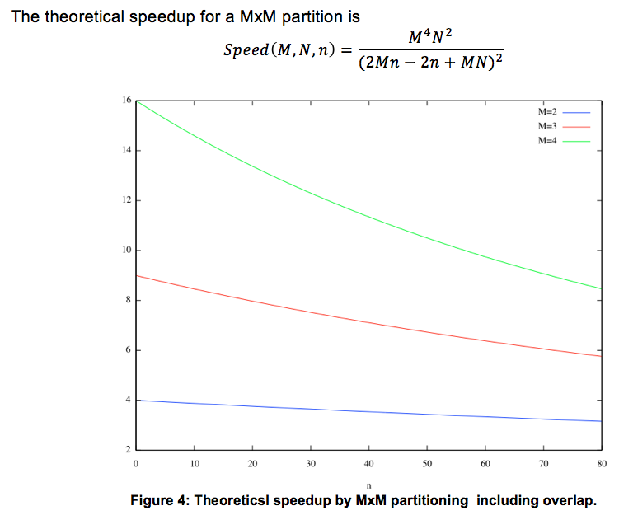
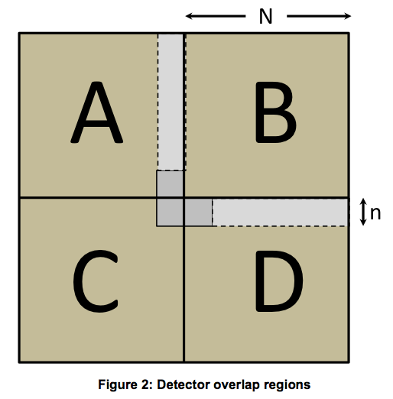
NMX Speedup
Reused Slide
February 2018 mtg.

Slide 9
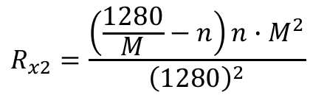
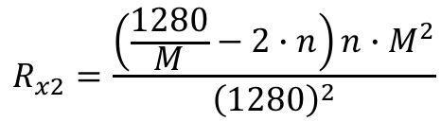
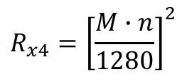
NMX Speedup
$$R_{x2}=\frac{\left(\frac{1280}{M}−n\right)n∙M^{2}}{{\left(1280\right)}^{2}}$$
Corners
$$R_{x2}=\frac{\left(\frac{1280}{M}−2∙n\right)n∙M^{2}}{{\left(1280\right)}^{2}}$$
Centers
$$R_{x4}={\left[\frac{M∙n}{1280}\right]}^{2}$$
All
‘Worst case‘ a region receives 127%

Slide 10
CPU00
CPU01
CPU04
CPU02
CPU03
CPU00
CPU01
CPU04
1
2
3
Frontend
Master
CPU02
CPU03
4
5
6
P1 P2 P3 P4 P5 P6 P7 P8
7
8
9
CPU00
CPU01
CPU04
CPU02
CPU03
CPU00
CPU01
CPU04
CPU02
CPU03

Slide 11
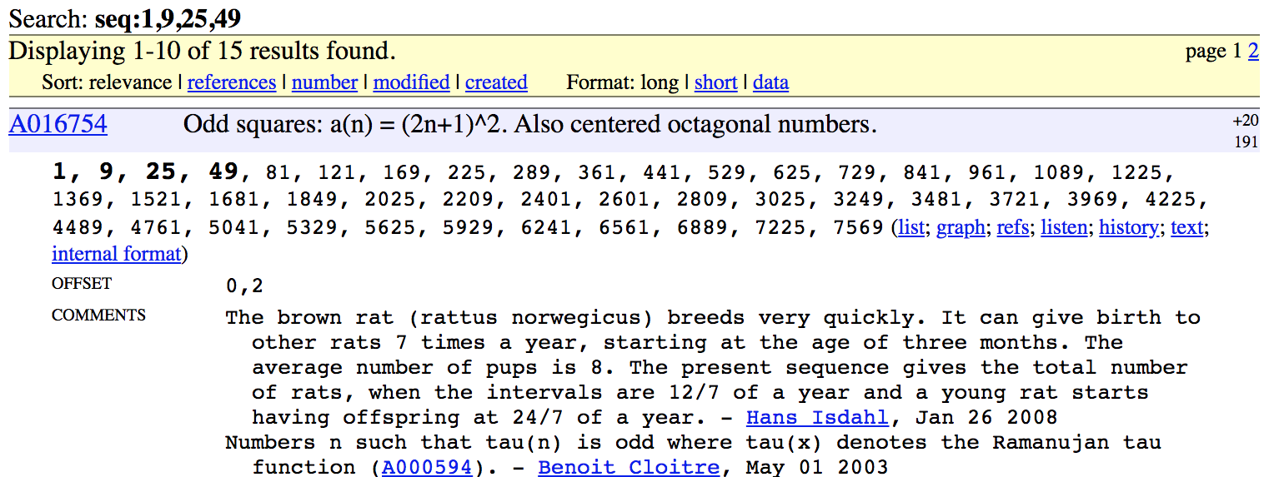

Partitions
# regions equals # of required output queues
$$Regions\left(r,c\right)=4rc −2\left(r+c\right)+1$$
panel 1
overlap x2 0
overlap x3 0
Regions 1
panel 4
overlap x2 4
overlap x3 1
Regions 9
panel 12
overlap x2 17
overlap x3 6
Regions 35
panel 9
overlap x2 12
overlap x3 4
Regions 25
panel 16
overlap x2 24
overlap x3 9
Regions 49

Slide 12
Considerations: Data path
Topology
  A readout master sends to one or more EFUs
  EFUs receive from one or more RO Masters
How to get the relevant readout data to the right destination?
  mapping ‘channels’ to IP/UDP destinations
  a single IP/UDP port may not be sufficient
Duplication?
  ‘overlapping’ regions, can they be transmitted to multiple receivers?
Reused Slide
February 2018 mtg.

Slide 13
Considerations: Data path
Topology
  A readout master sends to one or more EFUs
  EFUs receive from one or more RO Masters
How to get the relevant readout data to the right destination?
  mapping ‘channels’ to IP/UDP destinations
  a single IP/UDP port may not be sufficient
Duplication?
  ‘overlapping’ regions, can they be transmitted to multiple receivers?

Slide 14
Basic operation
Source based readout redirection to different output queues
Ensapsulate in suitable Ethernet/IP/UDP packets
Use IEEE 802.1 switches to distribute packets to servers

Slide 15
IP unicast – no overlap
Use ethernet switch mac address table to ensure line speed forwarding of unicast packets.
Requires population of switch mac address tables by ping, arp or other communication across switch.
2 regions
1 2
P10
reg 1
reg 2
reg 1
P1
P11
reg 2
Switch

Slide 16
VLAN – unicast + broadcast
Use ethernet vlan to replicate packets in same vlan to all member ports.
Requires population of switch’s mac address tables by ping, arp or other communication across switch.
Requires special NICs allowing hw stripping of vlan tags.
3 regions
1 2 3
port vlans
1 5, 6, 7
10 5, 6
11 6, 7
P10
reg 1
reg 2
reg 1
reg 2
reg 3
P1
P11
reg 2
reg 3
Switch

Slide 17
IP unicast + multicast
Use ethernet switch’s flooding of multicast packets to send overlap data to all hosts and use NIC multicast address tables to filter out unwanted traffic in hw.
Requires population of switch’s mac address tables by ping, arp or other communication across switch.
3 regions
1 2 3
P10
reg 3
reg 2
reg 1
NIC
reg 1
reg 2
reg 4
reg 3
reg 2
reg 1
P1
P11
reg 3
reg 2
reg 3
NIC
reg 2
reg 3
Switch

Slide 18
FPGA Master

Slide 19
FEE/FR
Number of supported channels
  Minumum 128 (NMX/VMM)
Data format
  Draft version should be proposed and reviewed
  {FEEid, Channel}, readout specific data
  channel unwrapping – 2 x 64 chs should be represented as 1 x 128
  where is timestamping added?
How many FEEs are supported per ring?

Slide 20
Frontend Master
What is the number of supported output queues?
  Some ‘magic’ numbers would be 49, 35, 27, 25
FEE/channel multiplexer proposed
Output queue encapsulations
  UDP/IP unicast, multicast
  VLAN + UDP/IP broadcast
  Source UDP port range
Packet needs to contain
  FEE#, channel#, FR# to correctly identify readout source
Per output queue sequence numbers

Slide 21
Detector Bulk Interface and Slow Control Workshop
Deployability Considerations

Slide 24
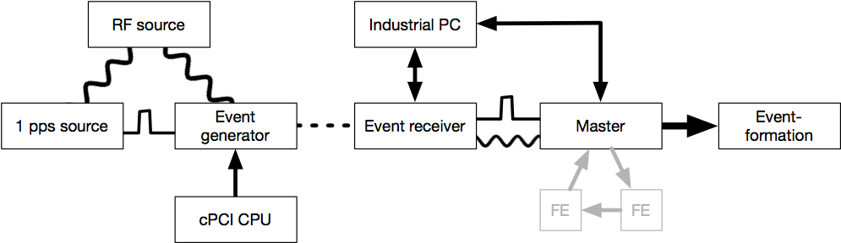

Slide 25
Standalone Master
Frontend
Master
control & config – 100M/1G
10G/100G – bulk data
EFU

Slide 26
Wishlist
Standalone Master operation
  Integrated EPICS interface (i5)
  ”Timing hw less” operation
  Single 100G port configuration option
Ethernet interface for config
Support for efficient configuration
  Waveform/bulk configuration
Support for efficient operation/test
  Interface for querying counters and stats

Slide 27
Output queues / Ethernet parameters
Ethernet IP UDP
DMAC
SMAC
VID
SIP
DIP
SPORT
DPORT
00:01:02:03:04:05 unicast
01:00:5e:xx:yy:zz ip multicast
ff:ff:ff:ff:ff:ff broadcast
00:01:02:03:04:05 unicast
Source MAC addresses can only be unicast
0-4095 VID (vlan id)
VLAN tag not present when not using VLAN
10.20.30.40 unicast
Source IP addresses can only be unicast
10.20.30.40 unicast
224.xx.yy.zz multicast
255.255.255.255 broadcast
0 - 65535 variable
Source port needs to vary for multi-cpu distribution since all other fields are constant once configured.
0 - 65535 specific value

Slide 28
Configuration data size
NMX
  3 panels with
  80 VMM ASICS having
  18 registers of
  3 x 32 bits
  ~ 13.000 32-bit writes (51840 bytes)
Input queue config
  24 IQs with tables of
  16 (?) FEEs having 16 OQ descriptors
  ~ 6.100 8-bit writes (6144 bytes)
Output queue config
  49 (?) queues of 26 bytes
  ~ 320 32-bit writes (1247 bytes)

Slide 30
Eth
IOC

Slide 32
Wish list for the collaboration
Roadmap for the DG/DMSC interface
Roles and responsibilities
Early detector readout prototype
  first expected instrument, easiest implementation or most common readout technology (vmm?)
Documentation
  Architecture specification
  Use case for configuration
  Use case for operation
  Design of FE for VMM3
Reused Slide
February 2018 mtg.

Slide 33

FPGA Master

