Slide 1
The beam monitors common project at ESS
Kalliopi Kanaki
Steven Alcock, Ioannis Apostolidis, Vendula Maulerová
Richard Hall-Wilton
IKON16, 12.02.19

Slide 2
Goal of the project
Turn-key provision of beam monitoring solutions
  For each instrument
  From design to provision, installation and cold commissioning
  Operating up to 2 MW
  Standardization
2 phases foreseen
  Design phase: 2019
  Provision phase: 2020-2025

Slide 3
Phase 1 (2019): design
Preliminary Design Report PDR by September 2019 (initial project scope)
Critical Design Report CDR by January 2020 (what will be built/procured)
DG public confluence page for sharing results
  https://confluence.esss.lu.se/display/DG/Beam+monitors+common+project
  Contains list of BM needed by ESS instruments (~50)
  Requirements as currently understood

Slide 4
Phase 2: provision
Starts in 2020 after completion of design phase
Includes
  Procurement
  Site acceptance tests (SAT)
  Installation
  Cold commissioning
High fraction of instrument participation is expected.

Slide 5
BM zones with different focus

Slide 6
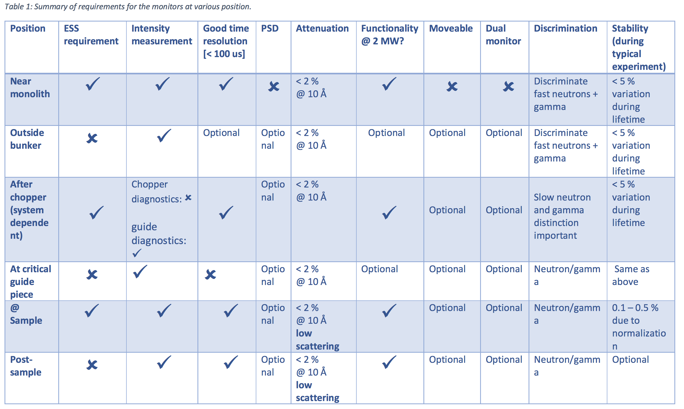
Requirements depend on location and function

Slide 7
Preliminary BM choices
Qualified per location (rate capability, saturation)
  Bunker: fission chambers, ionization chambers, GEM
  Guide/choppers: γ monitor, V monitor, external efforts (B-GEM, N-GEM, ESS Bilbao)
  Sample: wire detectors
  Transmission: wire detectors
Qualification per function
  Only flux?
  Flux and time resolution?
  Efficiency? Only for thermal neutrons?
Input from instruments
  McStas models (please upload to nosg-baselines repository)
  Commissioning plan

Slide 8
Priorities of DG in the coming months
Analyze requirements for bunker and guides/choppers (Kalliopi: 50% of time, already started)
  Identify which detector choices need further development
  Prepare in-beam tests at high flux environments (to be performed latest by end of year)
Mechanical integration (Ioannis, up to 50% of time, already started)
  Reserve envelopes in instrument CAD drawings
  Determine utilities
  Meetings with instrument engineers over IKON16
Standard readout integration (Steven, 10-15% of time)
Continue other monitor efforts (parasitic and quasi-parasitic)
  Proof of concept for γ monitor in place (publication in progress, Fatima/Richard)
  Upcoming in-beam tests at HZB (V17, V20) for Vanadium monitor (Vendula)
  See also talks in 2nd part of BM session

Slide 9
Envelope example from NMX
2nd chopper
1st chopper
Reserved space in green

Slide 10
Validation and qualification for use at ESS
Detection efficiency
  Response both at high and at low fluxes
Beam attenuation including vacuum windows and realistic mechanical integration
Time resolution
Discrimination against fast n and γ background
Stability
Simplicity of integration with the ESS backend readout
Maintenance plan

