Slide 1

Development of the NitroGEM monitor at ISIS
Davide Raspino, Jacob Young
IKON16, Lund
Feb 2019

Slide 2
Introduction
The NitroGEM monitor has been designed for use on high intensity neutron beamlines
Nitrogen:
  Low efficiency: N₂ absorption cross section 1.9 barn at 1.8 Å
  Reaction n+¹⁴N→p+¹⁴C, 620 keV proton energy
GEM:
  technology proven to be able to work at high neutron rate (~MHz/cm²)
  Low gain needed
Transparency

Slide 3
Detector Layout
Al
N₂/Ar/CO₂
n

Slide 4
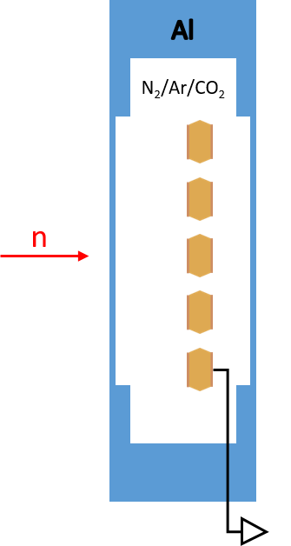
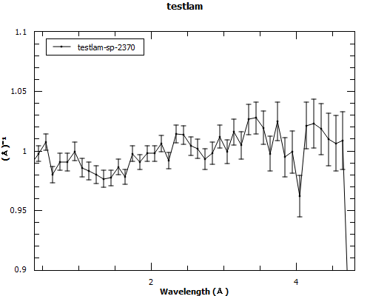
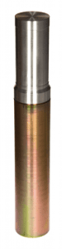
Transparency
Preliminary measurement, against a standard ISIS monitor
ALF beamline at ISIS
A GEM between two 0.5 mm thick plates of aluminium
Thanks to R. Bewley

Slide 5
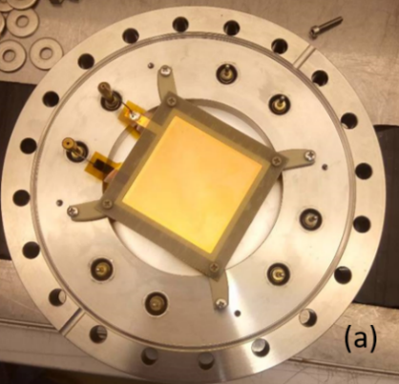
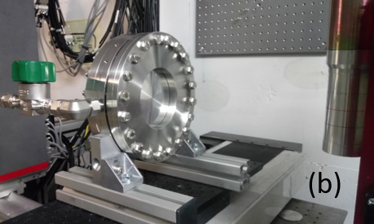
First Prototype
Old vessel from a previous detector development project
Thick entrance and exit window
16 mm thick active volume
Good to measure gamma/neutron separation, efficiency
Standard GEM from CERN:
  50x50 mm² active area
  Framed
  Capacitance: 2 nF
Standard electronics used to readout ³He tubes at ISIS

Slide 6
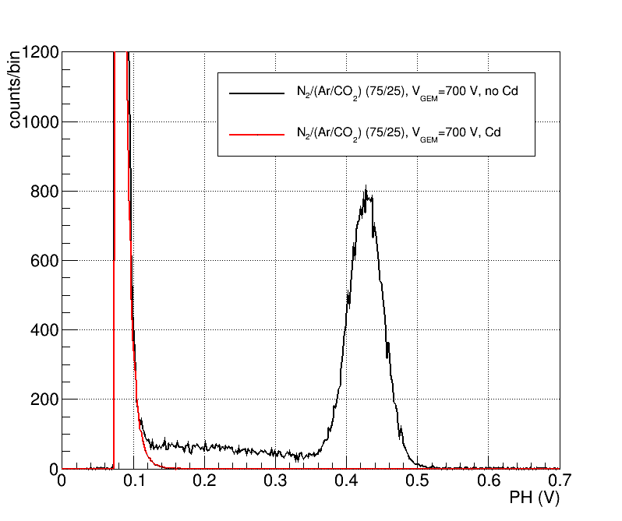
Pulse Height
Emma Beamline at ISIS
Gas mixture:
  75% Nitrogen
  25% Ar/CO₂ (70/30)
V_{gem}=700 V
E_{d}=1.2 kV/cm
Good γ/n separation
Gas flushing through the detector

Slide 7
V_{gem} vs Gas Mixture
Sparks
1 bar total pressure
N₂+Ar/CO₂(70/30)
Sealed vessel
0.6 bar

Slide 8
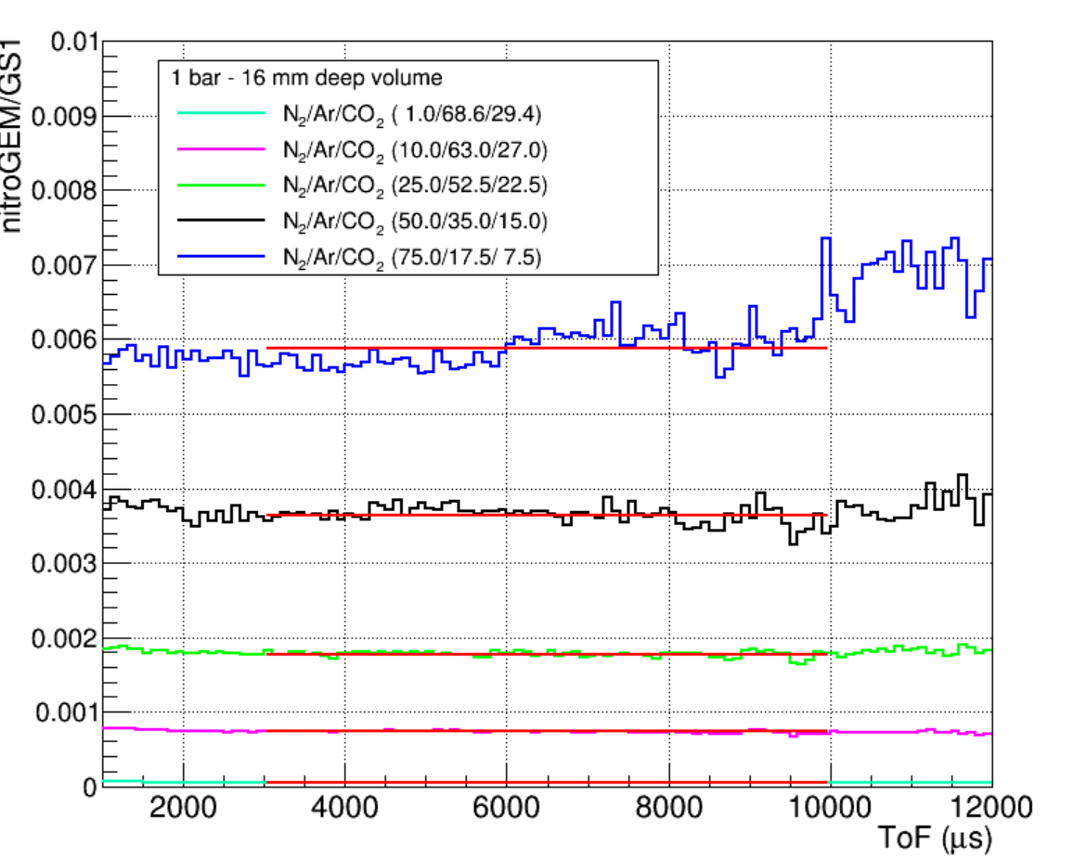
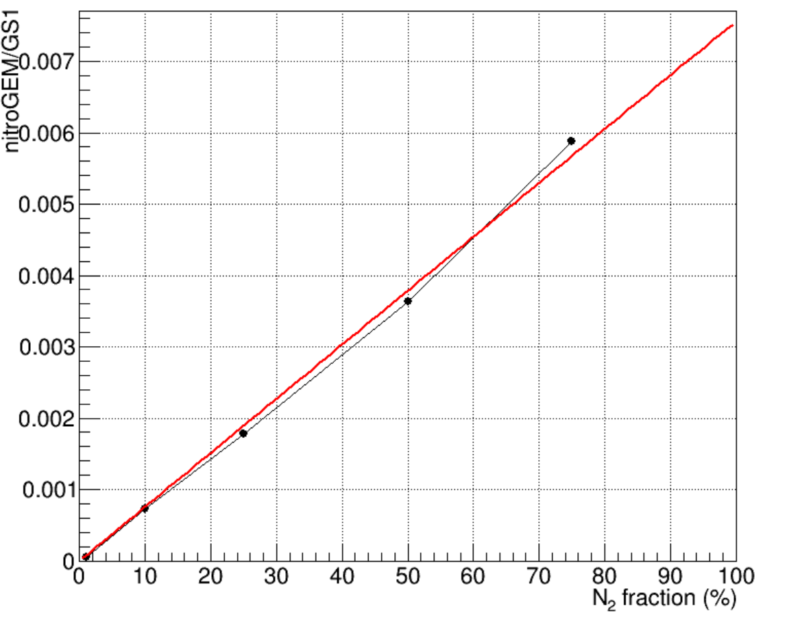
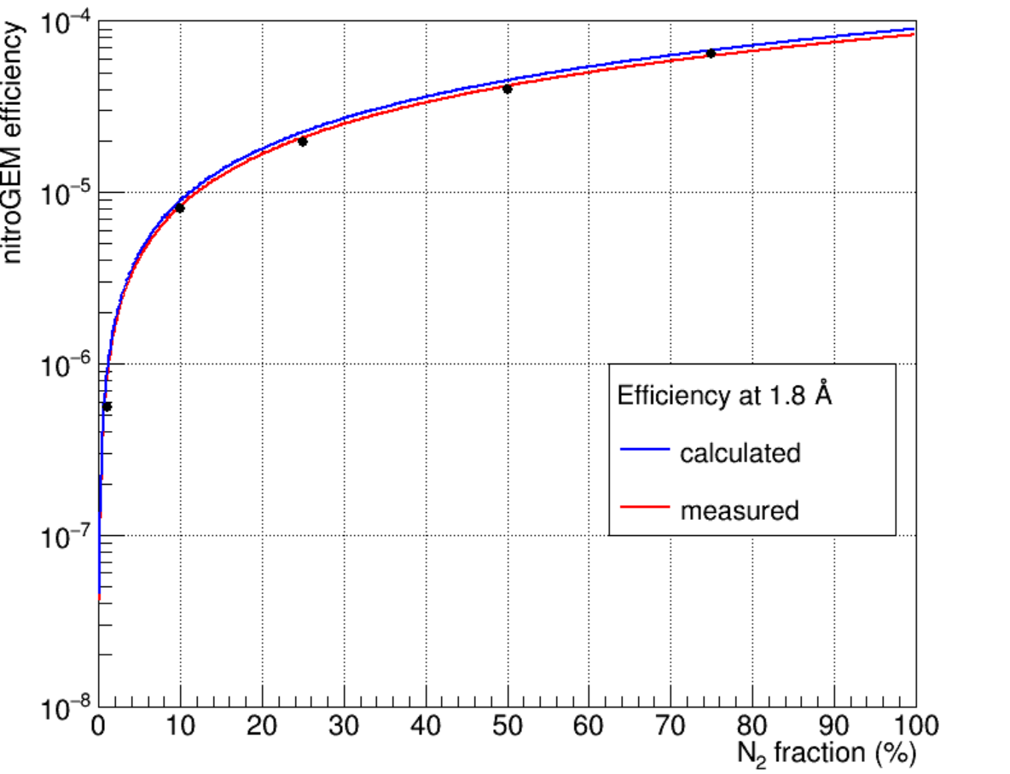
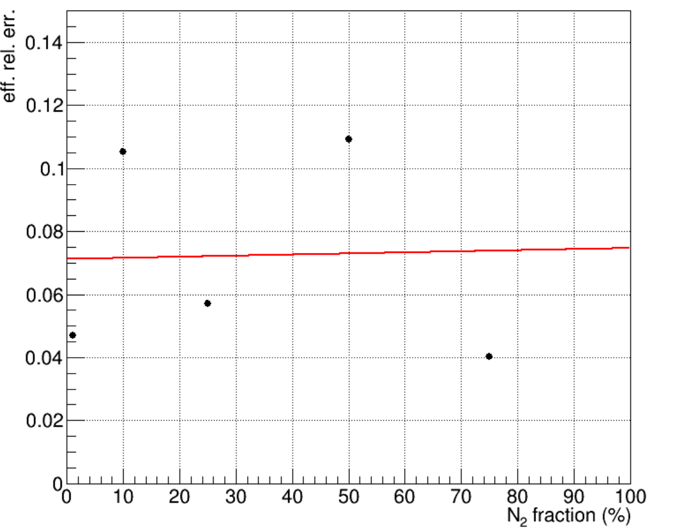
Efficiency
Measured against an ISIS monitor:
  0.25 mm thick GS1 scintillator
  35x35 mm² active area
  1.1% efficiency at 1.8 Å
20x20 mm² collimated beam
Gas mixture
  Sealed gas volume
  N₂/Ar/CO₂ mixture
  1 bar total pressure
  N₂ between 1 and 75%
  Precision 1 mbar

Slide 9
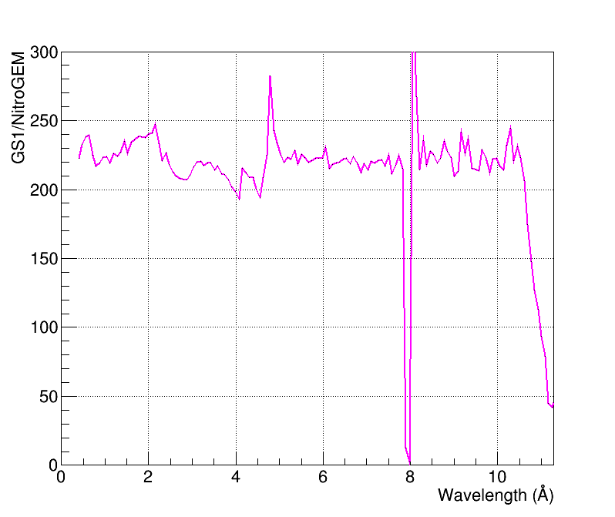
Long Wavelength Efficiency
On the CRISP beamline
0.6 bar total pressure
N₂/(Ar/CO₂)(50/50)
V_{gem}=480 V
Sealed vessel

Slide 10
Conclusions
A single GEM in Nitrogen based gas mixture has enough gain to detect neutrons, at a V_{gem} safe against spark
The γ/n discrimination from the pulse height look very similar to the ³He detectors
Good agreement between the measured and calculated efficiency
The efficiency can be tuned by a factor 100 just changing the gas mixture in the range between 10⁻⁷ and 10⁻⁵
The operation in a sealed volume drastically simplifies the operation on a beamline even if it requires a very careful procedure to assemble and fill the detector

Slide 11
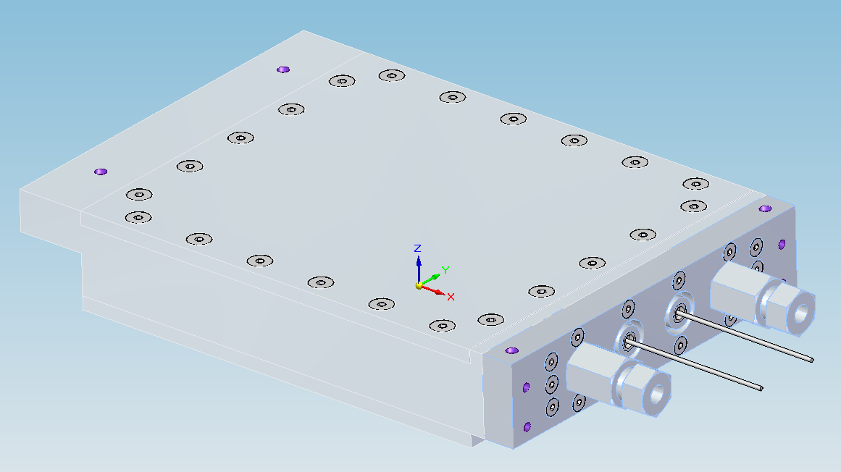
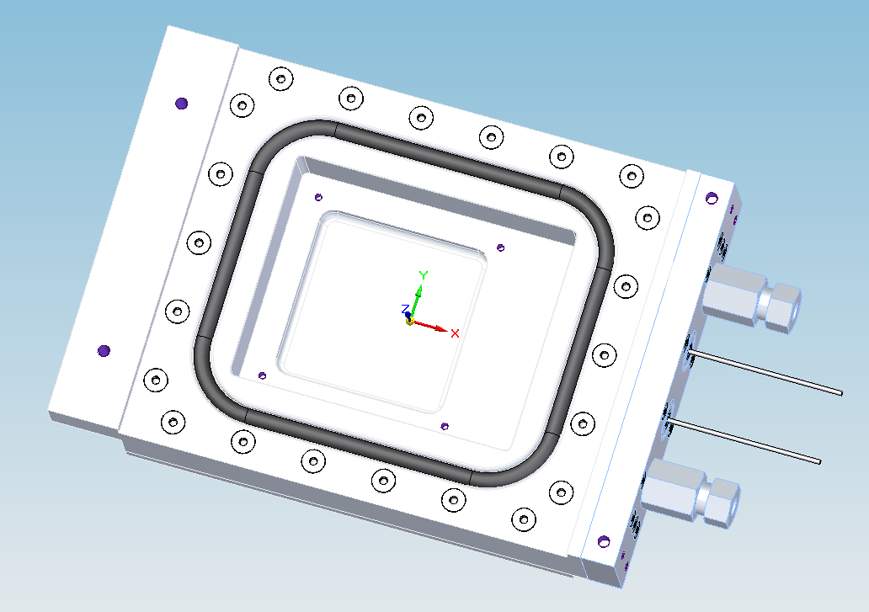
Development activities
Build the new detector vessel
Perform transmission measurement
Measure the pulse height as a function of the thickness of the active volume and with different stopping gas (CO₂, CF₄, C₃F₈) and total pressure
Quantify the gamma and high energy neutron sensitivity.
Test the detector with faster electronics to:
  determine pulse shape gamma/neutron discrimination.
  measure the maximum rate achievable with the NitroGEM monitor.
  verify that the NitroGEM monitor is able to provide sufficient time resolution to allow the time setting of complex chopper systems.
Measure the stability of the detector as a function of time and temperature.
Integrate the monitor into the facility data acquisition system.
Abi Basham

Slide 12
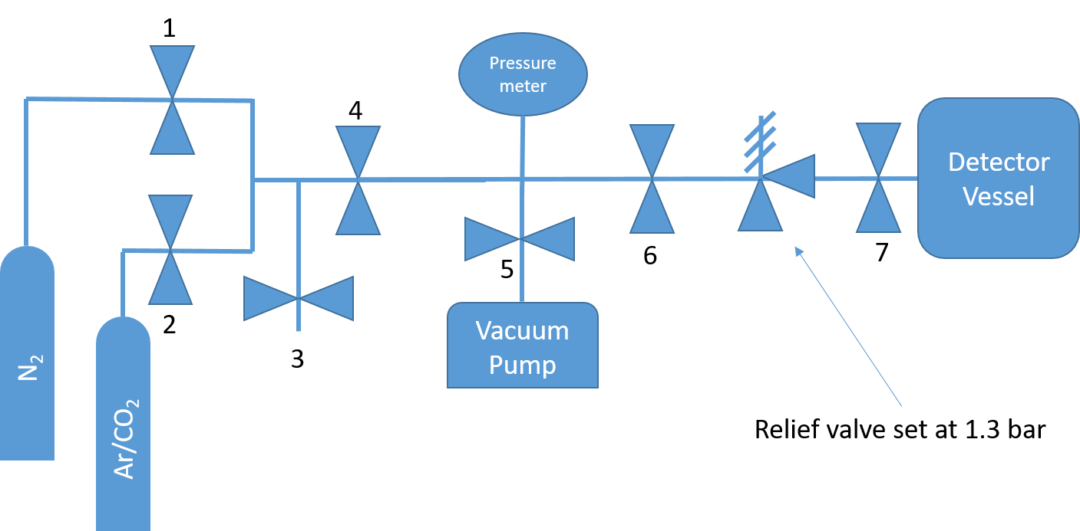
Filling rig
Pressure set with an error of ±1 mbar
No plastic components in any part of the rig
Problems with relief valves
  Set to too low pressure for their spring
  By-passed to avoid pollution inside the monitor vessel

Slide 13
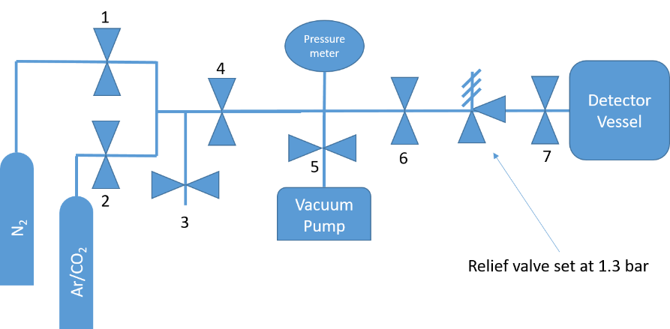
Procedure
Vent the N₂ line for few minutes to clean from any impurities in the pipe: valves 1 and 3 open, valves 2 and 4 closed
Vent the Ar/CO₂ line for few minutes to clean from any impurities in the pipe: valves 2 and 3 open, valves 1 and 4 closed
Evacuate the detector vessel down to ~10⁻⁶ mbar: valves 5, 6 and 7 open, valve 4 close
These three steps can happen at the same time
Fill the detector vessel with the N₂:
  Valves 1, 6 and 7 open, valve 2,3 and 5 closed
  Gradually open valve 4
  Close valve 4 when the desired N₂ pressure is reached
  Close valve 7 to isolate the detector
  Close valve 1 to isolate the N₂ line
Fill the detector vessel with the Ar/CO₂:
  Valves 1,2,3 and 7 close, 4,5 and 6 open
  Evacuate the filling rig that was previously filled with N₂ down to 10⁻⁶ mbar
  close valve 5
  Fill the rig with Ar/CO₂ at a pressure higher than the N₂ pressure inside the vessel:
    Close valve 4, open valve 2
    Open valve 4 until the desired pressure is reached
    Close valve 4
    Open valve 7
  Gradually open valve 4 until the desire pressure of Ar/CO2 inside the vessel is reached
  Close valve 4 and 7
  Close valve 6
Disconnect the detector from the rig

