Slide 1
DEMAX: the ESS support lab for deuteration & crystallization
IKON16
13 February 2019

Slide 2
Deuteration and Macromolecular Xtallization (DEMAX)
Outline
- Who and what is DEMAX?
- How are we organized?
- What do we offer and to which communities?
- Proposal call, proposal review details & timeline

Slide 3
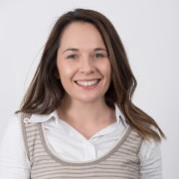
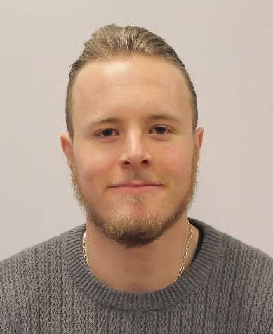
DEMAX offers 3 pillars of support
ESS Deuteration and Macromolecular Crystallization (DEMAX) Platform
Chemical Deuteration
Organic (chemical) synthesis
Enzymatic Synthesis
Separate, analyze a range of molecules
Yeast-derived total lipid preparation
Future: extraction of lipids, oils and other small molecules from biomass
Biological Deuteration
Deuterated biomass production (algae, bacteria)
Protein expression & purification
Biophysical characterization (DLS, thermofluor, nanotemper, purity)
D incorporation with ESI-MS
Future: yeast biomass
Macromolecular Crystallization
High- and low-throughput screening
Large volume crystallization
Optimization (seeding, fine-screening, temperature)
X-ray testing 100 K @ MAX lab (with LP3)
Support for xtal mounting & H/D exchange for RT measurements
0.5 FTE
(LU)

Slide 4
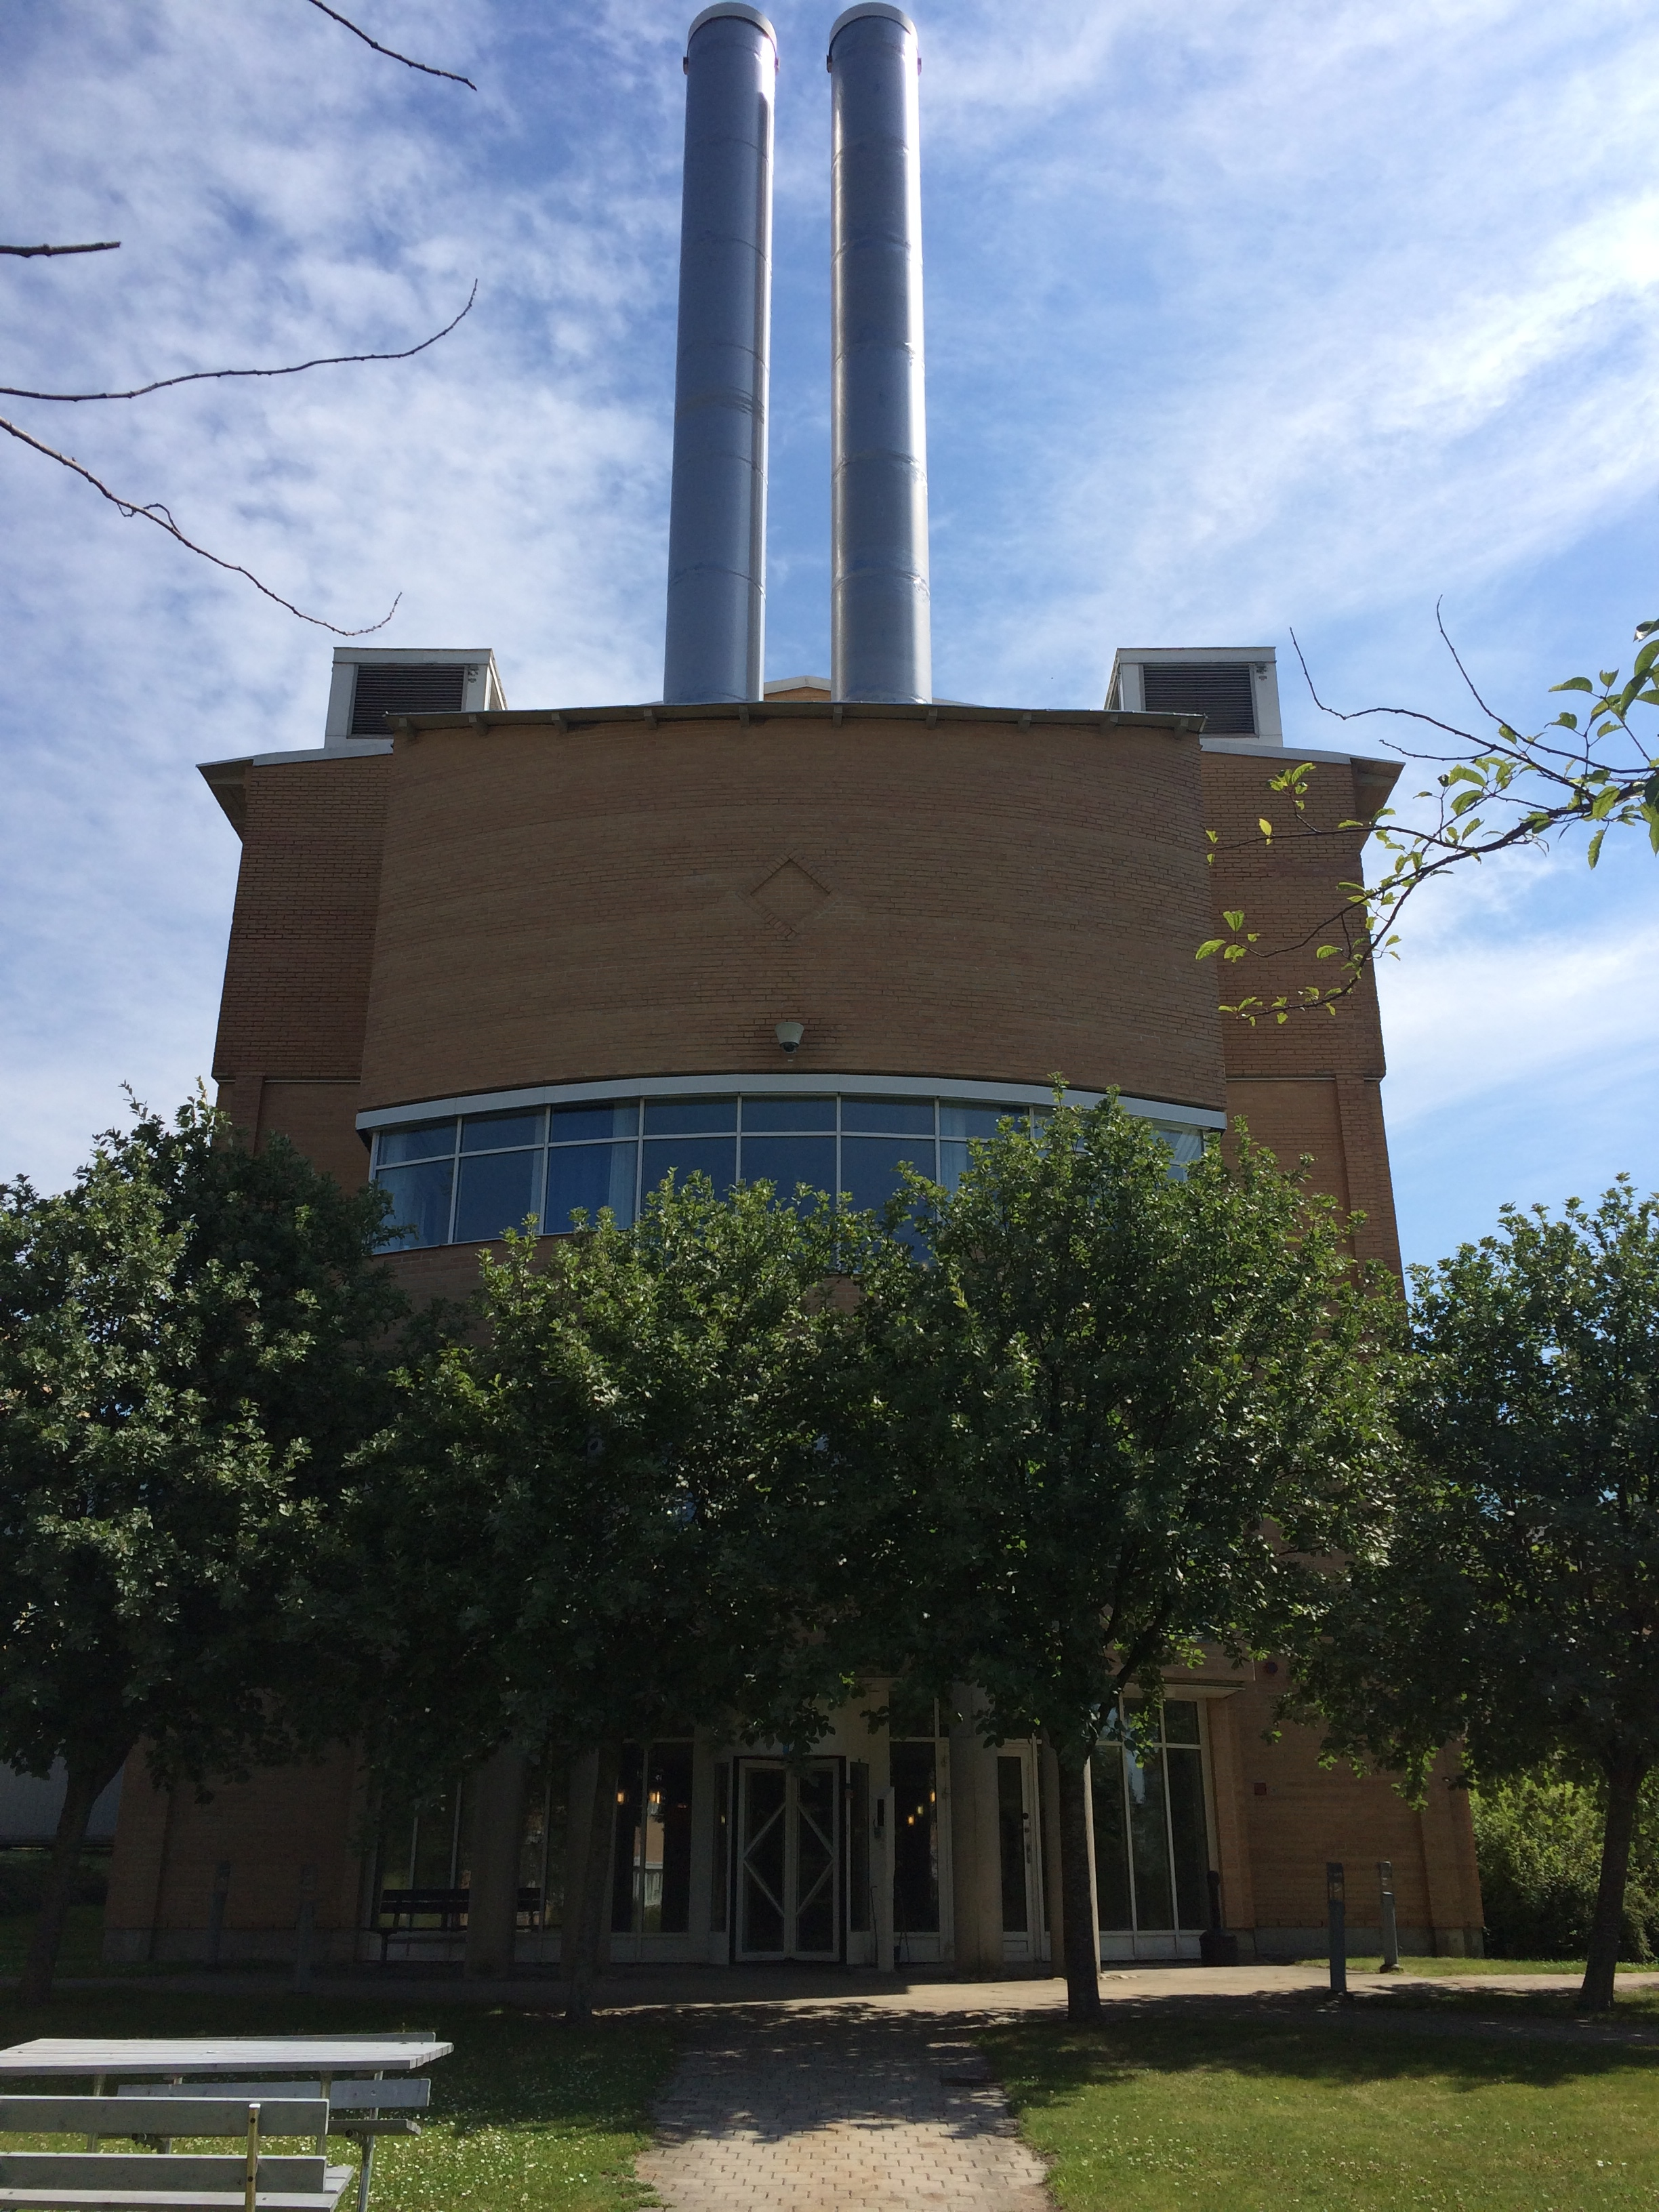
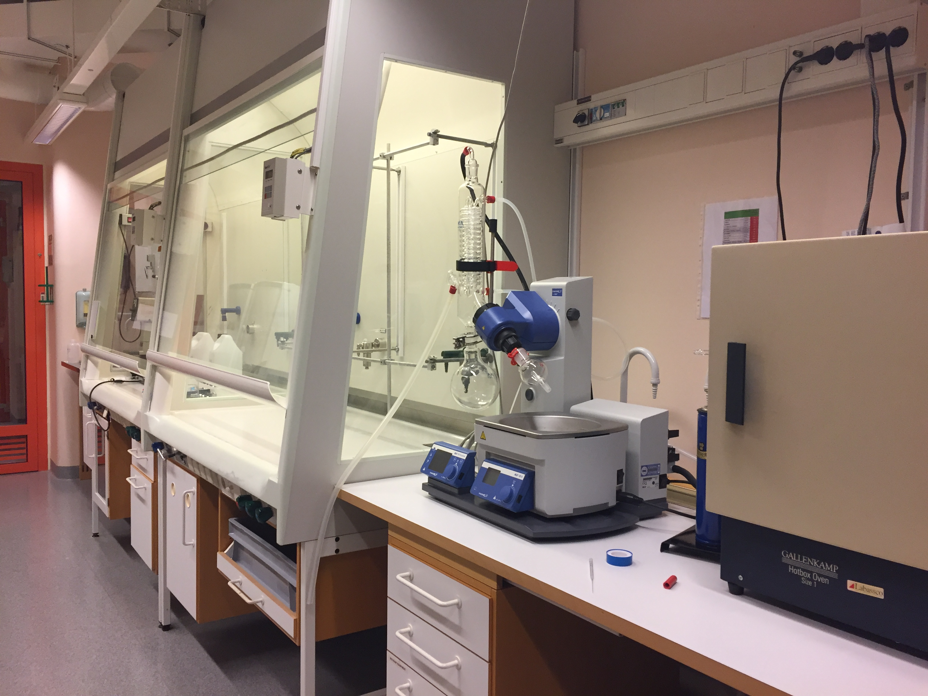
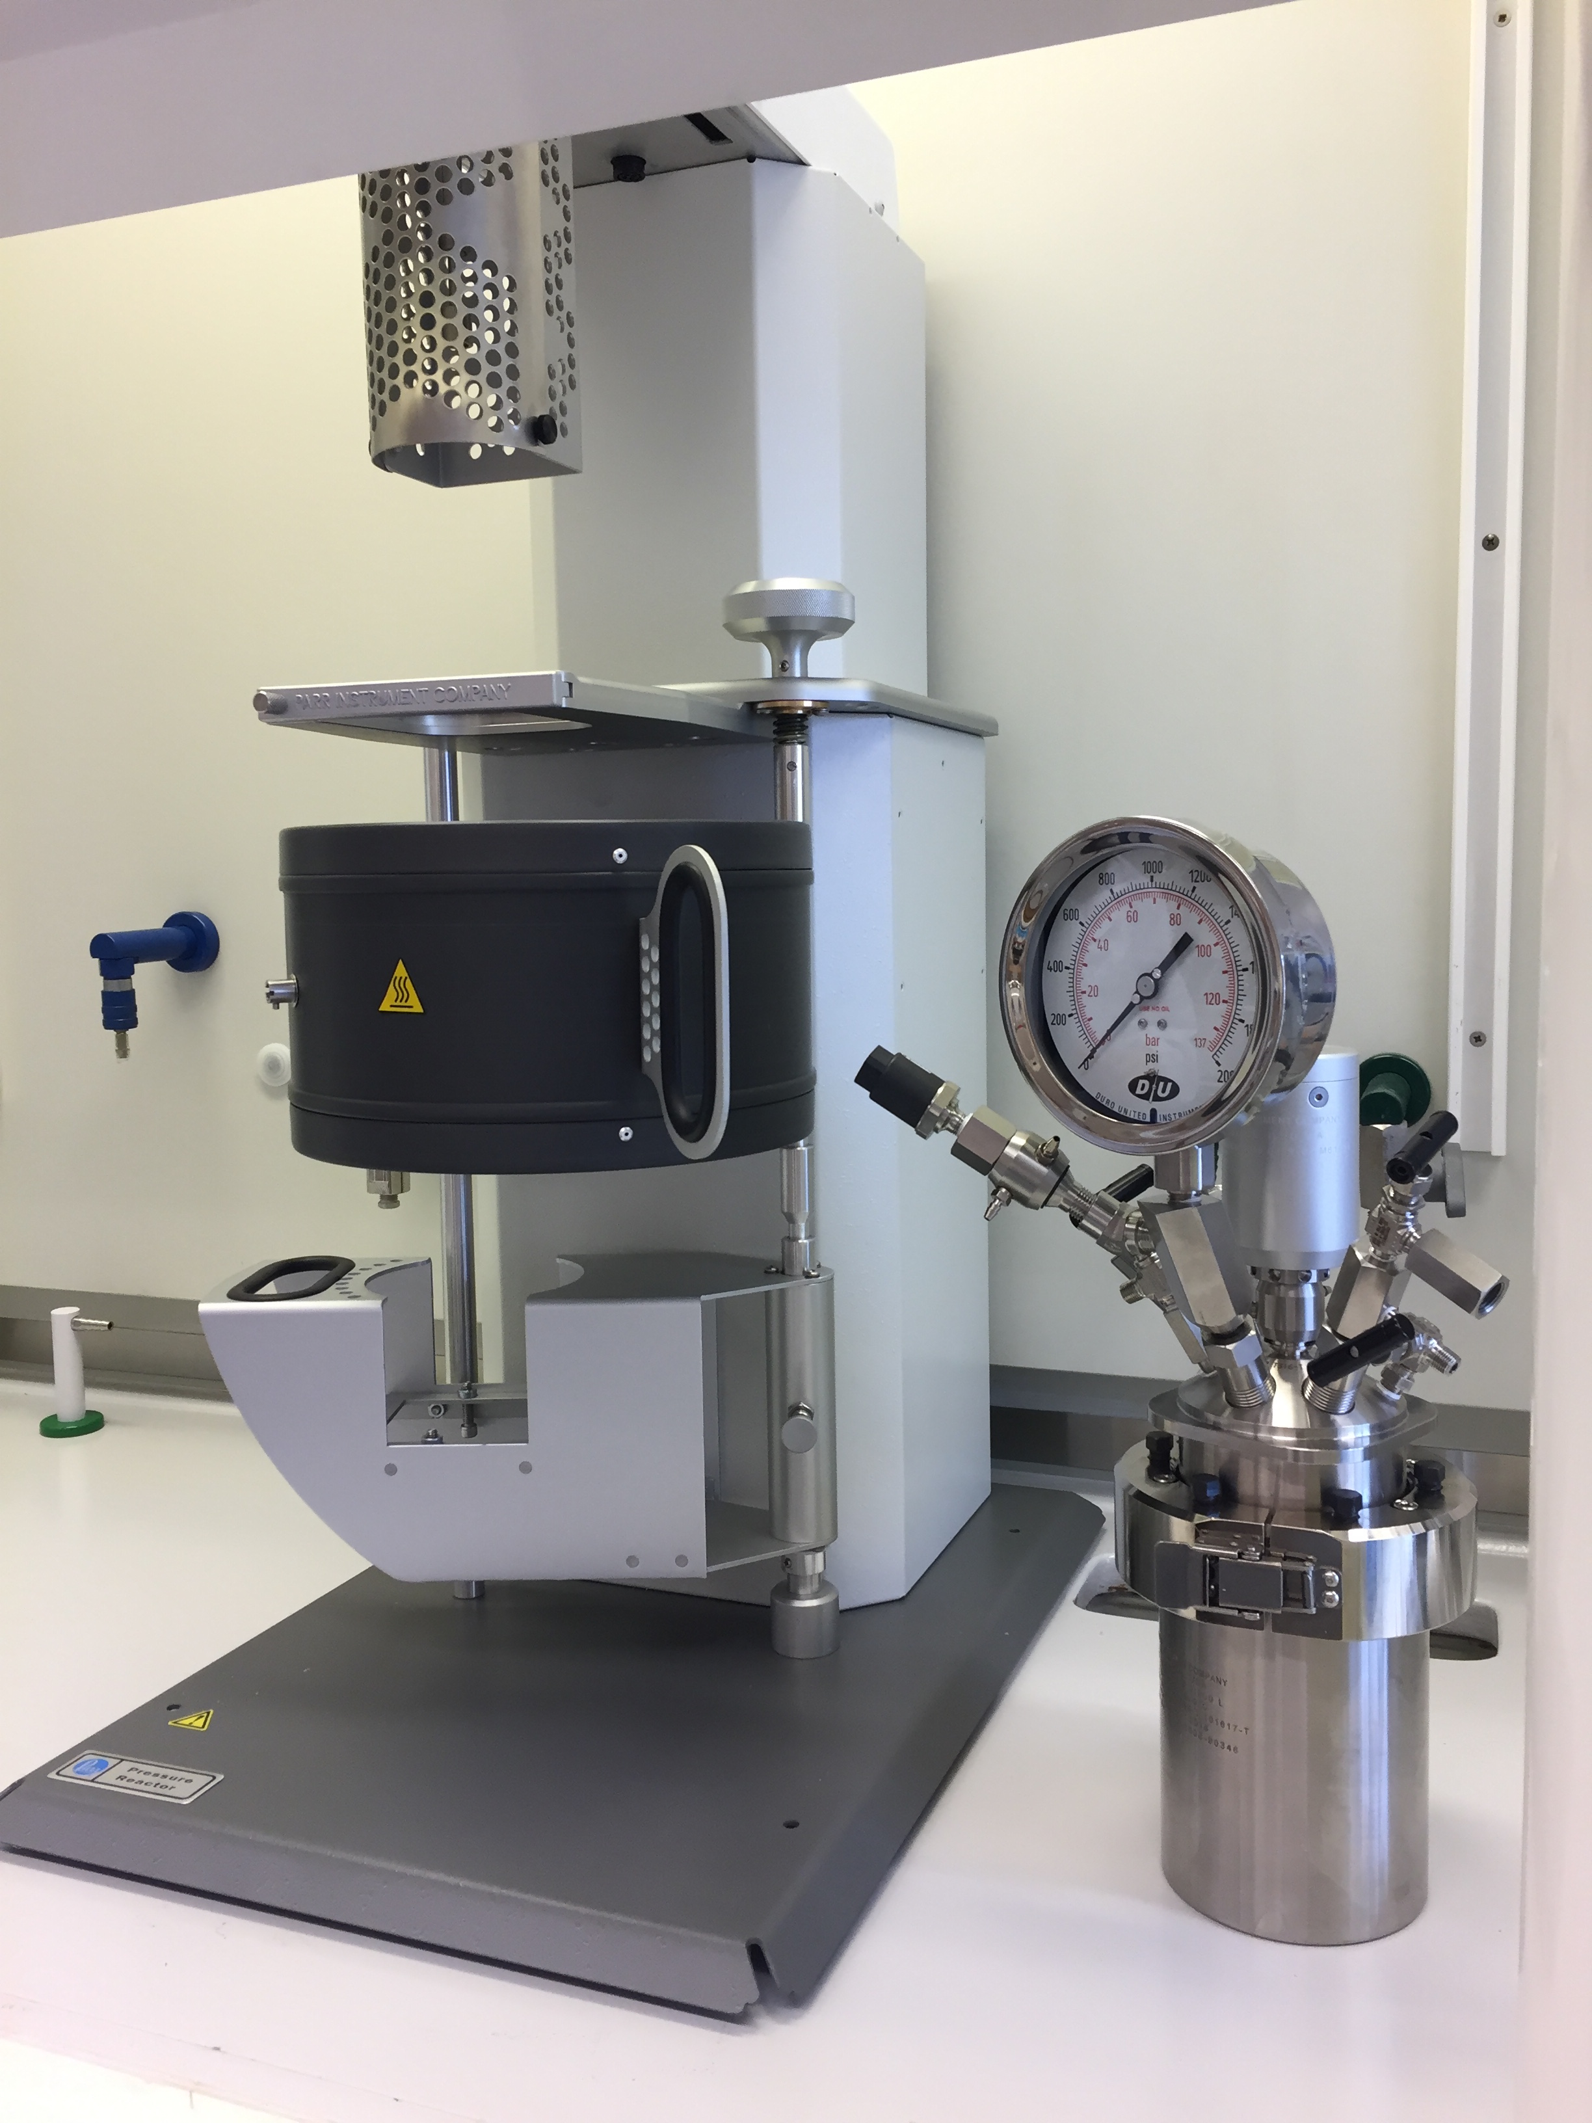
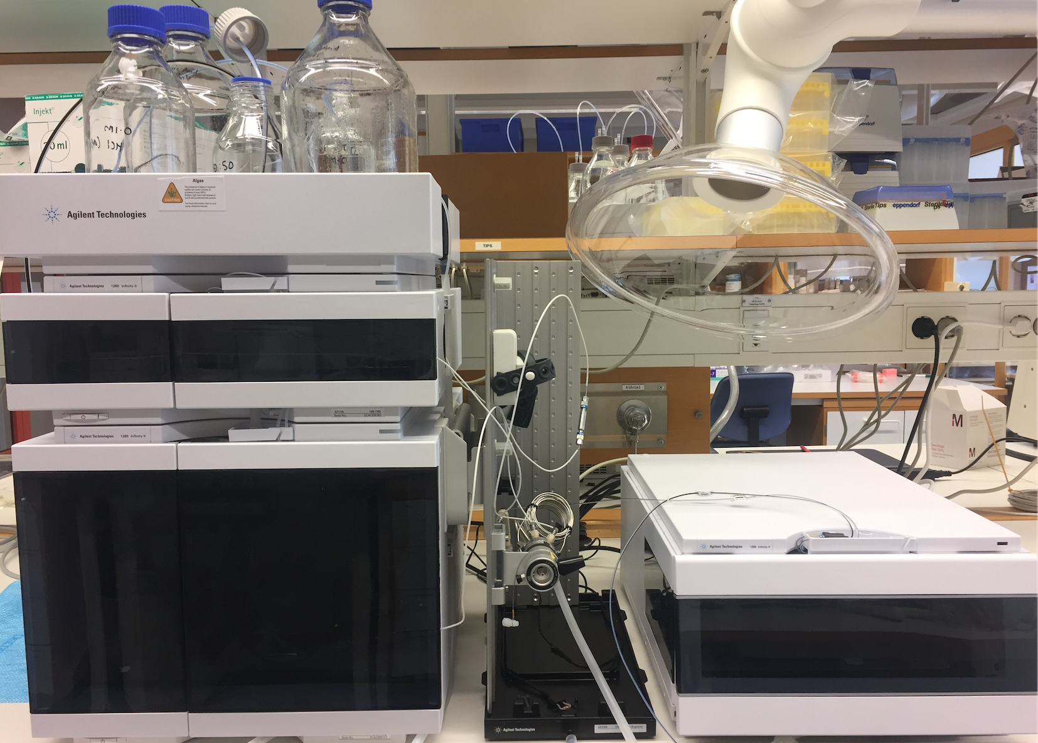
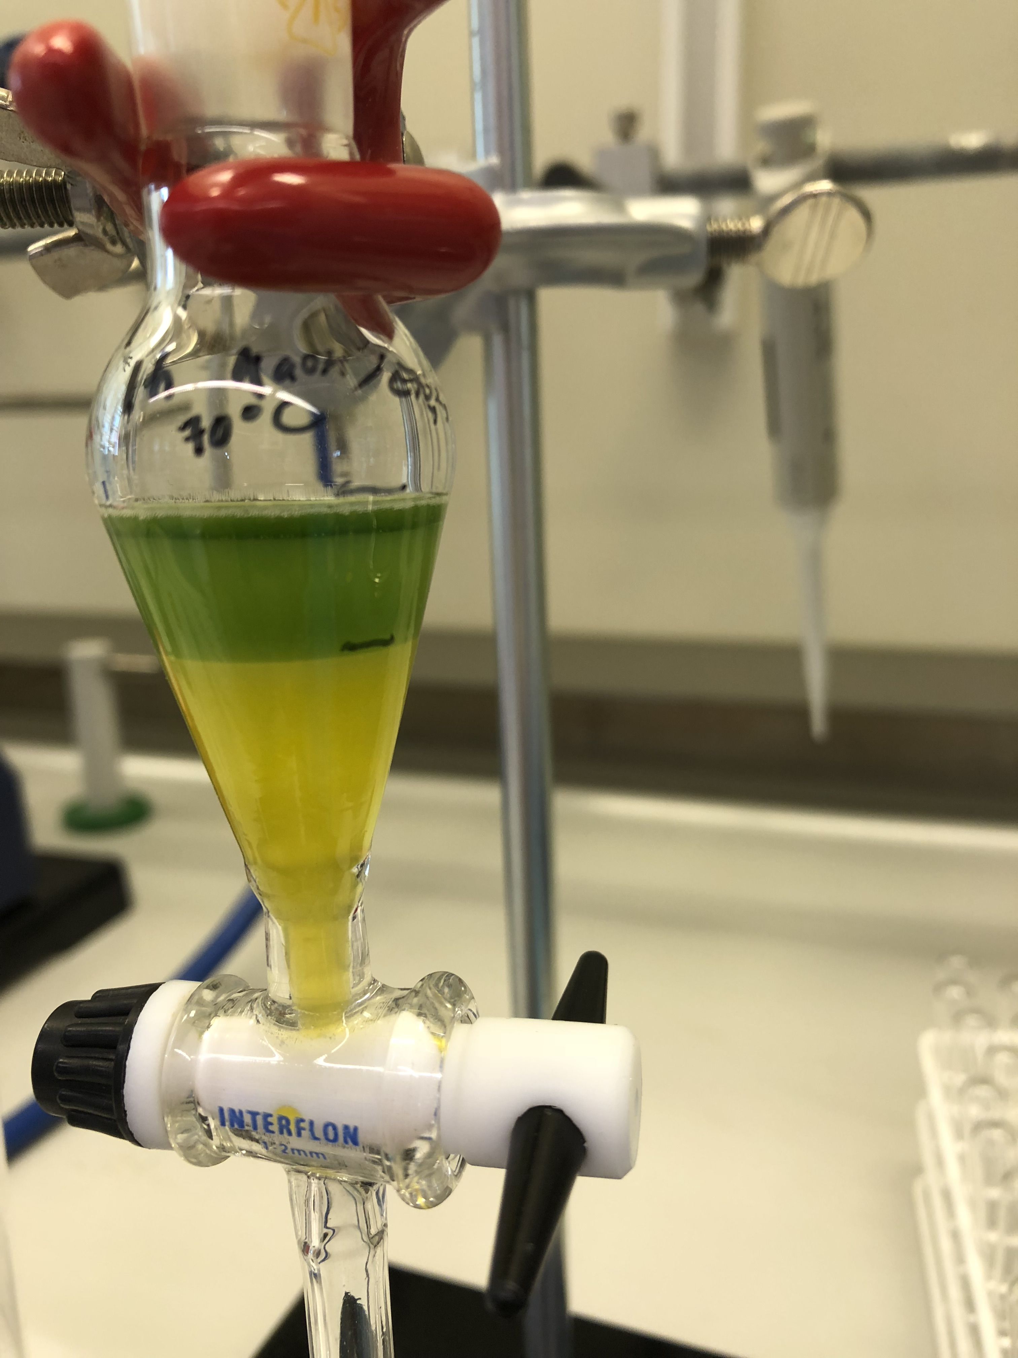
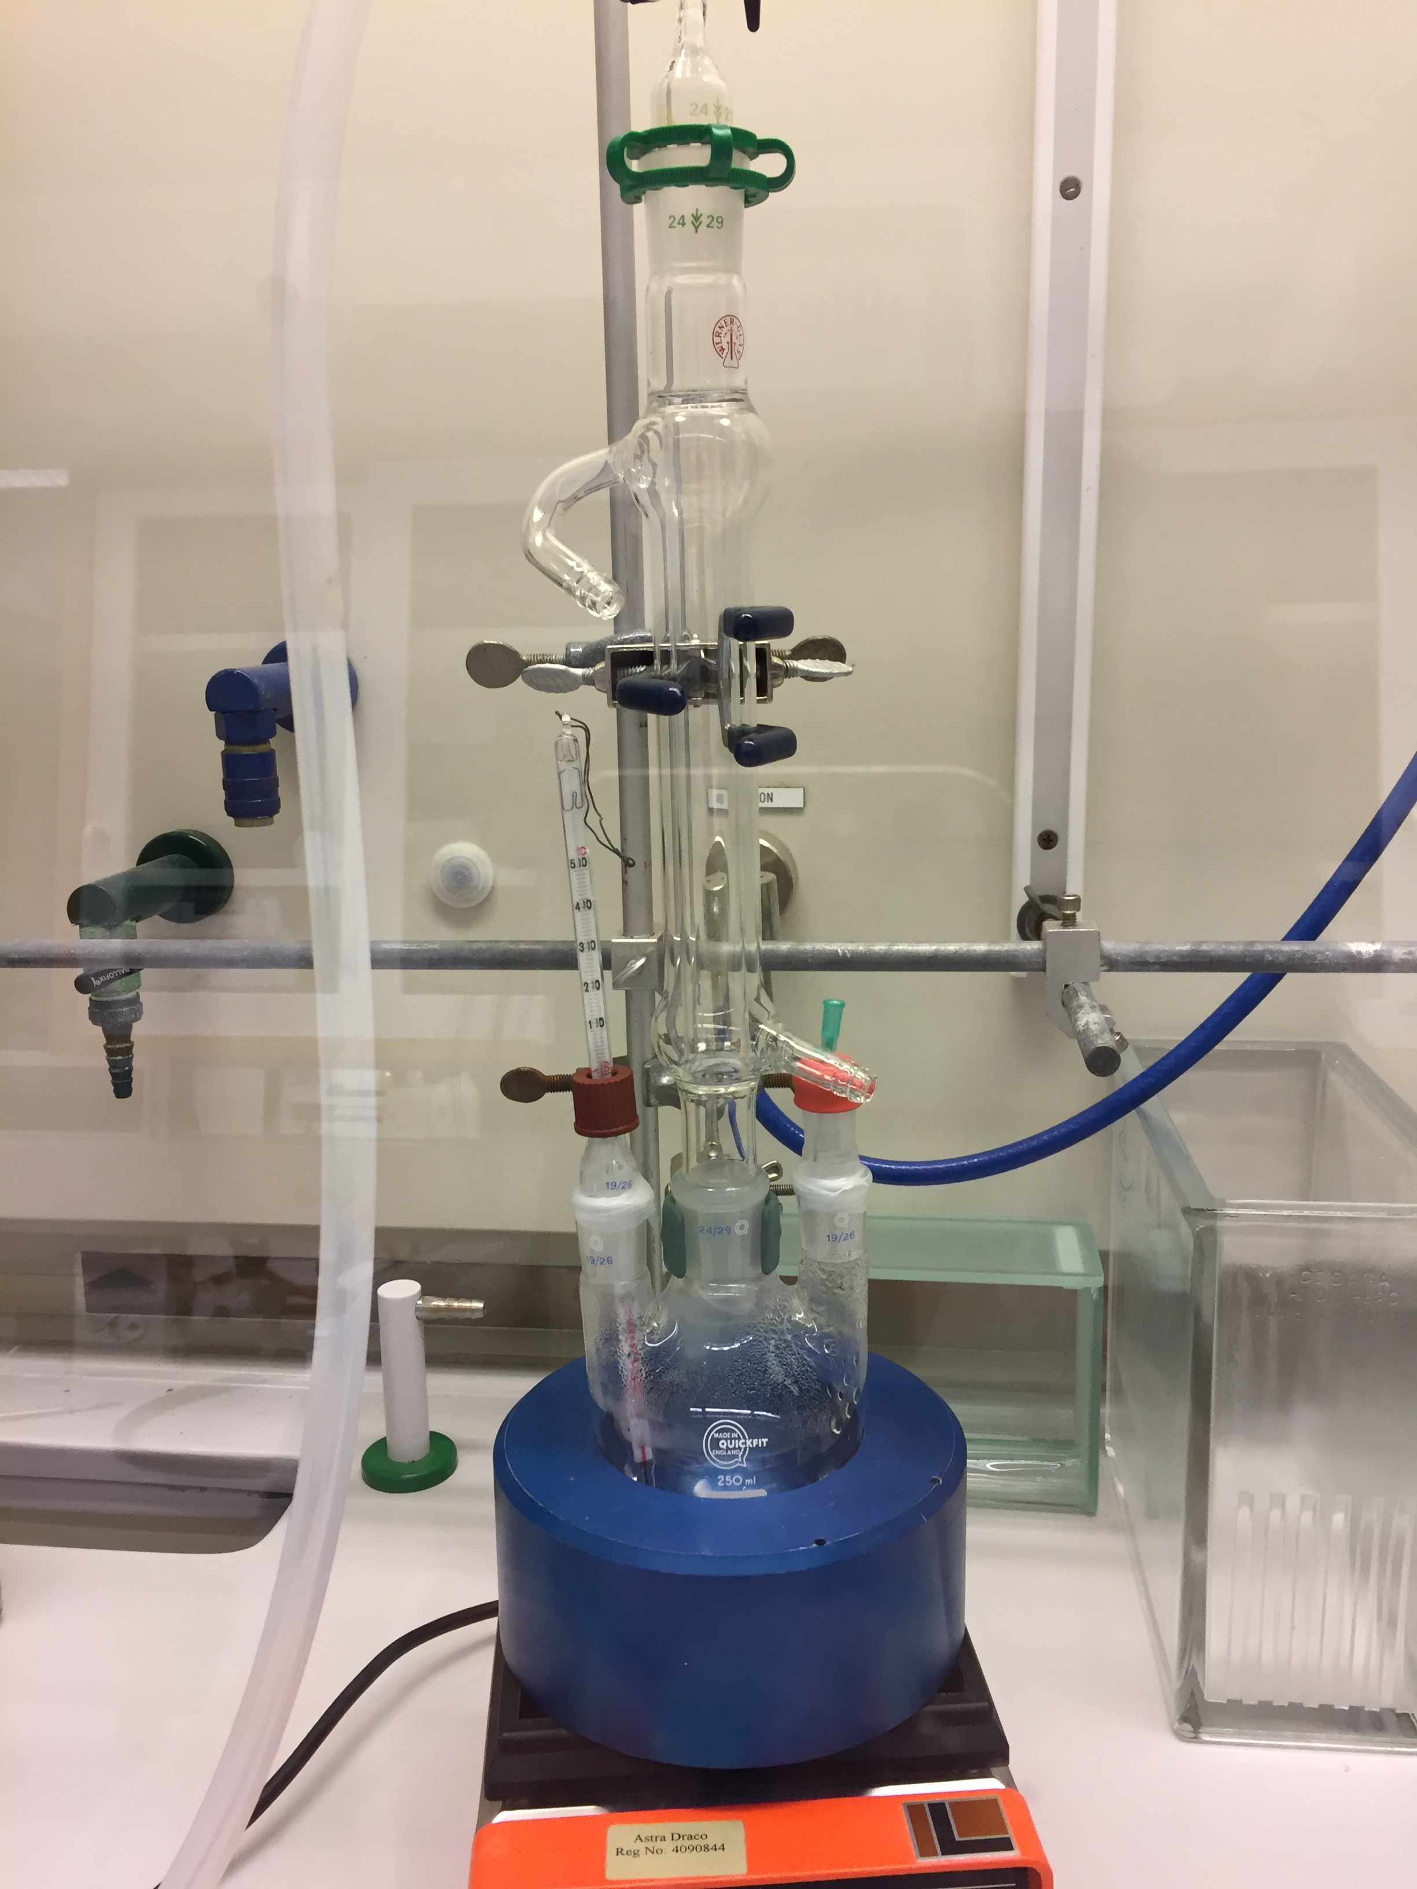
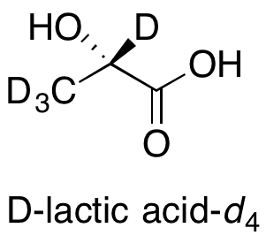
Chemical Deuteration
Leased space in MV
Functioning chemistry lab, essential equipment is in place for synthesis, separation, characterization
For some characterization needs (e.g. NMR, GC-MS) we have service arrangements with Red Glead & LU Chemistry.
Current capabilities:
Deuterated chemical synthesis using “standard” and enzymatic techniques; purification and analysis; lipid and other small molecule extraction/separation/ characterisation from biomass

Slide 5
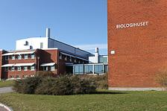
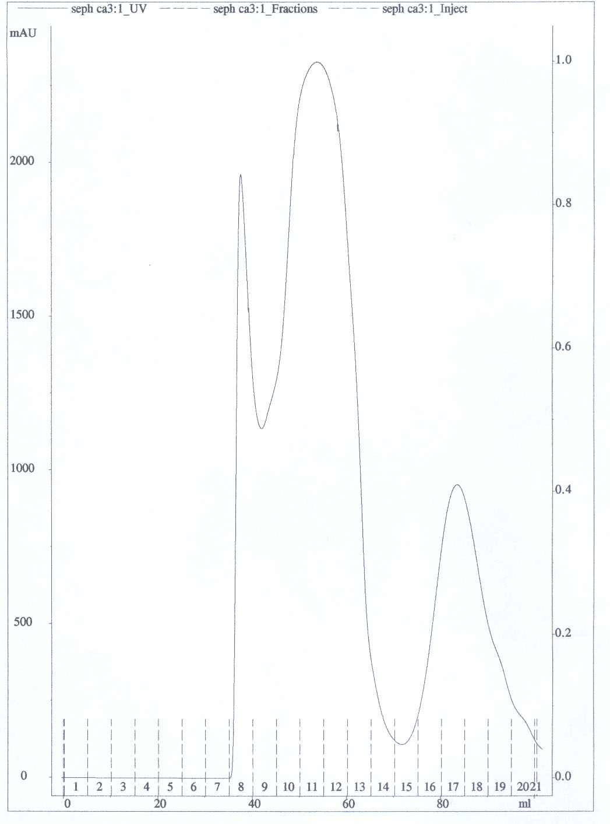
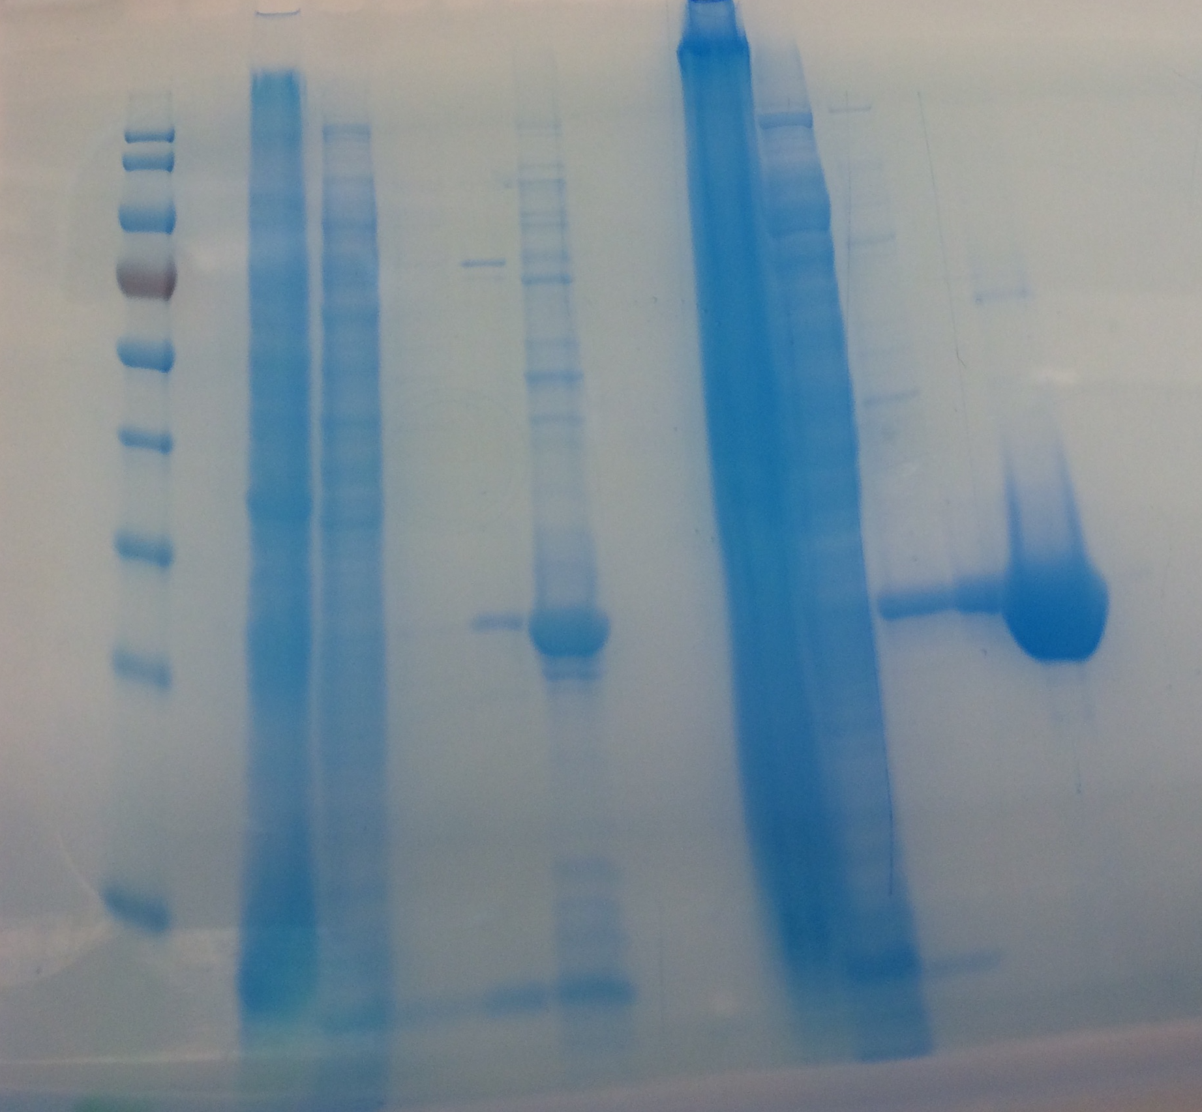
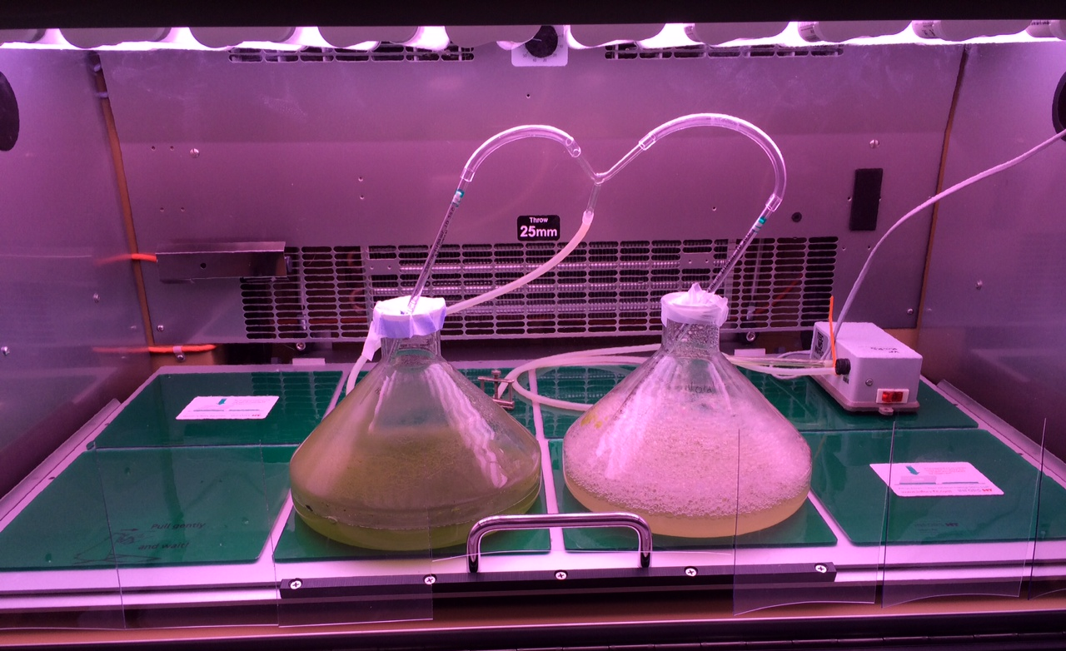
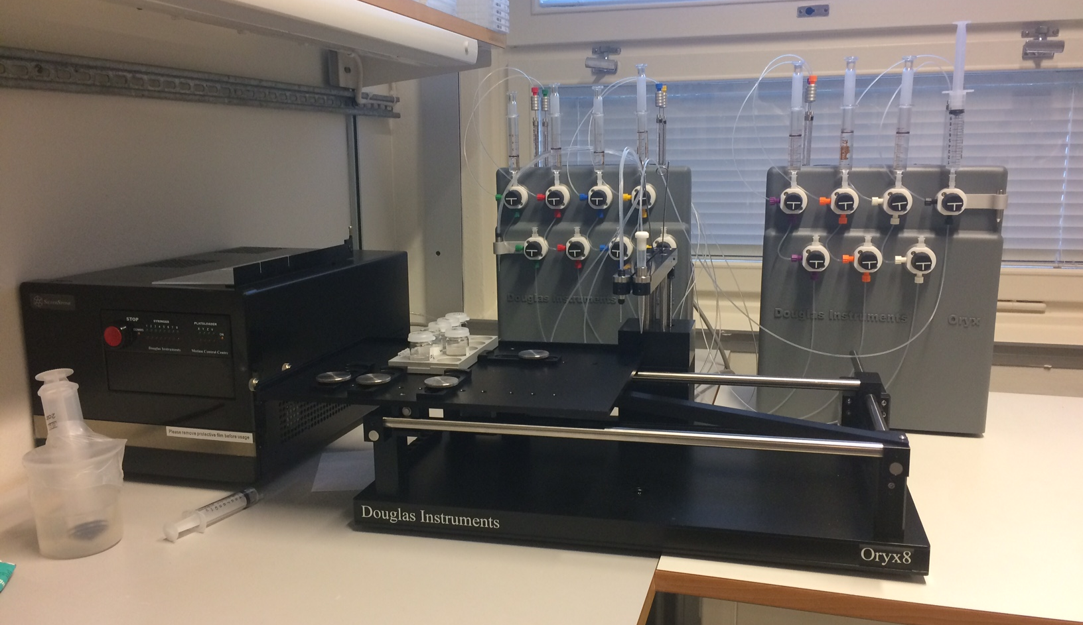
Biological Deuteration & Crystallization
Co-located with LP3 in Biology Department (LU)
Service agreement, shared tech
Essential equipment in place
X-ray screening/data collection at MAX lab; ESI-MS for D-incorporation measurements with Karolinska I.
Current capabilities:
Culture algae & bacteria in D₂O (yeast), deuterated biomass, protein purification, protein crystallisation (large volume); X-ray screening, biophysical characterization of labelled proteins.

Slide 6
DEMAX will accept service requests end of February 2019
We will issue our first call at the end of February
We will aim to service ~12 of the requests within a 6 month period
Limited capabilities so we can not take all proposals and not too difficult
Access will be granted on both Technical/Safety/Feasibility (internal) and Scientific Peer (external) review
Customer should demonstrate awarded beam time, draft beamtime proposal, or explain intention/plan to apply for beamtime

Slide 7
First round(s) of proposals
2019-2021 gives us 3 chances to run these pilot calls, positions us to support early scientific success for a number of ESS instruments entering hot commissioning in 2022.
Access is not limited to ESS member countries, scientific excellence should be the main objective (ESS access policy will be respected once in place).
*Free of charge to users, as we are growing and developing methods and expanding capabilities. (*S&H will be paid by users)
25 FEB – 5 APR | 5 - 19 APR | 19 APR – 6 MAY | 06-19 | 07-19 | 08-19 | 09-19 | 10-19 | 11-19 | 12-19
PROPOSAL SUBMISSION OPEN | INTERNAL REVIEW | EXTERNAL REVIEW & NOTIFY | IN PROG | IN PROG | IN PROG | IN PROG | IN PROG | IN PROG | WRAP-UP, MAIL OUT, REPORT
Call will go out via ESS website and community mailing lists
A survey will be sent out at the end of this pilot call

Slide 8
Non-commercial materials and services offered:
Deuterated bacterial cell paste
Purified recombinant proteins
Yeast-derived total lipid extract
Fatty alcohols/halides/thiols, lactic acid
Saturated fatty acids and oleic acid
Surfactants (e.g. sugar, amino acid)
Support for large crystal growth (large volume optimization in vapour diffusion & dialysis, temperature control, fine-screening and optimization)
If you ask for something we can not currently make, we collect the information as an ”expression of interest”.
This is very important for our future expansion and capability growth and keep us informed on the user community’s evolving needs

Slide 9
User office software
Supported by DMSC under direction of Tobias Richter (Gareth Murphy, Jeremias Hillerberg)
There is a working version with all the basic functionality in place
User registration, generate new proposal, fill in information, attach references/images/protocols, save and generate integrated PDF of the entire application for review
It will go live when calls is published

Slide 10
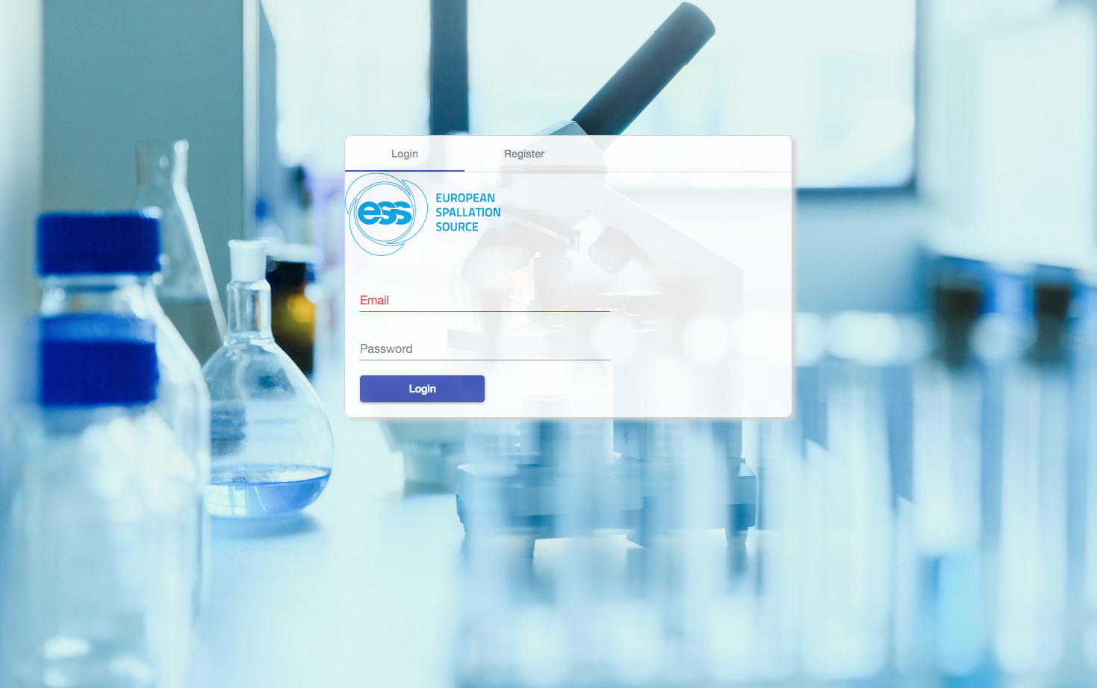
http://scicat02.esss.lu.se:8080/

Slide 11
Keep an eye on the dates and look for the announcement
Please spread the word within your community and networks
We encourage people to reach out to us BEFORE submitting a proposal
demax@esss.se
We look forward to hearing from you!
25 FEB – 5 APR | 5 - 19 APR | 19 APR – 6 MAY | 06-19 | 07-19 | 08-19 | 09-19 | 10-19 | 11-19 | 12-19
PROPOSAL SUBMISSION OPEN | INTERNAL REVIEW | EXTERNAL REVIEW & NOTIFY | IN PROG | IN PROG | IN PROG | IN PROG | IN PROG | IN PROG | WRAP-UP, MAIL OUT, REPORT

