Slide 1

Common Guide Shielding
Mechanical
Senad Kudumovic – Mechanical Design Engineer
13.02.2019

Slide 2
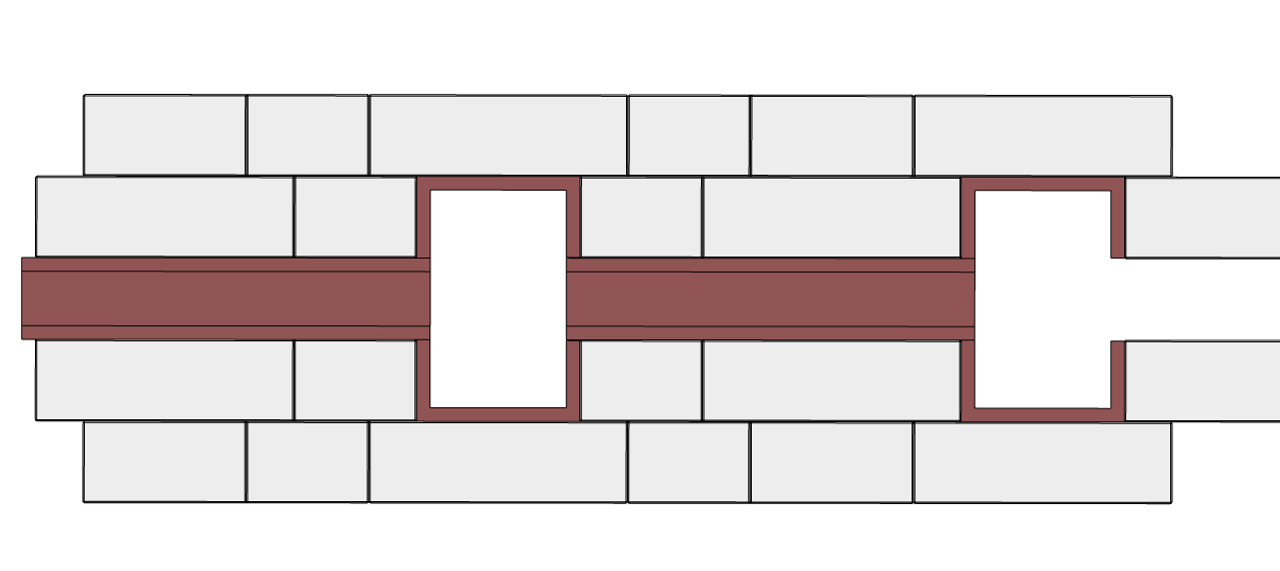
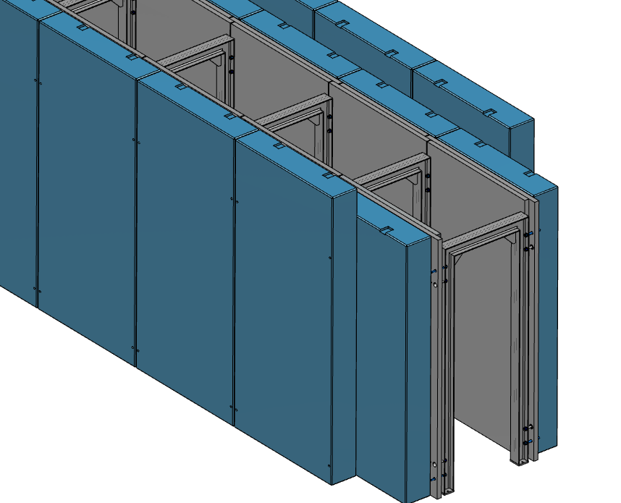
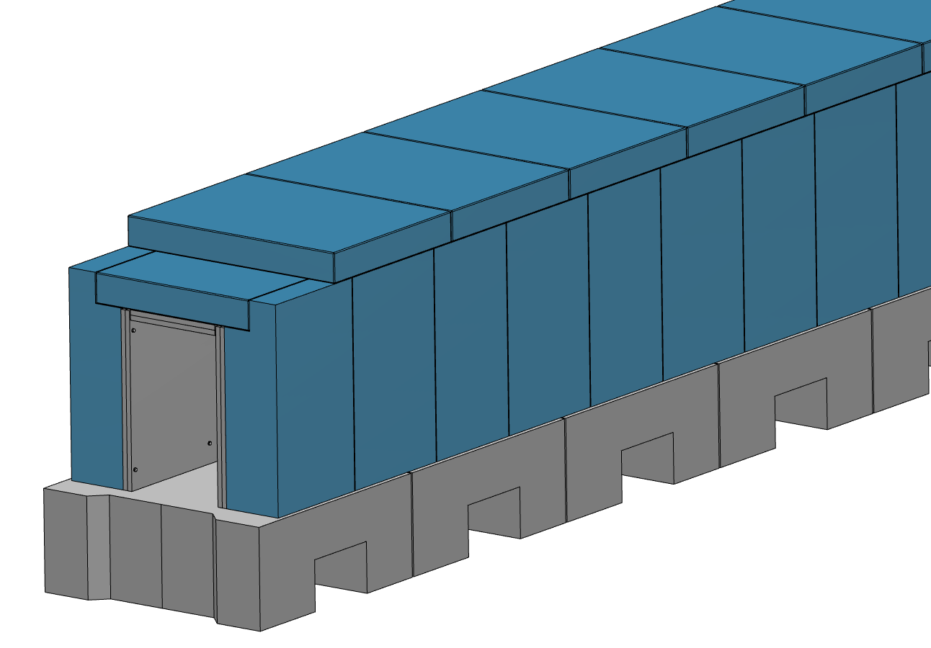
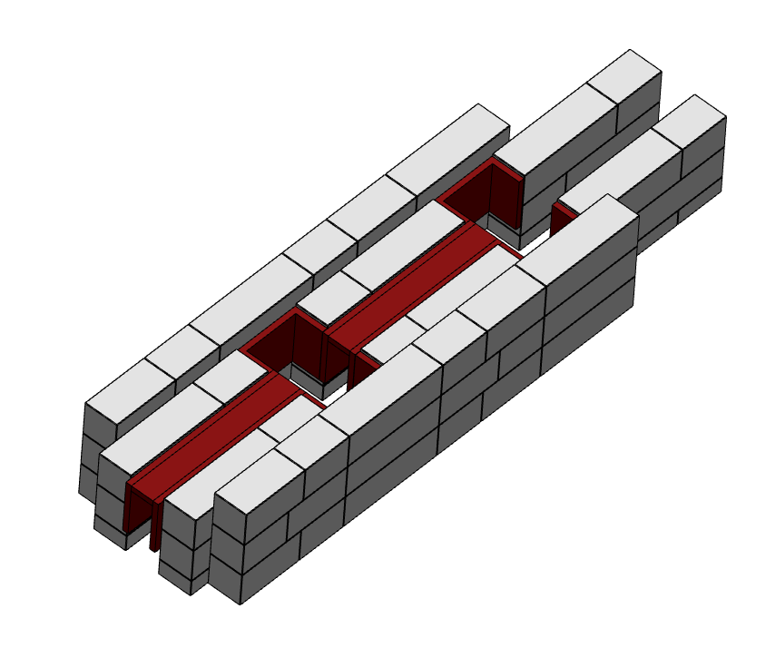
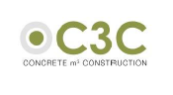
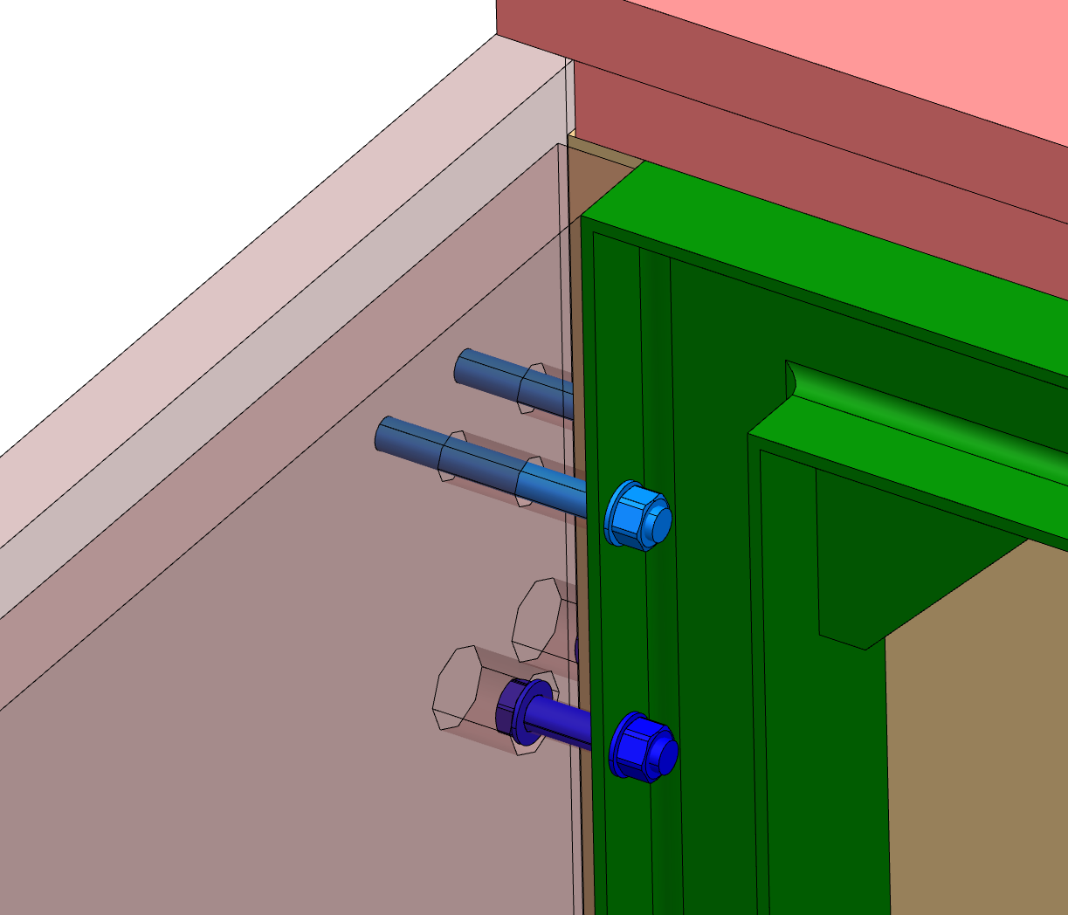
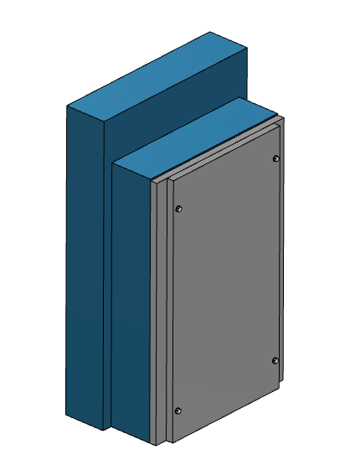
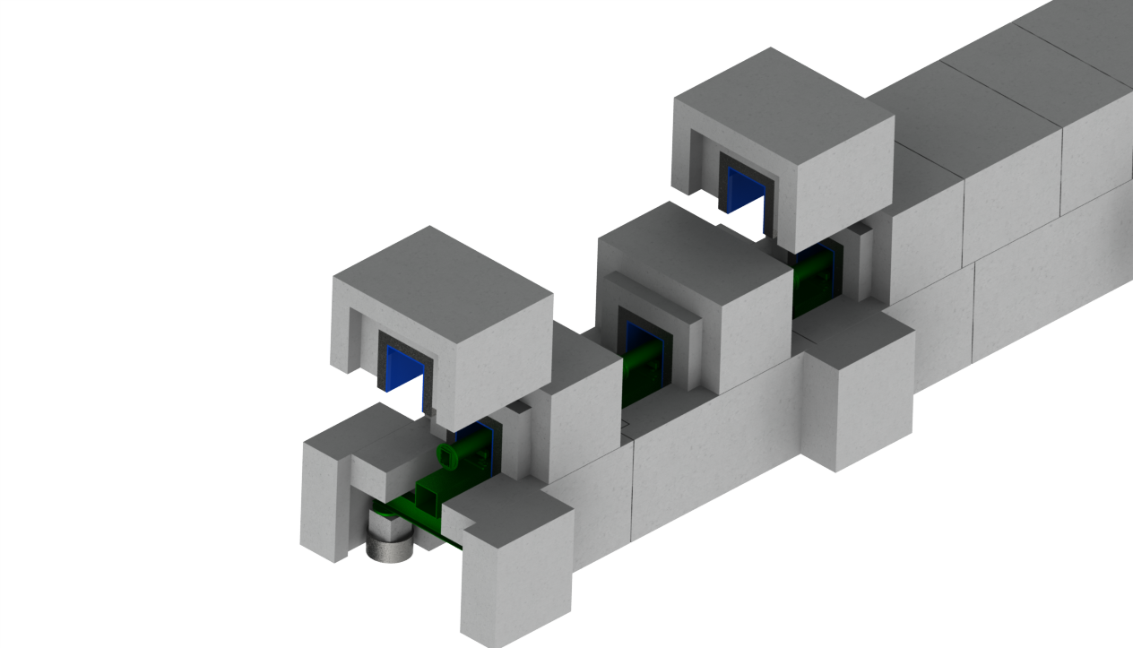
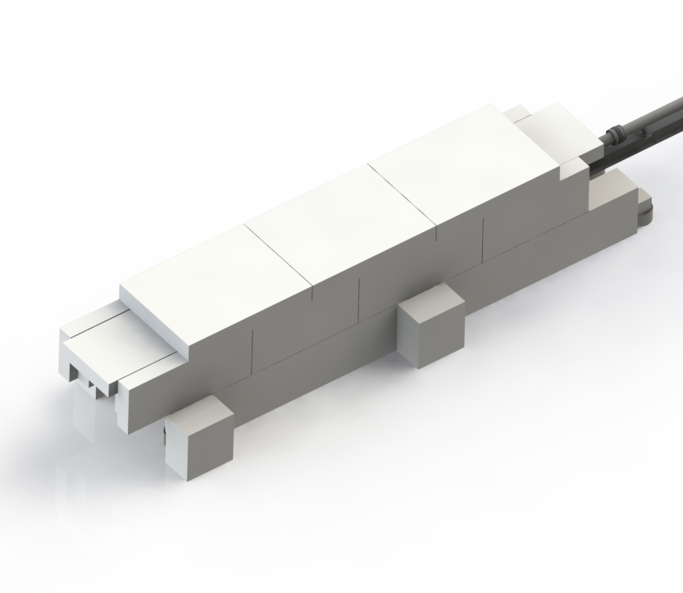
Shielding Evolution
Concept 1
Concept 2
Concept 3
Current Concept
Concept 4

Slide 3
Requirements
https://confluence.esss.lu.se/display/SPD/Instrument+shielding
Radiation:
  Safety requirement for environmental radiation
    Contact dose
    Dose contribution
  Instrument background requirement
Structural/Construction
  Eurocode 1: Actions on structures (EN 1991)
  Eurocode 2: Design of concrete structures (EN 1992)
  Eurocode 3: Design of steel structures (EN 1993)
Logistics
  Maximum Weight of a block: 5 ton (E02) – 10 ton (D01/D03)
  Maximum size of a block (volume): 3000 x 1500 x 1500 mm
Survey
  Easy access for the guide alignment features to verify position

Slide 4
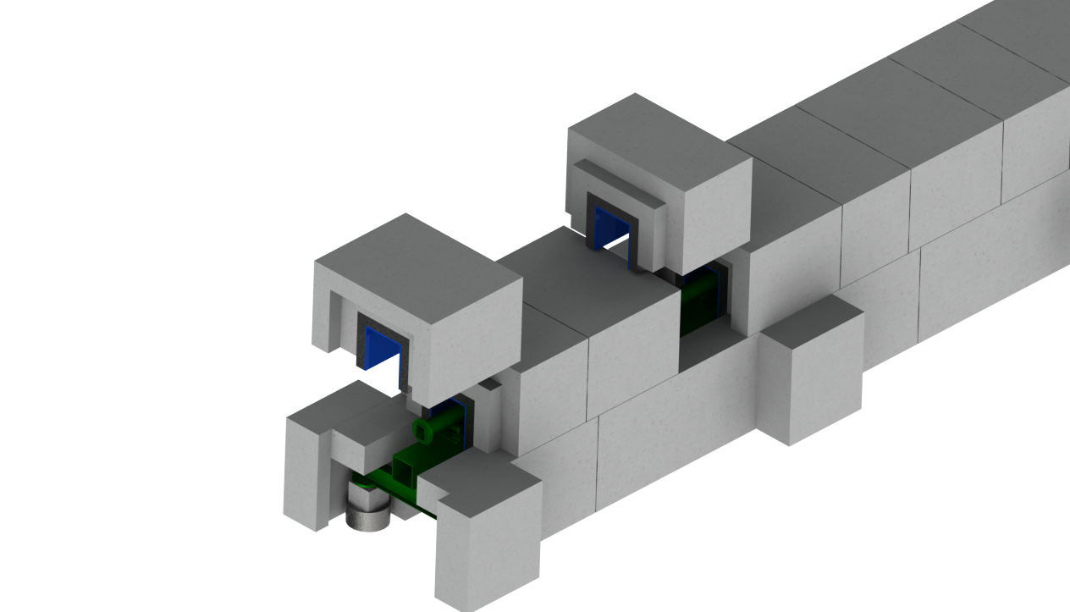
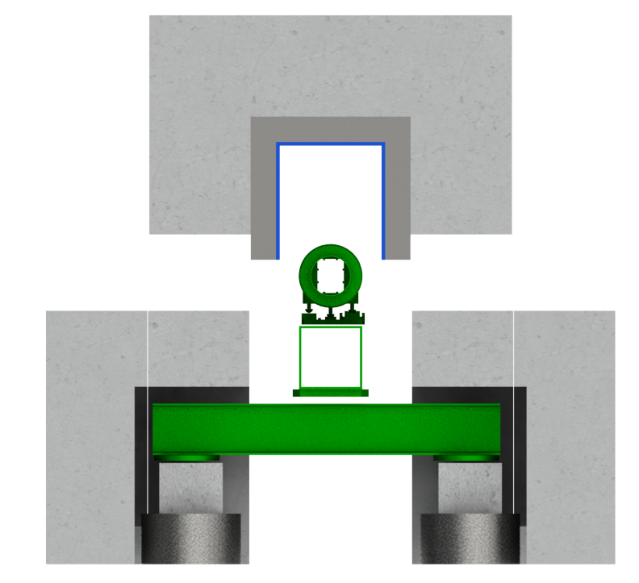
Structural/Construction
Designed to be installed / maintained
Shielding close to the instrument guide
Load affect minimisation
Lower shielding is static (not removed for maintenance)
Minimising load removal effects on miss/re/alignment

Slide 5
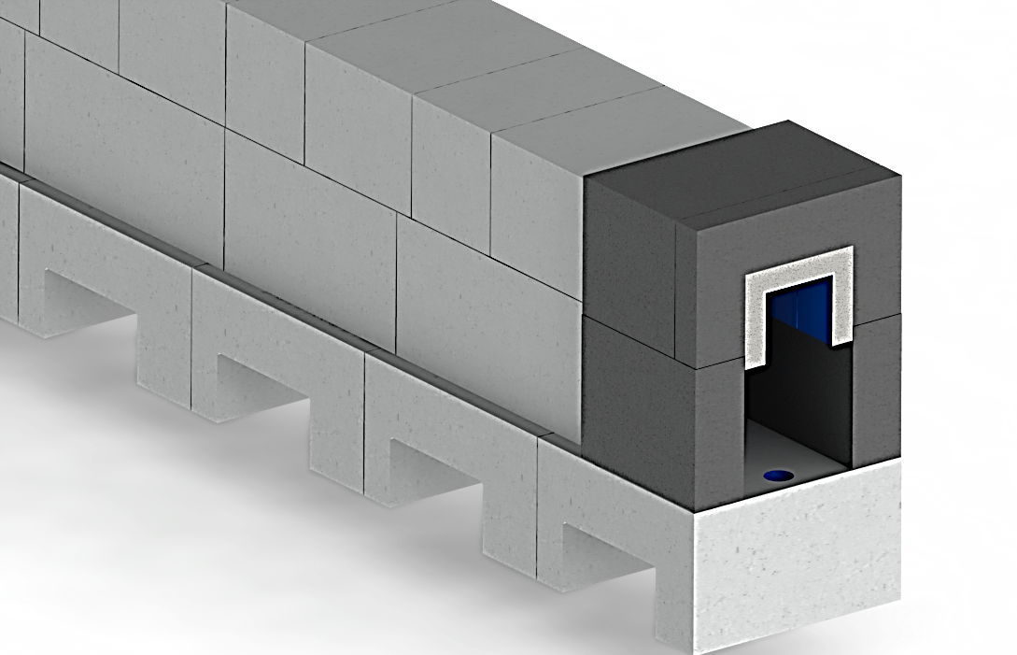
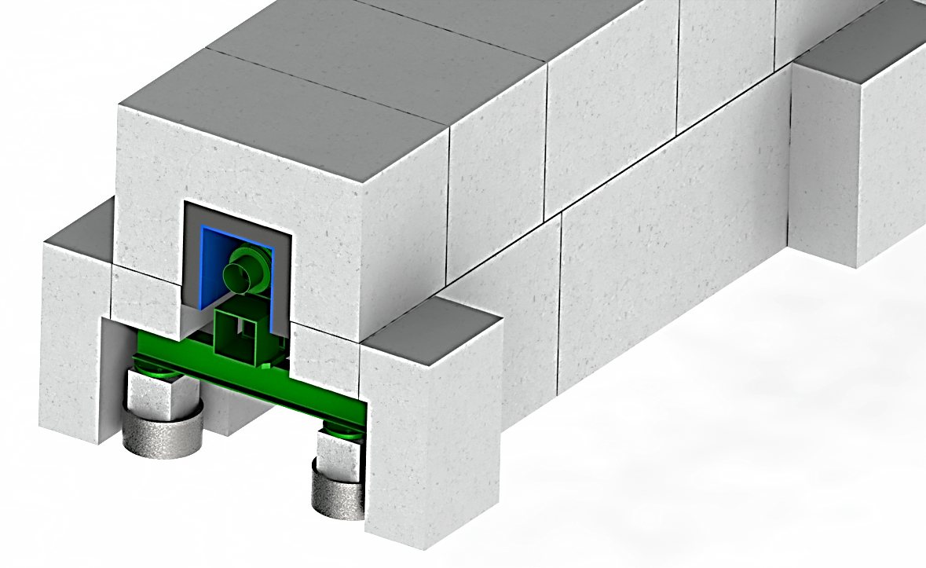
Structural/Construction
D01/D03 vs E02
E02
1 m
D01/D03
Identical upper shielding blocks at D01/D03 and E02
Simillar lower shielding blocks at D01/D03 and E02
E02
D01/D03

Slide 6
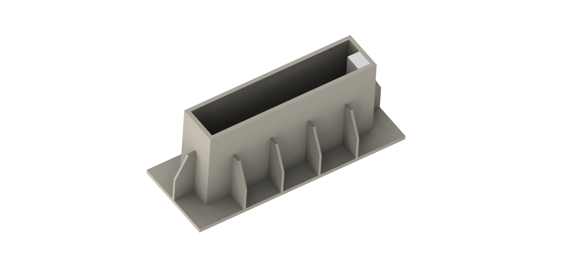
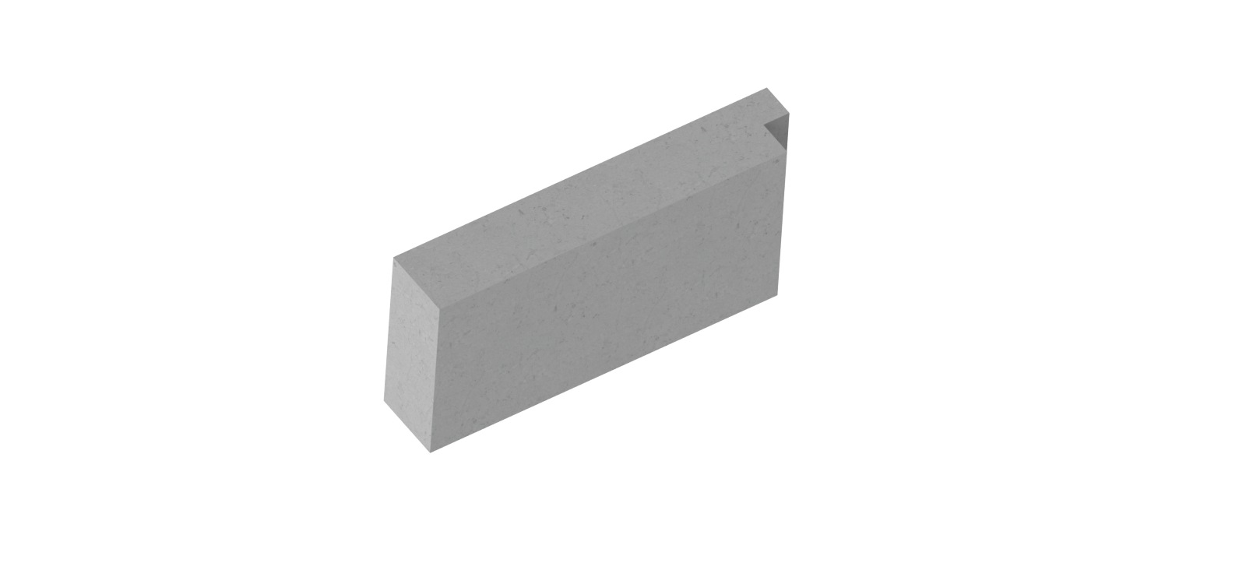
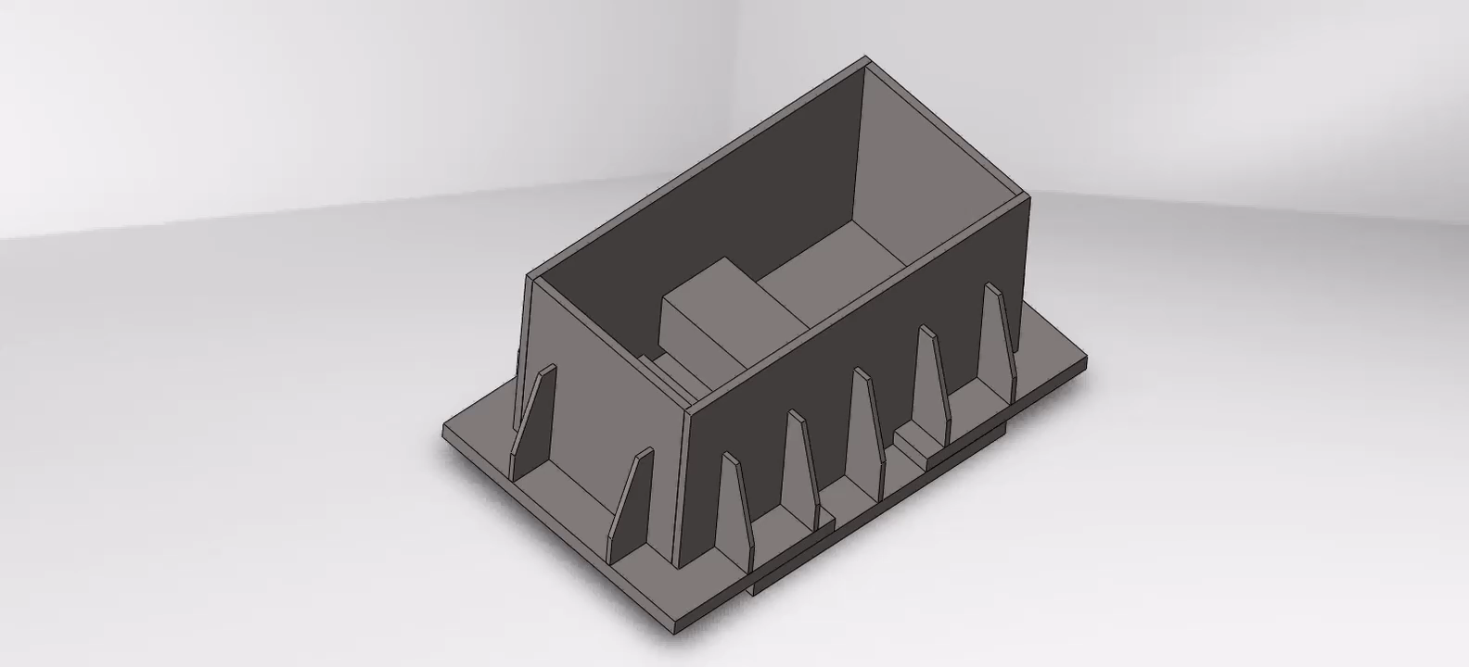
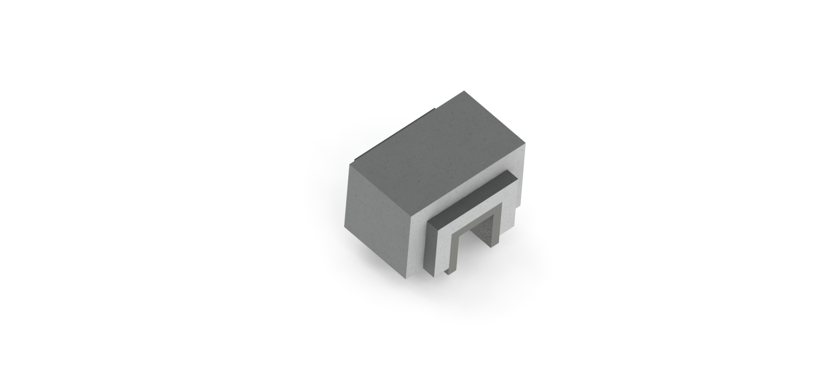
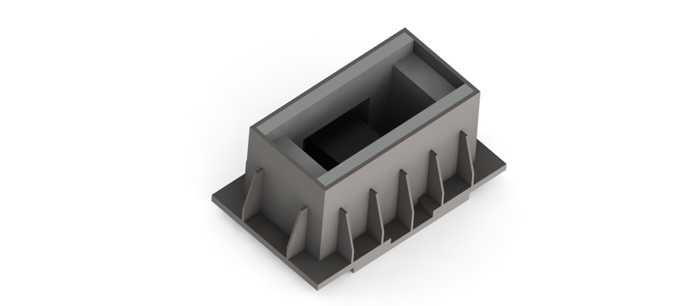

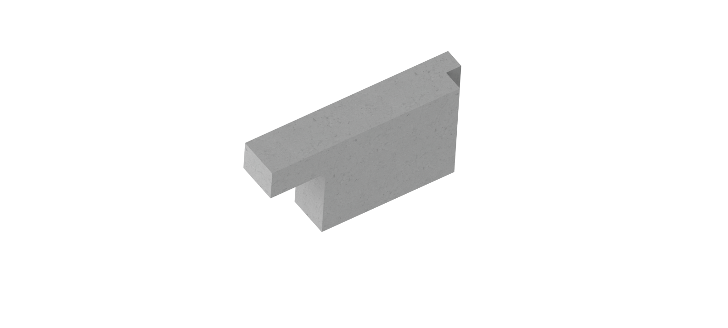
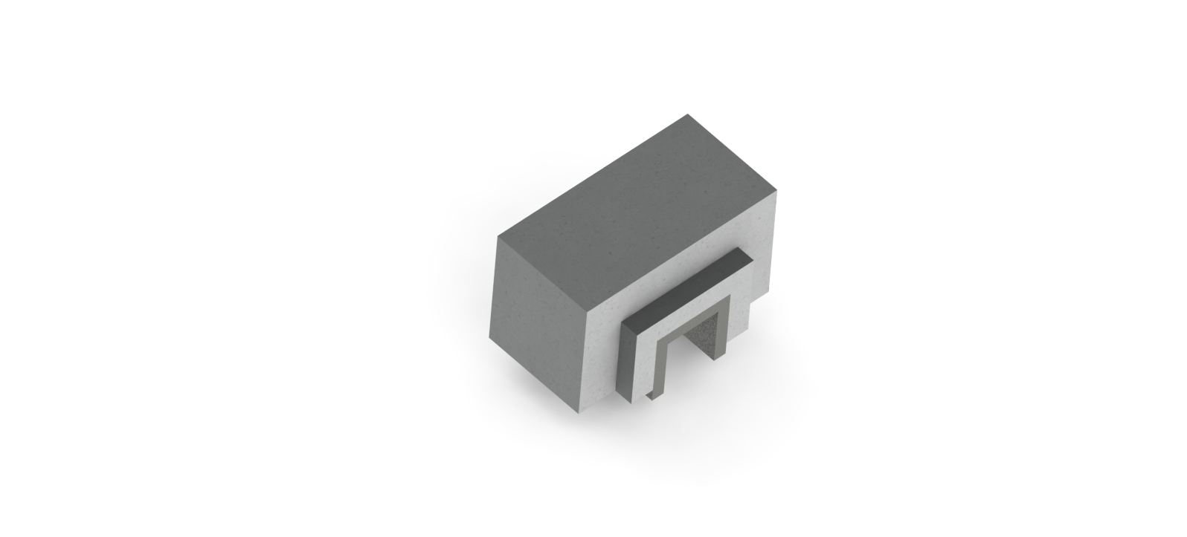

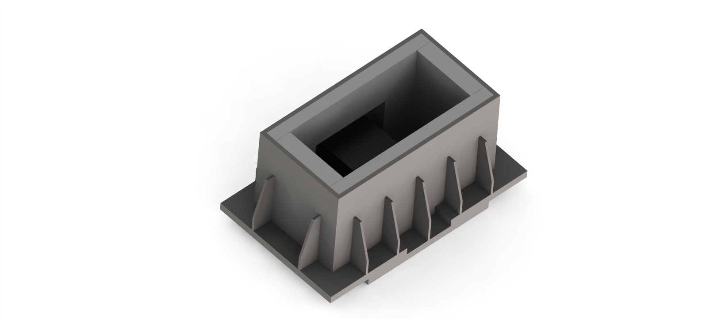
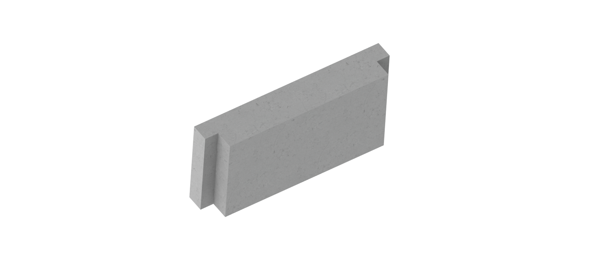
Structural/Construction
Same formwork – different blocks

Slide 7
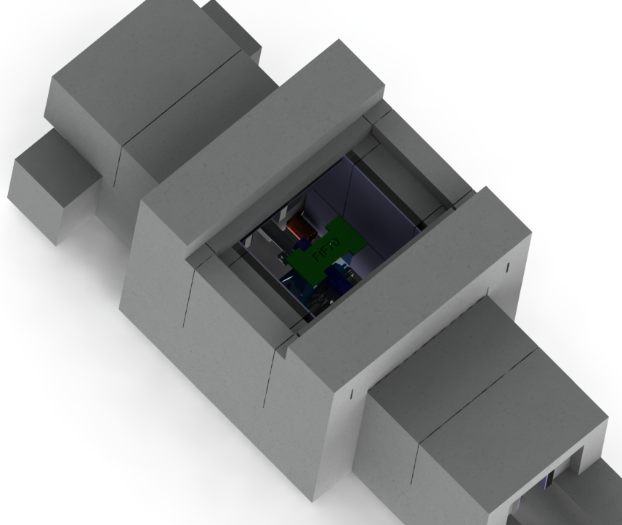
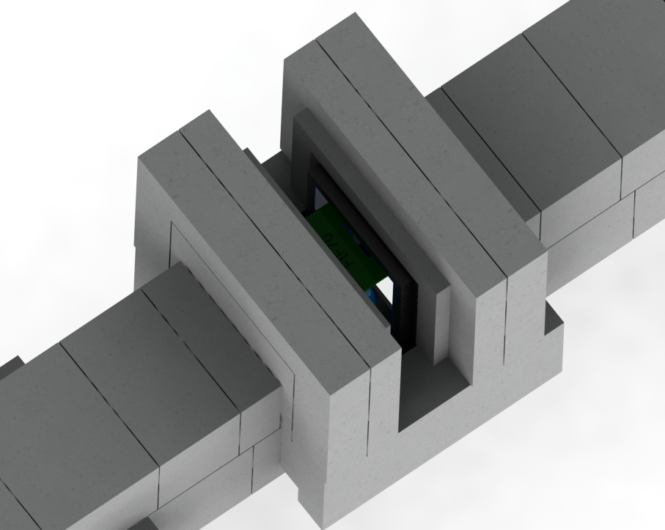
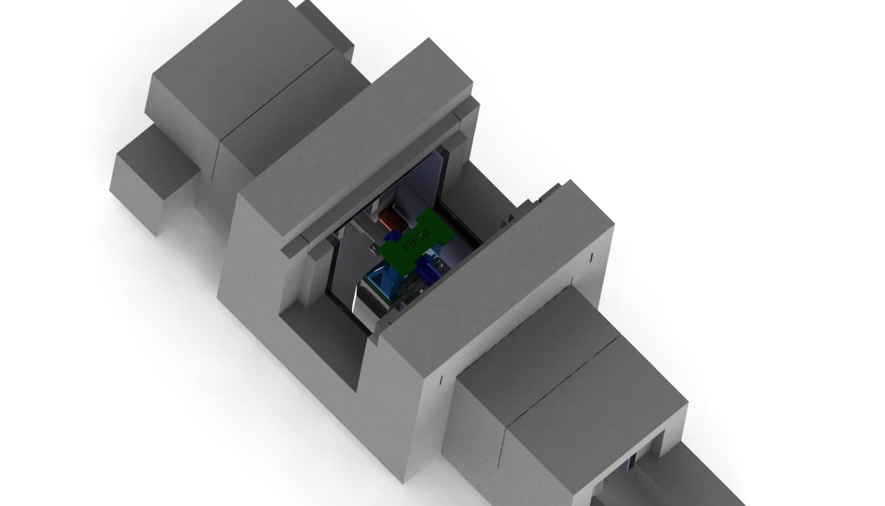
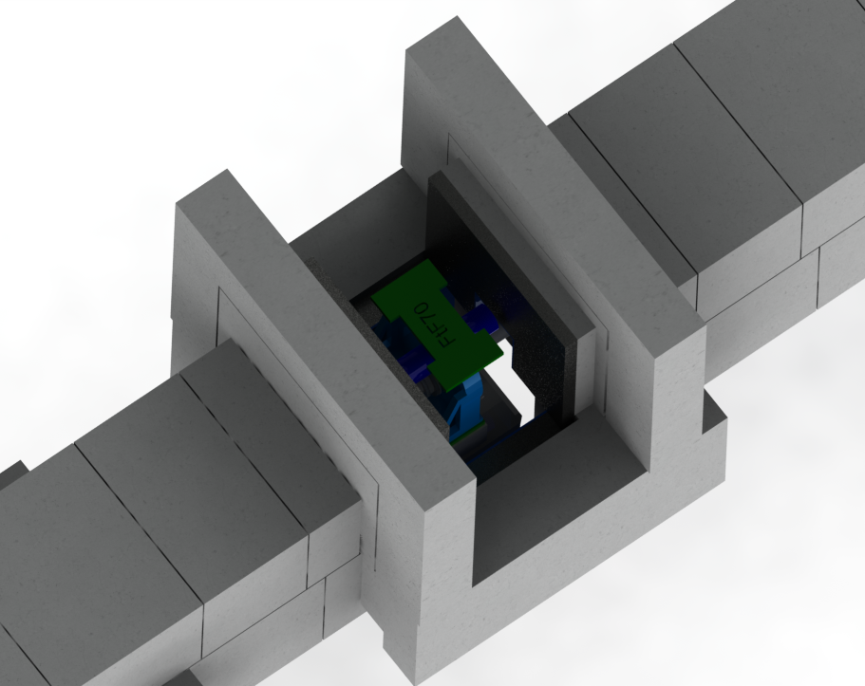
Structural/Construction
Chopper Pit
2 lifts for wide opening in the roof (≈1 m)
or
2 lifts for narrow opening from 3 sides (≈0,3 m)
4 lifts for full access

Slide 8
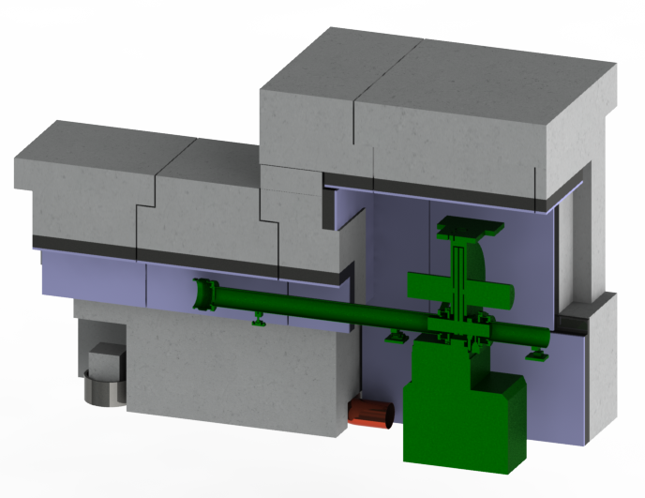
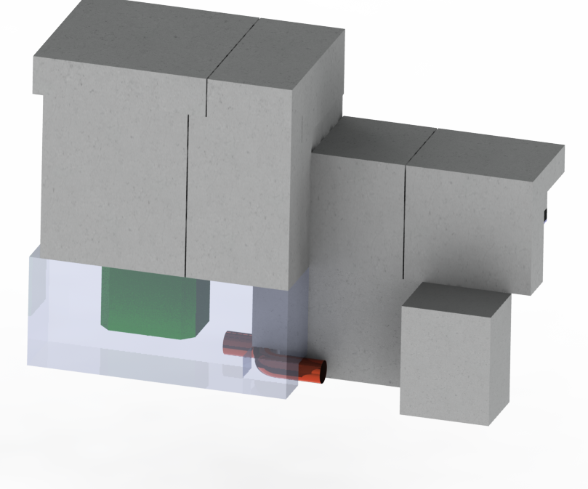
Feedthrough
Chopper Pit
Feedthroughs for a Chopper pits are intendent to be through the lower shielding. Opening is 250 x 250 mm which will allow installation of the feedthrough pipe Ø200 mm with bending radius 110 deg. (size to be checked and validated during detail design for each chopper with Chopper group).

Slide 9
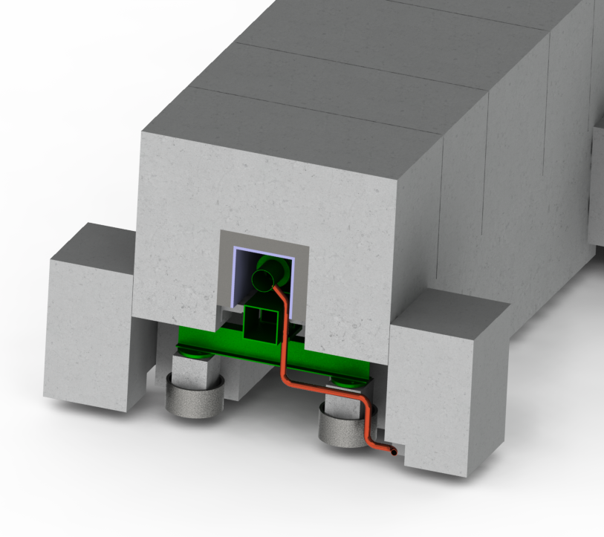
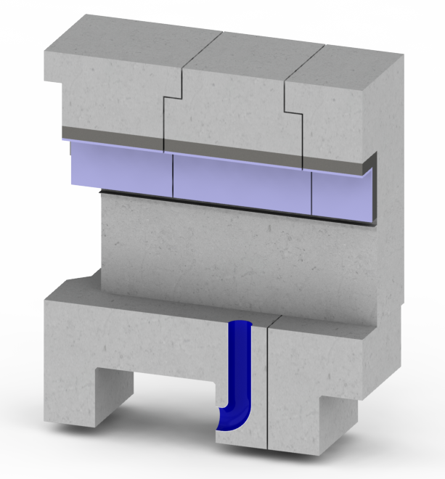
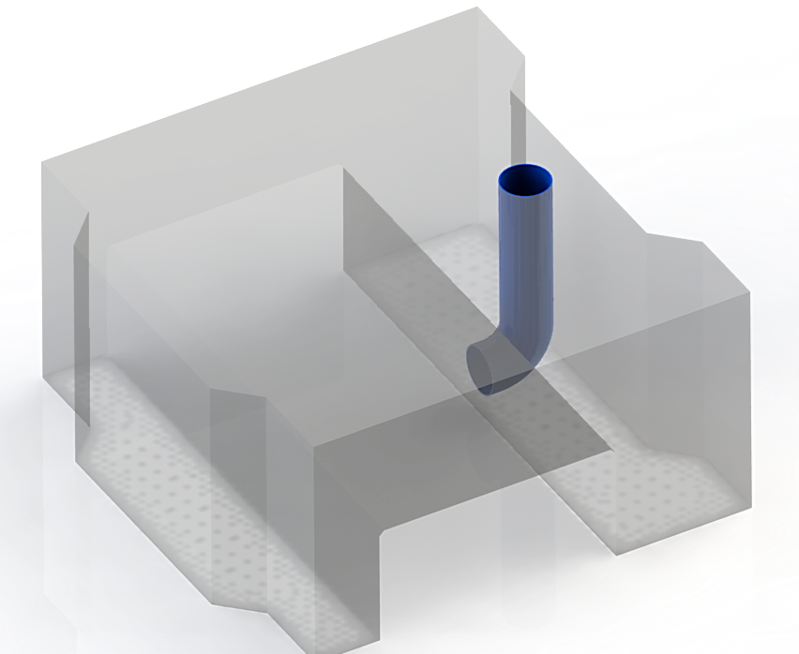
Feedthroughs
Vacuum Pipes
Feedthroughs for vacuum pipes inside the E02 portion of the shielding are intendent to be through the side blocks next to the piles. Current opening inside the side block is 150 x 150 mm. (to be checked and validated during detail design with Vacuum group)
E02
D01/D03

Slide 10
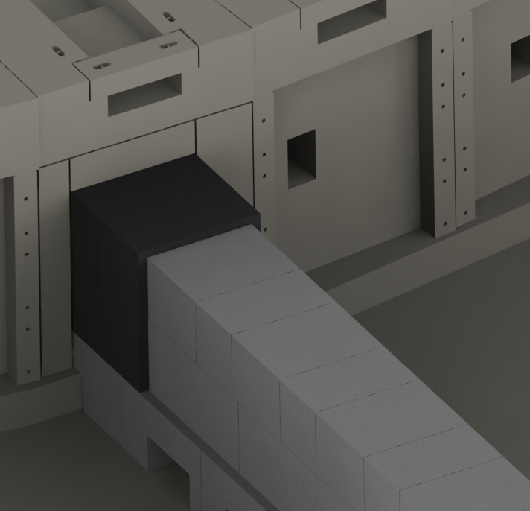
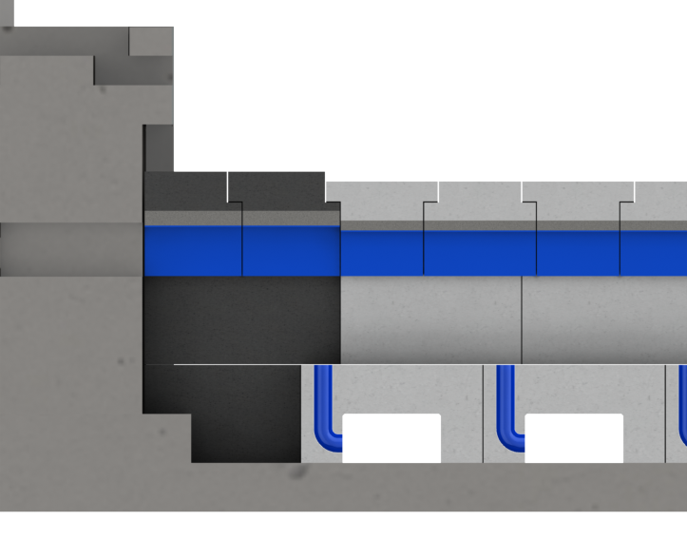
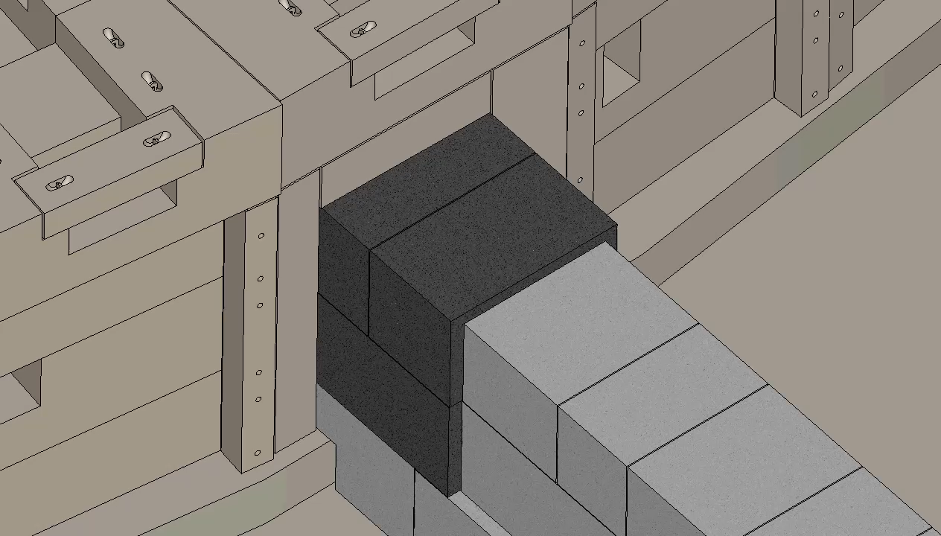
Interfaces
Bunker Wall
Customized heavy concrete panels around guide shielding connected to the bunker wall
3 Lifts to reach Bunker Guide Insert.

Slide 11
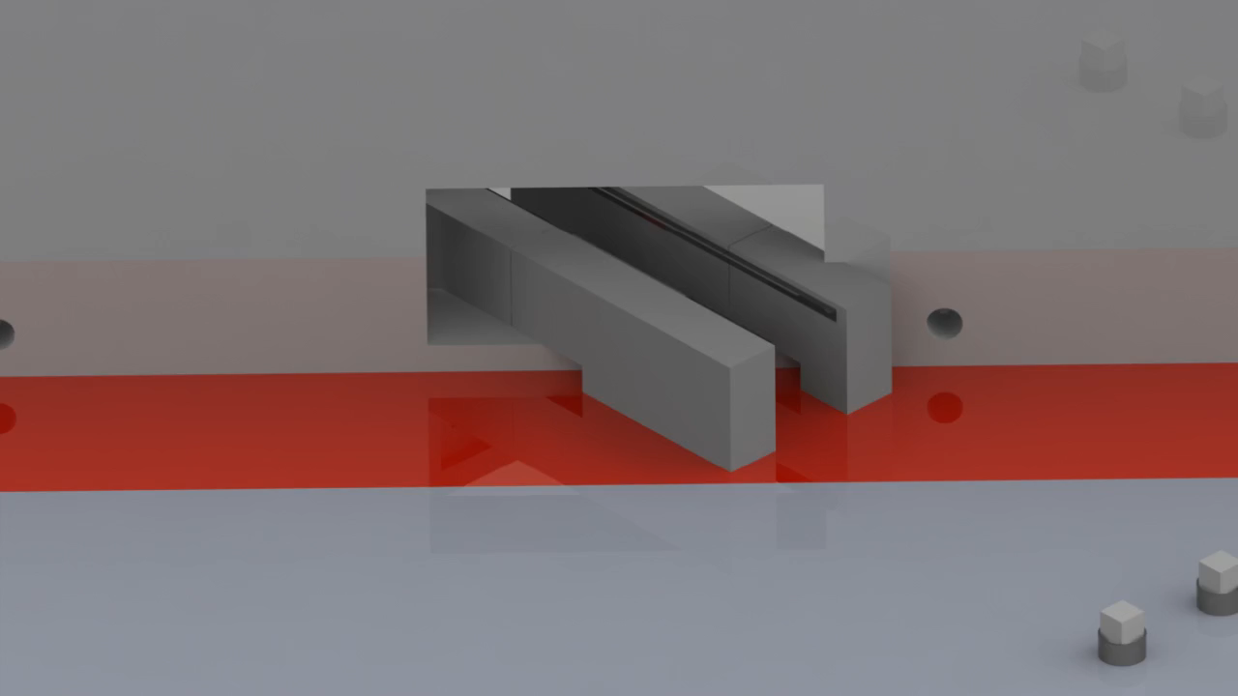
Interfaces
CF Wall
Guide shielding through and next to the CF wall will be bricked. Driven by that, alignment guide features should be far as possible from the CF wall meaning less lifts during realignment.
Two customized blocks outside the bricked portion of the shielding, reachable with cantilever spreader bar

Slide 12
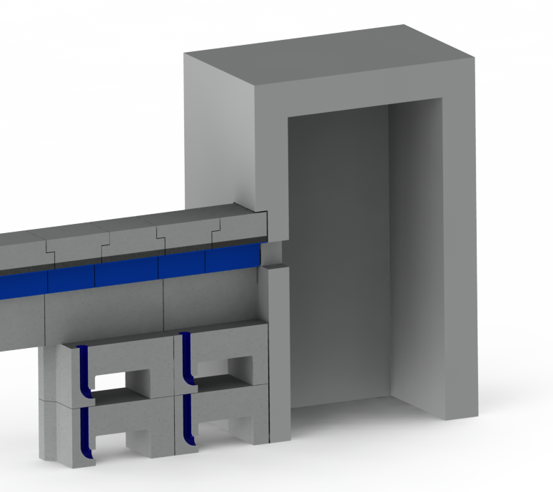
Interfaces
Caves
Cave interface to be defined in detailing phase in collaboration with cave designers. General plan is to have simple opening for guide shielding providing necessary chicanes.
Gap between E02 and E01 to be bridged using D01/D03 supporting blocks stacked in two levels

Slide 13
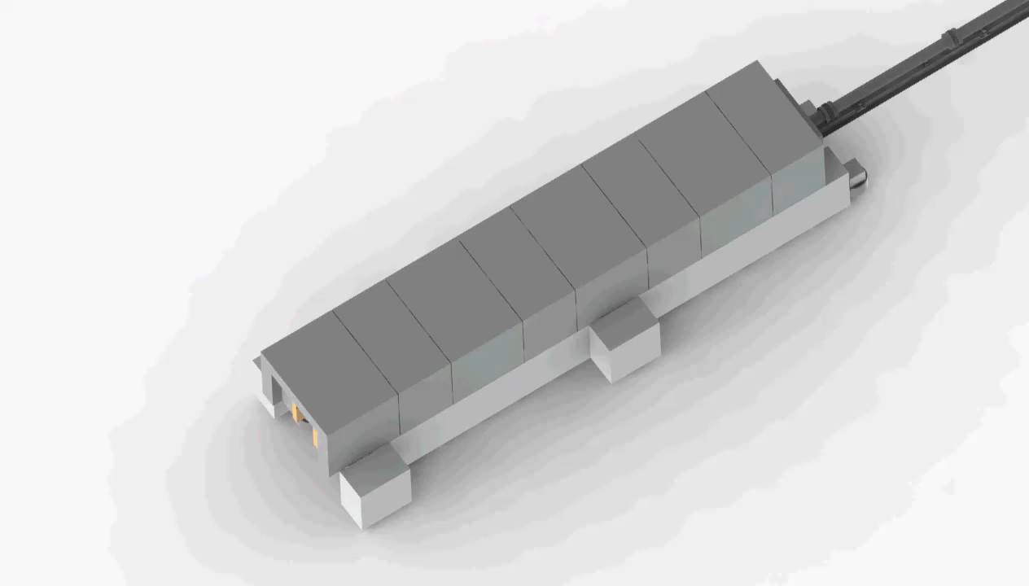
Survey and Alignment E02
Lifting optimisation
Blocks designed in a way to place
”pocket” blocks in line with the piles
Providing this, only ONE lift needed
to access alignment features
”extrude” block
”pocket” block

Slide 14
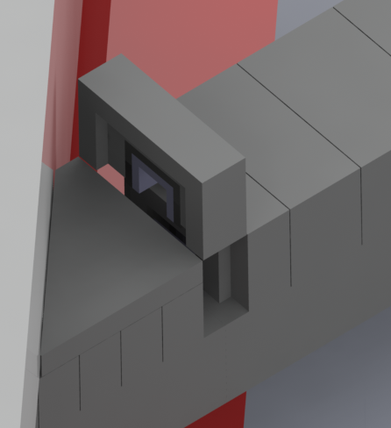
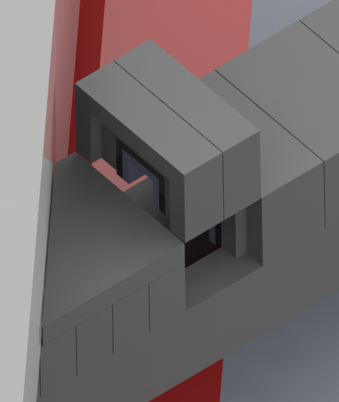
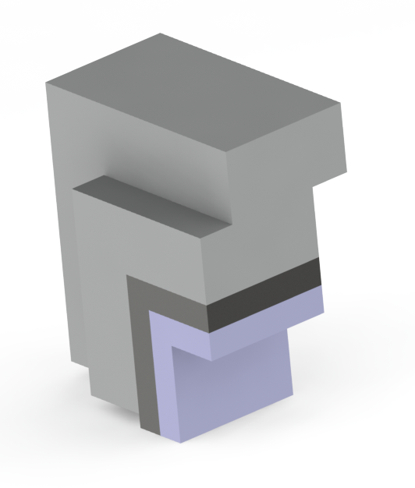
Survey and Alignment D01/D03 – E02
Lifting optimisation
Blocks designed in a way to place
”pocket” blocks in line with the guide alignment features
Providing this, one or two lifts needed
to access alignment features
”pocket” block
”extrude-pocket” block

Slide 15
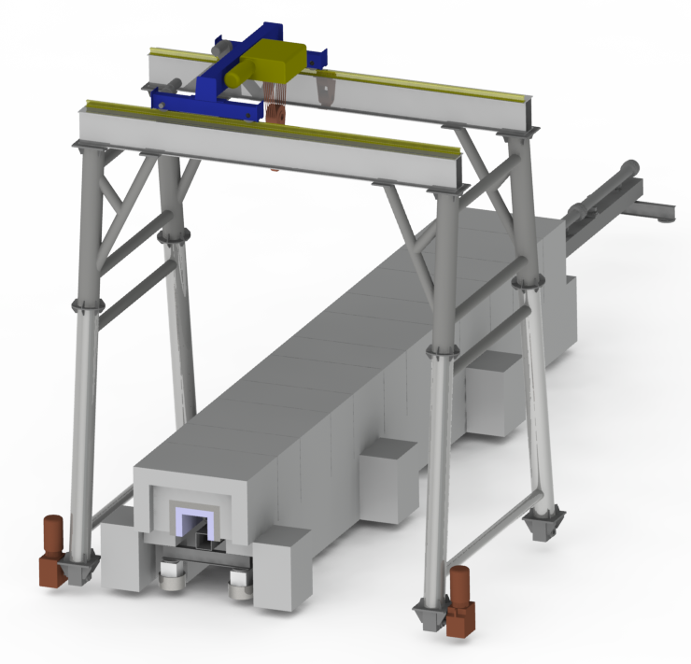
INSTALLATION

Slide 16
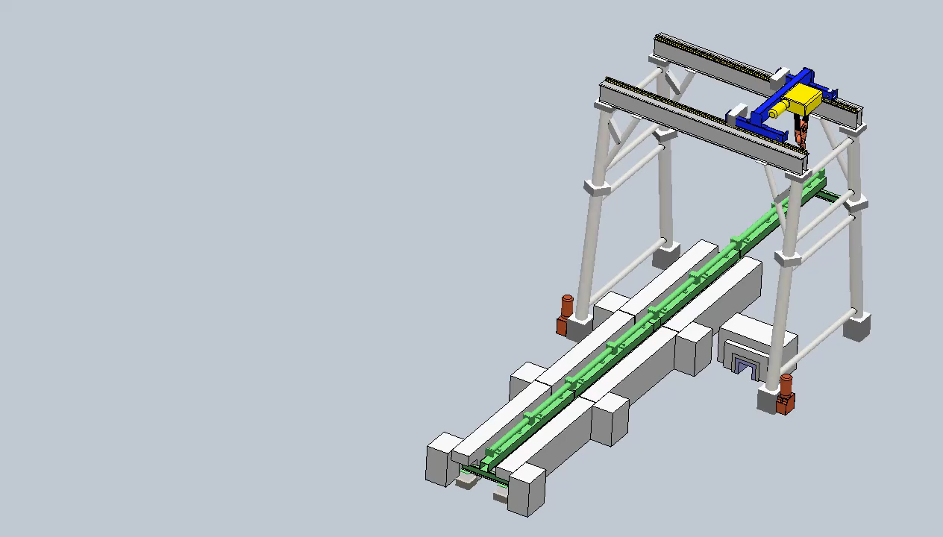
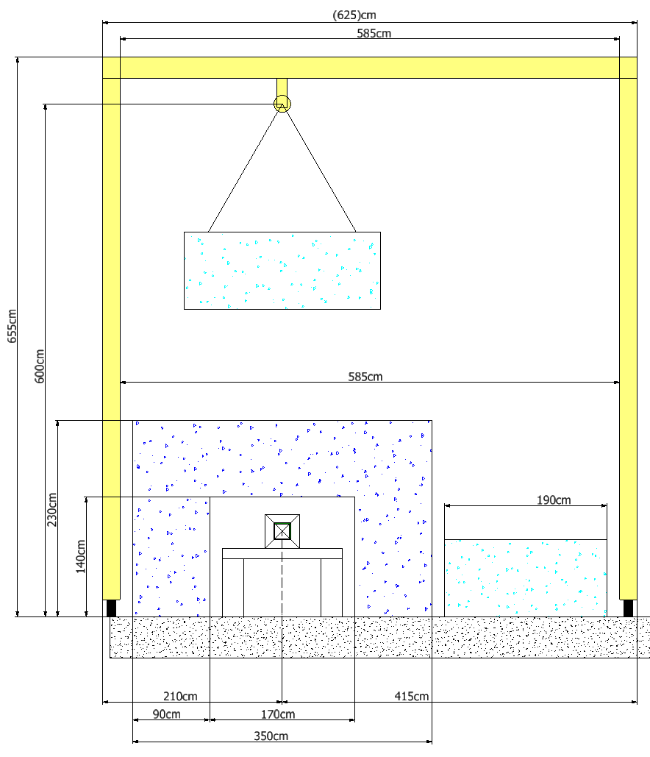
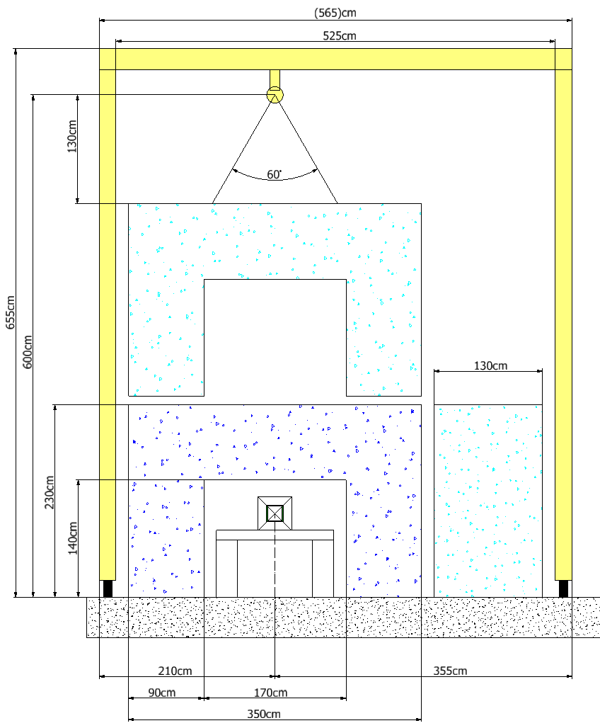
Installation
Easy and comfortable installation
Moving shielding blocks along the beam without rotation
Worst case and second worst case

Slide 17
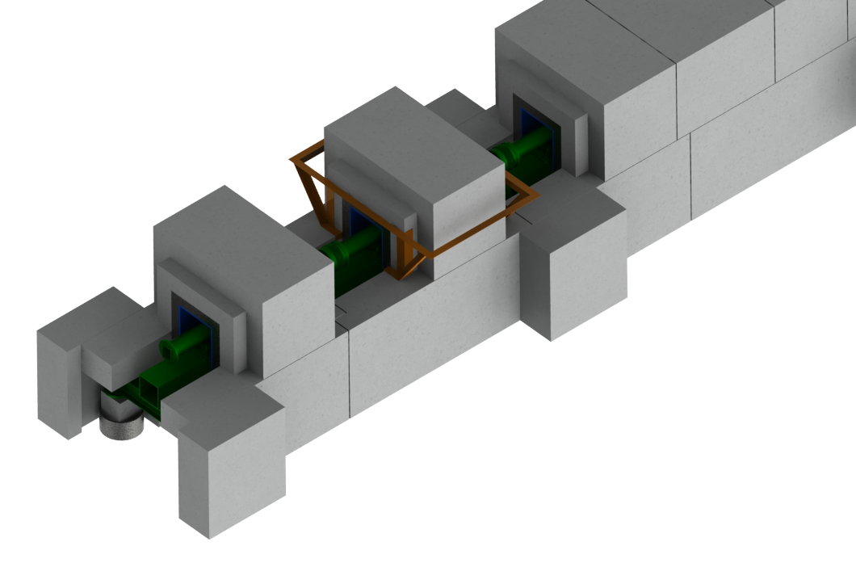
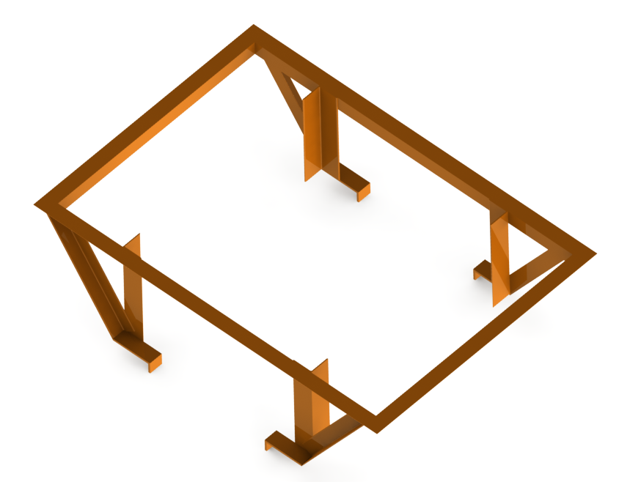
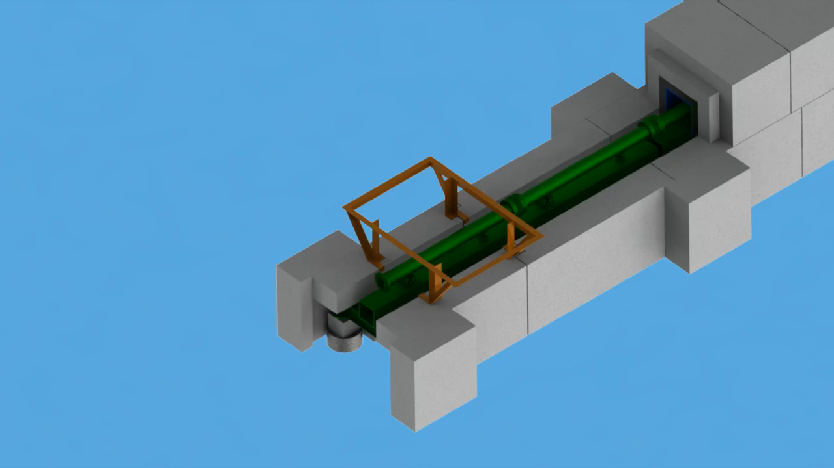
Installation
Positioning tool
Easy installation
Eliminating posibility of guide impact

Slide 18
Q/A
Thank you for your attention.
Questions?

Slide 19
Dimensions
D01/D03

Slide 20
Dimensions
E02

Slide 21
10 cm of steel + Concrete vs Concrete

Slide 22
Shielding Thickness
INSTRUMENT |  | 30 | 40 | 60 | 80 | 100 | 120 | 140 | 150 | 160
SCPEC | Steel | 75 | 75 | 70 | 50 | 45 | 50 | 55 | 60 | 100
 | No Steel | 115 | 115 | 115 | 95 | 80 | 95 | 92 | 100 | 130
 | Common Design | 75 | 75 | 75 | 50 | 50 | 50 | 60 | 60 | 100
BIFROST | Steel | 65 | 40 | 35 | 35 | 35 | 35 | 35 | 40 | 75
 | No Steel | 100 | 65 | 60 | 60 | 60 | 60 | 60 | 75 | 110
 | Common Design | 65 | 50 | 40 | 40 | 40 | 40 | 40 | 40 | 80
MAGIC | Steel | 70 | 70 | 70 | 50 | 50 | 50 | 50 | 50 | 80
 | No Steel | x | x | x | x | x | x | x | x | x
 | Common Design | 70 | 70 | 70 | 70 | 50 | 50 | 50 | 50 | 80
T-REX | Steel | See below |  |  | 50 | 50 | 40 | 15 | 40 | 80
 | No Steel |  |  |  | 90 | 90 | 70 | 50 | 70 | 120
 | Common Design |  |  |  | 50 | 50 | 50 | 50 | 50 | 80
DREAM | Steel | See below |  |  | 60
 | No Steel |  |  |  | 90
 | Common Design
ODIN | Steel (20cm) | 60 | 60 | 60
 | No Steel | x | x | x
 | Common Design | x | x | x
HEIMDAL | Steel (25cm) | 50 | 50 | 50 | 50 | 50 | EXPANSION ZONE
 | No Steel | x | x | x | x | x | x | x | x | x
 | Common Design | x | x | x | x | x | x | x | x | x
 |  | 2cm B4C – 10 cm of steel – 2cm B4C – 60 cm of concrete

Slide 23
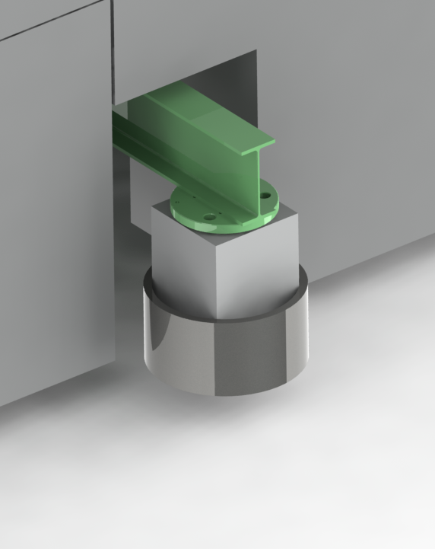
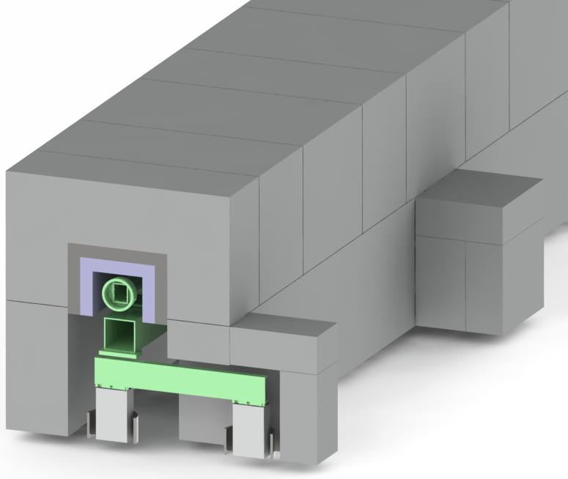
Out of Center Line

