Slide 1
Services and labs for LoKI
Andrew Jackson, Judith Houston, William Halcrow, Clara Ines Lopez, Jacob Cooper, Richard Heenan
IKON16

Slide 2
Services and Labs for LoKI - Content
Layout of secondary flightpath (computer hutch, experimental cave, sample preparation area), nearest chemistry laboratory
Sample preparation area/instrument specific lab or any area used to prepare the experiment on the instrument
“sample/sample environment flow” into/out of the experimental cave – how will you get something into the instrument and back out of it (e.g. provisions for sample cabinets, tables etc.)
Schematic layout of experimental cave (sample area) and important components for sample conditioning/handling (gas cylinders, heater etc.)
Incorporation of containment ventilation and possibly chemical ventilation

Slide 3
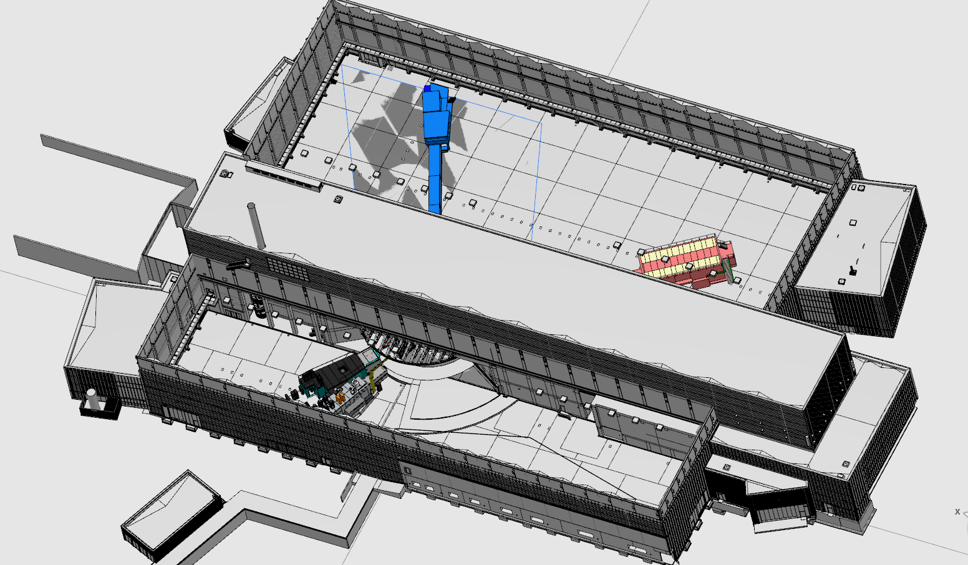
LoKI Instrument Hall Allocation: D03 – N7
Chemistry laboratory:
Building D04 has a general chemistry labs with preparation and characterization possibilities
LOKI will make use of those for sample preparation
LOKI only needs a sample handling area at the instrument and potentially a gas cylinder cabinet (chemical ventilation) to keep flammable gas cylinders for flow experiments (containment ventilation)
Chem. Lab: D04
LoKI: D03
Distance from sample cave to lab: 51 m

Slide 4
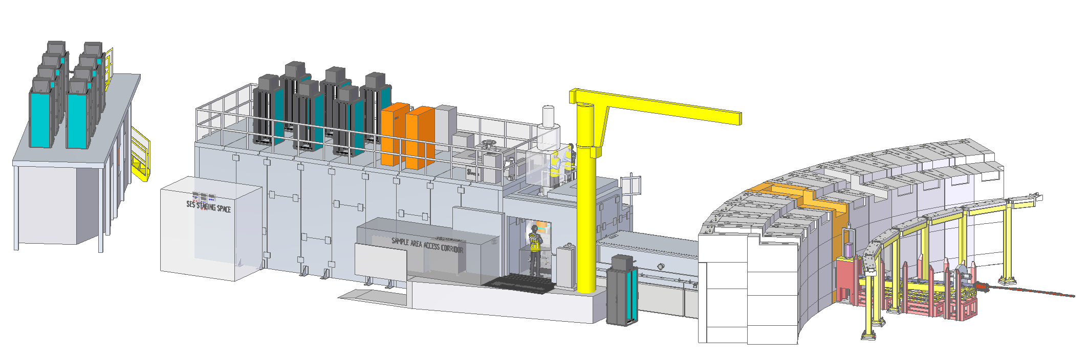
LoKI Instrument Set-up
Roof access to sample area
Instrument crane
Lifting platform
Control hutch
SES Staging space
Sample area access corridor
Sample area cave
Access to sample cave: hourly
Access to sample cave roof: hourly (during <5% of beamtimes)
Access to control hutch: all the time

Slide 5
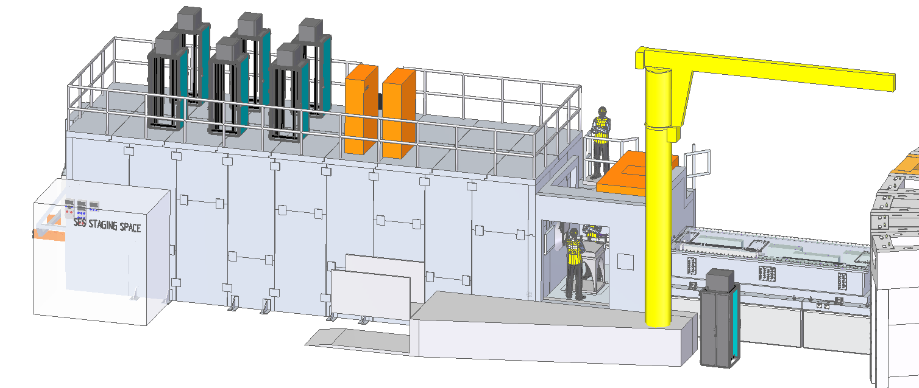
LoKI Sample Area Set-up
LOKI is a side- & top-loading instrument:
The experimental cave has a door & a hole in the roof
SEE will be wheeled in or craned in
Sliding roof for top access to sample area
External SEE staging area
Lifting platform
The lifting platform can be used to:
move sample environment equipment
gas cylinders/ liquid N₂ dewars
other instrumentation…
without needing the crane.
Limited space for turning
5

Slide 6
Sample Area - Dimensions, Tools & Utilities
12 m
area = 31 m²
area = 6 m²
area = 10.7 m²
Control hutch
SES Staging space
Sample area cave
Sample area access corridor
Cooling water
Pumps for vacuum
Power supply
Active sample cabinet
Containment ventilation
HVAC for control hutch
Utilities panel
Racks for PSS (2x)
Racks for detectors
Racks for choppers
MCA racks (jaws +sample changer+stack)
UPS for detectors

Slide 7
Installation & Daily Operations
SEE Installation:
Most SEE will be mounted on a pallet, and wheeled in through the cave door
Craned to onto the instrument roof and SE lifted through the hole in the roof
Sample Preparation:
- All sample preparation, e.g. dissolving powders, will happen in the chemistry lab
Sample Handling:
Where possible samples will be loaded in the lab, e.g. quartz cuvettes
Rheometers, pressure cells, etc. will need to be loaded in the SEE staging area or directly in the sample area
Cryostats will be be loaded via the roof access
After the measurement:
When necessary, activated samples will be stored at the instrument and left to cool down

Slide 8
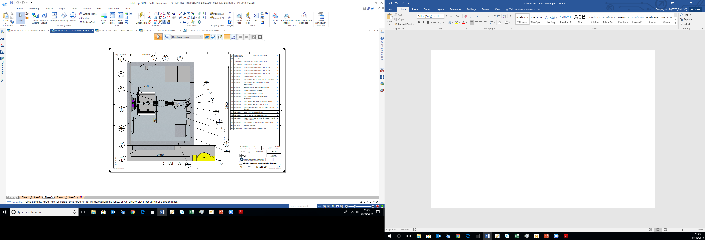
LoKI Cave Layout
Chemical & containment ventilations
Julabos
Sample table
Adjustable collimation snout
“Duck under” area
Detector tank window
Liquid N₂/He dewars
Panels with cooling water and electrical outlets
X-/y-/z- translation stage
Storage for activated samples
Pull down table for storage or placing a laptop
Cave door
Plug for future feedthrough
Instrument crane

Slide 9
LoKI SEE Staging Area
Work benches with sample cabinet underneath
Computer for setting up SEE offline
Set-up area for off-line alignment
Liquid N₂/He dewars
Cabinet for instrument tools & exchangeable parts, e.g. sample apertures
Utility panel for power, gas & water supply rack
2 m
3 m
Offline set-up & alignment of SEE, e.g. rheometer, electromagnet
Sample preparation will be in the chemistry lab - however, some sample handling will occur at the instrument e.g. filling rheometer cells, pressure cells

Slide 10
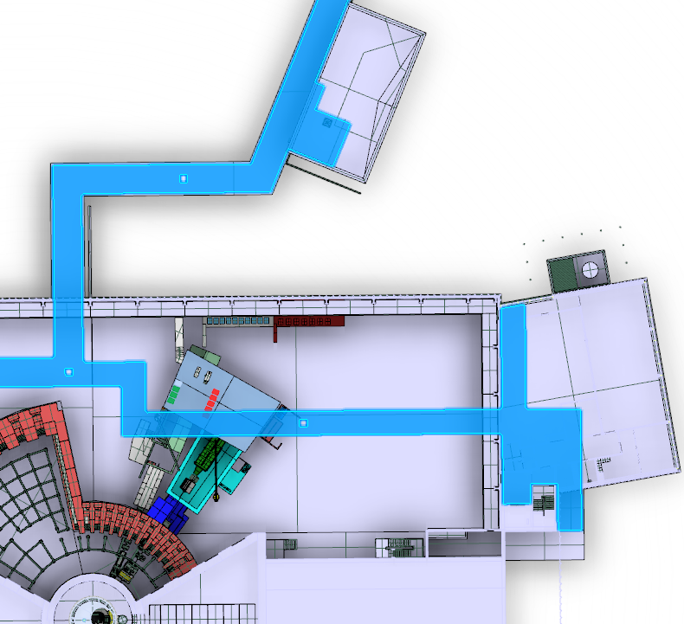
Gallery Access – Ventilation & other things
Conventional
ventilation
Electrical conduit
Sprinkler
Cable trays
He gas
Cooling water
Ar, N₂,
deionised
H₂O,
air
Water waste
2600 mm
…& containment ventilation

Slide 11
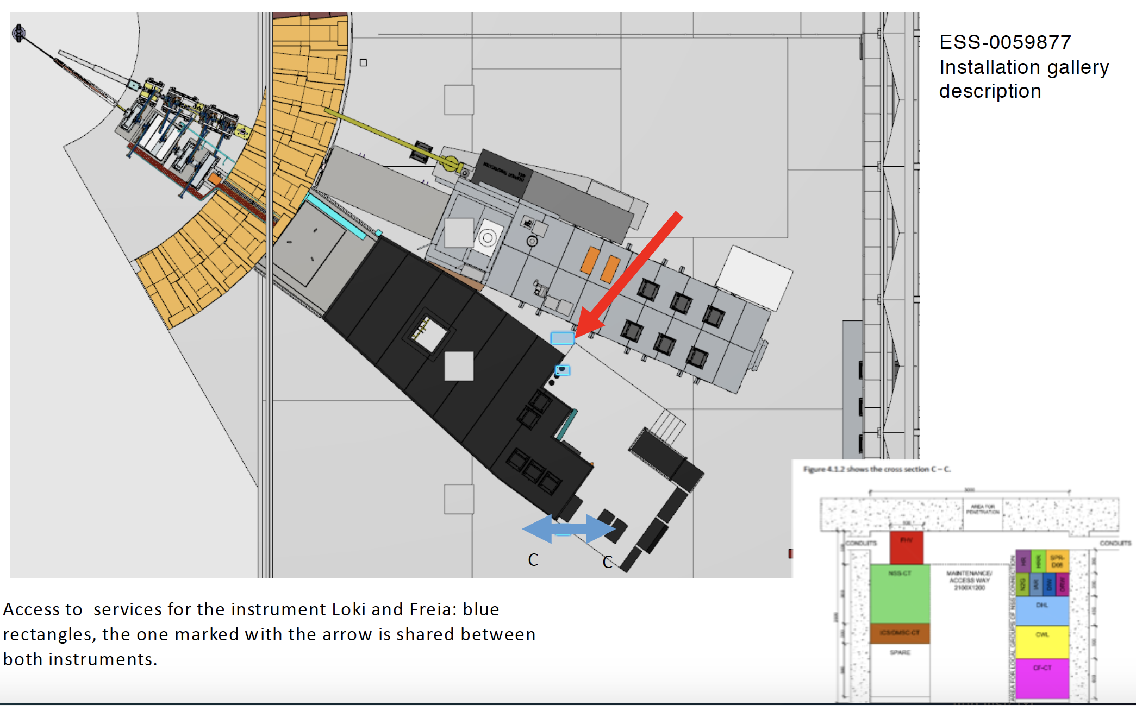
Gallery Access – Ventilation & other things
ESS-0059877
installation
gallery
description
Large access point shared between LoKI & Freia:
500 x 1000 mm
FREIA access point:
500 x 250 mm

Slide 12
Containment vs conventional exhaust
Containment exhaust: goes to the main stack of ESS, can be used on sample area even if materials are radioactive
Typical use: pump exhaust in experimental cave to provide containment for radioactive material or for gas flow experiments
Conventional ventilation: goes to a regular exhaust (NO radioactive fumes are allowed!)
Typical use: fume hood in instrument area for preparing samples or exhaust for flammable solvent/gas cylinder cabinet

Slide 13
Containment ventilation
Containment exhaust → inner diameter 250 mm
Usable for:
  vacuum pump exhaust from sample area
  slow gas flow over sample
Needed from the instrument teams:
  run pipe to the experimental cave area of instrument,
  install HEPA filter to catch particles,
  Keep line closed when not in use
Provided by ESS: ESS-0040840 (will be updated)
  Specifications for HEPA filters
  Specify restrictions for use (e.g. no large amount of undiluted corrosives….)

Slide 14
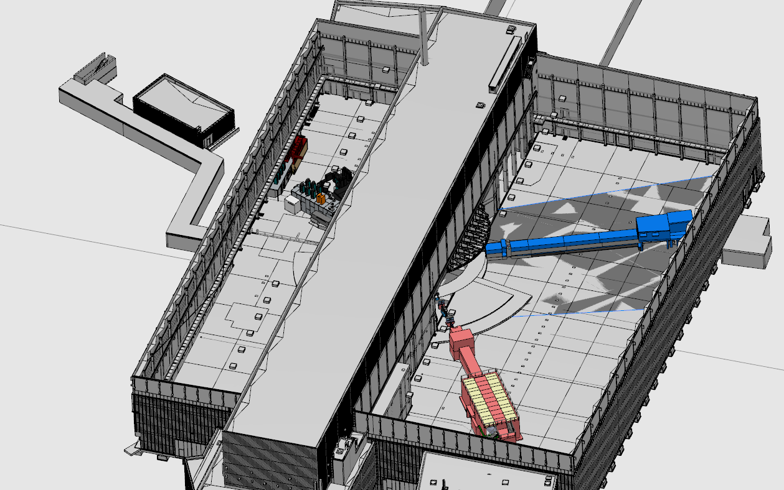
Containment ventilation
Containment ventilation for Loki and Freia: Location back wall, red line in the schematic

