Slide 1
Instruments – Bunker Wall interfaces Follow-up
Dawid Patrzalek
European Spallation Source ERIC
12.02.2019

Slide 2
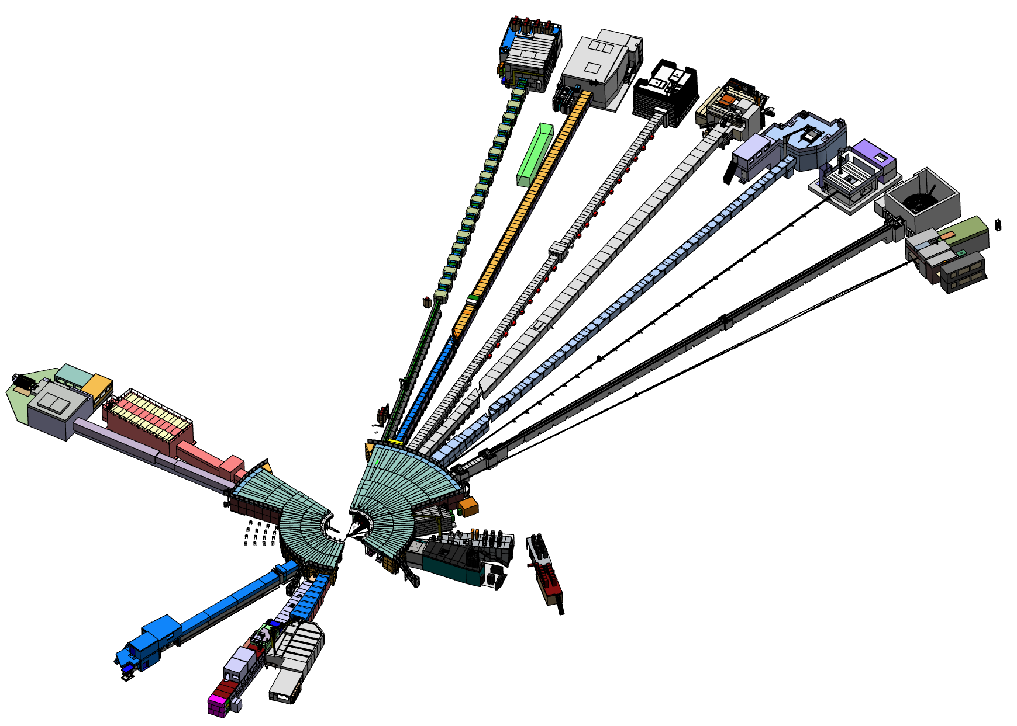
Type of interfaces
Follow up on:
Neutron Guides – Bunker’s Wall Feed-through interface
Neutron Guides – Bunker’s Upstream Supports interface

Slide 3
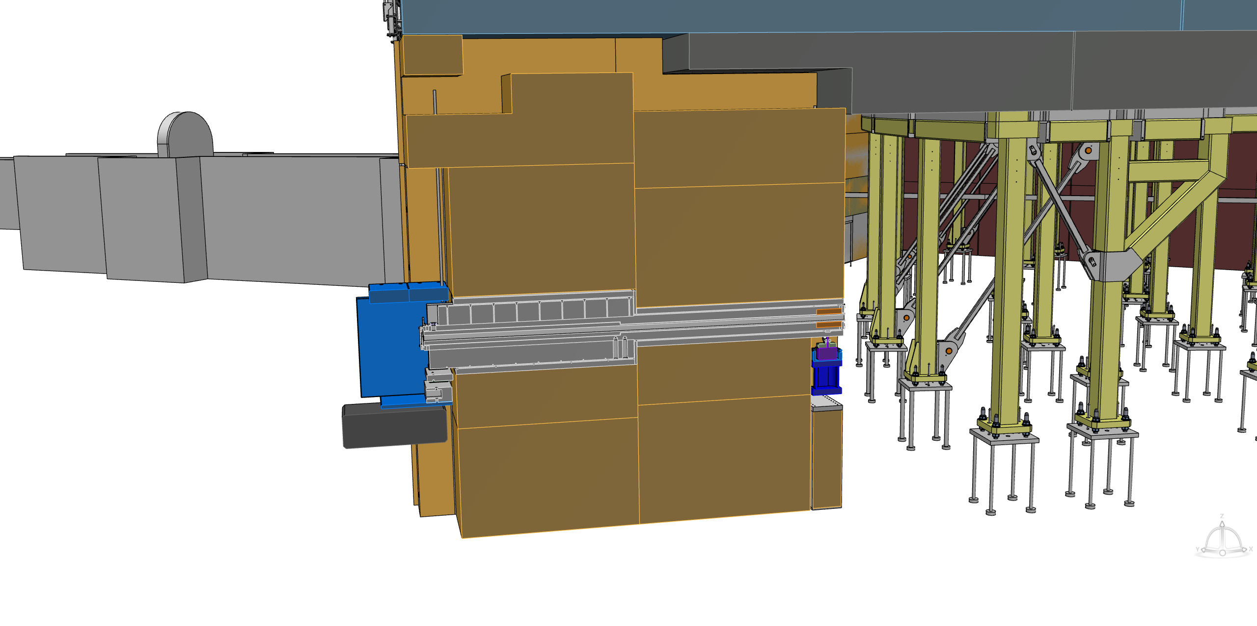
Neutron Guides – Bunker’s Wall Feed-through interface
All Neutron Guides – Bunker’s Wall Feed-through interfaces have been fixed.
Final design of the whole Bunker Project has been handed over to the contractor.
Manufacturing of concrete blocks will start soon.

Slide 4
Neutron Guides – Bunker’s Upstream Supports interface
After two feedback iterations between the Bunker Team and instrument teams, upstream supports interface has been fixed.
All details have been handed over to the contractor and manufacturing will start soon.

Slide 5
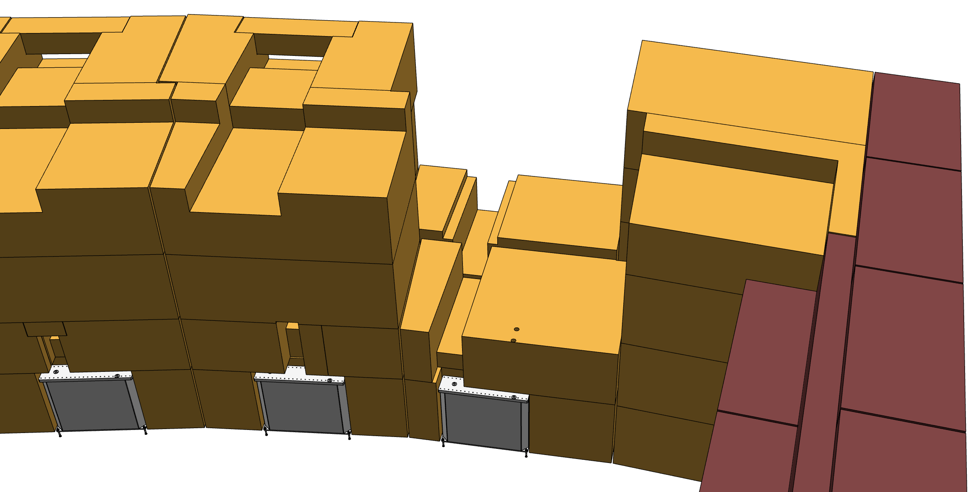
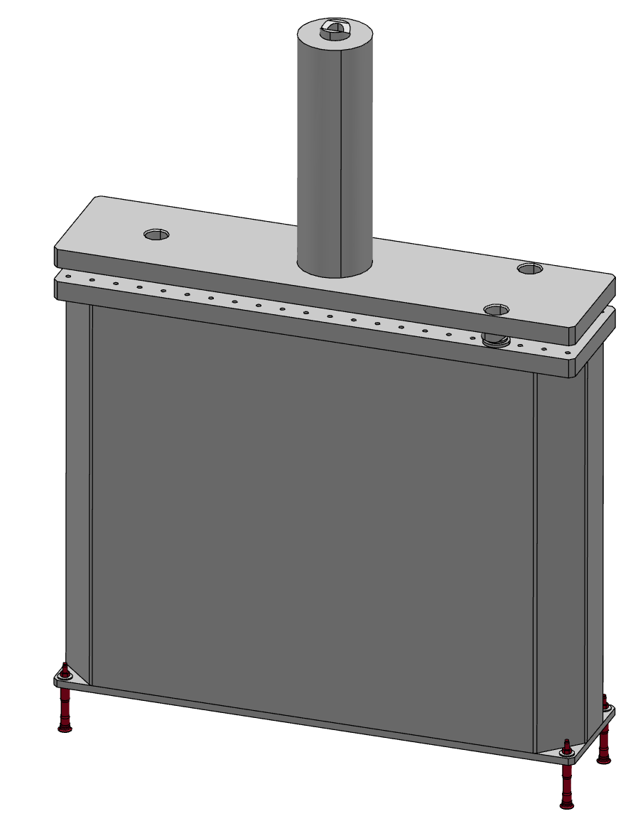
Neutron Guides – Bunker’s Upstream Supports interface
In case of an insert realignment which requires usage of the upstream support, the wall must be disassembled to this level:
Illustrative leveling module

Slide 6
Future design changes of an instrument wall envelopes
What if an instrument wall envelope design change is requested from an instrument team?
Change request must be prepared by an instrument team
Change request will be forwarded to the contractor
Contractor evaluates cost of the changes
Changes are implemented by the contractor
An instrument team covers expenses

Slide 7
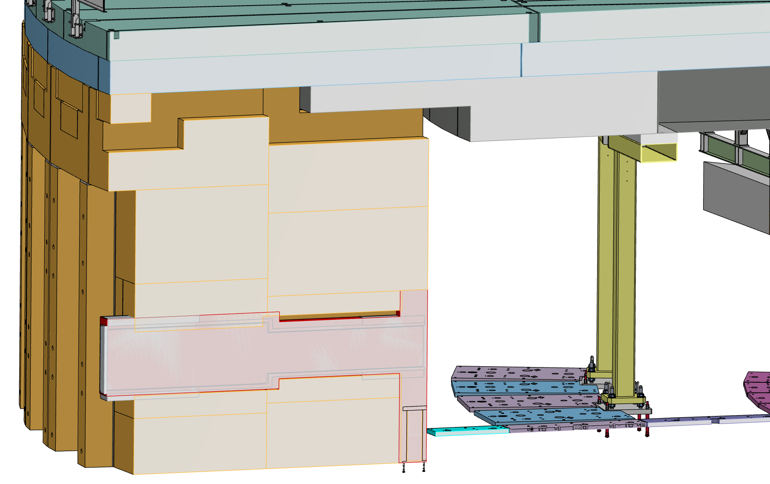
N5 (FREIA) integration

Slide 8
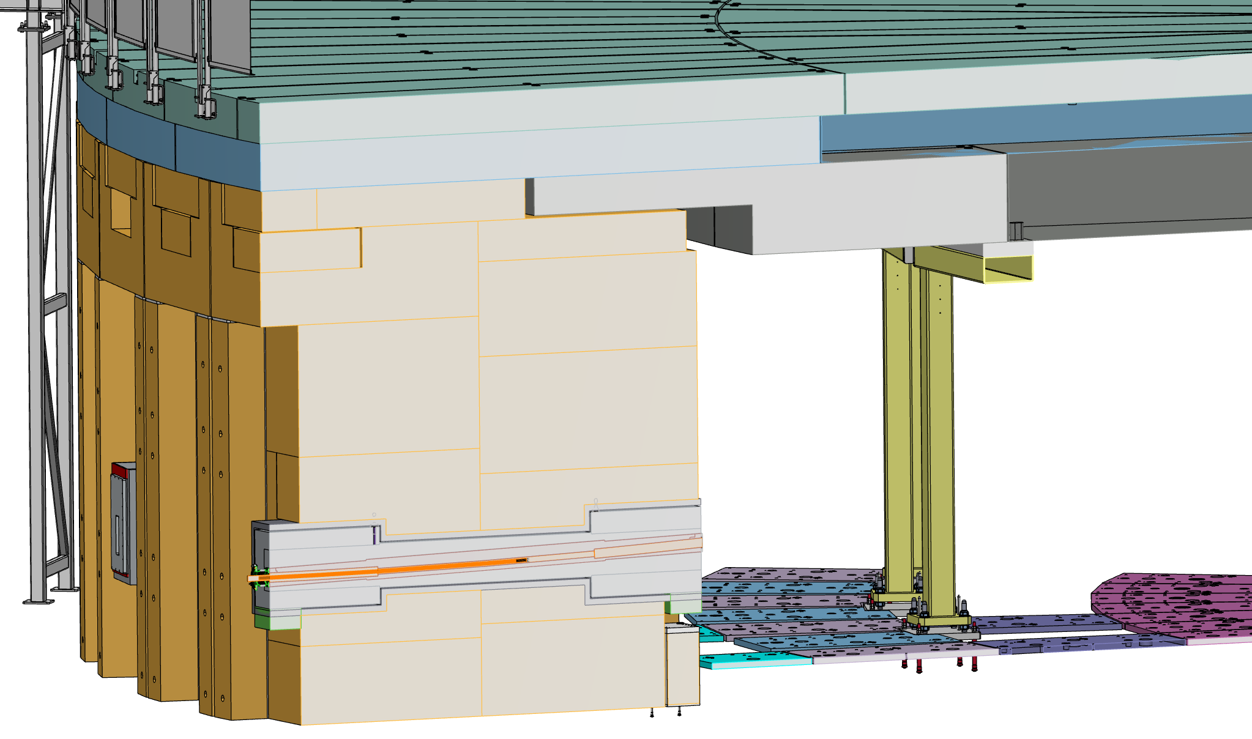
N7 (LOKI) integration

Slide 9
W1 (NMX) integration

Slide 10
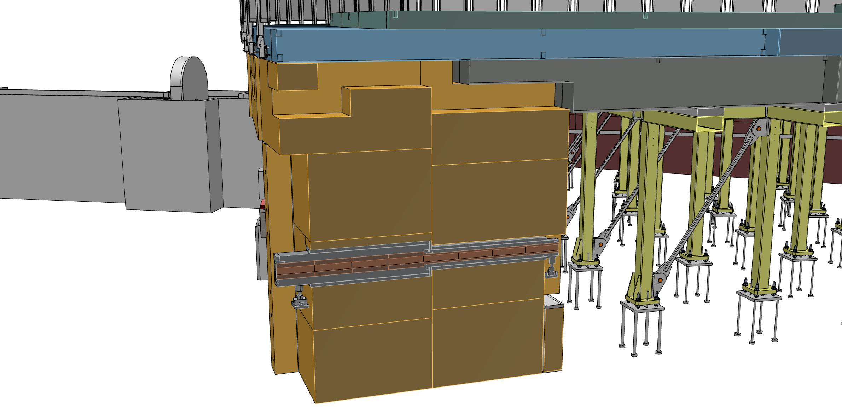
W2 (BEER) integration

Slide 11
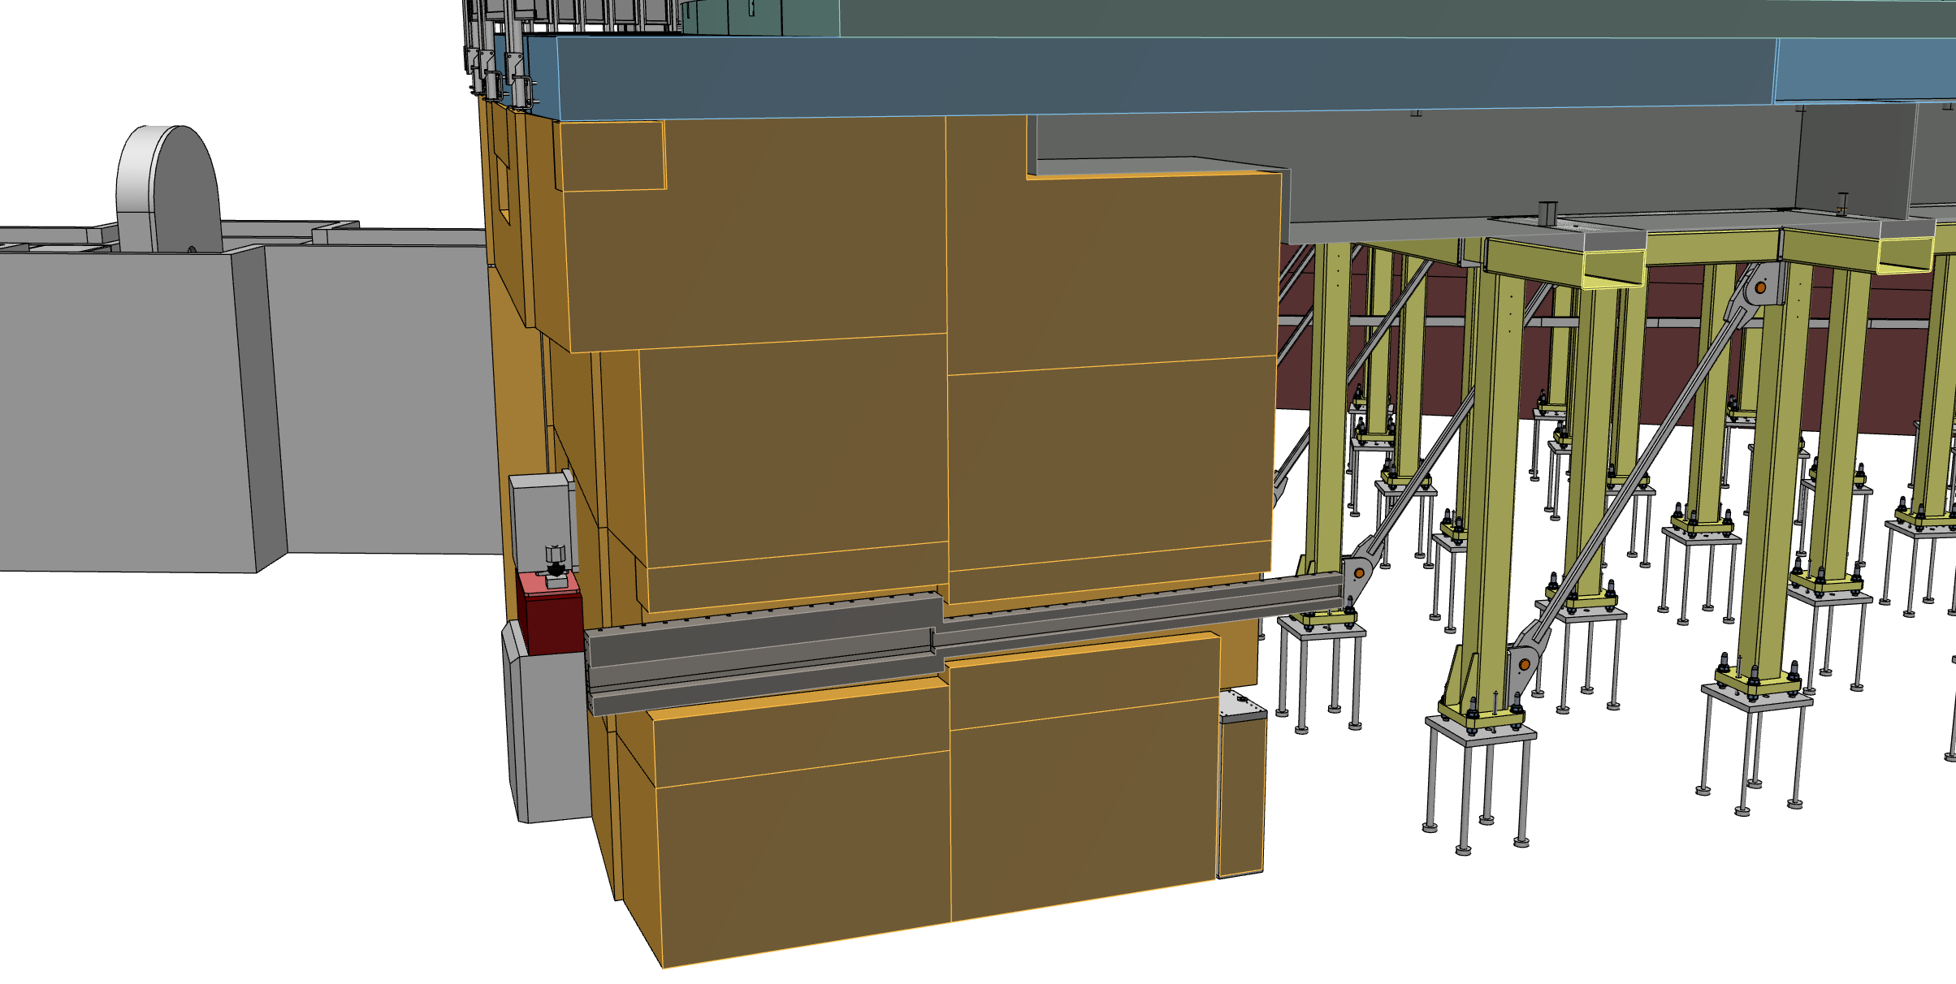
W3 (C-SPEC) integration

Slide 12
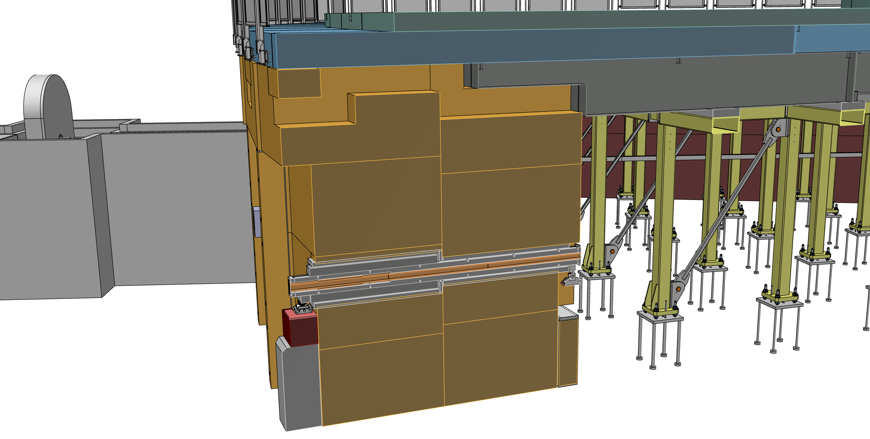
W4 (BIFROST) integration

Slide 13
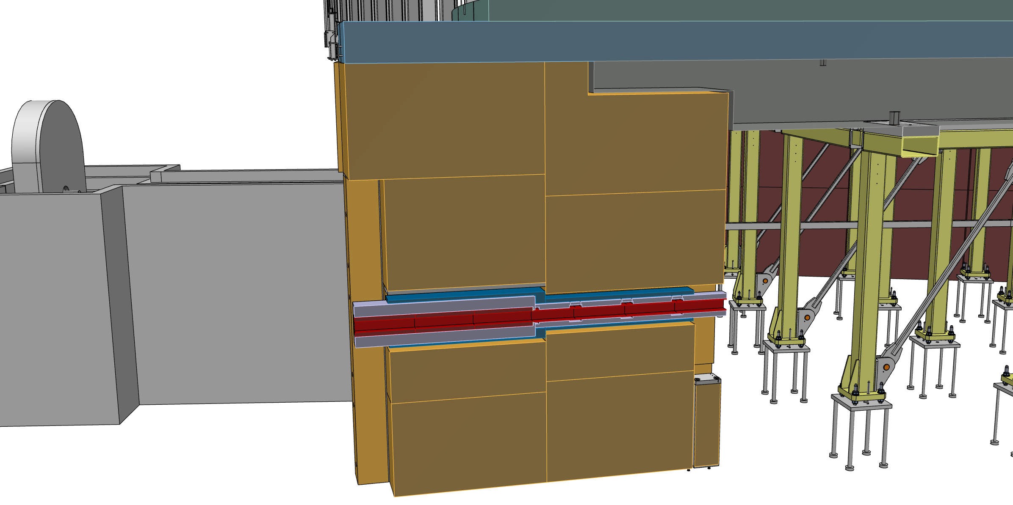
W5 (MIRACLES) integration

Slide 14
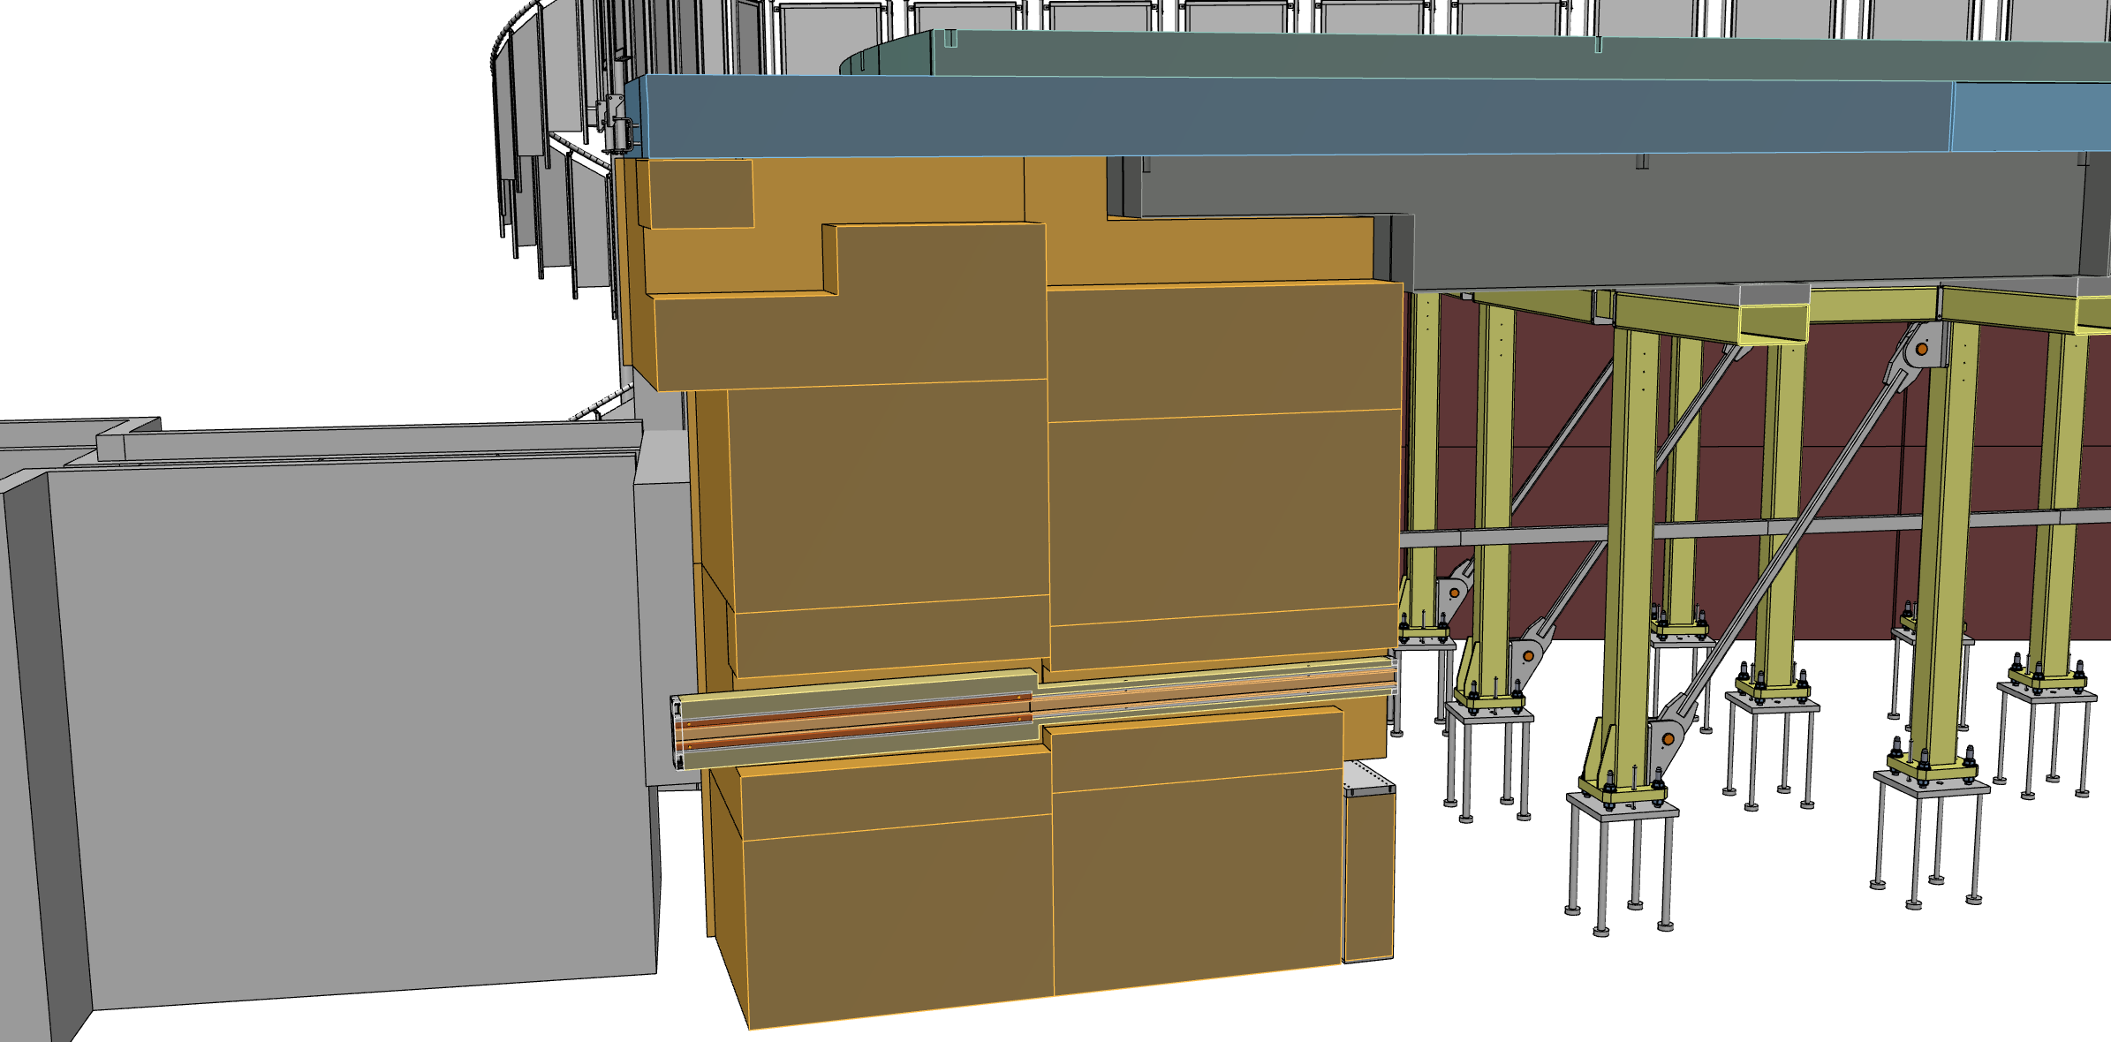
W6 (MAGIC) integration

Slide 15
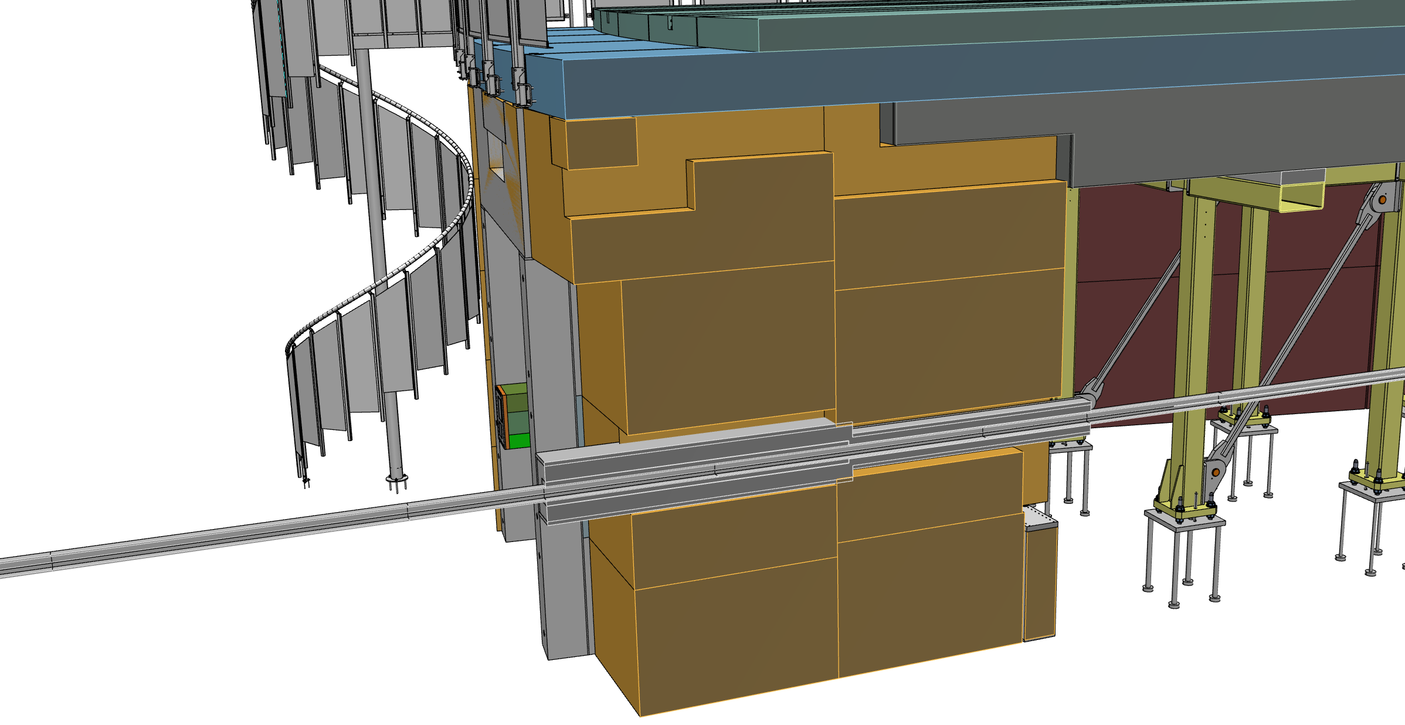
W7 (T-REX) integration

Slide 16
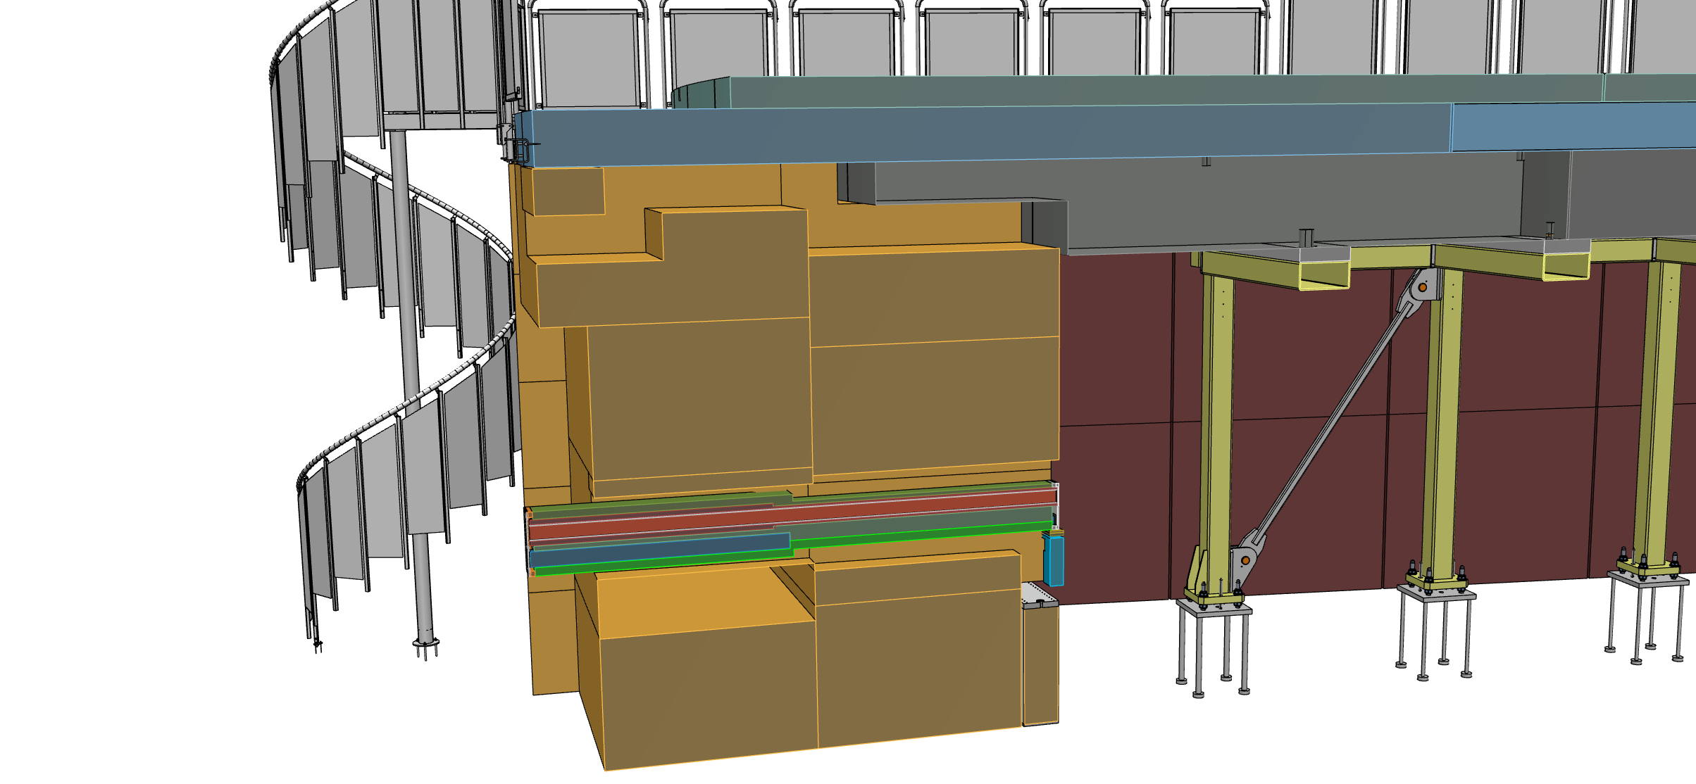
W8 (HEIMDAL) integration

Slide 17
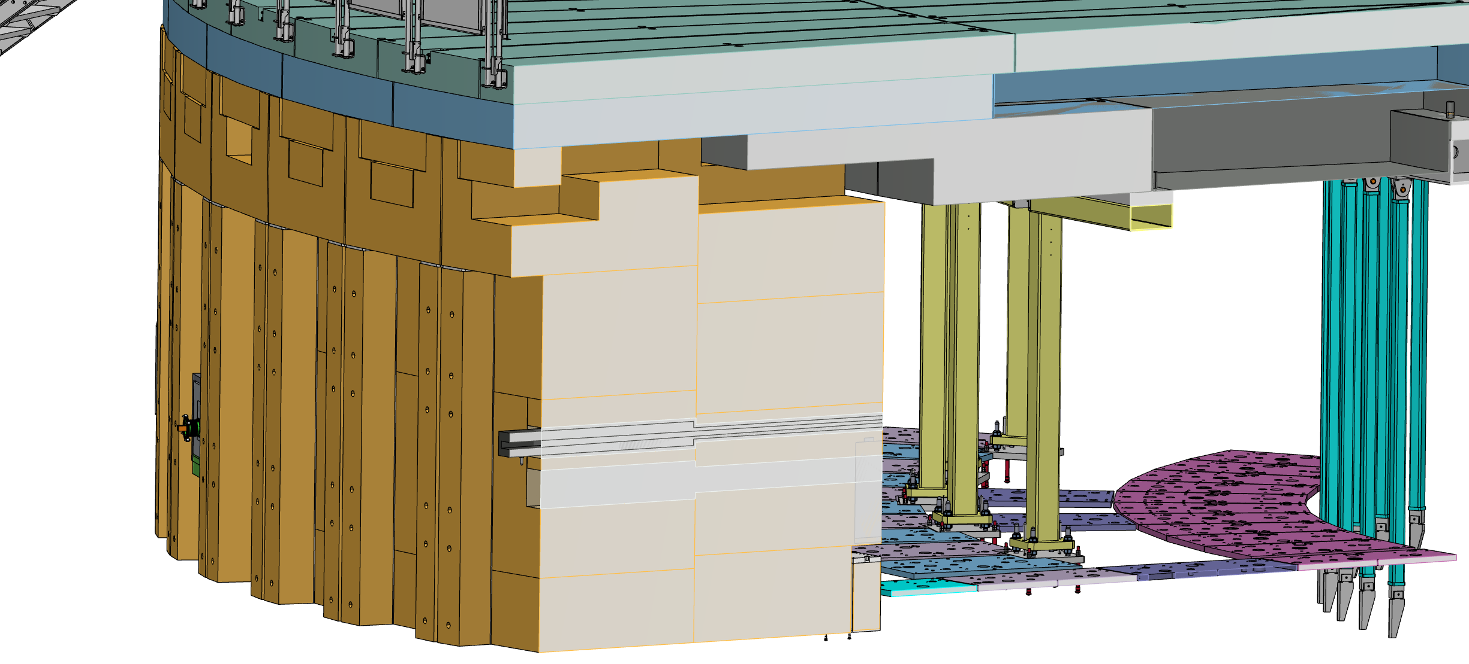
W11 (TBL) integration

Slide 18
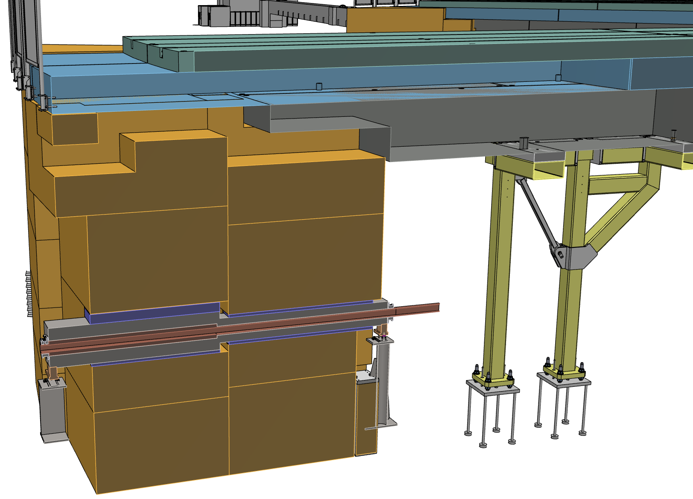
S2 (ODIN) integration

Slide 19
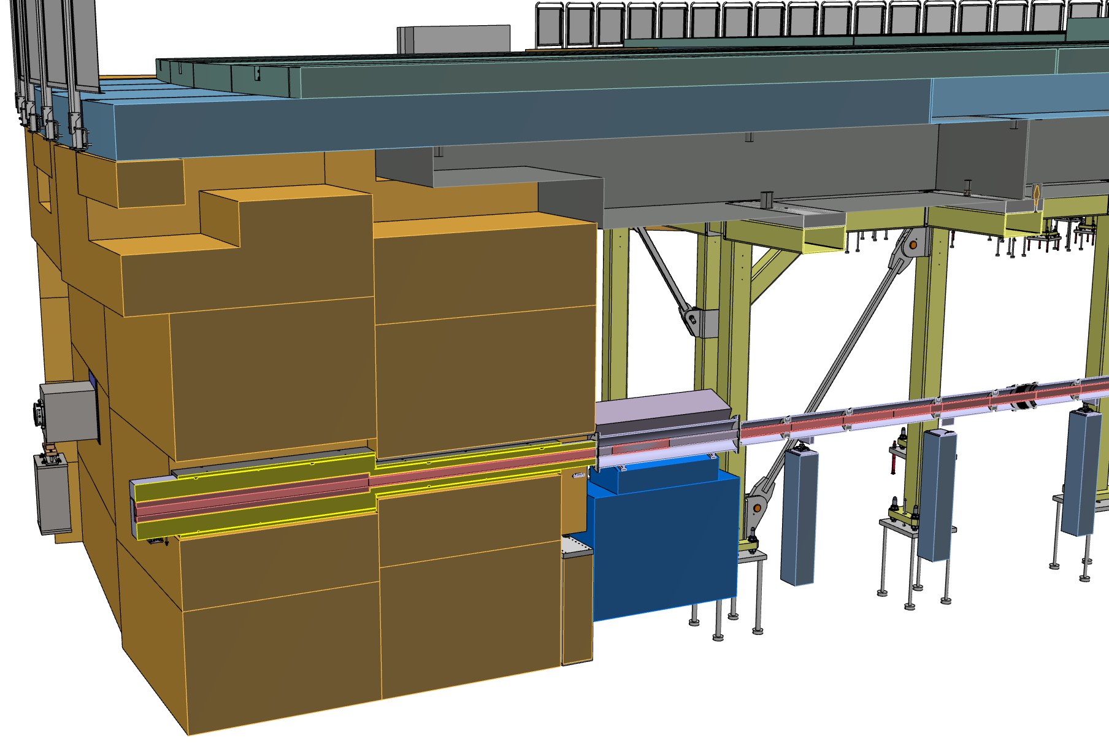
S3 (DREAM) integration

Slide 20
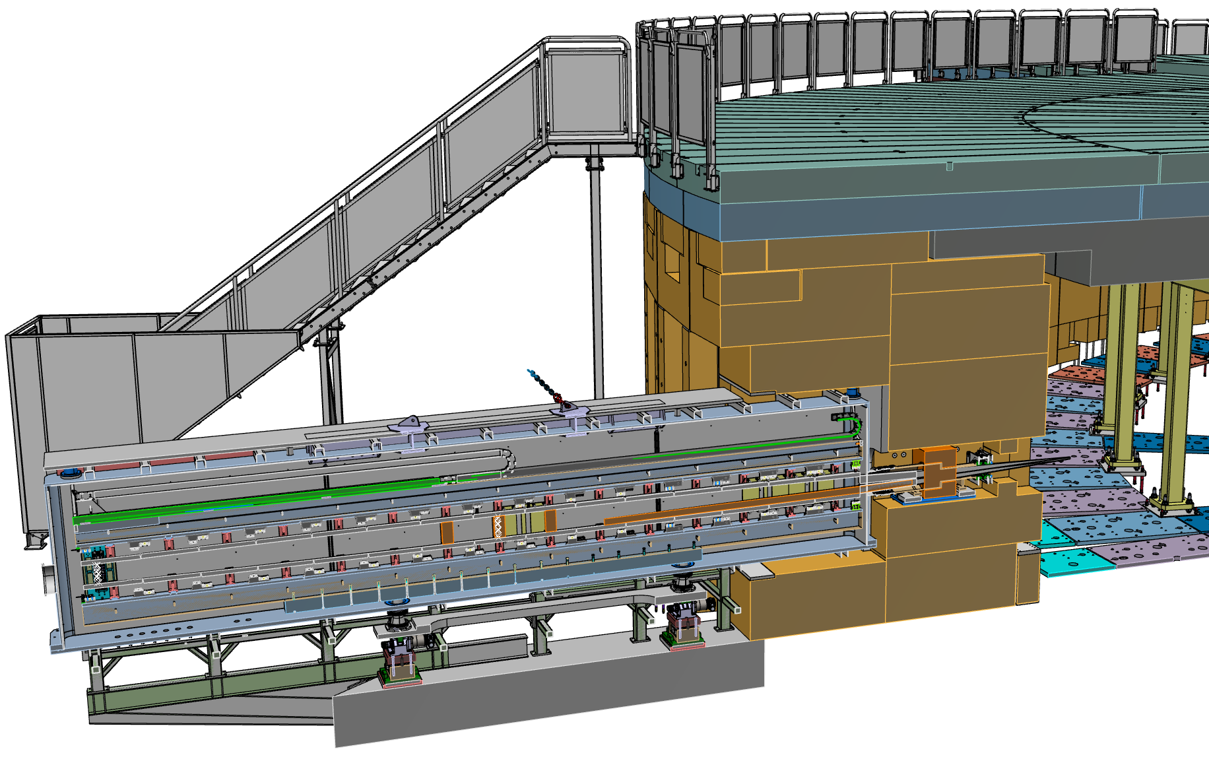
E2 (ESTIA) integration

Slide 21
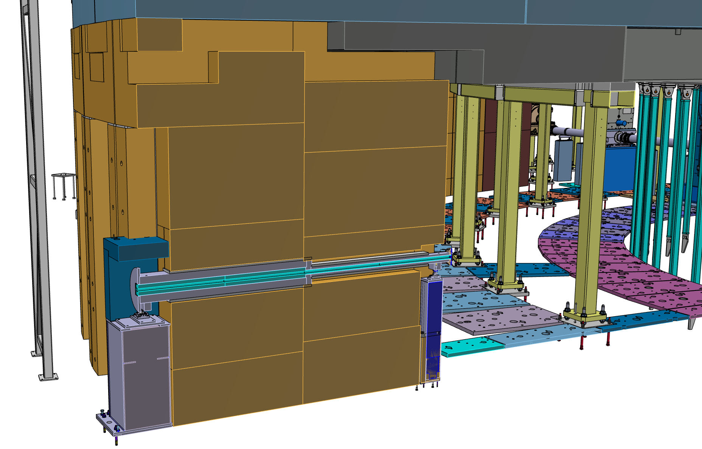
E3 (SKADI) integration

Slide 22
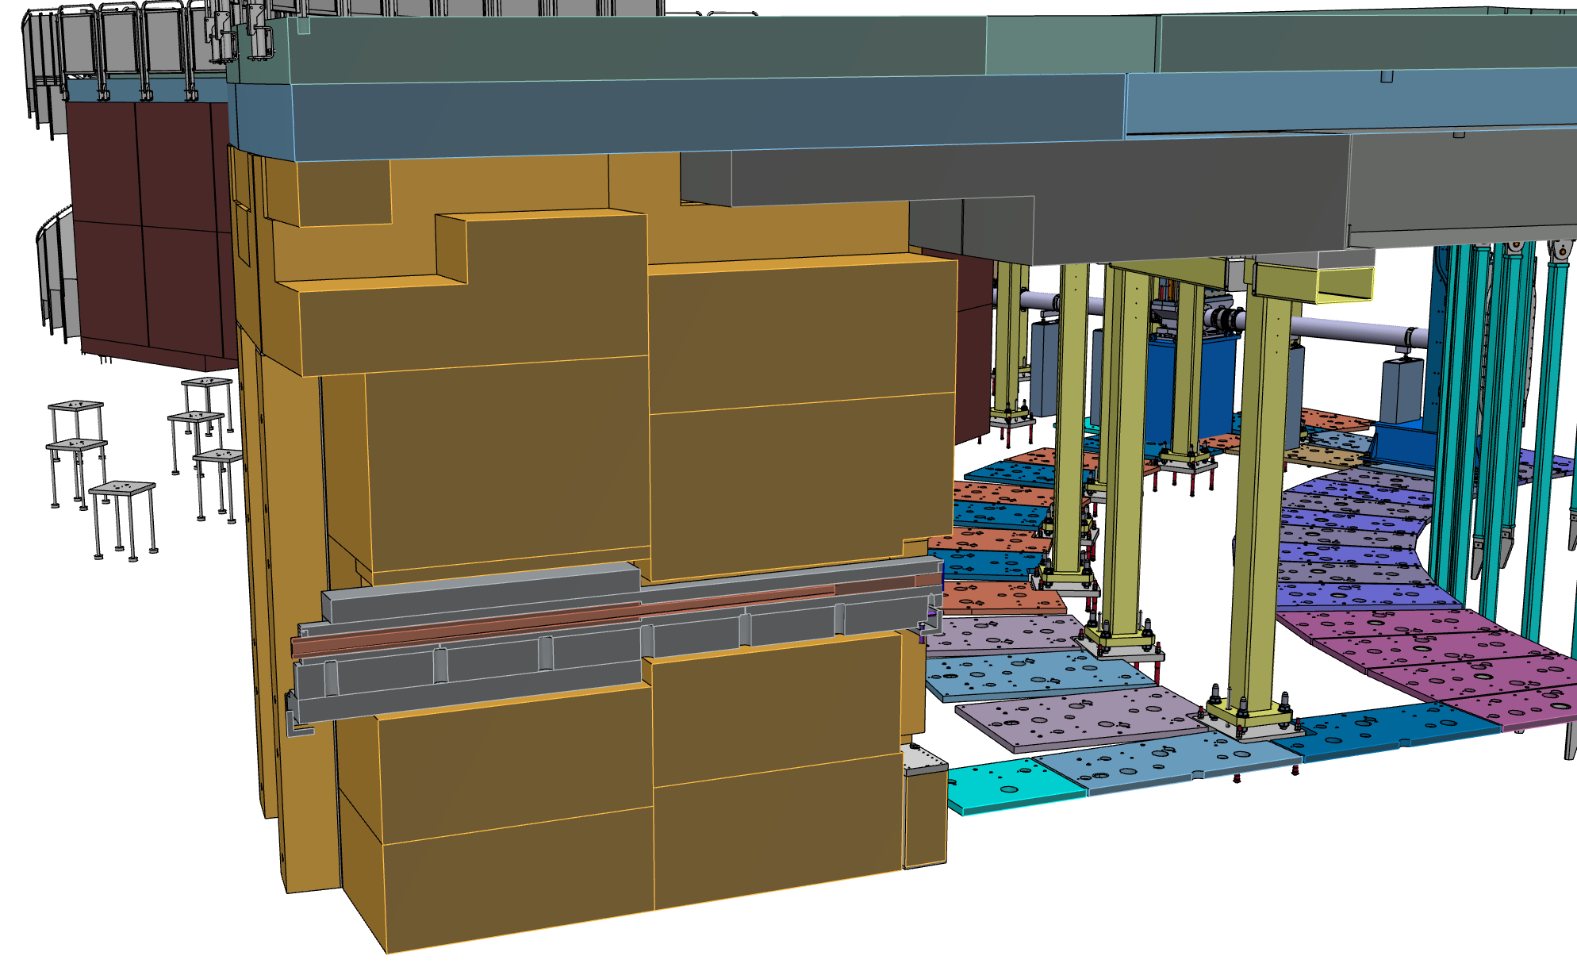
E7 (VESPA) integration

Slide 23
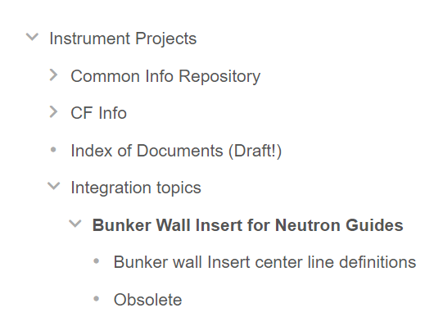
Q&A
Questions?
Remember, follow the Confluence page!

