Slide 1
PSS for Instruments
IKON16
Stuart Birch
ICS-Protection Systems Group- Senior Engineer Personnel Safety Systems
ESS/ICS/PS
2019-02-12

Slide 2
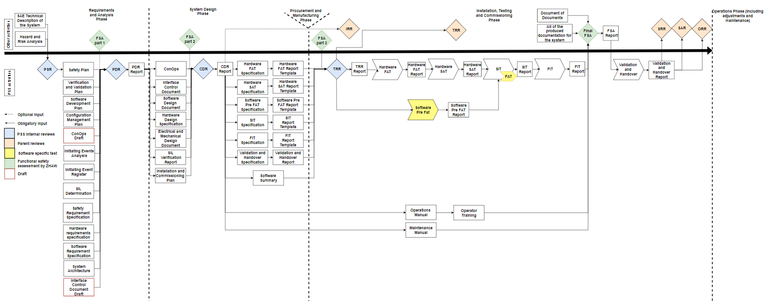
PSS flow

Slide 3
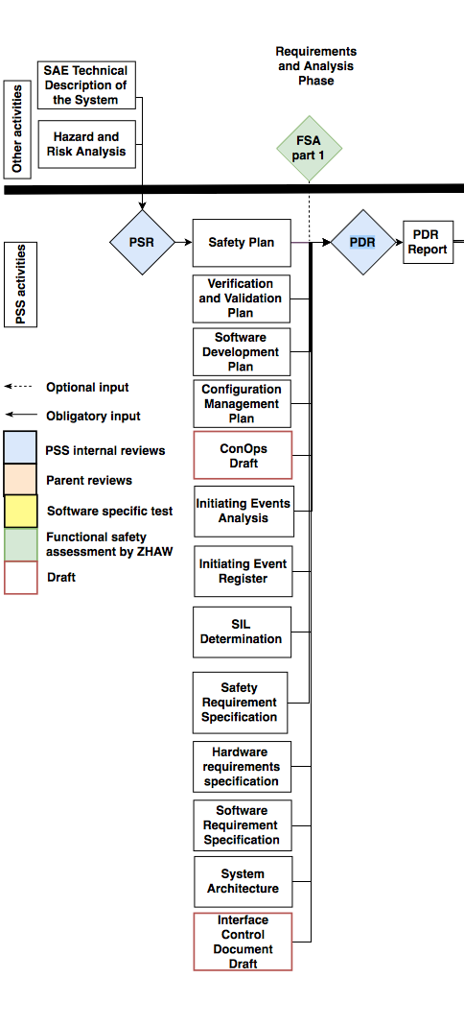
Contents
Stakeholder Associated Equipment (SAE) Technical description.
Global Hazard and risk assessment (operational)
PSS Pre-start Review
Safety Plan - ESS-0469185
V&V Plan - ESS-

Slide 4
Instrument Technical Description
Instrument Technical Description

Slide 5
Instrument Technical Description
Most up to date technical description of the instrument from the target through to the
beam stop including:
Light/neutron shutter
Bunker installations
Beamline guide equipment including:
Choppers
Collimation
Cave and cave equipment including:
Sample positions
Detectors
Jaw sets
Moving equipment
Collimators
Any other instrument permanent equipment that is used in normal operations
Please also provide:
Concept of operations
Cartoon/plan drawing showing all equipment and equipment positions

Slide 6
Hazard and Risk Assessments
Hazard and risk assessment.

Slide 7
Hazard and Risk Analysis
Workshops shall be held with personnel from different groups representing the different systems involved. The system should divided into two nodes: equipment inside the bunker and equipment outside of the bunker.
Classification of risk.
Classification of risk for radiological hazards shall been carried out in accordance with:
General Safety Objectives ESS-0000004
Charter for Radiation Safety Committee ESS-0440582
Classification of risk for non radiological hazards shall be carried out in accordance with:
Risk matrix for conventional safety ESS-0379511

Slide 8
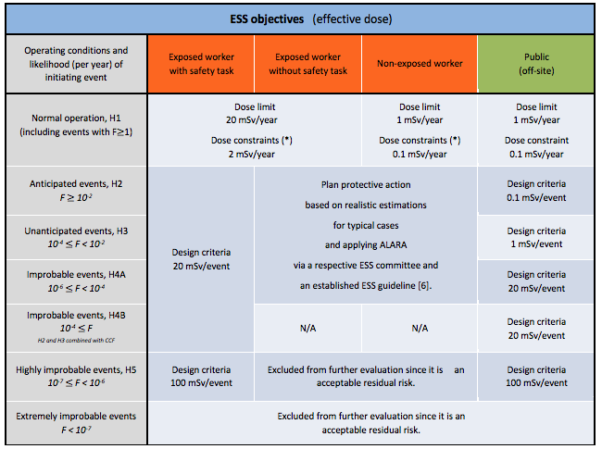
Radiation Safety Matrix
 | Acceptable range for exposure level (effective dose in mSv)
Event class Likelihood | Exposed workers without safety task | Non exposed workers (including public on site)
Anticipated events - H2 F $≥$ 10⁻² | order of magnitude for maximum value : 6 mSv for exposed workers Category B 20 mSv for exposed workers Category A | Order of magnitude for maximum value : 1 mSv for non-exposed workers
Unanticipated events - H3 10⁻⁴ $≤$ F < 10⁻²
Improbable events – H4A 10⁻⁶ $≤$ F < 10⁻⁴

Slide 9
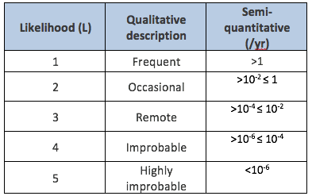
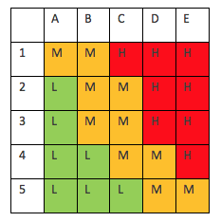
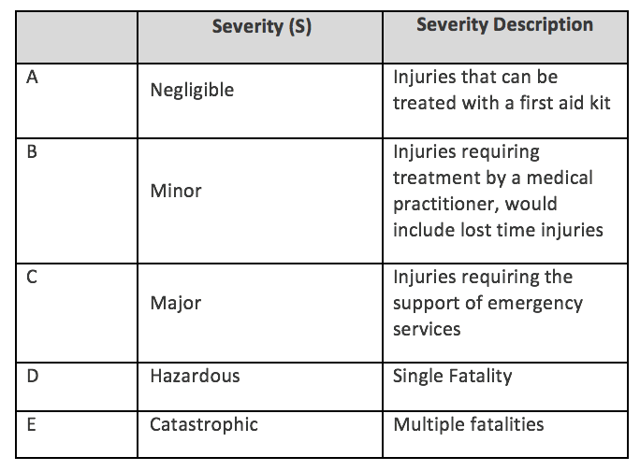
Conventional Safety Matrix
Likelihood
Severity

Slide 10
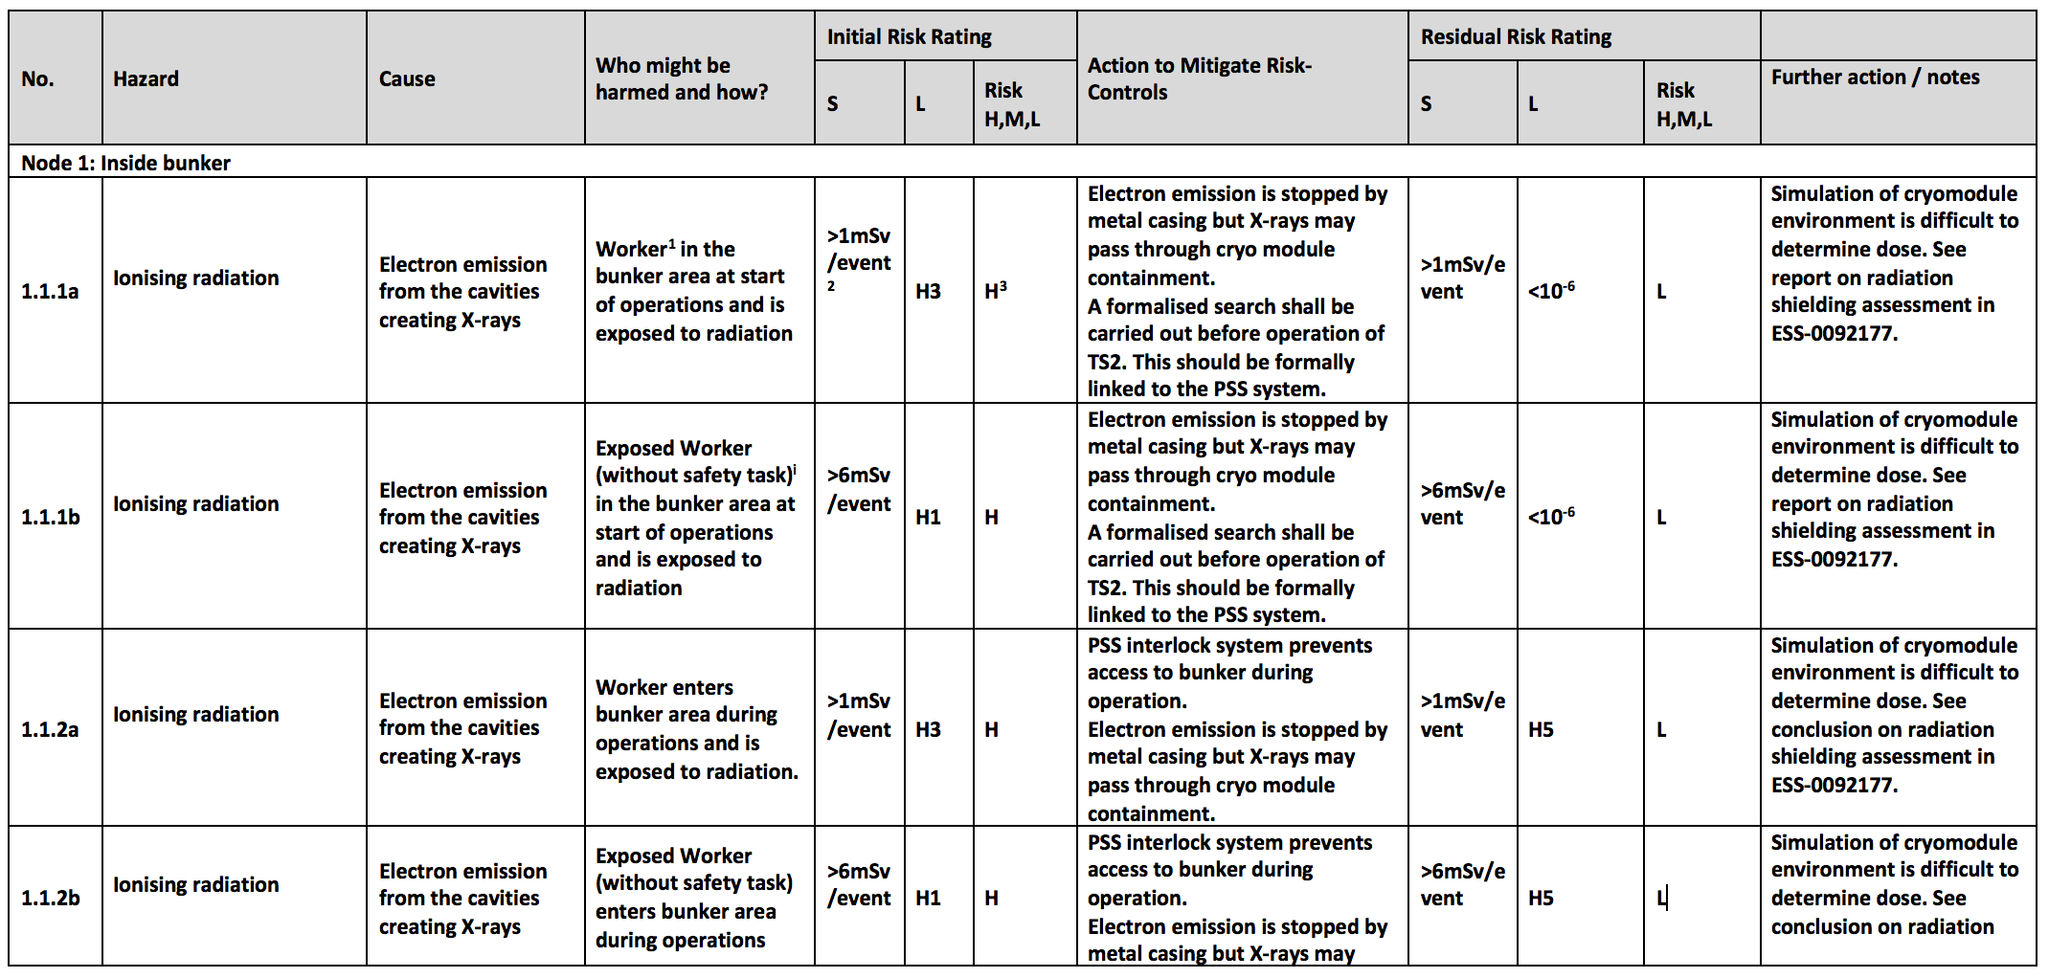
Hazard and Risk Analysis – Example

Slide 11
Safety Plan – ESS-0469185
Safety Plan - ESS-0469185

Slide 12
Safety Plan – ESS-0469185
This safety plan defines the life-cycle activities for Personnel Safety Systems (PSS).
It establishes how the steps in the safety life-cycle are accomplished and ensures that the required activities during each life-cycle phase are adequately planned.
These activities range from:
Ensuring proper risk and hazard analysis,
Compliance with safety requirements,
Planning and execution of installation
commissioning to ensuring functional safety during operation.
This safety plan also defines the roles and responsibilities related to the life-cycle activities.
The development of a PSS follows IEC 61511

Slide 13
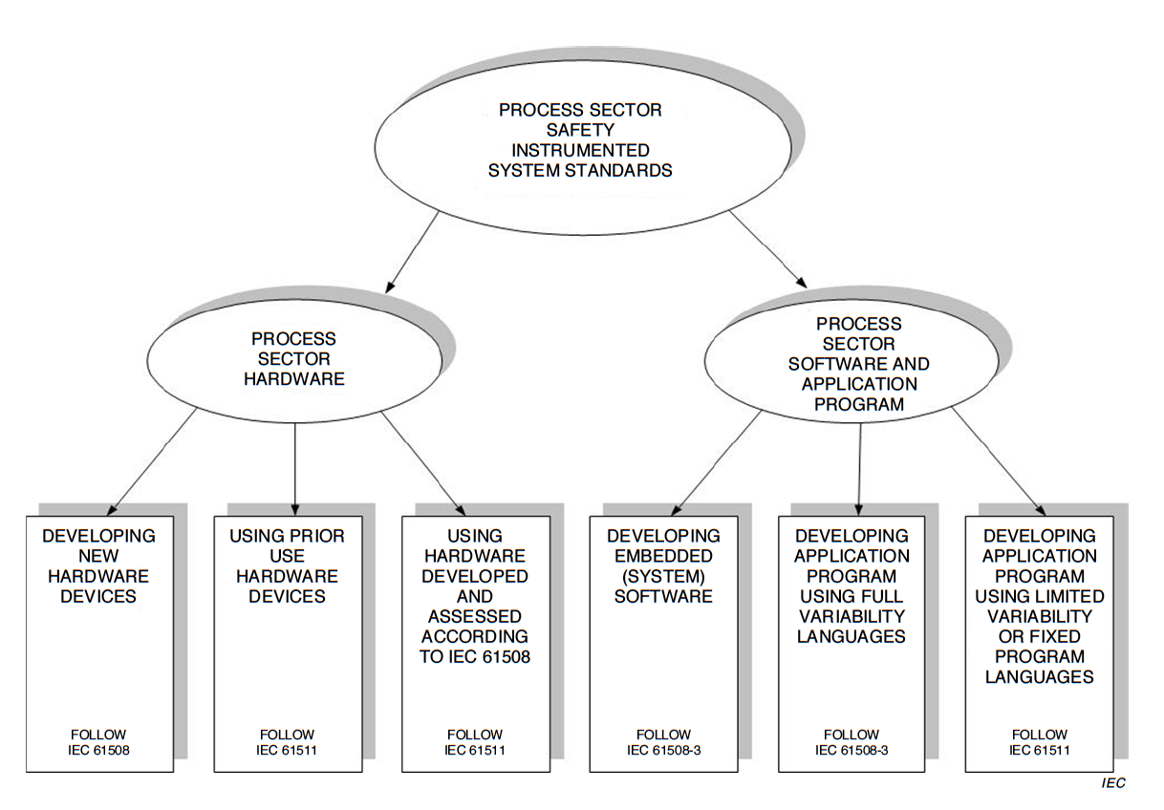
Standards
IEC 61508
✓
✗
IEC 61511
Notes:
Commercial of the shelf components
Using TIA portal and standard Siemens safety function blocks and logic.

Slide 14
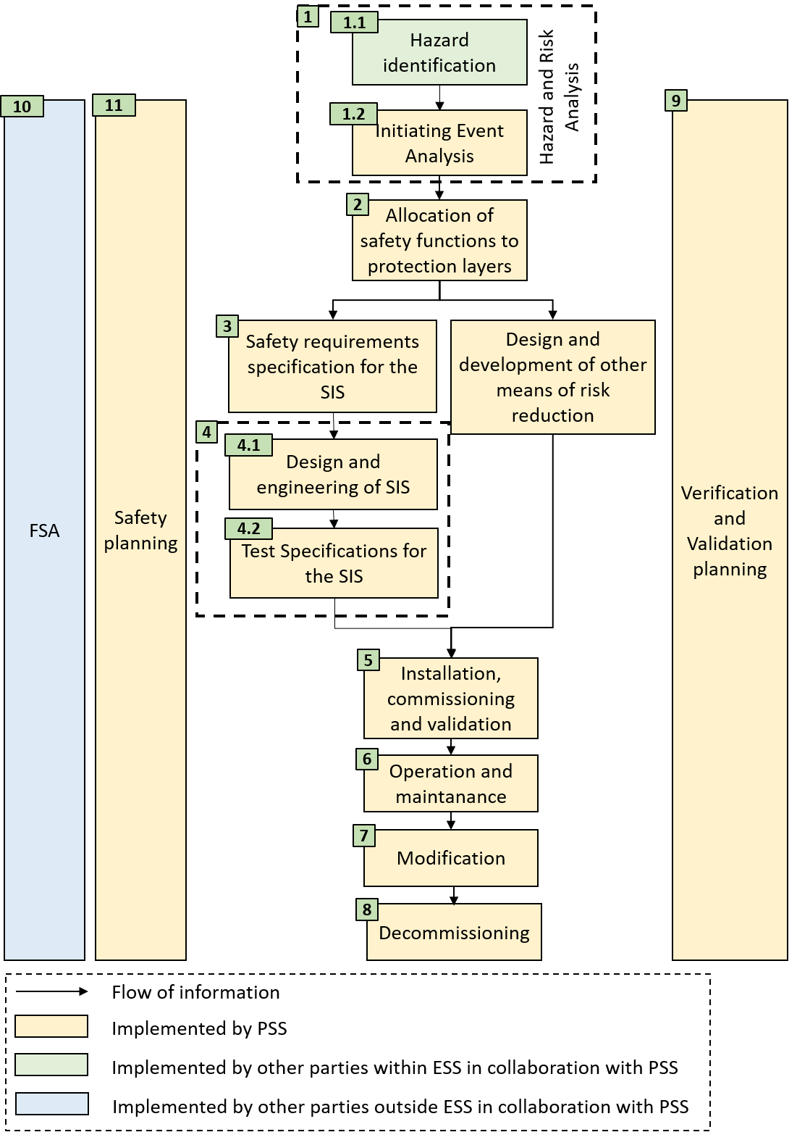
Safety Plan – ESS-0469185
Lifecycle phases
The plan describes each phase in the lifecycle
Each Phase has:
An overall objective
Inputs
Outputs
Acceptance requirements
Tools and methods
Responsibilities

Slide 15
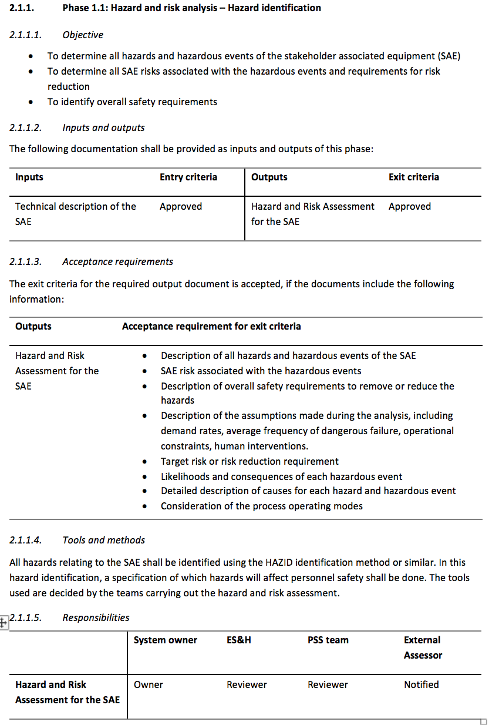
Safety Plan – ESS-0469185
Lifecycle phases

Slide 16
Safety Plan – ESS-0469185
Functional Safety Assessment
A FSA shall be performed to review the work carried out in the previous stage and the corresponding results at the following stages:
After safety life-cycle phase 3: Safety requirements specification
After safety life-cycle phase 4.1: Design and engineering
After safety life-cycle phase 5: Installation, commissioning and validation
In safety life-cycle phase 6: Operation and maintenance
In safety life-cycle phase 7: Modifications
At each of these stages, the external assessor shall review the documentation up to this point and evaluate the functional safety of the PSS under development.

Slide 17
Safety Plan – ESS-0469185
Appendices
Appendix A - Initiating Event Register:
The initiating event register summarizes all initiating events in relation to the hazards resulting from them and provides qualitative assessment of hazardous scenarios against a radiation and Conventional safety risk matrix. The appendix gives a step by step guide through this process.

Slide 18
Safety Plan – ESS-0469185
Appendix B – Safety Integrity Level SIL. determination and Verification
details the methodology used for determination and verification of SILs during the allocation of safety functions in the safety life-cycle.
General concepts of risk reduction
Safety Integrity Level SIL
Risk targets
Layer Of Protection Analysis LOPA
LOPA for low demand safety instrumented functions SIF’s
LOPA for High demand or continuous SIF’s
Independent protection layers
Hardware reliability
Probability of failure on demand
Failure rate
Mean down time
Voting configuration
Common Cause failure

Slide 19
Safety Plan – ESS-0469185
Appendix B (continued) –
Architectural Assessment Methodology
Hardware fault tolerance
Safe Failure Fraction SFF
Architectural constraints
Appendix C - Requirements formulation and naming :
Details the formulation and naming of the requirements developed in phase 3 of the lifecycle.
The requirements are to be formulated to be:
Unambiguous (Only one interpretation possible)
Traceable (Having a unique identifier)
Consistent (No conflict with other requirements)
Verifiable (It shall be possible to check whether the system meets the requirements)
Complete (No lack of relevant information)
The requirements are written statements using either “shall” “should”, where
“shall” is a mandatory statement and
“should” is an optional statement.

Slide 20
Verification and Validation Plan – ESS-0328060
Verification and Validation Plan- ESS- 0328060

Slide 21
Verification and validation – ESS-0328060
Prior to any operation or energization of the systems interlocked by PSS, the PSS shall be verified and validated.
It will not describe the test activities in detail, giving all complete approved test specifications and test reports.
Provides an overview of standards, required tests, reviews and assessments
When (sequence), where, who and how!
Inputs, outputs, entry criteria, acceptance criteria and roles for all:
Reviews
Tests
Tools
Methods
Functional Safety Assessments
It shall be used as an input when designing the test specifications and test reports.

Slide 22
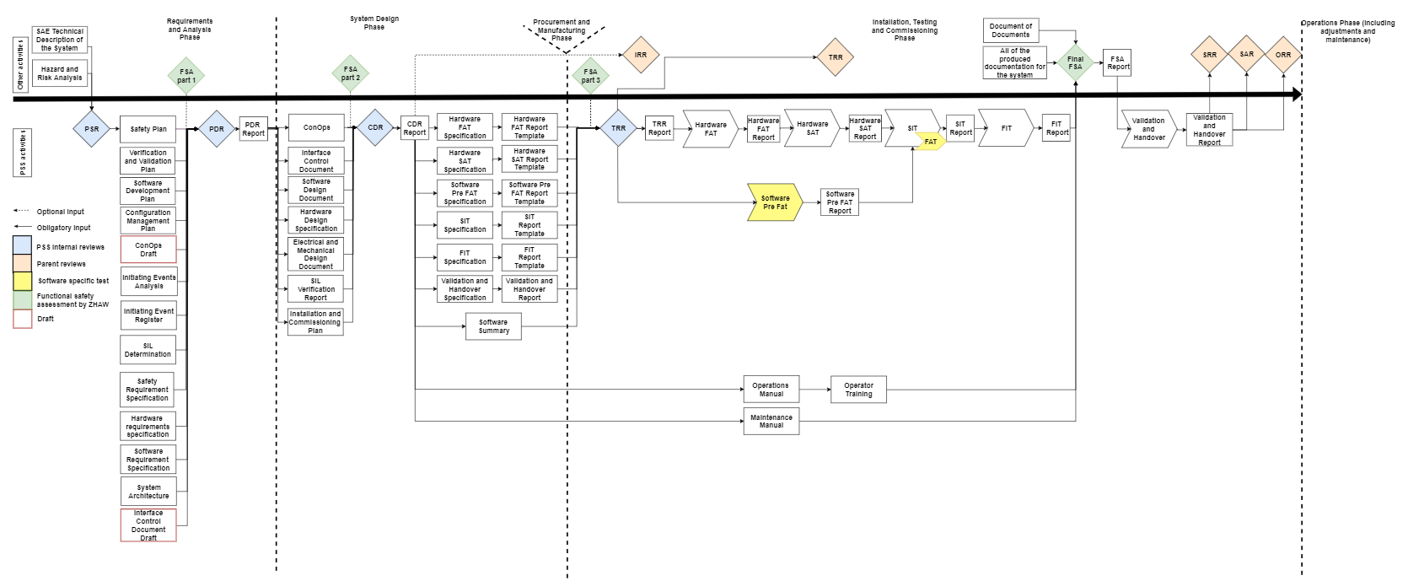
V&V FLOW
Notes:
PSR: The PSR verifies that enough information is available to start working on the PSS system.
PDR: The PDR verifies that the conceptual design and the planned technical approach shall meet the requirements
CDR: The CDR verifies that the specified requirements are met by the detailed, or critical design and demonstrates that maturity of the design is appropriate to proceed into implementation and installation.
TRR: The TRR verifies that the product, its test equipment, support personnel, and test procedures are ready for verification and validation.
Functional Safety assessment (FSA): Zurich University of Applied Sciences (ZHAW). The shortcomings of the items under assessment shall be specified and recommendations on modifications shall be proposed by Zurich University of Applied Sciences (ZHAW).

Slide 23
Verification strategy
HW and SW component tests, system integration tests, the tests planning, and documentation shall be carried out according to:
Functional safety – Safety instrumented systems for the process industry sector (IEC 61511), 2016.
Automation systems in the process industry – Factory acceptance test (FAT), site acceptance test (SAT), and site integration test (SIT) (SS-EN 62381), 2012.
All documents shall be reviewed and approved by appropriate reviewers
NORA
Notified
Owner
Reviewer
Approver
Reviews (PSR, PDR, CDR, TRR)
Functional Safety Assessment
The software shall have documented code reviews
Traceability

Slide 24
Traceability for instrument PSS
The Initiating Event Analysis document the Overall Safety Requirements.
The Requirement Specification(s) (SRS)
The safety requirements for each SIF.
It includes specifications of both the functional and safety integrity requirements for the system.
Each test and validation report template and report shall have a traceability matrix

Slide 25
Hardware FAT
Verifies that the as-built hardware system meets the specified design.
Includes component test
Performed by the vendor, but it should be designed and accepted by ESS.
Note:
The HWFAT follows the ESS guideline for FAT.
Notes:
Methods: Inspection and test, checks insultation resistance, disruptive discharge, residual voltage etc
Tools: Multimeter, Insulation tester, Loop calibrator, Windows laptop with a PLC programming tool to force and monitor signals to PLC modules

Slide 26
Hardware SAT
Verifies that the hardware system is installed as specified in its operational environment (On site).
HWSAT include the same tests as the HWFAT and some additional field device tests and a loop check.

Slide 27
Software verification
The Software FAT follows the recommendations from IEC 61511 standard and has two stages:
Software Pre FAT - preparation for software FAT, where the software developer tests the code in test environment, mainly through simulation.
Software FAT (included in PSS SIT and FIT)

Slide 28
Software Pre FAT
It includes the software code review
shall include a confirmation from independent software code review that software is ready for SIT.

Slide 29
Site Integration Test (SIT)
The SIT verifies that installed hardware and software work together properly.
For software (A.12.5.3 in IEC 61511-2):
Performance tests
Integration-level structural tests
System-level integration tests
Tools:
Windows laptop with PLC programming tool
Multimeter for continuity tests
PSS PLCs
PSS HMI-s
Note: To reduce the risk of damaging the SAE due to repeated tests, the SAE shall be disconnected from PSS during PSS SIT.

Slide 30
Final Integration Test (FIT)
The FIT is a repetition of SIT whilst SAE is operational and connected to PSS.
Stakeholder associated equipment (SAE)
Equipment in that instrument PSS interlocks in order to mitigate risk associated with them.

Slide 31
System demonstration and handover
The demo covers the real system and the positive tests from the FIT
To prove that PSS meets the safety and operational requirements
Presented to all identified stakeholders
The stakeholders shall have access to all PSS documentation before the handover and demonstration.

Slide 32
Questions?
Thank you for your attention!

