Slide 1
Time-Referenced
Data Acquisition @ V20 (HZB)
Tobias Richter
Beamline Controls
IKON 16, Lund, February 2019

Slide 2




Previous Experience
Source Chopper
Front Monitor
Mini chopper
Back Monitor
Reactor
EPICS Forwarder
V4
Timing system
DETECTOR GROUP CONTROL & TIMING DEMONSTRATOR
ADC
TEST
STATUS
DATA
TIMING
CONTROL
JTAG
POWER
File writer
Kafka
EFU

Slide 3
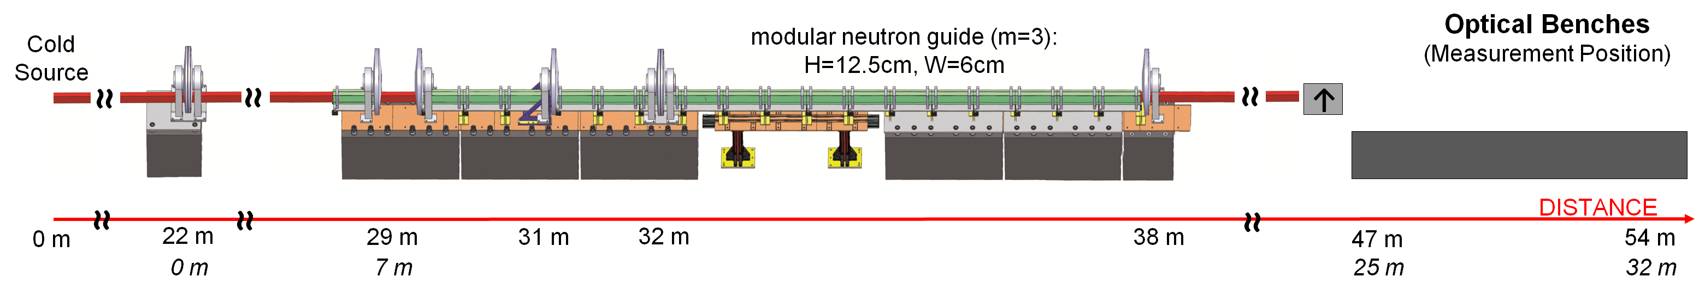
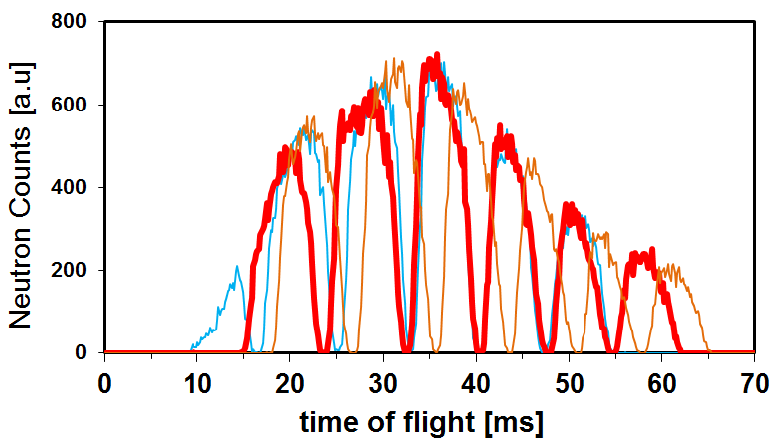
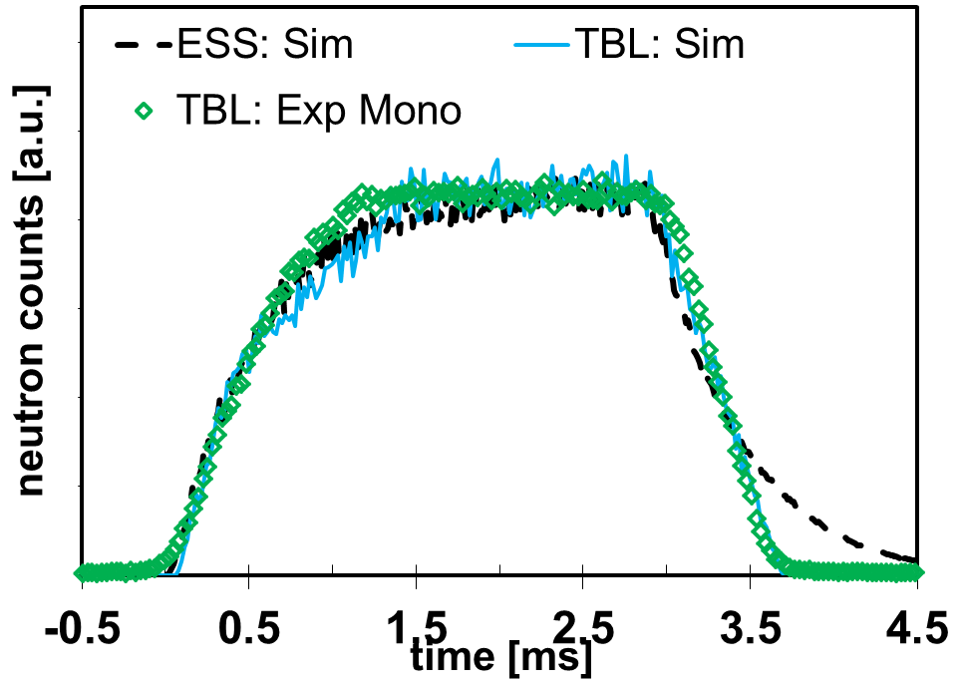
ESS Test beamline @ HZB (V20)
Source
Chopper
WFM
Chopper
WB
Chopper
FOL
Chopper
FOL
Chopper
Prototypes Wavelength Frame Multiplication (WFM) mode
Deployed ESS controls & DAQ stack with timing
DAQ architecture and Data Processing Methods

Slide 4
Chopper Time Distance Diagram

Slide 5
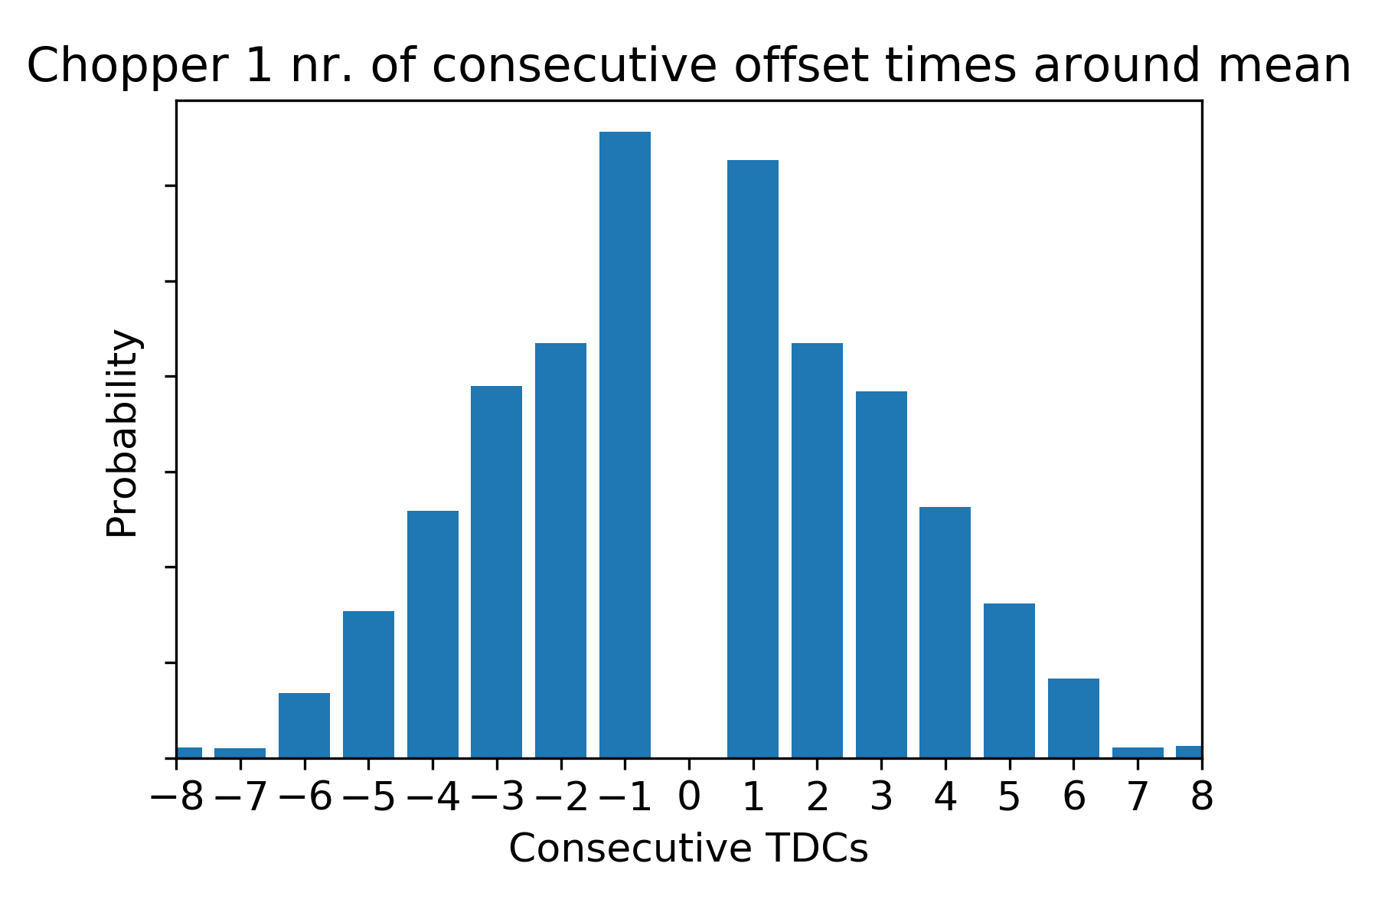
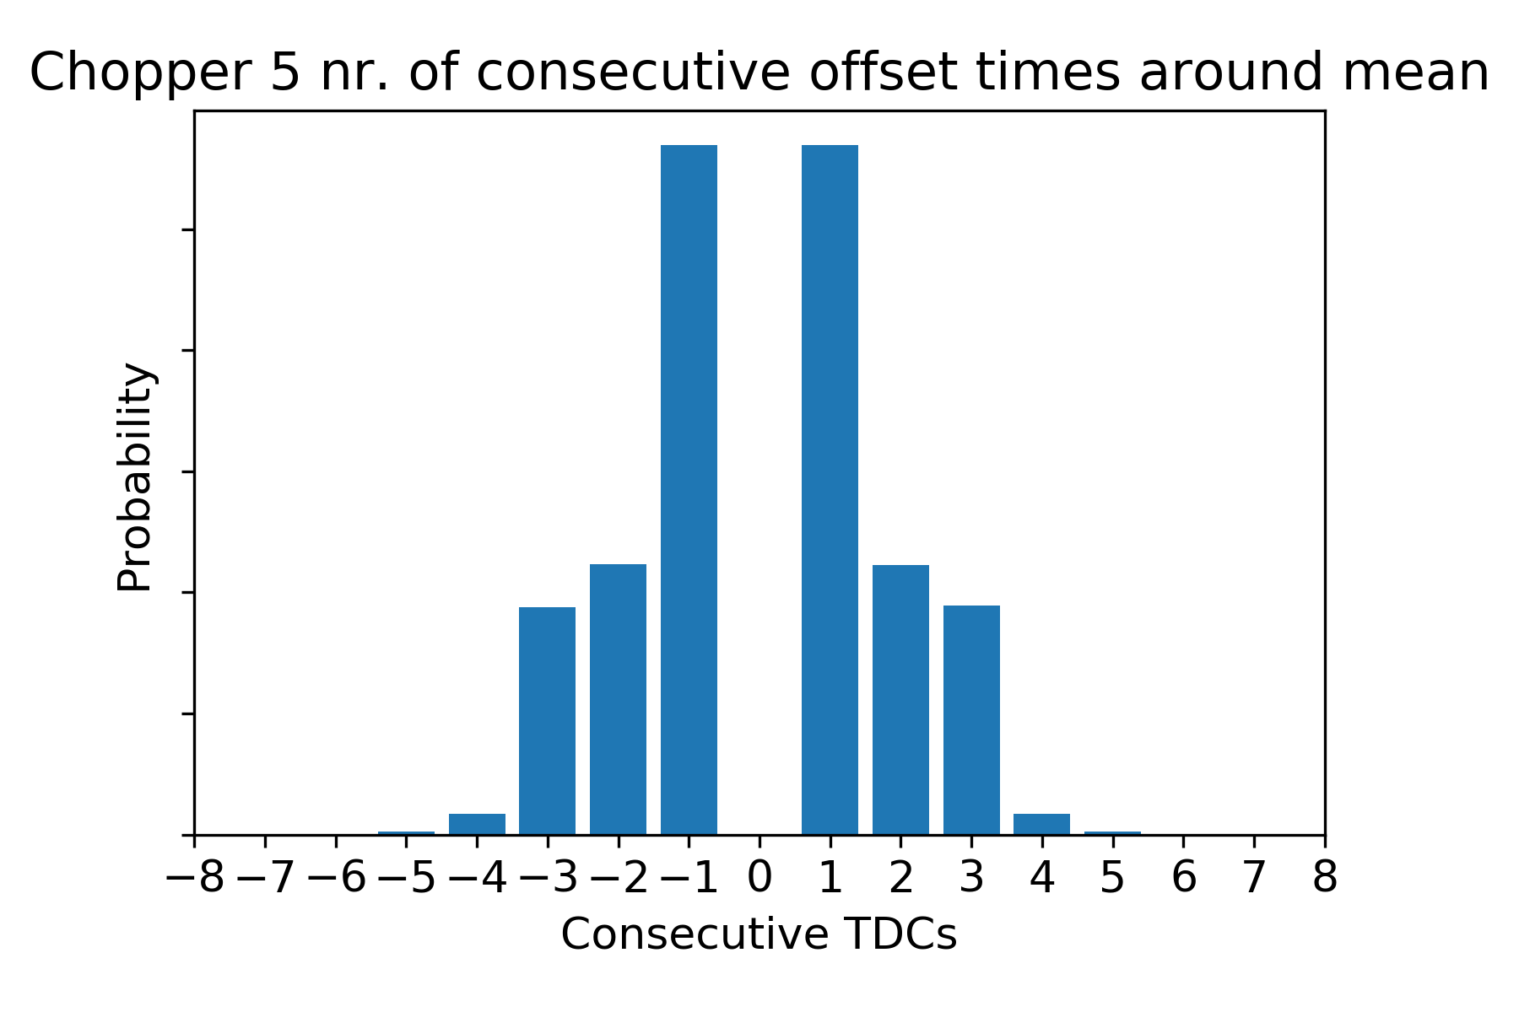
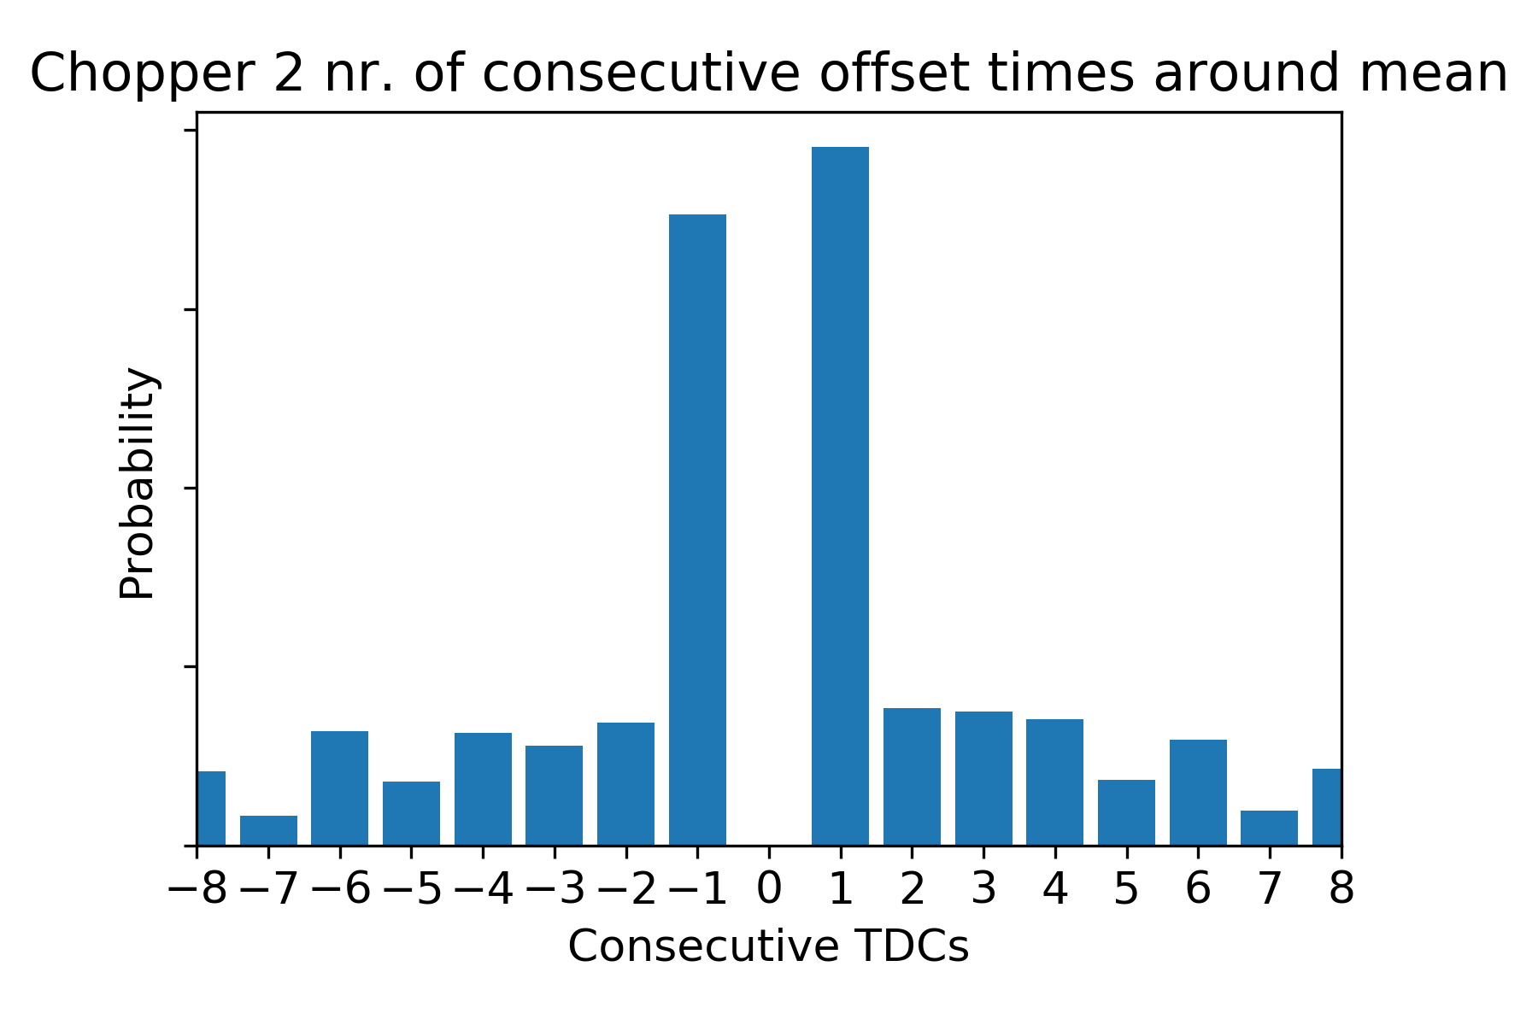
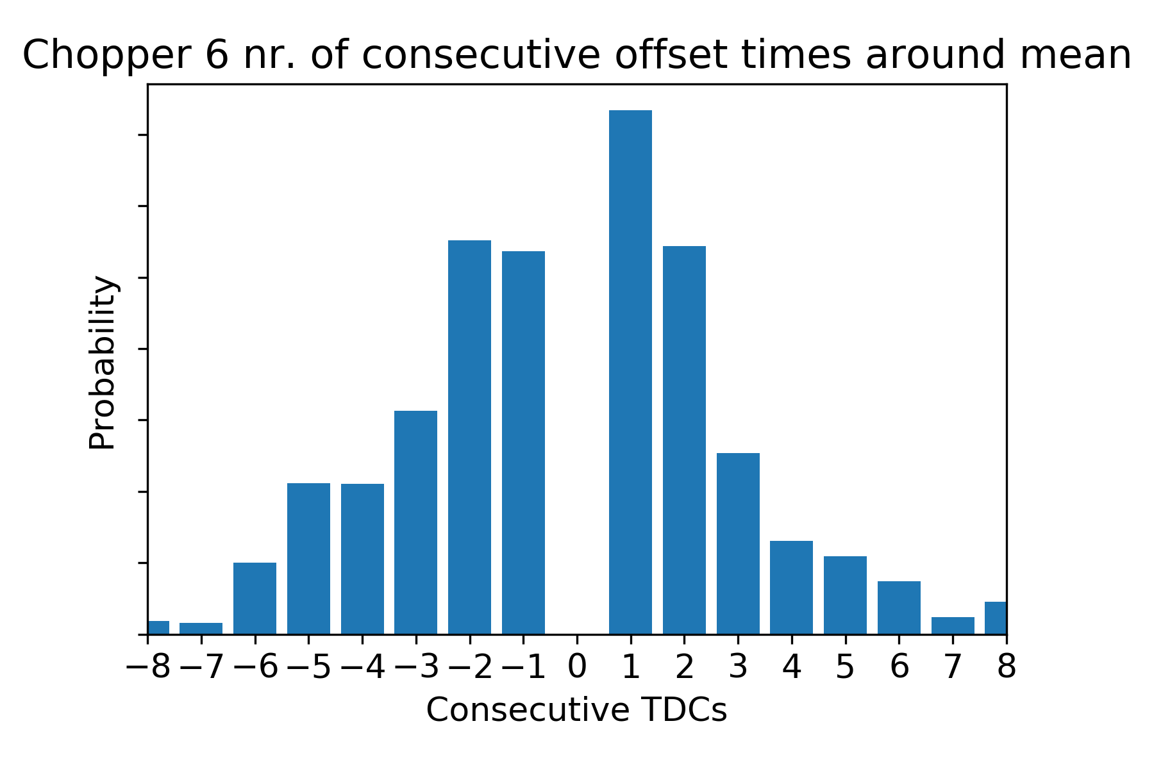
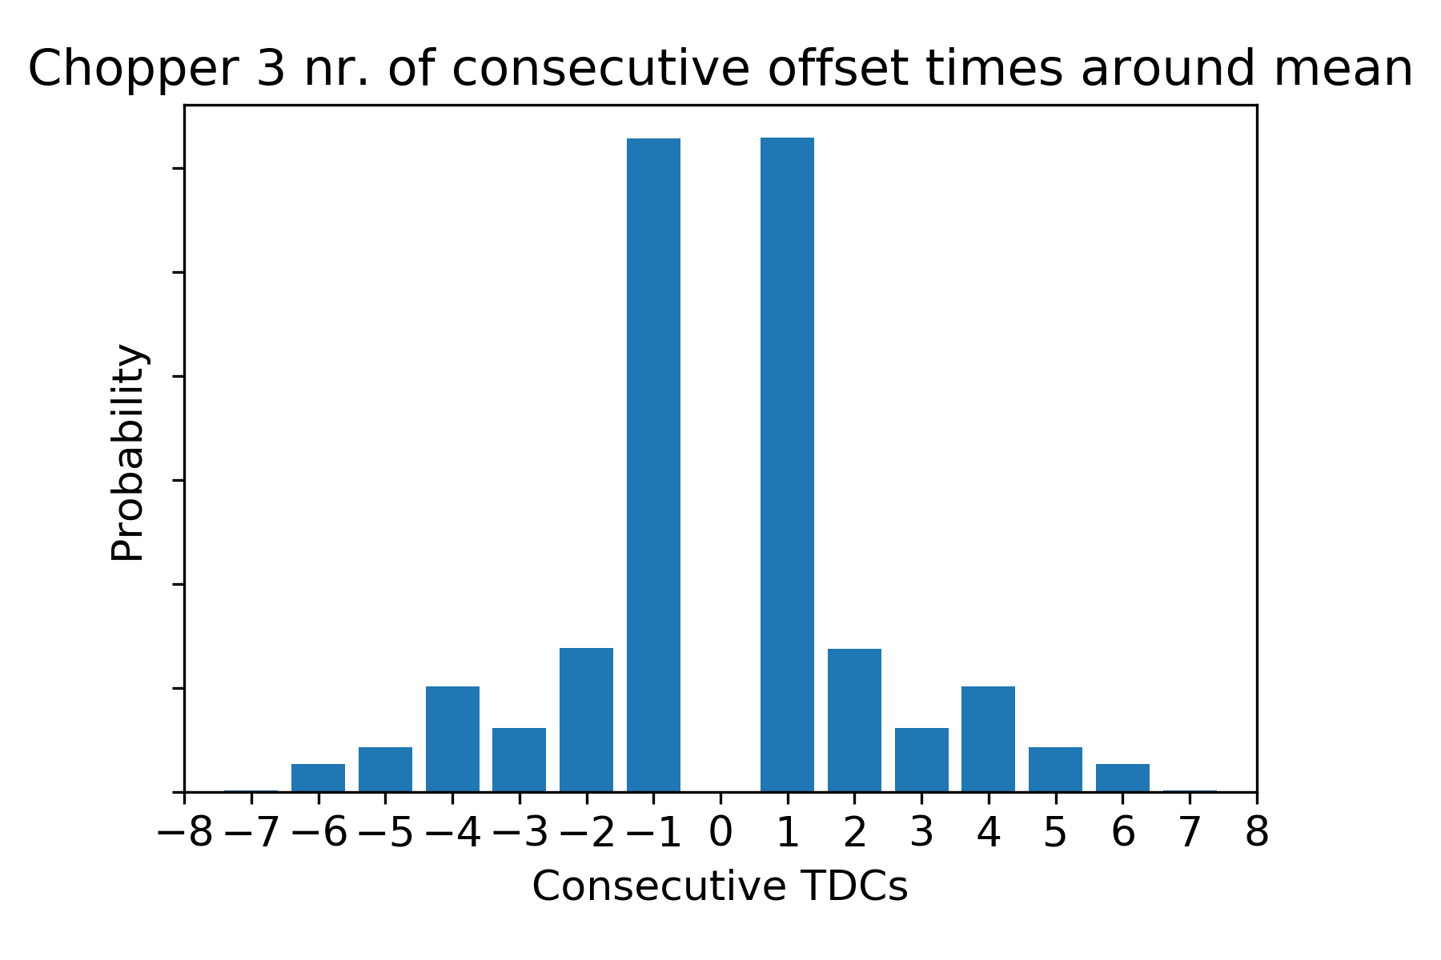
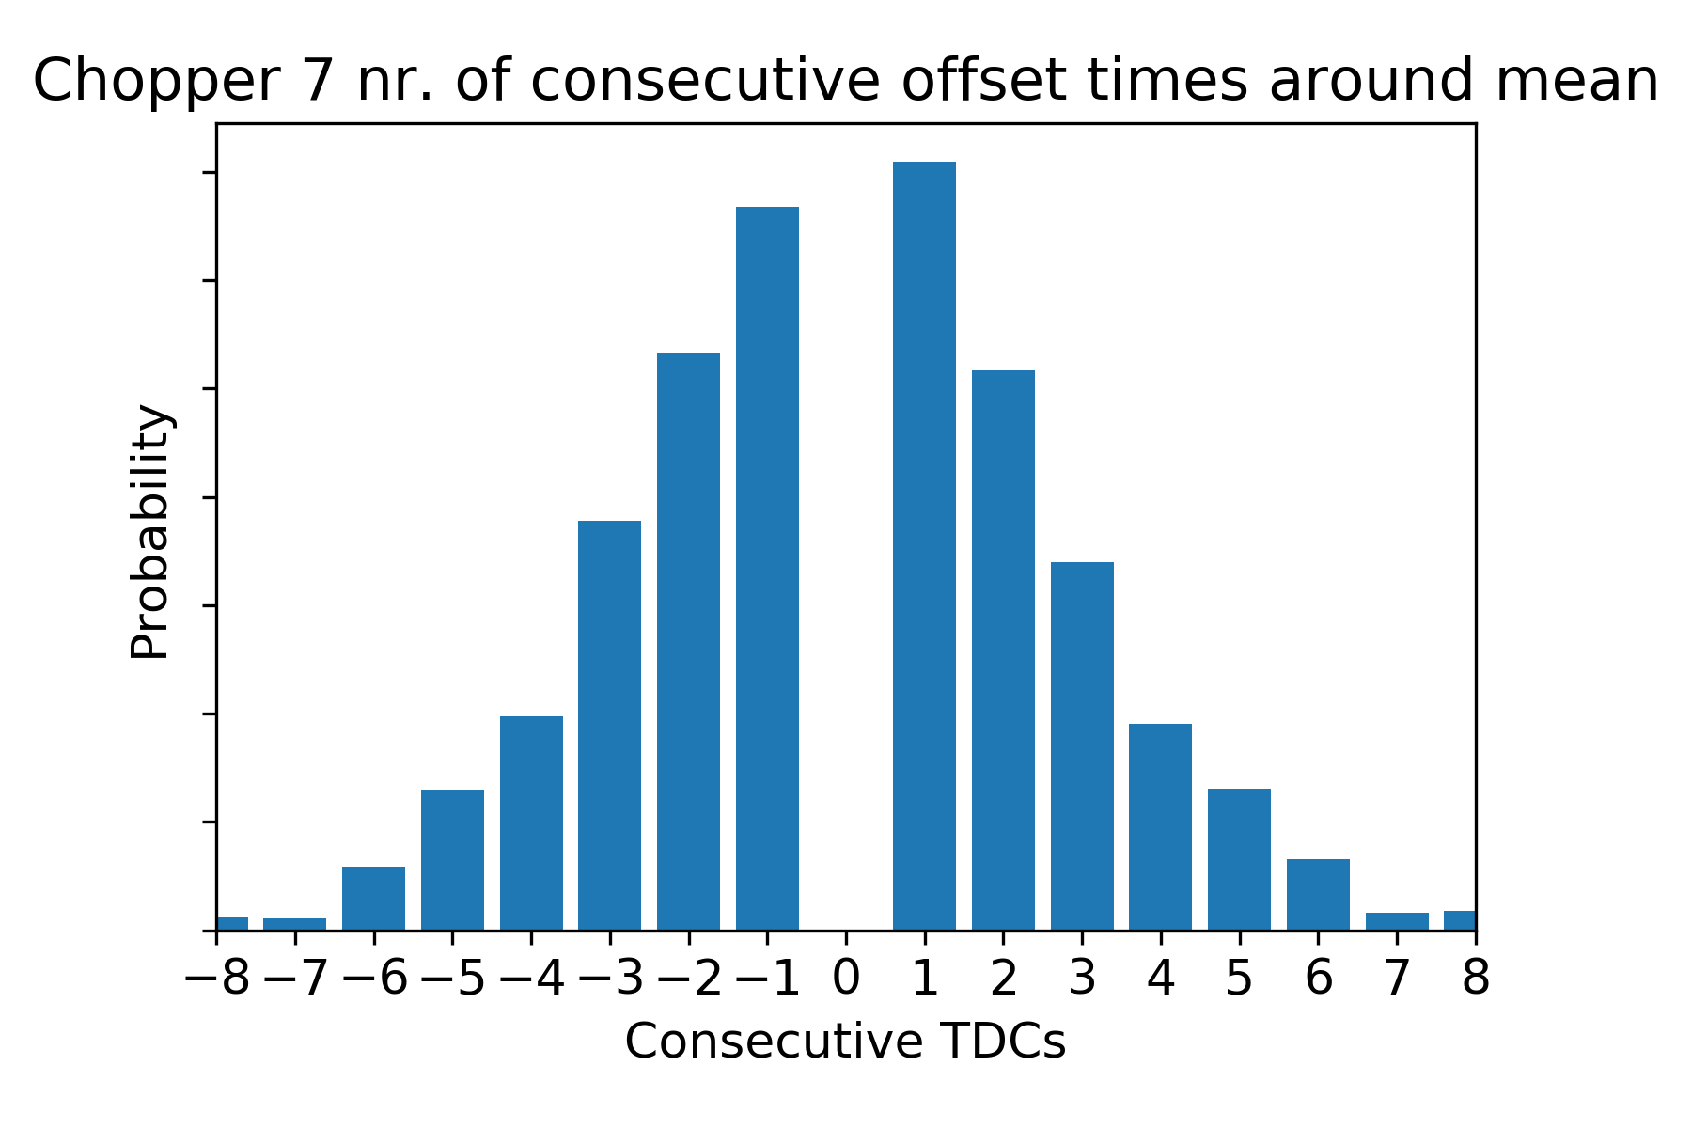
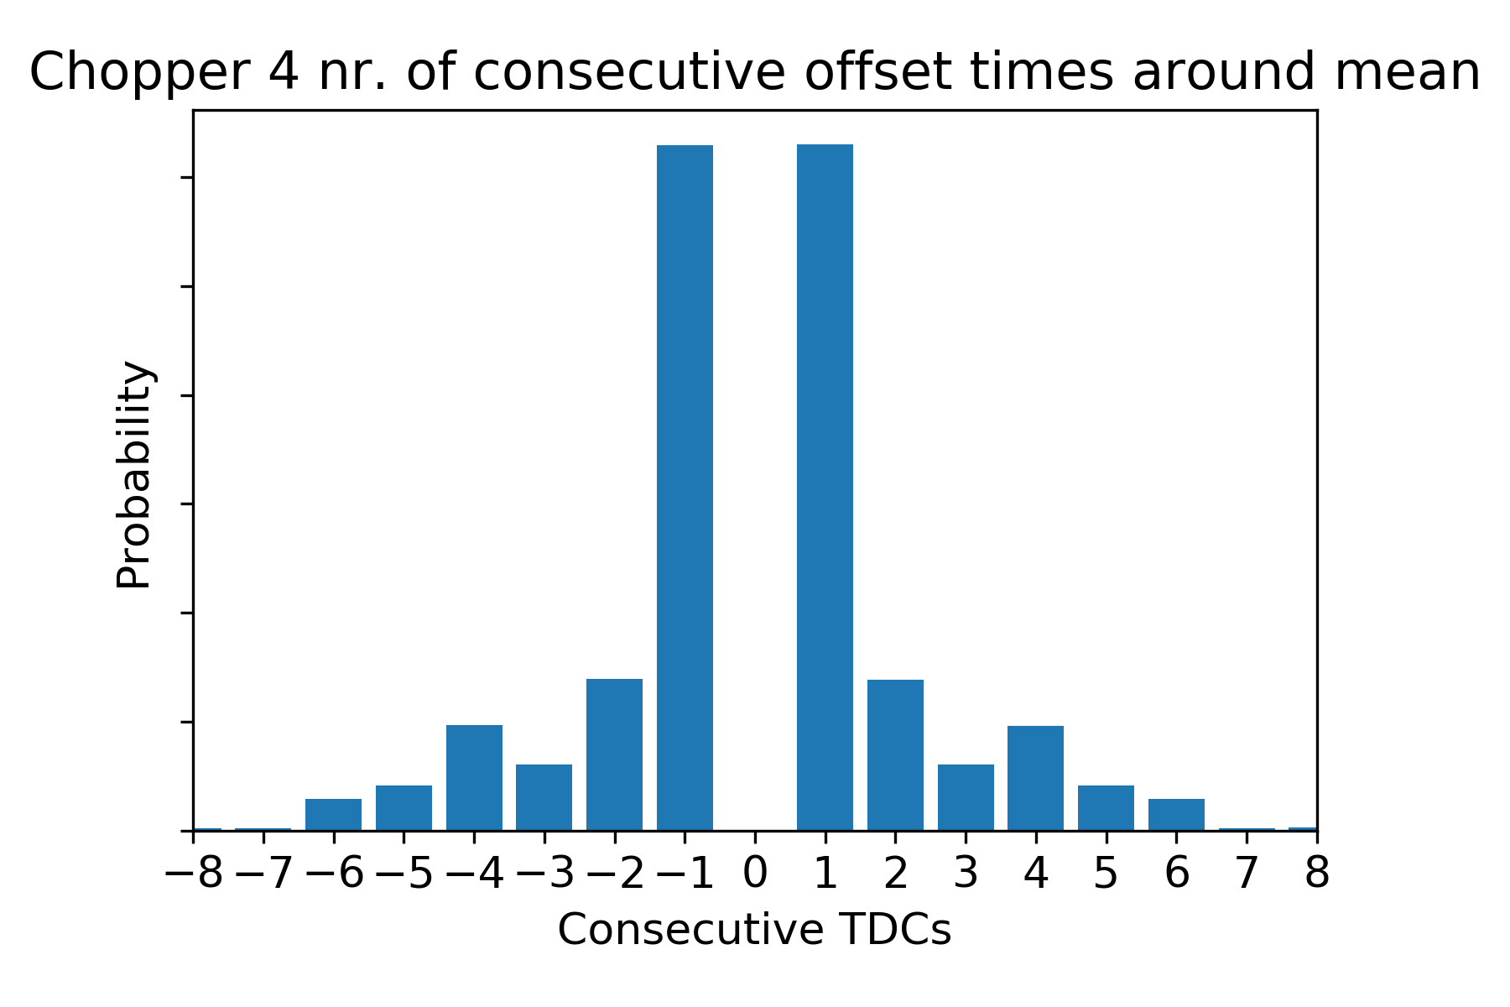
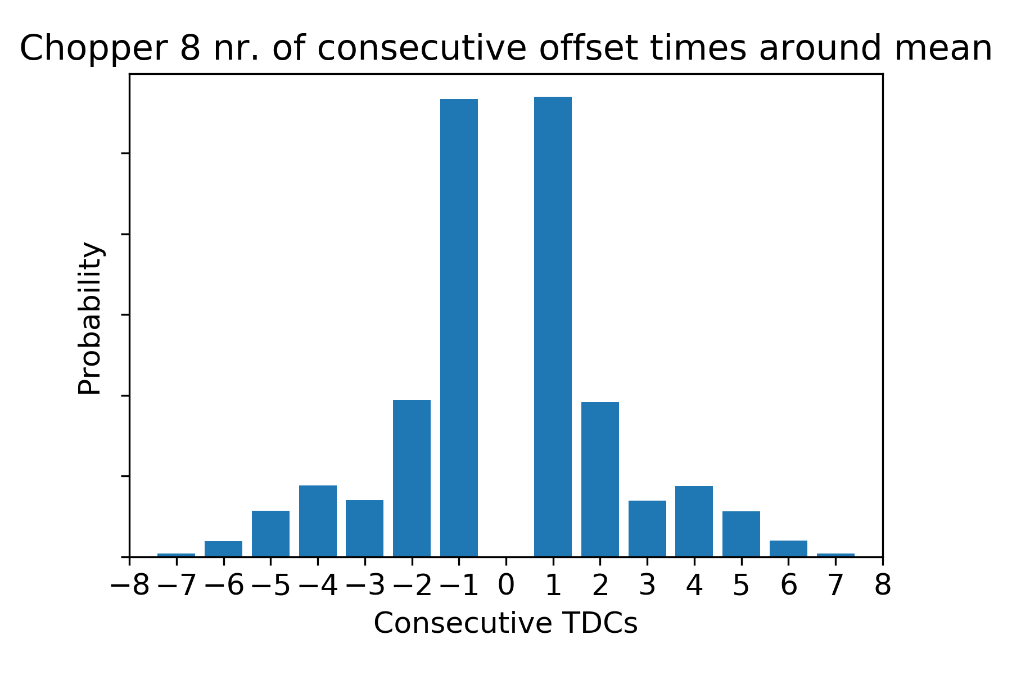

Slide 6
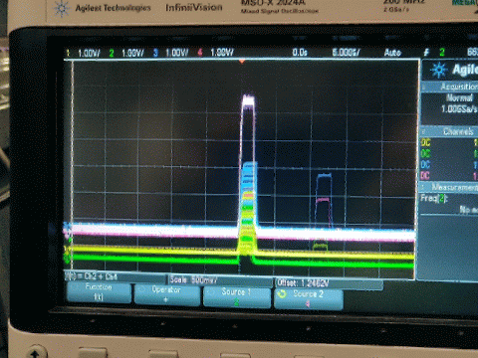
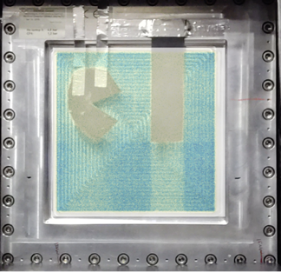
Timing Detector Events
V20 Delay Line Detector
4 wires and 1 cathode readout signals
Using same ADC readout demonstrator that was used for the monitors in earlier tests – with some analogue electronics
(unlike at ESS in operations)
Reconstructing detector image in software
(like at ESS in operations)
DETECTOR GROUP CONTROL & TIMING DEMONSTRATOR
ADC
TEST
STATUS
DATA
TIMING
CONTROL
JTAG
POWER

Slide 7
Unstitched
Raw Data

Slide 8

Stitched in Mantid

Slide 9
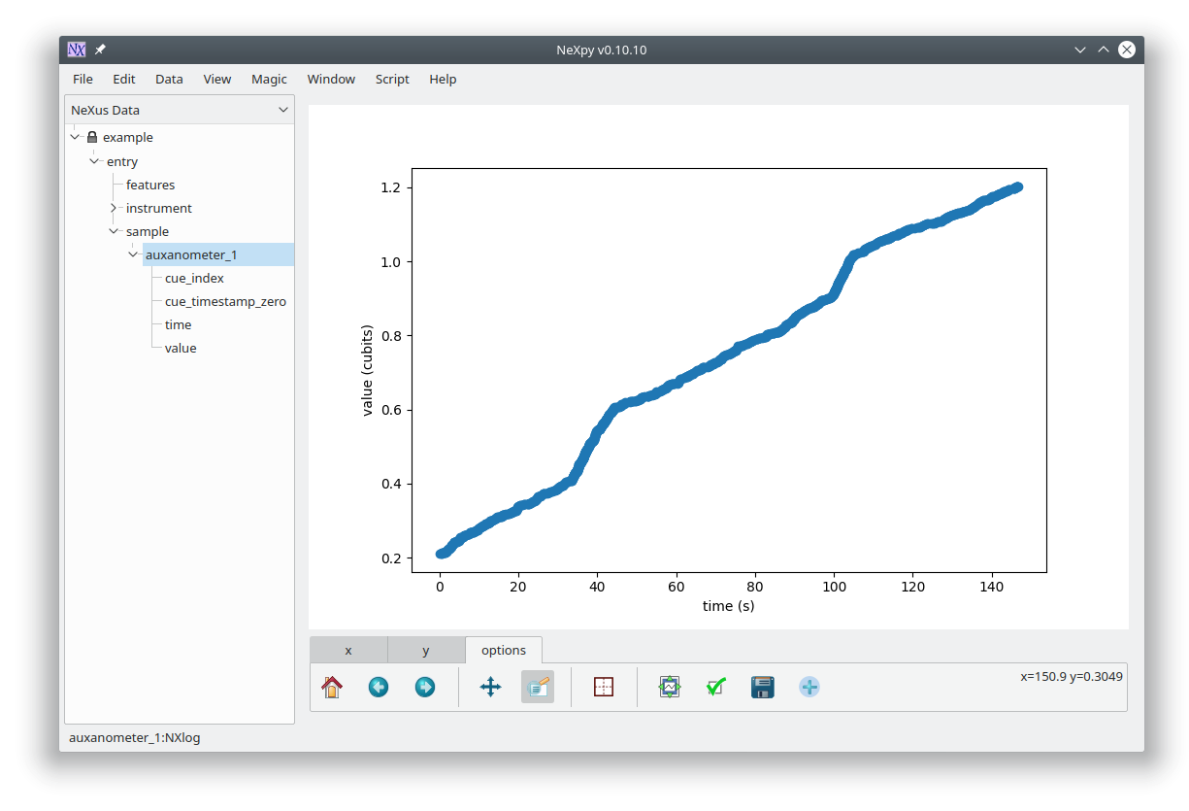
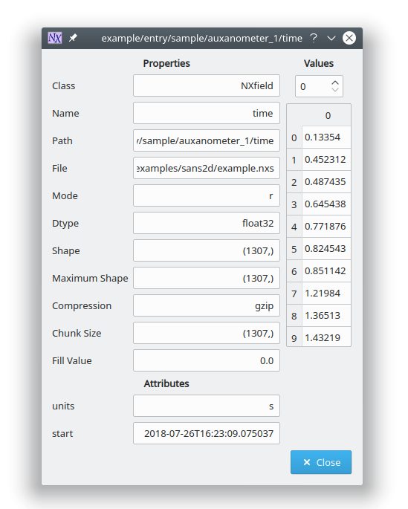
Timestamped Asynchronous Metadata
Any additional slow parameter like sample environment information can be recorded in sync by time stamping with the same GPS clock.

Slide 10
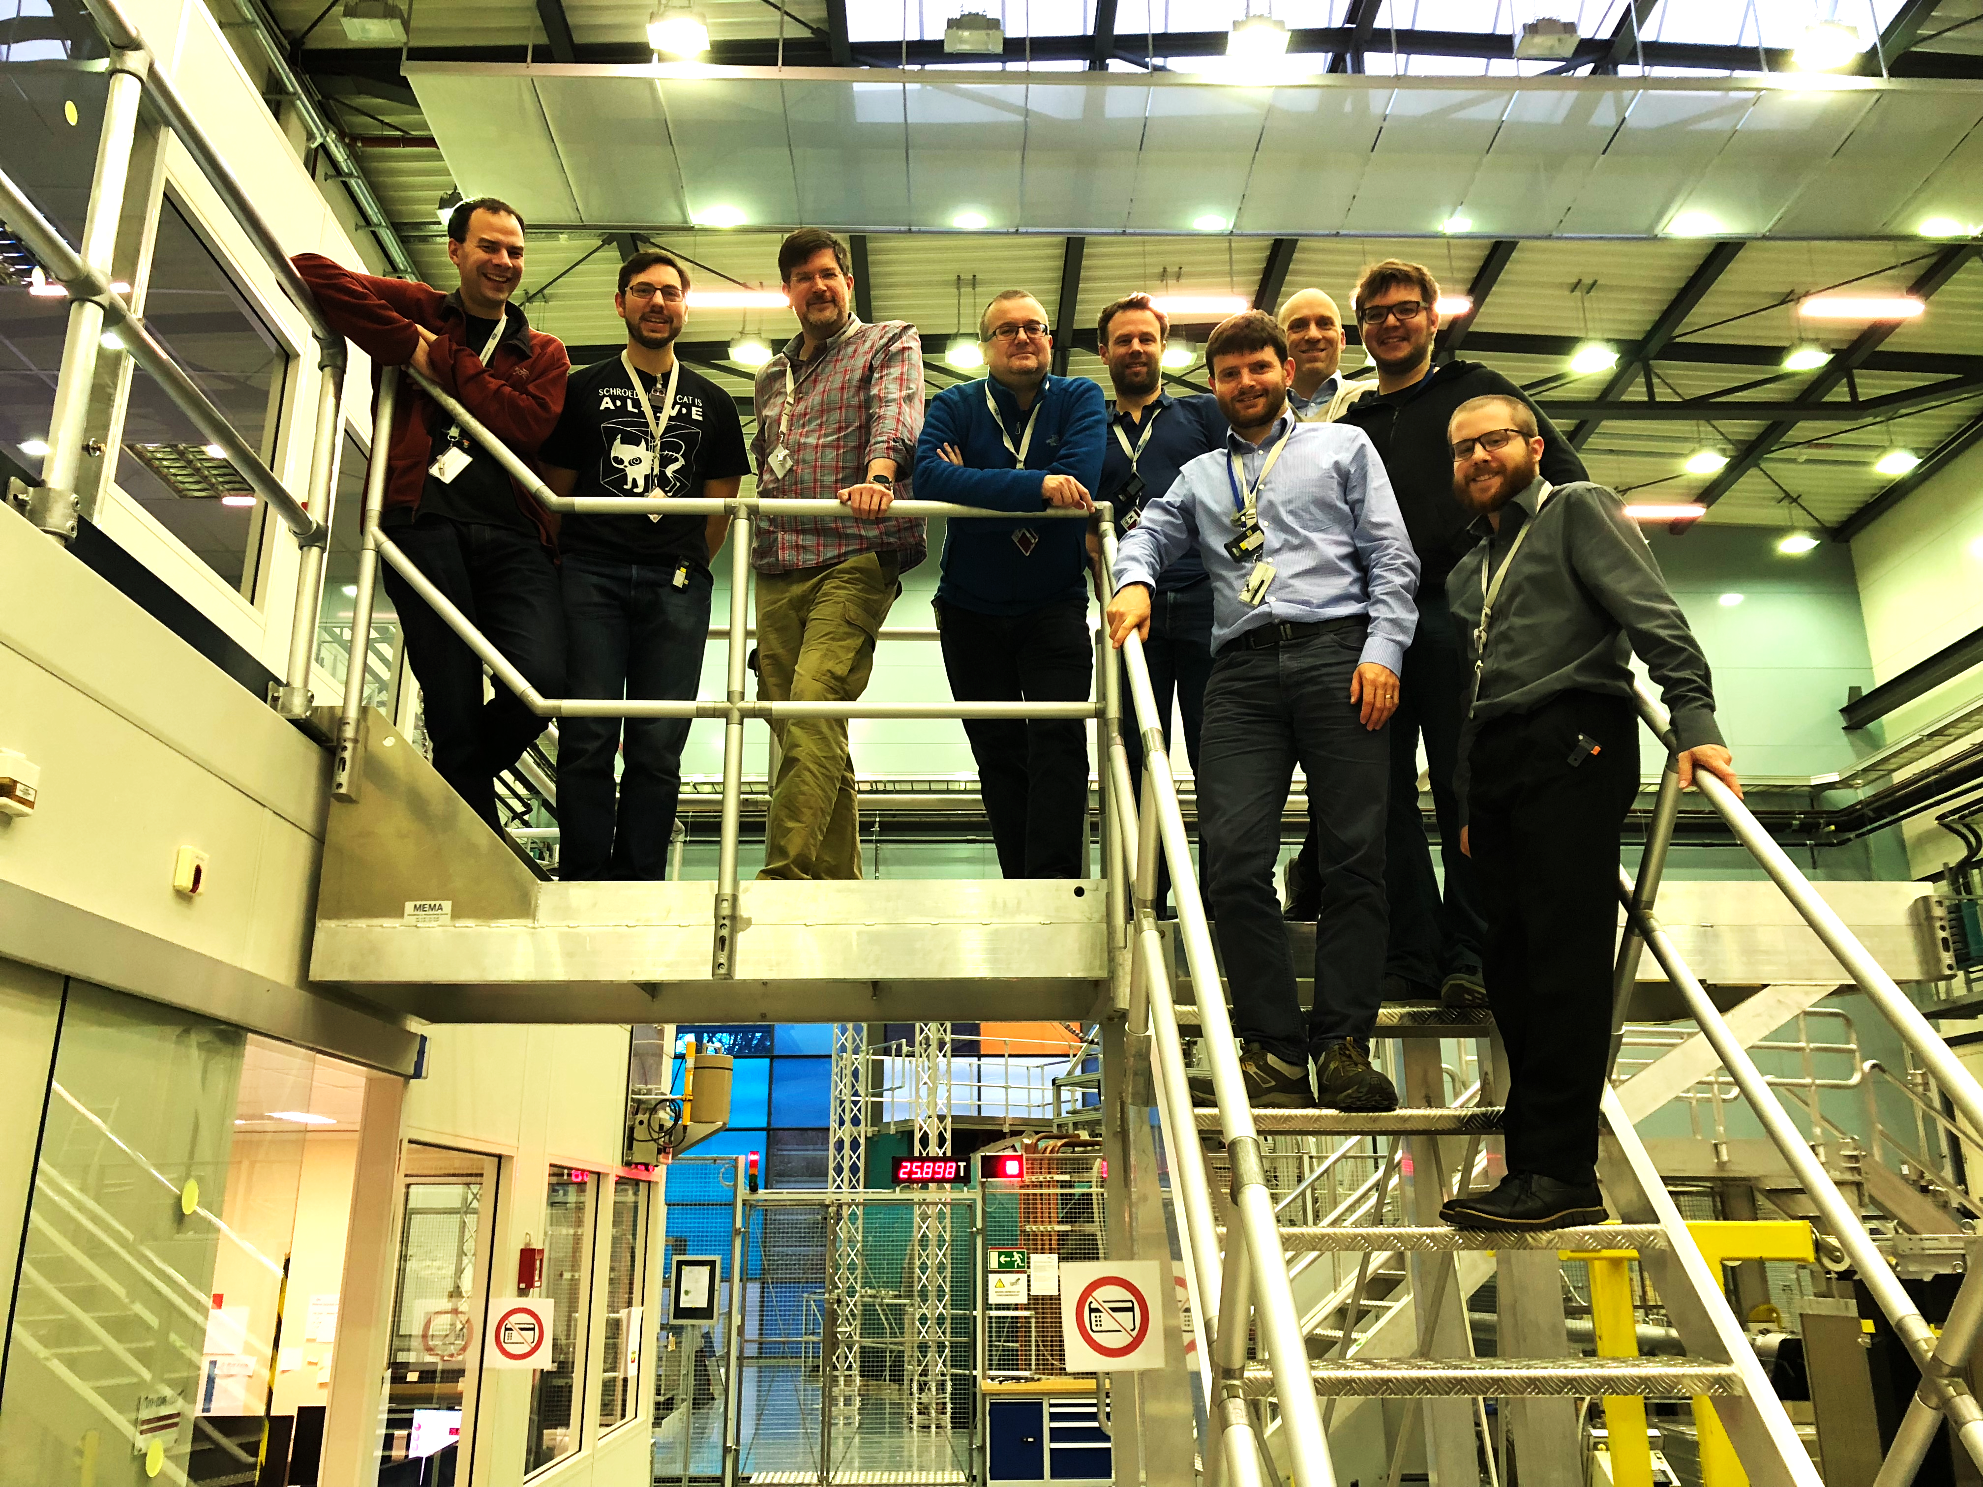
Summary
Acknowledgements
  Afonso Mukai
  Gregor Nowak
  Irina Stefanescu
  Jonas Nilsson
  Maria Romedahl
  Markus Olsson
  Matt Clarke
  Matthew D Jones
  Michael Hart
  Neil Vaytet
  Nicklas Holmberg
  Owen Arnold
  Peter Kadletz
  Robin Woracek
  Steven Alcock
  Torben Nielsen
  Wayne Lewis
  Will Smith
Timing system and referenced data acquisition work.
Running neutron detectors in a TTL-free setting can be done. Diagnostics capabilities exist.
Gathered useful data we continue to analyse
(e.g. for soft-veto).
Running through the full use case gives excellent input in where to improve.
More tests at V20 coming up throughout 2019.

