Slide 1
Online alignment survey for long components hidden under shielding
Sébastien GAUTROT LLB
February the 12th 2019

Slide 2
WHY?
Instruments specs at ESS:
- 20 m to 150 m of guide shielding
- 60 cm thickness concrete shielding
- 4m foreseen guide housings
- neighboring instruments won’t be built in the same time
If there is a loss of neutrons, where shall we open?
BECAUSE TIME IS MONEY!!!!!

Slide 3
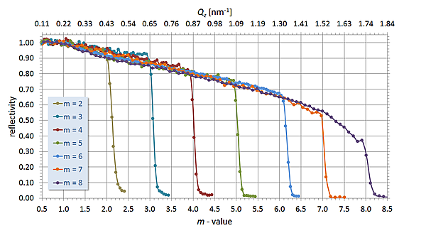
SOME NUMBERS
translation of 5mm OR rotation of 0,1° → Loss of flux ≈ 15%
30 mm
30 mm
Solution : Online alignment survey

Slide 4
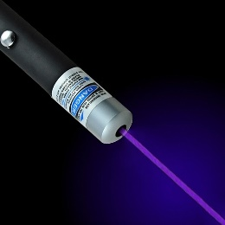
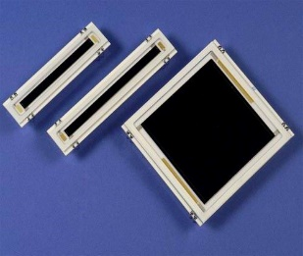
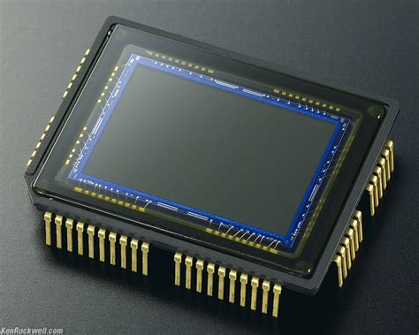
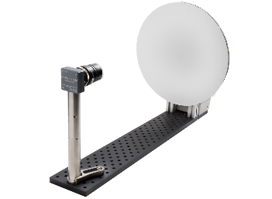
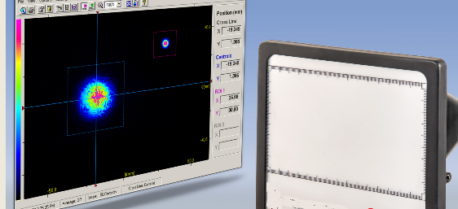
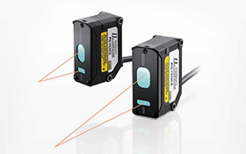
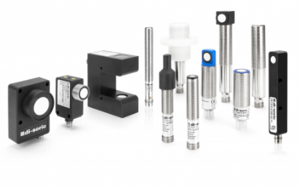
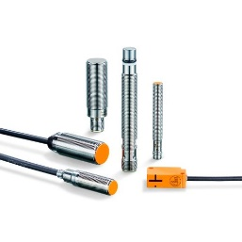
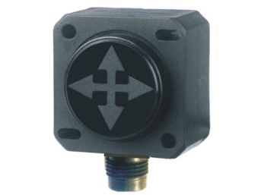
HOW WITHOUT CONTACT?
Laser + PSD / CCDsensor / camera
Distance photoelectric Sensors
Ultrasound detectors
Magnetic sensors
Inclinometers

Slide 5
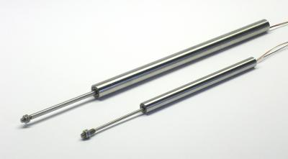
HOW WITH CONTACTS ?
LVDT probe sensors
Linear scales

Slide 6
MEASUREMENT CONSTRAINTS
Work in a dark and closed environment
Uncertainty (100-500 µm)
Repeatability
Low cost
Easy to install
Radiation resistant
Compact (400X400mm² with guide vessel)

Slide 7
PRINCIPLE
Laser + PSD / CCD / camera
target
laser
laser rotation of 0.1° = translation of beam on target
7mm at 4m
90mm at 50m
Absolute or relative measurement

Slide 8
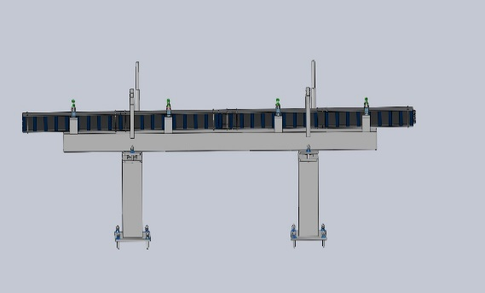
Laser + CCD
ABSOLUTE REFERENCE
For short instruments (to 40m/50m)
0,1° for a 40 m instrument = 70 mm translation
Precision ≤ 100µm and 2.10-3 °
Two lasers per housing to have translation and rotation
1 CCD 150X80 mm target on the bunker
Laser multiplexing
Y
Δα
X
Yo = original adjustment
Ym1 = shifting of the laser 1
Ym2 = shifting of the laser 2
If translation Ym2-Yo2=Ym1-Yo1
If rotation Ym2-Ym1=(X2-X1)sinΔα

Slide 9
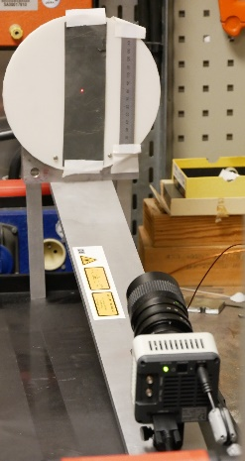
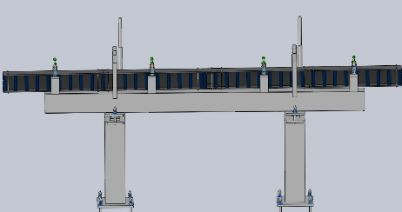
Laser + camera
ABSOLUTE REFERENCE
For instruments up to 80m
Y
1 camera imaging a Ø300 mm target on a wall of the bunker
Two lasers per housing to have translation and rotation

Slide 10
Laser + CCD or camera
ABSOLUTE REFERENCE
Advantage:
low cost ≈6000€ total for a CCD ≈8000€ total for a camera
Disadvantage :
limited up to 80m instruments
measurement 1 by 1
fine adjustement for lasers far from the sensor.
Impact on shielding?

Slide 11
Laser + PSD
RELATIVE REFERENCE
A reference on the bunker wall and a laser / PSD on each housing.
If we add an inclinometer, we can know if it is a translation or a rotation.
PSD
laser
inclinometer
1 PSD on a wall of the bunker as reference

Slide 12
Laser + PSD
Advantage :
easy to position
can be used on all the instruments.
Disadvantage :
price 950€ per housing in the industry.

Slide 13
Inclinometers
Add to laser solutions
Single?
Only the rotation in 2 axis If rotation or translation = effect on each housing? High precision inclinometer ≈ 0.01°
Need to study more

Slide 14
Inclinometers
Advantage :
easy to position and to install
can be used on all the instruments
very low price ≈ 200€ per housing
Disadvantage :
can not measure directly a translation
(but may be indirectly)

Slide 15
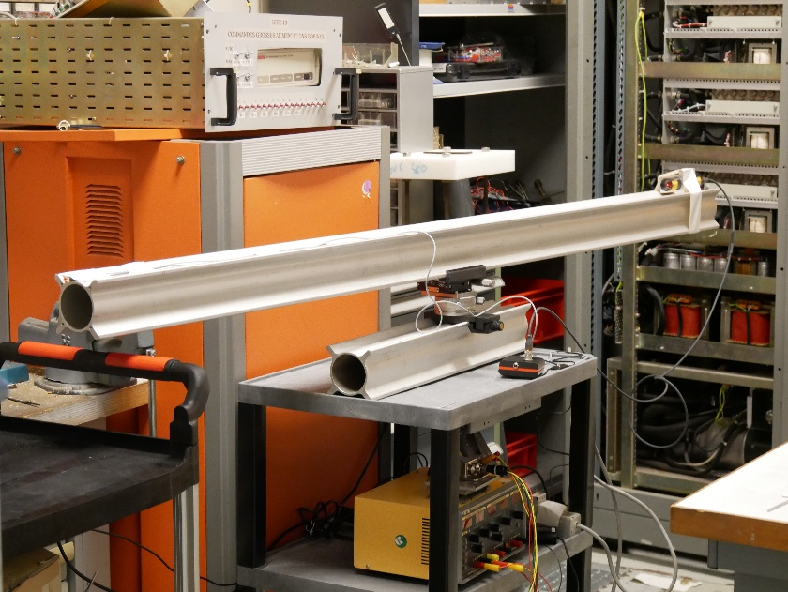
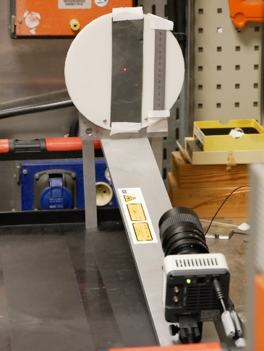
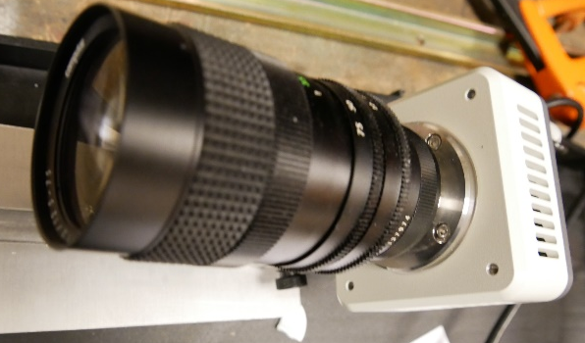
Bench Test
Target Surface Ø200mm²
Laser 1
Laser 2
Camera C11440-36U Hamamatsu
1920X1200 pixels with 1 pixel = 5,86µm
1pixel correspond to 167µm on target
Objective X30 at 500mm
rotation

Slide 16
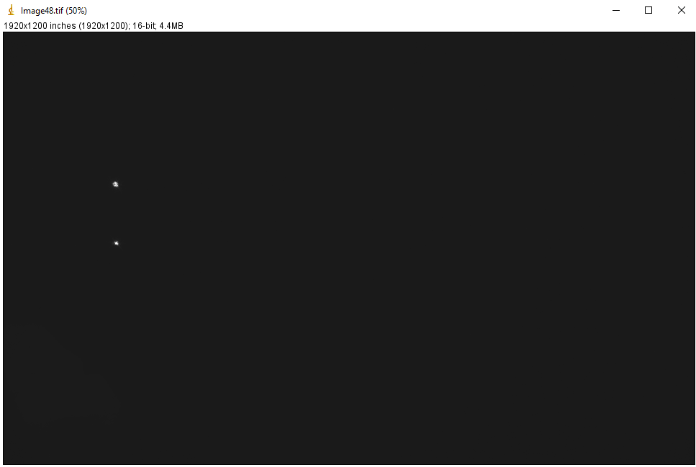
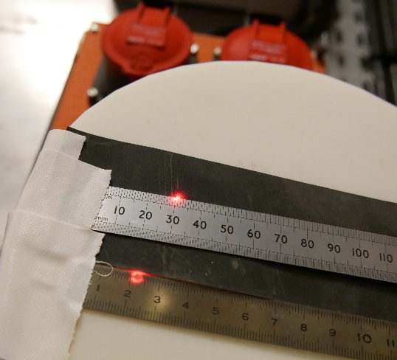
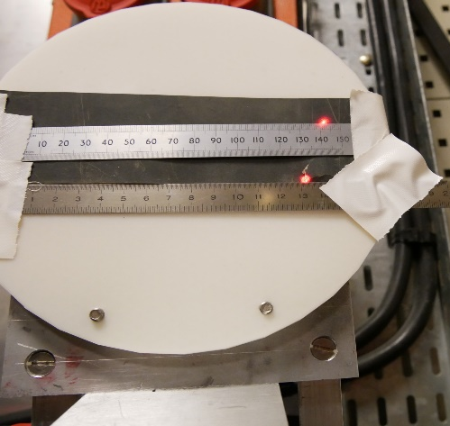
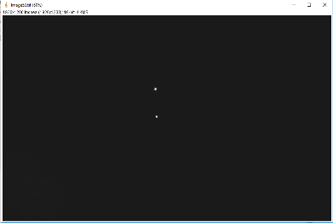
Some tests
2 Lasers + CCD / camera
Origin X1=312
X2=316
1° X1=512
X2=516
3° X1=896 X2=900
origin
3°
Problem :
no difference between the 2 lasers positions

Slide 17
The 2 lasers are one the same axis (carter), so no difference!
The ΔY is function of the rotation point and not of the laser position.
If pilar 1 move, so the rotation point is pilar 2

Slide 18
Laser + CCD or camera +inclinometer
Add a inclinometer and keep only one laser The same as a PSD.
1 2
L1
L2
Y
Problem at long distance to discriminate translation and rotation
At 12m/ 0,01°= 2mm
Need a 0,001° inclinometer (expensive).

Slide 19
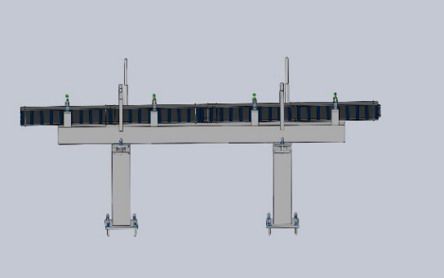
Control principle
The rotation depend on which pilar moves.
For rotation < 1° tanα = α
Y
translation = Y1-Y0
L1
1
2
L2
Y
angle - 1 down more than 2
rotation = Y1-Y0 = L2 α
1
2
Y
angle + 2 down more than 1
rotation = Y1-Y0 = L1 α
1
2
Y
Rotation and translation
YRotation = L1 α or L2 α (sign) translation = ΔY - ΔYrotation
1
2

Slide 20
Inclinometer
Calibration of a Pepperl 0,01° inclinometer
angle ° | U (mV) | Angle manufacturer | Fic caméra | Y | angle measuered
0,000 | 5 | 0 | 56 | 685,5 | 0,000
0,774 | 5,259 | 0,777 | 59 | 483,4 | 0,796
1,548 | 5,52 | 1,56 | 60 | 285,4 | 1,575
1,935 | 5,65 | 1,95 | 61 | 191,0 | 1,947
1,161 | 5,404 | 1,212 | 62 | 373,5 | 1,228
The incertitude of the inclinometer value will induce a incertitude on the translation on the target.
We can calculate it as : $δ$Tα = Tα $√$($\frac{δL^{2}}{L^{2}}+\frac{δα²}{α²}$)
For example : 0,5° at 1,3 m = 0,01°

Slide 21
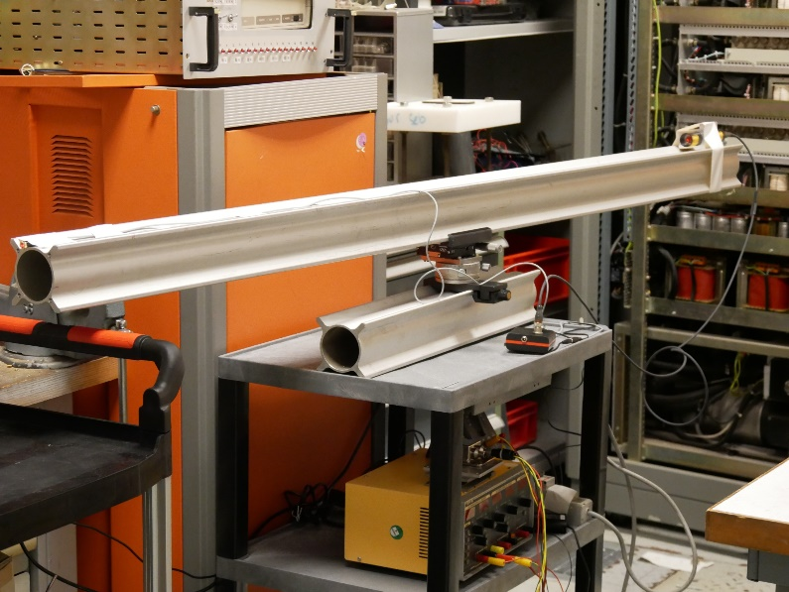
Measure of Linearity
Angle ° | Y | delta Y pixel | delta Y mm | delta pixel / 0,2° | delta mm / 0,2°
0 | 541,40 | 0 | 0
0,2 | 512,40 | 29,00 | 4,84 | 29,01 | 4,84
0,4 | 481,97 | 59,43 | 9,92 | 30,42 | 5,08
0,6 | 454,08 | 87,32 | 14,58 | 27,89 | 4,66
0,8 | 425,28 | 116,12 | 19,39 | 28,80 | 4,81
1 | 394,71 | 146,69 | 24,40 | 30,57 | 5,11
1,2 | 364,4 | 177,0 | 29,56 | 30,31 | 5,06
1,4 | 336,27 | 205,13 | 34,26 | 28,13 | 4,70
 |  |  | Standard deviation | 1,04 | 0,17
Rotation at 2 m of the target
Laser at 2,7 m of the target
Good linearity, with a precision of rotation of ± 0,01°
It is possible to measure small angle deviation < 0,01°

Slide 22
Online alignment survey for long components hidden under shielding
Stability
Measure every 10 mn in the same position
 | X | Y
4046 | 658.888 | 205,29
4046 | 658.729 | 205,75
4046 | 658.325 | 205,27
4046 | 658.422 | 205,10
4046 | 658.175 | 204,94
4046 | 658.197 | 205,15
4046 | 657.811 | 205,06
4046 | 658.009 | 205,49
4046 | 657.833 | 205,35
4046 | 657.767 | 205,48
4046 | 657.850 | 205,62
4046 | 657.944 | 205,72
4046 | 658.005 | 205,41
4046 | 658.061 | 205,68
4046 | 657.885 | 205,41
4046 | 657.927 | 205,50
moy (pix) | 658,10 | 205,39
sigma (pixel) | 0,31 | 0,24
sigma (mm) | 0,05 | 0,04
Very good stability 40µm on 3 hours

Slide 23
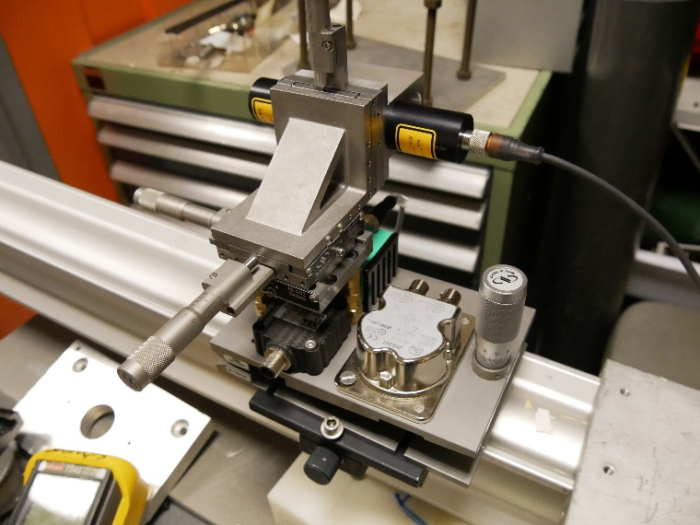
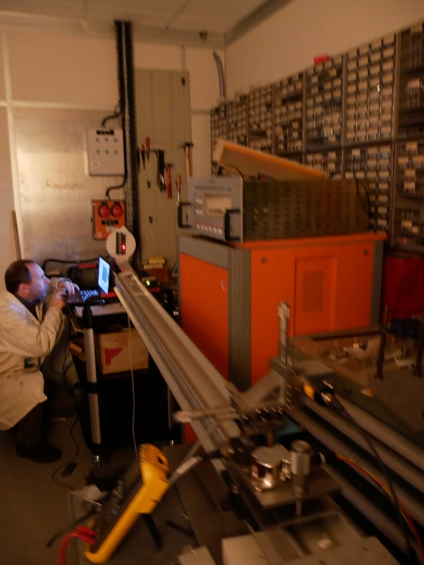
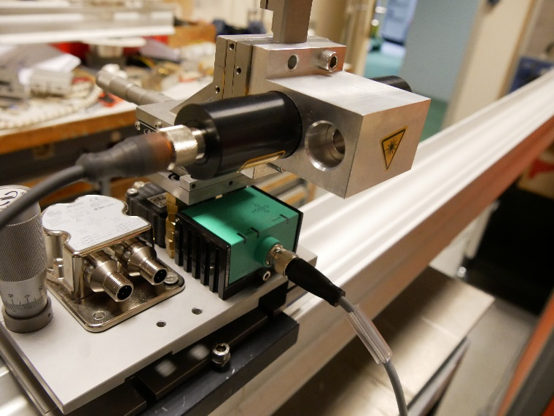
Precision of the process with a camera
Angle° | Trans mm | INCLINO | angle inclino | difference in mm angle | laserY | difference mm | translation
 |  | 4414 | 0 | 0 | 255,9 | 0,000 | 0
 | 2 | 4414 | 0 | 0 | 243,938 | -1,999 | 1,999
0.1 | 2 | 4376 | 0,114 | 2,53 | 258,582 | 0,449 | 2,078
0.2 | 2 | 4348 | 0,198 | 4,39 | 270,626 | 2,461 | 1,928
0.3 | 2 | 4314 | 0,3 | 6,65 | 284,452 | 4,768 | 1,881
0.4 | 2 | 4278 | 0,408 | 9,04 | 298,11 | 7,049 | 1,995
0.5 | 2 | 4245 | 0,507 | 11,24 | 311,4 | 9,269 | 1,969
0.5 |  | 4245 | 0,507 | 11,24 | 323,371 | 11,268 | -0,030
0.5 | 5 | 4245 | 0,507 | 11,24 | 294,133 | 6,385 | 4,853
 |  |  |  |  |  | standard deviation in mm | 0,0633
Precision of the translation $δ$Tx = $√$($δ²∆t$+$δ²Tα$)
For example : 0,5° at 1,3 m = 0,05mm
Good accordance between uncertainty calculation and measure
Precision of the process should be better with a PSD

Slide 24
conclusion
Several solutions from 200€ to 1500€ per housing of 4m
Mixing of solutions for long instruments
Can be used only in some strategic point
such setup can also be used for manual realignment during shutdown when/if laser tracker systems/ressources not available.
Exemple of Cost
for 50m instrument minimum ≈ 12000€
for 150m instrument maximum ≈ 40000€
The good questions are :
What is the price?
What is the benefit?

Slide 25
THANK YOU Open to any comment, discussion or information sebastien.gautrot@cea.fr

Slide 27
Focus on: Laser + PSD / CCD / camera Inclinometers
TECHNICAL SOLUTIONS
Incompatible solutions
Magnetic sensor very short distance between sensor and ref (10 mm)
Ultrasound sensor bad uncertainty for 1m between sensor and ref
LVDT probe sensors the sensor musn’t be in contact with the ref
Linear scales Limited distance (30 cm) for target uncertainty
photoelectric Sensors To expensive > 1800€ per housing

