Slide 1

Report on 2nd Grounding Implementation Workshop
(Lund, 6th December 2018)
IKON 16
Lund, 12th February 2019
Guido Vehres
Forschungszentrum Jülich GmbH

Slide 2
2ND Grounding Workshop Agenda
Summary from first Workshop
Electrical aspects of Grounding
Electrical design for instruments halls
Electrical design rules.
Electrical safety of zoning concept
Personal Safety System
Summary
Workshop chair: Thomas Gahl
Technical advisory panel: Peter Göttlicher (DESY),
Roland Lundberg (ONE Nordic),
Guido Vehres (JCNS)

Slide 3
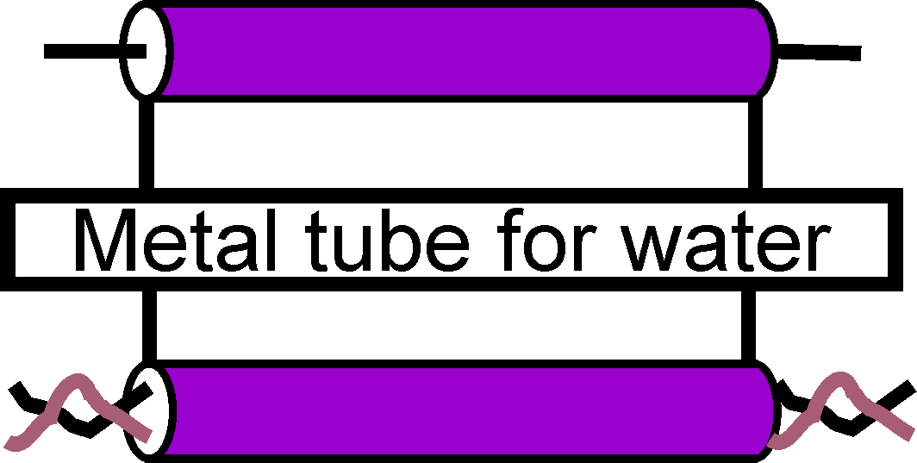
Basics “typical coupling”
Impedance coupling
Magnetic coupling
Helpful things:
Impedance coupling
Minimize a shared conductor
Shared conductor can be any metal piece in the system used for the signal and the reference path.
Magnetic Coupling
Control currents and returns
Minimize loop sizes
Enforce no overlaps even if current uses other metal systems like pipes
Source Rd. Peter Göttlicher, Dipl. Ing. Karl-Heinz Otto
Frequency range DC..100Mhz

Slide 4
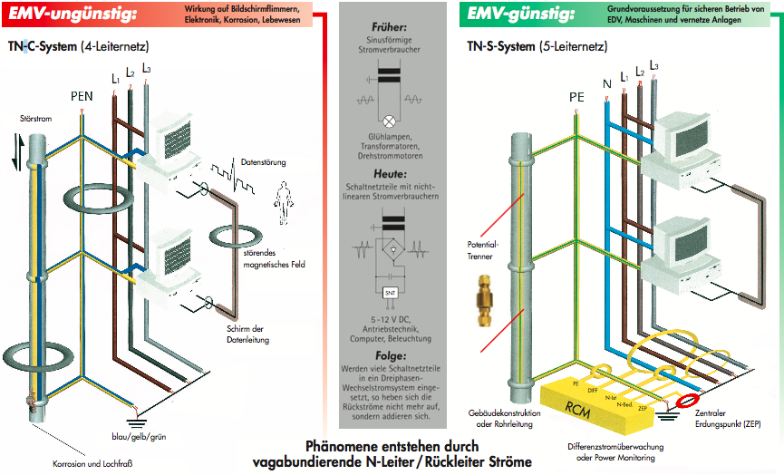
GRID: basics TN-S system
Source Dipl. Ing. Karl-Heinz Otto

Slide 5
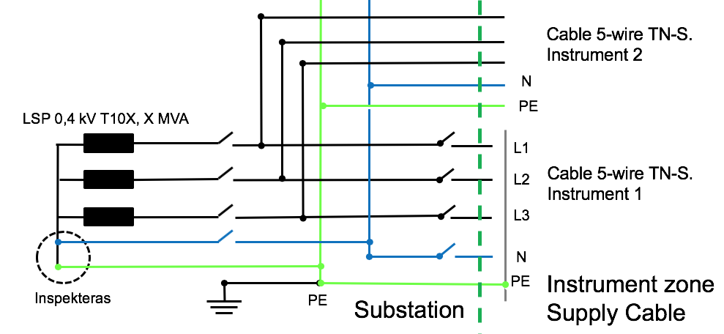
Electrical Power Infrastructure
General Recommendations I
Only TN-S (3L + N +PE) allowed.
Connection of N+PE only in substation allowed.
Only circuit breakers 3L+N and L+N allowed

Slide 6
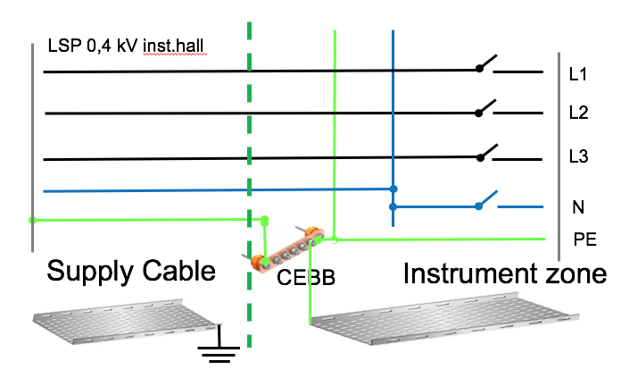
Electrical Power Infrastructure
General Recommendations II
A small equipotential bonding bar (EBB) is the Zone Entry Point (ZEP) and acts as the central star point of the grounding installation inside the zone (incl. cable trays)
ZEP is connected to the earthing terminals of the respective substations (PE of power cable + additional single conductor PE cable).
External part of the cable tray needs to be bonded to local ground.

Slide 7
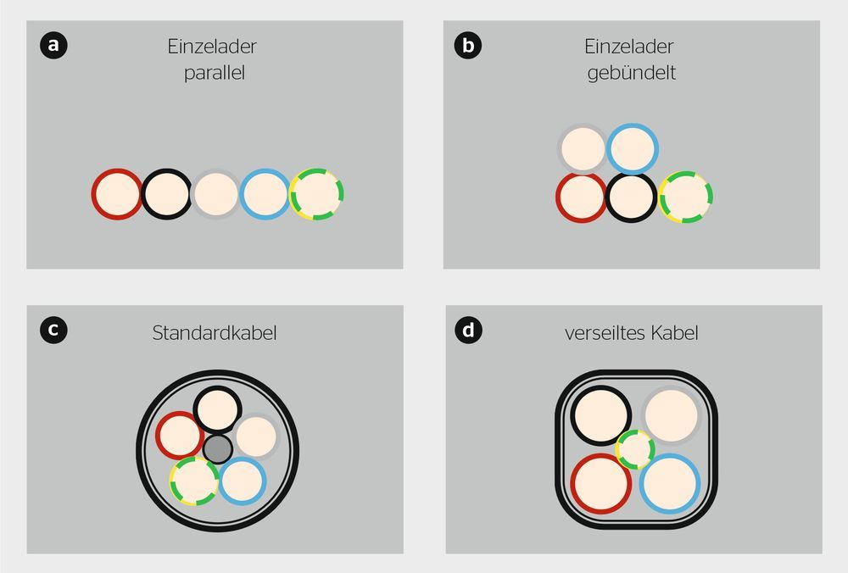
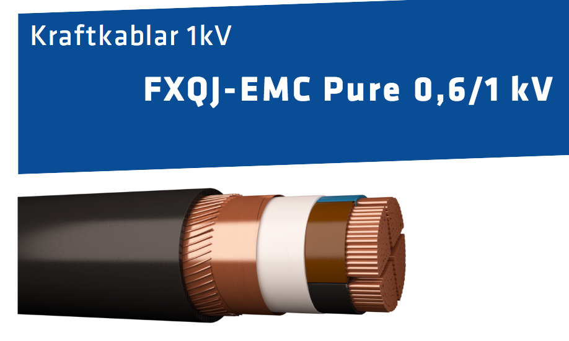
Electrical Power Infrastructure
Power cables
Power cables: 4 wire cable, EMC shielded (3L+ N +PE-shield).
If necessary add additional PE cable
Power cable and associated PE cable side by side (=same metal cable tray).
Section of extra PE cable needs to be calculated according to safety aspects
✗
✗
✗
✓
Source CFW-EMV-Consulting

Slide 8
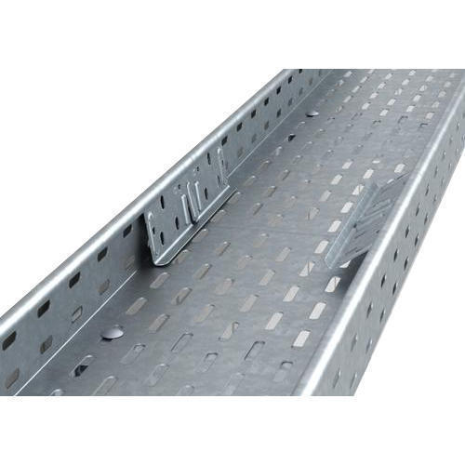
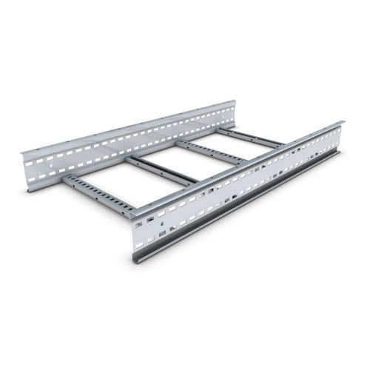
Electrical Power Infrastructure
Cable trays
Strong recommendation from the Technical Panel to use U-shape open cable trays.
The cable trays shall be connected to each other along the whole way from substation to the instrument zone entry point. Interconnections of tray parts with flat metal braids.
Cable trays shall be connected to local grounds along the way, especially at the start and end points.
Cable tray from the substation shall be isolated from ZEP.
✗
✓

Slide 9

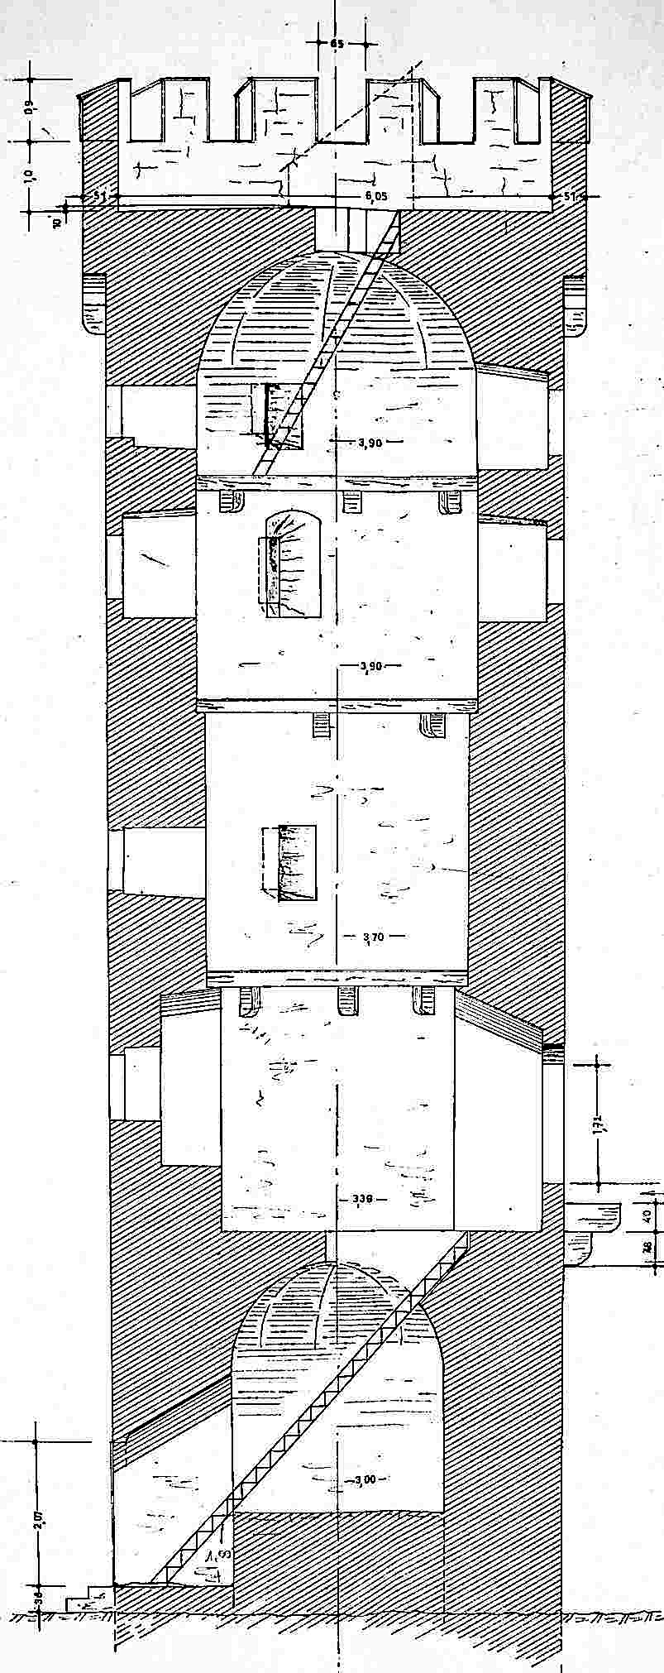
Zone Entry Point (ZEP)
Each instrument zone shall have only a single point where utilities, cables and other metallic structures pass through the otherwise isolated zone boundary (as defined in the first Grounding Implementation Workshop).
At this point a small equipotential equilibration bar is mounted in isolation serving as the central star point of the grounding installation inside the zone: The Zone Entry Point (ZEP)
Installations from outside that can pass the ZEP:
  L + N wires of the power cable
  Optical fibers (without steel braid reinforcement)
Installations that are connected to the ZEP:
  PE wire of the power cable, additional PE cable
Installations to be isolated before passing ZEP:
  Cable trays
  utilities piping/tubing
  i.e. compressed air, cooling, vacuum
Entry point
Source Thomas Gahl, Peter Burkhart

Slide 10
Connections at the zone entry point
All metal installations from outside the zone shall be connected to local ground before being isolated and entering the zone:
  Cable trays
  utilities piping/tubing
  i.e. compressed air, cooling, vacuum
All metal installations + the PE + the Equipotential Bonding Bars (EEB) from inside the zone shall be connected to the ZEP.
Each instrument zone shall have its own power distribution panel located at the zone entry point.
Power panel, measurement equipment, ZEP and the utilities isolation could be installed in one standardised cabinet.
More details in Thomas talk
Entry point
Source Thomas Gahl, Peter Burkhart

Slide 11
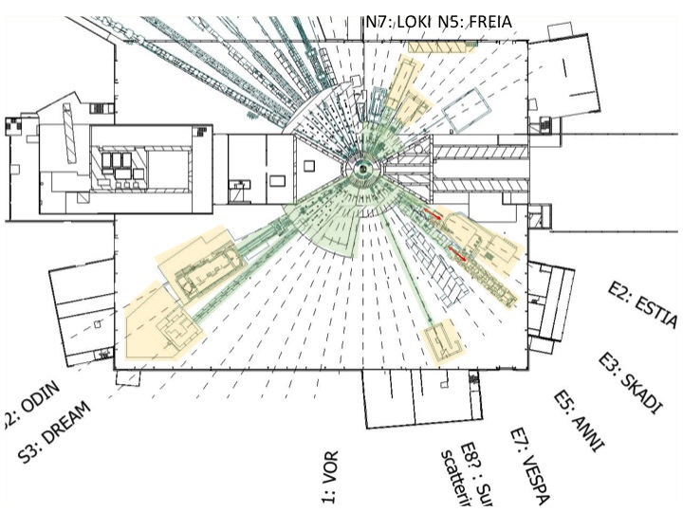
Designated zones for short/medium Instr. D01 and D03
Green:
Common Zone,
(Bunker and instruments
in D01 and D03)
Yellow:
Instruments Cave Zone,
Instr. Auxiliary Zone
11

Slide 12
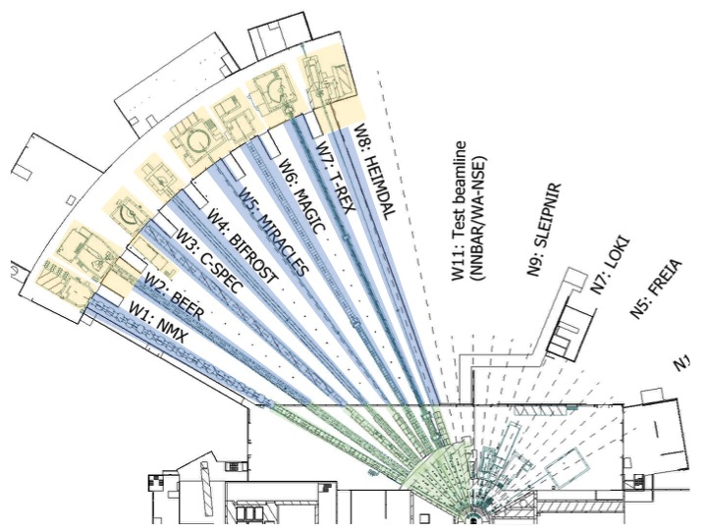
Designated zones for long instruments
E01, E02, D03
Green:
Common Zone, Bunker
Blue:
Intermediate Zone
Yellow:
Instruments Cave Zone,
Instr. Auxiliary Zone
12

Slide 13
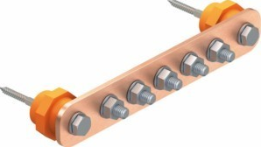
Installation Yellow Zone
Cave Zone, “the sensitive zone”
EBB along the walls inside the cave, connected to the ZEP.
No closed loop of the EBB inside the zone !
Material of bar: Copper
Holes / Threaded holes to connect conductive equipment to EBB
Isolated, sensitive equipment shall be connected directly to the ZEP with an isolated bonding wire (clean earth concept).
Cable trays can be mounted directly on the cave wall (as the wall is integral part of the zone).
Cable trays are connected to each other and to the ZEP.
EEB = Equipotential Bonding Bar , ZEP= Zone Entry Point
13

Slide 14
Installation Blue Zone
Intermediate Zone (long instruments only)
Cable tray along the beamline shall be mounted outside the beamline shielding.
Cable tray shall be mounted isolated to the building (floor, shielding wall).
Interconnection of tray parts like above, tray shall be connected to the ZEP.
The tray will be used as EBB, an additional (uninsulated) copper cable along the tray could be used to lower the resistance.
Conductive beamline equipment (neutron guide housing) shall be connected to the tray on both ends for equipotential bonding.
Intermediate connections shall be foreseen every 10-20 meters.
If we have a gap in the neutron housing (windows in the beamline), both sides of the gap shall be connected to the tray.
Small grounding loop for choppers as created between rack, chopper spindle and baseplate are acceptable.
14

Slide 15
Installation Green Zone
Common zone (green), “the dirty one”
Bunker and other parts of the common zone will be a normal industrial solution (meshed grounding connections, everything on everything).
Within bunker: conductive equipment, cable trays and construction elements shall be connected to local grounding points.
Details need to be defined with the bunker design.
Outside bunker: like intermediate zone but no isolation of tray against the building necessary. Tray shall be connected with a PE cable to the EBB of the power distribution cabinet, side by side with the power cable.
15

Slide 16
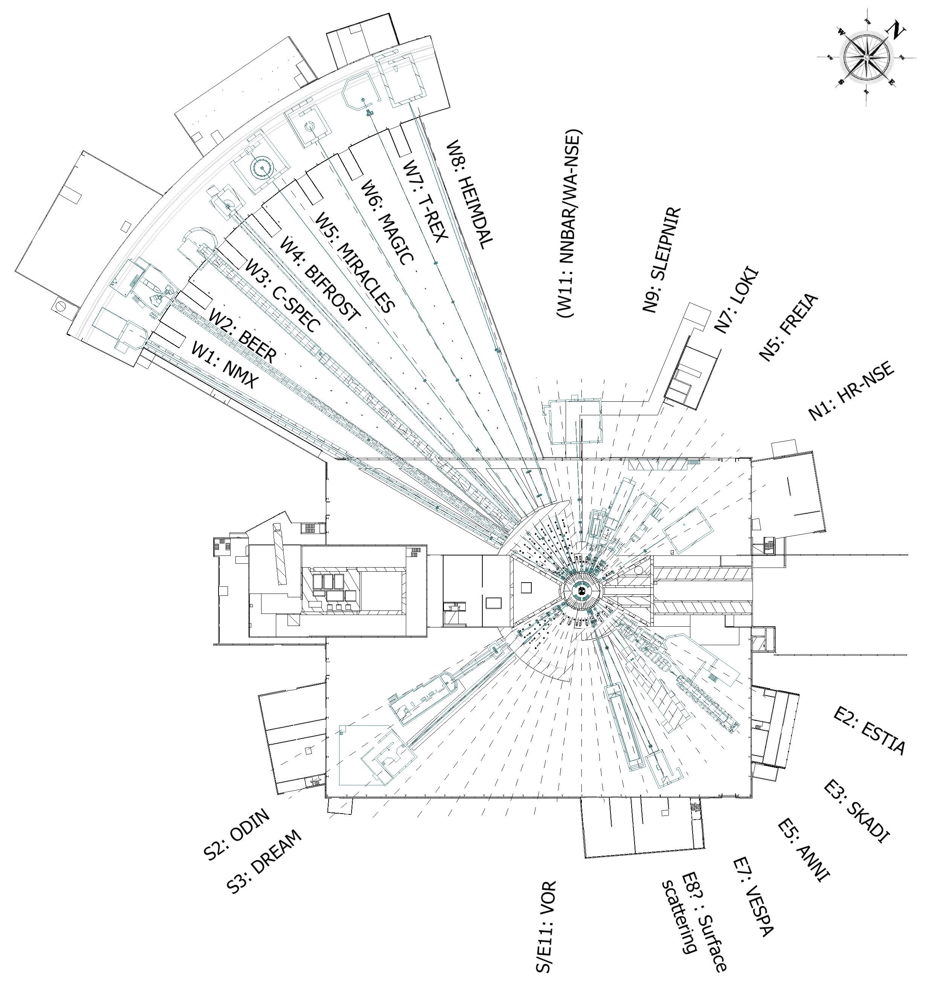
Allocation of zones to substations
E05
E04
E03
Favoured allocation
Cave zones in E01 (yellow) connected to E05
Intermediate zones in E02 (blue) to E05
Cave zones in D01 and D03 (yellow) to either D05 ore D06
Common zone in D01 and D03 (green) to the other available one (D06 ore D05)
Was not planned like that
Ongoing review, needs to be finalized soon
D05
D04
D08
D06
D07
16

Slide 17
Recommendations for documentation
Schematics shall include for every cable or bonding bar
  Name
  Type, round cable or flat braid
  Cross section
  Colour
  Length
Cable lists should be provided at each power panel or power distribution.
Cable lists for trays.
Details need to be discussed next workshop
17

Slide 18
Electrical Safety
General problem: Potential difference between two isolated zones within reach of a person could be larger than 50V AC
Fault Scenario I - Short circuit by fault of equipment:
  Short circuit currents are limited by the long power cables (ohmic), limited in time (=energy) by circuit breakers.
  Further calculations necessary (consultant)
Fault Scenario II – Lightning:
  Substation and instrument buildings are connected to the mesh, to the outer ring conductor, the common metallic outer shells and the installed lightning rods.
  As a result, all building stay on the same potential during a lightning strike.
Transient overvoltage protection units for limitation of voltages to 3 to 50V are commercially available
Special thanks to Roland Lundberg for the important discussion
18

Slide 19
Outlook / Open Topics
Control hutch in E02? Extended cave area?
Ground connection of shielding blocks and other metallic infrastructure especially in the bunker, further discussion with Jörgen Matsson + Roland Lundberg.
Discuss safety aspects + PE cross section calculations with Roland Lundberg.
Allocation of zones and substations for the D-buildings.
Need to organize a third workshop. Topics:
  Power distribution/zone entry cabinet
  Measurement and monitoring
  Zone marking
  Documentation
  PSS
  fire protection …

Slide 20
Questions?
20

Slide 21
Thanks to
Thomas Gahl (ESS, Chair)
Peter Göttlicher (Technical advisor, DESY)
Roland Lundberg (Consultant for Electrical safety and grounding)
Rikard Larsson (CF-SKANSKA)
Markus Olsson (Chopper team, minutes)
Bea Linnenberg (Organisation)

Slide 22
Spare

Slide 23
PSS Suggestions
Option I: Optical Safety Profinet Link: Additional cabinet with Profinet-Terminals in the common zone (for shutter position detection and approval of shutter control)
Option II: Isolated switch and cable in different variations
Still further discussion needed, next workshop

