Slide 1
ODIN: Optical and Diffraction Imaging with Neutrons at the ESS Instrument Hazard Analysis
PSI: M. Morgano, M. Strobl
TUM: E. Calzada, M. Lerche, M. Schulz
Notes:
Phase 2, May 31st. 2017

Slide 2
Outline
ODIN Overview
How to
Resources

Slide 3
Overview
Cave: ~14x6x5.5m³
Guide shielding ~ 3m high
~75 motors
two large sample stages
heavy collimator

Slide 4
How to come up w/ Hazards
Virtual Tour of the Instrument
Own (painful) experience
Think of all the things that can go wrong e.g. in your kitchen.
did they?
Be “creative”

Slide 5
Be creative?

Slide 6
Yes, creative

Slide 7
Content
Major | Sub | Source | Cause | Event | Conse-quence | Risk level |  |  | Treatment
Sample Exposure System | Sample Positioning | Motorized components | Robotic Sample Changer | Personnel is unaware of motion | Body parts pinched | 1X3 | A | M | Emergency Stop Button
Whole instrument |  | Uneven Surfaces | Utility cables/pipes on the floor | Personnel trips over obstacle | Head or Body impact | 2X2 | A | E | Use of proper cable/pipe guides if routing along floor cannot be avoided
BT&C | Beam Filtering system | Toxic substances | Use of Cadmium sheets for filtering | Personnel exposed to Cd particles | Exposure to Carcinogen | 1X4 | T | E | Cd sheets shall be encapsulated (in Al)
Obvious: Large Moving Components
Day to Day: Tripping hazards, power outlets, sharp corners
Special (high consequence): Toxic materials, high voltage and current…

Slide 8
Content types
Obvious: Large Moving Components
relatively easy to spot and usually not too many
Day to Day: Tripping hazards, power outlets, sharp corners
just too many -> general policy e.g. no loose cables on the floor
Special (high consequence): Toxic materials, high voltage and current…
relatively easy to spot but more thoughtfulness required e.g.:
provide Material Safety Data Sheets, or
maintenance procedures required (e.g. Log Out Tag Out)

Slide 9
Resources
Data Sheets
Procedures
Forms and Signs

Slide 10
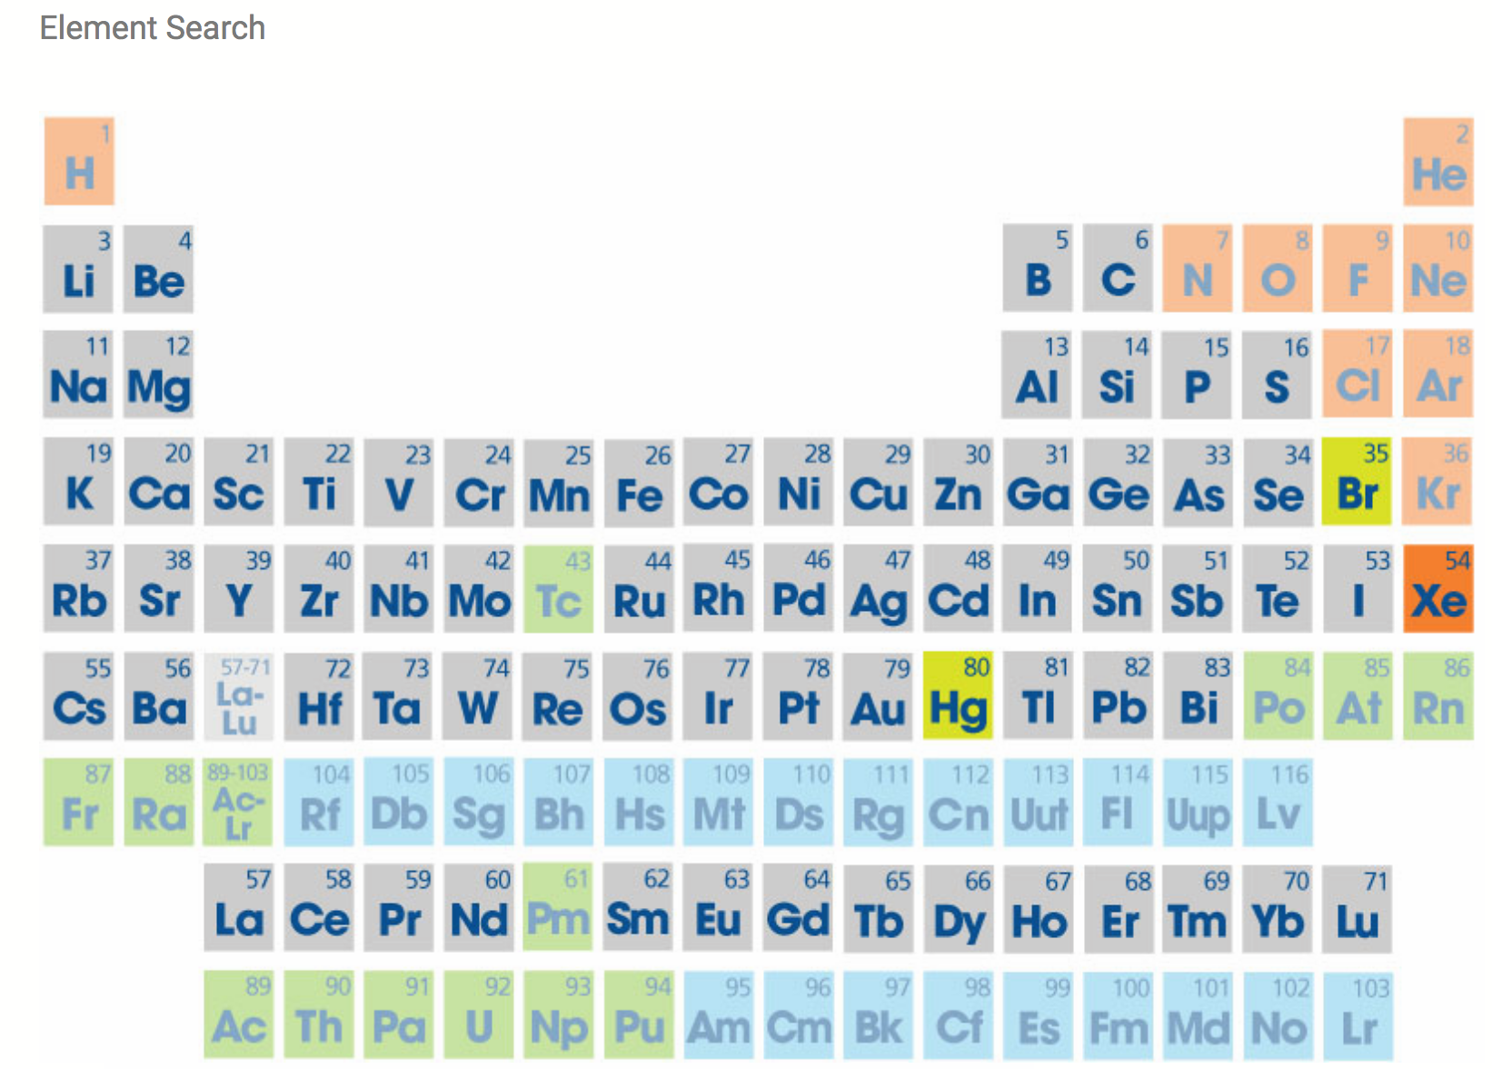
MSDS resources
Suppliers have to provide data.
Most suppliers offer web-based search

Slide 11
MSDS resources

Slide 12
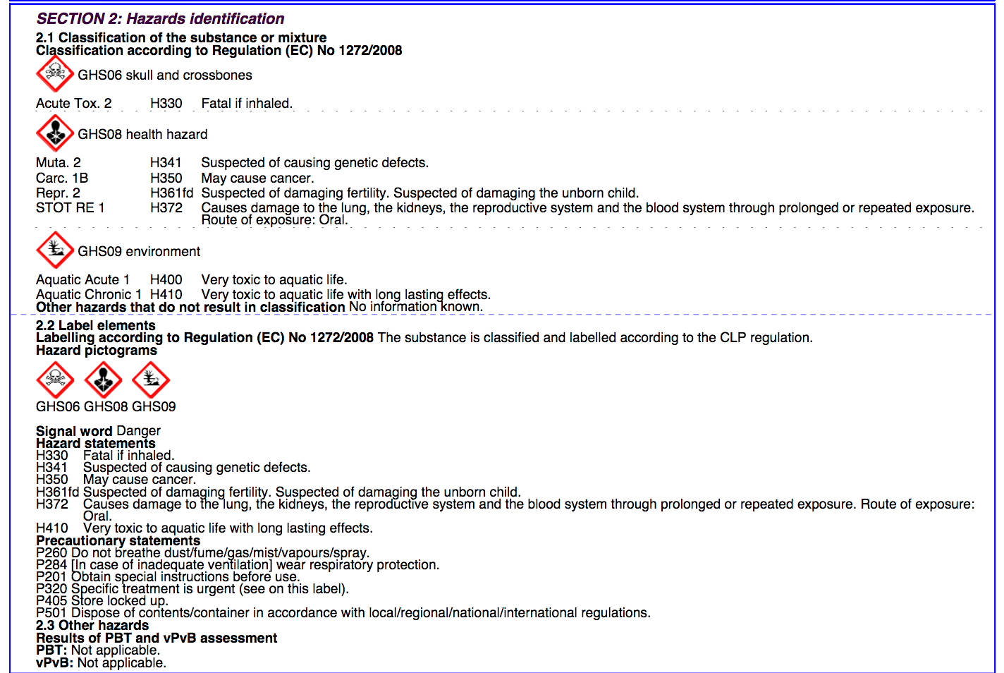
MSDS resources

Slide 13
Procedures/ Forms/ Signs
OSHA (Occupational Safety and Health Administration, US Dept. of Labor)

Slide 14
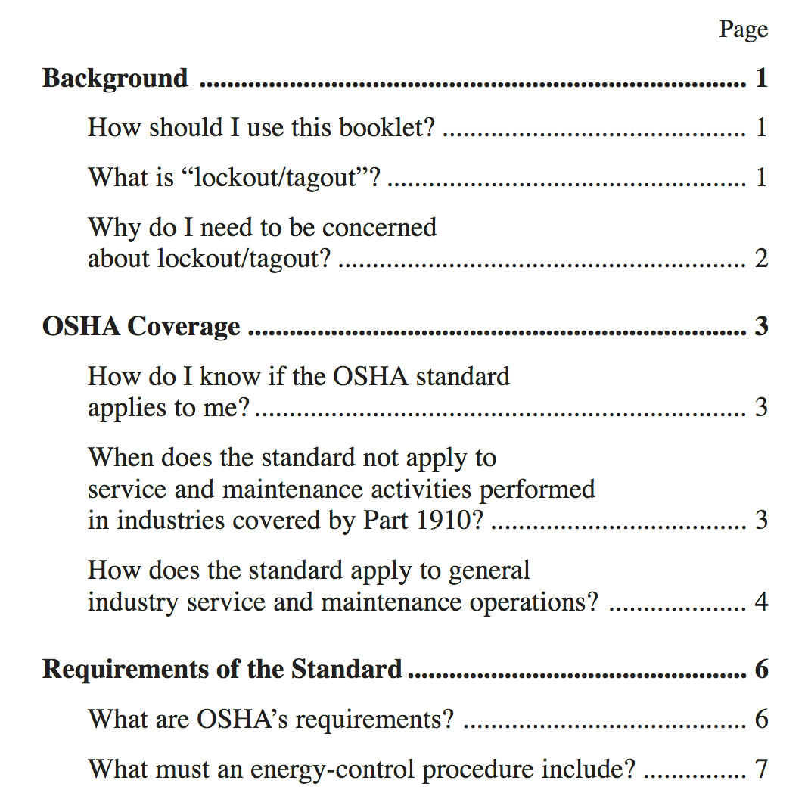
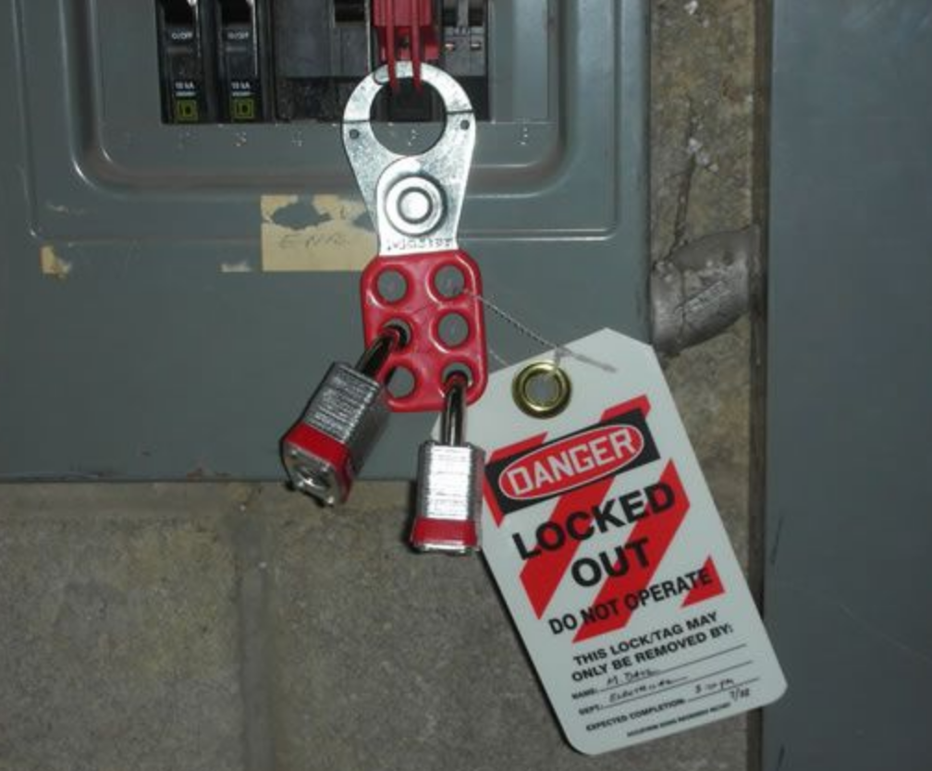
Procedures/ Forms/ Signs
OSHA (Occupational Safety and Health Administration, US Dept. of Labor)

Slide 15
Procedures/ Forms/ Signs
OSHA (US Occupational Safety and Health Administration)
https://www.osha.gov/
EU-OSHA (Members: all european union countries)
https://osha.europa.eu/en/
https://echa.europa.eu/information-on-chemicals/
Your local Employer's Liability Insurance Association e.g.:
Berufsgenossenschaft (D)
Your local Health and Safety Legislator e.g.:
Health and Safety Executive, Dept. of Work and Pensions (UK)

Slide 16
Thank You!

