Slide 1
Phase 2 and TG3 updates
- IKON 16 -
Judith Freita Ramos
NSS Instrument Project Tollgate Coordinator
www.europeanspallationsource.se
12 February 2019

Slide 2
TG3 schedule: date facts
Summary of timeline:
Oct’18
Nov’19
Aug’21
First CTV and IDR
First Final TG3
Last Final TG3
TG3 reviews so far:
CTVs: 12
IDRs: 4
Sub-TG3s: 1
Busiest: Apr’19-May’20

Slide 3
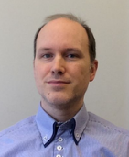
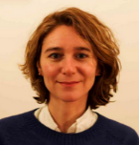
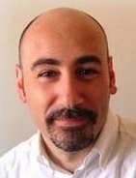
Resources for TG3
NSS Lead Instrument Engineer
NSS Instrument Project Tollgate Coordinator
Instrument Integration Engineer
NSS TG3 Team:
Pool of Reviewers: 52 ESS experts
 | No. of reviews | Hours/ reviewer | Reviewers no./review | Total hours /review | Hours/ALL reviews
CTV | 34 | 8 | 5 | 40 | 1 360
IDR | 31 | 24 | 7 | 168 | 5 208
Reviewers mtg before IDR | 31 | 2 | 5 | 10 | 310
IDR meeting | 31 | 8 | 7 | 56 | 1 736
Sub-TG3 | 43 | 16 | 7 | 112 | 4 816
Final-TG3 | 15 | 24 | 10 | 240 | 3 600
Reviewers mtg for FinalTG3 | 15 | 3 | 8 | 24 | 360
NSS Team
Total reviews+mtgs | 169 |  |  |  | 17 390

Slide 4
Resources: TG3 Team and Reviewers
NSS Lead Instrument Engineer
NSS Instrument Project Tollgate Coordinator
Instrument Integration Engineer
NSS TG3 Team:
Pool of Reviewers: 52 ESS experts
ESS experts and allocated roles:
Expert-To-Be-Notified:
Expertise relevant, but not core for the specific component.
Shall be made him/herself available to the Inst. Team while working on the detailed design process.
Notified and invited to the review events.
Offers feedback to Gabor.
Marked as “To be notified” on CHESS.
Reviewers:
Main expert(s) at a given review.
Reviews and provides core feedback
Main contact for the Inst. Team while working on the detailed design process.
Notified and invited to the review events.
Marked as “Reviewer” on CHESS.

Slide 5
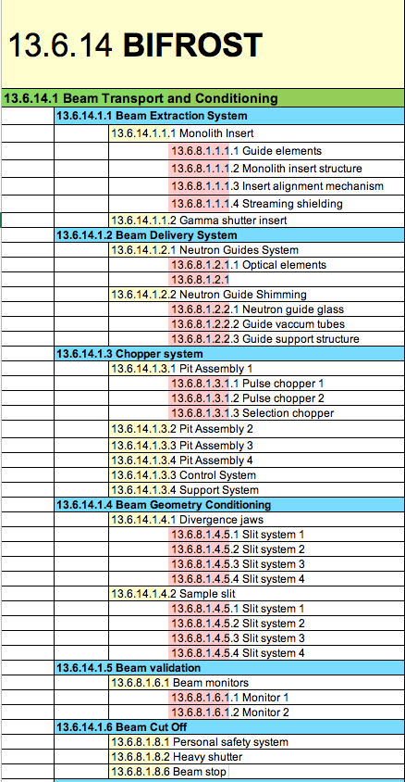
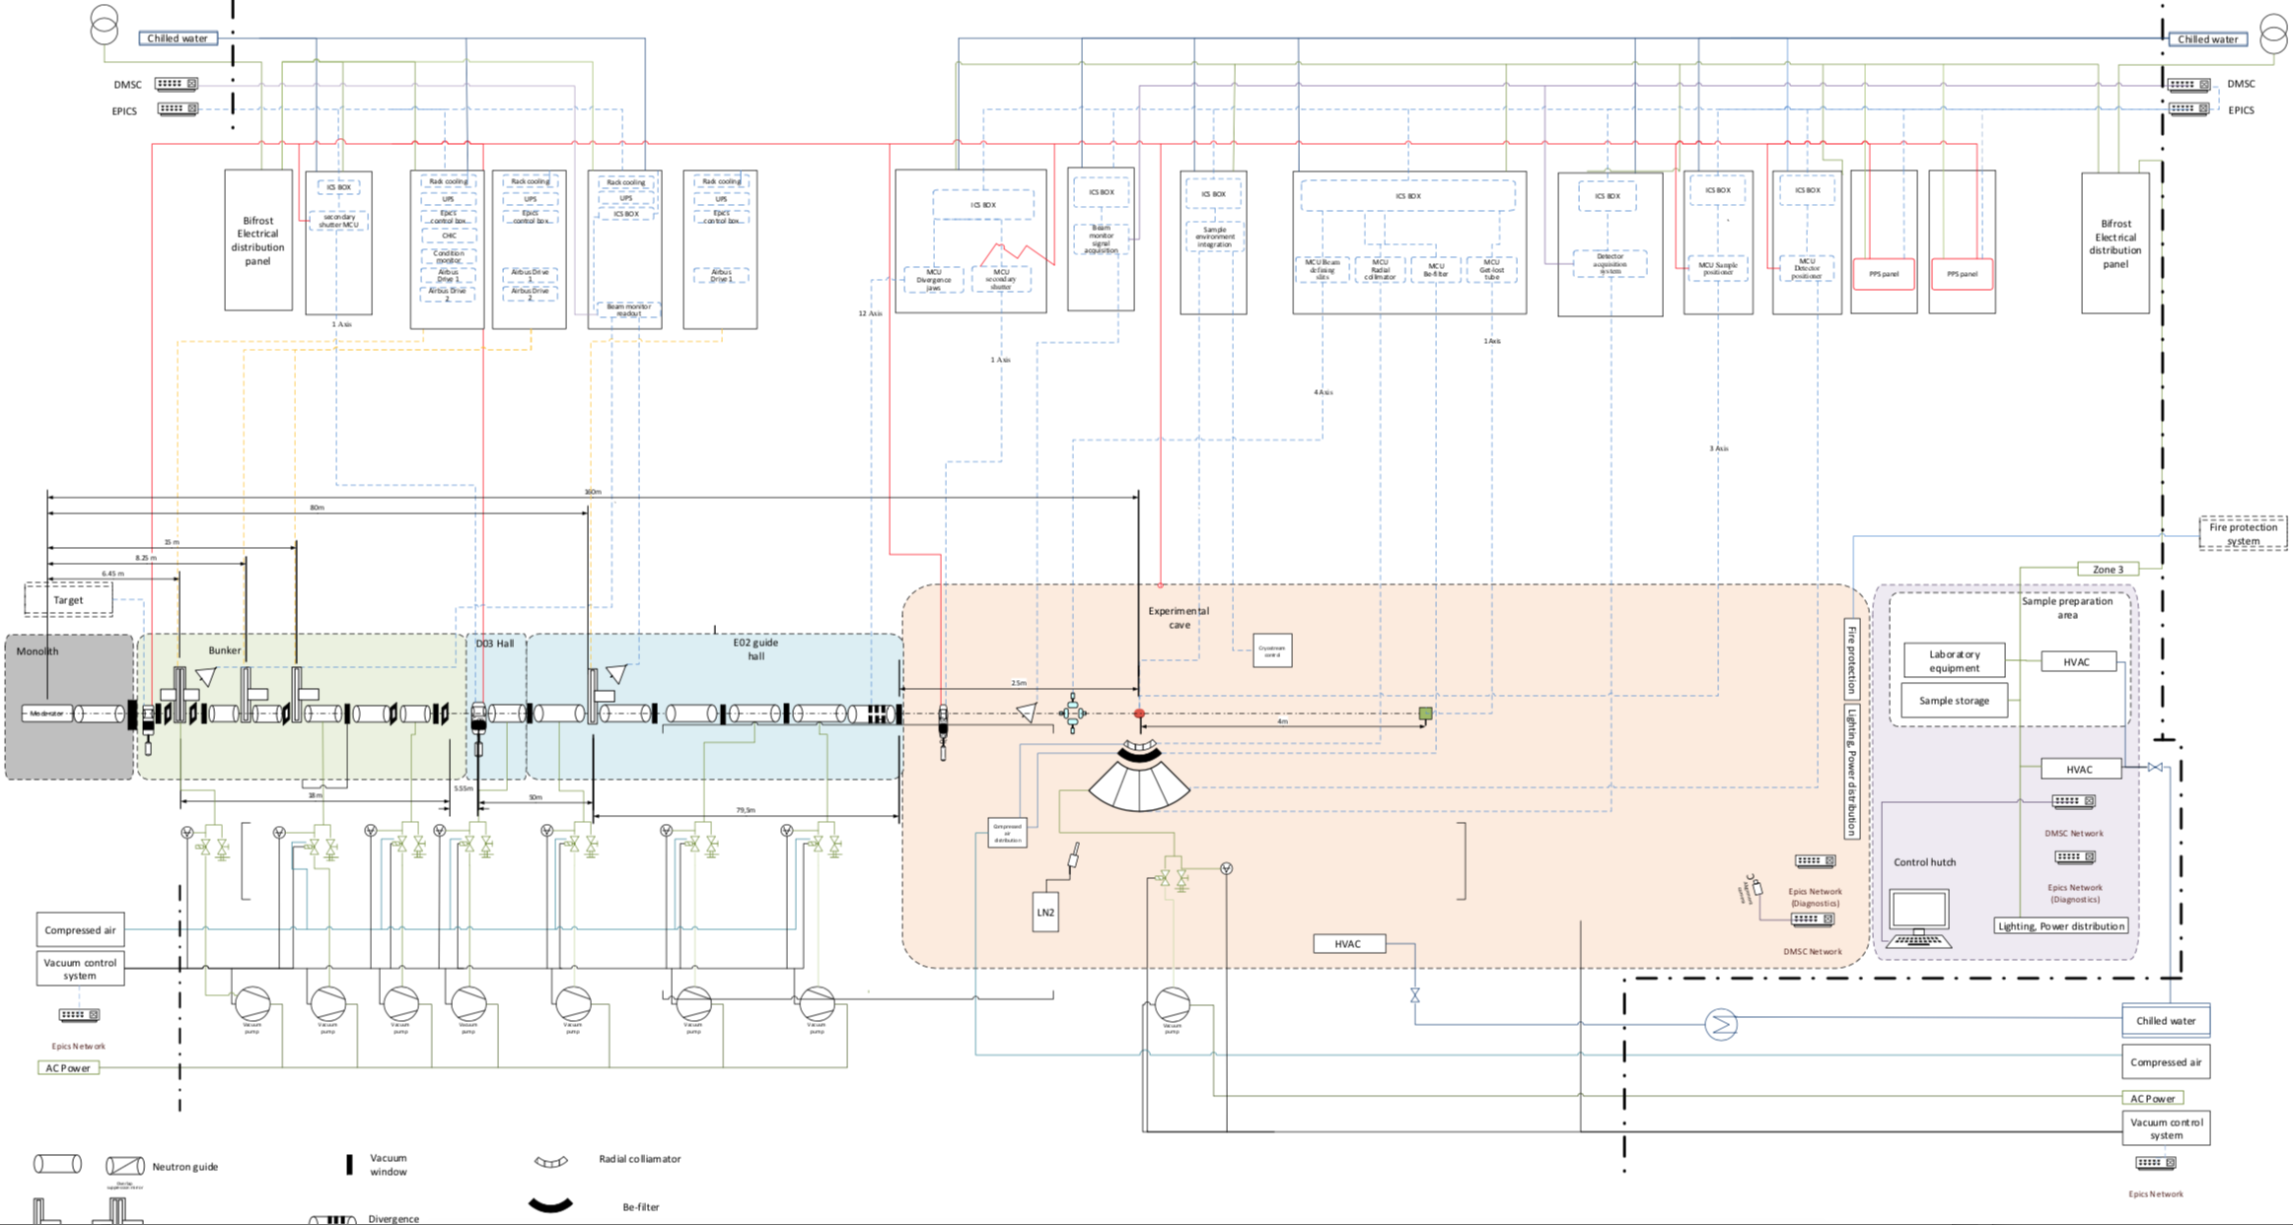
TG3 schedule revision
BIFROST
BEER
CSPEC
MAGIC
NMX

Slide 6
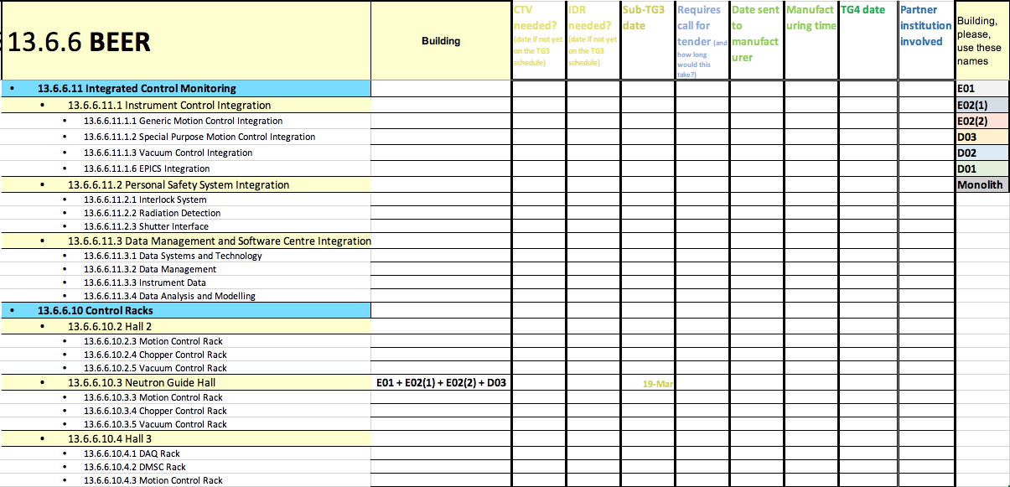
Bridging TG3 and TG4 schedules

Slide 7
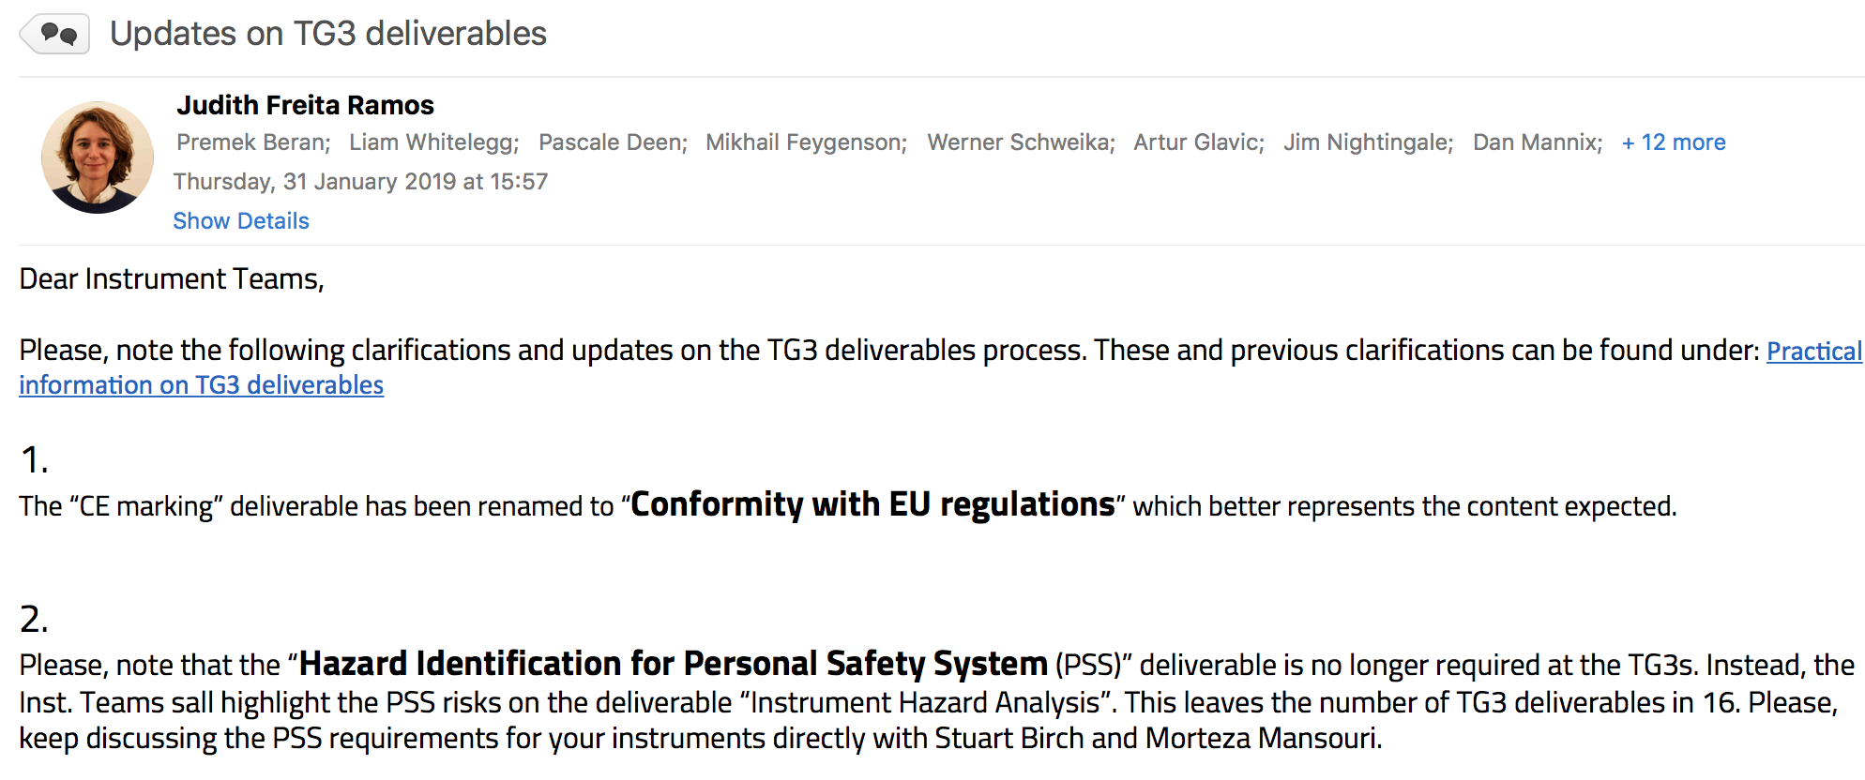
Improving the TG3 process

Slide 8
Some recent updates
Announcement of the upcoming reviews
Removal of deliverable: "Hazard Analysis Identification for Personal Safety System"
Updates on Choppers and on MCA documentation
Examples of deliverables
Practical checklist for deliverables
Requirement of updated schedule at the IDR reviews

Slide 9
IDR meetings open
Open attendance upon request in the meeting room
Via Vidyo

Slide 10
TG3 looking into
Finding assistance for the Inst. Teams with
Project Quality Plan
Conformity with EU regulations
… Soon more on these

Slide 11
Deliverables in CHESS

Slide 12
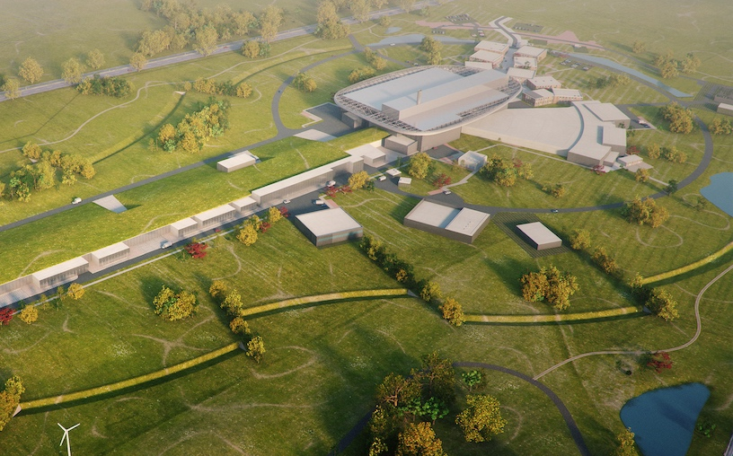
Thank you
2025
ESS Construction Phase Complete
2014
Construction Starts on Green Field Site
2023
ESS Starts
User Program
2009
Decision to Site ESS in Lund
2019
Start of Initial Operations Phase
2012
ESS Design Update Phase Complete
2003
European Design of ESS Completed

