Slide 1
TG3 Deliverables
IKON 16
Gabor Laszlo
NSS Lead Instrument Engineer
www.europeanspallationsource.se

Slide 2
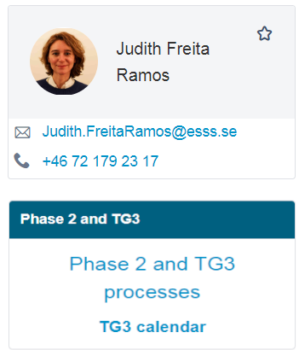
TG3 Summary page on Confluence
ESS-0099059 - Neutron Instrument Design and Construction -Phase 2 Technical Data Package Specification.
ESS-0212907 - NSS Guideline for Instrument Construction Projects - TG3 Review and Decision
https://confluence.esss.lu.se/display/SPD/Phase+2+and+TG3+processes

Slide 3
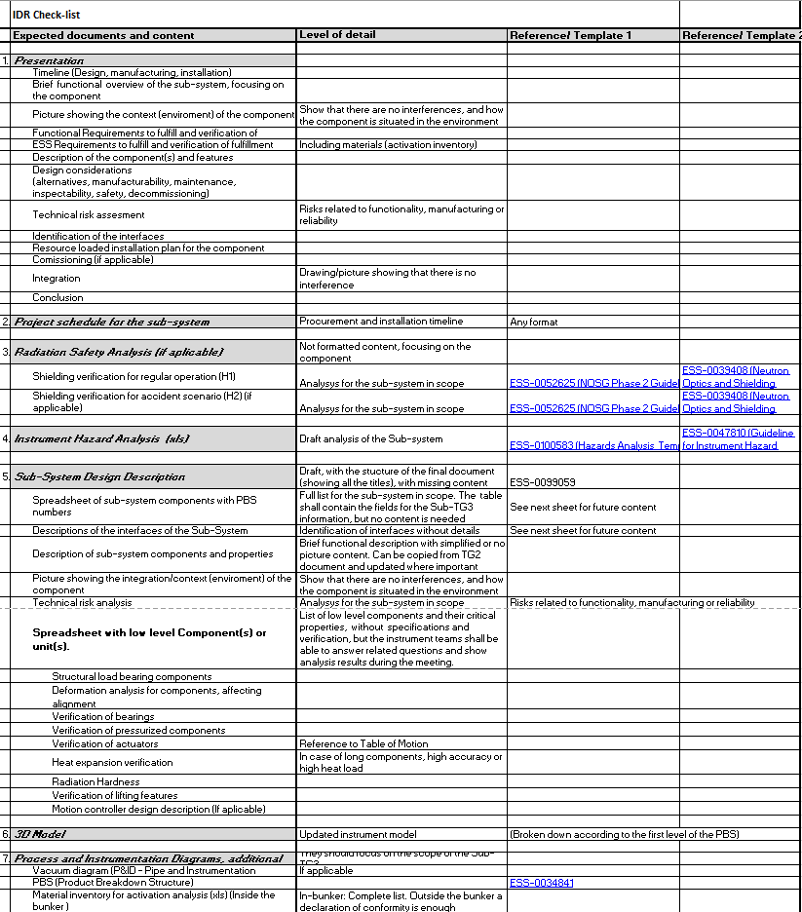
TG3 Content Summary Spreadsheet
ESS-0503621 - Phase 2 Check list
IDR
Presentation
Project schedule for the sub-system
Radiation Safety Analysis (if applicable)
Instrument Hazard Analysis
Sub-System Design Description (SSDD)
3D Model

Slide 4
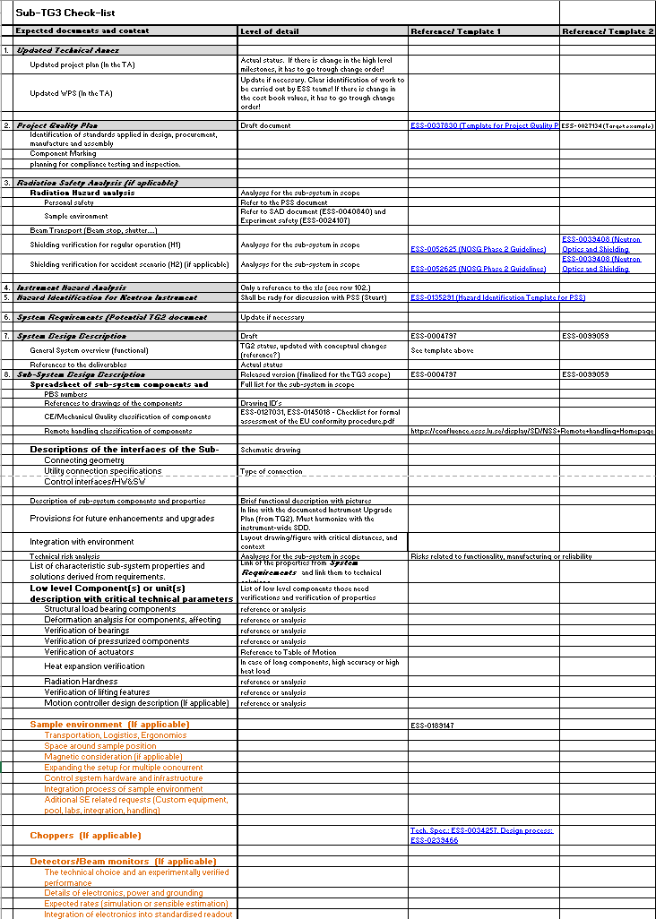
TG3 Content Summary Spreadsheet
Sub-TG3
Updated Technical Annex (if applicable)
Radiation Safety Analysis (if applicable)
Instrument Hazard Analysis
System Requirements (if applicable)
System Design Description (SDD)
Sub-System Design Description (SSDD)
Interface description (if applicable)
System Integration & Verification Plan
  (Installation and Cold Comm.)
System Validation Plan (Hot comm.)
System Operation and Maintenance Manual
3D Model
Detailed drawing documentation
Process and Instrumentation Diagrams,
  additional documents
Hazard Identification for Neutron Instrument PSS

Slide 5
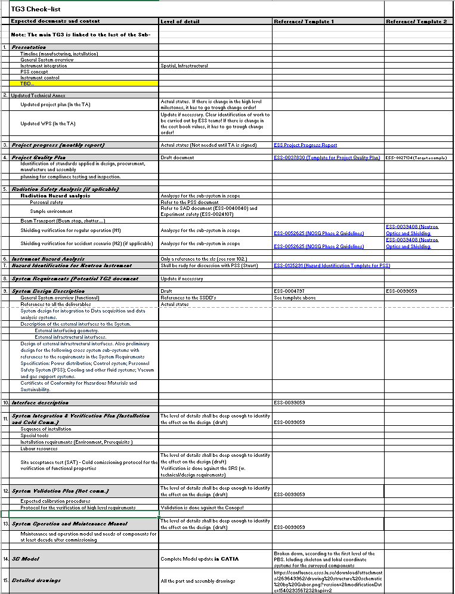
TG3 Content Summary Spreadsheet
TG3 (Final)
System Design Description (SDD)
Project Quality Plan
Interface description (if applicable)
System Integration & Verification Plan
  (Installation and Cold Comm.)
System Validation Plan (Hot comm.)
System Operation and Maintenance Manual
Checklist(s) for formal assessment of the EU conformity procedure
  ESS Documents (Vacuum, PSS, ICS)

Slide 6
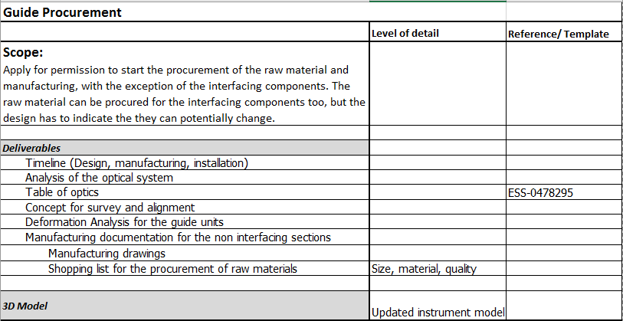
TG3 Content Summary Spreadsheet
Guide substrate/Guide procurement

Slide 7
General CE-Marking Process
Identify the applicable directive(s) and harmonized standards
  Most relevant topics
  Electromagnetic compatibility (EMC)
  Equipment for explosive atmospheres (ATEX)
  Low Voltage (LVD)
  Lifts
  Machinery (MD)
  Pressure equipment (PED)
  Simple Pressure Vessels (SPVD)
Verify product specific requirements
Identify whether an independent conformity assessment (by a notified body) is necessary. The assessment is carried out by the manufacturer. If the applicable legislation requires it, a conformity assessment body is involved in the conformity assessment process – see Notified bodies. (In case of the instrument is a very rare case if needed at all!)
Test the product and check its conformity
Draw up and keep available the required technical documentation
Affix the CE marking and draw up the EU Declaration of Conformity

Slide 8
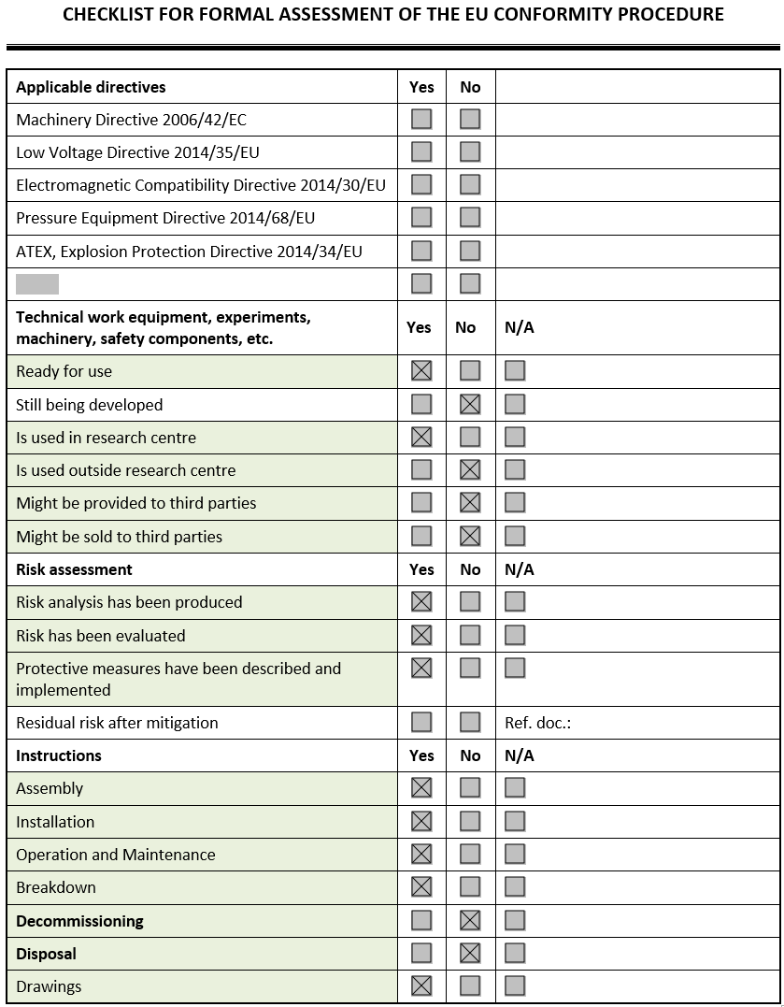
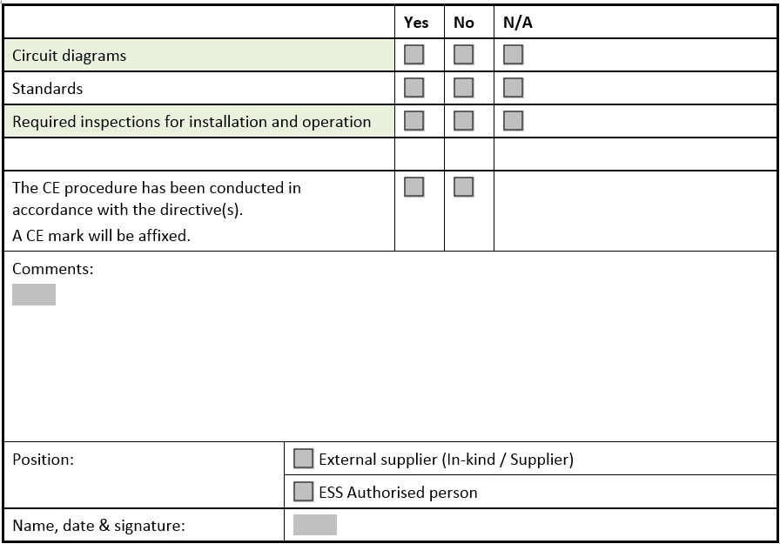
”CE-Marking” for the design process
CE-Marking:
Declaration of conformity with EU directives
TG4 Deliverable: ESS-0145018
If you follow the TG3 process, you can already tick off the rows marked with green

Slide 9
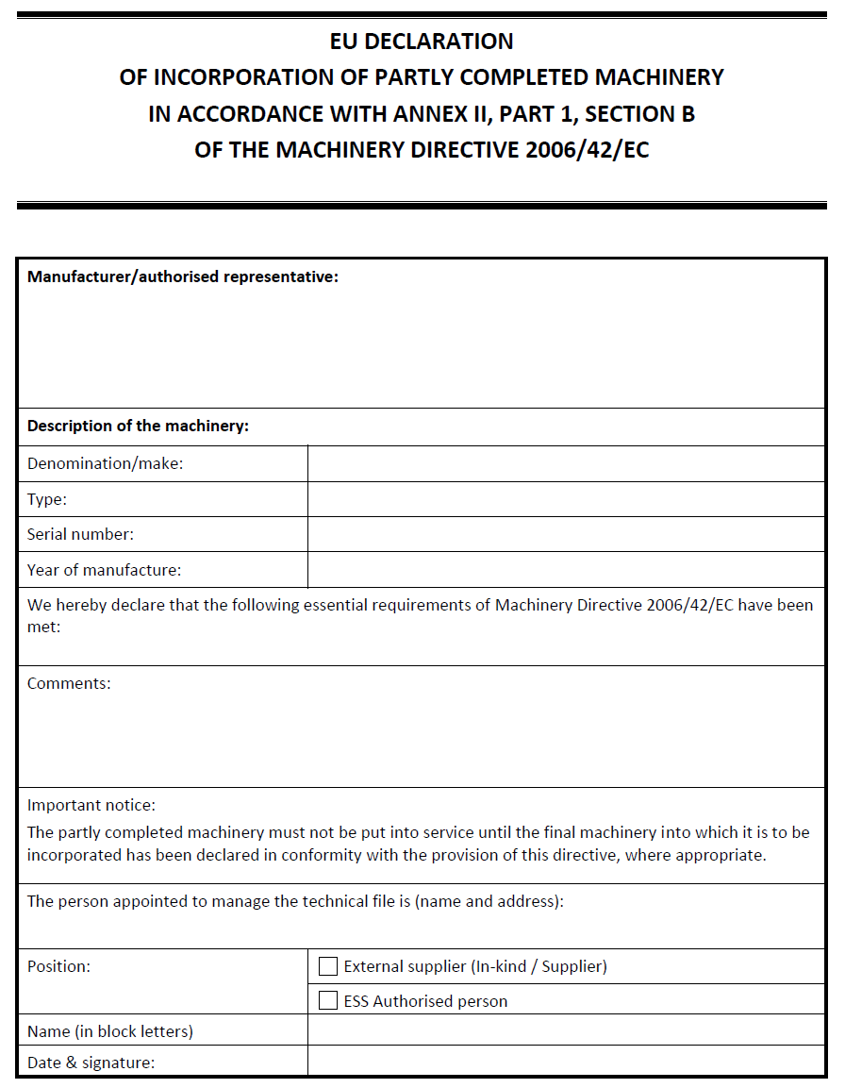
”CE-Marking” for Manufacturing
Fill in and sign:
ESS-0145023 - EU Declaration of Incorporation.pdf

Slide 10
QA classification of instrument components
Translation of QA Classes
RCC-MRx
Design and Construction Rules for Mechanical Components
in high-temperature structures, experimental reactors and fusion reactors
N1Rx → N2Rx → N3Rx → Industrial Standards
ESS Mechanical Classification
MQC1 → MQC2 → MQC3 → MQC4 : Industrial Standards

Slide 11

QA classification of instrument components
Safety SSC (Structure, system, component)
Safety Related and Non Safety SSC
MQC1 → MQC2 → MQC3 → MQC4
What does it mean to the instruments?
According to Preliminary Safety Assessment Report (PSAR):
Safety SSC (Structure, System, Component)
Personal Safety System
Safety Related and Non Safety SSC
All the rest
MQC4 (Industrial Standards)

Slide 12
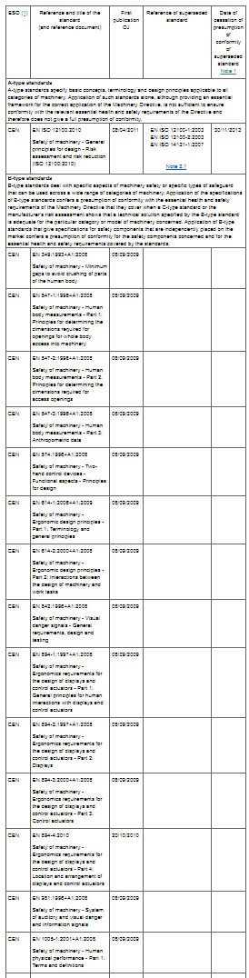

QA classification of instrument components
General requirements
ESS-0016468 - ESS rule for identification and classification of safety important components / Appendix 4.
Industrial Standards (MQC4)
https://ec.europa.eu/growth/single-market/european-standards/harmonised-standards_en
Plan
ESS/NSS Recruits an engineer to identify the applicable standards, and extract the relevant content from the standards.

Slide 13
Radiation Safety Analysis
Hazard analysis: Technology specific risks shall come from technology groups. Instruments shall identify if they have special risks and do the analysis only for that. The analysis method shall be similar to the conventional risk analysis procedure. (ESS-0440582). “It is a mess, but we are working on it”
- Identification and mitigation of hazards and components related to
  Activation/degradation by radiation (ESS-0051491)
  Shielding of radiation /See below
2. Use the template (ESS-0114728 - Template for Shielding reports) for the analysis of the shielding
3. Fill out the template according to ESS-0019931 (ESS Procedure for designing shielding for safety) and ESS-0052625 (NOSG phase 2 guidelines for designing instrument shielding for radiation safety).
4. Refer to the NSS radiation hazard analysis (Not ready yet)

Slide 14
Project Quality Plan
Template: ESS-0037830 - Project Quality Plan Template:
Example: ESS- 0027134 - Target Project Quality Plan
Simplified Content:
ESS Specific quality requirements (If any)
General Quality goals
How we make sure to achieve the goals
Design Quality → ESS Design process
Quality of manufacturing → PQAP & Requirements towards Suppliers QA Plan
Quality of the installed instrument → Cold and hot commissioning documents
Conclusion: NSS is planning to provide a generic one that can be used by the instruments. Only needed for TG3.

Slide 15
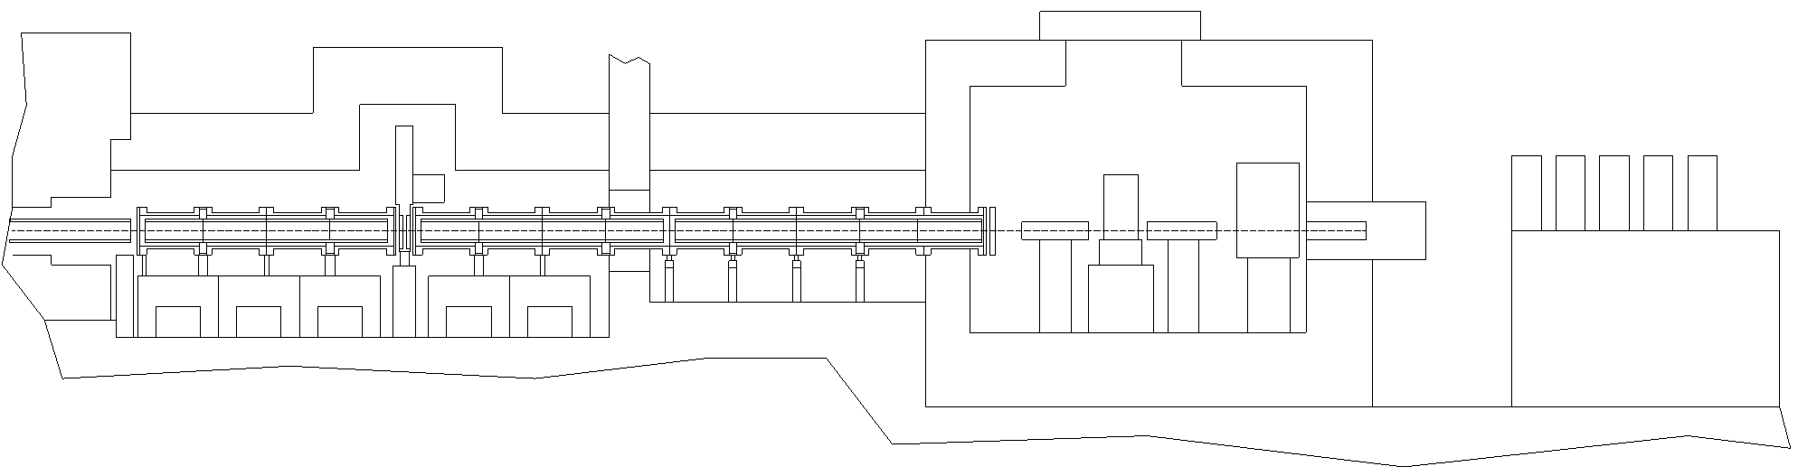
Instrument Fire Protection
If there is combustible material in the shielding cavity (rare):
EI 60 Fire
Insulation
D03-E01 wall:
Brick it off
EI 60 Fire
Insulation
Fire supression system
Based on Safety evaluation
Bunker
Reasonable mitigation:
We have to verify if there is a fire risk from the chopper
if yes, then mitigate it
You can find additional details In Fredrik Jörud´s presentation

Slide 16
System Integration & Verification Plan
(Installation and Cold Commissioning)
Installation (ESS-0115727 – Information requirement…)
(ESS- 0115143 – Project chedule guideline)
Sequence of installation
Special tools
Installation requirements (Environment, Prerequisits )
Labour resources
Site acceptance test (SAT) - Cold comissioning protocol for the verification of functional properties. It shall be based on the requirements

Slide 17
System Validation Plan
(Hot commissioning)
For TG3 – Only considerations, consequences for design.
Expected calibration procedures
Protocol for the validation of high level requirements

Slide 18
Tagging, Marking and Labeling
  Baseline document
  ESS Generic Requirements for Marking and Labelling (ESS-0094091)
No standard ESS templates, only examples.
Marking and labeling can be combined.

Slide 19

Marking
  Dataplate from the manufacturer
  Identification of important property
  Warning

Slide 20
Tagging (ESS-Name & FBS-TAG)
What shall be tagged?
  ESS-Name
  All devices that has a signal shall be registered in the naming database to get their ESS-Name.
    ESS Naming Convention (ESS-0000757)
  FBS-TAG
  All devices down to the level of operation and maintenance or where they have an ESS-Name shall be registered in the Facility Breakdown Structure.
  ESS Rules for Project Information Management (ESS-0050017)

Slide 21


Labeling
Everything that has an FBS-Tag has to be labeled
Functional Label
  FBS-Tag – Also with QR code
Optional Content
  ESS-Name (when needed)
  Optionally Description
  Optionally a Alternate TAG

Slide 22
Spatial Integration and Facility Breakdown Structure (FBS)
  ≠
FBS (PBS) Breakdown: (ESS-0034841)
Beam Transport & Conditioning
Sample Exposure System
Scattering characterisation System
Optical Cave
Experimental Cave
Control Hutch
Sample Preparation Area
Utilities Distribution
Support Infrastructure
Control Racks
Integrated Control and Monitoring
NSS will do it, in cooperation with the instrument teams
Spatial (model) Breakdown
(Details in Fabiens Session)
Instrument Skeleton
In-Bunker
Experimental Hall
Experimental Cave
Beam Transport & Conditioning
Space claims and intraface points
Shielding
Utilities distribution
Instruments shall do it.
Links shall be established (By ESS)

Slide 23
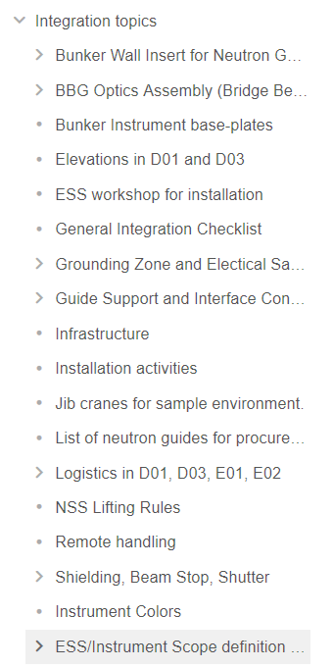
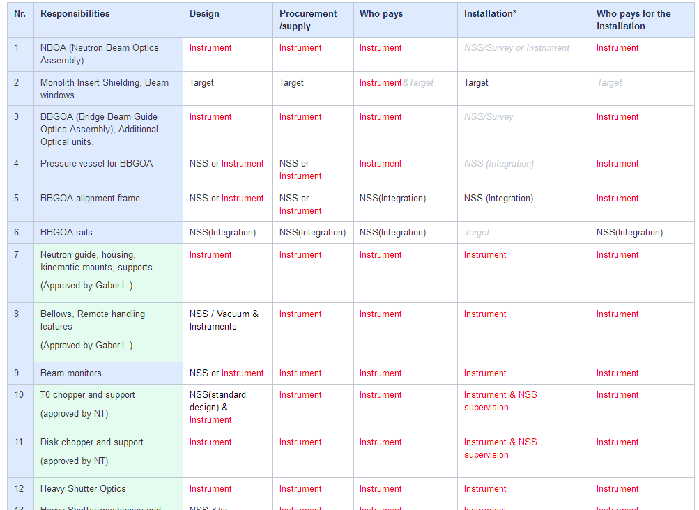
ESS – Instrument scope definition
https://confluence.esss.lu.se/pages/viewpage.action?pageId=295784877

Slide 24
Thank you!

Slide 25
Tagging, Marking and Labeling
Remote compatible bellow is working. Detailed model will be provided in a few months. ~5000 EUR

