Slide 1
Sample cave study
Sylvain Désert
IKON’16 13/0219

Slide 2
introduction
NID June 2018: offer made by LLB to study Instrument Sample Caves
7 instruments answered: C-SPEC, BIFROST, MAGIC, T-REX, DREAM, SKADI, ESTIA
Study performed by Artélia from JUL to OCT 2018

Slide 3
Input data
Instrument teams
Instrument cave designs
General Civil Design Criteria
Installation Logistic
Access logistics
Crane coverage
Shielding concepts
Load specification
Gallery penetrations and conduits
Confluence
| PAGE 3

Slide 4
Regulatory context
Construction code
Eurocode 1: Actions on structures (EN 1991)
Eurocode 2: Design of concrete structures (EN 1992)
Eurocode 3: Design of steel structures (EN 1993)
Seismic requirements
ESS-0122941: Load Specification Miscellaneous Seismic Topics D Buildings
ESS-0061819: General Civil Design Criteria (GCDC) for D01 D02 and D03

Slide 5
Technical constraints
7.5 T and 30 T crane available in hall D01
10 T crane available in E01
Handling equipments available for construction in D01 and E01
→ operated by ESS
No seismic requirement for the caves in hall (D01 and E01)
→ shielding must not fall on the structural pillars of the building
Structural dimensions of caves will not change during their operation time
Generation of dust, noise and slight vibrations during the dismantling
operations has no impact on the overall operation in the facility
Impact on cave on the galleries not studied

Slide 6
hypothesis
Planning
Experimental cave area clean and free
No interface to manage with other systems
Handling equipments available
Construction & installation full responsability of the supplier (not ESS)
Quotation
Only for the concrete part of the caves
For turnkey contract:
→ detailed design, drawings, manufacturing, transportation
Based on numerous feedbacks and current market price in France + Tyrens

Slide 7
Construction methodologies
Anchored walls (~ 200 mm) in the slab
→ structural continuity
Assembled concrete blocks laid on the slab
→ advanced structural calculation to check wall performance
regarding the mass of the roof and shock constraints

Slide 8
Building methodologies
5 methodologies:
Full Cast Concrete
Precast Walls
Customized Blocks
Empty Shuttery Blocks + Concrete
Mixed Cast concrete + Beam slabs
3 types of structures:
Additional slabs: meth. 1
Walls: meth. 1 → 4
Roof: meth. 1 → 3 + 5

Slide 9
Building methodologies
Precast Walls
Thickness 600+mm uncommon
→ specific development
Homogeneity of poured concrete not guaranted
Transportation and access to halls
→ smaller sizes ⇒ more joints
Specific cranes required (1.5 k€/day)
Difficulties to check the materials origin
Difficulties to install if the floor flatness not perfect

Slide 10
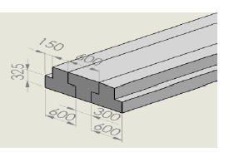
Building methodologies
Full beam slabs for roof
Incompatible with easy opening roof
→ requires dismounting
Specific cranes required (1.5 k€/day)
Specific development (size and shape)
→ expensive

Slide 11
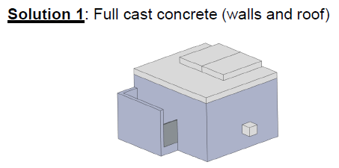
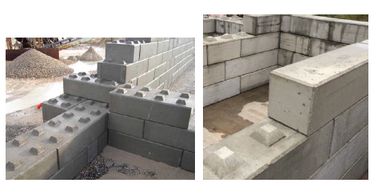
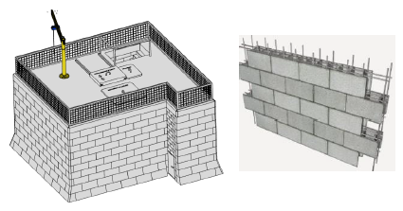
Methodologies studied

Slide 12
Solution 1:
full cast concrete
Concrete pouring of slabs, walls and roof on site at the final cave location
Suitable for all cave configuration
Limited number of joints
Better radiation shielding
Ideal for high thicknesses
Better concrete hardness
Good tracability: origin & quality of materials
Good adaptation to slab flatness
Noise and dust during work
Difficult to deconstruct
Anchors in the slab required
Vibration, noise and dust during demolition

Slide 13
Solution 2:
mixed Full cast concrete / slabs
Concrete pouring of slabs, walls and opening parts of roof
Beam slabs used for other parts of roof
- same as SOLUTION 1 -
Possibility to have easy removable roof parts
- same as SOLUTION 1 -
Not adapted for high thickness roof (weight)

Slide 14
Solution 3:
blocks + Full Cast Concrete roof
Custom concrete blocks pre-fabricated walls + full cast concrete roof
Suitable for all cave configuration
Limited noise and dust production
Easy disassembly of the walls
No anchor in the slab
Ideal for roof with high thickness
Good tracability: origin & quality of materials
Altimetry differences removed by casting of the roof
Important design phase (maximize block size, minimize molds)
Difficult to deconstruct the roof
Adaptation required for slab flatness
Heavy handling system to install the blocks
The crane inside the cave cannot be fixed to the wall

Slide 15
Solution 4:
bloCks + mixed cast concrete / slabs
Custom concrete blocks pre-fabricated walls + cast concrete and beam slabs roof
- same as SOLUTION 3 -
Possibility to have easy removable roof parts
- same as SOLUTION 3 –
Not adapted for high thickness roof (weight)

Slide 16
Solution 5:
shuttering blocks + full cast concrete
Shuttering blocks walls + full cast concrete roof
Suitable for all cave configuration
Limited noise and dust production
Limited requirement of handling tools (walls)
No structural integrity
Not compatible with large wall thickness (concrete inhomogeneity)
Anchor in the slab
Difficult to deconstruct the roof
Demolition cost
Vibration, noise and dust during demolition
The crane inside the cave cannot be fixed to the wall

Slide 17
Solution 6:
shuttering blocks + mixed cast concrete / slabs
Shuttering blocks for walls + cast concrete and beam slabs roof
- same as SOLUTION 5 -
Possibility to have easy removable roof parts
- same as SOLUTION 5 –
Not compatible with high thickness roof (weight)

Slide 18
Technical analysis
Selection criterias for QUALITY:
Structural capacity
Radiation protection
Ease of assembly
Impact on the slab
Compatibility with in-house handling equipment
Ease of demolition
Noise, dust and vibration during demolition

Slide 19
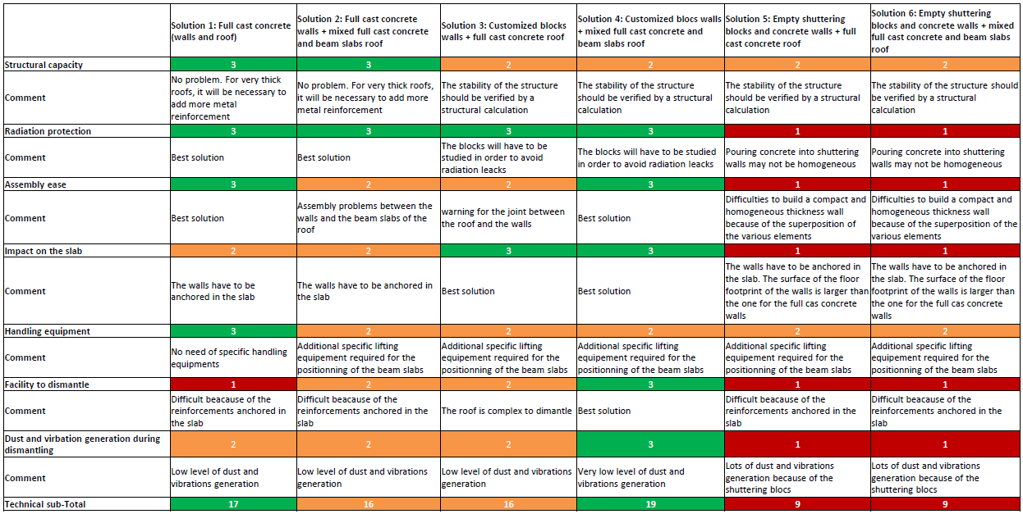
Quality Summary
Shuttering blocks methodology discarded
COST & DELAY studied for Solutions 1 to 4

Slide 20
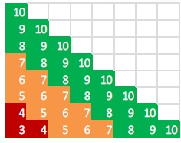
delay Summary
Dream cave

Slide 21
cost hypothesis
Hypothesis:
Concrete density 2500 kg / m³
Cost of steel 2500 € / T
Concrete cost 120 € / m³
Steel density (slabs) 150 kg / m³
Steel density (flor/walls) 75 kg / m³
Mobile crane + other 1500 € / day
Note: ESS provides workforce for assembly/installation in case of blocks
ESS invoicing costs unknown (handling equipment operation, instalation, services…)
Solution 1: no ESS cost
Solution 2: 2 ESS workers for 5 days
Solution 3: 2 ESS workers for 15 days
Solution 4: 2 ESS workers for 24 days

Slide 22
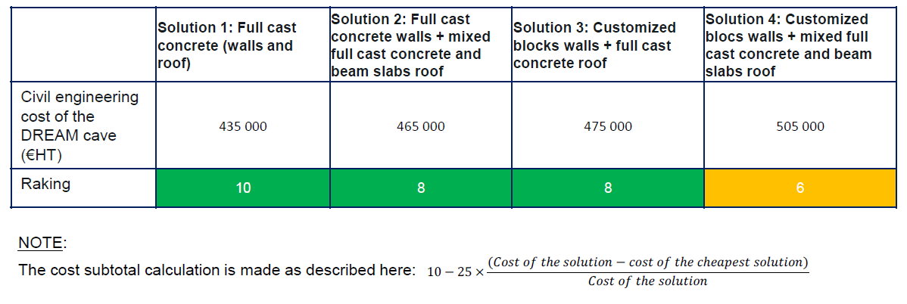
Cost Summary
Dream cave

Slide 23
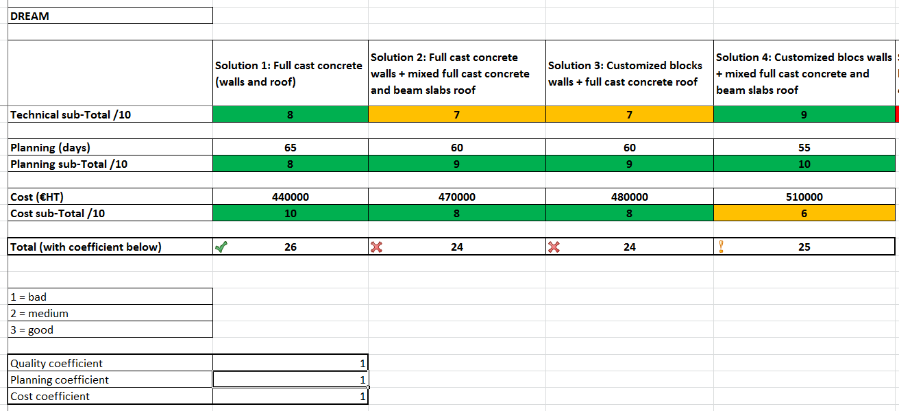
quality / cost / delay
Dream cave
⇒ Final results are close
⇒ Full cast concrete better for all the 7 caves
⇒ Weights for Quality / Cost / Delay can be customized depending on priority
→ may change the most appropriate solution

Slide 24
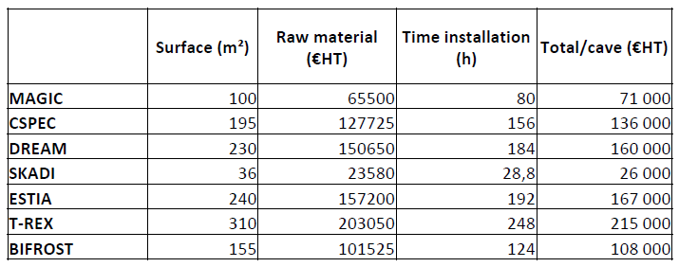
B4C Shielding
Hypothesis:
5 mm of Boreflex on all inner surface but the floor:
Price: 655 €/m²
Installation time: 2.5 m²/h with 2 people
Transporattion to ESS 1.5 k€
(⇒ Jefferson Lab solution looks a possible better alternative)

Slide 25
Cave impact on floor
E01: 20 T / m²
D01: 14 T / m²
All caves are made of regular concrete with average density of 2500 kg / m³
Internal crane and additional components on the walls or roof not considered
⇒ No impact on the floor for most caves but DREAM
⇒ Basement of the walls can be increased for larger footprint

Slide 26
aknowledgements
Yassine HAKIM
Sébastien Le Couster
Nathanaël Schmidt
Thomas Robillard
Sébastien Gautrot
Sylvain Rodrigues
Patrice Permingeat

