Slide 1
Installation Risk Assessment IKON 16
Helen Boyer & Helena Ramsing
OHS
European Spallation Source ERIC
13/02/2019

Slide 2
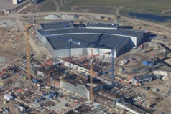
Content
Swedish AFS
How to carry out an installation risk assessment.

Slide 3
Why do we need an Installation risk assessment
Contractor Responsibility according to Provision 1999:3 – Risk assessment
The party carrying on activity at the construction site shall submit to the BAS U particulars of the risks which the activity may give rise to. BAS U shall take part in the planning of the work and shall see to it that work environment viewpoints of common concern are taken into account and coordinated

Slide 4
What is a RAMS?
What does RAMS stand for?
Risk Assessment and Method Statement
What does a RAMS consist of?
The RAMS consists of two parts:
A method statement, i.e. a detailed break down/description of the work to be carried out and material to be used to perform this task
A risk assessment, i.e. identify the risks associated to the work steps detailed in the method statement.
What’s the purpose with a RAMS?
Systematically identify hazards and associated risks for an activity and determine if sufficient controls are in place (to reduce the risks to an acceptable level). For all workers/staff and fellow colleagues to take ownership and be more aware of their risks associated to their activities.
Who is responsible for preparing the RAMS?
Supervisor for preparing it. In-Kind/ESS staff wishing to perform task onsite
Instrument Installation Lead for making sure it’s prepared.
Notes:
Helen

Slide 5
Risk Assessment - 1
Ref | Activity | Hazard | Who might be harmed and how? | Initial Risk Rating |  |  | Action to Mitigate Risk- Controls | Residual Risk Rating |  |  | Further actions
 |  |  |  | Severity | Likelihood | Risk H,M,L |  | Severity | Likelihood | Risk H,M,L
1.
2.
Notes:
Helen

Slide 6
HAZARD Checklist
Hazard
Ionising radiation | Falling objects
Pressure hazards | Working at heights
Flammable materials | Operational modes
ODH | Dynamic situation hazards
Toxic substances | Objects under induced stress
Corrosive substances | Environmental
Temperature | Noise
Electricity | Ergonomic (human factors) hazards
Electromagnetic radiation | Security-related hazards
External escalation | Psychological hazards
Escape, Evacuation and Rescue | Biological hazards
Failure of critical systems (non-failsafe)

Slide 7
Risk Assessment - 2
Identify activity, consider hazard list and consider who may harmed and how.
Ref | Activity | Hazard | Who might be harmed and how? | Initial Risk Rating |  |  | Action to Mitigate Risk- Controls | Residual Risk Rating |  |  | Further actions
 |  |  |  | Severity | Likelihood | Risk H,M,L |  | Severity | Likelihood | Risk H,M,L
1. | Install hanging brackets | Working at heights - dropped objects | People below due to dropped tools
2.
Notes:
Helen

Slide 8
Risk Matrix
 | Severity (S) | Severity Description
A | Negligible | Injuries that can be treated with a first aid kit
B | Minor | Injuries requiring treatment by a medical practitioner, would include lost time injuries
C | Major | Injuries requiring the support of emergency services
D | Hazardous | Single Fatality
E | Catastrophic | Multiple fatalities
 | A | B | C | D | E
1 | M | M | H | H | H
2 | L | M | M | H | H
3 | L | M | M | H | H
4 | L | L | M | M | H
5 | L | L | L | M | M
Likelihood (L) | Qualitative description
1 | Frequent
2 | Occasional
3 | Remote
4 | Improbable
5 | Highly improbable

Slide 9
Risk Assessment - 3
Ref | Activity | Hazard | Who might be harmed and how? | Initial Risk Rating |  |  | Action to Mitigate Risk- Controls | Residual Risk Rating |  |  | Further actions
 |  |  |  | Severity | Likelihood | Risk H,M,L |  | Severity | Likelihood | Risk H,M,L
1. | Install hanging brackets | Working at heights - dropped objects | People below | D | 2 | H | Work at height requires a permit. Tool lanyards must be used Pouches should be used for loose items like screws Barrier the area below and restrict access for a 5m area Signs must be posted below with details of the work, who is carrying it out, contact information and task time. Safety helmets worn in area
Notes:
Helen

Slide 10
Risk Assessment - 3
Ref | Activity | Hazard | Who might be harmed and how? | Initial Risk Rating |  |  | Action to Mitigate Risk- Controls | Residual Risk Rating |  |  | Further actions
 |  |  |  | Severity | Likelihood | Risk H,M,L |  | Severity | Likelihood | Risk H,M,L
1. | Install hanging brackets | Working at heights - dropped objects | People below | D | 2 | H | Work at height requires a permit. Tool lanyards must be used Pouches should be used for loose items like screws Barrier the area below and restrict access for a 5m area Signs must be posted below with details of the work, who is carrying it out, contact information and task time. | D | 4 | M
Notes:
Helen

Slide 11
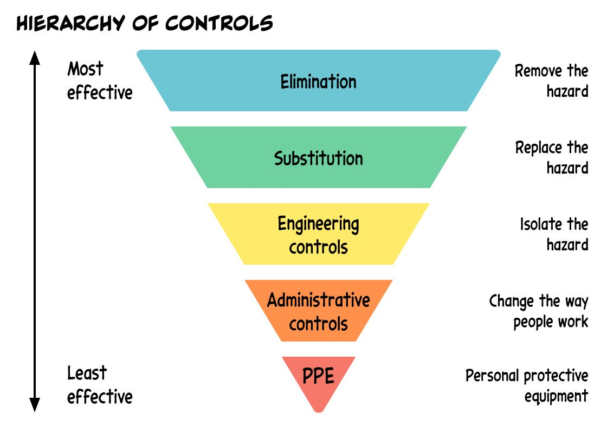
Hints and Tips
Always use the hierachy of controls
Look at worst credible
Don’t spend too much time trying to accurately assess the likelihood, the point of it is so that you can easily see the high risk activities
Medium risk - ask is there anything else that can be reasonably done to prevent this risk from occurring?

Slide 12
Thank you for your time!

Slide 13
Electrical safety: In-Kind Contributors
An Electrical contractor with qualifications from an EES country other than Sweden may temporarily perform electrical installation work.
Must submit an application to get a temporary authorization.
There are 2 types of authorization
General authorization- High and Low Voltage (AB)
Can perform all types of electrical installation work
General authorization – Low Voltage (ABL)
Can perform all types of electrical installation work on facilities for nominal voltage up to 1 000 Volt AC or 1500 Volt DC.
Notes:
Helen

