Slide 1
Radiation Protection for neutron experiments
Dr. Sigrid Kozielski
Groupleader Radiation Protection
European Spallation Source ERIC
13.02.2019

Slide 2
Environment Safety Health and Quality Division
Organigram
Director General of ESS
Environment Safety and Health(ESH) & Quality (Q)
ESH
Q
Occupational Health and Safety
Radiation Protection

Slide 3
Radiation Protection Group
Role and mission
ESS Document “Functional description for the Radiation Protection Group” (ESS-0298187)
The Radiation Protection Group provides expertise and services in radiation protection
Is the owner in charge of the Radiation Protection Handbook, which outlines the regulatory frame work for matters of radiation protection
Protecting people on the ESS site and the public from ionising radiation hazards linked to ESS activities.

Slide 4
Radiation Protection Expert Function
Organisation of ESS Radiation Protection Group
Radiation Protection Expert Function
Operational Radiation Protection
Radiation Protection Services
Radiation Protection Expert (RPE)
Radiation and Environmental Monitoring System (REMS)
Radiation Protection Officer (RPO)
Personal Dosimetry
Accelerator
Target
Storage and Tracking of activated material
Test Stands/
Klystron Gallery
Instruments & laboratories
Radioactive waste buidling
Radioactive Waste management
Radioanalytical laboratory

Slide 5
Radiation Protection and Radiation Safety
Radiation Protection means Protecting people on the ESS site and the public from ionising radiation hazards linked to ESS activities. This is the mandate of the radiation protection group who is is responsible for the design, installation and maintenance of systems owned by the RP group including the handling of radioactive waste. This includes the Radiological & Environmental Monitoring System (REMS) covering both the ESS site as well as the surrounding area, the dosimetry system and the radioactive waste handling system.
Radiation Safety includes the design, construction and operation of radiation sources or using radiation source This is within the responsibility of every ESS division owning radiation sources or using radiation sources put at its disposition. The divisions are in charge of implementing the requirements laid down in ESS’s Safety rules and documents or specified by ESH division to ensure the safe operation of their existing and future installations (accelerator, target, experiments,..).

Slide 6
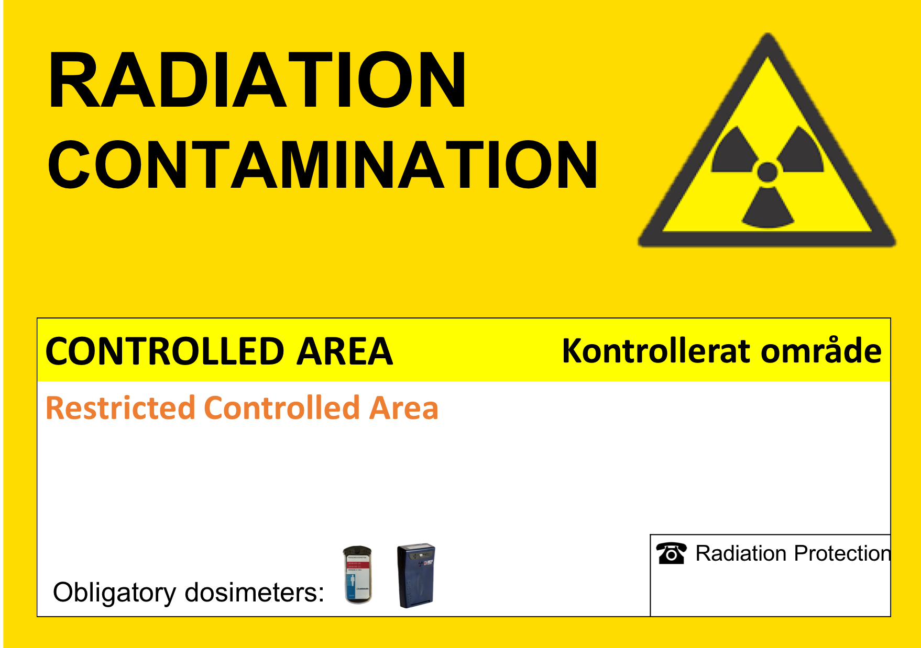
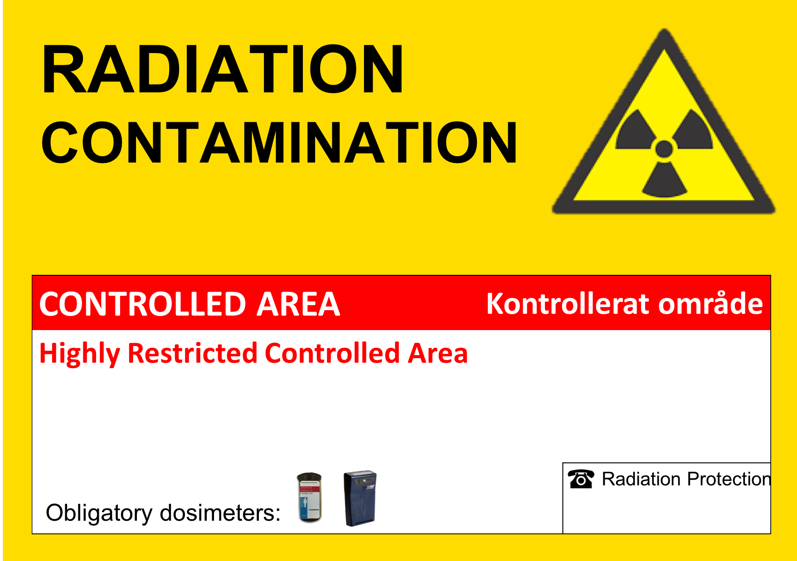
Radiation area classification
Area classification |  | Legal dose limit ESS Ambient equivalent dose rates | Access | Monitoring Personal dosimetry | Signposting
Non-designated area |  | 1 mSv/year H*(10)’ < 0.5 μSv/h | No restriction, all personnel | Passive or active monitoring No personal dosimetry
Designated area or Radiation area | Supervised | 6 mSv/year H*(10)’ < 3 μSv/h | Supervised, Workers and short term users/contractors | Passive or active monitoring Personal dosimetry (passive)
 | Controlled blue | 20 mSv/year H*(10)’ < 25 μSv/h | Controlled | Passive or active monitoring Personal dosimetry (passive and active)
 | Controlled yellow | 20 mSv/year H*(10)’ < 2.5 mSv/h | Limited stay area Cat. A Cat. B with time limit | Passive or active monitoring Personal dosimetry
 | Controlled red | 20 mSv/year H*(10)’ > 2.5 mSv/h | Limited stay area Cat. A | Passive or active monitoring Personal dosimetry

Slide 7
Categorisation of workers - Legal dose limits
Category A: less than 20 mSv per year
Category B: less than 6 mSv per year
Less than 1 mSv/year
(Occupationally) exposed workers
(Occupationally) non - exposed workers

Slide 8
Categorisation of workers – work in radiation areas
Radiation area | Exposed worker - Category A | Exposed worker – Category B | Non-exposed worker
Supervised area | Unlimited stay | Unlimited stay | Stay allowed up to two months per year
Controlled area - Blue | Limited stay | Limited stay | Access prohibited
Controlled area - Yellow
Controlled area - Red

Slide 9
Dose constraints
Art. 4, Definitions, No. 22 from EU Directive 2013/59/Euratom
Dose constraint means a constraint set as a prospective upper bound of individual doses, used to define the range of options considered in the process of optimisation for a given radiation source in a planned exposure situation.
The goal in radiation protection and radiation safety is to keep the classification of an area As Low as Reasonable Achievable (ALARA).
ESS Dose constraints are given in ESS General Safety Objectives (ESS-0000004)
Non-exposed worker: less than 0.1 mSv per year
Exposed worker: less than 2 mSv per year

Slide 10
Principle of radiation protection
System of dose limits and dose contraints
Planned
Exposure situation
Dose
Taking into account other sources
Control of each source
Reduction of single exposure paths
Cost/benefit ratio
Dose limit
Dose constraint
ALARA
Optimisation

Slide 11
Monitoring of people and work areas
Environmental and area monitoring
Radiation Monitoring System ensures that all work areas keep the legal limit according to the area classification and control effluent releases
Personal dosimetry
Individual monitoring of external exposures is provided by passive and active dosimeters provided by the radiation protection group
Dose records are archived by the radiation protection group
For external visitors and contractors they are sent to the relevant service of the laboratory or company concerned

Slide 12
Handling of radioactive material and samples
Any institute/company/research facility that wish to use radioactive material or samples must obtain prior authorisation.
All radioactive sources/materials must be declared to the radiation protection group who checks whether checks it against the existing license for handling radioactive material
The radiation protection group must know at any time where activated material is located within the ESS premises.
The radiation protection group is responsible for the management of all activated material and radioactive sources on-site, including those for experiments.
The radiation protection group plans a process to establish a list of designated areas for storing radioactive materials and sources when they are not in use.
If you have any questions regarding the import, export, handling and storage of radioactive material please contact the radiation protection group.

Slide 13
RP Training
Successfully attending ESS-specific radiation protection courses is obligatory prior to working in Radiation Areas and will be required in order to obtain a personal dosimeter.
The course type will be linked to the classification of the area where staff and users will be working.

Slide 14
ESS Radiation Protection
Regulation
  Radiation Protection Handbook (ESS-0129743)
A selection of rules and procedures:
  ESS rules for roadwork permit and implementation of ALARA in operation (ESS-0150296)
  Configuration control management (ESS-0060903)
  ESS Rules for supervised and controlled areas (ESS-0001786)
  More ESS rules and procedures in preparation e.g.
  Release procedure of material leaving radiation areas
  Tracking and Clearance procedure of activated material
  Decontamination procedures for radiation areas
  Use of Electronic Personal Dosimeters (EPD) in controlled areas
  …..

Slide 15

Radiation Protection Group contacts
Radiation Protection Group leader: Dr Sigrid Kozielski (sigrid.kozielski@esss.se)
Radiation Protection Experts/Senior Radiation Protection Engineers
  Dr Lena Johansson (lena.johannsson@esss.se)
  Dr Riccardo Bevilacqua (riccardo.bevilacqua@esss.se)
  Dr Daniela Ene (daniela.ene@esss.se)
Radiation Protection Officer
  Ida Bergström (ida.bergstrom@esss.se)
  Fredrik Tidholm (fredrik.tidholm@esss.se)
Radiation Protection Services
  Radiation Environmental Monitoring System: Alasdair Day, Juha Hast, David Siecinski
  Radioactive Sources: Alasdair Day ( to be taken over by Joffrey Germa)
  Personal dosimetry: Lena Johansson, Ida Bergström
  …..more to follow
  radiationprotection@esss.se

