Slide 1
Installation Quality Regulations Quality Control Receiving Inspection
Cecilia Lowe
Quality Control Officer
European Spallation Source ERIC
6 February, 2019

Slide 2
What does ESS need?
High reliability and availability
Producing world class science for society
This require generically applied ways of working That is well documented and traceable
How do we jointly achieve this?
Remember - There is a life after installation!

Slide 3
Engineering phase (high level)
Procurement
Contr
Prep.
Prod.
FAT
SAT
Hand- over to Operations
Pre- study
Requirements & Analysis
System Design
Detailed Design
Manufact./Prefab. & Prepare Installation
Installation
Test & Verific.
Commissioning
Request
SRS
EDS
Req
Func. Review
PDR
CDR
IRR
TRR
SAR
ORR
Plant&Process
Design
System Design Procedure
Plant & Piping Design Procedure
Detailed Plant & Piping Doc
Electrical Design
Detailed Design
Detailed Documentation
Mechanical Design
Controls
Symbols:
Review
Requirement fulfilment is key
Documents for Manufacturing and Installation

Slide 4
Directive, Regulations, Standards and Norms
Mechnical Equipment
Manufacturing
Installation and operation / maintenance
MQC4
Safety Related SSC
Or
Non-Safety
(Industrial standard)
PED 2014/68/EU
AFS 2016:1
EN 13445, EN 13480
AFS 2017:3
PED 2014/68/EU AFS 2016:1
EN 13445, EN 13480
ESS requirements
Installation of couplings
Installation of expander bolt
Welding certificate, quality level and Oxidation level after welding of stainless steel
Cleanliness inside pressure vessels / pipe system
Documentation according to cat II-IV
Vacuum Handbook
Part 1 - General requirements for the ESS technical Vacuum system
Part 2 – Vacuum equipment Standardization
Part 3 – ESS Vacuum Design & Fabrication
Part 4 – Helium Leak Test
ESS Rules for Quality Regulation – Mechanical Equipment (ESS-0047989)

Slide 5
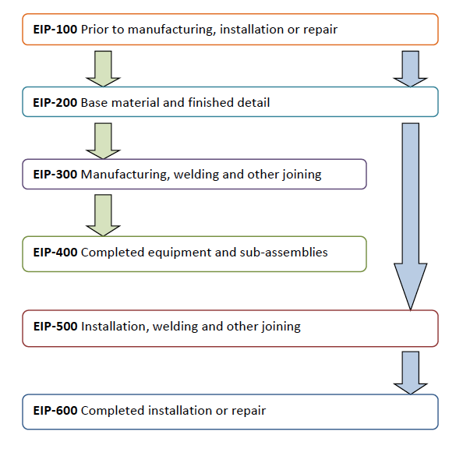
Quality Control Phases
Installation Binder
EIP-ESS Inspection Points

Slide 6
Directive, Regulations, Standards and Norms
Steel/Aluminium structure
Manufacturing
Installation and operation / maintenance
EN 1090 Execution of steel structures and aluminum structures
EN 1090-1 Requirements for conformity assessment of structural components
EN 1090-2 Technical requirements for steel structure
EN 1090-3 Technical requirements for aluminum structures

Slide 7
Conclusion
Test and verification
Commissioning
Handover
Requirements
Design
Install
Acceptance
Document and baseline the information

Slide 8
Translated regualtions from the Swedish Work Environment Authority
Translated regulations from the Swedish Work Environment Authority
Reg No | Titel | CHESS No
AFS 2017:3 | Use and Inspection of Pressurised Devices | ESS-0177972
AFS 2006:8 | Testing with overpressure or underpressure | ESS-0507641

Slide 9
Receiving inspection

Slide 10
Receiving Inspection
ESS procedure for Receiving inspection, ESS-0102301
Mandatory for Safety systems
Performed jointly
ESS apply graded approach
What is the purpose with the Receiving inspection?
Act as a independent reviewer of incoming goods
Secure that the requirements set by internal and external stakeholders are met.
Capture important technical documentation.
If the agreement with in-kind or other contractor’s states that they are responsible for delivery of the supplied material/components to site, a procedure shall be approved by ESS Quality Department on how to secure delivered goods.

Slide 11
Workflow – Receiving Inspection
Start
End
Logistics
ESS-0042154
To Projects
Address control
Content Control
Damage Control
Document Control
Receiver Notification
Goods Handover
To Storage
Security /
Dangerous Goods
ESS-0122078
Classification
Dangerous Goods Control
Security Control
WPM /
Goods Receiver
Receiving Inspection
N
Item Control
Y
Dialog WPM/QI
Corrective Action
Quality
ESS-0102301
Physical quality inspection
N
Approved
Blocked Goods
Contact WPM
Issue NCR
Document Review
Y
Report issuing and filing
Receiving inspection approved

Slide 13
Thank you for your time!

