Slide 1
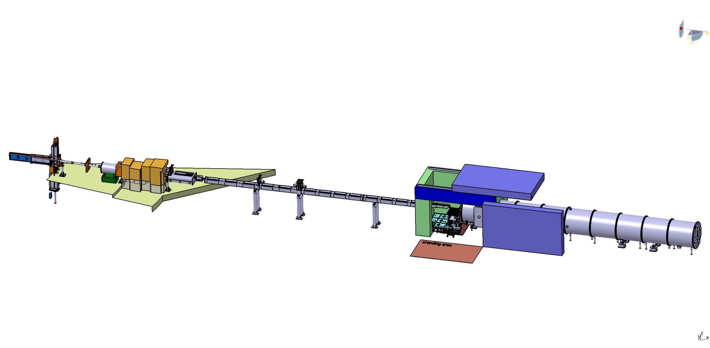
SKADI
Sample Environment & Handling
Feb. 13th 2019 I S. Jaksch

Slide 2
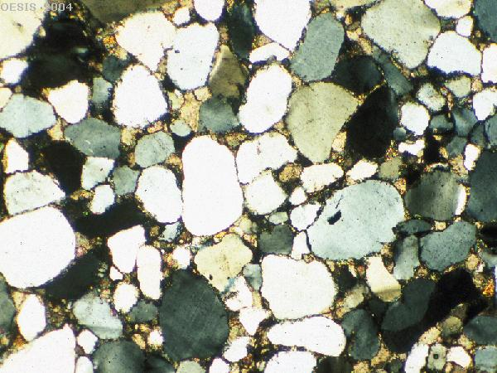
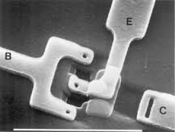
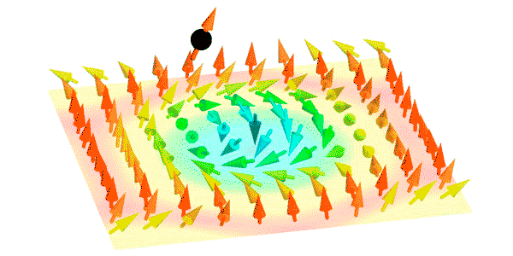
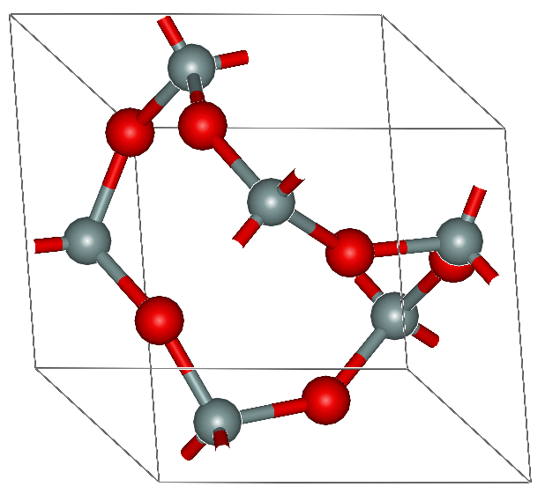
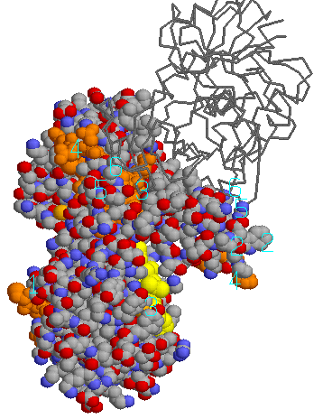
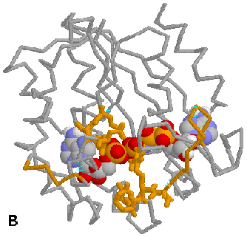
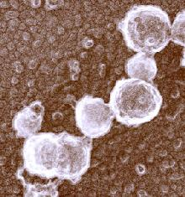
Overview Science Case
At what kind of samples are we looking?
Polymers
Electronics
Magnetic Systems
Geological Studies
Proteins
Food Science
Viruses and Cells
1Å
10Å
100Å
1000Å
1µ m
10µ m
Q
1Å⁻¹
0.1Å⁻¹
0.01Å⁻¹
0.001Å⁻¹
10⁻⁴Å⁻¹
10⁻⁵Å⁻¹

Slide 3
Environmental Conditions
Ideas, not a finished list
Ambient
High (temperature, pressure, stress, strain …)
Low temperature
In-situ (together with DLS, IR-spec, UV-Vis, …; during a process: polymerization, solubilization, crystallization, ….)
In-operando (running fuel cell, …)
Fast changes
Controlled ramping (temperature, concentration, …)
And many more to come

Slide 4
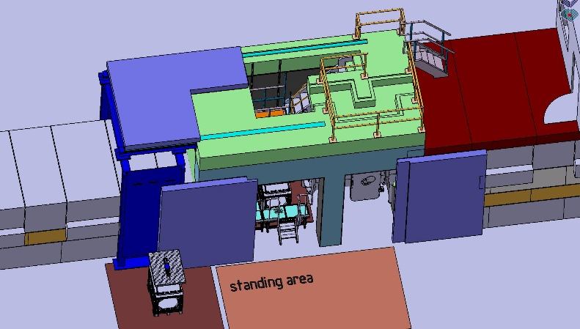
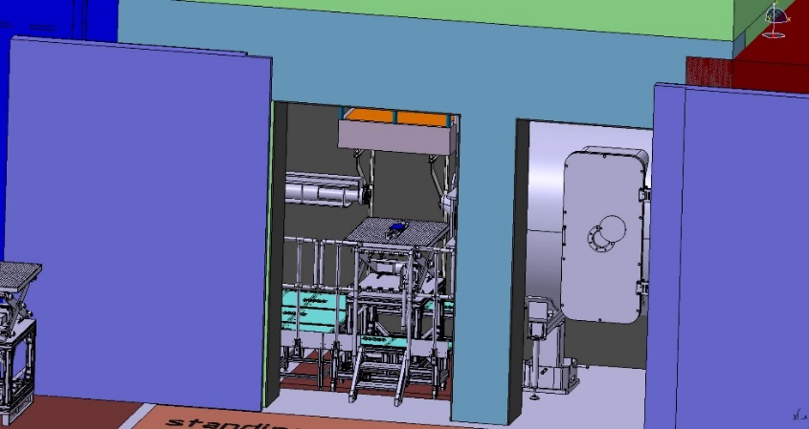
SETUP
Preparing the experiment
Prepare complete setup on mounting system outside
Test everything works (cooling, heating, movement, …)
Alignment
Transfer to sample cave
Check alignment
Start measurement

Slide 5
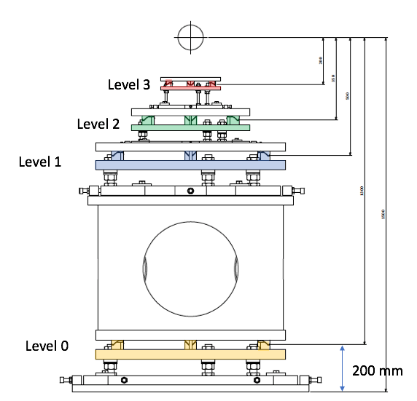
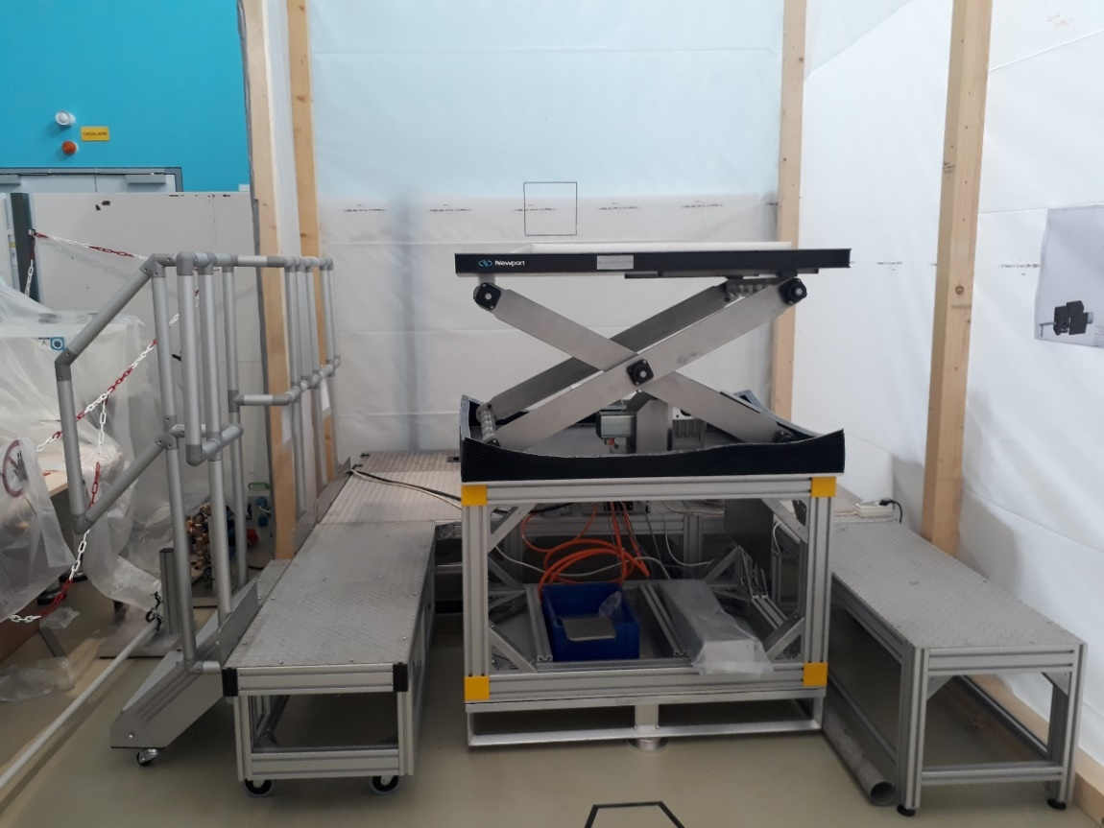
General Mounting
200
350
500
1300
1917 mm
Should be two weight stages
Really neccessary?

Slide 6
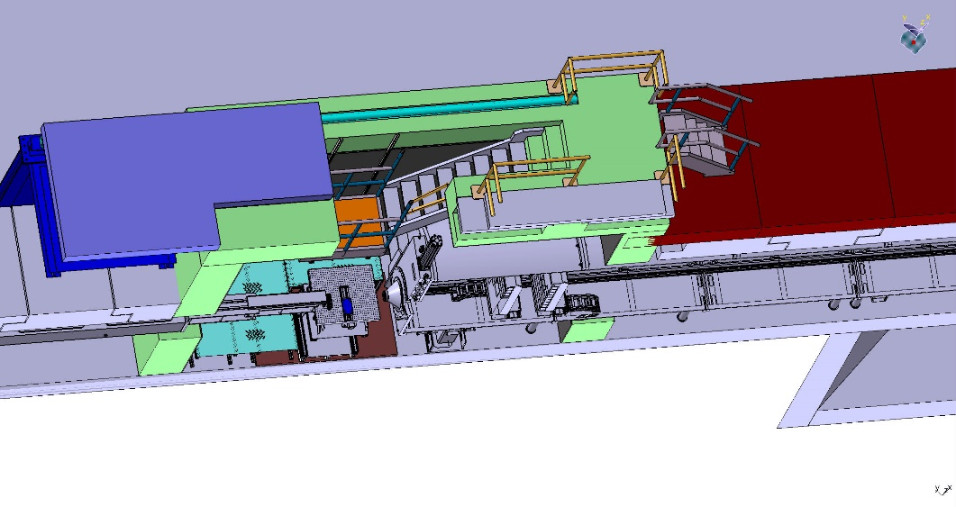
Cabling and Connectors
Hoses from dewars
Gas
Liquid
Electrical
Data
Hand crane
Swiveling arm with control PC/Laptop
Julabos
Permanent Installations

Slide 7
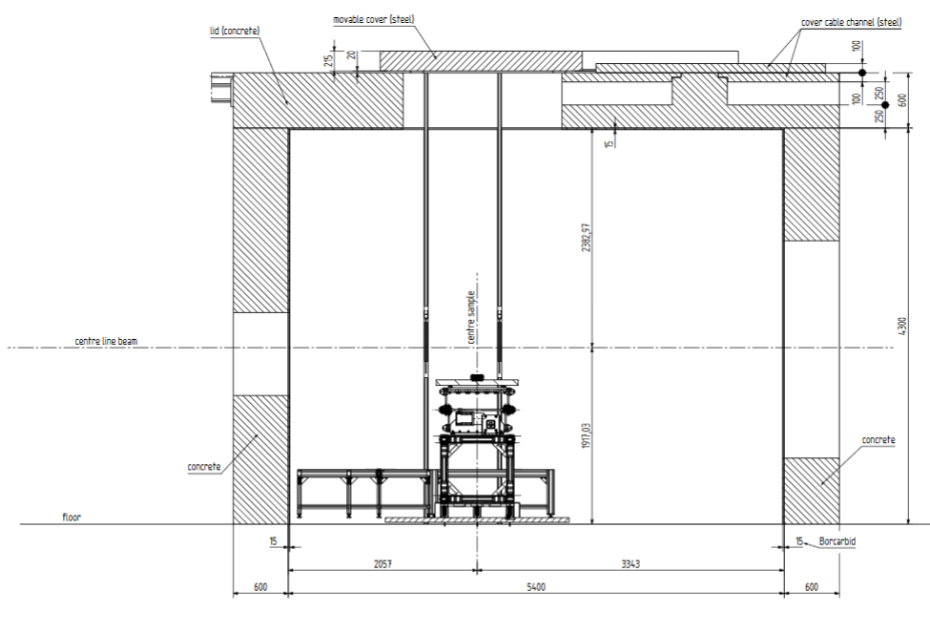
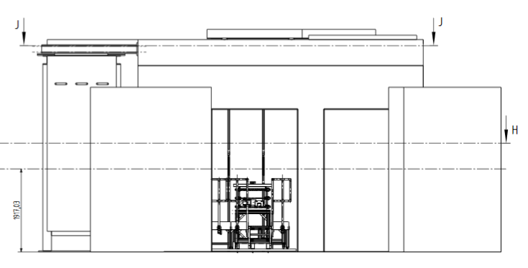
Access to the Sample
Struts at wall for mounting equipment
Top access by stairs
Platform at beam height
Side access by stairs
Movement of sample by pallet jack
2 m wide door
4.3 m full height
detector tube

Slide 8
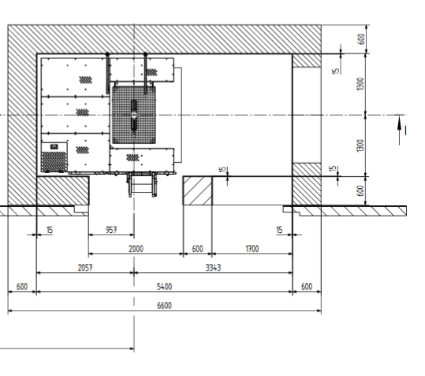
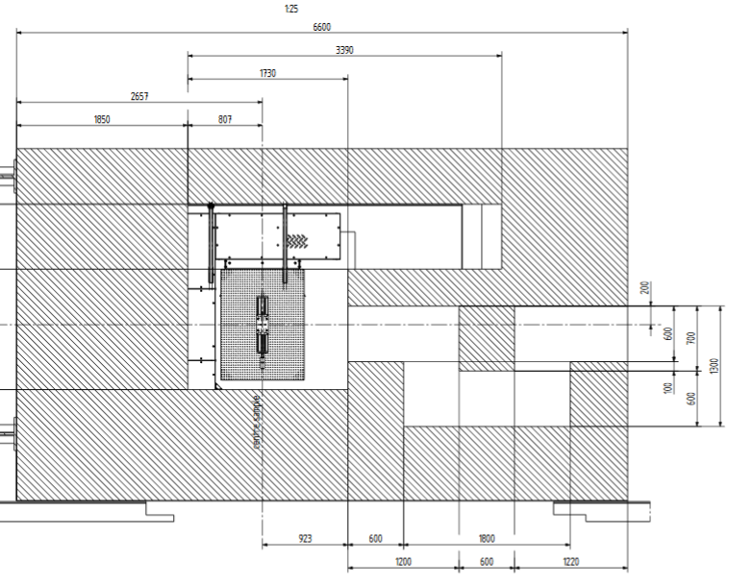
Access To the Sample
Full-size crane access
Top-access by stairs and platform
Instrument and hall crane are feasible
detector tube
Platform & stairs

Slide 9
Summary
We do not / cannot know what users will want at the instrument
We set up an infrastructure that facilitates access and interfacing
Standard heights/measures are kept
Based on this infrastructure, users are encouraged to develop custom sample environments
CAD drawings/support will be made available to users
Only what is simple to use will be used …
Simple access and setup by prealignment and mouting
Defined interfaces help fast and save handling (color/mechanical coding, plugs where you need them …)

Slide 10
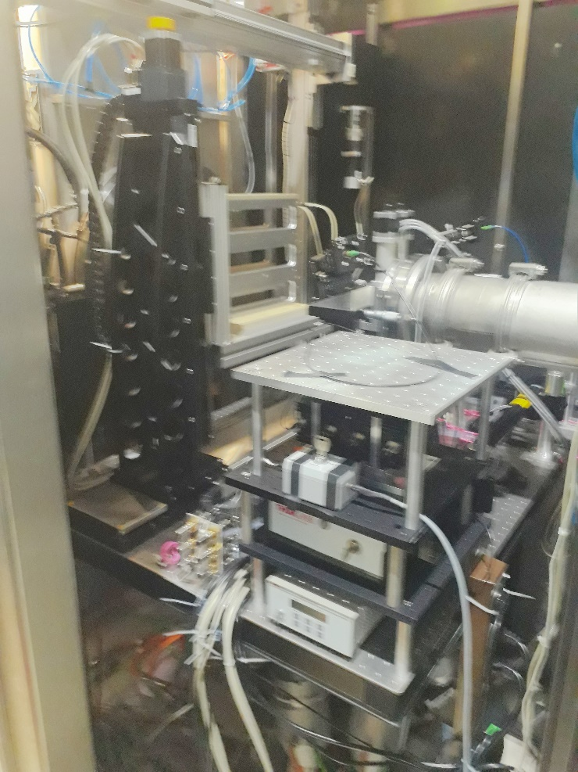
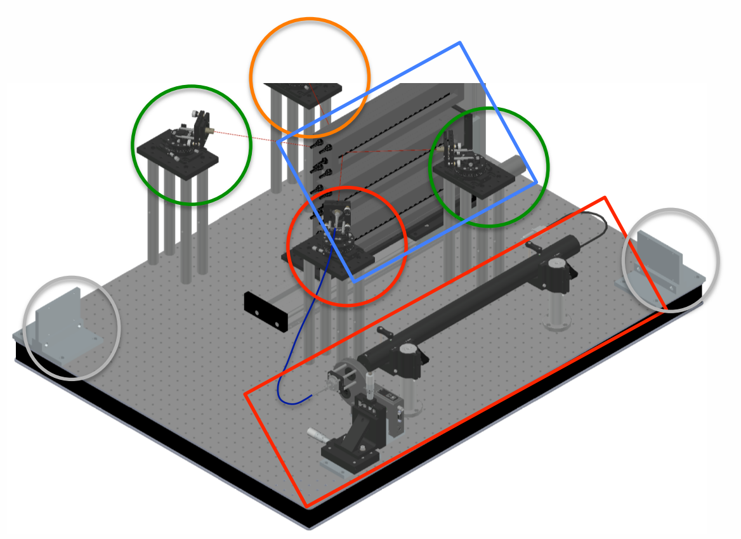
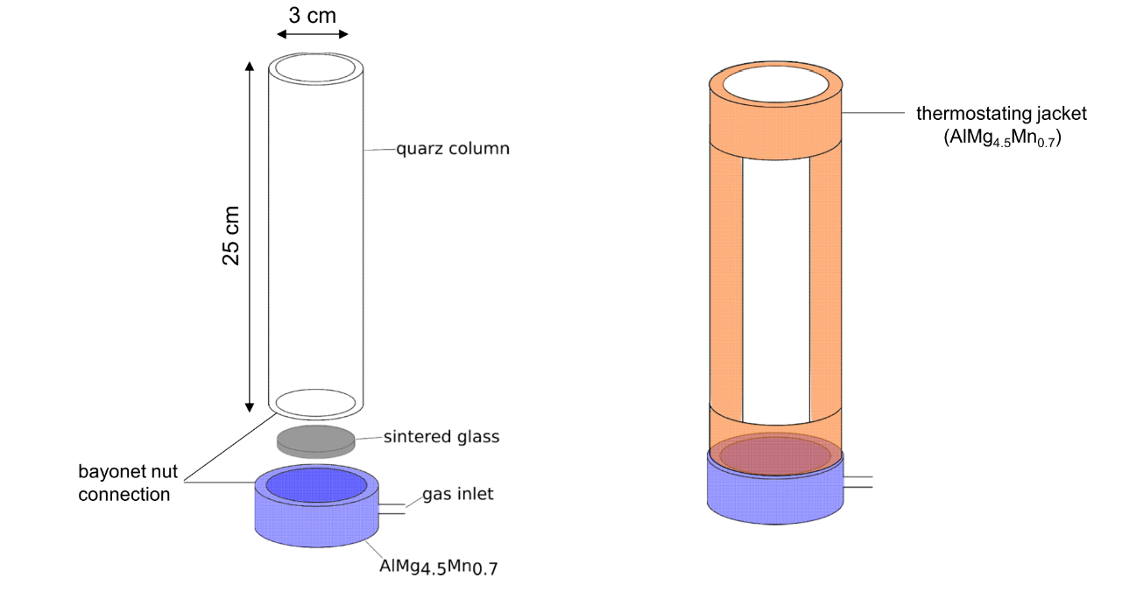
Examples: Flexiprob
DLS setup being tested in Garching
Foam Cell in development
Vapour chamber in develoment

Slide 11
Questions?
Thanks to …
Romuald Hanslik, FZJ
Henrich Frielinghaus, FZJ
Herbert Feilbach, FZJ
Ralf Engels, FZJ
Sylvain Désert, LLB
Jacques Jestin, LLB
Pascal Lavie, LLB
Flexiprob collaboration
… and a lot more
... and you, for your kind attention!

