Slide 1
Bifrost Cave - Concept
Liam Whitelegg – 13-02-2019
Notes:
1

Slide 2
Cave Design Background
Bifrost is a cold neutron spectrometer for investigating magnetism
The cave is situated inside the E01 hall – central region – 10 tonne crane limit
Will have high flux on samples so we require more shielding than others
Intend to use high field magnets – Up to 15T
Limit on magnetic materials allowed within 3m of the sample position
1.2m thick walls and 1.4m thick roof
Internal volume of 6.3m x 7.2m x 4m
Total - 270m³ of concrete needed
Current concept is to use concrete lego
Predominant access from above
Potential issues with activated samples
Notes:
3m radius chosen larger than SE recommendation based on calculations with big bit of iron.

Slide 3
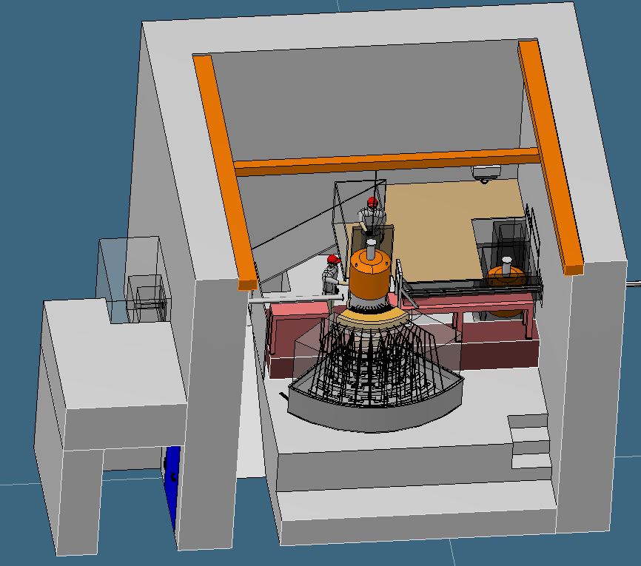
Design Evolution – 1 – TG-2 Design
Cave was almost 9m tall due to space for;
  Tall equipment
  Dilution stick
  Crane
Issues for SE auxiliary services
  Access when beam on
  Potential radiation damage
Activation issues
  How to approach activated areas
  Where to put active equipment

Slide 4
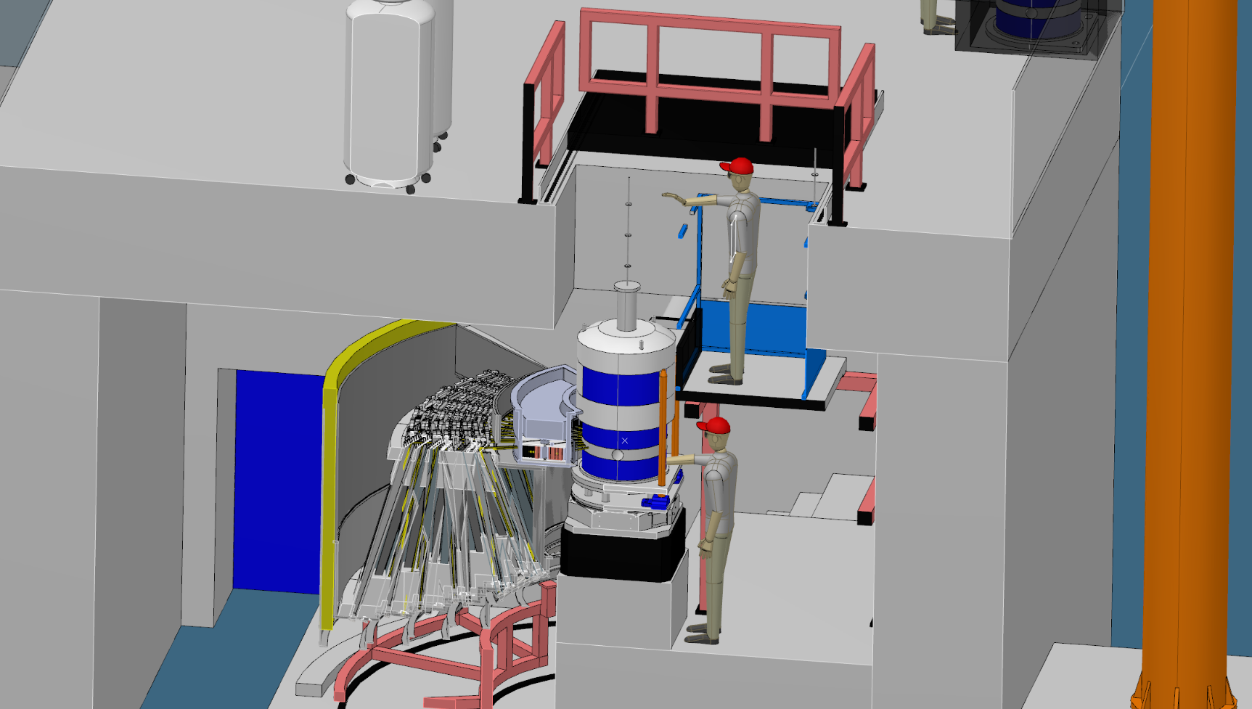
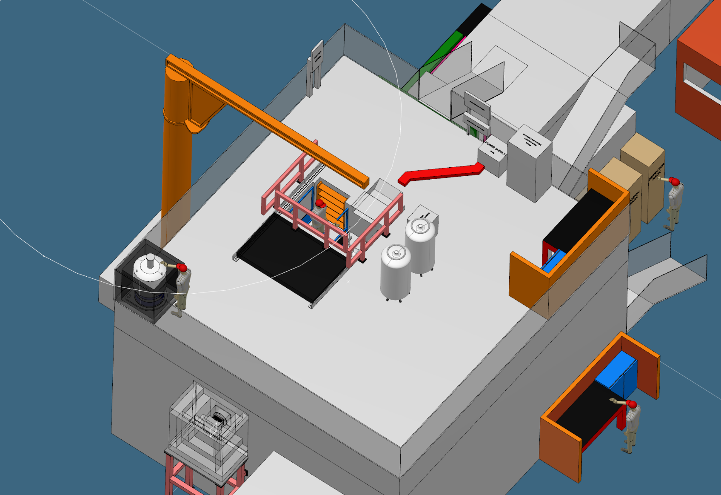
Design Evolution - 2
Shrank cave and moved to top access
Auxiliary equipment on the roof
Sliding hatch with a ladder down to platform
  Ladders were prohibited
  Stairs increased hatch size to over 30 tonnes

Slide 5
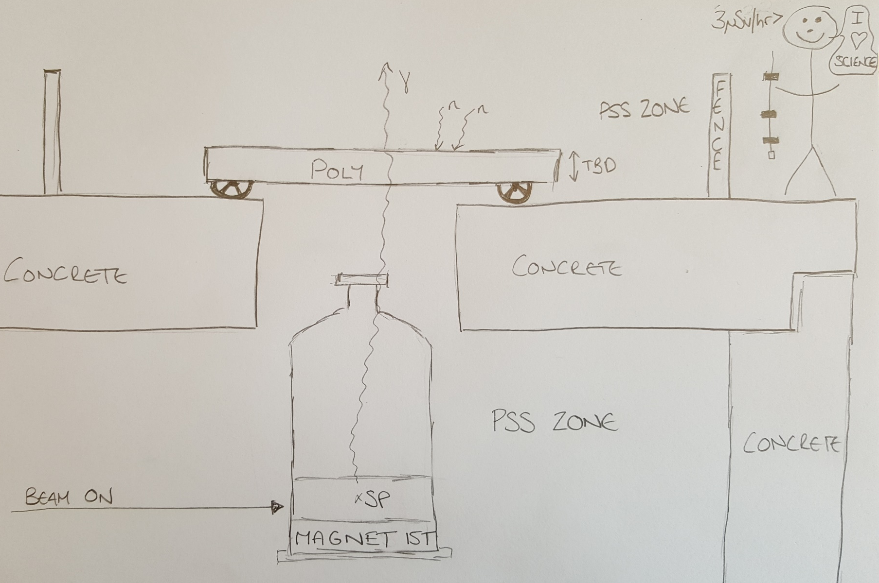
Design Evolution - 2
Notes:
Question – Are you allowed to just stop neutrons but not gammas? Currently no, but this would simplify things considerably.

Slide 6
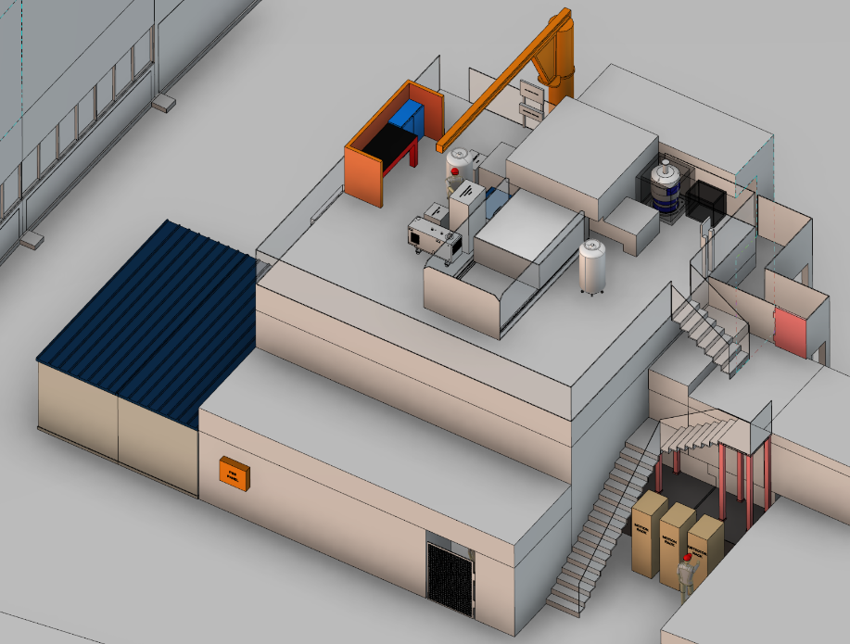
Design Evolution – 3 – Current Design
Sample Staging Area
Elevated labyrinth
Hutch
Retracting Hatch
25uSv Area
Elevated labyrinth access
Ground labyrinth access
Notes:
Current design – better access to top of SEE through labyrinth without stairs.

Slide 7
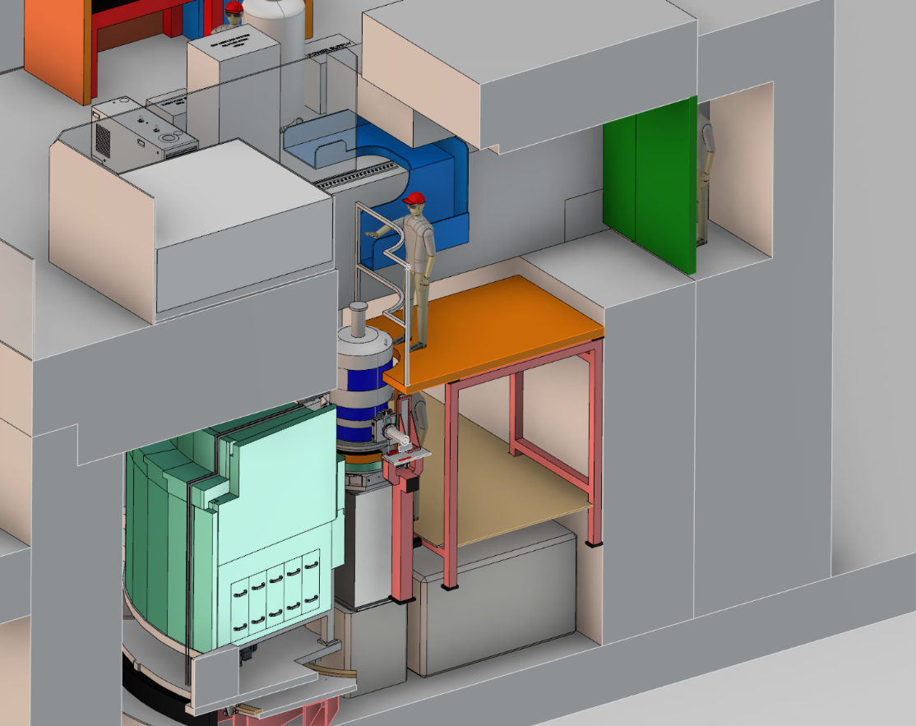
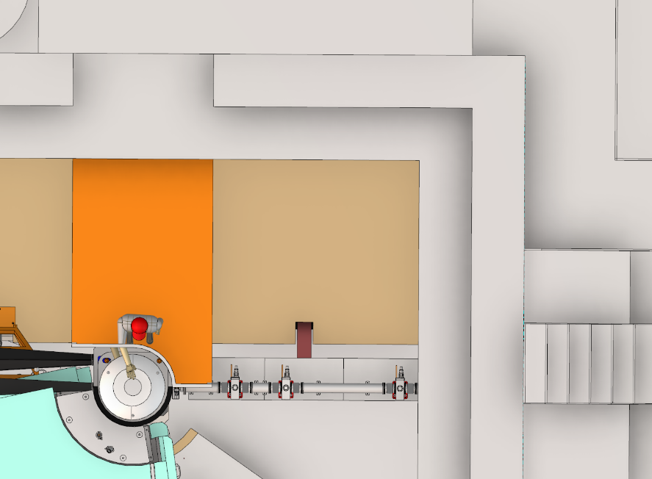
Design Evolution – 3 – Current Design
Same shorter cave – 5.4m
Create small labyrinth and tunnel for elevated access to SP
25uSv zone above hatch and on walkway. 3uSv everywhere else
Access is much easier with more space
Hatch is 13.2 tonnes
May add shielding underneath platform
1.6m

Slide 8
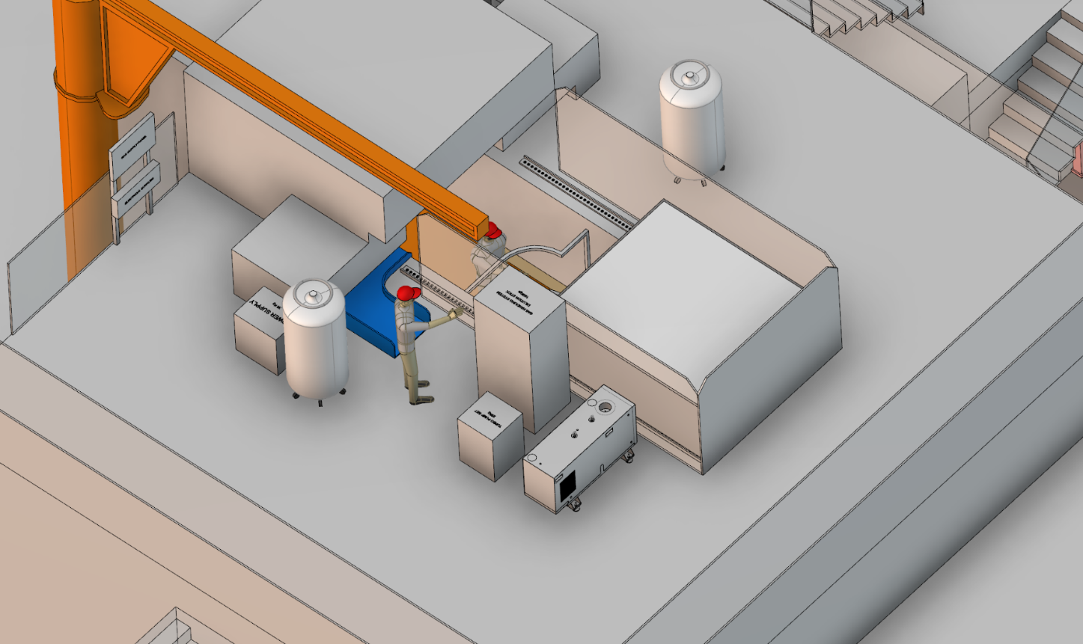
SAD Staging Area(??)
Lots of space for equipment and access available whilst beam is on
Need to finalise position, span and height of crane
  May need to remove part of safety barrier to lift tall equipment
All lifting operations require two people
Services tray (blue)
  Follows SAD rules
  Requires 2 people
  Neutronics needed
Storage of activated
equipment/samples on roof
Notes:
5-6m cables to reach SEE from aux equipment.

Slide 9
Access Route – Sample Change or SEE
Sample Staging Area
Elevated labyrinth
Hutch
Retracting Hatch
25uSv Area
Elevated labyrinth access
Ground labyrinth access
Notes:
How to get around.

Slide 10
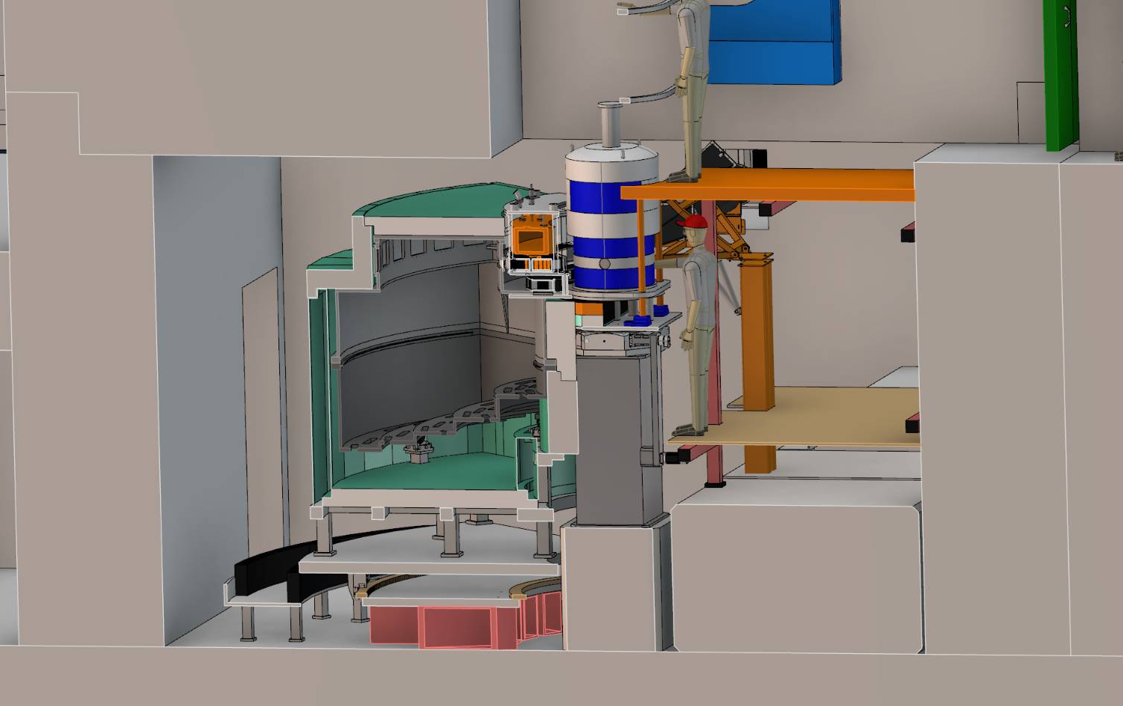
Access Route – Maintenance or side loading
Access sacrificed to allow for easier top loading
Will be cramped and may decide to lower the false floor height
Foreseen for maintenance and adjustments
Notes:
Access to both sample position and top of tall SEE

Slide 11
Future Considerations
Neutronics and statics work needs to progress
  Design could become simpler in places
Kinematic system
Crane placement & spec
Condensation

