Slide 1
Cave and Sample Handling MIRACLES
IKON-16 (Feb-2019)

Slide 2
Boundary conditions
Science case & Sample environment equipment
Experience (past experiments)
Design
Ergonomics and comfortability
ESS documentation
Simplicity, Clarice
ESS-0038078 - ESS Sample Environment Mechanical Interfaces for Instruments
ESS-0038163 - ESS Sample Environment Utility Supplies Reference Document for WBS 13.6.X.5.6
ESS-0038165 - Sample Environment Control System Reference
Sample management procedures: ESS-0024107, ESS-0024109, ESS-0024112

Slide 3
Sample environment equipment MIRACLES

Slide 4
Sample environment equipment MIRACLES
ESS-0038078

Slide 5
Controlled area “around” the sample: defining “around”
ESS-0024112 → “Around the sample will be a controlled area called “sample location” […] it might include the sample environment equipment […] contain the sample within this area using appropriate boundaries and safety devices. This is a flexible boundary.”

Slide 6
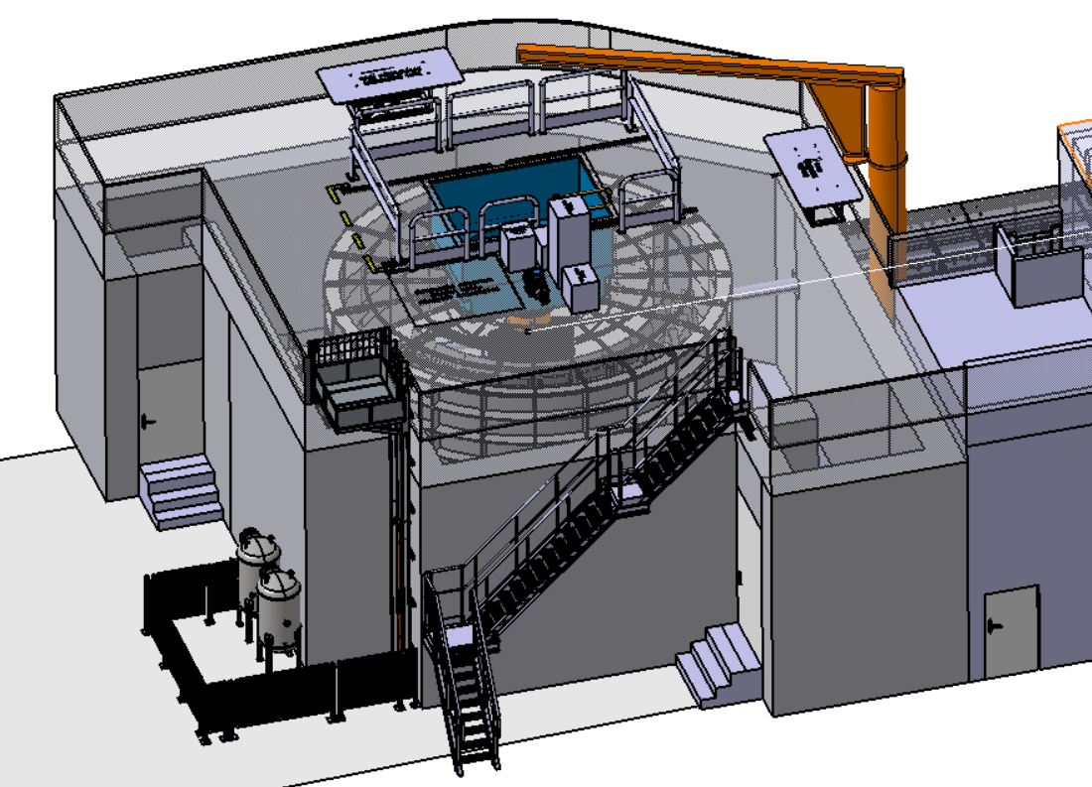
MIRACLES: Cave and SPAs
Sample loading area – Hatch
(if sliding slab: Controlled area 25 μSv/h)
Next-experiment preparation area
Control room
(PSS’ed w/ shutter)
Sample mounting area
Fluid storage area (l-N2, l-He, O2, H2)
Storage area (activated S, SEE)

Slide 7
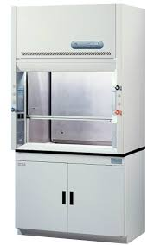
Instrument Specific Laboratories (IS labs)
IS lab = Area on each instrument used for handling samples
Experiment
Sample mounting area
Next-experiment preparation area
Storage
Sample storage area (standard, non-activated)
Sample storage area (solvents, flammable, toxic, nanoparticles,…)
Sample storage room (activated samples)
Documentation: MSDS, likely in the Control Room bookshelf
Gas Outlets
Patch panels
Cryogenics?
Double container (tray, chamber, double bottle,…)
Dessicator?
Fume hood or Laminar flow (bio)?
Own room, besides ESS room
Shielded cabinets
Inventory

Slide 8
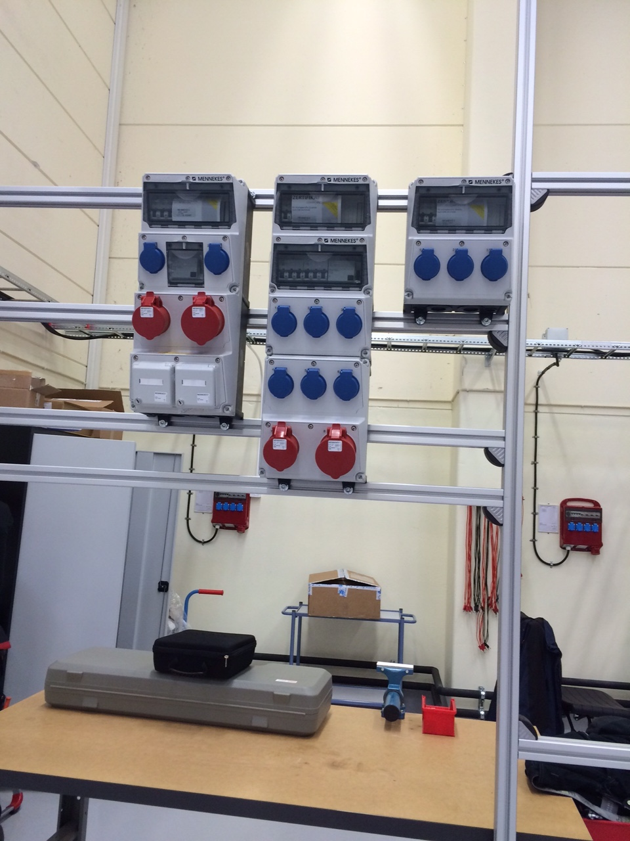
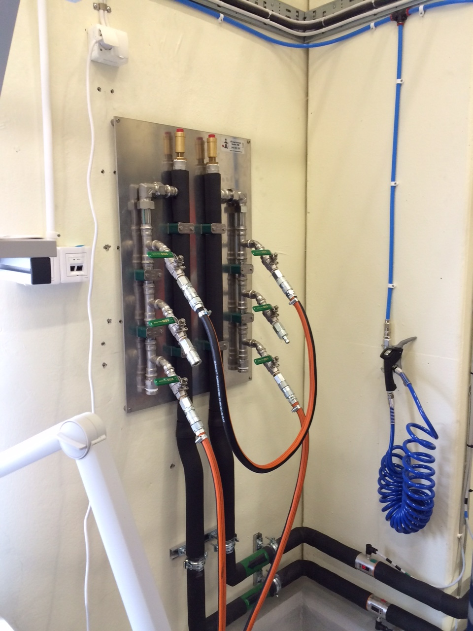
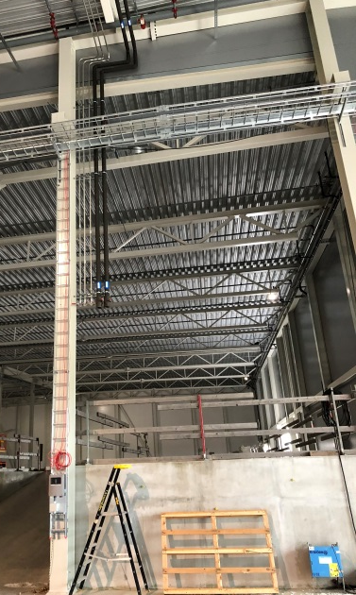
Utility Supply Set
He
ESS-0038163
Cooling water
Electrical power
Box_1 – 2 x [5 x 25 mm²] & 4 x Cat.6 Ethernet
Box_2 – 2 x [5 x 25 mm²]
Box_3 – 1 x [5 x 10 mm²]
Boxes including RCD (30mA) and cut out switches :
Box 1 : MENNEKES 950004
Box 2 : MENNEKES 940018
Box 3 : MENNEKES 920003
All boxes are regarding IP44 class.
Ball valves , 1 each
Cold outlet to SES device (Pin)
Warm inlet from SES device (Socket)
Gases
Supply | Tubing material | Flow/ pressure | Over- Pressure Valve | Purity | Number of independent Extraction points | Supply | Meter
Argon (Ar) | Stainless Steel | <= 8 bar | Y | 4.6 | 2 | Centrally supplied | y
Nitrogen (N₂) | Stainless Steel | <= 8 bar | Y | 4.6 | 2 | Centrally supplied | y
Helium (He) | Stainless Steel | <= 8 bar | Y | 4.6 | 2 | Centrally supplied | y
Compressed air | Stainless Steel | <= 8 bar | Y | Water free | 3 | Centrally supplied | Processing unit
Exhaust | Stainless Steel |  | Y |  | 2 | Centrally supplied
Helium recovery | Stainless Steel >= KF25 |  | Y |  | 3 | Centrally supplied

Slide 9
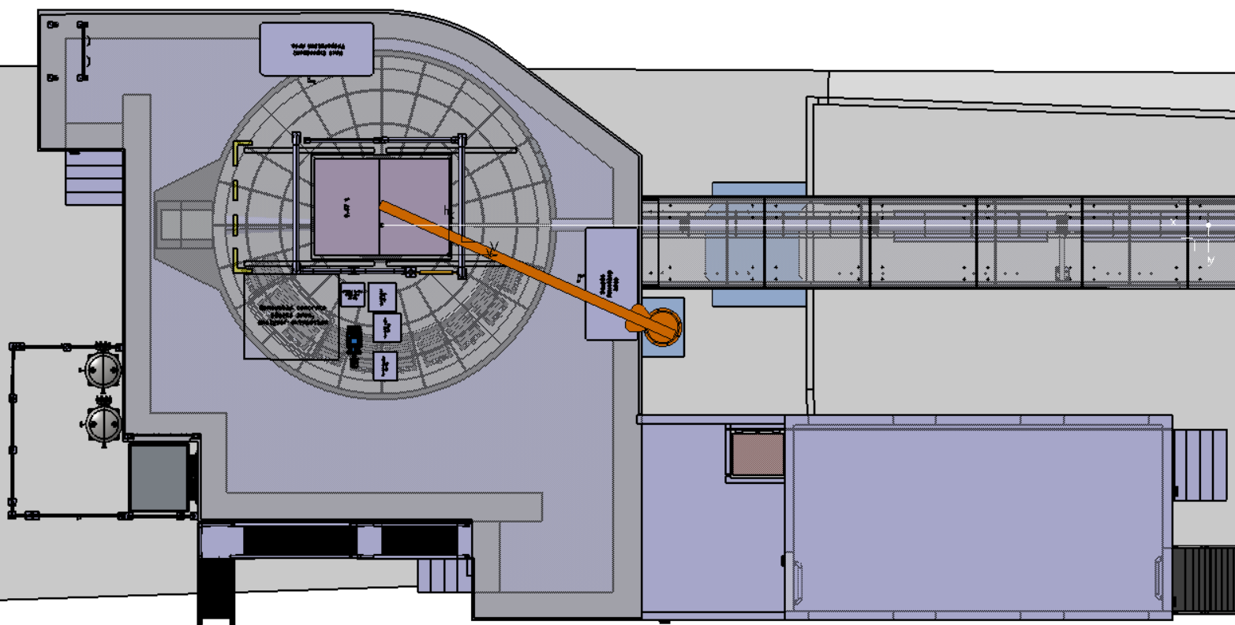
SPAs & Utility Supplies
Workshop (long tables)
Ancillary, Spares
Cabinets and Drawers
Next-Experiment
Preparation Area
(~1,75x4 m2)
Power
Ar
Hanging connectors
N2
He
C. Air
He -rec
Power
N2
C. Air
Sample Mounting Area
(~1,75x4 m2)
Service chicanes
Power
Ar
Data
He
Water
He -rec
Lift to storage area (activated)
Workshop (long tables)
Ancillary, Spares
Cabinets and Drawers
Exh.
Control room
Lift to fluid storage area

Slide 10
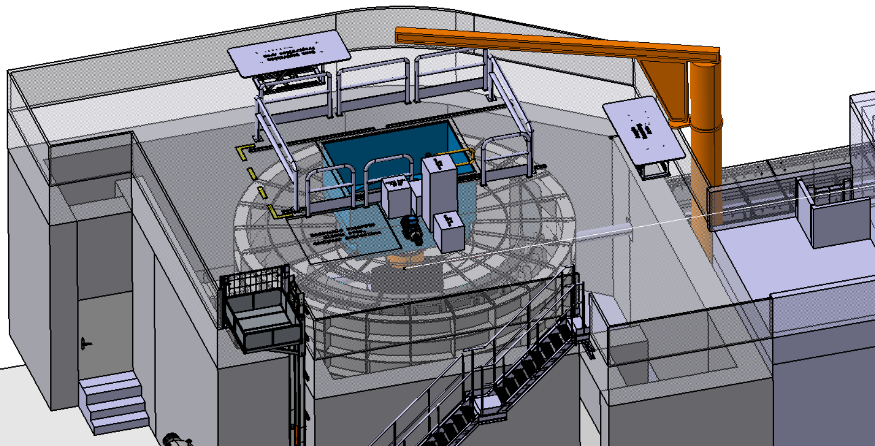
Gas handling, cryogenics
Vacuum Rack:
Rough pump
TM pump
Electronics
Gas Handling System
SEE Controls
& Power Rack
Gas Handling System
SEE Controls
& Power Rack
Vacuum Rack:
Rough pump
TM pump
Electronics
Lift to the Fluid Storage Area (l-N2, l-He, O2, H2)

Slide 11
Transport corridor
ESS-0038078

Slide 12
Transport Corridor
Next-Experiment
Preparation Area
(~1,75x4 m2)
1,5 m
2,5 m
Sample Mounting Area
(~1,75x4 m2)
1,5 m
Control room

Slide 13
Corridor: the guy/girl with the trolley check
Next-Experiment
Preparation Area
(~1,75x4 m2)
1,5 m
2,5 m
Sample Mounting Area
(~1,75x4 m2)
1,5 m
Lift to storage area (activated)
Control room

Slide 14
Hatch: loading area
To step down to the hatch (loading) we need hands free. So, comfortable stairs.
Changing sample stick
Filling cryogenics
Multiple connections

Slide 15
Thank you!

