Slide 1
Science Update
IKON 16
Andreas Schreyer
Director for Science
European Spallation Source ERIC
11-13 February 2019

Slide 2
Overview
News on the Bunker
Annual Review and First Science
Capability Gap Analysis
ILL-ESS User meeting
League of advanced Neutron Sources (LENS)
Instrument papers
Summary

Slide 3
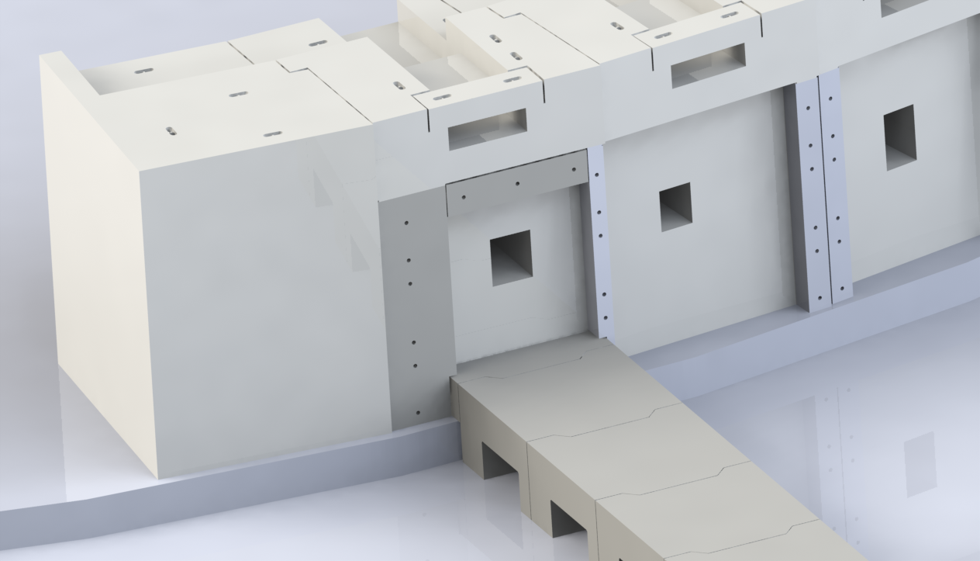
The Bunker moves ahead
C.14.13b
The CDR was successfully completed in October.
The Bunker CDR Committee:
  is impressed by the progress that has occurred since the previous review
  believes the project is ready to proceed with a design-build approach to the bunker with an industry partner
  There are still items that require attention, but these are not sufficient to delay the current approach to the bunker completion
We have received 3 bids for bunker manufacture. The new bunker design is significantly less costly than the old one, and the price will come in within budget.
The Bunker has been procured
Changes since Dec 2017:
Core material has been changed from steel/HDPE to Heavy Concrete - thickness is unchanged (3.5 m)
Design of the wall updated in accordance with the new neutronics design.
Key detail drawings have been done
All required documentation has been written
The bunker wall/Common shielding interface

Slide 4
Good progress in instrument projects
C.14.13b
Moving from Detailed Design to Procurement
The process, documentation and organisation of Tollgate 3 reviews authorizing procurements has progressed well.
The autumn series of STAP meetings is concluding.
Instruments have started procurement.
MIRACLES and FREIA have passed TG2

Slide 5
Summary Schedule and Critical Path for Remaining Work
ES added in response to rebaseling review
BOT - Beam on Target
ES - Early Science
SOUP - Start of User Programme
EOC - End of Construction project
RXXX - Ready for XXX
2018
2019
2020
2021
2022
2023
2024
2025
BOT
ES
SOUP
EOC
Warm LINAC Commissioning Steps
1.3 GeV Capability Installed
CF, Target, and NSS (Bunker) teams holding zero-float Critical path to BOT
Float to Accelerator RBOT reduced from 14 months to 11 months due to IK delivery slippage
Accelerator + ICS
Hi-Beta Install
Beam on Dump
(570 MeV)
Accel RBOT
Accelerator Schedule Float
CF + Target + NSS (Bunker+TBL) + ICS
Bunker and Test Beam Line RBOT
Access for Monolith Installation
Target RBOT
15th Instrument Complete (Ready for hot commissioning)
NSS Instruments + ICS
Instrument Hall Access for Start of Installation
RSOUP
Red line indicates critical path
Start beam commissioning for 1st Instruments

Slide 6
Focusing on meeting BOT and early science milestones as early as possible
Introduced new milestone for early science (ES), which is defined as initial science experiments conducted by expert users on the first ESS instruments
Based on guidance from Council, we are managing to a zero float schedule
  Keeping Council informed on a regular basis, and will propose moving BOT, ES, and SOUP milestones if negative float becomes too large
Monte Carlo schedule analysis shows 80% confidence level for meeting the ES milestone in Dec 2023
ES added in response to rebaseling review
Planned Early Finish BOT Jul-2022
80% Confidence BOT Apr-2023
Planned Early Finish ES Mar 2023
Planned Early Finish SOUP Dec 2023
80% Confidence ES Dec 2023
80% Confidence SOUP Sep 2024

Slide 7
Focusing on meeting BOT and early science milestones as early as possible
Introduced new milestone for early science (ES), which is defined as initial science experiments conducted by expert users on the first ESS instruments
Based on guidance from Council, we are managing to a zero float schedule
  Keeping Council informed on a regular basis, and will propose moving BOT, ES, and SOUP milestones if negative float becomes too large
Monte Carlo schedule analysis shows 80% confidence level for meeting the ES milestone in Dec 2023
ES added in response to rebaseling review
No Delays yet!
Planned Early Finish BOT Jul-2022
80% Confidence BOT Apr-2023
Planned Early Finish ES Mar 2023
Planned Early Finish SOUP Dec 2023
80% Confidence ES Dec 2023
80% Confidence SOUP Sep 2024

Slide 8
Early operations of the ESS Neutron Instruments and first scientific results (ESS 0402218)
C.14.13b
Agreement on priorities for accelerator ramp up & instrument access for first 5 years (from BOT)
Period | Dates | Current (mA) | Energy (MeV) | Power (kW) | Production availability | Availability/Total days
BOT -> BOT + 3 months | July - Sept 2022 | ~ 6 | ~ 570 | ~ 140 | > 1 shift/week | Not defined
Consolidation | Oct- Dec 2022 | ~ 6 | ~ 570 | ~ 140 | 6 shifts/week (consecutive) | Not defined
Performance assessment, Scientific Calibrations | Jan - Mar 2023 | ~ 6 | ~ 570 | ~ 140 | 9 -12 shifts /fortnight | Not defined
Demonstrate Performance, First Scientific Results | Apr - June 2023 | ~ 12 | ~ 570 | ~ 280 | 33 shifts /fortnight | 50 days
Ramp & Early science | July - Dec 2023 | ~ 12 | ~ 570 | ~ 280 | 33 shifts /fortnight | 80%, 100 days
March 2023 (BOT + 9):
Early Science with expert teams (ES)

Slide 9
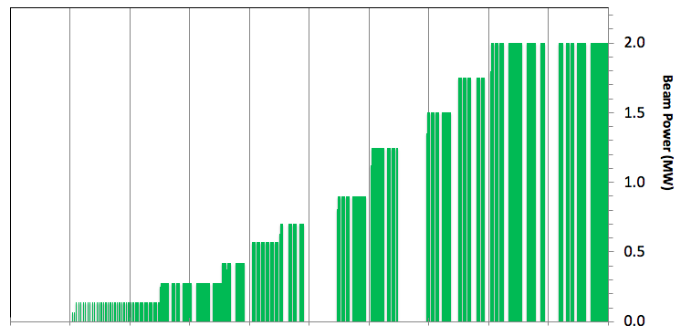
ESS Source Power ramp up (in line with ESS-0402218)
C.14.13b
In-bunker components for NBI 13-15 installed
Start of user program
In-bunker components for NBI 9-12 installed
In-bunker components for NBI 1-8 installed before BOT
200 days/yr for user program
March 2023 (BOT + 9):
Early Science with expert teams (FS)
2022 2023 2024 2025 2026
Power ramp up from NSS MS-V4.1 – 29th November 2018)

Slide 10

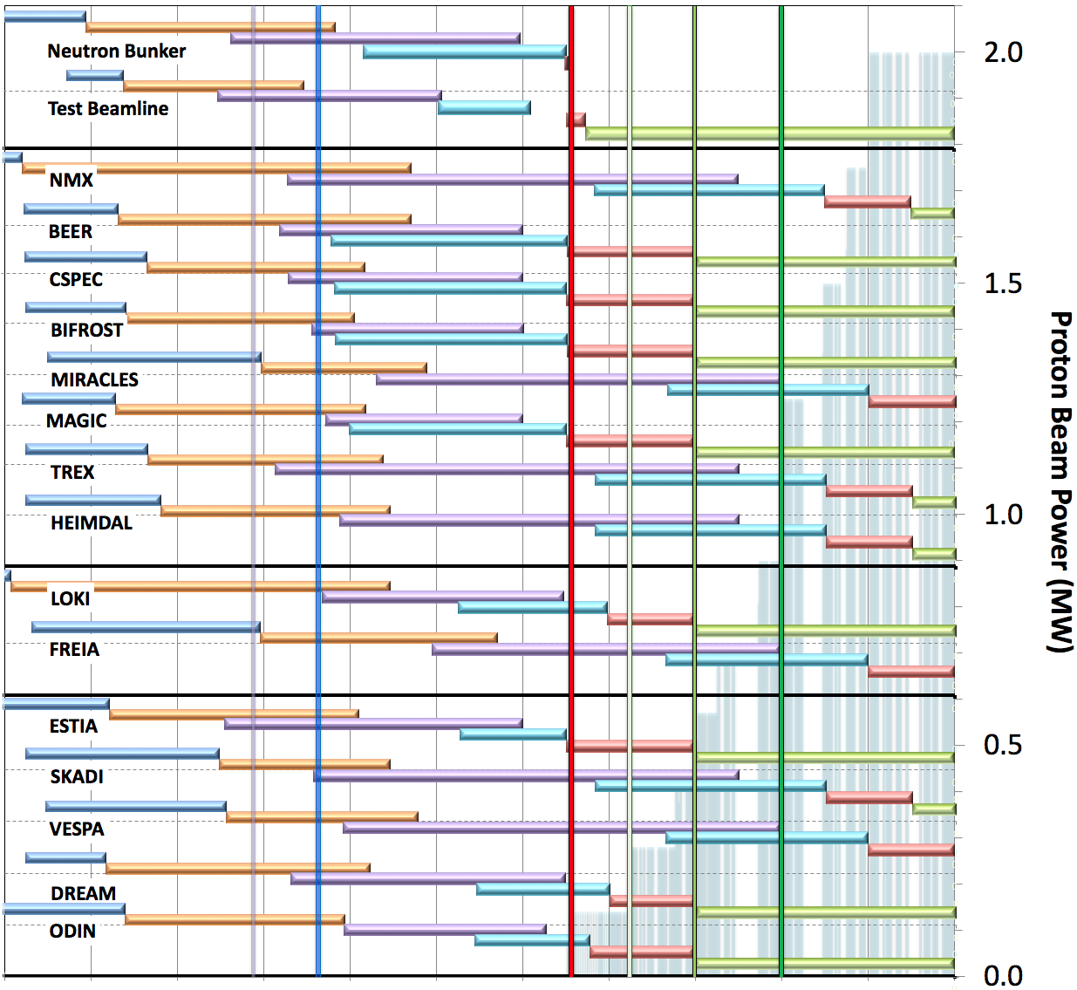
Rebaseline schedule for Neutron Beam Instruments (V4.1, 29th November 2018)
aligned with accelerator ramp up (ESS-0420218)
Preliminary Design
Detailed Design
Manufacturing & Procurement
Installation & Integration
Hot Commissioning/Early science
Operation
Current date
First access to NSS bldg (E01)
BOT
&
HC
SOUP
(3NBI*)
8NBI* in User Program
FS
First 3 NBI selected for SOUP: DREAM, LOKI & ODIN (best chance for early impact, as agreed by NSS, SAC and Council)
Back-up instruments (for risk of late access to D01 & D03) BEER, CSPEC, MAGIC or BIFROST, ESTIA
West sector
March 2023:
First Science (FS) with expert teams on any instrument above
Review progress of first 3 NBI for SOUP, implement backup plan if needed.
North sector
East and South sectors
2016 2017 2018 2019 2020 2021 2022 2023 2024 2025 2026
* NBI = Neutron Beam Instrument

Slide 11
The 15 NSS Project Instruments:
Even during ramp-up, first 8 will be competitive
Instrument Class | Neutron Instrument | CBV (M€) | Performance estimates (at Cost Book Value and @ 280 kW source power)
Large Scale Structures | LOKI (Broad band SANS) | 12.19 | > ½ D22 & 3 x SANS2D
 | ESTIA (Focusing Reflectometer) | 11.80 | Normal mode: > 10 x D17, High intensity mode: 10s of seconds for 1cm²
Diffraction | DREAM (Bispectral powder diffractometer) | 13.66 | > POWGEN & WISH
 | MAGIC (magnetism single crystal diffractometer) | 13.10 | Cold: > 10 x worlds best, and Thermal: 1mm³ crystals = ~ 1 hr
Engineering & Industrial | BEER (Engineering diffractometer) | 14.99 | Competitive with world standard in strain scanning, unique flexibility
 | ODIN (multi-purpose imaging) | 11.60 | world leading for high resolution & > world best for TOF methods
Spectroscopy | BIFROST (extreme environment spectrometer) | 13.45 | > THALES & MACS
 | C-SPEC (cold chopper spectrometer) | 16.50 | > 10 x IN5 (w RRM)
Sub-total cost book value (CBV) |  | 107.29

Slide 12
AR recommendation A2.1
The Committee believes that resources laboratory-wide should now be focussed on achieving at least the minimum criteria for a “day 1 of science” milestone. This will necessitate postponing activities which are not needed for the new focus, and reallocating resources between the key project areas (CF, Accelerator, Target, NSS). This focus will also provide a powerful driver toward cross-directorate cooperation and the effective centralisation of certain functions and capabilities, which inevitably must be done, but which will be of greatest benefit if it precedes installation. Scheduling and risk prioritisation/mitigations should be adapted to reflect the importance of this new milestone.

Slide 13
Communicating First Science
Communicate clearly which three instruments we believe should be operational in 2023
  Our current planning for the first three instrument for SOUP (BOT +18) are
    DREAM (D hall east), LOKI (D hall west), ODIN (D hall)
  4 instruments in E-hall to benefit from early occupancy: MAGIC, BEER, BIFROST, CSPEC
  First Science (BOT + 9) can happen on all of the above, maximizes chances for success
  In case of delays of D halls/installation: First Science on E-Hall instruments
  Builds on ‘early science’ concept endorsed by SAC (powder diffraction, SANS, imaging)
  Do not delay any instrument team now, potentially adjust plan when more information for resource loaded installation schedule becomes available
  Source power at BOT+9 expected to be between 140 and 280kW (based on SNS experience)
  Instruments will already be competitive for First Science

Slide 14
Why a gap analysis now?
C.14.13c
Instrument lead times are long: ~7 years from idea to commissioned instrument.
The first years are dominated by intellectual efforts and are thus not very costly.
As installation and commissioning efforts for the first 15 instruments decrease in 2023-2025, we can use some of our highly skilled resources to start constructing instruments 16 and beyond.
This will be timely to ensure continuous development at ESS that matches and leads scientific developments world-wide.
By working with the community now to understand what they will need from ESS for their future scientific endeavours, we make sure we’ll have the best and most relevant instrument concepts ready to implement when that time comes.
To create long-term scientific success and lasting societal impact.

Slide 15
Capability Gap Analysis
C.14.13c
Which significant capability gaps exist after construction of the 15 instruments?
  Guide choice of instruments 16-22
  Focus on instrumental capability
  Requested by ESS Scientific Advisory Committee (SAC) and ESS Council
  Needed for prioritization and planning of Initial and Steady-State Operations funding incl. Continuous Improvement Program (CIP)

Slide 16
Current 15 Instruments
C.14.13c
15 instruments selected over 3 proposal rounds
  2013, 2014, 2015
  Open, competitive process
  Reviewed by Scientific and Technical Advisory Panels (STAPs) and SAC
  Endorsed by Council
Guided by Early Success Strategy
  Workhorse, general-purpose instruments
  Build on ESS strengths
  Address new communities
Value-engineering
  Some capabilities reserved for instrument upgrades
  World-leading performance at 2 MW

Slide 17
Capability Gaps: Three levels of Priority proposed
C.14.13c
Already now more ideas than slots for instruments
1. High-Priority Capability Gaps
  Fundamental/Particle Physics
  High-Resolution Spin-Echo
2. Other Significant Capability Gaps
  High Pressure Diffraction
  Grazing-Incidence SANS
  Very Fast Spectroscopy
  Wide-Bandwidth Spectroscopy
  High Magnetic Fields
3. Lower-Priority Capability Gaps
  Bio-SANS
  Hydrogenous-Sample Diffraction
  Wide-Angle Spin-Echo
Strong support from SAC for High-Priority Gaps 1.
Open first call for these
Later: Open calls for priority 2. and 3.
No need to decide between priorities 2. and 3. now
New ideas welcome!
Based on proposals not prioritized so far as well as on some new ideas

Slide 18
Possible Instrument Placement (Priorities 1. and 2.)
C.14.13c
Space is available, no further cost incurred
T-REX
HEIMDAL
MAGIC
MIRACLES
BIFROST
West
West
CSPEC
BEER
NMX
North
FREIA
TBL
LOKI
GI-SANS
HR-NSE
South
East
ESTIA
ODIN
VOR
SKADI
DREAM
ANNI
MUSHROOM
ESPRESSO
VESPA

Slide 19
Status and proposed way forward
C.14.13c
The document is publicly available on the ESS website: https://europeanspallationsource.se/article/2018/10/05/ess-instrument-suite-capability-gap-analysis
It was presented and discussed at length at the ILL-ESS user meeting in October in Grenoble.
It will be discussed with other facilities within LENS in 2019.
It was discussed in depth at the SAC.21 meeting in October
First presentation to Council 14 for information
To be discussed further at upcoming Council meetings
Our biannual ILL-ESS user meetings, STAPs, SAC and other events provide us with good channels to keep the dialogue with the community active on several levels.
The analysis is not meant to provide a fixed path defining the next seven instruments, but rather a collected picture of currently known gaps and emerging possibilities.
Having a number of open slots available for new and currently unknown ideas is also important for a dynamic, successful facility.

Slide 20

First ILL – ESS – European Neutron User Meeting
10-12 Oct. 2018, WTC Grenoble, France
510 Participants attended (200-300 initially envisaged); very positive participants feedback
Facility Updates, Methodological Focus, User Feedback on ILL / ESS instrumentation
  Plenary presentations, Q&A session, posters, booth incl. virtual reality walk through ESS, survey
  Very much informal interaction with scientific community to ‘add value and unique possibilites for the science community … we develop our facilities with the users for the users.’ (AS)
Highlighting the great Science done using Neutrons
  10 scientific key notes, focus sessions, parallel topical workshops resulted in fire work of science (HS)
Agreed to organise such event regularly; next event 2020 in Lund (or surroundings)
https://www.ill.eu/news-press-events/press-corner/press-releases/ill-and-ess-bring-together-global-neutron-science-community-to-tackle-societys-biggest-challenges

Slide 21
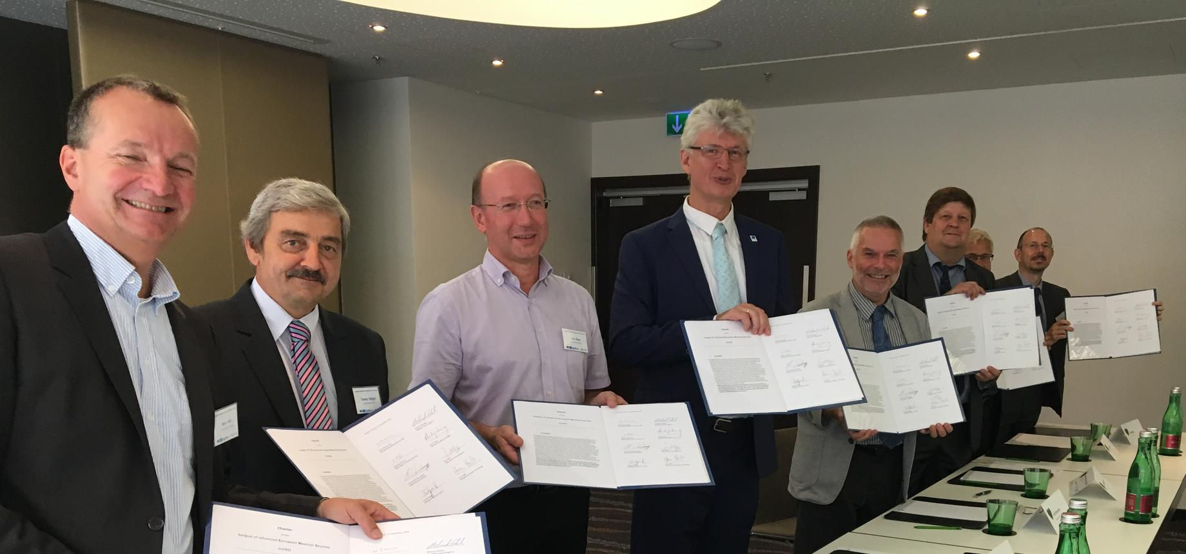
The League of advanced Neutron Sources (LENS)
C.14.13b
Charter signed in September by ESS and 7 other facilities
A new strategic consortium of European neutron source facilities with the aim to facilitate any form of discussion and decision-making process that has the potential to strengthen European neutron science via enhanced collaboration among the facilities.

Slide 22
Instrument papers
Single long paper for all instruments
  agreement to submit to Nucl. Instrum. Meth. A
  all instruments have written their part
  introduction drafted by Ken and has had input from Andreas
  introductory sections to each instrument class written by the instrument class coordinators
  First draft of whole paper now together for review by ICCs in next couple of weeks
  Full draft suitable for circulation back to instrument teams sent out by end of February for updates to their sections.
  harmonisation of figures and tables ongoing (Andrew)
Individual instrument papers
  to be timed roughly with TG3 of each instrument – should be starting late 2019
  need further discussions on paper format – some divergence of opinion exists
  instrument teams should start assembling content (if they haven’t already)
  several journals contacted – all agree to publish virtual issue
  journal decision to be made before first paper – must be in citation index

Slide 23
Summary
Good project progress, all TG2’s finished
Focus on First Science in 2023, new milestone
Suits us well, had always planned to hot commissioning in this way
High level discussions on the initial operations and the missing funding for construction future of ESS have progressed (2019 initial ops budget approved)
Instruments 16-22: Capability Gap Analysis published
Further progress on contracts and TAs is urgently needed, DE Contract passed ESS Council
Key goal for 2019: start installations in the E-Hall!

Slide 24
Summary
Good project progress, all TG2’s finished
Focus on First Science in 2023, new milestone
Suits us well, had always planned to hot commissioning in this way
High level discussions on the initial operations and the missing funding for construction future of ESS have progressed (2019 initial ops budget approved)
Instruments 16-22: Capability Gap Analysis published
Further progress on contracts and TAs is urgently needed, DE Contract passed ESS Council
Key goal for 2019: start installations in the E-Hall!
Next IKON in week 9.-13.9.2019

Slide 26
Implementation of rebaselining for NSS
Planned order of commencement of operation of first 8 instruments
Matching early success in delivery of scientific outputs with the capacity of Lead In-Kind partners to deliver on schedule (ISIS, PSI, FZJ, LLB, HZG/NPI, TUM/PSI, TUM/LLB & DTU lead consortium).
Instruments in bold type to be operational by Aug 2023 Dec 2024
Italic type indicates backups in case of delays to those in bold type
Currently planned first 3 instruments for SOUP shown in red.
Progress review of First Science on first & back-up instruments made in March 2023.
BOT in mid 2022
SOUP end of 2023
Very narrow window for hot commissioning of first instruments.
Instrument Class | Sub-class | Candidates
Large Scale Structures | Small Angle Scattering | LOKI (ISIS) or SKADI (FZJ/LLB)
 | Reflectometry | ESTIA (PSI) or FREIA (ISIS)
Diffraction | Powder Diffraction | DREAM (FZJ) or HEIMDAL (ÅU)
 | Single crystal diffraction | MAGIC (LLB) or NMX (ESS)
Engineering | Strain scanning | BEER (HZG/NPI)
 | Imaging and tomography | ODIN (TUM/PSI)
Spectroscopy | Direct Geometry | C-SPEC (TUM/LLB) or T-REX (FZJ)
 | Indirect Geometry | BIFROST (DTU), MIRACLES (Bilbao), VESPA (CNR)
UNCHANGED PRIORITIES
Cost increases due to delays managed within the ringfenced budget
Knock-on delays to later instruments:
#9 – #15 ~ 1 ½ yr
#16 – #22 > 1 yr

Slide 27
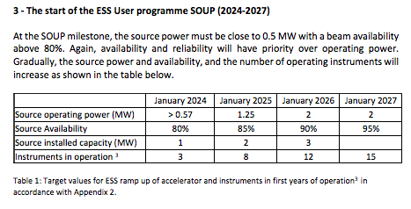
Early operations of the ESS Neutron Instruments and first scientific results
C.14.13b
Agreement on priorities for accelerator ramp up & instrument access for first 5 years (from BOT)
‡
‡ Source operating power of 0.57 MW could be:
(12 mA x 1.2 GeV) or (25 mA x 570 MeV) or something between

Slide 28
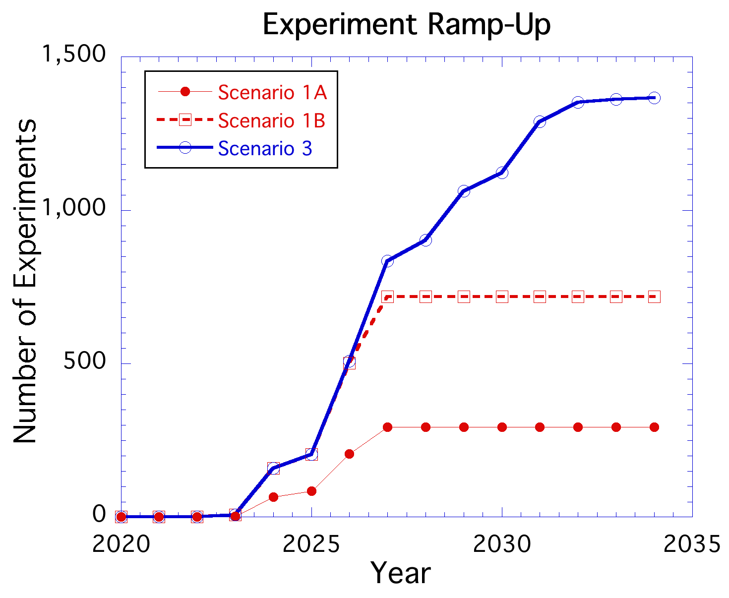
Reminder: Completion of Construction Report (2017)
C.14.13c
Construction of the additional seven instruments
Ugrades of the first 15 instruments
increase in accelerator power from 2 to 5 MW
2017: Strong recommendation by SAC for Scenario 3
Consistent with ESS Statutes
28

Slide 29
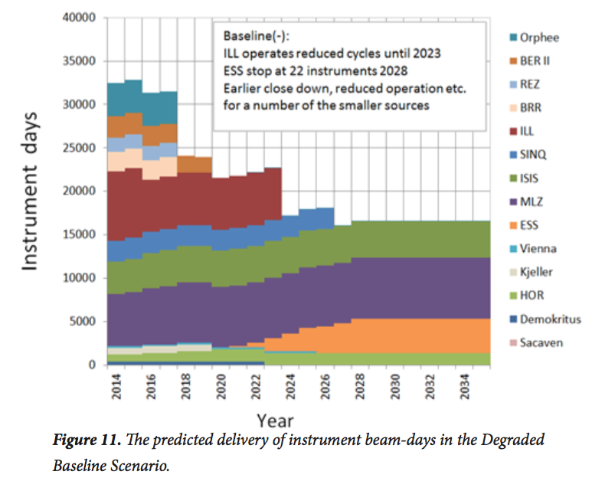
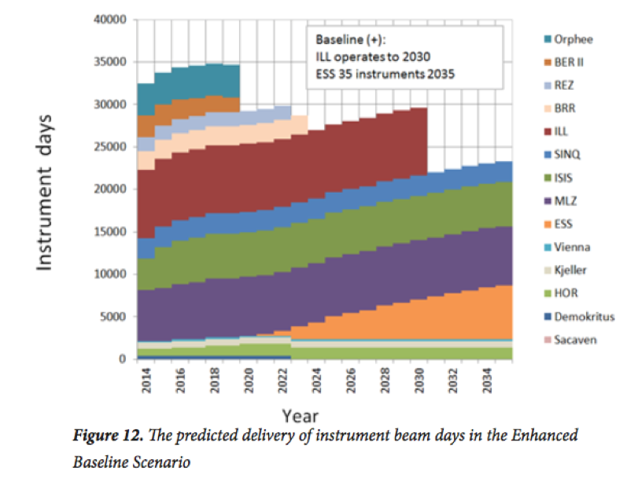
Future Scenarios outlined in the 2016 ESFRI Report
C.14.13c
ESS
ESS
Pessimistic scenario: ILL operates at reduced output until 2023, ESS with 22 instruments beyond 2028. Earlier closer and/reduced operations for a number of medium power sources
Optimistic scenario: ILL operates until 2030, ESS with 35 instruments beyond 2035.
29

Slide 30
Future Scenarios outlined in the 2016 ESFRI Report
C.14.13c
ESS
ESS
Pessimistic scenario: ILL operates at reduced output until 2023, ESS with 22 instruments beyond 2028. Earlier closer and/reduced operations for a number of medium power sources
Optimistic scenario: ILL operates until 2030, ESS with 35 instruments beyond 2035.
ESS needs to build up its research capacity
as soon as at all possible
30

